Slide 1

Notes:
Pre- dealing with MD, PT, drug issues
You’re likely only used to drugs, surgery, or PT as a solution. Some have even tried alternatives like massage, acupuncture, or standard chiropractic. What we’re discussing here are techniques, dietary protocols, and technologies being used in medicine and all over the world successfully every day and with research in the leading medical journals. You may not be aware, but it’s nothing we’ve created on our own or new – so make sure to pay careful attention to the details – it will get you to that 60-100% better.

Slide 2
The Fact Is You Can Experience:
60%-100%
Improvement?
Notes:
Don’t over-promise

Slide 3

Consider the Cost

Slide 4
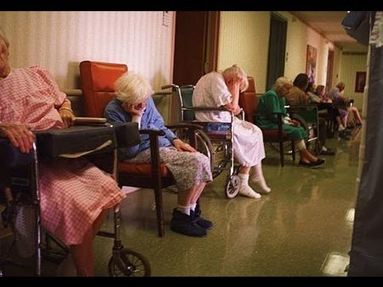
Planning for the Future

Slide 5
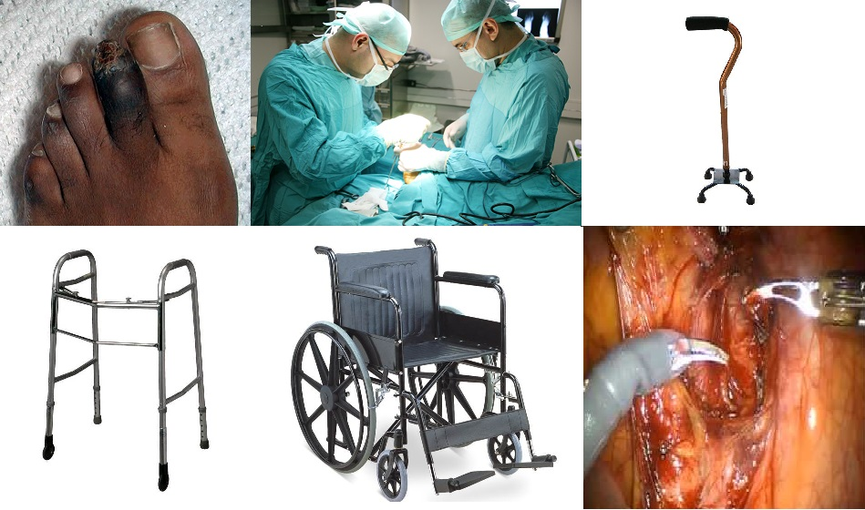
Just “Living With It” Can Lead To…
Notes:
Well, here’s what happens when you just live with it. INVOLEVMENT QUESTIONS “tell me what is happening to that toe at the left hand corner?
This is most likely infected right, most likely a gain green infection.
What do you think is going to happen to that toe?
As neuropathy gets worse, sufferers start sitting a lot more, they start coming very sedentary, they stop doing the activities that they love to do, and don’t get any exercise to keep their heart healthy. They are staying at home and start getting depressed because they want to be doing things but they can't. (raise your hand) who can relate to this?
I talk to patients like this every single day, they are very depressed because they can see their quality of life diminishing.

Slide 6

Imagine for a moment…
Back to enjoying your hobbies
Sleeping through the night peacefully
Walking with confidence and steadiness
Taking trips and enjoying family outings again
Feeling like you’re 10 years younger
Starting something new!
Notes:
So, imagine for a moment….
Sleeping through the night peacefully
Walking with confidence and feeling steady again
Taking trips and enjoying family outings again
Feeling like you’re 10 years younger
Who here would like to feel these feelings again?

Slide 7

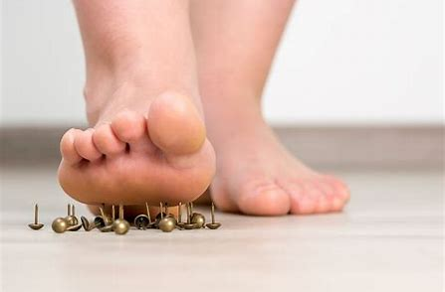

WHAT ARE SOME OF YOUR SYMPTOMS?
Notes:
Severe foot pain, like your stepping on a tac, stepping on marbles?Common symptoms of neuropathy, fibromyaglia, plantar fasciitis and other nerve or soft tissue conditions.

Slide 8

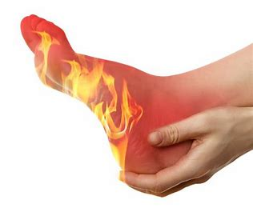
Numbness, Burning, or Cold Feet?

Slide 9
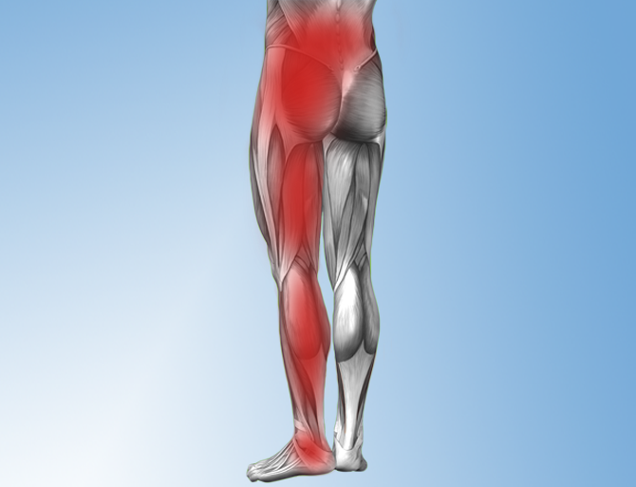
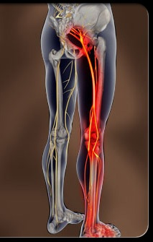
Pain Radiating Into The Hips, Legs, and Feet

Slide 10
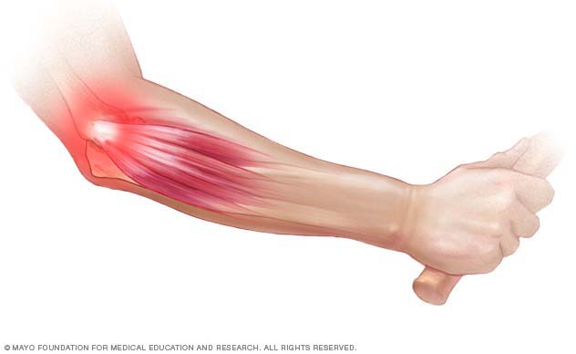
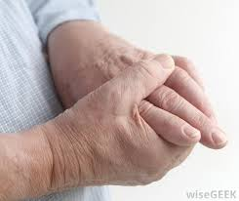

Upper Extremity Pain?

Slide 11
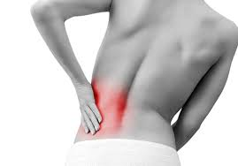
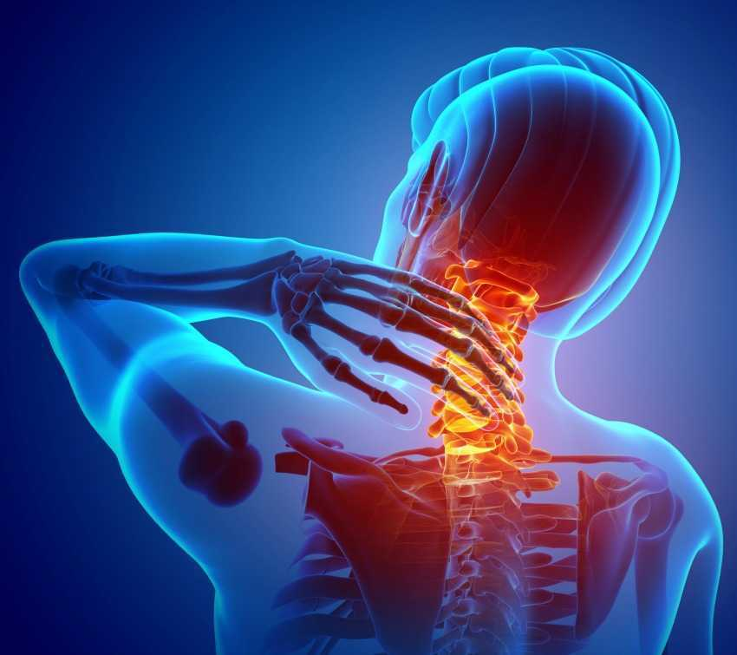
BACK and NECK PAIN?

Slide 12
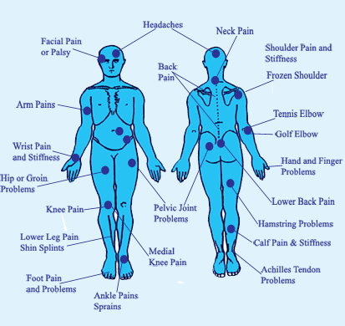
Universal Joint and Body Pain?

Slide 13
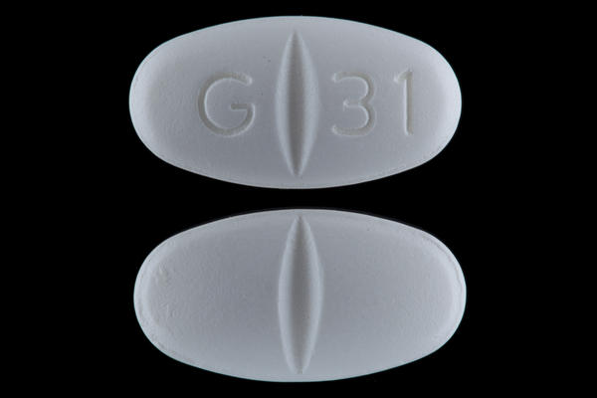
Neurontin(Gabapentin) &
Lyrica
Anti Seizure Medications
Attempt to block your brain from feeling pain
Do not treat or stop the progression of the disease
Notes:
Ask this question to keep involvement- Who here has heard of Neurontin aka gabapentin, raise your hand?” This is the number one medication that doctors prescribed for neuropathy pain and it’s made by Pfizer. How many of you think Neurontin was made to treat Neuropathy?
It's actually an anti-seizure medication, it's for seizures, -- so what do you think a seizure medication is going to do for neuropathy, how do you think it works?
WAIT AND LISTEN FOR AUDIENCE TO GIVE YOU ANSWERS
It’s a pain management medication, so what it literally does is slow your brain down so you stop feeling the pain signals from your feet. It doesn’t heal your nerves, it’s not healing neuropathy, it’s not keeping it from getting worse. What is it actually doing, then? (let audience answer).. That’s right – masking the pain

Slide 14
Gabapentin, Lyrica, and Opioids
Disrupts the formation of new synapses, hindering the neuroplastic health and development of the brain.
New synapse formation is our brains fight to stay young and prevent dementia
Gapapentin/Lyrica are part of the opiod concern as addiction and overdose are common and deadly

Slide 15
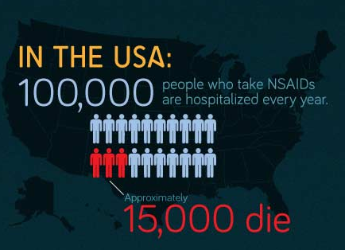
Death By Walgreens & CVS

Slide 16
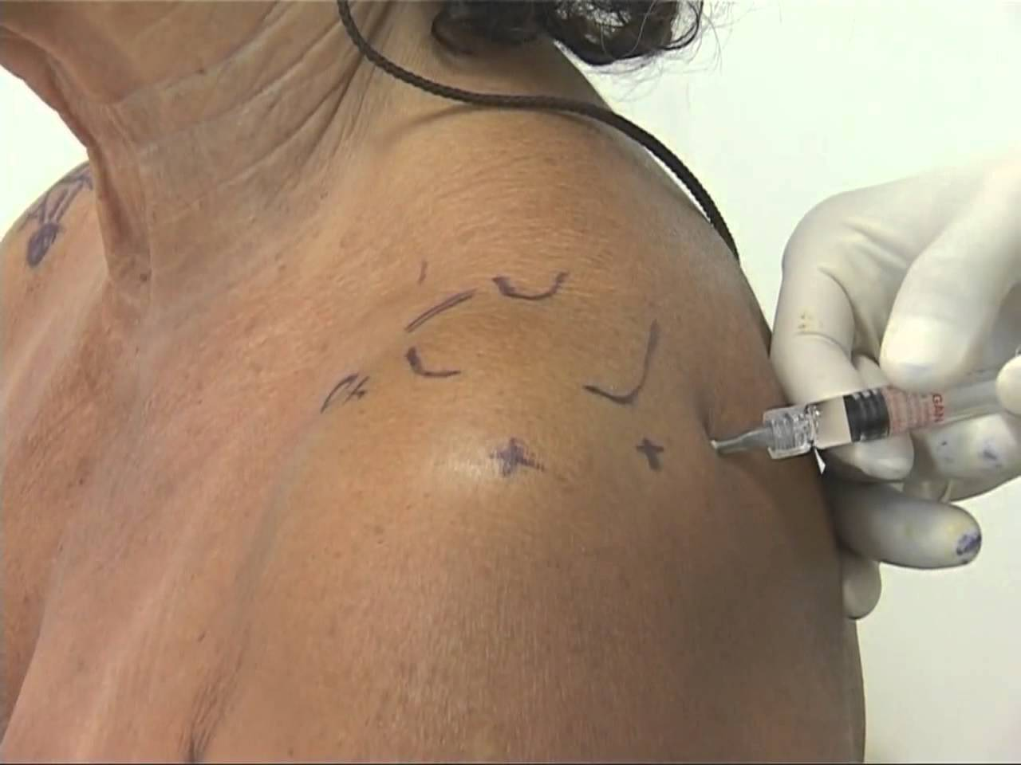
Other Solutions: Injections

Slide 17
Cortizone Injection Side-Effects
Dural puncture ("wet tap"). Bleeding.
Nerve damage. Damage the joint and ligaments
Localized increase in pain Non-positional headaches
Facial flushing Anxiety
Sleeplessness Fever the night of injection
High blood sugar Decreased Immunity
Stomach ulcers Severe arthritis of the hips
Cataracts (avascular necrosis)
Notes:
A dural puncture (wet tap) may cause a post-dural puncture headache (also called a spinal headache) that usually improves within a few days. Although infrequent, a blood patch may be necessary to alleviate the headache. A blood patch is a simple, quick procedure that involves obtaining a small amount of blood from a patient from an arm vein and immediately injecting it into the epidural space to allow it to clot around the spinal sac and stop the leak.

Slide 18
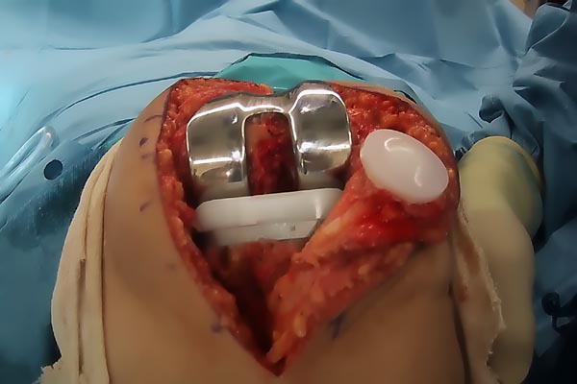
Joint Replacement Surgery
Notes:
This is a real picture. A good ending to avoid wherever possible.

Slide 19
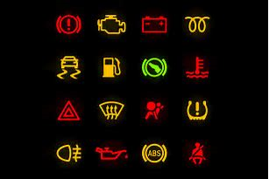
What Do You Do When The Light Flashes?
Notes:
Take it to the mechanic or cover it up with a piece of duct tape and keep going?
If you did keep driving, what eventually happens to the car?
Breakdown or – worse; engine or some vital part blows out completely, needs to be replaced, or the car becomes permanently damaged.

Slide 20

7 Common Warning Signs that you have Neuropathy:
Numbness
Burning Pain
Cramping
Sharp Electrical Pain
Prickling/ Tingling
Balance Problems and Falls
Can’t Sleep From Foot Pain
The Neuropathy Association, 2013.

Slide 21
Addressing The Causes of Peripheral Neuropathy
Diabetes/ Pre-diabetic
Poor circulation (micro-circulation)
Chemotherapy and medications
Spinal issues: subluxation, herniated discs,
spinal stenosis
Post-surgical
Autoimmune diseases
Infections (viral or bacterial)
Toxins, metals, and alcohol
Liver disease, kidney disease, Thyroid conditions
Notes:
Diabetes is the number one cause of neuropathy, but it’s not the only cause, a lot of things can damage your nerves and cause neuropathy damage, this is a top 10 list.
You can be a pre-diabetic and still develop neuropathy.
Number two on the list is poor circulation, you are not getting enough blood supply to your peripheral nerves. Number three chemotherapy drugs, about 40 to 50% of all chemo patients end up with neuropathy because their medication has damaged their nerves.
Neck and back problem like spinal stenosis, disc problems, surgeries, hip replacements, knee replacements and back surgeries often times neuropathy, autoimmune diseases like lupus, infections like staph infections, and alcohol and cigarette smoking damages nerves.
What's the last one, does anybody see that one down there, several medications, there is a lot of medications on the market that can actually cause damage to your nerves.

Slide 22
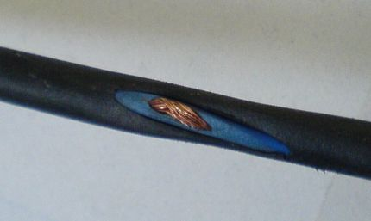
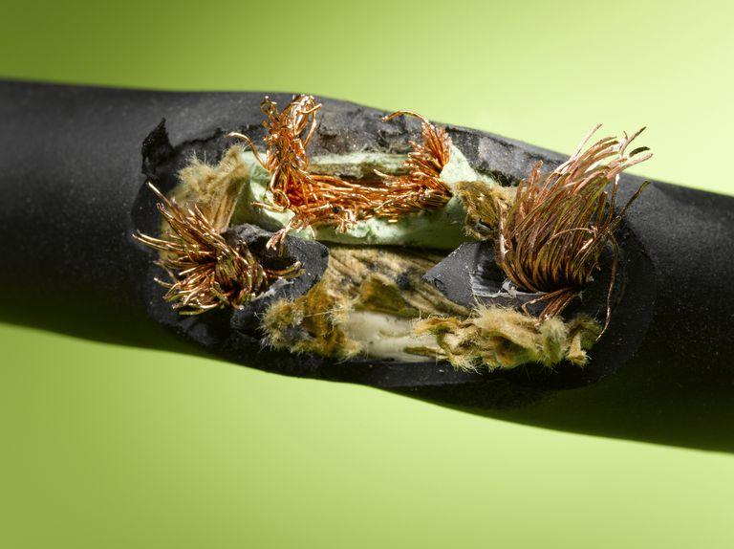
What Is Nerve Damage?
Notes:
EARLY … PROGRESSIVE
The insulation or rubber coating on the nerve is the myelin sheath. As nerve conditions progress, they continue actively eroding the sheath, exposing, and damaging the nerves until you do something to stop the progression of the disease and heal the nerves and damaged tissues.

Slide 23
PAIN CONDITIONS AND CAUSES
PLANTAR FASCITIS, FACIAL PAIN, CHRONIC PAIN
Inflammation in the muscles, joints, ligaments, and tendons
Systemic inflammation & oxidation
Toxic exposure
Back/neck – herniated disk, spinal stenosis
Post-surgical
Old accidents and injuries
Sports injuries
Posture, Repetitive Motion Injury, Sleep positions
Notes:
Many of the same causes of Neuropathy plus..

Slide 24
Causes of Fibromyalgia
Full-scale inflammation caused by
Spinal cord and nerve stress
Glutathione deficiency and subsequent extreme oxidation
Food intolerances
Auto-immune conditions
Toxicities
Thyroid problems
Leaky gut syndrome
Adrenal burnout
Gene mutations

Slide 25
Medical
1. Medications
2. Testing
3. More Medications
4. Surgery and medications
Notes:
Engagement question? “Who here has been to a neurologist?”
When you go to neurologist they will run some nerve tests, confirm that you have neuropathy, then likely prescribe medication.
What medication do they prescribe?
That’s correct the same medications.

Slide 26

Have you been told you’d have to live with it or nothing could be done?
National Institute of Health says:
“Peripheral nerves have the ability to regenerate as long as the underlying nerve cell has NOT been killed.”
Notes:
The National Institute of Health says ““Peripheral nerves have the ability to regenerate as long as the underlying nerve cell has NOT been killed.”
What does that mean? Not been killed… It means that if you wait too late to where the nerve is dead, it can not be helped.

Slide 27
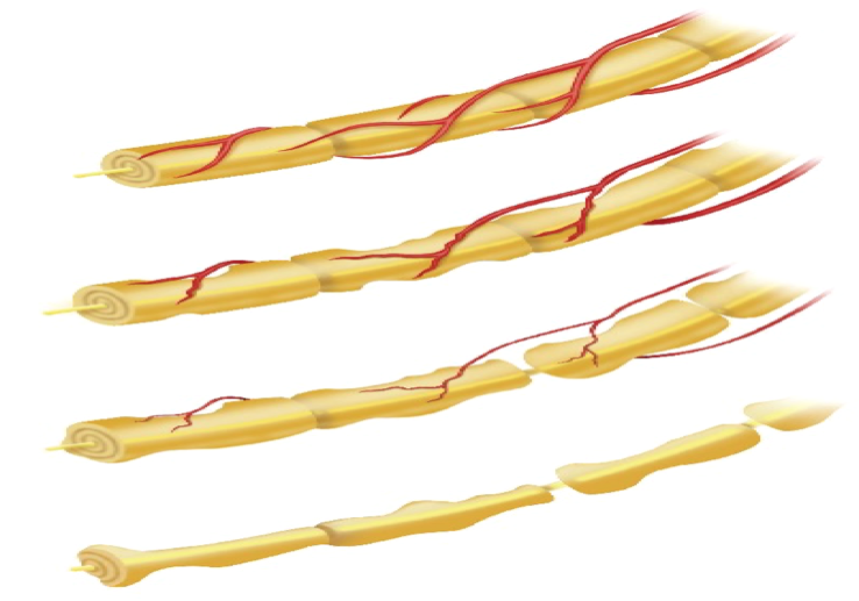
Best Type and Timing for Care
Notes:
At the top is a healthy nerve: it is whole and with full blood supply
As the disease progresses, the nerve deteriorates, you can see the rat bites taken out of it, and the blood supply diminishes. At this point, you’re having problems, but people will often ignore the problems here or just take medication. If you ignore or cover with drugs – what happens?
Level 3 – late stages of the disease, but as the NIH said, there’s still a “live” or viable nerve left so we can still turn this around.
At level IV, the nerve is dead and there’s nothing that can be done.
What’s the best timing to catch this diease?

Slide 28
Neuropathy is a Progressive Disease
Notes:
When should you start?

Slide 29
5 STEPS TO RECOVERY
1. Correct the spine and nervous system
2. Light therapy to increase circulation and boost the body’s ability to heal nerves and damaged tissue
3. Address inflammation with diet
4. Anti-inflammatory supplementation
5. Assess any inherent, poor genetic coding

Slide 30
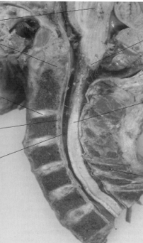
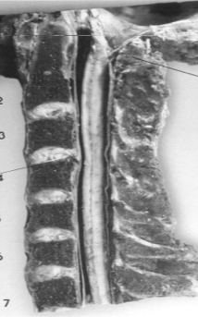
Stabilize Subluxation Degeneration

Slide 31
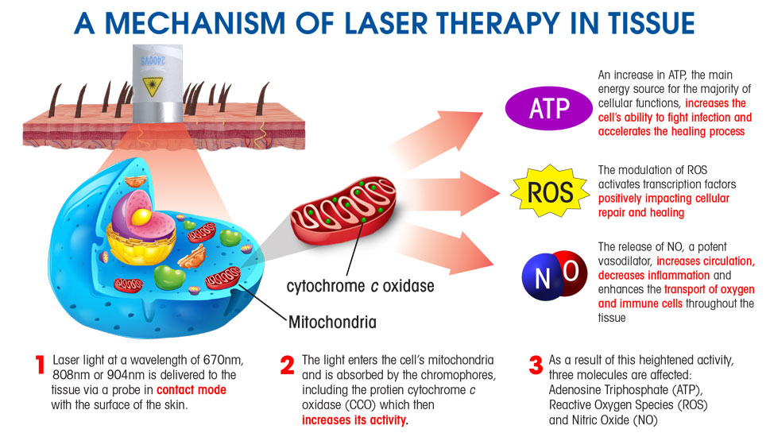
HOW LASERS WORK
Notes:
Medical therapy – already proven

Slide 32
WHO SHOULD COME SEE US IMMEDIATELY?
If you have ever been diagnosed with:
Fibromyalgia
Plantar Fasciitis
Chronic Fatigue
Arthritis
Facial neuralgia
Or suffer with:
Chronic pain from an accident or injury
Pain from past surgery
Pain in the joints, neck, back, or extremities
Bulging or ruptured disc in the neck, mid, or low back

