Slide 1
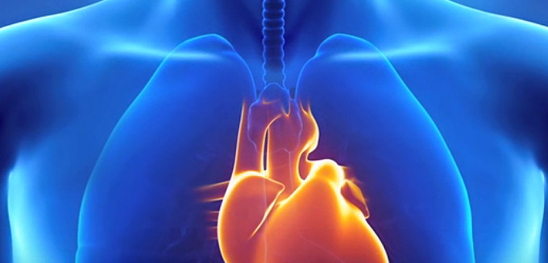
HEART HEALTH

Slide 2

#1Killer:8-900,000 Deaths In The US Each Year One person dies from CVD every 40 seconds
Notes:
It’s far and away the #1 killer – killing almost 2x the number of people each year that die from cancer.

Slide 3
STARTING YOUNG
1 OUT OF 3 DEATHS IS FROM CVD
*25% of children 5 and older already have plaque building up in the arteries! (US News and World Report)
*60% of 15-19 year olds have plaque building up in their coronary artery which supplies the heart!
https://www.ncbi.nlm.nih.gov/pmc/articles/PMC3951799/
Notes:
Tendency is to think that Heart Disease is a disease that adults/older people need to watch out for.

Slide 4
YOU CAN 10X YOUR CHANCES
Northwestern Medical Study on 2000 people: The impact of smoking, weight, exercise, diet, and alcohol on heart disease.
The more of these lifestyle areas you addressed, the lower the chance of disease.
The risk only decreased by 6 percent for participants who changed just one lifestyle factor such as nutrition
The decreased by 60 percent (10 times more) for those who made changes to all five lifestyle factors!
Notes:
The first study evaluated five lifestyle factors: smoking, weight, exercise, diet, and alcohol consumption. More than 2,000 people were recruited for this study. The results showed that healthy lifestyle choices such as not smoking, exercising regularly, and not consuming alcohol excessively dramatically lowered the risk of developing heart disease.
A really important aspect to understand was the more of these lifestyle essentials you addressed, the lower the chance of disease. The risk only decreased by 6 percent for participants who changed just one lifestyle factor such as nutrition, but it decreased by 60 percent (10 times more) for those who made changes to all five lifestyle factors!
“Health behaviors can trump a lot of your genetics,” said Donald Lloyd-Jones, M.D., chair and professor of preventive medicine at Northwestern University Feinberg School of Medicine and a staff cardiologist at Northwestern Memorial Hospital.“ This research shows people have control over their heart health. The earlier they start making healthy choices, the more likely they are to maintain a low-risk profile for heart disease.”
Do not miss our heart disease workshop on…. We will cover the lifestyle factors that are most deadly to your heart and the steps to better living that enjoyably give you a 10x greater chance at long life and good health.

Slide 5
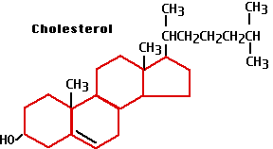
IS IT CHOLESTEROL?

Slide 6
What is Cholesterol?
HDL: is known as good cholesterol, because it carries cholesterol to the liver
LDL: is known as bad cholesterol, because it carries cholesterol to the body.
TRIGLYCERIDES: form fat moves through your bloodstream
Notes:
The public has been radically misled, told that because total cholesterol or LDL cholesterol was
“high” they are sick and need medication.
1. By continuously lowering what is considered high, without evidence to back it up, millions became drug customers. Out of fear, who wouldn’t take it.
2. Total cholesterol isn’t a useful number as HDL is good.
3. LDL numbers are also incredibly misleading as there are several other factors that must be present for this to be considered any type of health problem – additionally, there are many natural, healthy actions to take rather then a drug when there are concerns.
Cholesterol is a soft, waxy substance that is made by the liver (80%). It travels in the blood as two compounds: Low-density lipoproteins (LDL) and high-density lipoproteins (HDL).

Slide 7
WHY CHOLESTEROL?
NECESSARY FOR HEALTHY BRAIN TISSUE, MOOD, & MEMORY
PART OF OUR IMMUNE SYSTEM, WHERE THEY BIND AND NEUTRALIZE BACTERIA AND VIRUSES
VITAL TO HEALING DAMAGED TISSUE
Cholesterol is needed to manufacture Vitamin D.
To make hormones like; estrogen, testosterone, cortisone, and a host of others
Notes:
Often, cholesterol goes up for all of the right reasons mentioned here. It is needed to protect, restore health, rebuild tissue, or make critical hormones and nutrients.

Slide 8
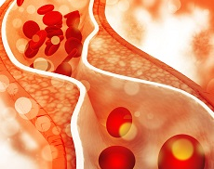
MYTH #1 (Disproven decades ago)
“THE MORE CHOLESTEROL IN YOUR DIET, THE HIGHER YOUR BLOOD CHOLESTEROL WILL BE”
Notes:
The liver regulates cholesterol production. High dietary intake, then low liver production – it all balances out in a healthy body. However, the side-effect of high sugar, carb intake is making bad cholesterol.

Slide 9
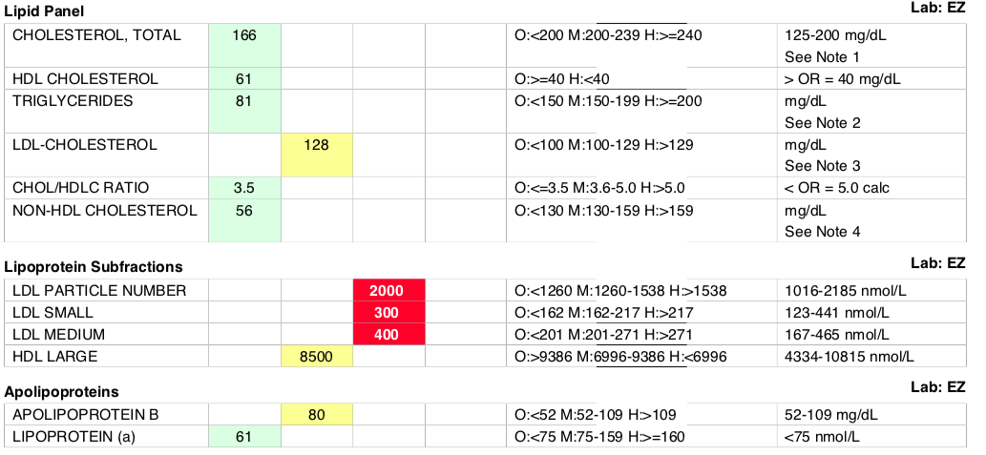
KNOW THE RIGHT NUMBERS
Notes:
The most important numbers: Triglycerides, LDL particle number and size (you don’t want high, small particles), and Apolipoprotein B (APOLIPOB).
Triglycerides, the fat in the blood stream, along with high LDL particle count, small LDL size, and inflammation is where there’s danger. Not simply the presence of a general high LDL or total cholesterol count.
LDL cholesterol levels and LDL particle number are often concordant (i.e. when one is high, the other is high, and vice versa), and this is probably why there is an association between LDL cholesterol and heart disease in observational studies. The elevated LDL cholesterol was more of a proxy marker for elevated LDL particle number in these cases. But here’s the kicker: they can also be discordant. In layperson’s terms, it’s possible to have normal or even low cholesterol, but a high number of LDL particles. (1) If this person only has their cholesterol measured, and not their particle number, they will be falsely led to believe they’re at low risk for heart disease. Even worse, the patients that are the most likely to present with this pattern are among the highest risk patients: those with metabolic syndrome or full-fledged type 2 diabetes.
Apolipoprotein B100 (apoB100) is bad and the primary protein in low-density lipoprotein (LDL) cholesterol. The apoB100 test measures the amount of this type of cholesterol in the blood. LDL is often referred to as “bad” cholesterol because high levels of it can damage the heart and blood vessels.
Controlled through anti-inflammatory diet and lifestsyle

Slide 10
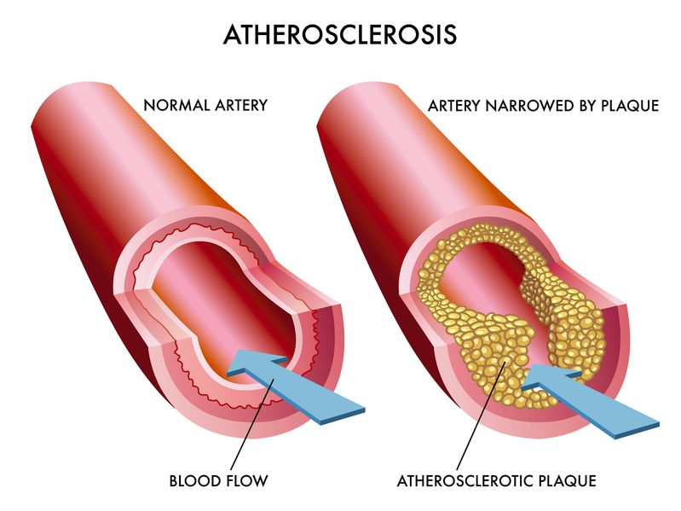
IMPORTANT NUMBERS
When the amount of triglycerides and LDL particles rises in the blood, this increases the chance that these particles will become oxidized and damage the walls of blood vessels, ultimately leading to plaque formation and heart disease.
Notes:
For LDL, biggest concern is particle count and particle size (small is bad, large is good)

Slide 11
BEST NUMBERS
MEN > 45
WOMEN > 50
LDL < 3X HDL
TRIGLYCERIDES < 150
Notes:
HIGH LDL – crusted arteries and pre-diabetes is a concern

Slide 12
Healthy Cholesterol Ratios:
LDL
HDL/cholesterol ratio (High is good)
Divide your HDL by your total cholesterol and multiply by 100.
HEALTHY RANGE: Greater than 24%
Triglyceride/HDL ration (High is bad)
Divide your triglyceride total by your HDL.
HEALTHY RANGE: Below 2%
Notes:
HDL (Good) Cholesterol carries fat out of arteries and away from the heart.
Your HDL/cholesterol ratio and triglyceride/HDL ratio is a strong indicator of your CVD risk.
A new study published in Expert Review of Clinical Pharmacology reviewed data from over 1 million individuals and concluded that LDL does not cause heart disease. This is in direct contradiction to recent publication European Society of Cardiology stating that LDL does directly cause heart disease.

Slide 13
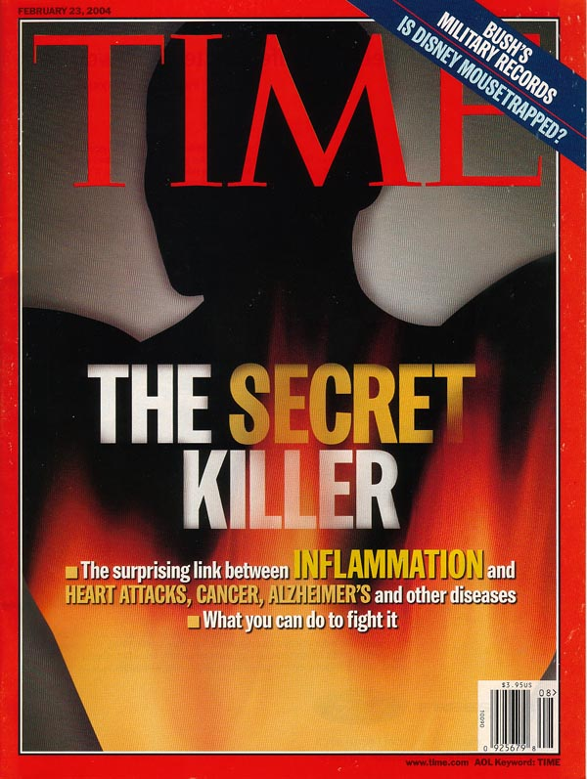
Inflammation is THE Problem
Notes:
Inflammation oxidizes or ignites the triglycerides and LDLs – damaging vessel walls.
The MD’s know that inflammation is bad. But they don’t ask WHY, just preferring to pull out the prescription pad and write for their favorite statin drug.
Unfortunately for these patients, statins don’t work very well. They lower numbers but do very little for preventing heart attacks or saving lives.
Get your hs-CRP and other markers of inflammation checked. If elevated, we need to figure out WHY. Hs-CRP is a marker of inflammation. It is a sign that your body is on fire. This is not good. If your hs-CRP is high, you need to find out WHY. The MD’s know that inflammation is bad. But they don’t ask WHY, just preferring to pull out the prescription pad and write for their favorite statin drug.
Unfortunately for these patients, statins don’t work very well. They lower numbers but do very little for preventing heart attacks or saving lives.
Get your inflammation checked. If elevated, we need to figure out WHY.

Slide 14
MYTH #2
“HIGH CHOLESTEROL = MORE HEART ATTACKS”
Lowering cholesterol does not lower mortality rates
FACT: High Inflammation (CRP) and Homocysteine are 4X more likely to cause a heart attack
Notes:
FRAMINGHAM HEART STUDY
-INCREASED DEATH RATES WITH LOWER CHOLESTEROL LEVELS IN ELDERLY
HONOLULU HEART PROGRAM
LONG TERM PERSISTANCE OF LOW CHOLESTEROL INCREASES RISK OF DEATH.
JAPANESE LIPID INTERVENTION TRIAL
HIGHEST DEATH RATE WAS AMONG THOSE WITH THE LOWEST CHOLESEROL

Slide 15
Dangers of Cholesterol Medication
▪ Heart failure (heart is a muscle)
▪ Limits protection from cholesterol against cancer
▪ Depression
▪ Memory Loss
PLUS: LEAVES THE CAUSE UNCORRECTED!
▪ Liver Damage
▪ Neuropathy
▪ Severe joint pain and ligament rupture
▪ Muscle wasting/atrophy

Slide 16
MORE PROBLEMS WITH STATINS
Statin work by inhibiting a vital enzyme that manufactures cholesterol in the liver.
PROBLEM 1: Your brain and nerve tissue is made of 60% cholesterol!
PROBLEM 2: CoQ10, an antioxidant needed to transfer energy from food to our cells, is inhibited when taking statin drugs. DEFICIENCY CAN CAUSE HEART ATTACK OR STROKE.
TAKING A STATIN?
(Lipitor, etc.) Make Sure To Supplement CoQ10!
Notes:
PROBLEM 1: Your brain and nerve tissue is made of 60% cholesterol!
If you lower cholesterol with drugs, the brain and nerve tissue begin to deteriorate. You block serotonin uptake sites, which decreases serotonin and causes depression!
PROBLEM 2: CoQ10, an antioxidant needed to transfer energy from food to our cells, is inhibited when taking statin drugs. CoQ10 helps reduce inflammation and protects you from cancer and aging. Deficiency can lead to heart attack and stroke – the problems you thought you were avoiding in taking the drugs.
It is also the primary building block for the cells of your brain and nervous system.

Slide 17
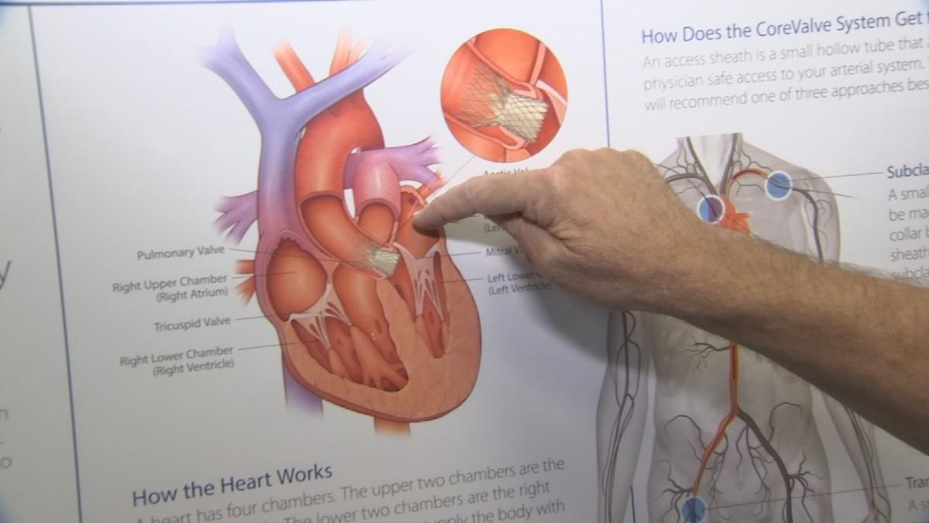
HEART SAFETY: START WITH TESTING

Slide 18
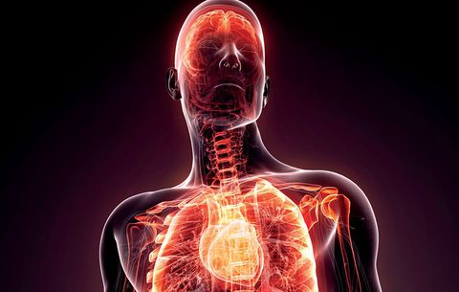
INFLAMMATION
HS-CRP
The marker for inflammation
HIGH CRP CAN GIVE YOU GREATER THAN 4X RISK OF HEART ATTACK AND STROKE!
Notes:
Hs-CRP. High sensitivity C Reactive Protein is one of the best overall measures of inflammation. Since we now understand that it’s inflammation and not cholesterol that’s the problem. CRP is a marker of inflammation. It is a sign that your body is on fire. This is not good. If your hs-CRP is high, you need to find out WHY.
Often not ordered because there is not a conventional drug/treatment for this!
Harvard Researchers have found that a high level of CRP increases risk of heart attack 4.4 times!
“Research showst that the C-reactive protein level is a stronger predictor of cardiovascular events than the LDL cholesterol level…”
Paul M. Ridker, M.D., Nader Rifai, Ph.D., Lynda Rose, M.S., Julie E. Buring, Sc.D., and Nancy R. Cook, Sc.D.
The New England Journal of Medicine
Volume 347:1557-1565 November 14, 2002 Number 20

Slide 19
TESTS
Biomarkers - CRP, omega 3 levels, Vitamin D, & homocysteine,
Cholesterol; triglyceride, HDL, LDL numbers and ratios
DNA
Food allergies: to evaluate gut and causes of inflammation

Slide 20

Test Vitamin D
When vitamin D levels are the highest, your risk of disease is the lowest.
Notes:
The sun is the best way to get in Vit D as its not found in high levels in foods. As most people do not spend even remotely enough time in the sun and without sunscreen, Vit D supplementation is generally a standard
However, if you listen to the government's recommendations about how much vitamin D you need to stay healthy you'll likely come up far too short to receive these amazing benefits to your heart. Based on the latest research, many experts now agree you need about 5,000 IU per day for adults and 2500 IU per day for children over the age of 5.
Vitamin D is involved with the function of virtually all genes, and low D increases inflammation and the risk of autoimmune disease, cancer, depression, and diabetes.

Slide 21
DNA TESTING
APO Genes (Cholesterol gene)
MTHFR (Homocysteine gene)
IL6 (Inflammatory gene)
CETP (Cholesterol ratio gene)
LPL (Triglyceride gene)
Dozens of others related to metabolism of sugar and fats
Notes:
At a high level, here are the key areas to focus on. However, it’s not 1 or 5 genes, but 1000s working with each other to create health. These genes are actionable, meaning there are lifestyle changes you can make to optimize their function, turn on good genes, and turn off bad ones.
MTHFR gene (MTHFR: 2 main variants C677T & A1298C) not breaking down Methylfolate and leads to high homocysteine. Give folate, B6, and B12 to manage both issues.
NOS -3, PEMT, COMT ARE OTHER IMPORTANT GENES. WE IMPROVE THESE WITH OUR GENE PROTOCOLS AND ARTERY CLEANING FOOD RECOMMENDATIONS.

Slide 22
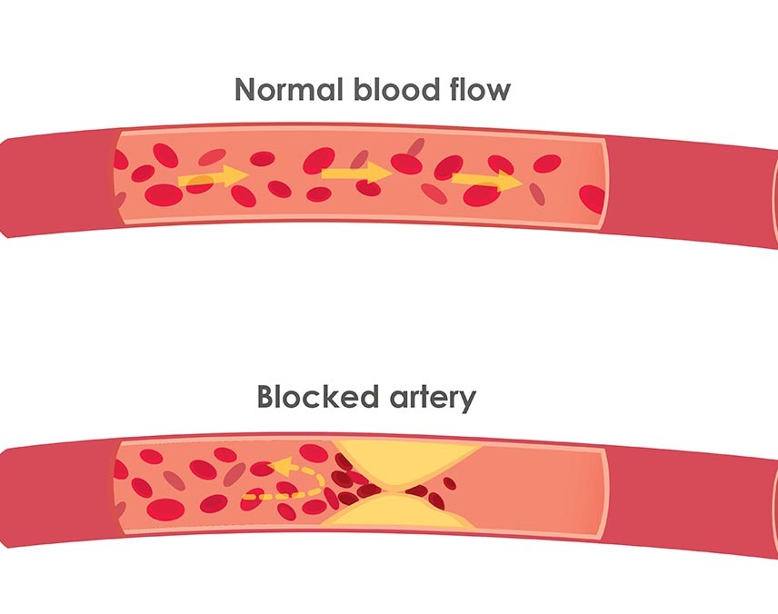
Test Your APO Genes
THESE GENES REGULATE:
CHOLESTEROL, TRIGLYCERIDE, AND FATTY ACID METABOLISM
Notes:
Part of managing the presence of APO genes is either a Mediterranean or modified Mediterranean based on the other genes.

Slide 23
NOS3 GENE
Makes nitric oxide to help blood vessels open and close.
Poor NOS3 gene increases risk of clogging

Slide 24
HELPING NOS3
L-theonine and CBD for calming effect (Be Calm)
Eat arginine foods (Turkey, chick peas, lentils, pumpkin seeds, almonds, and spirulina)*
Notes:
*WARNING: *Arginine makes NOS, but after heart attack, arginine causes a worse outcome. ADMA levels high and arginine low - then arginine. Never do arginine after heart attack. Arginine lowers lysine which hurts herpes. Even just eating the foods. Theory that Alzheimer’s causes by herpes in brain. Arg could make worse.

Slide 25
OTHER FOODS FOR NOS3
Calcium foods
Iron foods
Riboflavin/vitamin B2 foods
Foods that contain natural nitrates: for example, arugula, beets, celery, and spinach
NOS3 needs plenty of the nutrient oxygen: exercise and deep breathing
Notes:
Calcium foods: dark leafy greens, bok choy, okra, broccoli, and green beans (Goat or sheep’s milk)
Iron: seeds from squash and pumpkin; chicken liver; oysters, mussels, and clams; cashews, pine nuts, hazelnuts, and almonds; beef and lamb; white beans and lentils; dark leafy greens
Riboflavin/vitamin B2: liver, lamb, mushrooms, spinach, almonds, wild salmon, eggs
Finally, your NOS3 needs plenty of oxygen—which you get from exercising and deep breathing
Foods that contain natural nitrates: for example, arugula, beets, celery, and spinach

Slide 26
CLEAN COMT GENE
REQUIRED NUTRIENTS: B2, B9, B12, and MG
Minimize exposure to chemicals – plastics (BPA – xenoestrogen) and Round Up (Go organic and avoid the Dirty Dozen)
Detox and Build Glutathion (Daily Detox)
Minimize caffeine and sugar
Sleep and de-stress (Be Calm)
Hugs!! (Increases dopamine levels)
Balanced, smaller meals
Notes:
BPA – Bisphenol A, chemical found in plastic.
Xenoestrogens are found in a variety of everyday items. Many of us don’t think twice about the makeup we wear each day or the plastic container we use to pack our lunch. We know organic food is supposed to be better for us, but sometimes we just don’t want to pay the extra money. Unfortunately, all of the above may be altering the way our body naturally functions because they all contain endocrine disruptors called, xenoestrogens.
Caffeine lowers MG and antacids
Edison Pack!
Magnesium: dark leafy greens, nuts, seeds, fish, beans, avocados, whole grains (Mediterranean)
Plastics (Eg: BPA is Xenoestrogens),
ROUND UP, industrial chemicals
xenoestrogens mimic estrogens and COMT already struggles to optimize estrogen
Sleep
Estrogen foods: beets, carrots, onions, artichokes, cruciferous vegetables, dandelion, radishes.
Avoid toxic top 10.
Stress, sugar
Endocrine disruptors are a category of chemicals that alter the normal function of hormones. Normally, our endocrine system releases hormones that signal different tissues telling them what to do. When chemicals from the outside get into our bodies, they have the ability to mimic our natural hormones; blocking or binding hormone receptors. This is particularly detrimental to hormone sensitive organs like the uterus and the breast, the immune and neurological systems, as well as human development.

Slide 27
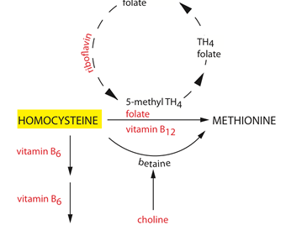
TEST & HANDLE HOMOCYSTEINE
Get Your B’s
Notes:
High levels accompanied by common MTHFR issues and the need for B vitamins, particularly Folate.
Homocysteine: Homocysteine is an amino acid that plays a role in destroying the lining of your artery walls, promoting the formation of blood clots, and also accelerates the buildup of scar tissue. High levels may increase the chance of heart disease and stroke, especially if you have other risk factors such as diabetes, high blood pressure, obesity, smoking, or family history. High levels of homocysteine is a sign of plaque building up in the arteries!
Long name but common test in the holistic doctor’s office. This molecule is necessary in the production of anti-oxidants, brain communication and cell replication. But too much of a good thing here is a risk factor for heart attacks and strokes.
The good news is that elevated levels are pretty easy to treat. Vitamins B6, B12 and folate are the perfect trio to help get your homocysteine in check. Ideally, a homocysteine level of 7 to 9 is where you want to be.
Don’t go for just any B vitamin.

Slide 28

MANAGE YOUR OMEGA 6:3 INDEX
Notes:
3) OMEGA 6:3 INDEX
6s are inflammatory, 3’s are antiinflamattory. The index should be between 2:1 – 4:1. Yet, our modern diets can be 30:1+
Omega 3 from the sea is linked to a lower risk of atrial fibrillation, heart attack, stroke and death. Omega 3 sits in the brain and in the cell membrane (like a fence) that keeps things inside the cell that belong inside and keeps things outside the cell that don’t. Cells speak with other cells and hormones with the help of Omega 3 DHA and EPA.
Best sources are wild salmon, sardines, and anchovies. Don’t forget about shellfish too. Skip the tuna, halibut, and other large fish due to the mercury and other possible contaminants. Again, most people do not eat enough fish or have good enough access to clean sources and require supplementation to meet their daily requirements.

Slide 29
FOOD ALLERGY TESTING
WHEN IS AN ALMOND OR AN AVOCADO BAD?
When you are allergic to it!
Foods that your body has developed an immune response to will create chronic inflammation in your body and many health issues if eaten regularly – or in some cases at all.

Slide 30
Maximize Magnesium
Magnesium Plays Substantial Role in Reducing Inflammation
More than 3,750 magnesium-binding sites and more than 500 enzymes in your body rely on magnesium
Low levels of magnesium are associated with cardiovascular disease and death from all causes.
Notes:
Low levels of magnesium are a culprit in the development of inflammation and may play a role in hardening of your arteries as they inhibit the deposit of lipids on your arterials walls and plaque formation.

Slide 31
CHIROPRACTIC AND THE #1 KILLER
Heart rate variability (HRV) is a vital health indicator like blood pressure, cholesterol, or heart Rate.
HRV: Measures how well the heart adapts to changes and challenges.
This adaptive response is managed through the nervous system.
Research by Zhang, MD, PhD proves chiropractic significantly improved HRV after only 1 year of care
Notes:
A healthy HRV is created by a balanced nerve system – there is a proper balance between the SNS and the PNS.
Dr. J. Zhang, MD, PhD. measured the effect of chiropractic care on the autonomic nervous systems measured by way of Heart Rate Variability (HRV). After one year of chiropractic care he found that there was improved neurological balance through an increase in parasympathetic stimulation; which is associated with a slower heart rate and less anxiety and worry. This reduced heart rate can potentially reduce heart attack and other cardiovascular diseases by increasing cardiac reserve and nutrient supply to cardiac muscles.
Zhang J, Dean D, Nosco D: Effect of Chiropractic Care on Heart Rate Variability and Pain in a Multisite Clinical Study. Journal of Chiropractic Education, Vol. 19, No. 1, 2005.

Slide 32
Organ Function and Subluxation
“Records of numerous cases including myocardial ischemia showed lesions of the spinal column are perfectly capable of stimulating accentuating, or making a major contribution to (organic ) disorders. There can, in fact, be no doubt that the state of the spinal column does have a bearing on the functional status of the internal organs”
W. Kunert MD (1965) Functional Disorders of Internal Organs Due to Vertebral Lesions,CIBA Symposium 13 (3) :85-96

Slide 34
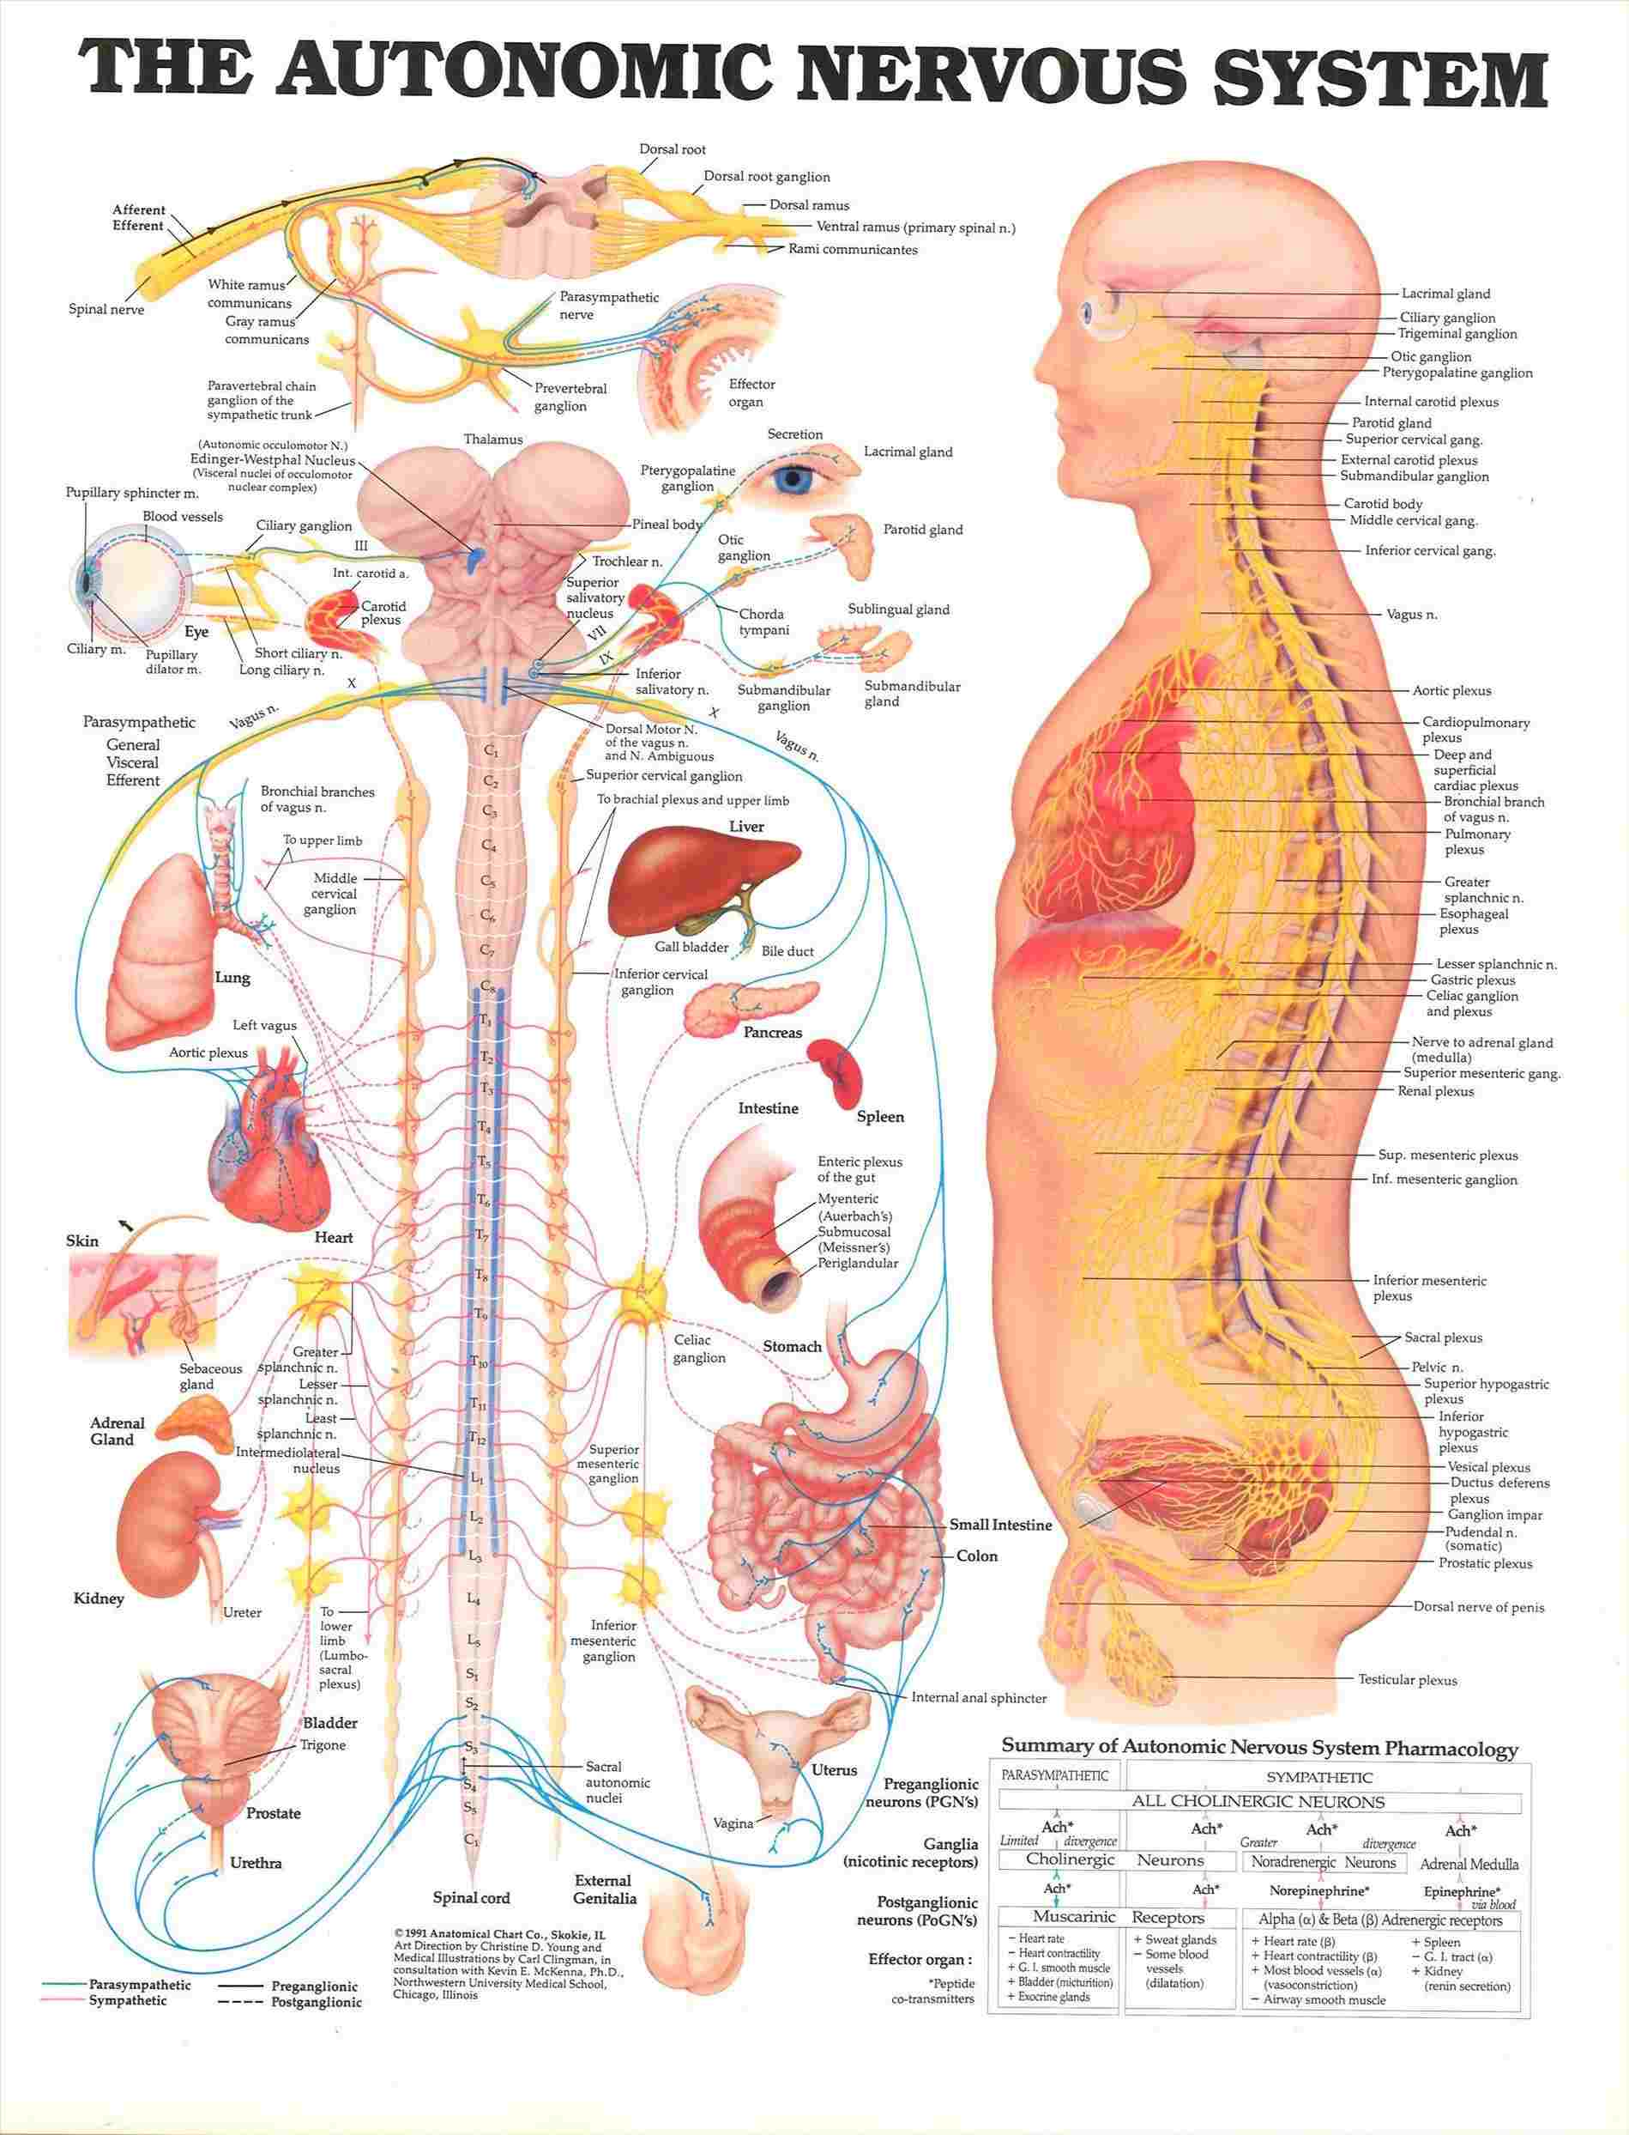
Notes:
Curves, angles, and heart function
Brain stem and heart function

Slide 35
THE CERVICAL SPINE
THE UPPER CERVICAL SPINE PROTECTS AND INFLUENCES THE BRAIN STEM WHILE
PROJECTIONS FROM C2 GO UP INTO THE MEDULLA
INFLUENCING CRANIAL NERVES DIRECTLY RELATED TO CARDIOVASCULAR FUNCTION
Chiropractic cuts Blood Pressure
U. Of Chicago did a study that showed Chiropractic cervical adjustments reduced Systolic Blood Pressure by 14 points and Diastolic by 8 points in 8 weeks.
Journal of Human Hypertension

Slide 36

STEPS TO A LONG, HEART HEALTHY LIFE

Slide 37




Eating Vegetable Oil Instead of Meat Fallacy
Notes:
Avoid vegetable oils!
This is a common medical theory disproven decades ago, but still circulates around as standard medical science. Commonly recommended by providers receiving old rhetoric rather than any actual nutritional training.
The Minnesota Coronary Experiment was a study performed between 1968 and 1973 that examined the relationship between diet and heart health.²¹ The researchers used a double-blind randomized trial to evaluate the effect of vegetable oil versus saturated fats in coronary heart disease and death.
The results were left unpublished until 2016, when they appeared in the BMJ. An analysis of the collected data revealed lowering your cholesterol levels through dietary intervention did not reduce your risk of death from coronary heart disease. The researchers concluded:²²
"Available evidence from randomized controlled trials shows that replacement of saturated fat in the diet with linoleic acid effectively lowers serum cholesterol but does not support the hypothesis that this translates to a lower risk of death from coronary heart disease or all causes.
Findings from the Minnesota Coronary Experiment add to growing evidence that incomplete publication has contributed to overestimation of the benefits of replacing saturated fat with vegetable oils rich in linoleic acid."
The researchers found that for every 30-point drop in total cholesterol, there was a 22 percent increase in the risk of death from cardiac disease. On autopsy, the group eating vegetable oil and the group eating saturated fat had the same amount of atherosclerotic plaques in their arteries, but the group eating saturated fat experienced nearly half the number of heart attacks as the group eating vegetable oil.
In 2004, Sylvan Lee Weinberg, the former president of the American College of Cardiology, stated that:
The low-fat, high-carbohydrate diet … may well have played an unintended role in the current epidemics of obesity, lipid abnormalities, type 2 diabetes, and metabolic syndromes. This diet can no longer be defended by appeal to the authority of prestigious medical organizations. (1)
1. https://www.ncbi.nlm.nih.gov/pubmed/14998608

Slide 38
Research on carbohydrate intake and cardiovascular disease
Cause atherogenic dyslipidemia (Atherosclerosis)
Increased triglycerides a
Increase small LDL particles
Decreased HDL,
Decrease insulin resistance
Increase obesity
Notes:
A comprehensive review of the research on carbohydrate intake and cardiovascular disease has concluded that a diet high in refined carbohydrate aggravates atherogenic dyslipidemia and is associated with increased triglycerides and small LDL particles, decreased HDL, insulin resistance, and obesity. (1) When the amount of triglycerides and LDL particles rises in the blood, this increases the chance that these particles will become oxidized and damage the walls of blood vessels, ultimately leading to plaque formation and heart disease.
1. Am J Clin Nutr. 2010 Mar; 91(3): 502–509. Published online 2010 Jan 20. doi: 10.3945/ajcn.2008.26285
PMCID: PMC2824150 PMID: 20089734
Saturated fat, carbohydrate, and cardiovascular disease^{1,2,3,4}
Patty W Siri-Tarino, Qi Sun, Frank B Hu, and Ronald M Krauss
https://www.ncbi.nlm.nih.gov/pmc/articles/PMC2824150/

Slide 39
GO LOW
SUGAR AND CARBS
Increase inflammation.
Trigger chemicals that release of insulin
Insulin promotes the accumulation of fat, the creation of triglycerides, and causes inflammation
Excess fat around your midsection is a major contributors to heart disease.²⁵
Notes:
Eat a low-glycemic, anti-inflammatory die

Slide 40
Top Inflammatory Foods
Sugar (Sodas and fruit juices).
Vegetable-Oil.
Fried Foods.
Refined Flour.
Grain-Fed Meat
Artificial Sweeteners.
Artificial Additives.
Processed Meats (Cold Cuts)
Gluten

Slide 41
*Foods that combat inflammation
Include plenty of these anti-inflammatory foods in your diet:
Fish, Coconut, Olive, and Avocado Oil
Green leafy vegetables, such as spinach, kale, and collards
Raw nuts and seeds like chia, flax, almonds and Macadamias
Low Glycemic Fruits: strawberries, blueberries, cherries, and raspberries
*Assuming there are no Food Sensitivities to the above

Slide 42
Healthy Fats vs. Damaged Fats
Healthy Fats
▪ Olive Oil
▪ Fish Oil
▪ Coconut Products
▪ Raw Nuts
▪ Organic, grass-fed meats* and free-range chicken.
▪ Avocado
▪ Flax & Chia Seeds
Damaged Fats
▪ Trans Fats
▪ Canola/Vegetable Oil
▪ Commercial Meat & Dairy
Notes:
Red meat, saturated fat is a problem for certain genes when eaten regularly

Slide 43
6 HIGHLY RESEARCHED WAYS TO CLEAN YOUR ARTERIES
B Vitamins – Journal of Atherosclerosis showed that taking Folate/B6/B12 for 1 year significantly reduced arterial thickness
Garlic
L-Arginine foods
Turmeric
Fermented foods
Sesame seeds
Notes:
Uwe Till, Peter Röhl, Almut Jentsch, Heiko Till, Andreas Müller, Klaus Bellstedt, Dietmar Plonné, Horst S Fink, Rüdiger Vollandt, Ulrich Sliwka, Falko H Herrmann, Henning Petermann, Reiner Riezler. Decrease of carotid intima-media thickness in patients at risk to cerebral ischemia after supplementation with folic acid, Vitamins B6 and B12. Atherosclerosis. 2005 Jul;181(1):131-5. Epub 2005 Feb 16. PMID: 15939064
Allen J Taylor, Hyun J Lee, Lance E Sullenberger. The effect of 24 months of combination statin and extended-release niacin on carotid intima-media thickness: ARBITER 3. Curr Med Res Opin. 2006 Nov;22(11):2243-50 PMID: 17076985
M Thoenes, A Oguchi, S Nagamia, C S Vaccari, R Hammoud, G E Umpierrez, B V Khan. The effects of extended-release niacin on carotid intimal media thickness, endothelial function and inflammatory markers in patients with the metabolic syndrome. Int J Clin Pract. 2007 Nov;61(11):1942-8. PMID: 17935553
George Ntaios, Christos Savopoulos, Dimitrios Karamitsos, Ippoliti Economou, Evangelos Destanis, Ioannis Chryssogonidis, Ifigenia Pidonia, Pantelis Zebekakis, Christos Polatides, Michael Sion, Dimitrios Grekas, Apostolos Hatzitolios. The effect of folic acid supplementation on carotid intima-media thickness in patients with cardiovascular risk: a randomized, placebo-controlled trial. Int J Cardiol. 2009 Feb 6. PMID: 19201496
T P Smith, C P Cruz, A T Brown, J F Eidt, M M Moursi. Folate supplementation inhibits intimal hyperplasia induced by a high-homocysteine diet in a rat carotid endarterectomy model. J Vasc Surg. 2001 Sep;34(3):474-81. PMID: 11533600
G Siegel, A Walter, S Engel, A Walper, F Michel. [Pleiotropic effects of garlic].Wien Med Wochenschr. 1999;149(8-10):217-24. PMID: 10483684
Hyun Ju Kim, Jin Su Lee, Hae Young Chung, Su Hee Song, Hongsuk Suh, Jung Sook Noh, Yeong Ok Song. 3-(4'-hydroxyl-3',5'-dimethoxyphenyl)propionic acid, an active principle of kimchi, inhibits development of atherosclerosis in rabbits. J Agric Food Chem. 2007 Dec 12;55(25):10486-92. Epub 2007 Nov 16. PMID: 18004805
M G Davies, H Dalen, J H Kim, L Barber, E Svendsen, P O Hagen. Control of accelerated vein graft atheroma with the nitric oxide precursor: L-arginine. J Surg Res. 1995 Jul;59(1):35-42. PMID: 7630134
Mehdi Nematbakhsh, Shaghayegh Haghjooyjavanmard, Farzaneh Mahmoodi, Ali Reza Monajemi. The prevention of endothelial dysfunction through endothelial cell apoptosis inhibition in a hypercholesterolemic rabbit model: the effect of L-arginine supplementation. Lipids Health Dis. 2008;7:27. Epub 2008 Aug 2. PMID: 18673573
Xiaoping Yang, D Paul Thomas, Xiaochun Zhang, Bruce W Culver, Brenda M Alexander, William J Murdoch, Mysore N A Rao, David A Tulis, Jun Ren, Nair Sreejayan. Curcumin inhibits platelet-derived growth factor-stimulated vascular smooth muscle cell function and injury-induced neointima formation. Arterioscler Thromb Vasc Biol. 2006 Jan;26(1):85-90. Epub 2005 Oct 20. PMID: 16239599
Shylesh Bhaskaran, Nalini Santanam, Meera Penumetcha, Sampath Parthasarathy. Inhibition of atherosclerosis in low-density lipoprotein receptor-negative mice by sesame oil. J Med Food. 2006 Winter;9(4) PMID: 17201634

Slide 44
TOXINS AND INFLAMMATION
Environmental Toxins
Everything you breathe
Touch
Drink
Eat
Cook in
Wash and clean with
Plus: pesticides, herbicides, towels/covers/sheets, household & building chemicals, flame-retardants in carpets and furniture, and perfumes & colognes.
Notes:
All cause inflammation, disturb cell function, and can create negative gene mutations “If it were just one, or two, or even twenty exposures daily, your body would have a much easier time shaking the toxicity off. But we’re talking hundreds of daily exposures—maybe even thousands—that your body was never designed to withstand.
There than 120 million industrial chemicals are registered, and many of them end up in our air. With every breath you take, you’re effectively bathing your body in a toxic soup. No wonder your genes are struggling!”
■“Dirty” food ■“Dirty” water ■“Dirty” air—including indoor air ■“Dirty” products: sprays, cleaners, cosmetics, paints, pesticides, herbicides

Slide 45
DON’T BE A STATISTIC! NEXT STEPS
GET TESTED!
Sign up for your test – at cost to people at this event
Schedule your free follow up consultation

