Slide 1
Nutrition As A Cause of Disease
How to remove causes
Notes:
Welcome everyone in the audience, then do some preframing and set the stage for the culture in your office:
Raise your hand if this is your first workshop? Round of applause. Raise your hand if you’ve been to at least 5, 10, 15? Whoever has their hand up last, give them a prize and ask them why they still come. Then cast your vision of LIFELONG LEARNING and lifetime family wellness care for everyone in the community.
That’s what tonight is all about because if the people OUT THERE knew what you’re going to learn tonight, we would empty out the hospitals. So I’m going to be asking you to do 2 things tonight:
Take what you learn and DO IT. Information doesn’t change lives, action does.
Get the people OUT THERE, IN HERE. Tell others what you know. We will show you how to do that later and if you’re a guest, how to get IN HERE as well.
Raise your hand if you suffer with or know someone who suffers with acid reflux, depression, anxiety, sleep problems, digestive problems or allergies.
These things are epidemic and have everything to do with your Gut brain connection!

Slide 2
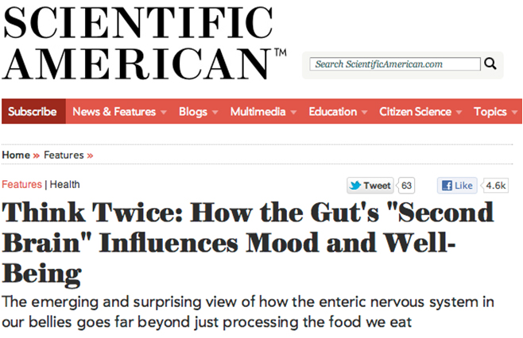
Your second brain
Our gut microbiota play a vital role in our physical and psychological health via its own neural network: the enteric nervous system (ENS), a complex system of about 100 million nerves found in the lining of the gut.
Notes:
Explain how the gut is our second brain.
Raise your hand if you’ve heard of serotonin? What does it do for you? Happy and sleep. 90% of the serotonin in your body is made in the GUT!
Our gut microbiota play a vital role in our physical and psychological health via its own neural network: the enteric nervous system (ENS), a complex system of about 100 million nerves found in the lining of the gut.
The ENS is sometimes called the “second brain,” and it actually arises from the same tissues as our central nervous system (CNS) during fetal development. Therefore, it has many structural and chemical parallels to the brain.
Our ENS doesn’t wax philosophical or make executive decisions like the gray shiny mound in our skulls. Yet, in a miraculously orchestrated symphony of hormones, neurotransmitters, and electrical impulses through a pathway of nerves, both “brains” communicate back and forth. These pathways include and involve endocrine, immune, and neural pathways.

Slide 3
How your gut affects your brain
Disturbances in gut health have been linked to multiple sclerosis, autistic spectrum disorders, Alzheimer’s, and Parkinson’s disease. This is potentially related to pro-inflammatory states elicited by gut dysbiosis-microbial imbalance on or inside the body. .
Notes:
Further, there is now research that is dubbing depression as an inflammatory disorder mediated by poor gut health. In fact, multiple animal studies have shown that manipulating the gut microbiota in some way can produce behaviors related to anxiety and depression. (Maes, Kubera, Leunis, Berk, J. Affective Disorders, 2012 and Berk, Williams, Jacka, BMC Med, 2013).
Show how the gut affects the brain, causing things like anxiety and depression.

Slide 4
YOUR BRAIN ON TOXINS
TODAYS CHEMICALS CANNOT BE METABOLIZED BY YOUR BODY AND CAN CROSS THE BLOOD-BRAIN BARRIER

Slide 5
Spine-Brain Connection
The intermedius nucleus of the medulla (InM) is in the caudal medulla, just above the atlas.)
InM project to brain regions involved in respiratory, cardiovascular, postural and oro-facial behaviors—the neighboring hypoglossal nucleus, facial and motor trigeminal nuclei, parabrachial nuclei, rostral and caudal ventrolateral medulla and nucleus ambiguous
Direct stimulation of the InM mimicked the response of second cervical nerve stimulation.
Notes:
These authors investigated “whether upper cervical sensory afferents, particularly those arising from muscle spindle afferents [mechanoreceptors/proprioceptors], do indeed influence cardiorespiratory activity.”

Slide 6
Spine-Brain-Body
C2 sensory afferents show projections to the intermedius nucleus of the medulla (InM), and the evidence indicates that they are proprioceptive.
The nucleus intermedius (InM) in turn influences the function of the lower 7 cranial nerves, including their parasympathetic functions, as well as medullary sympathetic relays.
The upper cervical spine mechanosensitive afferents have a major influence in the balance between the parasympathetic and sympathetic nervous systems, influencing homeostasis/allostasis and healthy organ function.
Brain Structure & Function March 2014 IJ Edwards, VK Lall, JF Paton, Y Yanagawa, G Szabo, SA Deuchars, J Deuchars From the School of Biomedical Sciences, University of Leeds, UK

Slide 7
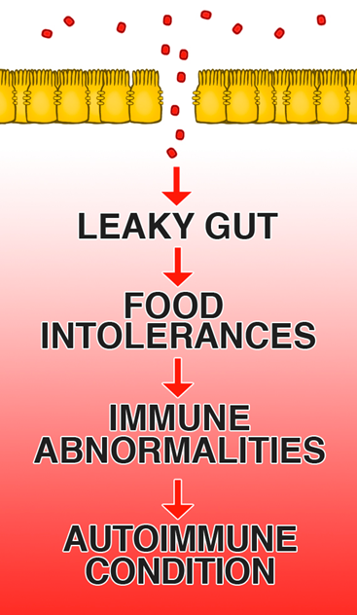
Leaky Gut
Conditions that Can Signal Leaky Gut Syndrome
Do you experience:
arthritis
allergies
depression
eczema
hives
psoriasis
chronic fatigue syndrome or fibromyalgia?
Notes:
All of these things can come from leaky gut. However, by the time you have actual symptoms or a diagnosis; you are very far down the road. The issues of leaky gut and the severely negative effect they have on the immune system amass over a long, long time before it’s bad enough for someone to finally do something about it.
Explain what leaky gut is and why it is such an epidemic right now…
“Leaky gut syndrome (also called increased intestinal permeability), is the result of damage to the intestinal lining, making it less able to protect the internal environment as well as to filter needed nutrients and other biological substances. As a consequence, some bacteria and their toxins, incompletely digested proteins and fats, and waste not normally absorbed may "leak" out of the intestines into the blood stream. This triggers an autoimmune reaction, which can lead to gastrointestinal problems such as abdominal bloating, excessive gas and cramps, fatigue, food sensitivities, joint pain, skin rashes, and autoimmunity. The cause of this syndrome may be chronic inflammation, food sensitivity, damage from taking large amounts of nonsteroidal anti-inflammatory drugs (NSAIDS), cytotoxic drugs and radiation or certain antibiotics, excessive alcohol consumption, or compromised immunity.”

Slide 8
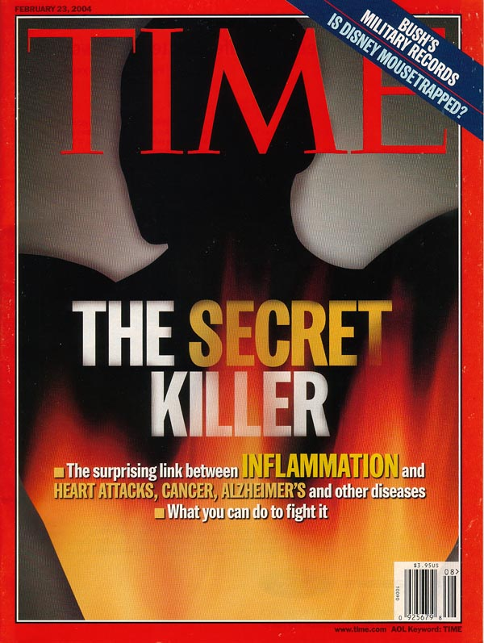
INFLAMMATION: The Gut Killer
Notes:
Inflammation is just like it sounds, it irritates the gut lining, causes it to open up, and let’s unhealth elements permeate the gut lining and make their way into the blood stream, cross the blood brain barrier, and enter into areas of the system they don’t belong. This triggers an unhealthy immune response leading to auto-immune and other serious immunologically based problems

Slide 9
What causes Inflammation?
Free Radicals
Food allergies
Stress and poor rest
Sugar and processed foods
Toxins
Consumption of artificial sweeteners
SUBLUXATION
Vitamin Deficiency
High Omega-6:3 Ratio
Chronic health conditions
Being Overweight
Sedentary lifestyle
Smoking
Notes:
Free radicals: These are defective molecule that sends out molecular shrapnel, damaging the coronary arteries and other cells in our bodies. They lead to advanced aging and changing of our DNA, therefore involved with cancer.
Occur from several causes to be named later, but include normal daily living such as when you metabolize food into energy, oxygen oxidizes (or burns) the food in order to produce energy which create by-products known as free radicals.
Also called “oxidation” – your body normally contains anti-oxidants that keep this under control. However, with modern over-exposure to free radicals, we use up our anti-oxidants.

Slide 10
Artificial Sweeteners: NOT A SOLUTION
Artificial sweeteners toxic to digestive gut bacteria.
Research shows that when exposed to only 1 milligram per milliliter of the artificial sweeteners, the bacteria found in the digestive system became toxic.

Slide 11
Nutrients and the Gut
Vitamin D helps your body absorb calcium and plays a key role in how your nerves, muscles, and immune system function, according to the NIH. What's more, healthy levels of Vitamin D are associated with a reduced risk for colon cancer.*
*Gut.Jun 25, 2015

Slide 12
Magnesium Deficiency
The bacteria in your gut pulls magnesium from other cells, leaving those cells deficient in magnesium – thus aggravating the existing deficiency.
Notes:
Magnesium is needed for more than 300 biochemical reactions in the body. It helps to maintain normal nerve and muscle function, supports a healthy immune system, keeps the heart beat steady, and helps bones remain strong. It also helps regulate blood glucose levels and aid in the production of energy and protein.Jan 7, 2017

Slide 13
Nutrients required for Gut Health
B Vitamins
Vitamin C
Selenium
Vitamin D
Zinc
Magnesium

Slide 14
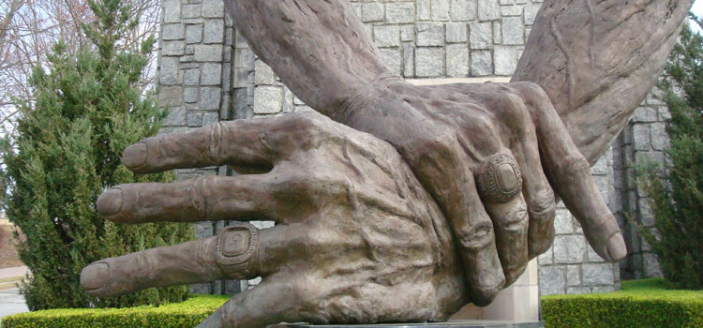
STEP 1: Get Adjusted!
Notes:
O
“This is not new…When stress hormones are released long term, all of these systems (reproductive, immune and GI systems) shut down. What’s the relevance to chiropractic? We know that the subluxation also causes these stress hormones to be released. It triggers the stress response to occur. (By adjusting and removing subluxations) We’re literally restructuring and rewiring the brain so that we stop these stress hormones from being released and we release other good hormones like oxytocin, dopamine and serotonin. Those are all not only our feel-good hormones, but they shut off the stress response and allow health and healing to take place.”
ne of the BEST WAYS to balance your brain chemistry is getting adjusted. Remove the interference that is CAUSING the interference!

Slide 15
Step 2: Address Inflammatory Foods and Test
Best: Get a food allergy, hsCRP, and Vitamin D test
At a minimum: Eliminate wheat, dairy, sugar, fried foods, processed foods, and rancid fats.
Switch to Anti-Inflammatory style diet
Notes:
If you don’t test, you guess. At the very least – look at the most common, damaging foods. Testing, however, shows if what are normally considered health foods are bad for you. The biomarkers of CRP and D let you know where you are at and if the changes you make have worked.
3 steps to repairing leaky gut:
Remove bad foods…your body needs no help to heal, just no interference. REMOVE the bad stuff
Replace with good anti-inflammatory foods
Rebalance with good bacteria.

Slide 16
Step 3: Necessary Supplementation
D, Mg, B, Se, Zn, & C needed for intestinal health
Pre-biotics for healthy flora
Fiber to support the body’s ability to move out toxins and “Frankenfood”
Detoxification to deal with the daily bombardment and the toxic burden on the brain and gut

Slide 17
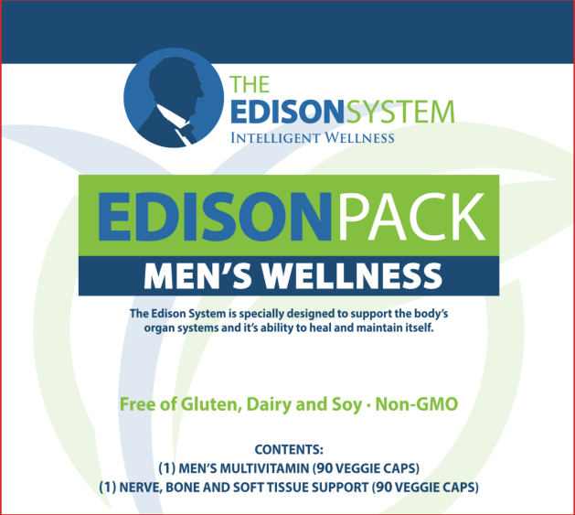

THE EDISON PACK
The Edison Pack is the cornerstone of the Edison System:
1
NERVE, BONE AND SOFT TISSUE SUPPORT
2
MEN’S AND WOMEN’S MULTIVITAMIN
Notes:
Contains all of the nutrients you need and Turmeric along with other anti-inflammatory factors.
Can also check out E-FlamX for more severe cases of inflammation.

Slide 18
Nutrients For Reducing Inflammation in the Gut
Turmeric is made up of anti-inflammatory and antioxidant compounds.
Turmeric has been recognized as beneficial for digestive help with heartburn, inflammation, and stomach ulcers.

Slide 19
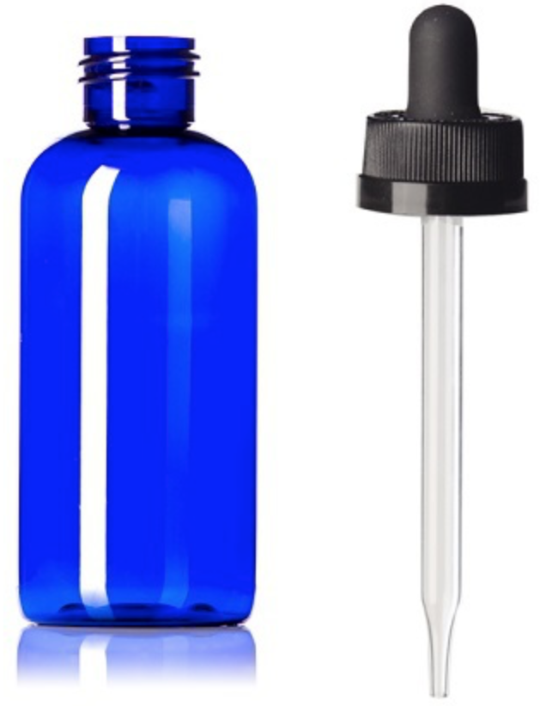
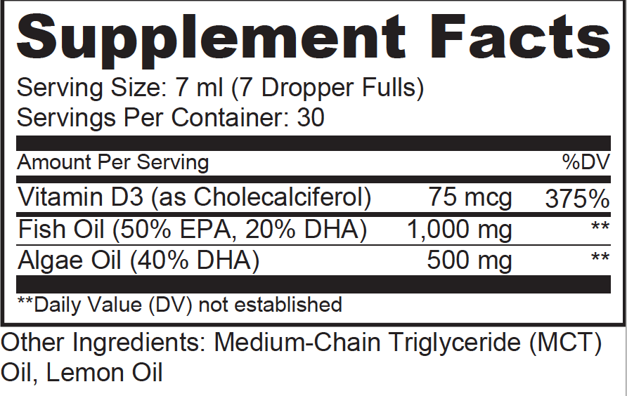
Fix Your Fatty Acids: Add OMEGA-3s
Notes:
Omega 6 is inflammatory, 3 is anti-inflammatory. Yet, the diets tend to be 20-30x Omega 6 vs. 3 rather than 2 or 3:1. All experts agree, the only way to restore balance is through a great Omega 3 supplement.
THE E-3 DIFFERENNCE
This one has both fish and vegetarian algal oil along with another great anti-inflammatory, anti-viral, fat-burning fat MCT.
Omega-6 lowers the presence of omega-3 and omega-9 in plasma and cells.
The omega 3 deficiency increases the risk of diseases including CVD, cancer, lung illness, and auto-immune.
The famous MRFIT study and studies of many different cultures show that people with the lowest percentage of Omega-6’s had the lowest death rate.
Linoleic acid (Omega 6 - w-6) is found in nuts, seeds, vegetable oils and animal products
It is converted to arachidonic acid (AA) downstream which is an inflammatory pathway.

Slide 20
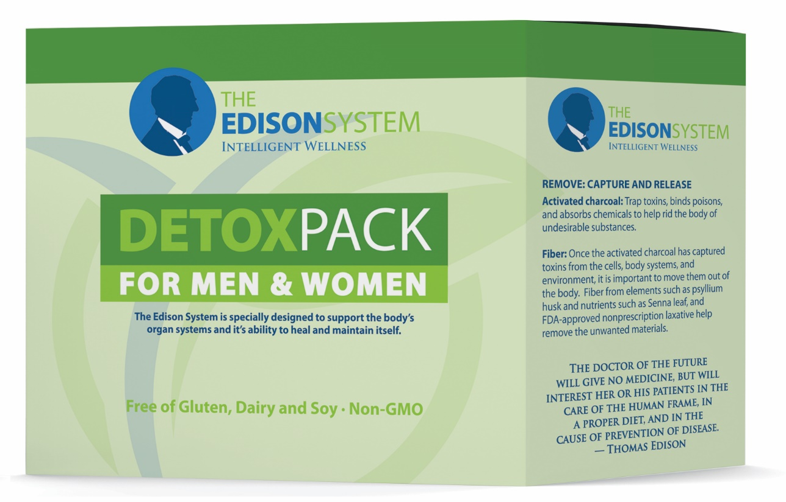
Pre-biotics, Fiber, and De-tox

Slide 21
Pre-biotics
Within the colon, bacteria make many different chemicals, called metabolites.
Your metabolic profile contains at least 107 of these chemicals. Some are toxic.
Prebiotic is able to change the bacterial makeup in a favorable manner and reduce or eliminate many of these toxins.

Slide 22
Step 4: Additional 30 Day Gut Protocol
1. Restore (Microbiome product)
2. Allicin & Oregano
3. Glutamine
Notes:
Don’t Miss Upcoming Events - I want you to do is take out the card that says, “Help my friends and family” do you guys see that card? Hold it up for me. On the back it says “Sign me up.” On the side that says “help my friends and family” I want you to write down the name of the friends and family that you want to invite to the Recipe night that we have coming up on Sept 19th.
We’re not telemarketers so I want to make sure that you call them and let them know that we will be reaching out to them ahead of time. I want you to write your name and number at the top and their names and numbers below. Make sure that you call them ahead of time and let them know that we will be calling; if they don’t want us to call, please let us know, but otherwise we will be calling within the next couple of days to get them to one of our events to see if we can get them the help they need. People are praying for answers, and we have the answer. If you write down four names and turn it in today, we’ll provide you with recipes for homemade non-toxic household cleaning items that will help you live healthy and save money all while reducing your exposure to toxicity – the less toxic you are, the faster you’ll lose weight and keep it off.
On the back of that page it says sign me up. Write your name, number, and email. If you want to receive weekly newsletters with recipes and information regarding future events, let us know. If you want to get registered for the Max Life Call – Fast Intense Results on June 12th, or our Recipe Night on June 16^{th,} or our PAD on June 30th, check the box on this card. You can drop these cards off with __________. __________ raise your hand. We have plenty of time so take your time filling this out, and once it’s complete drop it off in the back with __________. Don’t forget your products and resources are 15% off today only. You can go to the back to pick up the resources that you need, turn in your “Sign me up” card, and guests if you didn’t hand in your Exam form earlier, you can do that now. Thanks.

