Slide 1
Get Well Aligned!

Slide 2
Well-Aligned Goals
Reverse inflammation
Prevent acute and chronic diseases
Defy aging
Optimize nutrient levels in your body
Optimize performance
Minimize Injury
Become the healthiest you’ve ever been

Slide 3
Underlying Factors to Disease:
The Cause is the Cure
SYMPTOMS:
Early aging
Fatigue
Anxiety
Depression
Sleep abnormalities
Pain
Headaches
Inflammation
  Blood sugar imbalances
  Weight gain
  Nausea
  Bloating
  Gas
  Athletic performance
Address the Causes to prevent or defeat:
Obesity
Heart disease
Cancer
Auto-immune
Depression
Pain disorders
TEST UNDERLYING FACTORS:
CRP, D, IRON, FOOD ALLERGY, & Genes

Slide 4
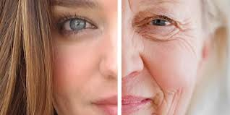
What Causes Us to Age?
Weight gain
Cancer
Heart Disease
Diabetes
Auto-immune
Depression, etc.
Inflammation
Oxidative stress
Insulin resistance
Nutrient depletion
Integrity of the cell
CAUSE
Notes:
That lead to the vast majority of age-related , longevity-impairing conditions (1-3)
(1) Lemon JA, Boreham DR, Rollo CD. A complex dietary supplement extends longevity of mice. J Gerontol A Biol Sci Med Sci. 2005 Mar;60(3):275-9.
(2) Aksenov V, Long J, Liu J, et al. A complex dietary supplement augments spatial learning, brain mass, and mitochondrial electron transport chain activity in aging mice. Age (Dordr). 2011 Nov 27.
(3) Aksenov V, Long J, Lokuge S, Foster JA, Liu J, Rollo CD. Dietary amelioration of locomotor, neurotransmitter and mitochondrial aging. Exp Biol Med (Maywood). 2010 Jan;235(1):66-76.

Slide 5
DEADLY INFLAMMATION
The Major Physiologic Cause of
ALL Pain & Disease

Slide 6
What Is Inflammation?
White blood cells receive instructions to flow to and defend any area that is injured or under attack and spray chemical weapons to neutralize injury or infection.

Slide 7
The Light Side and Dark Side
LIGHT SIDE
A critical, powerful solution designed to be short-term
DARK SIDE
When inflammation becomes systemic and goes unchecked for months or years, the same chemicals used for healing can cause suffering, weight gain, aging, and disease
Notes:
The same inflammation that can save your life in the short term can also kill you if inflammation becomes chronic.
When our bodies are in such an emergency, there is a complicated process through which more pro-inflammatory prostaglandins are created than anti-inflammatory ones, and the immune system is in a steady state of responsiveness

Slide 8
BAD IDEA FOR INFLAMMATION
Over the counter NSAIDs, prescription pain killers and steroids seem like quick, easy, sensible solutions to lower inflammation.
All come at potentially great cost with greater likelihood of
Heart attack, stroke, and serious intestinal conditions.

Slide 9
A Silent Killer
Systemic inflammation does not create pain like a sprained ankle.
It is therefore generally dismissed as signs of “normal” aging, immune related conditions, or obesity and being out of shape from poor lifestyle.
Notes:
As people age and gain weight, chronic systemic inflammation increases and leads to our most common disease.
Blood sugar imbalance is one of many ways we can cause inflammation in our bodies.
Inflammation can be silent – meaning we don’t necessary “experience” any major signs or symptoms.
With acute inflammation, we experience pain, redness, heat at the site of injury. This is our body’s way of repairing damage – so short term inflammation can be very beneficial
Long term inflammation is a concern because it can shift our biochemistry, which leads to many concerns

Slide 10
The #1 Killer of Men & Women
Beats about 100,000 times/day
Moves approx. 2,000 gal of blood through 60,000 mi of blood vessels/day
Blood circulates through the entire system o a minute.
The heart beats 2.5 billion X+ in your lifetime ---
Pumping more than 1 million barrels of blood

Slide 11
Atherosclerosis: Inflammation and Your Arteries
Inflammation from C-reactive protein (CRP) and elevated homocysteine
Also: Oxidation of LDL cholesterol by free radicals, elevated insulin, blood sugar, bad fats, poor diet, toxins, chemicals, and heavy metals.
CAUSE ATHEROSCLEROSIS
Notes:
The inner layer, called the intima or endothelium gets damaged over time by issues like: high blood pressure, oxidation of LDL cholesterol, cigarette smoke, free radicals, elevated homocysteine levels, elevated C-reactive protein (CRP) levels, elevated blood sugar and insulin levels, bad fats, poor diet, toxic chemicals and metals.
Inflammation most commonly leads to atherosclerosis
Atherosclerosis is the hardening of these arteries most commonly due to excessive amounts of plaque. This plaque contains cholesterol, calcium, white blood cells, collagen, elastin, platelets, and other materials driven there through chronic inflammation.
The saddest and perhaps most frustrating part to cardiovascular disease is that it is the #1 killer of men and women – causing more than 1 in 3 deaths in the U.S. each year, it is one of the most treatable and preventable of all health problems.

Slide 12
Causes and Provokes ALL Disease
Chronic inflammation is a symptom of virtually every disease and also aggravates all disease.
FOR EXAMPLE: Being overweight creates inflammation and inflammation provokes weight gain.
Notes:
Constant inflammation creates inflammatory cytokines, which are destructive, cell-signaling chemicals that lead to the most common forms of degenerative diseases: atherosclerosis, heart disease, cancer, arthritis, Diabetes, Alzheimer’s, immune conditions like allergies and asthma, autoimmune like colitis, Crohn’s, diabetes, and celiac disease, and liver conditions like hepatitis.
Inflammation causes cancer and cancer causes inflammation – a double edged sword and a vicious cycle in 1. Thankfully, inflammation can be addressed and gotten under control.
Research from Sweden showed that the higher the number of elevated inflammatory proteins, the greater the chances of weight gain.
Prior to these reports experts assumed that obese people had higher levels of inflammatory proteins because of the cytokines their fatty tissues secreted. In other words, doctors thought that obese individuals continued to deal with greater inflammation because they were obese. When you decrease your body’s inflammatory response, you will also lower your weight and your waist size.
The National Cancer Institute brought out a report highlighting inflammation research is too often ignored by oncologists.*
The report describes in great detail the processes by which cancer cells manage to lead the body’s healing mechanisms astray. Just like immune cells gearing up to repair lesions, cancer cells need to produce inflammation to sustain their growth. Through the inflammation process, they begin an abundant production of the same highly inflammatory substances—cytokines, prostaglandins, and leukotrienes—seen in the natural reparation of wounds, but now working against the future of the same body these process were designed to protect.
*Peek, R. M., Jr., S. Mohla, and R. N. DuBois, “Inflammation in the Genesis and Perpetuation of Cancer: Summary and Recommendations from a National Cancer Institute-Sponsored Meeting,” Cancer Research 65, no. 19 (2005): 8583-86.”

Slide 13
What causes Inflammation?
Free Radicals
Blood sugar imbalance
Stress and poor rest
Sugar and processed foods
Toxins
Consumption of artificial sweeteners
SUBLUXATION!
Chronic health conditions
Being Overweight
Sedentary lifestyle
Smoking
Chronic overconsumption of carbs
Notes:
Free radicals: These are defective molecule that sends out molecular shrapnel, damaging the coronary arteries and other cells in our bodies. They lead to advanced aging and changing of our DNA, therefore involved with cancer.
Occur from several causes to be named later, but include normal daily living such as when you metabolize food into energy, oxygen oxidizes (or burns) the food in order to produce energy which create by-products known as free radicals.
Also called “oxidation” – your body normally contains anti-oxidants that keep this under control. However, with modern over-exposure to free radicals, we use up our anti-oxidants.

Slide 14
Sugar and Inflammation
OUT OF CONTROL (“Modern”) SUGAR CONSUMPTION
Ancestors: 2 kilograms (4 pounds) a year per person.
(This would be where our original genetic makeup was created.)
1830: 5 – 8 kilograms (11-18 pounds) a year
TODAY: 68 - 77 kilograms (150 - 170 pounds) a year
Notes:
Research has shown that those with the highest level of IGF were seven times more likely to develop breast cancer than those with the lowest.
Additional research from Harvard and the University of California at San Francisco in the United States and McGill in Canada, demonstrated the same phenomenon for prostate cancer> For men, the risk was as much as nine times greater for those with the highest levels of IGF. Additional studies have shown that a high glycemic index is likewise associated with cancer of the pancreas, colon, and ovaries.
The study, published in the Journal of the National Cancer Institute, concludes that it is not obesity per se that is a risk factor for breast cancer, but rather high insulin levels that tend to be associated with excessive body weight. The women with the higher insulin levels (and who were not diabetic or taking hormone replacement therapy) had almost twice the risk of developing breast cancer during the follow-up period compared to those whose insulin levels were the lowest.
Peek, R. M., Jr., S. Mohla, and R. N. DuBois, “Inflammation in the Genesis and Perpetuation of Cancer: Summary and Recommendations from a National Cancer Institute-Sponsored Meeting,” Cancer Research 65, no. 19 (2005): 8583-86.”

Slide 15
The Sugar = Disease Effect
Insulin production causes IGF (Insulin-like Growth Factor) to be released and creates INFLAMMATION.
IGF stimulates faster cell growth and along with inflammation- is linked to disease; especially cancer.
Notes:
When we deliver high glycemic nutrients into the blood, glucose levels rise quickly.
The result is the release of insulin necessary to allow glucose to enter the cell. When insulin is released, anoter molecule called IGF (insulin ike growth factor)is released as well. IGF stimulates cell growth allowing sugar to provide for tissue nourishment and faster growth. A major negative to this duo of molecules is that they cause inflammation and are linked to several health issues including cancer.
The cell growth caused by IGF stimulates cancer cell growth.
This connects to diabetes. With high blood sugar levels, people with diabetes are known to be at above-average risk for cancer.

Slide 16
Bad Fats!
Too many Omega-6’s and not enough Omega-3’s creates potent inflammatory agents
Notes:
Omega Balance, Disease, and Inflammation
Omega-6 fats lead to the formation of “eicosanoids.”
These are inflammatory hormones. In fact, the action that allows many painkillers like aspirin to work is by inhibiting the enzymes that convert Omega-6 to inflammatory agents that are called prostaglandins.
Over time, it’s been estimated that the overabundance of Omega-6’s and the resulting deficiency of Omega-3’s is involved in the causes of heart disease, vascular disease, homicide, depression, bronchial disease, and many other brain, joint, and organ disorders.

Slide 17
CRP: The Marker of Inflammation
Fat cells, infections, blood sugar, insulin resistance, free-radicals, and toxins produce the inflammatory cytokine C-Reactive Protein (CRP)
Elevated CRP sparks full systemic, chronic inflammation and radically increases risk of both heart attack and stroke.
The more fat cells, health, and physiologic issues you have; the more inflammatory markers like CRP you will create.
Notes:
When the body produces more inflammatory mediators, such as CRP, this in turn sparks chronic systemic inflammation.
Essentially the more fat you have (particularly belly fat) or other issues you are managing, the more inflammation you suffer.
Several studies show the inflammation and fat connection. A particular study showed inflammation increased more than 50 percent in obese women whose fat was in their hips.*
* G. Davi, M. T. Guagnano, G. Ciabattoni, et al., “Platelet Activation in Obese Women: Role of Inflammation and Oxidant Stress,” Journal of the American Medical Association 288, no. 16 (2002): 2008–2014.”

Slide 18
Consequences of Inflammation (High CRP)
Cancer
Heart attack
Stroke
Migraines or headaches
Poor memory
Intestinal dx
Diabetes or pre-diabetes
Arthritis, Joint Pain
Weight gain
Injury
Depression
Auto-immune dx
Notes:
The major concerns associated with chronic inflammation are things like cancer, heart attack, stroke
This is especially scary because we can address chronic inflammation but addressing nutritional deficiencies, modifying our diet and lifestyle.
CRP is the blood marker you test to measure inflammation levels in your body

Slide 19
THE RANGES AND EFFECT OF CRP
MEN (Goal: <1)
CRP (mg/L) HEART ATTACK STROKE
>2.11 3X 2X
1.15 - 2.10 2.6X 2X
.56 -1.14 1 2X 2X
<0.55 1X 1X
WOMEN (Goal: <1.5)
CRP (mg/L) HEART ATTACK OR STROKE
>7.3 5.5X
3.8-7.3 3.5X
1.5-3.7 3X
<1.5 1X
Notes:
In a Harvard Women's Health Study, CRP test results were more accurate. Twelve different indicators of inflammation were looked at in healthy women who had already had menopause. Three years later, those with the highest CRP levels were more than four times as likely to have died from coronary disease, or had a heart attack that wasn’t fatal, or stroke, compared with those with the lowest levelsRP is one of, if not the most important marker to check to maximize both current and future health.
CRP is one of the most, if not the most important marker of health to get tested – other inflammatory markers like homocysteine or Lp-PLA2 are inflammation markers as well.

Slide 20
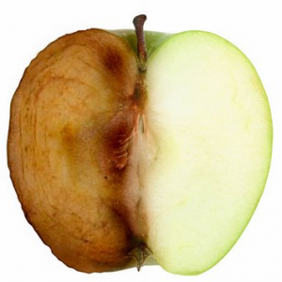
Oxidative Stress
Notes:
Oxidation causes inflammation.
Many of the same causes and conditions are related to both..

Slide 21
ANTI-AGING
“Premature” aging is caused by chronic inflammation, oxidation, and the other biomarkers for bodily stress
Life-extension is achieved through managing these issues through addressing their causes

Slide 22
Oxidative Stress
Oxidative Stress refers to the burden of free radicals that damage the cells all the way down to the DNA and cause inflammation.
Notes:
What is oxidative stress?
This term refers to a burden of free radicals in our body. (Reactive oxygen species)
Free radicals are unstable molecules in our body that can damage other cells and lead to the progression of cancer, cardiovascular disease and age related decline
To prevent free radical damage, we use antioxidants:
Antioxidants provide us with a defense mechanism against free radical damage by stabilizing these unstable molecules, but can’t keep up under heavy exposure. We end up running low on antioxidants and the free-radicals overcome our health.

Slide 23
IT’S NOT THE CHOLESTEROL, IT’S THE INFLAMMATION
When LDL cholesterol is oxidized, it is especially damaging to the arterial lining and causes plaque

Slide 24
What causes Oxidative Stress?
Exposure to toxins
Cigarette smoke
Pollution
Dehydration
Excess sugar
Processed foods
SUBLUXATION
Medication
Preservatives in foods
Alcohol consumption
Stress
Notes:
Our bodies are exposed to free radicals and oxidative stress in the environmental and internally by our own metabolic processes – the food and drinks we consume can help contribute to our oxidative stress
oxidative stress.
Toxins, emotional stress, radiation, physical stress like intense exercise, sugar, weight gain, insulin issues, inflammation, and can increase oxidation and make it even more difficult for your antioxidant defenses to keep up. So you can see where inflammation and oxidation are closely tied together in terms of cause and impact.

Slide 25
Consequences of Oxidative Stress
Inflammation
Cancer
COPD
Asthma
Alzheimer’s Disease
Depression, anxiety
Lack of energy and stamina
Joint or muscle pain
Premature aging
Heart disease
Diabetes
Notes:
The effects of long term oxidative stress can affect many different body systems and create chronic and deadly conditions

Slide 26
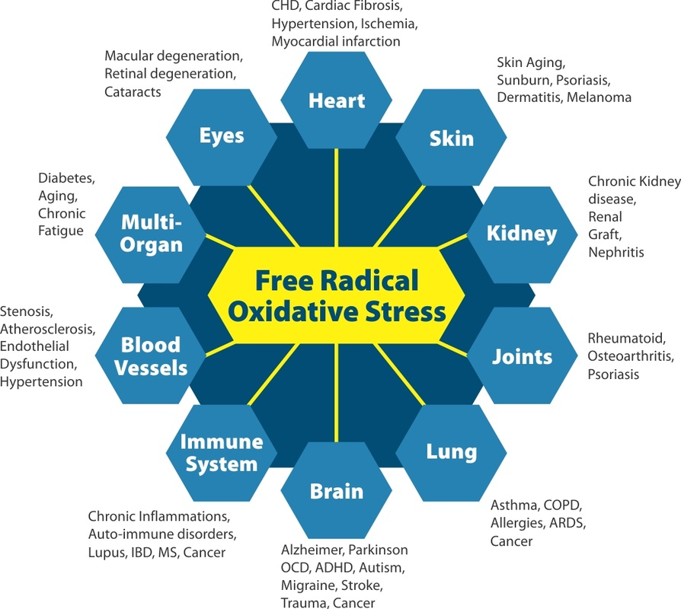
Notes:
These are a few examples of how oxidative stress can affect different body systems. Its systems specific and there are both general anti-oxidants as well as specific ones that help unique areas of the body.

Slide 27
Your Toxic Burden
Overwhelm bodily functions
Cross the blood-brain barrier and poison the nervous system
Damage your cells
Lead to chronic inflammation and oxidation
Slow your metabolic rate.
Disrupt absorption of critical
Disrupt hormonal activity due to changes in receptor sites.
Lower thyroid function.
Bind to fats making them tough to lose.

Slide 28
What causes Toxicity?
Exposure to mold, pesticides, and other environmental toxins
Use of plastic water bottles
Unfiltered water which contains chlorine, fluorine, heavy metals and toxins
Benzene, xylene, toluene exposure through fabrics, detergents, dyes, gasoline
Medications, vaccinations
Glyphosates
Cigarettes, alcohol
Commercial foods
Use of artificial sweeteners
Personal care products like shampoo, soap, and toothpaste
Pesticides, herbicides, fungicides and fertilizers
Household cleaners
Dental work
Notes:
Our bodies are constantly exposed to toxins in the environment, through our diets and through lifestyle choices
Our liver provides protection against toxins by filtering them out of our system
When we are chronically exposed toxins, the liver becomes overburdened and works less efficiently
We can overburden our liver with all of these things: [listed on slide]

Slide 29
Toxic Exposure
Glyphosates Packaging
Car Bottling
Home Beer & Wine
Work Fabrics
Outside environment Clothing
Food Drugs
Drinks Personal care products

Slide 30
Consequences of Toxicity
Cancer
Depression
Decreased vitamin levels
Antioxidant wasting
Breakdown of energy pathways
Chronic pain
Weight loss resistance
Inflammation/oxidation
Hormonal imbalances
Body odor, belching and gas
Bad breath
Skin problems
Notes:
Toxicity affects many pathways, and can lead to deadly cancer, depression, pain, hormonal imbalances etc

Slide 31
VITAMIN D
Other roles:
Normal immune function
Fighting infection
Muscle function
Cardiovascular regulation
Respiratory system support
Brain development
Notes:
100,000 people study showed that people with higher than average Vit E had a 43% lower risk of any heart or vascular metabolic disease. High Vit D had 33% less CV disease, 55%, less Type II Diabetes, and 51% less metabolic syndrome (Diabetes precursor with weight loss resistance, high plod pressure, and high triglycerides).
Optimal level is over 60 ng/mL – average person has less than half and labs have considered that “normal”
Depression, osteoporosis, heart disease, auto immune disease, infection, hypertension, and cancer (50% drop in intestinal cancers).

Slide 32
The Consequence of Low Vitamin D
Depression, osteoporosis, heart disease, auto immune disease, infection, hypertension, and cancer
AND YOU CANNOT GET ENOUGH FROM YOUR DIET
Notes:
New research has confirmed the importance of vitamin D3 in preventing cancer, particularly in countries where the lack of sunshine means that the skin cannot synthesize enough of this vitamin during the winter. I’ve therefore given more attention to this topic, and made new and more specific recommendations.”
“has recently been shown that a significant supply of vitamin D reduces considerably the risk of several cancers (by more than 75 percent with a daily intake of 1,000 international units [IUs] of the 25-hydroxyvitamin D form), in a Creighton University study published in 2007.121 In a Canadian pilot study of fifteen patients with prostate cancer, researchers reported on the effects of taking just 2,000 IUs of vitamin D3 daily over a median of eight months (up to sixty-five months for one of the patients). Fourteen of them saw a slowing of progression of their PSA levels (the most common marker of prostate cancer, used to follow its growth over time). And these levels actually dropped significantly in nine of the patients compared to their levels at the start of treatment.122
Other studies published recently have shown positive effects of vitamin D3 on breast cancer, non-small-cell lung cancer, colon cancer, and prostate cancer. Many researchers now believe that vitamin D3 contributes to slowing down all forms of cancer, at least in the early stages. Moreover, we now know that vitamin D3 very likely protects us from colds and flu and contributes to maintaining a[…]”
“Foods that contain the most vitamin D are cod liver oil (1,460 IUs in a tablespoon), salmon (360 IUs in 100 grams), mackerel (345 IUs in 100 grams), sardines (270 IUs in 100 grams), and eel (200 IUs in 100 grams). Milk enriched with vitamin D contains only 98 IUs per glass, an egg 25 IUs, and calf liver 20 IUs per 100 grams.”
“Long-chain omega-3s found in fatty fish (or in high-quality purified fish oil supplements) reduce inflammation. In cell cultures, they reduce cancer cell growth in a large number of tumors (lung, breast, colon, prostate, kidney, etc.). They also act to reduce the spread of tumors in the form of metastases. Several human studies show that the risk of several cancers is significantly lower in people who eat fish at least twice a week.125,126,127,128,129,130,131,132ai”

Slide 33
Test and Take Vitamin D
Vitamin D3
High-quality vitamin D3 supports health in countless ways. From boosting heart and bone health to and lessening inflammation and the risks of certain diseases, vitamin D is vital to ongoing health.¹ Vitamin D-deficiency, on the other hand, increases risk of stroke and heart failure.^{2, 3} While the human body produces vitamin D naturally when exposed to moderate sunlight, indoor jobs and cold weather climates have left nearly half of all Americans vitamin D-deficient.⁴
Senior author Bess Dawson-Hughes, M.D., director of the Bone Metabolism Laboratory at the Jean Mayer USDA Human Nutrition and Research Center on Aging at Tufts University, says, “We may need to reconsider the current recommended daily values of vitamin D for older adults.” Dawson-Hughes believes that “vitamin D may also improve muscle strength, thereby reducing fracture risk through fall prevention.” ⁵
Emerging science suggests that vitamin D receptors are found throughout the body. Over 900 genes and several areas of the body have vitamin D receptors, or proteins that bind to vitamin D.⁶ According to University of California Riverside’s Biochemistry Presidential Chair, this means that, “Vitamin D supports immune system, pancreas, heart, blood, cellular, muscle, bone and bone marrow, breast, colon, intestine, kidney, lung, prostate, retina, skin, stomach, uterine and brain health—and can [positively] impact 36 bodily organs.” Even improved memory and concentration have been linked to vitamin D intake!⁷
Vitamin D can also inhibit unwanted and unhealthy cell proliferation, while stimulating healthy cell differentiation.⁸ When some cells divide rapidly, or proliferate, the impact on your health can be devastating. Cell differentiation, however, can decrease unwanted cellular proliferation. Lung, skin, colon, bone and breast sites have been studied for vitamin D’s positive effects on cell proliferation and differentiation. Vitamin D causes cells to act as normal, mature cells by stimulating healthy cell differentiation. Dr. Cedric Garland, a 20-year veteran vitamin D researcher, believes vitamin D can prevent unwanted cell proliferation by 75 percent with optimal vitamin D blood levels.⁹
Many vitamin D supplement options are available, but nearly all contain synthetic versions derived from irradiated animal fat.¹⁰ A whole-foods option would provide the needed amount of vitamin D3 without a risk of excess sun exposure.

Slide 34
The Most Proven Vitamin: Proper Levels of D
33% less heart disease
55%, less Type II Diabetes
51% less weight loss resistance, high blood pressure, and high triglycerides)
Optimal level is over 60 ng/mL – average person has less than half and labs have considered that “normal”

Slide 35
Addressing Inflammation, Aging, and Disease
Test CRP, Food allergies
Test Vitamin D
Address daily exposure to toxins and detox
Sugar
Omega Fats
Fight Free Radicals with Anti-oxidants
Optimize Nutrient levels
Stress, Rest
Whole-food, Low glycemic diet

Slide 36
Up Omega-3s/Down Omega-6s
Add Omega-3’s and lowering the 6s is a major step in solving inflammation and its related conditions.
Notes:
The Omega-3’s in your body can compete for, slow down, and even stop the formation of these inflammatory Omega-6 hormones. This fact led to the discovery that increasing Omega-3 HUFAs as a percent of your body’s lipids could prevent diseases caused by Omega-6 inflammation.

Slide 37
Manage Sugar
Low-glycemic eating
Less carbs
Raise good fats
Avoid processed foods
Eliminate artificial sweeteners, additives, colorings, and preservatives

Slide 38
SOLUTION TO TOXICITY
(And Free Radical Oxidation)
  Glutathione is the main antioxidant of the body and your Master Detoxifier
  Our bodies naturally produce glutathione, but toxins, stress, trauma, and sickness cause deficiency.
  Toxins must be absorbed and removed from the body through channels
Notes:
Glutathione is the primary antioxidant of the body. It is unique because it actually recycles itself and will continuously seek out and destroy toxins! Glutathione is made up of the amino acids cysteine, glycine and glutamic acid. Sulfur specifically attracts and binds toxins which will allow glutathione to destroy it.
Sulfur Rich Compounds like glutathione bind toxins for removal
Glutathione
Vitamin U
Cultured Dairy Proteins
Whey Proteins (lactalbumin)
Glutathione has multiple functions:
It is the major endogenous antioxidant produced by the cells, participating directly in the neutralization of free radicals and reactive oxygen compounds, as well as maintaining exogenous antioxidants such as vitamins C and E in their reduced (active) forms.
Regulation of the nitric oxide cycle, which is critical for life but can be problematic if unregulated.
It is used in metabolic and biochemical reactions such as DNA synthesis and repair, protein synthesis, prostaglandin synthesis, amino acid transport, and enzyme activation. Thus, every system in the body can be affected by the state of the glutathione system, especially the immune system, the nervous system, the gastrointestinal system and the lungs.

Slide 39
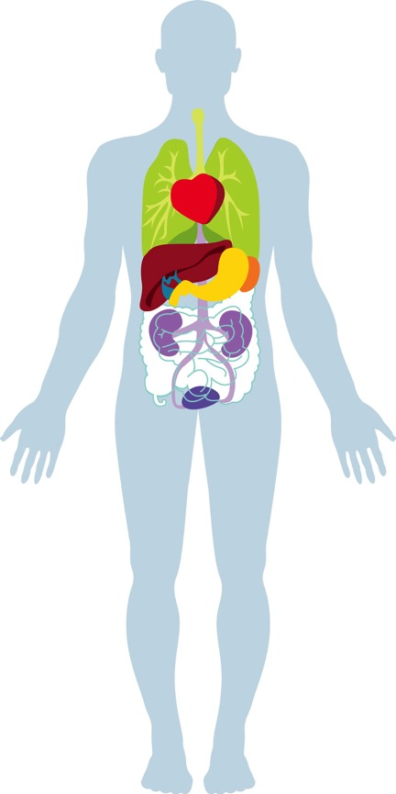
Your Body’s Detox Channels
Skin
Lungs
Colon*
Kidneys
Liver*
Lymphatic system
Fat cells
*Centers for processing and removal
Notes:
The toxic burden also causes a burden on the liver, which is your body’s detox super organ.
To maximize detox we need to look at all the detoxification channels. They include the skin, lungs, colon, kidneys, liver, lymphatic system and fat cells. Detoxification happens both inside cells and outside of them.
Skin
Lungs
Liver
Lymphatic System
Fat cells – researchers are leaning towards classifying body fat more like an organ rather than simply fat that is hanging around…Refer to visceral fat and its link to major health issues…fat as repository for toxins, carcinogens, and endocrine disruptors
Here is an interesting recent article on increased incidence of major diseases in obese Indian women, linking it to toxins stored in fat as major contributing factor:
http://dailypioneer.com/nation/42244-risk-of-breast-cancer-high-in-obese-indian-women-study.html
Perhaps a quick overview of what each organ/system is responsible for in the elimination spectrum.

Slide 40
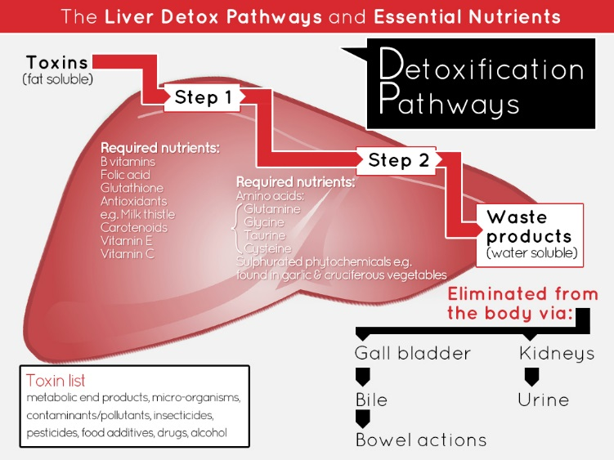
Notes:
This illustrates how many nutrients are required for adequate elimination of toxins from our body through the liver
As you can see, this is a multistep process and any type of nutritional deficiency could affect the efficacy of our detox pathways leading to a greater risk in development of disease.
Toxins can lead to a decrease in nutrients and glutathione wasting
The loss of glutathione is a bad things - Glutathione is our body’s natural detoxifier, without it, we have a more difficult time removing toxins
When we have an over abundance of toxins, our detoxification pathways shut down, making our toxin burden much higher
A higher toxin burden increases our risk of deadly disease

Slide 41
B Vitamins and Your Heart
Decreased B Vitamins leads to elevated CRP and homocysteine
Elevated CRP or homocysteine leads to increased risk of damage to your blood vessels and cardiovascular system
You are 4 times more likely to have heart attack from elevated homocysteine then elevated cholesterol
Notes:
Curr Med Res Opin. 2007 Aug;23(8):1879-86.
Effects of folic acid and vitamin B complex on serum C-reactive protein and albumin levels in stable hemodialysis patients.
Chang TY¹, Chou KJ, Tseng CF, Chung HM, Fang HC, Hung YM, Wu MJ, Tzeng HM, Lind CC, Lu KC.
After 3 months, levels of plasma tHcy and serum hs-CRP, Cr, and nPCR were significantly decreased while levels of serum albumin, vitamin B(12), folate, and BW were significantly increased. The dialytic dose (KT/V) and dietary intake remained unchanged. However, correlations between the magnitude of reduction of tHcy & hs-CRP, tHcy & Cr, and Cr & nPCR were statistically significant.
Another important thing that happens when we over utilize our B Vitamins because of stress: we create elevated levels of an amino acid known as homocysteine
Homocysteine leaves us more susceptible to damage in our cardiovascular system.
This means we have an increased risk of blood clots, heart attacks and strokes, simply because we don’t have enough B Vitamins
Serum total homocysteine level is an independent risk factor for coronary heart disease.
Int. J. Epidemiol. (1995) 24 (4):704-709. doi: 10.1093/ije/24.4.704
Serum Total Homocysteine and Coronary Heart Disease
EGIL ARNESEN*, HELGA REFSUM**, KAARE H BØNAA*, PER MAGNE UELAND**, OLAV H FØRDE* and JAN E NORDREHAUG†
Background Several studies have observed high plasma levels of homocysteine among patients with coronary heart disease (CHD). The only prospective study was based on US physicians, and concluded that homocysteine was associated with subsequent myocardial infarction (Ml). However, the association was limited to those above a threshold level of homocysteine.
Methods We conducted a nested case-control study among the 21 826 subjects, aged 12–61 years, who were surveyed in the municipality of Tromsø, Norway. Among those free from Ml at the screening, 123 later developed CHD. Four controls were selected for each case.
Results Level of homocysteine was higher in cases than in controls (12.7 ± 4.7 versus 11.3 ± 3.7 µmol/l (mean ± SD); P = 0.002). The relative risk for a 4 µmol/l increase in serum homocysteine was 1.41 (95% confidence interval (Cl): 1.16–1.71). Adjusting for possible confounders reduced the relative risk to 1.32 (95% Cl: 1.05–1.65). There was no threshold level above which serum homocysteine is associated with CHD events.
Conclusions In the general population serum total homocysteine is an independent risk factor for CHD with no threshold level.

Slide 42
Anti-inflammatory Nutrients
TURMERIC: It’s the curcuminoids
The source, amount, and concentration that gives it the anti-inflammatory and other disease-fighting benefits.
Boswellia
White Willow Bark

Slide 43
Anti-oxidants
Antioxidant vitamins help to prevent or repair the lining of the blood vessels that are damaged and to halt or diminish the destructive inflammatory response. Without adequate antioxidants, more plaque is formed. If this continues over decades, the fatty plaque builds up in your blood vessels, creating atherosclerosis”

Slide 44
Vitamin E: Potent Antioxidant
Body's most potent fat-soluble antioxidant
Crucial for protecting against free radical damage
Strengthens and regulates heartbeat (very important in preventing and treating heart disease and cardiac conditions)
Increases body's production of CD4 (natural killer cells) and certain antibodies
Slows down the mental decline associated with some neurological disorders

Slide 45
FIGHTING THE #1 KILLER
EDISON PACK HEART BLEND – FIGHT THE DAILY FIGHT!
D-ribose: repairs and prevents heart damage and improves recovery
Anti-oxidants specific to the heart
Resveratrol
CoQ10
Lycopene (Along with Saw Palmetto in the Men’s – also helps to prevent conditions of the prostate)
Notes:
Chemicals and stress raise free radicals and use up our antioxidants like Selenium and critical Vitamins A, C, and E as well as the vital mineral Zinc
Fight the good fight against damage to your heart through replacing these antioxidants and taking nutrients that fight free radicals that attack the heart and support the cardio vascular system’s ability to heal and repair.

Slide 46
MEN’S WHOLE FOOD ANTIOXIDANT BLEND
MEN’S: Saw Palmetto
Supports the urological system
Supports prostate health
Helps mitigate issues leading to hair loss
Assists in retaining testosterone levels

Slide 47
WOMEN’S WHOLE FOOD ANTI-OXIDANT BLEND
WOMEN’S: L-Threonine (amino acid)
Protects the cells against oxidative stress and improves mood, anxiety, depression, and sleep.
PLUS, many other great benefits!

Slide 48
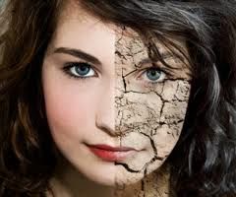
CoQ10: Aging Process
Notes:
CoQ10:
CoQ10 is an important component of energy production.
Remember: energy comes from the foods we eat, and just like B Vitamins are necessary to move those processes along, so is CoQ10.
In addition to helping produce energy, CoQ10 is an antioxidant and can protect your heart against oxidative stress
CoQ10 can be depleted by the use of statin drugs, which lower cholesterol. Cholesterol is another consequence of inflammation and oxidative stress.
More importantly, there are consequences to having low levels of CoQ10. These include heart failure, high blood pressure, blood sugar imbalance, and stomach ulcers.

Slide 49
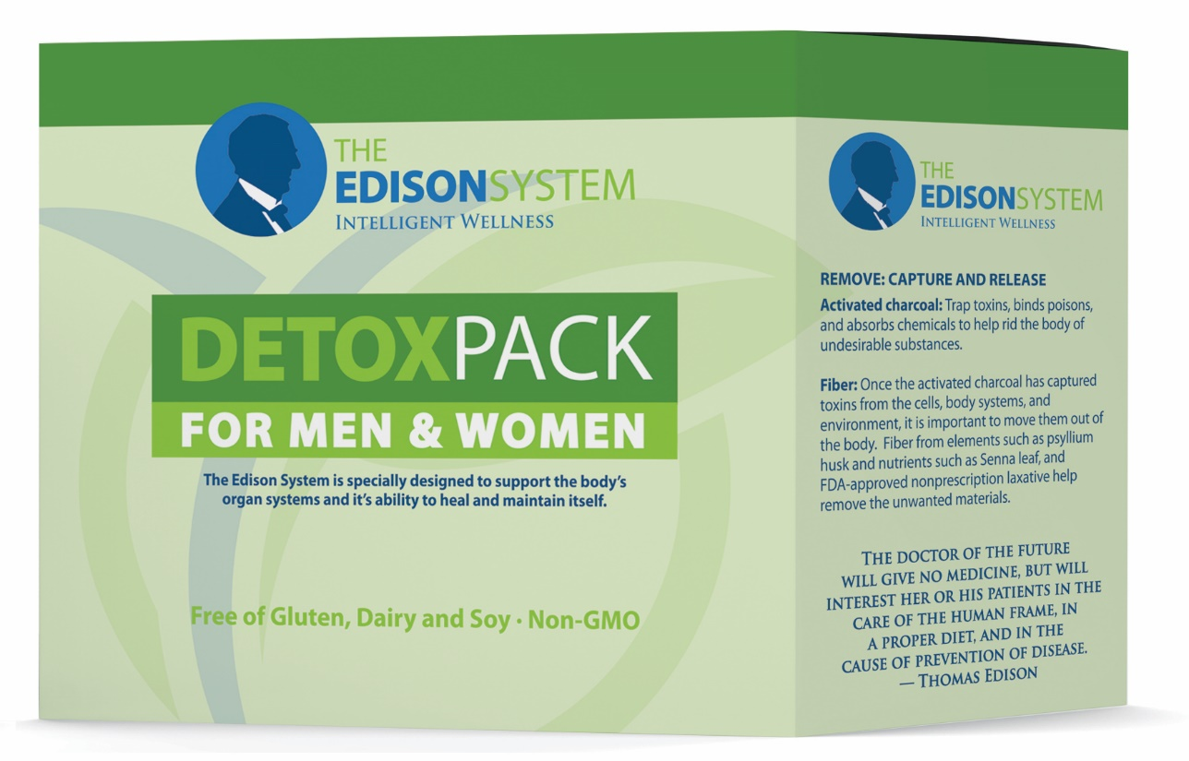
Notes:
NOTE: We have added a lot of information to this presentation. Please use what you need, and what you have time for, and delete slides that you don’t need. We thought it better to provide you with a robust presentation and allow you to modify to suit your needs. You will need to practice the presentation for timing.

Slide 50
Master Detoxifier
N-Acetyl-L-Cysteine (NAC)*
L-Glutamine*
L-Glycine*
Milk Thistle Seed Extract*
Apple Cider Vinegar (Powder)
Aloe Vera Leaf Powder
Broccoli Seed Extract Powder*
Chlorella
Cinnamon Extract
Dandelion Greens
Garlic Powder*
Green Tea Extract (Polyphenols, Catechins, and EGCG)
L-Glutathione*
*Increase and enhance Glutathione in the blood
Notes:
Milk Thistle, Broccoli, and Garlic all boost glutathione production.
N-Acetyl-L-Cysteine (NAC)*, L-Glutamine*, L-Glycine*, Broccoli Seed Extract Powder 13%*, Garlic Powder*, L-Glutathione*
As well as cruciferous vegetables in Part 2, Capture and Release

Slide 51
Milk Thistle
Powerful glutathione regenerator
Reduces and reverses liver damage caused by medications, radiation and alcohol
Used to treat alcoholic cirrhosis and alcoholic hepatitis
A potent antioxidant for the liver
Chemoprotective (2-4)
Notes:
. Also, milk thistle inhibits certain enzymes that promote free radical production, along with maintaining the electron-transport chain of cell mitochondria during stressful conditions.
2. Phytother Res. 2010 Oct;24(10):1423-32. doi: 10.1002/ptr.3207. Milk thistle in liver diseases: past, present, future. Abenavoli L¹, Capasso R, Milic N, Capasso F.
3, Indian J Biochem Biophys. 2006 Oct;43(5):306-11. Protective effects of silymarin, a milk thistle (Silybium marianum) derivative on ethanol-induced oxidative stress in liver.
Das SK¹, Vasudevan DM.
4 Antioxidants (Basel). 2015 Mar; 4(1): 204–247. Silymarin as a Natural Antioxidant: An Overview of the Current Evidence and Perspectives
Peter F. Sura

Slide 52
Key Co-Factors (Edison Pack)
Vitamin C –
Vitamin E –
B vitamins –
Selenium -
Magnesium -
Zinc –
Alpha lipoic acid –
Vitamin D
Notes:
The Edison pack contains all of these key co-factors critical as Selenium, Vitamin C, B-Vitamins, Vitamin E, Alpha Lipoic Acid (ALA), and Zinc are important co-factors for producing and maintaining adequate levels glutathione and helping glutathione work to fight free radicals and cleanse the body.
Vitamin C – as an antioxidant it assists glutathione in this function and has been shown scientifically to raise glutathione levels short term; it is recycled by glutathione from its oxidized state back to its active state, thus strengthening antioxidant defenses; vitamin C also recycles vitamin E and alpha lipoic acid.
Vitamin E – as an antioxidant it also assists glutathione in eliminating free radicals much like vitamin C; it is also required for the proper functioning of glutathione enzymes; it recycles vitamin C and alpha lipoic acid.
B vitamins – vitamins B1 and B2 maintain glutathione and its enzymes in their active forms; vitamin B2 participates in the formation of a glutathione molecule; vitamin B6 influences glutathione synthesis indirectly as it is important for the proper functioning of amino acids including GSH precursors; vitamin B6 increases the amount of magnesium (a vital cofactor) that can enter cells; folate (B9) pushes cysteine towards glutathione production rather than homocysteine production; folate and vitamin B12 work together in amino acid metabolism and protein synthesis. You can read more about vitamin B12 deficiency and its effect on immune health.
Selenium - part of the enzyme glutathione peroxidase (GPx). Glutathione peroxidases, also known as selenoproteins, are a family of antioxidant enzymes that speed up the reaction between glutathione and free radicals.
Magnesium - required for the proper functioning of the enzyme gamma glutamyl transpeptidase (GGT) involved in the synthesis of glutathione.
Zinc – zinc deficiency reduces glutathione levels, especially in red blood cells. However, zinc levels above normal have pro-oxidant properties and reduce glutathione too.
Alpha lipoic acid – an antioxidant produced by the body; it has been scientifically proven to enhance and maintain glutathione levels by stimulating enzymes involved in the synthesis of glutathione; it also helps increase the cellular uptake of cysteine, the crucial building block of glutathione; in addition, alpha lipoic acid recycles vitamins C and E.
It is very important to keep the intake of glutathione cofactors above the recommended daily amounts which were designed more than half a century ago and only to prevent deficiencies.

Slide 53
Capture & Release
Magnesium (as Magnesium Citrate 16%)
Psyllium Husk
Activated Carbon (Charcoal)
Flaxseed
Glucomannan (Konjac Root)
Acai Berry Powder
Alfalfa (Whole Plant)
Blueberry (Vaccinium corymbosum; fruit powder)
Brussels Sprout (Whole Plant)
Kale (Organic)

Slide 54
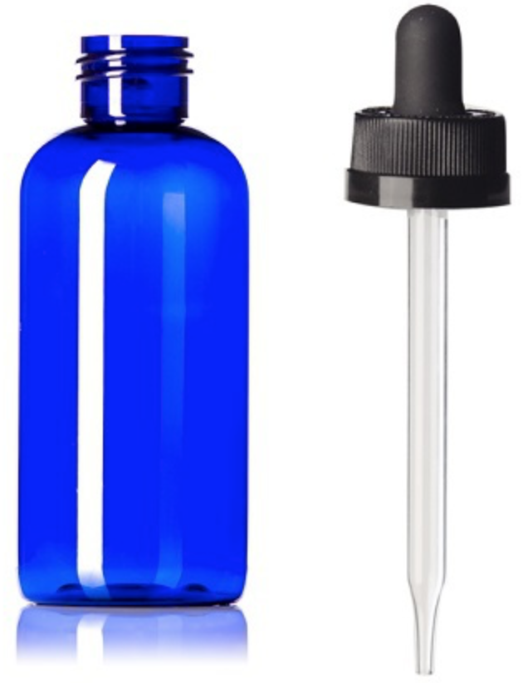
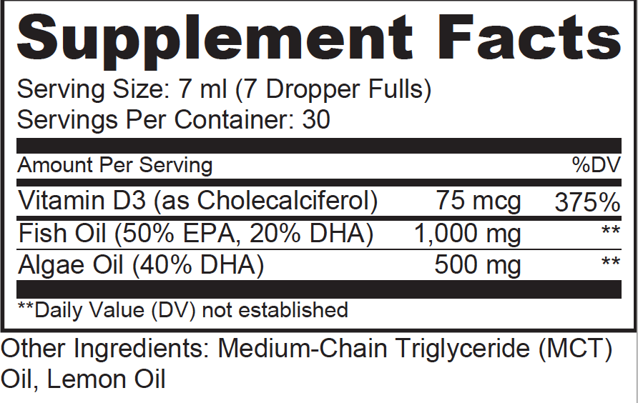
E3 Omega
Notes:
Don’t Miss Upcoming Events - I want you to do is take out the card that says, “Help my friends and family” do you guys see that card? Hold it up for me. On the back it says “Sign me up.” On the side that says “help my friends and family” I want you to write down the name of the friends and family that you want to invite to the Recipe night that we have coming up on Sept 19th.
We’re not telemarketers so I want to make sure that you call them and let them know that we will be reaching out to them ahead of time. I want you to write your name and number at the top and their names and numbers below. Make sure that you call them ahead of time and let them know that we will be calling; if they don’t want us to call, please let us know, but otherwise we will be calling within the next couple of days to get them to one of our events to see if we can get them the help they need. People are praying for answers, and we have the answer. If you write down four names and turn it in today, we’ll provide you with recipes for homemade non-toxic household cleaning items that will help you live healthy and save money all while reducing your exposure to toxicity – the less toxic you are, the faster you’ll lose weight and keep it off.
On the back of that page it says sign me up. Write your name, number, and email. If you want to receive weekly newsletters with recipes and information regarding future events, let us know. If you want to get registered for the Max Life Call – Fast Intense Results on June 12th, or our Recipe Night on June 16^{th,} or our PAD on June 30th, check the box on this card. You can drop these cards off with __________. __________ raise your hand. We have plenty of time so take your time filling this out, and once it’s complete drop it off in the back with __________. Don’t forget your products and resources are 15% off today only. You can go to the back to pick up the resources that you need, turn in your “Sign me up” card, and guests if you didn’t hand in your Exam form earlier, you can do that now. Thanks.

Slide 55
Omega Competition
Omega-6 lowers the presence of omega-3 and omega-9 in plasma and cells.
This increases the risk of diseases including CVD, cancer, lung illness, and auto-immune.
Notes:
Don’t Miss Upcoming Events - I want you to do is take out the card that says, “Help my friends and family” do you guys see that card? Hold it up for me. On the back it says “Sign me up.” On the side that says “help my friends and family” I want you to write down the name of the friends and family that you want to invite to the Recipe night that we have coming up on Sept 19th.
We’re not telemarketers so I want to make sure that you call them and let them know that we will be reaching out to them ahead of time. I want you to write your name and number at the top and their names and numbers below. Make sure that you call them ahead of time and let them know that we will be calling; if they don’t want us to call, please let us know, but otherwise we will be calling within the next couple of days to get them to one of our events to see if we can get them the help they need. People are praying for answers, and we have the answer. If you write down four names and turn it in today, we’ll provide you with recipes for homemade non-toxic household cleaning items that will help you live healthy and save money all while reducing your exposure to toxicity – the less toxic you are, the faster you’ll lose weight and keep it off.
On the back of that page it says sign me up. Write your name, number, and email. If you want to receive weekly newsletters with recipes and information regarding future events, let us know. If you want to get registered for the Max Life Call – Fast Intense Results on June 12th, or our Recipe Night on June 16^{th,} or our PAD on June 30th, check the box on this card. You can drop these cards off with __________. __________ raise your hand. We have plenty of time so take your time filling this out, and once it’s complete drop it off in the back with __________. Don’t forget your products and resources are 15% off today only. You can go to the back to pick up the resources that you need, turn in your “Sign me up” card, and guests if you didn’t hand in your Exam form earlier, you can do that now. Thanks.

Slide 56
Life or Death Omega Race
The famous MRFIT study and studies of many different cultures show that people with the lowest percentage of Omega-6’s had the lowest death rate.
Notes:
Don’t Miss Upcoming Events - I want you to do is take out the card that says, “Help my friends and family” do you guys see that card? Hold it up for me. On the back it says “Sign me up.” On the side that says “help my friends and family” I want you to write down the name of the friends and family that you want to invite to the Recipe night that we have coming up on Sept 19th.
We’re not telemarketers so I want to make sure that you call them and let them know that we will be reaching out to them ahead of time. I want you to write your name and number at the top and their names and numbers below. Make sure that you call them ahead of time and let them know that we will be calling; if they don’t want us to call, please let us know, but otherwise we will be calling within the next couple of days to get them to one of our events to see if we can get them the help they need. People are praying for answers, and we have the answer. If you write down four names and turn it in today, we’ll provide you with recipes for homemade non-toxic household cleaning items that will help you live healthy and save money all while reducing your exposure to toxicity – the less toxic you are, the faster you’ll lose weight and keep it off.
On the back of that page it says sign me up. Write your name, number, and email. If you want to receive weekly newsletters with recipes and information regarding future events, let us know. If you want to get registered for the Max Life Call – Fast Intense Results on June 12th, or our Recipe Night on June 16^{th,} or our PAD on June 30th, check the box on this card. You can drop these cards off with __________. __________ raise your hand. We have plenty of time so take your time filling this out, and once it’s complete drop it off in the back with __________. Don’t forget your products and resources are 15% off today only. You can go to the back to pick up the resources that you need, turn in your “Sign me up” card, and guests if you didn’t hand in your Exam form earlier, you can do that now. Thanks.

Slide 57
EFA: Omega-6 Pathways
Linoleic acid (w-6) is found in nuts, seeds, vegetable oils and animal products
It is converted to arachidonic acid (AA) downstream which is an inflammatory pathway.
Notes:
Don’t Miss Upcoming Events - I want you to do is take out the card that says, “Help my friends and family” do you guys see that card? Hold it up for me. On the back it says “Sign me up.” On the side that says “help my friends and family” I want you to write down the name of the friends and family that you want to invite to the Recipe night that we have coming up on Sept 19th.
We’re not telemarketers so I want to make sure that you call them and let them know that we will be reaching out to them ahead of time. I want you to write your name and number at the top and their names and numbers below. Make sure that you call them ahead of time and let them know that we will be calling; if they don’t want us to call, please let us know, but otherwise we will be calling within the next couple of days to get them to one of our events to see if we can get them the help they need. People are praying for answers, and we have the answer. If you write down four names and turn it in today, we’ll provide you with recipes for homemade non-toxic household cleaning items that will help you live healthy and save money all while reducing your exposure to toxicity – the less toxic you are, the faster you’ll lose weight and keep it off.
On the back of that page it says sign me up. Write your name, number, and email. If you want to receive weekly newsletters with recipes and information regarding future events, let us know. If you want to get registered for the Max Life Call – Fast Intense Results on June 12th, or our Recipe Night on June 16^{th,} or our PAD on June 30th, check the box on this card. You can drop these cards off with __________. __________ raise your hand. We have plenty of time so take your time filling this out, and once it’s complete drop it off in the back with __________. Don’t forget your products and resources are 15% off today only. You can go to the back to pick up the resources that you need, turn in your “Sign me up” card, and guests if you didn’t hand in your Exam form earlier, you can do that now. Thanks.

Slide 58
Essential Omega-6, Inflammation
INCREASED
Heart Disease
Cancer Risks
Joint and muscle pain
Arthritis and osteoporosis
Auto-immune disease
Digestive Disorders
Depression
Sleep Disorders
Aging
Skin disorders
Notes:
Don’t Miss Upcoming Events - I want you to do is take out the card that says, “Help my friends and family” do you guys see that card? Hold it up for me. On the back it says “Sign me up.” On the side that says “help my friends and family” I want you to write down the name of the friends and family that you want to invite to the Recipe night that we have coming up on Sept 19th.
We’re not telemarketers so I want to make sure that you call them and let them know that we will be reaching out to them ahead of time. I want you to write your name and number at the top and their names and numbers below. Make sure that you call them ahead of time and let them know that we will be calling; if they don’t want us to call, please let us know, but otherwise we will be calling within the next couple of days to get them to one of our events to see if we can get them the help they need. People are praying for answers, and we have the answer. If you write down four names and turn it in today, we’ll provide you with recipes for homemade non-toxic household cleaning items that will help you live healthy and save money all while reducing your exposure to toxicity – the less toxic you are, the faster you’ll lose weight and keep it off.
On the back of that page it says sign me up. Write your name, number, and email. If you want to receive weekly newsletters with recipes and information regarding future events, let us know. If you want to get registered for the Max Life Call – Fast Intense Results on June 12th, or our Recipe Night on June 16^{th,} or our PAD on June 30th, check the box on this card. You can drop these cards off with __________. __________ raise your hand. We have plenty of time so take your time filling this out, and once it’s complete drop it off in the back with __________. Don’t forget your products and resources are 15% off today only. You can go to the back to pick up the resources that you need, turn in your “Sign me up” card, and guests if you didn’t hand in your Exam form earlier, you can do that now. Thanks.

Slide 59
ESSENTIAL NUTRIENTS: Omega-3s
Essential = Must Eat
INCREASED
Brain health
Neurological function and development
Heart wellbeing
Lowering triglycerides
Reducing high blood pressure
Protecting against stroke
Immunity and helping in the fight against cancer
Weight loss
Increasing lean muscle mass
Joint function & Preventing and reducing arthritis
Wellbeing of eyes
Diminishing depression
Notes:
Don’t Miss Upcoming Events - I want you to do is take out the card that says, “Help my friends and family” do you guys see that card? Hold it up for me. On the back it says “Sign me up.” On the side that says “help my friends and family” I want you to write down the name of the friends and family that you want to invite to the Recipe night that we have coming up on Sept 19th.
We’re not telemarketers so I want to make sure that you call them and let them know that we will be reaching out to them ahead of time. I want you to write your name and number at the top and their names and numbers below. Make sure that you call them ahead of time and let them know that we will be calling; if they don’t want us to call, please let us know, but otherwise we will be calling within the next couple of days to get them to one of our events to see if we can get them the help they need. People are praying for answers, and we have the answer. If you write down four names and turn it in today, we’ll provide you with recipes for homemade non-toxic household cleaning items that will help you live healthy and save money all while reducing your exposure to toxicity – the less toxic you are, the faster you’ll lose weight and keep it off.
On the back of that page it says sign me up. Write your name, number, and email. If you want to receive weekly newsletters with recipes and information regarding future events, let us know. If you want to get registered for the Max Life Call – Fast Intense Results on June 12th, or our Recipe Night on June 16^{th,} or our PAD on June 30th, check the box on this card. You can drop these cards off with __________. __________ raise your hand. We have plenty of time so take your time filling this out, and once it’s complete drop it off in the back with __________. Don’t forget your products and resources are 15% off today only. You can go to the back to pick up the resources that you need, turn in your “Sign me up” card, and guests if you didn’t hand in your Exam form earlier, you can do that now. Thanks.

Slide 60
Fish & Algal Oil
Get your DHA and EPA from Fish and Algal Oil
With concerns over quality sources of fish oils, it is critical that these oils go through a purification process.
Algal is a powerful, vegetarian source of DHA
Notes:
Don’t Miss Upcoming Events - I want you to do is take out the card that says, “Help my friends and family” do you guys see that card? Hold it up for me. On the back it says “Sign me up.” On the side that says “help my friends and family” I want you to write down the name of the friends and family that you want to invite to the Recipe night that we have coming up on Sept 19th.
We’re not telemarketers so I want to make sure that you call them and let them know that we will be reaching out to them ahead of time. I want you to write your name and number at the top and their names and numbers below. Make sure that you call them ahead of time and let them know that we will be calling; if they don’t want us to call, please let us know, but otherwise we will be calling within the next couple of days to get them to one of our events to see if we can get them the help they need. People are praying for answers, and we have the answer. If you write down four names and turn it in today, we’ll provide you with recipes for homemade non-toxic household cleaning items that will help you live healthy and save money all while reducing your exposure to toxicity – the less toxic you are, the faster you’ll lose weight and keep it off.
On the back of that page it says sign me up. Write your name, number, and email. If you want to receive weekly newsletters with recipes and information regarding future events, let us know. If you want to get registered for the Max Life Call – Fast Intense Results on June 12th, or our Recipe Night on June 16^{th,} or our PAD on June 30th, check the box on this card. You can drop these cards off with __________. __________ raise your hand. We have plenty of time so take your time filling this out, and once it’s complete drop it off in the back with __________. Don’t forget your products and resources are 15% off today only. You can go to the back to pick up the resources that you need, turn in your “Sign me up” card, and guests if you didn’t hand in your Exam form earlier, you can do that now. Thanks.

Slide 61
THE OTHER POWER FAT: MCTs
Burned quickly for energy
Lower in calories than long-chain fatty acids
Lauric acid is anti-microbial
Contain potential anti-aging properties
Fat burning fat
Retaining lean mass
Appetite control
Treating neurological disease
Inhibits inflammation
Includes polyphenols, a group of natural antioxidants
Improve health markers diabetes and CVD risk
Notes:
Don’t Miss Upcoming Events - I want you to do is take out the card that says, “Help my friends and family” do you guys see that card? Hold it up for me. On the back it says “Sign me up.” On the side that says “help my friends and family” I want you to write down the name of the friends and family that you want to invite to the Recipe night that we have coming up on Sept 19th.
We’re not telemarketers so I want to make sure that you call them and let them know that we will be reaching out to them ahead of time. I want you to write your name and number at the top and their names and numbers below. Make sure that you call them ahead of time and let them know that we will be calling; if they don’t want us to call, please let us know, but otherwise we will be calling within the next couple of days to get them to one of our events to see if we can get them the help they need. People are praying for answers, and we have the answer. If you write down four names and turn it in today, we’ll provide you with recipes for homemade non-toxic household cleaning items that will help you live healthy and save money all while reducing your exposure to toxicity – the less toxic you are, the faster you’ll lose weight and keep it off.
On the back of that page it says sign me up. Write your name, number, and email. If you want to receive weekly newsletters with recipes and information regarding future events, let us know. If you want to get registered for the Max Life Call – Fast Intense Results on June 12th, or our Recipe Night on June 16^{th,} or our PAD on June 30th, check the box on this card. You can drop these cards off with __________. __________ raise your hand. We have plenty of time so take your time filling this out, and once it’s complete drop it off in the back with __________. Don’t forget your products and resources are 15% off today only. You can go to the back to pick up the resources that you need, turn in your “Sign me up” card, and guests if you didn’t hand in your Exam form earlier, you can do that now. Thanks.

Slide 62
The E3 Difference!
Clean, Purified Fish Oil
Algal Oil
MCT Oil
PLUS: 3000 IU of Essential Vitamin D3
Notes:
Don’t Miss Upcoming Events - I want you to do is take out the card that says, “Help my friends and family” do you guys see that card? Hold it up for me. On the back it says “Sign me up.” On the side that says “help my friends and family” I want you to write down the name of the friends and family that you want to invite to the Recipe night that we have coming up on Sept 19th.
We’re not telemarketers so I want to make sure that you call them and let them know that we will be reaching out to them ahead of time. I want you to write your name and number at the top and their names and numbers below. Make sure that you call them ahead of time and let them know that we will be calling; if they don’t want us to call, please let us know, but otherwise we will be calling within the next couple of days to get them to one of our events to see if we can get them the help they need. People are praying for answers, and we have the answer. If you write down four names and turn it in today, we’ll provide you with recipes for homemade non-toxic household cleaning items that will help you live healthy and save money all while reducing your exposure to toxicity – the less toxic you are, the faster you’ll lose weight and keep it off.
On the back of that page it says sign me up. Write your name, number, and email. If you want to receive weekly newsletters with recipes and information regarding future events, let us know. If you want to get registered for the Max Life Call – Fast Intense Results on June 12th, or our Recipe Night on June 16^{th,} or our PAD on June 30th, check the box on this card. You can drop these cards off with __________. __________ raise your hand. We have plenty of time so take your time filling this out, and once it’s complete drop it off in the back with __________. Don’t forget your products and resources are 15% off today only. You can go to the back to pick up the resources that you need, turn in your “Sign me up” card, and guests if you didn’t hand in your Exam form earlier, you can do that now. Thanks.

Slide 63
Food Allergies: Inflamed by what you eat!
Learn How Your Body Responds to Different Foods
This at-home test measures your body’s immune response to foods to help provide guidance on what foods may be the best to choose for an elimination diet.

Slide 64
Food Allergies and Health
This simple, affordable blood test can help identify food intolerances or hidden food allergies that may be the cause of chronic conditions such as arthritis, attention deficit (and hyperactivity) disorders, autism, chronic fatigue, diabetes, irritable bowel syndrome, migraine headaches, otitis media and more.

Slide 65
Inflammation, Stress, and Sleep
THE CBD DIFFERENCE

Slide 66
Condition Specific Patient

Slide 67
WHAT YOU CAN EXPECT
HOW TO GET LASTING RELIEF WITHOUT THE USE OF DANGEROUS DRUGS OR SURGERY

Slide 68

Notes:
You’re likely only used to drugs, surgery, or PT as a solution. Some have even tried alternatives like massage, acupuncture, or standard chiropractic. What we’re discussing here are techniques, dietary protocols, and technologies being used in medicine and all over the world successfully every day and with research in the leading medical journals. You may not be aware, but it’s nothing we’ve created on our own or new – so make sure to pay careful attention to the details – it will get you to that 60-100% better.

Slide 69
The Fact Is You Can Experience:
60%-100%
Improvement?

Slide 70

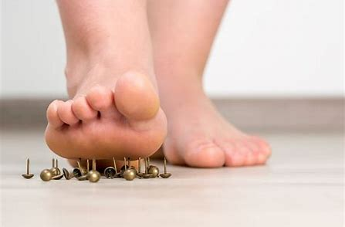
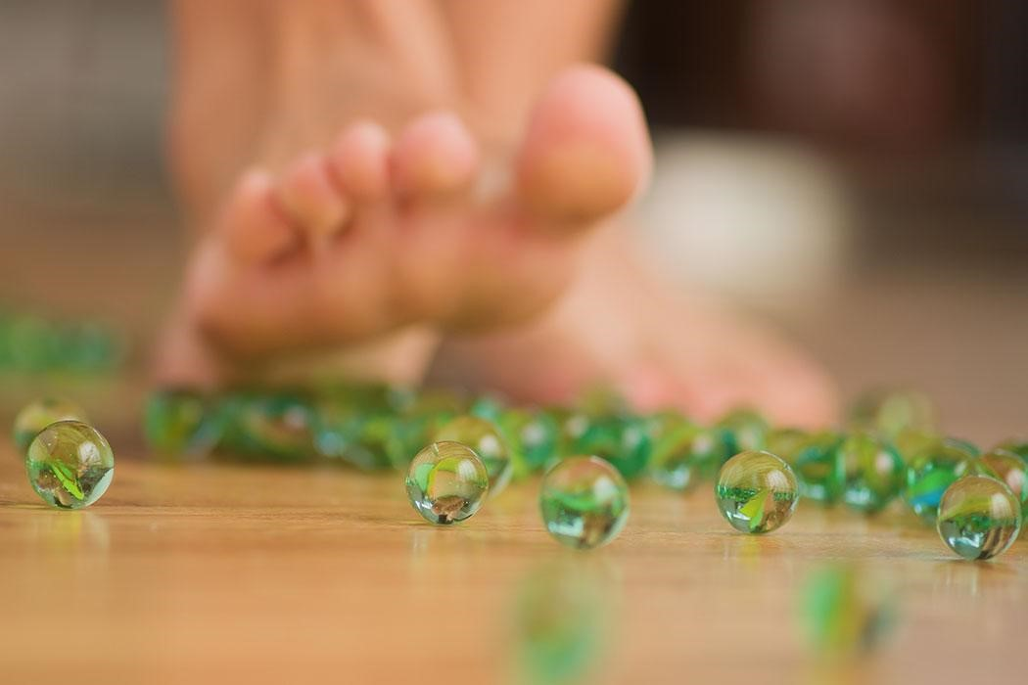
WHAT ARE SOME OF YOUR SYMPTOMS?
Notes:
Severe foot pain, like your stepping on a tac, stepping on marbles?Common symptoms of neuropathy, fibromyaglia, plantar fasciitis and other nerve or soft tissue conditions.

Slide 71

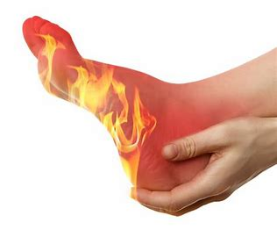
Numbness, Burning, or Cold Feet?

Slide 72
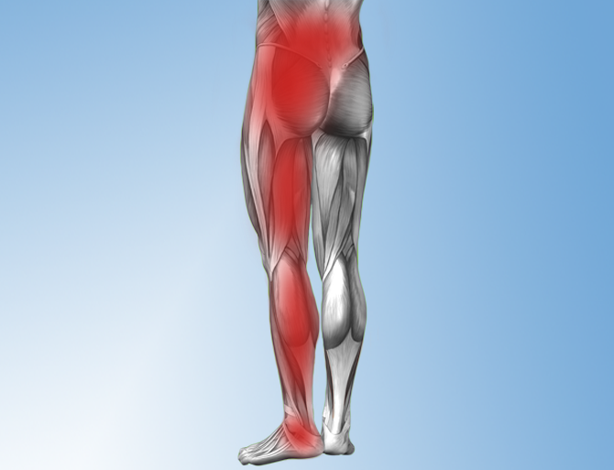
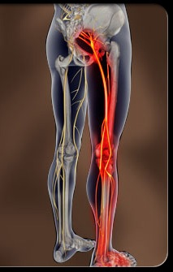
Pain Radiating Into The Hips, Legs, and Feet

Slide 73
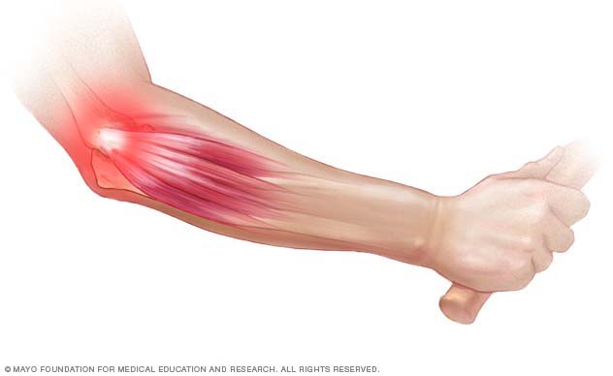
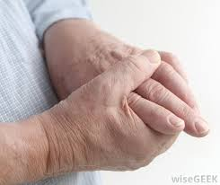
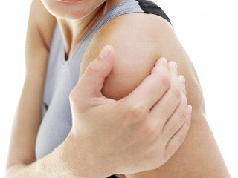
Upper Extremity Pain?

Slide 74
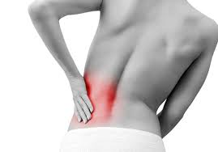
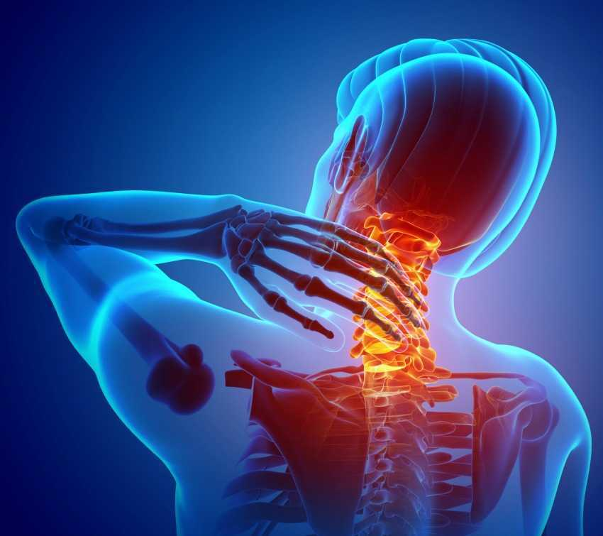
BACK and NECK PAIN?

Slide 75
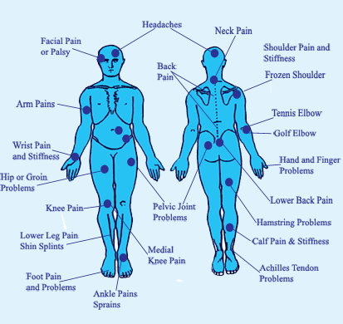
Universal Joint and Body Pain?

Slide 76
After Today You Will Know:
The documented facts about standard treatments for common inflammatory conditions
What could be causing your pain
The extreme dangers of uncorrected inflammatory illness
Proven methods for creating lasting relief
Easy steps you can take to today

Slide 77
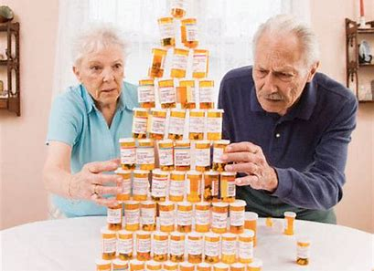
TOO MANY DRUGS!
WE AVERAGE 18 NEW MEDICATIONS EACH YEAR!
Notes:
Who here is tired of the standard: taking medications?
According to a 2014 study, The Institute for Healthcare Informatics found that people aged 65-79 receive more than 18 prescriptions for new drugs per year.

Slide 78
The US Consumes 75% Of The Medications Produced In The World. (NIH, 2014)
Notes:
We consume 75% of the world’s medication even though we’re only 5% of the world’s population (National Institute of Health study in 2014)

Slide 79

THE U.S. SPENDS $3.3 TRILLION ON HEALTH CARE!

Slide 80
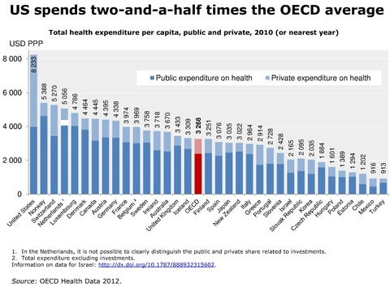
2.5x The Other Economically Developed Countries
Notes:
Organization for Economic Cooperation and Development

Slide 81
ARE WE BETTER OR WORSE?
Notes:
With all of the money and resources we put towards health

Slide 82

LIFE EXPECTANCY?
Notes:
Life expectancy in the United States declined again in 2017, the government said Thursday in a bleak series of reports that showed a nation still in the grip of escalating drug and suicide crises.
The data continued the longest sustained decline in expected life span at birth in a century, an appalling performance not seen in the United States since 1915 through 1918. That four-year period included World War I and a flu pandemic that killed 675,000 people in the United States and perhaps 50 million worldwide.
https://www.washingtonpost.com/national/health-science/us-life-expectancy-declines-again-a-dismal-trend-not-seen-since-world-war-i/2018/11/28/ae58bc8c-f28c-11e8-bc79-68604ed88993_story.html?noredirect=on&utm_term=.2bf8887912a3

Slide 83

Going Up or Down?
Diabetes THEY’RE ALL UP!
Cancer
Neuropathy
Fibromyalgia
Alzheimer’s
Depression
Auto-immune Dx, Etc.

Slide 84
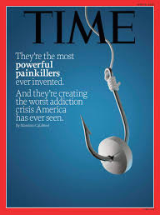
The Disturbing Trend in Medicine
Notes:
Nearly 200 people are dying from opioid addiction each day
Americans more likely to die of opioid overdose than car crash, says council report
This is the cover of Time magazine . Can you see what this cover is saying?
They ran a story on healthcare in America and this was the cover story for their magazine. What the article says, from June of 2015 - is that US Citizens feel that we were overmedicated, and that as a country we were taking far too many medications – all of these being recommended by our doctors.. More importantly, there is an epidemic of addiction attacking our society today
How many of you feel the same way?

Slide 85
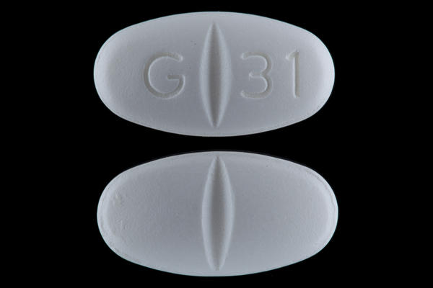
Neurontin(Gabapentin) &
Lyrica
Anti Seizure Medications
Attempt to block your brain from feeling pain
Do not treat or stop the progression of the disease
Notes:
Ask this question to keep involvement- Who here has heard of Neurontin aka gabapentin, raise your hand?” This is the number one medication that doctors prescribed for neuropathy pain and it’s made by Pfizer. How many of you think Neurontin was made to treat Neuropathy?
It's actually an anti-seizure medication, it's for seizures, -- so what do you think a seizure medication is going to do for neuropathy, how do you think it works?
WAIT AND LISTEN FOR AUDIENCE TO GIVE YOU ANSWERS
It’s a pain management medication, so what it literally does is slow your brain down so you stop feeling the pain signals from your feet. It doesn’t heal your nerves, it’s not healing neuropathy, it’s not keeping it from getting worse. What is it actually doing, then? (let audience answer).. That’s right – masking the pain

Slide 86
Gabapentin, Lyrica, and Opioids
Disrupts the formation of new synapses, hindering the neuroplastic health and development of the brain.
New synapse formation is our brains fight to stay young and prevent dementia
Gapapentin/Lyrica are part of the opiod concern as addiction and overdose are common and deadly

Slide 87
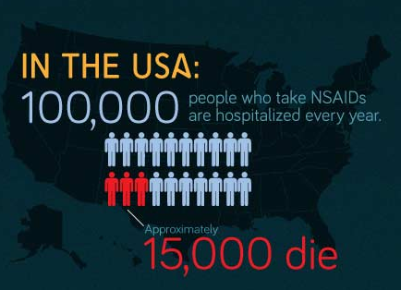

Slide 88
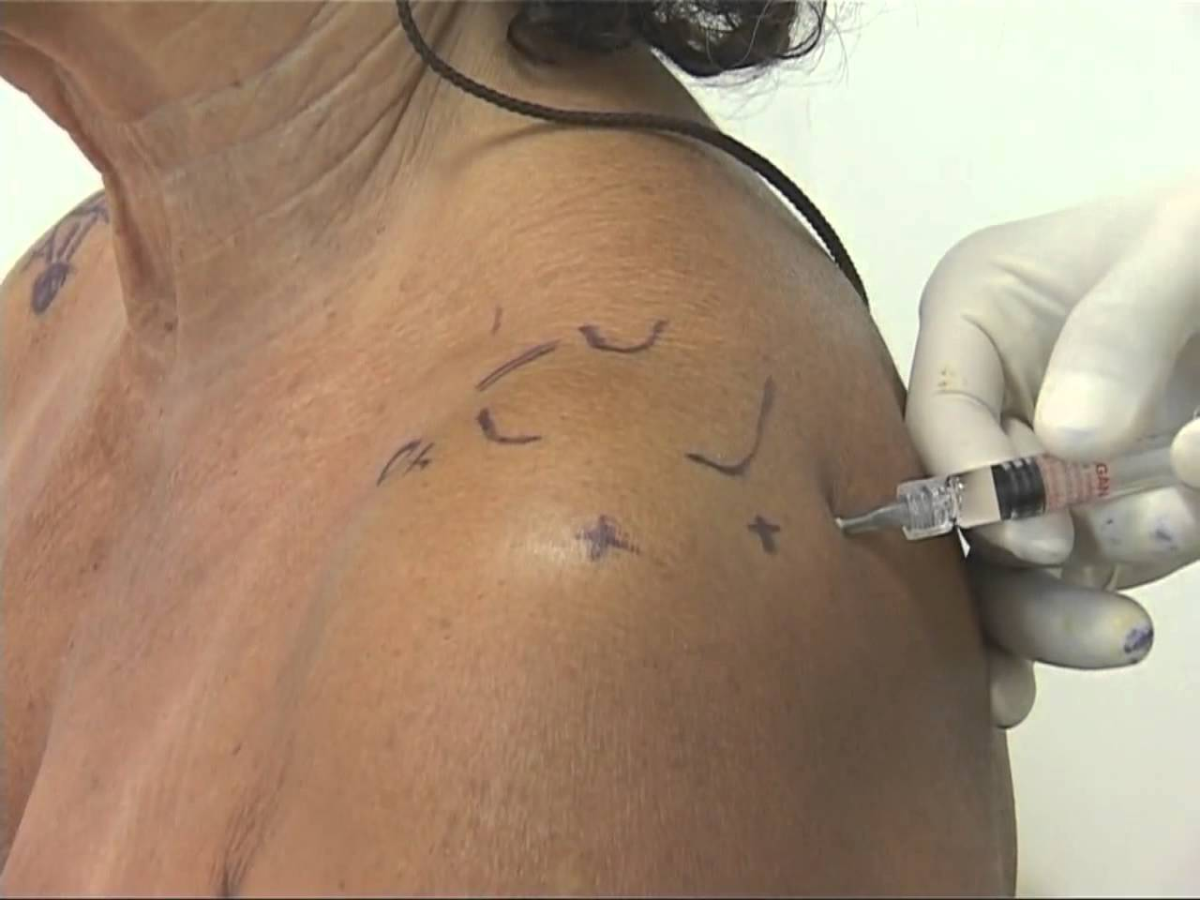
Other Solutions: Injections

Slide 89
Cortizone Injection Side-Effects
Dural puncture ("wet tap"). Bleeding.
Nerve damage. Damage the joint and ligaments
Localized increase in pain Non-positional headaches
Facial flushing Anxiety
Sleeplessness Fever the night of injection
High blood sugar Decreased Immunity
Stomach ulcers Severe arthritis of the hips
Cataracts (avascular necrosis)
Notes:
A dural puncture (wet tap) may cause a post-dural puncture headache (also called a spinal headache) that usually improves within a few days. Although infrequent, a blood patch may be necessary to alleviate the headache. A blood patch is a simple, quick procedure that involves obtaining a small amount of blood from a patient from an arm vein and immediately injecting it into the epidural space to allow it to clot around the spinal sac and stop the leak.

Slide 90


Slide 91
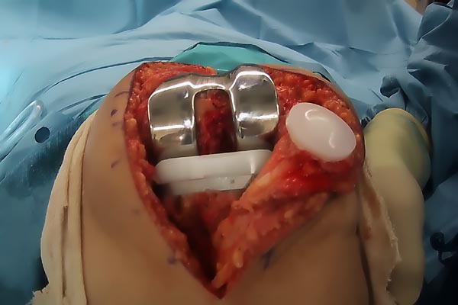
Joint Replacement Surgery
Notes:
This is a real picture. A good ending to avoid wherever possible.

Slide 92
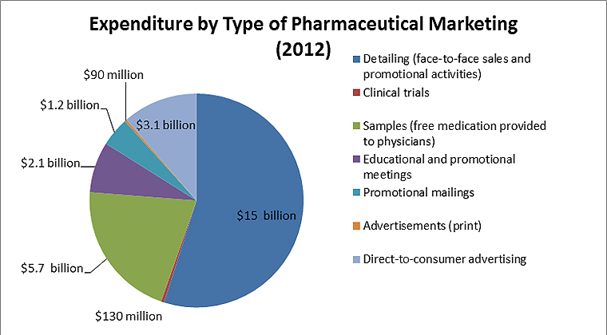
WHY DO WE DO IT?
Notes:
Brainwashed and It’s Free
Story of a man with his whole life ruined by health problems and drug side-effects. Asked why he doesn’t look for alternatives; it’s not covered. Hasn’t had a life in 20 years, but at least it’s covered.

Slide 93
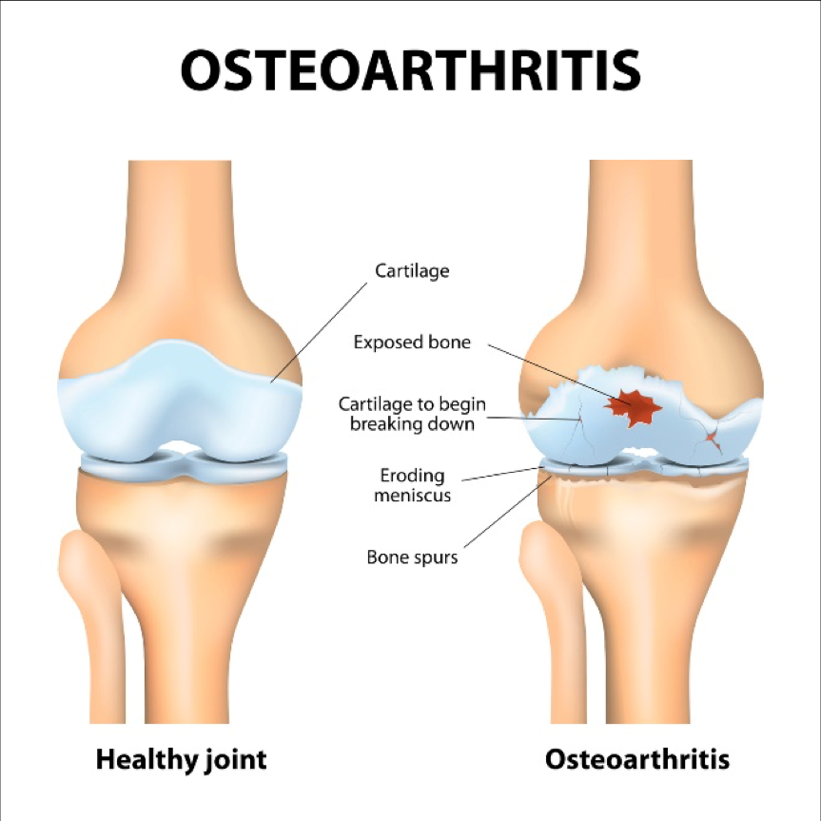
CAUSES?
Notes:
Unresolved injury
Subluxation
Poor biomechanics
Inflammation
Not Corrected with a drug or surgery. Masked or masking taped, but not healthy.
Not only that, the despite the drugs and surgery – the causes continue if not addressed. Even if you believe the drugs or surgery are needed or have already participated, you have to address the cause or it will eventually catch up with you – and usually with a vengeance. Just look at most people’s mobility after 55 or walk into the growing number of nursing homes in every community in N. America.

Slide 94
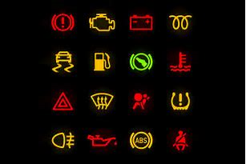
What Do You Do When The Light Flashes?
Notes:
Take it to the mechanic or cover it up with a piece of duct tape and keep going?
If you did keep driving, what eventually happens to the car?
Breakdown or – worse; engine or some vital part blows out completely, needs to be replaced, or the car becomes permanently damaged.

Slide 95

7 Common Warning Signs that you have Neuropathy:
Numbness
Burning Pain
Cramping
Sharp Electrical Pain
Prickling/ Tingling
Balance Problems and Falls
Can’t Sleep From Foot Pain
The Neuropathy Association, 2013.

Slide 96
Addressing The Causes of Peripheral Neuropathy
Diabetes/ Pre-diabetic
Poor circulation (micro-circulation)
Chemotherapy and medications
Spinal issues: subluxation, herniated discs,
spinal stenosis
Post-surgical
Autoimmune diseases
Infections (viral or bacterial)
Toxins, metals, and alcohol
Liver disease, kidney disease, Thyroid conditions
Notes:
Diabetes is the number one cause of neuropathy, but it’s not the only cause, a lot of things can damage your nerves and cause neuropathy damage, this is a top 10 list.
You can be a pre-diabetic and still develop neuropathy.
Number two on the list is poor circulation, you are not getting enough blood supply to your peripheral nerves. Number three chemotherapy drugs, about 40 to 50% of all chemo patients end up with neuropathy because their medication has damaged their nerves.
Neck and back problem like spinal stenosis, disc problems, surgeries, hip replacements, knee replacements and back surgeries often times neuropathy, autoimmune diseases like lupus, infections like staph infections, and alcohol and cigarette smoking damages nerves.
What's the last one, does anybody see that one down there, several medications, there is a lot of medications on the market that can actually cause damage to your nerves.

Slide 97
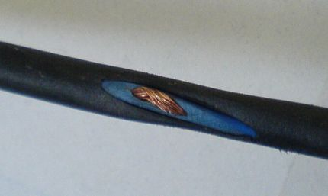
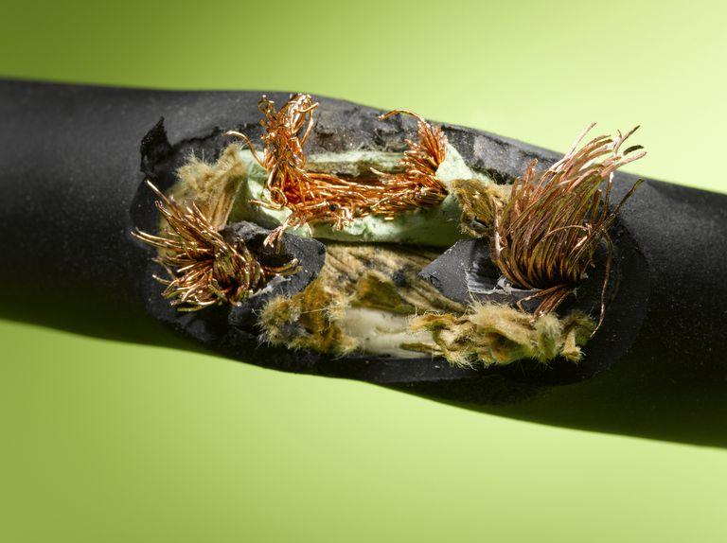
What Is Nerve Damage?
Notes:
EARLY … PROGRESSIVE
The insulation or rubber coating on the nerve is the myelin sheath. As nerve conditions progress, they continue actively eroding the sheath, exposing, and damaging the nerves until you do something to stop the progression of the disease and heal the nerves and damaged tissues.

Slide 98
PAIN CONDITIONS AND CAUSES
PLANTAR FASCITIS, FACIAL PAIN, CHRONIC PAIN
Inflammation in the muscles, joints, ligaments, and tendons
Systemic inflammation & oxidation
Toxic exposure
Back/neck – herniated disk, spinal stenosis
Post-surgical
Old accidents and injuries
Sports injuries
Posture, Repetitive Motion Injury, Sleep positions
Notes:
Many of the same causes of Neuropathy plus..

Slide 99
Causes of Fibromyalgia
Full-scale inflammation caused by
Spinal cord and nerve stress
Glutathione deficiency and subsequent extreme oxidation
Food intolerances
Auto-immune conditions
Toxicities
Thyroid problems
Leaky gut syndrome
Adrenal burnout
Gene mutations

Slide 100
Extreme Dangers of Pain and Numbness
Each year in the United States there are about 86,000 diabetes / neuropathy-related amputations, one of the most feared complications of the disease.
1/3 adults over 65 falls, with10% of falls being fatal. Falls are the leading cause of injury death in the elderly.
Notes:
86,000 diabetics every year lose an extremity.
Source: Centers for Disease Control: Falls Among Older Adults: An Overview, 2012; Hwang et al., Medication-Related Falls in the Elderly: Causative Factors and Preventive Strategies, 2012.

Slide 101
Options For Care
1. Do nothing
2. Drugs or Surgery
3. Address causes
Notes:
What are your options?

Slide 102
Medical
1. Medications
2. Testing
3. More Medications
4. Surgery and medications
Notes:
Engagement question? “Who here has been to a neurologist?”
When you go to neurologist they will run some nerve tests, confirm that you have neuropathy, then likely prescribe medication.
What medication do they prescribe?
That’s correct the same medications.

Slide 103

Have you been told you’d have to live with it or nothing could be done?
National Institute of Health says:
“Peripheral nerves have the ability to regenerate as long as the underlying nerve cell has NOT been killed.”
Notes:
The National Institute of Health says ““Peripheral nerves have the ability to regenerate as long as the underlying nerve cell has NOT been killed.”
What does that mean? Not been killed… It means that if you wait too late to where the nerve is dead, it can not be helped.

Slide 104
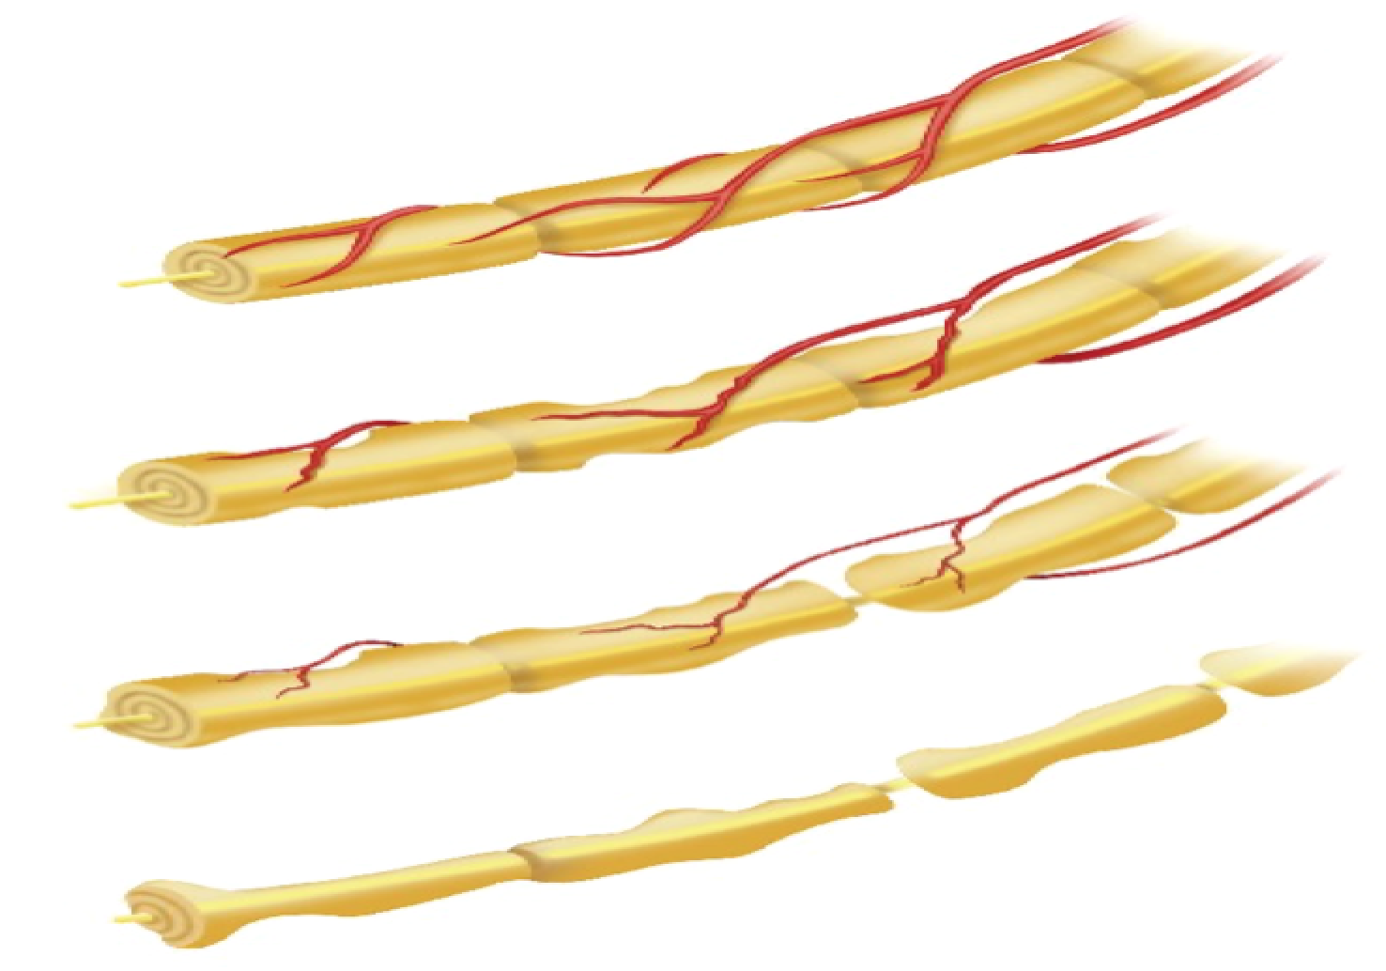
Best Type and Timing for Care
Notes:
At the top is a healthy nerve: it is whole and with full blood supply
As the disease progresses, the nerve deteriorates, you can see the rat bites taken out of it, and the blood supply diminishes. At this point, you’re having problems, but people will often ignore the problems here or just take medication. If you ignore or cover with drugs – what happens?
Level 3 – late stages of the disease, but as the NIH said, there’s still a “live” or viable nerve left so we can still turn this around.
At level IV, the nerve is dead and there’s nothing that can be done.
What’s the best timing to catch this diease?

Slide 105
Neuropathy is a Progressive Disease
Notes:
When should you start?

Slide 106
Steps to recovery for Nerve, Joint, and Muscle Disease:
Testing to see what can be done
Determine if anything can be done
Notes:
So, there are 4 keys to feeling better:
Rejuvenate by increasing blood flow
Stimulate the nerves
Activate through therapy
Empower by decreasing inflammation

Slide 107
5 STEPS TO RECOVERY
1. Correct the spine and nervous system
2. Light therapy to increase circulation and boost the body’s ability to heal nerves and damaged tissue
3. Address inflammation with diet
4. Anti-inflammatory supplementation
5. Assess any inherent, poor genetic coding

Slide 108
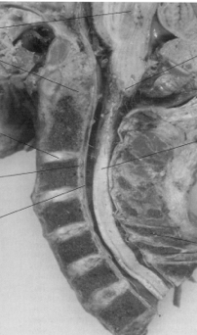
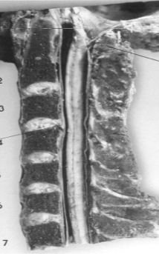
Stabilize Subluxation Degeneration

Slide 109
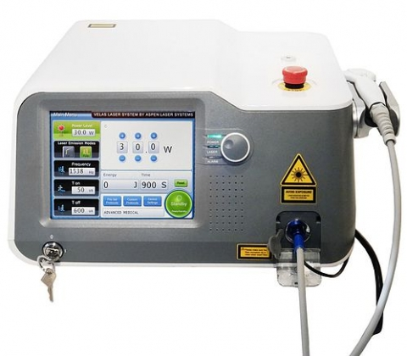
CLASS IV LASER THERAPY

Slide 110
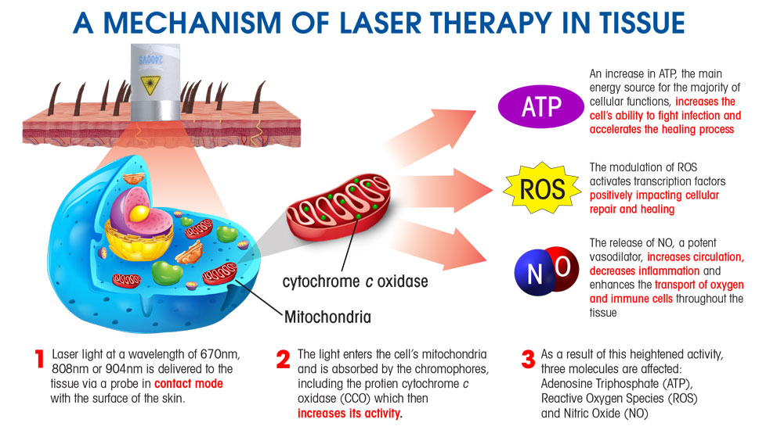
HOW LASERS WORK

Slide 111
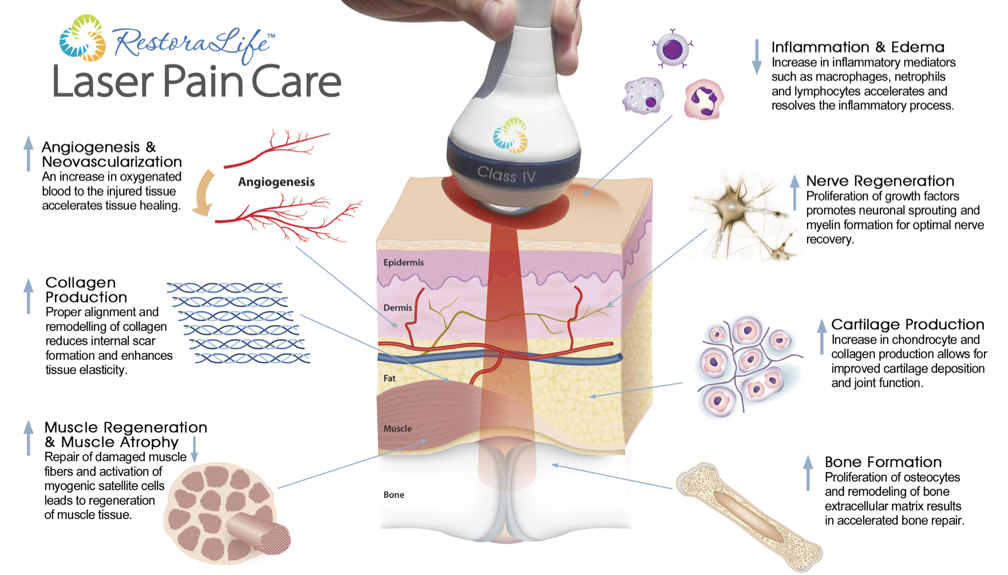
Laser Therapy: Repairing Damaged Nerve and Muscle Tissue

Slide 112
Laser Use In Healthcare
Virtually every branch of medicine utilizes laser light therapies.
There are over 2,000 references in the Index Medicus relative to promoting healing and pain relief.
Notes:
The device is used to heal the damaged nerves and tissues

Slide 113
Laser in Traditional Medicine
“If the traditional avenues did not work, our patients were without much hope. Adding MLS Laser Therapy to our practice has revolutionized how e can care for our patients. What we’re finding is that over 90% of our patients are experiencing significant improvement of their symptoms in as little as two treatments.“
-Ronald S. Lederman, MD
Center for Orthopedic Surgery, Sports Medicine & Physical Therapy

Slide 114
WHO SHOULD COME SEE US IMMEDIATELY?
If you have ever been diagnosed with:
Fibromyalgia
Plantar Fasciitis
Chronic Fatigue
Arthritis
Facial neuralgia
Or suffer with:
Chronic pain from an accident or injury
Pain from past surgery
Pain in the joints, neck, back, or extremities
Bulging or ruptured disc in the neck, mid, or low back

Slide 115
Next Steps
Set up a consult
If qualified: Set evaluated and tested
Review treatment plan to address the causes of your problem
Notes:
Here are your simple next steps…
Reserve your spot
Get your Consultation
We will perform an evaluation
Recommended treatment plan
Don’t want to waste anyone’s time or money. If the nerve is still viable, you will see results. 400% increase in circulation and the PEMF/laser work 93% of the time. Part of the initial evaluation is actual treatment. Between the test and treatment, we’ll know if we can help or even save your life.

Slide 116
Normal Pricing
$000.00
Notes:
Now, the cost of the consultation, evaluation, and written recommendations is $249.
PAUSE

Slide 117
Because you are here today…
      $000
Notes:
Because you came to the talk today and I was able to educate you in a group versus one on one we both save a lot of time so I can lower the price to only $149.

Slide 118
Who Qualifies For Care?
Notes:
OUR NUMBER 1 RULE IS THAT WE DON’T WANT TO WASTE ANYONE’S TIME OR MONEY
We will only accept you in for an appointment if it is a condition we believe we can help.
We’re also a very busy office. So please, do not make an appointment unless you’re serious about your health and truly want to get better.

Slide 119
If $000 is stretching your budget.
Notes:
Sometimes people say they can't afford the $149. They say it is really going to stretch my budget, but that just tells me that I didn't do a very good job educating you about this very serious and debilitating condition. And seriously if you sit and talk to patients every day like I do, you will see how it has devastated their lives, they cry in front of me and tell me their story.
That being said everybody has a concern about money and I understand. In fact, the first two questions I get are how much is your treatment and does my insurance cover it? So let me cover those two real quick, as far as cost, if I went around the room and talked to every single person her tonight, everybody will be completely different. Because some people might have pain shooting down from the back of their leg, some people might have diabetes, some people might have chemotherapy and so on. Everyone is in different stages and have different programs and costs.
CAR ANALOGY-So back to the car…it would be like if you went to the mechanic today, you walk in the front door and the first thing you said is how much is it to fix my car. They are not going to be able to tell you because they haven't looked under the hood. They need to do whatever it is they do to diagnose the problem and that's what we need to do, we need to be able to diagnose the problem before we can tell you what we are going to do because we dont know yet, so that's why we a professional, a doctor, do the evaluation.

Slide 120
Well Aligned Epigenetics

Slide 121
Change Your Genetics
Discover how to Upgrade Your Genes, Decrease Your Risks, and Improve Your Entire Life

Slide 122
What Is Your Genetic Risk?
Celiac Disease, Lactose, and Gluten-intolerance
Dementia and Alzheimer's Disease
Parkinson's Disease
Cancer
Heart Disease
Fibromyalgia, joint, and muscle pain
Depression and Anxiety
Obesity
Diabetes
Auto-immune Disease
Sleep disorders
Skin problems

Slide 123
YOUR GENOME
People have 46 chromosomes – 23 from each parent. The entire set of genetic instructions each of us carries is called your “Genome.”
Determines not only what life you will live now, but also what you will transfer on to future generations.

Slide 124
GENES BY THE NUMBERS
The human genome contains only 21-23,000 genes, which is about the same as other animals and insects and less than many plants
However, there are 3 billion genetic building blocks, or base pairs, that make us who we are; providing the master instructions to build, repair, and maintain all body functions and behaviors.

Slide 125
What the Genes Mean
It is all of the hereditary material possessed that gives your body instructions for building, operating, and maintaining all life functions

Slide 126
Your Genetic Code
The genes expressed and their code determines future:
Health tendencies
Disease susceptibility
Vibrancy or Struggle

Slide 127
Gene Defects: The Gene-Disease Connection
BRCA 1 and BRCA 2 are tumor suppressor genes found in all people
A defect or mutation in one or both of these genes increases the likelihood of breast cancer
Since then, it has become known that 11 "major" gene mutations, including BRCA 1 and BRCA 2, can cause breast cancer, while 25 or 30 other genetic variants are also linked to the disease

Slide 128
Challenges to Genes as Disease
CHALLENGE 1: It is now known that there are at least 11 "major" gene mutations, including BRCA 1 and BRCA 2, that can be involved in breast cancer, while 25 or 30 other genetic variants are also linked to the disease.
CHALLENGE 2: Only a fraction of the people with these genes ends up with a disease
CHALLENGE 3: Only a small fraction of the total people with the condition have the gene mutation.
* REMEMBER: There are 3 billion genetic building blocks, or base pairs creating intense complexity that would make it very difficult for life to simply be determined by 1 or a handful of genes.
Notes:
https://www.cnn.com/2018/12/10/health/breast-cancer-genetic-testing-study/index.html
Approximately 330,000 patients are diagnosed with breast cancer every year in the United States and of these cases, an estimated 10%
http://ascopubs.org/doi/10.1200/JCO.18.01631

Slide 129
The Truth About Genes
RANDOM MUTATIONS DON’T EXPLAIN DISEASE
Less than 2-5% of all diseases fall in this gene-caused category.
It’s knowing your genes and what you do with them that matter!
Notes:
Monogenic diseases, or diseases that result from errors in the nucleotide sequence of a single gene, are exceedingly rare and not responsible for the number of problems the gene myth would have someone believe.
Human Genome Project – goal was to map and sequence the entire human genome, figure out normal gene behavior, and therefore help to cure disease.
Among all the genetic findings for common illnesses, such as heart disease, cancer and mental illnesses, only a handful are of genuine significance for human health. Faulty genes rarely cause, or even mildly predispose us, to disease, and as a consequence no cures have come from their study.

Slide 130
CHANGING FOCUS
“The risk of focusing on gene mutations is missing opportunities to develop truly effective prevention strategies . . . based on a broad understanding of causative factors “
-The Journal of the National Cancer Institute

Slide 131
EXPRESSED VS. INHERETED
YOU ARE NOT THE GENES WITH WHICH YOU WERE BORN
IT’S THE GENES YOU EXPRESS THAT MATTER!

Slide 132
GENES CAN BE TURNED ON OR OFF
Based on Environment
1. Pro-cancer genes can be turned on
2. Pro-cancer genes can be turned off*
3. Genes that fight cancer can be turned on*
4. Genes that fight cancer can be turned off
*NOTE: Do 2 and 3

Slide 133
EPIGENETICS: Beyond Genetics
EPI (“ABOVE”) GENETICS
Refers to the fact that lifestyle choices can make changes in gene expression that are superior to the power of the DNA you inherited from your grandparents
What you do, how you think, the way you behave, and the environment you live in are more powerful than your DNA and can turn off bad genes and turn on good ones – or visa versa.
Notes:
Meanwhile, genetic testing "radically changed. It went from a difficult-to-do , and expensive, test to a quite inexpensive test. The cost dropped from, say, $5,000 for two genes to now we're doing 100s of genes for about $2-300."

Slide 134
DNA IS NOT DESTINY
Genes load the gun, but environment pulls the trigger.

Slide 135
Whole is greater than the sum of the parts
Genes may make up a pattern, but are influenced by everything they encounter in the ENIRONMENT:
Nervous system function
Mental state
Sleep
Diet: quality of nutrient, quantity of macronutrients, fatty acid, & nutrient levels
Activity level
Toxins
Culture

Slide 136
Epigenetics: Test - Correct
30 men with prostate cancer who decided against traditional medicine:
1. Changed the activity of 500 genes
2. Increased the activity in 48 disease-preventing genes
3. Turned off the activity of 453 disease-promoting genes involved in prostate and breast cancers
Ornish, Dean, and Mark Jesus M. Magbanua, Gerdi Weidner, Vivian Weinberg, Colleen Kemp, Christopher Green, Michael D. Mattie, Ruth Marlin, Jeff Simko, Katsuto Shinohara, Christopher M. Hagg, Peter R. Carroll, “Changes in Prostate Gene Expression in Men Undergoing an Intensive Nutrition and Lifestyle Invervention,” Proceedings of the National Academy of Sciences, June 17, 2008, Vol. 105, No. 24, 8369-8374, www.pnas.org_cgi_ doi_10.1073_pnas.0803080105.

Slide 137
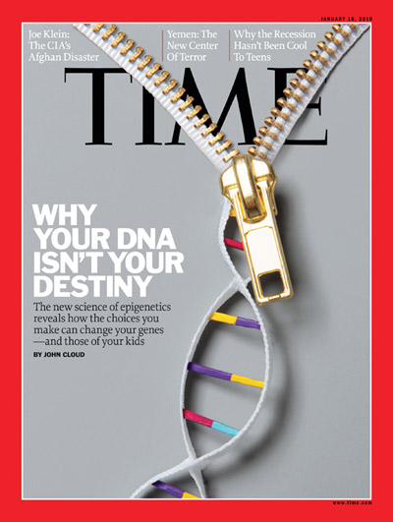
“The epigenetic code, not the genetic code controls your DNA is turning.
Epigenetics tells us that little things in life can have an effect of great magnitude.”

Slide 138
You Pass On Your Genes and Your Epi-genes!
Determines what life you will experience now AND
What you will transfer on to the next generation.
Epigenetics will pass down pro-cancer or anti-cancer genes for 4 generations.

Slide 139
TEST: Know Your Genes
CORRECT – The Environment That Effects Them
“The genes have been there for thousands of years, but if cancer rates are changing in a lifetime, that doesn't have much to do with genes. The best way to handle breast cancer (gene) risks is through lifestyle.”
- Michelle Holmes, Harvard University T.H. Chan School of Public Health
Notes:
Michelle Holmes | Harvard T.H. Chan School of Public Health
What can be achieved with screening has been achieved. We can’t do much more,” Carlo La Vecchia, chairman of the Epidemiology Department at the University of Milan, said in an interview. “It’s time to move on to other things.”
La Vecchia spoke Thursday at a European breast cancer conference in Barcelona. He noted information from the International Agency for Research on Cancer, which estimates that 25 to 30 per cent of breast cancer cases could be avoided if women were thinner and exercised more. The agency is part of the World Health Organization
https://www.hsph.harvard.edu/michelle-holmes/
Harvard T.H. Chan School of Public Health
Associate Professor in the Department of Epidemiology

Slide 140

Genes &
Nervous System
Brain is the interface between the environment and
the genes of our cells.
In response to environmental stimuli, the brain adjusts the composition of the body’s tissue fluids, the equivalent of “growth medium” or nutrition for our body’s cells.
Electrical signals travel from the CNS through the peripheral nervous system carry out the physiological responses “requested” by the brain.
http://www.biology.duke.edu/nijhout/polyphenism.htm

Slide 141
#1 Killer
#1 Most Preventable Disease
It’s been estimated that approximately 200,000 lives could be saved if certain heart risk environmental factors were addressed, even modestly.

Slide 142
THE WHOLE ENVIRONMENT IS IMPORTANT
2,000 people were recruited for smoking, alcohol, diet, exercise, managing stress dramatically lowered heart dx risk.
The more of these lifestyle essentials you addressed, the lower the chance of disease.
1 Lifestyle Factor: 6% Lower Risk
All 5 Lifestyle Factors: 60% (10X) Lower Risk
Notes:
Two large-scale clinical studies from Northwestern Medicine actually confirmed that the most important facets of healthcare such as two very large studies from Northwestern Medicine confirmed again that the number one killer, cardiovascular disease has far more to do with lifestyle than genetics. (14, 15)
Health behaviors can trump a lot of your genetics,” said Donald Lloyd-Jones, M.D., chair and professor of preventive medicine at Northwestern University Feinberg School of Medicine and a staff cardiologist at Northwestern Memorial Hospital.
13. Paul M. Is Heart Disease Genetic Destiny or Lifestyle?: Northwestern University News. https://www.northwestern.edu/newscenter/stories/2010/11/heart-disease.html. Published 2010. Accessed June 8, 2018.
14. Levine DA, Lewis CE, Williams OD, et al. Geographic and demographic variability in 20-year hypertension incidence: the CARDIA study. Hypertens (Dallas, Tex 1979). 2011;57(1):39-47. doi:10.1161/HYPERTENSIONAHA.110.160341.
15. Seeman TE. Social ties and health: the benefits of social integration. Ann Epidemiol. 1996;6(5):442-451. http://www.ncbi.nlm.nih.gov/pubmed/8915476. Accessed June 8, 2018.

Slide 143
TEST – CORRECT
Breast cancer is the leading cancer among women.
A 2006 study conducted in the UK found that obese women have a 60 percent increased risk of developing breast cancer, compared to women with normal weight.

Slide 144
Testing Genes and Cancer
Cancer is a perversion of genetics – a genome that becomes pathologically obsessed with replicating itself.
Identify the genes and overcome them by changing the environment
Notes:
This self-replicating machine co-opts the cell’s physiology, resulting in a shape-shifting illness that despite billions spent annually for half of a century, still defies our ability to treat or cure it.

Slide 145
After The Test: Upgrade Gene Examples
Example of a Diet that Damages Genes
Too many carbs
Too much sugar
Commercial protein, not enough protein
Bad fats, not enough healthy fat
A shortage of nutrients that your genes need to work properly, such as B vitamins, vitamin C, and zinc

Slide 146
Upgrade Your Genes Examples
Toxins
Medications
Heavy metals
Processed food
Electro-magnetic-frequencies (EMFs)
Tap water, plastic bottles
Indoor and outdoor air pollution
Pesticides and herbicides
Household products: sprays, cleaners
Personal care products: soaps, shampoos, sunscreen, cosmetics
Smoking, alcohol

Slide 147
More Gene Upgrades:
Correct Subluxation
Manage Inflammation and Oxidation
Physical Activity (Sedentary lifestyle, Overtraining, Dehydration)
Lack of Sleep, Stress, and Anxiety

Slide 148
RESULTS
Our CLIA-certified lab extracts DNA from cells in your saliva sample. Then the lab processes the DNA on a genotyping chip that reads hundreds of thousands of variants in your genome.
Your genetic data is analyzed, and we generate your personalized reports based on well-established scientific and medical research.
Finally – what you can do to Epigenetically improve your health and decrease your genetic disease-risk profile

Slide 149
DNA TESTING
THE FULL RANGE OF GENES
Your saliva contains DNA from cells in your mouth. We give you a saliva collection tube vs. swab as we are assessing 100s of genes and not jus a few dozen.
Our group of top genetic scientists, medical, and healthcare experts use an intensive process to create your genome report
Your report is totally personalized with the information corresponding to only well-established scientific health research

Slide 150
INFLAMMATION/SLEEP/CBD

Slide 151
Inflammation
Inflammation is a bodily response to harmful stimuli.
Short term signs are obvious: pain, swelling, soreness, fatigue, itchy skin, redness, heat, and even gut issues like Ulcerative Colitis, IBS, and diarrhea.

Slide 152
Elevated CRP levels have no outward, noticeable symptoms, but lead to:
      Cancer
      Cardiovascular disease
      Stroke
      Infection
      Autoimmune (Eg: Rheumatoid Arthritis, lupus, and inflammatory bowel disease).
      Depression
      Sleeplessness
      Skin conditions
      Advanced aging

Slide 153
Causes of Inflammation & CRP
Subluxations
Genetics
Sedentary lifestyle,
Stress
Exposure to environmental toxins
Diet
Nutrient deficiency
Notes:
The chronic inflammation behind an elevated CRP level may also be influenced by genetics, a sedentary lifestyle, too much stress, and exposure to environmental toxins such as secondhand tobacco smoke. Diet has a huge impact, particularly one that contains a lot of refined, processed and manufactured foods.
Gene issues, bad habits like poor diet, micronutrient deficiencies, excess stress, and constant exposure to endocrine disrupting chemicals like those found in plastics, smog in the air, and even many foods, are constantly bombarding our bodies every single day, and unless you are aware of them, you’re essentially just reinforcing their attack on your body.

Slide 154
CRP PRODUCED BY THE LIVER
Auto-immune and degenerative conditions:
Rheumatoid
Arthritis
Lupus
Neurodegenerative disease: Alzheimer’s & Parkinson’s

Slide 155
Why Sleep?
How the brain gets rid of waste (glymphatic system)
-Including amyloid beta(Alzheimer’s disease)
Notes:
To get rid of waste, the brain uses the so called glymphatic system. This area of the brain was discovered in 2015 by Aleksanteri Aspelund and Antoine Louveau, two researchers who were working independently of each other.
The glymphatic system removes toxins including amyloid beta, a protein found to accumulate in the brains of patients with Alzheimer’s disease.
This system is 60 percent more productive when you’re sleeping, which is why it’s important not to skip sleep, as your brain will miss the chance to rid itself of waste products.
Works best when laying on your side.

Slide 156
Sleep & Obesity
< 6 hours = obesity
A 2015 study showed that as sleep decreased, the hunger hormone grehlin increased
Notes:
Grehlin makes you hunger, leads to obesity

Slide 157
Heart and Immune Function
POOR SLEEP INCREASES THE RISK OF:
High Blood Pressure
Heart Attacks
Strokes
Heart Failure
Arrythmias
Blood Clots
Cold, Infection, and Flus

Slide 158
Colds and Infections
A University of California study discovered that those who slept for only 6 hours or less were more likely to get ill than those who slept 7 hours or more when exposed to viruses

Slide 159
Explaining Good Sleep
Light sleep
N1 sleep (5%)
N2 sleep (50%)
Deep sleep
N3 (REM Sleep -25%)
Restoration sleep during the first half of sleep
Most growth hormones are produced.
Immunity is boosted
Injury recovery
Strengthening of bones and muscles
Notes:
While you spend a mere five percent of a night’s sleep in the N1 state, you will spend around 50 percent of it in the N2 state. These two stages of sleep can be distinguished by looking at variations in brain patterns.
The next is deep sleep, or N3 sleep. This is a restorative period that causes you to feel rested when you wake up in the morning. Most deep sleep occurs during the first half of your night’s sleep. Adults tend to spend 25 percent of each night in deep sleep, but this number declines with age.
During this period, the most growth hormones are produced. Therefore, it’s needed to boost your immune system, help you recover from injuries and strengthen your bones and muscles.
The author dubs the third stage dream sleep, but its scientific name is REM sleep

Slide 160
Circadian Rhythms
Processes that operate on a 24-hour cycle, and determine when you feel tired or alert
Need zeitgebers; the cues that help set your internal body clock like the sun.
Notes:
Others are; Exercise, sleep and meals at specific times are further examples. The more zeitgebers you’re exposed to, the more synchronized your circadian rhythms will be.

Slide 161
CAUSES AND SOLUTIONS FOR INSOMNIA
The condition is often caused by anxiety, stress, and/or inflammation

Slide 162
GOOD SOLUTION: SLEEP HYGIENE
No light in the room
No or ambient noise
Temperature
Comfort
Routine: Like book reading
Keep emotional activities like work out or intense TV out
Consistent: Time when go to sleep and wake up
Manage stress and inflammation

Slide 163
BAD SOLUTION!
SLEPPING PILLS
Only minimally decrease time to fall asleep
Only slightly increases length of sleep
But reduce deep sleep (The same with alcohol and other drugs)
THEREFORE DO NOT HEAL, RECOVER, OR FEEL FULLY RESTED
AND
MANY BAD SIDE-EFFECTS

Slide 164
SLEEPING PILL SIDE-EFFECTS
Call your doctor right away if:
Dizziness
Drowsiness the day after you take this medicine
Headache
Allergic reactions like skin rash, itching or hives, swelling of the face, lips, or tongue
Breathing problems
Changes in vision
Confusion
Depressed mood or other changes in moods or emotions

Slide 165
GOOD SOLUTIONS
Reduce inflammation, anxiety, and support the nervous system

Slide 166
Beneficial Vitamins
B Vitamins are the neurological vitamins required for sleep

Slide 167
CBD
ADDRESSES THE CAUSES OF POOR SLEEP:
Inflammation
Anxiety
Sleep

Slide 168
Your body contains an Endocannabinoid System
Cannabinoid receptors that are part of many physiological functions
“Central and peripheral nervous systems and peripheral organs effecting a wide range of diseases and pathological conditions”:
Mood and anxiety disorders
Parkinson’s
Neuropathic pain
Multiple sclerosis
Cancer
Atherosclerosis, myocardial infarction, stroke, & hypertension
Obesity/metabolic syndrome
Osteoporosis (“Just to name a few”)
The Endocannabinoid System as an Emerging Target of Pharmacotherapy, PÁL PACHER, SÁNDOR BÁTKAI, and GEORGE KUNOS. Pharmacol Rev. 2006 Sep; 58(3): 389–462.

Slide 169
Anxiety, Insomnia and CBD
Several studies point to the potential benefits of CBD for:
General Anxiety Disorder (GAD)
Social Anxiety Disorder (SAD)
Post-traumatic stress disorder (PTSD)
Insomnia
Cannabidiol as a Potential Treatment for Anxiety Disorders. Esther M. Blessing, ¹ Maria M. Steenkamp,¹ Jorge Manzanares,^{1,2} and Charles R. Marmar¹ Neurotherapeutics. 2015 Oct; 12(4): 825–836.
https://www.projectcbd.org/sleep-disorders
Notes:
In 2011, a human study on CBD and its effects on SAD was published in the Journal of Psychopharmacology. Participants were given either an oral dose of 400 milligrams of CBD or a placebo. The results showed that those who took the CBD dose experienced overall reduced anxiety levels.
For generalized anxiety, the National Institute on Drug Abuse says that CBD has been shown to reduce stress in animal studies. Study subjects were observed as having lower behavioral signs of anxiety. Their physiological symptoms of anxiety, like increased heart rate, also improved. https://www.healthline.com/health/cbd-for-anxiety#what-the-research-says

Slide 170
Mental Health
CBD can also be used in the therapy of a range of mental health conditions, including anxiety.
A study by the University of São Paulo found that CBD significantly reduces subjective anxiety.
“These results suggest that CBD reduces anxiety in [social anxiety disorder] and that this is related to its effects on activity in limbic and paralimbic brain areas.”
Notes:
https://www.ncbi.nlm.nih.gov/pubmed/20829306/
J Psychopharmacol. 2011 Jan;25(1):121-30. doi: 10.1177/0269881110379283. Epub 2010 Sep 9.
Neural basis of anxiolytic effects of cannabidiol (CBD) in generalized social anxiety disorder: a preliminary report.
Crippa JA¹, Derenusson GN, Ferrari TB, Wichert-Ana L, Duran FL, Martin-Santos R, Simões MV, Bhattacharyya S, Fusar-Poli P, Atakan Z, Santos Filho A, Freitas-Ferrari MC, McGuire PK, Zuardi AW, Busatto GF, Hallak JE.

Slide 171
Depression and Anxiety
CBD To Help Depression and Anxiety
A large body of evidence in recent years has implicated this similar cytokine inflammatory response¹⁵ with depression in humans.¹⁶ The most convincing explanation is that the presence of excessive free radicals and oxidant species triggers the microglial cells to signal the release of the pro-inflammatory cytokines, which leads to depressive symptoms.
CBD has been reported to aid in calming this response in medical research.⁷
This study specifically assessed the anti-depressant and mood-elevating activity of CBD oil finding that its effect appeared to be dose dependent.¹⁷
This study posits that this anti-depressant effect of CBD oil is likely due to activation of 5-HT1A receptors in the brain
Notes:
16.
Song C, Wang H. Cytokines mediated inflammation and decreased neurogenesis in animal models of depression. Prog Neuropsychopharmacol Biol Psychiatry. 2011;35(3):760-768. [PubMed]
17.
El-Alfy A, Ivey K, Robinson K, et al. Antidepressant-like effect of delta9-tetrahydrocannabinol and other cannabinoids isolated from Cannabis sativa L. Pharmacol Biochem Behav. 2010;95(4):434-442. [PubMed]
18.
Zanelati T, Biojone C, Moreira F, Guimarães F, Joca S. Antidepressant-like effects of cannabidiol in mice: possible involvement of 5-HT1A receptors. Br J Pharmacol. 2010;159(1):122-128. [PubMed]

Slide 172
CANNABINOIDS ON INFLAMMATION
Cannabidiol as an emergent therapeutic strategy for lessening the impact of inflammation on oxidative stress
The endocannabinoid system: an emerging key player in inflammation
Anti-inflammatory role of cannabidiol and O-1602 in cerulein-induced acute pancreatitis in mice
Cannabinoids, endocannabinoids, and related analogs in inflammation
Vanilloid TRPV1 receptor mediates the antihyperalgesic effect of the nonpsychoactive cannabinoid, cannabidiol, in a rat model of acute inflammation
Cannabidiol attenuates cisplatin-induced nephrotoxicity by decreasing oxidative/nitrosative stress, inflammation, and cell death
Cannabinoids in clinical practice
Pure THC-V inhibits nitrite production in murine peritoneal macrophages
Cannabinoids, inflammation, and fibrosis
Amyloid proteotoxicity initiates an inflammatory response blocked by cannabinoids
Endocannabinoid 2-arachidonoylglycerol protects inflammatory insults from sulfur dioxide inhalation via cannabinoid receptors in the brain
Protective effect of CBD on hydrogen peroxide‑induced apoptosis, inflammation and oxidative stress in nucleus pulposus cells
Mechanisms of action of CBD in adoptively transferred experimental autoimmune encephalomyelitis
Cannabidiol, a non-psychotropic plant-derived cannabinoid, decreases inflammation in a murine model of acute lung injury: role for the adenosine A(2A) receptor
Cannabinoids suppress inflammatory and neuropathic pain by targeting α3 glycine receptors
Cannabidiol reduces intestinal inflammation through the control of neuroimmune axis
Diabetic retinopathy: Role of inflammation and potential therapies for anti-inflammation
Cannabidiol reduces Aβ-induced neuroinflammation and promotes hippocampal neurogenesis through PPARγ involvement
Cannabidiol attenuates high glucose-induced endothelial cell inflammatory response and barrier disruption
Notes:
Vanilloid TRPV1 receptor mediates the antihyperalgesic effect of the nonpsychoactive cannabinoid, cannabidiol, in a rat model of acute inflammation
Cannabidiol attenuates cisplatin-induced nephrotoxicity by decreasing oxidative/nitrosative stress, inflammation, and cell death
Cannabinoids in clinical practice
Pure THC-V inhibits nitrite production in murine peritoneal macrophages
Cannabinoids, inflammation, and fibrosis
Amyloid proteotoxicity initiates an inflammatory response blocked by cannabinoids
Endocannabinoid 2-arachidonoylglycerol protects inflammatory insults from sulfur dioxide inhalation via cannabinoid receptors in the brain
Protective effect of CBD on hydrogen peroxide‑induced apoptosis, inflammation and oxidative stress in nucleus pulposus cells
Mechanisms of action of CBD in adoptively transferred experimental autoimmune encephalomyelitis
Cannabidiol, a non-psychotropic plant-derived cannabinoid, decreases inflammation in a murine model of acute lung injury: role for the adenosine A(2A) receptor
Cannabinoids suppress inflammatory and neuropathic pain by targeting α3 glycine receptors
Cannabidiol reduces intestinal inflammation through the control of neuroimmune axis
Diabetic retinopathy: Role of inflammation and potential therapies for anti-inflammation
Cannabidiol reduces Aβ-induced neuroinflammation and promotes hippocampal neurogenesis through PPARγ involvement
Cannabidiol attenuates high glucose-induced endothelial cell inflammatory response and barrier disruption

Slide 173
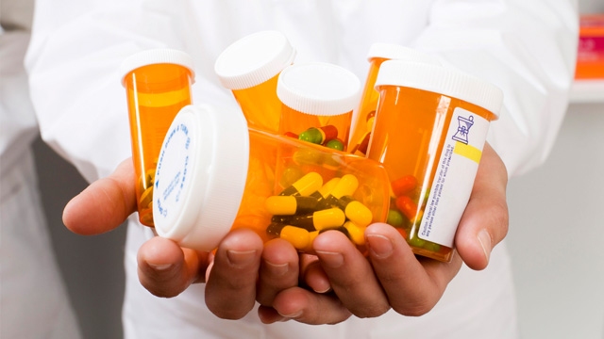
Medications

Slide 174
AN ALTERNATIVE TO OPIOIDS
Journal of Experimental Medicine supports these results. This research suggests that using CBD can reduce pain and inflammation.
They noted that cannabinoids, such as CBD, could offer helpful new treatments for people with chronic pain without building up a tolerance and needing to increase the dose as with opioids.
Notes:
https://www.ncbi.nlm.nih.gov/pmc/articles/PMC3371734/

Slide 175
Neuropathy
Hemp Extract, CBD and Pain:
Neuropathy is caused by microglia (the most common form of cellular immune defense) activation in the brain and spinal cord, which triggers the release of the cytokines interleukin-6 (IL-6), interleukin-1β (IL-1β), and tumor necrosis factor-α (TNFα), which put into simple terms, are pro-inflammatory molecules.
The causes of neuropathic pain itself are poorly understood outside of this basic biological reaction. However, neuropathy pain is present in nearly all common forms of disease such as diabetes, cancer, autoimmune diseases, and MS.⁹
CBD was demonstrated to alleviate heat sensitivity and allodynia (neuropathy pain) significantly.⁸
Two other studies demonstrated a very impressive calming of the immune system microglia/cytokine response along with promising anti-inflammatory improvements in patients with rheumatoid arthritis.⁹
Notes:
8.
Toth C, Jedrzejewski N, Ellis C, Frey W. Cannabinoid-mediated modulation of neuropathic pain and microglial accumulation in a model of murine type I diabetic peripheral neuropathic pain. Mol Pain. 2010;6:16. [PubMed]
9.
Kim D, You B, Jo E, Han S, Simon M, Lee S. NADPH oxidase 2-derived reactive oxygen species in spinal cord microglia contribute to peripheral nerve injury-induced neuropathic pain. Proc Natl Acad Sci U S A. 2010;107(33):14851-14856. [PubMed]
10.
Malfait A, Gallily R, Sumariwalla P, et al. The nonpsychoactive cannabis constituent cannabidiol is an oral anti-arthritic therapeutic in murine collagen-induced arthritis. Proc Natl Acad Sci U S A. 2000;97(17):9561-9566. [PubMed]
Malfait A, Gallily R, Sumariwalla P, et al. The nonpsychoactive cannabis constituent cannabidiol is an oral anti-arthritic therapeutic in murine collagen-induced arthritis. Proc Natl Acad Sci U S A. 2000;97(17):9561-9566. [PubMed]

Slide 176
Anti-Pain
Cannabidiol and Anti-Pain Anti-Inflammation Applications
Research in this area of CBD and inflammation is quickly evolving, and many of these papers I’ve cited here have put forward some very interesting theories surrounding promising therapies for people with diseases characterized by inflammation response due to microglial cell activation and the resulting pro-inflammatory cytokine increase.
I think it’s very important to also identify the actual causes of this inflammatory trigger, however countless people across the world are now in this state of poor health due to their own poor decisions (both known and unknown). It may not be their fault, but now it becomes our responsibility to do something positive to help ourselves by first calming down our inflammation response using effective natural therapies, then next we need to identify the causes of our personal inflammation and get rid of those bad habits, whether they’re stress-related, nutrition-relation, or due to exposure to environmental toxins.

Slide 177
OPIOID AND AMBIEN OUT
OUR PRODUCTS IN
INFLAMMATION, SLEEP, AND ANXIETY
1500mg of CBD with supportive essential oils and amino acids known to be helpful with stress, inflammation, and sleep (Lavendar, Valerian, Peppermint, Frankinsence, L-threonine)
NEURO-FIBRO ANALGESIC CREAM
500 mg broad spectrum Cannabinoids with other ingredients helpful in delivering into the tissues and reducing stress, tension, inflammation, and pain (Arnica, Boswellia (Indian Frankincense), Peppermint, Eucalyptus, DMSO, Menthol, Tea Tree, Lavendar, & Bergamot Oil)

Slide 178
Wellness Protocols

Slide 179
Well-Aligned Goals
Reverse inflammation
Prevent acute and chronic diseases
Defy aging
Optimize nutrient levels in your body
Optimize performance
Minimize Injury
Exceed your genetic potential

Slide 180
Inflammation Protocols
E-FlamX Anti-Inflammatory Supplement
E3 Omega-3s
Detox Pack
The Edison Pack
Anti-inflammatory eating and follow your food-allergy guide
IF D deficient: Additional Vit D

Slide 181
Underlying Factors to Disease and Aging
The Cause is the Cure
SYMPTOMS:
Early aging
Fatigue
Anxiety
Depression
Sleep abnormalities
Pain
Headaches
Inflammation
  Blood sugar imbalances
  Weight gain
  Nausea
  Bloating
  Gas
  Athletic performance
Address the Causes to prevent or defeat:
Obesity
Heart disease
Cancer
Auto-immune
Depression
Pain disorders
Neurological Illness
Digestive problems
TEST UNDERLYING FACTORS:
CRP, D, IRON, FOOD ALLERGY, & Genes
Notes:
5 MAIN CAUSES OF DISEASE AND AGING
Inflammation
Oxidative stress
Toxicity
Nutrient deficiency and bad diet
DNA concerns
That lead to the vast majority of age-related , longevity-impairing conditions (1-3)
(1) Lemon JA, Boreham DR, Rollo CD. A complex dietary supplement extends longevity of mice. J Gerontol A Biol Sci Med Sci. 2005 Mar;60(3):275-9.
(2) Aksenov V, Long J, Liu J, et al. A complex dietary supplement augments spatial learning, brain mass, and mitochondrial electron transport chain activity in aging mice. Age (Dordr). 2011 Nov 27.
(3) Aksenov V, Long J, Lokuge S, Foster JA, Liu J, Rollo CD. Dietary amelioration of locomotor, neurotransmitter and mitochondrial aging. Exp Biol Med (Maywood). 2010 Jan;235(1):66-76.
We’re not the sum of our parts, but the parts are made up of genes – and we must understand the genes. Then they work together to express health or illness.

Slide 182
BAD IDEA FOR INFLAMMATION
Over the counter NSAIDs, prescription pain killers and steroids seem like quick, easy, sensible solutions to lower inflammation.
All come at potentially great cost with addiction, death, and a greater likelihood of heart attack, stroke, and serious intestinal conditions.
Notes:
Systemic inflammation does not create pain like a sprained ankle.
It is therefore generally dismissed as signs of “normal” aging, immune related conditions, or obesity and being out of shape from poor lifestyle.
THE SILENT KILLER:
As people age and gain weight, chronic systemic inflammation increases and leads to our most common disease.
Blood sugar imbalance is one of many ways we can cause inflammation in our bodies.
Inflammation can be silent – meaning we don’t necessary “experience” any major signs or symptoms.

Slide 183
What causes Inflammation?
Free Radicals
Blood sugar imbalance
Stress and poor rest
Sugar and processed foods
Toxins
Consumption of artificial sweeteners
SUBLUXATION!
Chronic health conditions
Being Overweight
Sedentary lifestyle
Smoking
Chronic overconsumption of carbs
Notes:
Free radicals: These are defective molecule that sends out molecular shrapnel, damaging the coronary arteries and other cells in our bodies. They lead to advanced aging and changing of our DNA, therefore involved with cancer.
Occur from several causes to be named later, but include normal daily living such as when you metabolize food into energy, oxygen oxidizes (or burns) the food in order to produce energy which create by-products known as free radicals.
Also called “oxidation” – your body normally contains anti-oxidants that keep this under control. However, with modern over-exposure to free radicals, we use up our anti-oxidants.

Slide 184
The Sugar = Disease Effect
Insulin production causes IGF (Insulin-like Growth Factor) to be released and creates INFLAMMATION.
IGF stimulates faster cell growth and along with inflammation- is linked to disease; especially cancer.
Notes:
When we deliver high glycemic nutrients into the blood, glucose levels rise quickly.
The result is the release of insulin necessary to allow glucose to enter the cell. When insulin is released, another molecule called IGF (insulin ike growth factor)is released as well. IGF stimulates cell growth allowing sugar to provide for tissue nourishment and faster growth. A major negative to this duo of molecules is that they cause inflammation and are linked to several health issues including cancer.
The cell growth caused by IGF stimulates cancer cell growth.
This connects to diabetes. With high blood sugar levels, people with diabetes are known to be at above-average risk for cancer.

Slide 185
Bad Fats!
. Too many Omega-6’s and not enough Omega-3’s creates potent inflammatory agents
Notes:
Omega Balance, Disease, and Inflammation
Omega-6 fats lead to the formation of “eicosanoids.”
These are inflammatory hormones. In fact, the action that allows many painkillers like aspirin to work is by inhibiting the enzymes that convert Omega-6 to inflammatory agents that are called prostaglandins.
Over time, it’s been estimated that the overabundance of Omega-6’s and the resulting deficiency of Omega-3’s is involved in the causes of heart disease, vascular disease, homicide, depression, bronchial disease, and many other brain, joint, and organ disorders.

Slide 186
Consequences of Inflammation (High CRP)
Cancer
Heart attack
Stroke
Migraines or headaches
Poor memory
Intestinal dx
Diabetes or pre-diabetes
Arthritis, Joint Pain
Weight gain
Injury
Depression
Auto-immune dx
Notes:
The major concerns associated with chronic inflammation are things like cancer, heart attack, stroke
This is especially scary because we can address chronic inflammation but addressing nutritional deficiencies, modifying our diet and lifestyle.
CRP is the blood marker you test to measure inflammation levels in your body

Slide 187
TESTING RANGES AND EFFECT OF CRP
MEN (Goal: <1)
CRP (mg/L) HEART ATTACK STROKE
>2.11 3X 2X
1.15 - 2.10 2.6X 2X
.56 -1.14 1 2X 2X
<0.55 1X 1X
WOMEN (Goal: <1.5)
CRP (mg/L) HEART ATTACK OR STROKE
>7.3 5.5X
3.8-7.3 3.5X
1.5-3.7 3X
<1.5 1X
Notes:
In a Harvard Women's Health Study, CRP test results were more accurate. Twelve different indicators of inflammation were looked at in healthy women who had already had menopause. Three years later, those with the highest CRP levels were more than four times as likely to have died from coronary disease, or had a heart attack that wasn’t fatal, or stroke, compared with those with the lowest levelsRP is one of, if not the most important marker to check to maximize both current and future health.
CRP is one of the most, if not the most important marker of health to get tested – other inflammatory markers like homocysteine or Lp-PLA2 are inflammation markers as well.

Slide 188
Oxidative Stress
Notes:
Oxidation causes inflammation.
Man
What is oxidative stress?
This term refers to a burden of free radicals in our body. (Reactive oxygen species)
Free radicals are unstable molecules in our body that can damage other cells and lead to the progression of cancer, cardiovascular disease and age related decline
To prevent free radical damage, we use antioxidants:
Antioxidants provide us with a defense mechanism against free radical damage by stabilizing these unstable molecules, but can’t keep up under heavy exposure. We end up running low on antioxidants and the free-radicals overcome our health.
y of the same causes and conditions are related to both..

Slide 189
IT’S NOT THE CHOLESTEROL, IT’S THE INFLAMMATION
When LDL cholesterol is oxidized, it is especially damaging to the arterial lining and causes plaque

Slide 190
What causes Oxidative Stress?
Exposure to toxins
Cigarette smoke
Pollution
Dehydration
Excess sugar
Processed foods
SUBLUXATION
Medication
Preservatives in foods
Alcohol consumption
Stress
Notes:
Our bodies are exposed to free radicals and oxidative stress in the environmental and internally by our own metabolic processes – the food and drinks we consume can help contribute to our oxidative stress
oxidative stress.
Toxins, emotional stress, radiation, physical stress like intense exercise, sugar, weight gain, insulin issues, inflammation, and can increase oxidation and make it even more difficult for your antioxidant defenses to keep up. So you can see where inflammation and oxidation are closely tied together in terms of cause and impact.

Slide 191
Consequences of Oxidative Stress
Inflammation
Cancer
COPD
Asthma
Alzheimer’s Disease
Depression, anxiety
Lack of energy and stamina
Joint or muscle pain
Premature aging
Heart disease
Diabetes
Notes:
The effects of long term oxidative stress can affect many different body systems and create chronic and deadly conditions

Slide 192
Toxins Are Everywhere
Glyphosates Drugs & Vaccines
Car Bottling & Packaging
Home Beer & Wine
Work Fabrics & Clothing
Outside environment Paint, furniture, & flooring
Food & Drinks 1st/2nd smoke
Drinks Personal care products
Tap Water Pesticides
Notes:
Our bodies are constantly exposed to toxins in the environment, through our diets and through lifestyle choice
Our liver provides protection against toxins by filtering them out of our system
When we are chronically exposed toxins, the liver becomes overburdened and works less efficiently
We can overburden our liver with all of these things: [listed on slide]
Exposure to mold, pesticides, and other environmental toxins
Use of plastic water bottles
Unfiltered water which contains chlorine, fluorine, heavy metals and toxins
Benzene, xylene, toluene exposure through fabrics, detergents, dyes, gasoline
Medications, vaccinations
Glyphosates
Cigarettes, alcohol
Commercial foods
Use of artificial sweeteners
Personal care products like shampoo, soap, and toothpaste
Pesticides, herbicides, fungicides and fertilizers
Household cleaners
Dental work

Slide 193
Consequences of Toxicity
Cancer
Depression
Decreased vitamin levels
Antioxidant wasting
Breakdown of energy pathways
Chronic pain
Immune suppression
Weight loss resistance
Inflammation/oxidation
Hormonal imbalances
Body odor, belching and gas
Bad breath
Skin problems
Fibromyalgia
Chronic fatigue
Notes:
Overwhelm bodily functions
Cross the blood-brain barrier and poison the nervous system
Damage your cells
Lead to chronic inflammation and oxidation
Slow your metabolic rate.
Disrupt absorption of critical
Disrupt hormonal activity due to changes in receptor sites.
Lower thyroid function.
Bind to fats making them tough to lose.

Slide 194
WHY MEDICINE TESTS VITAMIN D
VITAMIN D (A Hormone) MANAGES:
Bone health
Normal immune function
Managing inflammation
Fighting infection
Muscle function
Cardiovascular regulation
Respiratory system support
Brain development
Notes:
100,000 people study showed that people with higher than average Vit E had a 43% lower risk of any heart or vascular metabolic disease. High Vit D had 33% less CV disease, 55%, less Type II Diabetes, and 51% less metabolic syndrome (Diabetes precursor with weight loss resistance, high plod pressure, and high triglycerides).
Optimal level is over 60 ng/mL – average person has less than half and labs have considered that “normal”
Depression, osteoporosis, heart disease, auto immune disease, infection, hypertension, and cancer (50% drop in intestinal cancers).

Slide 195
The Consequence of Low Vitamin D
Depression, osteoporosis, inflammation, heart disease, auto immune disease, infection, hypertension, and cancer
AND YOU CANNOT GET ENOUGH FROM YOUR DIET!
Notes:
New research has confirmed the importance of vitamin D3 in preventing cancer, particularly in countries where the lack of sunshine means that the skin cannot synthesize enough of this vitamin during the winter. I’ve therefore given more attention to this topic, and made new and more specific recommendations.”
“has recently been shown that a significant supply of vitamin D reduces considerably the risk of several cancers (by more than 75 percent with a daily intake of 1,000 international units [IUs] of the 25-hydroxyvitamin D form), in a Creighton University study published in 2007.121 In a Canadian pilot study of fifteen patients with prostate cancer, researchers reported on the effects of taking just 2,000 IUs of vitamin D3 daily over a median of eight months (up to sixty-five months for one of the patients). Fourteen of them saw a slowing of progression of their PSA levels (the most common marker of prostate cancer, used to follow its growth over time). And these levels actually dropped significantly in nine of the patients compared to their levels at the start of treatment.122
Other studies published recently have shown positive effects of vitamin D3 on breast cancer, non-small-cell lung cancer, colon cancer, and prostate cancer. Many researchers now believe that vitamin D3 contributes to slowing down all forms of cancer, at least in the early stages. Moreover, we now know that vitamin D3 very likely protects us from colds and flu and contributes to maintaining a[…]”
“Foods that contain the most vitamin D are cod liver oil (1,460 IUs in a tablespoon), salmon (360 IUs in 100 grams), mackerel (345 IUs in 100 grams), sardines (270 IUs in 100 grams), and eel (200 IUs in 100 grams). Milk enriched with vitamin D contains only 98 IUs per glass, an egg 25 IUs, and calf liver 20 IUs per 100 grams.”
“Long-chain omega-3s found in fatty fish (or in high-quality purified fish oil supplements) reduce inflammation. In cell cultures, they reduce cancer cell growth in a large number of tumors (lung, breast, colon, prostate, kidney, etc.). They also act to reduce the spread of tumors in the form of metastases. Several human studies show that the risk of several cancers is significantly lower in people who eat fish at least twice a week.125,126,127,128,129,130,131,132ai”

Slide 196
Test and Take Vitamin D
“Over 900 genes have vitamin D receptors, or proteins that bind to vitamin D.
Vitamin D supports immune system, pancreas, heart, blood, cellular, muscle, bone and bone marrow, breast, colon, intestine, kidney, lung, prostate, retina, skin, stomach, uterine and brain health—and positively impacts 36 bodily organs.”
Dr. Bess Dawson-Hughes, M.D., USDA Human Nutrition and Research Center on Aging at Tufts University
Notes:
Vitamin D3
High-quality vitamin D3 supports health in countless ways. From boosting heart and bone health to and lessening inflammation and the risks of certain diseases, vitamin D is vital to ongoing health.¹ Vitamin D-deficiency, on the other hand, increases risk of stroke and heart failure.^{2, 3} While the human body produces vitamin D naturally when exposed to moderate sunlight, indoor jobs and cold weather climates have left nearly half of all Americans vitamin D-deficient.⁴
Senior author Bess Dawson-Hughes, M.D., director of the Bone Metabolism Laboratory at the Jean Mayer USDA Human Nutrition and Research Center on Aging at Tufts University, says, “We may need to reconsider the current recommended daily values of vitamin D for older adults.” Dawson-Hughes believes that “vitamin D may also improve muscle strength, thereby reducing fracture risk through fall prevention.” ⁵
Emerging science suggests that vitamin D receptors are found throughout the body. Over 900 genes and several areas of the body have vitamin D receptors, or proteins that bind to vitamin D.⁶ According to University of California Riverside’s Biochemistry Presidential Chair, this means that, “Vitamin D supports immune system, pancreas, heart, blood, cellular, muscle, bone and bone marrow, breast, colon, intestine, kidney, lung, prostate, retina, skin, stomach, uterine and brain health—and can [positively] impact 36 bodily organs.” Even improved memory and concentration have been linked to vitamin D intake!⁷
Vitamin D can also inhibit unwanted and unhealthy cell proliferation, while stimulating healthy cell differentiation.⁸ When some cells divide rapidly, or proliferate, the impact on your health can be devastating. Cell differentiation, however, can decrease unwanted cellular proliferation. Lung, skin, colon, bone and breast sites have been studied for vitamin D’s positive effects on cell proliferation and differentiation. Vitamin D causes cells to act as normal, mature cells by stimulating healthy cell differentiation. Dr. Cedric Garland, a 20-year veteran vitamin D researcher, believes vitamin D can prevent unwanted cell proliferation by 75 percent with optimal vitamin D blood levels.⁹

Slide 197
Proper Levels of D =
33% less heart disease
55%, less Type II Diabetes
51% less weight loss resistance, high blood pressure, and high triglycerides)
Optimal level is over 60 ng/mL – average person has less than half and labs have considered that “normal”

Slide 198
Addressing Inflammation, Aging, and Disease
Test CRP, Food allergies
Test Vitamin D
Test DNA
Address daily exposure to toxins and detox
Sugar
Omega Fats
Fight Free Radicals with Anti-oxidants
Optimize Nutrient levels
Stress, Rest
Whole-food, Low glycemic diet

Slide 199
What Is Your Genetic Risk?
Celiac Disease, Lactose, and Gluten-intolerance
Dementia and Alzheimer's Disease
Parkinson's Disease
Cancer
Heart Disease
Fibromyalgia, joint, and muscle pain
Depression and Anxiety
Obesity
Diabetes
Auto-immune Disease
Sleep disorders
Skin problems
….and Inflammation, oxidation, and toxicity
Notes:
We all have certain genetic tendencies towards disease.
There are many genetic factors that predispose people to becoming more inflamed, oxidized, and toxic.

Slide 200
DNA IS NOT DESTINY
Genes load the gun, but environment pulls the trigger.

Slide 201
Whole is greater than the sum of the parts
Genes may make up a pattern, but are influenced by everything they encounter in the ENIRONMENT:
Nervous system function
Mental state
Sleep
Diet: quality of nutrient, quantity of macronutrients, fatty acid, & nutrient levels
Activity level
Toxins
Culture

Slide 202
Epigenetics: Test - Correct
30 men with prostate cancer who decided against traditional medicine:
1. Changed the activity of 500 genes
2. Increased the activity in 48 disease-preventing genes
3. Turned off the activity of 453 disease-promoting genes involved in prostate and breast cancers
Ornish, Dean, and Mark Jesus M. Magbanua, Gerdi Weidner, Vivian Weinberg, Colleen Kemp, Christopher Green, Michael D. Mattie, Ruth Marlin, Jeff Simko, Katsuto Shinohara, Christopher M. Hagg, Peter R. Carroll, “Changes in Prostate Gene Expression in Men Undergoing an Intensive Nutrition and Lifestyle Invervention,” Proceedings of the National Academy of Sciences, June 17, 2008, Vol. 105, No. 24, 8369-8374, www.pnas.org_cgi_ doi_10.1073_pnas.0803080105.
Notes:
Cancer is a perversion of genetics – a genome that becomes pathologically obsessed with replicating itself. These bad genes create cells that This are self-replicating machine co-opts the cell’s physiology, resulting in a shape-shifting illness that despite billions spent annually for half of a century, still defies our ability to treat or cure it.
SOLUTION: Test to identify the genes and overcome them by changing the environment.

Slide 203
The Truth About Genes
RANDOM MUTATIONS DON’T EXPLAIN DISEASE
Less than 2-5% of all diseases fall in this gene-caused category.
It’s not 1 or 2 genes, it is how 100s work together
THE SOLUTION? It’s knowing your genes and what you do with them that matter!
Notes:
Monogenic diseases, or diseases that result from errors in the nucleotide sequence of a single gene, are exceedingly rare and not responsible for the number of problems the gene myth would have someone believe.
You pass on your genes and your epi-genes: Determines what life you will experience now AND What you will transfer on to the next generation. Epigenetics will pass down pro-cancer or anti-cancer genes for 4 generations. You determine much of whether or not your children, grand-children, and great-great grandchildren will have a tendency towards health or disease (We tend to pass down our lifestyle too!)

Slide 204
Gene Upgrades
From your test, specifically address your environment:
Type of diet
Specific nutrient needs
Toxins
Correct Subluxation
Manage Inflammation and Oxidation
Type of Physical Exercise Activity
Address Lack of Sleep, Stress, and Anxiety

Slide 205
Inflammation Protocols
E-FlamX Anti-Inflammatory Supplement
E3 Omega-3s
Detox Pack
The Edison Pack
Anti-inflammatory eating and food-allergy guide
CBD Anxiety and Sleep
IF D deficient: Additional Vit D

Slide 206
E-FlamX: Inflammatory Support
TURMERIC: It’s the curcuminoids
The source, amount, and concentration that gives it the anti-inflammatory and other disease-fighting benefits.
Boswellia (Frankincense)
White Willow Bark (Where aspirin comes from before being synthesized into a dangerous chemical)

Slide 207
Up Omega-3s/Down Omega-6s
Add Omega-3’s and lowering the 6s is a major step in solving inflammation and its related conditions.
Notes:
The Omega-3’s in your body can compete for, slow down, and even stop the formation of these inflammatory Omega-6 hormones. This fact led to the discovery that increasing Omega-3 HUFAs as a percent of your body’s lipids could prevent diseases caused by Omega-6 inflammation.
The famous MRFIT study and studies of many different cultures show that people with the lowest percentage of Omega-6’s had the lowest death rate.

Slide 208
E3 Omega-3 Solution
Notes:
Get your DHA and EPA from Fish and Algal Oil
With concerns over quality sources of fish oils it is critical that these oils go through a purification process.
Algal is a powerful, vegetarian source of DHA while fish is necessary to get high levels of EPA. Both are essential to neurological, cardiovascular, immune, and overall health.
Also with MCTs
Burned quickly for energy
Lower in calories than long-chain fatty acids
Lauric acid is anti-microbial
Contain potential anti-aging properties
Fat burning fat
Retaining lean mass
Appetite control
Treating neurological disease
Inhibits inflammation
Includes polyphenols, a group of natural antioxidants
Improve health markers diabetes and CVD risk

Slide 209
Essential Omega-6, Inflammation
INCREASED
Heart Disease
Cancer Risks
Joint and muscle pain
Arthritis and osteoporosis
Auto-immune disease
Digestive Disorders
Depression
Sleep Disorders
Aging
Skin disorders
Notes:
Don’t Miss Upcoming Events - I want you to do is take out the card that says, “Help my friends and family” do you guys see that card? Hold it up for me. On the back it says “Sign me up.” On the side that says “help my friends and family” I want you to write down the name of the friends and family that you want to invite to the Recipe night that we have coming up on Sept 19th.
We’re not telemarketers so I want to make sure that you call them and let them know that we will be reaching out to them ahead of time. I want you to write your name and number at the top and their names and numbers below. Make sure that you call them ahead of time and let them know that we will be calling; if they don’t want us to call, please let us know, but otherwise we will be calling within the next couple of days to get them to one of our events to see if we can get them the help they need. People are praying for answers, and we have the answer. If you write down four names and turn it in today, we’ll provide you with recipes for homemade non-toxic household cleaning items that will help you live healthy and save money all while reducing your exposure to toxicity – the less toxic you are, the faster you’ll lose weight and keep it off.
On the back of that page it says sign me up. Write your name, number, and email. If you want to receive weekly newsletters with recipes and information regarding future events, let us know. If you want to get registered for the Max Life Call – Fast Intense Results on June 12th, or our Recipe Night on June 16^{th,} or our PAD on June 30th, check the box on this card. You can drop these cards off with __________. __________ raise your hand. We have plenty of time so take your time filling this out, and once it’s complete drop it off in the back with __________. Don’t forget your products and resources are 15% off today only. You can go to the back to pick up the resources that you need, turn in your “Sign me up” card, and guests if you didn’t hand in your Exam form earlier, you can do that now. Thanks.

Slide 210
ESSENTIAL NUTRIENTS: Omega-3s
Essential = Must Eat
INCREASED
Brain health
Neurological function and development
Heart wellbeing
Lowering triglycerides
Reducing high blood pressure
Protecting against stroke
Immunity and helping in the fight against cancer
Weight loss
Increasing lean muscle mass
Joint function & Preventing and reducing arthritis
Wellbeing of eyes
Diminishing depression
Notes:
Don’t Miss Upcoming Events - I want you to do is take out the card that says, “Help my friends and family” do you guys see that card? Hold it up for me. On the back it says “Sign me up.” On the side that says “help my friends and family” I want you to write down the name of the friends and family that you want to invite to the Recipe night that we have coming up on Sept 19th.
We’re not telemarketers so I want to make sure that you call them and let them know that we will be reaching out to them ahead of time. I want you to write your name and number at the top and their names and numbers below. Make sure that you call them ahead of time and let them know that we will be calling; if they don’t want us to call, please let us know, but otherwise we will be calling within the next couple of days to get them to one of our events to see if we can get them the help they need. People are praying for answers, and we have the answer. If you write down four names and turn it in today, we’ll provide you with recipes for homemade non-toxic household cleaning items that will help you live healthy and save money all while reducing your exposure to toxicity – the less toxic you are, the faster you’ll lose weight and keep it off.
On the back of that page it says sign me up. Write your name, number, and email. If you want to receive weekly newsletters with recipes and information regarding future events, let us know. If you want to get registered for the Max Life Call – Fast Intense Results on June 12th, or our Recipe Night on June 16^{th,} or our PAD on June 30th, check the box on this card. You can drop these cards off with __________. __________ raise your hand. We have plenty of time so take your time filling this out, and once it’s complete drop it off in the back with __________. Don’t forget your products and resources are 15% off today only. You can go to the back to pick up the resources that you need, turn in your “Sign me up” card, and guests if you didn’t hand in your Exam form earlier, you can do that now. Thanks.

Slide 211
Anti-inflammatory Eating:
Follow your food-allergy protocol
Low-glycemic carbohydrates
Raise good fats and naturally raised animal products
Avoid processed foods and chemicals
Eliminate or minimize grains
Minimize commercial meats and dairy
Notes:
Show Anti-inflammatory diet

Slide 212
SOLUTION TO TOXICITY
(And Free Radical Oxidation)
  Glutathione is the main antioxidant of the body and your Master Detoxifier
  Our bodies naturally produce glutathione, but toxins, stress, trauma, and sickness cause deficiency.
  Toxins must be absorbed and removed from the body through channels
Notes:
Glutathione is the primary antioxidant of the body. It is unique because it actually recycles itself and will continuously seek out and destroy toxins! Glutathione is made up of the amino acids cysteine, glycine and glutamic acid. Sulfur specifically attracts and binds toxins which will allow glutathione to destroy it.
Glutathione has multiple functions:
It is the major endogenous antioxidant produced by the cells, participating directly in the neutralization of free radicals and reactive oxygen compounds, as well as maintaining exogenous antioxidants such as vitamins C and E in their reduced (active) forms.
Regulation of the nitric oxide cycle, which is critical for life but can be problematic if unregulated.
It is used in metabolic and biochemical reactions such as DNA synthesis and repair, protein synthesis, prostaglandin synthesis, amino acid transport, and enzyme activation. Thus, every system in the body can be affected by the state of the glutathione system, especially the immune system, the nervous system, the gastrointestinal system and the lungs.

Slide 213
Detoxify Daily

Slide 214
#1 Master Detoxifier
N-Acetyl-L-Cysteine (NAC)*
L-Glutamine*
L-Glycine*
Milk Thistle Seed Extract*
Apple Cider Vinegar (Powder)
Aloe Vera Leaf Powder
Broccoli Seed Extract Powder*
Chlorella
Cinnamon Extract
Dandelion Greens
Garlic Powder*
Green Tea Extract (Polyphenols, Catechins, and EGCG)
L-Glutathione*
*Increase and enhance Glutathione in the blood
Notes:
Milk Thistle, Broccoli, and Garlic all boost glutathione production.
N-Acetyl-L-Cysteine (NAC)*, L-Glutamine*, L-Glycine*, Broccoli Seed Extract Powder 13%*, Garlic Powder*, L-Glutathione*
As well as cruciferous vegetables in Part 2, Capture and Release

Slide 215
Contains and Requires: Milk Thistle
Powerful glutathione regenerator
Reduces and reverses liver damage caused by medications, radiation and alcohol
Used to treat alcoholic cirrhosis and alcoholic hepatitis
A potent antioxidant for the liver
Chemoprotective (2-4)
Notes:
. Also, milk thistle inhibits certain enzymes that promote free radical production, along with maintaining the electron-transport chain of cell mitochondria during stressful conditions.
2. Phytother Res. 2010 Oct;24(10):1423-32. doi: 10.1002/ptr.3207. Milk thistle in liver diseases: past, present, future. Abenavoli L¹, Capasso R, Milic N, Capasso F.
3, Indian J Biochem Biophys. 2006 Oct;43(5):306-11. Protective effects of silymarin, a milk thistle (Silybium marianum) derivative on ethanol-induced oxidative stress in liver.
Das SK¹, Vasudevan DM.
4 Antioxidants (Basel). 2015 Mar; 4(1): 204–247. Silymarin as a Natural Antioxidant: An Overview of the Current Evidence and Perspectives
Peter F. Sura

Slide 216
Support Your Body’s Detox Channels
Skin
Lungs
Colon*
Kidneys
Liver*
Lymphatic system
Fat cells
*Centers for processing and removal
Notes:
The toxic burden also causes a burden on the liver, which is your body’s detox super organ.
To maximize detox we need to look at all the detoxification channels. They include the skin, lungs, colon, kidneys, liver, lymphatic system and fat cells. Detoxification happens both inside cells and outside of them.
Skin
Lungs
Liver
Lymphatic System
Fat cells – researchers are leaning towards classifying body fat more like an organ rather than simply fat that is hanging around…Refer to visceral fat and its link to major health issues…fat as repository for toxins, carcinogens, and endocrine disruptors
Here is an interesting recent article on increased incidence of major diseases in obese Indian women, linking it to toxins stored in fat as major contributing factor:
http://dailypioneer.com/nation/42244-risk-of-breast-cancer-high-in-obese-indian-women-study.html

Slide 217
DETOX CHANNEL SUPPORT: Capture & Release
Magnesium (as Magnesium Citrate 16%)
Psyllium Husk
Activated Carbon (Charcoal)
Flaxseed
Glucomannan (Konjac Root)
Acai Berry Powder
Alfalfa (Whole Plant)
Blueberry (Vaccinium corymbosum; fruit powder)
Brussels Sprout (Whole Plant)
Kale (Organic)

Slide 218
Key Co-Factors For Glutathione Function
Vitamin C –
Vitamin E –
B vitamins –
Selenium -
Magnesium -
Zinc –
Alpha lipoic acid –
Vitamin D
Notes:
The Edison pack contains all of these key co-factors critical as Selenium, Vitamin C, B-Vitamins, Vitamin E, Alpha Lipoic Acid (ALA), and Zinc are important co-factors for producing and maintaining adequate levels glutathione and helping glutathione work to fight free radicals and cleanse the body.
Vitamin C – as an antioxidant it assists glutathione in this function and has been shown scientifically to raise glutathione levels short term; it is recycled by glutathione from its oxidized state back to its active state, thus strengthening antioxidant defenses; vitamin C also recycles vitamin E and alpha lipoic acid.
Vitamin E – as an antioxidant it also assists glutathione in eliminating free radicals much like vitamin C; it is also required for the proper functioning of glutathione enzymes; it recycles vitamin C and alpha lipoic acid.
B vitamins – vitamins B1 and B2 maintain glutathione and its enzymes in their active forms; vitamin B2 participates in the formation of a glutathione molecule; vitamin B6 influences glutathione synthesis indirectly as it is important for the proper functioning of amino acids including GSH precursors; vitamin B6 increases the amount of magnesium (a vital cofactor) that can enter cells; folate (B9) pushes cysteine towards glutathione production rather than homocysteine production; folate and vitamin B12 work together in amino acid metabolism and protein synthesis. You can read more about vitamin B12 deficiency and its effect on immune health.
Selenium - part of the enzyme glutathione peroxidase (GPx). Glutathione peroxidases, also known as selenoproteins, are a family of antioxidant enzymes that speed up the reaction between glutathione and free radicals.
Magnesium - required for the proper functioning of the enzyme gamma glutamyl transpeptidase (GGT) involved in the synthesis of glutathione.
Zinc – zinc deficiency reduces glutathione levels, especially in red blood cells. However, zinc levels above normal have pro-oxidant properties and reduce glutathione too.
Alpha lipoic acid – an antioxidant produced by the body; it has been scientifically proven to enhance and maintain glutathione levels by stimulating enzymes involved in the synthesis of glutathione; it also helps increase the cellular uptake of cysteine, the crucial building block of glutathione; in addition, alpha lipoic acid recycles vitamins C and E.
It is very important to keep the intake of glutathione cofactors above the recommended daily amounts which were designed more than half a century ago and only to prevent deficiencies.

Slide 219
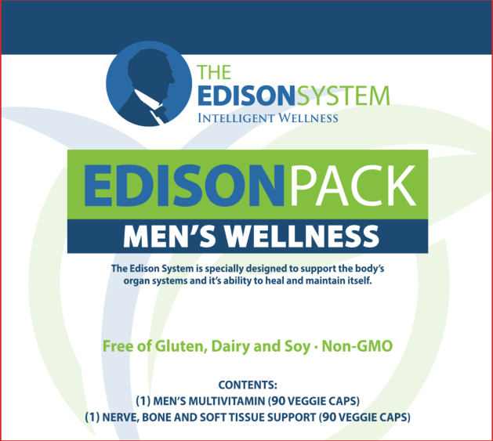
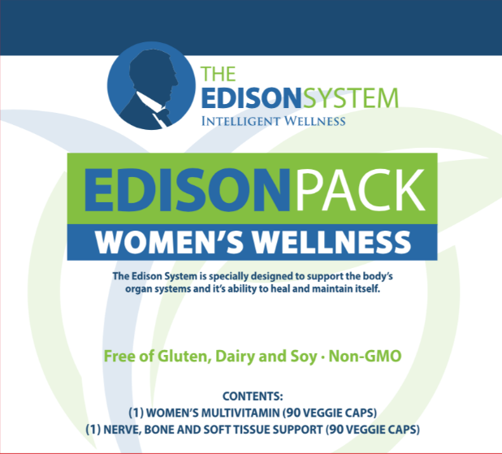
THE EDISON PACK
1
NERVE, BONE AND SOFT TISSUE SUPPORT
2
MEN’S AND WOMEN’S MULTIVITAMIN

Slide 220
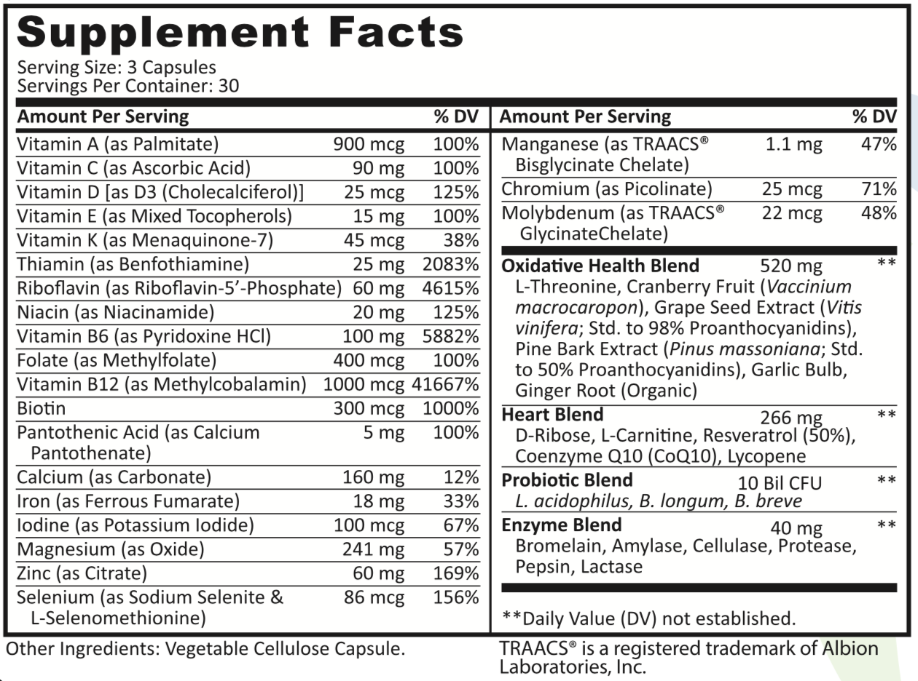
WOMEN’S MULTIVITAMIN

Slide 221
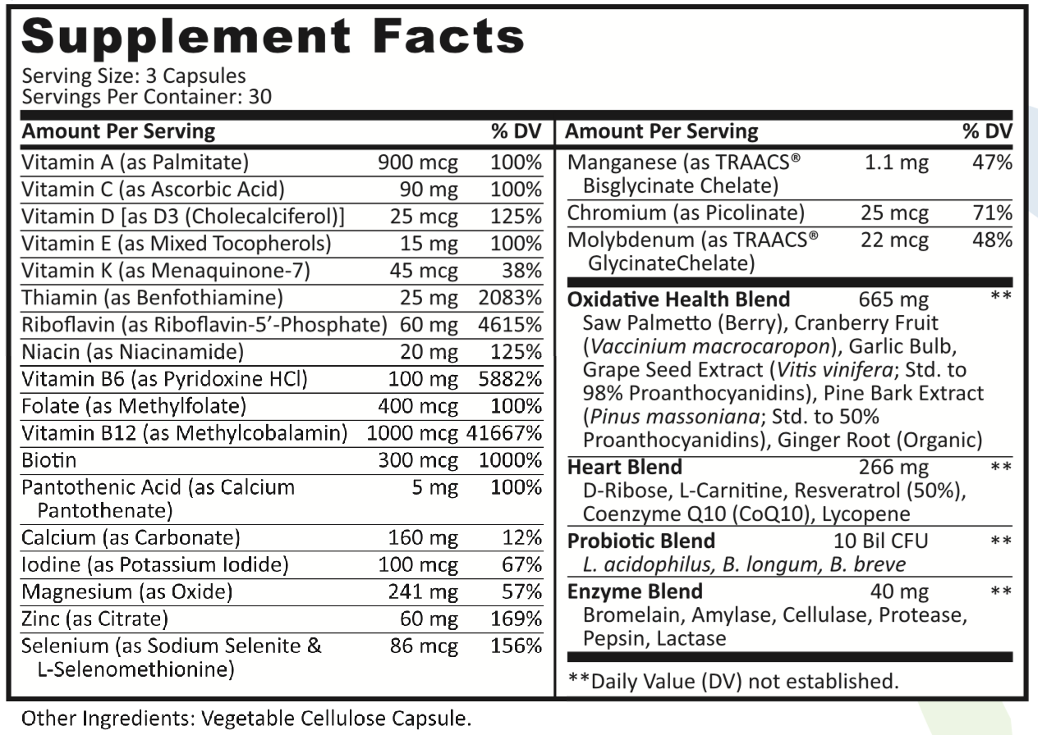
MEN’S MULTIVITAMIN

Slide 222
B Vitamins and Your Heart
Decreased B Vitamins leads to elevated CRP and homocysteine
Elevated CRP or homocysteine leads to increased risk of damage to your blood vessels and cardiovascular system
You are 4 times more likely to have heart attack from elevated homocysteine then elevated cholesterol
Notes:
Curr Med Res Opin. 2007 Aug;23(8):1879-86.
Effects of folic acid and vitamin B complex on serum C-reactive protein and albumin levels in stable hemodialysis patients.
Chang TY¹, Chou KJ, Tseng CF, Chung HM, Fang HC, Hung YM, Wu MJ, Tzeng HM, Lind CC, Lu KC.
After 3 months, levels of plasma tHcy and serum hs-CRP, Cr, and nPCR were significantly decreased while levels of serum albumin, vitamin B(12), folate, and BW were significantly increased. The dialytic dose (KT/V) and dietary intake remained unchanged. However, correlations between the magnitude of reduction of tHcy & hs-CRP, tHcy & Cr, and Cr & nPCR were statistically significant.
Another important thing that happens when we over utilize our B Vitamins because of stress: we create elevated levels of an amino acid known as homocysteine
Homocysteine leaves us more susceptible to damage in our cardiovascular system.
This means we have an increased risk of blood clots, heart attacks and strokes, simply because we don’t have enough B Vitamins
Serum total homocysteine level is an independent risk factor for coronary heart disease.
Int. J. Epidemiol. (1995) 24 (4):704-709. doi: 10.1093/ije/24.4.704
Serum Total Homocysteine and Coronary Heart Disease
EGIL ARNESEN*, HELGA REFSUM**, KAARE H BØNAA*, PER MAGNE UELAND**, OLAV H FØRDE* and JAN E NORDREHAUG†
Background Several studies have observed high plasma levels of homocysteine among patients with coronary heart disease (CHD). The only prospective study was based on US physicians, and concluded that homocysteine was associated with subsequent myocardial infarction (Ml). However, the association was limited to those above a threshold level of homocysteine.
Methods We conducted a nested case-control study among the 21 826 subjects, aged 12–61 years, who were surveyed in the municipality of Tromsø, Norway. Among those free from Ml at the screening, 123 later developed CHD. Four controls were selected for each case.
Results Level of homocysteine was higher in cases than in controls (12.7 ± 4.7 versus 11.3 ± 3.7 µmol/l (mean ± SD); P = 0.002). The relative risk for a 4 µmol/l increase in serum homocysteine was 1.41 (95% confidence interval (Cl): 1.16–1.71). Adjusting for possible confounders reduced the relative risk to 1.32 (95% Cl: 1.05–1.65). There was no threshold level above which serum homocysteine is associated with CHD events.
Conclusions In the general population serum total homocysteine is an independent risk factor for CHD with no threshold level.

Slide 223
BEAT OXIDATION: Anti-oxidants
Antioxidant vitamins help to prevent or repair the lining of the blood vessels that are damaged and to halt or diminish the destructive inflammatory response. Without adequate antioxidants, more plaque is formed. If this continues over decades, the fatty plaque builds up in your blood vessels, creating atherosclerosis”

Slide 224
Vitamin E: Potent Antioxidant
Body's most potent fat-soluble antioxidant
Crucial for protecting against free radical damage
Strengthens and regulates heartbeat (very important in preventing and treating heart disease and cardiac conditions)
Increases body's production of CD4 (natural killer cells) and certain antibodies
Slows down the mental decline associated with some neurological disorders

Slide 225
FIGHTING THE #1 KILLER
EDISON PACK HEART BLEND – FIGHT THE DAILY FIGHT!
D-ribose: repairs and prevents heart damage and improves recovery
Anti-oxidants specific to the heart
Resveratrol
CoQ10
Lycopene (Along with Saw Palmetto in the Men’s – also helps to prevent conditions of the prostate)
Notes:
Chemicals and stress raise free radicals and use up our antioxidants like Selenium and critical Vitamins A, C, and E as well as the vital mineral Zinc
Fight the good fight against damage to your heart through replacing these antioxidants and taking nutrients that fight free radicals that attack the heart and support the cardio vascular system’s ability to heal and repair.

Slide 226
MEN’S WHOLE FOOD ANTIOXIDANT BLEND
MEN’S: Saw Palmetto
Supports the urological system
Supports prostate health
Helps mitigate issues leading to hair loss
Assists in retaining testosterone levels

Slide 227
WOMEN’S WHOLE FOOD ANTI-OXIDANT BLEND
WOMEN’S: L-Threonine (amino acid)
Protects the cells against oxidative stress and improves mood, anxiety, depression, and sleep.
PLUS, many other great benefits!

Slide 228
CoQ10: Slows The Aging Process
Notes:
CoQ10:
CoQ10 is an important component of energy production.
Remember: energy comes from the foods we eat, and just like B Vitamins are necessary to move those processes along, so is CoQ10.
In addition to helping produce energy, CoQ10 is an antioxidant and can protect your heart against oxidative stress
CoQ10 can be depleted by the use of statin drugs, which lower cholesterol. Cholesterol is another consequence of inflammation and oxidative stress.
More importantly, there are consequences to having low levels of CoQ10. These include heart failure, high blood pressure, blood sugar imbalance, and stomach ulcers.

Slide 229

CBD and SLEEP
The nonpsychoactive Cannabis constituent cannabidiol is a wake-inducing agent
Cannabis, pain, and sleep: Lessons from therapeutic clinical trials of Sativex
Effects of acute systemic administration of CBD on sleep-wake cycle in rats
Effect of Delta-9-tetrahydrocannabinol and cannabidiol on nocturnal sleep and early-morning behavior in young adults
CBD modulates sleep in rats
Endocannabinoid modulation of cortical up-states and NREM sleep
Intranodose ganglion injections of dronabinol attenuate serotonin-induced apnea in Sprague-Dawley rat
Endocannabinoid Signaling Regulates Sleep Stability
Cannabis, Cannabinoids, and Sleep: a Review of the Literature
Effectiveness of Cannabidiol Oil for Pediatric Anxiety and Insomnia as Part of Posttraumatic Stress Disorder: A Case Report.
Notes:
The benefits are tied heavily to the impact on stress, anxiety, and inflammation

Slide 230
CBD: Anxiety and Stress Studies
Vanilloid TRPV1 receptor mediates the antihyperalgesic effect of the nonpsychoactive cannabinoid, cannabidiol, in a rat model of acute inflammation
Cannabidiol attenuates cisplatin-induced nephrotoxicity by decreasing oxidative/nitrosative stress, inflammation, and cell death
Cannabinoids in clinical practice
Pure THC-V inhibits nitrite production in murine peritoneal macrophages
Cannabinoids, inflammation, and fibrosis
Amyloid proteotoxicity initiates an inflammatory response blocked by cannabinoids
Endocannabinoid 2-arachidonoylglycerol protects inflammatory insults from sulfur dioxide inhalation via cannabinoid receptors in the brain
Protective effect of CBD on hydrogen peroxide‑induced apoptosis, inflammation and oxidative stress in nucleus pulposus cells
Mechanisms of action of CBD in adoptively transferred experimental autoimmune encephalomyelitis
Cannabidiol, a non-psychotropic plant-derived cannabinoid, decreases inflammation in a murine model of acute lung injury: role for the adenosine A(2A) receptor
Cannabinoids suppress inflammatory and neuropathic pain by targeting α3 glycine receptors
Cannabidiol reduces intestinal inflammation through the control of neuroimmune axis
Diabetic retinopathy: Role of inflammation and potential therapies for anti-inflammation
Cannabidiol reduces Aβ-induced neuroinflammation and promotes hippocampal neurogenesis through PPARγ involvement
Cannabidiol attenuates high glucose-induced endothelial cell inflammatory response and barrier disruption
Cannabidiol as an emergent therapeutic strategy for lessening the impact of inflammation on oxidative stress
The endocannabinoid system: an emerging key player in inflammation
Anti-inflammatory role of cannabidiol and O-1602 in cerulein-induced acute pancreatitis in mice
Cannabinoids, endocannabinoids, and related analogs in inflammation

