Slide 1
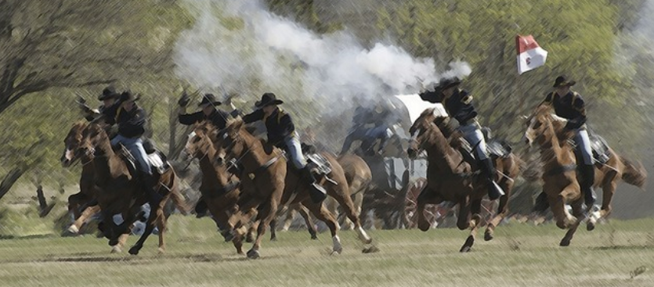
How To Prepare For and Conduct a CAV
The NFIP Community Assistance Visit
Floodplain Management Branch, FEMA HQ
Notes:
This session is geared to both the student with minor experience and to those with several years experience of preparing and conducting Community Assistance Visits (CAV).
We will be discussing the procedures and methods to prepare and conduct a CAV, outlining those procedures found in FEMA Manual F-776/April 2011.

Slide 2
Today’s Purpose
To deliver to State and Regional Floodplain Managers the necessary knowledge to conduct effective Community Assistance Visits.
This course will cover a wide range of CAV topics. You can pursue these various topics in depth by:
Taking additional courses at EMI;
Calling your FEMA Regional state liaison, or;
Downloading FEMA F-776/April 2011

Slide 3
Objectives
At the end of this workshop, you should be able to:
Describe the CAV process, including:
Community Selection;
Preparation;
Conducting, and;
Follow-up actions.
Understand the Community Compliance Program;
Must do, May do, and Do not’s, and;
Note ideas for possible use on the job.

Slide 4
Introductions
Please tell us your:
Name
Organization
Job responsibilities
Goal for this workshop

Slide 5
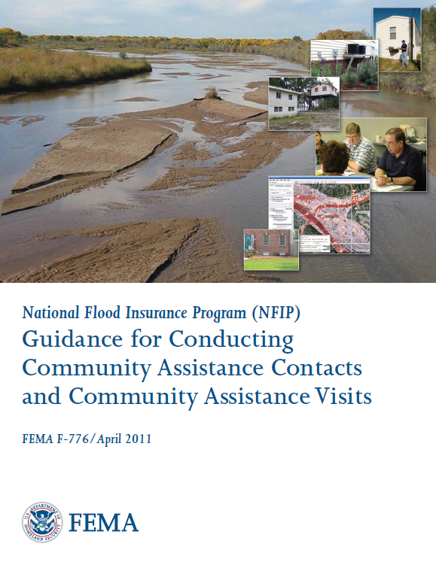
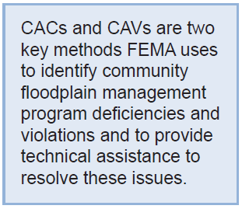
CAV Guidance
Notes:
This manual is an important foundation for building a factual (fact finding) case of a community’s non-compliance to support continued enforcement action.
You will find that during this session we will be focusing on “assessment” and not necessarily “assistance.” You must first know who to assess a communities floodplain management program before you can provide the necessary assistance.
Under the NFIP program out goal is to assistance communities in their implementation of sound comprehensive floodplain management criteria. If a community is not providing the necessary regulations of floodplain, is our responsibility to assess, assist and follow through with compliance.

Slide 6
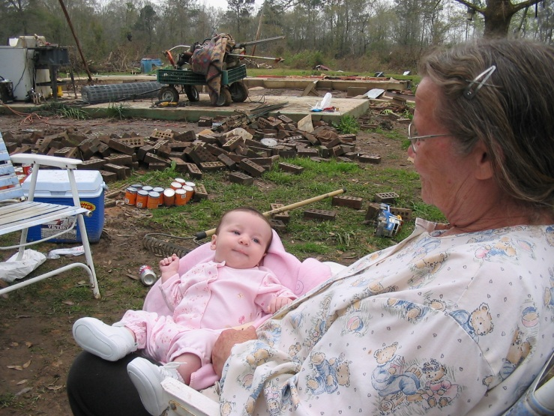
Key Purposes of the CAV
There are two:
1 - To ensure NFIP participating communities are achieving the flood loss reduction objectives of the program, which are:
To reduce the threat to life safety and property.
Notes:
Photo taken in 2004, Lamar County, MS. Post dam break, over 100 homes destroyed, no fatalities, less than 20 had flood insurance.

Slide 7
Key Purposes of the CAV (continued)
And:
2 - To provide technical assistance to communities and therefore identify, prevent, and resolve floodplain management issues before they develop into enforcement actions.
Notes:
Providing technical assistance via telephone conversations, visits, email, letters, and eventually CAV is the responsibility of the FEMA HQ, FEMA Regional and NFIP State Coordinators to assist communities in their implementation of the NFIP.
The needle represents the old adage: “A stitch in time saves nine.”

Slide 8
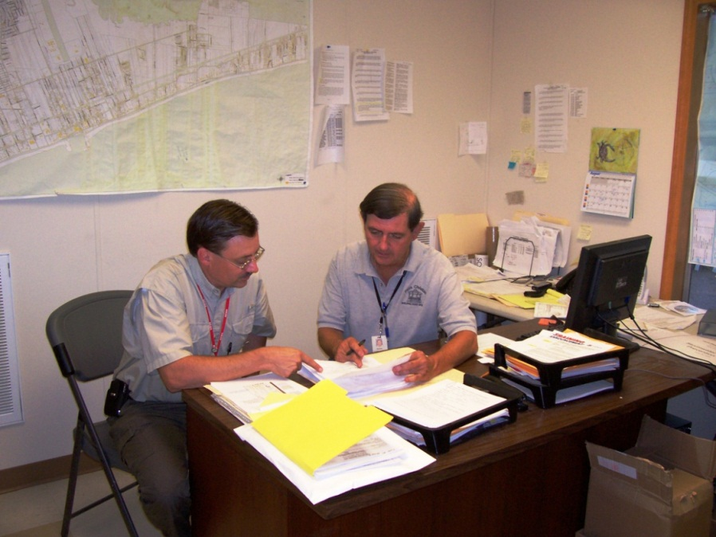
Goal of a CAV
“To establish a positive working relationship with NFIP communities and awareness of the NFIP requirements.”
Notes:
It is important to understand that sometimes as Federal or State representatives, we would like to take aggressive action toward a difficult community. But we as Federal and State employees and the goal of the NFIP, is to provide technical assistance in the implementation of the program regulations. Our goal is not to kick community’s out of the NFIP, but to help them understand the importance of floodplain management and their commitment to the Federal Government and the citizens.
If a community no longer is upholding their commitment, the recourse we may have is to place them on probation, and finally suspension.
However, in some cases, the community and the citizens may be better off struggling through a few years of difficult time resolving deficiencies and improving their program rather than being suspended from the NFIP.

Slide 9
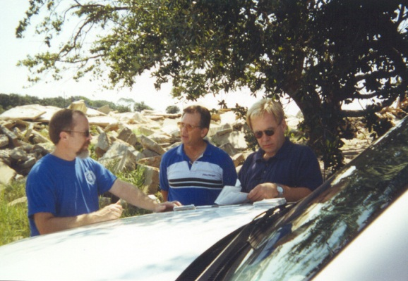
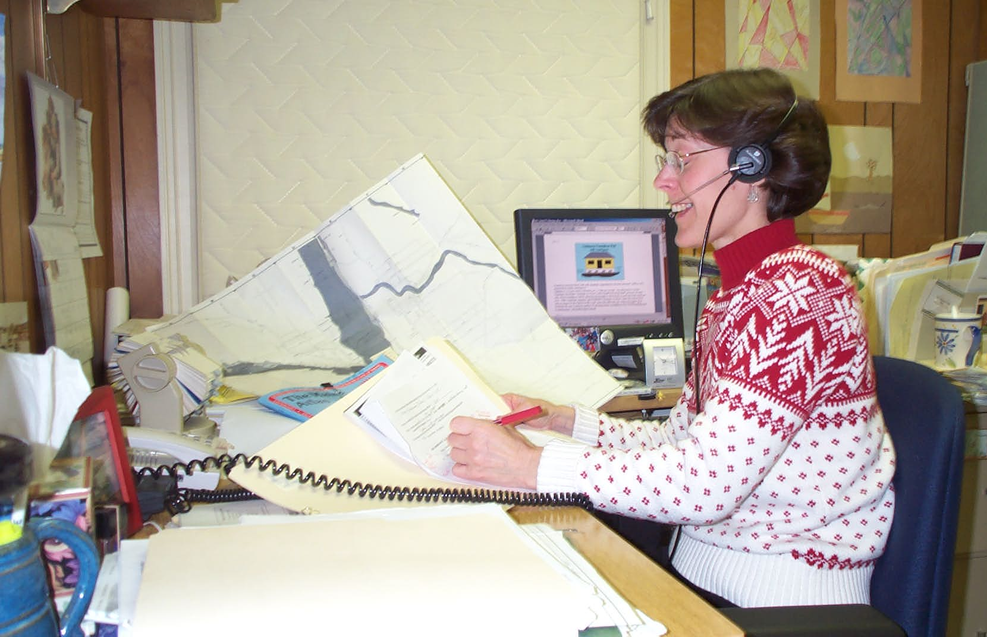

Community Assistance Contact
Notes:
CACs can be as easy as a phone call or an informal meeting with community officials.

Slide 10
Community Assistance Contact (continued)
A CAC:
Can consist of a telephone call or brief visit.
Is less comprehensive than a CAV.
CACs can be used:
As a screening tool to see if the more resource intensive CAV is necessary.
To establish or re-establish contact.
To determine if floodplain management issues exist.
Notes:
The CAC process has been used by some States to screen those communities that need assistance, have not been contacted for some time, or obtaining information about changes in contacts with the community.
Some communities have expressed desire to have a CAV. It is important to understand that there are some floodplain mangers that desire to have a CAV to determine if they are doing the right thing.
CAC would be good for those communities:
Just entered the NFIP
Citizens concerns via phone or correspondence
Map accuracy

Slide 11
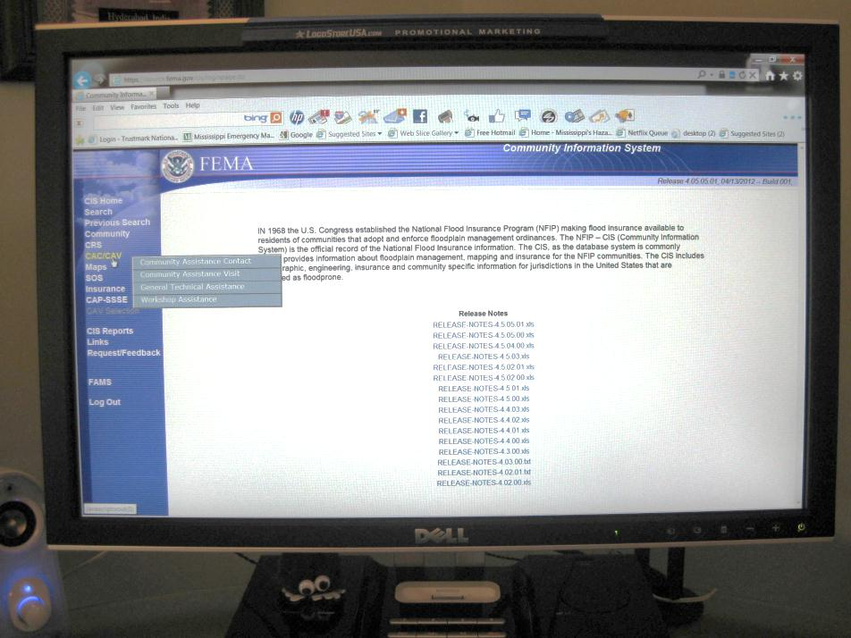
Community Assistance Contact (continued)
Let’s look in the Community Information System (CIS).
You can:
Use CIS to track CAC
actions;
You can enter data
as you conduct a call, and;
CIS creates a permanent
record.
Notes:
Ask if anyone has ever used CIS for this purpose before.

Slide 12
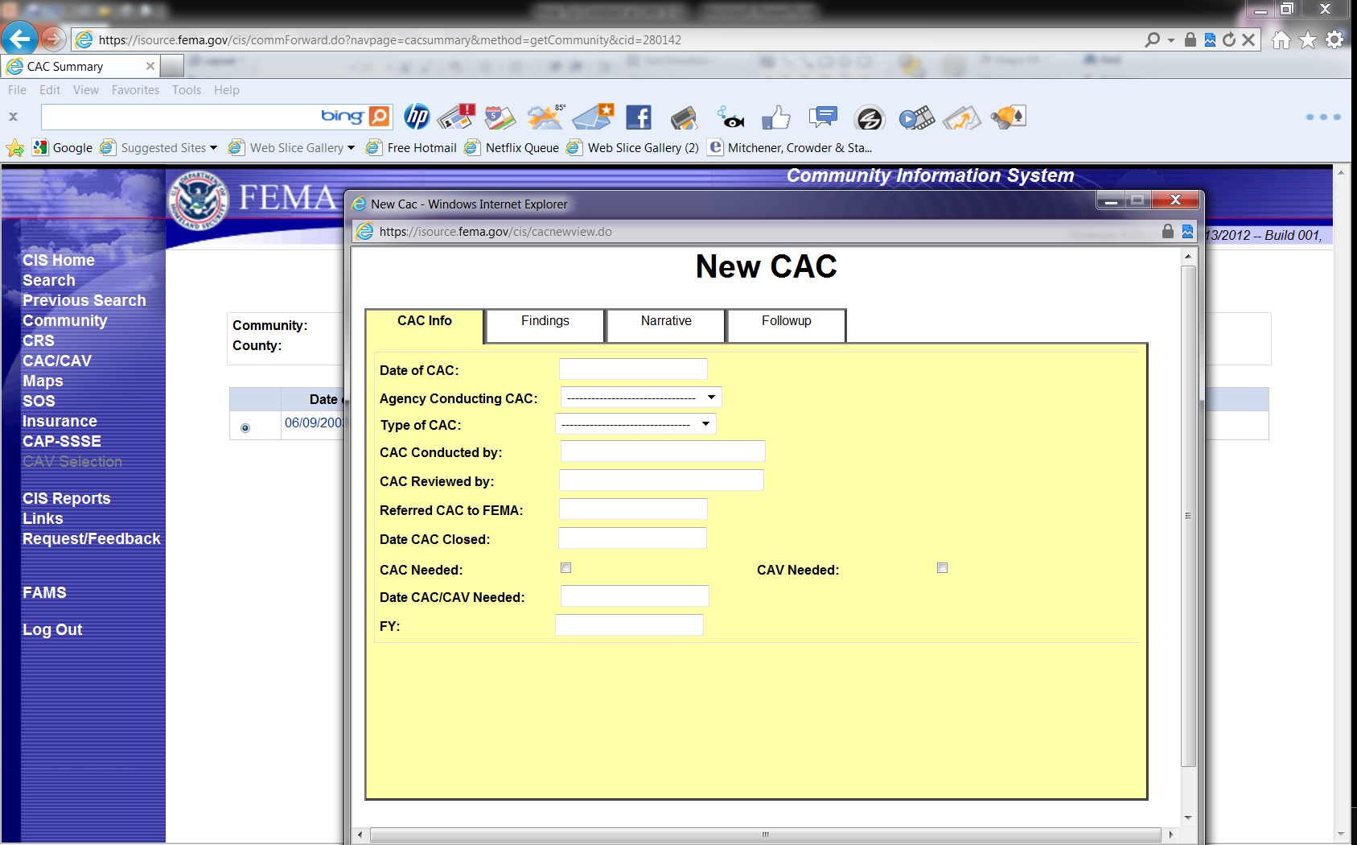
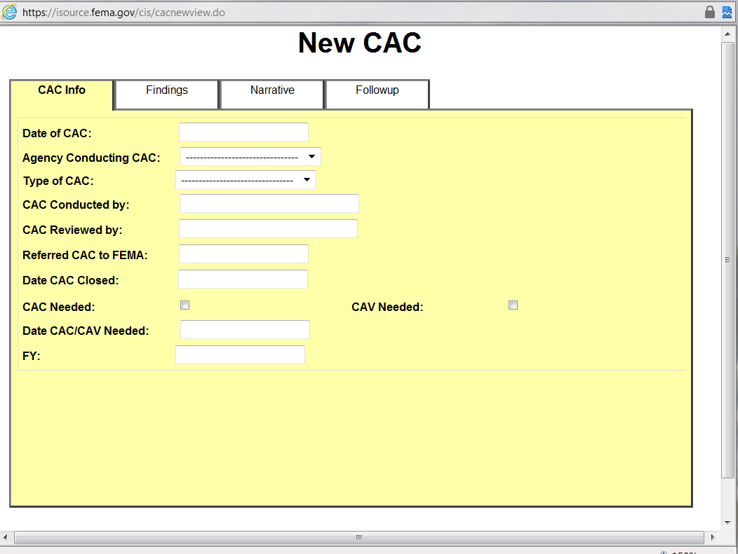
Community Assistance Contact (conclusion)
Notes:
After briefly describing the system, click to advance slide to larger view of “new” CAC screen.
Recording the information obtained from CACs are entered in CIS through the CAC screen – walk through with Laser pointer. Note that you can differ between phone and visit. Screen allows you to enter findings, notes, and follow-up needed. In add to the “CAV needed” checkbox on the “Info” screen, under findings, you can also check whether a CAV is needed within one year.

Slide 13




Community Assistance Visit
Notes:
I am with the government and simply wish to look at your program. Who them? Oh, just some guys who drove me here...

Slide 14
Community Assistance Visit (continued)
A CAV is an assessment of the community’s FPM understanding & abilities requirements under the NFIP.
May be used to resolve issues or problems identified via CAC or other source:
It is not to be a finger pointing exercise.
However, it can be a basis for subsequent enforcement action.
Assesses the effectiveness of programmatic and regulatory aspect of the NFIP.
Notes:
Assessing the community’s program provides you an opportunity to identify problems or potential problems that could be resolved before we have a compliance and/or enforcement action.
Explain the purpose of the CAV is to provide ASSISTANCE but if there are problems identified you cannot ignore them but you will help them with resolving the issue to the maximum extent possible. As a result of finding issues you must tell them that you must include those issues in your report. It is not your goal to find problems but to help solve difficulties.
You are from the government and you are there to help them.
The majority of local officials want to know what they are doing wrong and what they are doing right.

Slide 15
Community Assistance Visit (continued)
Gathering Information and Facts.
Make field observations – windshield survey.
Check for new development, substantial improvement, fill in SFHA, possible obstructions, etc.
Review permit files and any variance files.
Identify issues and problems and offer assistance to correct program deficiencies and/or remedy possible violations.
Notes:
During the floodplain tour, you are looking for possible violations. For example, fill in the floodplain/floodway, obstructions in water flows, new development, manufactured homes not properly tied down, subdivisions without proper drainage, etc.
Be sure to observe “No Trespassing” signs. Obtain permission from the community and/or property owner before entering property. Even though you have a FEMA badge, and or State ID, that does not give you authority to enter property without permission.
It may not be feasible to tour the entire floodplain if it is a large community. Identify those areas of concern, possibly those areas with high population, and/or those areas that have high degree of development sited. Get a general sense of the amount and type of development that is occurring with the community.
With smaller communities you may be able to tour the entire floodplain. Decide if you wish to have the local FA with you in the vehicle.
Decide what type of CAV will be conducted, e.g. a “digital CAV” or a “paper CAV.” This will dictate what equipment and materials will be needed.

Slide 16

Community Assistance Visit (continued)
CAV Phases:
Selection;
Preparation;
Community Visit;
Documentation & Fact Finding, and;
Follow-Up.
Notes:
There are many phases in the CAV process.

Slide 17
Community Assistance Visit (continued)
To CAV or Not to CAV, that is the question...
Ideally, a participating NFIP community should be contacted at least every year:
Impossible – too many;
Depends on State / FEMA staff, budget, and other resources and demands;
Depends on local staff turnover, and;
Every 5 years is a rule of thumb (but three years for select communities is recommend).
Notes:
Ideally – participating communities. However, a community that has been suspended and/or withdrew and now wants to reenter the NFIP, a CAV should be conducted. But for each community in the NFIP to be CAVed every year is impossible.
Depending on the priority and/or budget of a Region, a NFIP participating community should be evaluated every 3 to 5 years. In that period of time a new group of elected officials could be in office and the direction of a comprehensive floodplain management program may not be the priority of the administration now.
What is meant by a “select community” in reference to a three year cycle vs. a five cycle?

Slide 18
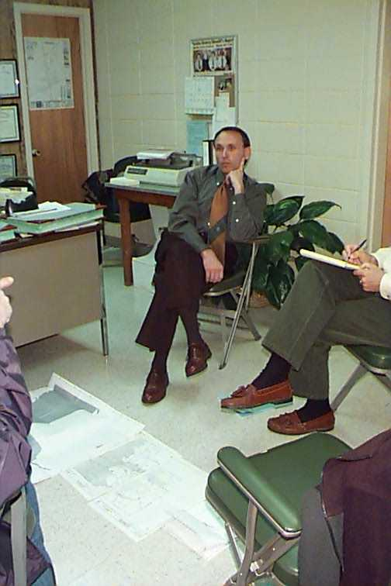
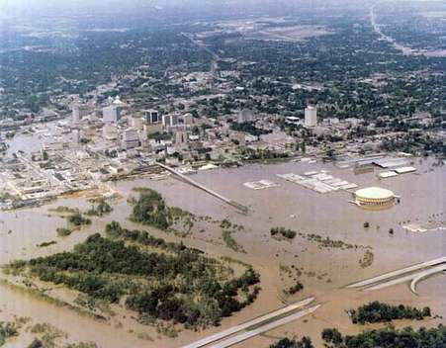
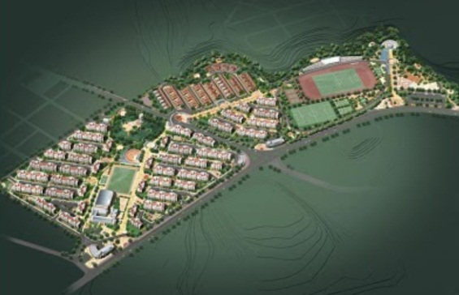
Risk-Based Selection Criteria
You should consider communities with:
Current and future high growth in SFHA;
High risks to existing SFHA development, and;
Known or suspected compliance issues.
Notes:
Photos: Left: Planned housing development in the SFHA Center: Downtown Jackson, MS flood of 1979. Right: A newly elected Mayor learning of pre-existing compliance issues in his town.
Once a preliminary list of CAVs has been identified (upcoming year), the FEMA RO and State Coordinating Office will determine who will conduct the visits. This occurs prior to or during the CAP-SSSE SOW negotiation process with States. IF the CAV/CAC is required for a participating Federally Recognized Tribal Government, then it must be done by FEMA.

Slide 19
Risk-Based Selection Criteria (continued)
Risk-Based Community Selection Process:
Risk-Based Selection Tool provides annual ranking of all communities in each State, and;
The list is divided into two groups (aka Tier 1 and Tier 2).
Tier 1:
Those with highest risk relative to new/existing development, and;
Those with suspected or potential FPM problems.
Notes:
The length of the Tier 1 list will depend upon the number of CAVs the State and FEMA can accomplish in a five-year cycle.
Additional info can be found on page 2-2 in FEMA F-776/April 2011. (NFIP Guidance for Conducting CACs and CAVs)

Slide 20
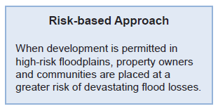
Risk-Based Selection Criteria (continued)
Risk-Based Community Selection Process:
Tier 2:
Those with a risk ranking that falls below Tier 1;
Should be scheduled for a CAC, training, or other contact without regard to timeframe (subject to staff availability), and;
The State and FEMA can perform CAVs, depending on resources and specialized knowledge of local conditions.
Notes:
Additional info can be found on page 2-2 in FEMA F-776/April 2011. (NFIP Guidance for Conducting CACs and CAVs)

Slide 21
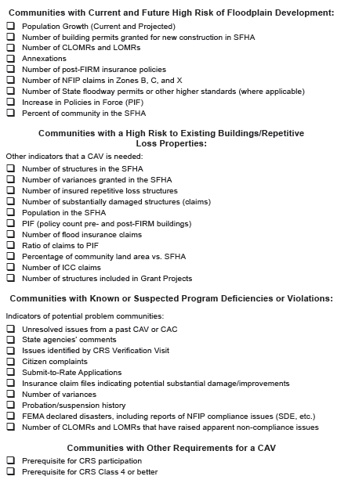
Selection Indicators
Notes:
Figure 2-1, page 2-5. Tell the students that this slide is divided into four sections in the following slides, so just listen.
There are many methods and topics that will put a community on the list for a CAV. However, more importantly, the files and communications that are received within the HQ and FEMA Regional Offices.
Submit to Rate is a good tool to begin your fact findings. If the community is lacking in knowledge of issuance of variances and/or non compliant construction, a CAV is a tool to research, and resolve problems before they become major damage and loss of life and property are the results.
Biennial reports that the community has completed will provide information on the areas of concern and immediate attention by the Regional Office.
New FIRMs with new elevations, increased SFHA or floodway delineated will cause concern with the community officials if they are not familiar with the requirements.
When the Regional Offices receive memorandums from HQ about a LOMR-F request and a possible violation noted, that should be a flag for a CAV. In addition, for those Regions that have basements, LOMR-F with basement construction would be another flag.
Complaints from citizens and congressional inquires could be a determination to conduce a CAV. However, sometimes we get those because a community is doing a good job and enforcing citizens to comply with the adopted standards.

Slide 22
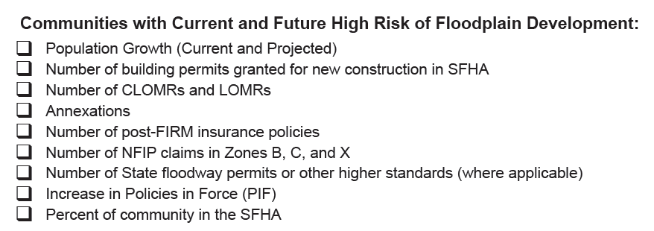
Risk-Based Selection Criteria (continued)
Selection Indicators
Notes:
Figure 2-1, page 2-5.

Slide 23
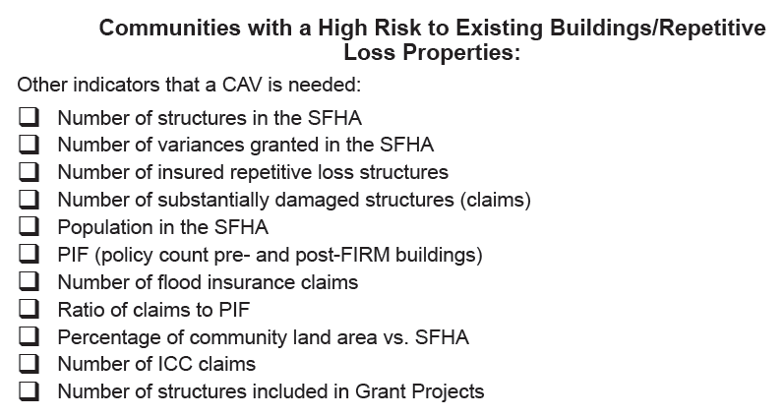
Risk-Based Selection Criteria (continued)
Selection Indicators
Notes:
Figure 2-1, page 2-5.

Slide 24
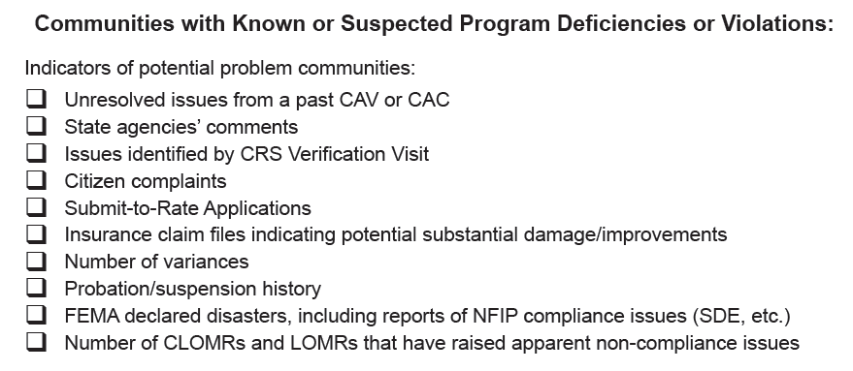
Risk-Based Selection Criteria (continued)
Selection Indicators
Notes:
Figure 2-1, page 2-5.

Slide 25
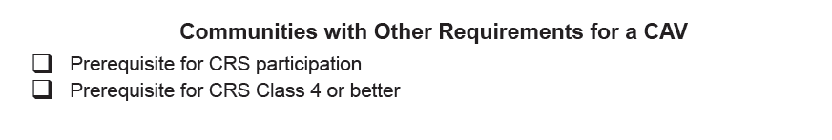

Risk-Based Selection Criteria (continued)
Selection Indicators
Notes:
Figure 2-1, page 2-5.
Also consider, issues from old CAC/CAV and recent disasters.

Slide 26
Research the Community
Information Sources:
Community Information System;
CAC/CAV records;
BSA web-based data, e.g. Submit-to-Rate information, Policies, Claims, RL, etc.;
State Agencies;

Slide 27
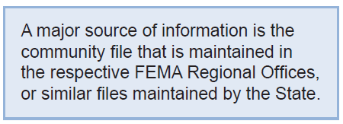



Research the Community (continued)
Information Sources (continued):
Federal Agencies;
Citizen complaints;
Recent disaster declaration, and;
Coordination with State Floodplain Associations.
Notes:
Disasters can be Presidential declarations, SBA, or State Declared Emergencies.
State Associations can be approached for information, but it depends on your relationship with them. Their purpose is not to “rat out” their member communities to the State or to FEMA. Perhaps you have conducted training at a conference and noted who needed the most help.

Slide 28
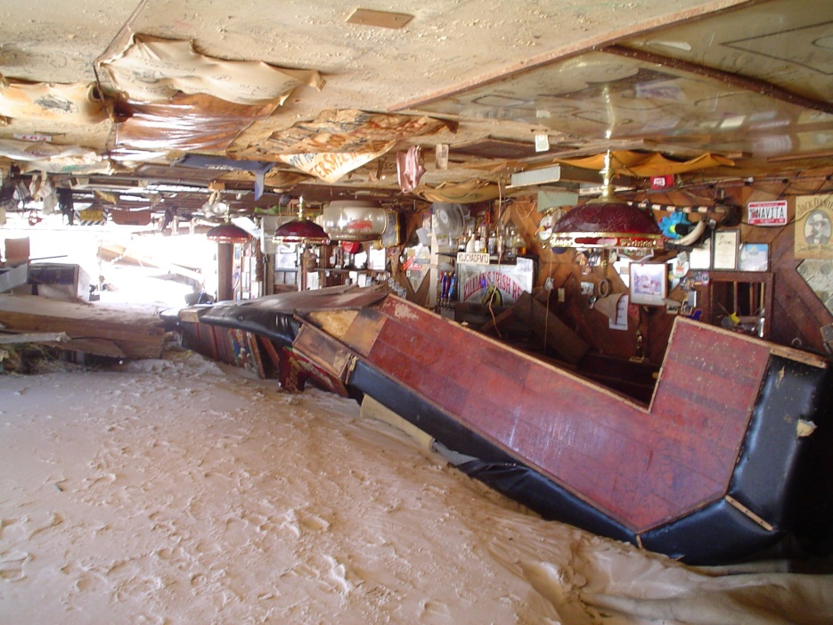
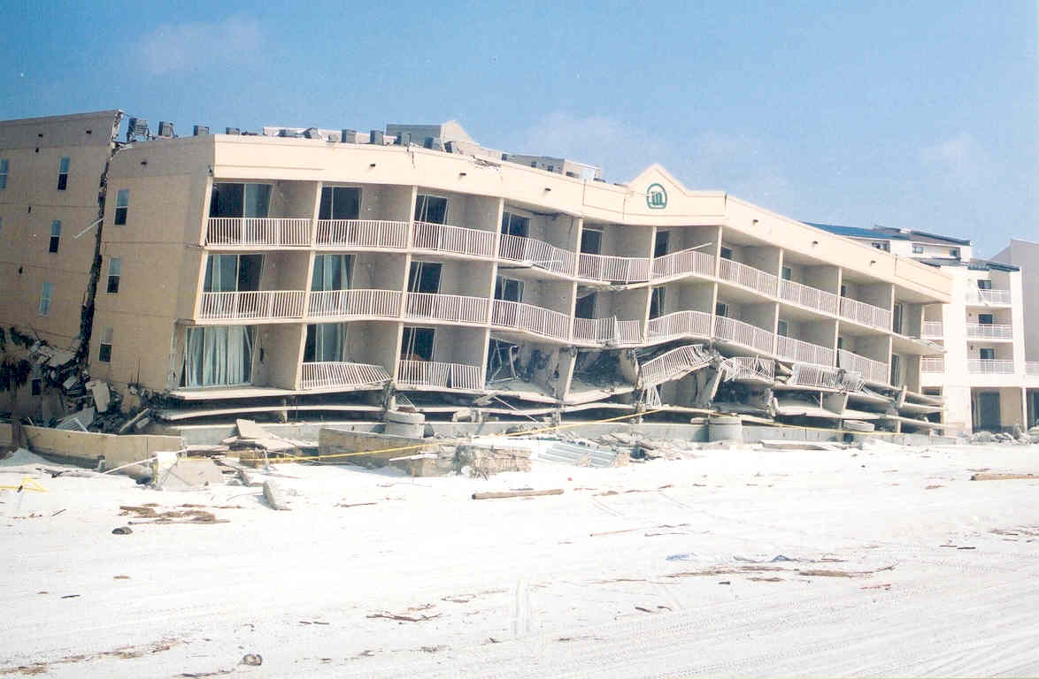
Research the Community (continued)
Information Sources (continued):
Disaster declaration / photos:
Notes:
How could these photos of a beach bar and a beachfront hotel assist you in your pre-CAV research?
What if these photos were taken five years past? One year past?
What if a new DFIRM was issued after this event?

Slide 29

CAV - Preparation
Before contact is made, key information must be reviewed:
Community Floodplain Management Regulations;
Flood Insurance Study and Maps;
Previous CAC and CAV Reports;
NFIP Community Data, and;
Recent Correspondence.
Notes:
Other sources are Google maps, state DFIRM viewers, etc. Cite http://www.city-data.com/ ; Municode.com, Otherwise rest in CIS etc.
Become familiar with the community.
Ensure complete coverage of the issues during the visit.
A good assessment requires a combination of the background information with the info gathered during the visit itself.

Slide 30
CAV - Preparation (continued)
Key points for guiding discussions with the community:
Most Current Community FPM Regulations;
Ascertaining Map Availability and Accuracy;
Development Review Process;
NFIP Community Information Review and Verification;
Address Program Deficiencies and Potential Violations, and;
Summarize the Findings and Follow-Up Actions.
Notes:
Has the community adopted building codes? Are there problems with the local ordinance?
Can the local Floodplain Administrator properly interpret the FIS and map? Any recent floods, annexations, structural flood-control projects, etc.
Determine what procedures are used in floodplain development reviews, permits, inspections. How are permits recorded?
Review and verify data obtained from CIS with local FA.
Address any unresolved issues from last CAC or CAV. Look for something to compliment, you are a coach/tech advisor.
Discuss findings, next steps, and any follow-up assistance to provide. Identify any community action that will be required.

Slide 31
CAV Preparation Items
You should review:
Current FPM ordinance;
Previous CAC and CAV reports in CIS;
History of HMA grants in community;
State and local hazard mitigation plans;
Substantial damage claims report;
Notes:
The most important source is the FEMA CIS data base. Each year there are improvements made to the CIS and States now have the capability to enter updated information into the CIS.
The CIS is a source of information that covers the information field from entry into the NFIP, map changes, ordinance information to CAVs that have been completed. It is also important to know who completed the CAV. Regional, State, or a Contractor. Knowing your source can identify if you need to do a more comprehensive CAV. Do you need to be “assisting” or “assessing”.
The BSA on-line reports are a wealth of information for insurance data such as Policies, Claims, Repetitive loss properties, submit-to-rate etc.
Now that Floodplain Associations are more involved in compliance, and the Certified Floodplain Managers (CFM) program, an Association can be a strong influence in your decision to contact a community. Not a prime source – doubt we really want to spend time on this…In addition to Floodplain Management Associations, River Authority would be a good source also. Many River Authorities have standards and easement requirements that exceed the NFIP minimum and the communities within the Authority’s jurisdiction must meet those standards. Therefore, River Authorities would be a partner in the regulations of floodplains.

Slide 32
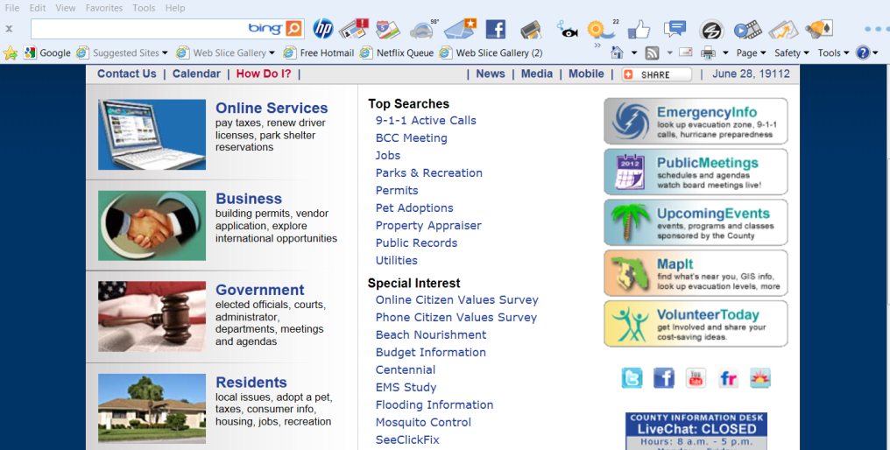
CAV Preparation Items (continued)
You should review (continued):
LOMCs;
Policies in force, and;
Community website for:
Elevation Certificates
Maps
Permits
Related ordinances
Notes:
Can you think of other items on the community’s website that might be of interest?

Slide 33
Research the Community
Items you should know:
Is there a Floodway;
What is the status of the FIRM/DFIRM/RiskMAP;
What about Higher Standards;
Has a building code been adopted, and;
Any controversy related to HMA programs, ICC, substantial damage, other issues.
Notes:
KNOW EVERYTHING YOU CAN ABOUT THE COMMUNITY.
You have determined what the status of the FIS and FIRM – how about are there State Standards that must be enforced?
Have you addressed any congressional inquires from concerned citizens?
Where there any controversial issues that came up during the last disaster declaration?

Slide 34
Contact the Community
Things you should do:
Give details about the purpose of the meeting;
Inform the official(s) you will be touring the floodplain;
Ask if digital permit files are available in advance, and;
Schedule sufficient time in the meeting to review and/or inspect files, answer questions, resolve issues, and provide possible solutions to identified problems.
Notes:
When contacting the community, be sure to identify yourself and explain the purpose of the visit.
Make sure they understand that communities are periodically visit to determine how they are enforcing the standards of the NFIP.
Tell them you will need to tour the floodplain and invite them to participate (helps with property access, technical assistance, training).
Schedule a time that will be sufficient to address all your concerns, review of the files, and address any questions or concerns that the community has. Remember, along with “assessing” the community’s program, we are there to provide “assistance.”
Indicate that all individuals that are included the process of accepting, reviewing, and approving and/or denying a permit should be available for the meeting.

Slide 35
Contact the Community (continued)
You should invite:
All local officials who need to be present at the meeting/field visit in confirmation letter and follow-up call;
Partial List:
Elected Official
Floodplain Administrator
CRS Coordinator
Building Official
Planning & Zoning
ANYONE INVOLVED WITH REVIEWING , ISSUING,
APPROVING, OR DENYING A DEVELOPMENT
PERMIT
Notes:
When contacting the community, be sure to identify yourself and explain the purpose of the call and plan for the visit.
Make sure they understand that communities are periodically visit to determine how they are enforcing the standards of the NFIP.
Schedule a time that will be sufficient to address all your concerns, review of the files, and address any questions or concerns that the community has. Remember, along with “assessing” the community’s program, we are there to provide “assistance.”
Indicate that all individuals that are in the process of accepting, reviewing, and approving and/or denying a permit should be available for the meeting.

Slide 36
Confirmation Letter
Items you should cover:
Confirm time, date, and place;
Confirm who should be in attendance;
Confirm what documents to have available (e.g. copy of ordinance, map update materials, restudy needs, existing data, etc.), and;
Other particular issues that may have been discussed during the scheduling of the meeting.
Notes:
Provide a confirmation letter to the community identifying the time, date, and place of the meeting.
Indicate what materials should be available, or can be obtained during your visit. For example, you may not need to have the complete filing system open and ready, but you should be meeting in an area that you can access the files easily.
Staff members should be ready and willing to provide information and/or documents.
Remember, according to the Ordinance adopted to enter the NFIP, the files are “open for inspection.”
Screen shots of sample letter on next slide.

Slide 37
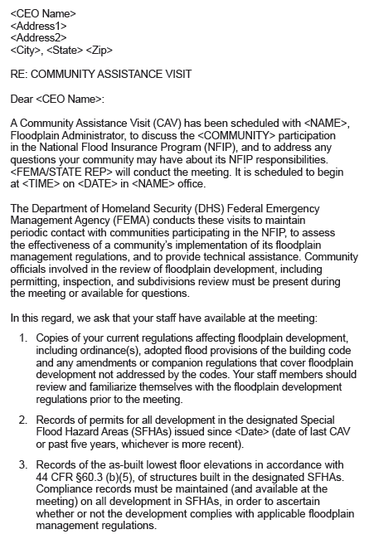
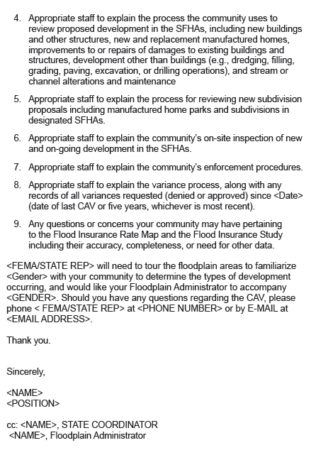
Confirmation Letter (continued)
Sample letter:
Notes:
Annex B-1 of the manual, sample letter confirming CAV meeting.
Provide a confirmation letter to the community identifying the time, date, and place of the meeting.
Indicate what materials should be available, or can be obtained during your visit. For example, you may not need to have the complete filing system open and ready, but you should be meeting in an area that you can access the files easily.
Staff members should be ready and willing to provide information and/or documents.
Remember, according to the Ordinance adopted to enter the NFIP, the files are “open for inspection.”

Slide 38
CAV Tool Kit
Some items you should have:
Insurance data: Submit-to-rate, substantial damage, RL insurance data, policies, claims, etc.;
FEMA grant projects listing mitigated structures;
Community disaster history;
Digital camera, GPS, computer laptop, and;
Whatever additional “tech multipliers” you might have to create a digital CAV.
Notes:
Don’t expect to walk out of the office to conduct a CAV with just a portfolio in hand. CAVs are “digital” now.
You need to have maps, studies, camera, hand level (if you know who to use it), topo maps, and anything else that will provide the assistance necessary TO YOU to conduct a comprehensive fact finding CAV.
Any equipment used by anyone not included in this list?

Slide 39
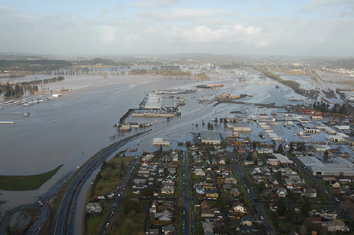
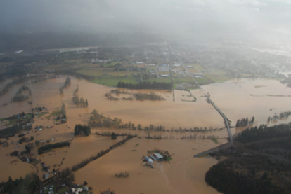
CAV Tool Kit
How can you use these photos of a recent flood?
Notes:
Lewis County, WA

Slide 40
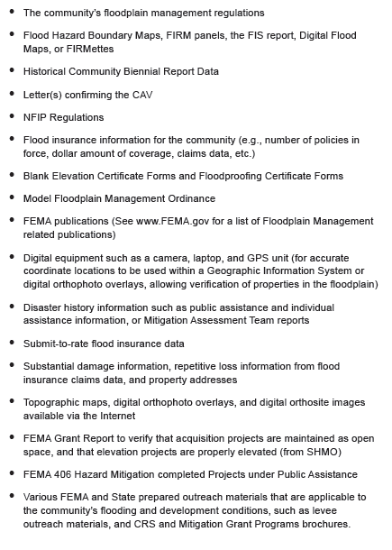
CAV Tool Kit (continued)
CAV Materials and Equipment List:
Notes:
Figure 4-2, page 4-11 of the manual.

Slide 41
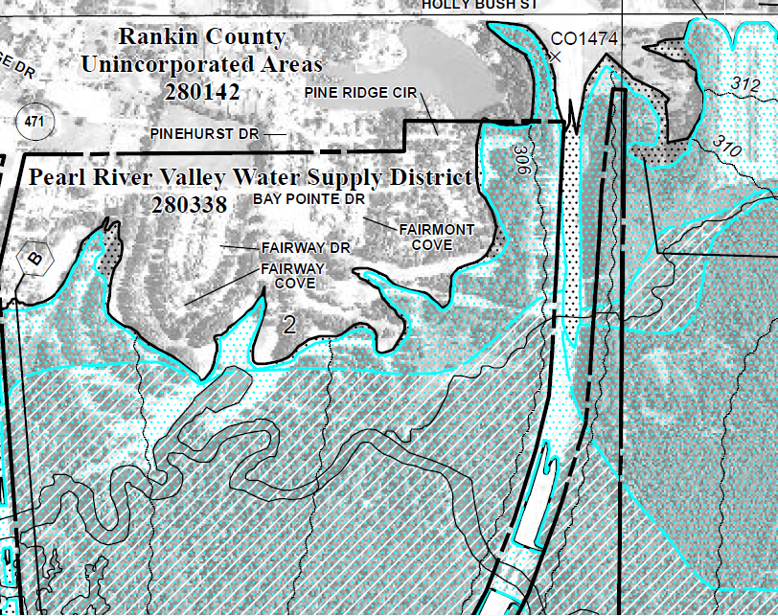
CAV Tool Kit (continued)
Mapping products you should have:
Latest flood hazard information and the
community’s Flood Insurance Study;
FIRMette;
FIRM, DFIRM, RiskMAP, and;
LOMCs.
Notes:
Maps – FIS – how can we do a CAV without those tools. In some cases, if a community has limited floodplains, you may be able to obtain a FIRMette for reference without carrying all the map panels.
In larger communities a Street Atlas or Mapsco is necessary.
If you are familiar with GPS, that is a good tool, especially if you are working a large rural area.

Slide 42
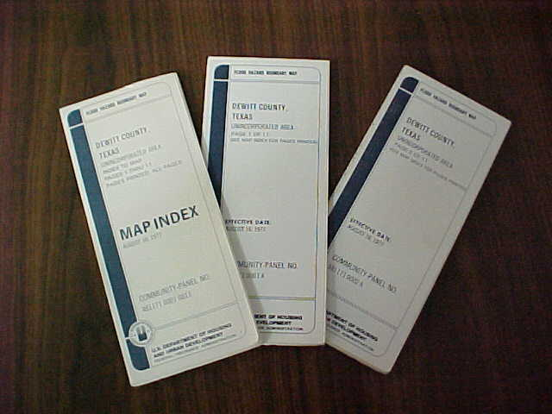
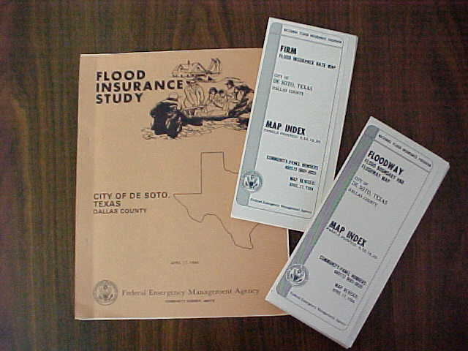
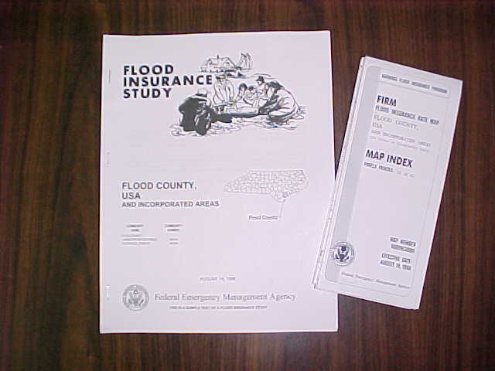
Maps and Flood Studies
Things you should know:
Who conducted the study;
When the study was conducted, and;
The type of study and/or maps produced.
FHBM
FIS w/FIRM & FBFM
Countywide
Notes:
What type of map or maps is missing from this slide? DFIRM and RiskMAP.
Do you have printed copies of DFIRMs and RiskMAP panels? What can you use as a substitute?
Should you know if a preliminary panel or perhaps a complete preliminary remapping of the community has occurred?
How can the existence of a preliminary map(s) change how a community regulates its floodplain?

Slide 43
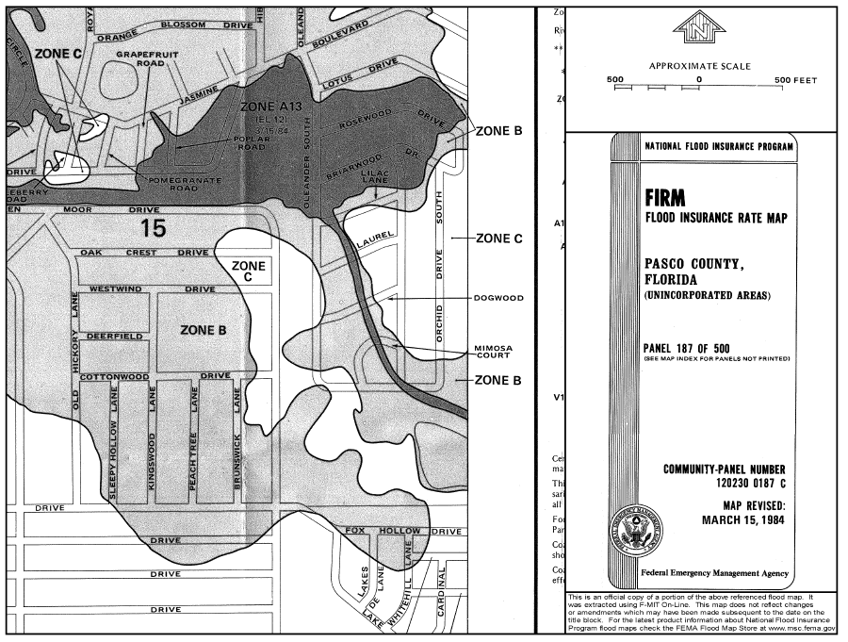
FIRM: Pre-1985
Flood Insurance Rate Map (FIRM):

Slide 44
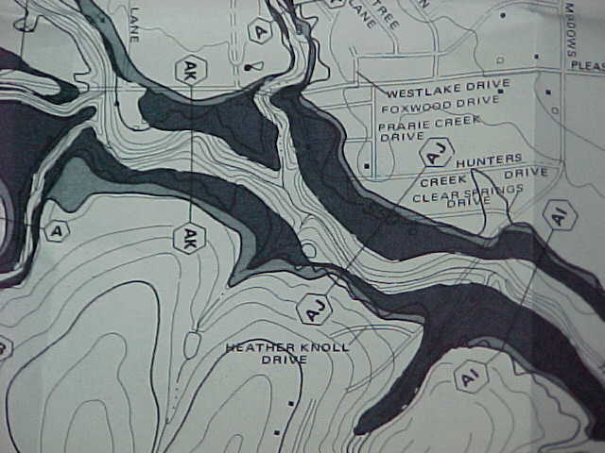
FBFM: Pre-1985
Flood Boundary Floodway Map (FBFM):

Slide 45
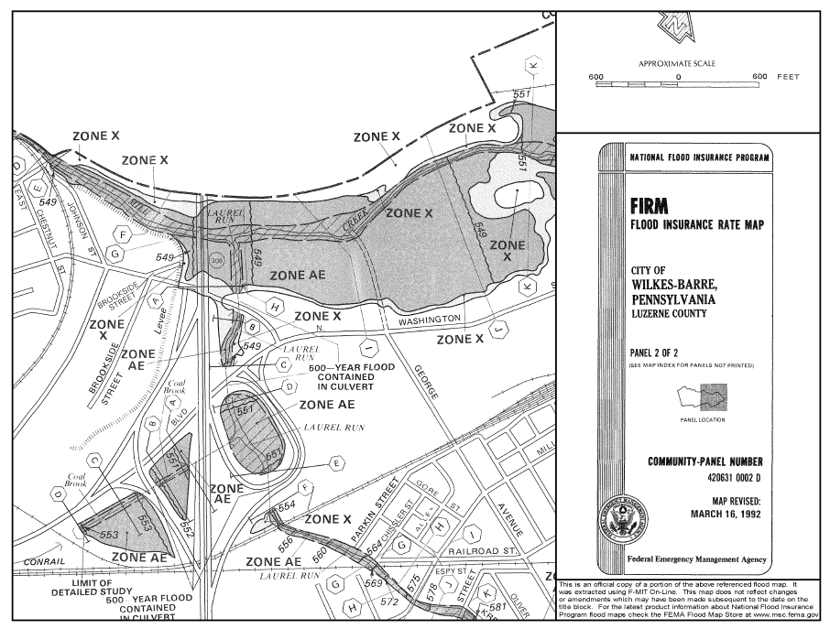
FIRM: Post-1985
Cross sections and floodway delineated:

Slide 46
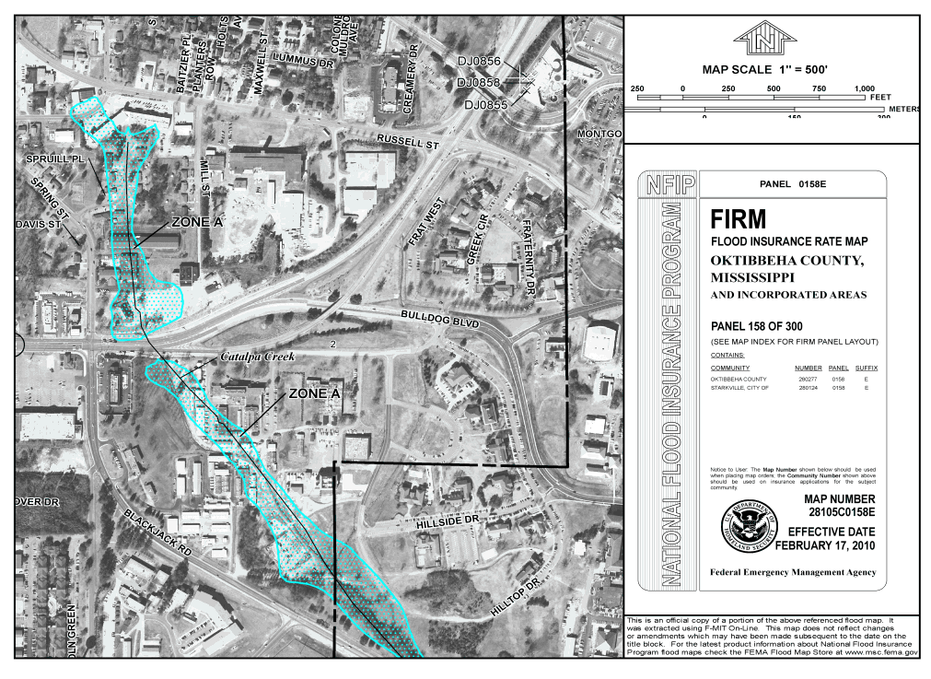
DFIRM: Post-2002
New Ortho-Based DFIRM:
Notes:
DFIRM in the FIRMette format.
This mapping format can be improved as a community’s provides newer imagery, along with better topographic information (using such products as LiDAR) to improve the base map information.

Slide 47
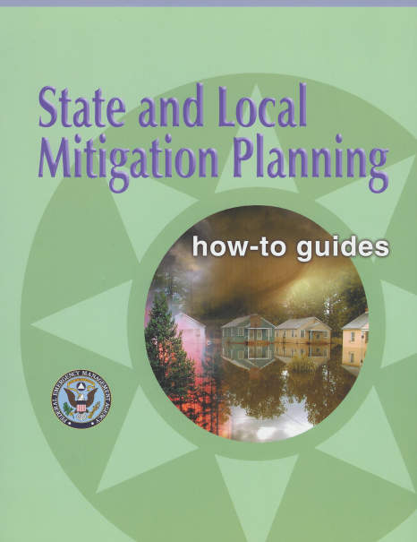
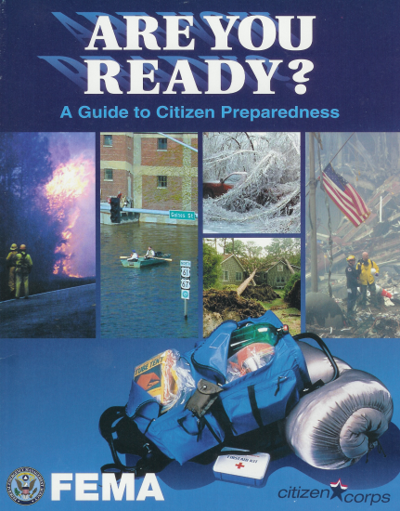
CAV Parting Gifts
Drop on your way out the door :
NFIP regulations (44 CFR);
FEMA/State produced NFIP publications;
Professional development information;
Information concerning the State FPM Association, and;
All-Hazards Mitigation reference materials.
Notes:
You may need to take or send ahead information and publications that will help the community understand floodplain management and even more important – All Hazard Mitigation.

Slide 48
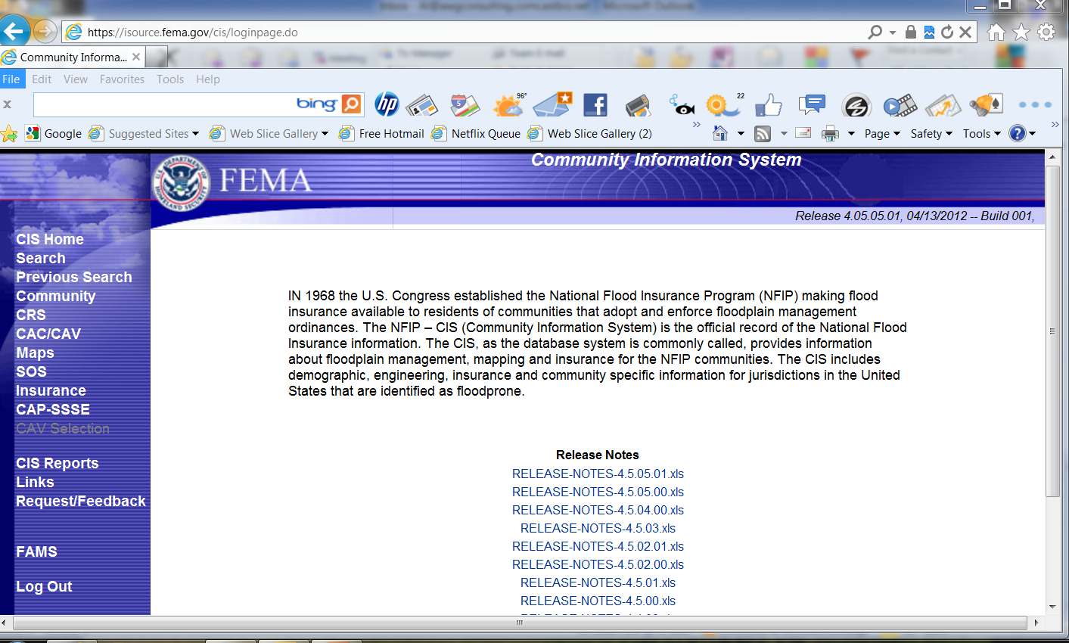
CAV Community Report
Using CIS:
Background information;
Mapping data;
CAV and CAC screens;
Workshop, GTA information;
Flood insurance policy and claim data;
Insurance policy by Zone;
RL, ICC, 1316, and;
CRS status.
Notes:
Use opening page of CIS to stimulate some discussion concerning CIS usage in CAV prep.

Slide 49
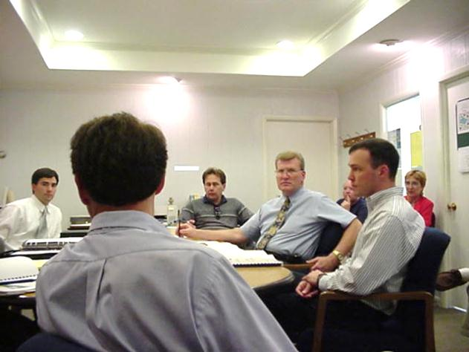
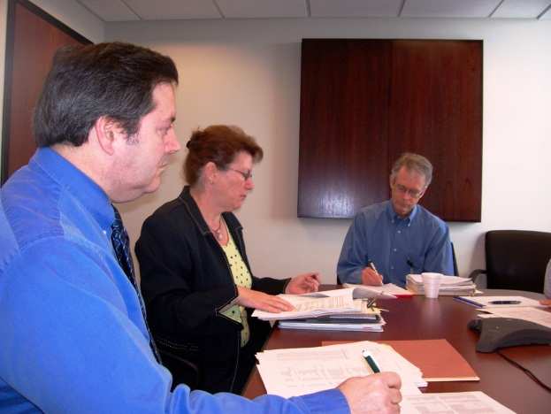
Community Visit Requirements
Four key elements :
Floodplain tour;
Meeting with local officials;
Examination of stipulated permits and variance files, and;
The all important summary meeting.
Notes:
When you notify the community of the pending CAV, do you give them the beginning date of the permits/records from which you will be “pulling?” Perhaps a good idea would be from the date of the last CAV.

Slide 50
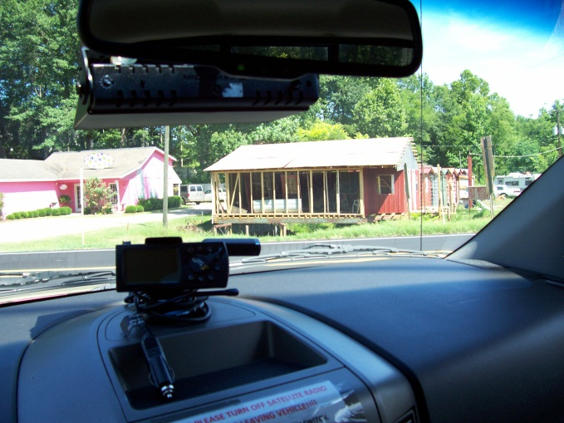
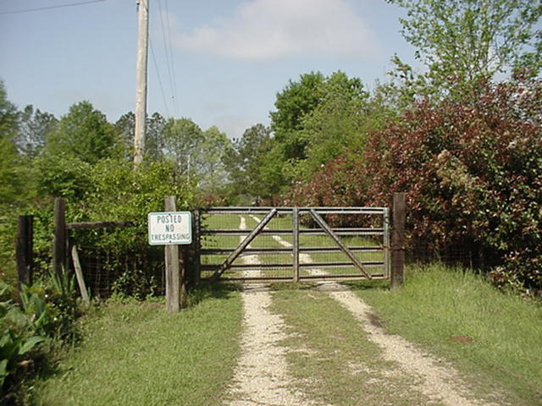
Floodplain Tour
It is recommended that the community official accompany you on the windshield tour (prior to initial meeting):
Encourage local FA to ride along;
In smaller communities it is often possible to tour the whole SFHA;
Get permission before entering private property;
Notes:
In come cases it may not be wise to have the local official accompany you on the CAV. He/she may want to guide you from non compliant development.
Do not always assume that if a small community is not growing, or there is little growth, that nothing is happening. Also, small communities tend to be a good example of enforcement and would serve to be a reference to neighboring communities.
Photos: L: A locked road with a sign No Trespassing R: Windshield tour discovers a structure built over a ditch.

Slide 51
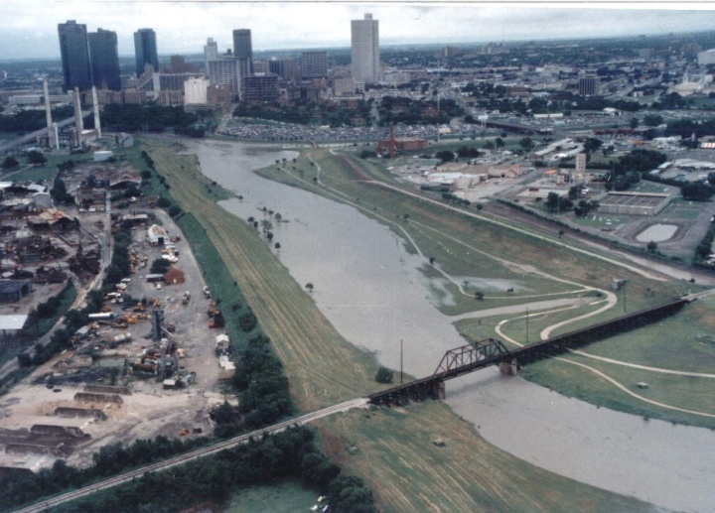
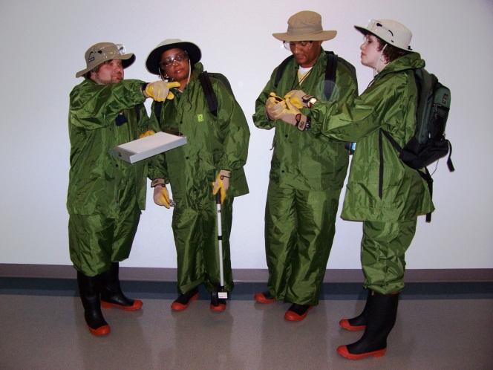
Floodplain Tour (continued)
Touring Larger Communities:
May not be feasible to tour the entire floodplain;
Tour the problem areas and sample;
Plan your route ahead of time, and;
Think about a “Team CAV.”
Notes:
In large communities, it may be more advantageous to conduct a “Team CAV.” Meaning that more than one person conduct the floodplain tour. Two teams of two people each reviewing the floodplain.
It can be very difficult to tour, observe the map, take notes, and record information via camera and reports with assistance.

Slide 52
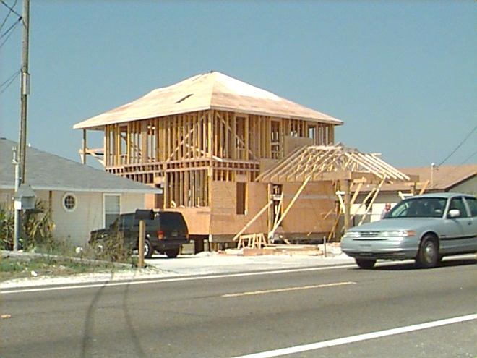
Floodplain Tour (continued)
Check SFHA for development:
New construction or substantial improvements;
Structures below the BFE;
Structures with noncompliant enclosed areas;
Absent or incorrectly placed flood openings, and;
Basements in LOMR-F areas.

Slide 53
Digital CAV Equipment
Three must have items:
Digital camera for those photos;
GPS for both navigation and marking any structure / development locations, and;
Laptop for documenting all findings, display screen for all background info, to include the pdf version of the FIRM.
Notes:
Ask how many people have conducted what they consider to be digital CAVs. Examples & discussion.

Slide 54
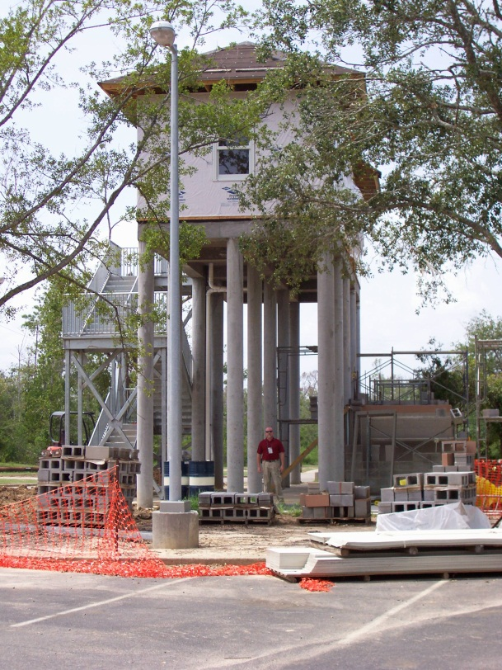
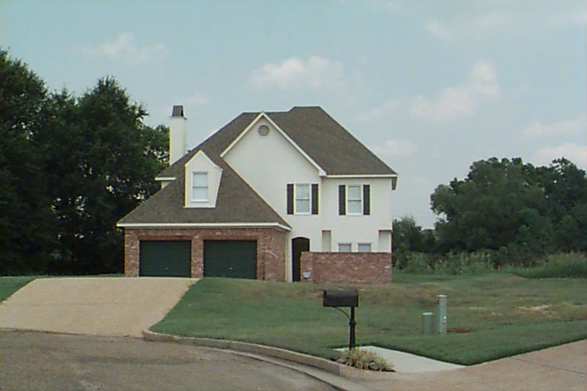
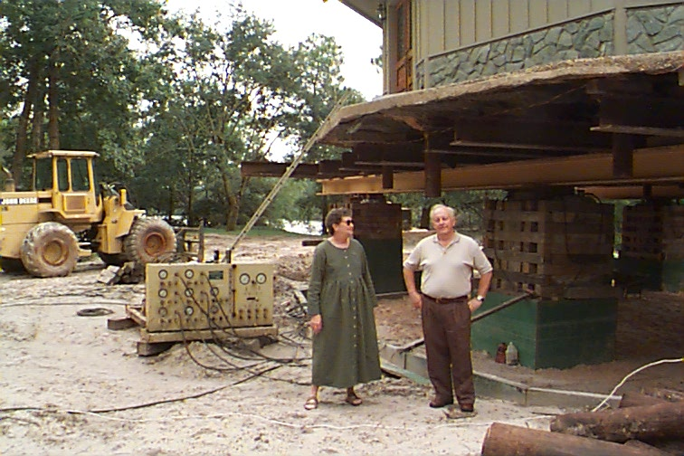
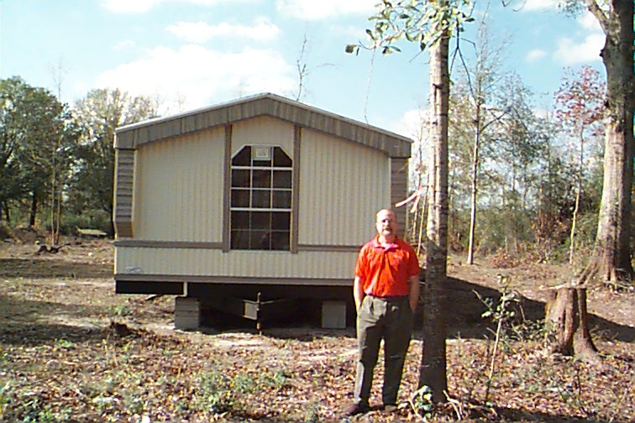

Digital Photos of Opportunity
Notes:
Left top: elevated gate house entrance to state park in CHHA, appears to be compliant.
Center top: Post-FIRM home built with a berm surrounding it, appears to be noncompliant.
Right top: RL structure HMGP elevation project in a floodway. Needs a “No Rise” certificate and better coordination with SHMO.
Center bottom: MFH recently moved on site, pink ribbon nailed to tree indicates BFE height.
Right bottom: Elevated structure in CHHA, appears to be compliant. However, what is behind the louvers?

Slide 55





GPS, what is it good for?
Notes:
Top left: Marking the location of a structure in the SFHA. Slab on grade, is it pre or post-FIRM? Is there an Elevation Certificate?
Top right: Finding that a RL list provided lat/long was incorrect.
Bottom left: Using a handheld GPS to navigate a river during a flood.
Bottom right: Photo of flood damaged home, taken with a “GPS camera.”
Pop-Up photo: close up of time and lat/long stamp on photo. This camera allows the image to be imported into GIS.

Slide 56





Laptop, got to have it.
Notes:
Top left: Checking RL data base during a windshield tour of SFHA.
Top right: Using a LCD projector to display windshield tour photos to local officials at the summary meeting.
Bottom left: Viewing a FEMA map service center FIRM panel.
Bottom right: Using a state developed DFIRM viewer.
Has anyone used the free SKYPE program in the field or during a meeting?

Slide 57


Windshield Tour Findings
Check SFHA for site alterations:
Encroachment in floodway;
Inadequate drainage in new subdivisions, and;
Altered watercourses.
Notes:
Left photo: Fill in a floodway.
Right photo: Altered watercourse.
NOTE TO FEMA: I personally never looked for “inadequate drainage in new subdivisions.” Where is that mentioned in 60.3?

Slide 58


Windshield Tour Findings (continued)
Fill and/or debris in floodway:
Notes:
What are possible resolutions for fill and or debris in a delineated floodway?
Can proper engineering and remapping change the situation?
Any ideas on how to correct the debris under the bridge? Who or what Agency could assist in the endeavor?

Slide 59


Windshield Tour Findings (continued)
New subdivision construction in the SFHA:
Home is located on a small hill; however, is the lowest floor above the BFE?
The adjacent foundation looks different…
Notes:
Curious minds want to know…

Slide 60


Windshield Tour Findings (continued)
Check for post-disaster activity:
Subdivision three years prior…
Today: No apparent elevation requirements…
Notes:
This community suffered sever damage during a Federally declared flood disaster three years prior to your CAV. It now appears that the community is allowing development to placed in the same area without elevation.
Solution: Require the community provide documentation and proof that the new development is meeting the adopted floodplain management standards. Have the community provide an copy of the permit application, and elevation certificate.

Slide 61



Windshield Tour Findings (continued)
Possible substantial improvement:
Notes:
It appears that the construction could be a substantial improvement.
Solution: Consult with community and require a copy of the permit application and/or elevation certificate.

Slide 62
Windshield Tour Findings (continued)
Miscellaneous Items:
MFH, not anchored, not elevated;
Electrical components not designed or elevated to withstand flood waters;
Enclosures without adequate flood openings, and;
Inadequate drainage paths around structures in AO and AH zones.
Notes:
Some communities may have regulations not allowing MFH to be placed within floodways.
There are alternate methods to place electric outlets below the BFE, such as using reel type extension cords in the floor above the ground.
Some flood openings might be engineered and appear to be inadequate to your eye.
Check to see if the community has drainage requirements in their flood damage prevention ordinance or other codes.

Slide 63


Windshield Tour Findings (continued)
Unanchored MFH?
Breached railway
?
Direction of flow
Notes:
1999. Hurricane Floyd in North Carolina.

Slide 64


Windshield Tour Findings (continued)
What would you say about these photos?
Notes:
Photo: Bottom left is a “chain or stem wall” construction, which is compliant. Top right photo is a house with compliant flood openings.
Both are compliant. However, you would not know that about the left photo unless you did what?

Slide 65

Windshield Tour Findings (continued)
You drive by this site.
Notes:
Photo: Elevating a home in Grundy, VA.
What questions should you ask of the local official?

Slide 66

Windshield Tour Findings (continued)
You drive by this site. What is it?
Notes:
Photo: A brick floodwall Grundy, VA.
What questions should you ask of the local official?

Slide 67


Windshield Tour Findings (continued)
Miscellaneous Items:
Drainage ditches or streams not maintained, important in a CRS community.
Notes:
These two photos should encourage some comments from the audience.
Which stream follows the natural and beneficial function thought and which is the standard get it out as soon as possible stream? The stream on the right is not being maintained (i.e. kept clear of obstructions). The stream on the left is “good.”

Slide 68




Windshield Tour Findings (continued)
Miscellaneous Development:
Notes:
All development must reviewed for compliance.
Upper left: lumber yard in A zone
Upper right: gravel pits
Lower left: storage building
Lower right: unknown construction

Slide 69




Windshield Tour Findings (continued)
CHHA Development:
Notes:
All development must reviewed for compliance.
Upper right: Electrical power transformer platforms for docking berths
Upper right: “hurricane proof house”
Lower left: “hanging enclosure”
Lower right: fill in the CHHA, done with an after the fact engineering document

Slide 70


Windshield Tour Findings (continued)
CHHA Development:
Notes:
Small craft harbor, Gulfport, MS Hurricane Isaac 2012.

Slide 71



Windshield Tour Findings (continued)
Use of the land:
Vacant Lots;
Project locations with open space restrictions;
Notes:
Vacant lots with for sale signs can suggest that development is anticipated. If the area is beginning to grow, or if the area has not been developing and now all of sudden growth is beginning. You may want to consult with the community official to determine if development placed in the designated area will comply with current regulations.
Land use of area where structures were purchased with HMGP monies, are they remaining open space. Is there development beginning to be occur? Has there been a change in Administration within the community, and now the policy has changed to allow development in the Open Space?
Photos: Bottom left: a new subdivision with SFHA surrounding it. Top right: Subdivision developing last lots, which are in SFHA, the opposite side of the street is not. Bottom right: floodway between parking lot and car wash, which has an vacant lot on it. The car wash is in the SFHA.

Slide 72



Windshield Tour Findings (continued)
Use of the land:
Areas below a dam, and;
Areas landward of levees.
Notes:
What about the area below dams?
How about those areas that have levee systems?
Photos: Bottom right: failed dam, over 100 homes destroyed. Bottom right: homes flooded behind overtopped levee.

Slide 73



Windshield Tour Findings (continued)
Map Accuracy:
New bridges & roads;
New & extensive development;
Fill in floodways, and;
Notes:
During your floodplain tour did you discover new Capital Improvement Projects, stream alterations, new roads, or possible new subdivisions being graded out.
Is the community recovering from a recent disaster and using the flood recovery maps? Are they accurate?
If no base flood elevations have been determined, what method is the community using to determine base flood elevations?
Photos: Bottom left: new bridge through CHHA or you could say a floodway. Bottom right: New dock and building in floodway, Top right: new road going through SFHA.

Slide 74


Windshield Tour Findings (continued)
Map Accuracy:
Levees, dams, berms, channel relocation, concrete channels, detention ponds, etc.
Notes:
Photos: Left: a “wet detention pond.” (There can also exist “dry detention ponds.”) Right: A berm surrounds a few pre-FIRM houses.

Slide 75

Windshield Tour Findings (continued)
Map Accuracy continued:
Construction in low water crossings;
Natural changes – channel relocation, landslides, mudslides, erosion, sedimentation, vegetation or debris buildup, and other natural changes, and;
Flood Recovery maps.
Notes:
During your floodplain tour did you discover new Capital Improvement Projects, stream alterations, new roads, or possible new subdivisions being graded out?
Is the community recovering from a recent disaster and using the flood recovery maps? Are they accurate?
If no base flood elevations have been determined, what method is the community using to determine base flood elevations?
Photo: erosion after tsunami

Slide 76



Windshield Tour Findings (continued)
Map Accuracy continued:
Construction in low water crossings;
Notes:
The low water crossing was developed from the traditional ford. A ford permits vehicular traffic to cross a waterway with wet wheels. The term "low water crossing" implies that the crossing is usually dry, while "ford" implies that the crossing is usually wet.

Slide 77




Windshield Tour Findings (continued)
Map Accuracy continued:
Natural changes:

Slide 78


Windshield Tour Findings (continued)
Map Accuracy:
Flood recovery maps in use?
No BFEs, what method used to determine them?
Notes:
Is the community recovering from a recent disaster and using the flood recovery maps? Are they accurate?
If no base flood elevations have been determined, what method is the community using to determine base flood elevations?
Photo: Advisory BFE Map for Terrebonne Parish, LA 2/23/2006

Slide 79


No BFE Provided:
Notes:
OPTIONAL SLIDE
Community have no BFEs in their SFHA. They use a topo map to assist in establishing a BFE for permitting. They do not use the 3 foot insurance default elevation above grade, as that is not FPM, but an insurance rating rule of thumb.
The blue dot is the proposed construction site.

Slide 80
How they produce a BFE.
240 at left bank
235 ft at right bank
Contour interval is 10 feet
240’
235’ + 5 = 240‘
BFE is 240’
EC provided has the Lowest Adjacent Grade as 235 feet
Notes:
OPTIONAL SLIDE
Toggle the overlaid FIRM back and forth after telling students to stare at the lake, an intersection etc.
Take the lower elevation, add ½ contour interval to it to obtain a BFE. Since the difference between 240 and 235 is the same or less than ½ the contour interval, you may use this method.
In this case, if the difference was 6 or more, you could not use this method.
Agree? Disagree? Discuss.

Slide 81

Meeting with the Community
Ideally, the meeting agenda should cover:
Introductions & Purpose of Meeting;
Brief overview of the NFIP & community statistics;
Explain inspection of community files;
Review the files;
Obtain information;
Provide latest NFIP technical guides;
Explain the follow-up process;
Offer technical assistance, and;
Answer questions.
Notes:
Be very exact in the purpose of the meeting. Those present may not be aware that communities are periodically visited, or that you have been touring their community for the last ___ hours.
Provide a brief overview of the requirements and goals and objectives of the NFIP. You may have a community official that is new to the Administration, or someone who may not completely understand what the community’s responsibilities are.
Explain that you have been touring the SFHA and have taken some photos that you have some questions and/or concerns. They may not all be possible violations, but be exact why you took the photograph and/or why you are concerned about the development.
In obtaining information, ask for a copy of the documents (for example, permit form, elevation certificate). Explain that the documents will not be used for public information but placed in the files at the Regional Office for reference and a record of the enforcement procedures of the community.
Try to resolve as many issues as possible during the meeting. If there are issues that cannot be resolved, explain the follow up process and what will be asked of the community. Explain that a timeframe must be established that will allow the community to complete any necessary actions to fulfill the requirements for documentation.

Slide 82
Permit File Review
In reviewing community files, the following issues should be addressed and documented:
Does the community maintain permit & variance files;
Do the files support the local official’s description of the development process and what was discovered during the floodplain tour;
How accessible are the permit and variance files, and;
How complete is the information contained in the file.

Slide 83
Review of Community Files
Are the BFEs and required elevation of lowest floor identified;
Certifications by architect/engineers on file (where necessary);
Floodproofing;
Openings (when design differs from NIFP minimum);
Anchoring of pile-and-column foundation, and;
Breakaway walls in V-zones.
Notes:
See Appendix D.

Slide 84
Review of Community Files (continued)
Requirements for subdivisions: Are developers being asked to provide BFE data when proposal is 5 lots/50 acres in A zone;
Variances, are justifications documented and available.
Record of inspection indicating ‘as-built’;
Also check ‘as-built’ follow-up to CLOMRs, and;
Notes:
See Appendix D.

Slide 85



Review of Community Files (continued)
Record showing all necessary Federal/State permits were obtained, particularly for ESA and Wetlands.
Notes:
See Appendix D.

Slide 86

Review of Community Files (continued)
Possible Flood Damage Prevention Ordinance deficiencies:
Update needed;
Most current FIS/FIRM not adopted;
Updated, not approved by FEMA;
Were higher standards implemented, and;
Floodplain Administrator not enforcing ordinance.
Notes:
Ordinance deficiencies can come in many ways. Here are a few:
- Has not been updated since 1980
- Does not adopt the most current FIRM and FIS
- Ordinance has been updated but not approved by FEMA as meeting or exceeding the minimum criteria
- Indicates that the City Manager is the assigned Floodplain Administrator, but the City Secretary is really doing all the paper work.

Slide 87

CAV Findings - CIS
Reporting in CIS:

Slide 88


Slide 89


Slide 90


Slide 91


CAV Report
Reporting in CIS:

Slide 92

CAV Report (continued)
Reporting in CIS:

Slide 93
Follow-Up Letter
Sent to the community CEO; copy FA and EMA;
Official method of informing community of the findings, and;
Include in the body of the letter:
Be positive – thank the community for their hospitality;
Identify deficiencies and/or violations;
Identify what documentation is needed;
Provide recommended solutions, and;
Stress the importance of enforcing a sound program.
Notes:
Follow up letter should be addressed not only to the CEO but a copy provided to everyone that was at the meeting. Be exact in the letter what your results of the fact finding visit during the SFHA tour and the meeting with the community officials.
Identify each deficiency and any resolution of those deficiencies.
Be informative and exact in what documents you are requesting from the community. In may be more advantageous to attached a detailed picture report to the letter.
Therefore, there are no questions, and the community does not have to guess about what is required. Recommend solutions to the deficiencies. Don’t leave the community in the dark.
Provide technical assistance via publications, reference other communities that are enforcing a comprehensive program, or other entities that can help.
Be positive in your comments. If the community had some good enforcement and/or procedures, point those out in the letter.
Recommend enhancements for the community. Remember to stress the all hazard approach to their community.

Slide 94
Follow-Up Letter (continued)
Include in the body:
Recommend enhancements, i.e. CRS, CFM, All-Hazards Mitigation Planning;
Provide names and telephone numbers of specialists who can provide assistance and technical support;
Establish a date when documentation must be provided;
Set a date that is sufficient for a response (i.e. 60 or 90 days), and;
Enclose publications, Technical Bulletins, and related NFIP publications.

Slide 95
Post-CAV Findings
Should Compliance Actions be Required:
Articulating program deficiencies;
Identifying violations;
Establishing factual information;
Defining next steps/follow-up;
Start a Chronology, and;
Document, document, and document some more.
Notes:
Be exact in what you are going to ask the community to provide. This is the beginning process to build a case to correct deficiencies and possible violations.
Identify those areas of concern with exact address and/or location. Take pictures that are clear and precise. Have actual addresses when possible.
If you are questioning the development, be exact in what you are questioning. Be exact in what you want. For example, do you want see a permit form, or do you want to see the permit form that particular development. Do you want to know they (community) utilize the FEMA Elevation Certificate, or do you want to see a FEMA Elevation Certificate for the development in question. The Community is looking to you as the official.
Be factual, clear and firm in what you are wanting from the community.
In defining the possible violations and/or concerns be exact in what you are asking the community to provide. If you questions the elevation, ask the community how they determine the elevation.

Slide 96
Post CAV Community Contacts
Contact the community during the response timeframe;
Ask if you can provide any assistance, and;
Stay in contact with the community.
Remember: “Assistance” is part of a “Community Assistance Visit.”
Notes:
Keep in contact with community during the response timeframe.
If you promised state or regional office TA – make sure you follow-through.
Always reply within 30 days to any community response to you.

Slide 97

Unique Situations
No development in the SFHA;
Misunderstanding of floodway concept;
De-Centralized permitting process, and;
Poorly defined or no permitting process, and;
Others…

Slide 98
Post CAV Follow-Up
Documentation has not been provided;
Community needs technical support;
Determination if enforcement action should be implemented, and;
CRS retrograde.

Slide 99

CAV Findings - CIS
CIS Compliance Follow-Up Screen

Slide 100


Slide 101

Learning Check
Ever feel like you are missing something vital? Let’s do a few quick “Look and Comment” slides.
Notes:
OPTIONAL SLIDE
The perfect CAVmobile.

Slide 102


Learning Check
CHHA on the FIRM:
Notes:
OPTIONAL SLIDE
Pre-FIRM restaurant in Myrtle Beach, SC. It has been damaged several times over the past two decades.

Slide 103


Learning Check
AE Zone on the FIRM:
Notes:
OPTIONAL SLIDE
Why is the structure higher than the building to the left? (The concrete driveway/garage foundation cost as much as the house itself.)

Slide 104


Learning Check
A Zone on the FIRM:
Notes:
OPTIONAL SLIDE
There is NO FLOOD IN PROGRESS at the time of the photo. The stream in the backyard was out of its banks after a heavy rain. The family states: “This happens all the time, that is why we have the boardwalk to the house, and we wear rubber boots a lot.”
No EC or permit on record. Homeowner additionally stated that they have a flood policy with a premium of $500.00 per year.

Slide 105

Learning Check
A Zone on the FIRM:
Notes:
OPTIONAL SLIDE
The County does not have building codes. Homeowner not at site. This is a primary residence.

Slide 106


Learning Check
A Zone on the FIRM:
Notes:
OPTIONAL SLIDE
After Hurricane Irene and Tropical Storm Lee flood waters eroded the stream bank in Pennsylvania, NRCS funds were used to “rip rap” 400 feet of this property owner’s land land. Good? Bad? Ideas?

Slide 107

Learning Check
Map Discrepancy:
Preliminary DFIRM
Owner of airstrip states this map is “wrong.”
Notes:
OPTIONAL SLIDE
The community has a clause in their Flood Damage Prevention Ordinance which allows them to use a preliminary map, if it is more restrictive than effective map.
A State Legislator has informed your office that the “new FEMA map is wrong,” and to please meet with the airfield owner while you are doing your CAV.

Slide 108



Learning Check
Stream is now underground, what should
have happened?
Notes:
OPTIONAL SLIDE
The air field owner had made improvements on the property and put the stream in pipes several years prior. No LOMC was submitted. The community did not identify the area during the DFIRM scoping meeting as having changed.

Slide 109


Learning Check
Map Discrepancy?:
Notes:
OPTIONAL SLIDE
The community DFRIM panel has a “strange” SFHA on it. Questions?

Slide 110


Learning Check
New additions found:
Notes:
OPTIONAL SLIDE
Left: Addition or new structure? Why is the floor lower than main structure?
Right: New addition on pre-FIRM house, without permit. Is it a substantial improvement?

Slide 111

Learning Check
New additions found:
Notes:
OPTIONAL SLIDE
What is this?

Slide 112

Learning Check
Disaster Photos:
Notes:
OPTIONAL SLIDE
How can you use this photograph of the 2007 Willow Creek flood in Iowa in CAV preparation?

Slide 113




Learning Check
Strange Structures:
Notes:
OPTIONAL SLIDE
What should you say about these?
Bottom Left: Foam blocks under the “deer camp” float the house up the poles. It worked in the Mississippi River Flood of 2011.
Aircraft body, caboose, and shipping containers.

Slide 114


Learning Check
Last Slide!!!
Flood Openings:
Notes:
OPTIONAL SLIDE
What should you say about these?
The foundation is a chain/stem wall with the “Smart Vents” in the lower enclosed area.

Slide 115
Summary
CAV: four key elements:
Floodplain Windshield Tour;
Meeting with local officials;
Examination of permits/variance files, and;
Summary Meeting.

Slide 116

Questions?

Slide 117
FEMA Contacts

