Slide 1
State Floodplain Manager 1 on 1
Module 0:
Introduction & Objectives Sachet
Notes:
This is an optional module. If used, hide the “Please Tell Us Your…” slide in the following module(s) that you covered afterwards.
The instructor(s) will welcome the participants and introduce the course instruction team. The introduction should include their backgrounds to establish their credibility as subject matter experts.
The lead instructor will then cover the remaining slides.
(Sachet means packet.)

Slide 2

Agenda
Housekeeping Items;
Your Expectations;
Introductions, and;
Rationale for Course, Course Goal, and Course Objectives.
I am Morgan Mentor, your tactical
gude for this mission. Let’s begin
with listing your expectations in
regard to mentoring.
Notes:
For the next ___ minutes we will cover these four bullet items depicted on this slide.
First, we will cover the obligatory housekeeping items that everyone expects. After that is accomplished, we will capture your course expectations on the flip chart and review the items at the end of the day/session.
Now for the first bullet, housekeeping. {Cover any emergency evacuation routes/procedures, location of restrooms, refreshments (if any), break/lunch times, any ground rules that you may wish to establish.}
Upon completion of the housekeeping items, click for the introduction of “Morgan Mentor.” This provides the opportunity to question the mentee(s) about their expectations concerning mentoring. Capture the items (as appropriate) on the flip chart. Review the items periodically throughout the course or at the end of the course or day.
After you are satisfied that expectations have been discussed and recorded, click for the next slide.

Slide 3
Introductions
PLEASE TELL US YOUR:
Name;
Local jurisdiction / Job Title;
Years spent in Floodplain Management, and;
One mystifying ‘topic’ that you want to better understand before you leave here today.
Notes:
Give the mentee(s) a few seconds to read the slide, then start the intro process.
If the mystifying question is not already on the flip chart list of expectations, start a “Question” chart or just add it to the list.

Slide 4
Rationale for the Course
The need for the development and nurturing of a State FPM leadership program has been identified by ASFPM and FEMA.
ASFPM is uniquely positioned to assist in this endeavor through a program to both transfer and integrate knowledge and insight into the federal floodplain management training process.
Notes:
Cover the two bullets.
Then, ask “is training and mentoring is the same thing?” The answers and discussion to this question will give everyone more clarity.
Take _______ minutes to facilitate this discussion.

Slide 5
Reflections on Mentoring
The relationship between the SFPM mentor and mentee as that of fellow collaborators and sometimes, fellow discoverers;
It should become a relationship where mentor and mentee/peer can merge…;
The process should provide both support and challenges, and;
FPM skills/knowledge/abilities can be instilled, if the relationship works.

Slide 6
SFPM Traits
The State Floodplain Manager is a professional who displays an innate adaptability to adapt, a strength of diversity, and the ability to focus on technological changes as they become available.
The most successful as those who are most adaptive to change.
Change (in FPM) is most driven by the political processes that follow community expectations paired with shrinking resources.

Slide 7

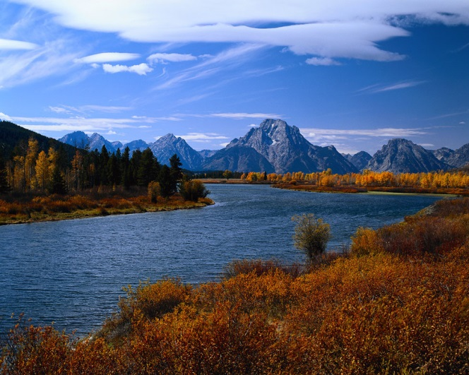
Course Goal
To build state capability for effective FPM that will reduce future flood risk, and promote the natural benefit and function of the nation’s floodplain.
Notes:
Microsoft Office clip art

Slide 8
Course Objectives
Describe effective program practices and floodplain management strategies used in the State FPM role.
Describe broad context of policy and organizational aspects of being a State FPM.
Identify tools and strategies to grow and expand state floodplain management programs.
Notes:
Add comments as needed.

Slide 9

READY TO START THE PROCESS?
Notes:
Passing the baton of FPM Knowledge…

