Slide 1

State Floodplain Manager 1 on 1
Module 11:
State Level Disaster Response and Disaster Recovery Duties
Notes:
This is the eleventh mentoring module of the State Floodplain Manager 1 on 1 course, “State Level Disaster Response and Disaster Recovery Duties.”
I {or We} will begin by presenting an overview of the module, then address/discuss each topic in sequence, allowing time for interaction and questions throughout the session.

Slide 2
Agenda
Introductions
Objectives
Scope
Methods
Emergency Management Phases and Components
Topics
Materials and References
Notes:
{Standard introductory slide for all 14 modules, which enables a module to be shared as an individual/stand-alone session if the need arises.}
Mentor should skip the first bullet if the module is not delivered as the first of a select series of modules or as an individual module.
For the next ___ minutes we will {do our introductions and} discuss the various duties of disaster response and recovery with which you should be familiar.
{First, we will cover the obligatory introductions portion of the module/session. After that is accomplished,} the last four depicted bullets will be discussed before we begin in earnest.

Slide 3
Introductions
PLEASE TELL US YOUR:
Name;
Local jurisdiction / Job Title;
Years spent in Floodplain Management, and;
One mystifying response and disaster recovery question that you want to better understand before you leave here today.
Notes:
Skip or modify this slide as deemed necessary.
Typical questions will be, IA, PA, why do HMA programs take so long?, how do you get elected officials to care?

Slide 4
Objectives
Upon completion, participants will be able to:
11.1 Define the Duties and Responsibilities of the State Floodplain Manager (SFPM) in Response and Recovery Operations.
11.2 Develop Standard Operating Procedures.
11.3 Understand the goal of establishing a joint FPM/Mitigation strategy.
11.4 Successfully function in a Joint Field Office Environment.
Notes:
Stress that this module has the four stated objectives (shown on this slide) that must be understood at the conclusion of the session.

Slide 5
Scope
This module includes the following eight topics:
The State Floodplain Manager in Support of Pre and Post-Disaster Operations. (Objectives 11.1, 11.2, & 11.3);
The State Hazard Mitigation Officer’s Role. (Objective 11.3);
The State Floodplain Manager’s Role. (Objective 11.3);
Notes:
Continued on next slide.

Slide 6
Scope (conclusion)
Mitigation Opportunities in a Post-Disaster Environment. (Objective 11.2, 11.3 and 11.4);
Training Opportunities in a Post-Disaster Environment. (Objective 11.2 & 11.3);
Increased Cost of Compliance: How is it Used After a Disaster. (Objectives 11.2, 11.3 & 11.4),
The EMAC and Intra-State Mutual Aid: How You Can Use Them? (Objective 11.4), and;
A Typical JFO: Where Do you Fit In? (Objective 11.4);
Notes:
Continued from previous slide.
EMAC is Emergency Management Assistance Compact.
JFO is Joint Field Office

Slide 7
Methods
Material contained in this module will be presented through:
Lecture and demonstration supported by 266 visuals/slides, and;
The State FPM Student Manual.
Notes:
Mentor will ensure that the required materials are on hand.
Allow for interaction and questions throughout the session.
Visuals, handouts, and glossary will be available to illustrate the teaching points in this module to both instructor(s) and participant(s).

Slide 8

Before we begin, we should cover
some basic emergency management info,
that will impact your job.
“The amount of effort expended prior to a disaster is greatly overshadowed by the floodplain management benefits achieved afterwards.” – Unknown
Notes:
The unattributed quote is a musing from a retired SFPM that should stimulate some discussion.
We will talk about your place or cog in the big wheel that is the federal disaster response program in some detail.
First, a quick look at the emergency management cycle.
Now…here…we… go.

Slide 9

Emergency Management: Phases
First, you should have a baseline of understanding of two of the five emergency management functions/missions/phases, as they “tie in” with the duties and responsibilities of the SFPM in response and recovery operations..
Prevention;
Preparedness;
Response;
Recovery, and;
Mitigation.
Notes:
Review the slide.
These five functions are arranged in different orders in different plans. I have primarily seen “Prevention, Protection, Mitigation, Response and Recovery” as the order.
Click slide to draw the circle around the third and fourth bullets.

Slide 10
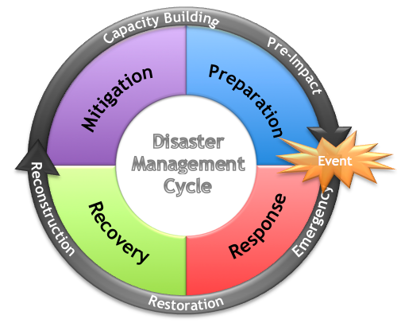
Phases (continued)
Notes:
Review the diagram.
Click slide

Slide 11
Phases (continued)
Prevention includes actions taken to avoid an incident or to intervene to stop an incident from occurring.
Preparedness is putting in place procedures, equipment and personnel capabilities that will be needed to respond.
Response is the actual mobilization of people, equipment and resources to take action during an emergency. (more to come)
Notes:
Review the slide.
Lead the discussion.
Click slide.

Slide 12
Phases (continued)
Response is the actual mobilization of people, equipment and resources to take action during an emergency. (conclusion)
Immediate and ongoing activities, tasks, programs and systems to manage the effects of an incident that threatens life, property, operations or the environment. Divided into sub-standards, such as incident management, operational procedures and emergency operation center.
Notes:
Review the slide.
Click slide.

Slide 13
Phases (continued)
Response: (conclusion)
The response phase for emergency managers is health and safety focused. They are the first responders and SFPMs are in the follow-up wave.
The majority of SFPMs aren’t involved in this phase. Why and how should you be involved in the response phase of an incident? Discuss…
Notes:
Review the slide.
Response is when the window opens to begin a mitigation strategy that will drive recovery towards resilience. Permits, substantial damage and repetitively damaged properties are where the SFPM can change future risk.
Click slide.

Slide 14
Phases (continued)
Recovery includes planning for any actions taken following termination of the emergency phase and signals the return to facility/emergency operations center to normal operations. (more to come)
Mitigation includes activities designed to reduce or eliminate risks to persons or property or to lessen the actual or potential effects or consequences of an incident. Mitigation measures may be implemented prior to, during or after an incident.
Notes:
Review the slide.
Lead the discussion.
Click slide.

Slide 15
Phases (continued)
Recovery includes planning for any actions taken following termination of the emergency phase and signals the return to facility/emergency operations center to normal operations. (continued)
Complexity of issues, with multiple stakeholders, distinctions between short -and long-term recovery and conceptual models of community recovery . Unlike response where all efforts have a singular focus, recovery has complex issues and decisions that must be made by both individuals and communities.
Notes:
Review the slide.
Lead the discussion.
Click slide.

Slide 16
Phases (continued)
Recovery involves actions and decisions concerning:
Rebuilding homes;
Replacing property;
Resuming employment;
Restoring businesses;
Permanently repairing/rebuilding infrastructure, and;
Enforcing FPM regulations.
Notes:
Review the slide.
All of these actions/decisions are the opportunities to reduce the risk for existing/built environment. These are opportunities to test and to show how regulation of new development performed against the risk.
Click slide.

Slide 17
Phases (continued)
Recovery: (conclusion)
The recovery phase draws in the SFPMs to begin implementing the bigger picture for mitigation of future risk / impact. There are common links between EM and FPM, find them.
Notes:
Review the slide.
Lead the discussion.
Click slide.

Slide 18
Phases (conclusion)
“… recovery is a complex and challenging process that involves all sectors of a community as well as outside interests. In many cases, it is not even clear if and when recovery has been achieved because of varying stakeholder goals for the community, for example with some wanting it returned to what is considered pre-disaster status and others wanting it to undergo change to realize a vision in which advances are made in risk reduction and other areas.”
Anderson, William A. 2008. Recovering From Disaster: A Summary of the 10/7/2007 Workshop of the Disasters Roundtable. Washington: The National Academies Press.
Notes:
Review the slide.
Let’s take a minute to read this statement from a 2007 workshop. I believe it very succinctly covers the complexity of recovery and how the SFPM is both affected and how he/she can affect the process.
Lead discussion.
Click slide.

Slide 19
Emergency Management Components
Why does the SFPM need to understand EM?
Generally, the SFPM is not located in the EM agency;
This requires that the two staffs liaise with each other frequently;
The goal: to better plan for, manage and mitigate flooding and its related issues, and;
To be effective in the disaster environment, the SFPM must know the priorities and fit into the process.
Notes:
Review the slide.
The SFPM can’t be an obstacle politically or socially. You must share the mutual goal of reducing future risk.
Click slide.

Slide 20

Components (continued)
For these goals to succeed, an effective environment for planning, preparedness, response and recovery cohesion must be established.
Clearly defined procedures, responsibilities and roles must be established prior to an event for a successful management of an emergency to occur.
What serves as the guidance for the emergency manager?
Notes:
Review the slide.
SFPMs need a process that links their duties with how EMs will respond/recover from an event. Emphasis must be placed on pre-disaster relationships.
Answer is NIMS. National Incident Management System.
Click slide.

Slide 21
Components (continued)
Emergency Management Guidance.
The Federal government responds in accordance with NIMS and the National Response Framework (NRF) as prescribed in Homeland Security Presidential Directive 5 (HSPD-5). The FEMA is responsible for coordinating the delivery of federal disaster relief to state and local governments under presidentially declared disasters and emergencies.
NIMS serves as the fundamental template of emergency management.
Notes:
Review the slide.
Lead the discussion.
Click slide.

Slide 22
Components (continued)
Emergency Management Guidance. (conclusion)
NIMS provides the environment in which local, state and federal governments function in order to prepare for, prevent, respond to and recover from incidents, regardless of cause, size or complexity.
Statutory authorizations are promulgated upon the individual state statues and Governor Executive Orders concerning EM and local codes which cover EM operations.
Notes:
Review the slide.
Lead the discussion.
Click slide.

Slide 23
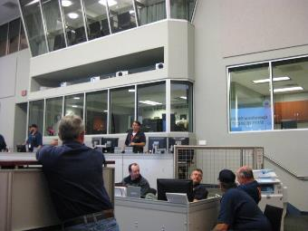
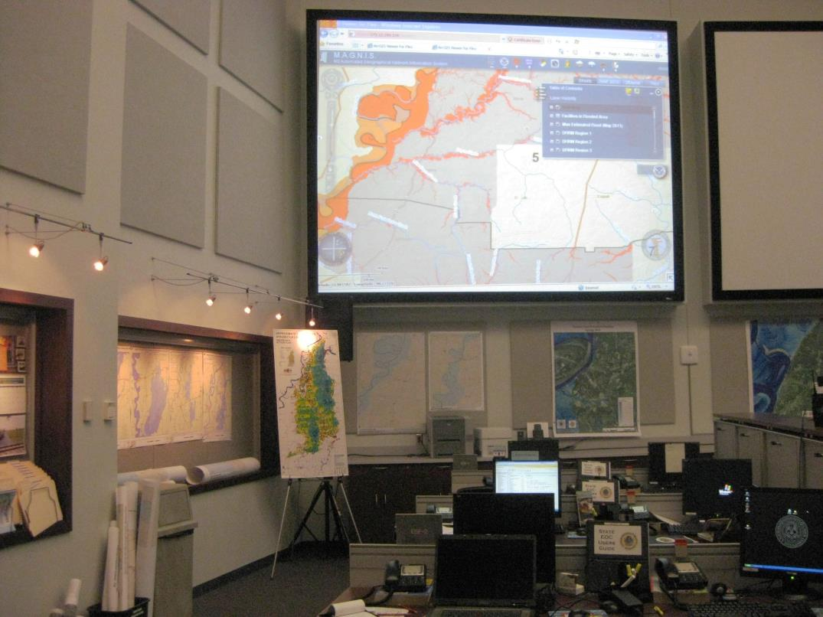
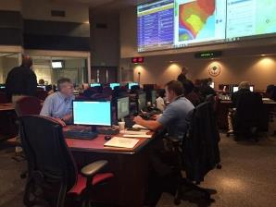
Components (continued)
What is a State Emergency Operations Center (SEOC)?
Photos courtesy of MEMA and SCEMD
Notes:
Review the slide’s photos.
Photos depict the Mississippi SEOC during the 2011 Mississippi River Flood (FEMA DR 1983).
Do you have an assigned role at your state EOC? If so, what is it?
Click slide.

Slide 24
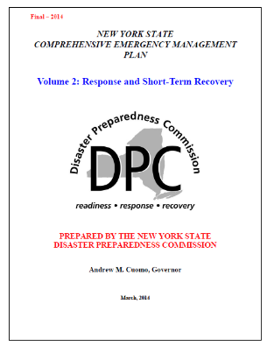
Components (continued)
How does your state frame its response and recovery effort?
A document that identifies
the State’s overarching
policies, authorities and
response actions that will
be implemented in an
emergency or disaster.
This document goes by many names.
Job Aid 1
Notes:
Review the slide. (Job Aid 1)
This slide depicts the New York State Comprehensive Emergency Management Plan Volume 2: Response and Short-Term Recovery. An outline of the State’s collective response and short term recovery to an emergency. It identifies the concept of operations, lines of coordination and the centralized coordination or resources that will be utilized in directing the State’s resources and capabilities in responding to and recovering from a disaster.
A basic CEMP establishes the fundamental policies and assumptions of statewide emergency management, outlines the State’s vulnerabilities to potential hazards, establishes a comprehensive emergency management concept of operations and outlines agency relationships and responsibilities.
Have you ever read your state’s CEMP or equivalent plan?
Click slide.

Slide 25

Components (continued)
Incident Annexes:
These annexes deal with specific hazards and address special considerations and priorities generated by these hazards and the corresponding actions required to cope with them effectively.
What annexes would you interact with?
Notes:
Review the slide.
The individual annexes for flood, hurricane, dam failure and levee failure.
Click slide.

Slide 26
Components (continued)
What is an Emergency Support Function?
An emergency support function identifies the specific activities required to support each numbered function and specifies the staff responsible for performing those activities.
There are 15 support functions labeled as to be compliant with National Incident Management System (NIMS). Some can be combined due to staff limitations.
Notes:
Review the slide.
The state’s CEMP/EOP will connect state activities to the broader federal system for coordination. Understanding it is key to SFPM roles in a complimentary way versus obstacle to emergency management efforts.
Click slide.

Slide 27
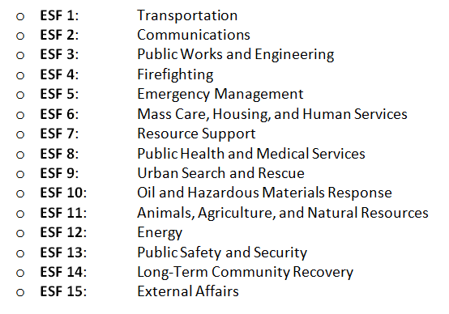
Components (continued)
ESF14 was superseded by National Disaster Recovery Framework. It is now
The National Disaster Recovery Support/Interagency Recovery Coordination.*
Notes:
Review the slide.
Which ESF should FPM fall under? ESF 3 is generally where FPM has a seat in the SEOC. The links to FPM leading the SD support teams (either intra-mutual aid or EMAC) generally come from ESF 7 and ESF 14. ESF 11 is “by default,” if the SFPM is located within a DNR.
*ESF14 varies by state plan (and their local plans). Some still use Long Term Community Recovery and the state of Florida uses External Affairs - Public Information. Florida changed ESF5, ESF14 and ESF15 for some reason, known only to them.
Click slide.

Slide 28
Components (continued)
Have you ever participated in the activation of a state emergency operations center?
Where is your SEOC?
Do you have an assigned role there?
What is your role in the state emergency plan?
At what ESF desk do you set up your operations?
What is an ESF?
Notes:
Review the slide.
Lead the discussion. This slide should give you an idea of the level of the participants’ experiences in emergency activations.
EOC is emergency operations center. ESF is emergency support function. The next three slides will cover them.
Click slide.

Slide 29
Components (continued)
Have you ever participated in the activation of a state emergency operations center? (conclusion)
Can you identify some of the information or monitoring that a SFPM does?
How can you add to the SEOC assessment and response planning?
Flood maps, historical flood information, gage information, NFIP policies and NFIP participating communities and areas of mitigation interest.
Notes:
Review the slide.
Click slide.

Slide 30

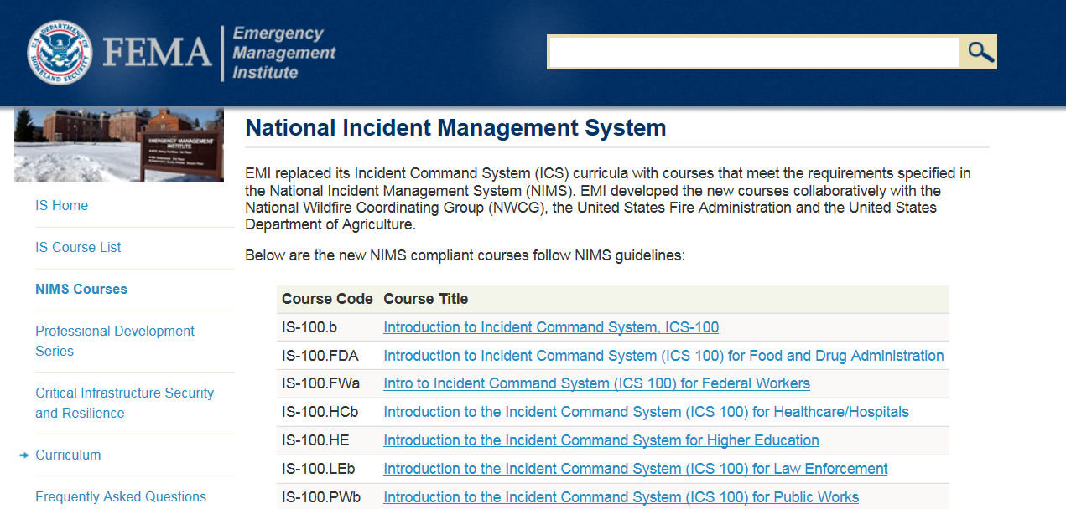
Components (continued)
Job Aid 2
Notes:
Review the slide. (Job Aid 2)
We recommend that you peruse the online FEMA courses offered by EMI.
Click slide.

Slide 31
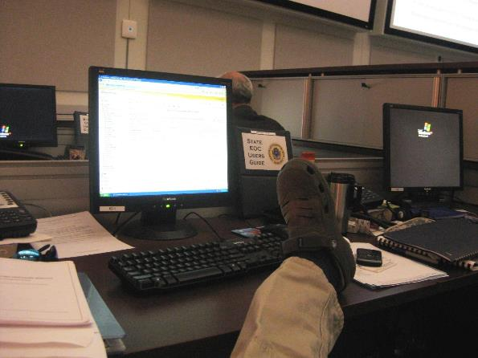
Components (conclusion)
Then you can do this…
Photo courtesy of MEMA
Notes:
Click slide

Slide 32
After Action Review
Feel like you are missing something vital?
Notes:
Review any items or questions that were raised to ensure that there is no confusion or mystery to what you have covered.
Are you on the ESF list?
How involved should the SFPM be with the SEOC?

Slide 33
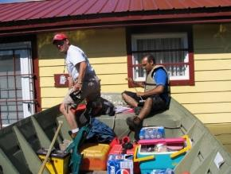
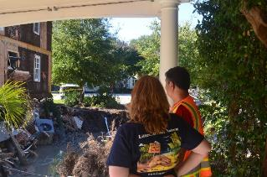
Disaster Duty
The State FPM in Support of Pre and Post-Disaster Operations.
Photos courtesy of OHDNR and SCDNR
Notes:
Review the slide.
Left photo: Paul Osman SFPM of Illinois, assisting with red tagging homes.
Right photo: Maria Cox-Lamm, SFPM of South Carolina.
Click slide

Slide 34
Disaster Duty (continued)
But first, how do I pay for disaster response? Look not further than you CAP-SSSE agreement.
Task 12: Assistance to Communities in Responding to Disasters: States are encouraged to provide post-disaster assistance and support to NFIP communities.
Notes:
Review the slide.
Click slide

Slide 35
Disaster Duty (continued)
Look not further than you CAP-SSSE agreement. (continued)
Examples of these activities include:
Technical assistance implementing substantial damage requirements;
Use of the substantial damage estimating software;
Assistance to communities enrolling into the NFIP;
Notes:
Review the slide.
Click slide

Slide 36
Disaster Duty (continued)
Look not further than you CAP-SSSE agreement. (conclusion)
Examples: (conclusion)
General floodplain management tech assistance;
Assistance with promotion and use of the ICC coverage, and;
Assistance with HMA programs.
Can be negotiated when a disaster occurs.
Notes:
Review the slide.
Click once to bring in the negotiation statement.
Click slide

Slide 37
Disaster Duty (continued)
This begs the question, what types of disasters are we talking about? How could they impact a SFPM? What are the types of declarations that can occur?
A governor declared state of emergency;
A Small Business Administration declaration, and;
A Presidential Disaster Declaration.
How would your role change, as the level of disaster ramps up? Why?
Notes:
Review the slide.
Local municipalities and boroughs/counties/parishes can also declare an emergency. A Presidential Disaster Declaration (FEMA DR) can occur for seemingly moderate levels of damage, when compared to events like Katrina or Sandy. A wild fire/tornadoes/localized flooding can destroy homes/businesses in multi-county areas that can lead to the creation of a JFO in your state. Don’t think, I will never see a JFO, we don’t have hurricanes.
Every state has been declared at least once, for a PDD.
Click slide.

Slide 38
Disaster Duty (continued)
A governor declared state of emergency:
When it is believed that a disaster has occurred or will occur that is severe enough to require state aid to supplement local resources in preventing or alleviating damages, loss, hardship or suffering. (rescue, evacuate, shelter, provide essential commodities like fuel and food)
Activates the state EOP, SEOC to coordinate response and recovery operations.
Notes:
Review the slide.
Click slide

Slide 39
Disaster Duty (continued)
A Small Business Administration declaration:
In any county or other smaller political subdivision of a State or U.S. possession, at least 25 homes or 25 businesses, or a combination of at least 25 homes, businesses, or other eligible institutions, each deemed destroyed or having sustained major damage.
Notes:
Review the slide.
The governor of the state in which the disaster occurred submits a written request to SBA for a physical disaster declaration by SBA. This declaration is published in the Federal Register.
Does this say flood? Any cause, eh? What about structures within the SFHA, does that interest you?
Click slide.

Slide 40
Disaster Duty (continued)
A Presidential Disaster Declaration, under the Stafford Act (P.L. 93-288):
Section 401. Procedures for Declaration. All requests for a declaration by the President that a major disaster exists shall be made by the Governor of the affected state. Such a request shall be based on a finding that the disaster is of such severity and magnitude that effective response is beyond the capabilities of the state and the affected local governments and that the federal assistance is necessary. As a part of such request, and as a prerequisite to major disaster assistance under this Act, the Governor shall take appropriate response action under state law and direct execution of the state’s emergency plan. The Governor shall furnish information on the nature and amount of State and local resources which have been or will be committed to alleviating the results of the disaster and shall certify that, for the current disaster, state and local government obligations and expenditures (of which state commitments must be a significant proportion) will comply with all applicable cost-sharing requirements of this Act. Based on the request of a Governor under this section, the President may declare under this Act that a major disaster or emergency exists.
Notes:
Review the slide. Let them read it fully and discuss.
Nothing about a flood, but structures within the SFHA might or can be impacted. Homes damaged or destroyed by wildfire within the SFHA still fall within your area of responsibility.
This will bring with it a Joint Field Office (JFO) with all the bells and whistles, which will vary in size and scope.
Click slide.

Slide 41
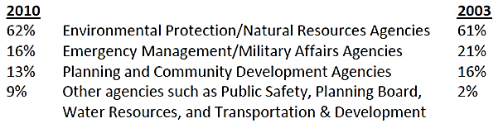
Disaster Duty (continued)
In 2010, ASFPM found that the NFIP Coordinating Office was located within these agencies:
Notes:
Review the slide.
So, the majority of the people in the room aren’t in emergency management, is that a good thing?
The chart is found on Page 7 of the FPM 2010: State and Local Programs.
Click slide.

Slide 42
Disaster Duty (continued)
The SFPM should prepare a “ready organization” that has:
A management structure ready to respond, by knowing who is doing what, when, where, how and why;
A relationship prior to a disaster with emergency management, in order to smoothly transition into a “wartime” environment;
Notes:
Review the slide.
In both the SEOC and JFO, you will find that some competing silos of programs and agencies do not play well together. You can’t allow your FPM message to become lost in the shuffle.
The increase use of GIS can greatly increase your visibility through the production of maps of your choosing.
Click slide

Slide 43
Disaster Duty (continued)
… a “ready organization” that has: (continued)
An assigned seat in the SEOC, where staff can manage requirements, allocate and request resources, assign and monitor tasks and communicate across the assembled ESFs, external partners and stakeholders quickly and effectively;
A plan for pre/post disaster duties (i.e. inspections for SD, RL target properties, Areas of Mitigation Interest and permitting for repair and recovery, and;
Notes:
Review the slide.
Areas of Mitigation Interest: FEMA’s RiskMAP is a resource for this information. Also get with PA.
Click slide.

Slide 44


Disaster Duty (continued)
… a “ready organization” that has: (conclusion)
A notification plan of your staff and others to alert them as to what action they must take, to keep them appraised of the situation as it changes and any other instructions as needed.
Notes:
Review the slide.
Click slide

Slide 45

Disaster Duty (continued)
Pre-Disaster planning & training.
Take an inventory of your assigned equipment and identify any shortfalls. Locate additional assets.
Ascertain and correct any staff training needs.
Conduct situational awareness meetings within your organization.
Pre-coordinate with other agencies, state FPM association and VOADs.
Photo courtesy of MEMA
Notes:
Review the slide.
VOAD: Voluntary Organizations Active in Disaster.
This slide can be tied to effective FPM guiding Principles 6, 8 and 9.
Click slide.

Slide 46
Disaster Duty (continued)
Pre-Disaster planning & training. (continued)
Many SFPMs and staff are not identified as “essential personnel” or have emergency work/response provisions in their job descriptions.
What would it take to make sure the SFPM has response capability?
Notes:
Review the slide.
Click slide

Slide 47

Disaster Duty (continued)
“Silver Jackets” Program:
An innovative forum / program that provides an opportunity to consistently bring together multiple state, federal and sometimes tribal and local agencies to learn from one another and apply their combined knowledge to reduce risk.
Multiple agencies and programs can be leveraged to provide a cohesive solution.
Notes:
Review the slide.
Have you heard of the Silver Jacket program? (In Mississippi, it is called the “Camo Jackets.”) Does your agency participate?
A USACE initiative, a team was first established in the state of Ohio in 2005, the second in Indiana in 2006.
State based to meet the unique programmatic needs found within the state.
Click slide.

Slide 48
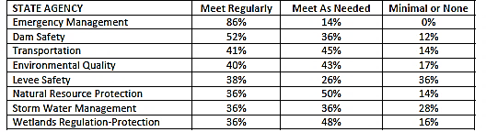
Disaster Duty (continued)
In 2010, ASFPM found that the degree of coordination between a SFPM program and other state programs was:
Notes:
Review the slide.
Table 3, page 17 of the FPM 2010: State and Local Programs.
This is the opportune time to use the NFIP as the mitigation tool it was designed to be. “Correction” of at-risk built environment occurs through SD, RL and ICC processes.
Click slide.

Slide 49
Disaster Duty (continued)
Pre-Disaster planning & training. Keep in mind:
Pre-event planning must be “outside the box”;
Catastrophic events and the Stafford Act;
Flood Damage is a direct consequence of floodplain investment actions, an unpopular fact;
Mitigation actions aren’t always politically palatable with elected officials. Politics surrounding FPM quickly becomes complicated;
Notes:
Review the slide.
Click slide

Slide 50
Disaster Duty (continued)
Keep in mind: (continued)
Have prepared “talking points” to brief politicians on why mitigating (not just restoring) a community is the right thing to do;
Think about future costs avoided and impact to people and property;
Notes:
Review the slide.
Click slide

Slide 51
Disaster Duty (continued)
Keep in mind: (continued)
Citizens will be devastated, choose your words carefully;
Many citizens who live in the SFHA really don’t know what that entails/means;
Every FEMA program doesn’t know the NFIP regulations impacts its silo;
The public will be confused by all the inspections/assessments made by multiple people;
Notes:
Review the slide.
Use of words/terms: belongings instead of debris, don’t show your emotions (be strong for the impacted person).
Click slide.

Slide 52
Disaster Duty (continued)
Keep in mind: (continued)
The FEMA reservist may know less than you;
The volunteer organizations will move in and start repairs without local FPM or your office’s oversight;
Every document you release will be critiqued, time the release of information to match the EM phases;
People will complain, and;
You won’t have all the answers, all the time.
Notes:
Review the slide.
Phases: Response, recovery, mitigation risk and COMPLIANCE.
Click slide.

Slide 53
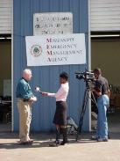
Disaster Duty (continued)
Keep in mind: (continued)
Recovery will be a marathon, not a sprint;
Enforcement of the local flood damage prevention ordinance and any state regulations will be a challenge;
Be prepared to address any potential mitigation opportunities that present themselves;
Be prepared to “feed the beast” with media opportunities, and;
Photo courtesy of MEMA
Notes:
Review the slide.
Click slide.

Slide 54
Disaster Duty (continued)
Keep in mind: (conclusion)
Establish a simple message for FPM and EM to get behind. Perhaps something like:
The Risk is Real. Mitigating now to create a better position in the future is the right thing to do.
Your agency and EM (if they are different) know what works, such as Floodproofing, relocating, elevating and demolishing.
Disaster brings with it both resources and opportunities.
Notes:
Review the slide.
Click slide

Slide 55
Disaster Duty (continued)
Post-Disaster, you should perform three primary roles:
Monitoring and assessment (i.e. participation at the SEOC and JFO;
Collection, processing and dissemination of damage information (i.e. to support NFIP compliance, identification of mitigation opportunities, build record of damage history, and;
Participation in recovery assistance to communities.
Notes:
Review the slide.
Click slide

Slide 56
Disaster Duty (continued)
Post-Disaster, prepare your After Action Report (AAR). This documents:
What you did and whether you did it well, and;
How should you change anything to be more effective in the future.
(More on AAR process on the next five slides.)
Notes:
Review the slide.
Click slide

Slide 57
Disaster Duty (continued)
Conduct an After Action Review:
Taking the results and applying to them to future events;
Use the information gleaned to assess your individual actions/programs to identify weaknesses;
Identify training needs or technical assistance needs, and;
Improve your proficiency in floodplain management.
Notes:
Review the slide.
The after action review will lead to the after action report or lessons learned report.
Click slide.

Slide 58
Disaster Duty (continued)
How do you accomplish this?
Openly and honestly discuss what actually transpired, in sufficient detail that everyone will understand what did and did not occur… and why.
The key is the spirit in which the AAR is conducted.
Notes:
Review the slide.
Click slide

Slide 59
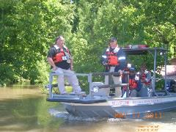
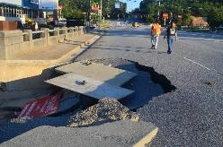
Disaster Duty (continued)
AAR worksheet format:
Discussion: (i.e. warning, response and recovery actions).
Conclusions: (how did you do, i.e. scale of 1-10).
Recommendations: (how you could have done better or what is needed to improve).
Photos courtesy of MEMA
Notes:
Review the slide.
Right photo: Bolivar County EMA Director/FPM on damage assessment boat ride. 2011
Left photo: Maria Cox-Lamm walking a damage road in SC, 2015.
Click slide.

Slide 60
Disaster Duty (continued)
Each AAR worksheet can be as simple as:
Date/Time of Event:
Location:
Discussion:
Conclusions:
Recommendations:
Notes:
Review the slide.
Click slide

Slide 61
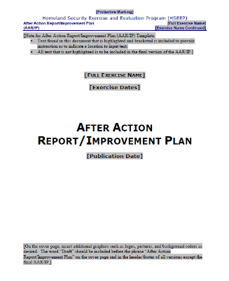
Disaster Duty (continued)
The product will be the After Action Report or Lessons Learned document.
DHS has a format online, the Homeland Security Exercise and Evaluation Program (HSEEP)
Job Aid 3
Notes:
Review the slide. Job Aid 3.
This format was developed for exercises, but can be used to guide an actual event report.
Click slide.

Slide 62

Disaster Duty (continued)
So, perhaps you are now ready…
Photo courtesy of MEMA
Notes:
Review the slide.
DE state coordinator, Mike Powell.
Click slide

Slide 63
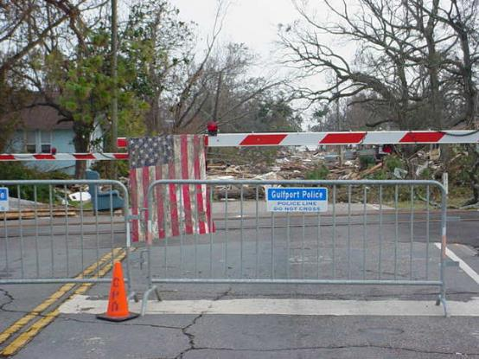
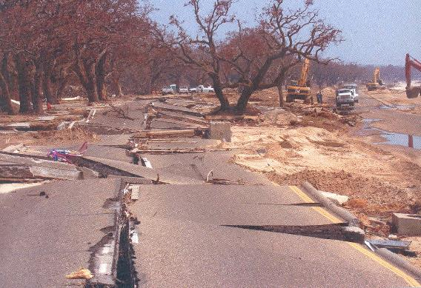
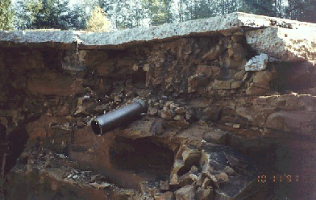
Disaster Duty (continued)
Photos courtesy of MEMA & state of WA
Notes:
Review the slide.
Upper left and right side photos: Gulfport and Biloxi after Katrina, August 26th 2005.
Lower left photo: Seminary Hill Reservoir failure, 1991, Centralia, WA.
Click slide.

Slide 64
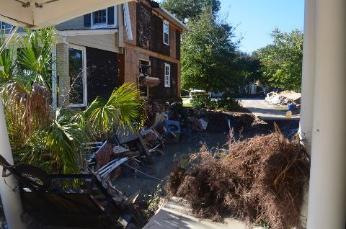
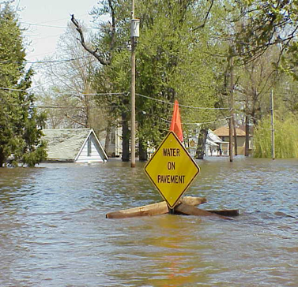
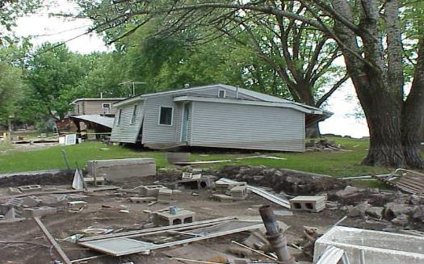
Disaster Duty (continued)
Photos courtesy
of Ohio and SC DNR
Notes:
Review the slide.
Photos: Illinois flood sign and houses in Illinois and South Carolina.
Click slide.

Slide 65
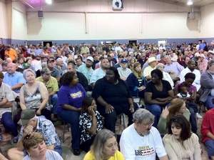

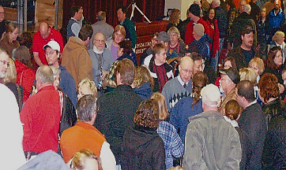
Disaster Duty (conclusion)
Perhaps not…
Photos courtesy of MEMA and OH DNR
Notes:
Review the slide.
Photo on left: Mississippi Department of Health, SERT team vehicle, located in Gulfport, MS… late at night.
Photo on upper right: View from SFPM’s chair during a public meeting concerning flood recovery, 2006.
Photo on lower right: FEMA staffer and ILL state FPM staff at a public meeting.
Click slide.

Slide 66
After Action Review
Feel like you are missing something vital?
Notes:
Review any items or questions that were raised to ensure that there is no confusion or mystery to what you have covered.

Slide 67

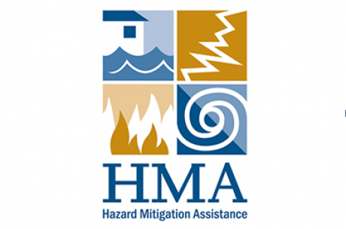
The SHMO’s Role
The State Hazard Mitigation Officer’s Role.
Photo courtesy of MEMA
Notes:
Photo: Ms. Jana Henderson, Mississippi SHMO, 2016.
Click slide.

Slide 68
The SHMO’s Role (continued)
The daily role of the SHMO:
Works with local community government;
Coordinates the collection of data;
Monitors and evaluates progress of grants;
Monitors the financial status of projects;
Conducts on-site inspections, and;
Conducts audit of project files and financial records.
Notes:
Review the slide.
The SHMO is the official representative of State government who is the primary point of contact with FEMA, other Federal agencies, and local governments in mitigation planning and implementation of mitigation programs and activities required under the Stafford Act.
If an Indian Tribe decides to participate, the SHMO will be the Tribal Hazard Mitigation Officer. Tribes are unique in that they can be an Applicant (equivalent to States) or sub-applicant to the State. California and Arizona don’t have the capability to pass State money through to tribes, so Tribes have to be Applicants there.
Click slide.

Slide 69

The SHMO’s Role (continued)
The SHMO’s available alphabet soup: HMGP, FMA and PDM grants:
Cost share:
75% federal, 25% non-federal for HMGP, FMA and PDM
100% federal, for SRL properties
90% federal and 10% non-federal for RL properties
Notes:
Review the slide.
The Consolidated Appropriations Act, 2016 (Public Law 114-113); the Fiscal Year 2016 FMA grant program pulled the old SRL and RFC grants under FMA.
Click slide.

Slide 70
The SHMO’s Role (continued)
Hazard Mitigation Grant Program (HMGP):
Federal formula based, post-disaster program.
State receives up to 20% of disaster costs for an enhanced plan, 15% for non-enhanced plan.
All hazard in nature.
Funds can be used for statewide projects.
7% of funds available for planning projects.
5% of funds available for projects which don’t meet FEMA benefit cost requirement.
Notes:
Review the slide.
Click slide.

Slide 71
The SHMO’s Role (continued)
Flood Mitigation Assistance (FMA) Program:
Federal formula based program funded by NFIP.
Eligible projects: Measures that eliminate or reduce flood risk associated with insured properties.
Funds can be used for acquisition, demolition or elevation.
Properties must have a flood insurance policy in effect at the time of application.
Applicants must have approved FEMA mitigation plan.
Notes:
Review the slide.
Must have an insurance policy and must meet the B/C.
Click slide

Slide 72
The SHMO’s Role (continued)
FMA: (conclusion)
The old SRL and RL grants have been rolled up into FMA.
FMA properties are eligible for up to 75% federal cost share.
Severe Repetitive Loss properties are eligible for up to 100% federal cost share.
Repetitive Loss properties are eligible for up to 90% federal cost share.
Notes:
Review the slide.
HMA and insurance both provide rep loss lists. Their criteria is not the same!
The bigger the flood, the bigger the political interest. Know what allocation formula you can defend.
Know the HUD contacts and how to leverage for mitigation actions.
Click slide.

Slide 73
The SHMO’s Role (continued)
Pre-Disaster Mitigation Program (PDM):
Nationally competitive program, available annually.
All hazard in nature.
No flood insurance requirement.
Planning and project funds are available.
Applications undergo a national peer review process.
Projects with high benefit cost ratios are favored.
Federal funding is available for up to 75% of eligible costs.
Notes:
Review the slide.
Click slide.

Slide 74

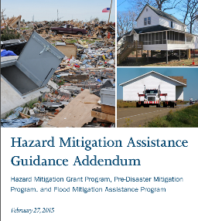
The SHMO’s Role (continued)
FY 15 HMA Guidance 2/27/2015
FY 15 HMA Guidance Addendum 2/27/2015
Job Aids 4 & 5
Notes:
Review the slide.
This guidance applies to HMGP disasters declared on or after 2/27/2015. This also applies to PDM and FMA.
Job Aids 4 & 5.
Click slide.

Slide 75
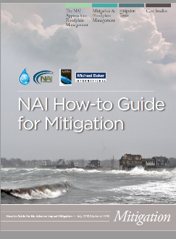
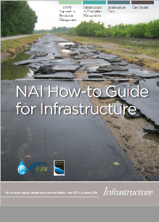
The SHMO’s Role (continued)
NAI How-to Guide for Mitigation 7/2016
NAI How-to Guide for Infrastructure 7/2016
Job Aids 6 & 7
Notes:
Review the slide.
ASFPM updated publications.
Job Aids 6 & 7.
Click slide.

Slide 76
The SHMO’s Role (continued)
Remember this?
Notes:
Review the slide.
Click slide.

Slide 77
The SHMO’s Role (continued)
The SHMO in a disaster. Priority targets are:
Coordinate with the NFIP State Coordinator, especially in regard to mitigation strategies, substantial damage, repetitive loss determinations and same public messages concerning mitigation and rebuilding;
Outline a plan of direction with FEMA up front;
Coordinate with FEMA disaster staff to deploy their “no cost” mitigation classes to local communities;
Notes:
Review the slide.
Click slide.

Slide 78
The SHMO’s Role (continued)
Priority targets: (continued)
Take advantage of the FEMA’s ability to order and receive FEMA publications;
Facilitate any needed HMTAP requests with SFPM;
Focus on the use of local and state hazard mitigation plans early in the outreach effort;
Identify projects that have already been put together for another funding source, such as stormwater utilities;
Notes:
Review the slide.
Click slide.

Slide 79
The SHMO’s Role (continued)
Priority Targets: (continued)
Facilitate a FEMA loss avoidance study for the mitigation projects that have been completed, which are provided by a FEMA Hazard Performance Analysis (HPA) team;
Notes:
Review the slide.
Loss Avoidance Study, shows the benefit of the mitigation in the target area by calculation of damage that didn’t occur.
Click slide.

Slide 80
The SHMO’s Role (continued)
Priority targets: (continued)
The opportunity for both the SHMO, HM Planner and SFPM to work out a strategy to give to communities to reduce their future flood risk, by perusing the community’s hazard mitigation plan and see what they have as mitigation actions;
Work closely with PA staff to identify mitigation projects where Section 406 funding for PA projects can be implemented;
Notes:
Review the slide.
Click slide.

Slide 81
The SHMO’s Role (continued)
Priority targets: (conclusion)
The opportunity for both the SHMO, HM Planner and SFPM to talk about any needed changes, such as:
Higher Standards
Mitigation Projects
The opportunity for both the SHMO and SFPM to influence mitigation and resilience through policy and priorities for the recovery effort. (Prevent the disaster from becoming a disaster.)
Notes:
Review the slide.
Higher standards can be “cost savings” when next the flood occurs.
Click slide.

Slide 82
The SHMO’s Role (conclusion)
Most common ‘take away’ items from a disaster:
Being in the JFO is “where the work is,” the HMA and NFIP principals should be there, and;
Having staff, field support for substantial damage and repetitive loss determinations is a must.
Notes:
Review the slide.
Click slide.

Slide 83
After Action Review
Feel like you are missing something vital?
Notes:
Review any items or questions that were raised to ensure that there is no confusion or mystery to what you have covered.

Slide 84




The SFPM’s Role
The State Floodplain Manager’s Role.
Photo courtesy of MEMA
Notes:
Review the slide.
Photo: Stacey Ricks, Mississippi SFPM.
The NFIP logo was modified to depict compliant construction, instead of flooded buildings.
Click slide.

Slide 85
The SFPM’s Role (continued)
Pre-disaster, what you should emphasize:
SFPMs must engage their local FPMs.
Supporting them and their efforts should be a priority.
Know how communities will issue permits and where local ability will be exceeded.
Holding countywide meetings and linking local FPMs to each other will pay huge dividends.
Notes:
Review the slide.
Get the word out concerning SFPM assistance capabilities. Explain how to request help.
Click slide

Slide 86

The SFPM’s Role (continued)
Pre-Disaster planning & training, what should you emphasize to your local floodplain managers?
Read the ordinance and know what it really says;
Have a plan;
Identify disaster response team for FPM
Determine the level of support
Know adjacent floodplain managers
Tour your SFHA and produce a master map
Create files for each structure in the SFHA
Photo courtesy of SEMA
Notes:
Review the slide.
SFPMs can promote the value of enforcement and compliance early in the process to make the local job of permitting and substantial damage determinations easier.
Discuss how using elected officials and EMs as lead champions for recovery can influence the success of mitigation.
Click slide.

Slide 87

The SFPM’s Role (continued)
Pre-disaster, what you should emphasize: (continued)
Have a plan; (conclusion)
Build relationships with VOADs
Emergency permit procedures
Update SDE notification and results letter templates
Review any MOUs, and;
Conduct SDE training as needed. (more on SD in the next topic of this module)
Notes:
Review the slide.
Click slide.

Slide 88
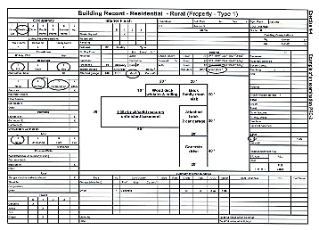
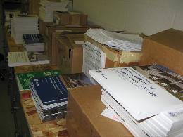
The SFPM’s Role (continued)
What to emphasize… (continued)
Obtain property records from the tax assessor;
Increase public outreach;
Stockpile fact sheets, FEMA publications and public outreach brochures;
Photo courtesy of SEMA
Notes:
Review the slide.
Click slide.

Slide 89
The SFPM’s Role (continued)
What to emphasize… (continued)
Develop a check list for field use, a “Go-Kit,” include such items as:
Pre-Disaster inventory files;
A community master map (see next slide);
FIRMs and FIS;
ID badges;
Damage assessment work sheets;
Cameras (with chargers or batteries);
Notes:
Review the slide.
These items will be referenced in the substantial damage topic, also in this module.
Click slide

Slide 90
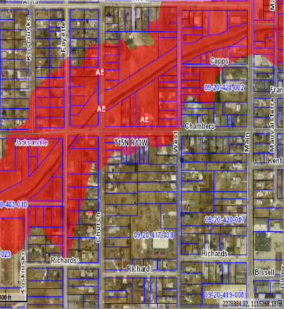
The SFPM’s Role (continued)
A community master map.
A unique parcel number helps to quickly locate a property.
Example:
09-20-416-040
09 = Township Number (Watson Township)
20 = Section number (Section 20)
416 = Block number (designates ¼ section: 100 = NW ¼, 200 = NE ¼,
300 = SW ¼, 400 = SE ¼)
040 = individual parcel of land within the block
From this number, we can tell that this structure is located in Watson Township, Section 20, T15N, R10W - in the SE 1/4, block 416 and IS in the SFHA!
Notes:
Review the slide.
Click slide.

Slide 91
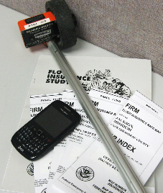
The SFPM’s Role (continued)
What to emphasize… (conclusion)
“Go-Kit” items: (conclusion)
100-ft tape measure or wheel;
Safety clothing and equipment;
Cell phones;
Handheld GPS devices, and;
First aid kit, sunscreen, bug juice and bottles of water.
Photo courtesy of SEMA
Notes:
Review the slide.
These items will be referenced in the substantial damage topic section.
Click slide

Slide 92
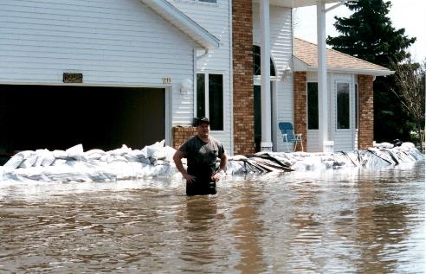
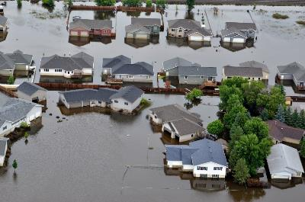
The SFPM’s Role (continued)
Disaster strikes:
Photos found on internet
Notes:
Review the slide.
Click slide.

Slide 93
The SFPM’s Role (continued)
Post-disaster, what you should coordinate with the SHMO to:
Ensure that the affected community hazard mitigation plans are approved or “under review” at the time of the event.
This can include verifying that the community had adopted the plan before the disaster and obtaining official conformation of adoption.
Notes:
Review the slide.
Click slide.

Slide 94
The SFPM’s Role (continued)
Post-Disaster, what you should emphasize to the locals:
Survey the floodplain for damage;
Document high water marks
Digital photographs
Mark locations on a map
Conduct substantial damage assessments;
Post notices on properties
Delivery/Mail follow-up letters
Notes:
Review the slide.
Click slide.

Slide 95
The SFPM’s Role (continued)
Post-Disaster, what you should emphasize to the locals: (conclusion)
Communicate with the State Coordinating Office;
Communicate with citizens and elected officials;
Communicate with VOADs, and;
Attend training/information sessions from State.
JFO duties will be covered later.
Notes:
Review the slide.
Know federal agency contacts and resources for both Federal/State.
Silver Jackets is a good link to relationships that need to exist.
Click slide to bring in the note concerning JFO duties.

Slide 96

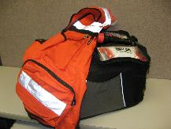
The SFPM’s Role (continued)
Local teams:
Photos courtesy of FEMA & SEMA
Notes:
Review the slide.
Click slide.

Slide 97
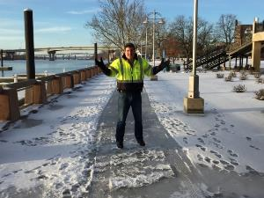
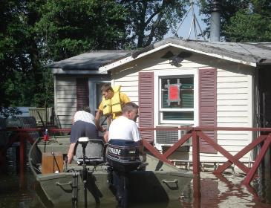
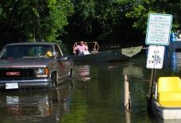
The SFPM’s Role (continued)
Local teams:
Photos courtesy of IL DNR
Notes:
Review the slide.
Click slide.

Slide 98
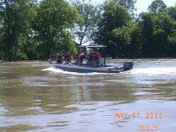
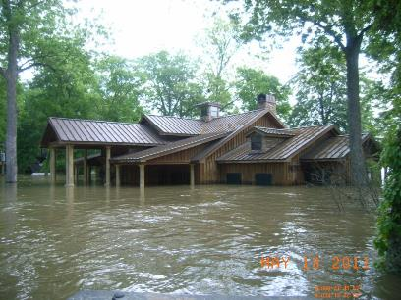
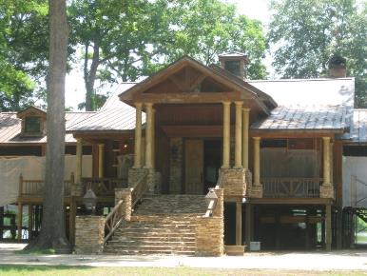

The SFPM’s Role (conclusion)
State teams:
Photos courtesy of MEMA
Notes:
Review the slide.
Photos: May and June 2011 photos of an attorney’s “fish camp.” Coahoma County, MS.
Click slide

Slide 99
After Action Review
Feel like you are missing something vital?
Notes:
Review any items or questions that were raised to ensure that there is no confusion or mystery to what you have covered.
CAP-SSSE funding may be available to address gaps in promoting service (regions, states, etc.).

Slide 100
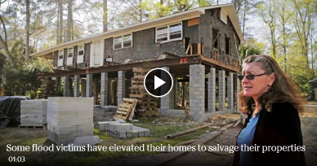
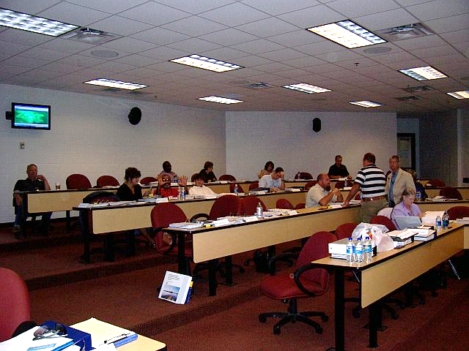
Mitigation Opportunities
Mitigation Opportunities in a Post-Disaster Environment.
Photo courtesy of MEMA
Notes:
Review the slide.
Photo on the left: Homeowner in South Carolina, 2015. Columbia, SC resident Mary Morgan Kerlagon talks about her rental home that was damaged during last year's flooding. More than five months after the event, homeowners like Kerlagon, have started raising their structures to meet floodplain code or to try and salvage their properties.
The elevation process, including necessary renovations and mold remediation, could up to $125,000. The flood insurance claim will take care of roughly $86,000 of that, but savings will have to cover the difference. That is counting the maximum $30,000 in federal aid (ICC) available to help homeowners lift, relocate or demolish their homes.
Often the SFPM and the SHMO will require help in identifying what they need.
Photo on the right: L273 workshop in Gulfport, Mississippi (post Katrina), 2006.
Click slide.

Slide 101

If we do as we have always done, we will
get what we have always had, disasters by
design, a cycle of predictable and
preventable losses.
Notes:
Review the slide.
Click slide.

Slide 102
Mitigation Opportunities (continued)
You have the responsibility to ensure that your state’s floodplains are managed and developed wisely. After a disaster, a window of opportunity exists to recover from that event in a “smarter” way. If the damage occurs within the SFHA, recovery must be done in accordance with local regulations.
Are you concerned with areas outside the SFHA?
Notes:
Review the slide.
Click slide.

Slide 103
Mitigation Opportunities (continued)
Perhaps the first mitigation opportunity you will have is to reinforce that NFIP Compliance is a mitigation strategy. Such as:
Post-disaster floodplain development permitting
Substantial damage estimates
Repetitive loss structure surveys
Notes:
Review the slide.
Click slide.

Slide 104
Mitigation Opportunities (continued)
The post-disaster environment creates a series of difficult choices (under difficult circumstances) for mitigation staff. Such as:
Is it more important to rebuild quickly or stronger?
Will the rush to rebuild lead to early decisions that might foreclose opportunities for building long-term resiliency? and
How should you choose between competing priorities?
Notes:
Review the slide.
Click slide.

Slide 105
Mitigation Opportunities (continued)
What are some of the typical choices faced by residents, business owners and community leaders that must be considered?
Put everything back exactly as it was pre-disaster;
Reduce future vulnerabilities through mitigation, but this may add to the immediate cost of rebuilding, and;
Rebuild in a way that enhances community amenities, efficiency and/or equity and achieves multiple community objectives.
Notes:
Review slide.
Click slide.

Slide 106
Mitigation Opportunities (continued)
Typical choices are also fueled by the human disaster, environmental disaster, infrastructure impacts on the communities. Such as drinking water, sewer, electrical, fuel contaminants, etc.
“Everywhere I’ve been, people have asked me, ‘When are they going to come fix it?’ They? There is no ‘they.’ No cavalry is coming to make the decisions. It’s us.”
- Longmont, CO Public Works Director, 11/3/2013
Notes:
Review slide.
Click slide.

Slide 107
Mitigation Opportunities (continued)
Notes:
Review slide.
Slide taken from presentation by Brian Varrella, the 2013 Floodplain Administrator of Ft. Collins, CO.
Click slide.

Slide 108
Mitigation Opportunities (continued)
Various funding opportunities are at their greatest following a disaster (not all are from FEMA). These funds are or can be:
Part of the community decision-making process;
Preventive funding to halt repetitive cycle of damage;
Multiplier for increased community resilience; reduction of time needed for recovery, and;
Save $4 in repair costs for every $1 spent on mitigation.
Notes:
Review slide.
Click slide.

Slide 109
Mitigation Opportunities (continued)
Remember the benefits of mitigation when rebuilding. What opportunities could contribute to long-term resiliency?
Housing;
Critical infrastructure;
Historic preservation;
New technologies, and;
New policies and procedures.
Notes:
Review slide.
Now, let’s briefly look at each of these five topics of opportunities in the next slides.
Click slide

Slide 110
Mitigation Opportunities (continued)
Opportunities and challenges you may encounter:
Housing;
Rebuilding may provide opportunity to increase supply of affordable units.
Critical infrastructure;
Use available funds to rebuild higher/safer standards to relocate.
Historic preservation;
Rebuild to strengthen structures and preserve them.
Notes:
Review slide.
Click slide.

Slide 111
Mitigation Opportunities (continued)
Opportunities and challenges: (conclusion)
New technologies, and;
Opportunity to integrate energy-efficient, green building techniques as structures are rebuilt.
May be able to combine funds with incentive programs to achieve sustainability objectives.
New policies and procedures.
Development permits, development review procedures, such as increasing reliance on GIS platforms.
Notes:
Review slide.
Click slide.

Slide 112
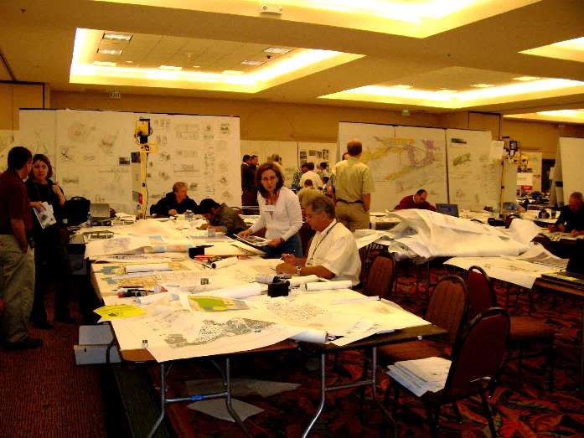
Mitigation Opportunities (continued)
There are many resources available to help local officials in creating more disaster resilient communities, such as:
State Homeland Security agency;
State DNR (or similar agency);
State sponsored design charrette;
HUD resiliency grants;
American Planning Association, and;
ASFPM.
Photo courtesy of MEMA
Notes:
Review slide.
Photo: The governor’s design charrette in coastal Mississippi post-Katrina. Lots of “New Urbanism” designers attended. The only real product was the “Katrina Cottage.”
Click slide.

Slide 113

Mitigation Opportunities (continued)
Worth a look…
Job Aid 8
Notes:
ASFPM developed several specific recommendations for improving post-disaster mitigation operations through the JFO.
Job Aid 8.
Click slide.

Slide 114
Mitigation Opportunities (conclusion)
FPM issues encountered with HMGP:
HMGP shouldn’t be a problem. The floodplain management requirements should be well known and understood by mitigation grant specialists.
However, some state coordinators request a FEMA NFIP staffer to review all HMGP projects within the JFO.
Notes:
Review slide.
Click slide.

Slide 115
After Action Review
Feel like you are missing something vital?
Notes:
Review any items or questions that were raised to ensure that there is no confusion or mystery to what you have covered.

Slide 116
Training Opportunities
Training staff and resources will be made available to the SPFM by FEMA. Such as:
Substantial Damage Estimator training
Increased Cost of Compliance training
L273: ‘Managing Floodplain Development through the NFIP’
Community Rating System workshops
FPM 101 workshops
Notes:
Review the slide.
Click slide.

Slide 117
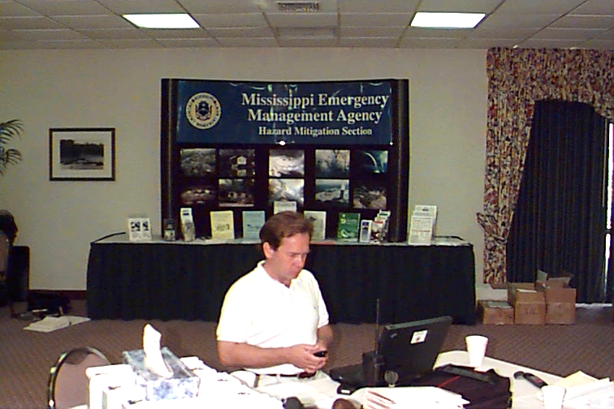
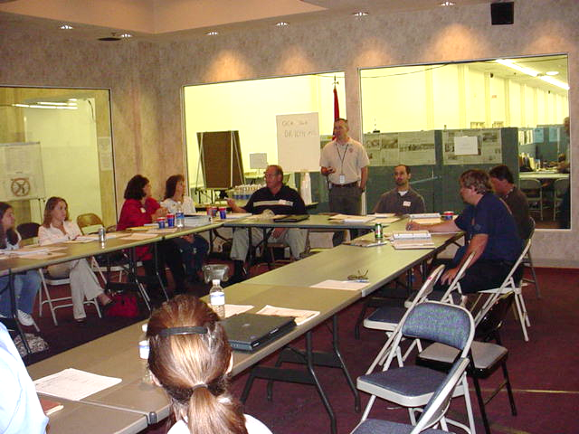
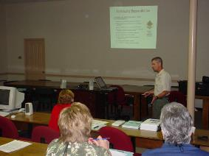
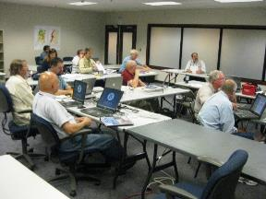
Training Opportunities (continued)
DFO L273 workshop, 2005
Field location L273 workshop, 1998
Field location FPM 101 workshop, 2004
JFO SDE training, 2011
Photos courtesy of MEMA
Notes:
Review the slide.
Photos: Top left: L273 workshop in Biloxi next to DFO, 1998. Top right: Local officials taking the L273 workshop at the Biloxi DFO, 2005. Bottom left: SDE workshop in Clinton JFO, 2011. Bottom right: FPM 101, Lucedale, MS 2003 (post Ivan).
The yellow circle highlights the FEMA disaster issue cell phone (looks like a WW II walkie talkie).
Click slide.

Slide 118
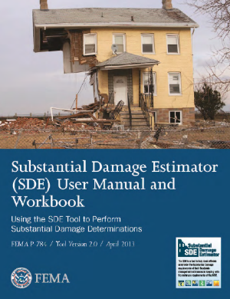
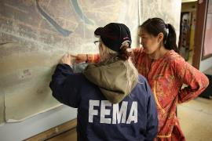
Training Opportunities (continued)
Utilization of the FEMA Substantial Damage Estimator Program.
Photos courtesy of FEMA
Notes:
Review the slide.
No hardcopy, you must download it.
Photo: FEMA Reservist working with local official in Alaska.
Click slide.

Slide 119

Training Opportunities (continued)
Job Aid 9
Substantial Improvement/Substantial Damage Desk Reference
FEMA P-758
May 2010
Notes:
Job Aid 9.
Click slide.

Slide 120

Training Opportunities (continued)
Optional SDE Training Video
Time Length 32:04
Notes:
Review the slide.
Click slide.

Slide 121

Training Opportunities (continued)
Notes:
FEMA estimates that it will take you three hours to complete the course.
Click slide.

Slide 122

Training Opportunities (continued)
Understanding Substantial Damage, please recall:
The 50% Rule: If damages from any source (i.e. flood, fire, tornado, alien attack, etc.) exceed 50%, the structure must be brought into compliance with local floodplain regulations.
Notes:
Review the slide.
Click slide.

Slide 123

Training Opportunities (continued)
Understanding Substantial Damage, please recall:
Cumulative Damage: If the ordinance contains the language.
Notes:
Review the slide.
Click slide.

Slide 124

Training Opportunities (continued)
Examples of large scale SDE efforts:
Mississippi in 2005
Notes:
Review the slide.
Click slide.

Slide 125



Training Opportunities (continued)
Examples: (conclusion)
Mississippi in 2011
June to August 2011
12 counties: 2,490 structures
304 miles along the river, as the crow flies
Photos courtesy
of MEMA
Notes:
Review the slide.
SDE inspections by URS contract teams.
Click slide

Slide 126



Training Opportunities (continued)
Photos courtesy of MEMA
Notes:
Review the slide.
SDE inspections by FEMA Reservists prior to the HMTAP contractors coming on line.
Click slide.

Slide 127

Training Opportunities (continued)
Notes:
Review the slide.
Click slide.

Slide 128
Training Opportunities (conclusion)
Notes:
Review the slide.
JFO produced maps of SDE collection points.
Click slide.

Slide 129
After Action Review
Feel like you are missing something vital?
Notes:
Review any items or questions that were raised to ensure that there is no confusion or mystery to what you have covered.

Slide 130


Increased Cost of Compliance
Increased Cost of Compliance: How is it Used After a Disaster?
Job Aid 10
Notes:
Review the slide.
ICC extends the NFIP mitigation capability by “funding” homeowner actions required to reduce risk. So many times if there is no HMGP or FMA, the public says that they won’t or can’t afford mitigation action. They miss that enforcement of the NFIP is not an option at this point, so ICC is like icing on the cake.
Job Aid 10.
Click slide

Slide 131

ICC (continued)
State Floodplain Manager’s Role in ICC:
There is a unique role that the SFPM plays in the ICC process. Ensuring that the communities are:
Ready to issue permits
Make substantial damage declaration
Make repetitive loss declaration
Are ready to support the ICC process
And…
Notes:
Review the slide.
Discuss ways that SFPMs may be able to help local FPMs quickly assess like SD (e.g. Pre-FIRM structures, FEMA RL properties, communities with higher standard regulations, such as rep loss tracking.
Click slide.

Slide 132
ICC (continued)
State Floodplain Manager’s Role in ICC: (conclusion)
Provide information to the communities that ICC isn’t just another program that insurance adjusters handle independently of the community. Reinforce that the ICC triggers are:
Insured building
Damaged by flood
Declared substantially damaged or a repetitive loss
Building owner willing to take a mitigation action (2004)
Notes:
Review the slide.
Since 2004, ICC has had specific statutory authorization to be triggered upon an offer of mitigation, and not just based on substantial damage or community increased lowest floor requirements.
Click slide.

Slide 133

ICC (continued)
Prior to the advent of ICC in 1994, the local building official / code enforcement officer had what role in facilitating payment of a flood insurance claim?
Notes:
Review the slide.
Answer: none
FYI. All NFIP policies have an ICC “rider” that everyone pays. However, not everyone actually has access to it. What are the conditions for ICC payment?
Click slide.

Slide 134
ICC (continued)
ICC, what is it?
It is an endorsement of the flood insurance policy that provides a claim payment directly to the property owner for the costs to comply with state or community floodplain management laws or ordinance after a direct physical loss caused by flood.
It is part of the standard flood insurance policy, it is not a grant.
Provides up to $30K to assist with code compliance.
Notes:
Review the slide.
Lead a general discussion about how much the participants know about the need for state or local determination that SD or RL is made.
Is there any example of a state doing this?
Click slide.

Slide 135
ICC (continued)
ICC, what is it? (continued)
ICC coverage is an automatic endorsement; however, not everyone can use it. Why not?
All buildings in Regular Phase communities are eligible, except:
Buildings insured under Group Flood Insurance Policy
Units insured under a condo unit owner policy
Buildings in Emergency Phase are not eligible.
Notes:
Review the slide.
Click slide.

Slide 136
ICC (continued)
ICC, what is it? (conclusion)
Maximum ICC coverage:
$30,000.00
No separate deductible
Maximum amount collectible for both ICC claim and direct loss payment for claim of flood:
$250,000.00 - single family
$500,000.00 – nonresidential
$250,000.00 – residential condo x number of units
Notes:
Review the slide.
Click slide.

Slide 137

ICC (continued)
ICC, what is key?
The key point is for the use of ICC, is that the locally designated official has to make the declaration of substantial damage or a repetitively damaged structure, if the local regulations support that. Also, check the building code for substantial damage definition, for consistency.
Notes:
Review the slide.
Click slide.

Slide 138
ICC (continued)
Local Floodplain Manager’s Role in ICC:
Enforce the repetitive loss provision in the flood damage prevention ordinance, if repetitive loss occurs;
Make substantial damage and repetitive loss determinations;
Provide mitigation options to policyholders; help package ICC benefits with other funding sources, and;
Issue Certificate of Completion/Occupancy.
ICC can be used as a non-Federal match to HMGP and FMA grants.
Notes:
Review the slide.
Click once to “appear” the blue rectangle.
Click slide.

Slide 139
ICC (continued)
If the community declares a building substantially damaged or a repetitive loss due to flooding:
An owner with an ICC policy can file an insurance claim.
The ICC benefit pays the cost to bring the building into compliance with State and/or local FPM laws or ordinances.
ICC coverage provides payment up to $30K for mitigation measures (there is a major caveat).
Notes:
Review the slide.
ICC will not max out the payment if the filed flood insurance payment doesn’t leave any room for the maximum allowed ceiling of payment of $250K.
Click slide.

Slide 140

ICC (continued)
(An example from a local FPM.) What if the adjuster says:
I don’t think there is that much damage, when you deduct the cost of elevation, it is back under 50%, you the local official don’t have the authority to require this structure to be elevated and the replacement cost of this structure is much higher.
Notes:
Review the slide.
Second half of quote is on the following slide.
Click slide.

Slide 141

ICC (continued)
What the adjuster was really saying:
I have never taken the time to read the NFIP Insurance Manual, the ICC Guidebook or your local ordinance so I don’t have the foggiest idea that you, the local official, have total authority determining substantial damage and I apologize for my ignorance and I hope you will not embarrass me in front of my other insurance adjuster pals.
Notes:
Review the slide.
Submitted by Ray Nees, FPM of Rock Island County, IL.
Click slide.

Slide 142


ICC (continued)
ICC Mitigation Solutions, known as FRED:
Floodproofing (nonresidential properties only);
Relocating to a new site, outside of the SFHA;
Elevating above the flood level in the community, and;
Demolishing the building.
Photos courtesy
of MEMA
Notes:
Review the slide.
Click slide.

Slide 143

ICC (continued)
Photo courtesy of MEMA
Notes:
Bolivar County, MS. Post 2011 Mississippi River Flood. ICC elevation project.
Click slide.

Slide 144

ICC (continued)
Butler Co., KS
More than 50% damaged. The right hand side garage was removed. Elevated eight feet. ICC paid the full $30K allocated and the homeowner paid the balance.
Photos courtesy of KS Dept of Agriculture
Notes:
Review the slide.
Photos by Steve Samuelson, KS Department of Agriculture.
Click slide.

Slide 145
ICC (continued)
Repetitive Loss vs. Substantial Damage.
An ICC repetitive loss structure, per community determination:
Was flood damaged twice within ten years.
Had a repair cost that equaled/exceeded 25% of market value each time.
Notes:
Review the slide.
Click slide.

Slide 146
ICC (continued)
Repetitive Loss vs. Substantial Damage. (conclusion)
An ICC structure substantially damaged by flood:
Was flood damaged by a single event.
Will cost 50% or more of the pre-flood market value to restore to pre-damage condition.
Notes:
Review the slide.
Click slide.

Slide 147
ICC (continued)
Eligibility for ICC Coverage:
Eligible: Buildings in the SFHA in Regular Program communities.
Not eligible:
Buildings insured under Group Flood Insurance Policy.
Units insured under a condo unit owner policy.
Buildings in Emergency Program communities.
Notes:
Review the slide.
Click slide.

Slide 148
ICC (continued)
Eligibility for ICC Repetitive Loss Payment:
To receive payment:
Community adopted / enforces a repetitive loss provision, or
Building has a history of NFIP claim payments that satisfy the NFIRA of 1994 definition of “repetitive loss structure.”
Notes:
Review the slide.
Click slide.

Slide 149
ICC (continued)
How is ICC implemented on properties in A zones?
Under the minimum NFIP regulations, States and communities must require the elevation or Floodproofing (non-residential only) of buildings in an A zone to the BFE where elevation data from a Federal, State or other sources is obtained, reviewed and reasonably utilized.
After this data is obtained, the community adopts the determined BFE. Information is entered on the EC.
ICC will not pay for the cost to develop the BFE.
Notes:
Review the slide.
Click slide.

Slide 150
ICC (continued)
How does the process work?
Policyholder:
Reports flood loss to insurer
Adjuster / Claims Representative:
Estimates flood damage and tells policyholder that claim may be eligible for ICC benefits
Building Department / Floodplain Administrator
Determines if the building is substantially damaged or is a repetitive loss. Provide written determination to policyholder.
Notes:
Review the slide.
SFPMs can have a big support role by providing templates for the letters and a model permit form to correctly document costs, market value and suggestions for good sources to determine needed information.
Click slide.

Slide 151
ICC (continued)
How does the process work? (continued)
Building Department / Floodplain Administrator
Discusses mitigation options that will comply with ordinance. Issue any necessary building permits for agreed upon mitigation measures.
Policyholder
Provides the local official’s written determination of substantial damage or repetitive loss to the adjuster.
Notes:
Review the slide.
Click slide.

Slide 152
ICC (continued)
How does the process work? (continued)
Adjuster / Claims Representative
Sets up an ICC claims file
Obtains damage and market value information on structure. For a repetitive loss structure, obtain previous claim information
Verifies that flood related damages for the current building claim supports community information
Notes:
Review the slide.
Click slide.

Slide 153
ICC (continued)
How does the process work? (continued)
Policyholder
Obtains a signed contract that details costs to perform the mitigation activity and gives it to the adjuster/claims representative
Adjuster / Claims Representative
Provides Proof of Loss form to the policyholder
Notes:
Review the slide.
Click slide.

Slide 154
ICC (continued)
How does the process work? (continued)
Policyholder
Provides form and copy of community permits to the insurance company in order to receive the first portion of the ICC claim money
Adjuster / Claims Representative
Provides an initial ICC claim payment to the policyholder
Policyholder
Completes the stipulated mitigation measure
Notes:
Review the slide.
Click slide.

Slide 155
ICC (continued)
How does the process work? (conclusion)
Building Department / Floodplain Administrator
Inspects completed mitigation work and issues a CO or other written evidence that the work is compliant with flood damage prevention ordinance
Policyholder
Provides a copy of CO or other evidence to the insurer
Adjuster / Claims Representative
Makes final payment upon receipt of CO or other evidence of compliance
Notes:
Review the slide.
Click slide.

Slide 156




ICC (continued)
Photos courtesy of IL DNR
Notes:
This home was substantially damaged by flood in Illinois.
Click slide.

Slide 157




ICC (continued)
Photos courtesy of IL DNR
Notes:
Review the slide, same structure from previous slide.
Click slide.

Slide 158


ICC (continued)
This elevation happened approximately 30 days after the flood loss, according to the Illinois SFPM.
Photos courtesy of IL DNR
Notes:
Back when that 30-day project happened, FEMA would routinely pay half the claim up front. This particular homeowner had the elevation contractor lined up and waiting to go as soon as he got the approval from his agent. He was elevated within 30 days after the red tag letter.
Click slide

Slide 159




ICC (continued)
Photos courtesy of IL DNR
Notes:
Review the slide.
Two different homes from the same Illinois flood.
Click slide.

Slide 160
ICC (continued)
Typical mitigation grant timeline
Intent letters sent to community 1 month
Pre – application deadline 2 months
Pre apps received and reviewed 1 month
Full app request to community 1 month
Full apps reviewed by state 1 month
B/C and environmental review 2 months
Prepare paperwork and send to FEMA 2 months
FEMA review and approval 3 to 8 months
Grant agreement to locals 1 or 2 months
Public meetings 1 or 2 months
Appraisals 2 or 3 months
Review of appraisals 2 or 3 months
Local title search 1 month
Agreement 1 month
Closing 1 month
Demolition 3 to 8 months
Buyout, relocation or elevation 1 year to 10 years? More?
Notes:
Review the slide.
Click slide.

Slide 161

ICC (continued)
A state’s ICC claim history, 2005 to 2009 (Bureau Net).
2016 Update:
ICC closed: 3,485
Pending: 27
Total: 3,512
Total Paid: $58,428,207.85
Demolition: 1,523
Elevation: 1,757
Other: 198
Relocation: 7
Notes:
Review the slide.
Click slide.

Slide 162

ICC (continued)
ICC Training Video
Time Length 14:35
Notes:
Two errors in the video. 1- The local FPM cannot access the claims data on the internet. 2- ICC is now $30K and not $20K.
Click the slide.

Slide 163


ICC (conclusion)
Notes:
The timespan from loss to the first ICC payment depends on:
How quickly the community gets the red tag letter to the homeowner,
How quickly the homeowner gets that letter to his agent,
How quickly the agent get the ICC claim request submitted to FEMA
How quickly FEMA reviews and approves the ICC request, and
How quickly the contractor can start the elevation work.
If all these stars are perfectly aligned….it can happen.
Paul Osman: “I would say the majority of Illinois ICC projects have occurred within 6 months of the event.”
Click slide.

Slide 164
After Action Review
Feel like you are missing something vital?
Notes:
Review any items or questions that were raised to ensure that there is no confusion or mystery to what you have covered.

Slide 165


Mutual Aid
The Emergency Management Assistance Compact and Intra-State Mutual Aid: How Can You Use Them?
Notes:
Review the slide.
EMAC is the best tool you can reach for in a major disaster. You need to know how to use it and who to use.
Found out who has the authority to submit an EMAC request in your agency.
Click slide.

Slide 166
Mutual Aid (continued)
Pre-Event (if that is possible):
Coordinate with other state floodplain managers that you wish to EMAC to your state.
Provide links to or actual copies of state specific regulations (i.e. cumulative damage).
Provide state developed publications that are commonly referenced within the state by local officials.
Coordinate with you state’s EMAC ‘A’ Team leader.
Notes:
Review the slide.
Click slide.

Slide 167
Mutual Aid (continued)
Submit an EMAC request for help.
A mutual aid agreement administered by NEMA.
Ratified into law in 1996 as PL 104-321.
Passed in all 50 states, the District of Columbia, the U.S. Virgin Islands, Puerto Rico, and Guam.
Through EMAC, states may share any resource with another state during an emergency or disaster, whether natural or man-made.
Notes:
Review the slide.
EMAC is administered by NEMA. The Mutual Aid Support System (MASS) is utilized to create mission ready packaging, based on NIMS resource typing.
The EMAC coordinating staff is found in the state emergency management agency. You have to coordinate with them in order to request assistance for your program from other state FPM programs. Do this quickly.
Click slide.

Slide 168



Mutual Aid (continued)
Job Aid 11
Notes:
Job Aid 11.
Click slide.

Slide 169

Mutual Aid (continued)
Notes:
Review the slide.
Example of a SHMO requesting assistance.
Click slide.

Slide 170

Mutual Aid (continued)
If you are mobilized, you should:
Plan according to the stipulated days of deployment and;
Make travel arrangements per specific agency procedures and policies.
Notes:
Review the slide.
Click slide.

Slide 171
Mutual Aid (continued)
Suggested Personal Equipment Checklist:
Immunization Record (Yellow Book);
Official Personal Identification Badge;
Personal Health & Medications as required;
Adequate amount of U.S. currency to procure meals for seven days (ATMs might not be available);
Toilet articles
Flashlight with spare batteries;
Notes:
Review the slide.
Click slide.

Slide 172

Mutual Aid (continued)
Suggested Personal Equipment Checklist: (conclusion)
Smartphone or alarm clock;
Pocket knife;
Earplugs;
Small back pack, safety shoes or boots as required;
Rain gear and hat and;
Glasses (reading and sunglasses).
Photos courtesy of MEMA
Notes:
Review the slide.
Click slide.

Slide 173
Mutual Aid (continued)
Things to consider to brief EMAC personnel upon their arrival:
Identification of job responsibilities and performance requirements;
Identification of co-workers within the specific job function;
Location of the work area;
Identification of eating and lodging options;
Notes:
Review the slide.
Click slide.

Slide 174
Mutual Aid (continued)
Things to consider to brief an EMAC personnel upon their arrival: (continued)
Instructions for obtaining additional supplies, services and personnel;
Identification of operational period and works shifts;
Clarification of any important points pertaining to assignment;
Notes:
Review the slide.
Click slide.

Slide 175
Mutual Aid (continued)
Things to consider to brief an EMAC personnel upon their arrival: (conclusion)
Copy of the current Incident Action Plan;
Review the potential hazards of the assignment;
Instructions for proper use of PPE for the task, and;
Provisions for specific debriefing at the end of the assignment.
Notes:
Review the slide.
Click slide.

Slide 176
Mutual Aid (continued)
In example, statistics in Mississippi, post-Katrina:
48 states participated in the EMAC process;
There were 739 missions completed:
Personnel deployments totaled:
10,395 state/local employees
50,000 National Guard soldiers (Army & Air)
Cost:
$193 million in civilian reimbursements
$346 million in National Guard reimbursements
Notes:
Review the slide.
Click slide.

Slide 177

Mutual Aid (continued)
Mississippi EMAC statistics: (conclusion)
Seven states deployed either NFIP State Coordinators or members of their staff:
California: 2 Delaware: 1
Florida: 1 Illinois: 1
Kansas: 1 Missouri: 3
Virginia: 2
Photos courtesy of Al Goodman
Notes:
Review the slide.
Photo: George Reidel, Rhonda Montgomery, Al Goodman (host) and Paul Osman.
Click slide.

Slide 178
Mutual Aid (continued)
Intra-State Mutual Aid:
How well are the communities within your state prepared to respond to a disaster in the SFHA?
What agency within your state administers your intra-state mutual aid process?
Do you have such a process?
Have you used this asset before?
What organizations within the state might have teams already prepared to assist other jurisdictions? If there are, how does it work?
Notes:
Review the slide.
Intra state mutual aid is generally administered by the state emergency management office.
Lead the discussion.
Click slide.

Slide 179

Mutual Aid (continued)
In example, the Oklahoma Floodplain Managers Association Disaster Response Team (DRT):
OFMA DRT members volunteer to respond to communities that are about to or just have had a disaster in the SFHA, in order to assist the local Floodplain Administrator to deal with necessary tasks to evaluate flood damage or other natural disaster damage.
Does your state have a DRT?
Photo courtesy of OFMA DRT
Notes:
Review the slide.
2013, state FPM associations that had shown interest in creating a DRT.
Alabama
Texas
Indiana
Kentucky
New Jersey
Florida
Louisiana
Lead the discussion.
Click slide.

Slide 180


Mutual Aid (conclusion)
Intra-State Mutual Aid: (conclusion)
Keep in mind that any structures within the SFHA must be considered for inspection, regardless of the source of damage.
What role would the State Floodplain Manager play in this scenario?
Photos courtesy of OFMA DRT
Notes:
Review the slide.
Intra state mutual aid is generally administered by the state emergency management office.
We discussed the state floodplain chapter’s disaster response team earlier in this module.
Lead the discussion.
Photos: Left photo is the Miami, OK EOC, 2007. The right photo is DRT member Illinois River flooding, 2011.
Click slide.

Slide 181
After Action Review
Feel like you are missing something vital?
Notes:
Review any items or questions that were raised to ensure that there is no confusion or mystery to what you have covered.

Slide 182



Joint Field Office
A Typical JFO: Where Do You Fit In?
Photos courtesy of MEMA
Notes:
Left photo is of the FEMA Reservist desks and common area in the Biloxi , MS JFO in 2005.
Top right side photo is the NFIP Section of the Mitigation Nation area of the Clinton, MS JFO in 2011.
Bottom right side photo: is the MEMA NFIP section of the Ridgeland, MS DFO in 2003.
Now that you have a basic background knowledge of emergency management, what is this JFO?
Click slide.

Slide 183
Joint Field Office (continued)
Background: Homeland Security Presidential Directive (HSPD)-5, directed the development of a National Incident Management System (NIMS) and a National Response Plan (NRP). The NRP required DHS to:
Coordinate and consult with other departments and agencies;
Develop a series of detailed operational procedures implementing key NRP concepts, including the JFO.
Notes:
Review the slide.
HSPD-5 was issued on February 28, 2003.
Click slide.

Slide 184
Joint Field Office (continued)
Background: The Presidential Policy Directive 8 (PPD-8) was signed on March 30th, 2011. Thus, national preparedness and the national mitigation framework was finalized in May 2013. Seven core capabilities:
Threats and Hazard Identification;
Risk and Disaster Resilience Assessment;
Planning;
Community Resilience;
Notes:
Review the slide.
Click slide.

Slide 185
Joint Field Office (continued)
Background: The Presidential Policy Directive 8 (PPD-8): (continued)
Public Information and Warning;
Long-Term Vulnerability Reduction, and;
Operational Coordination.
Notes:
Review the slide.
HMA funding is consistent with Long-Term Vulnerability Reduction capabilities.
Click slide.

Slide 186
Joint Field Office (continued)
Background: The Robert T. Stafford Disaster Relief and Recovery Act authorized field-level management and facilities such as:
The DHS-FEMA Federal Coordinating Officer (FCO);
The Disaster Field Office (DFO)
The later NRP created the JFO to be the Federal facility for enabling the effective and efficient coordination of Federal incident-related prevention, preparedness, response and recovery actions (using the previous DFO model).
Notes:
Review the slide.
Click slide.

Slide 187
Joint Field Office (continued)
Background. The disaster is almost upon your state, or has happened (without advance notice). The state EOC has “stood up” and you might be invited to play. Your job is to:
To work within the framework of the Emergency Support Functions (ESFs) or as special staff, and;
Begin to coordinate with your communities in a response mode.
What does this really entail?
Notes:
Review the slide.
Lead the discussion.
Click slide.

Slide 188

Joint Field Office (continued)
Notes:
Review the slide.
This is the typical framework in a State EOC.
ESF 3: Public Works and Engineering
ESF 6: Mass Care, Emergency Assistance, Temporary Housing and Human Services
ESF 14: Long Term Community Recovery (superseded by National Framework).
Click slide.

Slide 189

Joint Field Office (continued)
Now, we change gears from state ESF to federal ESF/RSF.
Notes:
Review the slide.
Remember, ESF is emergency support function and RSF is recovery support function.
Click slide.

Slide 190
Joint Field Office (continued)
Post-2011 Background: Upon a declaration of a major disaster or emergency, FEMA appoints a FCO. The FCO ensures federal assistance is provided.
The FEMA regional administrator coordinates with the governor to execute a FEMA-state agreement.
A governor’s authorized representative (GAR) is designated, along with a state coordinating officer (SCO).
Notes:
Review the slide.
Click slide.

Slide 191
Joint Field Office (continued)
Background: (continued)
The GAR provides executive oversight and direction of the disaster or emergency on behalf of the governor.
The SCO provides operational oversight and direction of the disaster or emergency and acts on behalf of the GAR. Interfaces and coordinates with the FCO.
The SCO (in conjunction with the GAR) appoints disaster program officers (i.e. Individual Assistance Officer, Public Assistance Officer and Hazard Mitigation Officer.
Notes:
Review the slide.
Click slide.

Slide 192
Joint Field Office (continued)
Background: (continued)
FEMA and the state negotiate the placement and location of disaster recovery facilities which may include a JFO and other such facilities as an AFO.
The National Disaster Recovery Framework (NDRF) sets out the JFO operational structure, which includes the FCO and SCO. Also incorporated is the Federal Disaster Recovery Coordinator (FDRC) and SDRC.
Notes:
Review the slide.
Click slide.

Slide 193
Joint Field Office (continued)
Background: (continued)
FEMA’s Advanced Emergency Response Team (ERT-A) will be the initial team to your state. It is composed of FEMA program and support staff and representatives from selected federal agencies.
They will serve as the nucleus of a full ERT. They will work directly with the SEOC to gather information and identify specific requirements for federal assistance. Some will deploy to the field to identify a JFO location.
Notes:
Review the slide.
Click slide.

Slide 194
Joint Field Office (continued)
Background: (continued)
FEMA’s Emergency Response Team (ERT) will be formed at the JFO and will be headed by the FCO.
This team will consist of the 15 ESF staffs to coordinated response, determine support requirements, coordinate requirements, task the ESFs under the NDRF or any other federal agencies to perform support missions.
Notes:
Review the slide.
Click slide.

Slide 195
Joint Field Office (continued)
Background. The 2011 National Disaster Recovery Framework has made some adjustments in the JFO structure. The NDRF defines:
Core recovery principles (listed in the next slides);
Roles and responsibilities of recovery coordinators and other stakeholders;
A coordinating structure that facilitates communication and collaboration among all stakeholders;
Notes:
Review the slide.
Lead the discussion.
Click slide.

Slide 196
Joint Field Office (continued)
Background. The NDRF defines: (conclusion)
Guidance for pre- and post-disaster recovery planning, and;
The overall process by which communities can capitalize on opportunities to build stronger, smarter and safer.
These elements are meant to improve recovery support and expedite recovery of disaster-impacted individuals, families, businesses and communities.
Notes:
Review the slide.
Lead the discussion.
Click slide.

Slide 197
Joint Field Office (continued)
Just to mess with your head, these are the nine “Recovery Core Principles.”:
Individual and Family Empowerment;
Leadership and Local Primacy;
Pre-Disaster Recovery Planning;
Partnership and Inclusiveness:
Public Information:
Unity of Effort;
Notes:
Review the slide.
Lead the discussion.
Click slide

Slide 198

Joint Field Office (continued)
“Recovery Core Principles”: (conclusion)
Timeliness and Flexibility;
Resilience and Sustainability, and;
Psychological and Emotional Recovery.
Job Aid 12
Notes:
Review the slide.
Lead the discussion. (Job Aid 12).
Click slide

Slide 199
Joint Field Office (continued)
“Take Away” terms. The NDRF introduced four new concepts and terms:
Federal Disaster Recovery Coordinator (FDRC);
State or Tribal Disaster Recovery Coordinators (SDRC or TDRC);
Local Disaster Recovery Managers (LDRM), and;
Recovery Support Functions (RSFs).
Notes:
Review the slide.
Lead the discussion.
Click slide.

Slide 200
Joint Field Office (continued)
The transition between ESFs and RSFs varies. The two will coexist until the response phase is over and the DFRC takes over from the FCO.
Notes:
Review the slide.
Lead the discussion.
The life time span of an ESF is typically weeks to months. The RSF operational timeframe is months to years.
As the level of response declines and recovery activities accelerate, the FDRC and the RSF coordinators will work closely with the ESF leads. The FCO will determine when a specific ESF is no longer required.
Click slide.

Slide 201

Joint Field Office (continued)
Notes:
Review the slide.
Using the Recovery Support Strategy as a guide, the FDRC continuously tracks the recovery progress, evaluates the adequacy and pace of recovery assistance and works with local, State, Tribal, Federal, nonprofit, faith-based and private-sector stakeholders to identify gaps and/or additional support needs. The FDRC is responsible for closely coordinating this progress, tracking timelines and communicating information with local, State and Tribal officials as well as other key stakeholders. Close communication and coordination with the local, State and Tribal governments and stakeholders throughout the recovery process reinforces a shared understanding of the objectives and expectations for the unified disaster recovery effort and eventual Federal demobilization.
Click slide.

Slide 202
Joint Field Office (continued)
In review, the Recovery Support Functions (RSFs) are:
Community Planning and Capacity Building;
Economic;
Health and Social Services;
Housing;
Infrastructure Systems, and;
Natural and Cultural Resources.
Notes:
Review the slide.
Lead the discussion.
Click slide.

Slide 203



Joint Field Office (continued)
Now back to the typical JFO:
Photos courtesy of MEMA
Notes:
Review the slide.
Lead the discussion.
Three different JFO buildings: post Katrina in Biloxi, MS (top two photos) and 2011 Mississippi River Flood Clinton JFO.
Click slide.

Slide 204


Joint Field Office (continued)
JFO setup procedures:
Job Aid 13
JFO Video
Time Length 3:14
https://www.fema.gov/media-library/assets/videos/76927
Notes:
3:14 minute video. You have to have internet access.
(Job Aid 13).
Click slide.

Slide 205

Joint Field Office (continued)
An imposing temporary federal field office:
Photo courtesy of FEMA
Notes:
The JFO is established by FEMA, usually an empty office building or similar structure. The duration of its existence depends on the severity of the disaster. Their job is to work themselves out of a job, doesn’t always happen in a timely fashion.
Photo: Building in Alaska used by FEMA as an Area Field Office (AFO).
Click slide.

Slide 206
Joint Field Office (continued)
You will find that the typical JFO is a multi-agency/multi-program mashup of competing goals and objectives. Your job is to:
To work with all groups to build flood resilient communities, and;
Provide floodplain management and NFIP related knowledge to get ahead of the tensions caused by the uncertain expectations that exist between the impacted communities and the state/federal government programs that will descend upon them.
Notes:
Review the slide.
Very often, these response agencies may or may not play well together.
Click slide.

Slide 207
Joint Field Office (continued)
The typical JFO coordination process defines a sequential pattern of meetings, information exchange, planning, logistics and finance/admin activities generating a Coordination Plan consistent with NIMS. This is done to provide:
Current information accurately describing the incident situation, the situation in the area outside the incident, and the resource status;
Notes:
Review the slide.
Click slide.

Slide 208
Joint Field Office (continued)
This is done to provide: (conclusion)
A prediction of the probable course of events;
Critical Information, Support and Coordination Objectives, along with strategies to achieve them, and;
An accurate, realistic Coordination Plan for the next coordination period (roughly analogous to the Incident Operational Period but focused on coordination timeframes).
Notes:
Review the slide.
Click slide.

Slide 209
Joint Field Office (continued)
Technological changes have improved our ability to see a common operating picture of current and anticipated situations on the ground. Such as:
GIS platforms can provide current and future flood inundation area mapping, maps of impacted areas, building counts, etc., and;
Digital photos paired with cell phone/WiFi/internet submissions can give real-time looks at conditions in the field.
Notes:
Review the slide.
Lead discussion.
Click slide.

Slide 210
Joint Field Office (continued)
Technology
Notes:
Review the slide.
The JFO GIS staff can produce various types of maps that are very useful to SFPM staff.
Click slide.

Slide 211


Joint Field Office (continued)
Photo courtesy of MEMA
Notes:
Review the slide.
Photo: MEMA FPM Bureau staff on the Mississippi River, 2011.
Click slide.

Slide 212
Joint Field Office (continued)
Notes:
Review the slide.
Point out that portions of Adams County, Mississippi is actually on the Louisiana side of the river.
Click slide.

Slide 213


Joint Field Office (continued)
Notes:
Review the slide.
The JFO GIS staff can produce various types of maps that are very useful to SFPM staff.
Click slide.

Slide 214
Joint Field Office (continued)
Technology (conclusion)
Notes:
Review the slide.
The JFO GIS staff can produce various types of maps that are very useful to SFPM staff.
Click slide.

Slide 215


Joint Field Office (continued)
I can’t be here, I have to be in the field!!!
Or do you?
Notes:
Review the slide.
I’m not kidding, this is the process. You should be in the JFO, but if that isn’t possible, you will need a trusted representative just to attend the many daily meetings.
The JFO creates its own universe, that isn’t necessarily based on what is actually outside of its walls. No, really.
As the SFPM, you have the ability to influence the federal and state policies related to mitigation and recovery. The JFO may be the perfect place for you.
Click slide.

Slide 216
Joint Field Office (continued)
Political pressures can be felt, which are driven by community expectations and shrinking resources.
Perhaps some communities are more equal than others?
What are examples of political pressure (in regard to floodplain management issues)?
How might you steer these issues to a reasonable conclusion?
Notes:
Review the slide.
Lead discussion.
The SFPM should take some talking points ready for community elected/political figures to reinforce why permitting must happen and that SD and RD determinations open doors for additional resources to those impacted.
The common goal of emergency management, SFPM and political officials is health, safety and welfare of the public.
Finding common ground in mixed missions can be helpful.
Click slide

Slide 217
Joint Field Office (continued)
Media stories and legal inquiries often do not recognize that natural disasters are inevitable. There seems to be a trend to “find who is accountable” to the flood damaged community and/or homeowner.
Legal inquiries are morphing; however, the trend of wind vs. water continues in major hurricane events.
When a highly rated CRS community is heavily impacted by flood/surge, who is at fault?
How can you assist the PIO in media releases?
Notes:
Review the slide.
Lead discussion.
JFO media services can assist the SFPM to get the correct message out. Such as press releases, editorial boards, etc.
Click slide.

Slide 218

Joint Field Office (continued)
If you could write the headline, what would it say?
Notes:
Review the slide.
Lead discussion. This should spark a good discussion about what SFPMs want media to focus on and help them frame talking points for future use.
Click slide.

Slide 219
Joint Field Office (continued)
Generally, you will find yourself in the “Mitigation Nation” portion of the JFO, firmly entrenched with a host of FEMA reservists.
Bring with you all state FPM related publications that you have (digital preferred), your community data and an infinite amount of patience.
Be prepared to answer all sorts of questions and don’t let FEMA dictate to you what will be done. It is a partnership, but it is your State (and you will have to do any needed “clean up” after they are gone).
Notes:
Review the slide.
Generally, the FEMA reservist in charge is used to an absent landlord response by the State NFIP Coordinating Office, so he or she will have a “take charge” attitude.
FEMA will bring generic materials if the State doesn’t provide them.
Frequent frustrations for FEMA reservists are caused by the State not being available for a briefing and overview of any state specific (e.g. higher standards, different authorities, SD support) information.
Click slide.

Slide 220


Joint Field Office (continued)
The
“Mitigation Nation.”
FEMA
Notes:
Review the slide.
Typical schematic of a hazard mitigation branch.
Click slide.

Slide 221




Joint Field Office (continued)
Examples of past JFO plans that you will be presented.
Job Aids 14-17
Notes:
Review the slide.
Lead discussion. (Job Aids 14, 15, 16 and 17.)
There is a trend now that the JFO NFIP lead will produce a three ring binder of all the NFIP accomplishments produced by the FEMA staff. Smile, take it and put it on the shelf back in the office.
Click slide.

Slide 222
Joint Field Office (continued)
Typical first FEMA interactions will be in regard to:
Updating the community information part of CIS;
Enroll any impacted communities not in the NFIP;
Accompany community relations team visits;
Conduct workshops and public meetings;
Perform Community Assistance Contacts;
Find and document repetitive loss structures;
Perform substantial damage assessments, and;
Notes:
Review the slide.
Lead discussion.
Click slide.

Slide 223

Joint Field Office (continued)
Typical first FEMA interactions: (conclusion)
They might show you a previous report/CD that was provided to another State after a previous disaster, do not be afraid.
What is in this report?
Photo courtesy of MEMA
Notes:
Review the slide.
Lead discussion.
This slide is followed by two more, which show the prologue and summary report headings.
Click slide.

Slide 224

Joint Field Office (continued)
Information courtesy of MEMA
Notes:
Review the slide.
Lead discussion.
Click slide.

Slide 225
Joint Field Office (continued)
Information courtesy of MEMA
Notes:
Review the slide.
Click slide.

Slide 226


Joint Field Office (continued)
Also, you might be asked to serve on a Community Relations team.
Photos courtesy of FEMA
Notes:
Review the slide.
Photo for CR team in Queens, NY, post Hurricane Sandy, 2012.
Click slide.

Slide 227


Joint Field Office (continued)
In a Disaster Recovery Center.
Photos courtesy
of FEMA
Notes:
Review the slide.
DRC photos in Vicksburg, Mississippi in 2011.
Click slide.

Slide 228


Joint Field Office (continued)
Or, in Public Outreach (big box stores or POD sites).
Photo courtesy of MEMA
Photo courtesy of FEMA
Notes:
Review the slide.
POD is Point of Distribution. Public obtains water, ice, MREs, etc. Great place to hand out SD/permitting info.
Photos: Left: Paul Fox, FEMA Reservist at a Home Depot in Mississippi. Right: Point of Distribution site in NY after Sandy.
Click slide.

Slide 229






Joint Field Office (continued)
Assist in developing and maintaining a social media presence.
Notes:
Review slide.
The public relies heavily on Social Media for their information and as a means to share information.
In example, in flood of 2013 the city of Ft. Collins, CO’s Facebook page had 178,872 views and 264,967 shared views. The city’s population was 150,000 at that time. The city’s Twitter account had a 12-fold increase in traffic and a 20% increase in followers.
Click slide.

Slide 230
Joint Field Office (continued)
You should classify your SFPM priorities. Such as:
Assess: What damages are covered by insurance and other federal / state programs;
Outreach: Ensure that affected communities know their ordinance requirements and actions required;
Monitor / Enforcement: Keep tabs on the response of all involved during the response and recovery phases (CACs, SD determinations, RL determinations etc.) and any HMTAP projects.
Notes:
Review the slide.
Lead discussion.
Click slide.

Slide 231


Joint Field Office (continued)
Hazard Mitigation Technical Assistance Program (HMTAP-Non A & E Services):
Used for technical assistance need(s).
Funded 100% by FEMA.
Photos: MEMA
Notes:
There is also the HMTAP that is applied for through the Federal Coordinating Officer in the JFO by the Governor’s Representative.
Frequently the HMTAP is used to conduct flood damage assessments using the SDE program by contract teams.
A & E Services: Architectural and Engineering Services
Other projects could be: Development of mitigation success stories, mitigation planning workshops, EOC evaluations, development of state specific NFIP Quick Guide, etc.
HMTAP was originated in 1995, to provide surge support to respond to additional Congressional requirements following the Mississippi River Flood of 1993. It provides FEMA greater flexibility and surge capability to respond to multiple presidentially-declared disasters.
Administered by the FIMA, Risk Reduction Division, Building Science Branch.
Originated in the 1990’s, to bring together building science engineers and natural hazard experts to conduct problem-focused studies. These studies result in publications on relevant technical information for hazard mitigation and emergency management across the nation.
Requested by the state to the Federal Coordinating Officer.
Photos are of URS damage assessment teams in Mississippi in 2011, a HMTAP contract.
Click slide.

Slide 232
Joint Field Office (continued)
HMTAP: (conclusion)
Are you, as the SFPM or the communities are in need of a critical piece of information to support mitigation actions? Perhaps HMTAP can provide it.
In example, BFEs for A zones and lowest floor elevation for Pre-FIRM or repetitive loss properties.
Notes:
Review the slide.
Click slide.

Slide 233



Joint Field Office (continued)
Photos courtesy of MEMA
Notes:
Review the slide.
Photo: Top left, SDE training of FEMA reservists
Photo: Top right, ABFE maps presentations
Photo: Bottom center, information table during meeting with community officials and public
Click slide.

Slide 234

Joint Field Office (continued)
Some things your FEMA staff can provide to you:
Quick Claims
Focus reports
WEBINAR hosting
Notes:
Review slide.
Click slide.

Slide 235
Joint Field Office (continued)
Some things your FEMA staff can provide to you:
Quick Claims. The regional staff can provide this information to the SFPM, who can then provide it to the communities.
Communities cannot request this directly from FEMA.
The report indicates where claims are being filed, which assists in knowing where other damaged structures could be located.
Notes:
Review slide.
Click slide.

Slide 236

Joint Field Office (continued)
Quick Claims
Notes:
Review slide.
Click slide.

Slide 237

Joint Field Office (continued)
Focus reports.
Notes:
Review slide.
Click slide.

Slide 238


Joint Field Office (continued)
Some things your FEMA staff can provide to you:
WEBINAR hosting
Notes:
Review slide.
Click slide.

Slide 239
Joint Field Office (continued)
Some other FEMA programs you will interact with:
Individual Assistance/Individuals and Households Program. This program is the primary assistance for individuals after a PDD. This program funds:
Temporary housing
Limited housing repair or replacement
Uninsured medical, dental or other personal needs
Grants may not exceed $33,300 per individual or household.
Notes:
Review slide.
PDD is a Presidentially Declared Disaster.
Click slide.

Slide 240
Joint Field Office (continued)
IHP comments:
For IHP (IA), there is no set number for a PDD, but as a rule of thumb, at least 100 homes with major/destroyed damage that are underinsured per county must be found before a request for a declaration is submitted.
Election years and other political factors can play in, but the primary concern is wither a community can recover on its own or with State assistance.
Notes:
Review slide.
Click slide.

Slide 241

Joint Field Office (continued)
FPM Issues encountered with IA/IHP:
The Individual Assistance/Individuals and Households Program has field inspectors. They will be on site, do an inspection and tell the homeowner they can now begin repairs.
FEMA can now complete up to 20,000 home inspections by the 15th day of the disaster.
Photo found on internet
Notes:
Review slide.
Ask why is this a problem? Link up with your state’s IA person and get him or her onboard with NFIP requirements within the SFHA. You should be invited to meetings (housing and rebuilding). These meetings will generally include VOADs. You can inform those in attendance of the permitting requirements and give them a heads up concerning SDE inspections that are required. This will greatly reduce any issues in the field; however, there will always be that one IA inspector that will have to be pulled from the field.
Photo found on www search, no identification.
Click slide.

Slide 242
Joint Field Office (continued)
FPM issues encountered with Voluntary Organizations Active in Disaster (VOAD):
The various volunteer organizations and religious based relief organizations will quickly respond and quiet frequently repair structures within the SHFA without permits.
In Mississippi (post-Katrina) there were 350,000 registered volunteers, who performed 3.5 million hours of work.
Notes:
Review slide.
Click slide.

Slide 243




Joint Field Office (continued)
Photos courtesy of FEMA
Notes:
Review the slide.
Faith based organizations arrive at the onset and continue to assist the remaining population for months/years afterwards.
Click slide.

Slide 244



Joint Field Office (continued)
Volunteers mean well, but…
noncompliant construction in regard
to community lowest floor requirements.
Photos courtesy of city of Biloxi
Notes:
Review the slide.
Non-compliant structures built by volunteers. City inspectors found them after the fact.
Lead the ensuing discussion.
Click slide.

Slide 245
Joint Field Office (continued)
Some other FEMA programs you will interact with:
Public Assistance. This is FEMA’s primary program for state and local governments. The grants may be used to repair, replace, or restore disaster damaged, publicly owned facilities and facilities of certain private nonprofit organizations that perform a governmental function.
Notes:
Review slide.
Click slide.

Slide 246
Joint Field Office (continued)
Other FEMA programs:
Public Assistance. (continued)
This program has a wide range of eligible activities, including:
Removal of debris
Repair of roads and bridges
Repair of water control facilities
Notes:
Review slide.
Click slide.

Slide 247
Joint Field Office (continued)
Other FEMA programs:
Public Assistance. (continued)
There is generally a 25% matching requirement, but the statue authorized the President to waive part or all of the required match. Federal funds must be obligated for approved applications within 45 days of the approval of applications for assistance (project worksheets). The state generally splits the 25% match requirement with the local government (12.5%).
Notes:
Review slide.
Click slide.

Slide 248
Joint Field Office (continued)
FPM issues encountered with PA:
Traditionally, public assistance staff are known for their desire to “get the project work sheet” out the door quickly.
It will pay dividends, if a FEMA NFIP Specialist is assigned to review all PA projects within the JFO.
Get to know Section 406 of the Stafford Act.
Notes:
Review slide.
Click slide.

Slide 249

Joint Field Office (continued)
Floodplain culvert design
courtesy of MN DNR.
Notes:
Review the slide.
PA staff should be reminded of mitigation features that can be incorporated into their projects.
Click slide.

Slide 250
Joint Field Office (continued)
FPM issues and PA:
The Repair vs. Replacement of a Facility under 44 CFR 206.226(f), also known as the 50% Rule.
The cost of compliance with FPM ordinances requiring upgrades to the entire facility is not included in the repair cost for the purpose of evaluating the eligibility of replacement. These costs are included in the replacement cost. A FPM’s SDE determination, is separate and distinct from the 50% rule and does not trigger eligibility for replacement.
Notes:
Review slide.
Click slide.

Slide 251
Joint Field Office (continued)
FPM issues and PA:
In April 2016, PA Program and Policy Guide was posted for public comment. Instructions included the following:
When using PA funds to repair, replace ore construct building located in hazard-prone areas, applicants would use, at a minimum, the hazard-resistant standards reflected or referenced in the IBC.
Notes:
Review slide.
It appears that FEMA PA is being put on notice to consider FPM.
Click slide.

Slide 252


Joint Field Office (continued)
FEMA Corps:
FEMA and the Corporation for National and Community Service have partnered to create the FEMA Corps, that recruits young people to perform work in emergency management through a 10-month service assignment with FEMA.
Photos courtesy of Al Goodman
Notes:
Review slide.
FEMA Corps members are used in supporting state and local communities as they respond to and recover from disasters.
Has anyone had experience utilizing FEMA Corps kids?
Photos taken in Vicksburg, MS.
Click slide.

Slide 253


Joint Field Office (continued)
Small Business Administration:
For an IA SBA declaration, there only has to be 25 or more homes or businesses with major damage and underinsured.
That is why the Preliminary Disaster Assessment teams partner with local officials to find all impacted structures.
Photo courtesy of MEMA
Notes:
Review slide.
Click slide.

Slide 254
Joint Field Office (continued)
Small Business Administration:
Businesses and nonprofit organizations may borrow up to $42 million to repair or replace damaged or destroyed real estate, machinery and equipment, inventory and other business assets.
Loans up to $200K are available to homeowners to repair or replace damaged or destroyed real estate.
Homeowners and renters are eligible for loans up to $40K to repair or replace damaged or destroyed personal property. (Loans for greater than $25K require collateral.)
Notes:
Review slide.
Interest rates are 3.215% for businesses, 2.5% for nonprofit organizations and 1.938% for homeowners and renters with terms up to 30 years. (As of 7/15/2017.)
Click slide.

Slide 255
Joint Field Office (continued)
Dam Safety and Levee Safety Programs:
What state agencies are charged with the oversight of dams and levees?
What federal agencies are involved?
How does this tie in with your state floodplain mapping program?
Disaster recovery?
Notes:
Review slide.
Lead discussion.
Click slide.

Slide 256
Joint Field Office (continued)
Additional tasks:
Conduct “beaucoup meetings” with locals and temporarily assign FEMA NFIP Specialists to local permitting offices;
Local FPM must be facilitated by Federal and State Agencies to prevent near-sighted approaches that promote at-risk redevelopment and its inevitable rising disaster costs to the taxpayers;
Communities must foster long-term sustainability planning that contributes to their disaster resilience;
Notes:
Review the slide.
Lead discussion.
Click slide

Slide 257
Joint Field Office (continued)
Additional tasks: (continued)
Local governments must become the focus of hazard mitigation efforts, as they already have HM plans;
Successful activities of CRS communities must be publicized and shared;
Federal and State collaborative efforts are essential;
Some people just never seem to learn;
Notes:
Review the slide.
Lead discussion.
Click slide.

Slide 258
Joint Field Office (continued)
Additional tasks: (continued)
Plan to coordinate with FEMA NFIP staff, in regard to data such as areas of flooding, high water marks, IA numbers;
Provide local contact information for insurance agent workshops;
Assist in obtaining venues for insurance agent and local building officials workshops;
Provide SD training quickly and frequently;
Notes:
Review the slide.
Lead discussion.
Click slide.

Slide 259
Joint Field Office (continued)
Additional tasks: (conclusion)
Plan to coordinate with FEMA NFIP staff to conduct local workshops for policyholders, if the DRCs are overwhelmed or if there were serious issues in a community that can best be addressed in a public meeting;
Assist FEMA insurance staff in resolution of issues with claims problems and promotion of policyholder understanding, and;
Notes:
Review the slide.
Lead discussion.
Click slide.

Slide 260
Joint Field Office (continued)
Last Advice:
You (the SFPM) might not be in the state emergency management agency, so you can feel like “a fish out of water.” You must develop the symbiotic relationship between FPM and EM in order to link this JFO provided ‘think tank’ for recovery policy and long-range support of community efforts to your state program.
Notes:
Review the slide.
Lead discussion.
Click slide.

Slide 261
Joint Field Office (conclusion)
And don’t forget, when the mud dries and the JFO is just a strange memory, you must have an After Action Review with your staff. What is the purpose?:
Assist to identify how to correct program deficiencies;
Identify and sustain your program strengths;
Focus on mission essential task lists, and;
Develop a “lessons learned” list for individual program improvement (state and local), which becomes your After Action Report.
Notes:
Review the slide.
Click slide.

Slide 262
After Action Review
And that was Module 11!
Notes:
Review any items or questions that were raised to ensure that there is no confusion or mystery to what you have covered.

Slide 263
Materials and References
The following references were used in the development of this module:
FEMA National Strategy Recommendations: Future Disaster Preparedness, September 2013;
New York State CEMP: Volume 2: Response and Short-Term Recovery;
FEMA 229, September 2005. Disaster Assistance: A Guide to Recovery Programs;
FEMA Damage Assessment Operations Manual;
Notes:
Review the slide.
Click slide.

Slide 264
Materials and References (continued)
The following references were used…: (continued)
Congressional Research Service, Federal Disaster Recovery Programs: Brief Summaries 2009;
FEMA B-761 Incident Management Handbook, 2010;
ASFPM Floodplain Management, 2010;
EMI Independent Study Program Course, 2015.
Missouri EMA presentation: Preparing for Post-Disaster Responsibilities, 2013;
ASFPM Nat’l Flood Programs & Policies in Review, 2015;
Notes:
Review the slide.
Click slide

Slide 265
Materials and References (conclusion)
The following references were used…: (conclusion)
Ohio DNR SOP for Flood Disasters, 2006;
Ohio DNR Substantial Damage Determinations: A Guide for Local Officials, 2013;
South Carolina DNR presentation, Disaster Responsibilities, 2015;
Illinois DNR substantial damage materials, 2016, and;
Oklahoma FMA: disaster response team presentation, 2013.
Notes:
Review the slide.
Click to advance to the final slide.
Click slide

Slide 266


Questions?

