Slide 1
State Floodplain Manager 1 on 1
Module 2:
Developing & Maintaining an Effective State Floodplain Management Program Part 2
Notes:
This is the second mentoring module of the State Floodplain Manager 1 on 1 course, “Developing and Maintaining an Effective State Floodplain Management Program Part 2.”
I {or We} will begin by presenting an overview of the module, then address/discuss each topic in sequence, allowing time for interaction and questions throughout the session.

Slide 2
Agenda
Introductions
Objective
Scope (topics)
Methods
Materials and References
Notes:
{Standard introductory slide for all 14 modules, which enables a module to be shared as an individual/stand-alone session if the need arises.}
Mentor should skip the first bullet if the module is not delivered as the first of a select series of modules or as an individual module.
For the next ___ minutes we will {do our introductions and} discuss Developing and Maintaining an Effective State Floodplain Management Program.
{First, we will cover the obligatory introductions portion of the module/session. After that is accomplished,} the last four depicted bullets will be discussed before we begin in earnest.

Slide 3
Introductions
PLEASE TELL US YOUR:
Name;
Local jurisdiction / Job Title;
Years spent in Floodplain Management, and;
One mystifying State Floodplain Management Program question that you want to better understand before you leave here today.
Notes:
Skip this slide as deemed necessary.

Slide 4
Objectives
Upon completion, participants will be able to:
2.1 Explain the Strategic Planning Process.
2.2 Identify available resources for State Floodplain Management professional development.
2.3 Explain program evaluation techniques and documentation.
2.4 Identify professional development resources.
Notes:
Briefly introduce each objective and review at the conclusion of the session.

Slide 5
Scope
This module includes the following four topics:
Strategic Planning (Mission, Vision, Goals, Monitoring, and Tracking (Objective 2.1);
Funding and Staff Levels (Objective 2.2);
Program Evaluation and Documentation (Objective 2.3), and;
Professional Development (Objective 2.4);
CFM Program
Staff Training Resources
Notes:
Note that each of the four topics in this module are tied to the stated objectives.

Slide 6
Methods
Material contained in this module will be presented through:
Lecture and demonstration supported by 146 visuals/slides, one job aid, six exercises, and;
The State FPM 1 on 1: Student Manual.
Notes:
Mentor will ensure that the required materials are on hand.
Allow for interaction and questions throughout the session.
Visuals, handouts, and glossary will be available to illustrate the teaching points in this module to both instructor(s) and participant(s).
The use a acronyms and FPM jargon will curtailed. If I say something that you do not understand please stop me. This verbal shorthand (in the land of the uninitiated outside our FPM circle) can also lead to confusion and frustration. So we can do the secret handshake now and go on from here.

Slide 7

What is our Objective?
Now, let’s paddle over to “Strategic Planning.”
Notes:
Morgan Mentor, the “on point” ASFPM commando.
All of the previous material (building blocks or paddle strokes) we covered in Module 1 leads to building an effective state FPM program and to strategic planning.

Slide 8
Effective State FPM Program
The various annual work plans, long-range plans, CTP agreements, Risk MAP statements of work, CAP Cooperative Agreements, etc., should not be “stove piped” to simply meet various FEMA requirements. They should instead:
Develop strategies and goals that collectively and cooperatively direct both FEMA and the state program toward the “big outcome” of reduced flood risk and naturally functioning floodplain.
Notes:
Have you seen or noticed that too many efforts seem to duplicate other required plans, reports, programs, etc.?
This is a slide to enable the mentee(s) to change mental gears and start thinking about the strategic planning process and how it can assist them in their state FPM program.
CTP: Cooperative Technical Partner MAS: Mapping Activity Statements

Slide 9
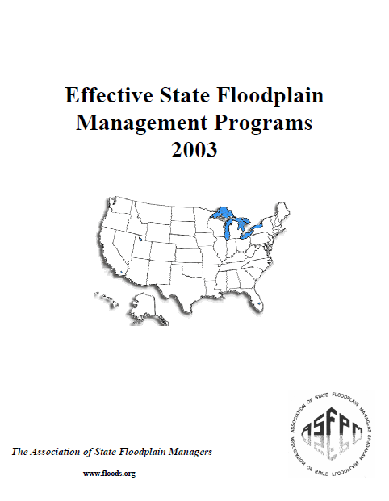
Effective State FPM Program (continued)
The state has the lead role in making FPM programs effective. That role is:
To clearly understand
what being effective in
FPM really means;
To identify the specific
capabilities and capacities
that the state has;
Notes:
Recommend that the mentee(s) peruse this ASFPM publication.

Slide 10
Effective State FPM Program (continued)
That role is (conclusion):
To identify what it needs to improve to be effective, and;
To provide accountability for federal and state funding.

Slide 11
Effective State FPM Program (continued)
The FEMA role is defined by the CAP-SSSE program, basically to obtain state assistance to achieve the goals of the NFIP. That role is:
To understand that states can and should have FPM program elements beyond NFIP coordination;
To match state capability and service requests, and;
To provide funding related to state need and capacity.
Notes:
Does CAP-SSSE fund your entire program? In other words, is it the only funding source you have to accomplish FPM within your state?

Slide 12
Effective State FPM Program (continued)
Overview of the method:
Foundation (Vision, Mission, and Mandates);
Scan (SWOT, self-assessment, gap analysis);
Strategies (build capability, increase capability, change policy), and;
Action (Who? How much? When?).
Notes:
SWOT: Strength, Weakness, Opportunity, Threat. (Yeah, I don’t really buy into “threat” either.)
A SWOT analysis enables you to identify the positives and negatives inside your FPM program and outside of it, in the external environment. It is helpful in giving you a full awareness of your situation and can assist you with both strategic planning and decision-making.

Slide 13
Effective State FPM Program (continued)
There are four building blocks in the strategic planning model. The first is preplanning:
Mission, Vision, and Mandates, and;
Provides the broad direction and philosophy that will be used to draw conclusions in the planning of strategies and actions.

Slide 14
Effective State FPM Program (continued)
The second is scanning:
CAP-SSSE GAP Analysis;
ASFPM Effective Programs Self-Assessment;
External Environmental Analysis, and;
Internal Environmental Analysis.
Notes:
External refers to large-scale trends, opportunities, threats.
Internal refers to capability, capacity, strengths and weaknesses.
What is influencing your ability to accomplish the mission and vision?

Slide 15
Effective State FPM Program (continued)
The third is planning strategies:
Broad strategies in response to issues or opportunities;
Profile of current state capability and capacity, and;
Desired outcomes.
Notes:
Profile of current state capability is knowledge, skill, and training. State capacity is staff and budget.
Desired outcomes are capability for effective service, flexible capacity, valued partner.
Build on strengths, take opportunities, compensate for weaknesses, and avoid threats.

Slide 16

Effective State FPM Program (continued)
The last building block / paddle stroke is acting to achieve:
Develop short and long-range specific actions (with measurement) to move from current capability and capacity to the desired level.
The “desire” is a balanced effective
State FPM program that includes
NFIP coordination.
Notes:
Review the bullet and then click to bring up Morgan and the stated “desire.”

Slide 17
Effective State FPM Program (continued)
The results:
State knowledge of the 10 guiding principles for an effective state floodplain management program;
Baseline of current state capability and capacity;
State has gap analysis data to show where resources and need do not match;
Notes:
This is the first time that we have mentioned “self-assessment.” The next slide will reveal what we mean by that.

Slide 18
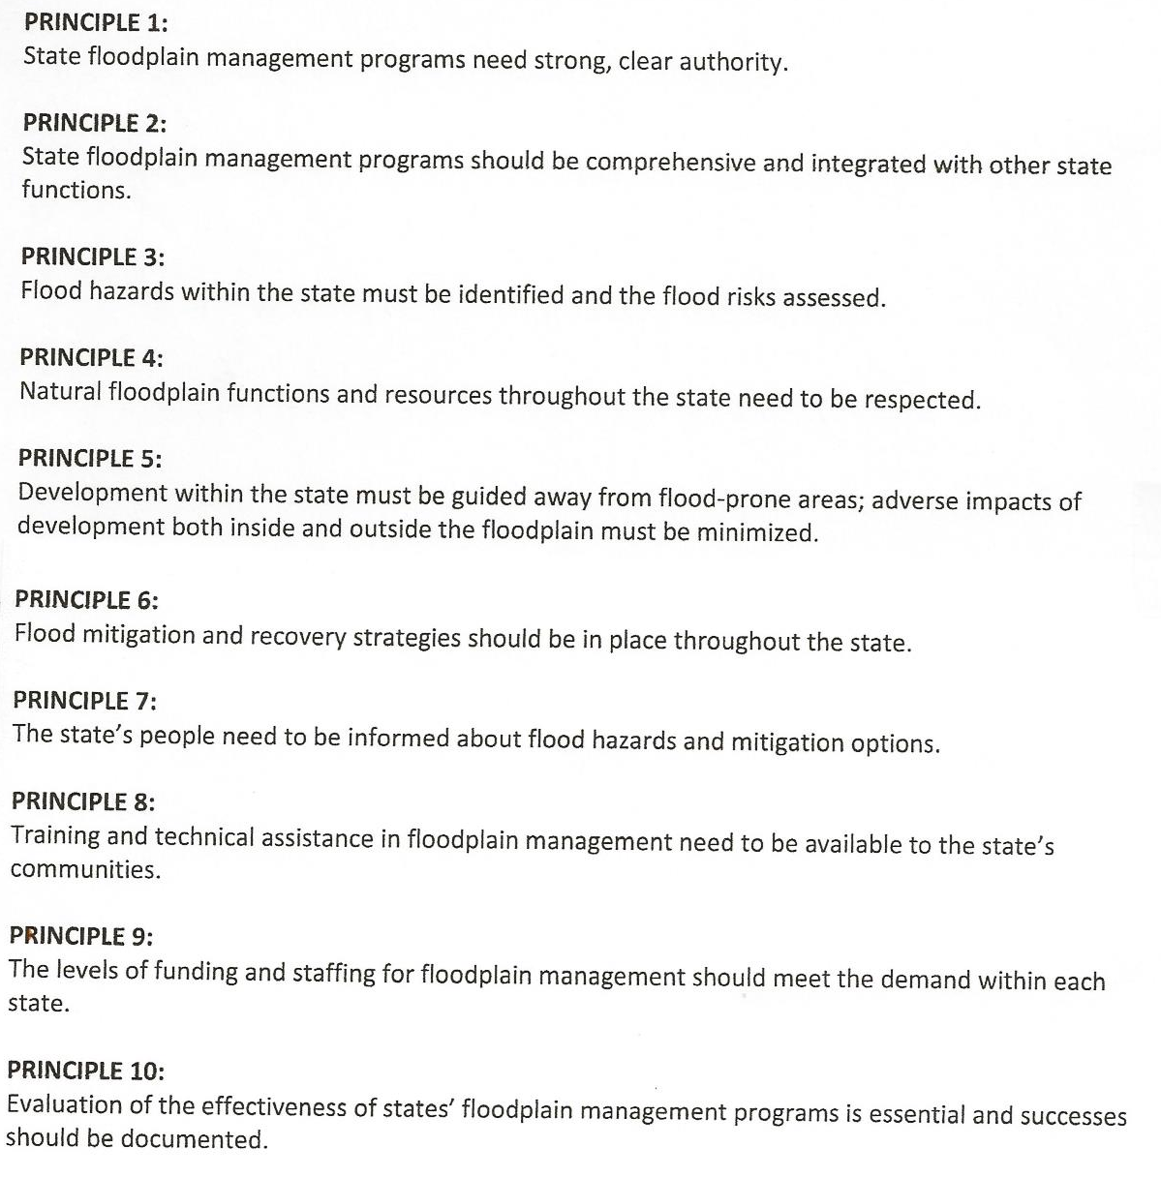
Self Assessment
The 10 guiding principles describe the main concepts of all effective state FPM programs and the “ideal” effective program elements to be used as a “blueprint” for state programs.
Notes:
(Job Aid 1)
This will be covered later in this module.

Slide 19
Effective State FPM Program (conclusion)
The results (conclusion):
State and FEMA NFIP goals can be integrated in long-range planning, and;
Strategies and annual work plan actions linked and measured against mutual outcomes of reducing flood damage and protection of floodplain resources.

Slide 20
After Action Review
Ever feel like you are missing something vital?
Notes:
Review any items or questions that were raised to ensure that there is no confusion or mystery to what you have covered.

Slide 21
Strategic Planning
Introduction. FEMA and ASFPM have developed:
Method for strategic planning that incorporates NFIP coordination with overall state FPM program;
Guidance for using self-assessment and the 10 guiding principles for developing effective state FPM programs, and;
Recommendations for using state capability and capacity information in CAP-SSSE planning.
Notes:
Review each bullet.

Slide 22
Strategic Planning (continued)
Key Strategic Terms
Outcome (aka the result) – Improved state FPM program effectiveness through capability in a full-range of floodplain management services, and flexible capacity to address changing NFIP coordination or state priorities.

Slide 23
Strategic Planning (continued)
Key Strategic Terms (continued)
Capability – Equals competency, knowledge, skill and training in the basic program elements and functional areas of floodplain management.
Capacity – Is the current, or projected, ability to take action and the resources needed to perform the required or desired activities.

Slide 24
Strategic Planning (continued)
Key Strategic Terms (conclusion)
Outputs (aka products):
Baseline of current state capability and capacity; needs and resources;
State Self-Assessment for effective FPM;
CAP-Gap Analysis;
CAP 5-Year Strategic Plan, and;
CAP Annual Work Plan.
Notes:
What are you doing now?
What should you do?
What strategies and goals will get you to where you wish to go?
How are you committing the resources that you have?

Slide 25
Strategic Planning (continued)
Why Strategic Planning?
Direction – Supports logical and planned response to dynamic changing environment;
Implementation – Uses strategies that build on strengths and avoids threats while linking actions to achievements, and;
Evaluation – Provides measure for progress and shows results.
Notes:
Standard strategic planning jargon.

Slide 26
Strategic Planning (continued)
Strategic planning objectives:
State gain ability to assess FPM program effectiveness and prioritize activities;
Accountability;
Integrate NFIP coordination with overall state FPM activities;
Notes:
Review each bullet.

Slide 27
Strategic Planning (continued)
Strategic planning objectives (conclusion):
FEMA gains understanding of state needs, capability and capacity, and;
Identify gap between state capability / capacity and needed service / activity.
Notes:
Review each bullet.

Slide 28

Practical Exercise #1
Let’s look at the Strategic Planning Worksheet #1:
Mission
What do you do, why, and for whom?
Consistent with your statutory authority and purpose? Are you unique?
Vision
What is your ideal future state?
Stakeholders
Who’s affected by your actions?
Notes:
Direct the mentee(s) attention to Worksheet #1 and complete the exercise.

Slide 29
Practical Exercise #2
Let’s look at the Worksheets #2 & #3:
SWOT – Identify specific issues, trends and forces that can influence the achievement of your mission and vision.
Strengths
Weaknesses
Opportunities
Threats
Notes:
Direct the mentee(s) attention to Worksheet #2 and complete the exercise.
Direct the mentee(s) attention to Worksheet #3 and complete the exercise.

Slide 30
After Action Review
Ever feel like you are missing something vital? Let’s do a quick review and then take a break.
Notes:
Review any items or questions that were raised to ensure that there is no confusion or mystery to what you have covered.

Slide 31
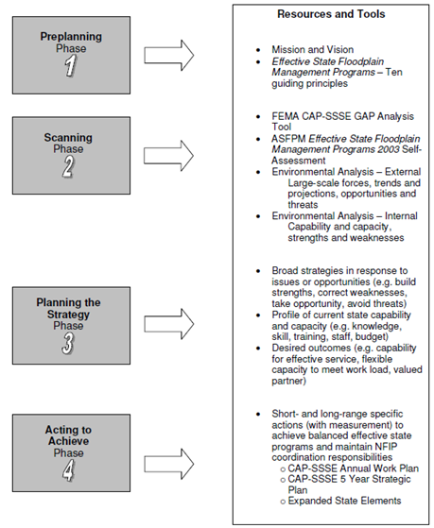
Strategic Planning (continued)
A Quick Review:
Strategic Planning Model
Notes:
As a reminder, here’s what we are trying to do with the strategic planning:
consider the purpose of the floodplain management program/activities;
prioritize decisions;
Identify strategies and actions that move toward the outcome;
allocate resources and people.

Slide 32
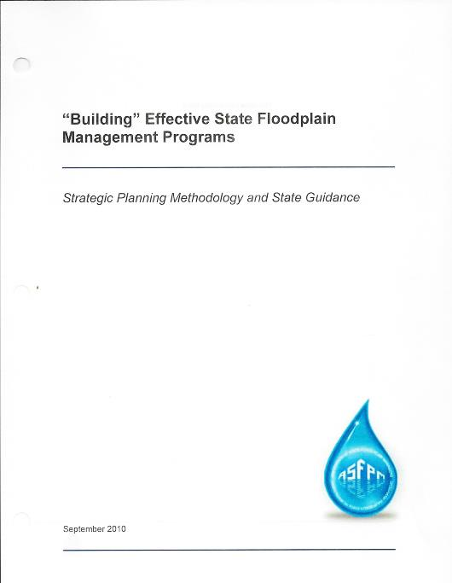
Strategic Planning (continued)
Preplanning Phase
Mission, Vision, and Mandates;
Stakeholders, and;
What does “effective” look like?
ASFPM “Building” Effective State Floodplain Management Programs.
1
Notes:
Phase 1 of the planning process. ASFPM has a publication entitled “Building” Effective State Floodplain Management Programs, which would be of interest to you.
Strategic Planning also includes a “preplanning phase” and a “scanning phase.”
Review the bullets.
This is the foundation for building an effective state floodplain management program.
Understanding
why your program/agency exists,
whom you serve, and
what your authorities, statutes and mandates require
will serve as filters for decisions about priorities, funding, and resources.

Slide 33

Strategic Planning (continued)
Mission Statement | Ideally, this is a short concise summary of why your agency or program exists. Answer what you will do? Why you do it? For whom you do it? Sample: Provide leadership to local governments, state agencies, and interested parties for cooperative management of State of Perfection’s floodplains to support reduced flood damage and protection of natural floodplain functions and benefits. Broad strategies of partnership, technical assistance, public awareness/education, and development standards will be used to achieve the goals.
Vision Statement | The vision should be the picture of what you want to become, or be at some point in the future. The vision focus is on the outcomes that you want to achieve. Sample: A balanced state where people are safe, development is minimally impacted by flooding and floodplain functions and resources are healthy when it floods!
Mandates / Statutory Authorities | The mandates are the “must be done” items. These should be clearly related to why you exist (e.g. addressing a specific problem, avoiding a potential problem, correcting a past problem) and for whom you serve. Sample: Annual CAP-SSSE Guidance; State Enabling Statutes for NFIP Coordination or Floodplain Management Coordination.
Notes:
Quick overview of the foundation for the planning effort - Mission, Vision, Mandates. This example is related to building effective state floodplain management programs and is in the state guidance.
Hopefully, most programs/agencies will have some basic mission, vision, and mandate information to support the preplanning.
Beginning to SCAN the environment – Worksheet #2. Information from the scan will tell us the parameters and constraints affecting how we build the program .

Slide 34
Strategic Planning (continued)
Scanning Phase
External / Internal Environmental Analysis;
CAP-SSSE GAP Analysis, and;
ASFPM Effective Programs Self-Assessment.
2
Notes:
Phase 2 of the planning process.
Review the bullets.
We can build effective programs following the same concepts we use to build structures -
Once the foundation is laid, we begin to “frame” a building.
Strategically speaking the “frame” of our program will address the constraints, parameters and limitations that affect how we operate as a program.
Scan the environment to identify the constraints, parameters and limitations.
How do we SCAN?
SWOT analysis
CAP-SSSE Gap Analysis
Self-assessment against the ASFPM Effective Program Principles
External environment are the broad factors that you don’t necessarily have control over, but need to be aware of (political / legal changes, technological changes, demographic changes, public attitudes, economic changes, climate changes and trends and projections).
Internal environment are the narrower circle of things that impact what and how you achieve your mission (statutory authority / mandates, human resources, capability, capacity, organizational structure, financial resources).
The NFIP Evaluation and ASFPM reviews are good sources for environmental analysis (AIR and State and Local Programs).
The CAP GAP Tool will show us the capability and capacity information for NFIP Coordination.
Self-Assessment applies the concepts of capability and capacity information beyond NFIP coordination activities to all effective program activities.

Slide 35
Strategic Planning (continued)
NFIP Coordination – CAP-SSSE
NFIP Coordination: CAP-SSSE funds specific activities in support of the NFIP goals. CORE CAP activities require a state resource and funding commitment.
CAP Annual Work Plan: provides accountability, target goals, specific actions, budget and staffing requirements.
Notes:
Module 5 covers CAP-SSSE in great detail. This module simply shows how CAP ties in with the holistic view of FPM.
Review the bullets.

Slide 36

Strategic Planning (continued)
NFIP Coordination – CAP-SSSE (continued)
CAP 5-Year Strategic Plan: NFIP coordination integrated with overall state floodplain management program.
Notes:
Review the bullet.

Slide 37
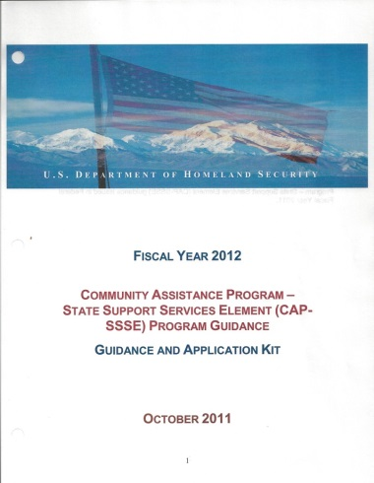
Strategic Planning (continued)
NFIP Coordination – CAP-SSSE (continued)
2012 CAP Guidance included ten program elements that lead to effective CAP programs built around CORE tasks.
CORE tasks are those needed to maintain a basic state capability and competency to help communities with NFIP participation.
Notes:
Review the bullet.

Slide 38
Strategic Planning (continued)
NFIP Coordination – CAP-SSSE (continued)
CAP GAP Analysis Tool contains:
State specific information
“Time and Effort” assumptions
Baseline level of effort for a specific task
GAP calculated on state input versus baseline for a task
CORE CAP program summary of state commitment
Notes:
Review the bullets.

Slide 39
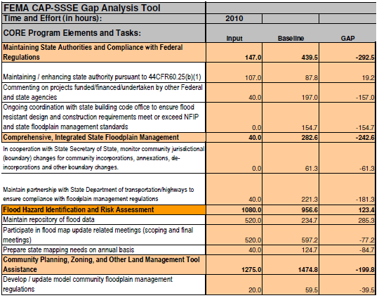
Strategic Planning (continued)
Notes:
Remember this? The tab where you input your state’s time and effort forecast for five years.
This is an example of a state Gap Analysis from the FEMA Tool.
The Core Activities (colored headers) are linked to the functional areas of effective state floodplain management programs.
The “input” column represents the state effort.
The “baseline” was determined based upon a survey of states and is the average level of effort and or cost required for the activity.
The “gap” is the difference between the state’s effort and the average of many states.

Slide 40
Strategic Planning (continued)
Notes:
Remember this? The tab which indicates your percentage of gap.
The GAP Tool provides a summary of the state’s effort relative to an “average” or baseline for each of the functional areas. When the state’s level results in a “gap” of greater than 25%, the state is encouraged to review why and rebalance commitments if needed.
Using the GAP summary, a state can determine if they are meeting the capability and capacity demands for CORE CAP activities.

Slide 41
Practical Exercise #3
Let’s look at the Strategic Planning Worksheet #4:
CAP GAP – Allocating your resources among the 10 CAP-SSSE program elements
How does the state compare to the baseline level of time and effort? GAP areas?
Are there CORE elements or tasks not addressed in current efforts?
Notes:
Direct the mentee(s) attention to Worksheet #3 and complete the exercise.
The “input” compared to the “baseline” projections for each program element will show a state where it is meeting the need and where adjustment may be necessary.
The “gap” is provided in both hours and dollars for CAP Core activities.
This summary sheet provides a snapshot of how the state’s resources (man hours and dollars) are distributed among the 10 program elements (relate to the ASFPM 10 principle functional areas).
This tool can help a state to evaluate how well it balances CAP activities, and how the allocation impacts broader overall effective state FPM program elements and activities.
For example, how might post disaster activities impact other state program priorities such as compliance monitoring or ordinance assistance?

Slide 42
Strategic Planning (continued)
NFIP Coordination – CAP-SSSE (conclusion)
Non-CAP GAP Analysis:
The CAP GAP uses baseline data (national survey, custom formulas, state specific info) for CORE CAP activities.
The Non-CAP and Advanced CAP activities have no established baseline. Use current capability and capacity as a start-point.
Notes:
Review the bullets.
CAP Gap Analysis is a good tool, BUT it doesn’t show a state the whole picture. It is limited to only CAP, NFIP activities so far.
States that are familiar with CAP GAP Analysis, can build off this to begin a comprehensive gap analysis that includes activities that are ADVANCED CAP and state floodplain management (above and beyond NFIP).
Challenge – we don’t have the baseline yet for program activities beyond CORE CAP.
Alternatives:
One way to address this is to use “current state” time and effort versus a “desired state” to begin collecting information.
ASFPM is also exploring ways to use the data collected from the survey of state and local floodplain programs to provide national averages on time and effort for a variety of activities and program elements above and beyond the NFIP.

Slide 43
Self-Assessment
Self-Assessment. The goals are:
A baseline profile of unique, comprehensive state program elements and activities related to the ASFPM 10 Guiding Principles;
Documented capability, capacity and needs (gap identified) for FPM service, and;
Use of the ASFPM “vision” as a consistent approach to integrate CAP-SSSE activities and balanced state programs.
Notes:
We have the GAP Tool data, why self-assessment? As Paul Harvey might have said “…for the rest of the story.”
The CAP GAP Analysis gives states a clear picture of what it will take to coordinate the NFIP. However, it does not necessarily show all the state does for floodplain management and will not document overall program needs and gaps for service and activities other than NFIP.
The state self-assessment against ASFPM Effective State Programs is recommended to address this need. The 10 guiding principles provide key areas to review.
Capturing state capability and capacity in activities and program elements will allow a state to compare comprehensive program activities with CAP NFIP activities.
This approach will begin to integrate NFIP coordination with overall comprehensive state floodplain management through planning, gap analysis, and self-assessment.
Pages 23-34 in the state guidance provides more information on how self-assessment should be done.

Slide 44
Self Assessment (continued)
Self-Assessment. The goals are (conclusion):
Use of the ASFPM effective state floodplain management program “vision” as a consistent approach to integrate CAP-SSSE activities and balanced state programs.
Notes:
And the …

Slide 45
Self Assessment (continued)
Self-Assessment: Capability and Capacity are the assessment focus.
Knowledge, skill, and training.
Ability to take an action (budget and staff).
Notes:
And the …
The self-assessment should be conducted to document capability and capacity in the same consistent way the CAP Gap Tool was designed.
Remember the strategic terms CAPABILITY and CAPACITY!

Slide 46
Self Assessment (continued)
Self-Assessment:
States should use the 10 principles and best practices identified in the ASFPM “Effective State Floodplain Management Programs” as a benchmark for effectiveness.
Identify where your program is relative to the “standard.”
Notes:
Think of the 10 guiding principles from ASFPM as a benchmark or “blueprint” for an effective state program.
Evaluate how well your state program compares to the peer identified standard. In the later stages of strategic planning you will identify specific actions or program elements to bring you closer to the effective overall state floodplain management program.
Pages 26-31 of the guidance manual provide instruction and an example of how to profile your state program elements and activities.

Slide 47
Self Assessment (continued)
The 10 guiding principles describe the main concepts of all effective state FPM programs and the “ideal” effective program elements to be used as a “blueprint” for state programs.
Notes:
Job Aid 8
Let’s review the principles quickly. These are the key areas or functions that are common to effective state floodplain management programs.
The principles and related program elements and activities are derived from ASFPM research that is detailed in the “Effective State Floodplain Management Programs 2003” publication. You should pre-read and be familiar with the information in this publication to complete a successful self-assessment for strategic planning.

Slide 48
Self Assessment (conclusion)
Self-Assessment:
A peer standard for effective state floodplain management programs has been established.
Create a profile of your state’s activities and services in the program elements and functional areas of an effective program (the 10 Guiding Principles).
Notes:
Self-assessment provides data (consistent capability and capacity information) to use in decisions about how and what will be done, and what will be needed to do it.
Include the CAP-SSSE activities under the appropriate principles to provide a comprehensive picture of the state’s floodplain management program.
Even states with no program elements or activities beyond their current CAP-SSSE activities can benefit by reviewing what other program elements and activities might be effective in their state.

Slide 49
Practical Exercise #4
Let’s look at Worksheets #5 & #6:
Program Element Profile Worksheet #5
This worksheet provides a template for recording and reviewing your state activities in each of the floodplain program functional areas.
Worksheet #6
This is a checklist that can be used with Worksheet #5 to help identify activities, services, tools and techniques.
Notes:
How do you profile the current program activities and elements?
Worksheets #5 and #6 support the self-assessment by providing a template for the profile of current or desired program activities and elements related to the 10 principles.
Use Worksheet #6 as a checklist for helping to identify which activities or program elements your state has in the 10 functional areas identified for effective programs. Your response to the ASFPM State and Local Floodplain Management Program Survey may also be useful.

Slide 50
Practical Exercise #5
Let’s look at the Strategic Planning Worksheet #7:
Self-Assessment Gap Summary
For each state program element summarize the current service/activity level and the desired service/activity level.
The “gap” becomes the difference between your current capability and capacity levels and the desired levels.
Notes:
Following the same approach as the CAP GAP Analysis, once you have completed the individual activity/element worksheets, summarize the activities currently done and relate them to the desired or future level target need.
The “gap” will be the difference of capability and capacity now, versus where you would like to be.

Slide 51

After Action Review & Break
Ever feel like you are missing something vital? Let’s do a quick review and then take a break.
Notes:
Review any items or questions that were raised to ensure that there is no confusion or mystery to what you have covered.
Take a 15 minute break.

Slide 52
Strategic Planning (continued)
State Role:
Clearly understand what being effective in floodplain management means;
Identify specific capabilities and capacities;
Identify what needs improvement to be more effective, and;
Be accountable for federal and state funding.
Notes:
Our planning efforts, strategies and goals should cooperatively direct FEMA and states toward the big outcomes of reduced flood risk and naturally functioning floodplains!
State benefits from effective floodplain management include:
Protecting health and safety of citizens
Preserving quality of life (environmental and economic)
Minimizing State and Local economic cost (response, recovery, mitigation)

Slide 53
Strategic Planning (continued)
Next Steps:
Revisit Mission, Vision, and Mandates;
Gather stakeholder input;
Complete SWOT;
Complete CAP GAP Analysis;
Complete Self-Assessment using ASFPM’s 10 Principles for Effective FPM Programs.
Notes:
Phase 3 and 4 of the process – Building Strategies and Acting to Achieve will be based on the information that comes from the first two phases of the process.
Do you have a good foundation? - understanding the purpose of the program/agency and whom it serves.
What external threats and opportunities can impact your program? - identify relevant issues from the scan information.
What internal program strengths and weaknesses have been identified? – remember capability and capacity.

Slide 54
Strategic Planning (continued)
Managing a State Strategic Planning Effort
Timeline:
Four-step process
Writing CAP plans
Assignments:
SWOT & CAP Gap Analysis
Program Self-Assessment & Writing the Plan(s)
Notes:
The estimate is that the four step process can be completed in 6-8 weeks. It’s most beneficial if done when you are preparing CAP-SSSE application and work plan.
Maybe with reluctance, but the reward can be big!

Slide 55
Strategic Planning (continued)
Timeline
Preplanning (1 week)
Acting to Achieve (3-4 weeks)
Scanning (3-4 weeks)
Kick-off meeting [date]
SWOT [due date]
CAP GAP Analysis [due date]
Program Self-assessment [due date]
Strategy Building (2 weeks)
Strengths / Opportunities
Strategies development meeting [date]
Goals and measures [due date]
CAP 5-Year Strategic Plan [draft due]
CAP Annual Work Plan [draft due]
Threats / Weaknesses
Capability / Capacity
Notes:
The actual time to complete the process will depend on how the state wants to manage the activities. Many activities can be done simultaneously (especially in the first two phases).
The state should have 1-3 key strategies that will guide the preparation of the CAP 5-Year Strategic Plan, before scheduling the second visit.
The FEMA GAP Analysis Summary should be used to prepare the CAP Annual Work Plan.
With State commitment and good preparation, the effort is estimated to take 6-8 weeks.

Slide 56
Strategic Planning (continued)
Getting Organized:
Supporting the planning process
Drawing conclusions from the scan
Preparing the long-range CAP Plan
Content and format
Preparing the CAP annual work plan
Content and format
Notes:
At this point, you have a lot of information – it needs to become relevant.
In terms of the process, you are looking to organize data to determine what your state capability and capacity is relative to the 10 principle areas of effective floodplain management programs (including NFIP Coordination).
You need to evaluate how well your state program is performing compared to the “standards” for effectiveness?
The CAP plans are how the state and FEMA will communicate the planned strategies and actions for achieving outcomes and goals. The annual plan provides a means to measure progress and account for funding. Performance measures, deliverables and budget are appropriate components.
The long-range strategic plan (5 year focus) provides broad key strategies that move the state toward the desired outcome(s). Progress milestones, outcomes and goals are appropriate.

Slide 57
Strategic Planning (continued)
Planning the Strategy Phase:
Developing strategies
Planning actions to manage the issues and challenges
Supporting data and valid conclusions
3
Notes:
In phase three of the process, the focus is on PLANNING or strategizing to develop broad direction and goals that will keep you moving toward what you want to achieve, despite the environmental factors that can hinder or challenge your progress.
It’s about making decisions. Having what you need to support good decision-making.

Slide 58
Practical Exercise #6
Let’s look at the Strategic Planning Worksheet #8:
Strategy Development
Worksheet #8 should be used to identify strategic issue(s), one or more broad strategies to address it and specific actions and measures to track progress toward the outcome.
The details on the worksheet will help to develop the long-range and annual work plans.
Notes:
To begin to understand the broad nature of strategies think about the two big issues the strategic planning will address.
Does your state have capability (core floodplain management competencies) to be effective?
Does your state have capacity (staff and budget) to meet the planned workload for NFIP Coordination? For state floodplain management priorities?

Slide 59
Strategic Planning (continued)
Strategy Development:
Understand your state FPM problems and issues
Review SWOT information for major issues and trends.
What happens if you don’t address the problems or issues?
Notes:
“If you don’t know or care where you are going – does it matter what road you take?”
Pages 34-38 in the state guidance show you some examples of how to draw conclusions from the information you have collected.
Are there specific competencies that have not been developed in your state? Maybe you have no mapping ability, or no compliance authority?
If you don’t develop these areas, will floodplain management in your state be impacted? Hazards not identified? Future development with increased risk?

Slide 60
Strategic Planning (continued)
Strategy Development (continued):
What are you doing well and what needs to be improved?
Does your state have capability (core FPM competencies) and authority to be effective?
Does your state have capacity (staff, budget to meet NFIP coordination workload? For state FPM activities?
Notes:
Your strategies should be built on the capability and capacity you have and intentionally direct you away from threats.

Slide 61
Strategic Planning (continued)
Strategy Development (continued):
What are you mandated to accomplish?
Worksheet #1
What would you like to achieve?
Develop broad strategies that direct the specific actions that will be needed to achieve the outcomes and goals.
Notes:
Think strategically, make decisions based on consistent data (capability and capacity) about what you are doing, what you should be doing and what will be effective.

Slide 62
Strategic Planning (continued)
Strategy Development (continued):
What is a strategic issue?
A policy or challenge that affects your ability to take actions, serve constituents or allocate resources to achieve the mission.*
*Based upon the work of John M. Bryson (Strategic Planning for Public and Nonprofit Organizations, 1993)
Notes:
Based upon the scan information (SWOT, CAP GAP Analysis and Self-Assessment) are there things jumping out?
Strengths, Weaknesses, Opportunities and Threats
Look for issues that you can do something in response to.
For example, as the demand for technical assistance increases we notice that our staffing and budget are shrinking. We also see that technology improvements provide us with more efficient ways to retrieve, interpret and distribute flood hazard information. Can we identify a strategy that will help address more service demand with better technical assistance delivery?

Slide 63
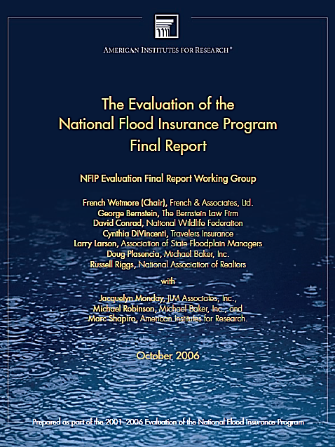
Strategic Planning (continued)
Strategy Development (continued):
Strategic issue:
“Some would view CAP-SSSE as not effective because there is poor accountability, no link to state need or capability, and state potential is not fully used.”
Notes:
To demonstrate how a strategy should be in response to a strategic issue look at this CAP specific example.
The issue was identified in the NFIP Evaluation.

Slide 64

Strategic Planning (continued)
Strategy Development (continued):
Strategy:
Collaborative strategic planning to balance NFIP Coordination (CAP activities) with the complete range of floodplain services needed for an effective state program.
Notes:
The strategy for strategic planning developed out of FEMA ASFPM collaboration.

Slide 65
Strategic Planning (continued)
Strategy Development (continued):
Review of State Scan Data:
SWOT
CAP GAP
Self-assessment
Notes:
Identify 1-3 key strategic issues you want to address.

Slide 66
Strategic Planning (continued)
Planning Actions to Manage Issues:
Using what we know - States:
What being effective means;
Specific capabilities and capacities;
Weaknesses and threats are areas for improvement, and;
Accountable.
Notes:
Once the issue is framed, the actions to address it can be developed.
The issue - CAP-SSSE is an important mechanism to both states and FEMA in achieving FPM goals and outcomes, but it is not as effective as it could be.
A broad STRATEGY to address the issue –integrate the NFIP coordination into effective state FPM programs.
FEMA and states will need many actions to achieve the outcome.
This project begins the foundation through planning and data collection.

Slide 67

Strategic Planning (continued)
Planning Actions to Manage Issues (continued):
Using what we know - FEMA:
States can/should have FPM beyond the NFIP;
Match NFIP service with state capability;
Provide funding related to state need and capacity, and;
Accountable.

Slide 68
Strategic Planning (continued)
Planning Actions to Manage Issues (conclusion):
Actions address the outcomes and outputs.
Possible Outcome areas (results):
Safe people;
Sustainable development;
Healthy floodplain functions and resources, and;
Balanced NFIP coordination and effective state FPM.
Notes:
This brings us full circle in the planning process – what we do (program actions and elements) has to get us to the outcomes we are after. The outputs are the things that show we are working, but not the end results.
Pages 47-49 in the guidance manual provide more explanation of these terms and how to use them in the plans.

Slide 69
Strategic Planning (continued)
Acting to Achieve Phase:
Writing the plans
Outcomes and Outputs
Objectives and Goals
Actions and Measures
CAP-SSSE 5-Year Strategic Plan
CAP Annual Work Plan
4
Notes:
The 4th phase of the planning process.
Strategic thinking and the planning process have value in themselves; however, committing your plan to writing will also have value. It becomes the communication tool and helps you to measure progress and document success.
Pages 46-52 in the guidance manual provide more support for writing the CAP plans strategically.

Slide 70

Strategic Planning (continued)
Acting to Achieve Phase:
Writing the plans (continued)
Outcome equals Achievement or desired performance level
Output equals products and deliverables that result from activities
Notes:
Review of key strategic elements.
Examples of the outcome and output for the strategic issue of CAP-SSSE effectiveness.
Outcome: FEMA and the states experience strategic thinking and action while cooperatively building effective state floodplain management programs.
Output: Communication and strategic plans for NFIP coordination and state program development.

Slide 71
Strategic Planning (continued)
Acting to Achieve Phase:
Writing the plans (continued)
Strategies are broad and guiding; consistent with the purpose, policy and resources of your agency / program; in response to strategic issues.
Goals / Objectives defines the aspect of what you are trying to achieve; specific, measurable and realistic; linked to a timeframe.
Notes:
Review of key strategic elements.

Slide 72
Strategic Planning (continued)
Acting to Achieve Phase:
Writing the plans (continued)
Actions detail of what needs to be done and how success will be measured.
Measures are specific on time, outcome or output; shows progress and defines success.
Notes:
Review of key strategic elements.

Slide 73
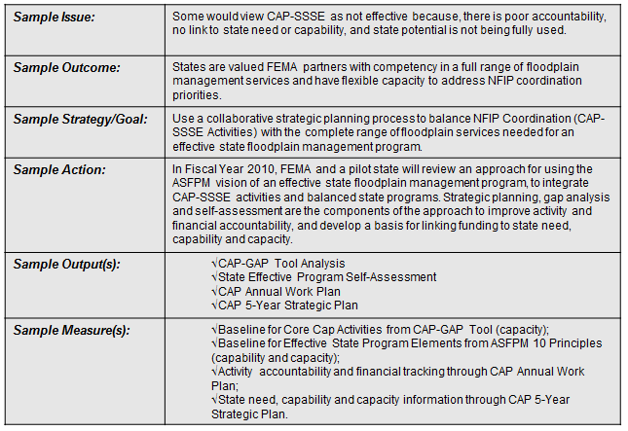
Strategic Planning (continued)
Writing the Plans:
Notes:
This slide should depict how you “pull all the pieces together.”

Slide 74
Strategic Planning (continued)
Acting to Achieve Phase:
CAP 5-Year Strategic Plan
Purpose is to support collaborative negotiation between FEMA and the states; long-range outcomes and communication tool.
Notes:
Review of the CAP strategic plan.
Long-range can be overall state floodplain management and show how the NFIP is integrated.

Slide 75

Strategic Planning (continued)
Acting to Achieve Phase:
CAP 5-Year Strategic Plan (conclusion)
Strategic issues are funding not matched to need and NFIP coordination service demand; criteria for allocation of CAP funding; consistent state need and capability information; accountability for activities and funding..

Slide 76
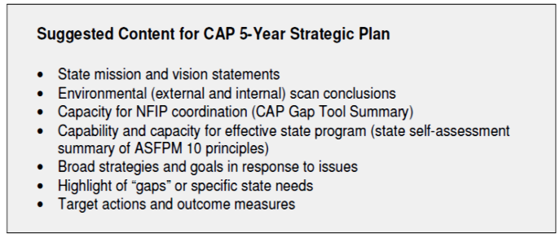
Strategic Planning (continued)
Writing the Plans:
Notes:
See page 46 in Strategic Planning Methodology and State Guidance.

Slide 77
Strategic Planning (continued)
Acting to Achieve Phase:
Writing the plans (continued)
CAP Annual Work Plan’s purpose is to address specific CAP-SSSE grant criteria.
GAP Analysis Tool worksheet provide framework for the work plan. Specific task measures (outputs and deliverables) and financial accountability (time and cost details) are all present.
Notes:
This is where you provide accountability. Outputs, resources – budget and staff

Slide 78
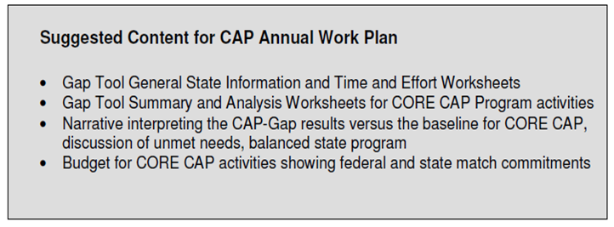

Strategic Planning (continued)
Writing the Plans:
You are ready to put
your plan to paper!
Notes:
Morgan thinks you are ready. Let’s quickly cover “Outcomes,” “Outputs,” and “Success.”

Slide 79
Strategic Planning (continued)
Helpful Strategic Hints:
Outcomes:
Self-assessment approach to evaluate state FPM program effectiveness;
Strategic planning process to integrate capability and capacity needs for basic CAP-SSSE performance and effective state floodplain management service, and;
Documented state capability and capacity information for floodplain management activities (NFIP & state priorities).

Slide 80
Strategic Planning (continued)
Helpful Strategic Hints (conclusion):
Outputs:
CAP Gap Analysis;
State Effective Program Self-Assessment;
Improved CAP 5-Year Strategic Plan, and;
Improved CAP Annual Work Plan.

Slide 81

Strategic Planning (conclusion)
Progress toward your Goals:
Success:
FEMA and states thinking strategically;
Improvement of current capability and capacity through vision for effectiveness;
Creating the climate for and identifying opportunities for change, and;
Integration of NFIP Coordination with overall state floodplain management program.

Slide 82
After Action Review
Ever feel like you are missing something vital?
Notes:
Review any items or questions that were raised to ensure that there is no confusion or mystery to what you have covered.

Slide 83
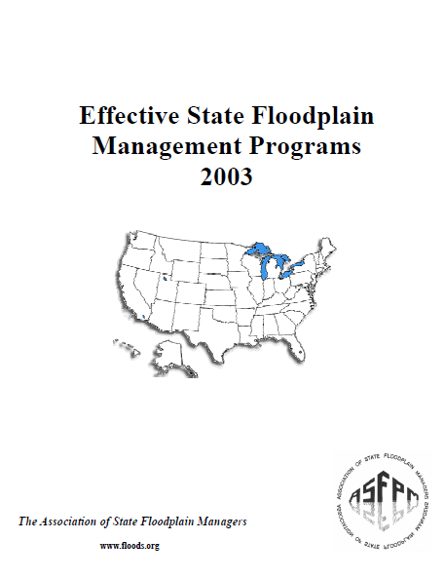
Funding & Staff Levels
Notes:
Pages 88 – 91 of this ASFPM publication covers the topic of Funding and Staffing quite well.
We will summarize the topic in the next few slides. I recommend that you peruse this document for further details.

Slide 84
Funding & Staff Levels
The funding and staffing of a state NFIP Coordinating Office will vary greatly depending on:
The size of the state agency (in relation to available state budget / funding);
The emphasis placed upon floodplain management by the state coordinating agency itself, and;
Past experiences with both state and federally declared flood/hurricane state of emergencies.
Notes:
Now, let’s begin the summary.
Review each bullet and ask for reactions from the mentee(s).
There is no actual “manning chart” or any other description of a federally approved NFIP Coordinating office staff’s makeup.
There is only the duties and responsibilities of the NFIP State Coordinator’s office set forth in 44 CFR 60.25 of the NFIP regulations.
Click for a “screen capture” of the duties as listed in 44 CFR 60.25.

Slide 85
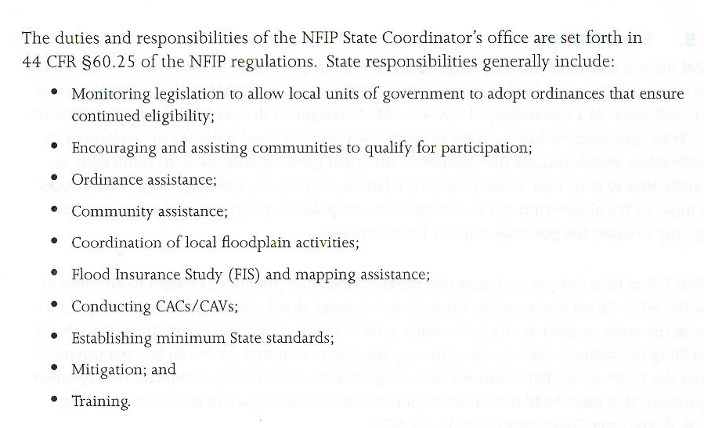
Funding & Staff Levels (continued)
Notes:
The duties and responsibilities of the NFIP State Coordinator’s office are set forth in 44 CFR 60.25.
How would you go about developing a manning/staffing chart for an office charged with these duties? What FEMA provided tool might assist in this endeavor?
How is your office presently organized? What is your job title and the titles of any staff you may have? What types of vehicles do you have at your disposal? Equipment? Do you see a need for change? Is this a case of “That’s the way it has always been?”

Slide 86
Funding & Staff Levels (continued)
The levels of funding & staffing for FPM should meet the demand within the state:
Effective state FPM programs should not rely solely on federal funding.
Adequate state provided staff resources and funding are necessary to reduce state and local flood costs and damage.
Notes:
Review the bullets.

Slide 87
Funding & Staff Levels (continued)
Effective state programs have:
Assessed the needed level of funding and staffing, based on factors appropriate to the state such as:
Frequency and severity of flooding
Extent and capability of local administration
The anticipated functions of staff members
Notes:
Review the bullets.
With this information a budget can be developed for salaries, operations, mapping, and other activities.

Slide 88
Funding & Staff Levels (continued)
Making wise use of the state’s floodprone areas is fundamentally the responsibility of state and local governments.
The state program cannot rely solely on federal standards to address local circumstances; nor on federal funding to meet all of the state’s needs and the local demands.
Notes:
Review the bullets.

Slide 89

Funding & Staff Levels (continued)
Most importantly, the state cannot depend on federal action to reduce state and local costs and damage associated with flooding.
Notes:
Review the bullets.
Photo by Al Goodman. DHS Blackhawk which arrived at the State Emergency Response Team location a few days after Katrina in 2005. They didn’t bring any help that could be used. “We asked for ice and ICE dropped in.”

Slide 90
Funding & Staff Levels (continued)
The most definitive way to establish the optimum number of staff positions and appropriate funding levels is to:
Conduct a detailed needs assessment that examines all aspects of the FPM program.
It must include readily measurable tasks and those which can only be assessed indirectly.
Notes:
Review the bullets.
What does the second bullet mean? Let’s see. (Click for next slide.)

Slide 91
Funding & Staff Levels (continued)
For example:
Past records of the number and types of technical assistance rendered to the local communities may not reflect the number of requests and assistance provided.
Locals may not be aware of the availability of your tech assistance and simply have not asked.
These are hidden costs that must be identified.
Notes:
Review the bullets.
A method must be found (which works for you) that will access these hidden needs in order to assign funds and staff.

Slide 92
Funding & Staff Levels (continued)
Staff Levels and Capabilities:
State FPM programs are affected by:
Adequate staffing with personnel who have the required knowledge, skills, and abilities in FPM;
The number of floodprone local jurisdictions;
The frequency and severity of flooding;
Notes:
Review the bullets.

Slide 93
Funding & Staff Levels (continued)
Staff Levels and Capabilities:
State FPM programs are affected by (continued):
The degree of state regulatory authority affects staffing requirements (e.g. state permit issuance requires more personnel than one that only monitors the local jurisdiction performance);
Notes:
Review the bullets.

Slide 94
Funding & Staff Levels (continued)
Staff Levels and Capabilities:
State FPM programs are affected by (continued):
A state mapping program that performs studies in-house, or reviews and approves LOMC from local communities requires a different type of staffing, and;
The number and frequency of community visits (CAC and CAV), tech assistance, and workshops often determines the number of staff needed.
Notes:
Review the bullets.
However, how you determine the method needed to achieve your goals and objectives is up to you. Some assistance might be in another state agency or a different department in your agency.

Slide 95
Funding & Staff Levels (continued)
Staff Levels and Capabilities:
State FPM programs:
The “rule of thumb” can be the assignment of one staff person per 25 to 35 NFIP member communities (can be adjusted up or down, depending on size of the state), and;
Field Offices can be established in the various districts within the state.
Notes:
Review the bullets.
These ideas may or may not be possible, depending on budget staffing, etc.
Why would a “field office” be a positive asset to a state program? (Communities would get to know the FPM Specialist, trust them, call on them for tech assistance and guidance.)

Slide 96
Funding & Staff Levels (continued)
Staff Levels and Capabilities:
Appropriate mix of professional disciplines can be selected among the following:
Certified Floodplain Managers
Professional Planners
Civil engineers, water resources engineers, and structural engineers;
Notes:
Review the bullets.

Slide 97
Funding & Staff Levels (continued)
Staff Levels and Capabilities:
Appropriate mix of professional disciplines can be selected among the following (continued):
Geographic Information System specialists
Specialists in geology, geography, ecology, coastal geomorphology, fluvial geomorphology, hydrology, meteorology, and emergency management;
Notes:
Review the bullets.

Slide 98
Funding & Staff Levels (continued)
Staff Levels and Capabilities:
Appropriate mix of professional disciplines can be selected among the following (conclusion):
Public information specialists and trainers needed to develop outreach initiatives and deploy workshops and training sessions, and;
Administrative support staff, including technicians.
Notes:
Review the bullets.

Slide 99
Funding & Staff Levels (continued)
Maintaining an effective state level FPM program depends on adequate and consistent funding.
Different funding sources can be used to support elements of a FPM program, including appropriations of state funds and federal grants.
FEMA CAP-SSSE funding is for specific functions of the NFIP, but it is not intended to support all elements of an effective state program.
Notes:
Review the bullets.

Slide 100

Funding & Staff Levels (continued)
As with staffing, establishing your appropriate funding levels depends on your program’s components and where they are distributed among your agency or state agencies.
Notes:
Review the bullets.

Slide 101
Funding & Staff Levels (continued)
Four elements of funding are:
1- Staff budget:
Regardless of the location of staff or program elements, the state government should consider the elements as a whole when establishing funding levels.
Notes:
Review the bullets.

Slide 102
Funding & Staff Levels (continued)
Four elements of funding are:
2- Operating budget:
The operating budget must be sufficient to accomplish the work, make progress towards program goals, and meet the needs of local jurisdictions.
Notes:
Review the bullets.

Slide 103
Funding & Staff Levels (continued)
Four elements of funding are:
3- Mapping program budget:
The appropriate level of funding is identified by your priority of mapping needs, map maintenance, and revision.
This protects your state’s and FEMA’s initial investment in Map Modernization and Risk MAP.
Notes:
Review the bullets.

Slide 104
Funding & Staff Levels (continued)
Four elements of funding are:
4- Mitigation project grant budget:
An effective state FPM program supports the development of local mitigation plans and projects.
Some state FPM programs administer the FEMA Hazard Mitigation Assistance grant program’s Flood Mitigation Assistance program.
Notes:
Review the bullets.
FMA will be covered in Module 12 “The FEMA Hazard Mitigation Assistance Program and NFIP Mitigation Opportunities.”

Slide 105
Funding & Staff Levels (continued)
Perception is the most significant threat to funding of state programs, floods just don’t occur by the calendar.
State legislatures look at short term budgets and memories of flood loss dim quickly.
Long-term effectiveness is ensured by long term commitment of state funding.
Notes:
Review the bullets.

Slide 106
Funding & Staff Levels (conclusion)
The examination of alternative funding sources should be considered. Such as:
Fees for services (such as permits) such as
Charging a fee for any state permits
Assessing a surcharge on local permit fees
Assessing a surcharge or tax on flood insurance policies and dedicating the income to FPM, and
Assessing a fee on property sales and dedicating a portion to floodplain management.
Notes:
Review the bullets.

Slide 107
After Action Review
Ever feel like you are missing something vital?
Notes:
Review any items or questions that were raised to ensure that there is no confusion or mystery to what you have covered.

Slide 108
Program Evaluation
Evaluation of the FPM program is essential and successes should be documented:
Achieving and maintaining an effective state FPM program is an ongoing effort.
It is easier to measure through regular evaluations, in order to identify needed adjustments or add new programs.
Notes:
Review the bullets.

Slide 109
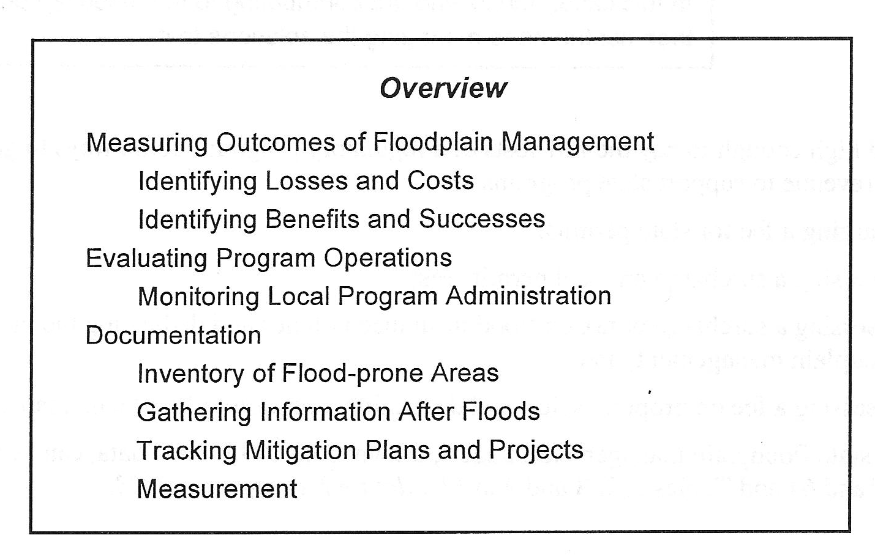
Program Evaluation (continued)
Notes:
Review the bullets.
Measuring successful FPM can be difficult, since success is the measurement of damages that did not occur after a flood event.

Slide 110
Program Evaluation (continued)
Some unrecorded measures of effectiveness:
Decisions not to build within the SFHA;
The number of times damage was avoided by proper construction within the SFHA, and;
The amount of recreational use, habitat, or natural flood protection provided by open space.
Notes:
Review the bullets.

Slide 111
Program Evaluation (continued)
Measuring Outcomes of Floodplain Management:
The two primary purposes of FPM at all levels are:
Avoidance or minimization of damage and disruption caused by floods, and
Protection of natural floodplain resources and functions.
Progress towards the above is an “outcome.”
Notes:
Review the bullets.

Slide 112
Program Evaluation (continued)
Desirable Outcomes would be:
Lower actual flood losses;
Lower potential for future losses, and;
Improved floodplain functions and resources.
Notes:
Review the bullets.

Slide 113
Program Evaluation (continued)
Undesirable Outcomes would be:
Increased flood damage and losses;
Additional people and property at risk, and;
Reductions in the natural functions and resources of the floodplains.
Notes:
Review the bullets.

Slide 114
Program Evaluation (continued)
Identifying Losses and Costs:
Effective State FPM Programs:
Establish ways to measure the losses;
Decide what level of loss is acceptable;
Track changes over time, and;
Make adjustments to program, policies, and approaches as needed.
Notes:
Review the bullets.

Slide 115
Program Evaluation (continued)
Direct losses that should be measured include:
Physical damage sustained by buildings;
Loss of personal belongings and business inventory;
Physical damage associated with flooded critical facilities;
Catastrophic losses associated with dam, levee, or floodwall failures, and;
Costs of repairs to infrastructure.
Notes:
Review the bullets.

Slide 116
Program Evaluation (continued)
Indirect losses include:
Increased costs associated with emergency response to floods (evacuation, SAR operations, patrols);
Costs associated with delayed capital projects and diverted government services (staff time);
Loss of use of buildings, including lost business income, lost tax revenue, and lost wages;
Notes:
Review the bullets.
S & R: Search and Rescue

Slide 117
Program Evaluation (continued)
Indirect losses include (conclusion):
Reduced property values and possible lowering of property taxes;
Increased health risks, cost of importing potable water, and environmental cleanup costs, and;
Health problems associated with mold.
Notes:
Review the bullets.

Slide 118
Program Evaluation (continued)
Identifying Benefits and Successes:
Floodplain management benefits are generally described as being either “direct” or “indirect,” but many fall in the indirect category and are hard to quantify.
Additionally, benefits usually accrue over time, which is hard to compare to costs.
Notes:
Review the bullets.

Slide 119
Program Evaluation (continued)
Examples of direct and indirect benefits are:
Fewer at-risk buildings in floodplains;
Citizens having more money quickly to repair damage and incorporate mitigation measures;
Fewer critical facilities in floodplains;
Reduced losses and costs from floods, and;
Fewer income tax claims of casualty loss deduction.
Notes:
Review the bullets.

Slide 120
Program Evaluation (continued)
Evaluating Program Operations:
Regular evaluations should be scheduled in order to:
Review specific activities, staffing levels, budget, and other operational matters, and;
Review of how the program’s work is affecting FPM outcomes throughout the state.
Notes:
Review the bullets.

Slide 121
Program Evaluation (continued)
Evaluating Program Operations (continued):
Some examples are:
Reduced damage when floods exceed design levels as a direct result of higher standards;
Increased property value due to dedication of floodprone areas to open space and recreation;
The availability of more money due to initiatives to encourage the purchase of flood insurance;
Notes:
Review the bullets.

Slide 122
Program Evaluation (continued)
Evaluating Program Operations (conclusion):
Some examples are:
Increased property values due to open space and compatible recreational uses;
More natural habitats, healthier wetlands, better water quality, etc., and;
Reduced variance issue, resulting from state training and technical assistance.
Notes:
Review the bullets.

Slide 123
Program Evaluation (conclusion)
Monitoring Community Program Administration:
Successful FPM programs monitor:
Number of permits issued and types of activities authorized in the SFHA;
Number and nature of variances considered and the number that are approved, and;
Number of cited violations and how they were resolved.
Notes:
Review the bullets.
Another item to monitor could be: the number of structures removed from the SFHA through mitigation measures.

Slide 124
After Action Review
Ever feel like you are missing something vital?
Notes:
Review any items or questions that were raised to ensure that there is no confusion or mystery to what you have covered.

Slide 125

Program Documentation
Baselines are established for assessing progress, keeping records of floods, finding ways to measure floodplain-related benefits and losses, and keeping records of successes that are not quantifiable.
Notes:
Review the bullets.

Slide 126
Program Documentation (continued)
Inventory of Floodprone Areas:
An effective baseline / status of the state’s floodprone lands should include:
The amount and types of lands that are floodprone;
The amount and types of development that exist in mapped flood hazard areas;
Floodprone lands that are protected from encroachment, and;
Notes:
Review the bullets.

Slide 127
Program Documentation (continued)
Inventory of Floodprone Areas (continued):
An effective baseline / status of the state’s floodprone lands should include (conclusion):
The growth potential of undeveloped parcels.
Such an inventory is most useful when undertaken at the community level. The state program should encourage or require such inventories be conducted.
Notes:
Review the bullets.

Slide 128
Program Documentation (continued)
Inventory of Floodprone Areas (continued):
A digital map of floodprone areas (SFHA and perhaps 500 year floodplain) is required for a workable inventory of development.
You can get as detailed as you wish in what is tracked in what is a de facto HIRA of at risk structures and other development.
Notes:
Review the bullets.

Slide 129
Program Documentation (continued)
Inventory of Floodprone Areas (conclusion):
An inventory can include:
Residential buildings (single family, multi-family);
Commercial and industrial buildings;
Public and institutional buildings;
Vacant parcels as a measure of potential development, and;
Lands in public ownership, roads, bridges, & culverts.
Notes:
Review the bullets.

Slide 130
Program Documentation (continued)
Gathering Information after Floods:
An effective state FPM program provides technical assistance to local communities in:
Gathering and cataloging information post flood;
Use the results to track losses and successes;
Identify trends, and;
Document the state’s progress in floodplain management.
Notes:
Review the bullets.
Such information should be tracked by community, year, and event frequency.

Slide 131
Program Documentation (continued)
Gathering Information after Floods (continued):
An effective state FPM program provides technical assistance to local communities in:
Gathering and cataloging information post flood;
Use the results to track losses and successes;
Identify trends, and;
Document the state’s progress in floodplain management.
Notes:
Review the bullets.

Slide 132
Program Documentation (continued)
Gathering Information after Floods (continued):
For each flood, data recorded should include:
Location and water body;
Land area affected;
Number and occupancy of building affected;
Frequency and elevation of flooding;
Dollar estimates of actual damage, and;
Number of insured and uninsured buildings.
Notes:
Review the bullets.

Slide 133
Program Documentation (continued)
Gathering Information after Floods (conclusion):
Information can be obtained through PDA tours or geographic information systems and other computerized tools.
Success stories can also be identified by inspectors, in reference to damage avoided and success in the preservation and protection of natural floodplain functions.
Notes:
Review the bullets.
PDA: Preliminary Damage Assessment
Take photos of successes and share with your PIO or External Affairs staff. Information such as this, tied into any mitigation projects or the structure’s owner’s efforts (elevation?) with costs incurred and damages prevented make good stories for the public.

Slide 134
Program Documentation (continued)
Tracking Mitigation Plans and Projects:
Every mitigation action should be tracked to capture evidence of damages avoided:
Before mitigation and after photographs;
Photos of elevated buildings above flood waters;
Stories of homeowners who benefitted from flood insurance;
Notes:
Review the bullets.

Slide 135
Program Documentation (continued)
Tracking Mitigation Plans and Projects (conclusion):
The stories about property owners who implemented protective measures on their own initiative and suffered little or no damage, and;
Estimates of how much damage and disruption was avoided by the mitigation efforts that protected public facilities and infrastructure.
Notes:
Review the bullets.

Slide 136
Program Documentation (continued)
Measurements:
Your FPM program should develop a method of measurement to track losses and successes:
Records of floods and losses, tracked by community, year, and event frequency;
Amount of acreage that are constrained to protect or restore natural floodplain functions (open space, recreation, wetlands, etc.);
Notes:
Review the bullets.

Slide 137
Program Documentation (continued)
Measurements (continued):
Number of state funded activities and/or projects that were reviewed for consistency with FPM standards;
Number of state-owned/community owned buildings in flood hazard areas;
Extent of successful application of planning and land use (determined by surveys of local planning officials, and;
Amount of mitigation funds spent in communities.
Notes:
Review the bullets.
The last bullet should lead to some discussion of cost benefit or losses prevented by HMA funded or otherwise funded mitigation projects.

Slide 138

Professional Development
The CFM Program and Staff Training Resources:
The ASFPM Certified Floodplain Manager Program or CFM was established in 1999.
It is a national programed managed by the ASFPM Executive Office and is a registered trademark of ASFPM.
Notes:
The CAP-SSSE Guidance and Application Kit includes an encouragement for state FPM staff to attain CFM credentials. CAP funding can be used to cover initial exam and biennial CFM renewal fees.
States are also encouraged to sponsor and proctor CFM training and exams in coordination with ASFPM.

Slide 139
Professional Development
The CFM Program (continued):
ASFPM’s role is to set minimum national standards, administer the program itself, provide and expand training opportunities, and accredit and monitor State programs.
Notes:
Are you and your staff currently CFMs? Is it a requirement to be a CFM at the state or local level? Why not?

Slide 140
Professional Development
The CFM Program (continued):
The program’s community benefits include:
Reduced community liability;
Safer development;
Increased local capability;
Reduced flood insurance premiums, and;
Reduced property damage.

Slide 141
Professional Development
The CFM Program (continued):
The program’s personal benefits include:
Confidence in professional knowledge;
Professional/Public recognition;
Job advancement potential;
Motivation for continued education, and;
Personal satisfaction.

Slide 142
Professional Development
The CFM Program (continued):
Maintaining certification:
Certification renewed every two years;
Pay biennial renewal fee ($50 for ASFPM members);
Continued education requirements can be fulfilled by attending training workshops, conferences, home study courses, or web based training.
Notes:
Proof of 16 CECs within the previous 24 months, with a maximum of 12 CECs earned in any one year.

Slide 143
Professional Development
Staff Training Resources:
Staff development are focused on NFIP, FEMA/state coordination activities, and CAP program implementation;
FEMA/State Regional Meetings, which occur once or twice a year;
EMI Training opportunities, and;
ASFPM/State Chapter conferences.

Slide 144
Professional Development
Possible Sources:
ASFPM conferences, workshops, and training sessions;
Redvector – online training;
State chapters or associations’ conferences;
EMI floodplain/mitigation related courses, and;
Federal or state agency training on related subjects.
Notes:
Think of any others?

Slide 145
What we covered in Module 2
For the past few hours, we have covered the seven topics introduced at the beginning of the session. What were they?
Job Description
The Body of Knowledge
GAP Analysis
Strategic Planning
Funding & Staff Levels
Program Evaluation & Documentation
Professional Development
Notes:
Click to advance to final slide.

Slide 146


Questions?

