Slide 1
State Floodplain Manager 1 on 1
Module 3:
Framework for Floodplain Management Part 1
Notes:
This is the third mentoring module of the State Floodplain Manager 1 on 1 course, “Framework for Floodplain Management Part 1.”
Our focus will be what a State Coordinator needs to know about federal agencies and programs that should be integrated with state FPM programs (Principal 2).
I {or We} will begin by presenting an overview of the module, then address/discuss each principal/topic in sequence, allowing time for interaction and questions throughout the session.

Slide 2
Agenda
Introductions
Objectives
Scope (topics)
Methods
Materials and References
Notes:
{Standard introductory slide for all 14 modules, which enables a module to be shared as an individual/stand-alone session if the need arises.}
Mentor should skip the first bullet if the module is not delivered as the first of a select series of modules or as an individual module.
For the next two hours we will {do our introductions and} discuss the first of two modules concerned with the framework for floodplain management.
{First, we will cover the obligatory introductions portion of the module/session. After that is accomplished,} the last four depicted bullets will be discussed before we begin in earnest.

Slide 3
Introductions
PLEASE TELL US YOUR:
Name;
Job Title;
Years spent in Floodplain Management, and;
One mystifying State Floodplain Management Program question that you want to better understand before you leave here today.
Notes:
Skip this slide as deemed necessary.

Slide 4
Objectives
Upon completion, participants will be able to:
3.1 Define the Federal, State, and Local roles in FPM.
3.2 Describe the relationship between federal legislative acts, Executive Orders and State programs.
3.3 Overview of FPM related State Agencies and Programs.
3.4 Discuss the integration of federal agencies into their state floodplain management program.
Notes:
Stress that this module has the four stated objectives (shown on this slide) that must be understood at the conclusion of the session.

Slide 5
Scope
This module includes the following four topics:
Brief History of FPM in the USA (Objective 3.1);
Federal, State, and Local Roles Defined (Objective 3.2);
Federal Legislation, Regulations, and Polices (including Executive Orders) (Objectives 3.3), and;
Notes:
Third bullet is continued on the next slide.

Slide 6
Scope (conclusion)
Federal Legislation, Regulations, and Polices … (continued)
National Flood Insurance Act
Stafford Disaster and Emergency Assistance Act
Water Resources Development Acts
Executive Orders 11988, 11990 and 13690
FPM related State agencies and programs (FPM integration) (Objective 3.4).
Notes:
Continued from previous slide.

Slide 7
Methods
Material contained in this module will be presented through:
Lecture and demonstration supported by 64 visuals/slides, six job aids and;
The State FPM 1 on 1: Student Manual.
Notes:
Mentor will ensure that the required materials are on hand.
Allow for interaction and questions throughout the session.
Visuals, handouts, and glossary will be available to illustrate the teaching points in this module to both instructor(s) and participant(s).

Slide 8

The European settlers faced a wilderness without roads for transportation, only coastlines and rivers.
These coasts and rivers provided harbors and docking sites along transportation routes, sources of water power and food.
Now people like to live near the water for recreation and scenery.
You may ask yourself, why are people
and cities in the floodplain?
Notes:
Unintended consequences are flood damages, since everything was built in the coastal high hazard area or riverine floodplain. It is hard to just pick up cities and move them.

Slide 9
Brief History of FPM
Pre-1968: Federal Structural Methods for FPM.
Flood control works: dams, levees, channelization, sea walls, etc.
Focus on flood control structures instead of FPM.
Notes:
Use bullets to stimulate discussion.

Slide 10
Brief History of FPM (continued)
State floodplain management programs must be comprehensive and integrated with many federal, state and local functions and programs.
In 1968, Congress authorized the NFIP to encourage states and local governments to recognize flood hazards in their land use and development decisions.
Notes:
Floodplain management with multiple purposes and mixed solutions (maps, regulations, mitigation and insurance).
The reduction of flood risk for development within the floodplain was the primary goal. How was this to be accomplished?
(By applying flood protection criteria and guiding development to areas of lower flood risk.)

Slide 11
Brief History of FPM (continued)
The authority for the NFIP is derived from the NFIA of 1968 and the Flood Disaster Protection Act of 1973.
Procedures are developed from Title 44 Code of Federal Regulations, Parts 59 and 60.
The NFIP is unique (as a Federal program) in that the authority of implementation is held at the local level.
Notes:
NFIA: National Flood Insurance Act
It is common to hear people to speak of “The FEMA program or the FEMA regulations.” Neither are true representations of reality, it is the locally adopted flood damage prevention ordinance which is enforced by the local community. FEMA and the state FPM staff provide tech assistance and oversight as needed.

Slide 12
Brief History of FPM (continued)
In order for a “community” to join the NFIP, it agreed to adopt, administer and enforce a flood damage prevention ordinance, based upon federal / state requirements and a provided Flood Insurance Study.
A State is considered a “community” by FEMA.
Notes:
Click for the definition of community.

Slide 13
Brief History of FPM (continued)
Community: any State or area or political subdivision thereof, or any Indian tribe or authorized tribal organization, or Alaska Native village or authorized native organization, which has authority to adopt and enforce floodplain management regulations for the areas within its jurisdiction. – 44 CFR § 59.1
Notes:
If you do not have a copy of 44 CFR, get one.
Who is the Administrator of your state’s flood damage prevention ordinance? Do you have a copy of the ordinance?
Has your state program ever had a Community Assistance Visit by FEMA?

Slide 14
Brief History of FPM (continued)
State responsibilities are:
Designation, duties and responsibilities of the State Coordinating Agencies.
Enabling authority for local FPM.
Technical assistance.
Assist with flood risk identification.
Establish minimum state FPM regulatory standards equal to or exceeding NFIP.
Assist in identification and implementation of flood hazard mitigation.
– 44 CFR § 60.25
Notes:
Establish by regulatory or executive authority.

Slide 15



Brief History of FPM (conclusion)
The NFIP has been administered by:
US Department of Housing and Urban Development (1968-1979);
Federal Emergency Management Agency (1979-2003), and;
US Department of Homeland Security (2003-present).
Notes:
Examples of various NFIP “brands” or “logos” over the years.

Slide 16
After Action Review
Ever feel like you are missing something vital? Let’s do a quick review.
Notes:
Review any items or questions that were raised to ensure that there is no confusion or mystery to what you have covered.

Slide 17
Roles Defined
NFIP Roles: A Quick Thumbnail before Discussion
Federal
National program oversight
Risk Identification (mapping & mitigation actions)
Establish development standards
Provide insurance coverage
State
Integrating flood risk management
Establish state FPM standards equal or exceeding NFIP
Provide technical assistance to local communities & others
Coordinate and document floodplain management activities
Notes:
Effective state FPM program principles are to guide development away from flood-prone areas; adverse impacts of development within and outside of floodplain must be minimized.
A key risk management strategy is flood insurance and risk communication.
The state is the bridge between federal and local FPM activities. The SCs job is to be that bridge.

Slide 18
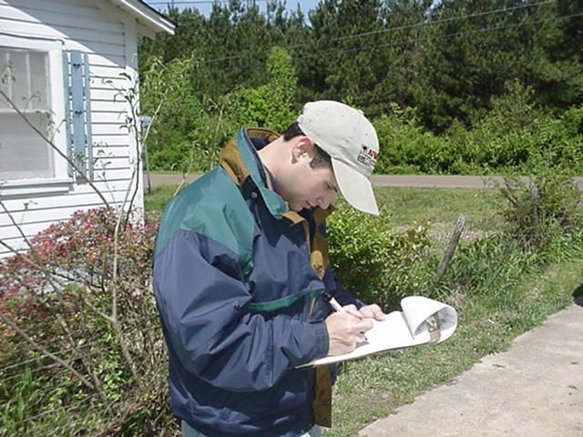
Roles Defined (continued)
NFIP Roles: A Quick Thumbnail before Discussion
Local
Adopt / enforce local floodplain management ordinances that comply with federal and state laws
Issue or deny development permits
Inspect development and maintain records
Development oversight is LOCAL
Photo: AWG Consulting
Notes:
Just a taste of what the local jurisdiction does on a daily basis. E273’s Unit 6 has much more detail.
What state enabling authority or legislation is the basis for the local flood damage prevention ordinance?
The SC supports and encourages local FPM.

Slide 19

Roles Defined: Federal (continued)
FEMA enrolls communities in the NFIP;
FEMA compliance activities;
FEMA sets minimum NFIP criteria, and;
FEMA coordinates the updating and release of maps.
Notes:
Now, let’s dig a little deeper.
The FEMA HQ FPM Branch coordinates with the ten FEMA Regional Offices on these activities.
They have the authority to enroll communities in the NFIP and to suspend or withdraw communities based upon the recommendations from the Regional Offices.
FEMA compliance: CRS reclassification (if applicable), Probation, Suspension and Insurance Denial.

Slide 20
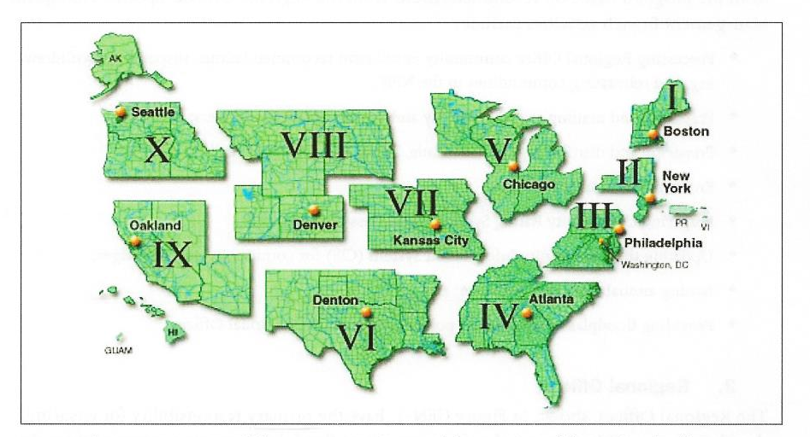
Roles Defined: Federal (continued)
Notes:
What FEMA Region is responsible for working with your state? Who is your State Specialist/Liaison?

Slide 21
Roles Defined: Federal (continued)
The FEMA Regional Offices have the primary responsibility for ensuring that their communities adopt and enforce compliant FPM regulations that meet or exceed the minimum NFIP requirements.
The Regional Office works closely with NFIP State Coordinating staff and FEMA HQ on the enrollment and eligibility of communities.
Notes:
The RO is your primary POC (as the SC).

Slide 22
Roles Defined: Federal (continued)
The FEMA Regional Office activities include:
Assisting communities in enrolling in the NFIP;
Reviewing NFIP application packages and making recommendations to FEMA HQ that a community be enrolled in the NFIP;
Working with States to develop model floodplain management ordinances that meet NFIP minimum requirements;
Notes:
State Coordinators and RO will be working closely together on these activities.
The reason that “minimum” is underlined here is that some FEMA staffers insist that the state model ordinance reflect the personal views of the FEMA reviewer. You do not have to change your ordinance, as long as the model meets minimum requirements. You are encouraged to insert your own higher standards that are particular to your state’s FPM program.

Slide 23
Roles Defined: Federal (continued)
Providing tech assistance to NFIP communities and monitoring their implementation of NFIP minimum requirements through CAVs, CACs and other means;
Assisting NFIP communities in adopting compliant FPM regulations and reviewing and approving those regulations;
Conducting enforcement actions for non-compliant communities, coordinating with FEMA HQ on community probation and recommending suspension;
Notes:
The vast majority of CAVs and CACs are conducted by the State NFIP coordinating staff.
These are CAP-SSSE agreement activities. (More info in Module Six.)

Slide 24

Roles Defined: Federal (conclusion)
Ensuring that all information on ordinance adoption is entered into CIS Community Information and Ordinance screens, by either the Region or the NFIP State Coordinator, and;
Negotiating agreements with States through CAP-SSSE to support Region in undertaking the above activities.
Notes:
CAP-SSSE will be discussed in detail in Module 6.

Slide 25
Roles Defined: State
Each Governor has selected a state agency to “host” the NFIP. The exact type of agency varies greatly among the states. However, they all have common activities including:
Ensuring that communities have the legal authorities necessary to adopt and enforce FPM regulations;
Establishing minimum State regulatory requirements consistent with the NFIP;
Notes:
You should know if your office is designated in state law or executive order.

Slide 26
Roles Defined: State (continued)
However, they all have common activities including:
Providing technical and specialized assistance to local governments and the general public;
Coordinating the activities of various State agencies that affect the NFIP, and;
Encouraging and assisting communities to qualify for NFIP participation.
Notes:
Use bullets to stimulate discussion.

Slide 27
Roles Defined: State (continued)
Let’s paddle further up the stream of duties and responsibilities. The NFIP State Coordinator also:
Ensures that counties and municipalities can regulate development within floodprone areas using enabling authority;
Encourages and assists communities to qualify for participation in the NFIP;
Assists communities in developing, implementing, and maintaining local floodplain management regulations;
Notes:
Related to the effective program principle of strong and clear authority.

Slide 28
Roles Defined: State (continued)
Provides information on NFIP criteria for flood hazard area development;
Assists communities to disseminate information on the minimum elevation requirements for flood hazard area development;
Assists with identifying riverine and coastal floodprone areas, and provides any relevant technical information to FEMA;
Recommends county and municipality priorities for Federal floodplain management activities;
Notes:
Effective program principle: to guide development away from flood-prone areas; adverse impacts of development within and outside of floodplain must be minimized.
Effective principle: that flood hazards must be identified and flood risk assessed.
Although these are NFIP coordination, they dovetail with broader/comprehensive state FPM programs

Slide 29
Roles Defined: State (continued)
Works with FEMA to resolve differences between local floodplain management programs and the NFIP minimum requirements;
Establishes state standards consistent with NFIP and other Federal and State environmental and water pollution standards for prevention of water pollution during flooding;
Coordinates FPM activities with other state, area-wide and local planning and enforcement agencies, and;
Participates in floodplain management training and flood hazard preparedness programs.
Notes:
Effective program elements to consider natural benefit and functions of floodplains, integrate throughout state functions and programs.
This second bullet may or may not apply to your state agency’s mandate.

Slide 30

Roles Defined: State (conclusion)
Other FPM duties and responsibilities, deemed appropriate by the State may be performed by the NFIP State Coordinator and may be funded solely by the State. Prior coordination with FEMA may result in partial Federal funding.
Notes:
Effective programs address public awareness of flood risk; staffing and funding are consistent with the need of state.

Slide 31
Roles Defined: Local
Communities work through the NFIP State Coordinator on all NFIP related issues.
The local community/jurisdiction is the basic unit of participation in the NFIP.
Since the NFIP is voluntary, communities can choose not to participate if they are willing to forego flood insurance and Federal assistance in designated Special Flood Hazard Areas.
Notes:
Use bullets to stimulate discussion.

Slide 32
Roles Defined: Local (conclusion)
The community is responsible for regulating all development in the Special Flood Hazard Area;
Permit process, and;
The enforcement requirements in regard to new, improved, and damage structures in the SFHA.
44 CFR § 59.22 through §60.3 covers the local roles in detail.
Notes:
This is where the rubber meets the road in FPM.

Slide 33
After Action Review
Ever feel like you are missing something vital? Let’s do a quick review.
Notes:
Review any items or questions that were raised to ensure that there is no confusion or mystery to what you have covered.

Slide 34
Legislation, Regulations & Policies
Pre-1940: Flood control structures
1942: “Human Adjustment to Floods”
“Floods are acts of God but flood losses are largely acts of man.” Dr. Gilbert F. White (1911-2006)
1965: Water Resources Planning Act
1966: House Document (HD) 465: Unified National Program for Managing Flood Losses
Notes:
Why do you care about federal regulations/policies/etc? It affects your state program and activities.
This shows the federal progression from structural flood policies to non-structural and multiple objective policies.

Slide 35


I highly recommend
this book.
Notes:
The second bullet on the previous slide spoke of Dr. White’s doctoral thesis. This slide shows you an excellent addition to your professional library.
Broaden your perspective!!!
The biography of Dr. Gilbert F. White, the “Father of Floodplain Management.” Published by Johnson Books in 2006. www.johnsonbooks.com
Morgan Mentor loves this book.

Slide 36
Legislation (continued)
The National Flood Insurance Act of 1968
The Flood Disaster Protection Act of 1973
The National Flood Insurance Reform Act of 1994
Disaster Mitigation Act of 2000
The National Flood Insurance Reform Act of 2004
The Flood Insurance Reform Act of 2012
The Homeowner’s Flood Insurance Affordability Act of 2014
Notes:
Now here is the flood related legislation laundry list that everyone should be familiar with. We will briefly discuss each act in the next few slides.
As a state coordinator, you should know that it has been through multiple revisions and is ever evolving.

Slide 37
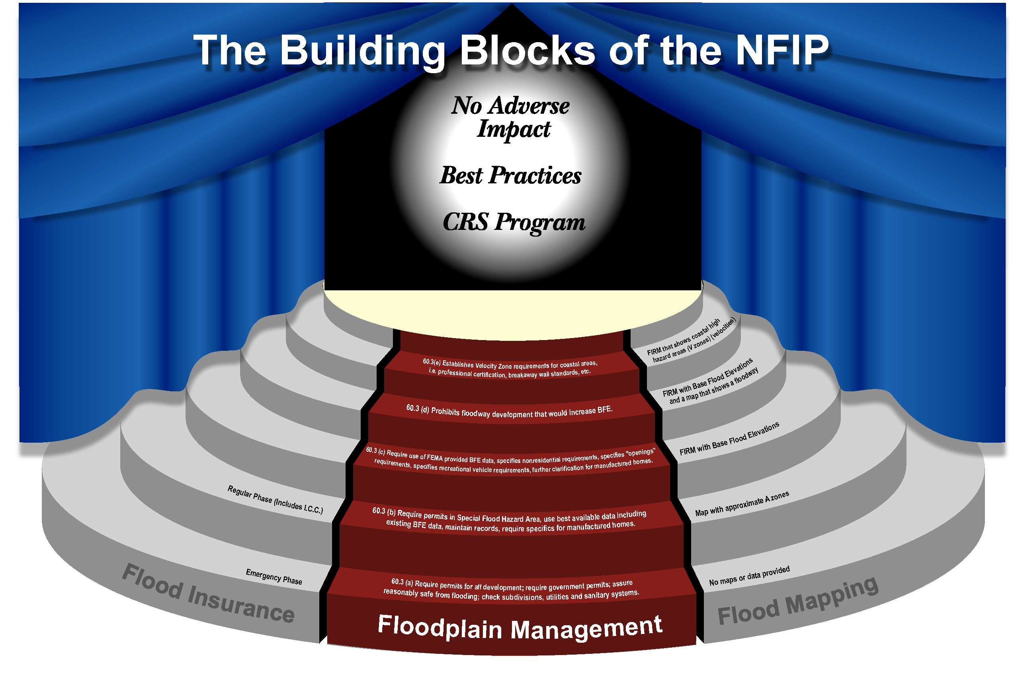
Legislation (continued)
National Flood Insurance Act of 1968:
Three basic components:
Hazard Identification
Flood Insurance
Floodplain Management
Notes:
Use bullets to stimulate discussion.
The trifecta of flood risk mitigation, the three legged stool, the tirade of flood deterrence.
FEMA now utilizes a “four legged stool” NFIP diagram. The legs are:
Flood Insurance Rate Maps
Insurance
Building codes, regulations and CRS
Mitigation Grants

Slide 38
Legislation (continued)
Flood Disaster Protection Act of 1973:
Mandatory purchase requirement enacted;
Enhanced floodplain management, and;
Required NFIP participation to receive some types of disaster assistance.
Notes:
Use bullets to stimulate discussion.

Slide 39
Legislation (continued)
National Flood Insurance Reform Act of 1994:
Introduced lender penalties for failing to enforce mandatory purchase requirements;
Created Flood Mitigation Assistance Program;
Increased Cost of Compliance created;
Codified the Community Rating System, and;
Increased flood insurance policy waiting period to 30 days.
Notes:
Use bullets to stimulate discussion.

Slide 40
Legislation (continued)
Disaster Mitigation Act of 2000 (aka DMA2K):
Required the adoption of community/state mitigation plans to obtain Federal assistance;
Revised and broadened scope of existing disaster relief programs (Stafford Act), and;
Established the Pre Disaster Mitigation (PDM) program.
Notes:
Use bullets to stimulate discussion.
Established the PDM and provided incentives for funding.

Slide 41
Legislation (continued)
National Flood Insurance Reform Act of 2004:
Reauthorized NFIP through 9/30/2008;
Created Severe Repetitive Loss mitigation program;
Amended the basic FMA program;
Authorized FEMA to fund mitigation activities for individual repetitive claim properties;
Notes:
Use bullets to stimulate discussion.

Slide 42
Legislation (continued)
National Flood Insurance Reform Act of 2004 (conclusion):
Authorized charging Actuarial Rates on certain properties, and;
Formalized NFIP claims appeals process.
Notes:
Use bullets to stimulate discussion.

Slide 43
Legislation (continued)
Biggert-Waters Flood Insurance Reform & Modernization Act of 2012 (aka BW12):
Reauthorizes the NFIP through 9/30/2017;
Extended cap on annual premium increases from 10% to 20%;
Gave government greater leeway to raise rates;
Phases out subsidies for vacation homes;
Notes:
Use bullets to stimulate discussion.

Slide 44
Legislation (continued)
Biggert-Waters Flood Insurance Reform & Modernization Act of 2012 (aka BW12):
Imposes minimum deductibles for flood claims;
Enables multi-family properties to purchase policies, and;
Established a technical mapping advisory council.
Notes:
Use bullets to stimulate discussion.

Slide 45
Legislation (continued)
BW12 made several major changes to the FEMA HMA program. Highlights below.
Consolidated the Severe Repetitive Loss (SRL) and Repetitive Flood Claim (RFC) programs into the Flood Mitigation Assistance (FMA) program.
For multi-hazard planning, FMA funds can only be used for the flood planning portion.
Notes:
BW12: Biggert-Waters Flood Insurance Reform Act of 2012.

Slide 46
Legislation (continued)
BW12 (continued):
It also now allows elevation, relocation or floodproofing of utilities as a eligible mitigation activity.
Also adds mitigation reconstruction as an allowed FMA activity (from the previous SRL program).
Allows “direct” FMA grants to structure owner, if it is determined that neither the state nor community can manage the mitigation grant.
Notes:
BW12: Biggert-Waters Flood Insurance Reform Act of 2012.
The third bullet will probably not be frequently used.

Slide 47
Legislation (continued)
BW12 (conclusion):
Provides denial of grant funds if they are not obligated within five years of grant approval.
Restructures the federal share requirement:
Up to 100% for severe repetitive loss structures
Up to 90% for repetitive loss structures
Up to 75% for other approved mitigation activities
Notes:
BW12: Biggert-Waters Flood Insurance Reform Act of 2012.
HMA guidance defines repetitive loss and severe repetitive loss in FMA differently from NFIP guidance (big surprise eh?), so confusion could ensue in say, submission of AW-501 forms in CRS program, if they are on the NFIP’s list, but not the FMA list.
The increased federal cost share is only possible if States/Indian Tribes/Territories have a RL strategy in their Applicant-level mitigation plans.

Slide 48
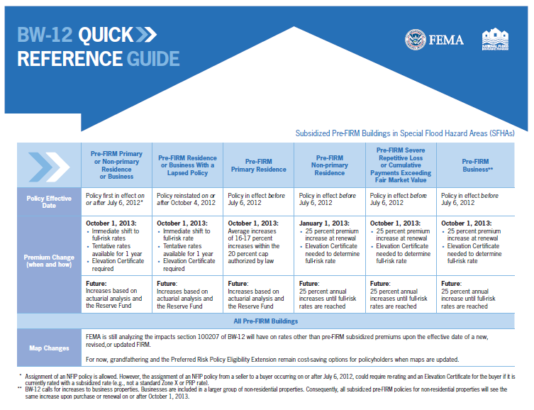
Legislation (continued)
Notes:
Use chart to stimulate discussion.
(Job Aid 1.)

Slide 49
Legislation (continued)
The Homeowner Flood Insurance Affordability Act of 2014 (aka Grimm-Waters):
Lowered recent rate increases on some policies, prevents some future rate increases and implements a surcharge on all policy holders;
Repeals the provision in BW12 regarding the elimination of grandfathering rates, and;
Established the office of flood insurance advocate at FEMA HQ.
Notes:
Use bullets to stimulate discussion.

Slide 50
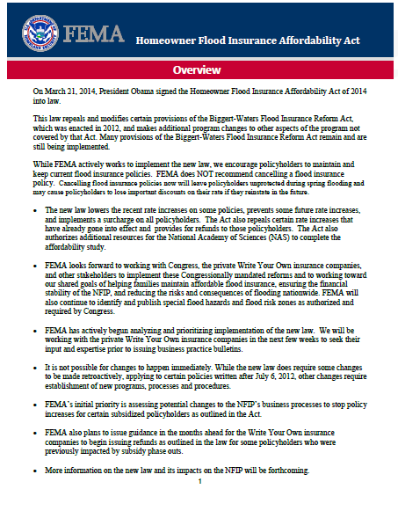
Legislation (conclusion)
Notes:
(Job Aid 2.)

Slide 51
Companion Legislation
Stafford Disaster Relief and Emergency Assistance Act (Public Law 93-288, as amended):
A federal law designed to bring an orderly and systemic means of federal natural disaster assistance for state and local governments in carrying out their responsibilities to aid citizens.
Created a system by which a Presidential Disaster Declaration triggers financial and physical assistance through FEMA.
Notes:
Note that this act has to do with “Natural Disaster Assistance.” The “Deepwater Horizon” oil release incident in 2010 was not covered under the Stafford Act, the EPA and not FEMA had the lead, which caused much confusion and problems in the Emergency Management world.
FEMA and State Mitigation staffs, especially in JFOs, are required to have the NFIP staff review each PA and HMA grant for FPM compliance. They will attempt to forget to do that. It is your job and your FEMA State Specialist’s to ensure that it happens.

Slide 52
Companion Legislation (continued)
The Stafford Act is a 1988 amended version of the Disaster Relief Act of 1974 (Public Law 93-288):
Section 409 stipulates that natural hazards are to be evaluated and mitigated as a condition of receiving a hazard mitigation grant.
The Federal Response Plan implements the contributions of 28 federal agencies and NGOs.
Notes:
Use bullets to stimulate discussion.

Slide 53
Companion Legislation (conclusion)
Water Resources Development Acts (WRDA):
The biennial legislation that authorizes the Civil Works program for the USACE activities in the areas of:
Water Resources Conservation and Development;
Inland Waterway Navigation and Transportation ;
Flood Control;
Shoreline Protection;
Dam Safety, and;
Miscellaneous Programs and Projects.
Notes:
WRDAs are supposed to be passed every two years. The WRDA of 2000 wasn’t followed until 2007.
It is an authorization bill, whose main purpose is to deem water-related projects eligible for funding. Projects are studied for a year, subjected to a 103-step feasibility process and finally receives a “yes” or “no” determination as an optimum solution.
WRDA does provide authority for programs aimed at coastal-storm and flood damage, new navigation projects, ecosystem restoration, and USACE policies and procedures, but does not provide funding.

Slide 54

Federal Executive Orders
Executive Orders
11988 Floodplain Management
11990 Protection of Wetlands
13690 Floodplain Management
Notes:
We will cover these three EOs.

Slide 55
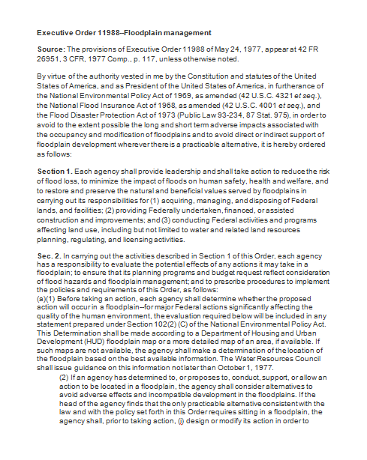
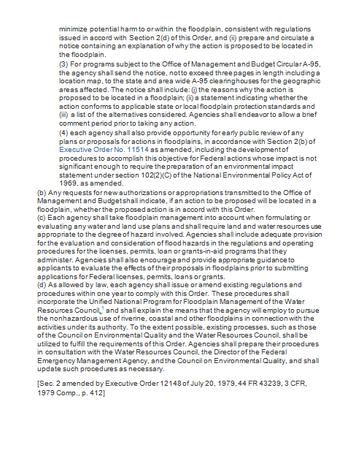
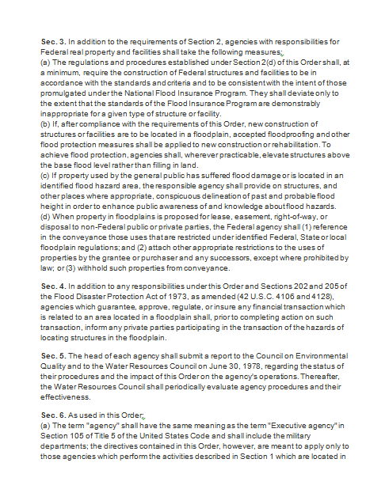
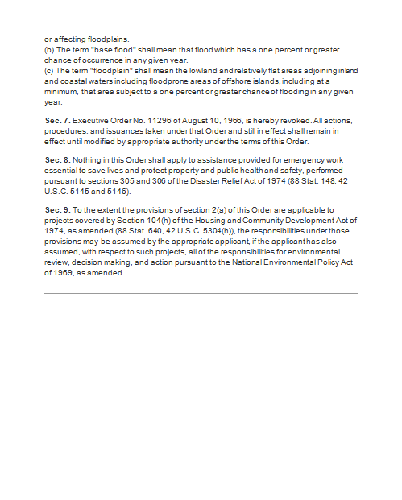
Federal EOs (continued)
Federal Executive Order 11988: Floodplain Management. (5/24/1977)
Avoid long and short term adverse impacts
Minimize impact
Maintain natural functioning
Restore natural functioning
Notes:
(Job Aid 3.)

Slide 56
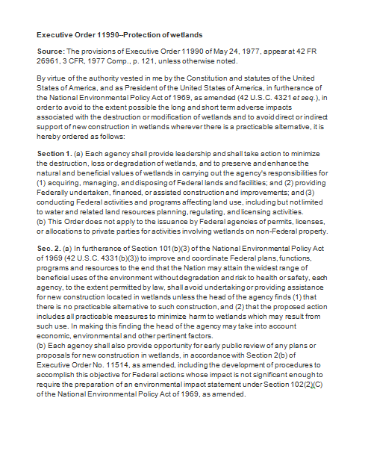
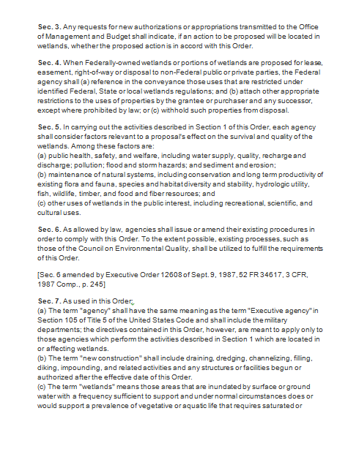
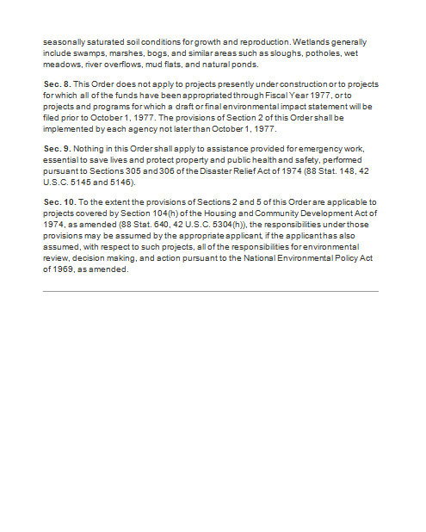
Federal EOs (continued)
Federal Executive Order 11990: Protection of Wetlands. (5/24/1977)
Minimize destruction, loss, or degradation
Maintain beneficial uses
Consider survival and quality
Notes:
(Job Aid 4.)

Slide 57
Federal EOs (conclusion)
Federal Executive Order 13690: Establishing a Federal Flood Risk Management Standard and a Process for Further Soliciting and Considering Stakeholder Input. (1/30/2015)
It doesn’t affect private development, only for actions using federal funds.
Establishes a new flood risk management standard for federal investment and programs, and;
Gives federal agencies flexibility to use on of three standards for establishing flood elevation and flood hazard areas.
Notes:
(Job Aid 5 and Job Aid 5a.)
The three standards are: 1) informed best available climate science 2) Freeboard: the 100-year plus two foot freeboard for regular projects the 100-year plus three foot freeboard for critical actions 3) build to the 500-year elevation
This standard applies when federal funds are used to build significantly retrofit or repair structures in or around floodplains.
Impedance was the recommendations for the President’s task force on climate change.
Requires federal agencies to incorporate input from public stakeholders in their specific programs and policies.

Slide 58
After Action Review
Ever feel like you are missing something vital? Let’s do a quick review.
Notes:
Review any items or questions that were raised to ensure that there is no confusion or mystery to what you have covered.

Slide 59
State Agencies & Programs
“Your FPM program” is not an island. In order to create and maintain an effective state FPM program, you must partner with other state level agencies and programs.
You should recruit a cross-section of state partners to obtain “buy-in” with the FPM program.
Many viewpoints can give greater perspective.
Notes:
Discuss the three bullets with the mentee(s) and see if they have some ideas on partnership with other agencies and programs.
What other agencies and programs should you partner with?

Slide 60
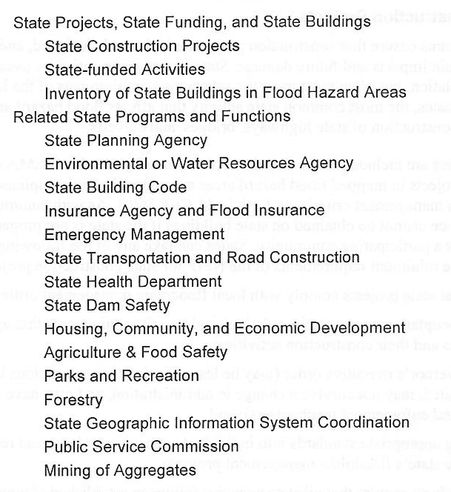
State Agencies (continued)
Key State Partners
Notes:
Briefly review the various agencies, departments, programs on the list with the mentee(s).

Slide 61

State Agencies (continued)
Who was left off the list?
Governor’s Office;
State Attorney General’s Office;
History and Archives;
Department of Education;
Coastal Zone Management, and;
State Fire Marshal’s Office.
Any others?
Notes:
Why would these staffers be important to your state FPM program? (Give some real life examples of working with them.)
Click for the last question to appear.
In what agency is your state’s Floodplain Administrator located?
Does your state have a hazard mitigation council?

Slide 62
State Agencies (conclusion)
State FPM programs are also encouraged by FEMA’s CAP-SSSE program to coordinate with other State administered programs that impact FPM such as the Hazard Mitigation Assistance (HMA) program. We will cover these FEMA programs in Module 4.
Notes:
In what agency is your State Hazard Mitigation Officer located? Who is it? Have you worked with him or her before?

Slide 63
What we covered in Module 3
For the past two hours, we have covered the four topics introduced at the beginning of the session. What were they?
Brief History of FPM in the United States
FEMA, State, and Local Roles Defined
Federal Legislation, Regulations, and Policies (including Executive Orders)
FPM related State agencies and programs
Notes:
Click to advance to final slide.

Slide 64


Questions?

