Slide 1
State Floodplain Manager 1 on 1
Module 4:
Framework for Floodplain Management Part 2
Notes:
This is the fourth mentoring module of the State Floodplain Manager 1 on 1 course, “Framework for Floodplain Management Part 2.”
I {or We} will begin by presenting an overview of the module, then address/discuss each topic in sequence, allowing time for interaction and questions throughout the session.

Slide 2
Agenda
  Objectives
  Scope (topics)
  Methods
  Materials and References
Notes:
For the next hour and a half we will discuss the second of two modules concerned with the framework for floodplain management.

Slide 3
Introductions
  PLEASE TELL US YOUR:
  Name;
  Job Title;
  Years spent in Floodplain Management, and;
  One mystifying State Floodplain Management Program question that you want to better understand before you leave here today.
Notes:
Skip this slide as deemed necessary.

Slide 4
Objectives
  Upon completion, participants will be able to:
  4.1 Describe the FEMA HMA program.
  4.2 Identify the key federal & state agencies and programs involved in FPM.
  4.3 Identify three key Non-Governmental Organizations involved in floodplain management.
Notes:
Stress that this module has the three stated objectives (shown on this slide) that must be understood at the conclusion of the session.

Slide 5
Scope
  This module includes the following 11 topics:
  Flood Hazard Mitigation Assistance programs (history and overview) (Objective 4.1);
  USACE FPMS and Planning Assistance to States (PAS) (4.2);
  USGS stream gaging programs (Objective 4.2);
  NOAA/NWS programs (Objective 4.2);
Notes:
FPMS is the USACE’s Floodplain Management Services (Water Resources Development Act of 1974: Section 22).

Slide 6
Scope (continued)
  NRCS programs (Objective 4.2)
  Coastal Zone Management Program (Objective 4.2);
  National Dam Safety Program (Objective 4.2);
  Association of State Floodplain Managers (ASFPM) (Objective 4.3);
  National Association of Flood & Stormwater Management Agencies (NAFMA) (Objective 4.3);
Notes:
Continued from previous slide.

Slide 7
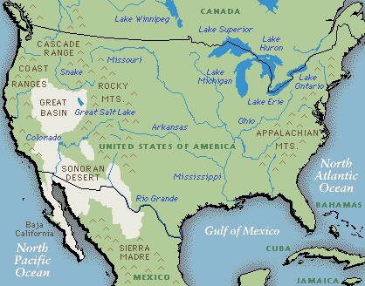
Scope (conclusion)
  Association of State Dam Safety Officials (ASDSO) (Objective 4.3);
  American Planning Association (APA) (Objective 4.3);
  International Association of Emergency Managers (IAEM) (Objective 4.3), and;
  National Emergency Management Association (NEMA) (Objective 4.3).
Notes:
Continued from previous slide.

Slide 8
Methods
  Material contained in this module will be presented through:
  Lecture and demonstration supported by 136 visuals/slides and nine job aids, and;
  The State FPM 1 on 1 Student Manual.
Notes:
Mentor will ensure that the required materials are on hand.
Allow for interaction and questions throughout the session.
Visuals, handouts, and glossary will be available to illustrate the teaching points in this module to both instructor(s) and participant(s).

Slide 9

Now, let us paddle the white waters
that are FEMA’s HMA programs.
    There are three FEMA mitigation grant programs that are designed to be a juxtaposition of halcyon outcomes… in other words, grants to address the problems created by typical dreamscape actions that are known as floodplain development. – Unknown
Notes:
The unattributed quote is a musing from a retired SFPM that should stimulate some discussion.
We will talk about the FEMA HMA programs in some detail, as they can directly impact your floodplain management program.
We will also discuss the key federal agencies (and their programs) and some of the key non-governmental organizations involved in FPM in this module.
Now…here…we… go.

Slide 10
Hazard Mitigation Assistance
  The role of the state agency which hosts the SHMO:
  The state (Applicant) administers the FEMA mitigation funds to the local government (sub-applicant);
  Maintains the State Administrative Plan;
  Identifies and prioritizes potential mitigation projects;
  Provides technical assistance in grant applications, and;
  Reviews grant applications.
Notes:
SHMO: State Hazard Mitigation Officer
Who is the SHMO in your state? In what agency? What is your relationship?

Slide 11
Hazard Mitigation Assistance (continued)
  The role of the SHMO:
  Works with local community government;
  Coordinates the collection of data;
  Monitors and evaluates progress of grant;
  Monitors the financial status of project;
  Conducts on-site inspections, and;
  Conducts audit of project files and financial records.
Notes:
The SHMO is the official representative of State government who is the primary point of contact with FEMA, other Federal agencies, and local governments in mitigation planning and implementation of mitigation programs and activities required under the Stafford Act.
If an Indian Tribe decides to participate, the SHMO will be the Tribal Hazard Mitigation Officer. Tribes are unique in that they can be an Applicant (equivalent to States) or sub-applicant to the State. California and Arizona don’t have the capability to pass State money through to tribes, so Tribes have to be Applicants there.

Slide 12

So, who ya goin’ call?
The SHMO.
Notes:
What does SHMO stand for?

Slide 13
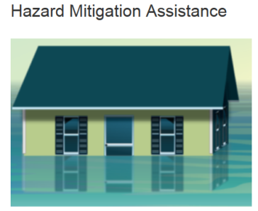
Hazard Mitigation Assistance (continued)
  Hazard Mitigation is any sustained action taken to reduce or eliminate long-term risk to people and property from natural hazards and their effects.
  All mitigation is local;
  Pre-disaster plan and post-disaster implementation roles, and;
  Earnest attempts to not replicate past mistakes.
Notes:
The last bullet is the most difficult to accomplish.
How engaged is your office in hazard mitigation planning and grants?
Discuss for a few minutes.

Slide 14



Hazard Mitigation Assistance (continued)
  The three HMA programs are:
    Hazard Mitigation Grant Program (HMGP)
    Pre-Disaster Mitigation (PDM) program
    Flood Mitigation Assistance (FMA) program
Notes:
Catalog of Federal Domestic Assistance (CFDA) numbers for the three HMA programs are:
97.039: Hazard Mitigation Grant Program (HMGP)
97.047: Pre-Disaster Mitigation (PDM) program
97.029: Flood Mitigation Assistance (FMA) program

Slide 15
Hazard Mitigation Assistance (continued)
  Hazard Mitigation Grant Program overview:
  The HMGP was created by Congress in 1988 to fulfill four objectives:
    Prevent loss of life and damage to property;
    Implement State or local mitigation plans;
    Implement mitigation measures after a disaster, and;
    Provide funding for previously identified projects.
Notes:
Section 404 of the Robert T. Stafford Disaster Relief and Emergency Assistance Act, 42 U.S.C. 5170c and implemented at part 206, subpart N, created the Hazard Mitigation Grant Program (HMGP) in November 1988 as a post-disaster funding source for mitigation actions. It also required state level mitigation planning.
The HMGP assists states and local communities in implementing long term / cost-effective hazard mitigation measures following a major disaster declaration. The grant is a cost-share of 75% federal share and 25% state and/or local share.
(Job Aid 1.)

Slide 16
Hazard Mitigation Assistance (continued)
  Hazard Mitigation Grant Program Overview (continued):
  HMGP funding:
    Becomes available after a Presidential Disaster Declaration
    Amount of funding is based upon the estimated total of Federal assistance provided by a Presidential declaration (subject to a sliding scale formula).
Notes:
The key purpose of HMGP is to ensure that critical mitigation measures are taken after a disaster during the recovery phase.
The sliding scale formula provides up to 15% of the first $2 billion of assistance, up to 10% for amounts between $2 billion and $10 billion, and up to 7.5% for amounts between $10 billion and $35.333 billion.

Slide 17
Hazard Mitigation Assistance (continued)
  Hazard Mitigation Grant Program Overview (continued):
  HMGP provides 75% of eligible projects costs:
    Non-federal share can be local funds, owner funds, CDBG, ICC, private non-profit group, in-kind, or donated services.
Notes:
Review slide.

Slide 18
Hazard Mitigation Assistance (continued)
  Hazard Mitigation Grant Program Overview (continued):
  For a community to be eligible:
    Projects sited within SFHA are eligible only if community participates in the NFIP;
    Have an approved hazard mitigation plan, and;
    Have ability to provide non-federal share.
Notes:
Review slide.
There are no NFIP participation requirements for HMGP hazard mitigation planning.

Slide 19
Hazard Mitigation Assistance (continued)
  Hazard Mitigation Grant Program Overview (continued):
  Project Eligibility:
    Compliant with State’s plan;
    Approved local mitigation plan;
    Conform to environmental regulations;
    Solve a problem;
Notes:
Review slide.

Slide 20
Hazard Mitigation Assistance (continued)
  Hazard Mitigation Grant Program Overview (continued):
  Project Eligibility (conclusion):
    Meet all applicable local and State codes;
    Demonstrate cost-effectiveness, and;
    Consider a range of alternatives.
Notes:
Review slide.

Slide 21
Hazard Mitigation Assistance (continued)
  Pre-Disaster Mitigation program overview:
  Created in DMA2K and funding allocated in 2003:
    A competitive grant application process.
    There are significant differences between HMGP, FMA, and PDM.
Notes:
2013 HMA Guidance Manual states that the revamped PDM program was authorized under section 203 of the Robert T. Stafford Disaster Relief and Emergency Assistance Act, 42 U.S.C. 5133.

Slide 22
Hazard Mitigation Assistance (continued)
  PDM program overview (continued):
  Differences include:
    Supported by an annual appropriation;
    Competition is nationwide;
    Projects that address different hazards will compete with each other, and;
    The number of projects can be limited based on funding allocated by Congress.
Notes:
PDM is also a main funding source for updating hazard mitigation plans. It was slated for elimination as a program in 2013, but Congress put some funds back into the program. It might disappear at some point in the future.

Slide 23
Hazard Mitigation Assistance (continued)
  PDM program overview (conclusion):
  Established under DMA2K.
  National competitive selection process.
  FEMA establishes funding priorities, States prioritize the projects.
  Ineligible projects include major flood control projects, flood studies, response and communications equipment.
Notes:
PDM has in the past been limited to $150 million (nationally) with a $3 million cap on Federal share of a project.
Not used that frequently in the past, just too hard to pull together.

Slide 24
Hazard Mitigation Assistance (continued)
  Flood Mitigation Assistance (FMA) overview:
  Originally authorized in 1994, focused on insured repetitive loss properties by using flood policy premiums as the source of funds. Its goal is to:
    Assist State and local governments in funding cost-effective actions that reduce or eliminate the risk of flood damage to buildings, manufactured homes, and other structures insured under the NFIP.
Notes:
The 2013 HMA Guidance Manual now states that the Flood Mitigation Assistance (FMA) program was created as part of section 1366 of the National Flood Insurance Act of 1968, as amended, 42 U.S.C. 4104c, and implemented at parts 78 and 79 with the goal of reducing or eliminating claims under the NFIP.
When the United States Department of Homeland Security was created, it took FEMA’s FMA funds to buy furniture and equipment for its new headquarters… well Congress did give them the OK…☹
Properties included in a FMA project must be NFIP insured at time of the application and for the life of the building.

Slide 25
Hazard Mitigation Assistance (continued)
  FMA program overview (conclusion):
  FMA funding:
    Grants are for flood mitigation projects, state and local flood mitigation plans, and related tech assistance, and;
    CRS communities may apply for funding of flood mitigation plans .
Notes:
Plans prepared for the FMA program, need only address flood hazards. They must be clearly identified as being flood mitigation plans, and they will not meet the eligibility criteria for other mitigation grant programs, unless flooding is the only natural hazard the jurisdiction faces.

Slide 26
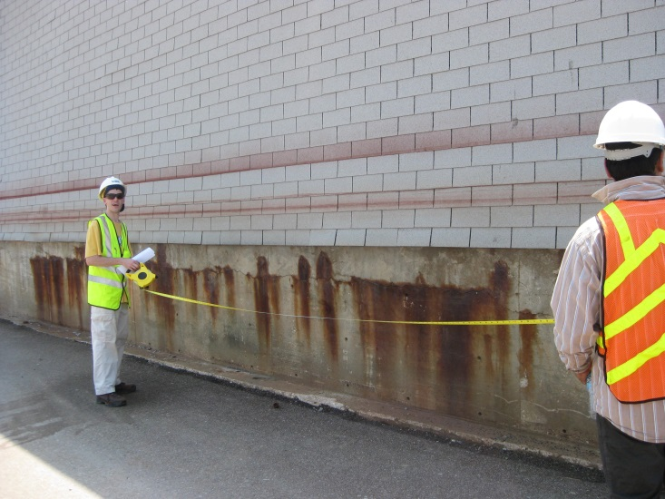
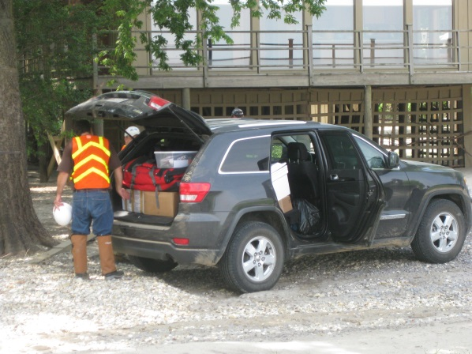
Hazard Mitigation Assistance (continued)
  Hazard Mitigation Technical Assistance Program (HMTAP-Non A & E Services):
  Used for technical assistance need(s).
  Funded 100% by FEMA.
Photos: MEMA
Notes:
There is also the HMTAP that is applied for through the Federal Coordinating Officer in the JFO by the Governor’s Representative.
Frequently the HMTAP is used to conduct flood damage assessments using the SDE program by contract teams.
A & E Services: Architectural and Engineering Services
Other projects could be: Development of mitigation success stories, mitigation planning workshops, EOC evaluations, development of state specific NFIP Quick Guide, etc.
HMTAP was originated in 1995, to provide surge support to respond to additional Congressional requirements following the Mississippi River Flood of 1993. It provides FEMA greater flexibility and surge capability to respond to multiple presidentially-declared disasters.
Administered by the FIMA, Risk Reduction Division, Building Science Branch.
Originated in the 1990’s, to bring together building science engineers and natural hazard experts to conduct problem-focused studies. These studies result in publications on relevant technical information for hazard mitigation and emergency management across the nation.
Requested by the state to the Federal Coordinating Officer.
Photos are of URS damage assessment teams in Mississippi in 2011, a HMTAP contract.
This concludes the section on the FEMA HMA programs.

Slide 27
Hazard Mitigation Assistance (continued)
  As the NFIP State Coordinator and / or State Floodplain Manager (or staff), you must coordinate with the SHMO and FEMA mitigation staff in regard to their hazard mitigation assistance programs.
  You must also coordinate with the Public Assistance (PA) and Individuals and Households Program (IHP) Officers during a post-disaster environment.
Notes:
This slide is designed to plant the idea that the NFIP isn’t an island, and neither are the other FEMA programs.
Discuss your experiences working with these programs as the State Floodplain Manager. PA and IHP will be discussed in Module #10: State Level Disaster Response and Disaster Recovery Duties.
Individual Assistance was changed to Individuals and Households Program a few years past. Most people still say “IA.”

Slide 28
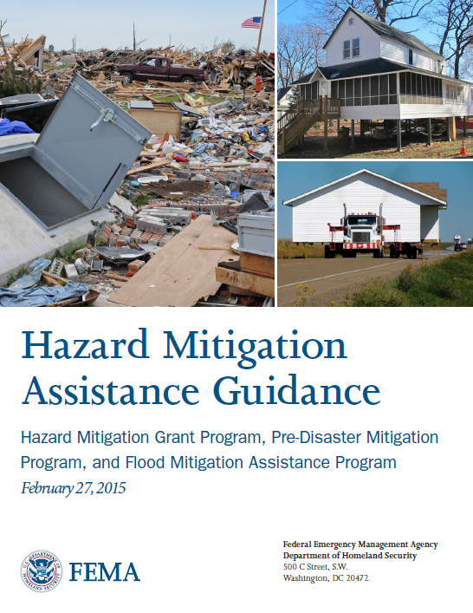

Hazard Mitigation Assistance (continued)
  The 2015 HMA Guidance is the primary source for all HMA information.
Notes:
(Job Aid 2 and Job Aid 2a.)

Slide 29
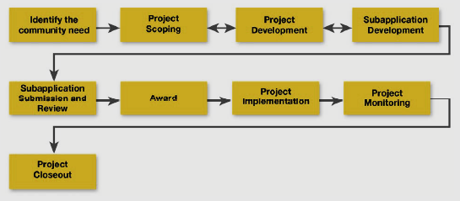
Hazard Mitigation Assistance (continued)
  Overall Project Lifecycle:
Notes:
First, a simple diagram which illustrates the project lifecycle of the typical HMA grant process.
Review slide.

Slide 30
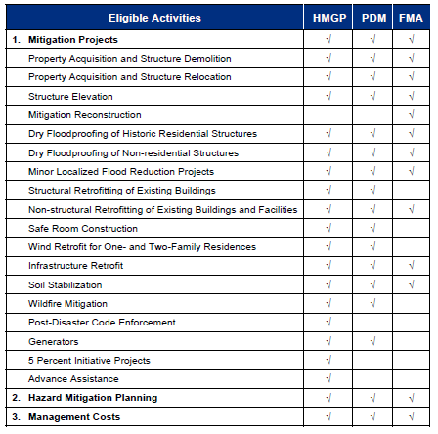
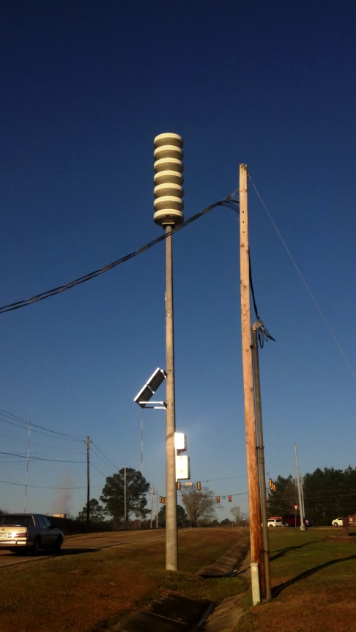
Hazard Mitigation Assistance (continued)
  Eligible Activities by Program:
Photo: AWG Consulting
Notes:
This chart serves as a snapshot of various eligible activities that can be funded by HMA grants.
Click to bring up the siren photo.
An example of a possible use of HMGP 5% funds are emergency warning sirens.

Slide 31
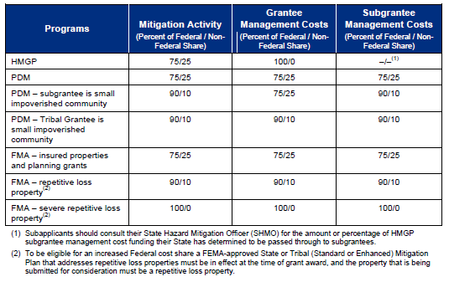
Hazard Mitigation Assistance (continued)
  Cost-Share Requirements:
Notes:
This chart covers the cost-share requirements of the three HMA grant programs.
Review slide.

Slide 32

Hazard Mitigation Assistance (continued)
  Now, before we can really get into HMA, we’ve got to talk about that approved haz-mit plan requirement…
Notes:
There is another aspect to this program.

Slide 33
Hazard Mitigation Assistance (continued)
  Hazard Mitigation Planning:
  Effective 11/1/2004, communities must have an approved haz-mit plan in order to receive a mitigation grant. Required steps are:
    Local planning team and public participation;
    Hazard Identification and Risk Assessment;
    Vulnerability analysis and capability assessment, and;
    Identify strategies, review and update the plan and implement the plan.
Notes:
This approved plan requirement came from DMA2K. States must have, at the minimum, a Standard State Mitigation Plan which is updated every three years. (There is also an Enhanced State Mitigation Plan, but it is not commonly used at this time.)
A Standard State Mitigation Plan that addresses SRL properties will receive the reduced cost share for FMA and SRL programs. (Up to a 90% federal cost share.)
Policies and procedures for mitigation planning can be found in section 322 of the Stafford Act, 42 U.S.C. 5165.
Up to 7% of HMGP funding is to be used for mitigation planning, in accordance with 44 CFR § 206.434

Slide 34
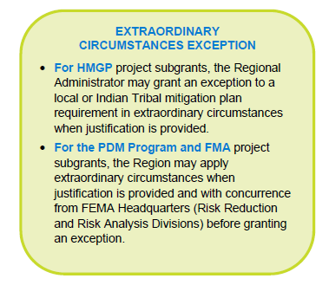
Hazard Mitigation Assistance (continued)
  Hazard Mitigation Planning (continued):
Notes:
There is always an exception. In this there is an “Extraordinary Circumstances Exception” to the existing plan requirement.

Slide 35
Hazard Mitigation Assistance (continued)
  Hazard Mitigation Planning (conclusion):
  There are two types of planning grants:
    Planning grants for the development of “local level” and “state level” multi-hazard mitigation plans and updates (HMGP and PDM).
    CRS floodplain management plans (FMA).
Notes:
Review slide.

Slide 36
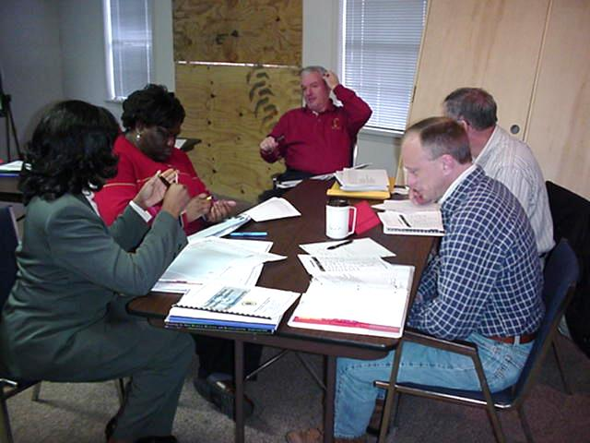
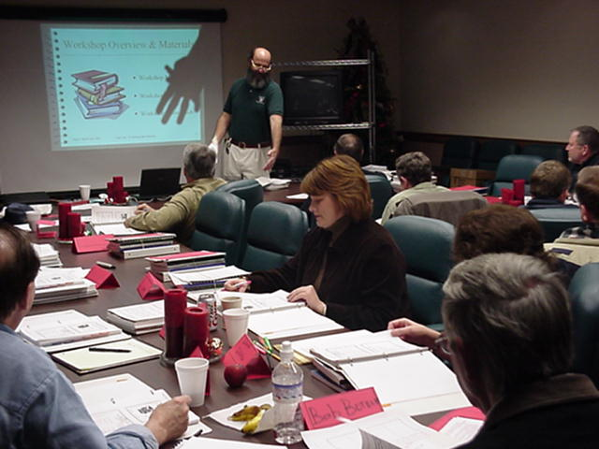
Hazard Mitigation Assistance (continued)
  Hazard Mitigation Planning:
Photo: MEMA
Photo: TMAC
Notes:
Planning grants are awarded to local regional and local entities to assist with the development of mitigation plans.
Photos are of a local community planning group (upper left) and a regional planning group (lower right).

Slide 37
Hazard Mitigation Assistance (continued)
State Hazard Mitigation Council
State Hazard Mitigation Plan
Hazard Mitigation Planning Grants
Technical Assistance
Hazard Mitigation Project Funding
State
Regional
Planning & Technical Assistance
Coordination of Regional initiatives
Local
Designate Point of Contact
Organize local Mitigation Council
Local Hazard Mitigation Plan
Adopt & Implement Plan
Private
Notes:
The “Regional” block refers to a regional planning and development districts or similar organization that some states have and use.

Slide 38
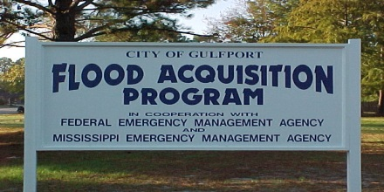
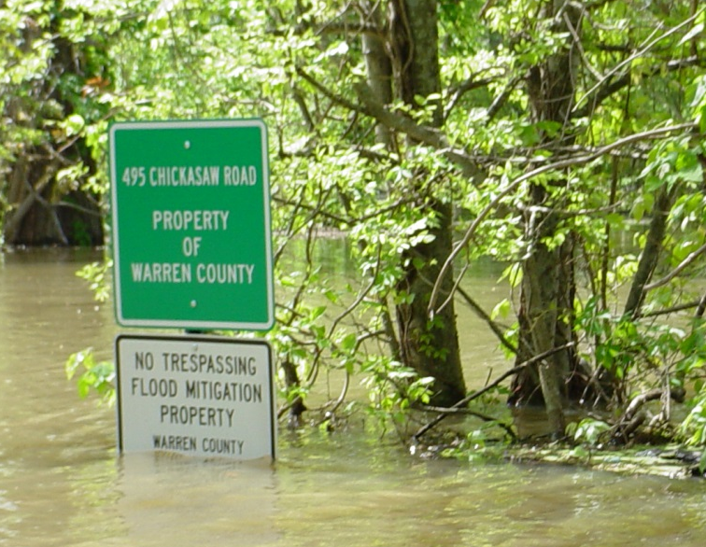
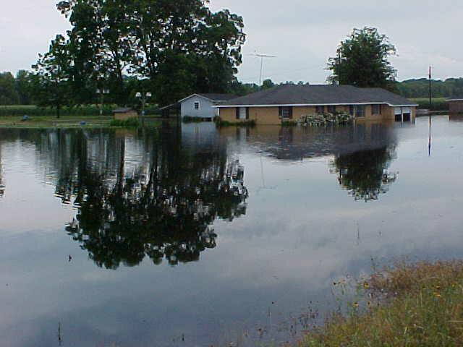
Hazard Mitigation Assistance (continued)
  Outcomes:
  Acquisition / Buyout;
  Elevation in place, and;
  Relocation.
Photos: MEMA
Notes:
Bottom Left photo: RL house that was bought out in Warren County, MS.
Top Right photo: Buyout project in the city of Gulfport, MS.
Bottom Right photo: Previous buyout location in Warren County, MS. Photo taken during the 2008 Mississippi River flood.

Slide 39
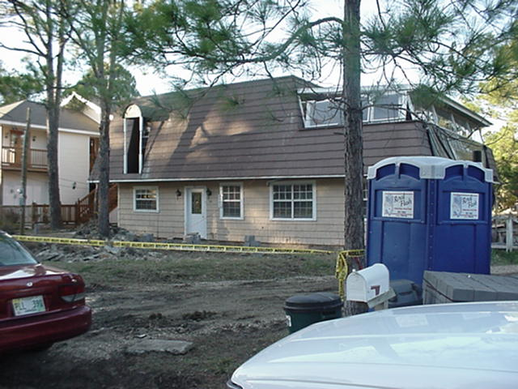
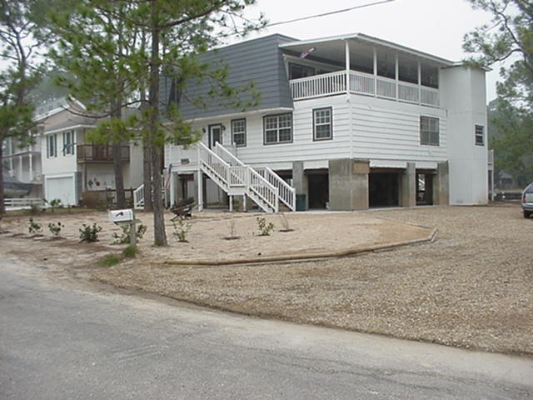
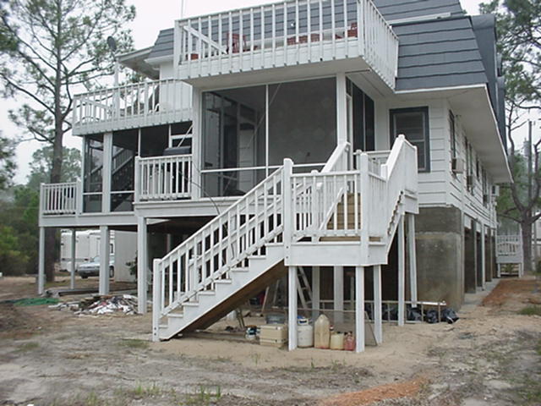

Hazard Mitigation Assistance (continued)
Before
After
After
Photos: MEMA
Notes:
Photos: RL house in Pass Christian, MS which was elevated in 2002, destroyed in 2005 by Katrina.
This project was an elevation of a repetitive loss structure in 2002. Three years later, it was destroyed by Hurricane Katrina. Why are elevation projects not considered to be effective mitigation efforts in some cases?
The FEMA Risk Reduction Division has recently determined that the average benefits for acquisitions and elevations in the SFHA, that cost less than or equal to the amount of benefits, are considered to be cost effective.

Slide 40
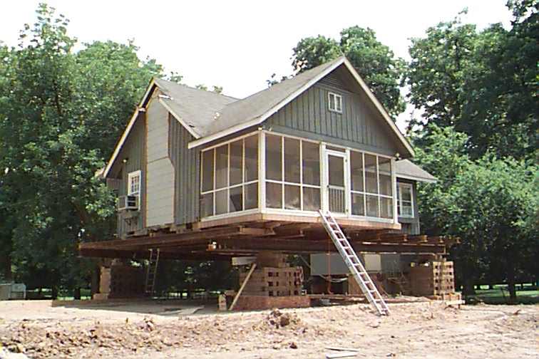
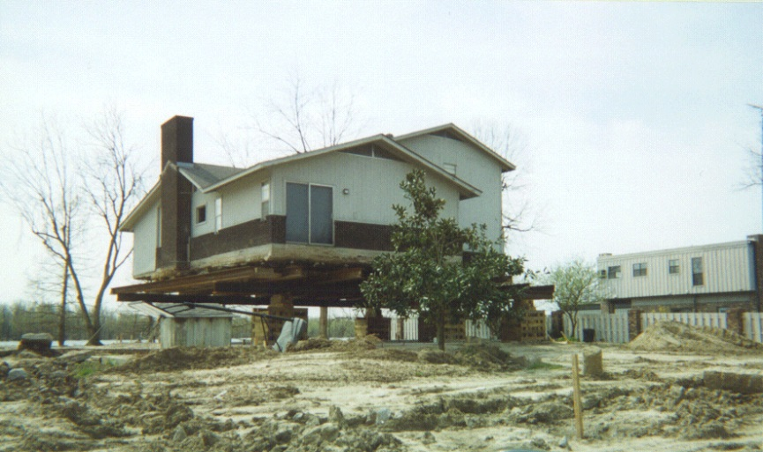
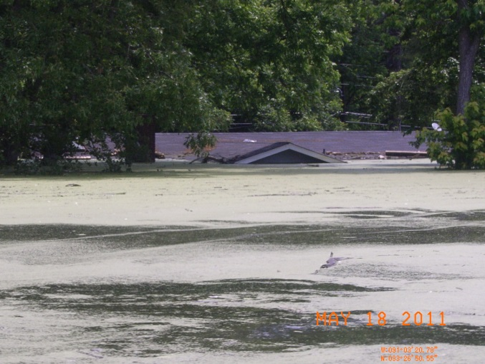
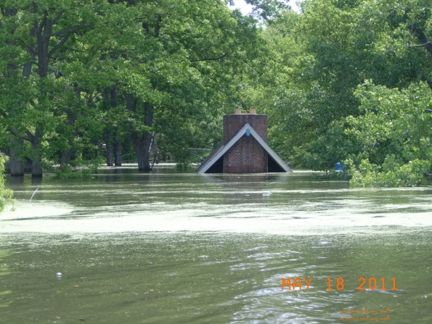
Hazard Mitigation Assistance (continued)
Photos: MEMA
Notes:
Upper Left and Right photos are of elevation projects in 1999, Lake Ferguson area, Washington County, MS.
Lower Left and Right photos are the same area in 2011, homes that did not elevate.
The area was flooded in 2009 and 2011 by the Mississippi River. The HMGP elevated structures were undamaged. Why is this situation different from the previous slide?
Is elevation always the best solution?
If the SHMO is in a different agency than the NFIP, does he/she coordinate with you to see if the community is considered compliant before initiating a mitigation project there?

Slide 41
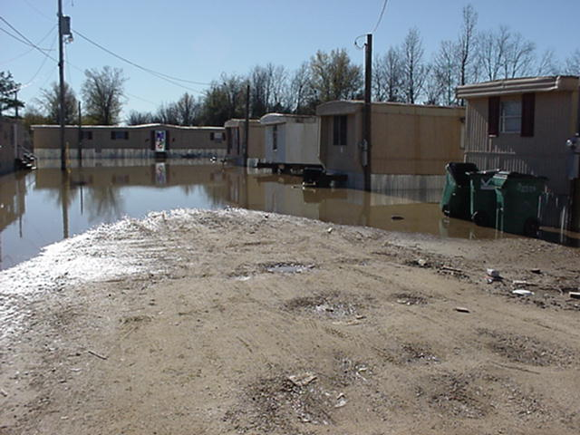
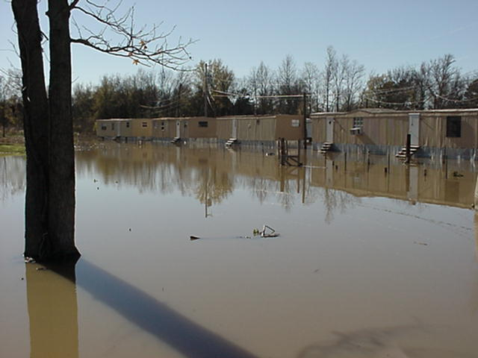
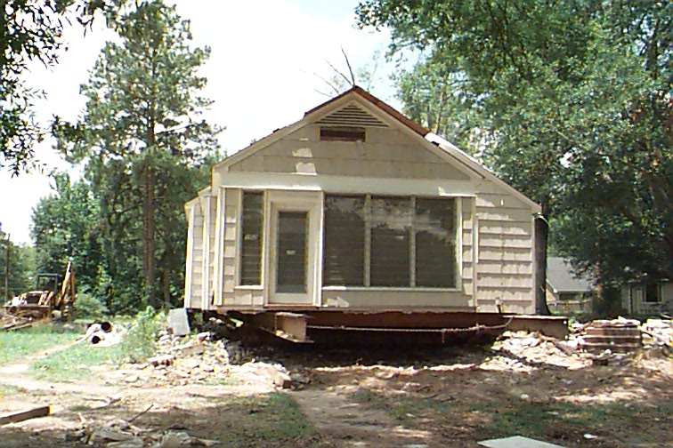
Hazard Mitigation Assistance (continued)
Mitigation / relocation
  HMGP funds can be provided for relocation of mobile homes and stick built homes.
Photos: MEMA
Notes:
In this example, mobile homes in the town of Tchula, MS were located in a C zone, approximately five feet below adjacent road. The Town Council rezoned the C zone to a Community Flood Hazard Area (CFHA) and allowed no development without elevation.
Community Flood Hazard Area (CFHA) is an area that has been determined by the Floodplain Administrator (or other delegated, designated, or qualified community official) from available technical studies, historical information, and other available and reliable sources, which may be subject to periodic inundation by floodwaters that can adversely affect the public health, safety and general welfare. This includes areas downstream from dams.
You can also pay to move/relocate a structure from the SFHA.

Slide 42
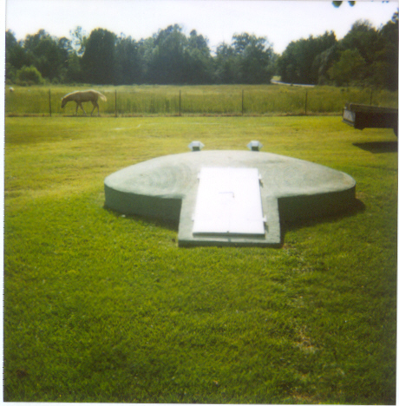
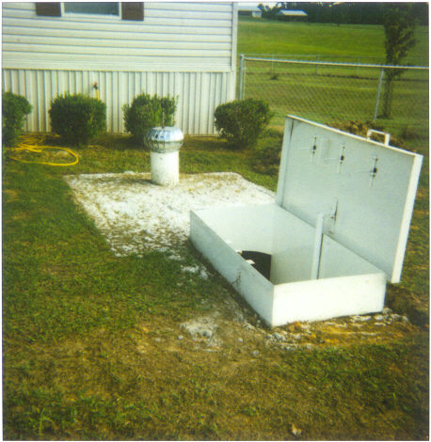
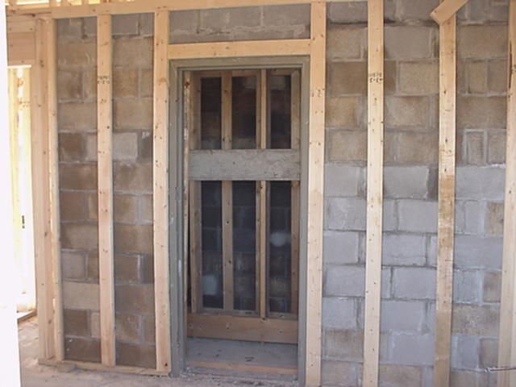
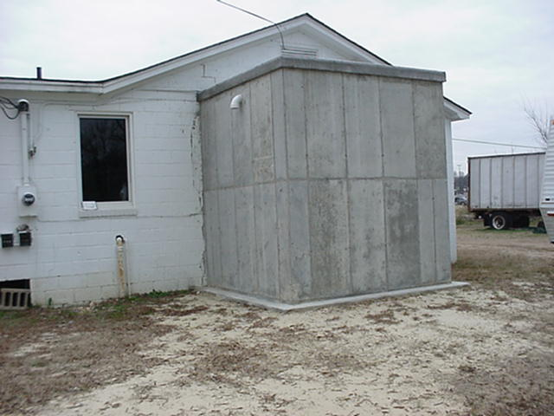
Hazard Mitigation Assistance (continued)
Photos: MEMA
Safe rooms and storm shelters
Notes:
Many states have used HMGP funds to construct safe rooms and underground storm shelters. There are flood mitigation requirements for any shelters placed in the SFHA.

Slide 43
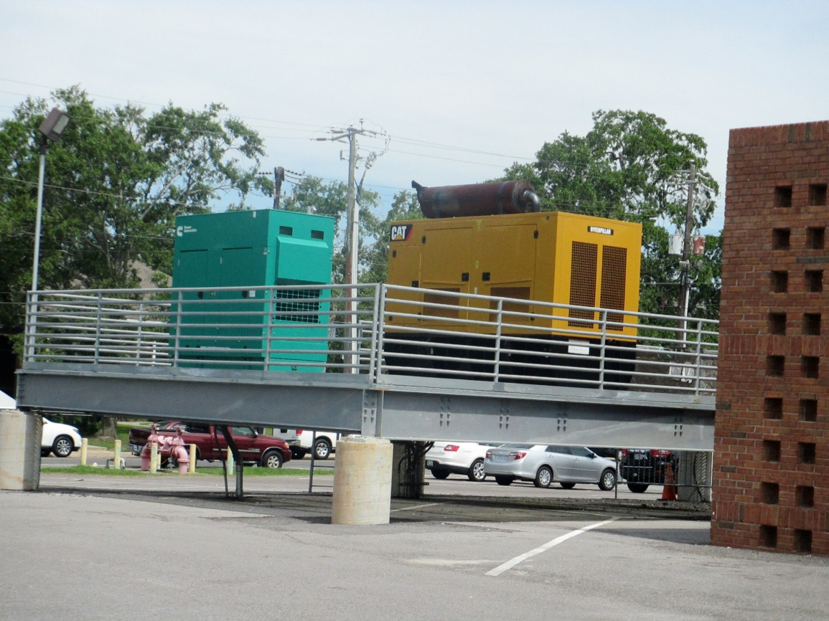

Hazard Mitigation Assistance (continued)
Generator for Critical Facilities
Photo: AWG Consulting
Notes:
Retrofitting of critical facilities with a stand-alone project (in this case a generator).
Photo taken in April 2013 at the Jackson County, MS EOC.

Slide 44
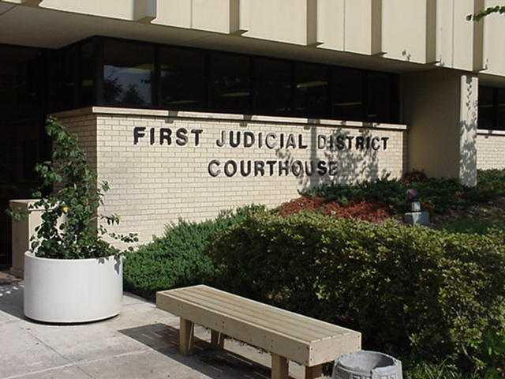
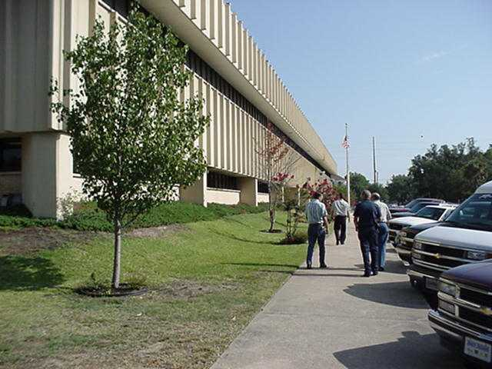


Hazard Mitigation Assistance (continued)
Identification of a
need for hurricane
shutters for a Critical
Facility.
Photos: MEMA
Notes:
Planning a retrofit project of a critical facility with hurricane shutters in Gulfport, MS.
Are you aware of any special FPM requirements in your state concerning critical facilities? The FEMA Community Rating System has its own requirements also.

Slide 45
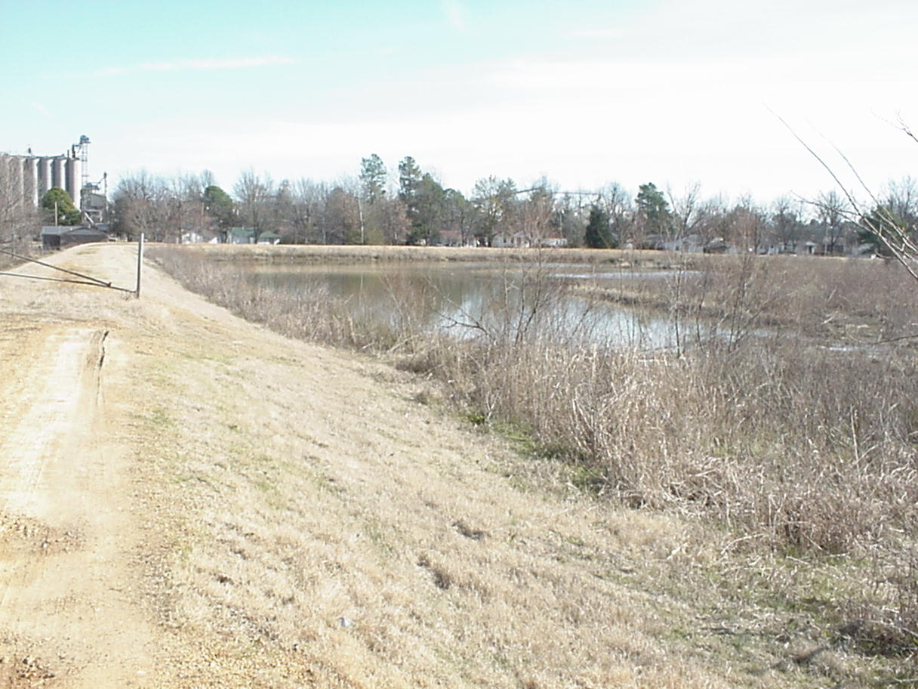
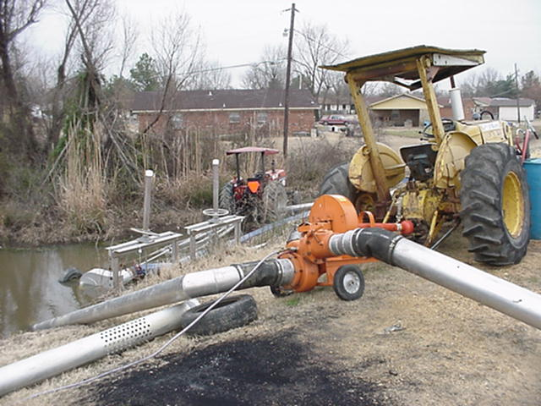
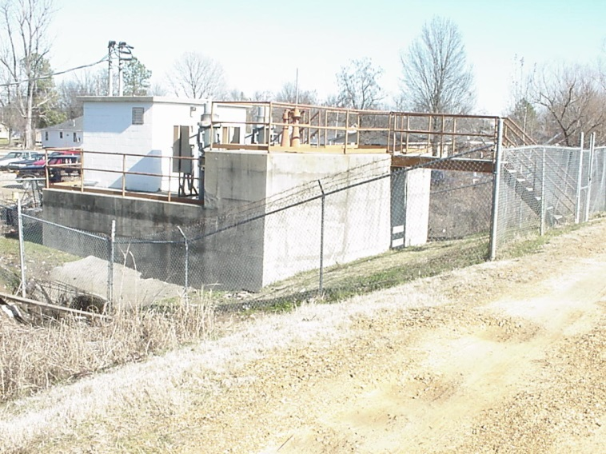
Hazard Mitigation Assistance (conclusion)
  Structural measures
Photos: MEMA
Notes:
Town of Marks, MS. Purchase of portable pump system and an upgrade of onsite pump station. CDBG funds provided the non-federal 25% share.
Minor flood control measures like berms (small ring levee) have also been constructed with 75% HMGP funds in the past.

Slide 46
After Action Review
  Feel like you are missing something vital?
Notes:
Review any items or questions that were raised to ensure that there is no confusion or mystery to what you have covered.

Slide 47
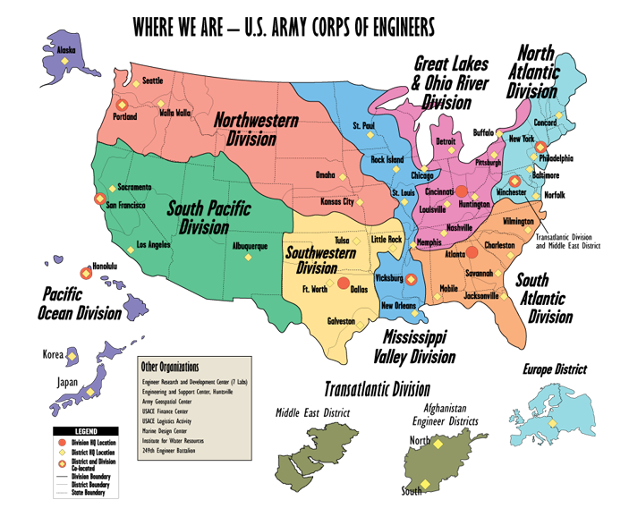

US Army Corps of Engineers
Notes:
Map taken from USACE webpage.
Discuss the map with the mentee(s).

Slide 48
US Army Corps of Engineers (continued)
  Four programs that are intertwined with a state’s FPM program:
    National Flood Risk Management Program
    The Floodplain Management Services (Water Resources Development Act of 1974: Section 22);
    Planning Assistance to States (PAS) program, and;
    Silver Jackets Program.
Notes:
Have you ever worked with any of these programs? Do you know the Corps district person who is the point of contact for FPM?

Slide 49
US Army Corps of Engineers (continued)
  The NFRMP’s objective is to foster open and collaborative mitigation planning, response, and recovery efforts both within USACE programs, activities, and initiatives and externally with our federal, state, local, and tribal partners.
Notes:
Review the slide.

Slide 50

US Army Corps of Engineers (continued)
  FPMS Program types of assistance:
  General Technical Services
  General Planning Guidance
  Special Studies
  Guidance and Assistance for meeting requirements of the NFIP
Notes:
(Job Aid 3).

Slide 51
US Army Corps of Engineers (continued)
  Planning Assistance to States program:
  Authority and Scope from Section 22 of WRDA 1974, which provided authority for the USACE to assist in the preparation of comprehensive plans for the development and conservation of water and related land resources.
Notes:
States, local governments and Indian Tribes often have needs in planning for water and related resources of a drainage basin or a larger region. The Corps has the expertise to assist.

Slide 52
US Army Corps of Engineers (continued)
  Planning Assistance to States program (continued):
  Program Development: The planning assistance is determined by the individual States and Tribes. They do not include detailed design for project construction. They do involve analysis of existing data for planning purposes, although some data collection is often necessary.
Notes:
Review slide.

Slide 53
US Army Corps of Engineers (continued)
  Planning Assistance to States program (continued):
  Typical Studies: The PAS program can encompass many types of studies, such as:
    Environmental Conservation / Restoration;
    Dam Safety / Failure;
    Flood Risk Management;
    Floodplain Management;
    Coastal Zone Management / Protection, and;
    Harbor / Port studies.
Notes:
Review slide.

Slide 54
US Army Corps of Engineers (continued)
  Planning Assistance to States program (conclusion):
  Funding: The program is funded annually by Congress. Allotments for each State or Tribe are limited to $500 thousand annually, but are typically much less. Cost share is 50% Federal – 50% non-Federal.
Notes:
State, local government and Tribal officials can contact the appropriate USACE District office for details.

Slide 55

US Army Corps of Engineers (conclusion)
  “Silver Jackets” Program:
  An innovative forum / program that provides an opportunity to consistently bring together multiple state, federal, and sometimes tribal and local agencies to learn from one another and apply their combined knowledge to reduce risk.
  Multiple agencies and programs can be leveraged to provide a cohesive solution.
Notes:
Have you heard of the Silver Jacket program? (In Mississippi, it is called the “Camo Jackets.”) Does your agency participate?
A USACE initiative, a team was first established in the state of Ohio in 2005, the second in Indiana in 2006.
State based to meet the unique programmatic needs found within the state.
(Job Aid 4.)

Slide 56
After Action Review
  Feel like you are missing something vital?
Notes:
Review any items or questions that were raised to ensure that there is no confusion or mystery to what you have covered.

Slide 57

US Geological Survey
  The mission of the USGS in natural hazards is to develop and apply hazard science to help protect the safety, security, and economic well-being of the Nation (2007 agency science strategy).
  In October 2010, the USGS Natural Hazards Science Strategy Planning Team (H-SSPT) was charged with developing a 10-year Science Strategy for the USGS mission in natural hazards.
Notes:
Review Slide.
Have you ever coordinated with your state’s USGS office? Are they in your Silver Jacket team?
Did they provide data for your state’s Map Mod or Risk MAP efforts?

Slide 58

US Geological Survey (continued)
  This 2010 report identified those scientific observations, analyses, and research that are critical for the Nation to become more resilient to natural hazards.
Notes:
Review Slide.
(Job Aid 5).

Slide 59

US Geological Survey (continued)
  Additionally, in 2010, USGS was reorganized to focus on seven science mission areas:
    Climate and Land Use Change;
    Core Science Systems;
    Ecosystems;
    Energy and Minerals;
    Environmental Health;
    Natural Hazards, and;
    Water.
Notes:
Review Slide.
The USGS changed from four scientific discipline areas (Geography, Geology, Biology, and Hydrology) to the seven issues-based organization depicted on this slide.
And you thought they just made topo maps and monitored river gages eh?

Slide 60
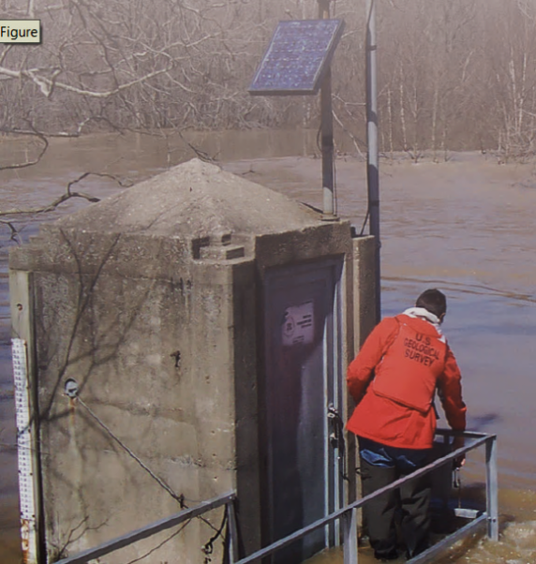
US Geological Survey (continued)
  This reorganization was a significant step toward collaboration with other agencies and the public in regard to natural science issues, both present and future. Workforce:
    Scientists & technicians in earth sciences;
    Hydrology;
    Biology;
    Geography, and;
    Social and Behavioral sciences.
Photo: USGS
Notes:
Review Slide.
Photo: Skillet Fork near Wayne City, IL.

Slide 61
US Geological Survey (continued)
  Core responsibilities:
    Operate monitoring networks for earthquakes, stream flow, volcanic activity and geomagnetic storms, and produce datasets of observations and near-real-time products.
    Conduct surveys, such as geological mapping and acquisition of geophysical data.
    Collect data during hazardous events that will support future research to reduce loss.
Notes:
Review Slide.

Slide 62

US Geological Survey (continued)
  Core responsibilities (conclusion):
    Develop long-term chronologies of hazardous events from both historical and paleo-hazard studies.
Notes:
Review Slide.

Slide 63
US Geological Survey (continued)
  SFPMs are most accustomed to the USGS stream gage network and online web interface.
    Nearly 7,800 near-real-time stream gages, with more than 4,000 forming the backbone of the NWS flood forecasting operation, which are used to forecast warnings to State agencies, dam operators, levee boards, EOCs, emergency managers, and the public.
Notes:
Review Slide.
Have you ever used a USGS website of a stream or river profile?
“During the 2011 Mississippi River flood, the USACE stated that the USGS stream flow data, water-quality data, and data communication efforts were critically important in preventing an estimated $108 billion in flood damages.” – USGS Circular 1383-F.

Slide 64
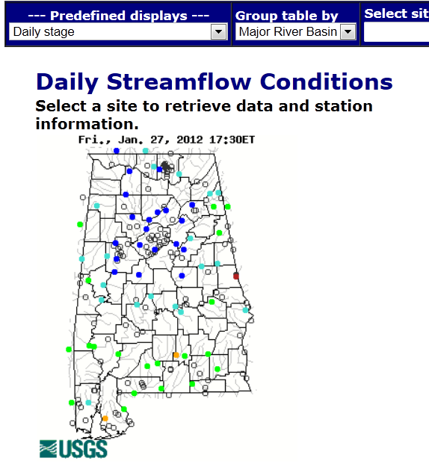
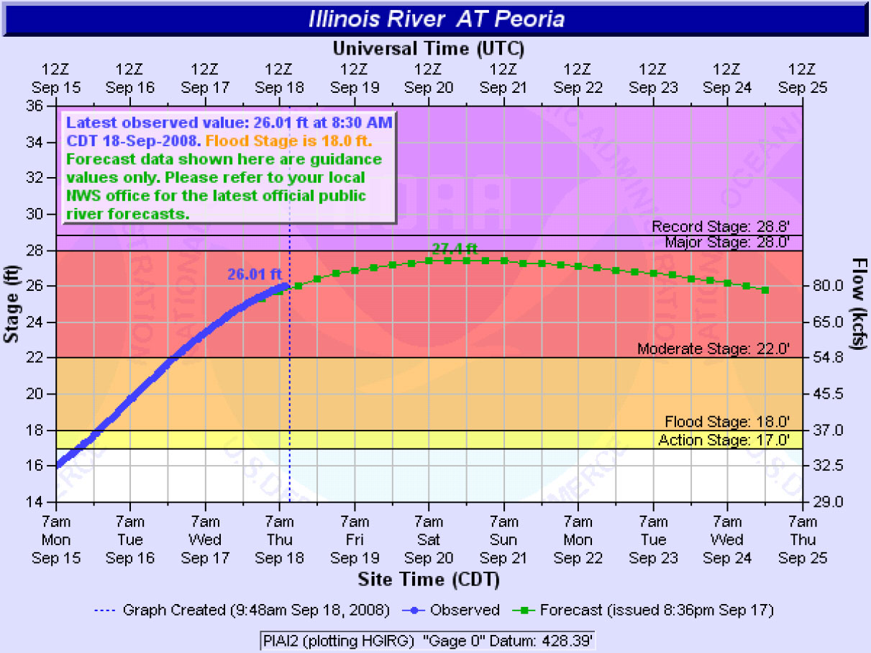
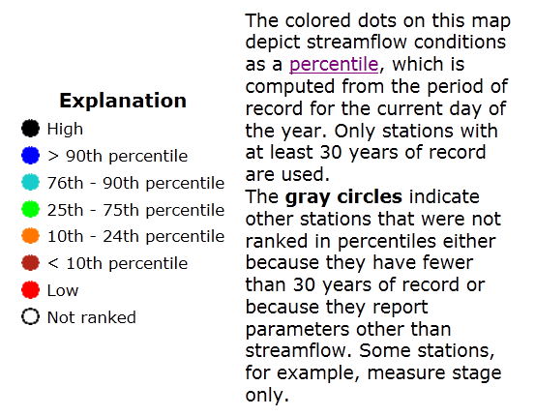
US Geological Survey (continued)
Notes:
On larger rivers, gages may be maintained by the Weather Service, USGS or another federal or state agency. Some not only tell you what the current reading is but, like the Illinois River example (NWS); they show the predicted time and level of flooding.

Slide 65
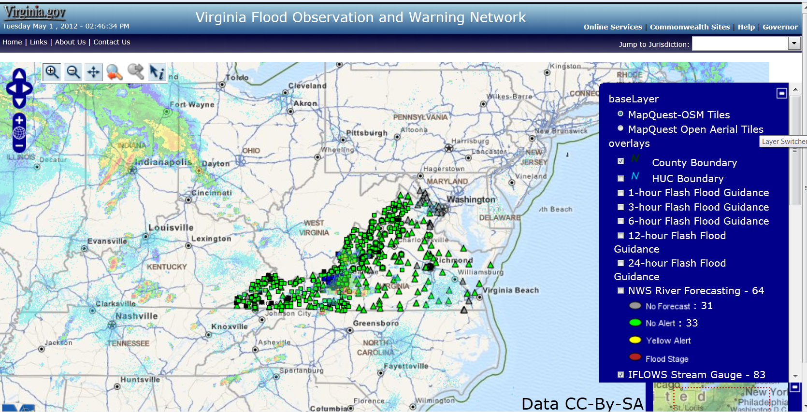
US Geological Survey (continued)
Notes:
This is an example of a flood observation and warning website hosted by other partners.

Slide 66
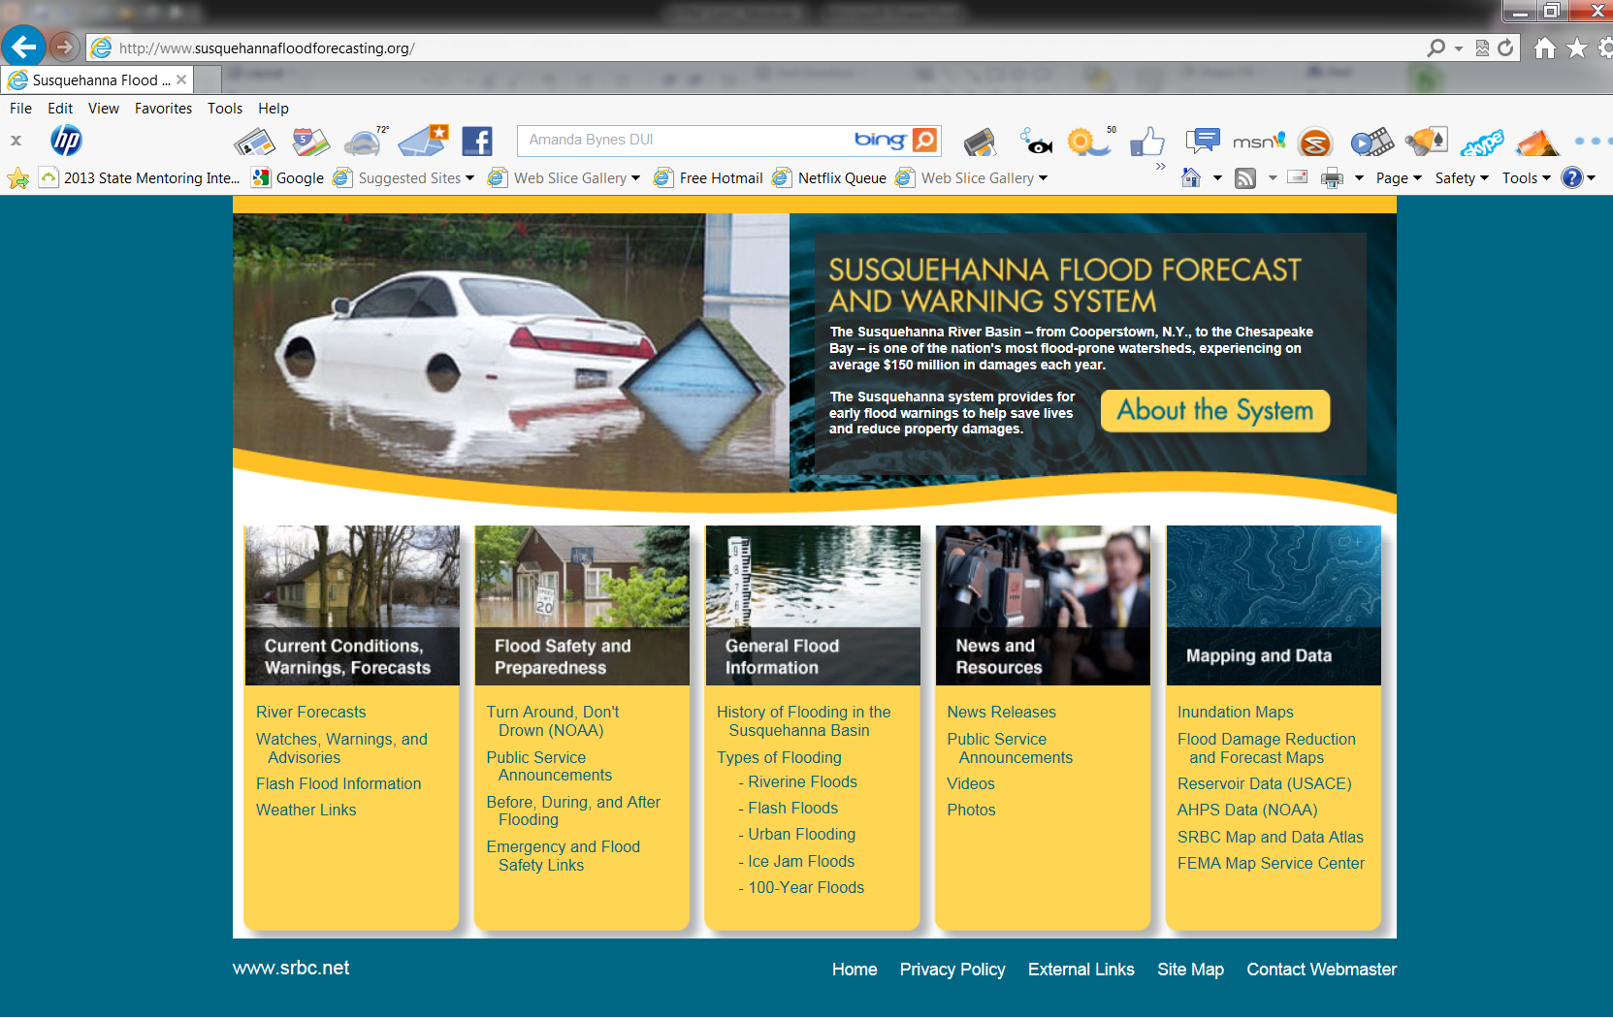
US Geological Survey (continued)
Notes:
This is another example of a flood observation and warning website hosted by other partners.

Slide 67
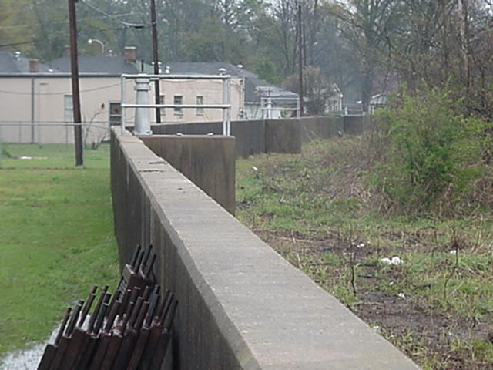
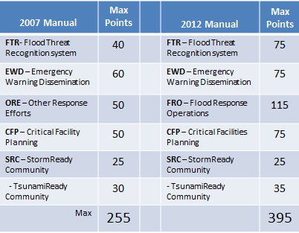
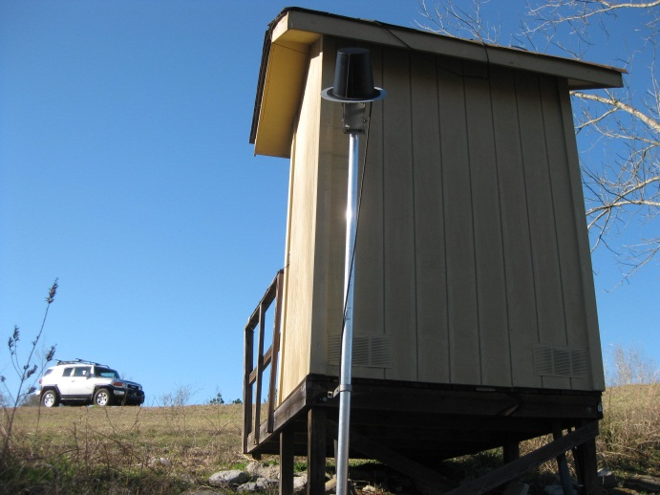
US Geological Survey (continued)
30
Photos: AWG Consulting
Notes:
In the CRS Activity 610, USGS gages play an important role in the FTR element. (This is a comparison chart of the 2007 CRS and the 2013 CRS manual for Activity 610: Flood Warning and Response.)
Upper left photo is a floodwall in Greenwood, MS.
Lower left photo is a USGS stream gage station in Rankin County, MS.

Slide 68
US Geological Survey (conclusion)
  In collaboration with NOAA and USACE, the USGS is predicting the likely interactions between storm forcing (surge and waves) and coastal topography (beaches, berms, and dunes) during hurricanes in near-real-time.
  This information enables anyone interested in flood risk to identify areas of damage or impact of greatest potential damage.
Notes:
Review Slide.
The important thing for the SC to know is that USGS is a good source for flood monitoring and evaluation tools.

Slide 69

After Action Review & Break
  Feel like you are missing something vital? Let’s do a quick review and then take a break.
Notes:
Review any items or questions that were raised to ensure that there is no confusion or mystery to what you have covered.
Take a 10 minute break.

Slide 70

Nat’l Oceanic & Atmospheric Administration
  NOAA’s Mission:
    Science, Service, and Stewardship;
    To understand and predict changes in climate, weather, oceans, and coasts;
    To share that knowledge and information with others, and;
    To conserve and manage coastal and marine ecosystems and resources.
Notes:
Review slide.
NOAA was formed in 1970. Its roots date back to 1807 to the “Survey of the Coast,” a scientific research group.
NOAA is part of the U.S. Department of Commerce. Why are they there?
Why is the U.S. Coast Guard in DHS? Nobody knows.

Slide 71

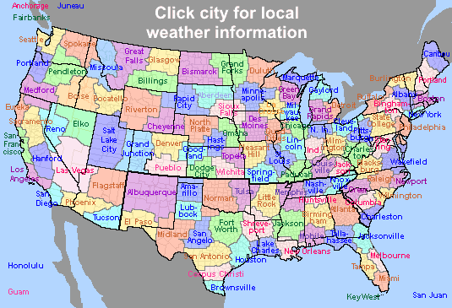
NOAA (continued)
    120 local NWS offices
    Provide local forecasts and warnings
    24/7 operations
www.nws.noaa.gov
Notes:
NWS Weather Forecast Office map. Review slide.
The best known portion of NOAA, the National Weather Service.
Ask mentee(s) about their experiences with the local NWS office(s) that cover their state.

Slide 72
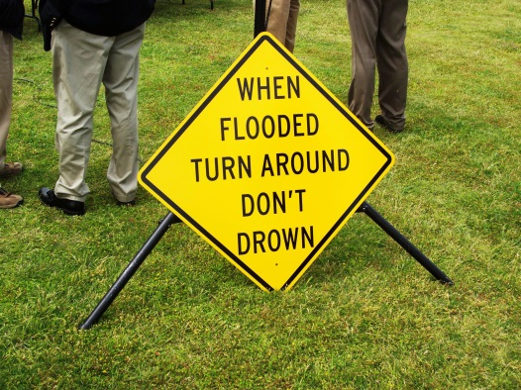

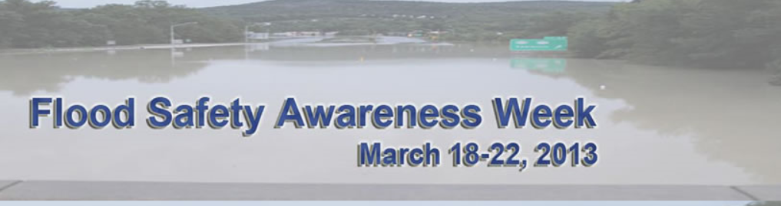

NOAA (continued)
Photo: MEMA
Notes:
Review slide. Photo of sign taken in Jackson, MS at a NWS press conference.
NWS outreach programs.
You can contact your local NWS office and ask if they have any TADD signs that can be supplied to your communities. They have limited numbers on hand each year.

Slide 73
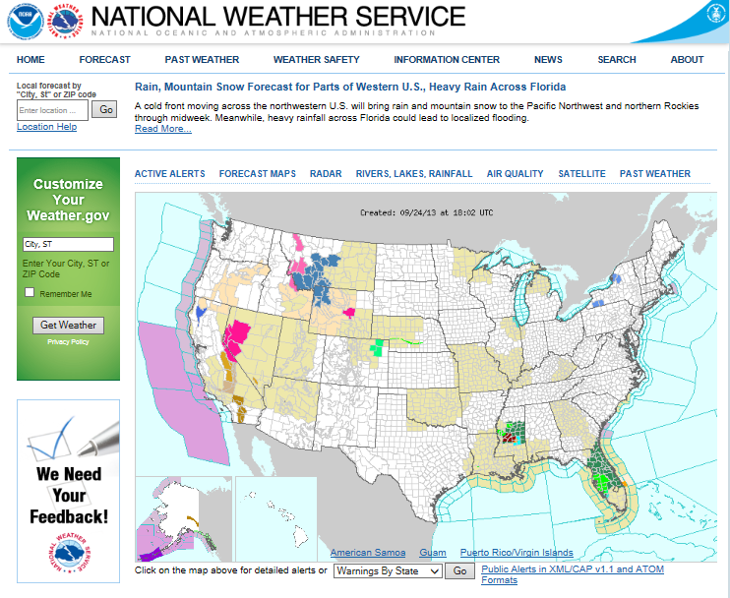
NOAA (continued)
Notes:
Review slide.
Screen capture on 9/24/13.

Slide 74
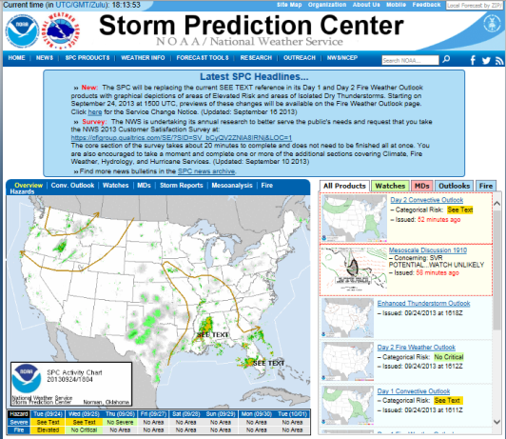



NOAA (continued)
Notes:
The NWS has loads of cool websites that convey flood/precipitation/storm information. All screen captures taken on 9/24/13, note the radar and gages.
Do you use such websites during a weather event? Can you see why NWS would be a big part of the Silver Jackets program?

Slide 75

NOAA (continued)
Notes:
This is a Tsunami warning website hosted by other partners of NOAA.
http://nvs.nanoos.org

Slide 76

NOAA (continued)
Notes:
An excellent example of a web based product that not only depicts flood heights, but a levee protected area. This type of information can be used in the FEMA CRS Activity 620: Levees.

Slide 77



NOAA (continued)
Notes:
Review slide.
The other well-known portion of NOAA, the National Hurricane Center.

Slide 78



NOAA (continued)
Notes:
HURREVAC program used by emergency managers to track tropical cyclones and plan evacuation notices. This program also contains rainfall, river gages, tide gages, and flood outlook information. Contact your state EOC for information on how to obtain the free program.

Slide 79

NOAA (continued)
Notes:
From a coastal FPM perspective, the big tools and data that are available on this website include:
The Sea Level Rise viewer, and;
The Coastal Flood Exposure Mapper.

Slide 80

NOAA (continued)
Notes:
Sea Level Rise Viewer page includes a recorded webinar.

Slide 81

NOAA (continued)
Notes:
The Coastal Flood Exposure Mapper (includes data from Maine to Texas). You can add images to visualize impacts of future management decisions (think ordinance updates for higher standards).
ASFPM is a founding Digital Coast Partner.

Slide 82
NOAA (continued)
  National Weather Service (NWS):
    In 2011, the NWS launched the “Weather-Ready Nation” initiative to build community resilience in the face of increasing extreme weather and water events.
    NWS “emergency response specialists” are now deployed to EOCs to facilitate effective communication between NWS and the affected communities.
Notes:
Review slide.

Slide 83
NOAA (continued)
  National Weather Service (continued):
    Enhanced warning language such as “Life-threatening situation, extensive damage to homes and buildings.” – in the case of severe storms
    “Area will be uninhabitable for weeks…water shortages will make human suffering incredible…livestock left exposed will be killed.” – in the case of hurricanes
Notes:
Review slide.

Slide 84

NOAA (continued)
  National Weather Service (continued):
    Partnership with FEMA and many of the biggest cellular carriers to provide NOAA warnings that are broadcast directly to cell phones as part of the Wireless Emergency Alert (WEA) system.
Notes:
Review slide.
Photo of Al Goodman’s cell phone receiving a weather alert after it emitted a loud tone during a Flash Flood Warning (while he was working on the NOAA portion of this module, hmm… synchronicity rearing its head).

Slide 85


NOAA (conclusion)
Notes:
Information concerning post-Hurricane Sandy activities. More to come in Module 10: State Level Disaster Response and Disaster Recovery Duties.
NOAA can do aerial surveys and also contribute LiDAR and other technical data for flood mapping along coastlines.
This slide concludes this summary of NOAA FPM related or ancillary programs.

Slide 86
After Action Review
  Feel like you are missing something vital?
Notes:
Review any items or questions that were raised to ensure that there is no confusion or mystery to what you have covered.

Slide 87
Natural Resources Conservation Service
  Part of USDA, the Natural Resources Conservation Service’s (NRCS) priority is the protection of the nation’s water resources. Clean and abundant water are critical to:
    Sustainable agricultural production;
    Ensuring healthy urban and rural communities, and;
    Supporting manufacturing, tourism and recreation.
Notes:
Review the slide.

Slide 88

NRCS (continued)
Notes:
The Wetlands Reserve Program (WRP) is a voluntary program offering landowners the opportunity to protect, restore, and enhance wetlands on their property.
More than 11,000 private owners have enrolled over 2.3 million acres into the WRP.

Slide 89

NRCS (continued)
Notes:
Emergency Watershed Protection (EWP) program.
The EWP is a recovery effort program aimed at relieving imminent hazards to life and property caused by floods, fires, windstorms, and other natural occurrences.
This is the NRCS program with which a local FPM will be most familiar.

Slide 90
NRCS (continued)
  Congress passed the Watershed Protection Program to help safeguard individuals and property endangered by natural disasters.
  The NRCS, which administers the program, has this authority under Section 216 of Public Law 81-516 and Public Law 95-334.
Notes:
Review slide.

Slide 91
NRCS (continued)
  EWP Program Funding and Sponsorship:
    Assistance is available for emergency work that presents a clear threat to life or property and requires immediate action.
    NRCS can pay up to 75% of the construction costs. Local sponsors are responsible for the remaining 25%. The local sponsor can be a city, county, or conservation district.
Notes:
Review slide.
It is not necessary for a national emergency to be declared for an area to be eligible for assistance.
The 25% Sponsor Contribution can be cash, in-kind goods / services, or any combination of cash and in-kind goods and services.
What would be examples of In-Kind Contributions?
Earth Work
Vegetation
Materials used in the construction of the project
Debris disposal (e.g. chipping, burning, or tipping fees)
Labor used in the construction of the project such as operators of equipment and vehicles, physical labor used for project installation.

Slide 92
NRCS (continued)
  EWP - Recovery:
    The above is the ‘practice measure’ that is the most common link to FPM.
    Remove debris from stream channels, road culverts, and bridges;
    Reshape and protect eroded banks;
    Correct damaged drainage facilities;
    Establish cover over critically eroding lands;
Notes:
Review slide.

Slide 93


NRCS (continued)
Notes:
Photo taken in Clarksdale, MS. Identification of a possible NRCS debris removal project during a CAV.

Slide 94



NRCS (continued)
Notes:
Upper left photo is in Magee, MS. A NRCS EWP project on Mill Creek, approximately 3,500 feet in length.
Lower right photo is in Grenada, MS. A NRCS EWP project on Browns Creek, stream bank stabilization.

Slide 95
NRCS (continued)
  Practice Measures (conclusion):
    Repair levees and structures, and;
    Repair conservation practices.
  NRCS may purchase EWP easements “in lieu of recovery” on any floodplain lands that have been impaired within the least 12 months or that have a history of repeated flooding (i.e. flooded at least two times during the past 10 years).
Notes:
Review slide.

Slide 96
NRCS (continued)
  The EWP cannot be used to:
    Solve problems that existed prior to the emergency;
    Perform operation and maintenance work or repair private or public transportation facilities;
    Reimburse previously completed work;
    Perform work on measures installed by another federal agency, and;
    Protect cropland or pasture.
Notes:
Review slide.

Slide 97

NRCS (conclusion)
Notes:
Photo from NRCS publication.
This concludes the section on the NRCS FPM related programs.

Slide 98
After Action Review
  Feel like you are missing something vital?
Notes:
Review any items or questions that were raised to ensure that there is no confusion or mystery to what you have covered.

Slide 99
Coastal Zone Management Program
  Although coastal counties comprise only 17% of the nation’s land area, they hold over 50% of the U.S. population. In 2003, 153 million lived along the coastlines, 33 million more than in 1980.
  Coastal natural hazards consist of:
    Coastal Storms
    Flooding
    Coastal Erosion & Land Subsidence
    Tsunamis
Notes:
Review slide.
In 2007, the coastal zone contributed $6.7 trillion to the U.S. economy.

Slide 100

CZMP (continued)
  Coastal Zone:
Notes:
Review slide.
Is your state included in this definition? (If yes, continue with this unit, if no, basically skip over CZMP.)

Slide 101
CZMP (continued)
  Coastal Zone Management Act (CZMP), which was passed in 1972, is administered by NOAA’s Office of Ocean and Coastal Resource Management.
  The CZMA outlines two programs:
    The National Coastal Zone Management Program
    National Estuarine Research Reserve System
Notes:
Review slide.

Slide 102

CZMP (conclusion)
  CZMP Strategic Plan: Improving Management of the Nation’s Coastal Areas FY 2007 – 2012.
Notes:
(Job Aid 6.)
This concludes the section concerning the Coastal Zone Management Program.

Slide 103
After Action Review
  Feel like you are missing something vital?
Notes:
Review any items or questions that were raised to ensure that there is no confusion or mystery to what you have covered.

Slide 104

National Dam Safety Program
  The NDSP is a partnership of the States, Federal agencies, and other stakeholders that encourages individual and community responsibility for dam safety. It includes:
    Information Needs for Dam Safety;
    Dam Safety Training;
    Grant Assistance to the States;
    Dam Safety Research, and;
    Creating a National Inventory of Dams.
Notes:
The NDSP has been operational since 1998.
The NID is maintained by the USACE. The NID used to be available on the internet, but has since been pulled down to frustrate any possible terrorist attacks…
Photo of emergency alert siren, you know, the one that sounds when a dam fails.
(Job Aid 7.)

Slide 105
NDSP (continued)
  Grant Assistance to the States.
    Provides vital support for the improvement of State Dam Safety programs that regulate most of the 83,000 dams in the United States. NDSP funds are used for the following types of activities:
      Dam safety training for state personnel;
      Increase in the number of dam inspections;
      Increase in the submittal and testing of EAPs;
Notes:
Review the slide.
EAP: Emergency Action Plan
There are approximately 4,400 unsafe non-federal dams in the United States. (Dams identified by state programs as susceptible to failure. This is not the same thing as a high hazard potential dam.)

Slide 106
NDSP (continued)
  Grant Assistance to the States (conclusion).
      More timely review and issuance of permits;
      Improved coordination with state emergency preparedness officials;
      Identification of dams to be repaired or removed, and;
      Conduct of dam safety awareness workshops and creation of dam safety videos and other outreach materials.
Notes:
Review the slide.

Slide 107
NDSP (conclusion)
  Does your state FPM program consider dams to be floodplain development?
  If so, how do your communities permit dams?
  Does your state model Flood Damage Prevention Ordinance include/mention dams?
Notes:
Discuss slide’s questions.
Cover your experiences with your State Dam Safety office and any items you have seen in local/state FPM ordinances in regard to dams.
This concludes the NDSP review.

Slide 108
After Action Review
  Feel like you are missing something vital?
Notes:
Review any items or questions that were raised to ensure that there is no confusion or mystery to what you have covered.
We will next cover five national associations fairly quickly, as a means of introduction. They have been identified as organizations that are connected to FPM activities and who serve as partners in mitigation.

Slide 109

Association of State Floodplain Managers
  About ASFPM.
    The Association is an organization of professionals involved in floodplain management, flood hazard mitigation, the NFIP, and flood preparedness, warning and recovery.
Notes:
Review slide.
Surprised huh? Have you ever heard of ASFPM? What did you hear?
ASFPM has state chapters. It is an individual membership organization.
(Job Aid 8). A history of ASFPM written in 2003.
The footer illustrates five events/programs that the Association promotes.

Slide 110

ASFPM (continued)
Notes:
Review slide.
Does your state have a state FPM association? Is it a state chapter of ASFPM?

Slide 111

ASFPM (continued)
Notes:
The 2014-2015 Officers and Board of Directors. Perhaps you know some of them?

Slide 112

ASFPM (continued)
Notes:
This is the ASFPM website. Information contained here can be of service to you and your state FPM program.

Slide 113

ASFPM (conclusion)
Notes:
What are your concerns with the Association, if any?
Since the remaining topics of this module are non-Federal entities, we will cover them more quickly. The next up is the National Association of Flood and Stormwater Management Agencies or NAFSMA.

Slide 114
Nat’l Association of Flood & Stormwater Management Agencies
  About NAFSMA.
    The Association was founded in 1978, and represents state and public agencies nationwide. NAFSMA is an organization of public agencies whose function is the protection of lives, property and economic activity from the adverse impacts of storm and flood waters.
Notes:
Have you heard of NAFSMA? It is an organization membership organization.
Review slide.

Slide 115
NAFSMA (continued)
  NAFSMA Mission.
    To advocate public policy, encourage technologies and conduct education programs which facilitate and enhance the achievement of the public service function of its members.
  NAFSMA Goal.
    To improve and ensure the continuation of water resource projects and programs of interest to flood and stormwater management agencies.
Notes:
Review the slide.

Slide 116
NAFSMA (continued)
  NAFSMA achieves this goal through:
    Education: Works to inform and educate congressional and federal policy makers of the importance of flood prevention, stormwater management, and disaster relief assistance.
    Presentations: Delivers information and materials supportive of the membership’s positions to Congress and administrative agencies.
Notes:
Review the slide.
NAFSMA was instrumental in the reauthorization efforts for the Clean Water Act and the various WRDAs in the past few years.

Slide 117

NAFSMA (conclusion)
  NAFSMA goal (conclusion):
    Coalitions: Frequently works with other public interest groups and national trade associations located in Washington, DC. Serves as the liaison to these organizations to ensure the interests of the membership are well represented.
Notes:
Review the slide.
NAFSMA and ASFPM have partnered in several coalitions. NAFSMA also has a permanent representative on the FEMA CRS Task Force, along with ASFPM.
This concludes the summary of NAFSMA. Any questions?
The next association we will cover is ASDSO.

Slide 118
Association of State Dam Safety Officials
  About ASDSO.
    The Association was officially formed in 1984. Its membership totals more than 3,000 state, federal and local governments, academia, dam owners, manufacturers, suppliers, consultants, and others.
Notes:
Review the slide.
There is an ASDSO representative on the CRS Task Force Series 600 Committee. This committee was instrumental in the reworking of Activity 630 in the 2013 manual.
(Job Aid 9).

Slide 119




ASDSO (continued)
Notes:
This map denotes the four regions which make up ASDSO.
There is currently only one chapter, the New Jersey/Pennsylvania Council for Safe Dams (CSD).
Latest inventory has around 84,000 dams identified, with over 15,000 classified as high hazard potential dams.
Is the State Dam Safety Official a member of your state FPM association? If no, why not?

Slide 120
ASDSO (continued)
  ASDSO Mission.
    To advance and improve the safety of dams by supporting the dam safety community and state dam safety programs, raising awareness of dam safety issues, facilitating cooperation, providing a forum for the exchange of information, representing dam safety interests before governments, providing outreach programs, and creating a unified community of dam safety advocate.
Notes:
Review the slide.

Slide 121

ASDSO (continued)
  ASDSO Goal.
    A future where all dams are safe.
Notes:
Review the slide.

Slide 122

ASDSO (conclusion)
Notes:
Review slide.
ASDSO’s primary focus is on these four areas. Legislative, Dam Safety, Tech Resources, and Education/Training.
This concludes the review of ASDSO. Any thoughts or questions?
CLICK

Slide 123

American Planning Association
  About APA.
    Traces its roots back to 1909 when the first National Conference on City Planning and Congestion Relief was convened in Washington, DC. In 1978, the American Planning Association emerged from the consolidation of the American Institute of Planners and the American Society of Planning Officials.
Notes:
Review slide.
The APA has state chapters.

Slide 124
APA (continued)
  APA Mission.
    To provide leadership in the development of vital communities by advocating excellence in planning, promoting education and citizen empowerment, and providing the tools and support necessary to meet the challenges of growth and change.
Notes:
Review slide.

Slide 125

APA (conclusion)
Notes:
Review slide.
ASFPM coordinates with APA. They are currently involved in updating the Planning Advisory Service Report: Subdivision Design in Flood Hazard Areas.

Slide 126

Int’l Association of Emergency Managers
  About IAEM.
    Founded in 1952 as the U.S. Civil Defense Council, becoming the National Coordinating Council of Emergency Managers in 1985, and the International Association of Emergency Mangers in 1997.
Notes:
Review the slide.
IAEM is an individual membership organization.

Slide 127
IAEM (continued)
  About IAEM (conclusion).
    Originally consisting of ten U.S. regions and a Student Region.
    2003 IAEM-Canada was established as a region followed by IAEM-Europa, IAEM-Oceania, and IAEM-Asia in 2004.
    In 2010, IAEM-Italy became the first non-U.S. region within the council and IAEM-Spain the first national chapter.
Notes:
The Student Region consists of members within colleges and universities.
IAEM has a Global Board of Directors.

Slide 128
IAEM (continued)
  IAEM Mission.
    To advance the profession by promoting the principles of emergency management;
    To serve our members by providing information, networking and professional development opportunities, and;
    To advance the emergency management profession.
Notes:
Review the slide.
The Association has 5,000+ members worldwide.

Slide 129
IAEM (continued)
  IAEM Goal.
    To drive the development of the profession of emergency management through the promotion of the Principles of Emergency Management, the Certified Emergency Manager (CEM) Program / Associate Emergency Manager (AEM) Program, and the support the Emergency Management Accreditation Program (EMAP).
Notes:
The CEM and AEM programs were created in 1993, as internationally recognized certification programs, to raise and maintain professional standards of emergency managers.
CEM® is a registered trademark of the International Association of Emergency Managers. Additionally, IAEM claims the rights to the use of the service mark for AEMSM.
IAEM partners with NEMA to support EMAP.

Slide 130

IAEM (continued)
http://www.emaponline.org/
Notes:
There are presently 29 EMAP accredited states, with two pending.

Slide 131

IAEM (conclusion)
Notes:
IAEM website. www.iaem.com
This concludes the thumbnail sketch of IAEM. Any thoughts?
Next, the last NGO we will discuss in this module, NEMA.

Slide 132

Nat’l Emergency Management Association
  About NEMA.
    Began in 1974 by state EMA directors to exchanged information on common emergency management issues that threatened their constituencies.
    The professional association of and for the 50 EMA state directors, eight territories, and the District of Columbia.
Notes:
Review slide.
NEMA is an organization membership organization.
State EMA directors are the core membership. Membership categories also exist for key state staff, homeland security advisors, federal agencies, nonprofit organizations, private sector companies, and concerned individuals.

Slide 133

NEMA (continued)
  NEMA Goal.
    Provide national leadership and expertise in comprehensive emergency management, serve as a vital emergency management information and assistance resource; and advance continuous improvement in emergency management through strategic partnerships, innovative programs, and collaborative policy positions.
Notes:
Review slide.

Slide 134
NEMA (continued)
  To accomplish this goal, NEMA focuses on:
    Strengthen the relationship with Congress and federal agencies;
    Develop strategic partnerships with key organizations and individuals who impact emergency management;
    Tackle emergency management issues through our pro-active committees;
Notes:
Review slide.

Slide 135
NEMA (continued)
  To accomplish this goal (conclusion):
    Hold two national conferences annually that bring together the most knowledgeable speakers and emergency management professionals from around the country;
    Serve as an information-sharing and support network for state directors and senior staff, and;
    Offer professional development and training so that emergency management professionals may continue honing their skills.
Notes:
Review slide. (Written like an agency director dictated the six items.)

Slide 136


NEMA (continued)
  NEMA Committees
Notes:
NEMA committees, do you see one that is also in the ASFPM PC list?

Slide 137

NEMA (continued)
  About EMAC.
    A mutual aid agreement administered by NEMA.
    Ratified into law in 1996 as PL 104-321.
    Passed in all 50 states, the District of Columbia, the U.S. Virgin Islands, Puerto Rico, and Guam.
    Through EMAC, states may share any resource with another state during an emergency or disaster, whether natural or man-made.
Notes:
EMAC is administered by NEMA. More information will be presented in Module 10: State Level Disaster Response and Disaster Recovery Duties.

Slide 138

NEMA (conclusion)
Notes:
Review slide.

Slide 139
What we covered in Module 4
  For the past hour and a half, we have covered the 11 topics introduced at the beginning of the session. What were they?
    Flood Hazard Mitigation Assistance programs;
    USACE FPMS and PAS;
    USGS;
    NOAA/NWS and NRCS;
    Coastal Zone Management Program;
    National Dam Safety Program;
Notes:
Review slide

Slide 140
Module 4 (conclusion)
  11 topics introduced (conclusion)
    Association of State Floodplain Managers;
    National Association of Flood & Stormwater Management Agencies;
    Association of State Dam Safety Officials;
    American Planning Association;
    International Association of Emergency Managers, and;
    National Emergency Management Association.
Notes:
Review slide.
Click to advance to final slide.

Slide 141

Take Away Thought
  Being a SFPM is simply just not about coordinating the NFIP. It is about working with all of those other authorities/entities to cooperatively reduce flood losses.
Notes:
Review slide.
Quote from Chad Berginnis.

Slide 142


Questions?
Notes:
If you have time. Ask the class how their state is actually working with those other authorities/entities/programs mentioned in this module.

