Slide 1
State Floodplain Manager 1 on 1
Module 5:
State FPM Program Authority & Structure and Coordination of the NFIP
Notes:
This is the fifth mentoring module of the State Floodplain Manager 1 on 1 course, “State FPM Program Authority & Structure and Coordination of the NFIP.”
I {or We} will begin by presenting an overview of the module, then address/discuss each topic in sequence, allowing time for interaction and questions throughout the session.

Slide 2
Agenda
Introductions
Objectives
Scope (topics)
Methods
Materials and References
Notes:
{Standard introductory slide for all 14 modules, which enables a module to be shared as an individual/stand-alone session if the need arises.}
Mentor should skip the first bullet if the module is not delivered as the first of a select series of modules or as an individual module.
For the next ___ minutes we will {do our introductions and} discuss the state FPM program authorities, structure, and coordination of the NFIP.
{First, we will cover the obligatory introductions portion of the module/session. After that is accomplished,} the last four depicted bullets will be discussed before we begin in earnest.

Slide 3
Introductions
PLEASE TELL US YOUR:
Name;
Job Title;
Years spent in Floodplain Management, and;
One mystifying FPM program authority question that you want to better understand before you leave here today.
Notes:
Skip this slide as deemed necessary.
To get it rolling on bullet four, instructor could prompt with “How does a community without a building code review and approve proposed floodplain development? The answer is through NFIP participation. States give them enabling authority to meet the NFIP minimums. This may help bring their thinking around to NFIP incorporated with other tools and authorities for FPM.

Slide 4
Objectives
Upon completion, participants will be able to:
5.1 Understand state authority for FPM and how that authority affects relationship with local FPM programs (i.e. full, partial, shared regulatory).
5.2 Understand how land use planning and zoning authorities work with building codes to address location, use and standards for construction and development (best practices).
Notes:
Stress that this module has six stated objectives that must be understood at the conclusion of the session.
The effectiveness of state FPM programs is related to the authority that a state exercises and how it coordinates with local communities to regulate development and manage floodplain resources.
Whether state or local regulation of floodplains is occurring, to be effective the program should have a review and approval process, methods for monitoring and providing technical assistance and methods for enforcing penalties to remedy violations and problems.

Slide 5
Objectives (conclusion)
5.3 Recognize the regulatory elements of an effective program (i.e. permits, monitoring and penalties).
5.4 Understand how the NFIP coordination fits with an overall effective state FPM program to include mapping.
5.5 Working knowledge of the duties and responsibilities of an NFIP State Coordinator (44 CFR section 60.25).
5.6 Describe the duties of a state floodplain manager.
Notes:
Stress that this module has six stated objectives that must be understood at the conclusion of the session.

Slide 6
Scope
This module includes the following ten topics:
State authorities for local government’s management of floodplains (i.e. Home Rule and Dillon Rule) (Objective 5.1);
State authority for management of floodplains (i.e. full/partial/shared regulatory land use and zoning (Objective 5.1);
Notes:
If we want to frame state authority (and how it relates to local) and NFIP participation as presented in Principle #1, we should consider the following:
Basic State authority that supports local FPM role (i.e. Home Rule and Dillon Rule).
State/local FPM authority division (i.e. full, partial, split).
Effective program regulatory elements (i.e. permit/review, monitoring/tech assistance, enforcement/penalties).
Overview of the NFIP as a state foundation for effective FPM.
NFIP State Coordinator responsibilities (i.e. 44 CFR 60.25).
Best Practice resource (i.e. ASFPM State and Local Programs 2010) and case studies.

Slide 7
Scope (continued)
Regulatory program elements (permit, review and penalties) (Objective 5.3);
Development Review and Permit Authorities (Objective 5.1);
Special Exemptions in State Law (Objective 5.2);
State Building Codes (Objective 5.2);
Notes:
State exemptions discussion will provide a good example of how state and local authority can work together for better FPM.
Building codes can also be addressed in this manner.

Slide 8
Scope (continued)
Overview of the NFIP as a basic starting for state FPM that engages local communities in cooperative partnerships to manage flood risk and floodplain resources (Objectives 5.2, 5.3 and 5.4);
Duties of the NFIP State Coordinator (44 CFR 60.2) (Objectives 5.5 and 5.6);
Overview of state programs (Objective 5.1), and;
Notes:
These bullets should help you (the instructor) to link the NFIP as a part of a broader state FPM program, they need to hear how the NFIP is a starting point that they build into the program they need.
Coordination of the federal NFIP is a good foundation for states that want to have effective FPM programs.
The NFIP provides a link to federal programs/agencies and engages local communities toward the common goal of reducing flood risk and protecting the natural benefit and function of floodplain resources.
NFIP State Coordinators need to understand how to be a good partner with FEMA, while creating state-specific goals and program activities that deal with the unique flood-related issues that every state faces.

Slide 9

Scope (conclusion)
Best Practices, Conflicts and Case Studies (Objective 5.1).
Fish/Deer Camps (state of Mississippi)
5-Year Rule Review (state of Ohio)
Notes:
Review the slide. This slide sets the stage for not only discussing the first principle of effective state programs, but ties into the coordination of the NFIP as a building block.
Being a good FEMA partner while building an effective state FPM program is a “Best Practice!”

Slide 10
Methods
Material contained in this module will be presented through:
Lecture and demonstration supported by 122 visuals/slides, and;
The State FPM 1 on 1 Student Manual.
Notes:
Mentor will ensure that the required materials are on hand.
Allow for interaction and questions throughout the session.
Visuals, handouts, and glossary will be available to illustrate the teaching points in this module to both instructor(s) and participant(s).

Slide 11
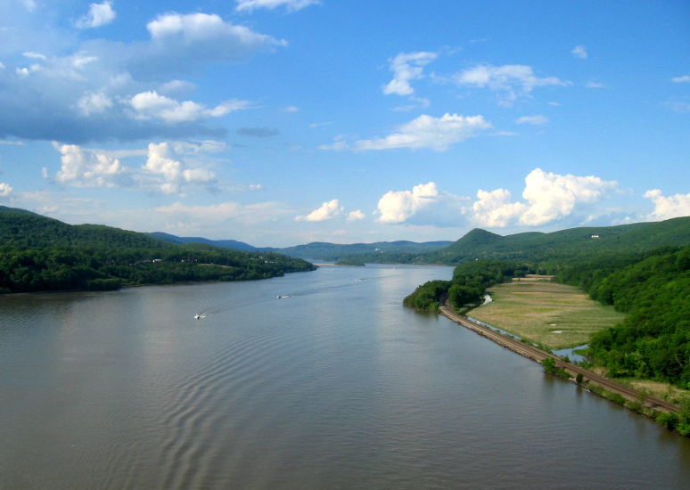

Let’s dive deep, into the waters of FPM authority
and structure long flowed past. As an ancient SPFM
once said, “knowledge is an impotent thing
when it is ignored.”
Wikipedia photo: Hudson River Valley
Notes:
Using Morgan’s advice, we will take a look at the ASFPM publication “Effective State Floodplain Management Programs 2003.”
Photo: Hudson River Valley viewed from the Bear Mountain Bridge, wikipedia.org

Slide 12
Authority & Structure
A State Floodplain Manager is proactive in managing the floodplains within the state (and coordinates with adjunct SFPMs whose rivers, dams, and levees may impact the home floodplain).
This “take charge attitude” vastly improves the chances of avoiding flood disasters and also reduce flood losses and disaster costs.
Notes:
Review the slide. Note that “A SFPM” means a state floodplain manager, not ASFPM, a happy coincidence… yes? Give any examples of your experience in working with adjacent State Floodplain Managers in your Region.
Paraphrased from the Executive Summary, page iv “Effective State Floodplain Management Programs 2003.”
The state has an opportunity to chart a program that avoids simple reliance on the federal program minimum regulatory standards of the NFIP. Familiarity with local authorities, interagency coordination and promotion of higher standards are areas where leadership can be exercised.

Slide 13
Authority & Structure (continued)
You have the ability to tailor the desired results to your individual state FPM situation, something that “one size fits all” national standards are incapable of accomplishing. You do this to:
Protect the health and safety of your citizens;
Improve the quality of life, and;
Save the state and local economies money.
Notes:
Review the slide.
Paraphrased from the Executive Summary, page iv “Effective State Floodplain Management Programs 2003.”
Most States derive their authority from the basic state responsibilities to protect the health and safety of its citizens, protect the floodplain resources and their functions for everyone’s benefit, and to build an economy that can be sustained. The authority for the NFIP is based on the federal responsibilities to identify flood hazards and reduce the impact of flooding. Similar but different!
Think “Public Trust Doctrine” as a foundation for why states are involved and responsible for effective FPM. With or without the NFIP, the State has the responsibility to protect floodpland resources/functions for everyone’s benefit.

Slide 14
Authority & Structure (continued)
Effective state programs provide for strong program leadership at both the state and at the local levels.
The program should extend into many facets of state government. Certainly beyond the duties and responsibilities listed in 44 CFR.
An effective SFPM program should coordinate with all state agencies and the state legislature to effect desired programmatic changes.
Notes:
Review the slide.
Effectiveness for a state floodplain management program is about accepting responsibility and acting to change the flood risk and protect natural floodplain functions and resources. The NFIP starts the coordination and cooperation with federal and local partners, but there are a variety of state programs and policies that directly influence floodplain use, development and opportunities for mitigating risk.

Slide 15
Authority & Structure (continued)
Effective state programs, which are stable and long lasting, are:
Founded with clear legal authority;
Cooperate with local governments and other state agencies and federal agencies, and;
Are supported with adequate resources.
Notes:
Review the slide.
Good state FPM programs allow for evolution and improvement in response to the changes brought by major events, new ideas, and new federal programs, to include new FPM initiatives.

Slide 16
Authority & Structure (continued)
There is no perfect model for a state FPM program. Why?
Every state has a unique combination of factors that shape its approach;
Flood hazard vary significantly by region;
Constitutionally established relationships between the state and local jurisdiction differ from state to state, and;
State politics and cultures differ.
Notes:
Review the slide.
Paraphrased from the Executive Summary, page iv “Effective State Floodplain Management Programs 2003.”
Although no model program, ASFPM has developed some guidance for states on the elements and components of an effective state floodplain management program.

Slide 17
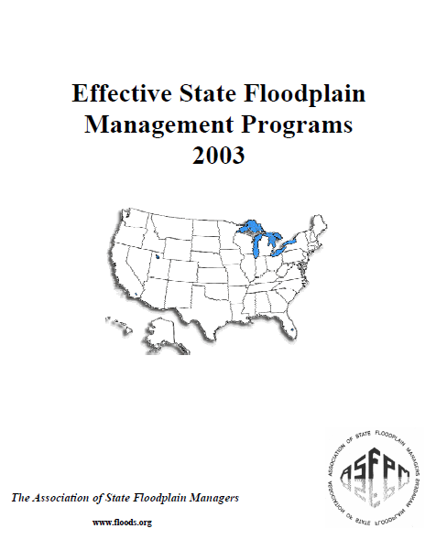
Authority & Structure (continued)
Notes:
An excellent read, for any State Floodplain Manager, regardless of time in position or experience.
ASFPM’s “Effective State Floodplain Management Programs 2003” provides insight on the components of effective state FPM programs.
The guidance has been organized into ten “principles.” These principles and their related activities can be used by a state as a “checklist” to assess their own strengths and identification of areas of improvement.
Job Aid 1. Invite the mentee(s) to peruse the document briefly with you.

Slide 18
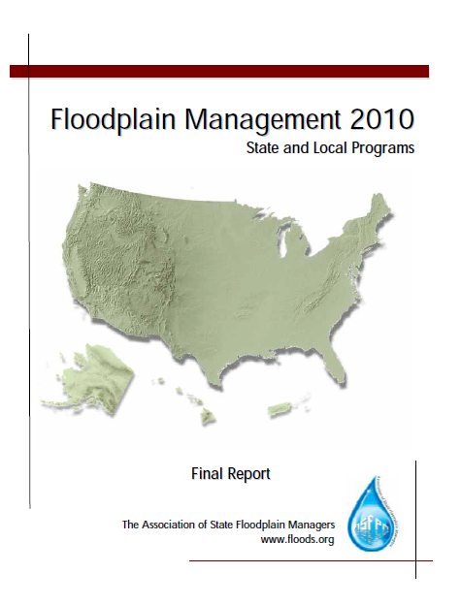
Authority & Structure (continued)
Notes:
Now let’s add another report to the mix. An excellent read, for any State Floodplain Manager, regardless of time in position or experience.
This report is a snapshot of state floodplain management programs in 2010, which ties in with the 2003 report that we are discussing. Its purpose was to share information between SFPMs in order to assist in the building of strong and sustainable FPM programs. Information contained therein is a summary of answers provided by individual SFPMs in response to a series of questions.
This publication is a look at what others have done and what works. Excerpts will follow during the session that will illustrate activities that make states effective.
Job Aid 2. Invite the mentee(s) to flip through the pages and follow the slides.

Slide 19
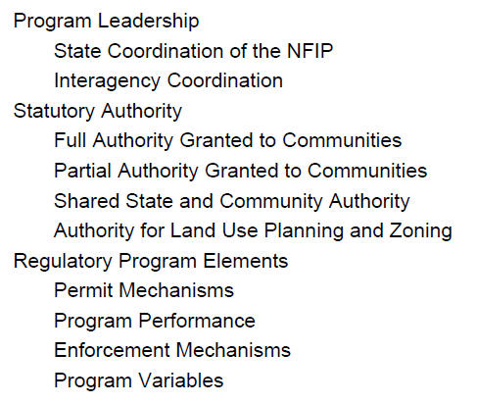
Authority & Structure (continued)
Notes:
This list forms the body of the first Guiding Principle, it can be found on page 7 of the report (Job Aid 1).
We will briefly cover the 13 topics in the next few slides.
Legal authority for state FPM and how that affects cooperation with local communities is explored in Principle #1. Let’s take a closer look at this principle which addresses state and local authority for FPM, and how the coordination of the NFIP in a state contributes to an effective program.
This module will explore aspects of the first principle for effective state FPM. The emphasis here is that this is about the State knowing how to be effective.

Slide 20

Authority & Structure (continued)
State FPM leadership flows like a river “with a clear mission, clear statutory authority, high-level support within the state, adequate financial resources, and demonstrated effectiveness.”
Notes:
Review the slide. (Page 8, “Effective State FPM Programs 2003”)
This slide is a great place for interaction with the participants. Have them think about all of the state agencies/programs (beyond the NFIP SC) that have an influence on the use and development of the SFHA and floodplain resources (e.g. DOT, DOD, EDU, EPA and Commerce).
Effective states couple strong leadership with their authorities. Floodplain management leadership can be demonstrated by outreach and coordination with a variety of state programs that influence floodplain use and development. Other state programs may provide opportunities for correcting existing flood risk. Through program permitting, funding and monitoring a state has significant influence on local and private land use and development decision.
What actions are necessary to affect other state agencies and programs, in regard to their support of FPM?
Name two federal agencies whose in-state activities support both state and local jurisdiction FPM programs and projects.

Slide 21
Authority & Structure (continued)
As stated earlier, program authority and foundation is found within Principle 1: State FPM programs need strong, clear authority.
Notes:
Review the slide.
State “authority” for FPM needs to cover: the state role in regulating the floodplain/flood hazard areas; the local role in regulating the floodplain/flood hazards areas; and coordination of the NFIP.
Each state is required to designate an agency as the NFIP Coordinating Agency, which will host the NFIP State Coordinator.
This Coordinator functions as the POC for FEMA for NFIP and FPM issues.

Slide 22

Authority & Structure (continued)
Statewide standards and enabling authority (continued)
Determining the extent of authority of state FPM and how that authority is derived is critical in determining the effectiveness of your state and the local FPM programs.
Notes:
Review the slide.
The state should make every effort to design a program that will compliment the local authorities and address the state flood-specific needs. For example: a state building code may provide a method for establishing flood protection criteria for structures, but if paired with a community’s comprehensive planning, high risk flood hazard areas may be completely avoided.
Image is from Microsoft clip art.

Slide 23
Authority & Structure (continued)
Statewide standards and enabling authority.
When an entity which is dependent on a legislative body for authorization of legitimacy is granted power by a legislative body, that is called enabling legislation.
Effective FPM requires many tools, some of which may require explicit authority at the state level.
Notes:
Review the slide.
The NFIP requires states and communities to issue permits and provides minimum flood protection criteria. Besides enabling authority to meet NFIP participation requirements, states can provide additional authorities to local communities that encourage comprehensive planning, zoning and building codes.
This is where we start to move toward comprehensive FPM, not just NFIP compliance or reliance on federal programs and agencies.

Slide 24
Authority & Structure (continued)
Division of authority for FPM related actions.
States have different forms of government which can be explained by two “rules.”
Home Rule: Allow local jurisdictions broad authority to adopt rules and regulations for its circumstances.
Dillon or Dillon's Rule: Strictly limit the authority of local jurisdictions to only those explicitly granted by the state legislature.
Notes:
Review the slide. (Handout concerning home rule and Dillion rule.) THIS IS THE ‘BIG PICTURE’ AUTHORITY FOR HOW THE STATE RELATES/WORKS WITH LOCAL FPM.
Home Rule: an amendment to the state constitution grants cities, municipalities, and/or counties the ability to pass laws to govern themselves as they see fit (so long as they obey the state and federal constitutions).
Dillion Rule: only limited authority has been granted to local governments by passage of statutes in the state legislature. In these states, a city or county must obtain permission from the state legislature if it wishes to pass a law or ordinance which is not specifically permitted under existing state legislation.
The Dillon rule is used in interpreting state law when there is a question of whether or not a local government has a certain power. Judge Forrest Dillon, the chief justice of the Iowa Supreme Court in 1868 expounded this famous rule, which was quickly adopted by state supreme courts around the nation.
A municipal corporation can exercise only the powers explicitly granted to them
Those necessarily or fairly implied in or incident to the powers expressly granted
Those essential to the declared objects and purposes of the corporation, not simply convenient, but indispensable

Slide 25
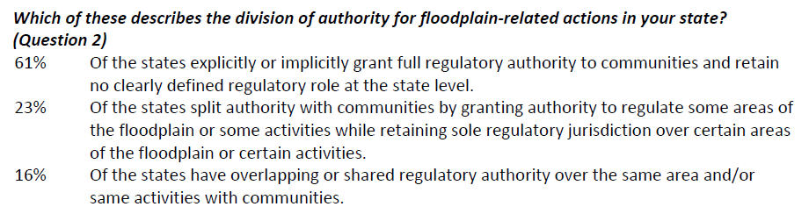
Authority & Structure (continued)
When asked the question below, the responding states said:
Notes:
Review the slide.
Which category describes your state?

Slide 26
Authority & Structure (continued)
Division of authority for FPM related actions.
States should decide the role they will have in regulation of floodplain management activities.
Full authority granted to local communities for NFIP participation and more.
Partial authority granted to local communities for NFIP participation and state retains some authority over specific floodplain-related area or uses.
Shared authority concerning permitting and review, and enforcement and penalties.
Notes:
A thorough understanding of what states can do and what local authorities exist, will establish a good basis for deciding the state’s role in having an effective floodplain management program that includes coordination of the NFIP.
At this point, we should understand that how the local role in FPM based on Dillon or Home Rule frames what the state needs to do for effective FPM. There could be gaps that the local authority may have, such as exemptions, lack of building codes and zoning.

Slide 27
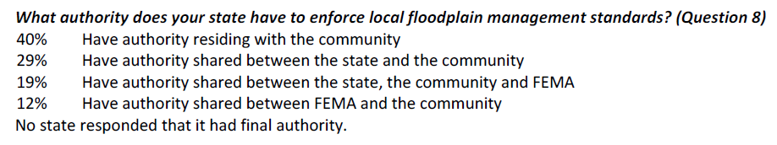
Authority & Structure (continued)
When asked the question below, the responding states said:
Notes:
Review the slide.
Your program corresponds to which answer?

Slide 28
Authority & Structure (continued)
The majority of states seem to grant full regulatory authority to the local jurisdictions, and retain no clearly defined regulatory role in FPM at the state level.
Interestingly, this tendency does follow the base requirements set forth for a community to participate in the National Flood Insurance Program.
Notes:
Review the slide.
So, the actual authority for the implementation of FPM resides at the local level of government.

Slide 29
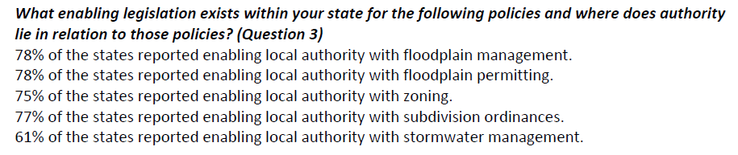
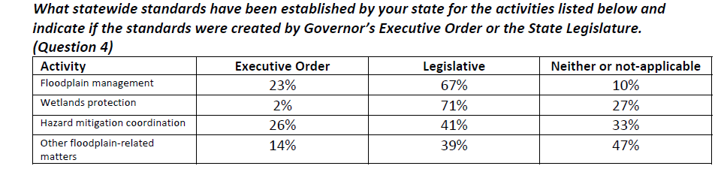
Authority & Structure (continued)
When asked the questions below, the responding states said:
Notes:
Review the slide.
Are you familiar with these answers? Where is your state in this mix?

Slide 30
Authority & Structure (continued)
In most states, local communities have authority for land use planning and zoning.
Building code authority is often at the state level, but may also be a local authority.
Using all the tools available to regulate the location, criteria for development and protection of naturally functioning floodplains and resources will be most effective.
Notes:
Review the slide.
So, the actual authority for the implementation of FPM resides at the local level of government.
Awareness of the local authorities and the minimum flood-protection criteria of the NFIP will allow a state to design it’s own program and activities to increase effectiveness in regulating floodplains and potential development in the high flood risk areas.
Management of flood hazards is more than just the issuance of permits for development in the floodplain. Land use planning and zoning must be included in total program.
Effective state programs require local land use planning and zoning. Effective state programs also grant communities the authority to use such tools.

Slide 31
Authority & Structure (continued)
Tools that can be used include:
Comprehensive planning to guide the rate, density, form and quality of development;
Zoning to guide the types of land uses anticipated;
Building and floodplain permits to specify controls;
Subdivision ordinances that provide standards and requirements for open spaces, and;
Inter-jurisdictional or watershed-based planning.
Notes:
Review the slide.
We have identified both state and local “tools” at this point.

Slide 32
Authority & Structure (continued)
When asked the question below, the responding states said:
Notes:
Review the slide.
Which category describes your state?
I should point out that the “State and Local Program Survey” data is a great resource to find other states like yours. Once a state can “identify” with a program that is similar to its own, they can use the response as a resource.
The activities and program elements in other states can serve as a checklist or benchmark for more effective programs.

Slide 33
Authority & Structure (continued)
Summary:
States enable local FPM regulation following Dillon or Home Rule principles;
States exercise authority for floodplain management by fully delegating regulation to local communities, partial delegation to communities for NFIP compliance and retaining authority for some floodplain areas and activities, or sharing some aspects of regulations such as permitting and enforcement;
Notes:
Review the slide.
Instructor review that Dillon’s Rule is very limited authority granted to local communities; while Home Rule provides local communities with broad authority to regulate as needed.
Floodplain management regulation is greatly improved when local communities have authority for land use planning and zoning in addition to meeting NFIP participation criteria for issuing permits and minimum criteria for flood protection.
Discuss how states support and compliment the local authorities by defining their own role to cover gaps or extend regulation beyond the minimum criteria for NFIP participation.
Examples of each type of authority (e.g. full local, partial, shared)
Full delegation to local community example is Wisconsin – Communities participate in NFIP and have authority for land use and zoning, but the State maintains oversight and enforcement power to ensure community performance.
Partial delegation of FPM regulation is exemplified by the Ohio use of building code authority – State regulates industrial/commercial and multi-family structures, unless the community has a “certified” building department, then locals permit and enforce.
Shared delegation is exemplified by Delaware – the State has identified coastal hazard areas in excess of the NFIP’s CHHA, communities can only issue permits after the state permit and review since the broader hazard can affect siting and development criteria.

Slide 34
Authority & Structure (continued)
Summary (continued):
States must have clear statutory authority;
A permit and review process, monitoring and technical assistance activities, and consistent enforcement are critical to effective regulatory programs at both the state and local level, and;
States should design programs with flexibility to adapt to state-specific goals and flood impacts.
Notes:
Review the slide.
Clear statutory authority contributes to stable and long-lasting state FPM programs, but what is “clear statutory authority?”
It includes:
A defined geographic area of regulation;
Identifies the state and local community responsibilities related to regulation;
Defines the activities that are subject to regulation;
Limits impact;
Defines the consequence of not complying with the regulation, and;
Identifies the entity that will issue permits and enforce criteria.
Instructor should address again how using only the minimum “one size fits all” approach of the NFIP will not be effective on the unique or specific state level.

Slide 35
Authority & Structure (conclusion)
Summary (conclusion):
Effective state FPM programs provide oversight, technical assistance and correct local program weaknesses through enforcement mechanisms, and;
Implementation of the base elements of FPM and the NFIP regulations continues to reside primarily at the local level of government.
Notes:
Review the slide.

Slide 36
Turning Authority into Regulation
An effective state or local regulatory program requires that applications are submitted and reviewed, criteria are applied, and permits are issued or denied. Common elements are:
Clear enabling authority;
Regulations that are clear, and;
Regulations that appropriately apply to each type of development activity.
Notes:
Review the slide.
Having authority to regulate, but failing to develop support processes for administering regulations, monitoring compliance and enforcing penalties will not be effective.
I should point out that regardless of State/Local FPM, effective programs share some common elements: permits, development review and enforcement. The next slides will look at these elements in more detail.

Slide 37
Regulatory Program Elements
An effective state or local regulatory program requires that applications are submitted and reviewed, criteria are applied, and permits are issued or denied. Common elements are:
Clear enabling authority;
Regulations that are clear;
Regulations that appropriately apply to each type of development activity;
Notes:
Review the slide.

Slide 38
Regulatory Program Elements (continued)
Effective state FPM programs have common regulatory characteristics:
Permit mechanisms by which to issue approvals;
Methods to monitor performance and provide technical assistance;
Comprehensive enforcement mechanisms, and;
The flexibility to incorporate variables to address specific needs and goals.
Notes:
Review the slide.
Let’s take a look at these elements of effective regulatory programs a little more closely in the next few slides.

Slide 39
Regulatory Program Elements (continued)
Permit mechanism and development review:
Requires application submittal;
Review and criteria, and;
Permit issuance or denial.
Notes:
Review the slide.
An effective program will support the permit process with some common elements:
Clearly written regulations;
Regulations that appropriately apply to each type of development activity;
Information that will help applicants understand the regulations and permit criteria;
Staff who are well-versed in the regulations and how to apply them;
Enough staff to process the permit load and help applicants;
Permit documents that clearly outline limitations, restrictions and consequences for failure to comply, and;
Authority for inspection and enforcement if violations are found.

Slide 40
Regulatory Program Elements (continued)
Common elements are (continued):
Explanatory materials for applicants;
Permit application forms that are complete;
Staff who are well-versed in the regulations and their practical application;
Sufficient staff to process the permit load and help applicants;
Notes:
Review the slide.

Slide 41
Regulatory Program Elements (continued)
Common elements are (conclusion):
Permit documents that clearly outline limitations, restrictions, and consequences for failure to comply, and;
Inspection and enforcement authority and resources.
Notes:
Review the slide.

Slide 42
Regulatory Program Elements (continued)
Management of flood hazards is more than just the issuance of permits for development in the floodplain. Land use planning and zoning must be included in total program.
Effective state programs also require local land use planning & zoning.
Effective state programs also grant communities the authority to use such tools.
Notes:
Review the slide.

Slide 43
Regulatory Program Elements (continued)
Monitoring & program performance evaluation:
NFIP requires local communities to adopt, administer and enforce local FPM regulations at least as restrictive as NFIP minimums.
Periodic checks and technical assistance visits are an effective way to monitor both state programs and local communities.
Notes:
Review the slide.
NFIP State Coordinators are expected to assist local communities (and sister agencies) in developing floodplain regulations and ensuring that those with the authority are enforcing their regulations.
The CAV and CAC are examples of the monitoring and technical assistance framework established by the NFIP.

Slide 44
Regulatory Program Elements (continued)
Enforcement Mechanisms.
Enforcement issues can and do arise in state agency jurisdictions. Such as:
Technical and administrative deficiencies in the management of the floodplain.
Notes:
Review the slide.
The first step is to provide additional technical assistance to the various state agencies with enforcement authorities.
Some state floodplain managers take a direct role; others act as a coordinator, while some refer the situation to the FEMA Regional Office. Which of the three do you do? One, two, all? Depends on the situation?

Slide 45
Regulatory Program Elements (continued)
Comprehensive enforcement:
An effective state needs the ability to address communities that do not meet the minimum NFIP requirements in addition to enforcing state regulations
Technical assistance may remedy a program deficiency.
Legal action is usually required to remedy a noncompliant development or activity.
Notes:
Review the slide.
There are three scenarios that represent the scope of enforcement actions that a state may face:
When property-owners or developers do not obtain the required floodplain management permit;
When a property-owner or developer does not comply with the criteria or conditions of a permit that was obtained, and;
When a community fails to properly administer local floodplain management regulations.
At a minimum, the NFIP State Coordinator is expected to assist in supplying evaluation and monitoring information to support the NFIP enforcement actions of “probation” or “suspension.”
An important point is that effective state programs should have enforcement mechanisms for state floodplain management regulations and community compliance with NFIP criteria.

Slide 46
Regulatory Program Elements (continued)
Program monitoring and enforcement.
State agencies have the authority to carry out a program of monitoring and enforcement
Monitoring: The review or oversight of activities that affect the floodplain, including local permitting and staff capabilities.
Enforcement: Those actions that may be undertaken to remedy violations.
Notes:
Review the slide.

Slide 47
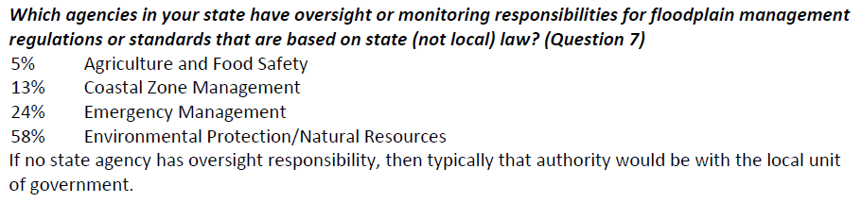
Regulatory Program Elements (continued)
When asked the question below, the responding states said:
Notes:
Review the slide.
If technical assistance and consultation do not meet with success, sanctions can be applied to the community or to the individual property owners and developers, depending on the situation and your FEMA Regional Office.
Some states have direct authority to apply enforcement themselves or ask a court to order a remedy.
FEMA can place a NFIP member community on probation or eventually suspend it from the program.

Slide 48
Regulatory Program Elements (conclusion)
Program flexibility for flood-related variables:
Every state has different flood-related problems and goals. Sticking to NFIP minimum criteria only does little to improve FPM for an individual state.
Some strategies for achieving state-specific FPM goals are:
Incorporate higher standards;
Use safety-based decisions in setting criteria, and;
Identify risk areas beyond FEMA SFHAs.
Notes:
Review the slide.
Having a national minimum standard may constrain what many states would like to achieve in terms of reducing flood risk and protecting naturally functioning floodplains and their resources.

Slide 49

Regulatory Program Elements (discussion)
There has been a national shift in the statewide authority for FPM, wetlands management and hazard mitigation coordination from Executive Orders to state legislatures. Why should that be a good thing?
Notes:
Review the slide.
This is a good way to get some interaction on authority – use as discussion starter.
Each incoming gubernatorial administration can change executive orders, which does not lend itself to permanent regulations, which a legislative action does.

Slide 50
Development Review & Permit Authorities
Management of flood hazards is more than just the issuance of permits for development in the floodplain. Land use planning and zoning must be included in total program.
Effective state programs also require local land use planning & zoning.
Effective state programs also grant communities the authority to use such tools.
Notes:
Review the slide.

Slide 51
Review & Permit Authorities (conclusion)
Tools that can be used include (continued):
Inter-jurisdictional or watershed-based planning, and;
Hazard mitigation plans.
Notes:
Review the slide.

Slide 52
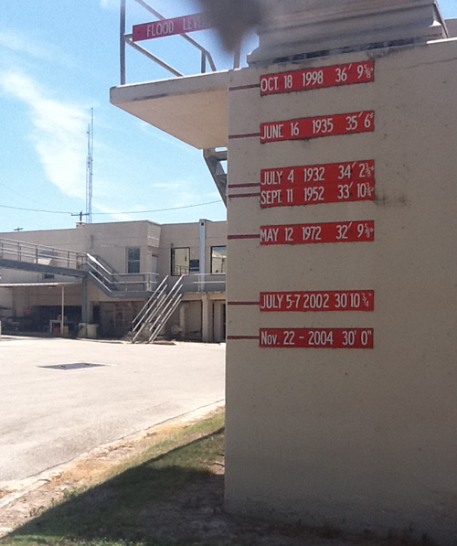

Be creative and consider
“Pushing the bar higher.”
Notes:
Photo of Texas Water Treatment Plant at Max Starcke Park. Photo credit is Texas Natural Resources Information System

Slide 53

After Action Review & Break
Feel like you are missing something vital? Let’s do a quick review and then take a break.
Notes:
Review any items or questions that were raised to ensure that there is no confusion or mystery to what you have covered.
Take a 10 minute break.

Slide 54
Special Exemptions in State Law
Does your state have any special exemptions or requirements concerning floodplain management?
If so, what are they?
Perhaps your state shares regulatory authority with the local communities? (Examples of such states can be found on the following slides.)
Notes:
Facilitate discussion.

Slide 55

Exemptions… (conclusion)
Examples of overlapping authority:
Delaware regulates a coastal zone that exceeds the NFIP’s CHHA. Local communities issue a permit only after the state has done so.
Indiana has primacy over development in designated floodways.
Notes:
Review the slide.

Slide 56
State Building Codes
An effective and comprehensive state FPM program should include a state building code that contains design and construction criteria for structures found within the floodplain.
What are the two primary objectives of a building code?
A related building code objective is the reduction of damage associated with identified hazards.
Notes:
Answer: Public safety and the protection of building occupants. Much like the public health and safety concerns put forth in the local flood damage prevention ordinances.

Slide 57
State Building Codes (continued)
The building’s location, which is a key factor in mitigating flood damage, can also be regulated by zoning and land use ordinances.
This leads to the observation that effective FPM programs should coordinate their work with those agencies responsible for zoning and land use planning, particularly at the local jurisdiction.
Notes:
Review the slide.

Slide 58
State Building Codes (continued)
States vary in their methods of building code adoption and usage, such as:
A state level building code, which delegates the implementation and enforcement to the local jurisdictions;
The state specifies which codes must be adopted by communities;
Notes:
Review the slide.

Slide 59

State Building Codes (continued)
States vary… (conclusion):
Authorize specific communities to adopt a specific code, but not others, and;
Some remain silent on what codes to adopt.
Notes:
Review the slide.
What else is possible in this mixture?
Some states don’t allow any local amendments to the building code.
Some allow communities to adopt only provisions that result in a higher level of protection.
Others allow modifications that are specifically justified and approved by a state authority.

Slide 60
State Building Codes (continued)
To have a complete program of FPM, a state should ensure that activities that are specifically exempt from a state building permit are captured by the local permit process.
Additionally, in addition to state-specific exemptions, eleven activities and structures must be addressed by the local flood damage prevention ordinance.
Notes:
Review the slide.

Slide 61
State Building Codes (continued)
These activities and structures are:
Agricultural buildings and structures;
Subdivision of land;
New and replacement MFH units;
Placement of temporary buildings, including RVs;
Installation of water and waste collection systems, including septic systems;
Filling, dredging, mining and gravel operations;
Notes:
Review the slide. Give examples as needed.

Slide 62

State Building Codes (continued)
Agricultural structures:
May be elevated or;
Wet floodproofed under conditions with a variance.
Photo: AWG Consulting
Notes:
Agricultural building (upper left). Variances are allowed for pole frame buildings, steel grain bins, steel frame corn cribs, general purpose feeding barns open on one side. Variances are not allowed for livestock confinement buildings, poultry houses, dairy operations, similar livestock operations.
Farm houses are not agricultural structures!
Generally, non-elevated agricultural structures must be considered on a site-specific basis and may be permitted only by variance. Applicants must show that sites are in “wide, expansive floodplain areas” and no other alternative location outside of the floodplain exists.
Remember, wet floodproofing can result in very high flood insurance premiums. See 44 CFR 60.6(a) – “insurance premiums…will not be modified by granting a variance…” Also see 44 CFR 60.6(a)(5) – community must notify applicant in writing the granting of a variance may result in increased premiums.
Photo of a pole frame barn in Simpson County, MS.

Slide 63
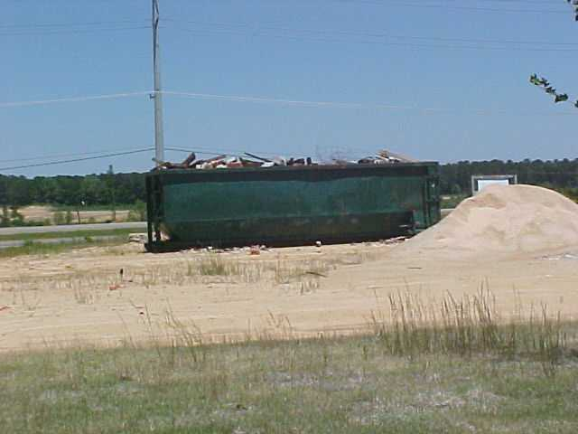
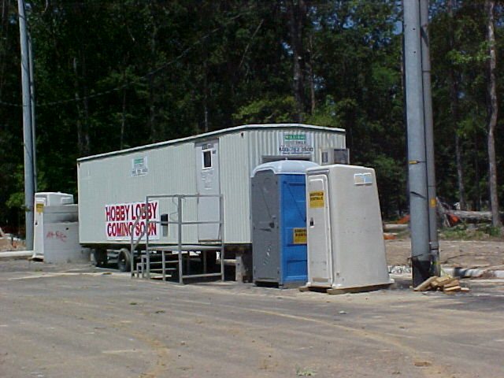
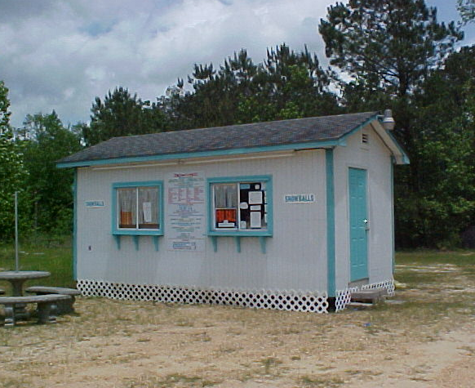
State Building Codes (continued)
Photos: AWG Consulting
Notes:
Temp structures that are often found within the floodplain, such as construction trailers, portable bathroom facilities, large trash receptacles and roadside stands.
Must have a conditional permit:
Stipulate the duration of placement
Can’t be placed in a floodway
Not advisable in a V zone
Flood warning system must be in place
Damage potential is minimized
Conditions listed on the permit
Appropriate follow-up and oversight, and
Require a bond if the permit holder is unable or unwilling to remove as part of exercise of removal.
Photos by AWG Consulting.

Slide 64
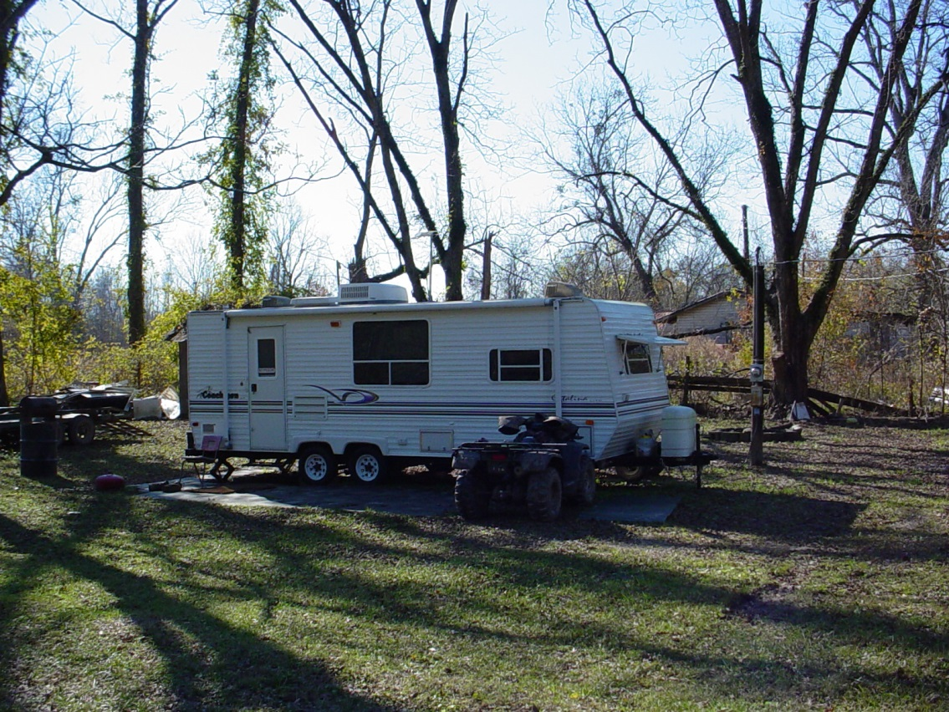
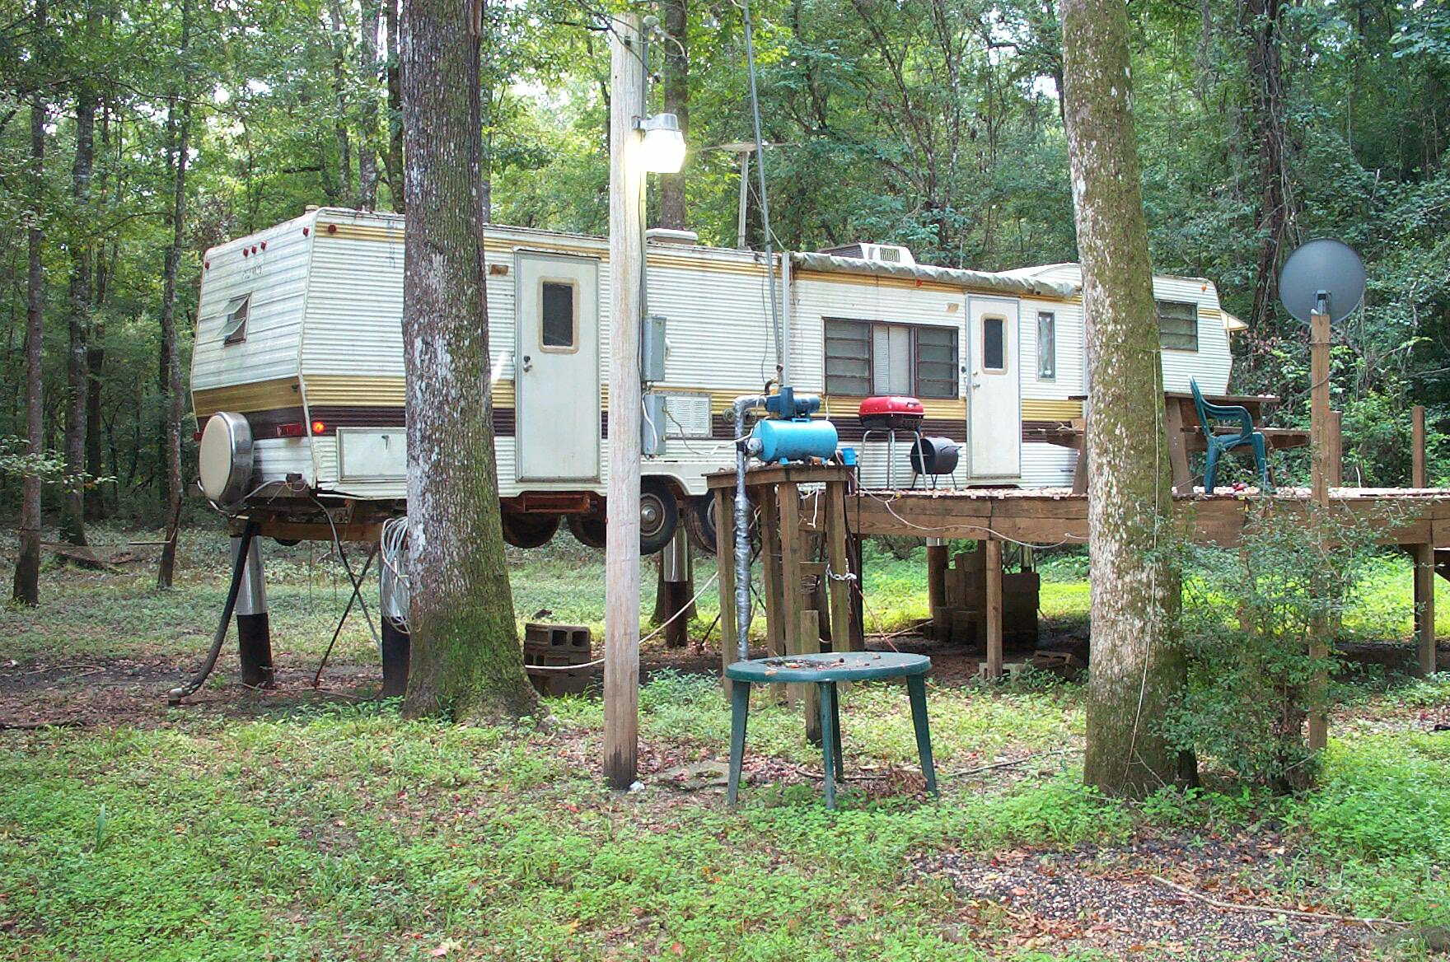
State Building Codes (continued)
Photos: AWG Consulting
Notes:
This is a recreational trailer that possibly meets the portability requirement. (RV is located in Claiborne County, MS)
CLICK
This is a recreational trailer that does not meet the portability requirement. (RV is located in George County, MS)

Slide 65
State Building Codes (continued)
These activities and structures (conclusion):
Filling and grading, including storm drainage, stormwater management facilities, and mound septic systems;
Structures such as towers, oil derricks, signs, and fences;
In-ground and above-ground pools;
Retaining walls, and;
Above-ground and underground tanks.
Notes:
Review the slide. Give examples as needed.

Slide 66
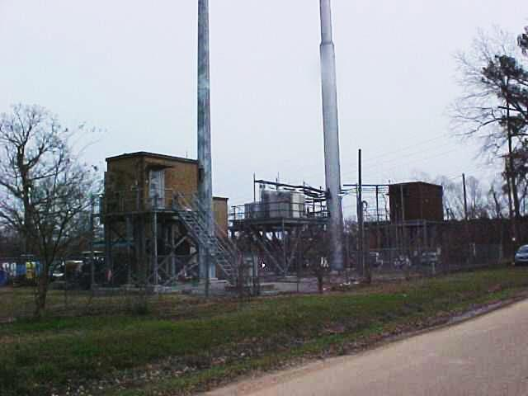

State Building Codes (continued)
Photos: MEMA
Notes:
Cell tower site in AE zone (Harrison County, MS) and swimming pool in Harrison County, MS post Katrina. (For some reason the pool was almost empty, the surge must have pulled the water out? Other in-ground pools looked like sewers.)
Photos by Mississippi Emergency Management Agency.

Slide 67
State Building Codes (continued)
Whatever method or procedure is used by a state, there must be a clear understanding between the community / jurisdiction and the state building code agency of ‘who is responsible for what’ in the floodplain development process.
Why?
Notes:
Review the slide.
Answer: To assure that the structures do in fact comply with all applicable requirements.

Slide 68
State Building Codes (continued)
Building codes include specific provisions to address:
Climatic and geographic variations;
Wind loads and snow loads;
Seismic design criteria;
Frost depth;
Fire suppression, and;
Flood hazards.
Notes:
Review the slide.
The International Code Council, the American Society of Civil Engineers, and the National Fire Protection Association have model codes which are consistent with the minimum provisions of the NFIP.
Some states (OR and NJ) have purposely excluded the SI/SD provisions from their state building code and that has resulted in many “new” structures that do not comply with minimum NFIP criteria. This is a huge problem.

Slide 69
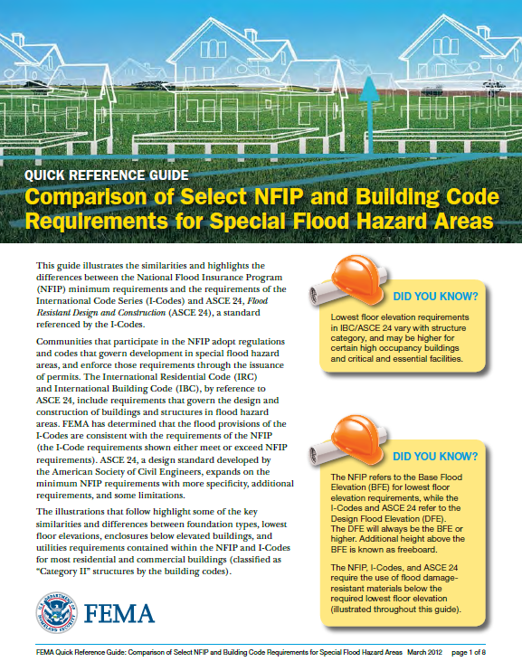

State Building Codes (continued)
Notes:
Job Aid 3. Refer the mentee(s) to the FEMA handout and briefly review its eight pages with them.
After your brief review, click for the stick figure to announce the next slide and job aids.
Now, let’s looks at four more job aids that will give you excellent background information for your later perusal.

Slide 70
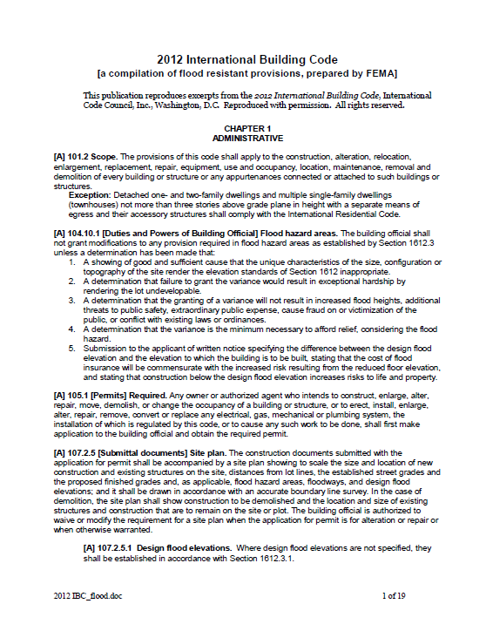
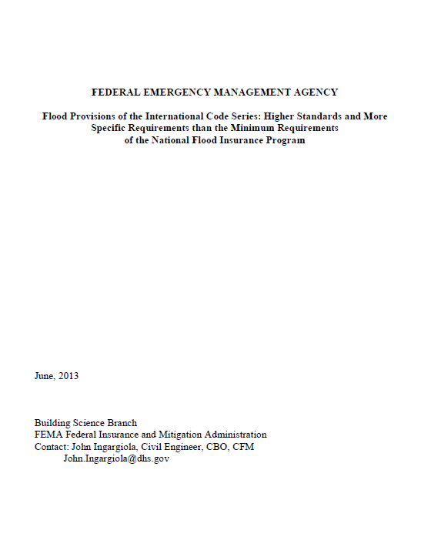
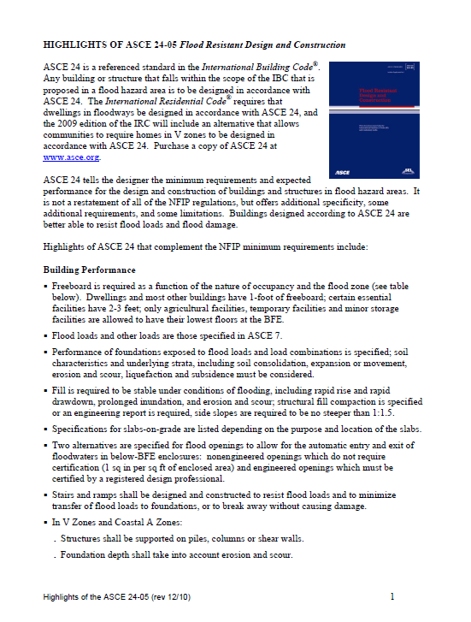
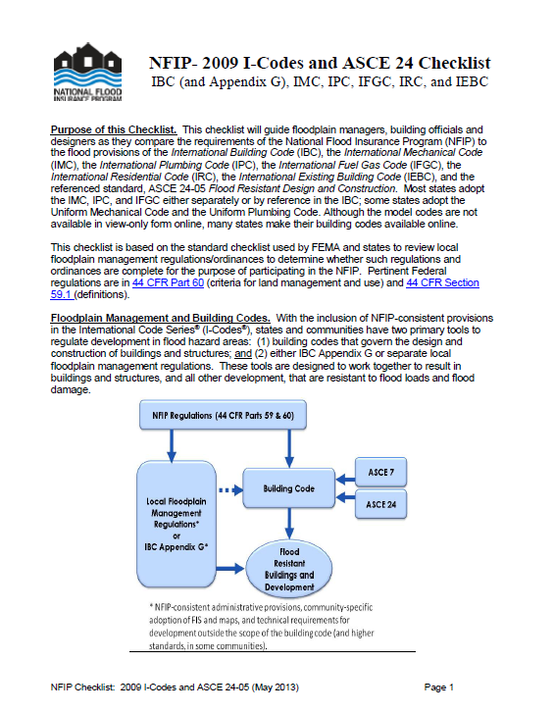
State Building Codes (continued)
Notes:
Job Aids 4, 5, 6, and 7. A review of each document could take up to 20 minutes.

Slide 71
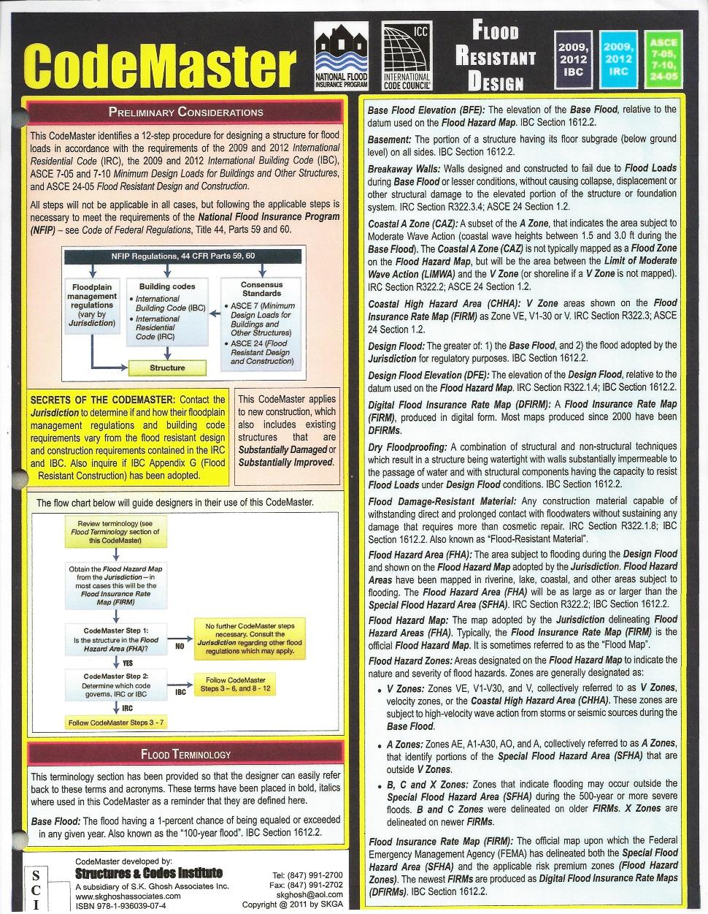
State Building Codes (continued)
Structures & Code Institute
(eight page guide)
Notes:
Also available is an eight page guide or “CodeMaster” from Structures & Codes Institute. This booklet identifies a 12-step procedure for designing a structure for flood loads in accordance with the requirements of the 2009 and 2012 IRC, IBC, ASCE 7-05 and 7-10, ASCE 24-05 and 44 CFR Parts 59 and 60.

Slide 72
State Building Codes (continued)
Issues related to state building code updates and State FPM interaction with state building code departments are:
No requirement that all model FPM standards have to be adopted – more controversial provisions may not be adopted at all;
State building code agencies are often stove piped and not located in the same agency tasked with coordination the NFIP, and;
Notes:
An example of building codes not having minimum standards - in the State of Oregon, the state building code does not have provisions for substantial improvement/substantial damage.
Sadly, there are many examples where the state building department does not value the relationship with the state floodplain manager and states have reported difficulty in building that relationship.

Slide 73
State Building Codes (continued)
Issues related are (continued):
State building code agencies usually have no awareness of required and necessary NFIP standards that building code updates my conflict with.
Notes:
Review the slide.

Slide 74
State Building Codes (continued)
Best practices for state building code updates and State FPM interaction with state building code departments include:
State FPM proactively sit down with their departmental legislative person, explaining need for consistency between state building code and NFIP requirements;
State FPM proactively schedule at least an annual meeting with state building code agency, and;
Notes:
Cover the slide.

Slide 75
State Building Codes (conclusion)
Best practices include (continued):
State encourage inter-agency agreements with building code officials at the local level, and;
State FPM chapter build relationship with state building code officials association.
Notes:
Review the slide.
Sometimes there are individuals who are members in both organizations.

Slide 76
After Action Review
Feel like you are missing something vital?
Notes:
Review any items or questions that were raised to ensure that there is no confusion or mystery to what you have covered.

Slide 77

State Floodplain Mapping Authority
Foundation starts with the Public Trust Doctrine:
By the law of nature these things are common to all mankind, the air, running water, the sea and consequently the shores of the sea… The seashore extends as far as the greatest winter flood runs up. -- - Institutes of Emperor Justinian I (535 AD)
Notes:
According to the U.S. Constitution, states retain ownership of the lands beneath navigable waters. Federal government retains supreme—but not exclusive—control over navigation.
Under the Public Trust Doctrine, states (and the federal government) have an affirmative duty to take the public trust into account in the planning and allocation of land and water resources, and to protect public trust uses whenever feasible.
A still more resonant aspect of Emperor Justinian I’s legacy was the uniform rewriting of Roman law, the Corpus Juris Civilis, which is still the basis of civil law in many modern nations.

Slide 78
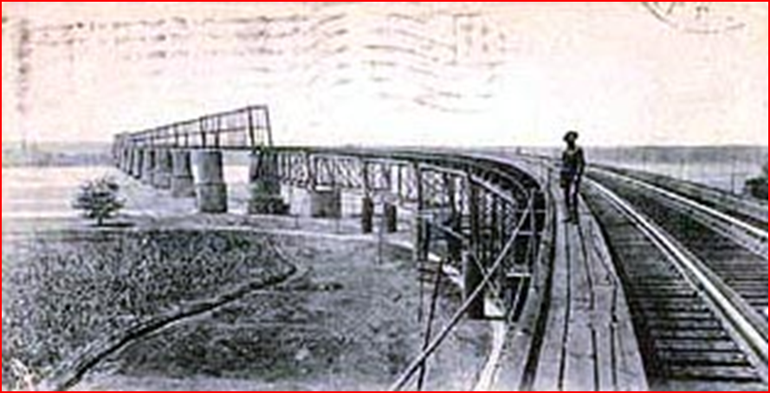
State Floodplain Mapping Authority (continued)
Illinois Central Railroad vs. Illinois (1892)
State had abdicated its responsibility to preserve the waters for public use.
Notes:
At the end of the nineteenth century, the U.S. Supreme Court firmly established the Public Trust Doctrine in American jurisprudence, finding that “the ownership of and dominion and sovereignty over lands covered by tide waters, within the limits of the several States, belong to the respective States within which they are found.” Illinois Central Railroad Co. v. Illinois, 146 U.S. 387, 435 (1892).
This court decision established that the Public Trust Doctrine is a State responsibility – and that it is responsibility that they cannot abdicate.
So fast forward 70 years . . . To be able to identify these lands and water areas, states began to identify and map flood prone areas.

Slide 79
State Floodplain Mapping Authority (conclusion)
By 1958 seven states had enacted and were enforcing state FPM standards principally for narrow channel encroachment areas:
Connecticut;
Indiana;
Iowa;
Massachusetts;
New Jersey, Pennsylvania and Washington.
All of these predated the existence of the NFIP!
Notes:
Six of these programs were adopted in response to catastrophic floods.
However, by the late 1960s, a number of states had statutes regulating broader flood hazard areas:
· A 1962 Washington state statute provided that the state establish flood control zones when data were available for that purpose. Any activity to construct, reconstruct, or modify any structure or works affecting flood waters within any established zone required a state permit.
· A 1965 California state code encouraged “local levels of government to plan land use regulations to accomplish floodplain management and to provide state assistance and guidance as appropriate.”
A 1966 New Jersey act authorized a state agency to delineate and mark flood hazard areas, to identify reasonable and proper use of these areas according to the relative risk, and to develop and disseminate other floodplain information.
A 1967 Nebraska state act established floodway encroachment lines of a 100-year frequency flood along watercourses by the state, when sufficient data had been acquired for this purpose. If an affected locality did not then adopt sufficient land use regulations within these areas, the state’s floodway would be enforced.
By 1969, Michigan, Minnesota, and Vermont mandated regulation of flood hazard areas. Vermont regulated the permitted use, type of construction, and height of floor levels within areas designated by the state as subject to periodic flooding.

Slide 80
Wisconsin
When Wisconsin became a state in 1848, its constitution included a section on the “Public Trust Doctrine” – that the waters of the state are held in trust for its citizens.
Notes:
The 1966 law required floodplain and shoreland zoning, and to implement and enforce zoning, floodplain mapping was necessary. NR 116.01 requires communities to adopt reasonable and effective floodplain zoning ordinances within their respective jurisdictions to regulate all floodplains where serious flood damage may occur within one year after hydraulic and engineering data adequate to formulate the ordinance becomes available.

Slide 81
Wisconsin (continued)
In 1966, following flooding on the Mississippi River, the WI legislature passed floodplain and shoreland zoning. Chapter 87.30 requires communities to implement floodplain zoning and requires the state to:
“ensure the accuracy…of the mapping used for floodplain zoning.”
Notes:
The 1966 law required floodplain and shoreland zoning, and to implement and enforce zoning, floodplain mapping was necessary. NR 116.01 requires communities to adopt reasonable and effective floodplain zoning ordinances within their respective jurisdictions to regulate all floodplains where serious flood damage may occur within one year after hydraulic and engineering data adequate to formulate the ordinance becomes available.

Slide 82
Wisconsin (continued)
Requires specific techniques to develop flood mapping data, not only dependent on FEMA standards;
State law grants the state final approval authority of flood maps to ensure mapping accuracy and adequacy;
Notes:
These are the four most significant aspects of Wisconsin’s state flood mapping authority. The point is, that as a state it began flood mapping before FEMA and even in an environment where FEMA mapping exists, it can complement the FEMA mapping program to do a better job at reducing flood risk.

Slide 83
Wisconsin (conclusion)
State enacted a .01 foot floodway rise standard for floodplain maps and;
Wisconsin has the unique requirement to compel mapping of hazard areas downstream of dams.
Notes:
Review slide.

Slide 84
New Jersey
In 1962, the state of New Jersey authorized its Department of Environmental Protection “to adopt land use regulations for the flood hazard area, to control stream encroachments, to coordinate effectively the development, dissemination, and use of information on flood damages.”
Notes:
Historically, New Jersey has taken a strong role in the development of a rigorous floodplain management program at the State level while supporting those same efforts at the Federal level with the Federal Emergency Management Agency (FEMA). The state's approach to effectively providing this information was to develop flood hazard area maps. The New Jersey maps predated the Federal maps and indicate the special flood hazard area or 100-year flood and the floodway that the Federal maps eventually showed but also delineates the New Jersey Flood Hazard Design Flood, based on discharge 25% larger than the 100-year flood discharge. As these maps preceded similar efforts at the federal level, they help demonstrate the history and depth of the State of New Jersey's commitment to floodplain management.

Slide 85
New Jersey (conclusion)
The NJ flood inundation maps predated the Federal maps and presented the 1% annual chance event, but also reflected a special hazard area derived from a 1% annual chance plus 25% discharge.
Notes:
New Jersey will integrate its mapping program with the FEMA program. This integration hinges on creating FEMA FIRMs for New Jersey, which delineates the New Jersey Flood Hazard Area (NJFHA). The flood hazard area, computed by using 100-year discharge plus 25%, may be simply a digital layer, but it is the state's regulatory standard. Currently, because FEMA FIRMs do not have this data, the state is bound to maintain and update its own state maps each time FEMA updates its maps. This is an arduous process and necessitates some duplication of effort. By including the NJFHA on the DFIRM, the state would be able to use the FEMA DFIRMs as the single source for both Federal and state flood plain management, freeing up staff resources and increasing efficiency

Slide 86
Aligning State and Local Floodplain Management …
…
An effective state floodplain management program will establish active partnerships with FEMA and local communities, and becomes a link between the two for purpose of the National Flood Insurance Program.
Notes:
Review the slide.
Let’s talk for a minute about how the NFIP can actually help a state build a more comprehensive an effective floodplain management program through many of the NFIP coordination activities…

Slide 87
National Flood Insurance Program
NFIP Program:
Mutual agreement between the federal, state and local levels of government to work toward reducing flood risk.
Private sector roles emerge in the lending and insurance aspects of the program.
Community and State roles in regulating and enforcing hazard areas and minimum flood protection criteria.
Notes:
Congress created the NFIP in 1968 with the intent that the framework provided would make use of the governmental authorities and involve the private decision-makers who influence land use and development.
Remember our discussion of program authorities and structure? The NFIP framework takes full advantage of local authorities to regulate development in defined areas, issue permits and enforce requirements for new, improved and damaged buildings. These are the characteristics of an effective regulatory program! Community responsibilities are expressed in Section 59.22 of 44 CFR.
Intent was to minimize the exposure of development to flood risk by applying flood protection criteria and guiding development to areas with lower flood risk. This was floodplain management with multiple purposes and mixed solutions (e.g. maps, regulation and insurance).
The states are asked to provide leadership by designating a State NFIP Coordinator and commit to minimum flood protection criteria (Section 60.3 of 44 CFR). The state responsibilities are expressed in Section 60.25 of 44 CFR.
A key state legislative roll is to provide authority to regulate land-use to local government. Absent the authority to regulate, FEMA cannot allow communities to join the NFIP.

Slide 88
National Flood Insurance Program (conclusion)
The main elements of the NFIP include:
Hazard identification and mapping to delineate areas of risk;
Flood-protection criteria established as minimum standards to be applied in identified risk areas;
Flood insurance as an assist for property owners to offset flood damage impact for buildings and contents.
Notes:
These elements were designed to provide risk information that would direct development out of high hazard areas and prevent future risk, and correct existing risk by applying standards when improving and repairing flood-damaged properties.
Flood insurance was offered as the traditional risk management strategy to eliminate some of the need for federal disaster assistance when floods occur.

Slide 89
Coordination of the NFIP
Active partnerships between FEMA and the local jurisdictions are established by the state FPM.
FEMA requires the state to identify an NFIP State Coordinator.
The “NFIP State Coordinator” responsibilities require leadership and coordination with other agencies and programs.
Notes:
Review the slide. Paraphrased from page 9, “Effective State Floodplain Management Programs” 2003.
The State NFIP Coordinator position is one of leadership and the expectation is that this position will engage other state agencies/programs and the local communities in floodplain management activities.

Slide 90

The NFIP State Coordinator
Previous modules have discussed the duties of the NFIP State Coordinator in some detail; however, we wish to highlight them in this module.
Notes:
Review the slide.

Slide 91
The NFIP State Coordinator (continued)
In the mid-1970s, each governor designated a “state coordinating agency” for the NFIP, with the coordinating duties and responsibilities under that program.
Since then, the scope and variety of state FPM authorities, responsibilities, and initiatives have multiplied.
Notes:
Review the slide.

Slide 92
The NFIP State Coordinator (continued)
In the majority of states and territories, the NFIP State Coordinator’s office is found within:
The department for natural resources;
Water resources;
Community planning;
Emergency Management, or:
Environmental protection.
Notes:
Review the slide.
The location of the state program (or in other words the hosting agency), affects its status among other state programs and often determines how effective it is in administering NFIP and FPM requirements.
Where do you fit into this list? Do you wish you were in another agency? Discuss.

Slide 93
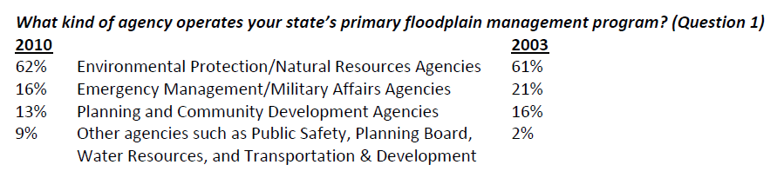
The NFIP State Coordinator (continued)
When asked the question below, the responding states said:
Notes:
Review the slide, which compares answers from 2003 and 2010.
As long as the state FPM program has the strong legal authority, adequate funding support, and sufficient staff to carry out its legislative mandate, the hosting agency is of secondary importance.
Very little change is the program’s location occurred in the seven year period depicted on this slide.

Slide 94
The NFIP State Coordinator (continued)
NFIP State Coordinator duties and responsibilities are found at [44 CFR §60.25]:
Enact legislation that enables communities to regulate development in SFHA;
Assist communities in joining the NFIP, create and enforce local flood damage prevention ordinances;
Notes:
Can you see how these responsibilities fit with the effective program principle of strong, clear authority?

Slide 95
The NFIP State Coordinator (continued)
44 CFR § 60.25 (continued):
Coordinate activities and dissemination of information concerning minimum requirements;
Assist with the delineation of riverine and coastal flood-prone areas;
Recommend priorities for federal FPM activities based upon community needs;
Establish state standards which are compliant with federal and state environmental standards;
Notes:
Review the slide. Paraphrased from page 9, “Effective State Floodplain Management Programs” 2003.
The state shall…(cover the bullets).
The activities associated with the first bullet actually link to another of the effective program principles (guiding development away from flood-prone areas and minimizing the adverse impacts of development within and outside of identified flood hazard areas).
Similarly, the middle two bullets are linked to another effect program principle stating that flood hazards must be identified and flood risk assessed.
The final bullet defines activities that broaden a program focus to consider natural benefits and functions of floodplains, and integrate with other environmental concerns that may have a floodplain management impact.

Slide 96
The NFIP State Coordinator (continued)
44 CFR § 60.25 (conclusion):
Assure coordination and consistency with other planning and enforcement agencies;
Assist with identification and implementation of flood mitigation measures, and;
Participate in and provide training opportunities.
Notes:
Review the slide. Paraphrased from page 9, “Effective State Floodplain Management Programs” 2003.
Again, you should see some of the concepts of principle #1 in these responsibilities. The NFIP State Coordinator is leading the coordination of the state’s floodplain management effort. Outreach, education and training are the day-to-day delivery of this leadership!
We have now reviewed the basic required activities and responsibilities of the NFIP State Coordinator. Can you see how coordinating the NFIP can fit with having an effective state floodplain management program?
The NFIP allows “other floodplain management duties, deemed appropriate by the State, to be part of the NFIP State Coordinator’s job. These may be funded by the State and if coordinated with FEMA, may result in some Federal funding and resources to support the state. See our discussion of CAP-SSSE in the next module!

Slide 97
The NFIP State Coordinator (continued)
60.2 (e): Local floodplain management regulations may be submitted to the State Coordinating Agency designated pursuant to §60.25 for its advice and concurrence. The submission to the State shall clearly describe proposed enforcement procedures.
Notes:
The NFIP State Coordinator is responsible for the review of the proposed local Flood Damage Prevention Ordinance. He or she often provides a model ordinance for the community to use as a template.

Slide 98
The NFIP State Coordinator (continued)
The NFIP State Coordinator role has expanded over time. The State Coordinating Agencies are expected to participate in and perform additional functions such as:
Administering various mitigation grant programs or coordinate with the agency which does;
Provide tech assistance to communities wishing to join the CRS program;
Notes:
Review the slide. Paraphrased from page 9, “Effective State Floodplain Management Programs” 2003.
This is what is referred to as “mission creep.”

Slide 99

The NFIP State Coordinator (continued)
Additional functions (conclusion):
Participate in pre and post-disaster planning initiatives and mitigation projects, and;
Foster and support state and local contributions to flood hazard mapping.
Notes:
Review the slide. Paraphrased from page 9, “Effective State Floodplain Management Programs” 2003.
How many of the four additional functions do you perform? Discuss.

Slide 100
The NFIP State Coordinator (continued)
Remember earlier when we said:
Coordination of the NFIP is a good foundation for states that want to have effective FPM programs;
The NFIP provides a link to federal programs/agencies and engages local communities toward the common goal of reducing flood risk and protecting the natural benefit and function of floodplain resources, and;
Notes:
Review the slide.

Slide 101
The NFIP State Coordinator (continued)
Remember earlier when we said (continued):
NFIP State Coordinators need to understand how to be a good partner with FEMA, while creating state-specific goals and program activities that deal with the unique flood-related issues that every state faces.
Notes:
Review the slide.

Slide 102
The NFIP State Coordinator (continued)
Is the NFIP State Coordinator the same thing as a State Floodplain Manager?
Notes:
Facilitate the discussion.

Slide 103
The NFIP State Coordinator (conclusion)
State Floodplain Manager
NFIP State Coordinator
In tune with the state’s political climate.
Has other agency duties and responsibilities, besides the coordination of the NFIP.
Aware of the unique factors that shape FPM.
An NFIP participation requirement.
Responsible for CAP-SSSE agreement and its implementation.
Coordinates with FEMA Regional Office in regard to community technical assistance activities.
Notes:
A few quick distinctions between the NFIP State Coordinator (classic sense) and a State Floodplain Manager.
Facilitate discussion.

Slide 104
After Action Review
Feel like you are missing something vital?
Notes:
Review any items or questions that were raised to ensure that there is no confusion or mystery to what you have covered.

Slide 105
Best Practices, Conflicts, and Case Studies
There are several documents or source material information concerning “best practices” in floodplain management, the ASFPM No Adverse Impact initiative comes to mind immediately.
Perhaps you have a state level practice that would fit into this category?
Notes:
Review slide and facilitate discussion with mentee(s).

Slide 106
Practices, Conflicts, and Studies (continued)
Are you aware of any floodplain management “conflicts” which exist within your state’s regulations?
Perhaps an example would be one agency’s interpretation of regulations that differs from another's.
Notes:
Review slide and facilitate discussion with mentee(s).

Slide 107
Practices, Conflicts, and Studies (continued)
Case Studies: Fish/Deer Camps in Mississippi
No state mandated building codes prior to 2006, when the state legislature directed the coastal counties to adopt the 2005 IRC and IBC.
Mississippi Code Section 17-2-9 passed which exempted hunting and fishing camps from the building codes. Ignored by communities in regard to FPM regulations.
Notes:
Review the slide.

Slide 108
Practices, Conflicts, and Studies (continued)
The governing authority of any county or municipality shall not enforce any portion of any building codes established and/or imposed under Sections 17-2-1 through 17-2-5 and Section 1 of this act which regulates the construction or improvement of a private unattached outdoor recreational structure, such as a hunting or fishing camp. In order for a structure to qualify as a "hunting camp" or "fishing camp" under the provisions of this subsection, the owner must file with the board of supervisors of the county in which the structure is located his signed affidavit stating under oath that the structure is a hunting camp or fishing camp, as the case may be, that he is the owner or an owner of the camp and that the camp is located in an unincorporated area of the county within, near or in close proximity to land upon which hunting or fishing activities legally may take place.
Notes:
This is what the exemption stated…
Read the slide.

Slide 109
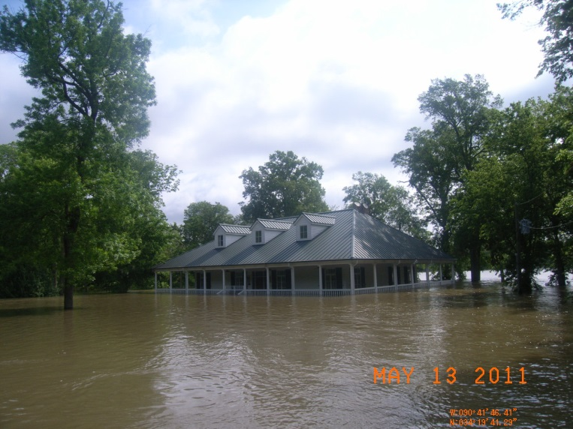
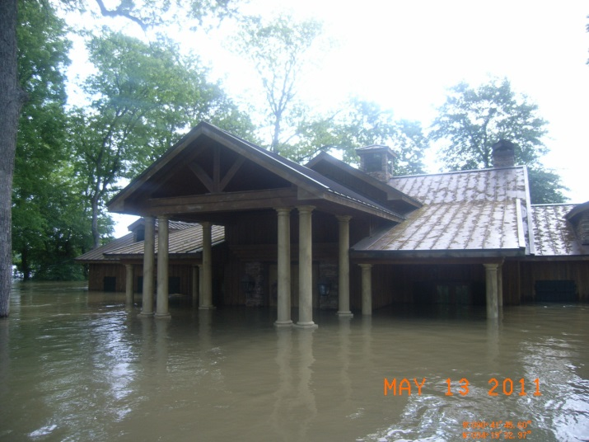


Practices, Conflicts, and Studies (continued)
Case Studies: Fish / Deer Camps in Mississippi
Great Mississippi River Flood of 2011, Coahoma County.
Notes:
Coahoma County, Mississippi. A small group of “fish camps” owned by a group of attorneys flooded. They had been built below the BFE, perhaps with the community’s consent.
SDE survey teams found these structures. Informed the county that they must be included in compliance actions, as necessary.
Long story short, the lawyers decided to sue FEMA to stop all regulation of structures between a river and a levee. Decided that wouldn’t work, so they used the statute passed in 2006 and said that the NFIP was a building code. The State Attorney General agreed with them.
Photos of two of the six structures taken by the state of Mississippi FPM Bureau staff, during the flood and after the flood. The river ‘s flood level was only moderate at the location of the structures.

Slide 110
Practices, Conflicts, and Studies (continued)
Case Studies: Fish/Deer Camps in Mississippi
Coahoma County was ‘CAVed’ prior to the flood by FEMA Region IV. Lots of problems, mostly with camps between the river and the main line levee.
State Attorney General opined in 2011 that such camps were exempt from FPM regulations due to state law.
Notes:
Review the slide.

Slide 111

Practices, Conflicts, and Studies (continued)
Case Studies: Fish/Deer Camps in Mississippi
Letters began to fly between concerned groups/communities and the AG. Between a Congressman and the AG.
Notes:
The Mississippi Attorney General was not supportive of FPM regulations, as they pertained to his political supporters… ☺
The NFIP State Coordinator met with the Governor’s staff and convinced them not to take the AG to court, but to allow FEMA to send a non-compliant letter to the state and use that to change the misinterpreted state statue of 2007.

Slide 112
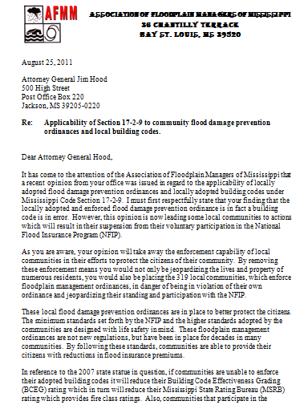
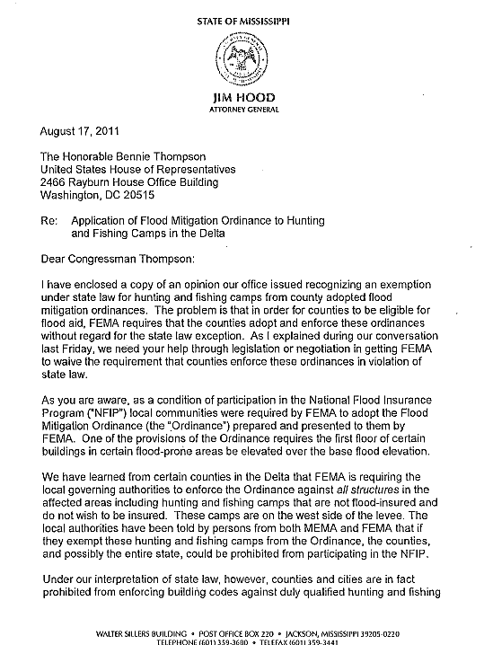
Practices, Conflicts, and Studies (continued)
Notes:
Job Aid 8 and 9. Give copies of letters to mentee(s).

Slide 113
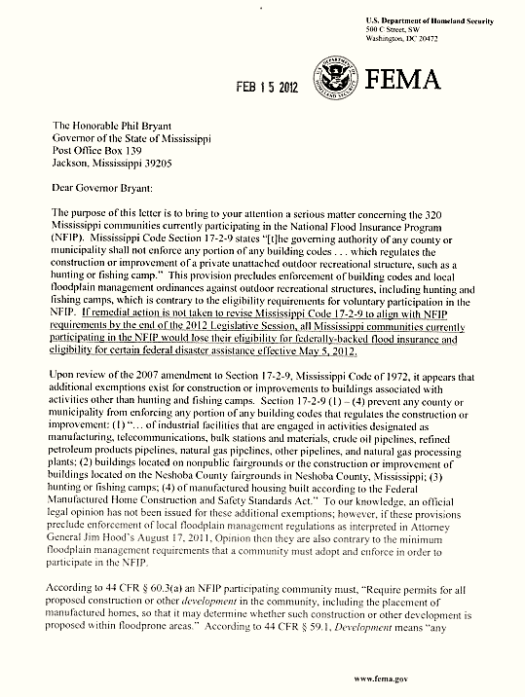
Practices, Conflicts, and Studies (continued)
Case Studies:
FEMA sent letter to Governor,
law makes all communities in
Mississippi non-compliant.
Notes:
Review the slide.
Job Aid 10. Handout a copy of FEMA letter.

Slide 114
Practices, Conflicts, and Studies (continued)
The provisions of this section shall not apply to any floodplain management ordinances or regulations necessary for eligibility for the National Flood Insurance Program, and such floodplain management ordinances or regulations shall apply retroactively to any construction or improvement permit granted for any structure exempted under this section before May 22, 2012.
Notes:
Governor and enlightened legislators modified the offending statue on May 22, 2012.
The fish camps in Coahoma County were deemed non-compliant. County resisted, FEMA is still pursuing probation and suspension against the county, as of 5/14/2014.

Slide 115
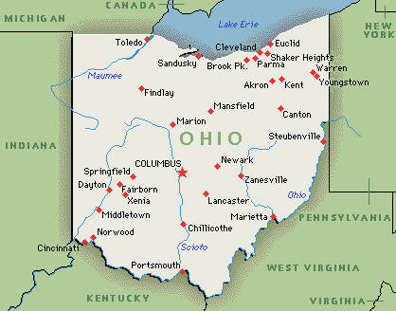
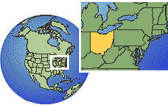
Practices, Conflicts, and Studies (continued)
Case Studies: 5-Year Rule Review in Ohio
An opportunity for review to make sure authorities are relevant and not in conflict with other agency rules and laws.
http://www.jcarr.state.oh.us/video?id=64
Notes:
Ohio law (O.R.C. 119.032) requires all agencies review existing rules every five years to determine if their rules should be eliminated or amended. If the agency determines the rules should not be amended, the rules are filed with JCARR as “no-change” rules. This literally means there are no changes to the existing rules. Agencies are responsible for determining when rules are subject to the five year review requirement. (There is a five year review exemption. The review exemption is for rules that are a federal government verbatim mandate.)
This is a check and balance within the state of Ohio. Causing agencies to certify that their rules/regulations did not have negative impacts due to (for example) environmental regulations.
The reality is that agencies don’t have the resources/staff/time to actually review all of their rules and regs every five years.

Slide 116
Practices, Conflicts, and Studies (conclusion)
Do you know of any other state level cases/examples that can or do cause conflicts?
Notes:
Discuss the Oregon and New Jersey examples.
Some states (OR and NJ) have purposely excluded the SI/SD provisions from their state building code and that has resulted in many “new” structures that do not comply with minimum NFIP criteria. This is a huge problem.

Slide 117
Overview of State Programs
Floodplain management is not just about reducing flood losses. It is also about the prudent management of floodplain resources.
Floodplain management can be regarded as a continuous decision-making process that aims to achieve the wise use of the nation’s floodplains.
Notes:
Review the slide.

Slide 118
Overview of State Programs (conclusion)
Program authority, foundation and funding;
Identifying hazards and planning;
Inform, train, educate and mitigate, and;
Evaluate.
Notes:
Review the slide.

Slide 119
What we covered in Module 5
We have covered the topics introduced at the beginning of the session. What were they?
Overview of state authorities
Special Exemptions in State Law & State Building Codes
Effective Regulatory Program Elements
Overview of the NFIP
The NFIP State Coordinator
Overview of state programs
Best Practices, Conflicts, and Case Studies
Notes:
Review slide

Slide 120


Questions?

