Slide 1
State Floodplain Manager 1 on 1
Module 8:
Community Training & Technical Assistance: Core CAP Activities
Notes:
This is the eighth mentoring module of the State Floodplain Manager 1 on 1 course, “Community Training & Technical Assistance: Core CAP Activities.”
I {or We} will begin by presenting an overview of the module, then address/discuss each topic in sequence, allowing time for interaction and questions throughout the session.

Slide 2
Agenda
  Introductions
  Objectives
  Scope
  Methods
  Materials and References
Notes:
{Standard introductory slide for all 14 modules, which enables a module to be shared as an individual/stand-alone session if the need arises.}
Mentor should skip the first bullet if the module is not delivered as the first of a select series of modules or as an individual module.
For the next ___ minutes we will {do our introductions and} discuss community training and technical assistance, which are Core CAP activities.
{First, we will cover the obligatory introductions portion of the module/session. After that is accomplished,} the last four depicted bullets will be discussed before we begin in earnest.

Slide 3
Introductions
  PLEASE TELL US YOUR:
  Name;
  Job Title;
  Years spent in Floodplain Management, and;
  One mystifying Core CAP activity question that you want to better understand before you leave here today.
Notes:
Skip this slide as deemed necessary.
Skip this slide as deemed necessary.
Tell them they have 5 minutes to complete this task and then each “pair” will be given 30 seconds to make their introduction
While each “pair” is introducing each other, tally the number of years of experience so you know what the collective years of experience is after everyone is finished.
After everyone has been introduced, announce the collective years of experience from the entire group.
Look at all the years of experience you bring as a group.

Slide 4
Objectives
  Upon completion, participants will be able to:
  8.1 Use NFIP Coordination as the foundation for effective state FPM.
  8.2 Define the process of administering oversight of local floodplain management programs.
  8.3 Prepare to conduct CAC and CAV actions with communities.
  8.4 Develop publications and outreach venues.
Notes:
Stress that this module has the four stated objectives (shown on this slide) that must be understood at the conclusion of the session.
Briefly discuss each objective and review at the conclusion of the session.
This module will shed some light on the Core CAP-SSSE activities which form the core building blocks of a good state FPM program.

Slide 5
Scope
  This module includes the following five topics:
  Enrolling Communities to participate in the NFIP (Objective 8.1);
  Ordinance Assistance (Objective 8.1);
  CRS Coordination (Objective 8.1);
  CRS Compliance and Retrograde Procedures
  CRS Verification Visits: The State’s Role
Notes:
Note that each of the five topics in this module is tied into the four stated objectives.

Slide 6

Scope (continued)
  Community Compliance: CACs and CAVs (Objectives 8.1 and 8.2);
  The Community Compliance Program
  Introduction to FEMA’s Manual F-776/April 2011
  Community Assistance Contact
  Community Assistance Visit
Notes:
Continued from previous slide.
Ask the mentee/participant for feedback on each bullet as you announce it. This will reveal the knowledge base of the participant(s) and lead to discussion opportunities.
Numbers 5 and 6 are continued on next slide.

Slide 7
Scope (continued)
  Community Compliance: CACs and CAVs (Objectives 8.1 and 8.2) (conclusion);
  5. CAV: Community selection & Prioritization Process
  CAV: Preparation, Conducting, Documentation, and Follow-Up Actions
Notes:
Continued from previous slide.

Slide 8
Scope (conclusion)
  Publications Development and Maintenance (Objective 8.4)
  State Manual for Administering Local Programs
  Model State Regulations
  Newsletters and Webpages
Notes:
Continued from previous slide.

Slide 9
Methods
  Material contained in this module will be presented through:
  Lecture and demonstration supported by 177 visuals/slides, and;
  The State FPM Student Manual.
Notes:
Mentor will ensure that the required materials are on hand.
Allow for interaction and questions throughout the session.
Visuals, handouts, and glossary will be available to illustrate the teaching points in this module to both instructor(s) and participant(s).

Slide 10
But first…
  Remember when you developed your State’s comprehensive list of programs for CAP-SSSE and listed your Core and Advanced CAP activities?
  So what are Core activities again?
Notes:
Gap Tool.

Slide 11

Core Activity or Task
  Core activities or tasks are those deemed necessary by FEMA for states to have in order to effectively maintain a basic level of state capability and competency to assist communities with NFIP participation.
Notes:
Review slide.

Slide 12
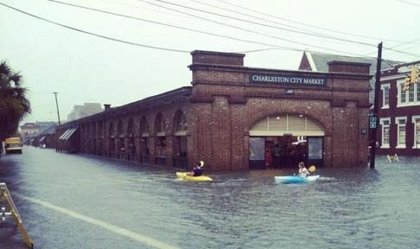

  “Core CAP activities include kayaking.” Morgan the Mentor
Notes:
Morgan can be quite the wag sometimes…
Photo provided by Brett Ravell, former student at the Citadel.

Slide 13
Enrolling Communities
  This topic (Enrolling communities to participate in the NFIP) is the focus of two FEMA publications:
  An orientation of the 2005 FEMA 496 publication “Joining the NFIP” , and;
  An orientation of the 2011 FEMA 553 “Community Enrollment and Eligibility Handbook.”
Notes:
FEMA 496 is only four pages.
FEMA 553 consists of 170 pages.
Now let’s discuss the first topic, enrolling communities.

Slide 14

Enrolling Communities (continued)
  FEMA 496:
Notes:
FEMA 496 is only four pages.
Job Aid 1. Take a couple of minutes to peruse it with the students.

Slide 15
Enrolling Communities (continued)
  Let’s quickly discuss your state’s level of NFIP participation:
  What (or how large) is the pool of possible NFIP communities in your state? Are they mapped?
  How many NFIP member communities do you presently have? Any pending?
  How many CRS member communities do you have? Any pending?
Notes:
Review the slide.

Slide 16
Enrolling Communities (continued)
  Keeping in mind that there is no current federal law that requires a community to join, what are the two major benefits of participation?
  The opportunity for citizens to purchase flood insurance, and;
  Avoidance of being sanctioned.
Notes:
Review the slide.
If a community has been identified as being floodprone and has not joined the NFIP within one year of being notified of being mapped, then Federal agencies cannot provide financial assistance for buildings in the identified Special Flood Hazard Areas.

Slide 17
Enrolling Communities (continued)
  FEMA’s mandate to map floodprone areas serves the public by:
  Creating flood hazard awareness by its identification of floodprone areas (maps);
  Providing those maps to States and communities for
    Health/safety codes and regulations;
    Emergency management, and;
    Land use planning, codes and regulations.
Notes:
Review the slide.

Slide 18
Enrolling Communities (continued)
  To participate in the NFIP:
  A community must adopt and enforce FPM regulations that meet or exceed the minimum requirements of the Program.
  These requirements are intended to
    Prevent loss of life and property;
    Reduce taxpayer costs for disaster relief, and;
    Minimize flood related economic and social hardships.
Notes:
Review the slide.

Slide 19
Enrolling Communities (continued)
  The community should review the FIS to determine if the NFIP would benefit the community and its citizens.
  Communities that have not been identified as being floodprone can still join the NFIP.
  Citizens in non-participating communities are ineligible for most forms of disaster assistance within the identified flood hazard areas.
Notes:
Review the slide.
Why should the FIS be reviewed?
What possible benefits could there be for joining the NFIP when you have no identified Special Flood Hazard Areas?

Slide 20
Enrolling Communities (continued)
  So, what must a community do to join the NFIP?
  Submit an application package that includes:
    FEMA Form 81-64 (application form);
    Resolution of Intent, and;
    Copy of adopted FPM regulations (that meet or exceed the minimum standards found in 44 CFR 60.3).
Notes:
Review the slide.
The FEMA Regional Office and the NFIP State Coordinating Agency are listed as the points of contact for a community who wishes to join.

Slide 21
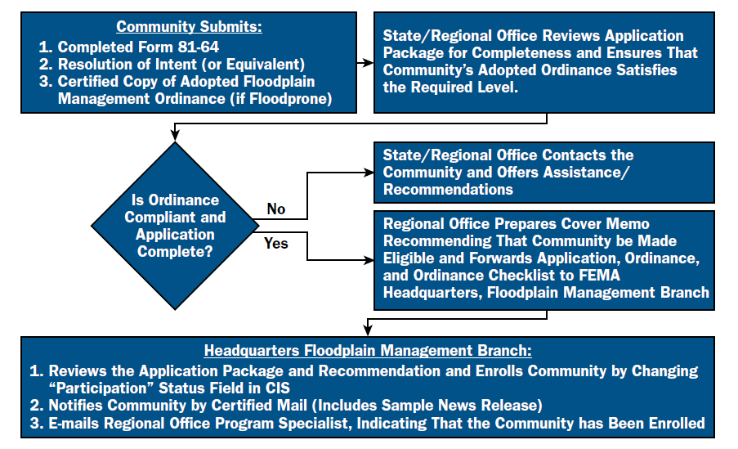
Enrolling Communities (continued)
  Emergency and Regular Phase Application Process
Notes:
Review the slide.

Slide 22
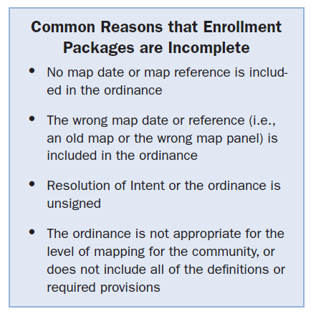

Enrolling Communities (continued)
Notes:
Review the slide.

Slide 23
Enrolling Communities (continued)
  What are the requirements that a community must adopt?
  Those requirements that reflect the type of flood hazard data provided to the community by FEMA.
  Legally enforceable regulations.
  The two bullets above are covered by your state model ordinance and FPM guidance policies.
Notes:
Review the slide.
State authority for FPM varies from State to State. Some require that communities regulate floodplains to a higher standard than the minimum NFIP requirements. Some States have the requirement that a community must first submit its draft Flood Damage Prevention Ordinance (or whatever its title) to the NFIP Coordinating Office prior to submission to FEMA.

Slide 24
Enrolling Communities (continued)
  What type of regulations can a community adopt?
  FPM regulations are generally found in:
    Zoning Ordinances
    Building Codes
    Subdivision Ordinances
    Sanitary Regulations
    “Stand Alone” FPM regulations
Notes:
Review the slide.
How your communities approach FPM depends on your State laws and regulations and also how the communities choose to manage their floodplains.

Slide 25
Enrolling Communities (continued)
  What happens if a community is identified as floodprone, but does not join the NFIP?
  The following sanctions apply within one year of being identified as floodprone by FEMA:
    Property owners can’t purchase NFIP policies and existing policies are not renewed
    Federal grants or loans within the SFHA are not available
Notes:
Review the slide.

Slide 26
Enrolling Communities (conclusion)
  What happens if a community is identified as floodprone, but does not join the NFIP? (conclusion)
    Federal disaster assistance for flood damage is not provided to repair insurable buildings in SFHA
    Federal mortgage insurance or loan guarantees will not be provided in SFHA
    Federally insured or regulated lending institutions can make conventional loans for buildings in SFHA (not eligible for Federal disaster assistance)
Notes:
Review the slide.

Slide 27
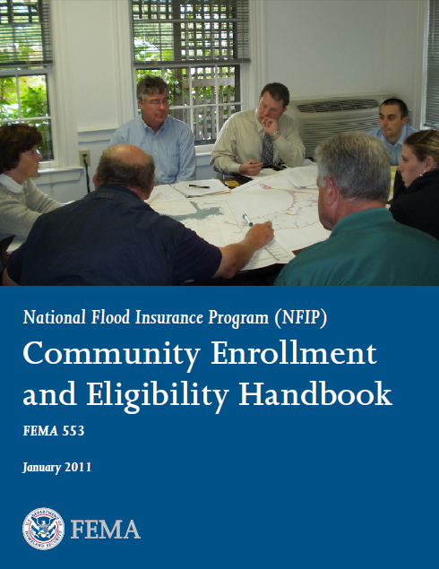
Enrolling Communities (continued)
  FEMA 553:
Notes:
FEMA 553 consists of 170 pages.
This publication contains a very nice list of frequently referenced NFIP regulations, found on pages REG-1 through REG-6. A nice guide for digging through 44 CFR for appropriate references.
Job Aid 2. Take a few minutes to peruse it with the class. Mention that it would take an hour to cover it, so we will only highlight Emergency and Regular Phase information.

Slide 28
Enrolling Communities (continued)
  What is the FEMA process for enrollment?
  The Regional Office is responsible for reviewing the final application package and ensuring that all of the contents are completed before forwarding to FEMA HQ’s Floodplain Management Branch (FMB) and updating the Community Information System (CIS).
Notes:
Review the slide.

Slide 29
Enrolling Communities (continued)
  What is the FEMA process for enrollment? (continued)
  After its review, the FMB enrolls the community in CIS, with the date of participation status becoming the entry date of the community into the Emergency or Regular Phase of the program.
  If all goes well, the enrollment occurs one week after receipt…
Notes:
Review the slide.

Slide 30
Enrolling Communities (continued)
  What is the FEMA process for enrollment? (conclusion)
  The FMB notifies the community by certified mail that it is enrolled in either the Emergency Phase or the Regular Phase.
  A sample news release is included in the letter.
  The community is published in the Federal Register under the “List of Communities Eligible for the Sale of Flood Insurance” notice.
Notes:
Review the slide.
FEMA HQ also will send an email to the Regional Office Program Specialist that the community has been enrolled.

Slide 31
Enrolling Communities (continued)
  What is this ‘Emergency Phase’ of which I speak?
  A community is entered into the Emergency Phase under four situations. Situation One:
    It is unmapped and has adopted legally enforceable FPM regulations
    Its flood hazard areas have been identified, a FHBM issued and it has adopted legally enforceable FPM regulations.
Notes:
Review the slide.
The second bullet is addressing A zones found on a FHBM or FIRM.

Slide 32
Enrolling Communities (continued)
  Emergency Phase: (continued)
  Situation Two:
    FHBM rescission, if analysis shows that the community will not be inundated by the 1% chance flood (NSFHA or Non-floodprone) or
    The adopted map does not accurately reflect the SFHA, has printing errors, community lacked land use authority or the map had inaccurate flood elevations.
Notes:
Review the slide.

Slide 33
Enrolling Communities (continued)
  Emergency Phase: (continued)
  Situation Three:
    If a community that does not have a current FIRM applies during the six month compliance period and has adopted the new effective FIRM, it will be enrolled and automatically converted to the Regular Phase on the date the FIRM becomes effective.
Notes:
Review the slide.

Slide 34
Enrolling Communities (continued)
  Emergency Phase: (conclusion)
  Situation Four:
    Emergency Phase entry can be had by the adoption of a preliminary map (if they don’t have a map), but only after the appropriate map reference can be added to the ordinance.
    This typically doesn’t occur until the FIRM effective date is established, the LFD issued and community readopts and makes reference to the new FIRM effective date.
Notes:
Review the slide.

Slide 35
Enrolling Communities (continued)
  Now, what is the ‘Regular Phase?’
  Communities that are mapped on a FIRM are entered directly into the Regular Phase of the program.
  The community must adopt legally enforceable FPM measures that are compliant with the determined level of the FIRM.
Notes:
Review the slide.
60.3 (b), (c), (d) or (e) level regulations. Discuss what these four levels consist of, e.g. (b) level regulations cover a FIRM with only A zones, (c) covers AE zones and no floodways, (d) covers A, AE and floodways and (e) A, AE, floodways and V zones.

Slide 36
Enrolling Communities (continued)
  Regular Phase: (conclusion)
  Communities that are designated “all Zone D,” which do not have a map can be Regular Phase if they submit a resolution compliant with 44 CFR 59.22 and 44 CFR 60.3 (a).
  Communities with no SFHAs may be entered by submitting a similar resolution or when FEMA provides a letter designating them with no SFHAs.
Notes:
Review the slide.

Slide 37
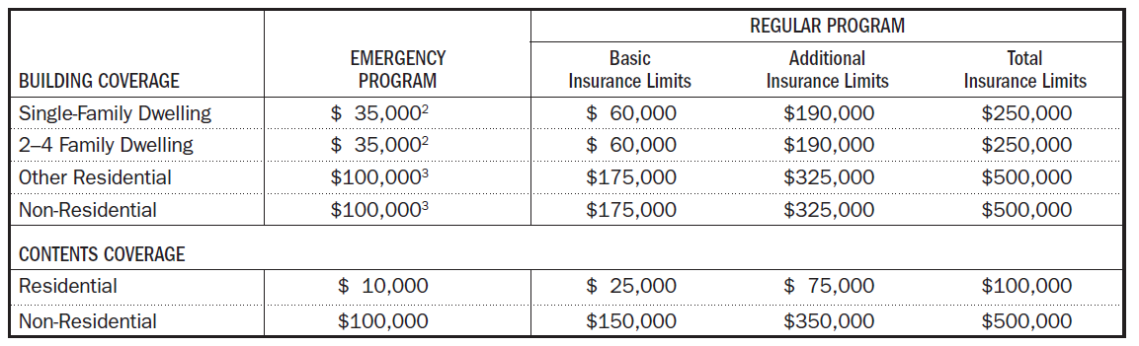
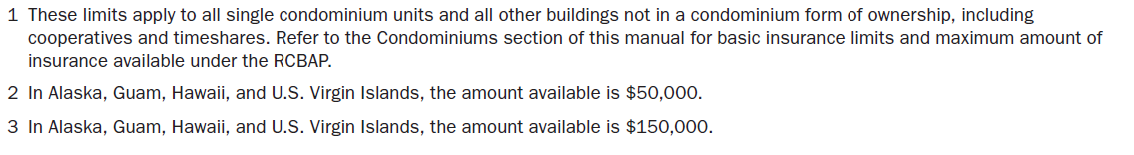
Emergency vs. Regular Phases
  Insurance coverage availability comparison.
Notes:
Review the slide.

Slide 38
After Action Review
  Feel like you are missing something vital?
Notes:
Review any items or questions that were raised to ensure that there is no confusion or mystery to what you have covered.

Slide 39
Ordinance Assistance
  Overview: This topic (Ordinance Assistance) can be covered by various checklists, publications and regulations, such as:
  The National Flood Insurance Act of 1968, Section 1315;
  The 2011 FEMA 553 “Community Enrollment and Eligibility Handbook,” and;
  Title 44 of the CFR, Parts 59 and 60.
Notes:
Review the slide.

Slide 40
Ordinance Assistance (continued)
  When reviewing a community’s flood damage prevention ordinance, a determination must be made that the ordinance meets or exceeds all of the applicable requirements of 44 CFR 60.3 and 60.6 (a).
  It must also be determined that it meets applicable provisions of State enabling legislation and has been legally adopted through due process requirements.
Notes:
Review the slide.

Slide 41
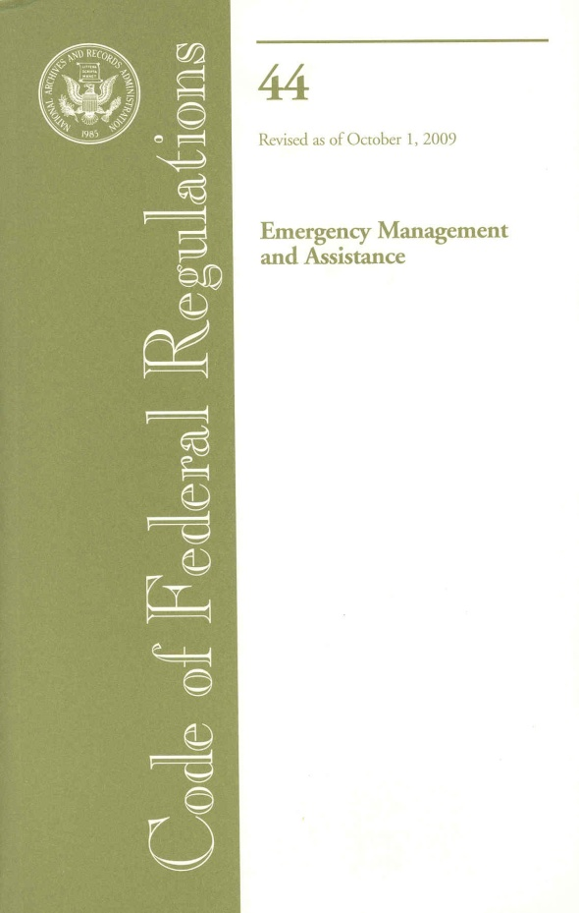
Ordinance Assistance (continued)
  Under Section 1315:
  Participating communities are required to have adopted adequate land use and control measures with effective enforcement measures which are consistent with Section 1361 and Title 44, Parts 59 and 60, and;
  Must be legally enforceable.
Notes:
Review the slide.

Slide 42
Ordinance Assistance (continued)
  Additionally:
  The community must include adequate administrative procedures for administering the ordinance, adequate enforcement procedures and a variance section.
  FEMA doesn’t specify the procedures required, but expects the community to utilize the same procedures it uses to administer other ordinances.
Notes:
Review the slide.
An ordinance without administrative procedures cannot be enforced and, therefore, is not a compliant ordinance.

Slide 43
Ordinance Assistance (continued)
  NFIP regulations require that:
  The community ordinance/regulations be applied “uniformly throughout the community to all privately and publicly owned land,” and;
  Must take precedence over any less restrictive conflicting laws, ordinances or codes.
Notes:
Review the slide.
What about Federal or State agencies? Communities may not be able to regulate them directly, but they are subject to EO 11988 and State FPM regulations or executive orders.

Slide 44
Ordinance Assistance (continued)
  Statutory Authority: An ordinance is a generic term for a law passed by a local government.
  Does your State use another term?
  In most States, a community’s authority to enact an ordinance comes from a State law. This authority can be general in nature or a specific authority to adopt and enforce OR a combination of both.
Notes:
Review the slide.

Slide 45
Ordinance Assistance (continued)
  Whichever type of State law applies, it generally includes the following:
  The purpose and limits of the regulatory authority;
  Minimum regulatory standards;
  Prerequisites for enacting or amending the ordinance;
  Requirements for issuing variances or allowing special uses, and;
  Prerequisites for the administering official if specified.
Notes:
Review the slide.

Slide 46
Ordinance Assistance (continued)
  Some States provide for State oversight of local regulations. A developer may be required to apply directly to the State for a permit.
  In some States, the developer may appeal to the State, if they feel the local community government has not interpreted its regulations correctly.
Notes:
Review the slide.

Slide 47
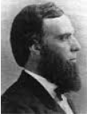
Ordinance Assistance (continued)
  Recall our earlier discussion in Module 5, that most States are subject to the 1868 “Dillon’s Rule.”
    Dillon’s Rule: because local governments are created by State government, they can only do what State laws specifically authorize.
    If an action is not authorized by statute, a community can’t perform the action in a “Dillon’s Rule” State.
Notes:
Review the slide.
John Forrest Dillon was an American jurist who served on federal and Iowa state courts. He authored a highly influential treatise on the power of states over municipal governments.

Slide 48
Ordinance Assistance (continued)
  State Approval of Communities’ FPM Regulations: The NFIP State Coordinator’s Office acts as a link between FEMA and communities.
  States often review FPM ordinances as a task under the CAP-SSSE or to ensure compliance with State laws or regulations.
  In some States, approval by the State is required.
Notes:
Review the slide.
If the State has FPM laws or regulations that establish requirements beyond the minimum criteria of the NFIP, then the State must approve.

Slide 49
Ordinance Assistance (continued)
  State Approval: (conclusion)
  The FEMA Regional Office must ensure that in a State that requires State approval of an ordinance, the community’s ordinance is actually approved. Why?
    Because a local ordinance in such a State may not be legally enforceable.
Notes:
Review the slide.
If a provision in the State model ordinance does not constitute a more restrictive State requirement, unless that provision is backed up by a law or regulation and is mandatory for all communities in that State.
A community will not be suspended for not adopting a provision of a model ordinance, provided that it otherwise meets NFIP minimum requirements.

Slide 50
Ordinance Assistance (continued)
  State Preemption of Local Ordinances: If a State law or regulation preempts a community from regulating certain types of activities or actions by State agencies, then the State agency overseeing the activity must apply FPM requirements equivalent to NFIP minimum criteria.
Notes:
Review the slide.

Slide 51
Ordinance Assistance (continued)
  Determining Compliance with 44 CFR §60.3: The requirements that apply to a particular community depends on its flood hazard and the level of detail of the data that FEMA has provided. In example:
  60.3(a) FEMA has not provided any maps or data to the community (also D Zones);
  60.3(b) FEMA has provided a map with A Zones;
Notes:
Review the slide.

Slide 52
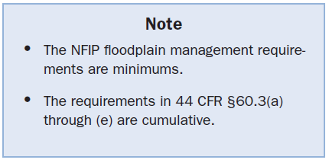
Ordinance Assistance (continued)
  In example: (continued)
  60.3(c) FEMA has provided a FIRM with BFEs;
  60.3(d) FEMA has provided a FIRM with BFEs and a floodway;
  60.3(e) FEMA has provided a FIRM with V Zones, and;
  60.3(f) FEMA has provided a FIRM that shows protection restoration area AR Zones.
Notes:
Review the slide.
This is called the “Level of Regulations.”

Slide 53
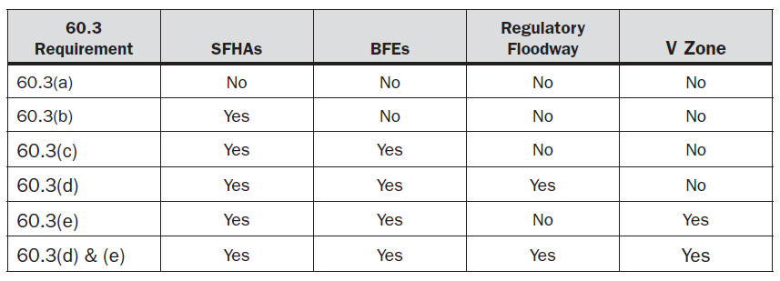
Ordinance Assistance (continued)
  This type of table can be used to determine the minimum NFIP requirements for a community.
Notes:
Review the slide.

Slide 54
Ordinance Assistance (continued)
  Determining Compliance: (continued)
  Other types of data that are shown on the FIRM must be determined. For example:
    Does the 60.3(d) community also have rivers or streams that have BFEs but no floodways, AO or AH zones, A zones or D zones? If it does, provisions of 44 CFR 60.3 (a), (b) and (c) that apply to that type of data must be included in the ordinance.
Notes:
Review the slide.
A mental stair step visual is useful here, as shown on the next slide.

Slide 55
Regulation Staircase
60.3(e)
FIS/BFEs/Floodway/Coastal
60.3(d)
FIS/BFEs/Floodway
60.3(c)
FIS/BFEs
60.3(b)
FEMA Map
60.3(a)
No Map
Notes:
Review the slide.
Remember this graphic from the E273 class?

Slide 56
Ordinance Assistance (continued)
  Types of FPM Regulations: There are a variety of FPM ordinances. We earlier mentioned:
  The “Stand-Alone” ordinance;
  Building Codes;
  Zoning Ordinance;
  Subdivision Regulations, and;
  Sanitary Regulations.
Notes:
Review the slide.

Slide 57
Ordinance Assistance (continued)
  Review of the Community Ordinance: There are ordinance checklists available. A checklist is a good tool to systematically ensure that an ordinance is compliant. What can it also do?
  Provide documentation that the ordinance was reviewed (by either the State or FEMA RO).
Notes:
Review the slide.
Have you ever reviewed a local Flood Damage Prevention Ordinance?
Did you use a checklist? If so, where did you obtain it? Was it filled? CIS updated?

Slide 58
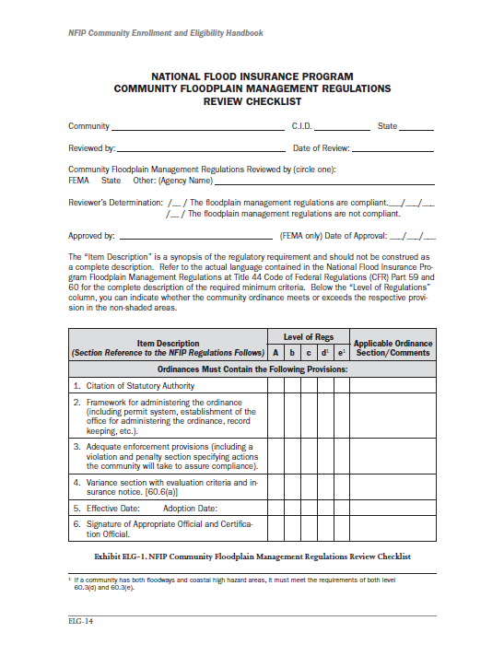
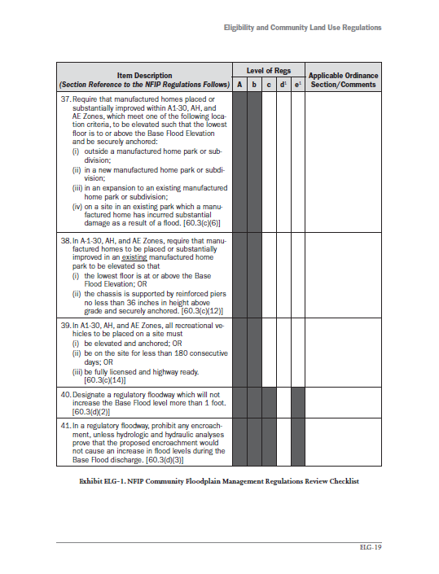
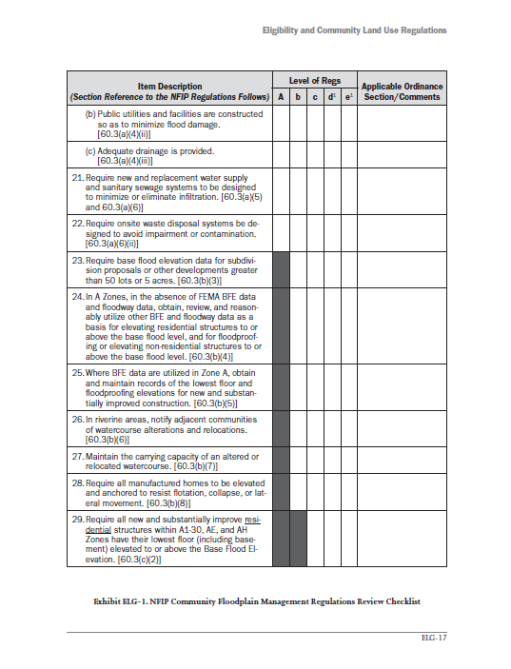
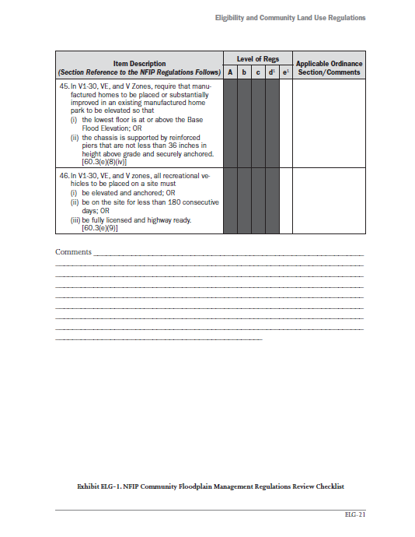
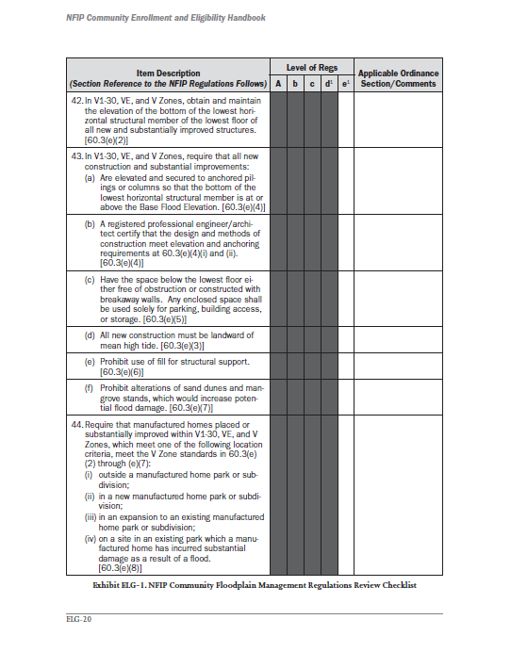
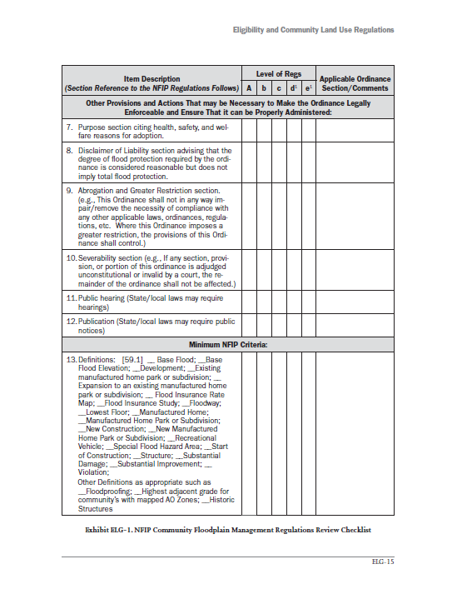
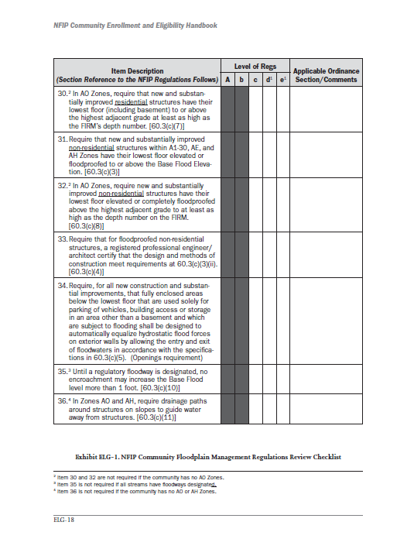
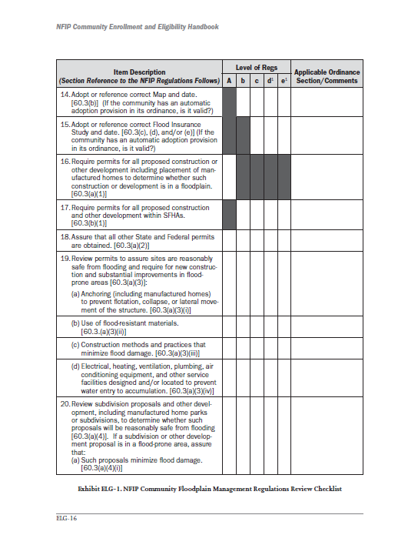
Ordinance Assistance (conclusion)
  Example Checklist: There is an example on pages ELG-14 through ELG-21 in Job Aid 2.
Notes:
Review the slide.
Let’s take a few minutes to look over this eight page review checklist provided by FEMA.

Slide 59

After Action Review & Break
  Feel like you are missing something vital? Let’s do a quick review and then take a break.
Notes:
Review any items or questions that were raised to ensure that there is no confusion or mystery to what you have covered.
Take a 10 minute break.

Slide 60
CRS Coordination
  Overview: The NFIP CRS was implemented in 1990, as a voluntary program for recognizing and encouraging community FPM activities exceeding the minimum NFIP standards. Any community in full compliance with the minimum NFIP requirements may apply to join.
  There are presently 1,296 CRS communities.
  These communities represent only 5% of the NFIP communities, but more than 67% of all policies.
Notes:
Review the slide.
Now, let’s look at examples of two states with almost the same number of CRS communities and discuss their differences.

Slide 61
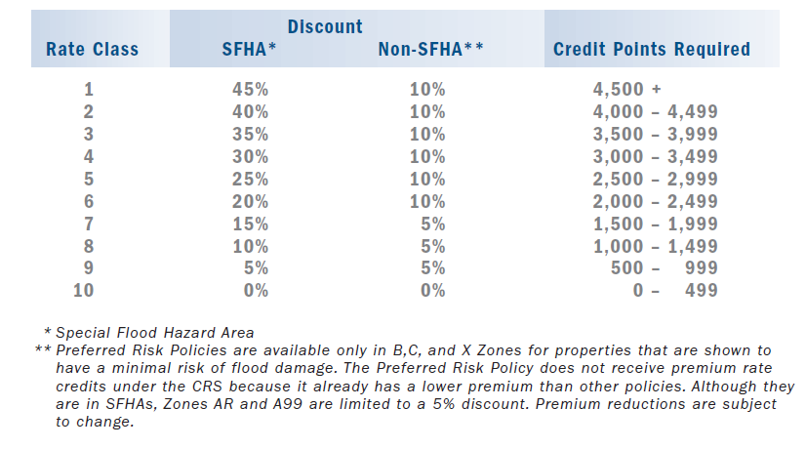
CRS Coordination (continued)
Notes:
Review the slide.
How much of an insurance premium discount can policyholders in a CRS community possibly receive (on the average)?

Slide 62
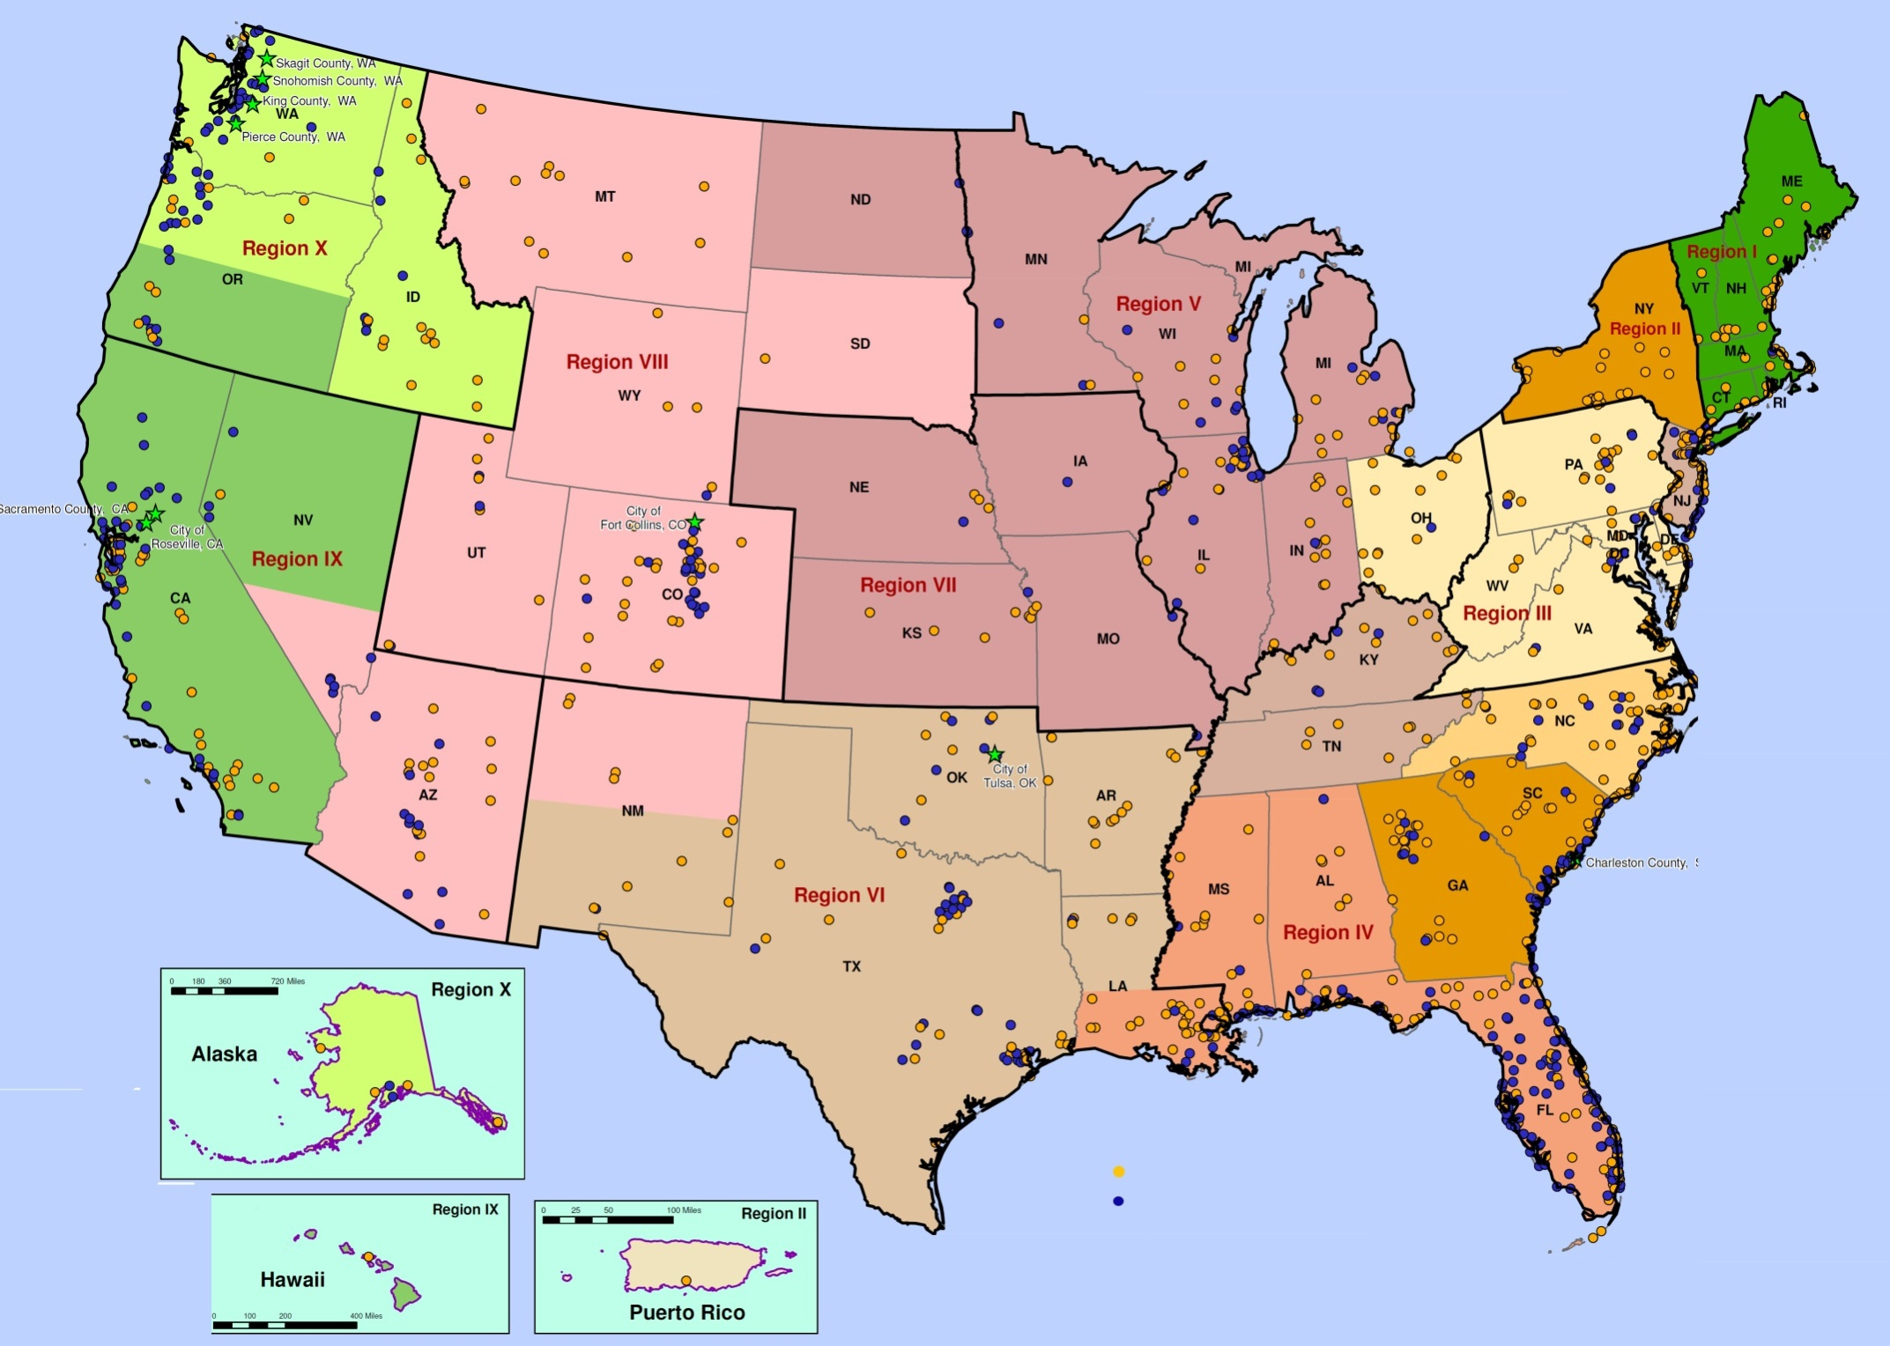
● Class 8 − 9
● Class 5 − 7
Class 1 − 4
Notes:
Review the slide.
Ask about the mentee’s state.

Slide 63
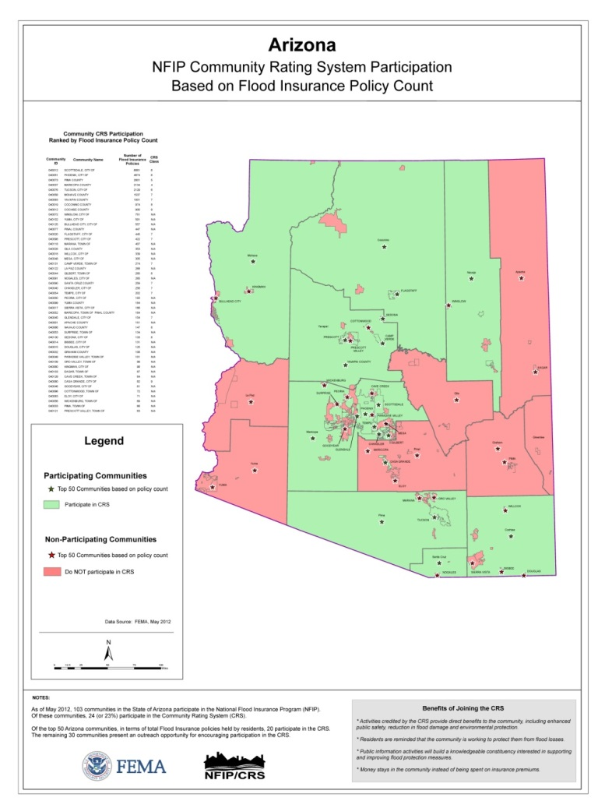

CRS Coordination (continued)
25 CRS Communities
104 Communities participate in the NFIP
2 communities do not participate
  Currently, 79 % of all flood policies in these CRS communities.
Notes:
Review the slide.
I will show you two state examples of CRS penetration statistics. The first is the state of Arizona.
Note the number of CRS member communities and percentage of flood insurance policies within those communities.

Slide 64
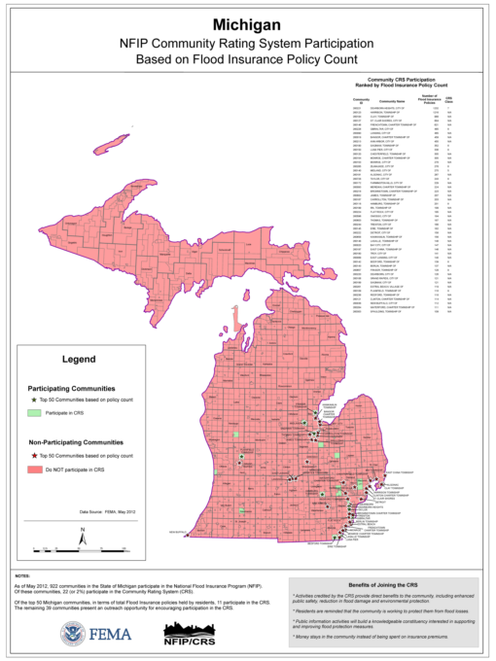
CRS Coordination (continued)
24 CRS Communities
981 Communities participate in the NFIP
152 Communities do not participate
  Currently, 16% of all flood policies in these CRS communities.
Notes:
Review the slide.
The second example is the state of Michigan. Almost the same number of CRS communities as Arizona, but with a significant policy count difference.
Note the number of CRS member communities and percentage of flood insurance policies within those communities. Compare with previous slide. Click back and forth as needed.

Slide 65
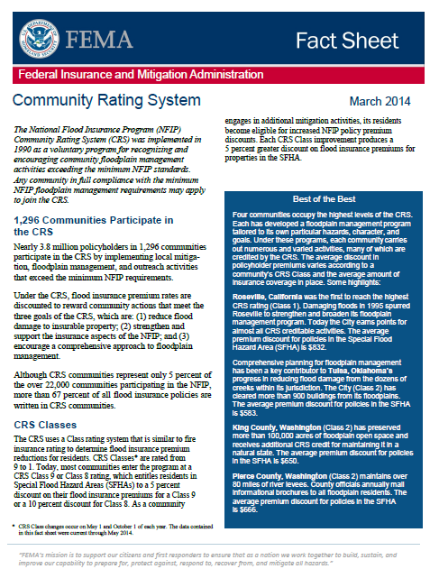
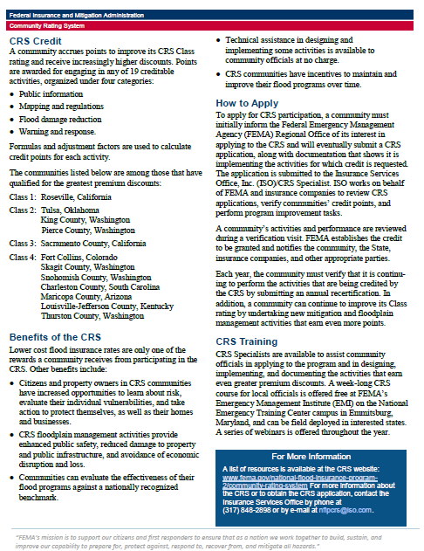
CRS Coordination (continued)
  CRS
  Fact
  Sheet
Notes:
Job Aid 3. Take a few minutes to peruse it with the class. Two pages.

Slide 66
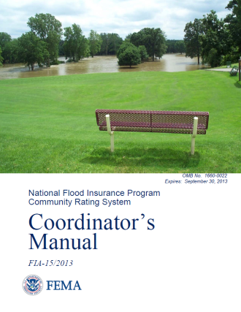
CRS Coordination (continued)
  Benefits of the CRS: Lower flood insurance rates for policyholders is only one benefit. Others include:
  Increased opportunities to learn about risk, evaluate vulnerabilities and take protective actions;
  Enhanced public safety, reduced damage to property and infrastructure;
  Avoidance of economic disruption and loss;
Notes:
Review the slide.
The CRS Coordinator’s manual is available on line for download. It is expected to be extended to 9/30/2016.

Slide 67
CRS Coordination (continued)
  Benefits of the CRS: (conclusion)
  Means to evaluate effectiveness of flood programs against nationally recognized benchmark;
  Receive technical assistance in designing and implementing some activities, and;
  An incentive to maintain and improve their flood programs over time.
Notes:
Review the slide.

Slide 68
CRS Coordination (continued)
  How they Apply: A community must inform FEMA of its interest, submit a CRS application and documentation that shows it is implementing the activities for which credit is requested.
  The application is submitted to the ISO/CRS Specialist for your State.
  A verification visit takes place to establish credit to be granted and appropriate parties are notified.
Notes:
Review the slide.
What is NFIP State Coordinator’s role in this application process? Is a compliant CAV required?

Slide 69
CRS Coordination (continued)
  How they Apply: (conclusion)
  Each year, the community must verify that is continuing to perform the activities that are being credited by submitting an annual recertification.
  They can improve their classification by undertaking new mitigation and FPM activities that earn even more credit points.
Notes:
Review the slide.

Slide 70

CRS Coordination (continued)
  “Costs” to Community:
  Pass a Community Assistance Visit;
  Designate a CRS Coordinator;
  Implement activities;
  Annual recertification;
  Maintain Elevation Certificates and FIRMS, and;
  Maintain other records until cycle visit.
Notes:
Review the slide.

Slide 71
CRS Coordination (continued)
  CRS Training: An ISO/CRS Specialist is available to assist community officials in applying and in designing, implementing and documenting the activities that earn premium discounts.
  There is a week long CRS course (E278) at EMI that is generally offered twice a year.
  A field deployed version (L278) is also available on a limited basis along with webinars.
Notes:
Review the slide.

Slide 72
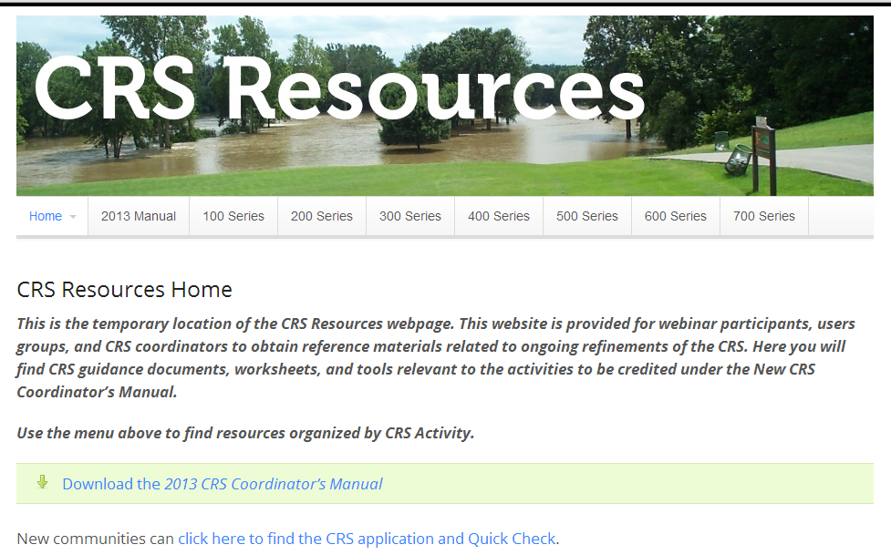
CRS Coordination (continued)
www.CRSResources.org
Notes:
Review the slide.
Click to animate the slide.

Slide 73
CRS Coordination (continued)
  CRS Compliance & Retrograde Procedures: To maintain the credibility of the CRS, FEMA requires that every community in CRS to be fully compliant.
  FEMA must determine if the community is compliant under the minimum NFIP requirements.
  Compliant communities are expected to have an updated ordinance, to have remedied violations to the maximum extent possible and corrected its deficiencies.
Notes:
Review the slide.

Slide 74
CRS Coordination (continued)
  CRS Compliance: (continued)
  Since 1996, a “clean CAV” is required before a new community may participate in the CRS.
  It is expected that a CRS community with a large amount of development may have minor program deficiencies and possible violations. However, any identified issues must be corrected expeditiously to the maximum extent possible.
Notes:
Review the slide.
A CAV must be conducted by the FEMA Regional Office or NFIP State Coordinator before a community can be provided with a compliance determination letter for initial CRS participation or for improvement to Classes 1 – 4.
A community cannot be considered in full compliance unless they have had a CAV within the past year.

Slide 75
CRS Coordination (continued)
  CRS Compliance: (continued)
  Additionally, if the community is not implementing or enforcing an activity, it will lose the credits for that activity and any possible cumulative effects the change has on the community’s classification.
Notes:
Review the slide.

Slide 76
CRS Coordination (continued)
  CRS Compliance: (continued)
  A community is not in compliance if any of the following apply:
    Within the pervious two years, the community has been put on probation or suspended for lack of enforcement. After the community is reinstated, an additional two years must pass before it can reapply to CRS, or;
    The community’s ordinance does not meet all current NFIP criteria.
Notes:
Review the slide.

Slide 77
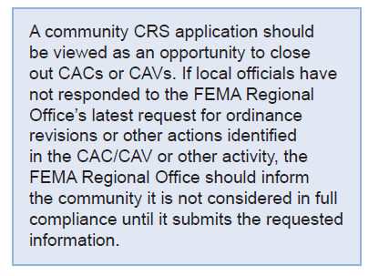

CRS Coordination (continued)
Notes:
Review the slide.

Slide 78
CRS Coordination (continued)
  Keep in Mind:
  CRS discounts are add-on benefits for communities that have exemplary FPM programs built upon a fully compliant base program.
  It is CRS policy to withhold any improved class until the community remedies these problems, and when necessary, to retrograde non-compliant communities to Class 10.
Notes:
Review the slide.

Slide 79
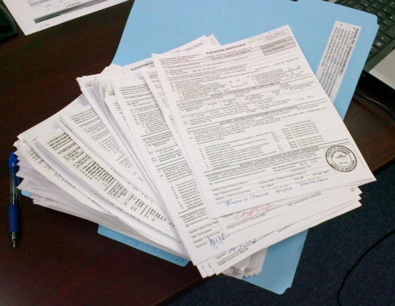
CRS Coordination (continued)
  CRS Retrograde Procedures: The FEMA Regional Office (in close cooperation with the State) judges a community's compliance. The RO must maintain documentation as to why a community is not considered to be in full compliance.
Notes:
Review the slide.

Slide 80
CRS Coordination (continued)
  CRS Retrograde Procedures: (continued)
  After suspected violations or program deficiencies are reported, the community is allowed to respond to the CAV report findings and either prove there are no deficiencies/violations or correct them.
  CRS communities are expected to show immediate action to remedy the problems.
Notes:
Review the slide.
What is the standard time frame allowed by your FEMA Region (after the date of the CAV findings letter) for a community to correct deficiencies or remedy all violations to the maximum extent possible? (SHOULD be up to six months.)
Extensions can be granted to the community IF remedial measures are underway but not completed.

Slide 81
CRS Coordination (continued)
  CRS Retrograde Procedures: (continued)
  FEMA should recommend retrograde to Class 10 prior to the completion of the six month period, if, at any time, a community is not responsive or the community does not have a fully functioning FPM program.
  What is a non-responsive community?
Notes:
Review the slide.
Click slide to answer the second bullet’s question.

Slide 82
CRS Coordination (continued)
  CRS Retrograde Procedures: (continued)
  What is a non-responsive community?
    One that has not met deadlines established in the initial CAV follow-up letter or subsequent letters, and has not initiated the necessary actions to correct the identified program deficiencies or remedy the violations.
Notes:
Review the slide.

Slide 83
CRS Coordination (continued)
  CRS Retrograde Procedures: (continued)
  What is a non-functional FPM program?
    The community has not required flood development permits, does not have a floodplain administrator, or otherwise does not have functioning system.
    This can easily happen in small communities and after FPM staff turnover.
Notes:
Review the slide.

Slide 84
CRS Coordination (continued)
  CRS Retrograde Deadlines:
  CRS class changes become effective twice a year, on May 1 and October 1.
  WYO and internal processing require that all class changes, including Class 10 retrogrades, be final NLT 120 days prior to these CRS effective dates.
  Therefore, retrograde recommendations must be made at least 180 days prior to the CRS effective date.
Notes:
Review the slide.
If the community’s deadlines fall after the effective date, the retrograde recommendation must be delayed to coincide with the next CRS effective date.

Slide 85
CRS Coordination (continued)
  CRS Retrograde Deadlines: (continued)
  FEMA RO recommendations for retrograde to Class 10 must adhere to the following schedule:
    RO sends one or more CAV follow-up letters with ascending CRS warnings;
    At least seven months prior to May 1/Oct 1 (Oct 1 / March 1): RO notifies community of recommend retrograde;
Notes:
Review the slide.

Slide 86
CRS Coordination (continued)
  CRS Retrograde Deadlines: (continued)
    At least six months prior to May 1/Oct 1 (Nov 1/April 1): RO sends memo to HQ recommending retrograde;
    At least five months prior to May 1/Oct 1 (Dec 1//May 1): HQ sends official notice to the community of CRS retrograde;
    At least four months prior to May 1/Oct 1 (Jan 1/ June 1): HQ notifies BSA to process all CRS classes for WYO companies;
Notes:
Review the slide.
The 30-day period between the FEMA RO’s recommendation of retrograde to Class 10 and the FEMA HQ notice to the community is not a formal appeals period, but does allow time to resolve issues raised by the community.

Slide 87
CRS Coordination (continued)
  CRS Retrograde Deadlines: (conclusion)
    At least three months prior to May 1/Oct 1 (Feb 1/ July 1): WYO companies program data and process renewals, and;
    On May 1/Oct 1: Insurance Agent’s Manual and WYO companies reflect new/revised CRS Classes.
Notes:
Review the slide.

Slide 88
CRS Coordination (continued)
  CRS Verification Visits, The State’s Role: FEMA uses consultants to process applications and provide tech assistance to FEMA, States and communities. The process is:
  Consultants schedule a verification visit.
  The visit is conducted both in the office and the field.
  Documentation is required for all activities in which the community receives credit.
Notes:
Review the slide.

Slide 89
CRS Coordination (continued)
  CRS Verification Visits, The State’s Role: (continued)
  A final report is provided showing the awarded points by activity and the awarded CRS class.
  While a CRS verification visit looks like a CAV, in some aspects, it varies in one key area, a CAV evaluates implementation of the minimum NFIP criteria. A CRS verification visit assumes full compliance and only measures activities that are above and beyond the minimum NFIP requirements.
Notes:
Review the slide.
Many NFIP State Coordinators once believed that ISO effectively “policed” the state’s CRS communities and therefor did not CAV them.

Slide 90
CRS Coordination (continued)
  CRS Verification Visits, The State’s Role: (continued)
  However, there is sufficient crossover to allow for information sharing, primarily from data gathered on the CRS visit by the ISO/CRS Specialist. In example:
    Elevations Certificates are examined in detail and specific examples of ECs containing floor elevations below the BFE or other suspected violations can be shared with the NFIP State Coordinator.
Notes:
Review the slide.
This sharing of information can lead to a possible follow-up CAC or CAV by the state FPM staff.

Slide 91
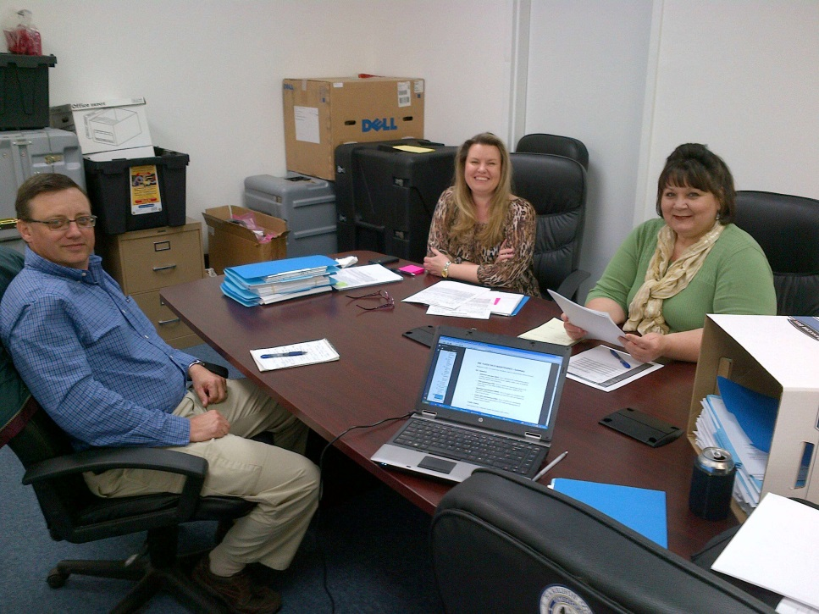

CRS Coordination (continued)
  CRS Verification Visits, The State’s Role: (conclusion)
  Your CAP-SSSE Agreement generally sets forth expected activities in regard to CRS visits.
  What examples can you think of?
Notes:
Review the slide.
Photo provided by MEMA. CRS cycle visit with Harrison County, MS 2014.
The second bullet should prompt some discussion and examples/war stories.

Slide 92
After Action Review
  Feel like you are missing something vital?
Notes:
Review any items or questions that were raised to ensure that there is no confusion or mystery to what you have covered.

Slide 93
Compliance: CACs and CAVs
  Overview: The connected system that makes up the Community Compliance Program has its emphasis on correcting local NFIP community FPM program deficiencies and remedying violations through community assistance and consultation prior to the initiation of an enforcement action. The primary tools:
  The Community Assistance Contact, and;
  The Community Assistance Visit.
Notes:
Review the slide.
We are with the government and we are here to help you…

Slide 94
Compliance: CAC and CAV (continued)
  NFIP compliance serves the interests of:
  Property Owner;
  Property Occupant;
  Future Owner / Occupant;
  Neighbors (near and far);
  Community;
  Federal and State Disaster Relief programs, and;
  The National Flood
Notes:
Review the slide.
Go into some detail on each bullet; use your discretion as to how much detail.

Slide 95
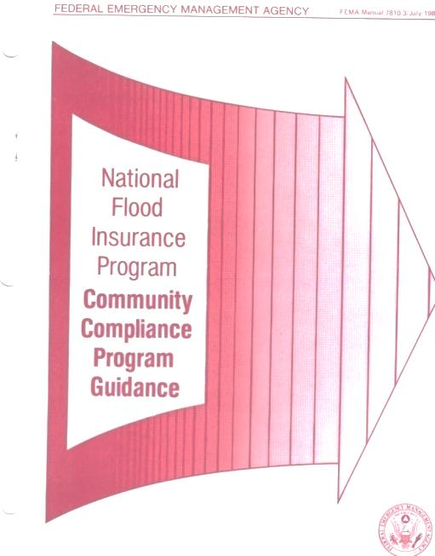
Compliance: CAC and CAV (continued)
  FEMA Manual 7810.3/July 1986:
  The Community Compliance Program (companion to the CAP-SSSE) provides an orderly sequence of enforcement options of varying severity.
  Two sets of enforcement options
    One for Communities, and;
    One for Individuals and Structures.
Notes:
Review the slide.
The Community Compliance Program is a companion to the NFIP Community Assistance Program (CAP-SSSE). IF problems are encountered during the implementation of the CAP that cannot be resolved by providing guidance to the community, this manual provides guidance for follow-up action by the FEMA HQ and Regional Offices.
Built on procedures found in 44 CFR 59.24 (b) and (c) and provides an orderly sequence of enforcement options of varying severity.

Slide 96
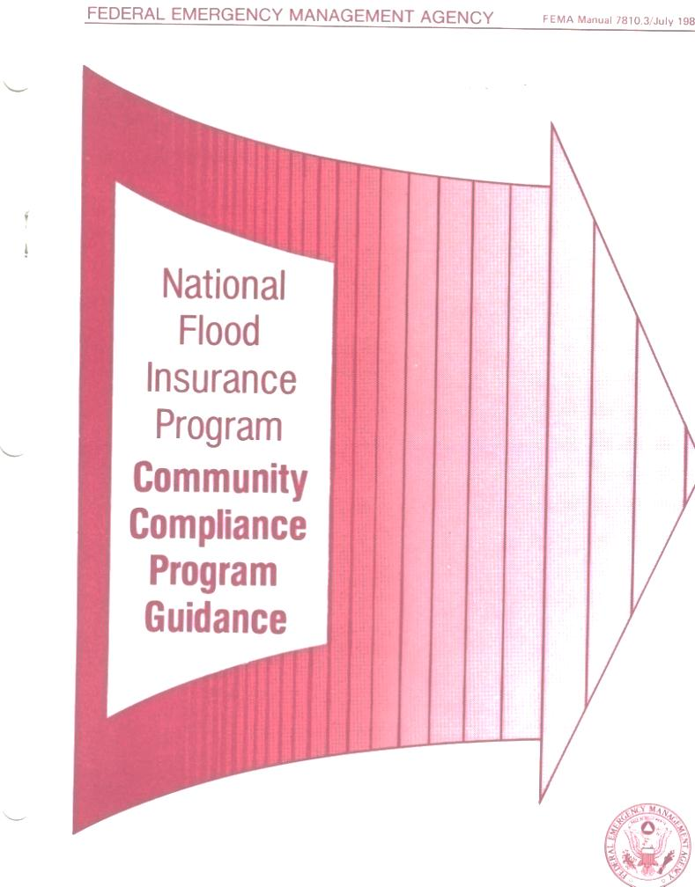
Compliance: CAC and CAV (continued)
  The “In-House” FEMA manual:
  NFIP Community Compliance Program Guidance
  FEMA 7810.3 July 1986
Notes:
Job Aid 4. Take a few minutes to peruse it with the class.
It is used as an “in-house” guidance manual.

Slide 97
Compliance: CAC and CAV (continued)
  Key Concepts:
  “All Program Deficiencies should be Corrected and all Violations Remedied. As a result of an enforcement action, each of the deficiencies in the local ordinance or administrative procedures should be corrected. Each violation that has been identified should be remedied to the maximum extent possible.”
Notes:
Review the slide.
Go over the statement and ask, now what does Maximum Extent Possible mean?

Slide 98

Compliance: CAC and CAV (continued)
  Key Concepts: (continued)
  Maximum Extent Possible: Remedying a violation to the maximum extent possible means to the most effective level of flood loss reduction attainable given practical and legal constraints. FEMA 7810.3/July 1986. page 1-5.
Notes:
Review the slide.

Slide 99

Compliance: CAC and CAV (continued)
  Key Concepts: (continued)
  Remedy a Violation: Remedying a violation means to bring the structure or other development into full or partial compliance with State or local regulations or, if this is not possible, to reduce the impacts of the fact that it is noncompliant. FEMA 7810.3/July 1986. page 1-7.
Notes:
Review the slide.
FEMA 7810.3/July 1986. page 1-7. Now what does this statement really mean?
This slide should trigger some comments from participants.

Slide 100
Compliance: CAC and CAV (continued)
  Key Concepts: (continued)
  The objectives of the Community Compliance Program can be described in these four bullets:
    Emphasize technical assistance vs. enforcement action;
    Provide a range of options for the community;
    Provide comparable treatment to all like-situated communities, and;
    Use enforcement options as a last resort.
Notes:
Review the slide.
Go into some detail on each bullet; use your discretion as to how much detail.

Slide 101
Compliance: CAC and CAV (continued)
  Key Concepts: (continued)
  The resolution of violations must be pursued in a manner that:
    Upholds the integrity of the NFIP, and;
    Takes advantage of a community’s legally established authorities which govern code compliance and enforcement.
Notes:
Review the slide.
Ask if anyone has ever taken a violation to court. What happened?
OR
Tell a personal account of a community taking legal action.

Slide 102
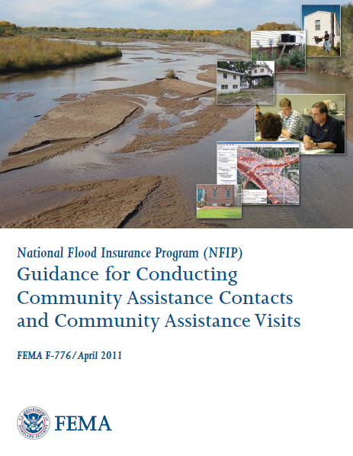
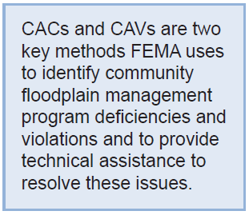
Compliance: CAC and CAV (continued)
  FEMA 776:
Notes:
Job Aid 5. Take a few minutes to peruse it with the class.
This manual is an important foundation for building a factual (fact finding) case of a community’s non-compliance to support continued enforcement action.
You will find that during this session we will be focusing on “assessment” and not necessarily “assistance.” You must first know who to assess a community’s floodplain management program before you can provide the necessary assistance.
Under the NFIP program out goal is to assistance communities in their implementation of sound comprehensive floodplain management criteria. If a community is not providing the necessary regulations of floodplain, is our responsibility to assess, assist and follow through with compliance.

Slide 103
Compliance: CAC and CAV (continued)
  FEMA 776:
  The manual has seven chapters which cover:
    General Information;
    Community Selection Process;
    Community Assistance Contact;
    Community Assistance Visit: Preparation;
    Community Assistance Visit;
    Community Assistance Visit: Documentation, and;
    Community Assistance Visit: Follow-Up.
Notes:
Review the slide.

Slide 104
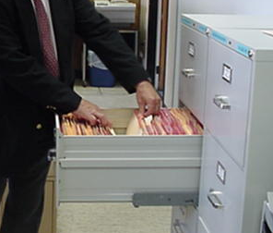
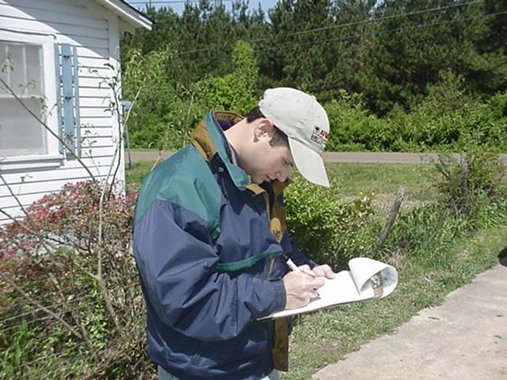
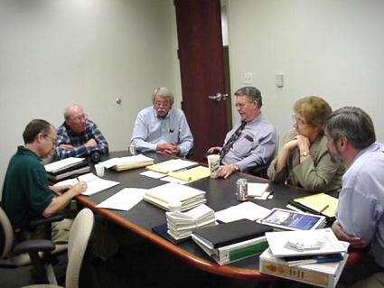
Compliance: CAC and CAV (continued)
  Before we proceed, let’s do an experience check:
  How many CACs and CAVs are “mandated” by your CAP-SSSE agreement per FY?
  Approximately how many CAVs have you conducted?
  What is a CAC to you?
Notes:
Review the slide. Lead the discussion.
Photos: The left hand shot is of a NFIP State Coordinator conducting a CAV with a county. The right hand side is a local FPM conducting a CAV.

Slide 105
Compliance: CAC and CAV (continued)
  The basics; what is a CAC?
  A Community Assistance Contact:
    Can consist of a telephone call or brief visit, and;
    Is less comprehensive than a CAV.
  CACs can be used:
    As a screening tool to see if the more resource intensive CAV is necessary;
    To establish or re-establish contact, and;
    To determine if any FPM issues exist.
Notes:
Review the slide.
The CAC process has been used by some States to screen those communities that need assistance, have not been contacted for some time, or obtaining information about changes in contacts with the community.
Some communities have expressed desire to have a CAV. It is important to understand that there are some floodplain mangers that desire to have a CAV to determine if they are doing the right thing.
CAC would be good for those communities:
Just entered the NFIP
Citizens’ concerns via phone or correspondence
Map accuracy

Slide 106
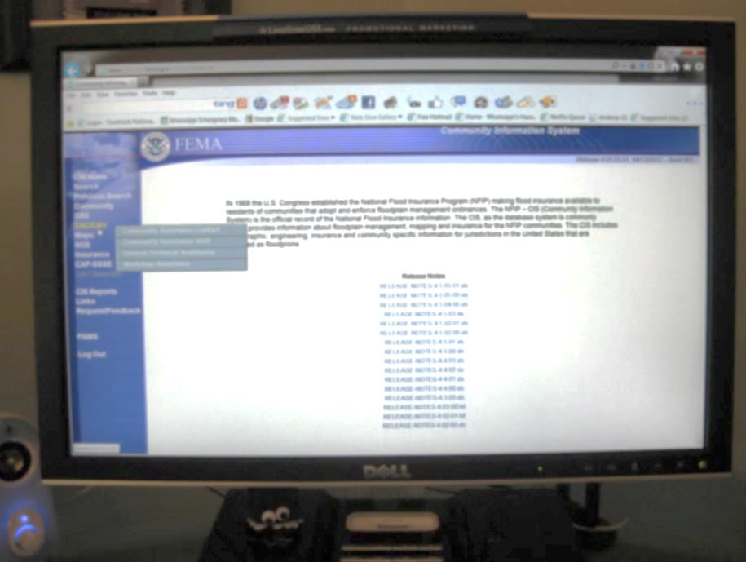
Compliance: CAC and CAV (continued)
  CAC: The Community Information System (CIS)
  CIS can be used to:
    Track CAC actions;
    To record data as you conduct a call, and;
    Create a permanent record.
Notes:
Review the slide.
Ask if anyone has used the Community Information System for this purpose.

Slide 107
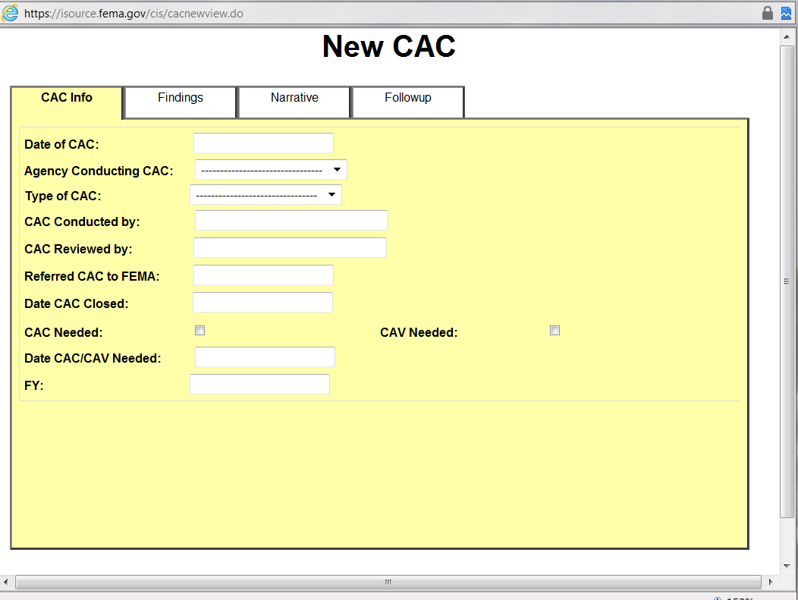
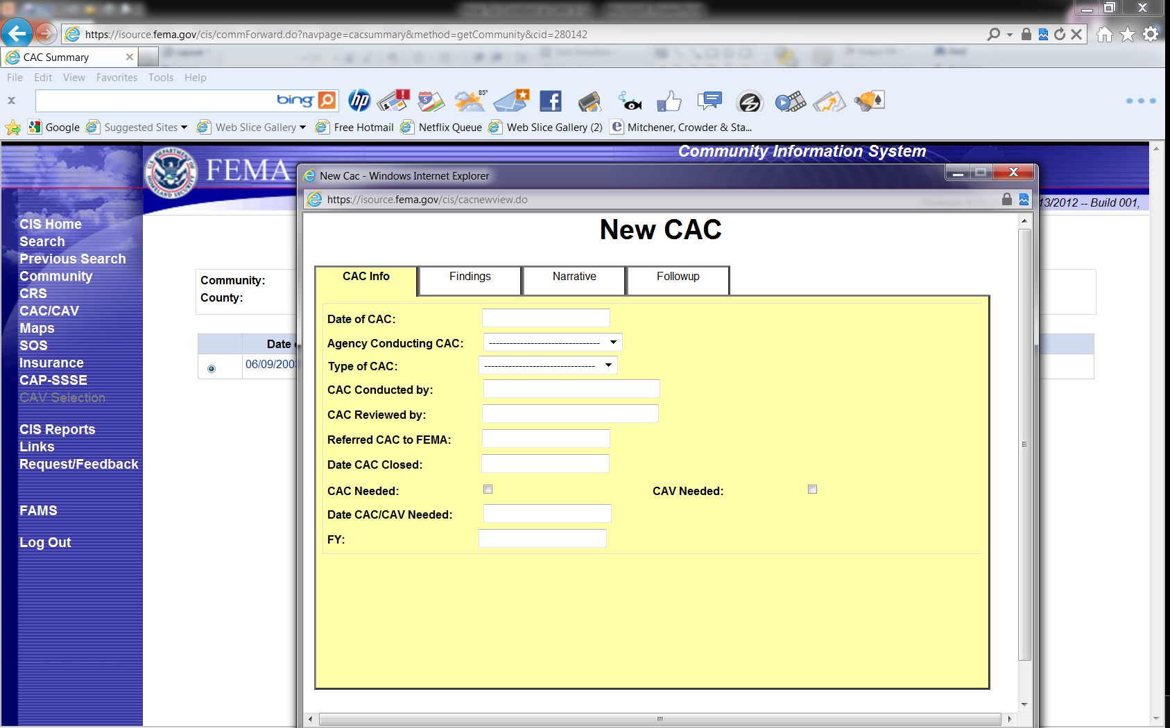
Compliance: CAC and CAV (continued)
  CAC: The Community Information System (CIS)
Notes:
Review the slide.
After briefly describing the system, click to advance slide to larger view of “new” CAC screen.
Recording the information obtained from CACs are entered in CIS through the CAC screen – walk through with Laser pointer. Note that you can differ between phone and visit. Screen allows you to enter findings, notes, and follow-up needed. In add to the “CAV needed” checkbox on the “Info” screen, under findings, you can also check whether a CAV is needed within one year.

Slide 108
Compliance: CAC and CAV (continued)
  The basics; what are the key purposes of a CAV?
  To ensure NFIP participating communities are achieving the flood loss reduction objectives of the program, which are:
    To reduce the threat to life safety and property, and;
    To provide technical assistance to communities and therefore identify, prevent and resolve FPM issues before they develop into enforcement actions.
Notes:
Review the slide.
Providing technical assistance via telephone conversations, visits, email, letters and eventually a CAV is the responsibility of the FEMA HQ, FEMA Regional and NFIP State Coordinators to assist communities in their implementation of the NFIP.

Slide 109
Compliance: CAC and CAV (continued)
  The basics; what is the goal of a CAV?
  To establish a positive working relationship with NFIP communities and awareness of the NFIP requirements.
Notes:
Review the slide.
It is important to understand that sometimes as Federal or State representatives, we would like to take aggressive action toward a difficult community. But we as Federal and State employees and the goal of the NFIP, is to provide technical assistance in the implementation of the program regulations. Our goal is not to kick community’s out of the NFIP, but to help them understand the importance of floodplain management and their commitment to the Federal Government and the citizens.
If a community no longer is upholding their commitment, the recourse we may have is to place them on probation, and finally suspension.
However, in some cases, the community and the citizens may be better off struggling through a few years of difficult time resolving deficiencies and improving their program rather than being suspended from the NFIP.

Slide 110


Compliance: CAC and CAV (continued)
  CAV: What the community thinks…
FEMA
State
Notes:
Review the slide. Always good for a laugh.
I am with FEMA and simply wish to look at your program. Pay no attention to my six accompanying staff. Who that guy? Oh, he is with the State and just drove me here...

Slide 111
Compliance: CAC and CAV (continued)
  CAV: Community Selection & Prioritization Process
  Ideally, a participating NFIP community should be contacted at least every year:
    Impossible – too many;
    Depends on State/FEMA staff, budget and other resources and demands;
    Depends on local staff turnover, and;
    Every 5 years is a rule of thumb (but every 3 years for select communities is recommended).
Notes:
Review the slide.
Ideally – participating communities. However, a community that has been suspended and/or withdrew and now wants to reenter the NFIP, a CAV should be conducted. But for each community in the NFIP to be CAVed every year is impossible.
Depending on the priority and/or budget of a Region, a NFIP participating community should be evaluated every 3 to 5 years. In that period of time a new group of elected officials could be in office and the direction of a comprehensive floodplain management program may not be the priority of the administration now.
What is meant by a “select community” in reference to a three year cycle vs. a five cycle?

Slide 112
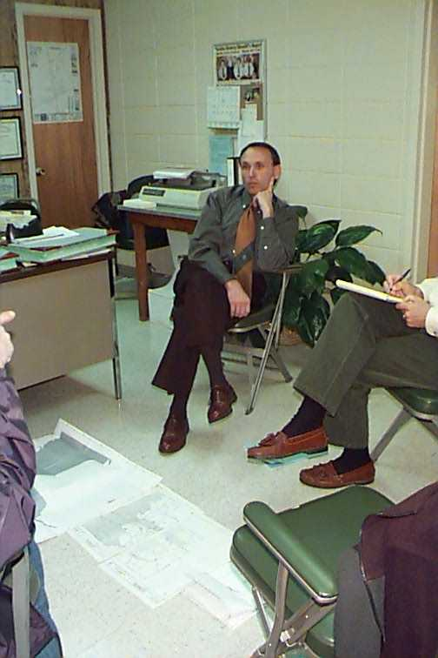
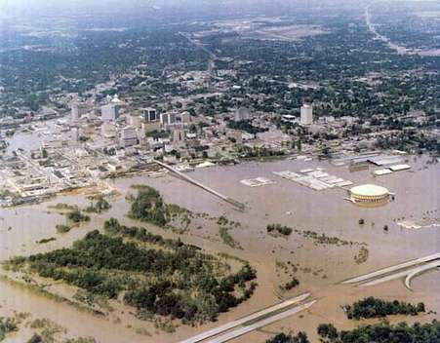
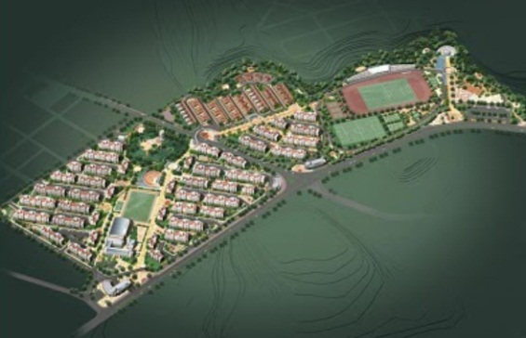
Compliance: CAC and CAV (continued)
  CAV: Selection & Prioritization Process (continued)
  You should consider communities with:
    Current and future high growth in the SFHA;
    High risks to existing SFHA development, and;
    Known or suspected compliance issues.
Notes:
Review the slide.
Photos: Left: Planned housing development in the SFHA Center: Downtown Jackson, MS flood of 1979. Right: A newly elected Mayor learning of pre-existing compliance issues in his town.
Once a preliminary list of CAVs has been identified (upcoming year), the FEMA RO and State Coordinating Office will determine who will conduct the visits. This occurs prior to or during the CAP-SSSE SOW negotiation process with States. IF the CAV/CAC is required for a participating Federally Recognized Tribal Government, then it must be done by FEMA.

Slide 113
Compliance: CAC and CAV (continued)
  CAV: Selection & Prioritization Process (continued)
  Risk-Based Community Selection Process:
    FEMA’s Risk-Based Selection Tool provides annual ranking of all communities in your State, and;
    The list is divided into two groups (aka Tier 1 and Tier 2 communities).
Notes:
Review the slide.
The length of the Tier 1 list will depend upon the number of CAVs the State and FEMA can accomplish in a five-year cycle.
Additional info can be found on page 2-2 in FEMA F-776/April 2011. (NFIP Guidance for Conducting CACs and CAVs)

Slide 114
Compliance: CAC and CAV (continued)
  CAV: Selection & Prioritization Process (continued)
  Risk-Based Community Selection Process: (continued)
    Tier 1: Those with the highest risk relative to new/existing development, and;
    Those with suspected or potential FPM problems.
    Tier 2: Those with a risk ranking that falls below Tier 1; and should be scheduled for a CAC and/or training and the State/FEMA can perform CAVs with them as time and resources become available.
Notes:
Review the slide.
The length of the Tier 1 list will depend upon the number of CAVs the State and FEMA can accomplish in a five-year cycle.
Additional info can be found on page 2-2 in FEMA F-776/April 2011. (NFIP Guidance for Conducting CACs and CAVs)

Slide 115
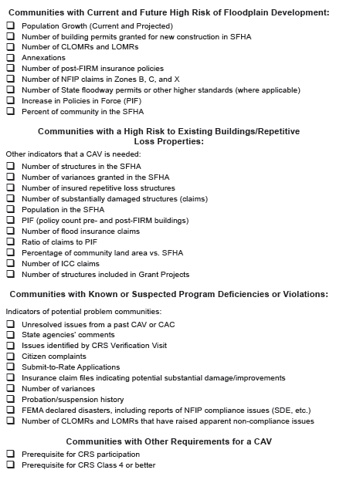
Compliance: CAC and CAV (continued)
  Selection Indicators
Notes:
Tell the students that this slide is hard to read, so it is divided into four sections in the following slides, so just listen.
There are many methods and topics that will put a community on the list for a CAV. However, more importantly, the files and communications that are received within the HQ and FEMA Regional Offices.
Submit to Rate is a good tool to begin your fact findings. If the community is lacking in knowledge of issuance of variances and/or non-compliant construction, a CAV is a tool to research, and resolve problems before they become major damage and loss of life and property are the results.
Biennial reports that the community has completed will provide information on the areas of concern and immediate attention by the Regional Office.
New FIRMs with new elevations, increased SFHA or floodway delineated will cause concern with the community officials if they are not familiar with the requirements.
When the Regional Offices receive memorandums from HQ about a LOMR-F request and a possible violation noted, that should be a flag for a CAV. In addition, for those Regions that have basements, LOMR-F with basement construction would be another flag.

Slide 116
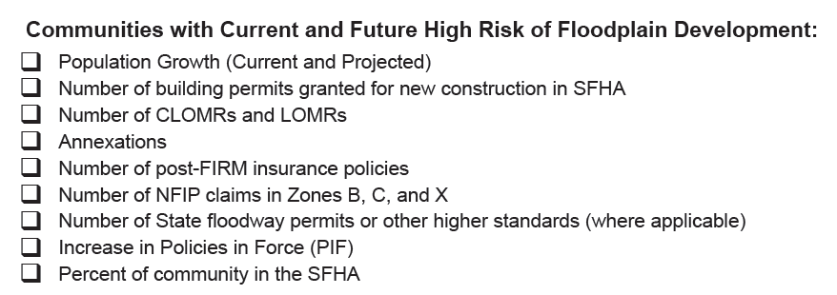
Compliance: CAC and CAV (continued)
  Selection Indicators
Notes:
Review the slide.

Slide 117
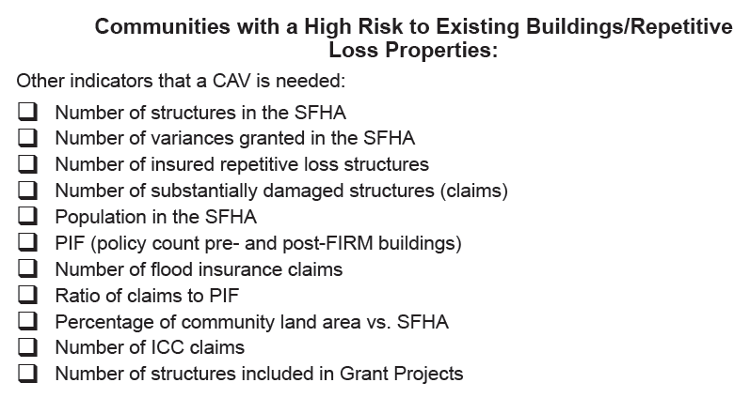
Compliance: CAC and CAV (continued)
  Selection Indicators
Notes:
Review the slide.

Slide 118
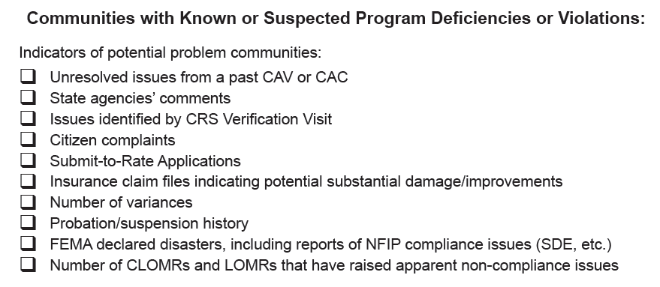
Compliance: CAC and CAV (continued)
  Selection Indicators
Notes:
Review the slide.

Slide 119
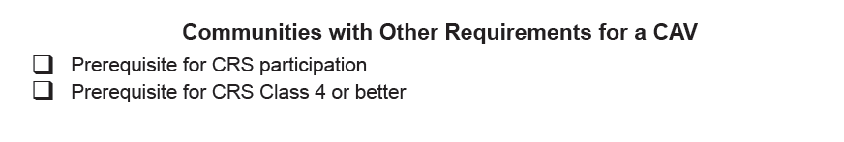
Compliance: CAC and CAV (continued)
  Selection Indicators
Notes:
Review the slide.
Also, consider issues from old CACs and CAVs and recent disasters.

Slide 120
Compliance: CAC and CAV (continued)
  CAV: Selection & Prioritization Process (continued)
  Research the community using:
    The Community Information System;
    CAC and CAV records;
    BSA web-based data, e.g. Submit-to-Rate information, policies, claims, repetitive loss data, etc.;
    Federal Agencies;
    Citizen complaints/recent disaster declarations, and;
    Your State Floodplain Management Association.
Notes:
Review the slide.
Disasters can be Presidential declarations, Small Business Administration or State Declared Emergencies.
State Associations can be approached for information, but it depends on your relationship with them. Their purpose is not to “rat out” their member communities to the State or to FEMA. Perhaps you have conducted training at a conference and noted who needed the most help?

Slide 121
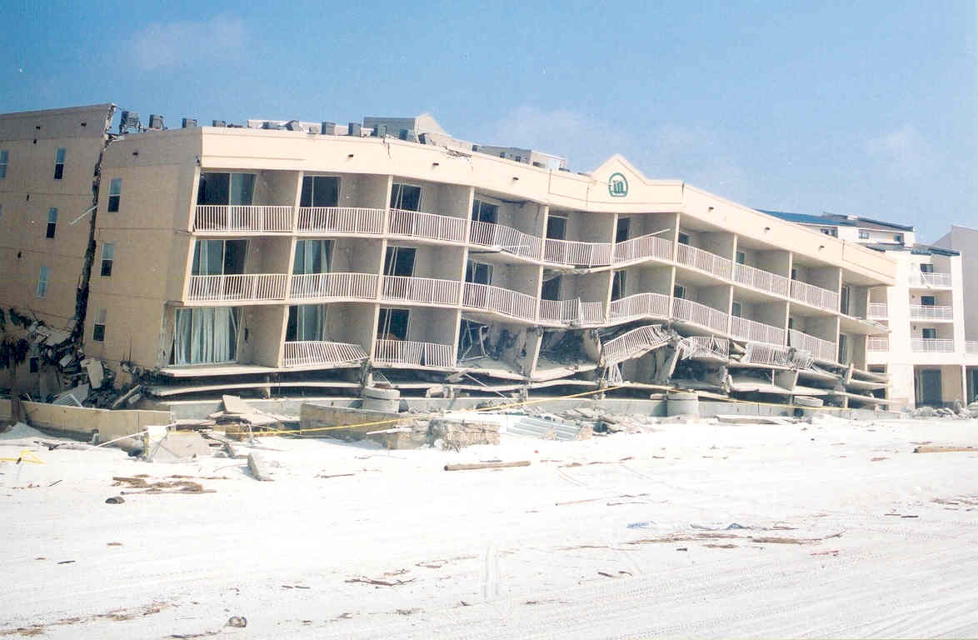
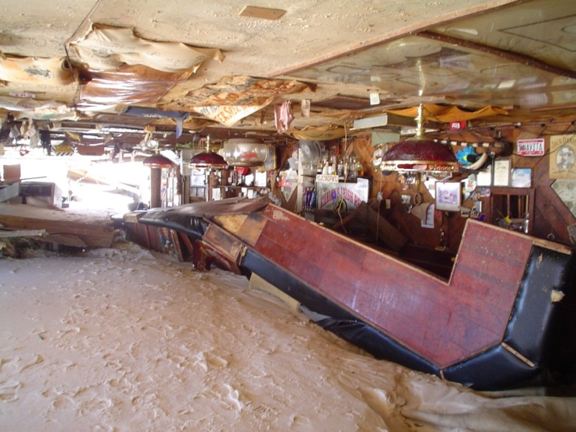
Compliance: CAC and CAV (continued)
  CAV: Selection & Prioritization Process (conclusion)
  Research using:
    Disaster declaration photos.
Notes:
Review the slide. Photos found on FEMA website.
How could these photos of a beach bar and a beachfront hotel assist you in your pre-CAV research?
What if these photos were taken five years past? One year past?
What if a new DFIRM was issued after this event?

Slide 122
After Action Review & Break
  Feel like you are missing something vital? Let’s do a quick review and then take a break.
Notes:
Review any items or questions that were raised to ensure that there is no confusion or mystery to what you have covered.
Take a 10 minute break.

Slide 123
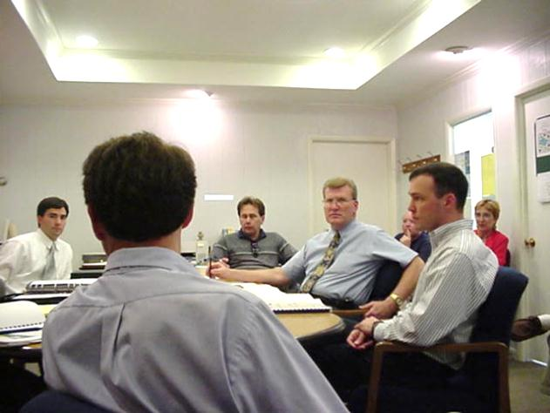
Compliance: CAC and CAV (continued)
  CAV: Preparation
  Four key elements of a CAV are:
    The floodplain tour;
    The meeting with local officials;
    Examination of stipulated permits and variance files, and;
    The all important summary meeting.
Notes:
Review the slide.
When you notify the community of the pending CAV, do you give them the beginning date of the permits/records from which you will be “pulling?” Perhaps a good idea would be from the date of the last CAV.
Photo: MEMA, the upper photo is a CAV with the city of Pascagoula by FEMA HQ.

Slide 124
Compliance: CAC and CAV (continued)
  CAV: Preparation (continued)
  Before contact is made, key information must be reviewed:
    Community FPM regulations;
    Flood Insurance Studies and associated FIRMs;
    Previous CAC and CAV reports;
    NFIP Community data (CIS);
    Recent correspondence;
Notes:
Review the slide.
Other sources are Google maps, your State DFIRM viewers, etc. Cite http://www.city-data.com/ ; Municode.com, Otherwise rest in CIS etc.
Become familiar with the community.
Ensure complete coverage of the issues during the visit.
A good assessment requires a combination of the background information with the info gathered during the visit itself.

Slide 125

Compliance: CAC and CAV (continued)
  CAV: Preparation (continued)
  You should review:
    History of HMA grants in the community;
    State and local hazard mitigation plans;
    Substantial damage claims reports;
    LOMCs;
    Policies in force, and;
    Community website.
Notes:
Review the slide.
Can you think of other items on the community’s website that might be of interest?

Slide 126
Compliance: CAC and CAV (continued)
  CAV: Preparation (continued)
  You should know the following:
    Is there a floodway;
    What is the status of the FIRM/DFIRM/Risk MAP;
    What about Higher Standards;
    Has a building code been adopted, and;
    Any controversy related to HMA programs, ICC, substantial damage and other issues.
Notes:
Review the slide.
KNOW EVERYTHING YOU CAN ABOUT THE COMMUNITY.
You have determined what the status of the FIS and FIRM – how about are there State Standards that must be enforced?
Have you addressed any congressional inquiries from concerned citizens?
Where there any controversial issues that came up during the last disaster declaration?

Slide 127
Compliance: CAC and CAV (continued)
  CAV: Contact
  Things you should do:
    Give details about the purpose of the meeting;
    Inform the official(s) you will be touring the floodplain;
    Ask if digital permit files are available in advance, and;
    Schedule sufficient time in the meeting to review and/or inspect files, answer questions, resolve issues and provide possible solutions to identified problems.
Notes:
Review the slide.
Make sure they understand that communities are periodically visited to determine how they are enforcing the standards of the NFIP.
Tell them you will need to tour the floodplain and invite them to participate (helps with property access, technical assistance, training, etc.).
Schedule a time that will be sufficient to address all your concerns, review of the files, and address any questions or concerns that the community has. Remember, along with “assessing” the community’s program, you are there to provide “assistance.”
Indicate that all individuals that are included the process of accepting, reviewing, and approving and/or denying a permit should be available for the meeting.

Slide 128
Compliance: CAC and CAV (continued)
  CAV: Contact (continued)
  You should invite:
    All local officials who need to be present at the meeting/field visit in confirmation letter and follow-up call. A few possible attendees are:
      Elected Officials;
      Floodplain Administrator/CRS Coordinator, and;
      Building Official/Planning & Zoning Official.
ANYONE INVOLVED WITH REVIEWING , ISSUING,
APPROVING, OR DENYING A DEVELOPMENT
PERMIT
Notes:
Review the slide.
When contacting the community, be sure to identify yourself and explain the purpose of the call and plan for the visit.
Make sure they understand that communities are periodically visit to determine how they are enforcing the standards of the NFIP.
Schedule a time that will be sufficient to address all your concerns, review of the files, and address any questions or concerns that the community has. Remember, along with “assessing” the community’s program, we are there to provide “assistance.”
Indicate that all individuals that are in the process of accepting, reviewing, and approving and/or denying a permit should be available for the meeting.

Slide 129
Compliance: CAC and CAV (continued)
  CAV: Contact (continued)
  In your confirmation letter, you should:
    Confirm time, date and place;
    Confirm who should be in attendance;
    Confirm what documents to have available, and;
    Other particular issues that may have been discussed during the scheduling of the meeting.
Notes:
Review the slide.
Provide a confirmation letter to the community identifying the time, date, and place of the meeting.
Indicate what materials should be available, or can be obtained during your visit. For example, you may not need to have the complete filing system open and ready, but you should be meeting in an area that you can access the files easily.
Staff members should be ready and willing to provide information and/or documents.
Remember, according to the Ordinance adopted to enter the NFIP, the files are “open for inspection.”
Screen shots of sample letter on next slide.

Slide 130


Compliance: CAC and CAV (continued)
  CAV: Contact (continued)
Notes:
Review the slide.
Provide a confirmation letter to the community identifying the time, date and place of the meeting.
Indicate what materials should be available, or can be obtained during your visit. For example, you may not need to have the complete filing system open and ready, but you should be meeting in an area that you can access the files easily.
Staff members should be ready and willing to provide information and/or documents.
Remember, according to the Ordinance adopted to enter the NFIP, the files are “open for inspection.”

Slide 131
Compliance: CAC and CAV (continued)
  The actual meeting scenario:
  Ideally, the meeting agenda should cover:
    Introductions & purpose of the meeting;
    Brief overview of the NFIP & community statistics;
    Explain inspection of community files;
    Review the files;
Notes:
Review the slide.
Be very exact in the purpose of the meeting. Those present may not be aware that communities are periodically visited, or that you have been touring their community for the last ___ hours.
Provide a brief overview of the requirements and goals and objectives of the NFIP. You may have a community official that is new to the Administration, or someone who may not completely understand what the community’s responsibilities are.
Explain that you have been touring the SFHA and have taken some photos that you have some questions and/or concerns. They may not all be possible violations, but be exact why you took the photograph and/or why you are concerned about the development.

Slide 132

Compliance: CAC and CAV (continued)
  The actual meeting scenario: (conclusion)
  Ideally, the meeting agenda should cover:
    Obtain information;
    Provide latest NFIP technical guides;
    Explain the follow-up process;
    Offer technical assistance, and;
    Answer questions.
Notes:
Review the slide. Photo is of FEMA IV and FEMA HQ staff conducting a “State CAV” in Mississippi in 2010.
In obtaining information, ask for a copy of the documents (for example, permit form, elevation certificate). Explain that the documents will not be used for public information but placed in the files at the Regional Office for reference and a record of the enforcement procedures of the community.
Try to resolve as many issues as possible during the meeting. If there are issues that cannot be resolved, explain the follow up process and what will be asked of the community. Explain that a timeframe must be established that will allow the community to complete any necessary actions to fulfill the requirements for documentation.

Slide 133
Compliance: CAC and CAV (continued)
  The actual meeting scenario: (continued)
  Key points for guiding discussion with the community:
    Most current FPM regulations;
    Ascertaining map availability and accuracy;
    Development review process;
    NFIP community information review and verification;
    Address program deficiencies and potential violations, and;
    Summarize the Findings and Follow-Up Actions.
Notes:
Review the slide.
Has the community adopted building codes? Are there problems with the local ordinance?
Can the local Floodplain Administrator properly interpret the FIS and map? Any recent floods, annexations, structural flood-control projects, etc.
Determine what procedures are used in floodplain development reviews, permits, inspections. How are permits recorded?
Review and verify data obtained from CIS with local FA.
Address any unresolved issues from last CAC or CAV. Look for something to compliment, you are a coach/tech advisor.
Discuss findings, next steps, and any follow-up assistance to provide. Identify any community action that will be required.

Slide 134
Compliance: CAC and CAV (continued)
  The actual meeting scenario: (continued)
  You should have with you:
    Insurance data, submit-to-rate, substantial damage, RL insurance data, policies claims, etc.;
    FEMA grant projects listing mitigated structures;
    Community disaster history;
    Digital camera, GPS, laptop;
    Whatever additional “tech multipliers” you might have to create a digital CAV.
Notes:
Review the slide.
Don’t expect to walk out of the office to conduct a CAV with just a portfolio in hand. CAVs are “digital” now.
You need to have maps, studies, camera, hand level (if you know who to use it), topo maps, and anything else that will provide the assistance necessary TO YOU to conduct a comprehensive fact finding CAV.
Any equipment used by anyone not included in this list?

Slide 135

Compliance: CAC and CAV (continued)
  The actual meeting scenario: (conclusion)
  Mapping products you should have with you:
    Latest flood hazard information and the community’s Flood Insurance Study;
    FIRMettes of identified areas of concern;
    FIRM, DFIRM, RiskMAP, and;
    LOMCs.
Notes:
Review the slide.
Maps – FIS – how can we do a CAV without those tools. In some cases, if a community has limited floodplains, you may be able to obtain a FIRMette for reference without carrying all the map panels.
In larger communities a Street Atlas or Mapsco is necessary.
If you are familiar with GPS, that is a good tool, especially if you are working a large rural area.

Slide 136


Compliance: CAC and CAV (continued)
  CAV: Conducting the Visit (continued)
  The floodplain tour:
    Encourage local Floodplain Administrator to ride along;
    In smaller communities, it is often possible to tour the entire SFHA;
    Get permission before entering private property;
Notes:
Review the slide.
In some cases it may not be wise to have the local official accompany you on the CAV. He/she may want to guide you away from non-compliant development.
Do not always assume that if a small community is not growing, or there is little growth, that nothing is happening. Also, small communities tend to be a good example of enforcement and would serve to be a reference to neighboring communities.
MEMA Photos: Lower Left: A locked road with a “No Trespassing” sign. Upper Right: Windshield tour discovers a structure built over a ditch.

Slide 137

Compliance: CAC and CAV (continued)
  CAV: Conducting the Visit (continued)
  Touring Larger Communities:
    It may not be feasible to tour the entire SFHA;
    Tour the problem areas and sample;
    Plan your route ahead of time, and;
    Think about a “Team CAV.”
Notes:
Review the slide.
In large communities, it may be more advantageous to conduct a “Team CAV.” Meaning that more than one person conduct the floodplain tour. Two teams of two people each reviewing the floodplain.
It can be very difficult to tour, observe the map, and take notes and record information via camera and reports without assistance.

Slide 138
Compliance: CAC and CAV (continued)
  CAV: Conducting the Visit (continued)
  Check the SFHA for:
    New construction or substantial improvements;
    Structures below the BFE;
    Structures with non-compliant enclosed areas;
    Absent or incorrectly placed flood openings, and;
    Basements in LOMR-F areas.
Notes:
Review the slide.

Slide 139


Compliance: CAC and CAV (continued)
  CAV: Conducting the Visit (continued)
  How can you use these photos of a recent flood?
Notes:
Photo of Lewis County, WA.

Slide 140





Compliance: CAC and CAV (continued)
  CAV: Conducting the Visit (continued)
  Photos of Opportunity.
Notes:
Left top: elevated gate house entrance to state park in CHHA, appears to be compliant.
Center top: Post-FIRM home built with a berm surrounding it, appears to be noncompliant.
Right top: RL structure HMGP elevation project in a floodway. Needs a “No Rise” certificate and better coordination with SHMO.
Center bottom: MFH recently moved on site, pink ribbon nailed to tree indicates BFE height.
Right bottom: Elevated structure in CHHA, appears to be compliant. However, what is behind the louvers?

Slide 141




Compliance: CAC and CAV (continued)
  CAV: Conducting the Visit (continued)
  GPS, what is it good for?
Notes:
Top left: Marking the location of a structure in the SFHA. Slab on grade, is it pre or post-FIRM? Is there an Elevation Certificate?
Top right: Finding that a RL list provided lat/long was incorrect.
Bottom left: Using a handheld GPS to navigate a river during a flood.
Bottom right: Photo of flood damaged home, taken with a “GPS camera.”
CLICK
Pop-Up photo: close up of time and lat/long stamp on photo. This camera allows the image to be imported into GIS.

Slide 142





Compliance: CAC and CAV (continued)
  CAV: Conducting the Visit (continued)
  Laptop, got to have it.
Notes:
Top left: Checking RL data base during a windshield tour of SFHA.
Top right: Using a LCD projector to display windshield tour photos to local officials at the summary meeting.
CLICK twice.
Bottom left: Viewing a FEMA map service center FIRM panel.
Bottom right: Using a state developed DFIRM viewer.
Has anyone used the free SKYPE program in the field or during a meeting?

Slide 143


Compliance: CAC and CAV (continued)
  CAV: Conducting the Visit (continued)
  Check SFHA for site alterations:
    Encroachments in floodway;
    Inadequate drainage in new subdivisions, and;
    Altered watercourses.
Notes:
Review the slide.
Left photo: Fill in a floodway.
Right photo: Altered watercourse.

Slide 144


Compliance: CAC and CAV (continued)
  CAV: Conducting the Visit (continued)
  Check for fill and/or debris in floodway.
Notes:
Review the slide.
What are possible resolutions for fill and or debris in a delineated floodway?
Can proper engineering and remapping change the situation?
Any ideas on how to correct the debris under the bridge? Who or what Agency could assist in the endeavor?

Slide 145


Compliance: CAC and CAV (continued)
  CAV: Conducting the Visit (continued)
  Check for new subdivision construction in SFHA.
Notes:
Bottom right photo: This new construction is located on a small hill; however, is the lowest floor above the BFE? Why? Click to bring up adjacent house’s foundation system.
CLICK to bring up elevated foundation system photo.

Slide 146


Compliance: CAC and CAV (continued)
  CAV: Conducting the Visit (continued)
  Check for post-disaster activity.
      Subdivision three years prior…
      Today: No apparent elevation requirements…
Notes:
This community suffered severe damage during a federally declared flood disaster three years prior to your CAV. It now appears that the community is allowing development to placed in the same area without elevation.
Solution: Require the community provide documentation and proof that the new development is meeting the adopted floodplain management standards. Have the community provide an copy of the permit application, and elevation certificate.

Slide 147



Compliance: CAC and CAV (continued)
  CAV: Conducting the Visit (continued)
  Check for substantial improvement.
Notes:
It appears that the construction could be a substantial improvement.
Solution: Consult with community and require a copy of the permit application and/or elevation certificate.

Slide 148
Compliance: CAC and CAV (continued)
  CAV: Conducting the Visit (continued)
  Check for miscellaneous items such as:
    MFH, not anchored, not elevated;
    Electrical components not designed or elevated to withstand flood waters;
    Enclosures without adequate flood openings, and;
    Inadequate drainage paths around structures in AO and AH zones.
Notes:
Review the slide.
Some communities may have regulations not allowing MFH to be placed within floodways.
There are alternate methods to place electric outlets below the BFE, such as using reel type extension cords in the floor above the ground.
Some flood openings might be engineered and appear to be inadequate to your eye.
Check to see if the community has drainage requirements in their flood damage prevention ordinance or other codes.

Slide 149


Compliance: CAC and CAV (continued)
  CAV: Conducting the Visit (continued)
  Check for land use, such as vacant lots and project locations with open space restrictions, areas below dams and areas landward of levees.
Notes:
Review the slide.

Slide 150

Compliance: CAC and CAV (continued)
  CAV: Conducting the Visit (conclusion)
  Drop on your way out of the door:
    NFIP regulations (44 CFR);
    FEMA/State produced NFIP publications;
    Professional development information;
    Information concerning the State FPM Association, and;
    All-Hazards Mitigation reference materials.
Notes:
Review the slide.
You may need to take or send ahead information and publications that will help the community understand floodplain management and even more important – All Hazard Mitigation.

Slide 151
Compliance: CAC and CAV (continued)
  CAV: Documentation & Follow-Up Actions
  After reviewing the files, the following issues should be documented:
    Does the community maintain permit & variance files;
    Do the files support the local official’s description of the development process and what was discovered during the floodplain tour;
    How accessible are the permit and variance files, and;
    How complete is the information contained in the file;
Notes:
Review the slide.

Slide 152
Compliance: CAC and CAV (continued)
  CAV: Documentation & Follow Up (continued)
  After reviewing the files, the following issues should be documented: (continued)
    Are the BFEs and required elevation of lowest floor identified;
    Certifications by architect/engineers on file (where necessary);
    Requirements for subdivisions: Are developers being asked to provide BFE data when proposal is 5 lots/50 acres in an A zone;
Notes:
Review the slide.
Bullet two: Certifications are necessary for floodproofing, flood openings (when design differs from NFIP minimum), anchoring of pile and column foundations and breakaway walls in V zones.

Slide 153
Compliance: CAC and CAV (continued)
  CAV: Documentation & Follow Up (continued)
  After reviewing the files, the following issues should be documented: (conclusion)
    Variances, are justifications documented and available;
    Record of inspection indicating “as-built”;
    CLOMR follow-up actions, and;
    Record showing all necessary Federal/State permits were obtained, particularly for ESA and Wetlands.
Notes:
Review the slide.

Slide 154

Compliance: CAC and CAV (continued)
  CAV: Documentation & Follow Up (continued)
  Reporting in CIS.
Notes:
Review the slide.

Slide 155

Notes:
Review the slide.

Slide 156

Notes:
Review the slide.

Slide 157

Notes:
Review the slide.

Slide 158


Compliance: CAC and CAV (continued)
Notes:
Review the slide.

Slide 159
Compliance: CAC and CAV (continued)
Notes:
Review the slide.

Slide 160

Compliance: CAC and CAV (continued)
Notes:
Review the slide.

Slide 161
Compliance: CAC and CAV (continued)
  CAV: Documentation & Follow Up (continued)
  The CAV follow-up letter:
    Sent to the community CEO; copy to Floodplain Administrator and Emergency Manager.;
    Official method of informing community of the findings.
Notes:
Review the slide.
Follow up letter should be addressed not only to the CEO but a copy provided to everyone that was at the meeting. Be exact in the letter what your results of the fact finding visit during the SFHA tour and the meeting with the community officials.
Identify each deficiency and any resolution of those deficiencies.
Be informative and exact in what documents you are requesting from the community. In may be more advantageous to attached a detailed picture report to the letter.
Therefore, there are no questions, and the community does not have to guess about what is required. Recommend solutions to the deficiencies. Don’t leave the community in the dark.
Provide technical assistance via publications, reference other communities that are enforcing a comprehensive program, or other entities that can help.
Be positive in your comments. If the community had some good enforcement and/or procedures, point those out in the letter.
Recommend enhancements for the community. Remember to stress the all hazard approach to their community.

Slide 162
Compliance: CAC and CAV (continued)
  CAV: Documentation & Follow Up (continued)
  Include in the body of the letter:
    Be positive, thank the community for their hospitality;
    Identify deficiencies and/or possible violations;
    Identify what documentation is needed;
    Provide recommended solutions;
    Stress the importance of enforcing a sound FPM program;
Notes:
Review the slide.

Slide 163
Compliance: CAC and CAV (continued)
  CAV: Documentation & Follow Up (continued)
  Include in the body of the letter: (continued)
    Recommend enhancements, i.e. CRS, CFM, All-Hazards Mitigation Planning;
    Provide names and contact information of specialists who can provide assistance and technical support;
    Establish a date when documentation must be provided;
Notes:
Review the slide.

Slide 164

Compliance: CAC and CAV (continued)
  CAV: Documentation & Follow Up (continued)
  Include in the body of the letter: (conclusion)
    Set a date that is sufficient for a response (i.e. 60 or 90 days), and;
    Enclose publications, Technical Bulletins and related NFIP publications as deemed necessary.
Notes:
Review the slide.

Slide 165
Compliance: CAC and CAV (continued)
  CAV: Documentation & Follow Up (continued)
  In the letter, should compliance actions be required, you must:
    Articulate identified program deficiencies;
    Identify possible violations;
    Establish factual information;
    Define next steps/follow-up;
    Start a Chronology, and;
    Document, document and document some more.
Notes:
Review the slide.
Be exact in what you are going to ask the community to provide. This is the beginning process to build a case to correct deficiencies and possible violations.
Identify those areas of concern with exact address and/or location. Take pictures that are clear and precise. Have actual addresses when possible.
If you are questioning the development, be exact in what you are questioning. Be exact in what you want. For example, do you want see a permit form, or do you want to see the permit form that particular development. Do you want to know they (community) utilize the FEMA Elevation Certificate, or do you want to see a FEMA Elevation Certificate for the development in question. The Community is looking to you as the official.
Be factual, clear and firm in what you are wanting from the community.
In defining the possible violations and/or concerns be exact in what you are asking the community to provide. If you question the elevation, ask the community how they determine the elevation.

Slide 166
Compliance: CAC and CAV (continued)
  CAV: Documentation & Follow Up (continued)
  Post CAV community contacts:
    Contact the community during the response timeframe;
    Ask if you can provide any assistance, and;
    Stay in contact with the community.
    Assistance, is part of a CAV…
Notes:
Review the slide.
If you promised state or regional office technical assistance – make sure you follow-through.
Always reply within 30 days to any community response to you.

Slide 167
Compliance: CAC and CAV (continued)
  CAV: Documentation & Follow Up (continued)
  Post CAV follow-up actions occur when:
    Documentation has not been provided;
    Community needs and/or requests technical support;
    A determination is made that enforcement action(s) should take place, and;
    A CRS retrograde action should be implemented.
Notes:
Review the slide.

Slide 168

Compliance: CAC and CAV (continued)
  CAV: Documentation & Follow Up (continued)
  CIS compliance follow-up screen.
Notes:
Review the slide.

Slide 169

Notes:
Review the slide.

Slide 170
After Action Review
  Feel like you are missing something vital?
Notes:
Review any items or questions that were raised to ensure that there is no confusion or mystery to what you have covered.

Slide 171

Publication Development
  Overview: This topic (Publications Development and Maintenance) introduces for our discussion the State Manual for Administering Local Programs, Model State Regulations and Newsletter/Webpages/Social Media.
Notes:
Review the slide.

Slide 172
Publication Development (continued)
  State Manual for Administering Local Programs:
  This manual is a proposed ASFPM publication, not yet developed. It will be based upon the NEMA developed “State Emergency Management Director Handbook” that is provided to SHMOs.
Notes:
Review the slide.
Gather comments by the participants.

Slide 173
Publication Development (continued)
  Model State Regulations:
  What models are presently used by your State?
  How can you determine if any exist? Who should your contact?
  To extrapolate this, does your FEMA Regional Office have any FPM models that you are required to use?
Notes:
Review the slide’s questions and lead the discussion.

Slide 174
Publication Development (continued)
  Newsletters and Webpages (Social Media):
  What newsletters are presently used by your State?
  Does your agency have a FPM webpage or Social Media presence?
  How about your FEMA Regional Office?
Notes:
Review the slide’s questions and lead the discussion.
What social media outlets do you use? (Facebook, Twitter, etc.)

Slide 175

Publication Development (continued)
  ASFPM Feature Publications
Notes:
Suggest that the class peruse the ASFPM website and download this publication.

Slide 176
What we covered in Module 8
  We have covered the topics introduced at the beginning of the session. What were they?
    Enrolling Communities to participate in the NFIP
    Ordinance Assistance
    CRS Coordination
    Community Compliance: CACs and CAVs
    Publications Development and Maintenance
Notes:
Review slide

Slide 177


Questions?

