Slide 1
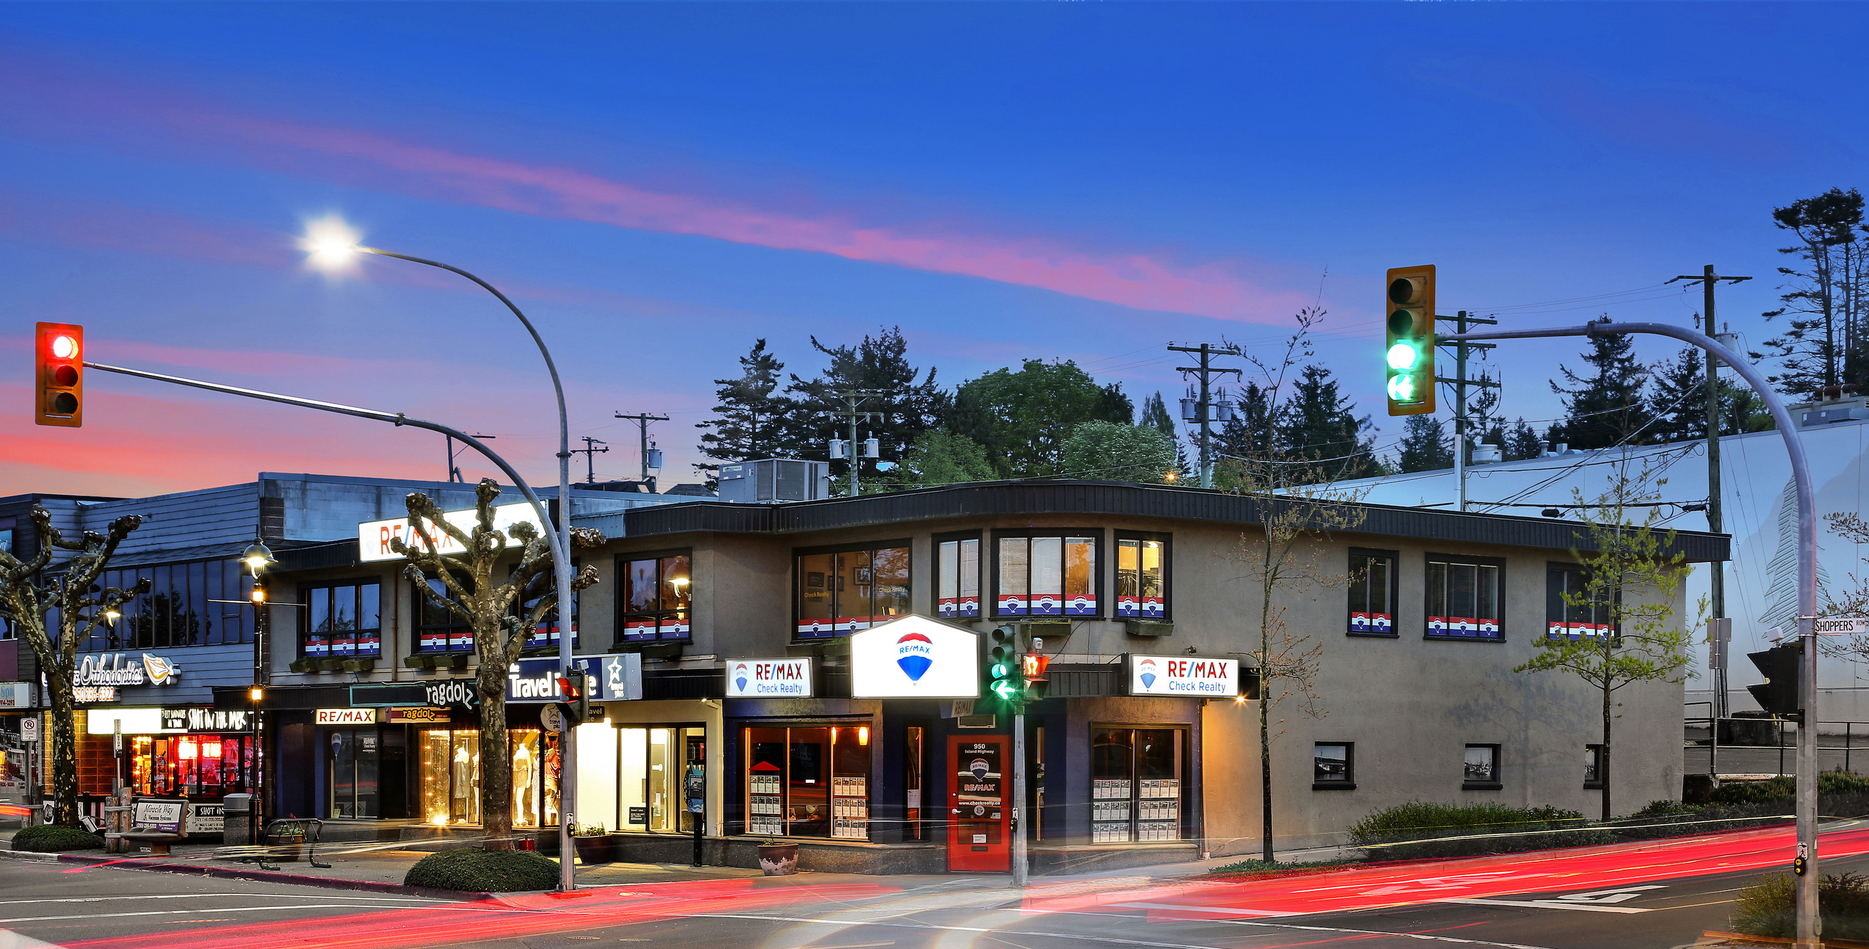

RE/MAX Check Realty
February 01, 2024
Based on Single Family Home Averages and drawn from the Vancouver Island Real Estate Board (VIREB) Graphstats.
36
40
UNITS LISTED
75
Active Listings
16
Sold Listings
46 AVG
Days to Sell
48
This month last year
107
This month last year
17
This month last year
57
This month last year
$713,655
AVG. Sales Price
4.6 MONTHS
Of Inventory
97.70%
Sell Price / List Price
40%
SELL/ LIST RATIO
$617,326
This month last year
Active Listings / Solds this month
96.80%
This month last year
35.42%
This month last year
950 Island Highway, Campbell River V9W 2C3
Office 250.286.1187 Email info@checkrealty.ca
http://remaxcheckrealty.ca
#remaxcheckrealty @remaxcheckrealty
Independently Owner and Operated
YOUR UNFAIR ADVANTAGE

