Slide 1
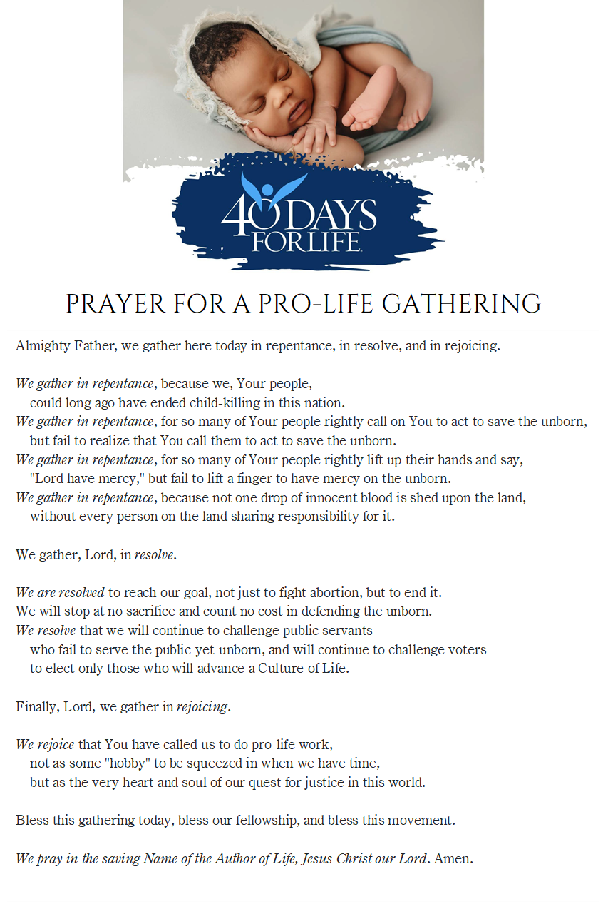

Slide 2
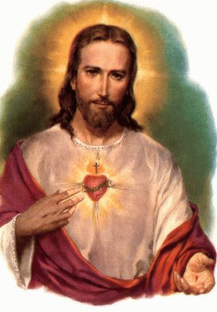
10/17/2022 SMM ProLife Feasts of Ss. Margaret Mary, Gerard Majella and Hedwig of Poland
Novena Prayer to the Sacred Heart by St. Margaret Mary Alocoque
I. O my Jesus, you have said: “Truly I say to you, ask and you will receive,
seek and you will find, knock and it will be opened to you.” Behold I knock,
I seek and ask for the grace of [insert your intention.]
Our Father…Hail Mary…Glory be to the Father…
Sacred Heart of Jesus, I place all my trust in you.
II. O my Jesus, you have said: “Truly I say to you, if you ask any thing of
the Father in my name, He will give it to you.” Behold, in your name,
I ask the Father for the grace of [insert your intention.]
Our Father…Hail Mary…Glory be to the Father…
Sacred Heart of Jesus, I place all my trust in you.
III. O my Jesus, you have said: “Truly I say to you, heaven and earth will
pass away but my words will not pass away.” Encouraged by your
infallible words I now ask for the grace of [insert your intention.]
Our Father…Hail Mary…Glory be to the Father…
Sacred Heart of Jesus, I place all my trust in you.
O Sacred Heart of Jesus, for whom it is impossible not to have compassion on the afflicted, have pity on us miserable sinners and grant us the grace which we ask of you, through the Sorrowful and Immaculate Heart of Mary, your tender mother and ours. Hail, Holy Queen…
St. Joseph, foster father of Jesus, pray for us.
PRAYER to ST GERARD
St. Gerard, you worshiped Jesus
as the Lord of Life.
I ask you today
to pray for: intentions
Lift up to Jesus
All those who seek to conceive a child,
All those having difficult pregnancies,
All who have suffered the loss of a child,
And all who lovingly
lift up their children
to God. Pray that
all of us, by caring for mothers, fathers, and children, born and unborn, may build a Culture of Life, in the name of Jesus Christ our Lord. Amen.
ProLife Rosary – Joyful Mysteries
The Annunciation
Mary is troubled by the angel’s greeting, yet rejoices to do God’s will. Let us pray that those who are troubled by their pregnancy may have the grace to trust in God’s will.
The Visitation
John the Baptist leapt for joy in his mother’s womb. We pray that people may realize that abortion is not about children who “might” come into the world, but is about children who are already in the world, living and growing in the womb, and are scheduled to be killed.
The Nativity
God Himself was born as a child. The greatness of a person does not depend on size, for the newborn King is very small. Let us pray for an end to prejudice against the tiny babies threatened by abortion.
The Presentation
The Child is presented in the Temple because the Child belongs to God.
Children are not the property of their parents, nor of the government.
They – and we – belong to God Himself.
The Finding of Jesus in the Temple
The boy Jesus was filled with wisdom, because He is God. Let us pray that all people may see the wisdom of His teachings about the dignity of life, and may understand that this teaching is not an opinion, but the truth.
St. Margaret Mary Alocoque began the devotion to the Sacred Heart of Jesus, that burns for love of all mothers, children, and mercy for those harmed by abortion. St. Gerard Majella is the patron saint of pregnant women and children unborn. St. Hedwig is the patron saint of children who have died –an example of a mother of seven and a queen who cared for the poor and showed great faith.

