Slide 1

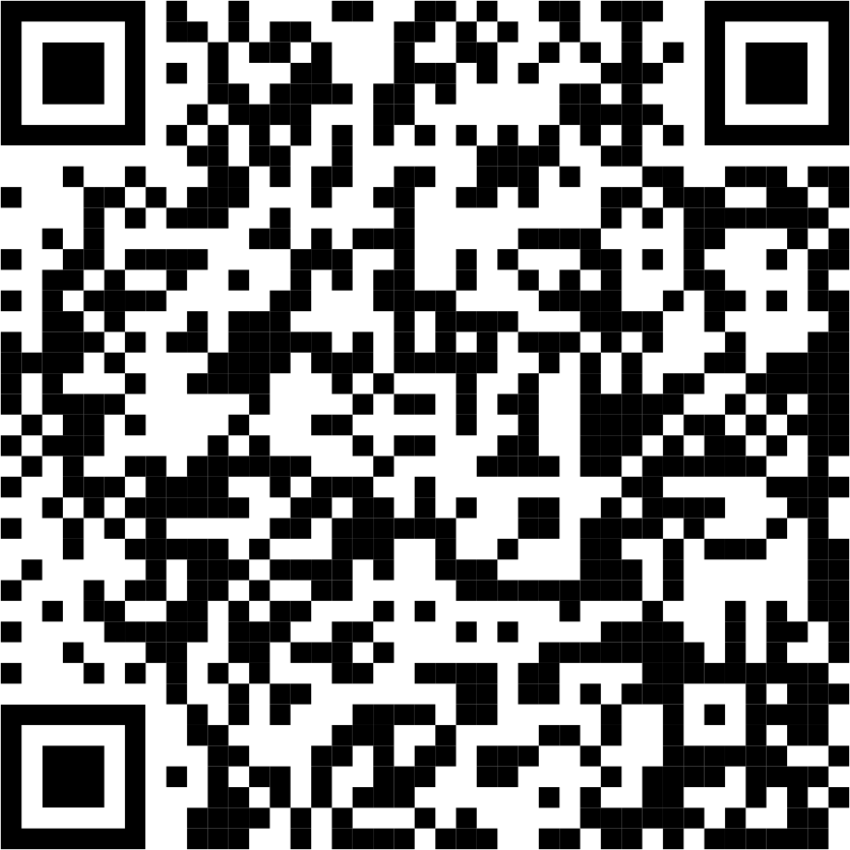
Sign Up for:
1-hour block(s) of Prayer Time between
7am to 7pm daily
Local Contact:
Kathy Gard
407-230-3666

