Slide 1
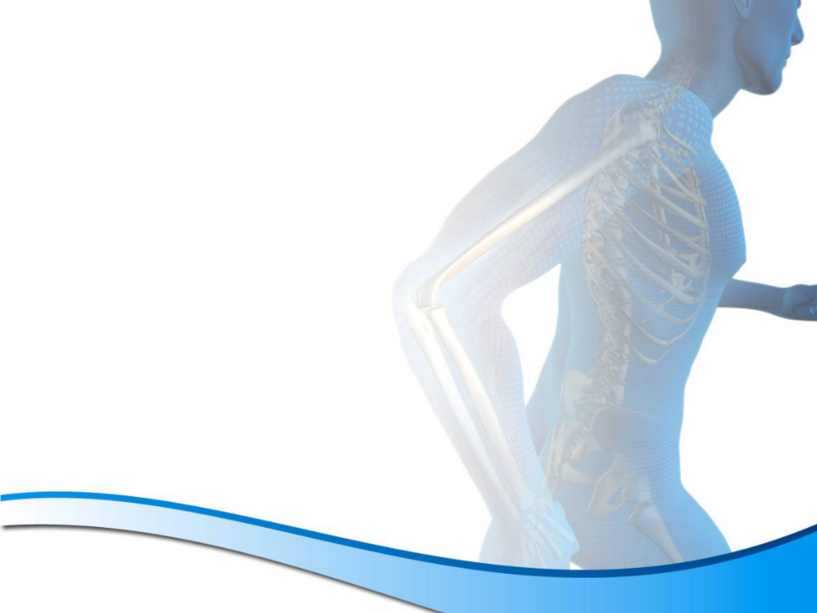

FIGHTING ARTHIRITIS AND PROMOTING HEALTHY JOINTS!
HELPING PATIENTS REACH
OPTIMUM HEALTH!
AT THIS WORKSHOP, YOU WILL DISCOVER:
Uncover False Advertisements & Calcium Products that Are Actually Hurting You
Learn How to Fight the Aging Process
Discover How to Reduce Bone Loss Simply & Naturally
See If Your Daily Habits Are Hurting You or Helping You
Join us.....
JUNE 5TH
6:00 - 7:00PM
SEE THE FRONT DESK TORESERVE YOUR SEAT!
OR CALL 804-270-6010

