Slide 1

New Year! New You!
Happier, Healthier,
& Leaner YOU!

Slide 2
Over 70% of
Diseases and Chronic Illnesses are caused by unhealthy lifestyles and are
PREVENTABLE!

Slide 3
The Average Person Is Sedentary 93% Of The Time
McDonald's Feeds More Than 46 Million People A Day - More Than The Entire Population Of Spain
1 out of 3 Children Born In The Year 2000 Will Develop Diabetes In Their Lifetime
On Average, 40% Of Family Meals Are Eaten Outside The Home

Slide 4

Don’t Fall For Clever Marketing
    Adding Vitamins to an UNHEALTHY
    Food will not make it HEALTHY!
    PROCESSED FOODS:
    ANYTHING in a box or bag that had to go through a machine to make it!
    JUST SAY NO!
    They do not provide your body with the nutrients it needs and will make you hungrier faster!

Slide 5
North Americans eat 31% more packaged food than fresh food, and they consume more packaged food per person than their counterparts in nearly all other countries.
DON’T EAT

Slide 6
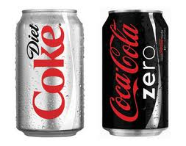
A University of Texas Health Science Center study found that the more diet sodas a person drank, the greater their risk of becoming overweight. Downing just two or more cans a day increased waistlines by 500%
DON’T EAT
DON’T EAT
Artificial sweeteners can disrupt the body’s natural ability to regulate calorie intake based on the sweetness of foods. That means people who consume diet foods are more likely to overeat, because your body is being tricked into thinking it’s eating sugar, and you crave more.

Slide 7
DON’T EAT
DON’T EAT
Within the first 10 minutes, 10 tsp of sugar hit your system. This is 100% of your recommended daily intake, and the only reason you don’t vomit as a result of the overwhelming sweetness is because phosphoric acid cuts the flavor.
Within 20 minutes your blood sugar spikes, and your liver responds to the resulting insulin burst by turning massive amounts of sugar into fat.
Within 40 minutes, caffeine absorption is complete; your pupils dilate, your blood pressure rises, and your livers dumps more sugar into your bloodstream.
Around 45 minutes, your body increases dopamine production, which stimulates the pleasure centers of your brain – a physically identical response to that of heroin.
After 60 minutes, you’ll start to have a sugar crash.

Slide 8
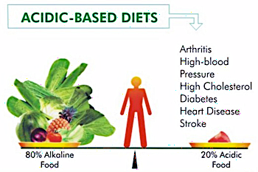

Slide 9
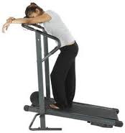
FITNESS GONE WRONG
FITNESS GONE WRONG
The Costs Of Chronic (Repetitious)
Mid- And High-level Aerobic Work
Requires Large Amounts Of Carbohydrates (SUGAR)
Decreases Efficient Fat Metabolism
Increases Stress Hormone Cortisol
Increases Systemic Inflammation
Increases Oxidative Damage
Boring
Plateaus In Weight Loss

Slide 10



OUR MENTAL DIETS

Slide 11
OUR MENTAL DIETS
Since 1988, Dr. Leif Salford and his colleagues at Lund University Hospital in Sweden has exposed over 1,600 experimental animals to low-level radiation.
Their results were consistent and worrisome: radiation, including that from cell phones, caused the blood-brain barrier to leak -the brain's first line of defense against infect and toxic chemicals
In those animals that had been
exposed to a cell phone, up to 2%
of the neurons in all areas of the
brain were shrunken and
degenerated.

Slide 12
RESEARCH SHOWS
Aerobic & resistance exercise can decrease the risk of heart disease by 20–60%
An alkaline diet results in bone health, reduce muscle wasting, as well as mitigating other chronic diseases such as hypertension and strokes.
Decreasing stress can decrease your chances of heart disease by up to 70%
Regular Chiropractic Care can boost the immune system by as much as 200%

Slide 13
STEP
Wellness Defined
BE FIT
EAT
RIGHT
GET ADJUSTED
THINK WELL
TRUE
VITALITY

Slide 14

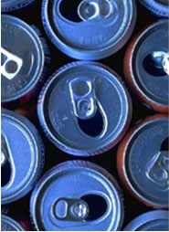
LETS TAKE THE ACIDITY TEST
HOW IS YOUR PH?
5.5 5.8 6.0 6.4 6.8 7.2 7.6 8.0

Slide 15

EAT RIGHT
Step 1:
GREENS FIRST
SUPER FOOD DRINK MIX
Balance Your Nutrition
Alkalize Your Body
Get 15+ Servings Of Fruits
& Vegetables Per Serving

Slide 16
EAT RIGHT
EAT RIGHT
Step 2: Fresh Fiber in the Morning
  Have Protein and a Fruit
  Eat within an hour of waking
  Meal with the most calories of the day
  On average people eat 300+ calories less per day when they eat a substantial breakfast

Slide 17
Breakfast Examples
EAT RIGHT
EAT RIGHT
  Eggs with Berries
  Fruit Smoothie with Protein Powder
  Egg with Tomato and Fresh Basil with a side of fruit
  Almond Butter and a banana

Slide 18
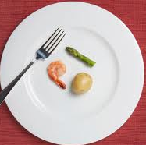
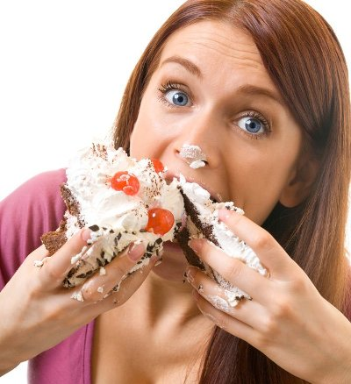
EAT RIGHT
EAT RIGHT
Step 3: Eat Throughout the Day
DO NOT TRY THE FAD DIETS THAT CAUSE YOU TO FEEL
LIKE YOU ARE CONSTANTLY HUNGRY!
Notes:
This will only cause you to binge and fall off the wagon!

Slide 19
EAT RIGHT
EAT RIGHT
Step 3: Eat Throughout the Day
  Your body needs FUEL!!!
Just like your car needs gas and can’t
run without it!
  When you decrease your food intake too low, your body goes into starvation mode and it begins to store energy sources and reserves

Slide 20
EAT RIGHT
EAT RIGHT
  Eat all of the colors of the rainbow to ensure that you get all the necessary nutrients.
  Load your diet fruits and veggies (75% of them Raw/Uncooked)
  Stop Eating by 7:00pm
  Have a lean source of protein at every meal along with a fruit or veggie
  Take Greens and Quality Supplements

Slide 21
EAT RIGHT
EAT RIGHT
Step 4: Drink enough water per day
You should drink ½ your body weight per day.
Stick to only1 Cup of coffee per day
Forget the SODAS!

Slide 22
BE FIT
The Benefits Of Interval Training
(Fast, Short Intense Bursts With Recovery)
Increases Muscle Fiber Strength
Increases Aerobic Capacity (Work Ability)
Increases Muscle Mitochondria (The Main Energy Production Center)
Increases Insulin Sensitivity
Increases Natural Growth Hormone Production

Slide 23
BE FIT
BE FIT
See better Results from Your Workouts In a
Fraction of the Time!
How to do it:
•Warm up for 15 minutes, adding a few 20-sec. bursts
at the end to prepare for the workout.
•Go 30 seconds at a nearly all-out effort. Take 3 minutes
active recovery and repeat the 30 on/3 off pattern 5 or 6
more times.
•Finish with a 5-10min cool down.

Slide 24
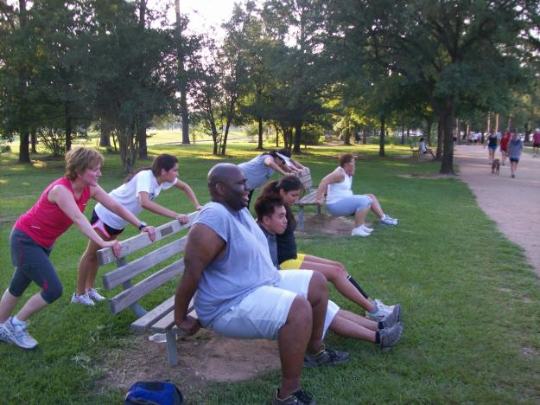

JOIN GROUP WORKOUTS
For Accountability and Motivation!

Slide 25
It Starts With Your Morning Rituals
(Your Hour of Power)
THINK WELL
Rise 30-60 minutes earlier than normal
Put your feet on the floor when alarm goes off
Meditate or pray for 10-15 minutes
Exercise aerobically and/or anaerobically for a minimum of 30 minutes
Start your morning with a nutritious breakfast
End your day with a gratitude meditation or prayer for 10 minutes

Slide 26
Get Your Sleep
THINK WELL
If you are sleep deprived you will tend to eat more sweet and starchy foods, rather than healthy foods.
Researchers suspect that cravings stemmed from the fact that your brain is fueled by glucose (blood sugar); therefore, when lack of sleep occurs, your brain searches for carbohydrates.
In short, sleep deprivation puts your body into a pre-diabetic state, and makes you feel hungry, even if you’ve already eaten.

Slide 27
HEALTH CARE QUIZ
True or False
It is possible that a person could have heart disease, cancer, high blood pressure and yet not feel a symptom?
TRUE or FALSE

Slide 28
HEALTH CARE QUIZ
True or False
Can you judge your health by how you feel?
TRUE or FALSE

Slide 29
“Take good care of your body.
It’s the only place you have to Live.”
-Jim Rohn

Slide 30

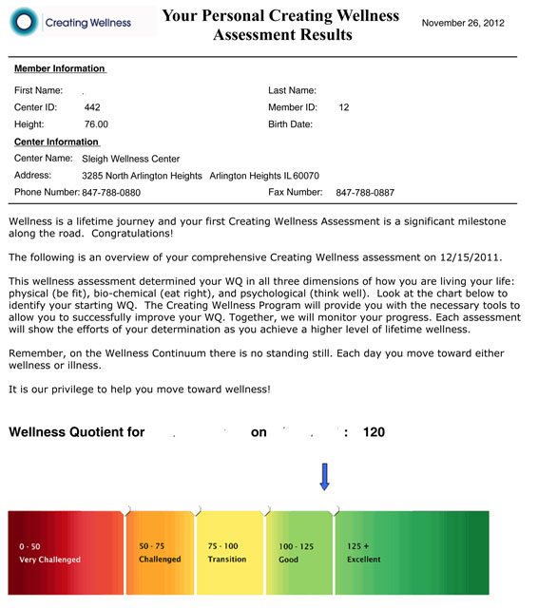
Step 1
Step 2

Slide 31

Become a
Happier
Healthier
Leaner
& More Energetic
YOU!
NEW YEAR! NEW YOU!
WELLNESS CHALLENGE!
90 Days to a NEW YOU!
APR. 16TH – JULY 2ND
TRANSFORM ^{into a} HEALTHIER,
LEANER more vital ^{and} ENERGETIC ^{you}

Slide 32
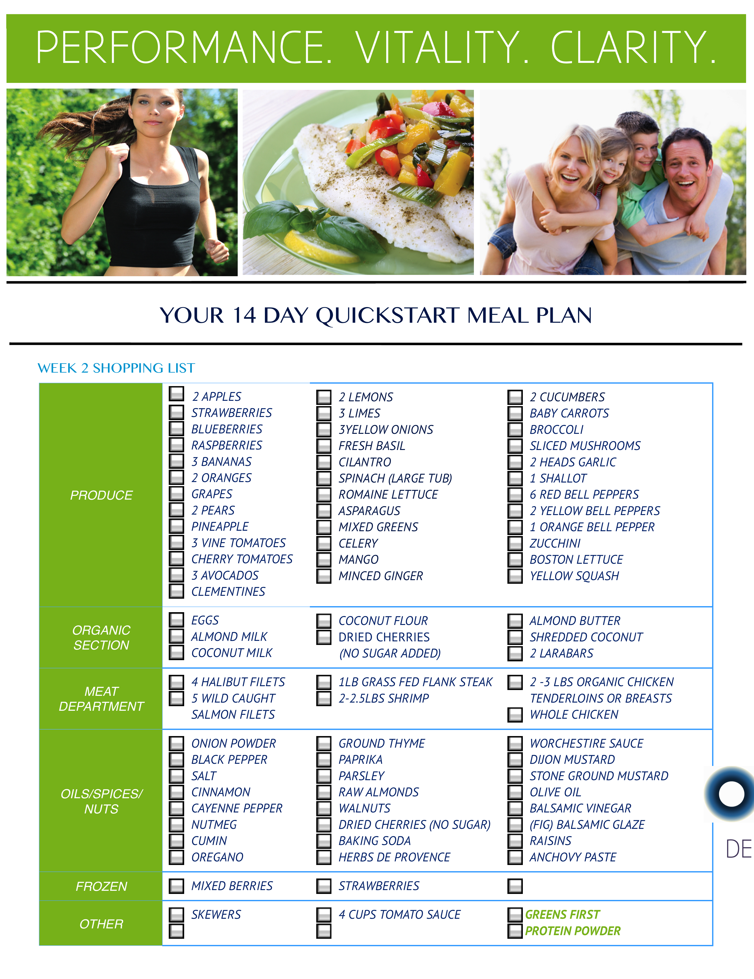
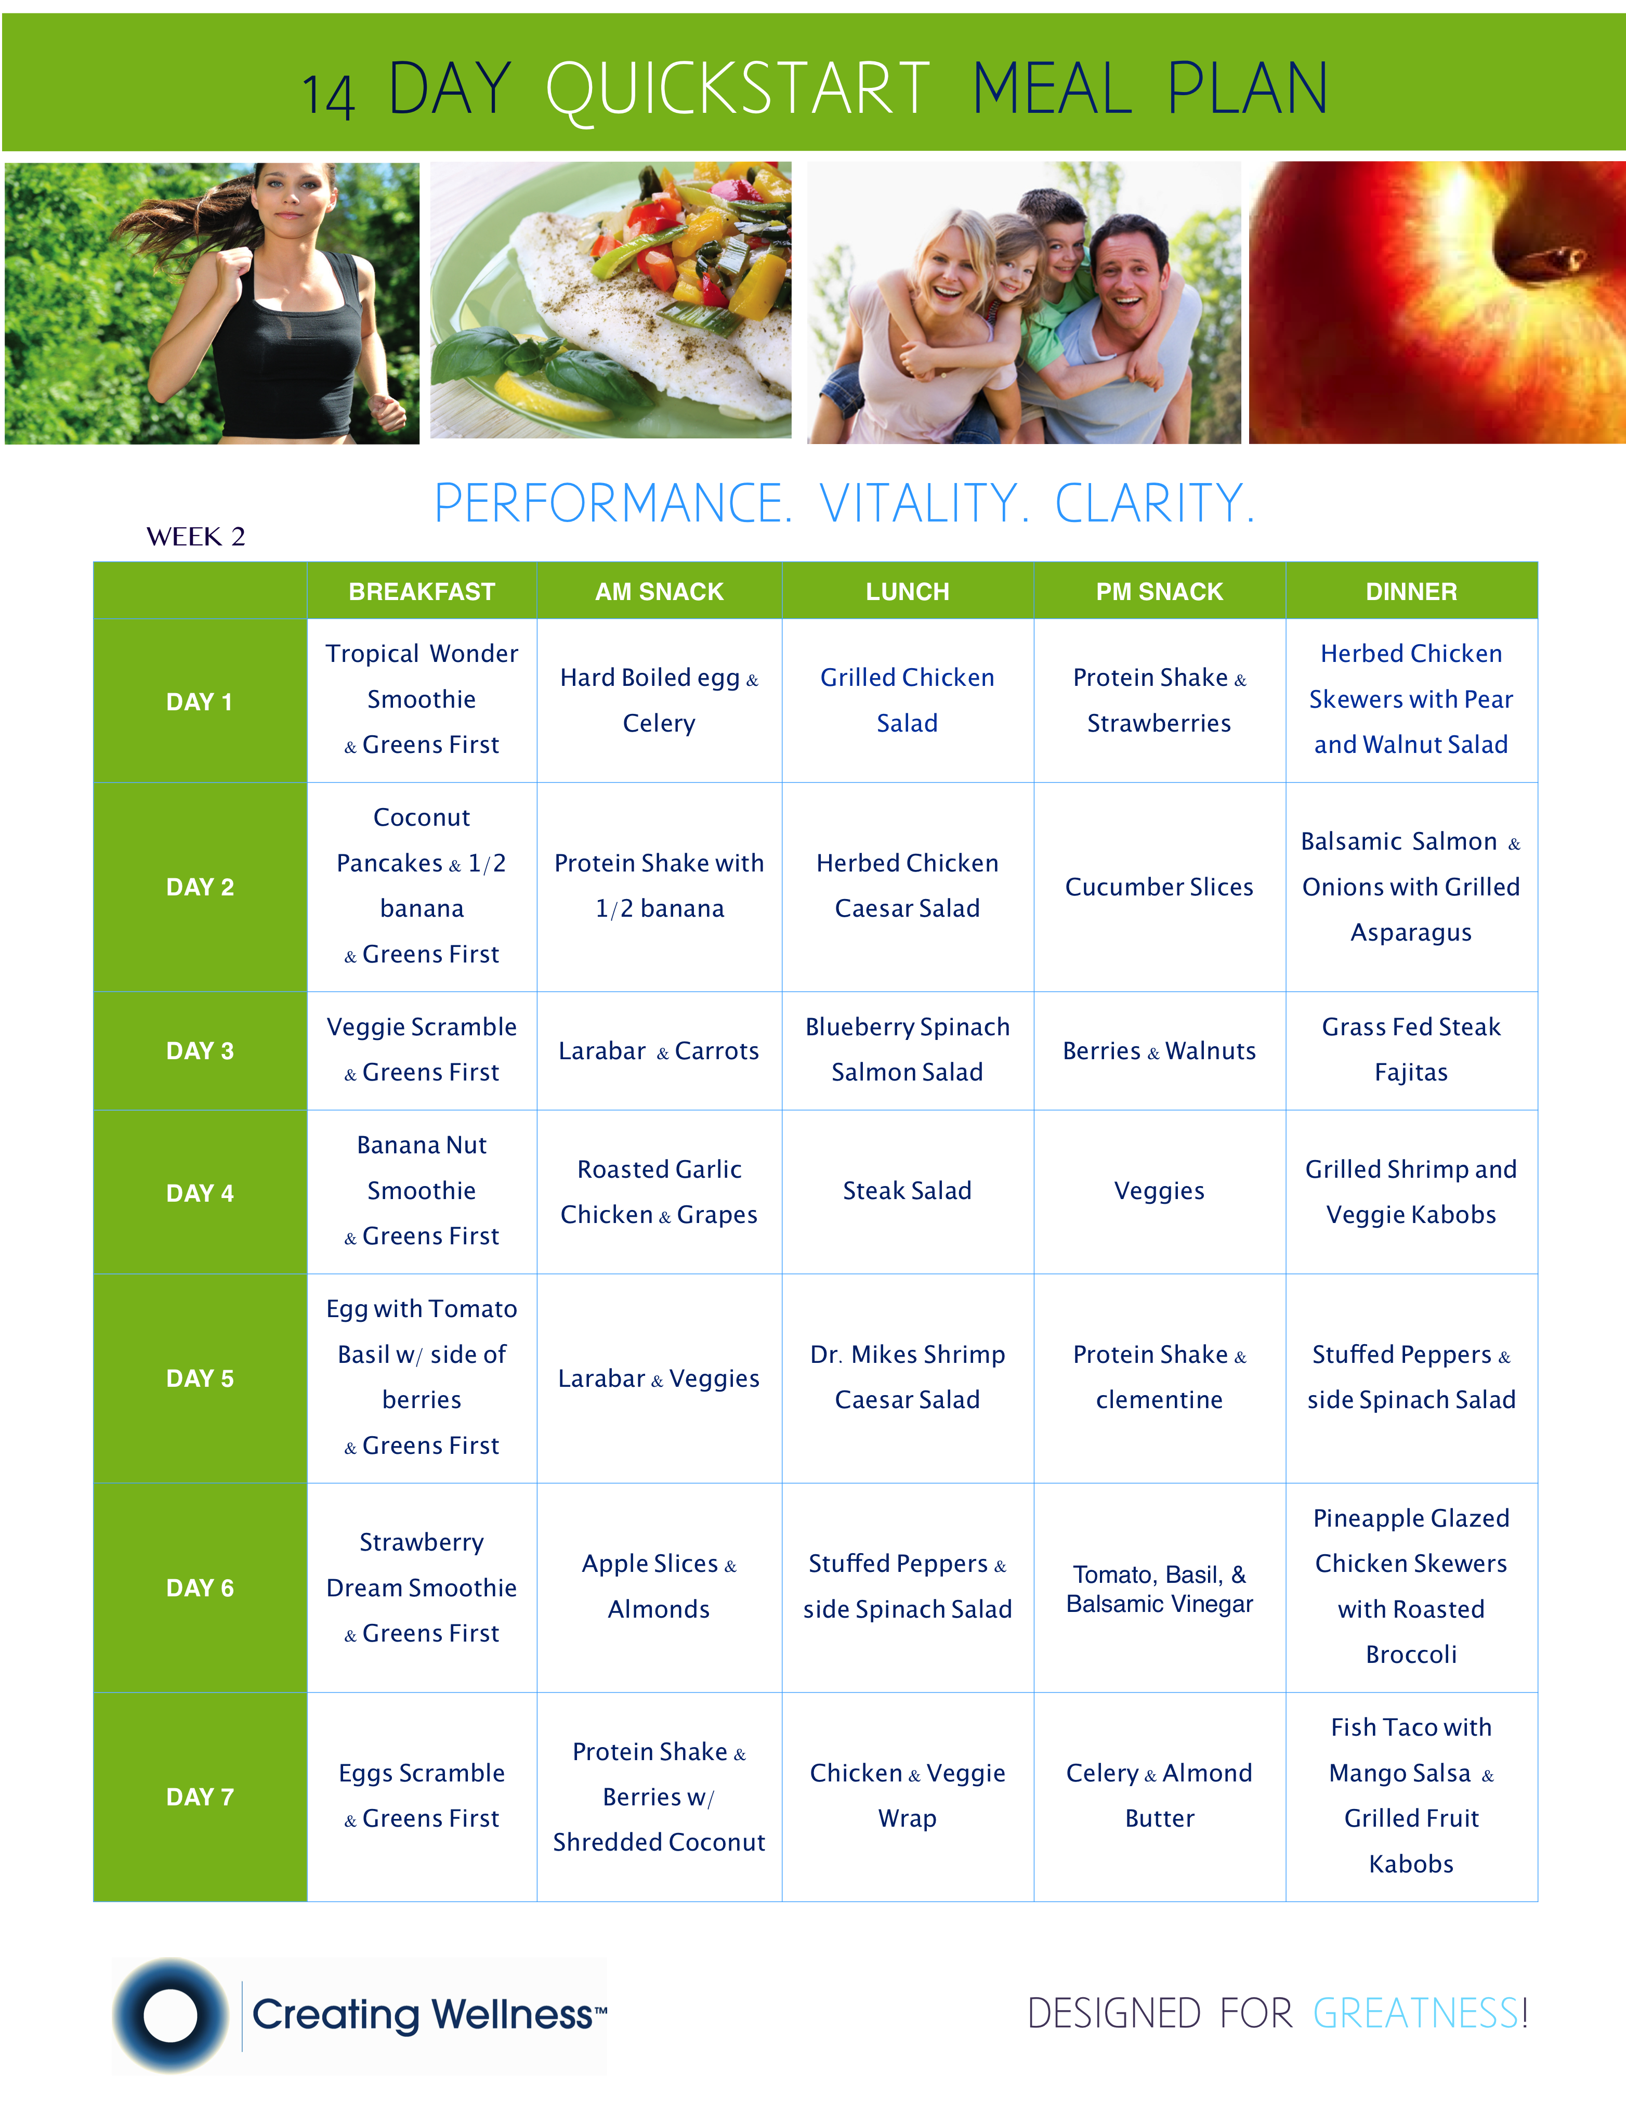
NEW YEAR! NEW YOU!
WELLNESS CHALLENGE!
MAXIMIZE WEIGHT LOSS
STEP 1:
14 DAY QUICKSTART
MEAL PLANS
  Meal Plans
  Recipes
  Shopping Lists

Slide 33
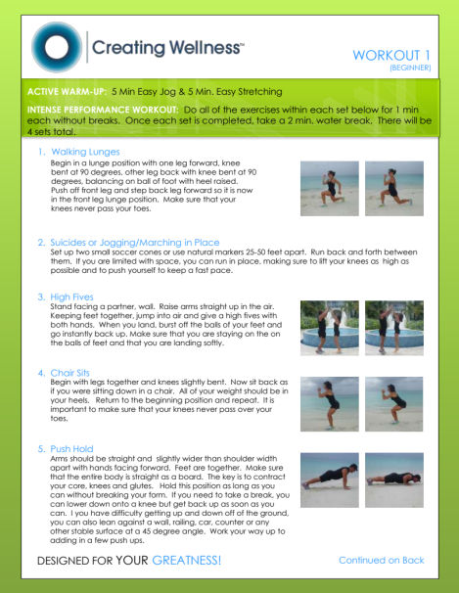
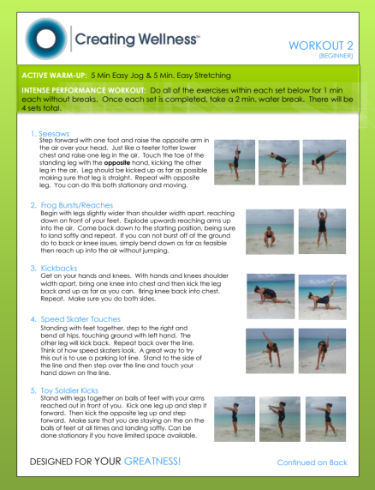
NEW YEAR! NEW YOU!
WELLNESS CHALLENGE!
GET LEANER FASTER
STEP 2:
CORE PERFORMANCE
INTERVAL WORKOUTS
  3 Beginner Workouts
  3 Advanced Workouts
  Supportive Advice to Maximize Your Fitness

Slide 34

NEW YEAR! NEW YOU!
WELLNESS CHALLENGE!
STEP 3:
JOIN AN ACCOUNTABILTY GROUP
CORE PERFORMANCE
GROUP WORKOUTS
Get Double The Results In The Same Amount Of Time
Make Working Out Fun
Burn Up To 600 Calories Per Hour

Slide 35
NEW YEAR! NEW YOU!
WELLNESS CHALLENGE!
INCREASE YOUR ENERGY
STEP 4:
GREENS FIRST
SUPER FOOD DRINK MIX
Balance Your Nutrition
Alkalize Your Body
Get 15+ Servings Of Fruits & Vegetables Per Serving

Slide 36
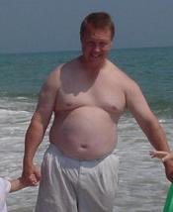
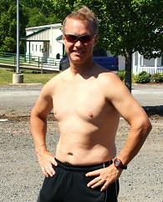
NEW YEAR! NEW YOU!
WELLNESS CHALLENGE!
Before
After

Slide 37
NEW YEAR! NEW YOU!
WELLNESS CHALLENGE!
GET STARTED TODAY
STEP 5:
SEE THE FRONT DESK
FOR MORE INFORMATION &
TO RESERVE YOUR SPOT TODAY!
APR. 8TH – JULY 1ST

