Slide 1




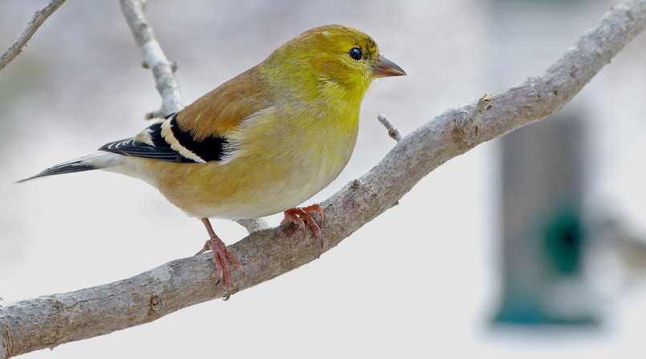

American Goldfinch
by Bob Vuxinic

Slide 2
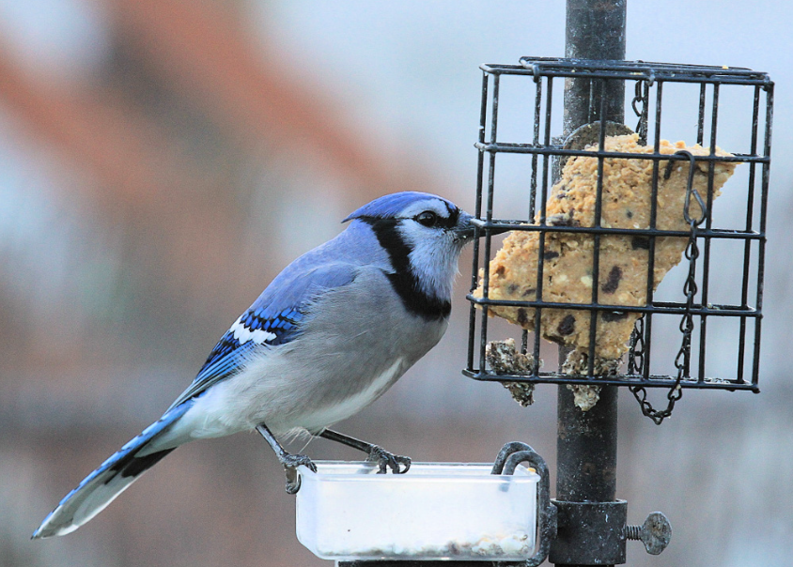
What is Project FeederWatch?
Anyone who feeds birds can participate
Repeated counts November – April
Maximum number of each species
Provides presence and
absence data
Behavioral Interactions
Blue Jay by
Maria Corcacas

Slide 3
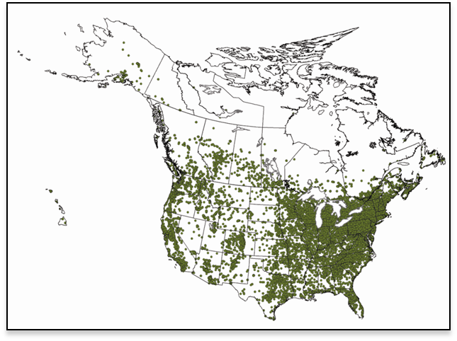
The Numbers
20,000 participants / year
52,000 count sites
100 million birds reported
4.2 million hours of volunteer time
2 books, 26+ scientific papers
Started in 1977 by Bird Studies Canada
Cornell Lab of Ornithology joined in 1987
Fully funded by participant fees and gifts

Slide 4
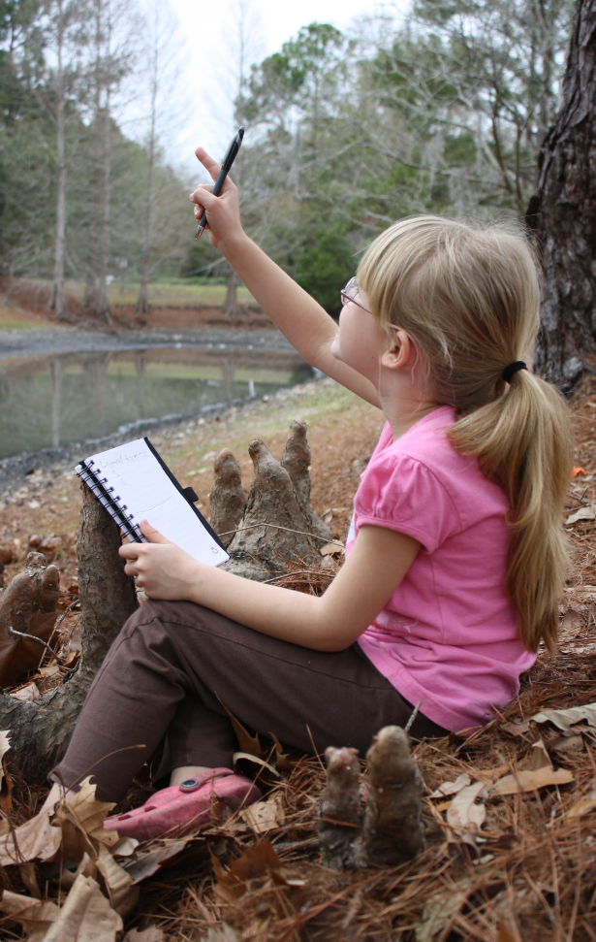
FeederWatch is Citizen Science
What is Citizen Science?
Involves the public in scientific research
Answers large-scale & longitudinal questions
Promotes environmental awareness &
scientific literacy
Your observations are important!
Amanda Boyarshinov

Slide 5
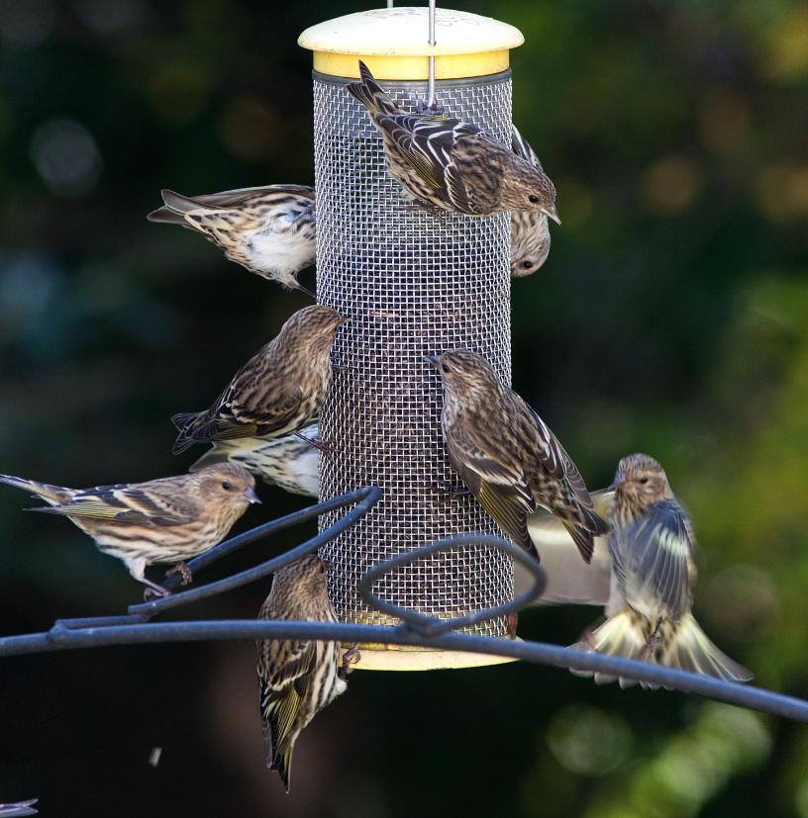
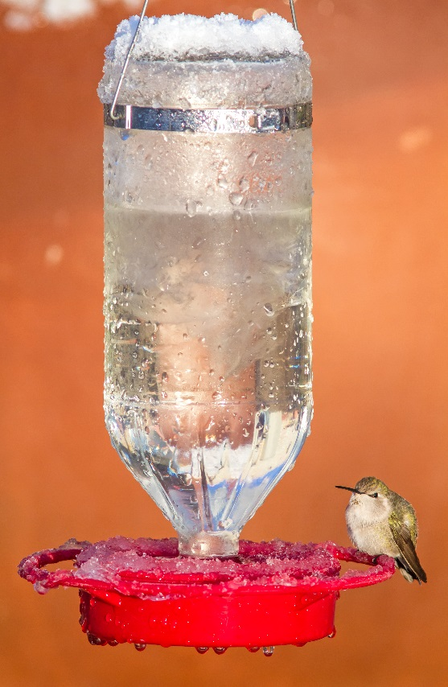
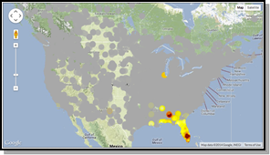
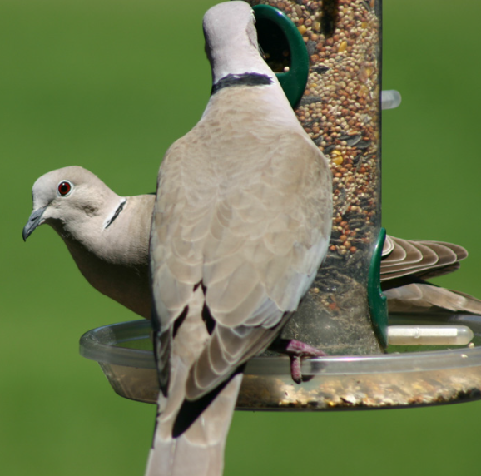
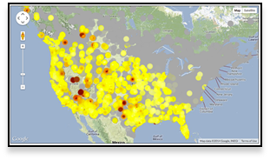
FeederWatch Data is used to…
Understand shifting bird populations
Follow winter range expansions or contractions
Record irruptions for winter finches and other species
Track the spread of non-native species
Monitor disease outbreaks
And much more!
Pine Siskin irruption by Paul Smith
Anna’s Hummingbirds expand
winter range by Susan Beebe
Eurasian Collard-Doves spread across North America by Kevin Carver

Slide 6
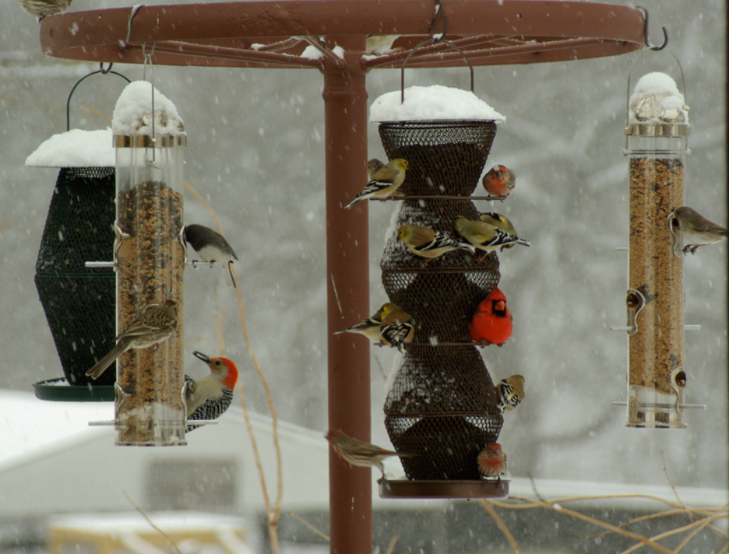
How to FeederWatch
Set up a count site
Choose count days
Count your birds
Record behaviors
Submit data
Mixed species by Marquita Seifried

Slide 7
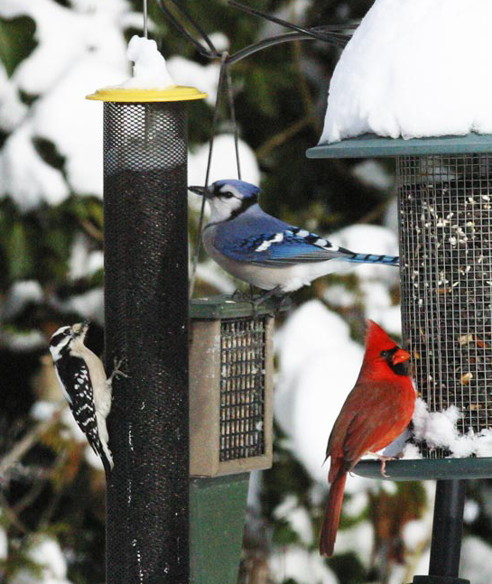
Your Count Site
Where your feeders are located
Bird-friendly habitat
Easily viewed
Downy Woodpecker, Blue Jay, &
Northern Cardinal by Eileen Mathias

Slide 8
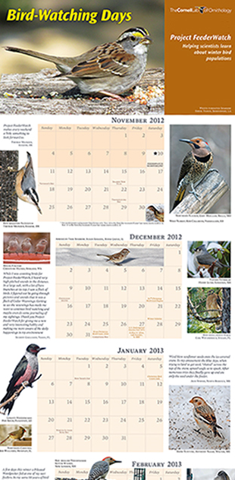
Choose Count Days
Count as often as once a week from November-April
Leave 5 days that you do not count between
each 2-day count
Keep track of how long you observed your count site
Observation time is flexible
(as short or as long as you like)

Slide 9
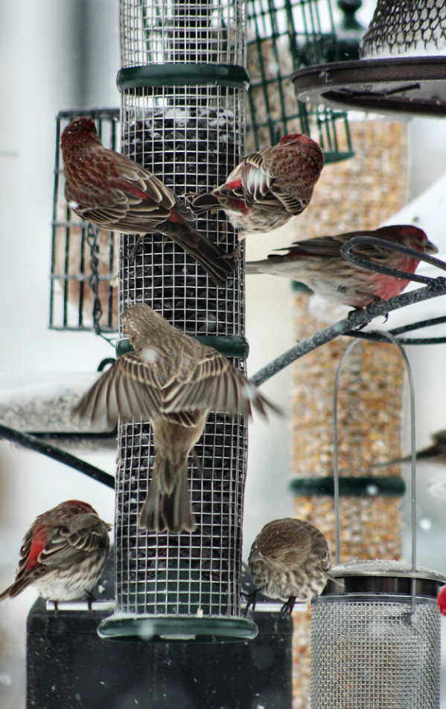
Count Your Birds
What should I count?
All of the individuals of each species in view at any one time
Birds attracted to food or water you provided
Birds attracted to fruits or plantings
Birds attracted to the activity around your feeders, including predatory birds and tag-a-long birds, even if the birds don’t come to your feeders or plantings themselves
House Finches by Maria Corcacas

Slide 10
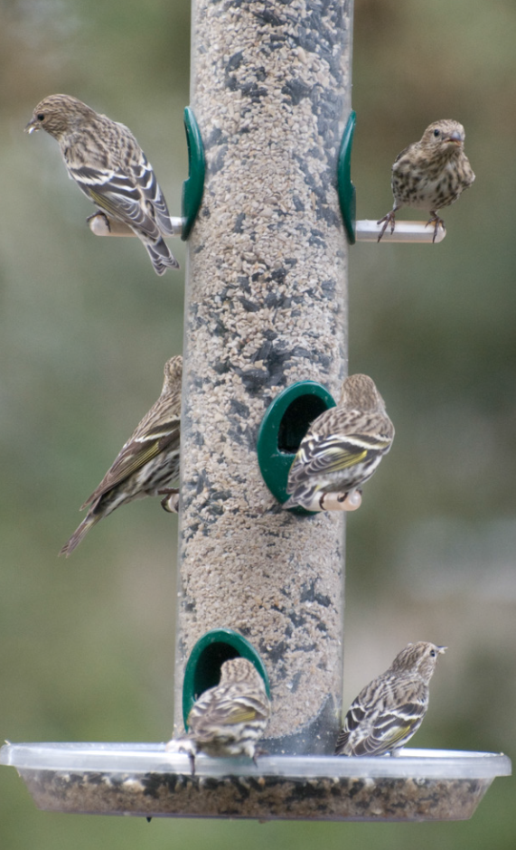
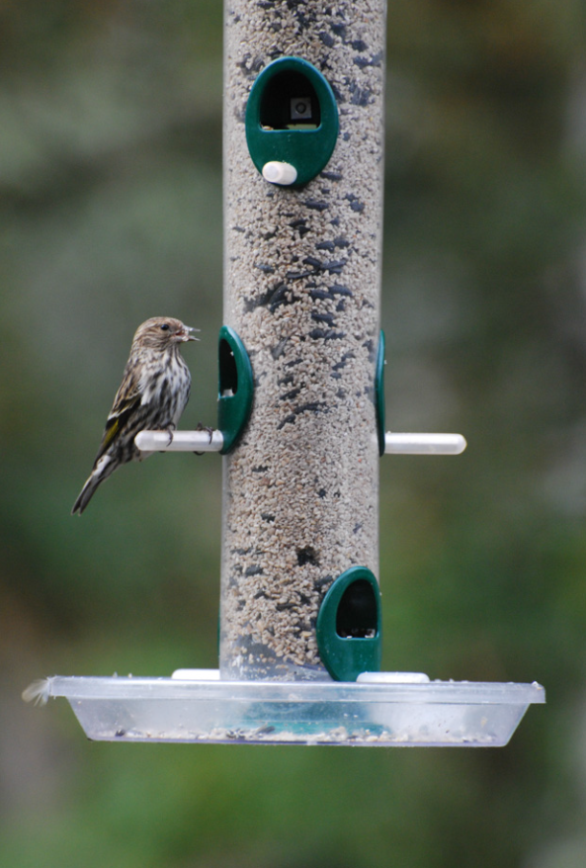
How to count
Day 1: Record the
maximum number of
each species seen
simultaneously.
Day 2: Repeat!
Your final count is the largest number for each species over both days.
Day 1 = 1
Day 2 = 6
Tally= 6
Pine Siskins by Brandon Green

Slide 11
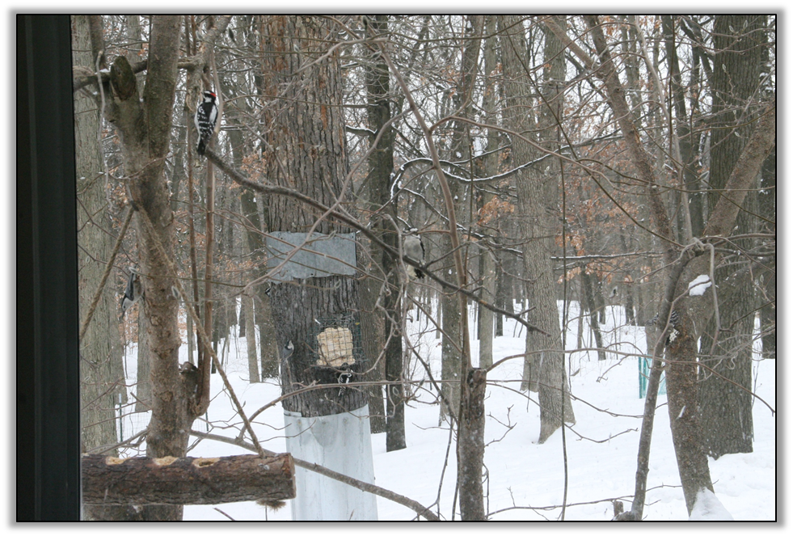
It can be tricky!
Mixed species by Lynda Hill

Slide 12
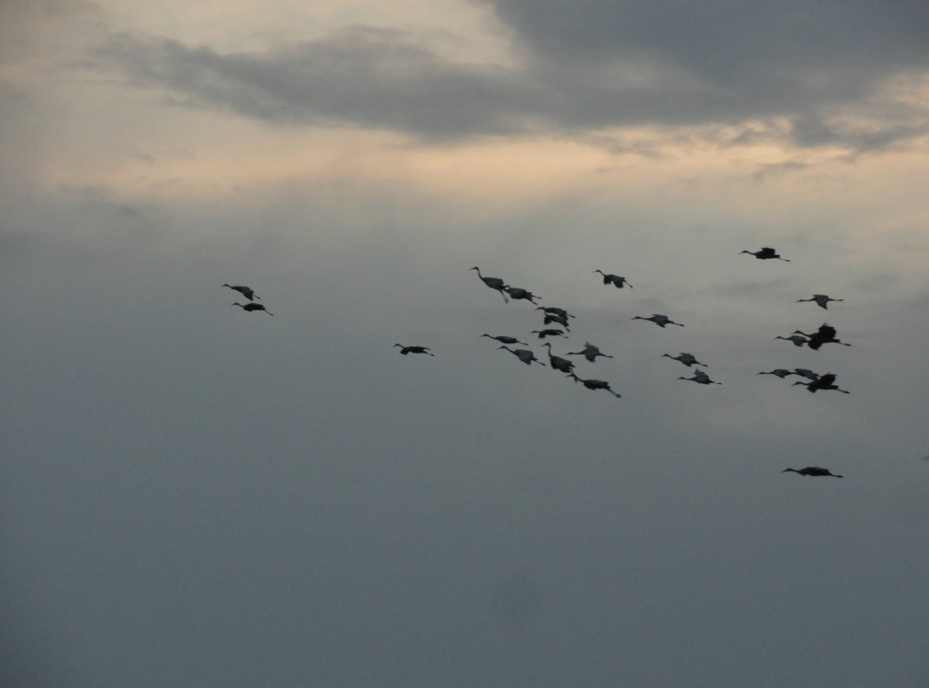
Don’t Count
Birds that fly over the count site
Birds seen on non-count days
Sandhill Cranes by Diana Adams

Slide 13
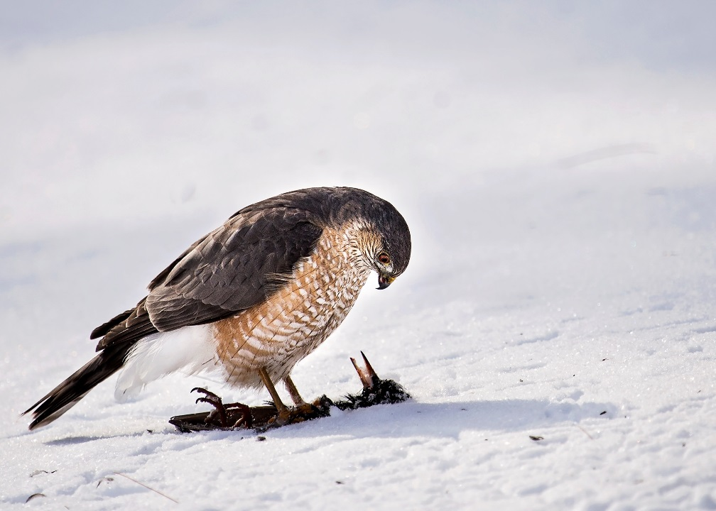
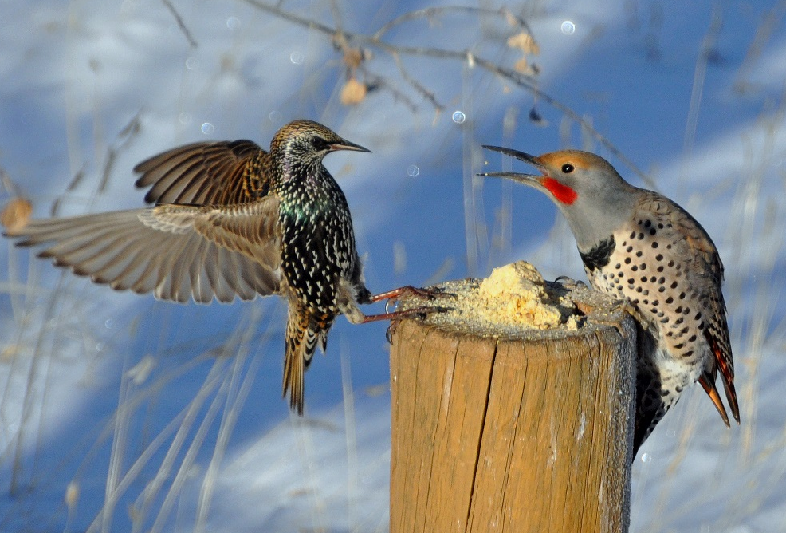
Behavioral Interactions
Record both successful and
unsuccessful interactions!
  Displacement = When one bird (the “source”) tries to take over a resource-food or a perch occupied by another bird (the “target”).
Predation = When one bird (the “source”) attempts to capture or kill another bird (the “target”).
Northern Flicker (source) displaces European Starling (target). Photo by Pam Koch.
Sharp-shinned Hawk (source) depredates European Starling (target). Photo by Karen Burke.

Slide 14
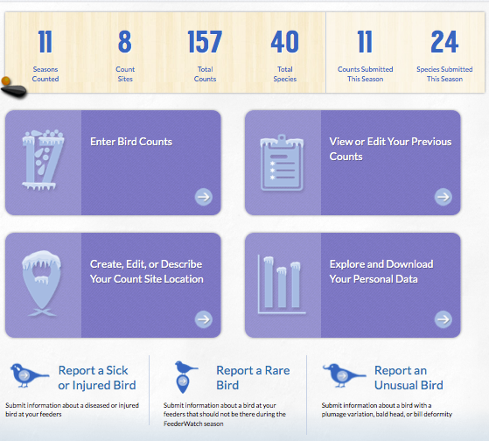
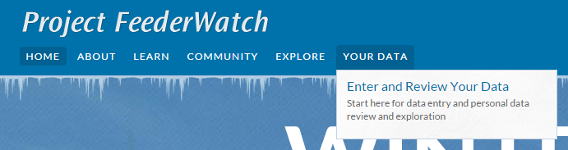
Submit Data

Slide 15
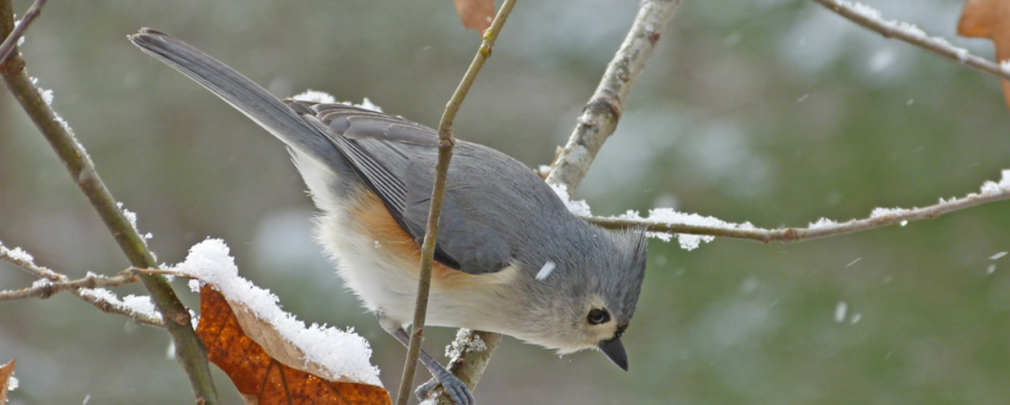
Record Weather & Time
What was the weather like during your count days?
How much time did you spend watching your site?
Tufted Titmouse by Bob Vuxinic

Slide 16
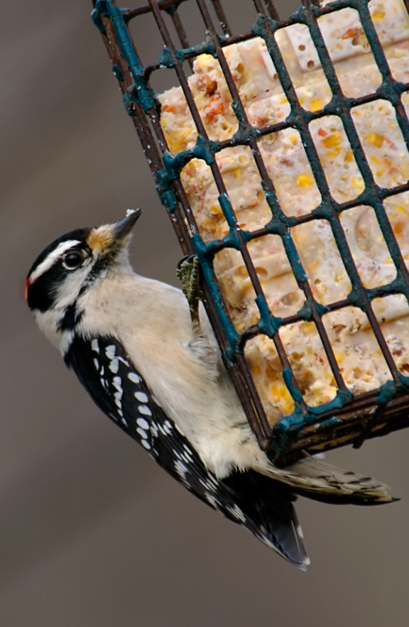
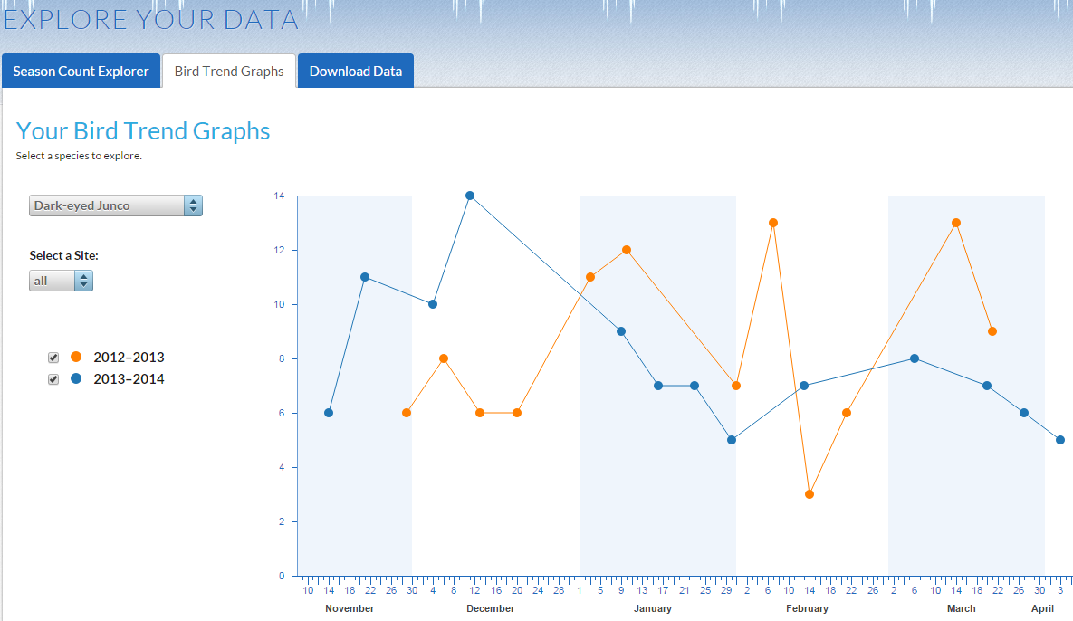
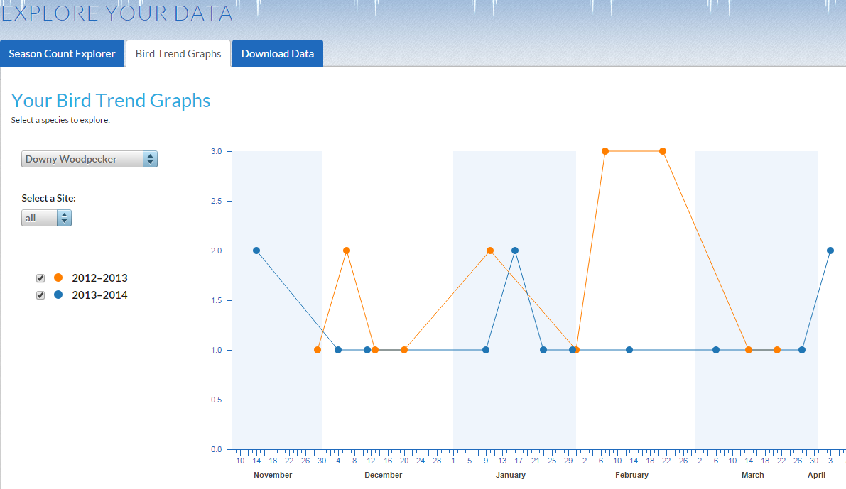
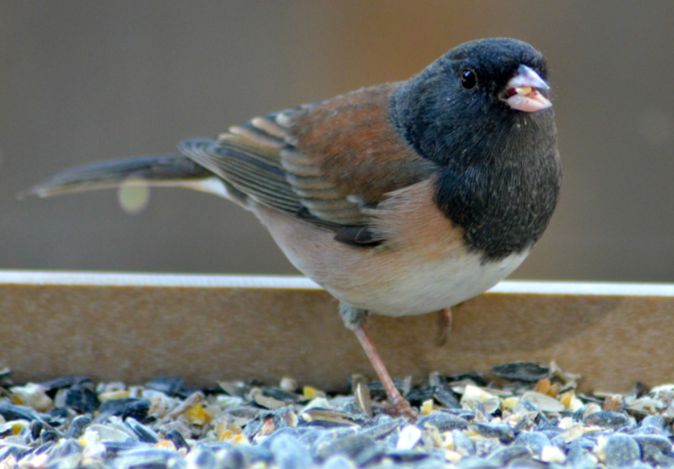
Explore Your Data
Track the birds in
your backyard.
Downy Woodpecker by Jennifer Taggart
Dark-eyed Junco by Sarah Maclean

Slide 17
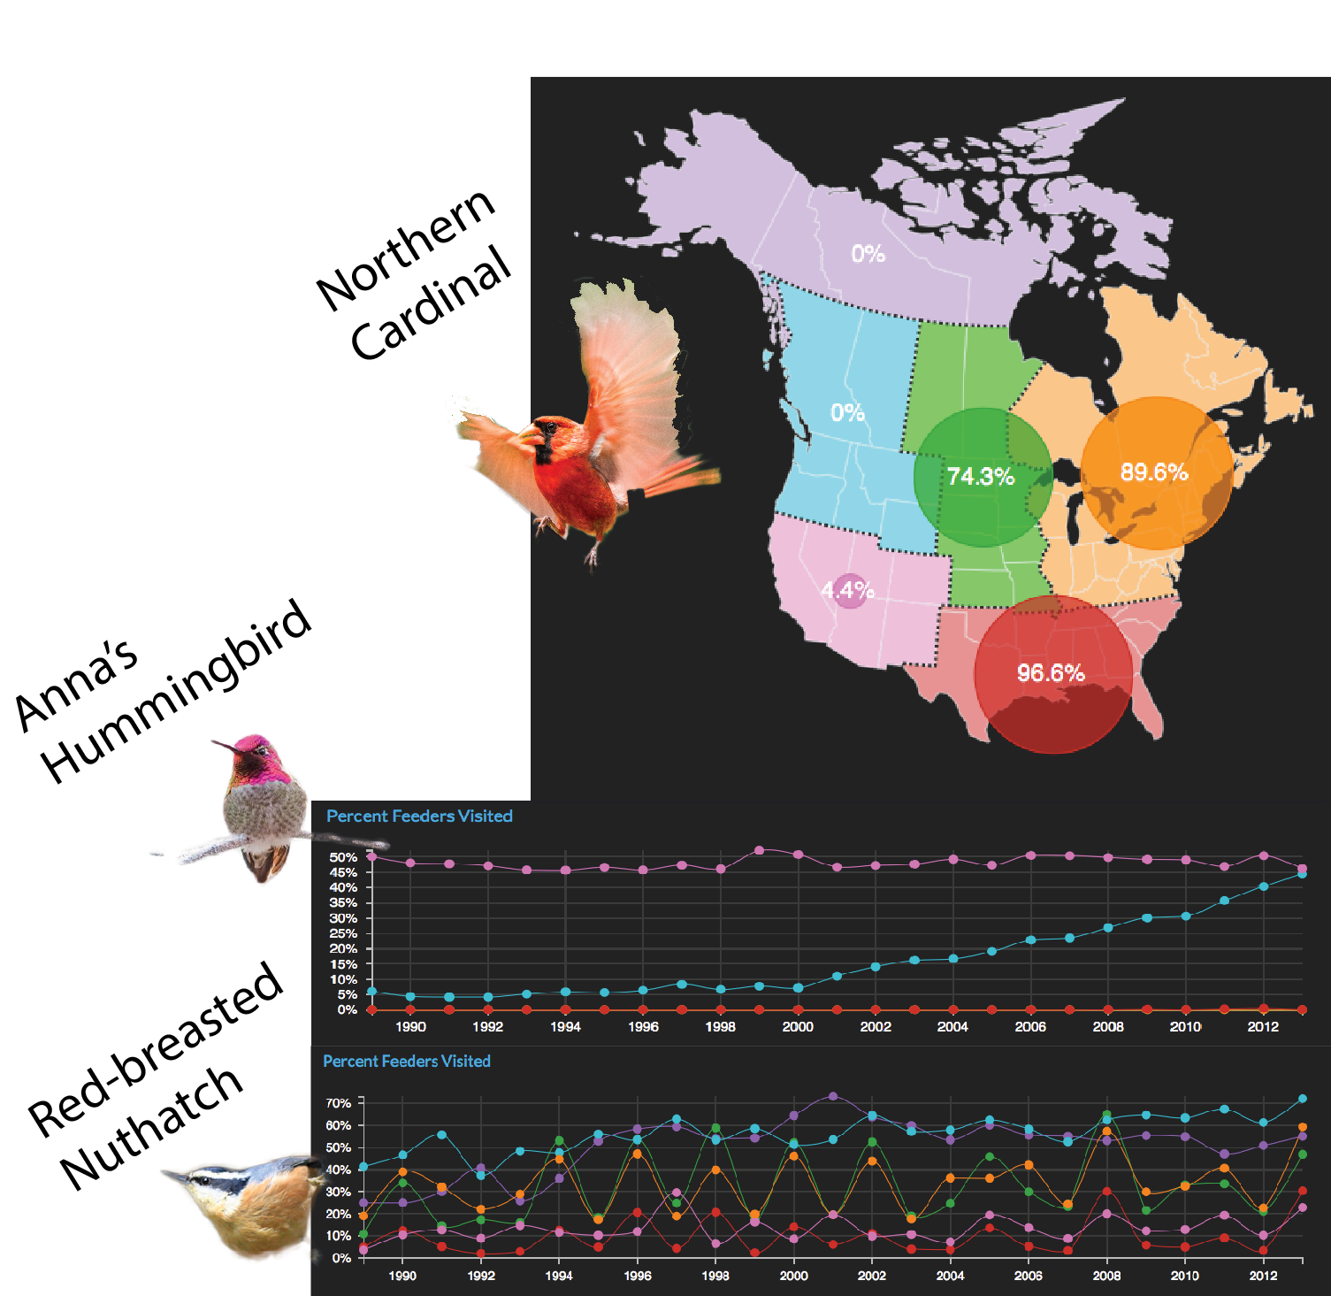
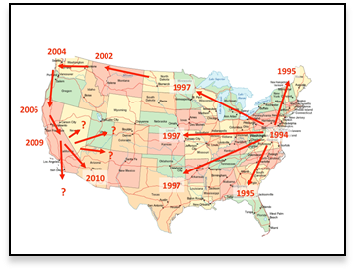
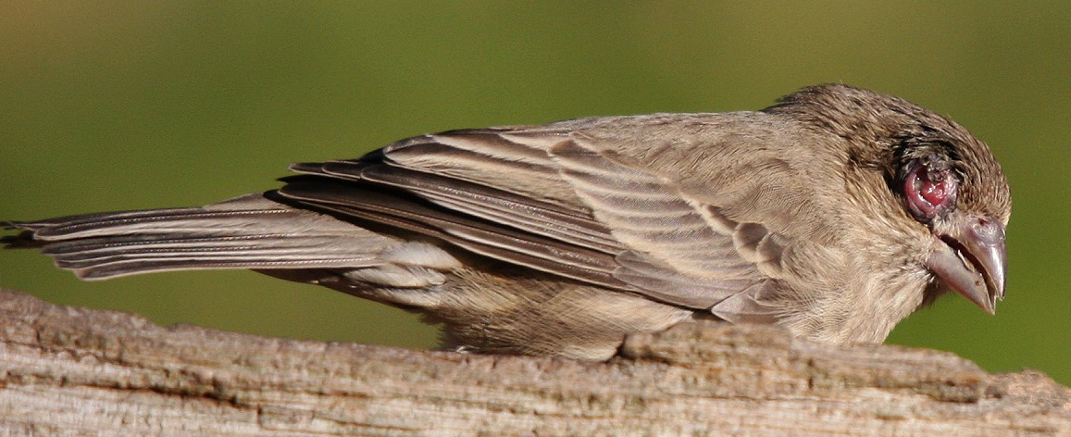
Explore Reports Across the Country
View:
Changes in population distribution
Trend graphs
Distribution maps
Frequently reported birds by state, province, & region
Rare & diseased birds
House Finch with Eye Disease by Errol Taskin

Slide 18
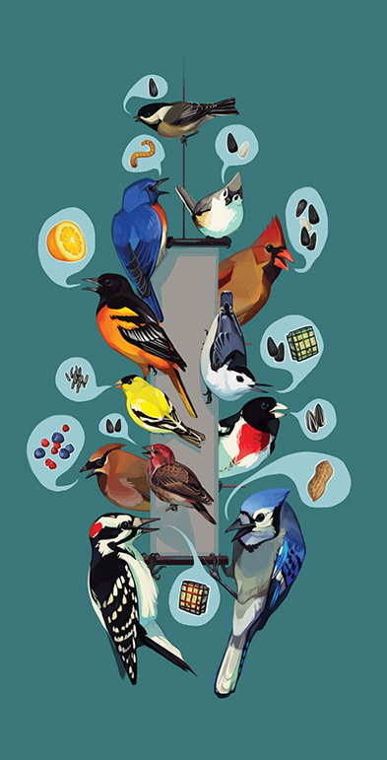
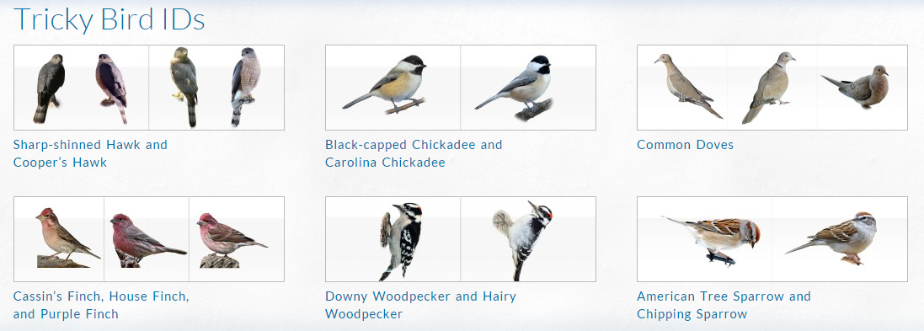
Enhance Your Experience
Web-based Learning:
Common Feeder Birds
Food & feeder preferences
by species
Tricky Bird IDs
Extensive FAQs
Participant photos
Articles about recent research

Slide 19
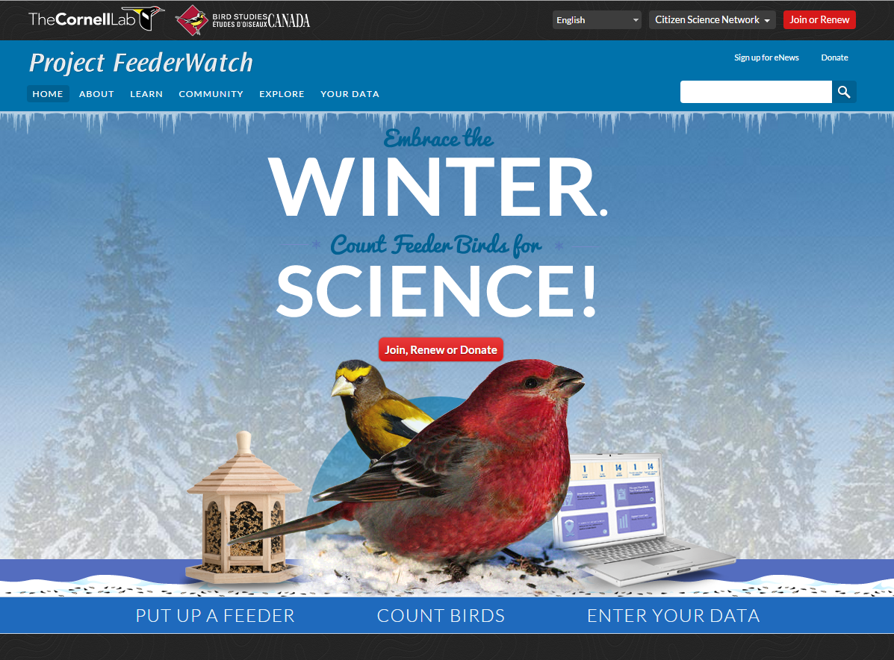
Get Involved!
Visit our website to join:
www.feederwatch.org
New members receive:
Handbook with instructions
Common Feeder Birds Poster
Bird-Watching Days
calendar
Winter Bird Highlights, our annual research summary

