Slide 1

Religion and Education
Introduction to Sociology
Notes:
All text in these slides is taken from
https://courses.lumenlearning.com/introductiontosociology-waymaker/ where it is published under one or more open licenses.
All images in these slides are attributed in the notes of the slide on which they appear and licensed as indicated.
Cover Image:

Slide 2
Religion
Religion describes the beliefs, values, and practices related to sacred or spiritual concerns
It is a social institution, because it includes beliefs and practices that serve the needs of society
Religion is a cultural universal, because it is found in all societies in one form or another

Slide 3
Sociological Terms for Discussing Religion
religious experience: the conviction or sensation that one is connected to “the divine”
religious beliefs: specific ideas that members of a particular faith hold to be true
religious rituals: behaviors or practices that are either required for or expected of the members of a particular group

Slide 4
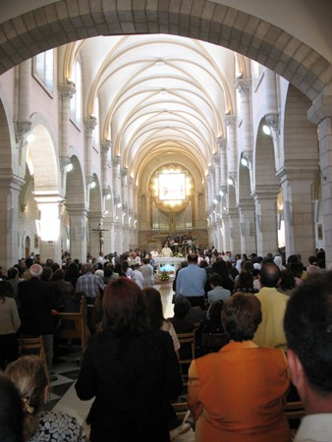
Functionalist View of Religion
Religion serves several purposes:
providing answers to spiritual mysteries
offering emotional comfort
creating a place for social interaction and social control
Notes:
(Photo courtesy of James Emery/flickr) in Introduction to Sociology 2e. Authored by: OpenStax CNX. Located at: http://cnx.org/contents/02040312-72c8-441e-a685-20e9333f3e1d/Introduction_to_Sociology_2e. License: CC BY: Attribution. License Terms: Download for free at http://cnx.org/contents/02040312-72c8-441e-a685-20e9333f3e1d@3.49

Slide 5
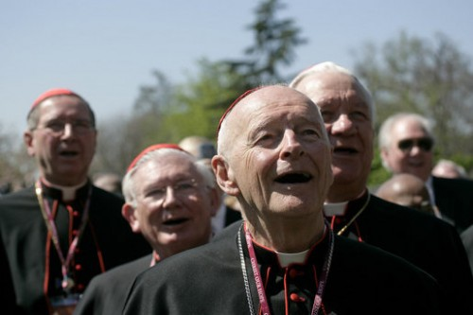
Conflict Theory on Religion
Religion is an institution that helps maintain patterns of social inequality that keep poor people poor and disempowered
Feminist theorists focus on gender inequality and promote leadership roles for women in religion
Notes:
(Photo courtesy of Wikimedia Commons) in Introduction to Sociology 2e. Authored by: OpenStax CNX. Located at: http://cnx.org/contents/02040312-72c8-441e-a685-20e9333f3e1d/Introduction_to_Sociology_2e. License: CC BY: Attribution. License Terms: Download for free at http://cnx.org/contents/02040312-72c8-441e-a685-20e9333f3e1d@3.49

Slide 6
Symbolic-Interactionist Views on Religion
Symbolic-interactionists study:
the interaction between religious leaders and practitioners
the role of religion in the ordinary components of everyday life
the ways people interpret and express religious values in social interactions

Slide 7
Organization of Religious Groups
Cults, sects, denominations, and ecclesia represent a continuum, with increasing influence on society, where cults are least influential and ecclesia are most influential

Slide 8
One Method of Classifying Religions
Religious Classification | What/Who Is Divine | Example
Polytheism | Multiple gods | Belief systems of the ancient Greeks and Romans
Monotheism | Single god | Judaism, Islam
Atheism | No deities | Atheism
Animism | Nonhuman beings (animals, plants, natural world) | Indigenous nature worship (Shinto)
Totemism | Human-natural being connection | Ojibwa (Native American) beliefs
Notes:
Introduction to Sociology 2e. Authored by: OpenStax CNX. Located at: http://cnx.org/contents/02040312-72c8-441e-a685-20e9333f3e1d/Introduction_to_Sociology_2e. License: CC BY: Attribution. License Terms: Download for free at http://cnx.org/contents/02040312-72c8-441e-a685-20e9333f3e1d@3.49

Slide 9

Hinduism
Originated in the Indus River Valley about 4,500 years ago
The third-largest of the world’s religions (1 billion followers)
Believe in a divine power that can manifest as different entities mainly —Brahma, Vishnu, and Shiva
The sacred text are the Vedas which contain hymns and rituals
Dharma is one’s duty in the world to perform “right” actions
Karma is the idea that spiritual ramifications of one’s actions are balanced cyclically in this life or a future life through reincarnation
Notes:
(Photo courtesy of Akash Mazumdar) in Introduction to Sociology 2e. Authored by: OpenStax CNX. Located at: http://cnx.org/contents/02040312-72c8-441e-a685-20e9333f3e1d/Introduction_to_Sociology_2e. License: CC BY: Attribution. License Terms: Download for free at http://cnx.org/contents/02040312-72c8-441e-a685-20e9333f3e1d@3.49

Slide 10
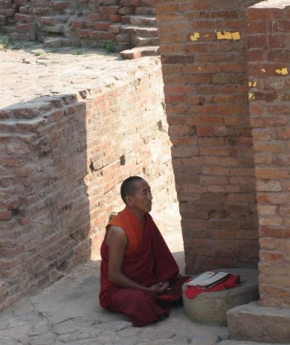
Buddhism
Buddhism was founded by Siddhartha Gautama around 500 B.C.E. in what is now Nepal
Buddhism emphasizes meditation
Notes:
(Photo courtesy of Prince Roy/flickr) in Introduction to Sociology 2e. Authored by: OpenStax CNX. Located at: http://cnx.org/contents/02040312-72c8-441e-a685-20e9333f3e1d/Introduction_to_Sociology_2e. License: CC BY: Attribution. License Terms: Download for free at http://cnx.org/contents/02040312-72c8-441e-a685-20e9333f3e1d@3.49

Slide 11
Buddhist Beliefs
Buddha’s teachings encourage Buddhists to lead a moral life by accepting the four Noble Truths:
life is suffering
suffering arises from attachment to desires
suffering ceases when attachment to desires ceases, and
freedom from suffering is possible by following the “middle way.”
The concept of the “middle way” is central to Buddhist thinking, which encourages people to live in the present and to practice acceptance of others
Buddhism tends to deemphasize the role of a godhead, instead stressing the importance of personal responsibility

Slide 12
Confucianism
Was the official religion of China from 200 B.C.E. until it was officially abolished by the communist leadership in 1949
Developed by Kung Fu-Tzu (Confucius), who lived in the sixth and fifth centuries B.C.E. as a system of religious morality to improve social order and cohesion in an anarchic time
Emphasizes self-discipline, respect for authority and tradition, and jen (the kind treatment of every person)
Primary text is the Analects
Some religious scholars consider it a social system not a religion

Slide 13
Taoism (also called Daoism)
The founder is generally recognized to be Laozi, who lived sometime in the sixth century B.C.E. in China
The purpose of life is inner peace and harmony
Tao is usually translated as “way” or “path”
Taoist beliefs emphasize the virtues of compassion and moderation.
The central concept of tao can be understood to describe a spiritual reality, the order of the universe, or the way of modern life in harmony with the former two
The yin-yang symbol and the concept of polar forces are central Taoist ideas

Slide 14
Judaism
Monotheistic
The Jews’ covenant, or promise of a special relationship with God, is an important element of Judaism
The Hebrew Bible includes the Torah, or five books of Moses
The Hebrew Bible also includes prophetic and other texts and is not the same as the Christian Old Testament – some of the books are different and they are organized into different narrative arcs
Talmud refers to a collection of sacred Jewish oral interpretation of the Torah
Jews emphasize moral behavior and action in this world as opposed to beliefs or personal salvation in the next world

Slide 15
Islam
Monotheistic
Follows the teaching of the prophet Muhammad, born in Mecca, Saudi Arabia, in 570
Muslims serve Allah (God)
Islam means “peace” and “submission”
The sacred text for Muslims is the Qur’an (or Koran)
Many of the Qur’an stories are shared with the Jewish faith
Divisions exist within Islam

Slide 16
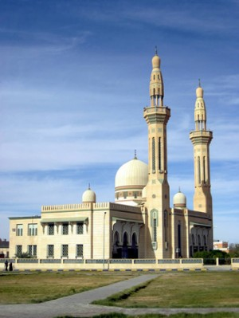
Five Pillars of Islam
All Muslims are guided by five beliefs or practices, often called “pillars”:
Allah is the only god, and Muhammad is his prophet
Daily prayer
Helping those in poverty
Fasting as a spiritual practice
Pilgrimage to the holy center of Mecca
Notes:
(Photo courtesy of David StanIntroduction to Sociology 2e. Authored by: OpenStax CNX. Located at: http://cnx.org/contents/02040312-72c8-441e-a685-20e9333f3e1d/Introduction_to_Sociology_2e. License: CC BY: Attribution. License Terms: Download for free at http://cnx.org/contents/02040312-72c8-441e-a685-20e9333f3e1d@3.49ley/flickr) in

Slide 17
Christianity
Today the largest religion in the world, Christianity began 2,000 years ago in Palestine, with Jesus of Nazareth
Although monotheistic, Christians often describe their god through three manifestations that they call the Holy Trinity: the father (God), the son (Jesus), and the Holy Spirit
The sacred text for Christians is the Bible (typically the Old and New Testaments) but different groups have variations in which books they include in the Bible
Christians believe that Jesus was the Messiah and the Son of God and that he will return

Slide 18
Religion and Social Change
Religion has historically been an impetus to social change
Disagreements between religious groups and instances of religious persecution have led to wars and genocides
Religion was central to the abolitionist and Civil Rights Movements in the U.S.

Slide 19
Liberation Theology
Began as a movement within the Roman Catholic Church in the 1950s and 1960s in Latin America
Today liberation theology is an international movement that encompasses many churches and denominations
Liberation theologians discuss theology from the point of view of the poor and the oppressed and interpret the scriptures as a call to action against poverty and injustice
In Europe and North America, feminist theology is a movement to bring social justice to women

Slide 20
Megachurches
A megachurch is a Christian church that has a very large congregation averaging more than 2,000 people who attend regular weekly services
Church buildings often resemble a sport or concert arena
Worship services feature contemporary music with drums and electric guitars
Typically, a single, highly charismatic male pastor leads the megachurch

Slide 21
Traits of Megachurches
Conservative theology
Evangelism
Use of technology and social networking
Few financial struggles
Multiple sites
Predominantly white membership
List their main focuses as youth activities, community service, and study of the Scripture

Slide 22
Are they too big?
Critics of megachurches believe they are too large to promote close relationships among fellow church members or the pastor, as could occur in smaller houses of worship
Supporters note that, congregations generally meet in small groups, and some megachurches have informal events throughout the week to allow for community-building

Slide 23
Secularization
Compared to other democratic, industrialized countries, the United States is generally perceived to be a fairly religious nation
While some scholars see the United States becoming increasingly secular others observe a rise in fundamentalism

Slide 24
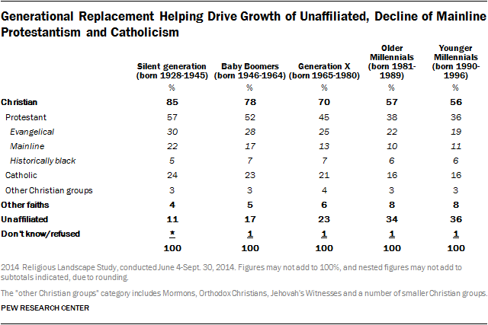
Practice Question: What trends do you see in this data?
Notes:
“America’s Changing Religious Landscape.” Pew Research Center, Washington D.C. (2015) http://www.pewforum.org/2015/05/12/americas-changing-religious-landscape/, accessed 4/28/2017.
The Pew Data suggests that more people are becoming secular. However, at the same time Evangelical churches represent a larger share of the Christian population. The data could suggest a hollowing out of the middle – as mainline Protestantism and Catholicism decline – and growing polarization between evangelicals and seculars with no religion. The Pew data doesn’t address fundamentalism per se but it could be that the Evangelical churches are growing more fundamentalist.

Slide 25

Education
Education is a social institution through which a society’s children are taught basic academic knowledge, learning skills, and cultural norms:
formal education is the learning of academic facts and concepts
informal education is education that involves learning about cultural values, norms, and expected behaviors through participation in a society
cultural transmission is the way people come to learn the values, beliefs, and social norms of their culture
Notes:
(Photo courtesy of eyeliam/flickr) in Introduction to Sociology 2e. Authored by: OpenStax CNX. Located at: http://cnx.org/contents/02040312-72c8-441e-a685-20e9333f3e1d/Introduction_to_Sociology_2e. License: CC BY: Attribution. License Terms: Download for free at http://cnx.org/contents/02040312-72c8-441e-a685-20e9333f3e1d@3.49

Slide 26
Comparing U.S. Schools to those in other Wealthy Countries
Many people fear the United States’ educational system may be on a descending path that could detrimentally affect the country’s economy and its social landscape.
Students in the United States had fallen from fifteenth to twenty-fifth in the rankings for science and math.
Top nations had well-established standards for education with clear goals for all students and recruited teachers from the top 5 to 10 percent of university graduates each year.
Part of the United States’ low rankings is due to disparities in educational resources such as money and the best teachers between schools that serve rich and poor children.

Slide 27
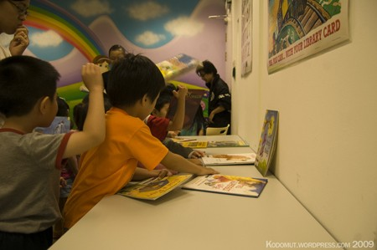
Universal Access
Universal access is the equal ability of all people to participate in an education system
On a world level, access remains difficult for certain groups based on race, class, or gender
The U.S. still struggles to provide equal educational opportunity to all student
The modern idea of universal access arose in the United States as a concern for people with disabilities
Advocates won the right to a free and appropriate public education for all students
Notes:
(Photo courtesy of kodomut/flickr) in Introduction to Sociology 2e. Authored by: OpenStax CNX. Located at: http://cnx.org/contents/02040312-72c8-441e-a685-20e9333f3e1d/Introduction_to_Sociology_2e. License: CC BY: Attribution. License Terms: Download for free at http://cnx.org/contents/02040312-72c8-441e-a685-20e9333f3e1d@3.49

Slide 28
Functionalist View of Education
Manifest Functions: Openly stated functions with intended goals | Latent Functions: Hidden, unstated functions with sometimes unintended consequences
Socialization | Courtship
Transmission of culture | Social networks
Social control | Group work
Social placement | Creation of generation gap
Cultural innovation | Political and social integration
Notes:
Introduction to Sociology 2e. Authored by: OpenStax CNX. Located at: http://cnx.org/contents/02040312-72c8-441e-a685-20e9333f3e1d/Introduction_to_Sociology_2e. License: CC BY: Attribution. License Terms: Download for free at http://cnx.org/contents/02040312-72c8-441e-a685-20e9333f3e1d@3.49

Slide 29

Key Vocabulary for Conflict Theory of Education
cultural capital: cultural knowledge that serves (metaphorically) as currency to help one navigate a culture
hidden curriculum: the type of nonacademic knowledge that people learn through informal learning and cultural transmission
sorting: classifying students based on academic merit or potential
tracking: a formalized sorting system that places students on “tracks” (advanced, low achievers) that perpetuate inequalities
Notes:
(Photo courtesy Thomas Ricker/flickr) in Introduction to Sociology 2e. Authored by: OpenStax CNX. Located at: http://cnx.org/contents/02040312-72c8-441e-a685-20e9333f3e1d/Introduction_to_Sociology_2e. License: CC BY: Attribution. License Terms: Download for free at http://cnx.org/contents/02040312-72c8-441e-a685-20e9333f3e1d@3.49

Slide 30
Conflict Theory on Education
The educational system reinforces and perpetuates social inequalities that arise from differences in class, gender, race, and ethnicity
Educational systems preserve the status quo and push people of lower status into obedience
School systems do this through tracking, hidden curriculums, disparities of resources available to students in richer and poorer neighborhoods, and through testing
Education systems can be viewed as legitimating inequality since rich children come to see themselves as most deserving based on their own merit

Slide 31
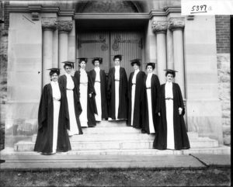
Feminist Theory of Education
Feminist theory aims to understand the mechanisms and roots of gender inequality in education, as well as their societal repercussions
Educational systems are characterized by unequal treatment and opportunity for women
Almost two-thirds of the world’s 862 million illiterate people are women, and the illiteracy rate among women is expected to increase in many regions, especially in several African and Asian countries
Notes:
female graduates in 1903. Provided by: Wikipedia. Located at: https://commons.wikimedia.org/wiki/File:Group_of_women_in_cap_and_gown_at_Western_College_on_Tree_Day_1903_(3191801017).jpg. License: Public Domain: No Known Copyright

Slide 32
Symbolic-Interactionist Views of Education
When teachers label students, they can create a self-fulfilling prophecy
Credentialism is the emphasis on certificates or degrees that symbolize what a person has achieved, and allows the labeling of that individual
Powerful social groups of peers label students in ways that can have serious consequences

Slide 33
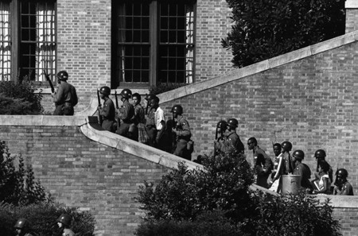
Contemporary Issues in Education
De facto segregation based on residential segregation
Resource disparities because schools are largely funded by local taxes
Bilingual education
“Teaching to the Test”
Common Core
How should we address gaps in educational outcomes based on class and race? (Head Start is one such program)
Notes:
(Photo courtesy of the U.S. Army) in Introduction to Sociology 2e. Authored by: OpenStax CNX. Located at: http://cnx.org/contents/02040312-72c8-441e-a685-20e9333f3e1d/Introduction_to_Sociology_2e. License: CC BY: Attribution. License Terms: Download for free at http://cnx.org/contents/02040312-72c8-441e-a685-20e9333f3e1d@3.49

Slide 34

More Contemporary Issues in Education
Should children be passed to the next grade if they have not met the standards for that grade?
How can we improve teacher quality?
Notes:
Confetti - Undergrad Graduation. Authored by: m00by. Located at: https://www.flickr.com/photos/m00by/2538526391. License: CC BY: Attribution

Slide 35
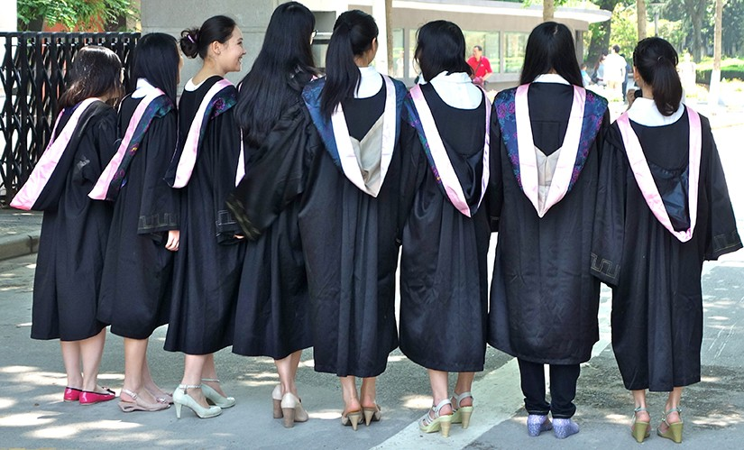
Contemporary Issues in Higher Education
Affirmative action
Rising student loan debt
Notes:
(Photo courtesy of Kevin Dooley/flickr) in Introduction to Sociology 2e. Authored by: OpenStax CNX. Located at: http://cnx.org/contents/02040312-72c8-441e-a685-20e9333f3e1d/Introduction_to_Sociology_2e. License: CC BY: Attribution. License Terms: Download for free at http://cnx.org/contents/02040312-72c8-441e-a685-20e9333f3e1d@3.49

Slide 36
Charter Schools
Charter schools are self-governing public schools that have signed agreements with state governments to improve student performance on tests
While such schools receive public money, they are not subject to the same rules that apply to regular public schools
Charter schools are free to attend and select students by lottery

Slide 37
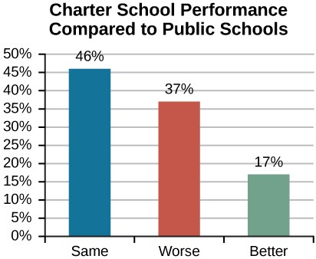
How Effective are Charter Schools?
The debate over the performance of charter schools vs. public schools is a charged one. This data comes from Stanford University’s CREDO study comparing public and charter schools
Notes:
(Source: Based on the CREDO study Multiple Choice: Charter School Performance in 16 States) in Introduction to Sociology 2e. Authored by: OpenStax CNX. Located at: http://cnx.org/contents/02040312-72c8-441e-a685-20e9333f3e1d/Introduction_to_Sociology_2e. License: CC BY: Attribution. License Terms: Download for free at http://cnx.org/contents/02040312-72c8-441e-a685-20e9333f3e1d@3.49

Slide 38
Homeschooling
Homeschooling refers to children being educated in their own homes, typically by a parent, instead of in a traditional public or private school system
Proponents of this type of education argue that it provides an outstanding opportunity for student-centered learning while circumventing problems that plague today’s education system
Opponents counter that homeschooled children miss out on the opportunity for social development that occurs in standard classroom environments and school settings
Half of homeschoolers believe they can better educate their child
40 percent choose homeschooling for “religious reasons”
To date, researchers have not found consensus in studies evaluating the success, or lack thereof, of homeschooling

Slide 39
Quick Review
How do major sociological perspectives view religion?
What are the basic tenets of major world religions?
What are some religious trends in the United States?
What are some educational differences around the world?
How do the major theoretical perspectives view education?
What are historical and contemporary issues in education?

