Slide 1
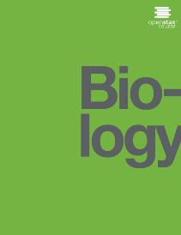

BIOLOGY
Chapter 14 DNA STRUCTURE AND FUNCTION
PowerPoint Image Slideshow

Slide 2
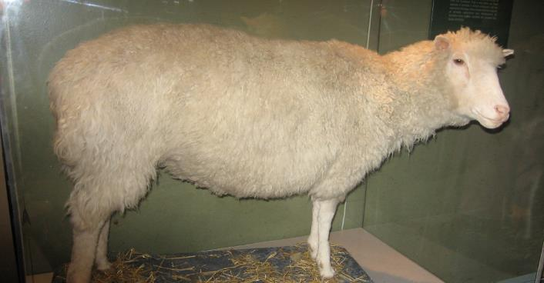
Figure 14.1
Dolly the sheep was the first large mammal to be cloned.

Slide 3
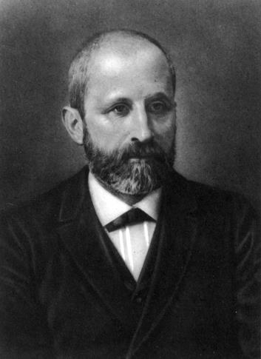
Figure 14.2
Friedrich Miescher (1844–1895 discovered nucleic acids.

Slide 4
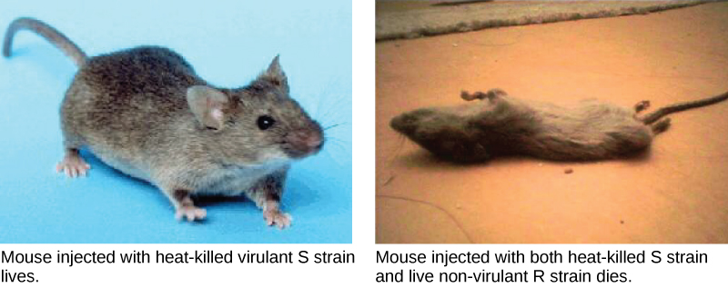
Figure 14.3
Two strains of S. pneumoniae were used in Griffith’s transformation experiments. The R strain is non-pathogenic. The S strain is pathogenic and causes death. When Griffith injected a mouse with the heat-killed S strain and a live R strain, the mouse died. The S strain was recovered from the dead mouse. Thus, Griffith concluded that something had passed from the heat-killed S strain to the R strain, transforming the R strain into S strain in the process. (credit “living mouse”: modification of work by NIH; credit “dead mouse”: modification of work by Sarah Marriage)

Slide 5
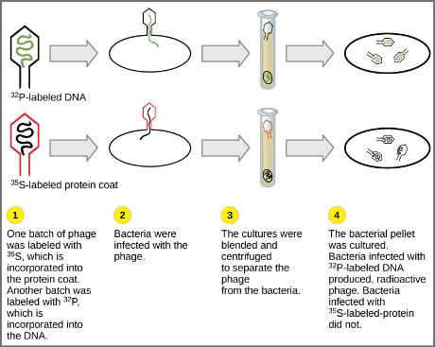
Figure 14.4
In Hershey and Chase's experiments, bacteria were infected with phage radiolabeled with either ³⁵S, which labels protein, or ³²P, which labels DNA. Only ³²P entered the bacterial cells, indicating that DNA is the genetic material.

Slide 6
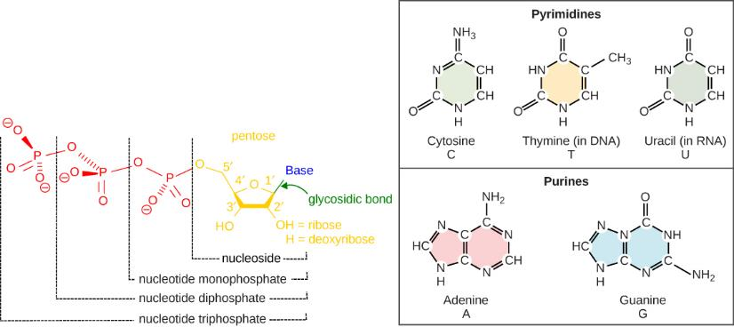
Figure 14.5
Each nucleotide is made up of a sugar, a phosphate group, and a nitrogenous base. The sugar is deoxyribose in DNA and ribose in RNA.

Slide 7
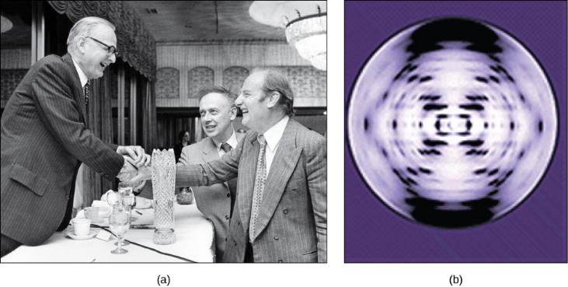
Figure 14.6
The work of pioneering scientists (a) James Watson, Francis Crick, and Maclyn McCarty led to our present day understanding of DNA. Scientist Rosalind Franklin discovered (b) the X-ray diffraction pattern of DNA, which helped to elucidate its double helix structure. (credit a: modification of work by Marjorie McCarty, Public Library of Science)

Slide 8
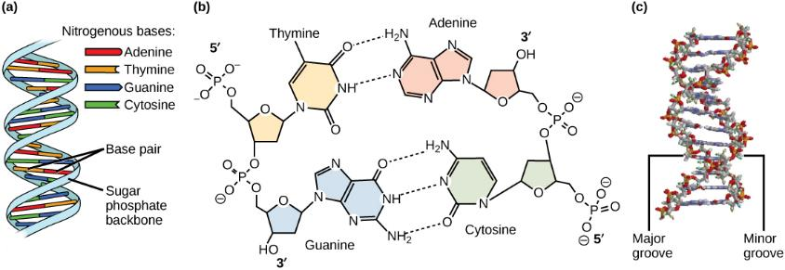
Figure 14.7
DNA has (a) a double helix structure and (b) phosphodiester bonds. The (c) major and minor grooves are binding sites for DNA binding proteins during processes such as transcription (the copying of RNA from DNA) and replication.

Slide 9
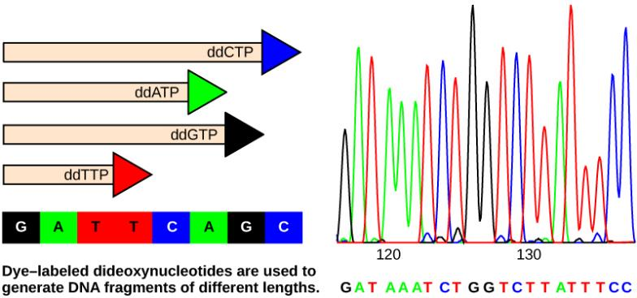
Figure 14.8
In Frederick Sanger's dideoxy chain termination method, dye-labeled dideoxynucleotides are used to generate DNA fragments that terminate at different points. The DNA is separated by capillary electrophoresis on the basis of size, and from the order of fragments formed, the DNA sequence can be read. The DNA sequence readout is shown on anelectropherogram that is generated by a laser scanner.

Slide 10
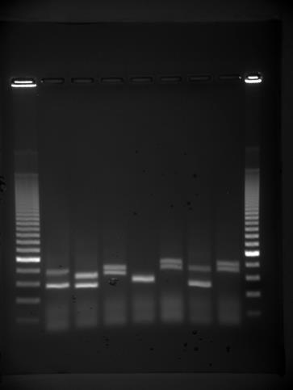
Figure 14.9
DNA can be separated on the basis of size using gel electrophoresis. (credit: James Jacob, Tompkins Cortland Community College)

Slide 11
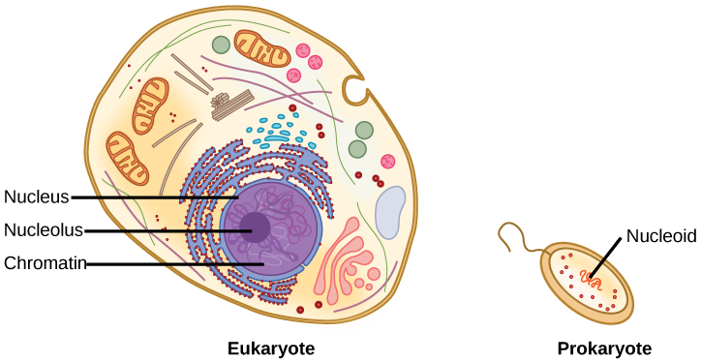
Figure 14.10
A eukaryote contains a well-defined nucleus, whereas in prokaryotes, the chromosome lies in the cytoplasm in an area called the nucleoid.

Slide 12
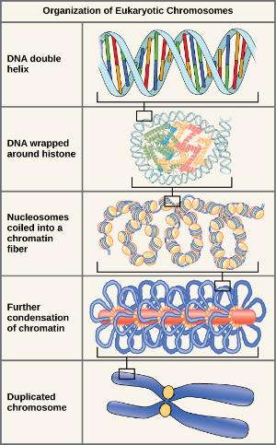
Figure 14.11
These figures illustrate the compaction of the eukaryotic chromosome.

Slide 13
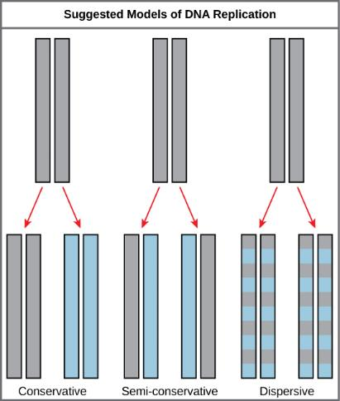
Figure 14.12
The three suggested models of DNA replication. Grey indicates the original DNA strands, and blue indicates newly synthesized DNA.

Slide 14
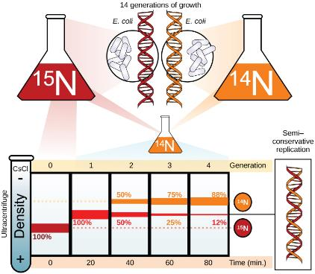
Figure 14.13
Meselson and Stahl experimented with E. coli grown first in heavy nitrogen (¹⁵N) then in ¹⁴N. DNA grown in ¹⁵N (red band) is heavier than DNA grown in ¹⁴N (orange band), and sediments to a lower level in cesium chloride solution in an ultracentrifuge. When DNA grown in ¹⁵N is switched to media containing ¹⁴N, after one round of cell division the DNA sediments halfway between the ¹⁵N and ¹⁴N levels, indicating that it now contains fifty percent ¹⁴N. In subsequent cell divisions, an increasing amount of DNA contains ¹⁴N only. This data supports the semi-conservative replication model. (credit: modification of work by Mariana Ruiz Villareal)

Slide 15
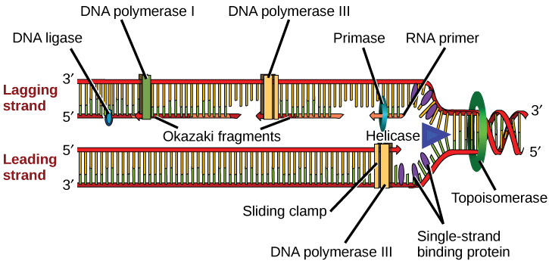
Figure 14.14
A replication fork is formed when helicase separates the DNA strands at the origin of replication. The DNA tends to become more highly coiled ahead of the replication fork. Topoisomerase breaks and reforms DNA’s phosphate backbone ahead of the replication fork, thereby relieving the pressure that results from this supercoiling. Single-strand binding proteins bind to the single-stranded DNA to prevent the helix from re-forming. Primase synthesizes an RNA primer. DNA polymerase III uses this primer to synthesize the daughter DNA strand. On the leading strand, DNA is synthesized continuously, whereas on the lagging strand, DNA is synthesized in short stretches called Okazaki fragments. DNA polymerase I replaces the RNA primer with DNA. DNA ligase seals the gaps between the Okazaki fragments, joining the fragments into a single DNA molecule. (credit: modification of work by Mariana Ruiz Villareal)

Slide 16
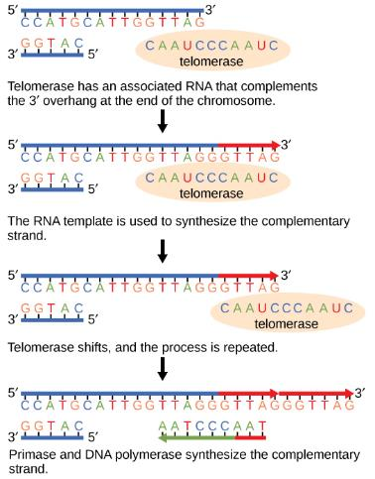
Figure 14.15
The ends of linear chromosomes are maintained by the action of the telomerase enzyme.

Slide 17
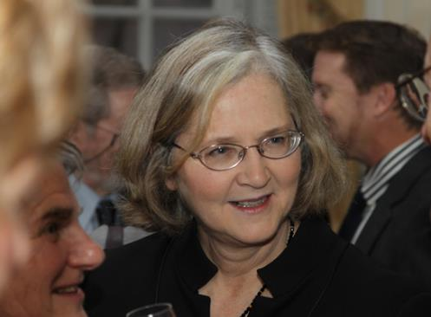
Figure 14.16
Elizabeth Blackburn, 2009 Nobel Laureate, is the scientist who discovered how telomerase works. (credit: US Embassy Sweden)

Slide 18
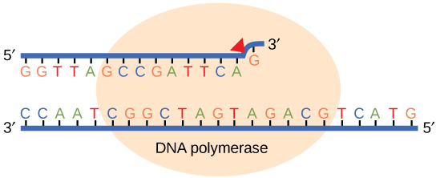
Figure 14.17
Proofreading by DNA polymerase corrects errors during replication.

Slide 19
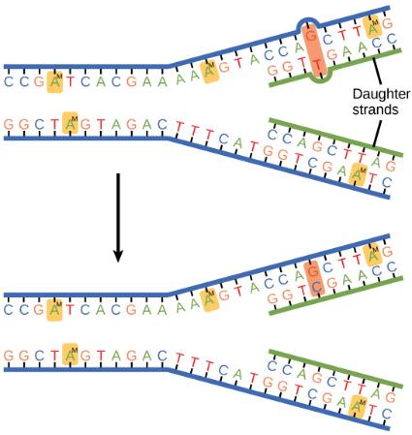
Figure 14.18
In mismatch repair, the incorrectly added base is detected after replication. The mismatch repair proteins detect this base and remove it from the newly synthesized strand by nuclease action. The gap is now filled with the correctly paired base.

Slide 20
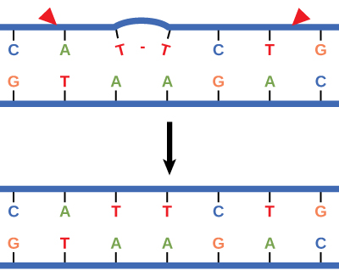
Figure 14.19
Nucleotide excision repairs thymine dimers. When exposed to UV, thymines lying adjacent to each other can form thymine dimers. In normal cells, they are excised and replaced.

Slide 21
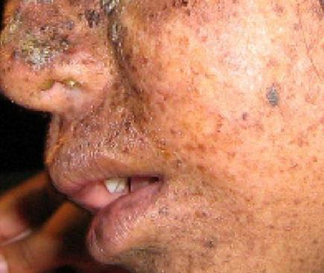
Figure 14.20
Xeroderma pigmentosa is a condition in which thymine dimerization from exposure to UV is not repaired. Exposure to sunlight results in skin lesions. (credit: James Halpern et al.)

Slide 22
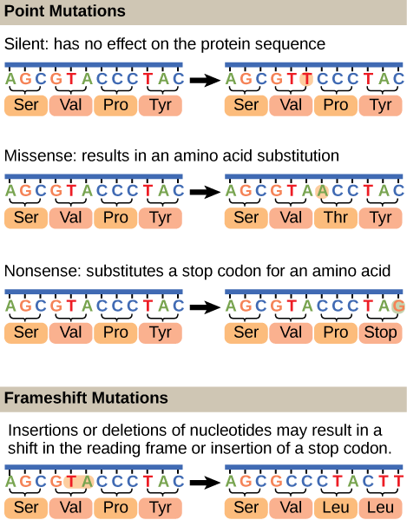
Figure 14.21
Mutations can lead to changes in the protein sequence encoded by the DNA.

Slide 23
This PowerPoint file is copyright 2011-2015, Rice University. All Rights Reserved.

