Slide 1
Study Skills and Classroom Success
Chapter 8

Slide 2
Reading in College
How to Read Your Textbooks More Efficiently - College Info Geek

Slide 3
Purpose of Academic Reading
Think about your career project…
Information comes from reputable sources: Academic sources such as textbooks and scholarly journal articles, on the other hand, are usually written by experts in the field and have to pass stringent peer review requirements in order to get published.
Learn how to form arguments: When instructors ask you to write a paper, they expect it to be argumentative in style. This means that the goal of the paper is to research a topic and develop an argument about it using evidence and facts to support your position. Since many college reading assignments (especially journal articles) are written in a similar style, you’ll gain experience studying their strategies and learning to emulate them.
Exposure to different viewpoints: In an ethics class, you might be asked to read a series of articles written by medical professionals and religious leaders who are pro-life or pro-choice and consider the validity of their arguments. Such experience can help you wrestle with ideas and beliefs in new ways and develop a better understanding of how others’ views differ from your own.

Slide 4
Reading Strategies for Academic Texts
Preview: Read the title, the back of the book, and table of contents. Scanning this information can give you an initial idea of what you’ll be reading and some useful context for thinking about it.
Read: While you read an academic text, you should have a pen or pencil in hand. Circle or highlight key concepts. Write questions or comments in the margins or in a notebook.
Summarize: After you an read academic text, it’s worth taking the time to write a short summary. Jotting down a few sentences or a short paragraph capturing the main ideas of the reading is enormously beneficial: it not only helps you understand and absorb what you read but gives you ready study and review materials for exams and other writing assignments.
Review: It always helps to revisit what you’ve read for a quick refresher. It may not be practical to thoroughly reread assignments from start to finish, but before class discussions or tests, it’s a good idea to skim through them to identify the main points, reread any notes at the ends of chapters, and review any summaries you’ve written.
Use online recourses available from your instructor or book publishers.

Slide 5
Vocabulary-Building Techniques
Read Everything and Read Often
Reading frequently both in and out of the classroom will help strengthen your vocabulary. Whenever you read a book, magazine, newspaper, blog, or any other resource, keep a running list of words you don’t know.
Make Connections to Words You Already Know
You may be familiar with the “looks like . . . sounds like” saying that applies to words. It means that you can sometimes look at a new word and guess the definition based on similar words whose meaning you know.
Make Index Cards
If you are studying certain words for a test, or you know that certain phrases will be used frequently in a course or field, try making flashcards for review. Create your own quizlet or similar assessment and keep adding words to review often.
Developing a strong vocabulary is similar to most hobbies and activities. Even experts in a field continue to encounter and adopt new words.

Slide 6
Strategies for Success – Reading The Textbook
Have you ever thought about how you read a textbook? It’s different from reading a novel or a magazine. Most people don’t read textbooks for relaxation or entertainment! They read textbooks to learn something. The book speaks to you like a teacher does in class, showing and explaining information and procedures.
Think about how you usually read your book, then check the appropriate column next to each behavior. (see next slide)

Slide 7
Have you ever thought about how you read a textbook? It’s different from reading a novel or a magazine. Most people don’t read textbooks for relaxation or entertainment! They read textbooks to learn something. The book speaks to you like a teacher does in class, showing and explaining information and procedures.
The table below lists some behaviors that may help you read your textbook effectively. Think about how you usually read your book, then check the appropriate column next to each behavior.
Did you check “Yes” for all the behaviors? _______ If not, which one(s) will you try next?
When I read my textbook, … | Yes | No, but I know I should | No, I never thought of it
I sit with an alert, but comfortable posture.
I am prepared to take notes—I have a pencil or pen in my hand. If I cannot write in my textbook, I have some paper, too.
I read every single word.
I look at all diagrams, graphs, and pictures carefully.
I underline or highlight important words and ideas.
If a procedure is shown, I work each step of the examples on paper.
I make sure I understand all the steps in any procedures that are explained. If I don’t understand how one step follows the step before, I put a question mark and get help as soon as possible.

Slide 8
Writing Strategies
Why Do Writing Skills Matter?
The pay-off from improving your writing comes much sooner than graduation. Suppose you complete about 40 classes for a 120-credit bachelors’ degree, and—averaging across writing-intensive and non-writing-intensive courses—you produce about 2,500 words of formal writing per class. Even with that low estimate, you’ll write 100,000 words during your college career. That’s roughly equivalent to a 330-page book.
Spending a few hours sharpening your writing skills will make those 100,000 words much easier and more rewarding to write. All of your professors care about good writing.

Slide 9
Writing Strategies
Professors look at you as independent junior scholars and expect you to write as someone who has a genuine, driving interest in tackling a complex question.
They expect you to look deep into the evidence, consider several alternative explanations, and work out an original, insightful argument that you actually care about.

Slide 10
What to Do With Essay Assignments
Summary Assignments
Being asked to summarize a source is a common task in many types of writing. An effective summary does the following:
reflects your accurate understanding of a source’s thesis or purpose
differentiates between major and minor ideas in a source
demonstrates your ability to identify key phrases to quote
demonstrates your ability to effectively paraphrase most of the source’s ideas
captures the tone, style, and distinguishing features of a source
does not reflect your personal opinion about the source
That last point is often the most challenging: we are opinionated creatures, by nature, and it can be very difficult to keep our opinions from creeping into a summary, which is meant to be completely neutral.
In college-level writing, assignments that are only summary are rare. That said, many types of writing tasks contain at least some element of summary, from a biology report that explains what happened during a chemical process, to an analysis essay that requires you to explain what several prominent positions about gun control are, as a component of comparing them against one another.

Slide 11
The Writing Process
Defined-Topic Assignments
Undefined-Topic Assignments
The Writing Process - Writing (Video Link)
No writer, not even a professional, composes a perfect draft in her first attempt. Every writer fumbles and has to work through a series of steps to arrive at a high-quality finished project.

Slide 12
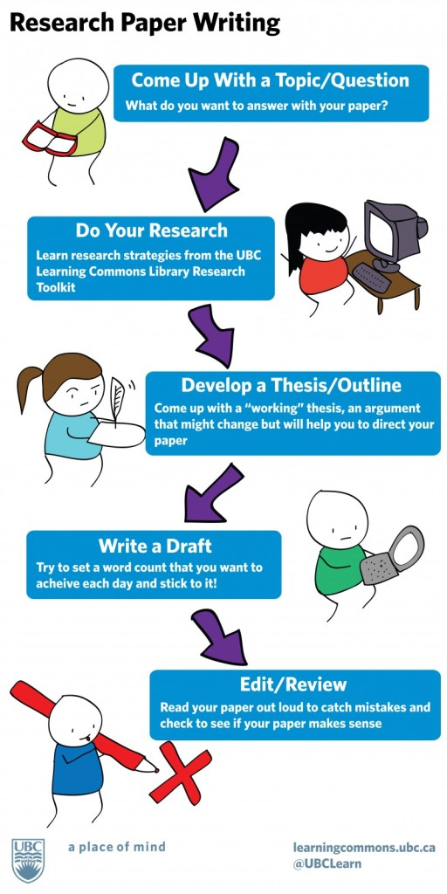

Slide 13
Revision and Proofreading
These last two stages of the writing process are often confused with each other, but they mean very different things, and serve very different purposes.
Revision is literally “reseeing.” It asks a writer to step away from a piece of work for a significant amount of time and return later to see it with new eyes. It allows some space in between, to let thoughts mature, connections to arise, and gaps in content or an argument to appear.
It’s also difficult to do, especially given that most college students face tight time lines to get big writing projects done. Still, there are some tricks to help you “resee” a piece of writing when you’re short on time, such as reading a paper backward, sentence by sentence, and reading your work aloud. Both are ways of re-conceptualizing your own writing so you approach it from a fresh perspective. Whenever possible, though, build in at least a day or two to set a draft aside before returning to work on the final version.
Proofreading, on the other hand, is the very last step taken before turning in a project. This is the point where spelling, grammar, punctuation, and formatting all take center stage.

Slide 14
Using Sources
Using Sources
College courses offer a few opportunities for writing that won’t require using outside resources. Creative writing classes, applied lab classes, or field research classes will value what you create entirely from your own mind or from the work completed for the class. For most college writing, however, you will need to consult at least one outside source, and possibly more.
The following video provides a helpful overview of the ways in which sources are used most effectively and responsibly in academic writing.
https://youtu.be/u6Pxx5q2u5g
Now take the writing strategies quiz located at the end of this section.

Slide 15
Testing
Just imagine how many tests have you taken in your lifetime:
In total, you may have taken an average of 113 standardized tests between pre-K and twelfth grade, according to the Council of the Great City Schools, which studied students in large urban districts.
You may feel as though you’ve already taken enough tests for a lifetime! But, for better or for worse, testing seems to be a fact of life, and it’s certainly a recurring feature of the college experience. So you’ll be in the best position for success if you can learn to take tests in stride and develop good test-taking skills.

Slide 16
Test Anxiety
For many test takers, preparing for a test and taking a test can easily cause worry and anxiety. In fact, most students report that they are more stressed by tests and schoolwork than by anything else in their lives, according to the American Test Anxiety Association.^{[2]}
Roughly 16–20 percent of students have high test anxiety.
Another 18 percent have moderately high test anxiety.
Test anxiety is the most common academic impairment in grade school, high school, and college.
Test anxiety is “the set of phenomenological, physiological, and behavioral responses that accompany concern about possible negative consequences or failure on an exam or similar evaluative situation.” (Zeidner, 1998) Put another way, test anxiety is a combination of overarousal, tension, worry, dread, fear of failure, and “catastrophizing” before or during test situations.

Slide 17
Moderate Anxiety | Extreme Anxiety
Being distracted during a test | Overanxious disorder
Having difficulty comprehending relatively simple instructions | Social phobia
Having trouble organizing or recalling relevant information | Suicide
Crying
Illness
Eating disturbance
Cheating
Acting Out

Slide 18
Test Performance
Poor test performance is also a significant outcome of test anxiety. Test-anxious students tend to have lower study skills and lower test-taking skills, but research also suggests that high levels of emotional distress correlate with reduced academic performance overall. Highly test-anxious students score about 12 percentile points below their low-anxiety peers. Students with test anxiety also have higher overall dropout rates. And test anxiety can negatively affect a student’s social, emotional, and behavioral development, as well feelings about themselves and school.

Slide 19
Strategies for Preventing and Controlling Test Anxiety
The following video, from the University of British Columbia, provides strategies for coping with any stress and anxiety you may have about an upcoming test or exam. It also provides strategies, such as the following, for acing an exam: https://youtu.be/Z5Ru8sx5d1c
Ask about the exam (materials covered, format, points, level of detail, etc.)
Take inventory of your notes
Set a study schedule
Keep your diet consistent
Don’t stop exercising
Get regular sleep
Make a five-day study plan for each exam

Slide 20
ACTIVITY:
TEST YOURSELF FOR TEST ANXIETY
Objectives
Gain insight to your level of test anxiety
Determine your best strategies for lessening test anxiety
Directions
Visit the Test Anxiety Assessment at HowToStudy.com.
Click on the “Continue to Assessment” button. You have the option to take the test in Spanish.
Click on the best answer to each of the 35 questions.
When you’re finished, you’ll receive a brief assessment of your level of text anxiety. You can also click on a link to learn 20 ways to reduce your test anxiety.

Slide 21
Common Types of Tests in College
There are many ways to understand how tests and exams fit into academia and college culture. One way is to ask what purpose the tests (also called assessments) serve. For example, what is your professor trying to achieve if she gives you a survey-type test on the first day of class? How might the purpose of that test differ from that of, say, a practice quiz given before a midterm? And what is the purpose of a midterm?
Obviously, each survey, quiz, practice test, midterm, and final exam can serve different purposes. Depending upon the purpose, the assessment will fall into one of the following three categories:
Pre-assessment
Formative assessment
Summative assessment

Slide 22
Common Types of Tests in College
Pre-assessments: Tests in this category are used to measure the beliefs, assumptions, knowledge, and skills that you have when you begin a class or before you begin working on a new topic. With preassessments, your professor gathers baseline data to use at a later time to evaluate change—that is, by comparing former knowledge or skills against what you learn in class.
Formative assessments: Tests in this category are typically quizzes, pop quizzes, review questions, and practice tests. With formative assessments, your professor’s goal is to monitor what you are learning and get feedback from you about what is needed next in teaching. Did students do well on the quiz? If so, it’s probably time to move to the next topic. If they didn’t do well, it suggests that more teaching time should be devoted to the concept. Formative assessments help the instructor to better meet your needs as a learner.
Summative assessments: Tests in this category are the assessments that students are most familiar with: midterm and final exams. In a summative assessment, a professor is evaluating how much you actually learned at the end of an instructional unit by comparing it with a benchmark of what you should have learned. Summative assessments can be stressful, but they can be an effective measurement tool. Most summative assessments are graded.
In college courses, tests are usually verbal—you might be asked to give an oral presentation, for example—or written—you might be asked to mark or write out your answers on paper or on a computer. For special courses you might also encounter physical tests, in which you’re asked to perform a set of skills (like demonstrating the procedure for giving someone CPR, for instance).

Slide 23
Common Test Types
Written
MC
T/F
Essay
Matching
Fill in the blank
Oral Tests
Physical Tests

Slide 24
Test Taking Strategies Test Taking Tips For Specific Types of Tests
Test Taking Strategies PDF

Slide 25
Strategies for Better Test-Taking Performance
LAB B2OWL DESCRIPTION
L LOOK: Look over the entire exam before you start. Take care to read the directions, underline test words, and circle questions you don’t fully understand.
A ASK: If you have any questions at all, ask. For example, if the exam doesn’t indicate total point allocation, be sure to ask your instructor.
B BUDGET: Budget your time based on the point allocation for each question. For instance, let’s say your exam has one essay question worth 50 percent, and 5 identifications worth 10 percent each. If you have two hours to take the test, this gives you one hour to complete the essay, and 10 minutes for each of the five short-answer questions. You will have 10 minutes in reserve to review your work before turning it in.
B2 BEGIN X 2: Begin with an easy question in order to build your confidence and get warmed up for the rest of the exam. Begin each answer with a thesis topic sentence. Restate the question in a single sentence to help you focus your answer.
O OUTLINE: Be careful to write a quick outline for your essay on a separate page before you begin. This will help you organize your facts and focus your ideas. It might also serve to show your professor where you were going if you don’t have time to finish.
W WATCH: Watch for key testing words like analyze, define, evaluate, and illustrate. These help you understand what your professor will be looking for in an answer.
L LOOK: Finally, look over your exam before turning it in to make sure you haven’t missed anything important.

Slide 26
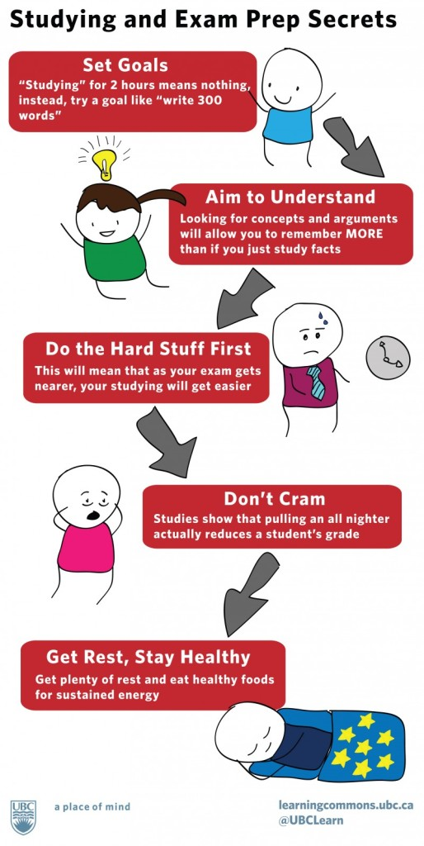

Slide 27
End of Section Quiz
Take the end of section Testing Strategies Quiz found in the course online textbook.

Slide 28
Presentation Strategies
Life After Death By PowerPoint Video Clip

Slide 29
Presentation Strategies
Choosing a font that is too small. The person in the very back of the room should be able to see the same thing as the person in the front of the room.
Putting too many words on a slide. Remember it’s called PowerPoint, not PowerParagraph! Keep your bullet points clear and succinct.
Having spelling errors. Have somebody proofread your slides. Any typos will detract from your presentation.
Choosing distracting colors that make it hard to read the information. PowerPoint gives you a lot of color choices in their design templates. The ideas in your brilliant presentation will be lost if your audience is struggling to read the content.
Selecting images or visuals that do not clearly align with the content. For instance, a cute photo of your cat may look lovely up on the screen, but if it doesn’t connect to your topic, it’s just fluff that detracts from your message. Every slide counts, so make sure the visuals support your message.

Slide 30
ACTIVITY: MAKE A PRESENTATION PLAN
Objective
Practice techniques to reduce anxiety prior to and during presentation delivery
Directions
As you plan for your presentation, it’s helpful to reflect on the challenges you may face when you present to your audience. Jot down a quick list of strengths and weaknesses. Be honest!
Now that you have an honest reflection of those strengths and weakness, it’s time to practice. Ask a friend or family member to watch you present. Request that they be honest with you and give constructive criticism about the strengths and weaknesses of your presentation. Have them jot down quick notes.
After the practice presentation, compare notes with the friend or family member. Compare and contrast how you felt about the quality of your presentation with the feedback you received. Use this information to help improve your presentation delivery.
What if you don’t have anyone available to practice your presentation? Record yourself using your phone or your laptop. It can be very difficult to listen to yourself, but it’s always enlightening to watch and/or listen to yourself present.

Slide 31
Taking Notes
It is impossible to write down everything your teacher says during a lecture. As you become a more skilled learner, you will learn how to glean what is important from a lecture. Here are some things that can help you organize your notes and your understanding of the content in them.
Consider these things before you start writing:
Where are you going to keep your notes? 3 ring binder, folder, spiral notebook? Taking notes with a computer in your math class may prove difficult when you need to draw a graph or geometric object.
How are you going to organize your notes on the page?
What purpose do your notes serve?
How do you plan to use your notes?

Slide 32
Organizing Your Math Notes
Before and During Class
As with any kind of class, you may need some time to figure out how to best organize the information you want to record. There are many popular styles of note-taking and if you have one you prefer, there is no reason to change. If you want to explore more ideas that have worked well for other students in math courses, consider these:
Split your page into two columns, one for descriptions/ definitions and one for examples
Cornell notes—good old “C Notes”—can be helpful, but require some deeper thinking than you may be able to do on the fly during a lecture. Consider saving C notes for use while reading your textbook, instead.
If you don’t understand something, write it down anyway and mark clearly that you have a question about it. If you don’t have time in class to ask about it, get help with it later. Writing down what you don’t understand may be the most important part of taking notes!

Slide 33
Organizing Your Math Notes
Homework journal
Summarizing/ Reviewing
After Class / Homework

Slide 34
Preparing for Your Math Exam
Recall the four sensory modalities in Fleming’s Learning Styles model:
Visual learning
Auditory learning
Read/write learning
Kinesthetic learning
You can use the understanding you have of your own learning style to your advantage as you prepare for a math exam.

Slide 35
Preparing for Your Math Exam
Visual/Spatial
Visual learners make sense of the world through pictures and images. They learn well when lesson plans incorporate photos, videos, or visual maps. A visual learner may describe their understanding as images or pictures rather than with words, and are drawn to design and spatially focused.
If you learn with pictures and images, you may benefit from creating drawings related to each concept. Diagrams and visual cues can help visual learners make important connections between concepts. Mind maps may also be a helpful tool for further solidifying your understanding of how mathematical concepts are connected. Additionally, if you are visual, you could color code your notes and study materials.
Auditory Learners
Aural learners are best equipped to understand and store information absorbed via sound and music. Their ears are particularly adept at deconstructing and parsing heavy mixes of tones. They will often do better with books on tape versus printed versions.
Many aural learners enjoy listening to music. Playing pleasant music in the background while learning mathematics can evoke positive emotions and stir up a bit of energy while you are working. Just make sure that the music is not overly distracting or played too loud. In addition, musical minded people can try to organize formulas and operations into musical patterns or rhymes. Coming up with a rhyme or melody to remember the quadratic equation may be more effective than simply attempting to remember the visual image of the formula. It may also help to find someone who will listen to you explain what you are learning or studying.

Slide 36
Preparing for Your Math Exam
Read/ Write
Read/ Write learners may prefer learning with words—both with speech and writing. If you are a read/ write learner you may soak up knowledge through various mediums centered around language. If you prefer learning this way, try sitting down after class to rewrite your notes. Translating a mathematical expression, graph, or equation into words may also help. If you learn from reading and writing, keeping a homework journal may be very beneficial to you.
Physical/Kinesthetic
Physical learners learn best by touch and movement. A lot of superb athletes tend to fall into this category as physical processes and activities seem to sync well with their learning and memorizing capabilities.
For physical learners, studying may seem like torture, but if you are committed to it, there are ways. If you tend to learn best when active, it is important for you to stay in motion while studying. This could involve squeezing a stress ball while working, or simply taking a break every 20 or 30 minutes to walk around the room. Hands on models are terrific as well when applicable. If there is a tangible learning device that you can actually touch and interact with, all the better.
As you work through problems to study for your exam, use this decision tree to help you optimize your time.

Slide 37
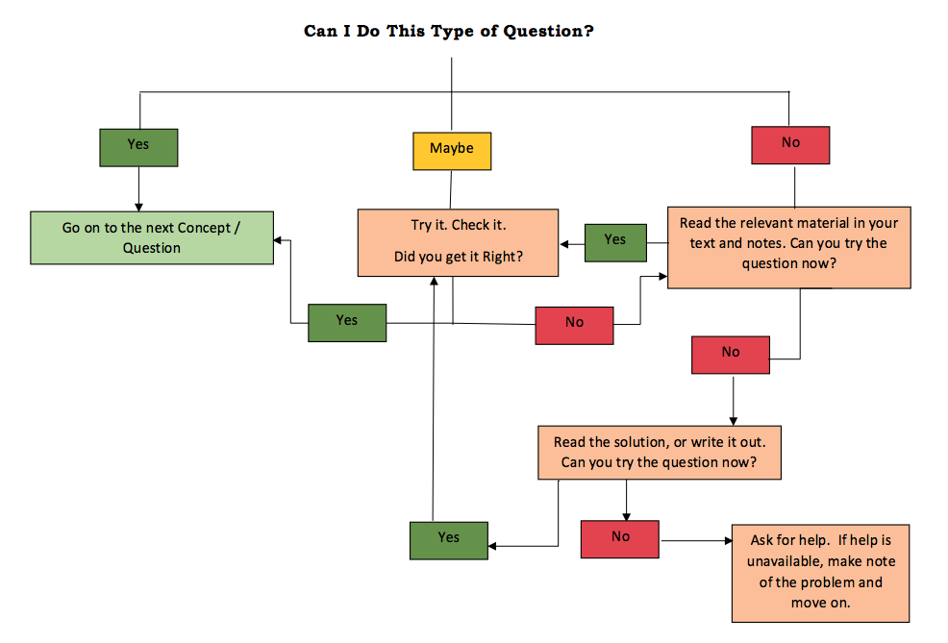

Slide 38
The Six Types of Test-Taking Errors
Carelessness. You lost focus on the question and made a silly error (like changing a sign or inventing a new rule of algebra).
Directions. You skipped over or misunderstood directions and as a result you did the problem incorrectly.
Concept. You did not understand the properties or principles required to work the problem.
Application. You understood the concepts involved, but did not apply them correctly in the context of the specific problem presented.
Nerves. You made errors in judgment due to the pressure of the test-taking environment. These include not completing the problem to the last step, changing a correct answer to an incorrect answer, getting stuck on one problem and spending too much time on it, rushing through the easiest parts of the test and making careless mistakes, leaving answers blank (no partial credit), or leaving early and not checking all of your answers.
Preparation. You studied the wrong material, or did not spend enough time studying the relevant topics.
Identifying what kinds of error you made will help you focus your strategy for study and preparation for the next exam. You can develop a plan for how to prevent similar types of errors, once you know where to concentrate your efforts.

Slide 39
Guidelines for Communicating with Instructors
Getting along with instructors and communicating well begins with attitude.
Prepare before meeting with the instructor. Go over your notes on readings and lectures and write down your specific questions.
Be sure to introduce yourself. Especially near the beginning of the term, don’t assume that your instructor has learned everyone’s name yet, and don’t make him or her have to ask you.
Respect the instructor’s time.
Understand that the instructor will recognize you from class. If you spent a lecture hour not paying attention, it will reflect badly on you to come to an office hour to find out what you missed.
Don’t try to fool an instructor. Insincere praise or making excuses for not doing an assignment will rarely play in your favor (they’ve heard it all before!).
Try to see things from the instructor’s point of view. Imagine that you spent hours preparing for class, on a topic that you find very interesting and exciting. You are gratified when people understand what you’re saying—they really get it! And then a student after class asks, “Is this going to be on the test?” How would you feel?
Be professional when talking to an instructor. You can be cordial and friendly, but it’s ideal to keep it professional and on an adult level. Come to office hours prepared with your questions—not just to chat or joke around. (Don’t wear sunglasses or earphones in the office or check your cell phone for messages.) Be prepared to accept constructive criticism in a professional way, without taking it personally or complaining.

Slide 40
Effective Email Communication with Instructors
Just as digital messaging has become a primary form of communication in business and society, it has a growing role in education and has become an important and valuable means of communicating with instructors. Most college students are familiar with digital messaging, such as email, texting, and messages via the online-course learning-management system. Using digital messaging respects other people’s time, allowing them to answer at a time of their choosing.
However, digital communication with instructors is a written form of communication that differs from communicating with friends. Students who text with friends often adopt shortcuts, such as not spelling out full words, ignoring capitalization and punctuation, and not focusing on grammar or using full sentences. Such texts are usually very informal and are not an appropriate style for communicating with instructors. Your instructors expect you to use a professional, respectful tone and fairly formal style.
See the next slide for more specific tips…

Slide 41
Effective Email Communication with Instructors
Use a professional email name. If you have a nickname you use with friends, create a different account with a professional name for use with instructors, work supervisors, and others. “BoatyMcBoatface” is not an appropriate, professional email name.
Include something in the subject line that readily communicates the purpose/topic of your email: “May I make an appointment?” says something; “Help!” doesn’t.
Address digital messages as you do a letter, beginning “Dear Professor ____.” Include your full name in the closing.
Get to your point quickly and concisely.
Write as you would in a paper for class, avoiding sarcasm, criticism, or negative language.
Avoid abbreviations, nonstandard spelling, slang, and emoticons like smiley faces.
Be courteous, accommodating, and respectful. Avoid stating expectations like, “I’ll expect to hear from you soon” or “If I haven’t heard by 4 p.m., I’ll assume you’ll accept my late paper.”
When you reply to a message, leave the original message within yours.
End the message with a “Thank you” or something similar.
Proofread your message before sending it.
Wait to send if you are upset. With any important message, it’s a good idea to wait and review the message later before sending it. You may have expressed an emotion or thought that you will think better about later. Many problems have resulted when people send messages too quickly without thinking.

Slide 42
Conflict-Resolution Strategies
Here are guidelines for talking about a grade or resolving any other problem or disagreement with an instructor:
Go over the requirements for the paper or test and the instructor’s comments. Be sure you actually have a reason to evaluate the grade—not just that you didn’t do well. Be prepared with specific points you want to discuss.
Make an appointment with your instructor. For face-to-face classes, don’t try to talk about your concern before or after class.
Be polite. Begin by politely explaining that you thought you did better on the assignment or test (not simply that you think you deserve a better grade) and that you’d like to go over it to better understand the result.
Allow the instructor to explain his or her comments on the assignment or grading of the test. Don’t complain or whine; instead, show your appreciation for the explanation. Raise any specific questions, or make comments at this time. For example, you might say, “I really thought I was being clear here when I wrote . . .”
Use good listening skills. Whatever you do, don’t argue!
Ask what you can do to improve the grade, if possible. Can you rewrite the paper or do any extra-credit work to help make up for a test score? While you are showing that you would like to earn a higher grade in the course, also make it clear that you’re willing to put in the effort and that you want to learn more, not just get the higher grade.
If there is no opportunity to improve on this specific project, ask the instructor for advice on what you might do on the next assignment or when preparing for the next test. You may be offered some individual help or receive good study advice, and your instructor will respect your willingness to make the effort—as long as it’s clear that you’re more interested in learning than getting a good grade.

Slide 43
Working with Instructors: Key Points
Go the extra mile: Talk to your professor when you
  Need an extension
  Need clarification on course material
  Are experiencing challenges in your personal life that impact your academic performance
  Are considering pursuing a major or graduate degree in their subject area
Visit early: Building rapport with your professors early in the semester will pay off if you need an extension or extra help later on. Professors like it when you visit office hours, but they don't appreciate it when panicked students ask for an extension an hour before an assignment is due. Most professors will be very accommodating if you ask for help well in advance.
Show your interest: Professors want you to be as interested in their subject as they are. Nothing excites them more than knowing you are passionate about what they teach. You can show your interest by participating in class, attending office hours, and emailing your professors if you have questions.
Meet your professor: Professors have many responsibilities to juggle including research, teaching, traveling to conferences, and administrative tasks. However, they DO want to talk with you. Go to office hours and meet your professors!
Build relationships: Believe it or not, your professors are really interesting people. You might just enjoy their company. They can also open doors to academic research, serve as mentors, and may write you a reference letter down the road. Build strong relationships with your profs while you have the chance.

Slide 44
Deep Learning vs. Cramming
How can you tell if you are actually engaged in deep learning? Dr. Bain offers the following classification of learners:
Surface learners: They do as little as possible to get by.
Strategic learners: They aim for the highest grades rather than for true understanding.
Deep learners: They gain a real, rich education in college because they pursue their passions more than grades. They are also comfortable with experimenting more than with “getting it right,” and they develop a personal connection to their studies.
Which learner do you feel you are now? Are you drawn to learn more deeply?

Slide 45
Deep Learning vs. Cramming
Learning deeply goes beyond just test scores. It connects to skills you will need the rest of your life, like critical thinking, critical analysis, applying principles to solve problems, assessing your effectiveness, revising, and applying what you know.

Slide 46
Techniques for Learning and Retaining Knowledge
Sometimes the best way to learn a new idea is to first “unlearn” an old idea that’s hindering the new one. This is certainly the case with principles of learning, because there are many misconceptions about how people best acquire knowledge and retain it. Below, we identify and deconstruct some of these misconceptions and replace them with ideas you can use to help you learn deeply.

Slide 47
Myth 1: Talent Is Everything!
If you believe that your learning abilities are fixed, you'll put up mental blocks that hinder your learning. For example, if you usually get straight A's, you may avoid taking intellectual risks that take you out of your comfort zone or jeopardize your perfect record. Similarly, if you believe you are not good at something, like math, you may avoid really trying or lower your expectations.

Slide 48
Myth 1: Talent Is Everything!
Bust the Myth
Know that your beliefs affect your behaviors. Cognitive psychologist Dr. Stephen Chew calls these "beliefs that make you stupid." Watch his video, below, for suggestions on how to overcome these beliefs.
https://youtu.be/RH95h36NChI

Slide 49
Myth 1: Talent Is Everything!
Bust the Myth
Apply what you learn in practice. Practice builds accuracy and fluency. This fluency also builds the confidence and flexibility to apply what you've learned in different situations. Professor of mathematics, Michael Starbird, describes how practice leads to deeper understanding in the following video:
https://youtu.be/ii0xJDVF8c8

Slide 50
Myth 2:
I Only Need One Good Method for Studying
If your tried-and-true study strategies aren't working, use a different approach. Monitor your learning by measuring your knowledge against what you expect. Before you start studying, think about how it will go. Predict your homework and test results, and see if you're accurate or not. Notice when your expectations fall short of reality, or overshoot it, and adjust your approach accordingly. This is called "metacognition," and it's an important part of deep learning.

Slide 51
Myth 2:
I Only Need One Good Method for Studying
Bust the Myth!
Reflect on your studying by asking yourself these three questions: What did you do? Was it effective? What can you change? Practice self-testing, described in the following video:
https://youtu.be/xIDkTZtOUq8

Slide 52
Myth 2:
I Only Need One Good Method for Studying
Bust the Myth!
Test your perceptions. After an exam, make a prediction of how many questions/problems you answered correctly. When you get the test back, see how your score matched with your prediction. If you were way off, consider changing your study strategy to incorporate more self-testing, spaced study sessions and varied approaches to practice.
Use strategies like generating your own questions and creating concept maps. Need some guidance? Take a look at the following video by Dr. Stephen Chew:
https://youtu.be/E9GrOxhYZdQ

Slide 53
Myth 3: If It's Easy, I Must Be Learning
When faced with familiar terms or examples, you might find yourself feeling like you really understand the material. But in fact your brain might really just be responding to the fact that it has seen this exact material before. This is called the familiarity trap—when everything seems familiar and your brain doesn't have to work so hard and so it feels like you've mastered the material, even though you haven't. Try to mix things up as you're studying.
More and more evidence suggests that confusion is where deep learning lies. It might even be that some level of confusion actually activates the parts of your brain that regulate learning and motivation, helping you achieve a greater level of understanding. If you're not confused, you might not be learning.
Try not to let yourself get discouraged if it feels like you aren't understanding something. Not understanding can be a good sign.

Slide 54
Myth 3: If It's Easy, I Must Be Learning
Bust the Myth
Retrieve—don't regurgitate. Develop your own test questions, ask yourself questions, solve sample problems, and analyze for deeper meanings. Need some good questions to ask yourself? Try this: Why is this answer important? What does it relate to? How does this answer connect with what I already know? Can I elaborate this answer? Can I illustrate it with an example? Retrieving what you’ve learned from your memory helps you strengthen connections and relearn each time you do it, that is, every time you retrieve something from memory, you’re essentially re-learning it and creating different pathways for retrieval.

Slide 55
Myth 3: If It's Easy, I Must Be Learning
Bust the Myth!
If you're confused, don't give up. Working hard to understand a problem or to figure something out isn't a bad thing, and it will likely lead to a deeper understanding of the material, which will stay with you for a long time. This is especially important if your other courses build on that concept you are grappling with. If you need help developing new strategies, the following video might do the trick.
https://youtu.be/1xeHh5DnCIw

Slide 56
Myth 4: Planning My Learning Is a Waste of Time
Planning can also help you develop a workable schedule for studying. "Research shows spacing study episodes out with breaks in between study sessions or repetitions of the same material is more effective than massing such study episodes. Massing practice is akin to cramming all night before the test.” Clark, C.M., Bjork, R.A. (2014)

Slide 57
Myth 4: Planning My Learning Is a Waste of Time
Bust the Myth
Target your studying: Try to study key themes, and take what you know about the exam structure into account when you're planning. If you know you'll have an essay, write outlines! If you have to solve problems, go over homework or make up your own problems.
Review or practice throughout the term. Without regular review, you may have to relearn a large portion of the course right before the final.

Slide 58
Myth 5: Failure should be avoided at all costs
Seeing failure as an opportunity for learning requires a fresh mindset. Once you make a mistake, you can ask, why is THAT wrong?
Failure is an important aspect of much creative work, though it goes by a different name: iteration. Iteration is important in refining, working though problems, starting small, and refining until more can be added. Iteration is a feature of work in design, science, technology, and really any field where innovation is important.

Slide 59
Myth 5: Failure should be avoided at all costs
Bust the Myth
Use failure as an opportunity to rethink and relearn. Ask yourself why you got it wrong and what happened. What is an alternative approach? How might a new approach be more successful? Watch Prof. Michael Starbird's video about making mistakes as a strategy for learning:
https://youtu.be/Txq-bsbbhaY

Slide 60
Additional Study Techniques
The following are additional study techniques you can use to work your brain, raise your grades, perform well on assignments, and, most important, learn deeply. See your textbook for a detailed description of each technique.
Consider real-world applications.
Monitor your learning.
Seek specific and meaningful feedback.
Chunk the information you’re studying.
Set priorities.
Create association maps.
Make connections.
Ask questions to reduce bias.

Slide 61
Getting the Most out of Peer Groups
Studying with fellow classmates and/or working with them on projects and class assignments can significantly enhance deep learning.
Group work can help teams chunk bigger tasks into more manageable parts and steps. It can also help participants manage their time better. In addition, group work often involves discussion and collaboration, which can improve everyone's understanding of the material.
Another benefit is the opportunity for feedback on ideas and performance. And working in groups always helps members develop stronger communication skills—both speaking and listening skills.
Getting the most out of working in a group, though, itself requires some special skills. The following video, Group Work, from the University of British Columbia, offers some pointers.
https://youtu.be/2yvNngrj1jo

Slide 62
Academic Honesty and Dishonesty
Cheating
Cheating can take the form of crib notes, looking over someone's shoulder during an exam, or any forbidden sharing of information between students regarding an exam or exercise.
Deception
Deception is providing false information to an instructor concerning an academic assignment.
Fabrication
Fabrication is the falsification of data, information, or citations in an academic assignment.
Plagiarism
Plagiarism, as defined in the 1995 Random House Compact Unabridged Dictionary, is the "use or close imitation of the language and thoughts of another author and the representation of them as one's own original work."[
See the chapter for more detailed lists on plagiarism and how to avoid this common error.

Slide 63
Learning from Testing and Test Results
In this section we offer a response to that thought: believe it or not, testing benefits you, too.
You may learn more when you take a test than when you study for it or are just taught the material. For example, if you are asked to learn five formulas for a math test, you will likely remember the three formulas you are actually tested on better than the others.
When you are tested—especially often—it encourages you to study more and procrastinate less.
The more you retrieve information, as you do during a test or quiz, the more likely you are to retain it in the long run.
Taking a test helps your brain organize knowledge better, and that helps you retrieve the knowledge more efficiently.
So, testing is not just a method of measuring how much you know (or torturing you). It can actually help you learn. In addition, the results of a test—even when you don't do very well—can also enhance your learning in valuable ways.

Slide 64
Learning from Mistakes
Two of the most important messages that students hear from teachers is “Don’t be afraid to fail” and "Learn from your mistakes—yours, mine, and ours.”
The following TedEd talk explores these familiar ideas. The speaker, Diana Laufenberg, makes the case for why learning through experience, feeling empowered, and embracing failure are all so important to students—so much more so than just going to school to get information.
https://www.ted.com/talks/diana_laufenberg_3_ways_to_teach?language=en

Slide 65
Reflection and Further Study
For some additional guidance on what to do in the event of failure and how to proceed with your studies, watch Dr. Stephen Chew's video I Blew The Exam—Now What?
https://youtu.be/-QVRiMkdRsU

