Slide 1




Slide 2
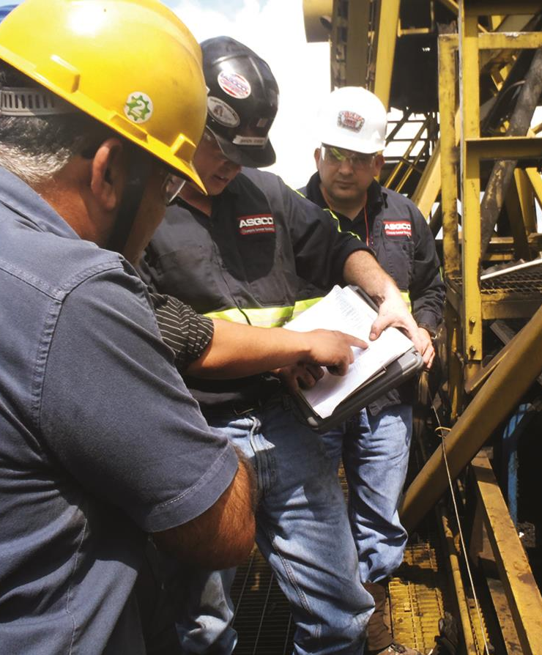

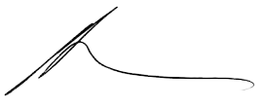
The ASGCO®
Promise
Applies to every client, every time.
Always think and work in terms of solutions that are best for the customer in the long term.
Provide prompt, reliable service
to every client, every time.
Develop and sell products that satisfy
the practical working needs of our customers.
Aaron Gibbs
President

Slide 3
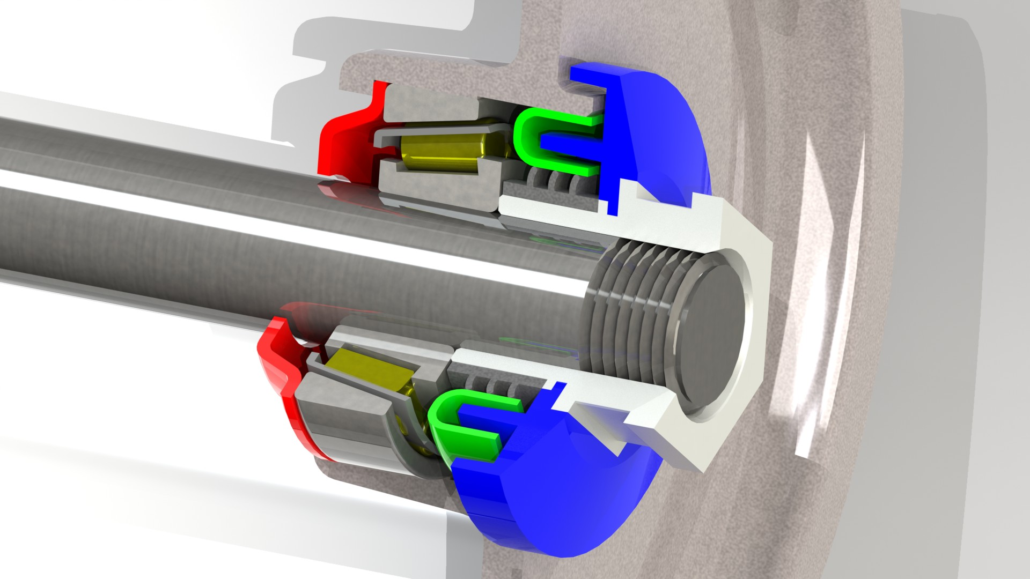
7
2
3
1
Tapered Roll Series
Designed for the CEMA C, D, E
and F Market
5,6
4
Adjusting Nut: Heavy duty precision machined adjusting nut secures the roll in the frame while serving to insure correct bearing and seal placement. Zinc plated for corrosion resistance.
Deflector: An impact resistant deflector provides first line protection against abrasive materials and washdown water.
Triple Labyrinth Seal: Durable, zinc plated inner metal labyrinth seal serves to fling out material and water while providing a smooth, corrosion resistant, heat conductive surface for the contact seal.

Slide 4
7
2
3
1
Tapered Roll Series
Designed for the CEMA C, D, E
and F Market
5,6
4
Triple Lip Contact Seal: Special wear resistant contact seal provides three levels of sealing against abrasive fines and washdown water. Suitable for dry, wet, and cold temperature conditions.
Tapered Roller Bearings: Distance from the bearings and shaft ends is minimized to achieve the highest load rating for the roll.
High Performance Grease: Lithium based extreme pressure (EP) grease offers excellent water, oxidation, and corrosion resistance under impact loads.
Back Seal: Durable back seal serves to retain a plentiful amount of grease in reserve for the bearings while shielding the bearings from any possible internal contaminates.

Slide 5
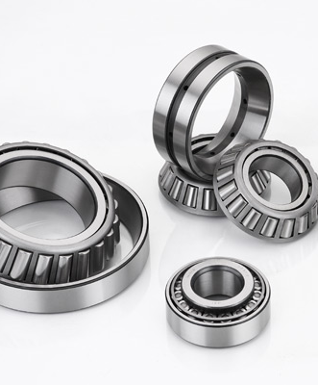
Quality Bearings
Modified Geometry Tapered Roller Bearings
High quality, through-hardened, anti-friction bearings with modified race
and roller contours to decrease
contact stresses.
Third Party (NES) Source Qualification Inspection (SQI)
Baseline Manufacturer (SKF) used for Comparison
Items Compared:
Dimensions and Tolerances
Race & Roller Profile and Contour
Surface Finish
Chemistry (AISI/SAE 52100 Alloy Steel)
Microstructure (Grains and Boundaries)
Hardness Range (Typically 58-64 HRc)
Inclusions and Contaminates
Basic Static & Dynamic Radial Load Rating

Slide 6
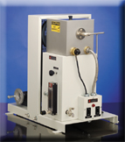
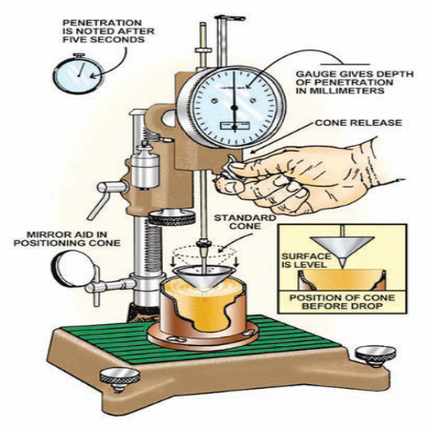
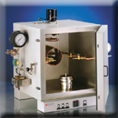
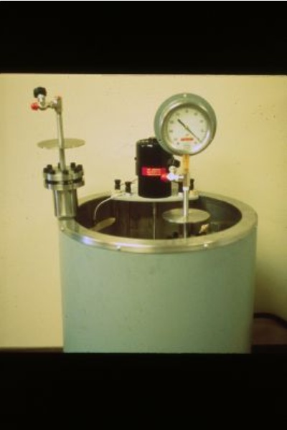
Standard Grease
National Lubricating Grease Institute
(NLGI) Grade 2
Broad Temperature Range
Resistant to Water Washout
Additives to Inhibit Bearing Corrosion and Grease Oxidation
Extreme Pressure (EP) Additives to Handle Impact Loads
Water Resistance Testing
Penetration Testing
Oil Separation Testing
Oxidation Testing
Oxidation Testing

Slide 7

Processed Heads
Ductile Iron Casting (65ksi Tensile, 45ksi Yield, 12% Elongation)
Tested in Cold Temperature Applications (-50 deg C)
Precision Machined for Excellent Bearing and Seal Alignment
Improves Concentricity of the Shell (Meets DIN Standard 22112)
Proven in High Speed Applications (up to 9 m/s)
Achieves ISO 1940 Imbalance Rating of G40 or Better
Proven Performance in High Load Applications (96” Belt Widths/60mm Bearings)
Can be used in Garland & Impact idler Configurations
Can be supplied in Aluminum (Head and Tube) for Weight Savings
Available in Ball Bearing or Taper Roller Bearing Configurations
Sealed for Life Applications with a variety of Seal Configurations

Slide 8
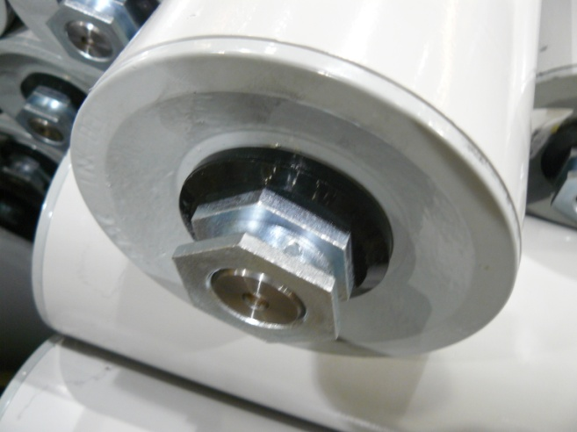
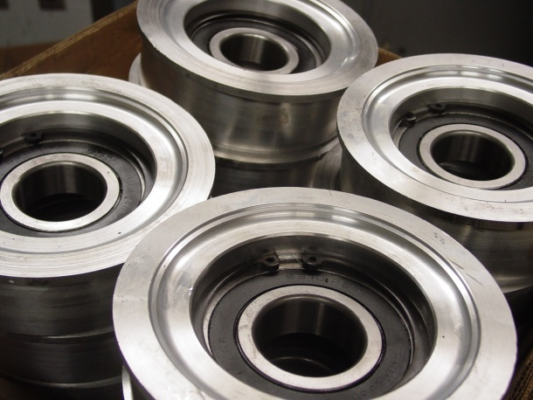

Slide 9
Resistance to Dust
(Standardized Test) DIN 22112
Measures the effectiveness of the seals to limit the ingress of dust particles.
Shaft is held stationary as the horizontal shell is rotated at 1 m/s.
Dust is agitated for 96 hours with paddles affixed to the shell.
Rolls are removed and disassembled to reveal the amount of ingress.
Results are both quantitative and qualitative.
Amount and rate of ingress can be measured.
Condition of any components can be identified.
Results are relative to the material and test conditions used.

Slide 10
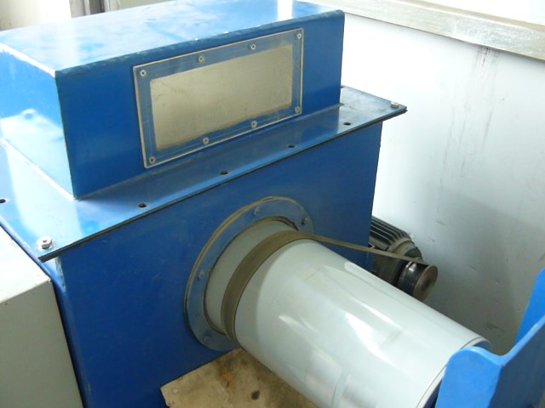
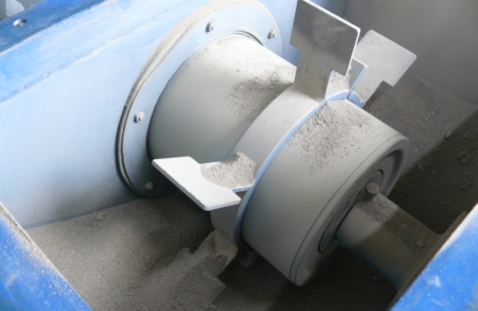

Slide 11
Quality Shafting
Cold Finished AISI C 1018 Low Carbon Steel
Excellent Machinability and Strength
Excellent Straightness and Concentricity
Excellent Surface Finish
Minimum Mechanical Properties:
64ksi Tensile, 54ksi Yield, 15% Elongation
STANDARD SHAFTING
AISI C 1018 Low Carbon Shafting
LOAD RATING | Shaft OD (Inches)
CEMA D | 0.750
CEMA E | 1.250
CEMA F | 1.750

Slide 12
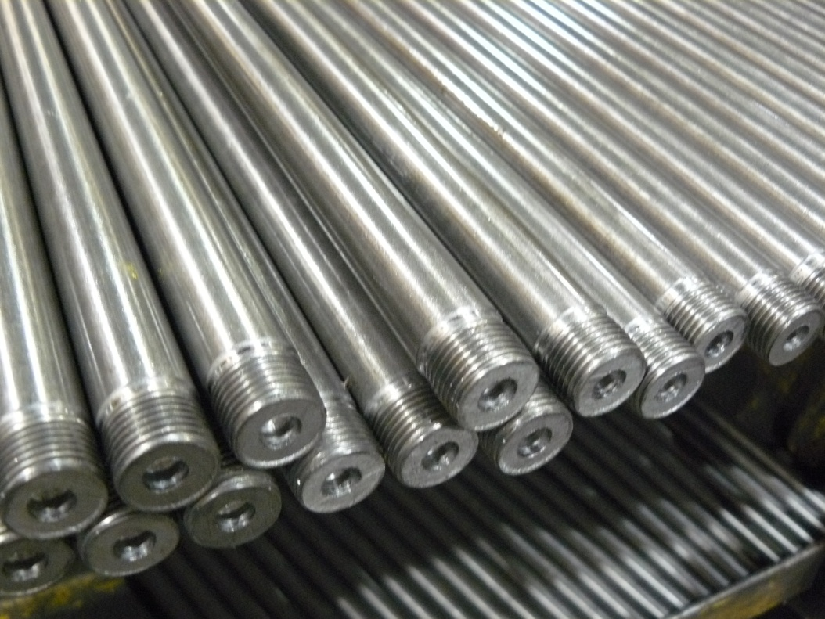
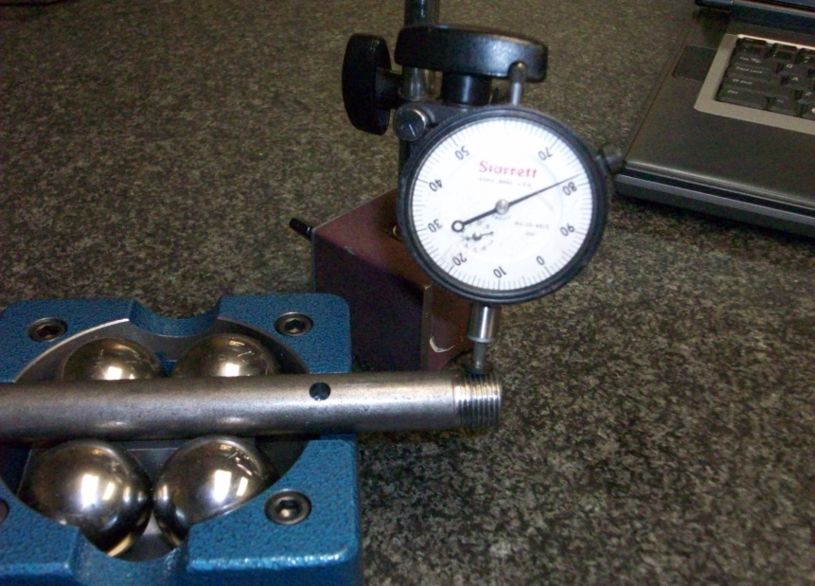

Slide 13
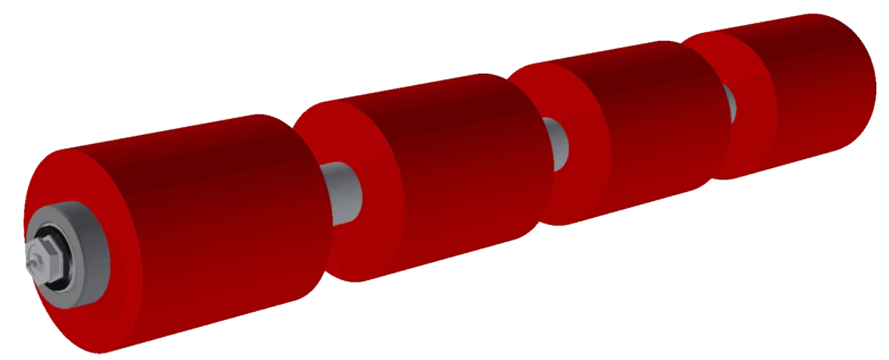
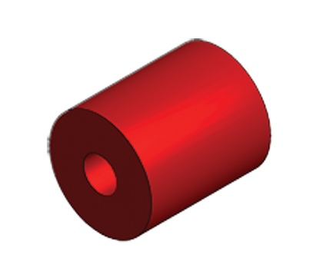
Dura-Sleeve™
Urethane Disc Return Idler
ROLLS
SHAFT
ADJUSTING RING
PATENTED REPLACEABLE SLEEVE
Also available for both CEMA
D, E and F Idlers
6”
7”

Slide 14
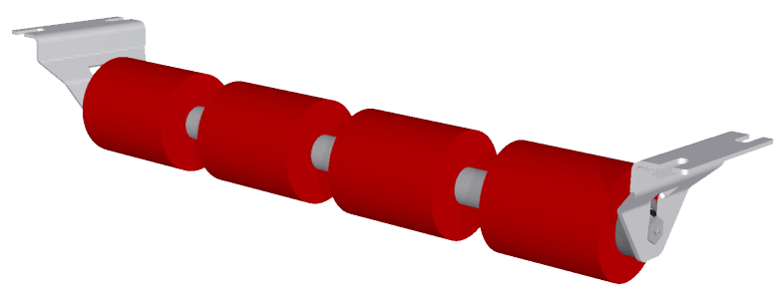
Dura-Sleeve™
Dura-Sleeve™
Urethane Disc Return Idler
Dura-Sleeve™ Return Idlers are a patented abrasion resistant urethane sleeve that is easily clamped on any existing or new rubber or urethane
disc return idler shaft.
They are used in abrasive mining conditions such as Iron Ore, Coke, Copper/Gold Ores underground coal mining and other hard rock mining conditions where traditional rubber disc and steel idlers do not last.
They are also used when wet or sticky materials tend to cling to the belt, where corrosion resistance us required or where chemical reaction to
iron or steel is involved.

Slide 15
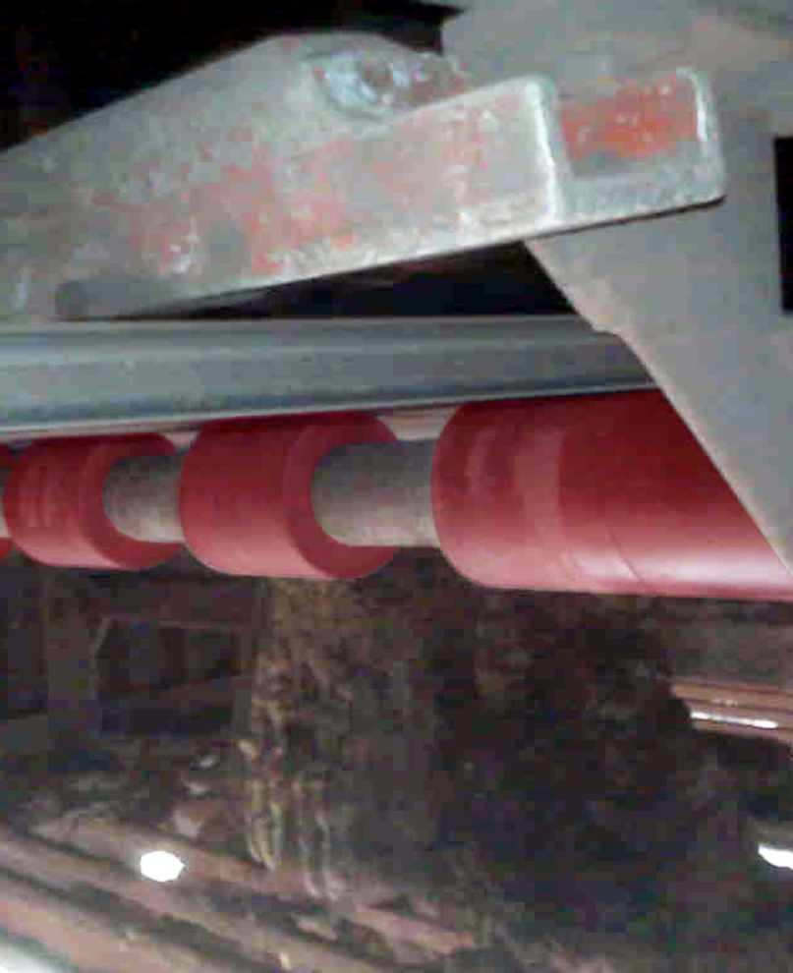
Dura-Sleeve™
Patented Replacement Sleeves
ASGCO®-Thane construction for
extra long wear.
5 year warranty, the longest warranty
on any Dura-Sleeve Idler.
Sleeves are also available for both
CEMA D and E Idlers.
Perfect concentricity promotes better
belt tracking
Long wearing life in abrasive environments
No material build-up

Slide 16
Dura-Sleeve™
Patented replaceable sleeves are also available in both CEMA D and CEMA E idlers
CEMA D DURA-SLEEVE™ IDLERS
Bearings
30 mm (1.1811 inch bore) precision
tapered roller with seals on both sides
Seals
Quad horizontal labyrinth outer seal
and dual lip nitrile rubber inner seal
Delrin outer labyrinth member
Bearings feature contact seals on both sides
Shaft
Solid 30 mm (1.1811-inch) ASTM A-108
C1018 CD material
2” OD
Dura-Sleeves
6” OD x 7” long
7” OD x 7” long
CEMA E DURA-SLEEVE™ IDLERS
Bearings
40 mm (1.5748 inch bore) tapered roller
bearing with seals on both sides
Seals
Quad horizontal labyrinth outer seal
and dual lip nitrile rubber inner seal
Delrin outer labyrinth member
Bearings feature contact seals on both sides
Shaft
Solid 40 mm (1.5748-inch) ASTM A-108
C1018 CD material
2.75” OD
Dura-Sleeves™
6” OD x 7” long
7” OD x 7” long

Slide 17


