Slide 1
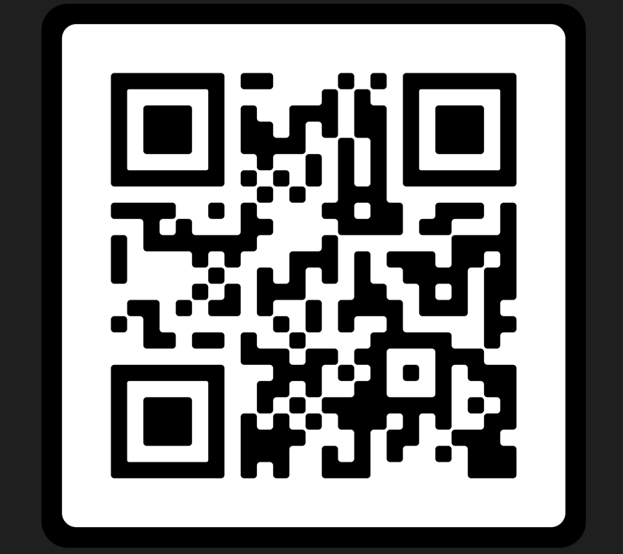
Structured Literacy
Four Schools’ Journeys

Slide 2
Agenda:
Chapter 49, Jennifer Wicht and Kate Bacher, PDE
West Shore School District
State College Area School District
Gettysburg Area School District
Halifax Area School District
SL Resources, Dr. Pam Kastner, PaTTAN

Slide 3
Structured Literacy
Locally Established, Grade-Based Requirement (LEGBR)
Alternative Assessment Pathway:
AP Exam Criterion
Systematic, explicit instruction that provides a strong core of foundational skills in the language systems of English
Integrates listening, speaking, reading, spelling, and writing
Emphasizes the structure of language across the speech sound system (phonology), the writing system (orthography), the structure of sentences (syntax), the meaningful parts of words (morphology), the relationships among words (semantics), and the organization of spoken and written discourse
Notes:
Clarification on the term “hold” and who will need to engage in Structured Literacy professional development by the end of the 2023-2024 term.
Early Childhood (PreK-3)
Elementary(K-6 or K-4)
Middle (4-8 or 6-9)

Slide 4
Structured Literacy Training
To ensure that school personnel have the knowledge and skill to teach all students to read, including students with dyslexia and other language-based learning disabilities, training shall address, but shall not be limited to:
1
Evidence-based intervention practices on structured literacy.
2
Explicit and systematic instruction in phonological and phonemic awareness.
3
The alphabetic principle, decoding and encoding, fluency and vocabulary.
4
Reading comprehension and building content knowledge.

Slide 5
Pennsylvania Educator Certification Preparation
Per the Chapter 49 Amendment (2022), Educator Preparation Programs (EPPs) require implementation of the Structured Literacy competencies into five certification programs by the 2024-2025 academic year. Assurance forms must be completed for these certification areas.
  Assurances for Structured Literacy Competencies Approval are required for Grades PK-4, Grades 4-8, Special Education PK-12, Reading Specialist PK-12, and EL Program Specialist PK-12 certification programs
Providers submit Assurance Forms by August 31, 2025.
For Major Reviews and Initial Program Reviews conducted after
August 31, 2025, program matrices will be expected to incorporate these sets of competencies.

Slide 6
Who and When?
Training in structured literacy for educators who hold instructional certificates in the following areas:
Early Childhood
Elementary/Middle
Special Education PreK—12
English as a Second Language
Reading Specialist
Locally Established, Grade-Based Requirement (LEGBR)
Alternative Assessment Pathway:
AP Exam Criterion
Competency Program Framework Guidelines | Continuing Professional Development Programs | Induction Programs | Ed Prep Programs
Structured Literacy | 2023-24 Academic Year* | Not applicable | 2024-25 Academic Year
Notes:
Clarification on the term “hold” and who will need to engage in Structured Literacy professional development by the end of the 2023-2024 term.
Early Childhood (PreK-3)
Elementary(K-6 or K-4)
Middle (4-8 or 6-9)

Slide 7






Comprehensive Plan
A school entity shall submit to the Secretary for approval a 3-year professional education plan every 3 years in accordance with the professional education guidelines established by the Secretary.
Language and Literacy Acquisition, including Structured Literacy Program Framework Guidelines
Notes:
The professional development plan must include a description of how the school entity will offer all temporary and professional employees opportunities to participate in continuing education and must be submitted every three years as a report included in the Comprehensive Plan.

Slide 8

PDE Introduction to Structured Literacy

Slide 9
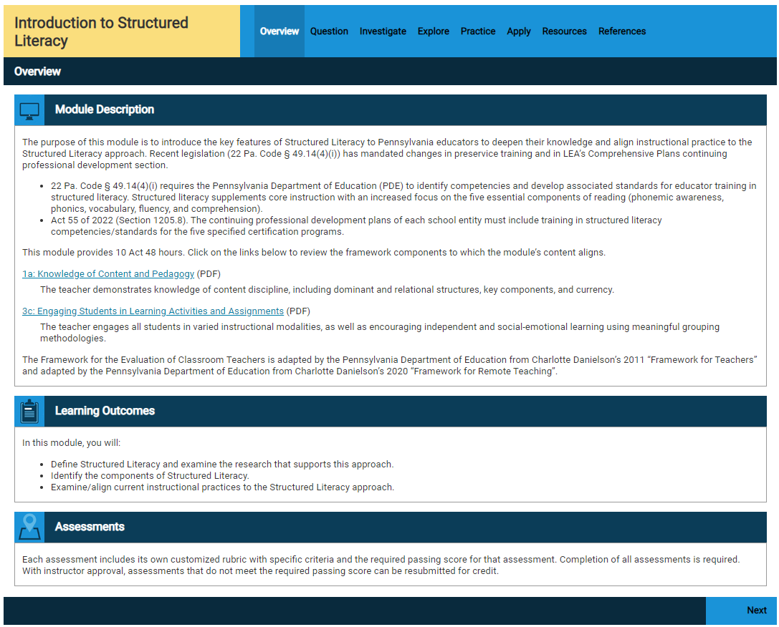
SAS Structured Literacy Course
Notes:
Explanation of the course structure, etc.

Slide 10
Structured Literacy Support
SAS Professional Learning Communities
  Important documents and resources in one location
  Communicate with others invested in SL
  PDE ELA Community and PDE SL Community
  Monthly ELA Community eBlasts featuring SL
  Communities - SAS
Notes:
PD required but implementation is not

Slide 11
West Shore School District
Angela Cibulka, Literacy Specialist
Angie Naugle, Kindergarten Teacher
Lisa Saar, Second Grade Teacher
The West Shore School District, located between Harrisburg and York in southcentral Pennsylvania, has eight elementary schools, three middle schools, two high schools, and a virtual learning academy. With more than 7,500 students and approximately 930 staff members, West Shore is the third largest public school district in the Greater Harrisburg metropolitan area.

Slide 12

Notes:
Candy toss - How do you feel when you are asked about Structured Literacy?

Slide 13
Where do we begin?
Master schedules aligned
Interactive training for all
Mindset shift (NOT how can I identify kids who need additional support…what can I do to strengthen CORE AND who needs additional support)
Resources to strengthen Tier 1, 2, and 3
  Ex. 95% Group, Heggerty, KidLips, Sound Wall, Secret Stories, PALS, Sonday System, Heart Words, 95% Multisyllabic Rts.
  NOT all at once
Keep It Slow and Simple!
Where do we begin?

Slide 14
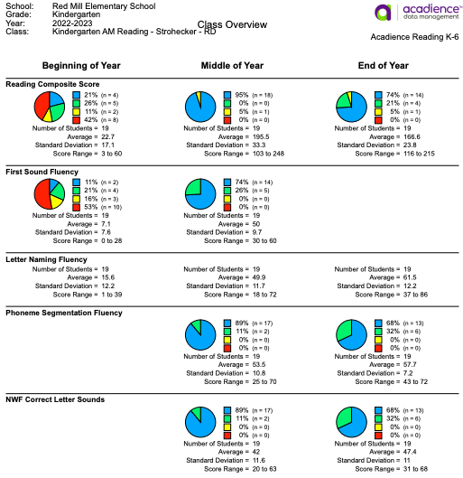
Universal Screener - Acadience
Displays composite scores, as well as each sub skill
Shows progress over time
Easy to see the trend of classrooms, grades, buildings or the entire district
Example Kindergarten Classroom Data

Slide 15
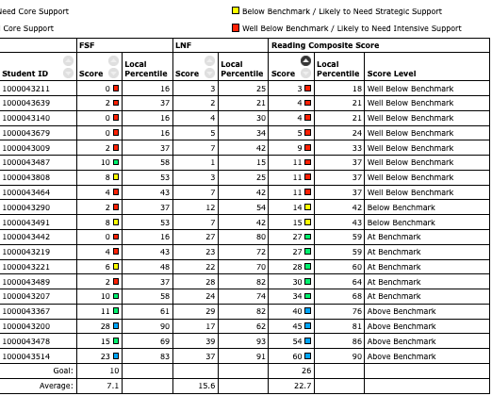
Classroom Data
Helps to indicate the needs of the class as a whole
Informs how best to utilize interventionists and support staff
Beginning of Kindergarten Data

Slide 16
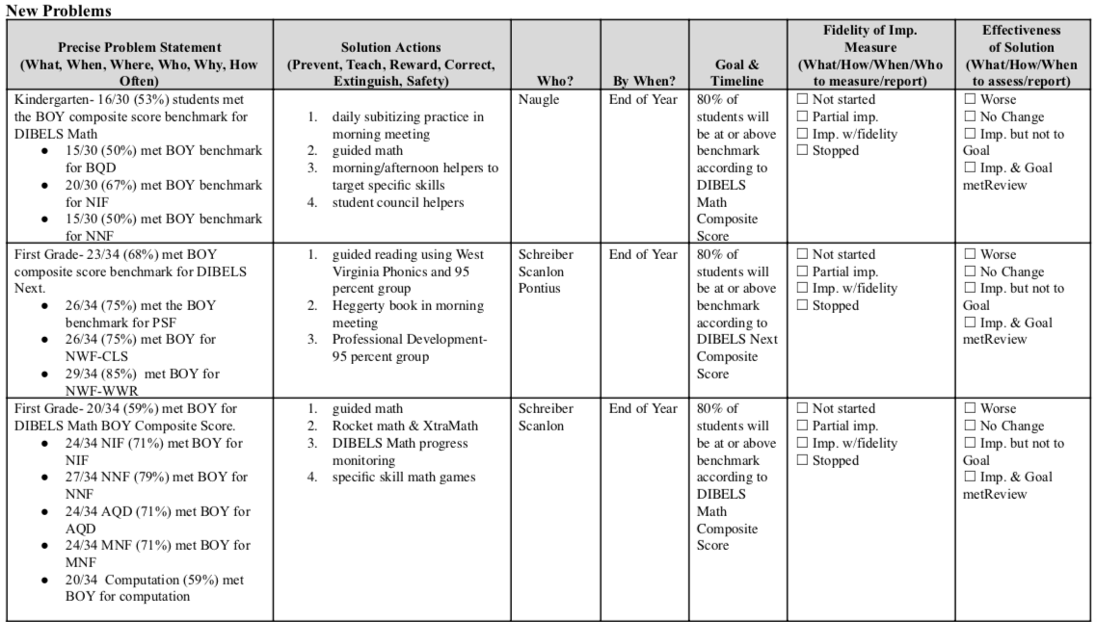
Sample Collective Problem-Solving
Notes:
Goals and action plans! On our TIPS form from the IU

Slide 17
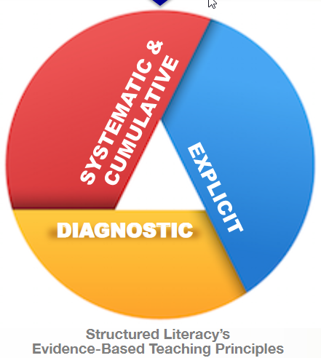
WHAT IS STRUCTURED LITERACY?
Science-based, structured approach to literacy instruction
3 evidence-based key features of instruction:
1. Systematic and Cumulative
2. Explicit Instruction
3. Diagnostic Literacy Instruction

Slide 18
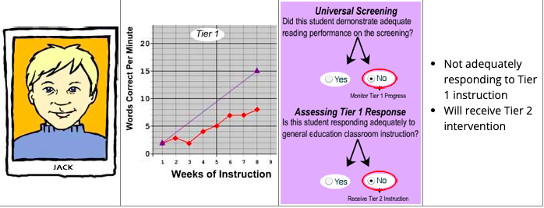
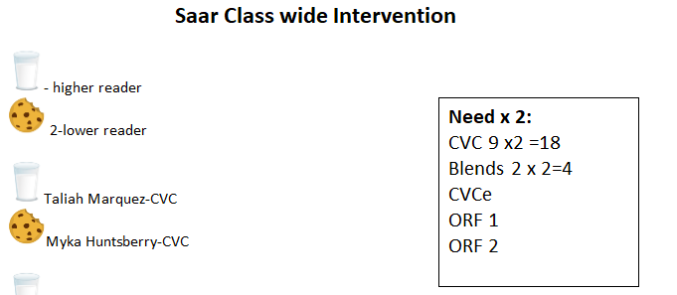
Tier 1 - Check Ins on Grade Level
Is the core instruction effective?
▪ What percent of students are achieving benchmark expectations (approximately 80% or more)?
Who Needs Help?
Classroom teacher progress monitors on grade level to check in.
We are piloting Wit & Wisdom/95% Core Phonics and HMH
Notes:
Example: Classwide Intervention by Matthew Burns

Slide 19
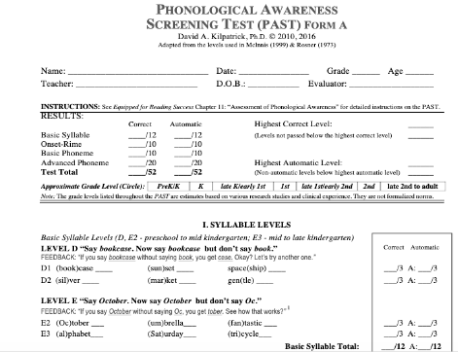
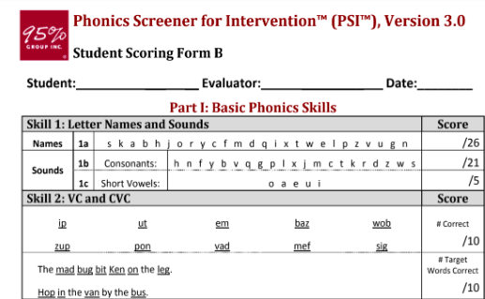
Tiers 2 & 3 - Provide More Intensive Support
This tier usually involves more intensive targeted intervention and frequent monitoring.
• Amount of additional time • Specific instructional strategies • Method and frequency of progress monitoring assessments • Delivery method • Size of group • Alignment with student needs • Personnel delivering intervention
What Help do they Need?
Sample Diagnostic Assessments to target skill deficits
Phonological
Orthographic

Slide 20
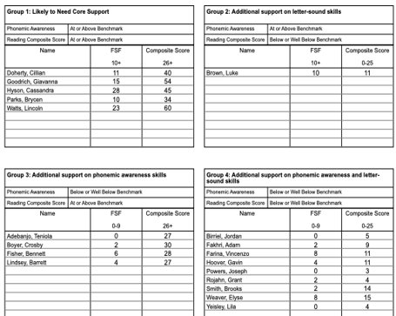
Group Students of All Tiers
Group students based on skill need:
Put data from assessments into a spreadsheet that works for you.
Analyze diagnostic assessments to determine a starting place
Use ongoing classroom assessments to reteach/reinforce skills
Matching Student Need to Instruction

Slide 21
Guided Reading Group vs. Skill Group
Traditional Guided Reading Group
Starts by selecting a leveled book
higher phonics skills mixed in text
Taught similar skills or strategies with different leveled texts
Doesn’t address individual student needs
not explicit or systematic
Skill Group
Starts by identifying the explicit skill
Fluid based on data
Explicit & multisensory instruction
Immediate corrective feedback with a lot of repeated practice
Focus on phonological awareness and phonics: encoding/decoding
Connect sound to print
Note: Students who are green or blue can be seen in small groups focusing on grade level skills/ strategies. If they have passed level J on the PAST, they can be in leveled text and out of decodables!

Slide 22
What does a small skill group look like?
Components of a small skill group lesson:
Phonological Awareness Tasks
Word Work linked to skill you are working on
Connection to text (decodables)
Encoding (written component where students write)
After the teacher uses the universal screener to run the initial grouping suggestions, the instructor should match these groups to lessons and materials to instruct what the student needs based on how they scored on all diagnostic assessments.

Slide 23
Tier Resources
Tier 1 - Your Core Program (We are using Benchmark Literacy, but are piloting new ones this year)
Tier 2 and 3 - Heggerty, Bridge the Gap, Kilpatrick Drills, 95% Group, Kid Lips, PALS, West Virginia Phonics, UFLI, 95% Multisyllabic Rts, FCRR, Secret Stories

Slide 24
Follow-Up: MTSS, Leadership, and Data Meetings (on-going)
There are three types of meetings that help drive effective MTSS:
A school-level meeting for school leadership to look at core curriculum health, benchmark growth, tier movement, distribution of resources and evolution of structures, the grade team or content team community meeting, to create group plans for students who need Tier 2 level support, and to check in on progress for all kids who need support, and an individual student support meeting to create individuated plans for students who need Tier 3 level support.

Slide 25
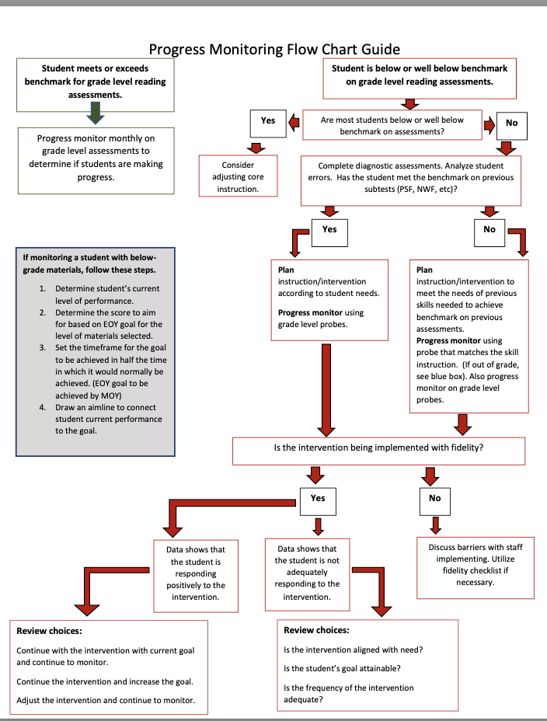
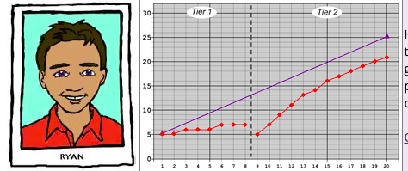
How do I know it’s working?
Monitor student progress by formatively assessing the skill you are teaching.
  Acadience Progress Monitoring Probes
  95% PLL End of Lesson Assessment
  PAST check in
  PSI check in
Use your teacher judgement on when to
move on if they can decode and encode
accurately and automatically.
Is the Help Helping?

Slide 26
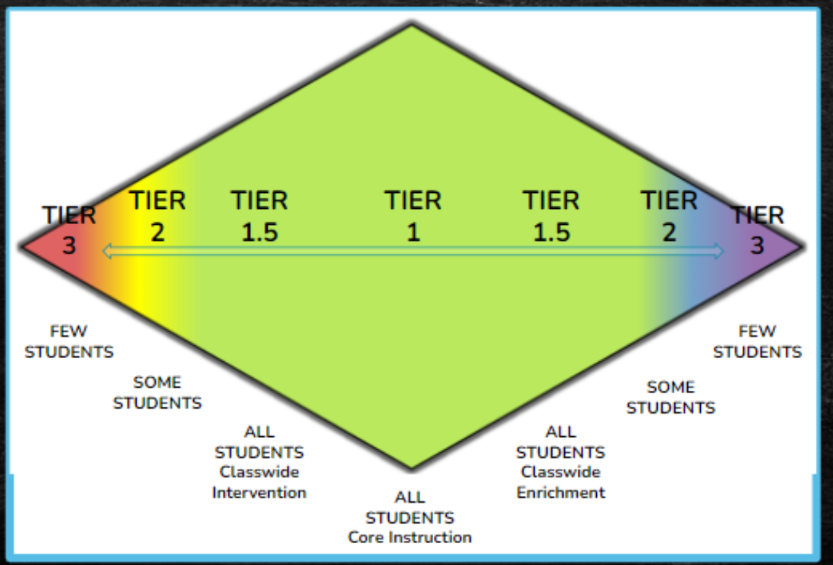
What Does Structured Literacy Look Like in Action?
Classwide Intervention
Brosky, 2022
Information from Dr. Sara Lobaugh and Mrs. Ami Healy
*shared with their permission
How do I deliver intervention?

Slide 27
Classrooms in Action!
Introducing:
Kindergarten Teacher, Mrs. Angie Naugle
and
Second Grade Teacher, Mrs. Lisa Saar

Slide 28
What Does Structured Literacy Look Like in Action?
Classwide Intervention:
An efficient method of providing intervention to a class due to more than half of the students needing interventions (Burns et al., 2015).
Information from Dr. Sara Lobaugh and Mrs. Ami Healy
*shared with their permission
How do I have time to meet all student needs?

Slide 29
What Does Structured Literacy Look Like in Action?
Classwide Intervention:
-efficient, effective, and equitable (Ardoin et al., 2005)
-provides support for an entire class when a majority of the students have a gap in learning (PDE, 2021)
Information from Dr. Sara Lobaugh and Mrs. Ami Healy
*shared with their permission
How do I use my time effectively?

Slide 30
Never do with a small group, what could be done as well with the whole class.
Shanahan, 2018
Information from Dr. Sara Lobaugh and Mrs. Ami Healy
*shared with their permission

Slide 31
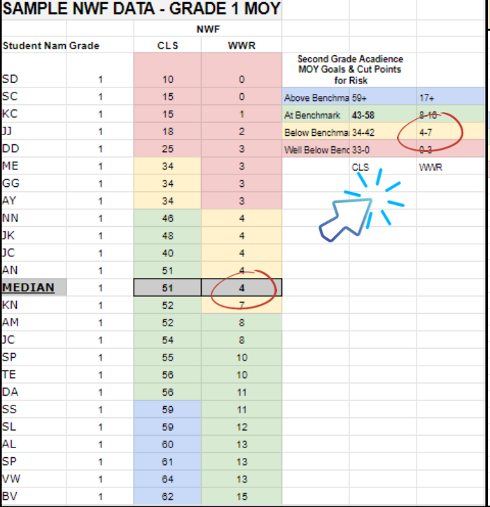
What Does Structured Literacy Look Like in Action?
Use Universal Screening Data:
-for a specific skill:
-order data from lowest to
highest and find the median
-if the median is below the
benchmark, classwide tier 1
intervention may be helpful
Information from Dr. Sara Lobaugh and Mrs. Ami Healy
*shared with their permission
How do I determine if classwide intervention is appropriate?

Slide 32
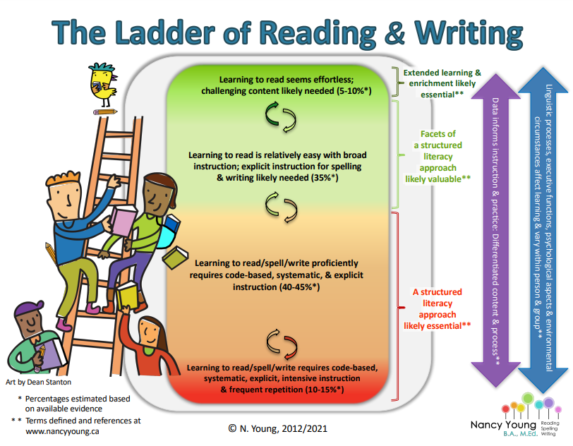
Just Remember-
Structured Literacy is for ALL students!

Slide 33

Journey of a Thousand Miles
State College Area School District
Danielle Yoder, Assistant Superintendent for Elementary Education
Heather Spotts, Title 1 Elementary Teacher
Jonathan Klingeman, Director of MTSS and Interventions
Chris Merritt, Superintendent of Curriculum K-12

Slide 34
Who we are
~6,800 students
Suburban School District in Centre County
Eight elementary schools
Two middle schools
One high school
One democratic alternative school (grades 6-12)
One hybrid virtual school (K-12)
ESL Population – Overall 6%
Hub Schools as high as 25%
Economically Disadvantaged - 20%
Schools Range between 11% and 40% overall
Elementary: Four Title I Schools and Four Title-Like Schools

Slide 35
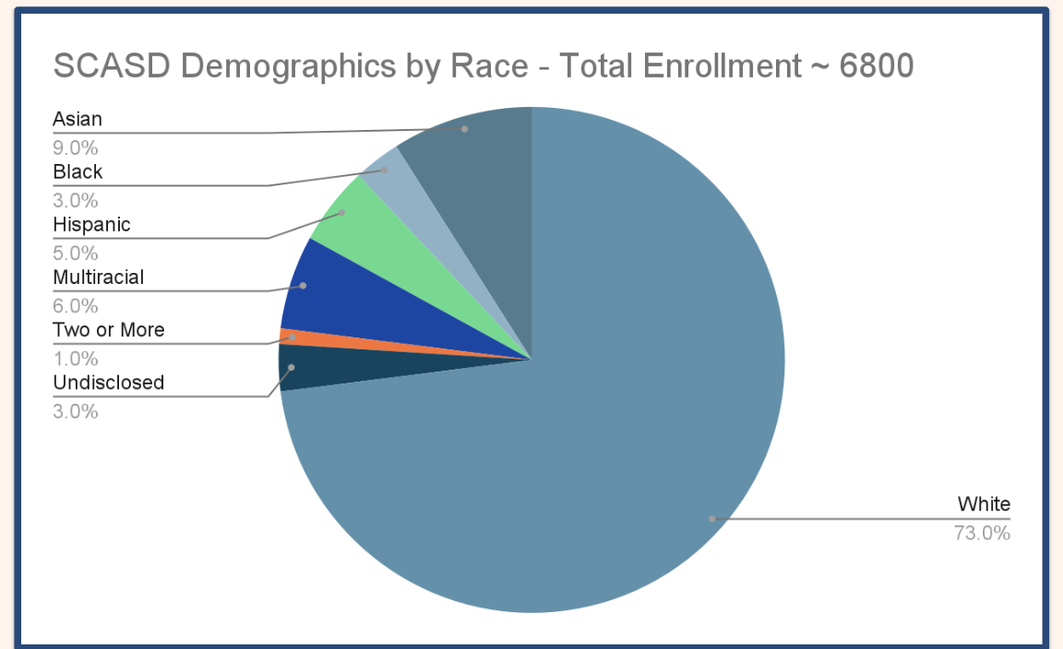

Slide 36
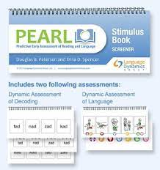



Universal Screeners
Diagnostics

Slide 37
Our Journey - Where we were
RTI for SLD approval for past 15+ years - ELA K-2
Units of Study for Reading and Writing - Grades K-5
  Lack of fidelity and lack of evidence-based programming
2018 - Heggerty K-1
2018-2019 - PATTAN/IU Collaboration began
2019 - ECRI w/ Journeys
2020 - Title and ESL trained in ECRI at all buildings
2021-2022 - Multiple Schools added ECRI in Tier 1

Slide 38
Our Journey - Where We Are Now & Headed
RTI for SLD in ELA - K-5
  Math in the future
Comprehensive Supports through PATTAN and IU related to Advanced Tiers
K-5 Implementation of HMH Into Reading with the ECRI Overlay in K-2 in all schools
All schools in grades K-2 at or above 80% on BOY benchmarking data
Grades 3-5 focusing on explicit vocabulary and targeting skill areas in small group
Currently working on aligning our writing to our reading program

Slide 39
Journey of Tier 2 & Tier 3
Where we were:
All advanced tiers working in isolation (ESL, Tier 2, Special Ed)
Outdated programs
Lack of updated understanding and structured literacy including resources
“Always done it this way” mindset
Inconsistent and lack of professional development
Where we are by targeting needs:
ECRI Pre-teach
ECRI Re-teach Fast-Track
Tier 3 Intensification
ERI
RAVE-O
Heggerty & Kilpatrick
Story Champs
Phonics for Reading
REWARDS
95% Group Comprehension Kit
Notes:
More aligned earlier on with Advanced Tiers.
Not necessarily understanding the importance of alignment and Tier 1

Slide 40
Progress Monitoring
Benchmarking 3 x / year
Tier 2 students monitored bi-weekly on level / on grade level monthly
Tier 3 students monitored weekly on level and on grade level
Advanced Tiers monitored weekly on level / on grade level monthly
Changes and Outcomes
Explore better methods for progress monitoring for consistency across the tiers
Moved to weekly on grade level for Tier 3 in order to gather more data to determine evaluation
Provide PD to help special education teachers and others understand the why behind aligned progress monitoring data collection

Slide 41
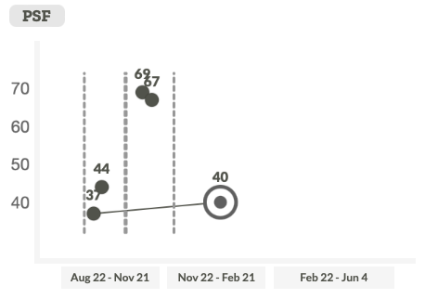
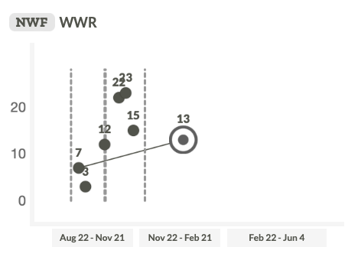
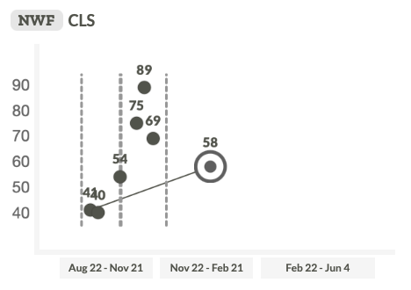
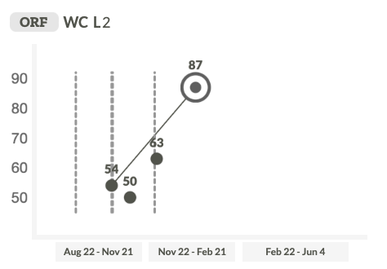
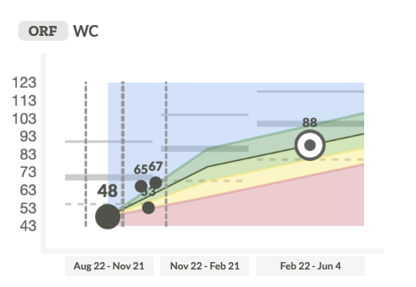
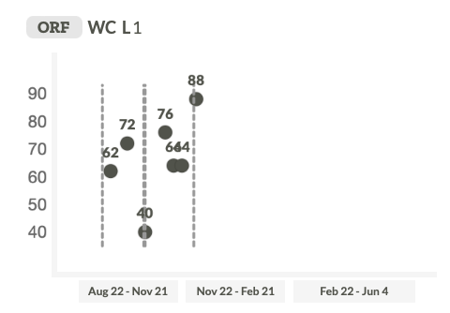
Progress Monitoring

Slide 42
Data, Data, Data - Reading Data/Data Team Forms
[Template] Data Analysis Team Recording - BOY
[Template] tier 2/3 Fall + Spring Check-In
[Template] Data Analysis Team Recording - MOY
[Template] Data Analysis Team Recording - EOY
2023-24 District Assessment & Survey Calendar
Notes:
Danielle will do

Slide 43
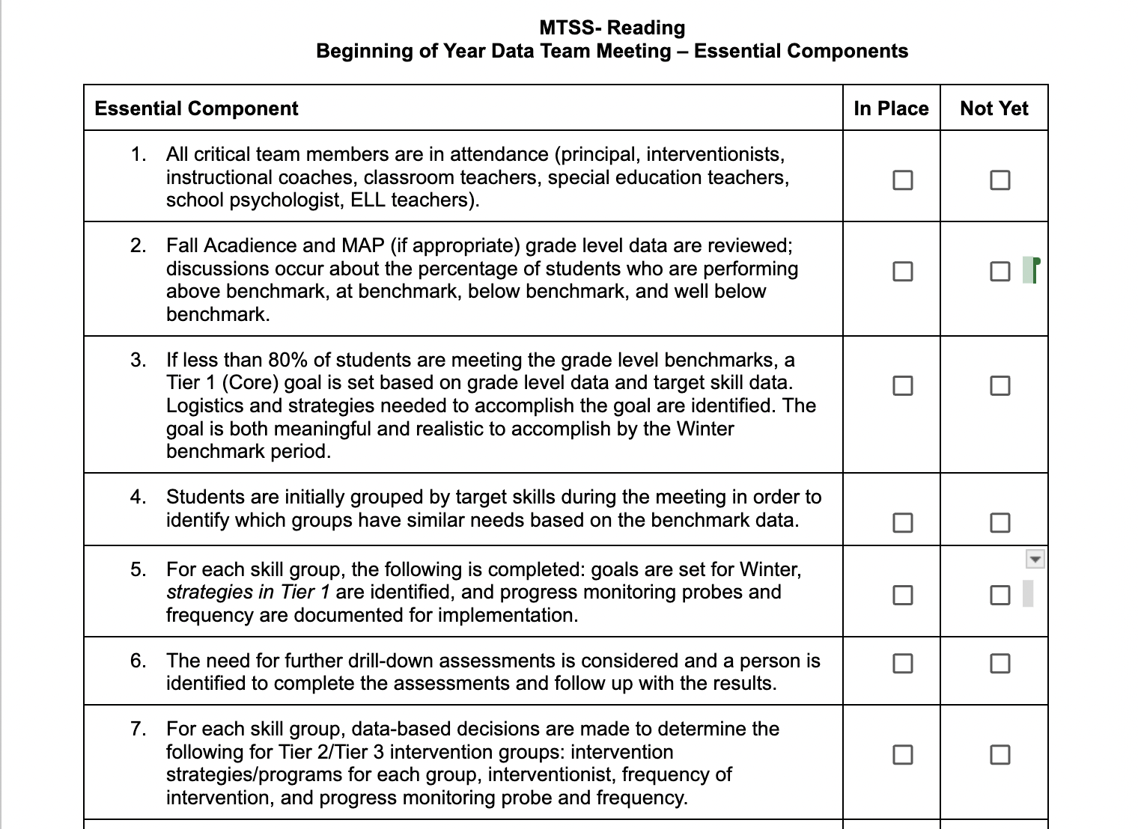
Data Team Essential Components
[Template] Data Team Essential Components
When? After the BOY Benchmark Meetings and after the first T2/T3 Check-In Meeting
Who? The Academic MTSS Reading Teams
Why? Serves as a fidelity checklist for our data-based decision making

Slide 44

Data Team Essentials
Who, What and When!

Slide 45
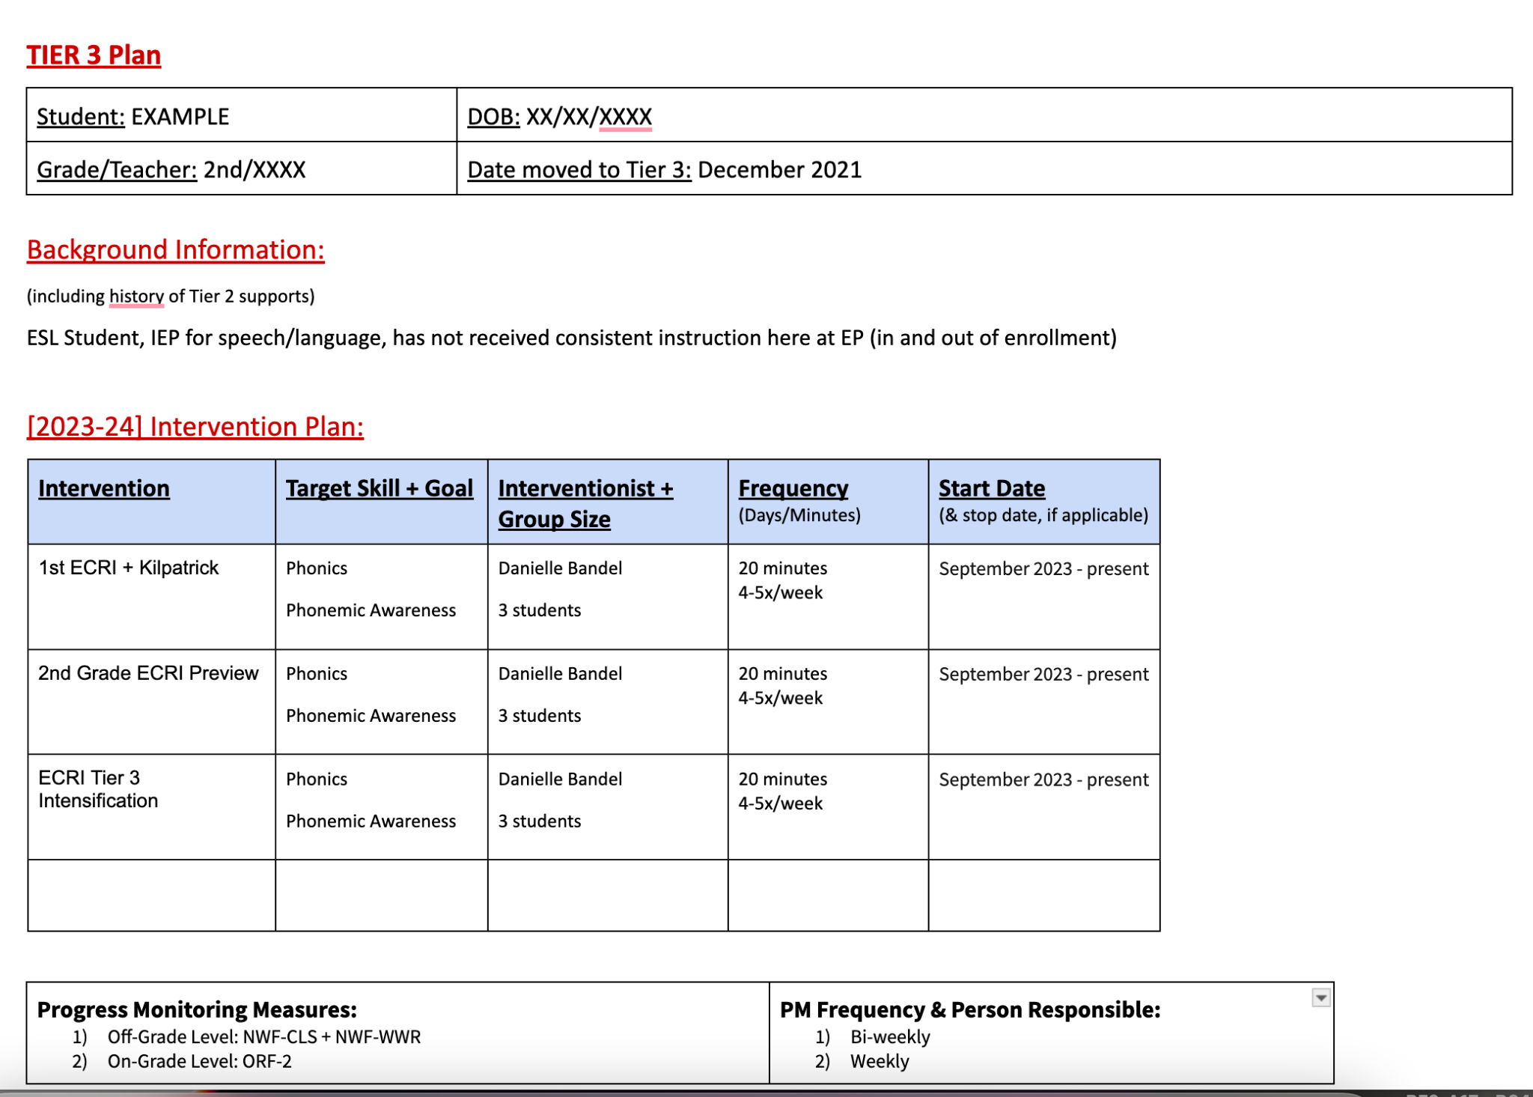
Tier 3 Intervention Plans
[Template] Tier 3 Intervention Plan
What to fill out when you are doing a Tier 3 Reading Intervention Plan for a student
Sample Tier 3 Plan
An example of “what goes where” for the T3 Plan
Notes:
Find correct link

Slide 46
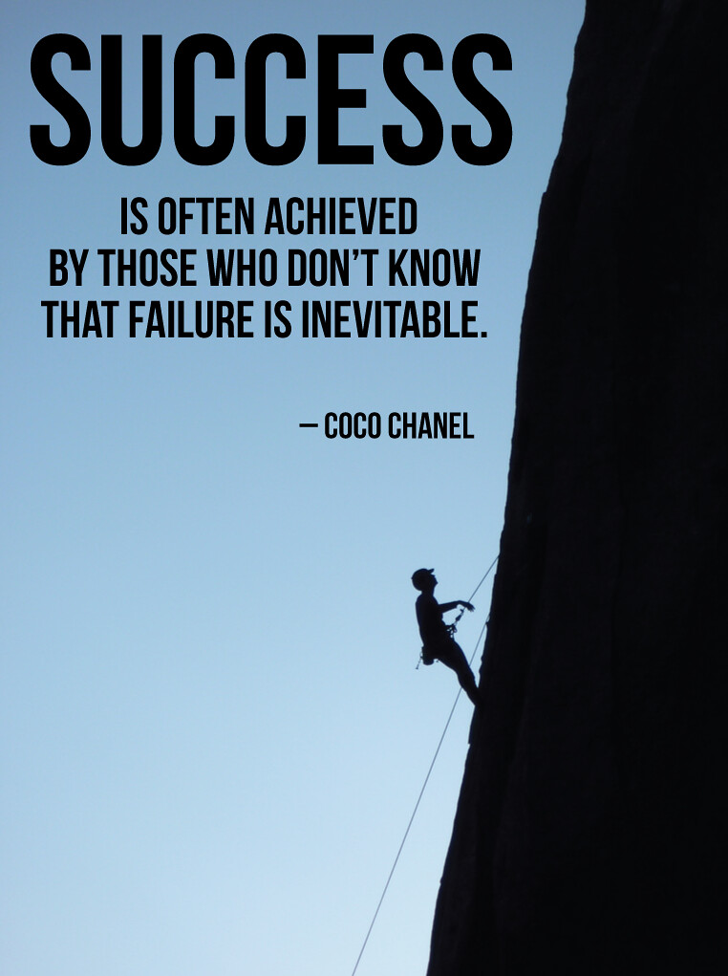
What’s Driving Success
Comprehensive supports from PATTAN and IU
Trained LETRS trainers in our district offering LETRS training to teachers and administrators
Continuous offerings of PD
ELA Curriculum Committee members
Retired Title 1 Reading teacher supporting literacy PD
Implementation coach from HMH
Title Reading Specialists, Special Education, and ESL supporting alignment
Principals receiving leadership training
Four instructional coaches focused in reading initiative and consistency across buildings
Admin Commitment: Ongoing sustained professional learning K-5 to support structured literacy program

Slide 47

Current Challenges and Future Goals
Alignment of All Tiers through an Academic MTSS Model
Integration of Special Populations (Special Ed, ESL) into processes
Elementary Schedules / WIN
Early stages, but moving into Secondary
Notes:
Talk about 2 new roles - K-12 Director of Curriculum and Director of MTSS Interventions

Slide 48

Gettysburg Area School District
A Journey into Structured Literacy
Rebecca Morris, Literacy Coach

Slide 49
Overview
Where we started
How an outcomes driven model has guided our journey
District Level
Building Level
Grade Level
Student Level
Sustainability

Slide 50
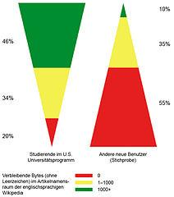
Where We Started
Inverted/Imbalanced pyramid
Yet, we had:
Universals Screeners
Progress Monitoring
3 full-time reading specialists in each building
Assessment Schedule for the district
Daily time in every teacher’s schedule for differentiated small group instruction

Slide 51

System of Change
Outcomes Driven Model
District Level | Building Level | Grade Level | Student Level
Assessment Calendar Train Teachers Evaluate Curriculums with data Instructional Coaches Focus on early intervention | Implementation of a WIN block Support/Train teachers to deliver Tier 2 interventions ACT teams Scheduled Time to review data | Create an Action Plan as a team Weekly Data Meetings Data Tracking | Benchmark Assessments Diagnostic Assessments Tier 2 and 3 Interventions Increasing time for Tier 3 Data Tracking Goal Setting/CST

Slide 52

Planning at the District Level

Slide 53
District Level Planning
Assessment Calendar
Universal Screener (Acadience Reading and Math)
Phonemic Awareness (Heggerty - k/1, PAST - 2)
Writing
Spelling - Test of Written Spelling-5 (spring)
Universal and norm-referenced Kindergarten Screener prior to the start of K
Training
LETRS for all teachers
Any curriculum/intervention that is taught = highly qualified
Build capacity for training in buildings/district (Heggerty, Acadience, LETRS, Wilson Fundations Facilitators and Level 1 certified interventionists)
Curriculum Evaluations and Changes
Notes:
(Heggerty, Acadience, LETRS, Wilson Fundations Facilitators and Level 1 certified interventionists)
Learn more = more willing to change
Experience with success = more willing to change

Slide 54
District Level Planning/Changes
 | Start | Improved | Continued to Improve | Today
Phonemic Awareness |  | Sporadically implemented phonemic awareness activities | Heggerty k-2 | Heggerty k-1 PAST/Equipped for Reading Success grade 2 Embedded in daily writing and phonics lessons
Encoding/Decoding | Words Their Way | Fundation k-3 |  | 95% Core Phonics k-3
Advanced Decoding | Journeys | Noticed incorrect instruction and stopped teaching it | 95% MSR 3-5 REWARDS 4-5 | Rewards when applicable
HIgh-Frequency Words | Memorize with flashcards and rainbow writing |  | Heart Word Routine | Daily systematic and explicit instruction with the Heart Word Routine aligned to phonics skills
Writing | Kidwriting k/1 Journeys grades 2-5 |  | Tried to move away from Kidwriting, but had no outlined scope or sequence TDA writing in grades 3-5 based on Journeys texts | Wrote our own K writing curriculum Integrated daily writing throughout the literacy block that is systematic and sequential

Slide 55
District Level Planning/Changes
Comprehension | Journeys |  | Reworking Journeys Lessons | CKLA Knowledge
Vocabulary | Journeys |  | Implemented a Vocabulary Routine with Tier 2 Journeys words 95% Vocab Surge | Integrated vocabulary and morpheme instruction with knowledge building
Grammar | Journeys |  | Reordered the skills in Journeys to be more systematic | Integrated into writing and language comprehension
Differentiated Instruction | Guided Reading |  | Skill based groups | WIN (teachers help with Tier 2 interventions) Flexible Skill-Based Instruction Lexia Lessons
Interventions | Reading Recovery/LLI | Wilson/ Fundations DD Intervention | Wilson/95% Group PALS/95% Group Chip Kits/95% PLL | Wilson/95% Group PALS/95% Group Chip Kits/95% PLL/LIPS/95% Comprehension

Slide 56
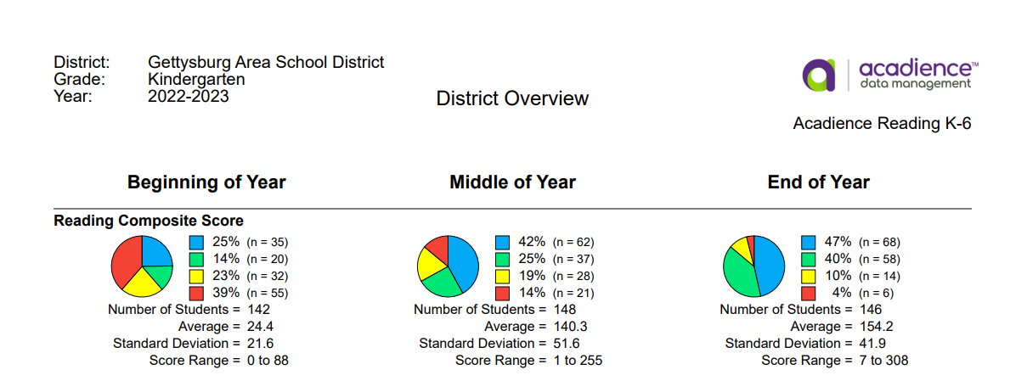
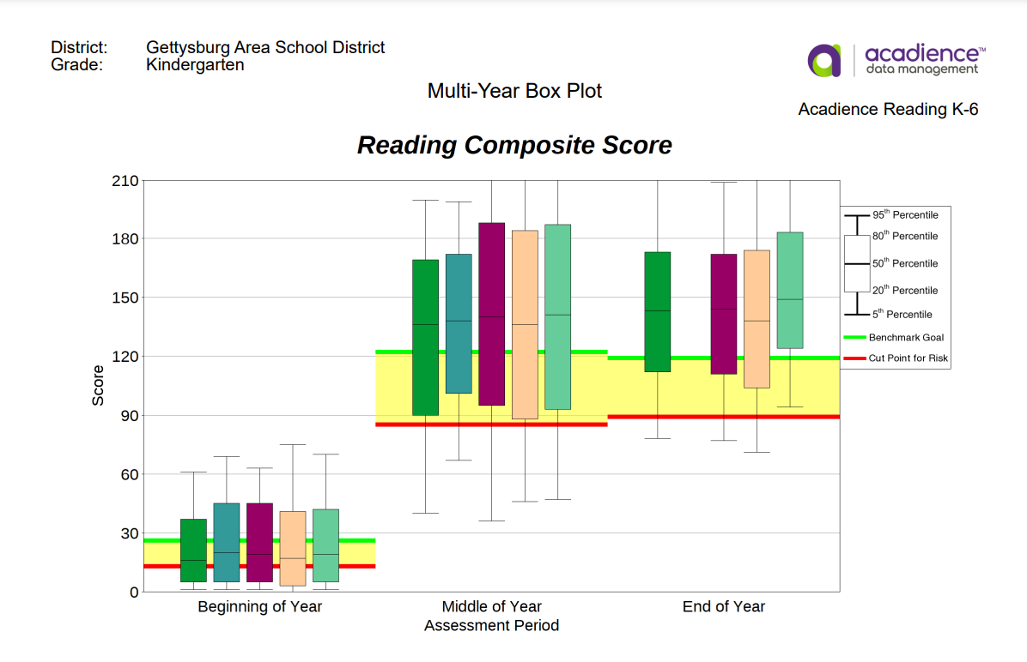
District Level Data

Slide 57
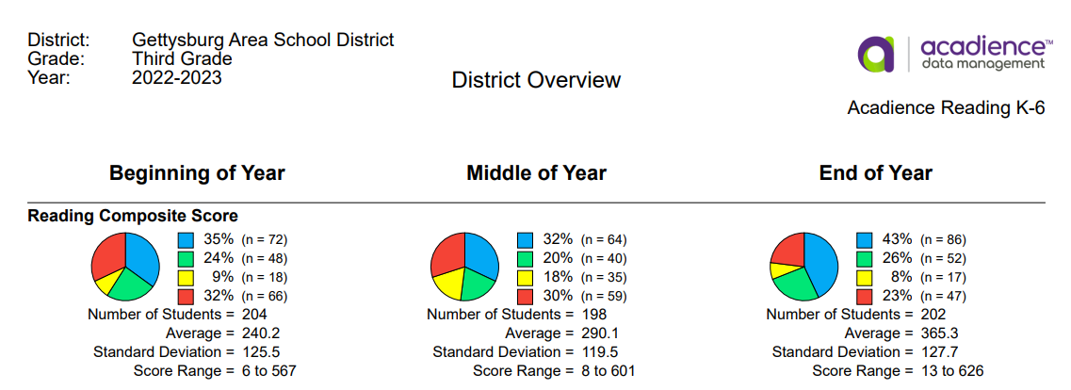
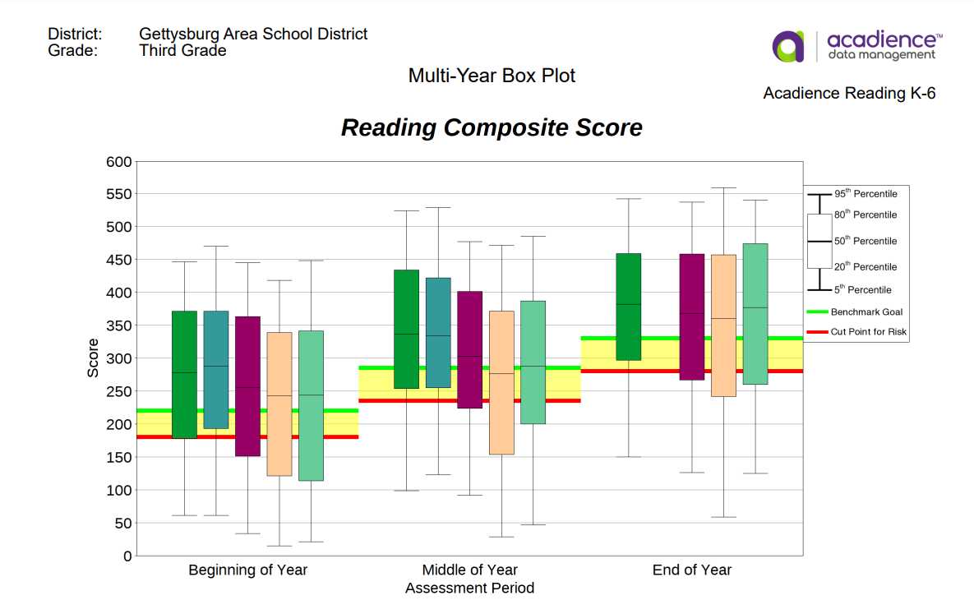
District Level Data

Slide 58

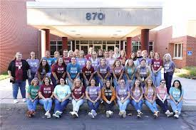
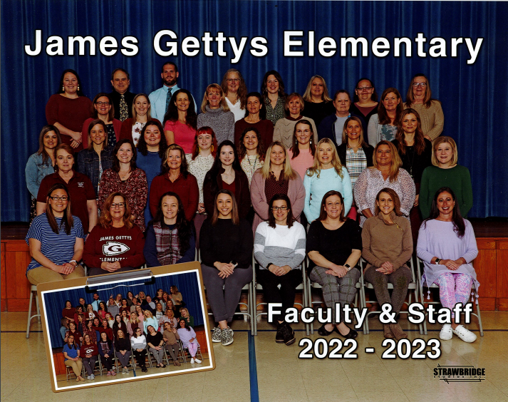
Building Level Planning
Lincoln
Franklin Township

Slide 59
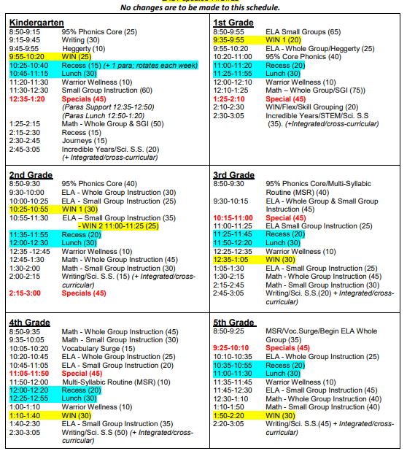
Building Level Planning
WIN Block for every grade
Pull out small groups for
Tier 2 vs specialist push-in
support for class intervention
Less support for upper grades to provide more support in early intervention

Slide 60
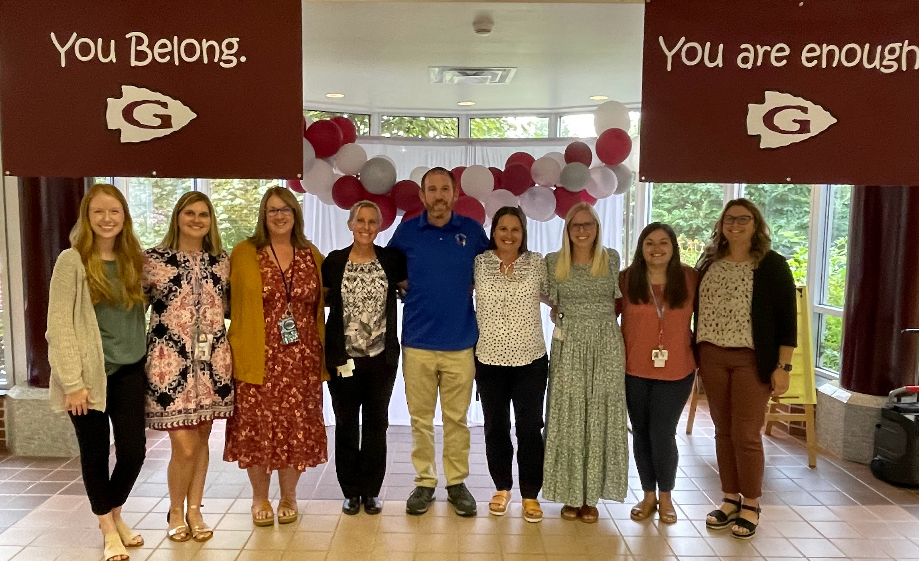
Building Level Planning
ACT Teams:
Purpose:
Administer Benchmarks assessments (interrater reliability)
Support grade levels with data reviews, goal setting, planning, and problem solving
Meet weekly to discuss and plan for students not making adequate progress
Members:
Principal
Psychologist
Reading Specialists
Learning Support Teachers
ESL Teacher
Speech and Language Pathologist
Literacy Coach and Math Coach
Anyone involved with an individual student that is a meeting focus (classroom teachers, OT, nurse, Fine Arts teacher, Guidance Counselor)

Slide 61
Grade Level Planning
Goal Setting: Identify grade level needs and work towards a common goal to impact student outcomes
Weekly meetings alternate between reading and math data
Collaborative
Teachers have support of specialists and grade level colleagues
Celebrate success and problem-solve students that need supports
Teachers progress monitor students in the classroom

Slide 62
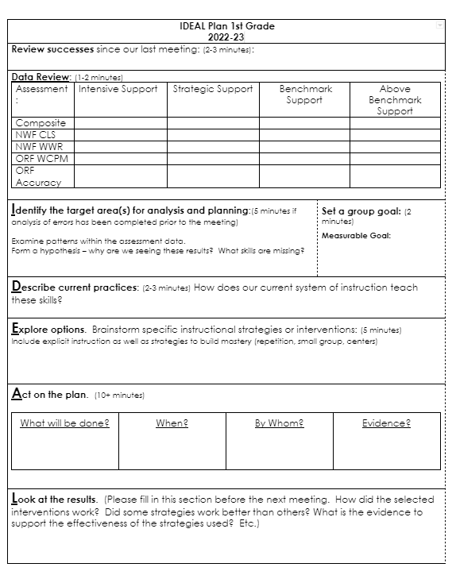
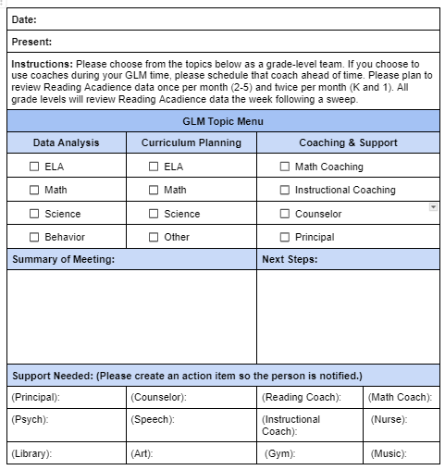

Slide 63
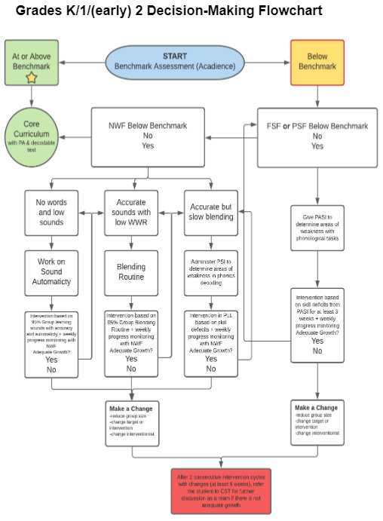
Student Level Planning
Diagnostics to confirm need for support and identify where support should begin
Frequent review of individual data to ensure progress is adequate and make changes to instruction when needed (ACT meetings or grade level meetings)

Slide 64
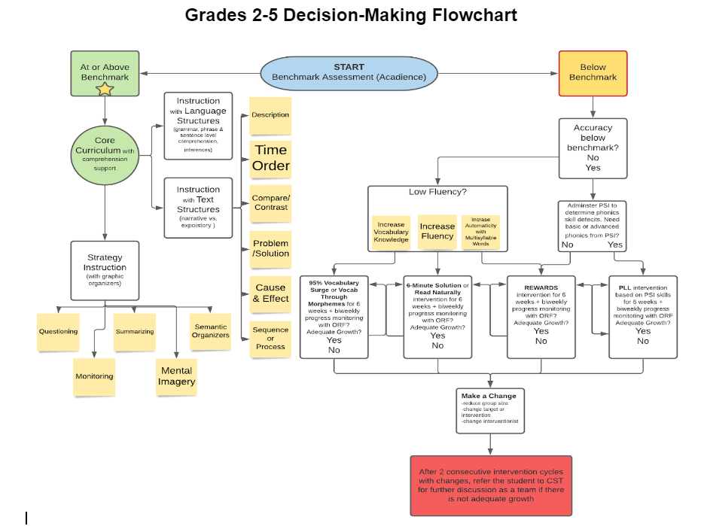
Student Level Planning
Increase time and/or intensity with systematic and explicit instruction; decrease group sizes
Move students sequentially and systematically through a scope and sequence to avoid gaps in skills

Slide 65
What’s Next?
Identify
Needs
Curricular
Teacher
Grade Level
Student
Review
Plan
Don’t get discouraged! Change takes time.
Implementation
Training
Interventions
Implement
-It’s not always easy and requires lots of flexibility!
-Power of positivity
-Lift each other up!

Slide 66

Candid Accounts from GASD Teachers
video

Slide 67
Our Journey at
Halifax Elementary
Carla Sauer, Director of Curriculum, Assessment, and Instruction
Amelia Bellis, K-4 Elementary Principal
Michaela Geyer, Regular Education Teacher
Tricia Bowman, Reading Specialist
Doddy Ochs, Interventionist
Rural Community
15 miles north of Harrisburg
901 PreK-12
91 teachers and 67 support staff
$22 million district budget

Slide 68
Something is not working…
Students who started receiving Title I supports continued with support throughout their elementary career
Universal Screener Data was showing 65-70% building wide proficiency on benchmark assessments
Students appeared to read fluently but weren’t comprehending text, OR students were not able to decode text
Not making AYP on PSSA assessments

Slide 69

Professional Development…
2019-2020 Title I teachers attended CAIU Reading Network meetings and started sharing what they were hearing
Fellow Administrators began sharing information
Everything we were hearing was contradictory to everything that we believed for YEARS.
We were using research-based programs… and even got new programs every so often…. Research based on what?…

Slide 70
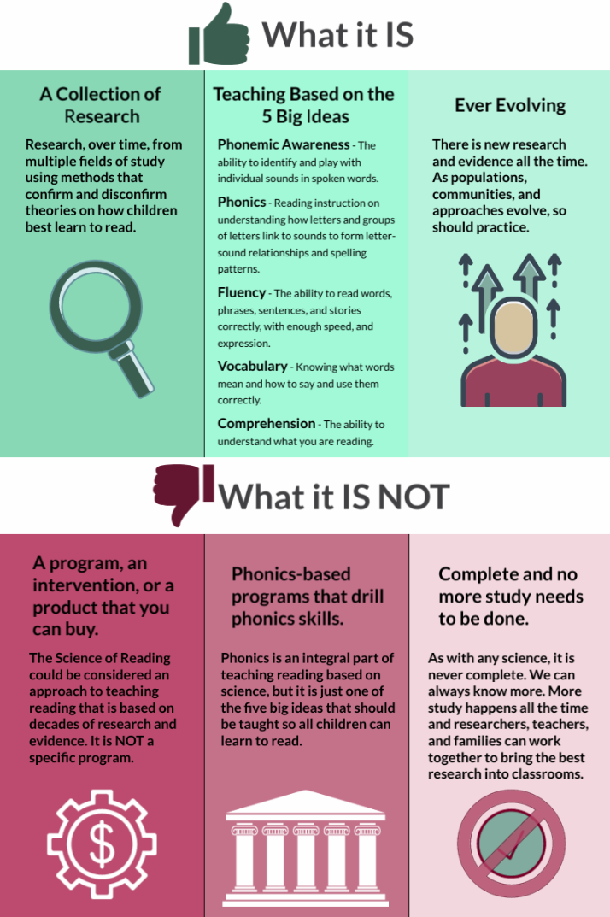
Professional Development…
As we began to learn more about the Science of Reading research and the Reading Rope….things began to click
Enhancing Early Literacy Outcomes Cohort (EELO)
  ECRI
  Heggerty
Most K-2 teachers already had LETRS training

Slide 71

From Guided Reading Groups to Skill Groups
Shift from using above level, on level, and below level text.
Using diagnostic tools to identify student needs
Project Read training summer of 2021 to support classroom teachers' phonics instruction
K-2 decodable text (many decodable sets were purchased)
Bookroom organized by phonics skills, leveled readers organized by theme
Sonday implemented in grades 3 & 4

Slide 72
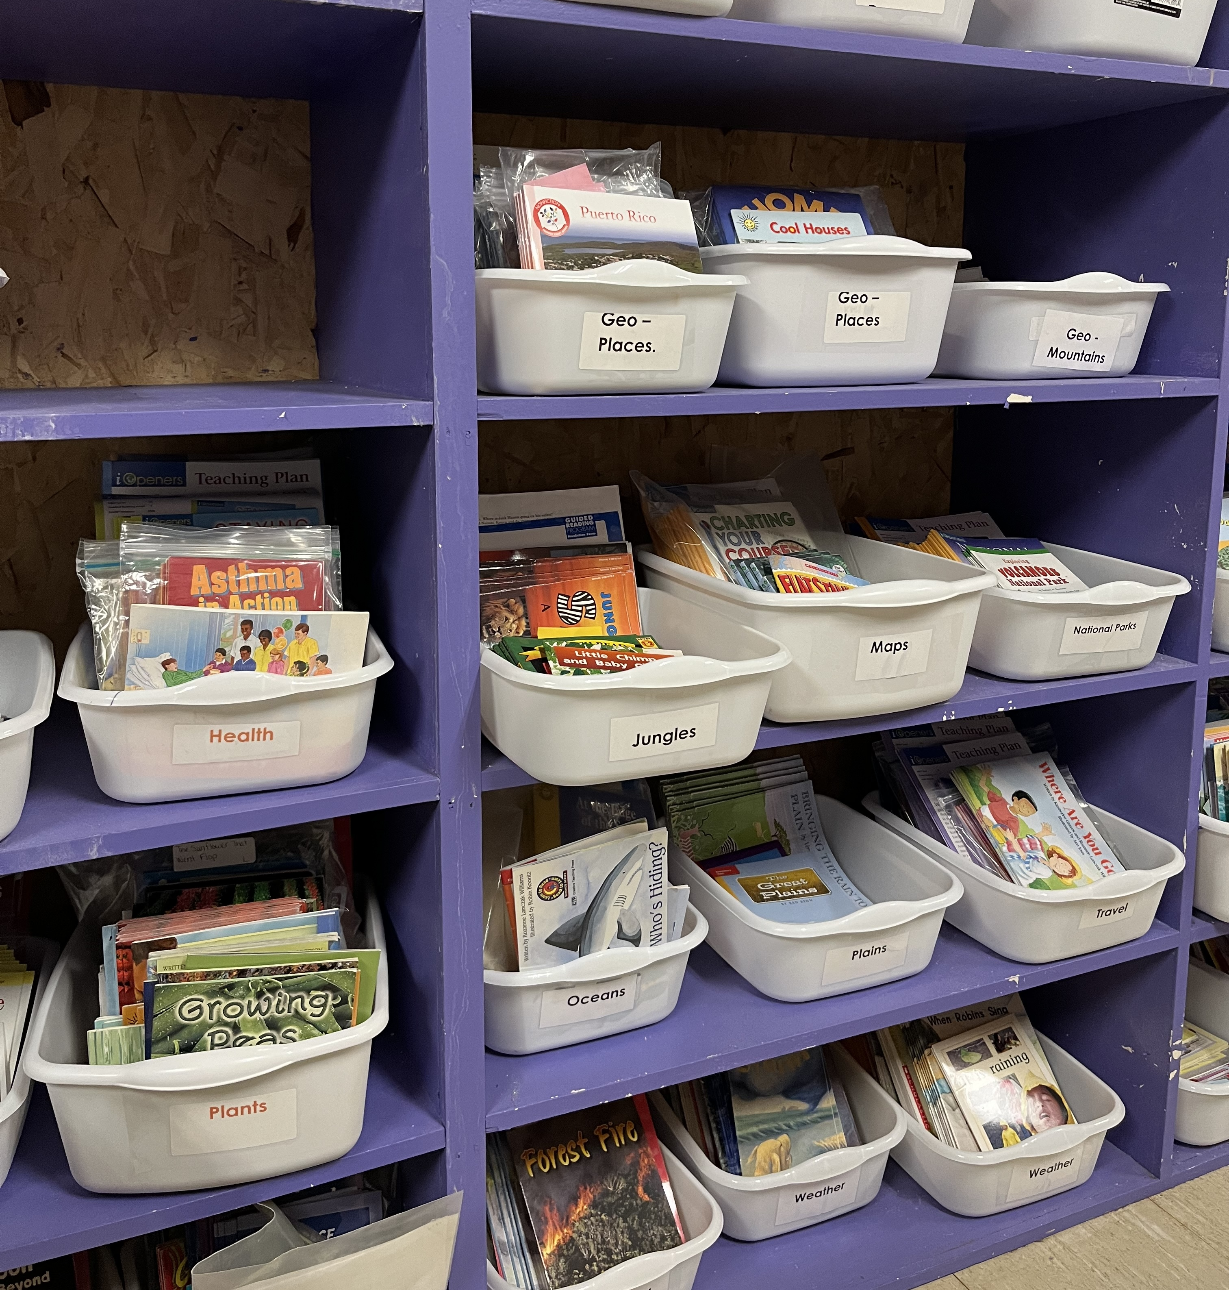
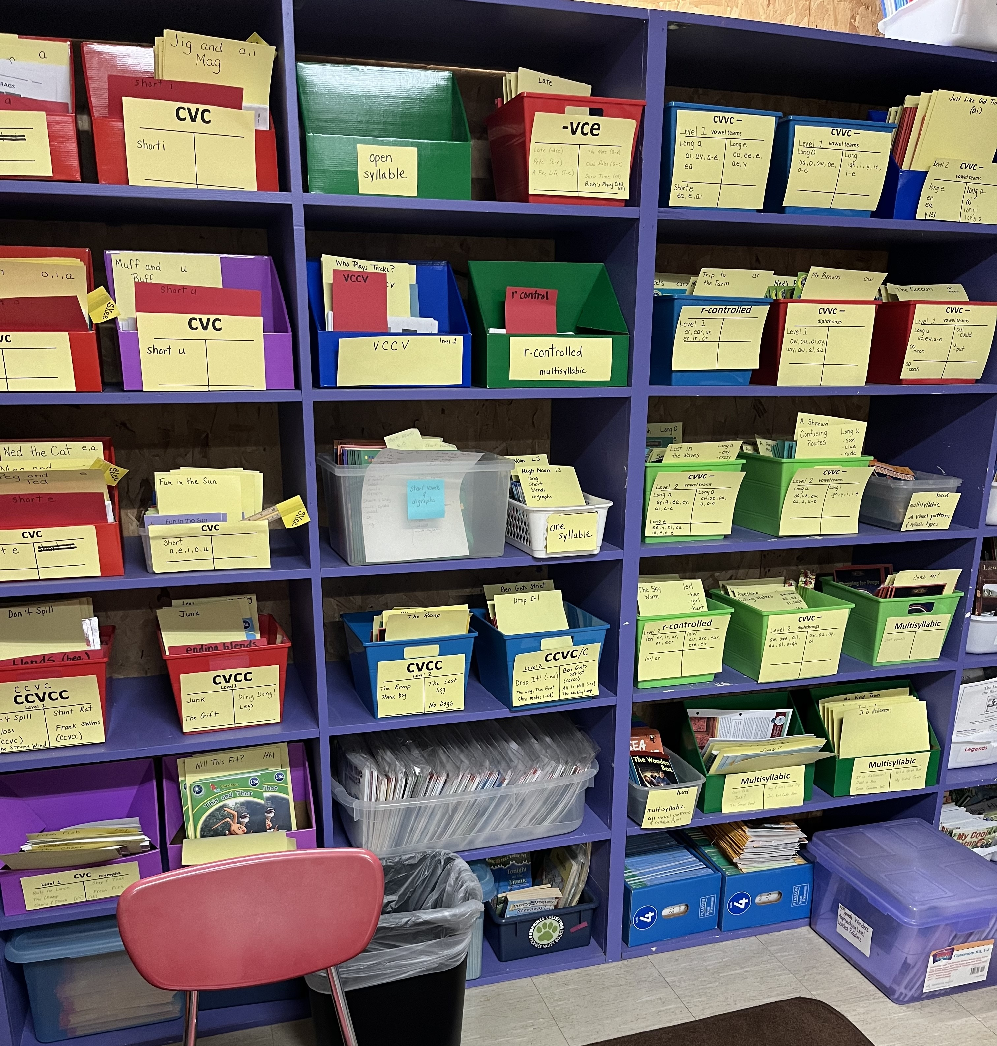

Slide 73

Tier I…
Set the stage for the why and shared with teachers- Fall 2019
Began to supplement our current program
  2020-21 ECRI grades K and 1
  2021-22
    ECRI grade 2
    Heggerty grades K-2

Slide 74
Tier I…
Began to supplement our current program
  2022-23 Sound walls grades K-2 (reference grades 3 and 4)
    Spelling – no more traditional lists from series
    2022-23 Sonday System Whole Group (grades 3 and 4)
Continuous reflection and PD
“Change is a process not an event.” (Fullon, 2001)

Slide 75
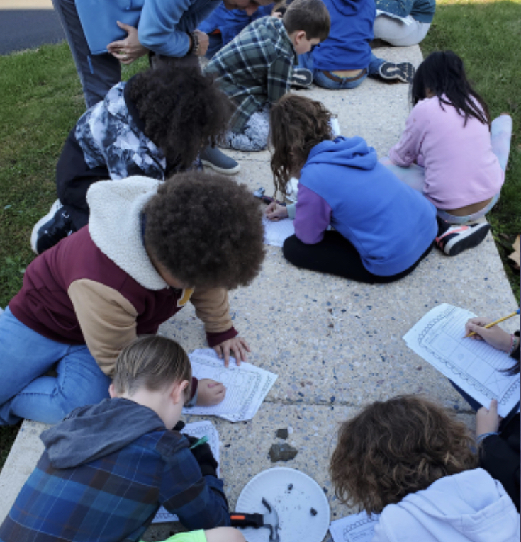
Providing the Structure
Create time in the building schedule
  Non-negotiable – needs to occur every day
Intervention/WIN time
  Non-negotiable – needs to occur every day
Importance placed on progress monitoring data to drive instruction
New position created at the elementary level- Data and Instruction Specialist

Slide 76
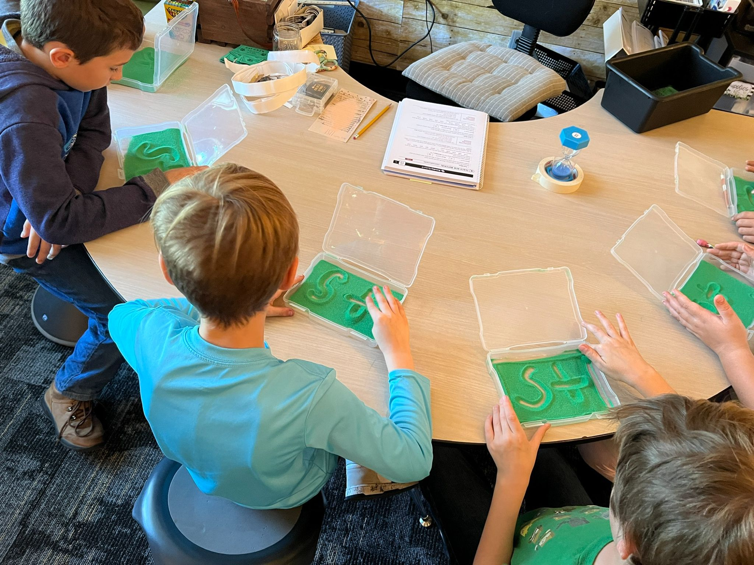
Tier II...
Skill specific and explicit instruction groups formed from Acadience data
  Sonday System intervention groups in 3rd & 4th grade
  WIN Time to target skill deficits utilizing grade level classroom teachers, Title I Reading teachers, special education teachers, and intervention teacher

Slide 77
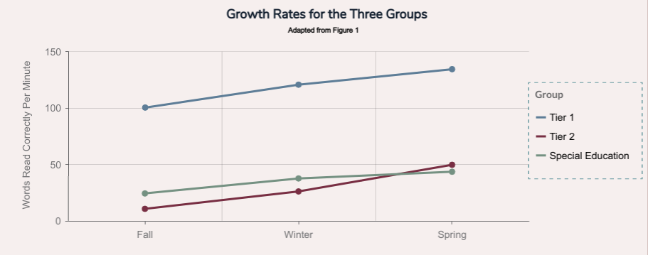
Using Data
After identifying needs
  Screener more in depth diagnostic (PAST, PSI)
Progress monitoring
Grade level data teams
Data teams/MTSS (tracking measurable goals for student outcomes)
Cyclical process

Slide 78
Reflection…
Our programs are only as good as those who are implementing them
  Teachers need to understand and have continuous PD in the Science of Reading and Structured Literacy
  Evaluating the student data in depth, rather than surface level is necessary to target specific student deficit

Slide 79
Structured Literacy Tools for the Journey
Dr. Pam Kastner
PaTTAN State Lead for Literacy

Slide 80

PaTTAN Structured Literacy Course
PA Science of Reading Course

Slide 81
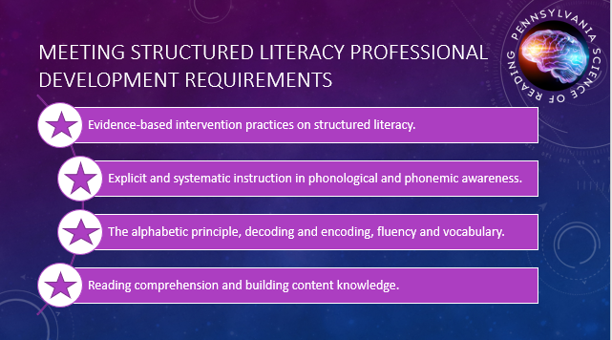
Notes:
The PaTTAN Science of Reading Knowledge, Schoology course meets the four criteria required by Act 55 and Chapter 49.

Slide 82
Course Sessions
Introduction to the Science of Reading
Introduction to the What and How of Reading
Assessment Within a Science of Reading Framework
Introduction to Language Comprehension
Introduction to Word Recognition
Applying Science to Instruction
Notes:
There are 6 sessions in this course on the Science of Reading. They include: [LIST]
Here’s how you will navigate through the course. Each course session has a number of content chapters to view. We recommend that you view Chapters consecutively because the content is scaffolded to build understanding. You may return to previous content and view again if you would like to review any of the sessions or chapters with more depth. There will be many opportunities embedded throughout the course to check for understanding. Please complete these checks for understanding before moving to the next session. All parts of the course are required for completion to earn Act 48 hours and any related credentials.
A copy of the course outline can be found in this welcome folder.

Slide 83
What You WILL Learn
What the data says about national and Pennsylvania reading outcomes and why there is so much urgency to improve outcomes and close reading gaps.
How the science of reading, as a knowledge base determined by the scientific process, can inform what and how we teach.
How the science of reading informs what we know about reading development.
How the science of reading informs how we teach reading.
Notes:
Specifically, as you work through the course, you’ll learn the following:
[CLICK] What the data says about national and Pennsylvania reading outcomes and why there is so much urgency to improve outcomes and close reading gaps.
[CLICK] How the science of reading, as a knowledge base determined by the scientific process, can inform what and how we teach.
[CLICK] How the science of reading informs what we know about reading development.
[CLICK] How the science of reading informs how we teach reading.

Slide 84
What You WILL do
  Interact with research and evidence-supported content relevant to the science of reading.
  Explore resources that guide reading instruction and program selection based on the science of reading.
  Interact with a model of the reading brain and understand its connections to reading science.
  View instructional videos and examples that demonstrate what science of reading-based instruction looks like.
  Reflect on new learning through embedded checks for understanding.
Notes:
As you work through the course, here are the things you’ll do. You’ll get to. . .
[EXAMPLES:
[CLICK] Interact with research and evidence-supported content relevant to the science of reading.
[CLICK] Explore resources that guide reading instruction and program selection based on the science of reading.
[CLICK] Interact with a model of the reading brain and understand its connections to reading science.
[CLICK] View instructional videos and examples that demonstrate what science of reading-based instruction looks like.
[CLICK] Reflect on new learning through embedded checks for understanding.

Slide 85

PaTTAN Resources
  PATTAN Literacy Hub
  PATTAN Literacy-Resources-for-Practitioners
  PATTAN Literacy
Notes:
PD required but implementation is not

Slide 86

PA Higher Education Summit was held May 2023
Communities of Practice
Goal: To build the capacity of PA Institutes of Higher Education for Structured Literacy Teacher Preparation
Sponsored by: Literacy Organizations throughout the state and the Treiman Foundation
Notes:
This is just an FYI
To be held at PaTTAN Harrisburg but not “sponsored” by PaTTAN or BSE. BSE/PDE is graciously offering the space for the summit.

Slide 87
PaTTAN Secondary Literacy Summit
Save the Date: May 29, 2024 PaTTAN Harrisburg
PaTTAN – Conferences
Dr. Sharon Vaughn
Dr. Anita Archer
Dr. Kim St. Martin
Dr. Louise Spear-Swerling
Dr. Mitchell Brookins
PaTTAN & IU Literacy Consultants
PA Secondary Practitioners

Slide 88

PaTTAN – Conferences

Slide 89

The Reading League: Defining Guide
Defining Guide eBook - The Reading League

Slide 90

When reviewing curricula for Tier I instruction, it is essential to ensure they do not include instructional practices that are not aligned with the scientific evidence base of how children learn to read.
The Curriculum Evaluation Guidelines are designed to highlight any non-aligned practices, or “red flags,” that may be present in the areas of:
Word Recognition
Language Comprehension
Reading Comprehension
Writing
Assessment
Curriculum Evaluation Guidelines - The Reading League

Slide 91


R-TFI: Reading Tiered Fidelity Inventory
MiMTSS Reading Tiered Fidelity Inventory - Elementary Level Edition
MiMTSS Reading Tiered Fidelity Inventory - Secondary Level Edition
Notes:
Overview and training announcement
From Stacey Cherny:
In terms of R-TFI, please feel free to tell the TAC in your region that they have the option accessing the training modules. I will be sending one last request for this year to Anthony on March 3rd. If you can provide to me a spreadsheet with the name and email address for anyone who needs to access the training, that is all I will need.
Please let me know if you have any additional questions.
Thanks,
Stacey
: https://forms.gle/WBHahDCQiQ64Zs9T8 to share with TaC at your regional meeting. This way, Stacey has easy access to the folks interested in the training. I listed the due date as Feb. 28.

Slide 92

Literacy Look-Fors Walkthrough Guide
The Science of Reading - Literacy Look-Fors Walkthrough Guide

Slide 93

District Literacy Scan
District Literacy Scan

Slide 94
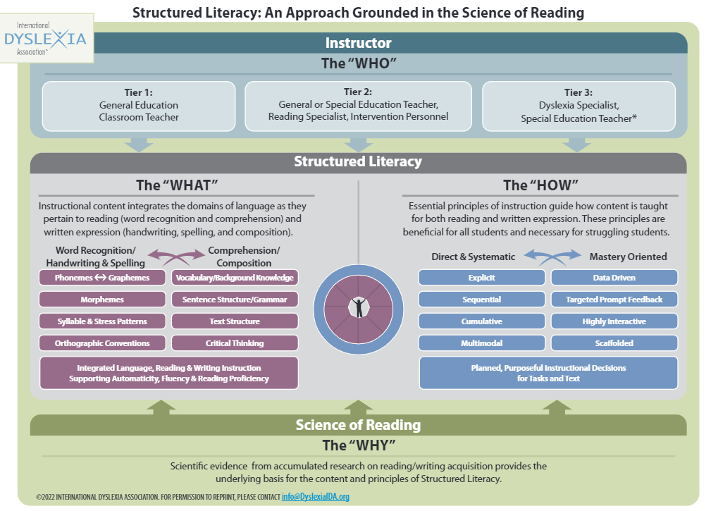
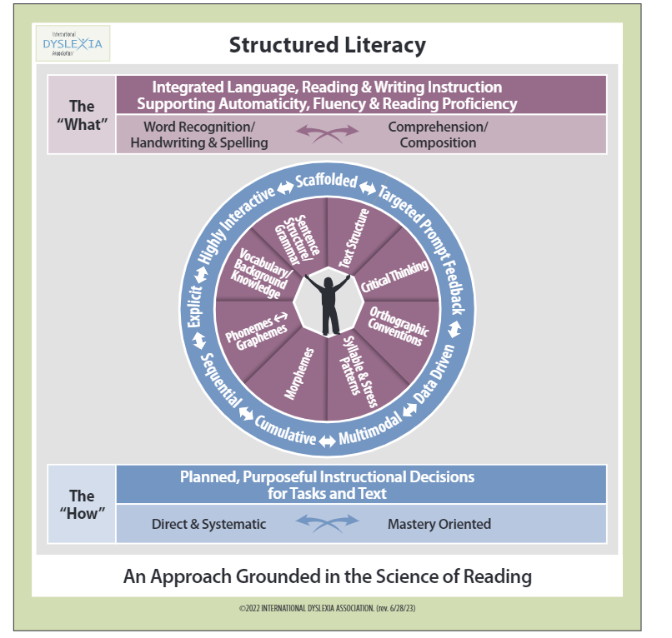
International Dyslexia Association– Structured Literacy
IDA infographics

Slide 95

Louise Spear-Swerling Structured Literacy and Typical Literacy Practices

Slide 96
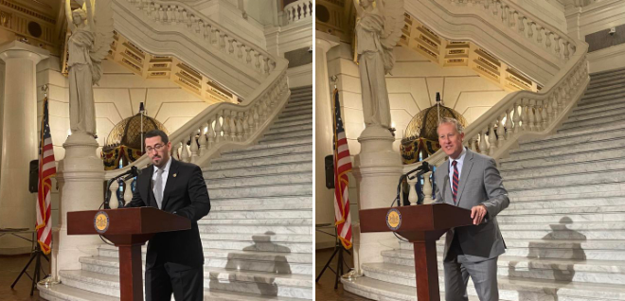
Pending Legislation
Representative Jason Ortitay (House Bill 998)
Senator Ryan Aument (Senate Bill 801)

Slide 97
“When you’re working on something
that’s so critical to a life- to a child’s life-
belief systems don’t cut it.
Evidence cuts it.”
Dr. Reid Lyon
September 28, 2023
Dr. Pam Kastner: SAS Structured Literacy Tools for the Journey (padlet.com)

Slide 98


Slide 99


Slide 100

QUESTIONS
BREAKOUT

Slide 101
Jennifer Wicht, ELA Content Advisor, PDE, jwicht@pa.gov
Kate Bacher, Structured Literacy Advisor, PDE, kabacher@pa.gov
Angela Cibulka, Literacy Specialist, West Shore SD, acibulka@wssd.k12.pa.us
Angie Naugle, K Teacher, West Shore SD, anaugle@wssd.k12.pa.us
Lisa Saar, Grade 2 Teacher, West Shore SD, lsaar@wssd.k12.pa.us
Chris Merritt, Superintendent of Curriculum K-12, State College Area SD, cmm16@scasd.org
Danielle Yoder, Asst. Superintendent Elem. Ed., State College Area SD, dcy12@scasd.org
Heather Spotts, Title 1 Elementary Teacher, State College Area SD, hls19@scasd.org
Jonathan Klingeman, Director of MTSS and Interventions, State College Area SD, jtk21@scasd.org
Rebecca Morris, Reading Specialist, Gettysburg Area School District, rmorris@gasd-pa.org
Carla Sauer, Director of Curriculum, Halifax Area SD, sauerC@hasd.us
Amelia Bellis, K-4 Elementary Principal, Halifax Area SD, bellisa@hasd.us
Michaela Geyer, Elementary Teacher, Halifax Area SD, geyerm@hasd.us
Tricia Bowman, Reading Specialist, Halifax Area SD, bowmant@hasd.us
Doddy Ochs, Halifax Area SD, ochsd@hasd.us
Dr. Pam Kastner, State Literacy Lead, PaTTAN, pkastner@pattan.net

