Slide 1
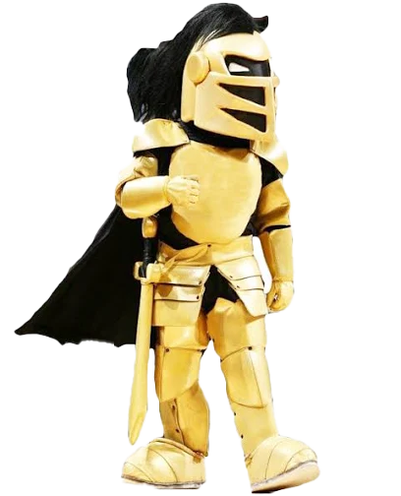
The
Knight
Code

Slide 2

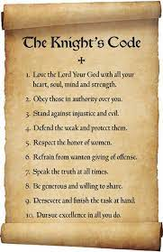
What is the Knight Code?
Long ago, Knights followed special rules called a 'code.'
This code included ways to live to prove they were worthy to become a Knight.

Slide 3
Our Knight Code shows us ways that we can show kindness, courage and respect in our community.

Slide 4
How does it work?
Teachers and staff will watch for students showing
Knight Code values.
When someone sees you showing those values, you will get Code Cash!

Slide 5
What do I do with my
Code Cash?
When you earn 5 Code Cash, you can turn them into
Mrs. Pauley for a Dress Down Day coupon!

Slide 6
Knight Code
Virtues

Slide 7
Faith
I will honor God in all I do, keeping Christ at the center of my words, actions and decisions.
EXAMPLE: I will follow the example of Jesus in how I act toward others and pray every day.

Slide 8
Honor
I will tell the truth, do what is right—
even when no one is watching.
EXAMPLE: If I accidentally break something or spill water, I tell the teacher right away instead of hiding it.

Slide 9
Servitude
I will place the needs of others before my own and expect nothing in return.
EXAMPLE: I hold the door open for classmates, even if I’m in a hurry.

Slide 10
Respect
I will treat every person as a child of God — with kindness, fairness and dignity.
EXAMPLE: I listen when others are talking and wait for my turn to speak.

Slide 11
Courage
I will face challenges with strength and perseverance and stand up for what is right.
EXAMPLE: I raise my hand to answer even if I’m not 100% sure, because trying is brave.

Slide 12
Excellence
I will always try my best — on the field, in the classroom and in my faith — and never give up.
EXAMPLE: I keep working on a tough math problem instead of giving up right away.

Slide 13
Loyalty
I will stand by my team, my school and my faith community, leading by example.
EXAMPLE: I cheer for my classmates during a game, even if my team doesn’t win.

Slide 14
Justice
I will seek what is right and stand up for those who cannot stand for themselves.
EXAMPLE: If I see someone being left out of a game, I invite them to join.

Slide 15
Gratitude
I will give thanks for my blessings and recognize that all good things come from God.
EXAMPLE: I say ‘thank you’ when someone shares or helps me, even for small things.

Slide 16
Peace
I will be a peacemaker, working together to create kindness and calm in our school.
EXAMPLE: If two friends are arguing, I help them talk it out instead of taking sides.

Slide 17
Why should I follow the Knight Code?
Makes our school a place where everyone feels included.
Helps you grow into leaders.
Earn dress down days and more!

Slide 18
The
Knight
Code

