Slide 1

I am an employee of CICOA Aging & In-Home Solutions (Indiana’s Area 8 Agency on Aging). I have no Relevant Financial Relationships or Relevant Non-Financial Relationship to disclose. - Kate Kunk
DISCLOSURE

Slide 2
Aging in Place
Key Considerations for
Best Outcomes

Slide 3
Introductions
Kate Kunk
Caregiver Options Counselor
CareAware Workshops
(317) 803-6002
kkunk@cicoa.org
Melinda Winnie
Caregiver Options Counselor
One-on-One Caregiver Support
(317) 803-6140
mwinnie@cicoa.org
Kendra Purvis
Outreach Options Counselor
Community Outreach, SHIP, SMP
(317) 803-6295
kpurvis@cicoa.org
CICOA Aging & In-Home Solutions
Indiana Association of Area Agencies on Aging

Slide 4
Introductions, continued…
You are:
Case Manager, Clinician, Service Provider
Co-worker, Employee, Student
Family member
Caregiver
Bystander, neighbor, fellow club member…
Taxpayer
Today’s message has broad application—
not only professionally, but socially as well.

Slide 5
At the close of this session,
attendees will be able to:
Discuss chronological stages of aging and the changes typically associated with the aging process.
Explain the physical, psychosocial and economic benefits of aging in place in lieu of institutionalization.
Articulate the role of assessment in working with older individuals; cite adaptations that may be necessary for successful aging in place to occur.
Identify the most common obstacles in serving the older population and discuss best practices for overcoming them, empowering individuals to achieve optimal independence, dignity and quality of life.
Notes:
Discuss the chronological stages of aging and the various changes that are typically associated with the aging process (distinguishing fact from myth).
Explain the physical, psychosocial and economic benefits of aging in place as an alternative to institutionalization.
Articulate the role of assessment in working with older individuals and cite at least six adaptations to environment or lifestyle that may be necessary for successful aging in place to occur.
Identify the most common obstacles in serving the older population and discuss best practices for overcoming them—assisting individuals to achieve optimal independence, dignity and quality of life.

Slide 6
What do “best outcomes” of aging in place look like?
Increased awareness, support, access
   
Reductions in the community, such as:
Loss of Independence
Preventable injuries in the home
9-1-1 emergencies + NON-emergency calls
Risks for elder abuse and/or neglect
Hospital readmissions
Unnecessary + premature nursing home admissions
   
Improved quality of life for all hoosiers
Notes:
“Increased public awareness of the services available, and our ability to facilitate these services, will quite naturally translate to a reduction in some things that are highly undesirable, such as preventable injuries, costly hospital readmissions, and diminished quality of life. And reductions like those you see here can certainly then result in improved MORALE, PRODUCTIVITY AND QUALITY OF LIFE for ALL of us because of the domino effect to literally every other segment of society.”

Slide 7
Quiz
Everyone over age 95 should be in a nursing home or living with someone else.
Anyone with Alzheimer’s disease should be in a nursing home or living with someone else.
Being older includes weak, brittle bones.
And therefore one should avoid exercise.
Older people are generally more cantankerous than people in middle age.
Older people tend to be grouchy and unappreciative of attempts to help them.

Slide 8

Stages of Aging

Slide 9
Chronological stages of aging²
Young-old: 65 to 74 years
Old-old: 75 to 84 years
Oldest-old: 85 years⁺

Slide 10
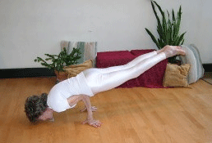
The dilemma with staging chronologically
Tao Porchon-Lynch, 99
“In my head, I’m still in my 20’s, and I have no intention of ever growing up”
Notes:
Technically, she was doing this particular pose at 93, but most of us weren’t doing it at 16.
Mr. Faukja Singh, who holds a number of world records for long distance running—just 5 weeks shy of his 102nd birthday, completed the Hong Kong marathon.
And of course, there was Yuichiro Miura, 80, the oldest person to climb Mount Everest (granted, he wasn’t able to get back down and they might have had to air lift him, but—just saying!)

Slide 11
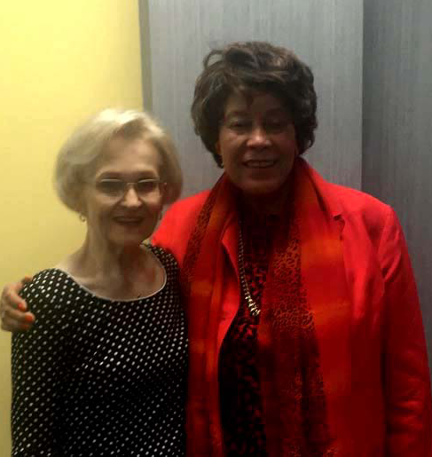
The dilemma with staging chronologically
Allie B. Latimer, 89
Champion for Social Justice
Notes:
Allie B. Latimer was the first woman and the first African American to serve as General Counsel of a major United States federal agency. Her achievements continue.

Slide 12
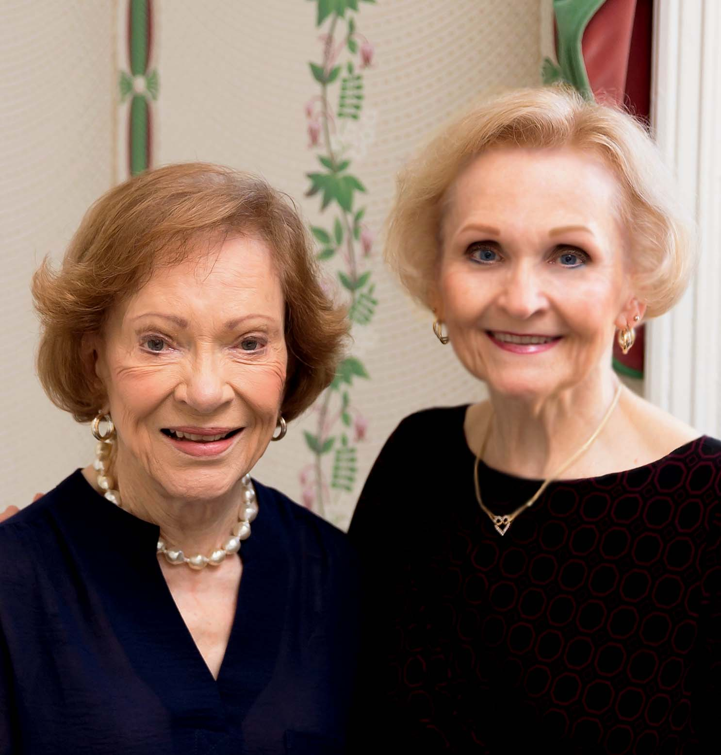
The dilemma with staging chronologically
Former First Lady Rosalynn Carter, 90
Champion for Caregivers and Mental Health

Slide 13
Chronological “stages”
Young-old: 65 to 74 years
Old-old: 75 to 84 years
Oldest-old: 85 years⁺
Notes:
Unfortunately, regardless of the categories, there ARE some givens about becoming older.
I’d like to show you probably the most common and most important ones, physically and mentally because these inevitably influence how we will relate in serving this population.

Slide 14
Physical changes for everyone!³
Cardiovascular ↓ elasticity & lumen of vessels, thick/rigid valves
Endocrine ↓ hormone production, (thyroid, insulin, et al)
Gastrointestinal ↓ taste; ↑ risk for aspiration, indigestion, constipation
Genitourinary ↓ renal filtration and bladder capacity
Immune ↓ immune response
Integumentary ↓ elasticity; skin becomes thinner, drier, more fragile
Musculoskeletal ↓ bone and mineral mass; tendons shrink/harden
Nervous ↓ reflexes; delayed responses
Respiratory ↓ breathing capacity & elasticity; lungs more rigid
Sensory organs ↓ taste (80% fewer taste buds), vision, hearing, touch, smell
Notes:
This is a VERY simple slide to illustrate that aging affects 1) all of us and b) every system in the body. Granted, the rate and sequence for ANY of these things will vary widely. But this is the sad truth—these are givens for every single one of us. And we have to consider that these are whatever else we’ve been dealing with physically over our lifetimes. For example, someone who has a messed up immune system to begin with might not do as well as someone else his age as he grows older and has a lowered immune response.
A huge key is how to manage them—not that we can control these, specifically, but because they are so interdependent, and we certainly DO have some control over whether or not they give us more problems. Take, for example, the person who has a reduced bladder capacity and hates having to urinate more often so reduces fluid intake and eventually isn’t drinking much water at all. Frequent urination is more of an annoyance than anything, but rejecting fluids has potentially catastrophic results for every other body system you see here, and more. Dehydration is only one example of the many things that can happen to put someone at increased risk for injury.
Brain is about ¾ water
Eriopoulos, Charlotte: Gerontological Nursing, 8th ed. Philadelphia, PA: Lippincott Williams & Wilkins, 2014.

Slide 15
Normal cognitive changes⁴
Some of the specific domains of cognitive ability:
Processing speed – speed with which cognitive activities are
performed and the speed of motor responses (decline starts in 30’s)
Attention
Auditory attention (slight decline)
Selective attention (change may be noticeable)
Divided attention (change may be noticeable)
Language – overall remains intact; vocabulary is stable
Visual confrontation naming – (unchanged until around 70)
Verbal fluency (declines)
Memory – as a group, older persons do not perform as well on some types of memory tests. (However, this may be partially due to the above other declines, e.g. in attention or processing speed.)
Notes:
For the purposes of this discussion, I’m mentioning only some of the normal cognitive changes we can expect to see in anyone as he/she grows older—and they would be those that have implications for your purposes in serving this population.
PROCESSING SPEED (begins to decline in the THIRD DECADE of life and continues throughout the lifespan)
ATTENTION
Auditory attention declines only slightly
Selective attention – ability to sort for the important while ignoring the irrelevant, e.g. driving or conversing)
Divided attention – multitasking
(Selective & Divided attention changes may be noticeable)
Language OVERALL LANGUAGE ABILITY REMAINS INTACT WITH AGING, AND VOCABULARY REMAINS STABLE AND EVEN IMPROVES OVER TIME. remains mostly intact, with a few minor exceptions. For example, the ability to see a common object and name it remains about the same until age 70 and then starts to decline.
And verbal fluency, which is the ability to perform a word search and generate words for a certain category—like animal names, or whatever, in a CERTAIN AMOUNT OF TIME also shows decline with aging.
Memory – may be due to decline in one of the above other areas, e.g. decline in processing speed or attention span
https://www.ncbi.nlm.nih.gov/pmc/articles/PMC4015335/
Normal Cognitive Aging
Caroline N. Harada,^{a,b} Marissa C. Natelson Love,^{c} and Kristen Triebel^{dTW,}
Harada, Caroline N., et al: “Normal Cognitive Functioning.” Elsevier: Clinics in Geriatric Medicine, Nov 2013, 29(4):737-752.
AARP reports that in a test involving the recall of random numbers, those who were chewing gum responded more quickly and accurately than those who were not. This was from a study at Cardiff University in Wales.
Keep Your Mental Focus
Older Americans have superior attention spans
by Ken Budd, AARP Bulletin, December 2017
https://www.aarp.org/health/brain-health/info-2017/mental-focus-smartphone-use.html

Slide 16
Benefits of
Aging in Place

Slide 17
Making the case for aging in place
PERSONAL PREFERENCE. 90% of Hoosiers surveyed in Central Indiana state that they prefer to age in place.
“Aging in place strategies create both healthcare and housing options that provide support at the margin of need, as defined by an individual’s personal desire and ability to live independently. Aging in place works best as part of a comprehensive and holistic approach to the support needs of an aging individual and an aging community.” ⁵
Notes:
Ball, M. Scott: “Aging in Place: A Toolkit for Local Governments.”
https://www.aarp.org/content/dam/aarp/livable-communities/plan/planning/aging-in-place-a-toolkit-for-local-governments-aarp.pdf retrieved Feb. 2018.

Slide 18
Making the case for aging in place
Aging in place FACILITATES THE PRESERVATION OF VALUABLE NETWORKS, particularly social ties.
Research has demonstrated that 'compared with persons who had five or six social ties [living in the community], those who had no social ties were at increased risk for incident cognitive decline after adjusting for a variety of socio-economic and physical factors.’” ⁵
Notes:
Ball, M. Scott: “Aging in Place: A Toolkit for Local Governments.” Retrieved from https://www.aarp.org/content/dam/aarp/livable-communities/plan/planning/aging-in-place-a-toolkit-for-local-governments-aarp.pdf Feb. 2018.

Slide 19
Making the case for aging in place
When appropriate for the individual, aging in place OFFERS SIGNIFICANT COST SAVINGS TO HOOSIERS in lieu of institutionalization.
Notes:
Ball, M. Scott: “Aging in Place: A Toolkit for Local Governments.”
https://www.aarp.org/content/dam/aarp/livable-communities/plan/planning/aging-in-place-a-toolkit-for-local-governments-aarp.pdf retrieved Feb. 2018.

Slide 20
Assessment
↓
reducing risk preventing injury

Slide 21
In professional assessment³
Respect the personal space – try to sit about four feet away (unless there is substantial vision or hearing impairment).
Identify/address any barriers to communication – language, cultural, hearing, cognition, loud surroundings, likelihood for interruptions, etc. Other communication issues might have to do with our own stereotypes, so be on guard for these, too.
Explain the purpose for the session, about how long it will take, and provide reassurance that all personal information shared is protected.
Be alert to nonverbal cues. “The interaction of assessment provides an opportunity for identifying new problems or change in status.”
Notes:
Whether for data collection or other types of assessment, assuming you need to find some things out about your client or patient’s situation before you can help him or her, one way or another you’re probably going to be asking some questions. The things we mention here are just common sense; maybe some of you haven’t been conscious of them before, and for others, they’re what you already know, in which case these are just reminders.
#2 In some cultures…
men do not look a woman of any age in the eye unless she is his wife
one must ask permission to ask questions of another person
And
Never arbitrarily assign nicknames such as “Dear,” “Sweetie,” or “Hon.”
Older people are not babies.
Eriopoulos, Charlotte: Gerontological Nursing, 8th ed. Philadelphia, PA: Lippincott Williams & Wilkins, 2014.

Slide 22
Obstacles

Slide 23
Potential obstacles in client participation
Client’s resistance to care for observed needs…why?
pride
fear of what it means to need help (increasing losses)
denial about the need
misinformation / preconceived notions
not wanting to be a burden
other
Family/informal supports, when needed are:
unavailable for support
uninformed of services/funding
in denial/unwilling to request help
in sibling rivalry for control over the elder’s care

Slide 24
Other considerations in working with an older person
Client’s physical condition (e.g. pain level, serious diagnosis)
Possible significant loss(es) of spouse, loved ones, friends
Fear of the future, fear of dying
Depression and sense of worthlessness
Response to social stigmas and feeling “left behind,” “useless”
Notes:
We’re all aware that we live in a very fast-paced world. People who do not have or use a computer really aren’t that rare in our business, but I can only imagine how some of them feel when I have to ask them if they are able to receive email and they have to say no. There’s a certain amount of lostness or less than to that, if you know what I mean.

Slide 25
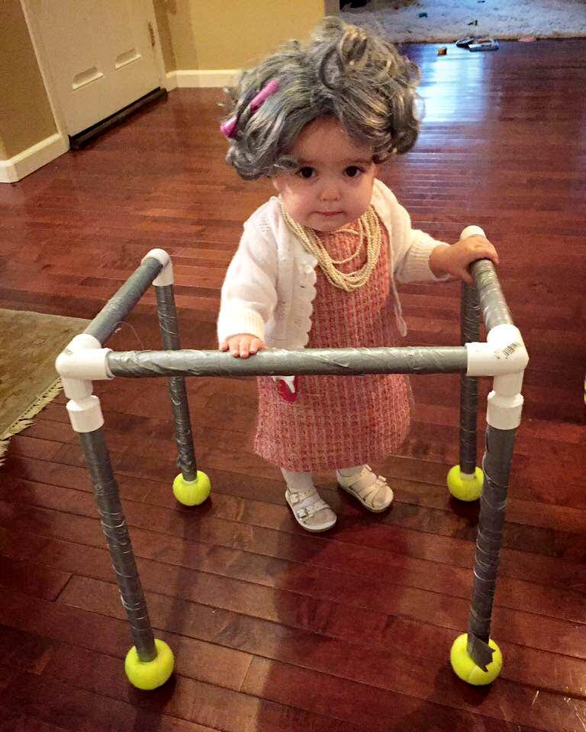
The insidious social obstacles of ageism
Notes:
We have a long way to go to eradicate the stigma of aging in this country.

Slide 26
Stereotypes in children RE: Aging
Preschoolers through 6th grade were shown photos of a man at 4 stages of life:
Even the 3 year-olds could pick out the oldest man.
67% of all the children considered the oldest man to be ‘‘helpless, incapable of caring for himself, and generally passive.’’
Notes:
We hear indications of stereotypes constantly from an early age.
Here’s an interesting study. Children, ranging from preschool to 6th grade, were shown drawings that depicted a man at four stages of life. Even the three year-olds could pick out the oldest man’s photo.
67% of all the children considered the oldest man to be ‘‘helpless, incapable of caring for himself, and generally passive.’’ HOW SAD IS THAT?

Slide 27
Stereotypes in children RE: Aging
When asked how they would feel about becoming an elderly person:
60% of these children gave responses rated as negative, including ‘‘I would feel awful.’’
Another study found that among children aged 4 to 7—66% mentioned that they prefer not to become old.

Slide 28
Stereotypes in adults RE: Aging
In a longitudinal study of 660 people 50 years and older revealed that:
Those with more positive self-perceptions of aging lived 7.5 years longer than those with negative self-perceptions of aging.
Older adults exposed to positive stereotypes have significantly better memory and balance.
Negative self-perceptions contributed to worse memory and feelings of worthlessness.
Notes:
ON THE OTHER HAND, HERE’S WHAT WE REALLY NEED TO KNOW:
Imagine that! You can live 7.5 years longer just by having good feelings about who you are and the age you are.
YOUR ATTITUDE AND WORDS TOWARD ANOTHER PERSON CAN FACILITATE THEIR LIVING AN AVERAGE OF AN ADDITIONAL 7.5 YEARS.
All of us as older persons can think better and fall less just by getting rid of the bad stereotypes about the older population.
Want to improve your memory and get rid of feelings of worthlessness? Have a positive attitude about yourself and those around you!

Slide 29
Death and life are
in the power of the tongue…
Ancient proverb

Slide 30
Programs and
Services

Slide 31
Mission Statement
CICOA Aging & In-Home Solutions
CICOA Aging & In-Home Solutions
empowers
older adults,
those of any age with a disability
and family caregivers
to achieve the greatest possible
independence, dignity and quality of life.

Slide 32
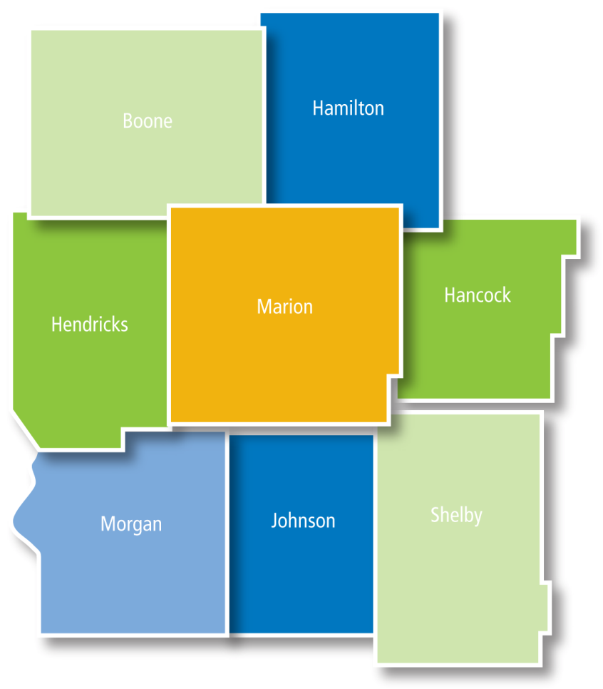
What’s an “Area Agency on Aging”?
The Indiana Area Agencies on Aging are Hoosiers’ “front door” to:
information and referral
community–based services
that can mean the difference between independence in the community—and preventable or premature institutionalization for long-term care.

Slide 33
CICOA Departments
Aging & Disability Resource Center
(information, referral, eligibility assessment for hcbc*)
CareAware
(caregiver supports)
Way2Go
(transportation)
Meals&More
(nutrition)
Safe at Home
(minor home modifications)
CICOA Volunteers
(a variety of volunteer services)
“In-Home” Services Case Management
(case management of home and community-based care)

Slide 34
Get to know your own local Area Agency on Aging!
Become familiar with services offered!
▬ ▬ ▬ ▬ ▬ ▬ ▬ ▬ ▬ ▬ ▬ ▬ ▬ ▬ ▬ ▬ ▬ ▬ ▬ ▬ ▬ ▬ ▬ ▬ ▬ ▬ ▬ ▬ ▬ ▬ ▬ ▬ ▬ ▬ ▬ ▬ ▬ ▬ ▬ ▬ ▬ ▬ ▬ ▬ ▬ ▬ ▬ ▬ ▬ ▬ ▬ ▬ ▬ ▬ ▬ ▬ ▬ ▬ ▬ ▬ ▬ ▬ ▬ ▬ ▬ ▬ ▬ ▬ ▬ ▬ ▬ ▬ ▬ ▬
Be alert to needs of people around you socially and professionally and share our information.
Know the process for referral, online or via phone:
https://cicoa.org/services/aging-disability/referral/ or (317) 803-6131.
▬ ▬ ▬ ▬ ▬ ▬ ▬ ▬ ▬ ▬ ▬ ▬ ▬ ▬ ▬ ▬ ▬ ▬ ▬ ▬ ▬ ▬ ▬ ▬ ▬ ▬ ▬ ▬ ▬ ▬ ▬ ▬ ▬ ▬ ▬ ▬ ▬ ▬ ▬ ▬ ▬ ▬ ▬ ▬ ▬ ▬ ▬ ▬ ▬ ▬ ▬ ▬ ▬ ▬ ▬ ▬ ▬ ▬ ▬ ▬ ▬ ▬ ▬ ▬ ▬ ▬ ▬ ▬ ▬ ▬ ▬ ▬ ▬ ▬
Do not delay calling for information, referral, or an eligibility assessment when help is needed for yourself or your own loved one.

Slide 35
Sources Referenced and/or Cited
Anderson, Jeff: “5 Amazing Elderly Athletes.” A Place for Mom Senior Living Blog, Aug 8, 2012. Retrieved from http://www.aplaceformom.com/blog/5-amazing-elderly-athletes/.
Moody, Harry R.. and Sasser, Jennifer R.: Aging: Concepts and Controversies, 9th ed. Thousand Oaks, CA, 2017.
Eriopoulos, Charlott:e: Gerontological Nursing, 8th ed. Philadelphia, PA: Lippincott Williams & Wilkins, 2014.
Harada, Caroline N., et al: “Normal Cognitive Functioning.” Elsevier: Clinics in Geriatric Medicine, Nov 2013, 29(4):737-752.
Ball, M. Scott: “Aging in Place: A Toolkit for Local Governments.” Retrieved from https://www.aarp.org/content/dam/aarp/livable-communities/plan/planning/aging-in-place-a-toolkit-for-local-governments-aarp.pdf Feb. 2018.
Wilding, Melody: “Ageism in America: Questions and Answers.” HealthWorksCollective blog post Aug 6, 2012. Retrieved from http://www.healthworkscollective.com/ecaring/42746/ageism-america-questions-answers.
U.S. Department of Health and Human Services, National Institutes of Health/National Institute on Aging: “Featured Health Topic: Memory/Cognitive Health.” Retrieved from https://www.nia.nih.gov/health/featured/memory-cognitive-health
Administration on Aging Administration for Community Living U.S. Department of Health and Human Services: “A Profile of Older Americans: 2014. Retrieved from https://www.giaging.org/documents/A_Profile_of_Older_Americans__2016.pdf.
Dittman, Melissa: “Fighting Ageism.” American Psychological Association, May 2003, Vol. 34, No. 5, p50. Retrieved from http://www.apa.org/monitor/may03/fighting.aspx.
Levy, Becca R. et al: "Longevity Increased by Positive Self-Perceptions of Aging." Journal of Personality and Social Psychology, 2002, Vol. 83, No. 2, pp261-270. Retrieved from http://www.apa.org/pubs/journals/releases/psp-832261.pdf.
Levy, Becca R.: “Mind Matters: Cognitive and Physical Effects of Aging Self-Stereotypes.” Journal of Gerontology, 2003, Vol. 58B, No. 4, pp203-211. Retrieved from http://www.iub.edu/~ltcmgt/module1/unit2/pdf/levy.pdf.

Slide 36
THANK YOU!
For information on matters regarding aging, disability, or caregiving, call
CICOA Aging & In-Home Solutions
(317) 803-6131

