Slide 1
Assistive Technology for Physical Impairments

Slide 2
Craig Burns, ATP – Mobility/Cognitive Team Lead Assistive Technology Center at Easterseals Crossroads
No relevant financial/non-financial relationship

Slide 3

AT for Physical Impairments
Impairments that challenge individuals to:
  Use a computer
  Access spaces like offices
  Complete daily activities
  Position properly
  Communicate
These can be at home, workplace, community. Anywhere.

Slide 4

Office Ergonomics

Slide 5
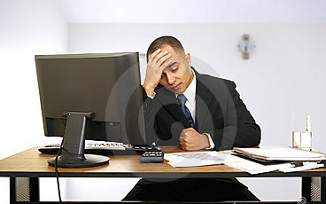

Office Ergonomics

Slide 6
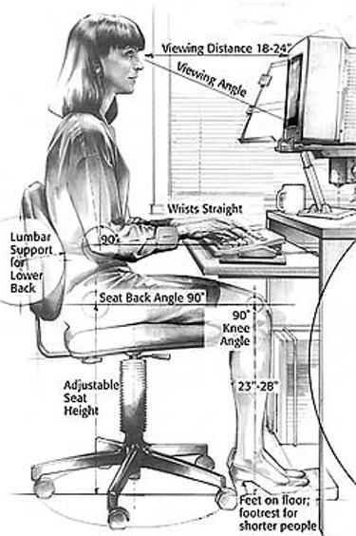
Office Ergonomics

Slide 7
Office Ergonomics
Seating
  Support areas
    Lumbar
    Shoulders
    Neck
    Arms
  Adjustability
    Height
    Tilt
    Depth
    Arms
Seating adjustments
https://youtu.be/Yz46lcrobDI

Slide 8
Office Ergonomics
Desks
  Fixed height
  Adjustable height
  Size
Monitors
  Size
  Positioning
  Stands/Arms
  Specialty
Common problems:
  Monitors in wrong position
  Poor seating
    Too little support
    No adjustability
  Inadequate desk size
  Old monitors with “fuzzy” text and images

Slide 9
Computer Access
Keyboards
  Standard
  Ergonomic
  Small footprint
  On-screen

Slide 10
Keyboards
Standard keyboards
  Some “key” differences
  Effects
Ergonomic
  Neutralizing design
  Wrist support
  “Reverse” angle
Common problems:
  Keyboard on wrong position
  Wrists in wrong placement
  Wrists pressing against table edge or laptop edge

Slide 11
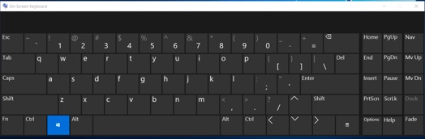
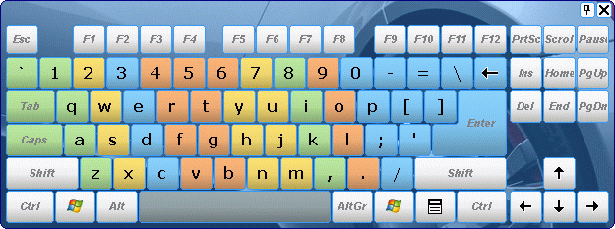
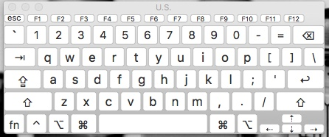
Onscreen Keyboards

Slide 12
What to do
Solutions
  Desk stands for laptops
  External keyboards
  Monitor arms for external monitors
  Work on larger external monitors rather than small laptop displays
  Improve lighting
  Personalized ergonomic seating
  Try a different keyboard
  Try a different mouse
  Upgrade your monitor
  Have ample work surface space
  Switch to wireless peripherals if possible
  Sit/Stand options

Slide 13
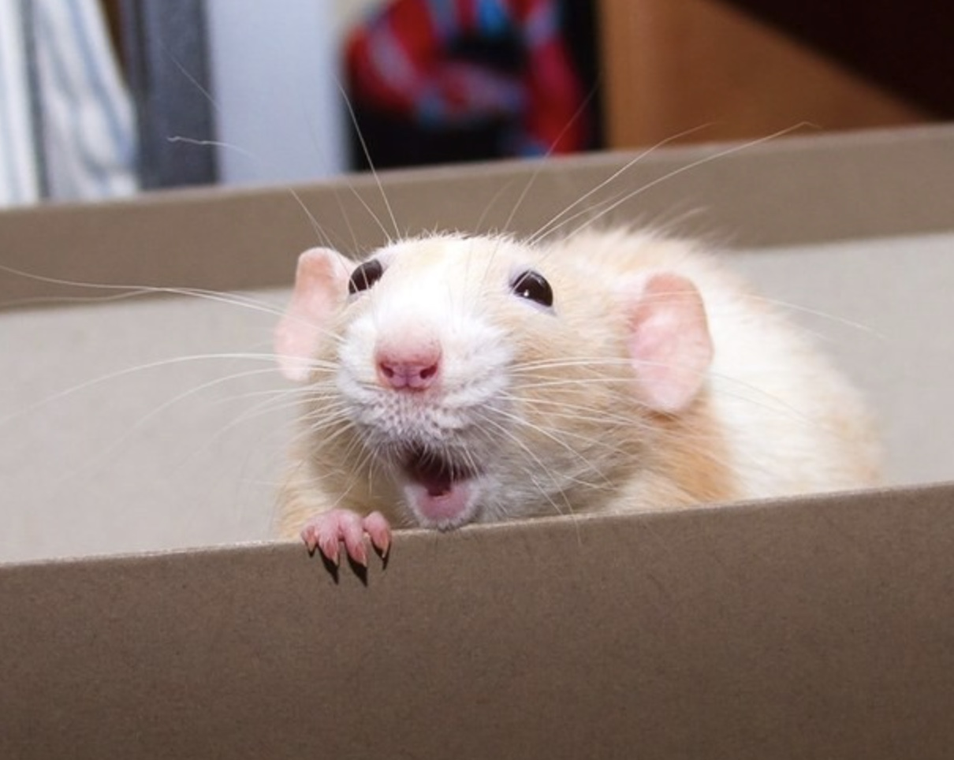
Mice

Slide 14
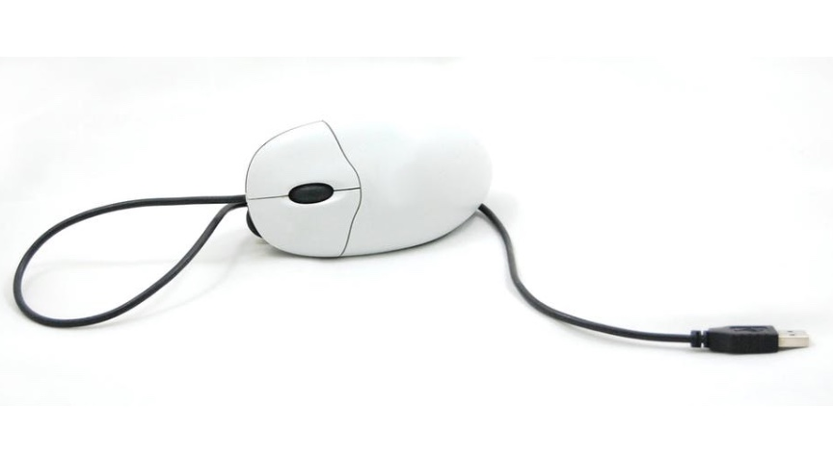
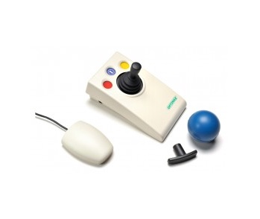
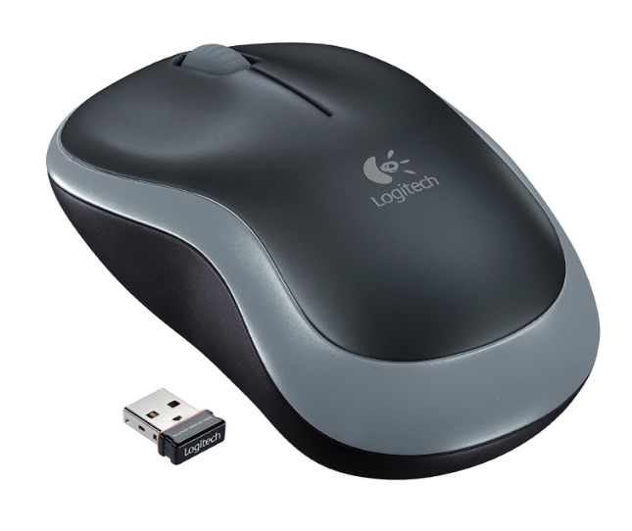
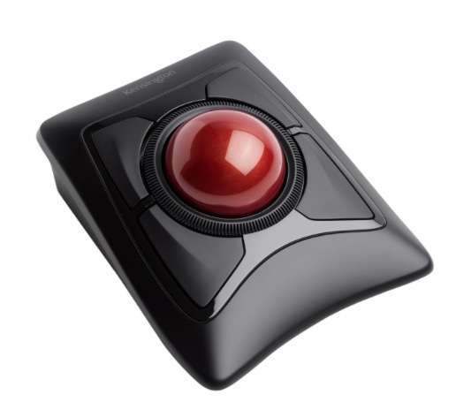
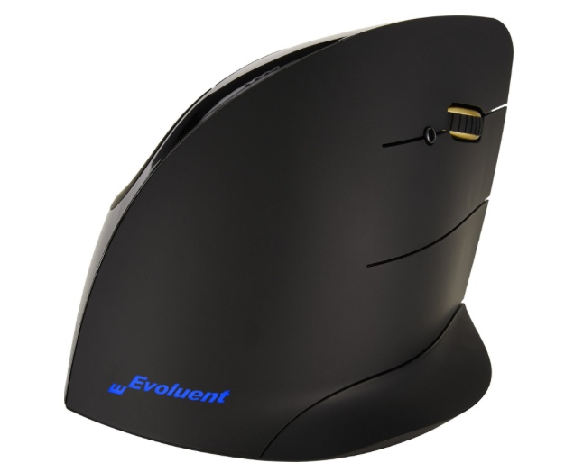
These kind
Wired
Joystick
Types
Wireless
Trackball
Vertical

Slide 15
Mouse Emulators
Headmouse
Eye Tracking
  PCEye Mini
  TM5
  Edge
Issues
Computer access
Head control
Eye movement

Slide 16
How eyegaze works
Differences
  Two eye capture
    2 lights – 1 camera
  Single eye capture
    1 light – 1 camera
Often tied to AAC systems

Slide 17
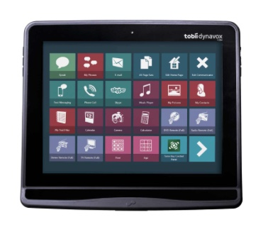
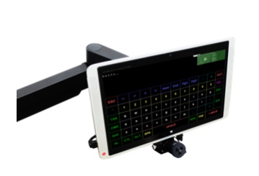
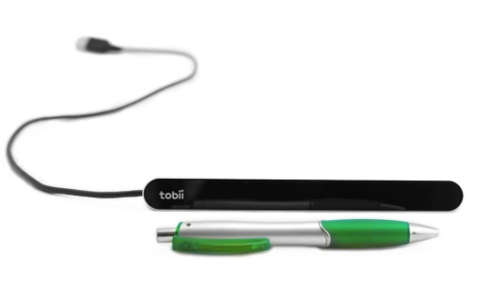
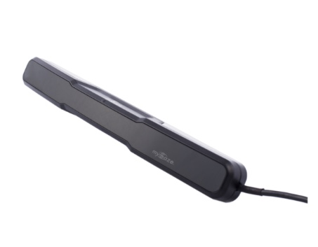
Eye Tracking/Gaze

Slide 18
AAC
Augmentative and Alternative Communication
  For speech impairments
    Unitelligible speech
    No speech
  Cerebral Palsy, ALS, TBI, Stroke, Cancer
History
Dedicated vs Open

Slide 19
Eye Tracking Access
Computer Access
  Self purchase
  Attach to an existing computer
  Other resources
Speech needs
  Often packaged as a complete turnkey solution
  Usually includes AAC solution
  Usually requires funding through MCD, MCR, PI because of cost
  Acquisition process requires SLP assessment, Dr. script, reports, payer source card copies, completion of specific doc

Slide 20
AAC Apps
iOS Apps
  TouchChat
  SonoFlex
  Snap + Core First
  Proloquo3go
  Verbally+
  Assistive Express
Android
  Assistive Express
  Let Me Talk
http://praacticalaac.org/praactical/133-free-lite-aac-apps-app-selection-resources-updated/

Slide 21
Demonstration
Headmouse
Eyegaze Edge

Slide 22
Questions
?

