Slide 1

Food Descriptions That Make You Hungry:
Hypnotic Menu Writing Tips & Secrets

Slide 2
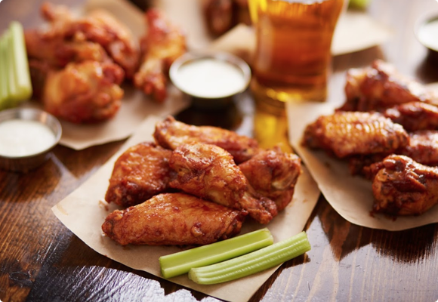
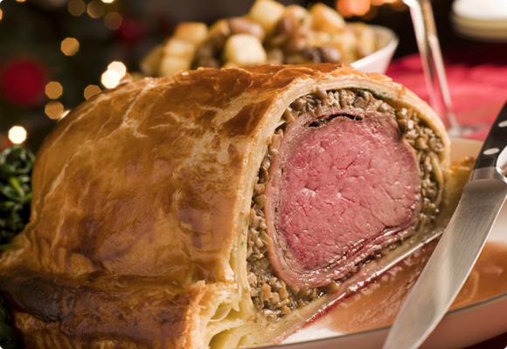
Emphasising appearance, flavour, texture or method of cooking:
Chicken: roast (roast chicken), crisp (crisp chicken wings), grilled, smoked (chicken, breast), tender, succulent, boneless chicken thighs, skinless
Beef: organic, grass-fed, spicy ground beef, peppery, lean, aged, spicy, stewed, Angus, other, own, pickled, poor, potted, tender, prime (prime beef tenderloin)
How To Use Persuasive Menu Writing Tips

Slide 3
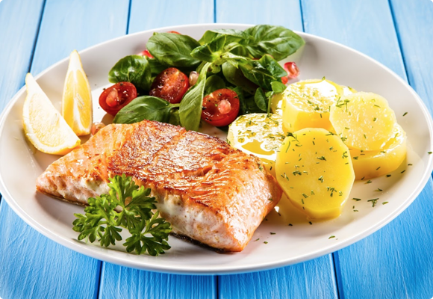
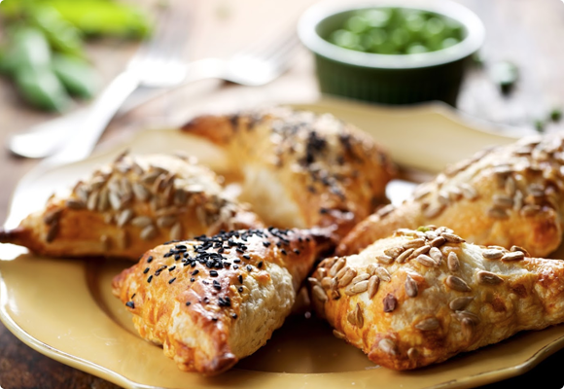
Emphasising appearance, flavour, texture or method of cooking:
Fish: boneless, smoked (salmon), briny (sardines), crispy, golden, freshwater, saltwater, baked, fried
Snacks: spicy (snacks), toasted (buns), warm (flour tortilla), soft (pretzels, flour tortilla), baked (mozzarella sticks)
How To Use Persuasive Menu Writing Tips

Slide 4
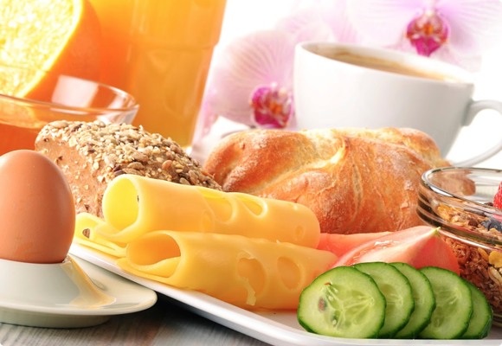
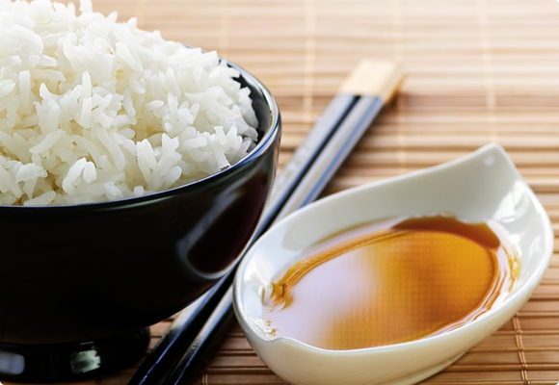
Emphasising appearance, flavour, texture or method of cooking:
Cheeses: fresh, dripping mozzarella, melty, fluffy, airy, creamy, velvety, crumbly, smoky, nuty, Roquefort, Camembert, Cotija, Chèvre, Feta, Mozzarella, Emmental, Cheddar, Gouda, Taleggio, Parmigiano-Reggiano, Manchego, Monterey Jack, Gorgonzola, Pecorino Toscano, Taleggio, Fontina d'Aosta, Parmigiano-Reggiano, Mozzarella di Bufala, Provolone, Asiago, Robiola Piemonte
Sauces: homemade, sweet, hot, spicy, ranch, milky, creamy, white, balsamic, sticky marinade (sauce)
How To Use Persuasive Menu Writing Tips

Slide 5
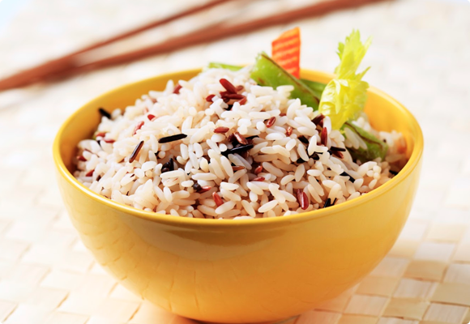
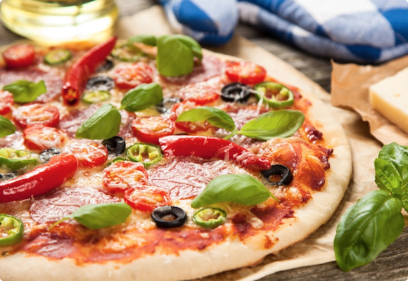
Emphasising appearance, flavour, texture or method of cooking:
Rice: spicy, basmati, steamed, fried, wild, brown, sticky, fluffy, puffed, Japanese, golden, Chinese, Indian, Oriental, soft, grained, short, medium, long-grain rice
Pizza: rustic, traditional, hearth-baked crust, homemade (sourdough), dripping mozzarella, baked, Italian, Mediterranean, vegetarian
How To Use Persuasive Menu Writing Tips

Slide 6
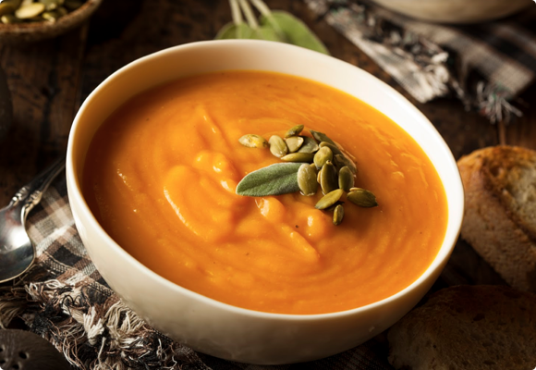
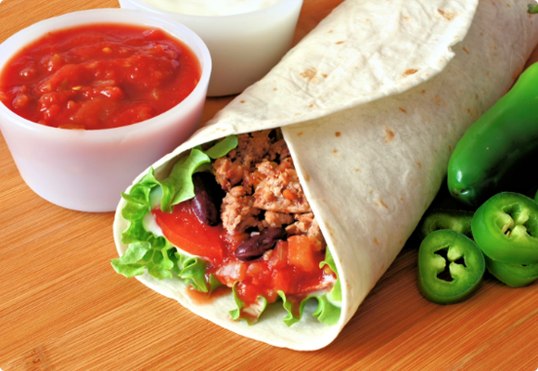
Emphasising appearance, flavour, texture or method of cooking:
Soup: homemade, traditional, creamy, slow-cooked (chicken soup), crock-pot (chicken soup), butternut squash soup, vegetable, healthy, golden, yellow, pumpkin, gourmet, tasty, delicious, organic, mashed, butternut squash, prepared, vegan, vegetable soup, salty, blended
Dips: creamy (avocado dip), sour (cream dip), balsamic, 3-layer dip (or replace with the desired number), Béarnaise
How To Use Persuasive Menu Writing Tips

Slide 7
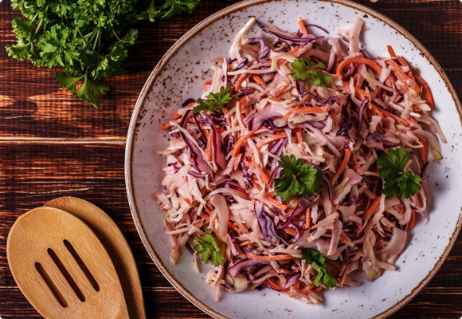
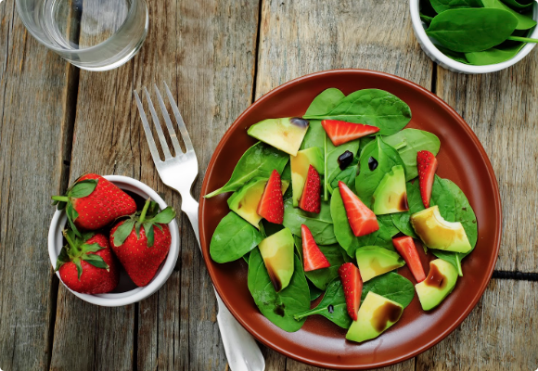
Emphasising appearance, flavour, texture or method of cooking:
Vegetables: crispy (crispy shallots), crisp (lettuce), caramelized, spicy (spicy hummus), buttery (buttery jack), fresh (salad), roasted (corn, potatoes), sun-kissed (tomatoes), sweet potatoes, baby (carrots), fermented (cabbage), grated (ginger), aromatic (herbs), mashed (potatoes), sautéed, seasoned (seasoned with dill)
Fruits: juicy, satin-smooth, nature's bounty, zesty, fresh, pureed (pureed fruit such as applesauce), candied, glace, pitted, seasonal, seedless, organic, tropical, exotic, locally-grown, garden-fresh, vitamin-infused (vitamin-infused smoothie with tropical foods), vitamin-rich, ripe
How To Use Persuasive Menu Writing Tips

Slide 8
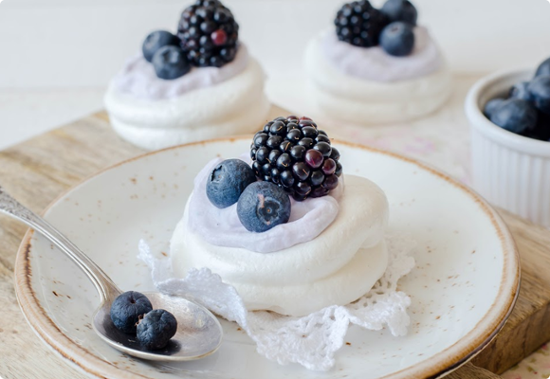
Emphasising appearance, flavour, texture or method of cooking:
Dessert: crunchy, sweet, savoury, flakey (flakey apple pie), crumbly (crumbly cheese, crumbly pie), gooey (gooey fudge), moist (moist chocolate cake), glazed, spiced (cinnamon spiced tart), sticky (sticky blueberry muffins), nutty, silky, minty, satin, naked (cake), bittersweet (chocolate chips), chocolatey (icing), salted caramel (brownies), flavored (almond flavored)
How To Use Persuasive Menu Writing Tips

Slide 9
Emphasising appearance, flavour, texture or method of cooking:
Adjectives related to the origins of the ingredients:
Authentic + Greek, Peruvian, American, Midwestern, Southwestern, Italian, Sicilian, Spanish, French, Romanian, Chinese, Vietnamese, Indian, Thai, Mexican, English, German, Dutch, Singaporean, Irish, etc.
Adjectives related to the food appearance:
Bite-sized, golden, golden-brown, powdered, glazed, sprinkled, drizzled, caramelized, crystalized, frosty, flambé, glossy,
Adjectives for plant-based VS meat-based foods:
Low-fat, kosher, gluten-free, vegan, vegetarian, raw, rare, medium-rare, medium or well-done
How To Use Persuasive Menu Writing Tips

