Slide 1
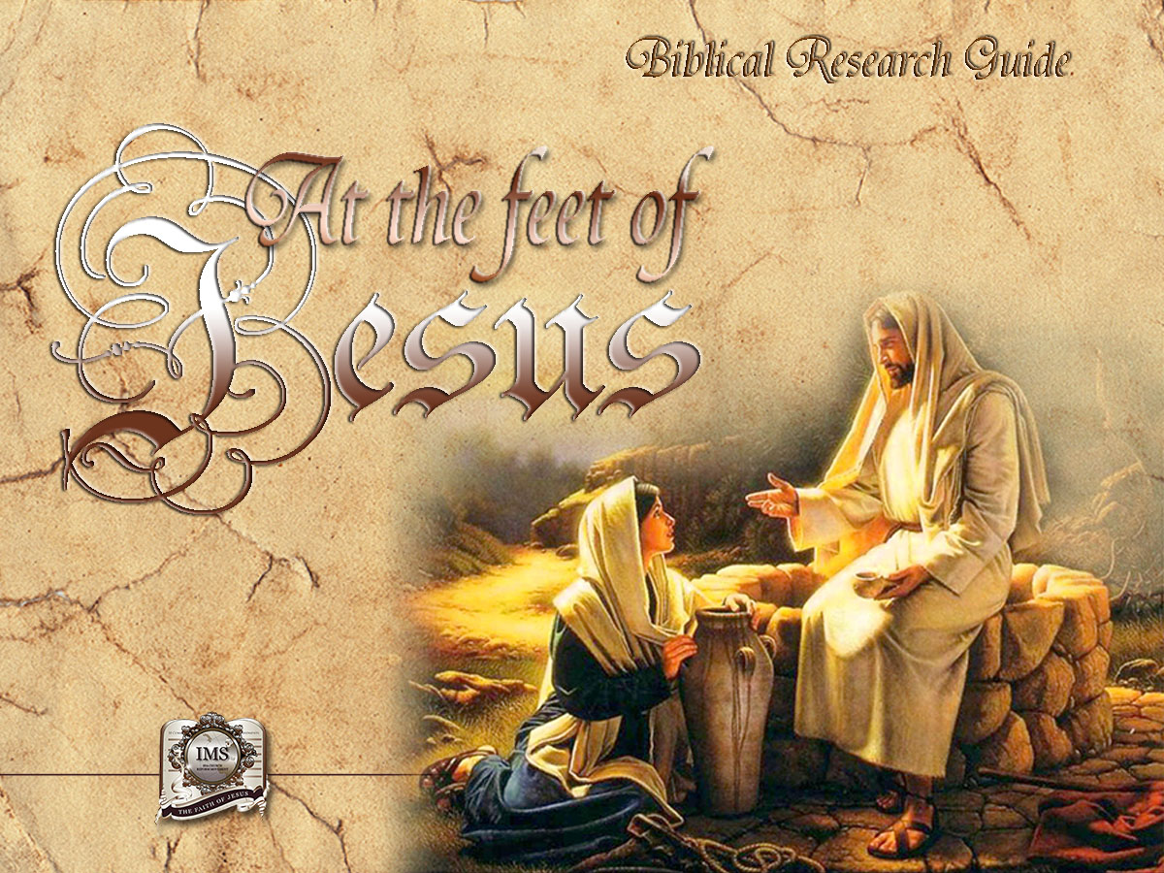

General Conference
Multimedia Department
Notes:
Congratulations on having decided to enrich your spiritual life with the Biblical Research Guide "At the feet of Jesus!"
The message that the Book of the books contains will bring you much satisfaction. The prophecies that reveal the past, the present and the future with surprising accuracy are outstanding, especially those of Daniel and the book of Revelation. The Scriptures answer the greatest questions of life: Where do we come from? Where are we going? What's beyond? Thousands can testify of the beneficial influence of this Holy Book. The topics found in this guide will give you an extraordinary vision and will fill your heart with faith and hope.

Slide 2
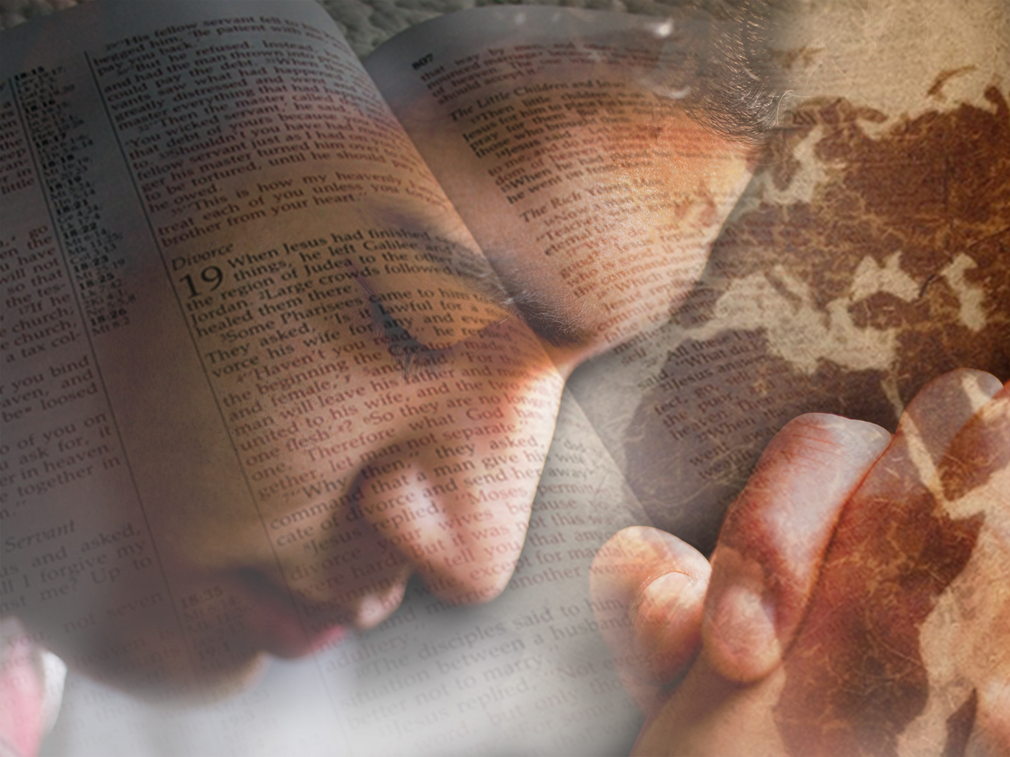

A moment of prayer…
Notes:
To go to the feet of Jesus is to find our inner selves and find God, to learn to communicate with Him and have the certainty that He hears us.
Let us ask God for enlightenment in order to understand the lesson that follows. He is willing to send us His Holy Spirit to understand His will, His counsels and His promises. Join us in the following prayer:
Lord, we thank you for having the opportunity to learn your Word. Give us your Spirit to understand the message you have in the Bible. Bless those who are accompanying us in this study. In the name of Jesus, amen.

Slide 3
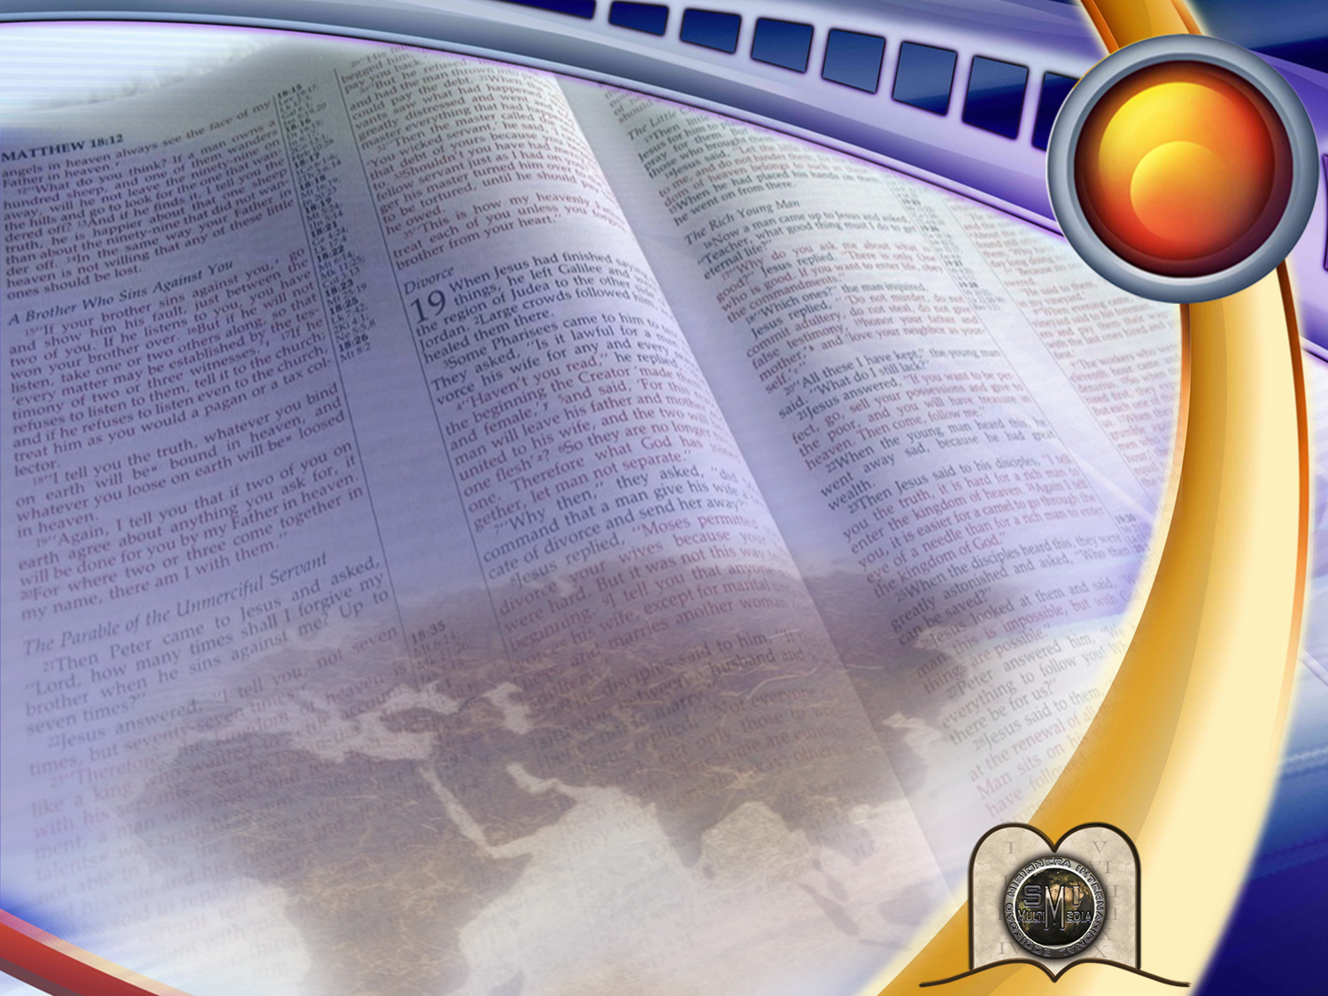
1
UNKNOWINGLY RICH
Notes:
UNKNOWINGLY RICH

Slide 4


Did you know that you have a great treasure?
It has been given to you by God himself, and its purpose is to make you happy.
We are talking about the Holy Scriptures.
The biblical texts have been taken from the Bible, King James Version (KJV).
Notes:
Somewhere in Texas, on an arid and barren land, lived a poor man. His very humble home had many debts. Just when he was about to lose his property, some men came with a contract for him to sign so that they could open a hole in his field. Soon, a pump was extracting large amounts of oil. The money received by the land owner made him a rich man overnight. In reality, he had been rich the whole time, only he didn´t know.
Did you know that you have a great treasure?
This treasure has been given to you by God Himself, and its purpose is to make you happy. We are talking about the Holy Scriptures.

Slide 5
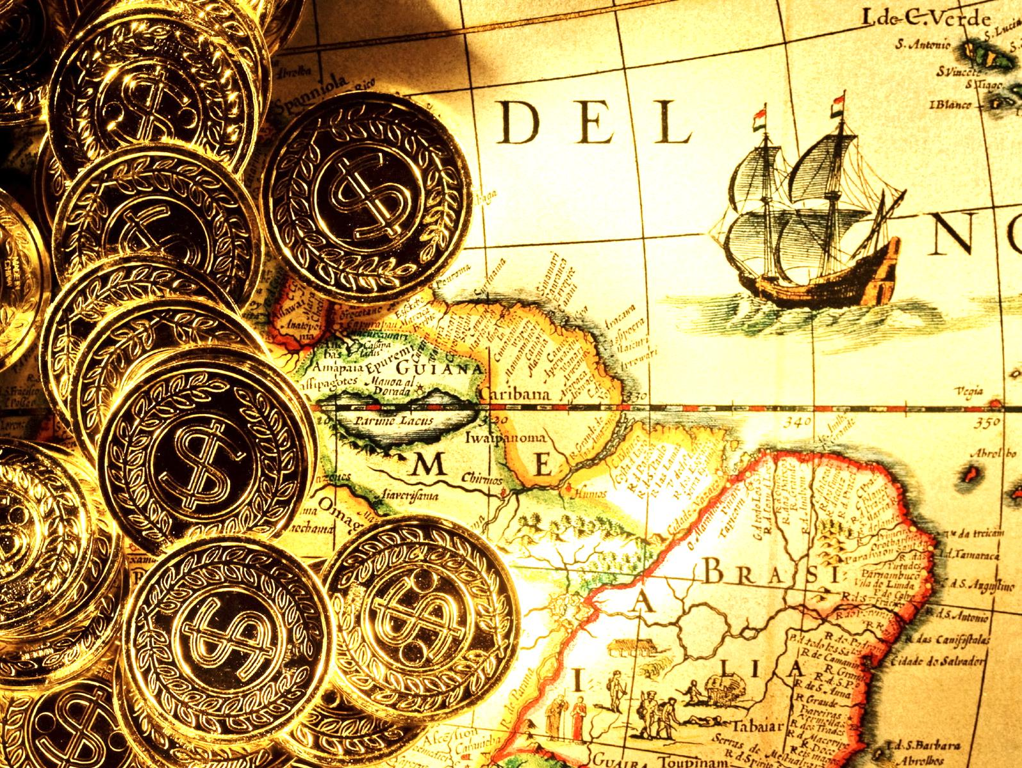
Why should
the Bible be
considered a treasure?
Because it contains 31,000 promises
and valuable advice for the home,
young people, and education.
It encourages, comforts, and strengthens us.
It tells us "Fear not” 360 times.
Notes:
Why should the Bible be considered a treasure?
Because it contains 31,000 promises and valuable advice for the home, young people, and education.
It encourages, comforts, and strengthens us.
It tells us "Fear not” 360 times.

Slide 6

God´s GPS
Notes:
>> The Bible is the GPS that God gave us to show us the direction we must take to live happy. It orients us through the past, the present and the future.

Slide 7
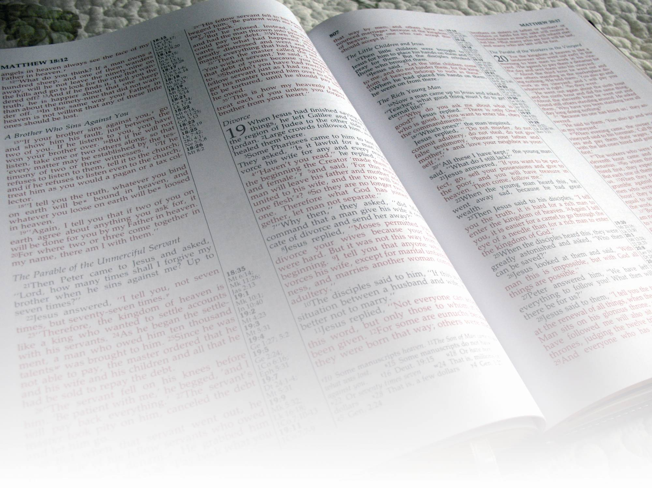
The Bible is also called:
• The Holy Scriptures
• The Word of God
• The Holy Book
• The Divine Letter
• The Book of Books
Notes:
The Bible is also called:
• The Holy Scriptures
• the Word of God,
• the Holy Book,
• the Divine Letter,
• the Book of Books

Slide 8
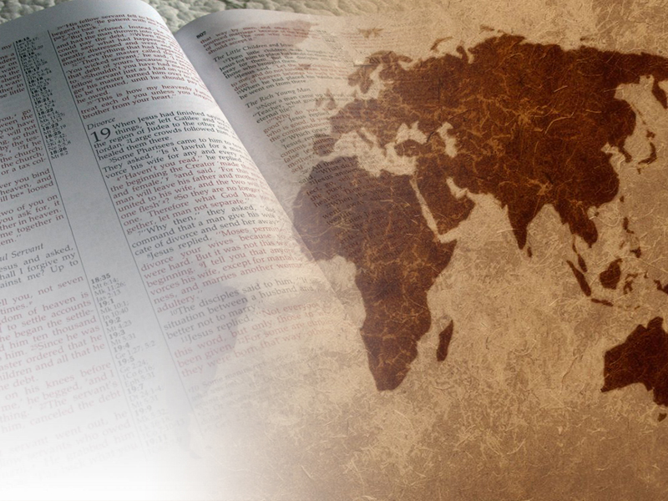
What does God reveal
in the Bible?
Notes:
1. What does God reveal in the Bible?

Slide 9

Amos 3:7
“Surely the Lord God will do nothing, but he revealeth his secret unto his servants the prophets.”
HIS SECRETS
AND PURPOSES
Notes:
Amos 3:7
“Surely the Lord God will do nothing, but he revealeth his secret unto his servants the prophets.”
His secrets and purposes

Slide 10
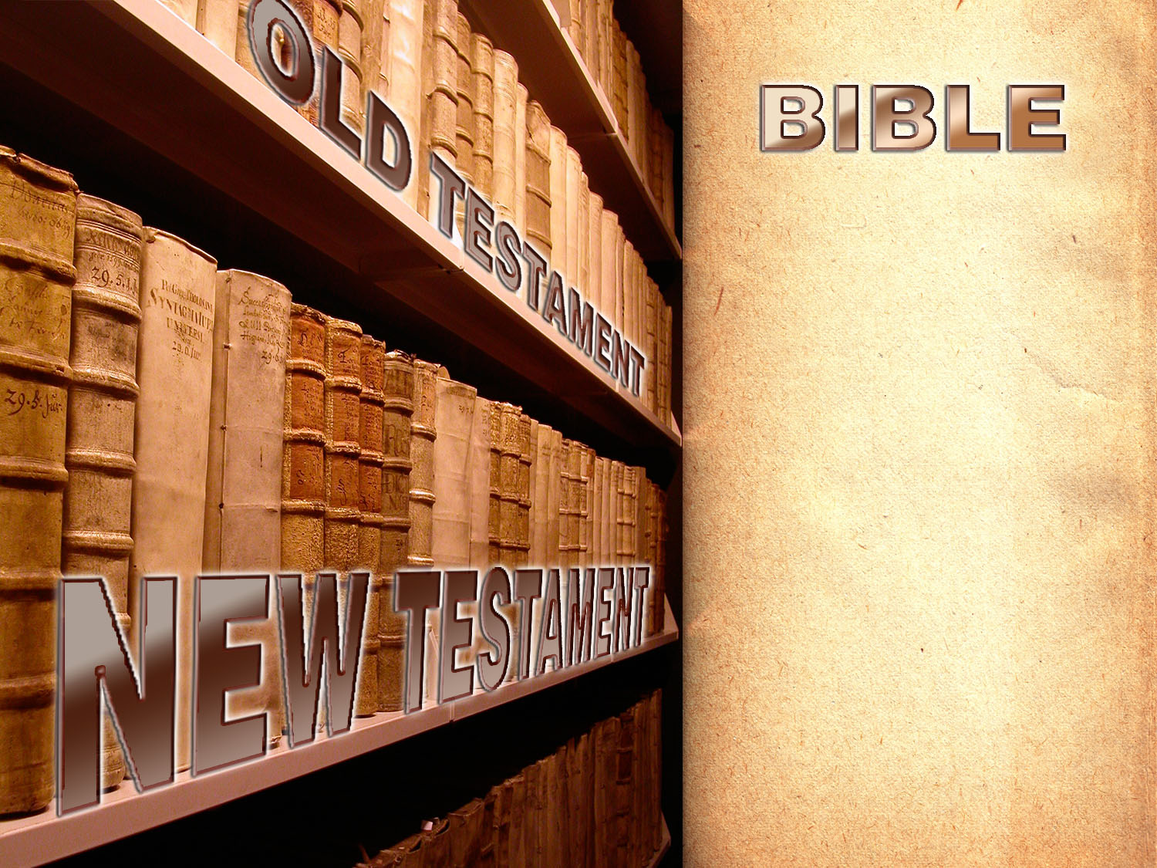
Means:
“a set of books”
39 Books
27 Books
Total: 66 Books
Notes:
The word Bible means “a set of books.” There are a total of 66 books:
39 in the Old Testament and 27 in the New Testament.

Slide 11
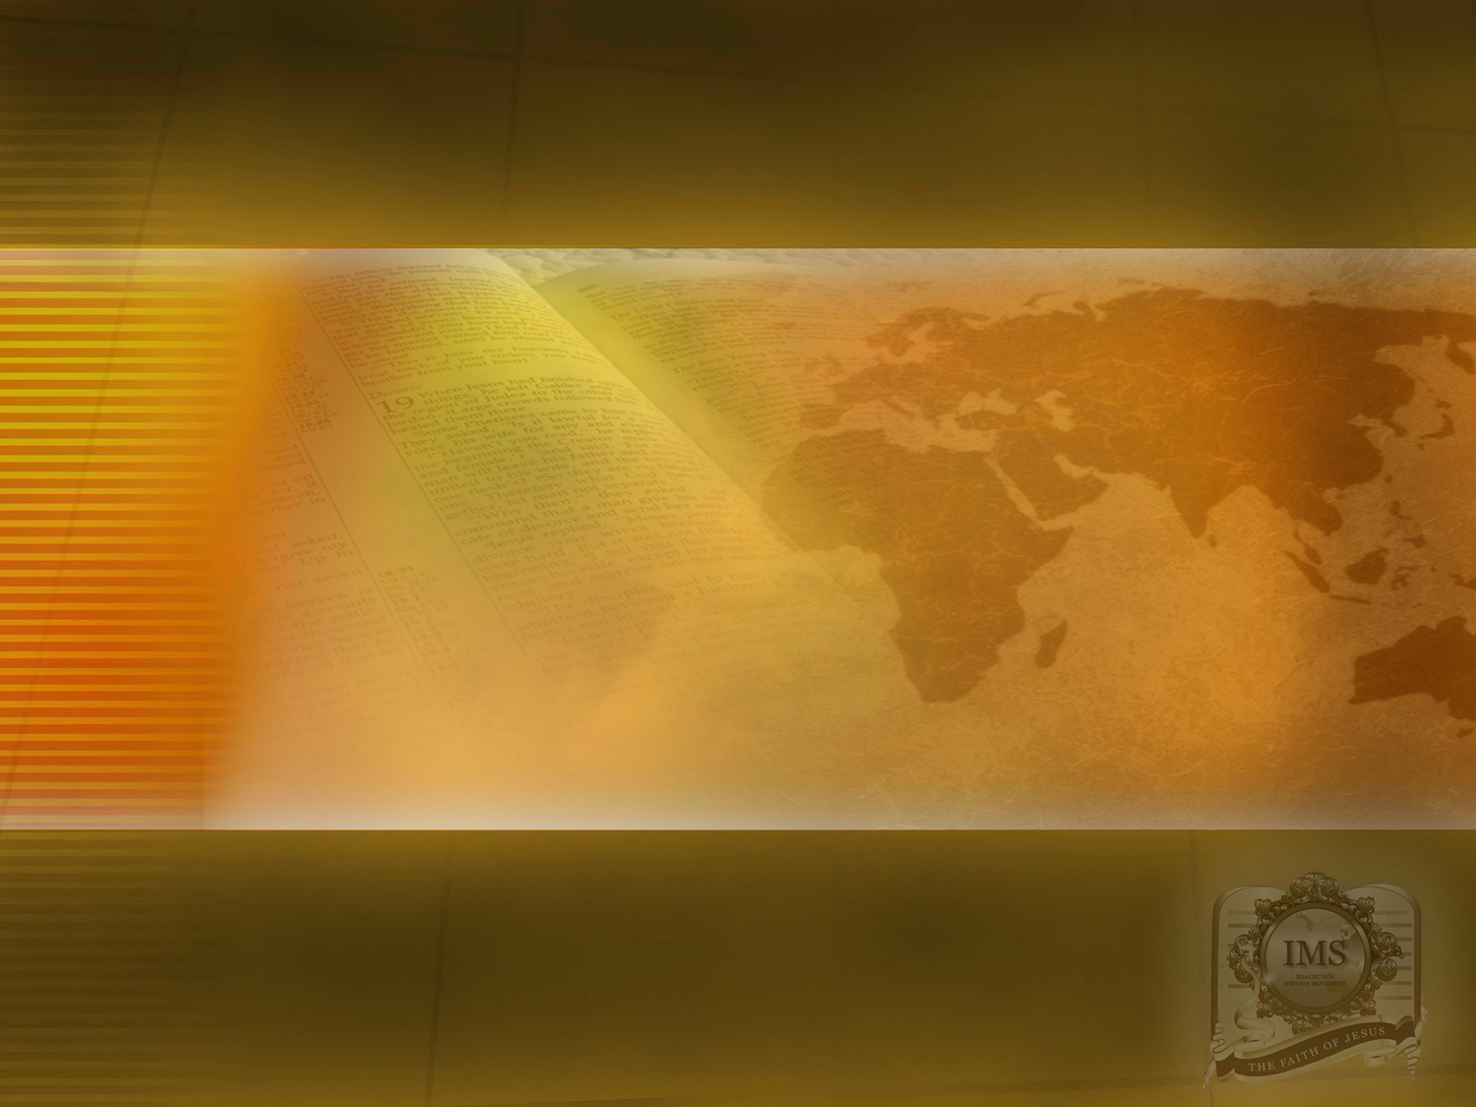
THE ORIGIN
OF THE BIBLE
Notes:
THE ORIGIN OF THE BIBLE

Slide 12
How was the Bible
given to men?
Notes:
2. How was the Bible given to men?

Slide 13

2 Timothy 3:16
“All scripture is given by inspiration of God…”
INSPIRED BY GOD
Notes:
2 Timothy 3:16
“All scripture is given by inspiration of God…”
The Holy Scriptures were _INSPIRED _ by God.

Slide 14


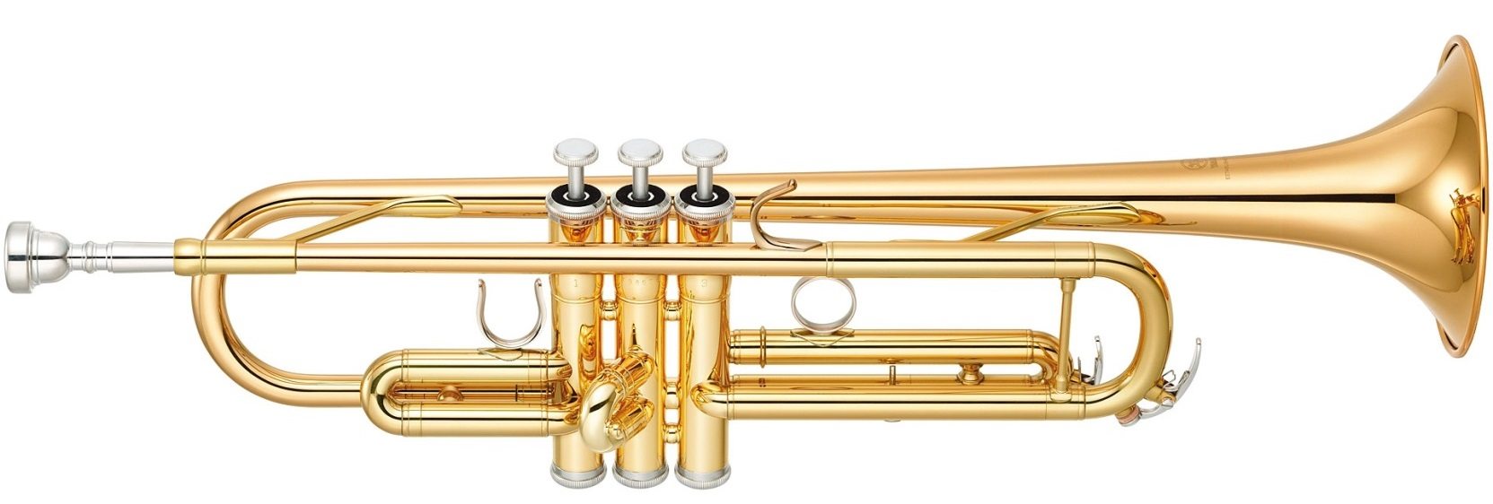
`INSPIRE´: Blowing into…
Notes:
The word `inspire´ means `blowing´ into ...
Example: - An executive dictates a letter to his secretary. Who is the author? the secretary who writes it down or the executive who dictated it? In the same manner, God is the true author.

Slide 15
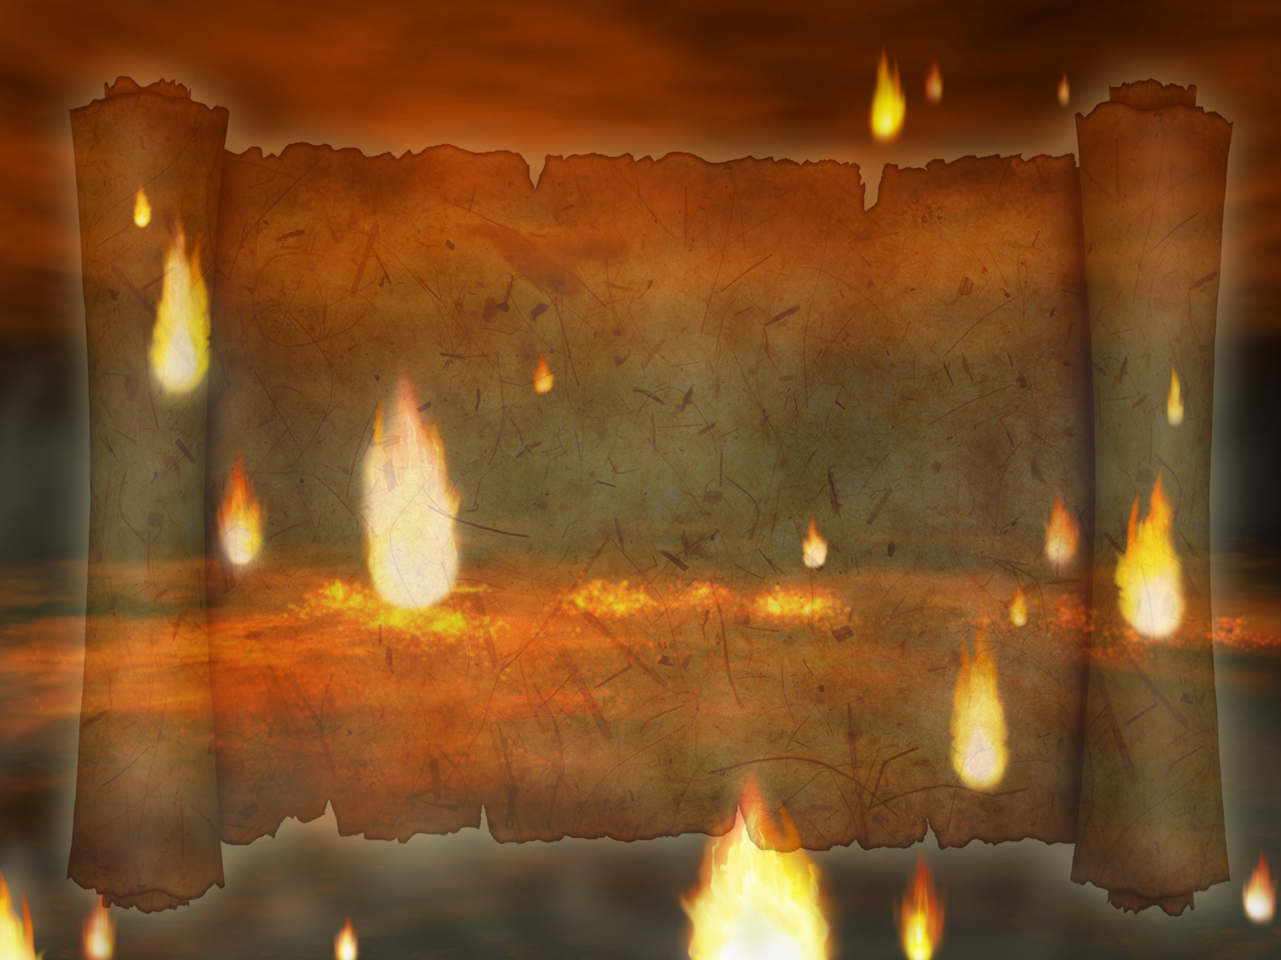
Who inspired the thoughts of these men?
Notes:
3. Who inspired the thoughts of these men?

Slide 16
2 Peter 1:21
“For the prophecy came not in old time by the will of man: but holy men of God spake as they were moved by the Holy Ghost.”
THE HOLY SPIRIT
Notes:
2 Peter 1:21
``For the prophecy came not in old time by the will of man: but holy men of God spake as they were moved by´´.
The Holy Ghost/Spirit.

Slide 17
Therefore, what can
the Bible be called?
Notes:
4. Therefore, what can the Bible be called?

Slide 18
1 Thessalonians 2:13
“For this cause also thank we God without ceasing, because, when ye received the word of God which ye heard of us, ye received it not as the word of men, but as it is in truth, the word of God, which effectually worketh also in you that believe.”
THE WORD OF GOD
Notes:
1 Thessalonians 2:13
``For this cause also thank we God without ceasing, because, when ye received the word of God which ye heard of us, ye received it not as the word of men, but as it is in truth, the word of God, which effectually worketh also in you that believe´´.
THE WORD OF GOD

Slide 19
evidences that God inspired the Bible
Notes:
5. What evidences exist that tells us that the Bible was inspired by God?

Slide 20

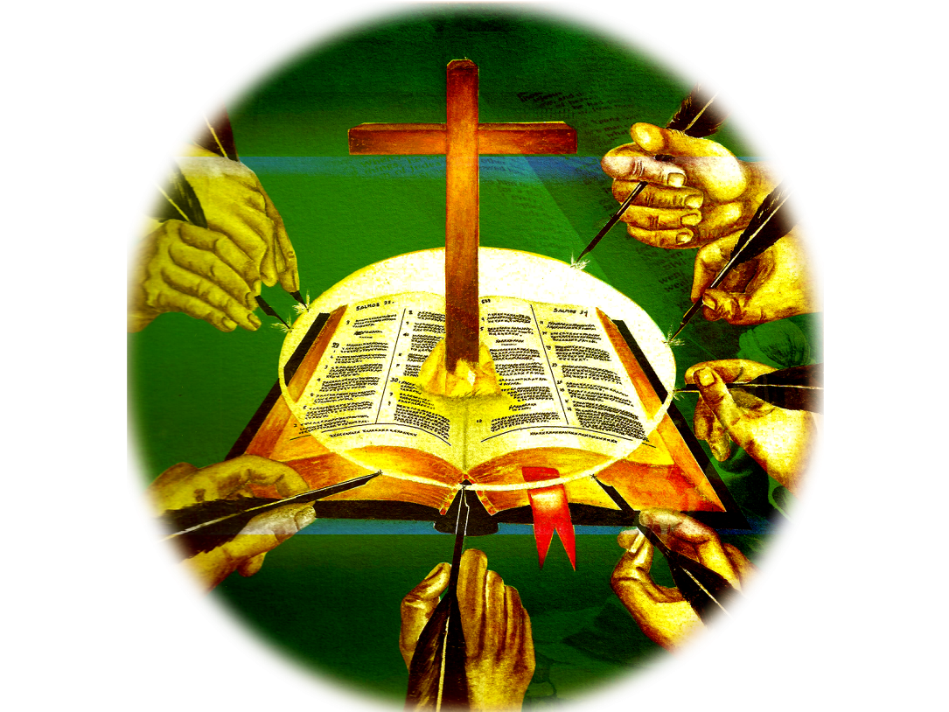
The harmony of its message
although it was written...
by more than 40 authors
over a period of 1600 years
These men came from different paths of life
Notes:
a) The harmony of its message, although it was written by more than 40 authors over a period of 1600 years, it presents a unified message. These men came from different paths of life. They were: kings, prime ministers, doctors, fishermen, shepherds, prophets.

Slide 21
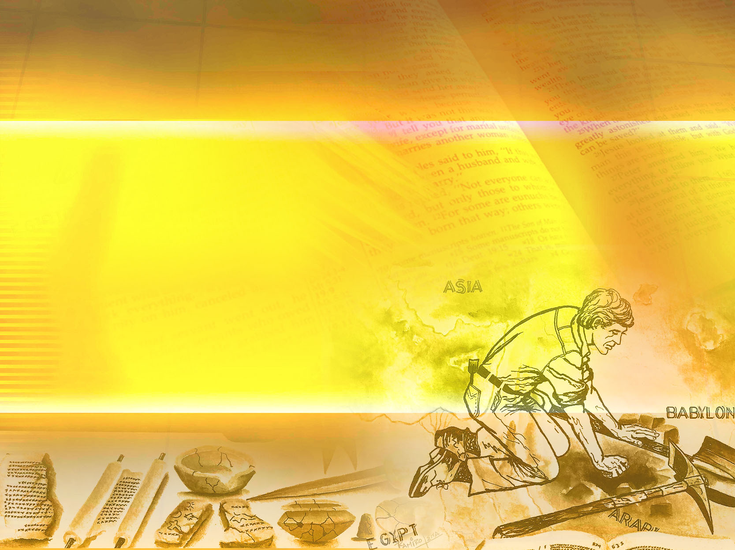
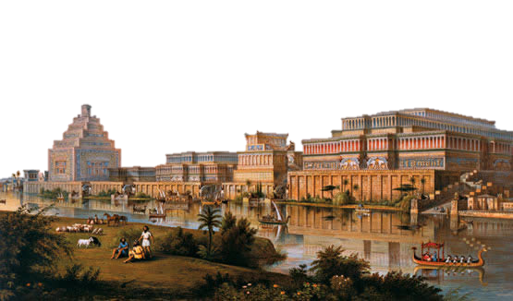
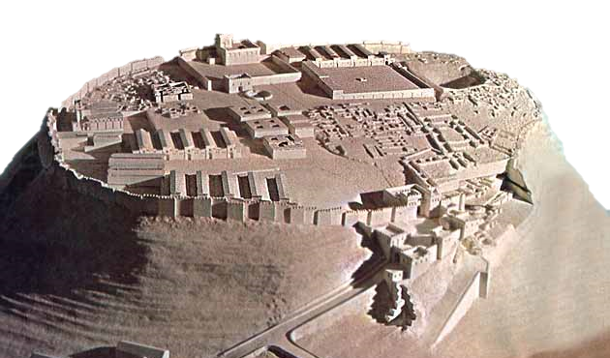
Proven by History
Its historical accuracy, proven by archaeology.
2,500 places were relocated that are related to Biblical lands.
Cities such as Tel Lachish, Tel Hazor, Megiddo, Nineveh and many others whose location were unknown before, were unearthed by archaeologists.
Notes:
b) Its historical accuracy, proven by archaeology.
- Numerous discoveries in the Middle East confirm Biblical history amazingly.
- Cities such as Tel Lachish, Tel Hazor, Megiddo, Nineveh and many
others whose locations were unknown before, were unburied
by archaeologists
> over 2,500 places were located that are related to Biblical lands. Several cities were unburied, whose locations
were unknown.
Example: - Megiddo 1 Kings 9: 15-19. King Salomon´s stables and mangers were found.
> - In Ezion Geber, its high furnaces were discovered under the sand.
> - Traces of an advanced civilization was found in Ur of the Chaldeans, the lands of Abraham.
- The lost city of Babylon, mentioned many times by the prophets, was uncovered, thus confirming various biblical records.
. Cities such as Nineveh, Tel Lachish, Tel Hazor and others were found, testifying on the veracity of the Bible.
> The existence of kings mentioned in the Bible and unknown in the annals of history, were confirmed by excavations.
> Example: - King Sargon. Isaiah 20: 1
In Khorsabad, close to Niniveh, the French consul Pablo Bota, found the palace that pertained to this king with an enormous statue of himself.
>Critics of the Bible considered the report of King Ahab’s Ivory Palace to be fantasy (1 Kings 22:39) until it was discovered in Samaria. They found a palace with white marble very similar to ivory and numerous colored ivory plaques covering the walls and some furniture. There were many more objects found made of this desired material.

Slide 22
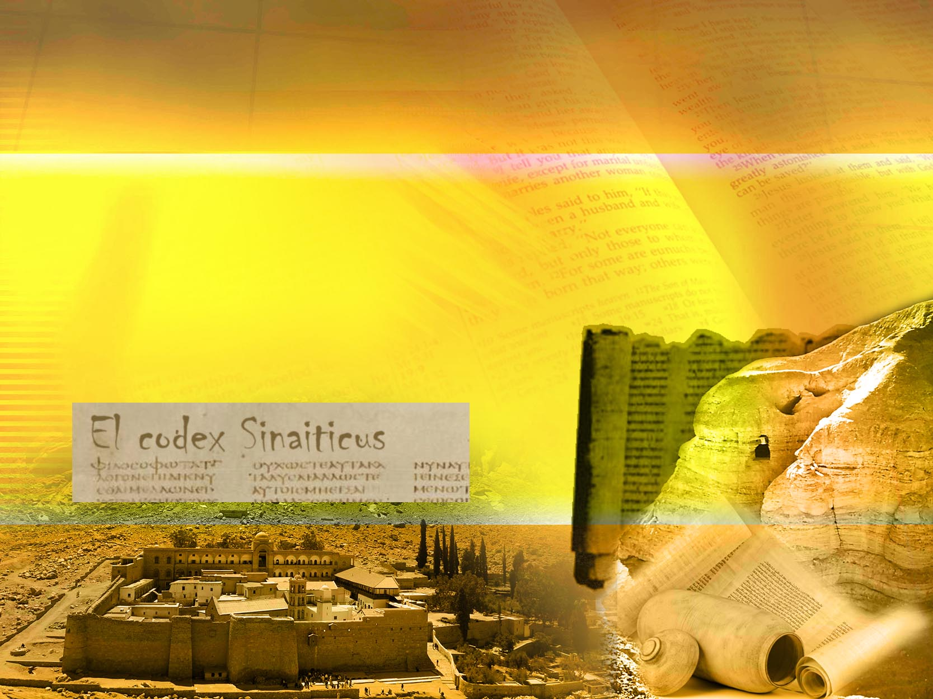
Proven by History
Its historical accuracy, proven by archaeology.
Many ancient manuscripts were found that prove that the Bible we have in our hands coincides with the originals.
Notes:
Entire libraries were discovered, revealing the knowledge of those times.
The library of Ashurbanipal was found with a collection of 20,000 clay tablets as well as a palace that belonged to the king of Mari from the time of Abraham, with 23,000 clay tablets.
Inscriptions on stone, ceramic, papyrus and leathers, confirm once again the biblical expressions.
The Dead Sea Scrolls. In 1947, a Bedouin shepherd found valuable scrolls in a cave close to the Qumran region of the Dead Sea. These scrolls contained parts of the Old Testament, from the books of Isaiah and Daniel. They were written in the first and second century B.C and were hidden in a hurry in caves located in the mountains of Qumran when war was threatening. Today the scrolls are at the Bible Museum in Jerusalem. After the discovery, several more expeditions were made to the area and they discovered parts of almost all the books of the Old Testament in about 2,000 caves.
Accuracy of the New Testament.
In 1931, there was the discovery of the Chester Beatty Papyrus along with 11 codex fragments. They contain parts of the Old Testament and a good part of the New Testament and were written during the third century.
>Several codices (very ancient copies), like Codex Sinaiticus, el Codex Vaticanus, el Codex Ephraemi were found. Just like the Dead Sea Scrolls, they demonstrate that the Bible that we have in our hands today coincides with the original texts. Prove it for yourself!

Slide 23
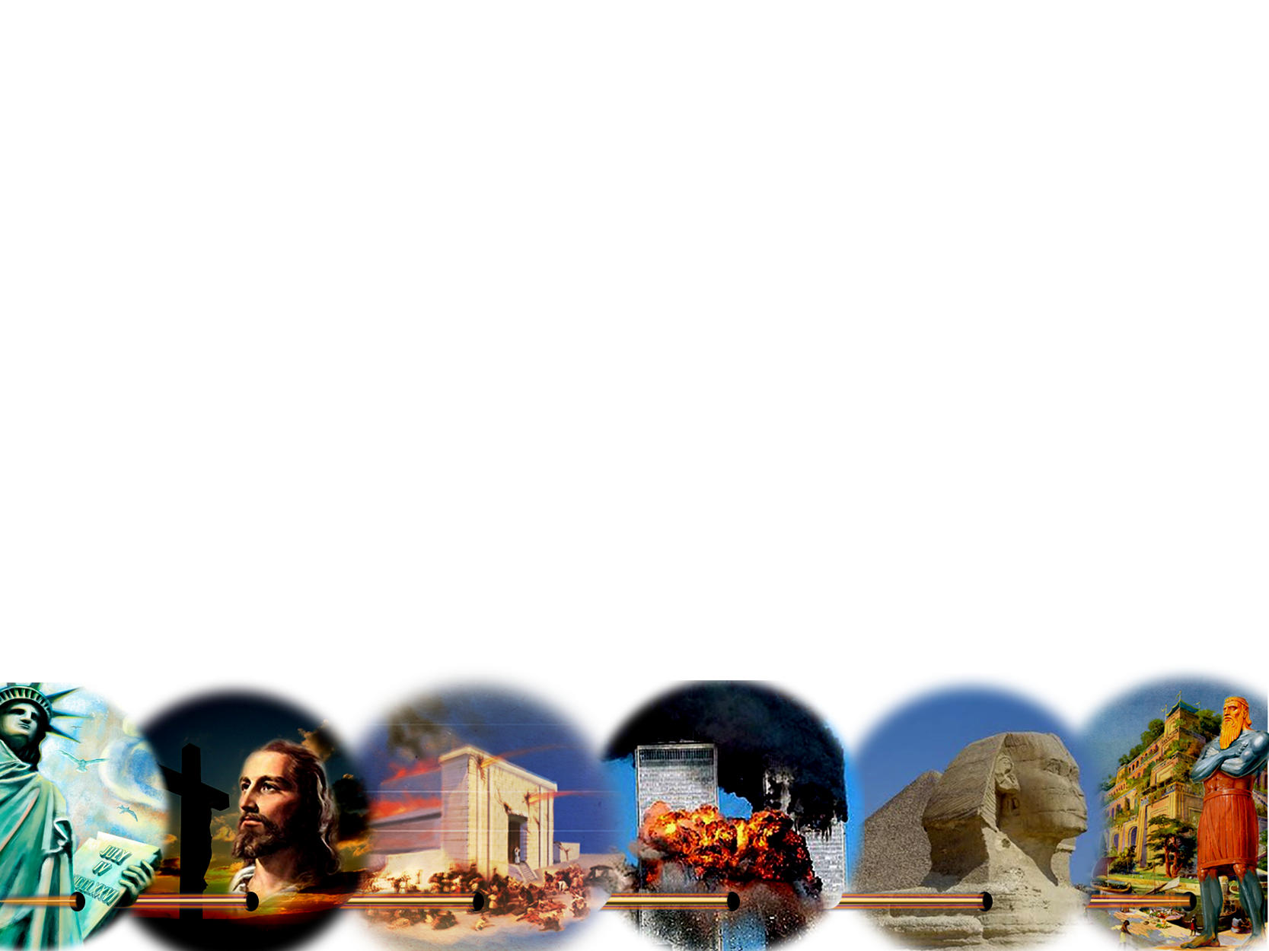
Accuracy of the prophecies
More than 2,300 prophecies accurately fulfilled:
The fate of empires and people.
The life of people before they were born.
The exact time in which certain events would occur.
Important ancient cities, such as Tyre, Babylon, Petra, Jerusalem, etc.
Notes:
More than 2,300 prophecies accurately fulfilled
- It is interesting what the prophecies mention about empires such as Babylon, Tyre, Sidon, Egypt, and nations like that of the Jewish people.
- It contains predictions about scientific advances. It mentions cars and airplanes, the laws of gravity, the weight of air, the earth’s roundness, etc., contrary to the knowledge of the time.
- Via various prophetic chains in the Book of Revelation, the political and religious history of about 2,000 years is told. We are told why Hitler and Napoleon lost the war, who will rule the world, the cause of the world´s current crisis, etc.
- There are 333 prophecies about a single man, which were written centuries before He was even born.

Slide 24
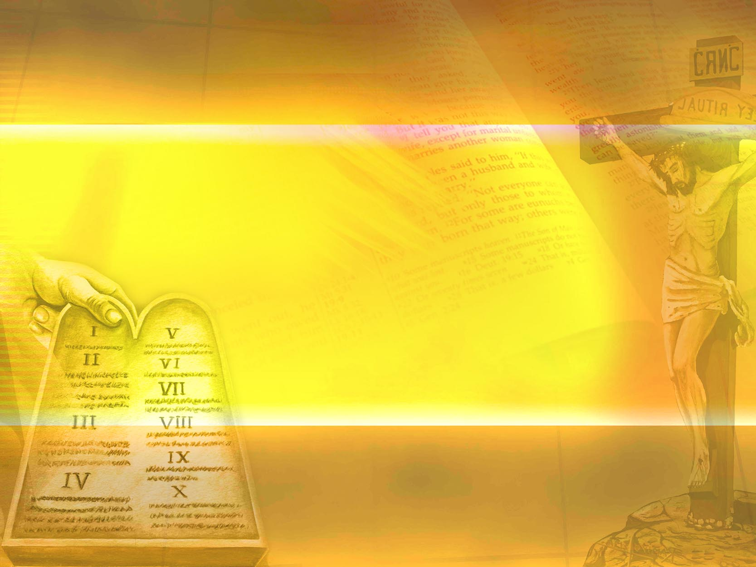
The purity of its message
An example are the 10 commandments.
The perfection of the 10 commandments.
The beatitudes and the whole message of the Gospel
Its profound and true councils for youth and the family.
Its words of comfort and hope.
Notes:
The purity of its message
An example are the 10 commandments.
> The perfection of the 10 commandments.
> The beatitudes and the whole message of the Gospel
> Its profound and true councils for youth and the family.
> Its words of comfort and hope.

Slide 25

The people who
were transformed by it
Millions of people found in the Bible the strength and help needed to change their course, of:
Sadness to joy.
Hate to love.
Vice to freedom.
Guilt to forgiveness.
Depression to hope.
Sickness to health.
Weakness to strength.
Deceit to veracity.
Enmity to friendship.
Illusion to truth.
Loneliness to protection.
Damnation to salvation.
Notes:
The people who were transformed by it
Millions of people found in the Bible the strength and help needed to change their course, of:
Sadness to joy.
Hate to love.
Vice to freedom.
Guilt to forgiveness.
Depression to hope.
Sickness to health.
Weakness to strength.
Deceit to veracity.
Enmity to friendship.
Illusion to truth.
Loneliness to protection.
Damnation to salvation.

Slide 26
Let's remember:
Five evidences of its divine origin:
The unity of its message
The accuracy of fulfilled prophecy
Its historical accuracy proven by archaeology
The purity of its message
The lives transformed by its influence
Notes:
Let's remember:
Five evidence of its divine origin:
The unity of its message
The accuracy of fulfilled prophecy
Its historical accuracy proven by archaeology
The purity of its message
The lives transformed by its influence

Slide 27
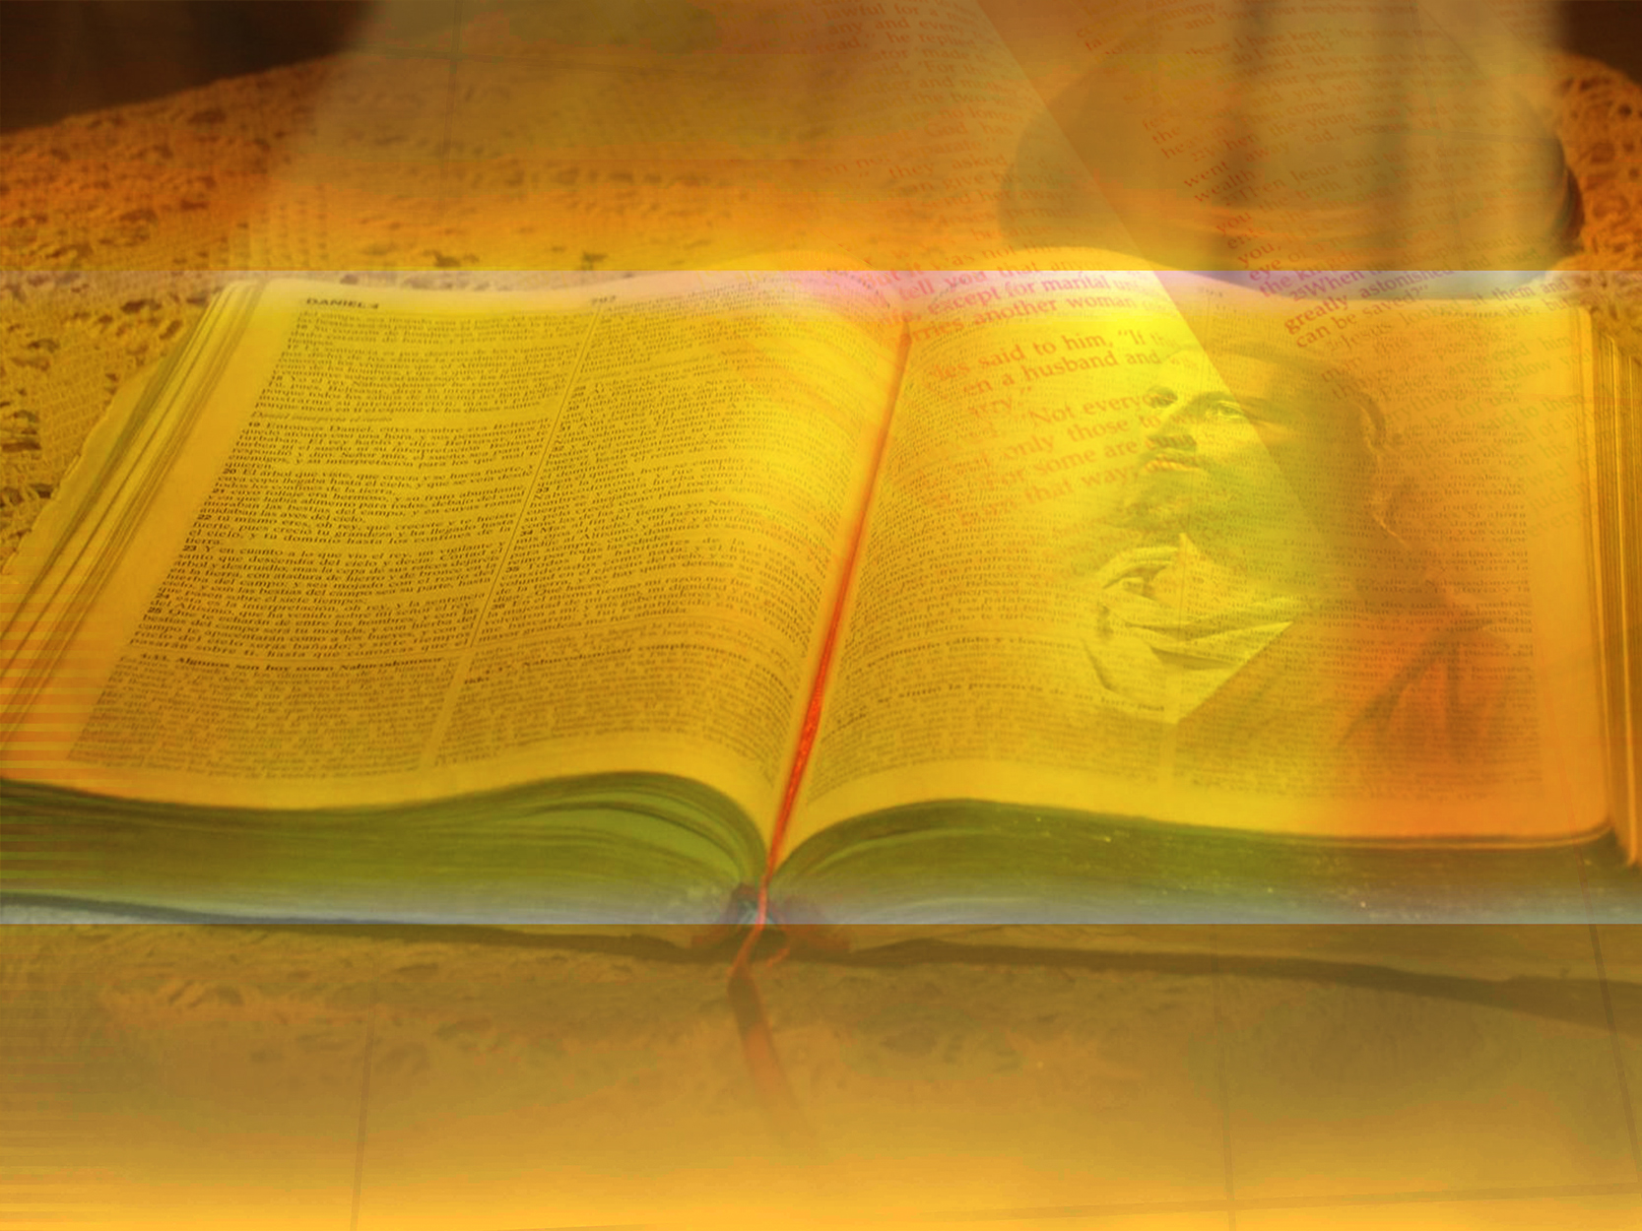
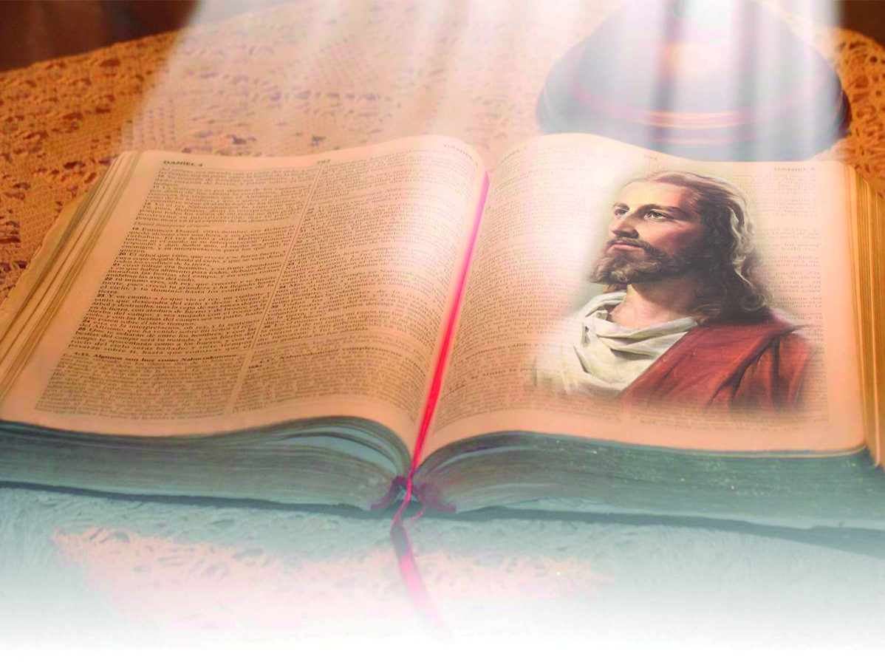
Central Figure
He is mentioned with more than 200 names that highlight His virtues.
333 prophecies pointing to His life and ministry before He was even born.
The New Testament describes the fulfillment of these prophecies.
The Bible’s central figure is
the wonderful person of: Jesus Christ.
Notes:
6. Who is its central figure?
The Bible’s central figure is the wonderful person of: Jesus Christ.
- He is mentioned with more than 200 names that highlight His virtues.
- 333 prophecies pointing to His life and ministry before He was even born.
- The New Testament describes the fulfillment of these prophecies.

Slide 28
THE PURPOSE OF THE BIBLE
Notes:
THE PURPOSE OF THE BIBLE

Slide 29
What do we obtain
through the study of the Bible?
Notes:
7. What do we obtain through the study of the Bible?

Slide 30
2 Timothy 3:15
“And that from a child thou hast known the holy scriptures, which are able to make thee wise unto salvation through faith which is in Christ Jesus.”
HEALTY WISDOM
Notes:
2 Timothy 3:15
``And that from a child thou hast known the holy scriptures, which are able to make thee wise unto salvation through faith which is in Christ Jesus´´.
Healthy wisdom

Slide 31
What can it be used for?
Notes:
8. What can it be used for?

Slide 32
2 Timothy 3:16-17
“All scripture is given by inspiration of God, and is profitable for doctrine, for reproof, for correction, for instruction in righteousness: That the man of God may be perfect, thoroughly furnished
unto all good works.”
TO TEACH, TO CORRECT…
Notes:
2 Timothy 3:16-17
“All scripture is given by inspiration of God, and is profitable for doctrine, for reproof, for correction, for instruction in righteousness: That the man of God may be perfect, thoroughly furnished unto all good works.”

Slide 33
What does the Bible
offer us?
Notes:
9. What does the Bible offer us?

Slide 34

Romans 15:4
“For whatsoever things were written aforetime were written for our learning, that we through patience and comfort of the scriptures might have hope.”
HOPE
Notes:
Romans 15:4
“For whatsoever things were written aforetime were written for our learning, that we through patience and comfort of the scriptures might have hope.”

Slide 35

Jeremiah 15:16
“Thy words were found, and I did eat them; and thy word was unto me the joy and rejoicing of mine heart: for I am called by thy name, O Lord God of hosts.”
JOY AND REJOICING
Notes:
Jeremiah 15:16
“Thy words were found, and I did eat them; and thy word was unto me the joy and rejoicing of mine heart: for I am called by thy name, O Lord God of hosts.”

Slide 36
To help us understand its virtues, what is the Bible compared to and why?
Notes:
10. To help us understand its virtues, what is the Bible compared to and why?

Slide 37

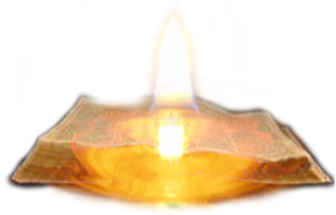
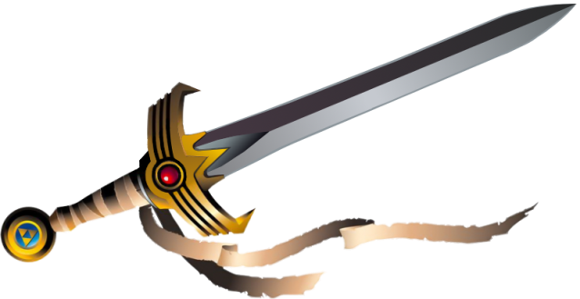
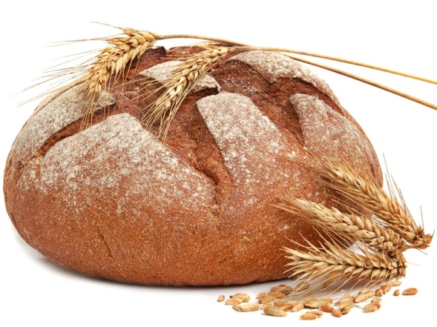
Psalm 119:105
Thy word is a lamp unto my feet, and a light unto my path.
Light
Hebrews 4:12
For the word of God is quick, and powerful, and sharper than any two-edged sword, piercing even to the dividing asunder of soul and spirit, and of the joints and marrow, and is a discerner of the thoughts and intents of the heart.
Sword
  Matthew 4:4
  But he answered and said, It is written, Man shall not live by bread alone, but by every word that proceedeth out of the mouth of God.
Bread
Notes:
a) Light. Psalm 119: 105. Thy word is a lamp unto my feet, and a light unto my path. It lights our path.
b) A sword. Hebrews 4:12. For the word of God is quick, and powerful, and sharper than any two-edged sword, piercing even to the dividing asunder of soul and spirit, and of the joints and marrow, and is a discerner of the thoughts and intents of the heart. It defends us against error.
c) Bread. Matthew 4: 4. But he answered and said, It is written, Man shall not live by bread alone, but by every word that proceedeth out of the mouth of God. It nourishes (feeds) our spiritual life.

Slide 38


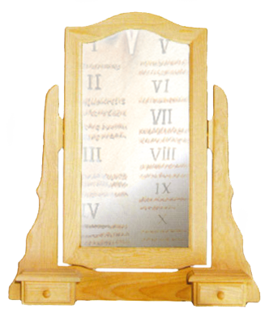
Fire and a
hammer
Jeremiah 23:29
Is not my word like as a fire? saith the Lord; and like a hammer that breaketh the rock in pieces?
1 Peter 2:2
As newborn babes, desire the sincere milk of the word, that ye may grow thereby.
Milk
James 1:23
For if any be a hearer of the word, and not a doer, he is like unto a man beholding his natural face in a glass.
Mirror
A love letter from our heavenly Father.
Notes:
d) Fire and hammer. Jeremiah 23:29. Is not my word like as a fire? saith the Lord; and like a hammer that breaketh the rock in pieces?.
Fire purifies and a hammer molds.
e) Milk. 1 Peter 2: 2. As newborn babes, desire the sincere milk of the word, that ye may grow thereby. It helps us grow spiritually.
f) A mirror. James 1:23. For if any be a hearer of the word, and not a doer, he is like unto a man beholding his natural face in a glass. It shows us our defects.
g) A letter. He speaks to us about His love.

Slide 39
FIVE KEYS TO UNDERSTAND
THE BIBLE
Notes:
FIVE KEYS TO UNDERSTAND THE BIBLE

Slide 40

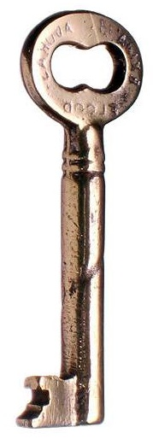
FIVE KEYS TO UNDERSTANDING THE BIBLE
1st. Key:
How should it be studied?
Notes:
1st. Key:
How should it be studied?

Slide 41
Acts 17:11
“These were more noble than those in Thessalonica, in that they received the word with all readiness of mind, and searched the scriptures daily, whether those things were so.”
SEARCH THE BIBLE
ON A DAILY BASIS
Notes:
Acts 17:11
“ These were more noble than those in Thessalonica, in that they received the word with all readiness of mind, and searched the scriptures daily, whether those things were so.”
Search the Bible on a daily basis. Confirm all things through the Scriptures.

Slide 42

FIVE KEYS TO UNDERSTANDING THE BIBLE
2nd. Key:
What should we be willing to do?
Notes:
2nd. Key:
What should we be willing to do?

Slide 43
John 7:17
“If any man will do his will, he shall know of the doctrine, whether it be of God, or whether I speak of myself..”
BE WILLING TO OBEY
Notes:
John 7:17
“If any man will do his will, he shall know of the doctrine, whether it be of God, or whether I speak of myself´´.
Be willing to obey.

Slide 44

FIVE KEYS TO UNDERSTANDING THE BIBLE
3rd. Key:
Which method is more effective:
just reading or studying topics, comparing one passage with another?
Notes:
3rd. Key:
Which method is more effective: just reading or studying topics, comparing one passage with another?

Slide 45
Isaiah 28:10
“For precept must be upon precept, precept upon precept; line upon line, line upon line; here a little, and there a little.”
STUDY IT BY SUBJECT
Notes:
Isaiah 28:10
“For precept must be upon precept, precept upon precept; line upon line, line upon line; here a little, and there a little.”
Study it by subject, comparing scripture with scripture

Slide 46

FIVE KEYS TO UNDERSTANDING THE BIBLE
4th. Key:
Is it advisable to receive Bible instruction from others?
Notes:
4th. Key:
Is it advisable to receive Bible instruction from others?

Slide 47
Matthew 28:20
“Teaching them to observe all things whatsoever I have commanded you: and, lo, I am with you always, even unto the end of the world. Amen.”
RECEIVE INSTRUCTIONS
FROM OTHERS
Notes:
Matthew 28:20
“ Teaching them to observe all things whatsoever I have commanded you: and, lo, I am with you always, even unto the end of the world. Amen.”
RECEIVE BIBLE INSTRUCTIONS FROM OTHERS

Slide 48


FIVE KEYS TO UNDERSTANDING THE BIBLE
5th. Key:
What should we do before we study?
Notes:
5th. Key:
What should we do before we study?

Slide 49
James 1:5
“If any of you lack wisdom, let him ask of God, that giveth to all men liberally, and upbraideth not; and it shall be given him.”
PRAY
Notes:
James 1:5
“ If any of you lack wisdom, let him ask of God, that giveth to all men liberally, and upbraideth not; and it shall be given him.”
PRAY

Slide 50
conclusiOn
Notes:
conclusiOn

Slide 51
Was the Bible overcome by the many persecutions it suffered?
Notes:
12. Was the Bible overcome by the many persecutions it suffered?

Slide 52
Isaiah 40:8
“The grass withereth, the flower fadeth: but the word of our God shall stand for ever.”
IT WAS NEVER DEFEATED
Notes:
Isaiah 40:8
“The grass withereth, the flower fadeth: but the word of our God shall stand for ever.”
The Word of God stands forever.
It was never defeated.

Slide 53

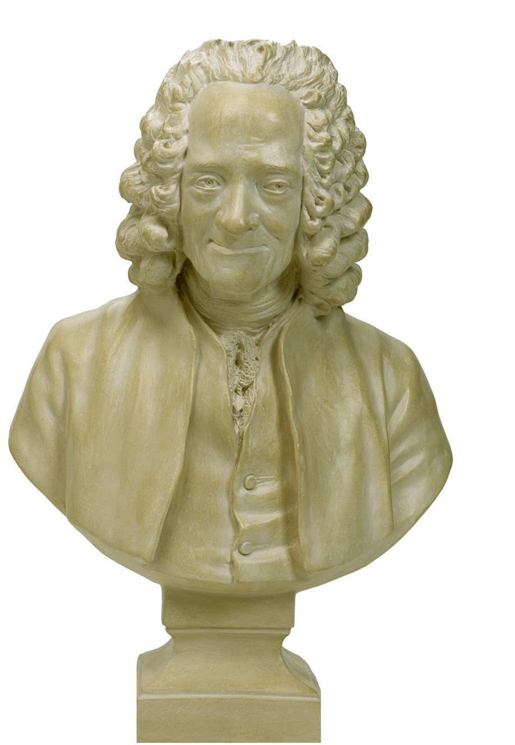
Voltaire prophesied that in the twentieth century there would hardly be a trace of the word of God and that if you wanted to find a Bible you would have to go to a Museum for ancient artifacts.
However ... irony of fate!
25 years after his death, his house was bought by the Company Geneva Bible, becoming a storage for Bibles while in print. Voltaire´s property was used to print sections of the Holy Book.
Notes:
Voltaire prophesied that in the twentieth century there would hardly be a trace of the word of God and that if you wanted to find a Bible you would have to go to a Museum for ancient artifacts. However ... irony of fate!
25 years after his death, his house was bought by the Company
Geneva Bible, becoming a storage for Bibles while in print. Voltaire´s property was used to print sections of the Holy Book.

Slide 54
What was Jesus’ advice?
Notes:
13. What was Jesus’ advice?

Slide 55
John 5:39
“Search the scriptures; for in them ye think ye have eternal life: and they are they which testify of me.”
SEARCH THE SCRIPTURES
Notes:
John 5:39
“ Search the scriptures; for in them ye think ye have eternal life: and they are they which testify of me.”
Search the Scriptures

Slide 56
What is said about those who study God’s Word?
Notes:
14. What is said about those who study God’s Word?

Slide 57
Revelation 1:3
“Blessed is he that readeth, and they that hear the words of this prophecy, and keep those things which are written therein: for the time is at hand.”
BLESSED
Notes:
Revelation 1:3
“ Blessed is he that readeth, and they that hear the words of this prophecy, and keep those things which are written therein: for the time is at hand.”
HAPPY, BLESSED

Slide 58
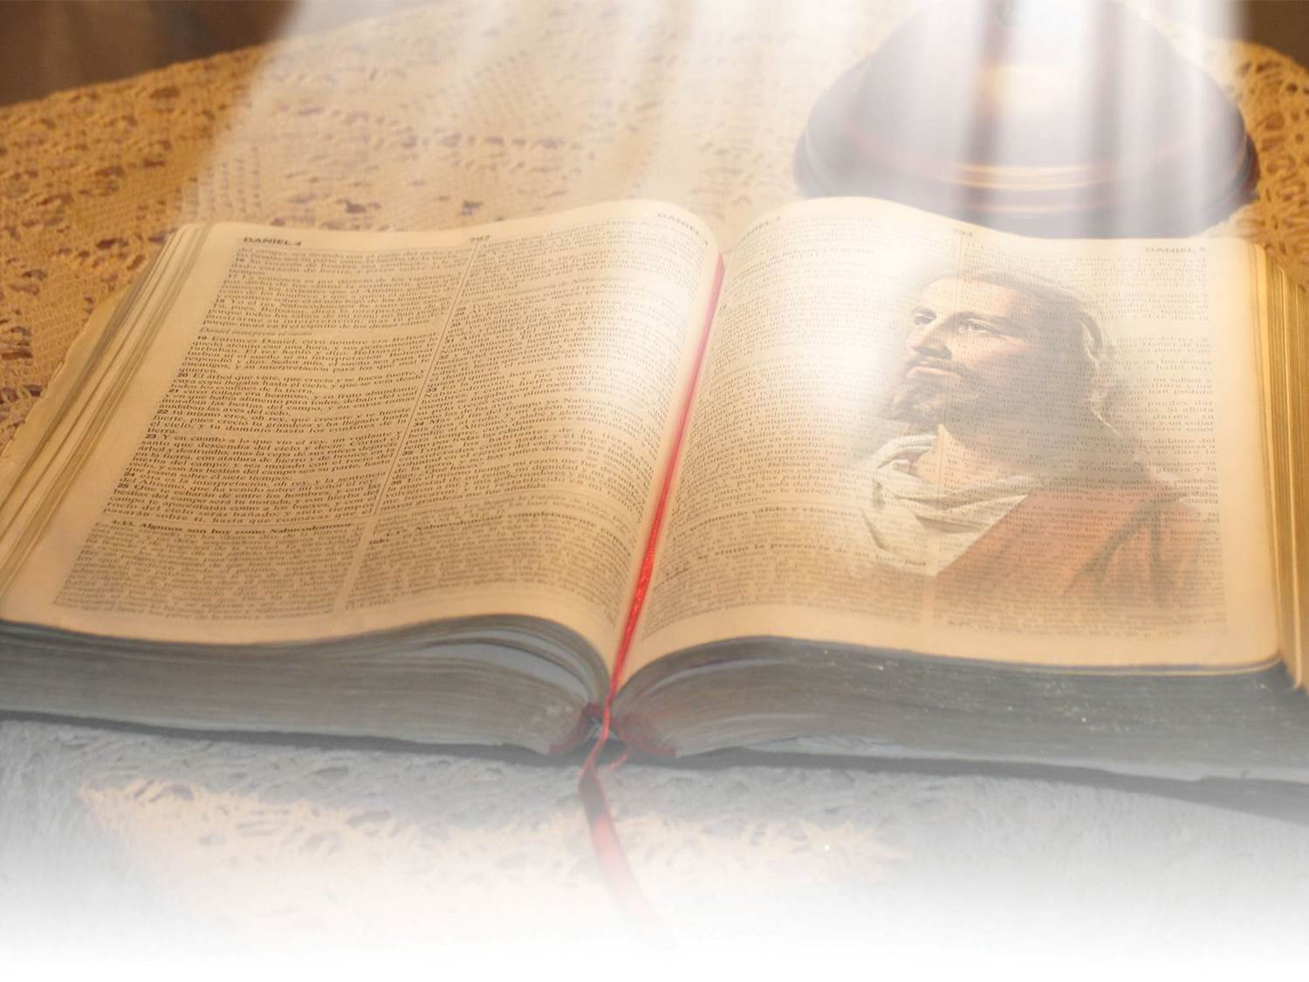
Reading the sacred pages each day
will bring you:
      Happiness in the family.
    You will have inner peace.
  You will have a better understanding of the world
  You will find the way to salvation.
John 5:39
Search the scriptures; for in them ye think ye have eternal life: and they are they which testify of me.
Notes:
Reading the sacred pages each day will bring you:
Happiness in the family.
You will have inner peace.
You will have a better understanding of the world
You will find the way to salvation.
John 5:39
Search the scriptures; for in them ye think ye have eternal life: and they are they which testify of me.

Slide 59



Thank you Lord
for your Word!
Notes:
Thank you Lord for your Word!
Join me in prayer:
Dear heavenly Father, I thank you for your Word, which is a guiding light in my path. I ask you to help me to understand it and to live its teachings every day.
Strengthen my faith so that I can face the challenges of life better.
In the name of Jesus. Amen.

Slide 60
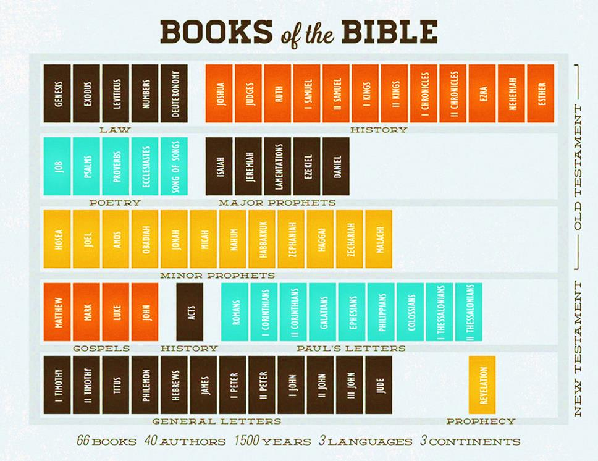
Notes:
The present lesson is accompanied by printed sheets that have a review questionnaire that will help you retain the above information.
We recommend that you look in your Bible for the texts that answer the questions.
If you hadn´t had practice in searching the Bible, we recommend the following:
Have a photocopy of the Index which is at the beginning of the Bible and keep it close when you study.
There you can find the names of the books with their abbreviations and page number.
Try to memorize the order of the books.
Browse the Bible until you find the book or page number.
There you will find that the largest numbers correspond to the number of the chapter.
The small numbers are the verses.
For example: Matthew 24: 2
Matthew: is the Book (the first of the New Testament)
24: is the number of the chapter
2: is the verse
In a short time you will not need to look at the page number anymore since you would have already become familiar with the books of the Bible, knowing approximatley where they are. For example, you will know that the book of Psalms is in the middle of the Bible and Revelation is at the end.

Slide 61

The next topic:
Is it possible to know the future?
A question that troubles many who want to know the future!
Interesting revelations have been studied that were made thousands of years ago in the Holy Bible:
• The history of the sentenced city...
• The prophecy about Egypt and the Jews...
• Interesting scientific anticipations on earth, space,
health; including the plane and the car...
• Some of the 333 prophecies about one man.
GOD BLESS YOU!
Notes:
The next topic: Is it possible to know the future?
A question that troubles many who want to know the future!
Interesting revelations have been studied that were made thousands of years ago in the Holy Bible:
The history of the sentenced city...
The prophecy about Egypt and the Jews...
Interesting scientific anticipations on earth, space, health; including the plane and the car...
Some of the 333 prophecies about one man.

Slide 62

biblewell.org
info@biblewell.org
Notes:
If you still have questions, write to us with confidence at: info@biblewell.org

