Slide 1
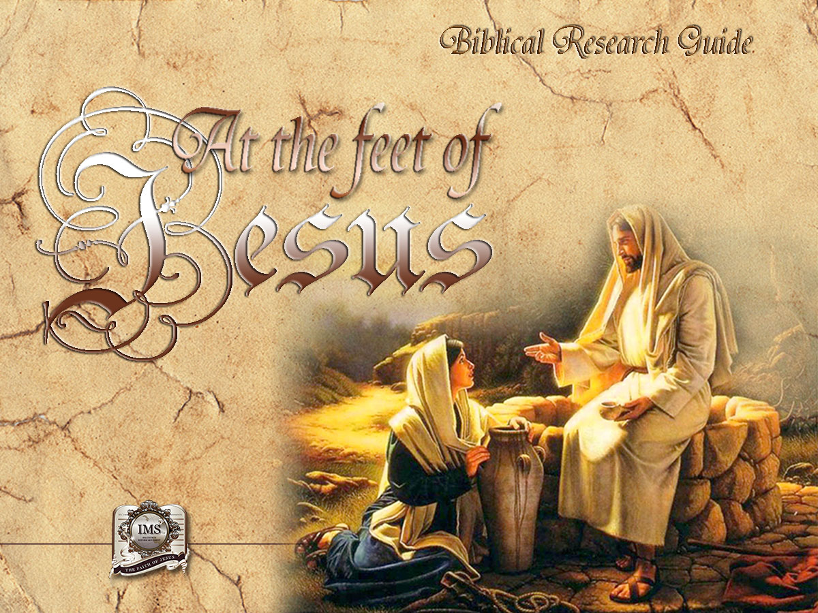

General Conference
Multimedia Department
Notes:
BIBLICAL RESEARCH GUIDE: “AT THE FEET OF JESUS”

Slide 2

A moment of Prayer…
Notes:
A moment of prayer…

Slide 3

11
A LIFE PLAN
THAT OFFERS
SECURITY
AND PEACE
Notes:
Chapter 11
A LIFE PLAN THAT OFFERS SECURITY AND PEACE

Slide 4
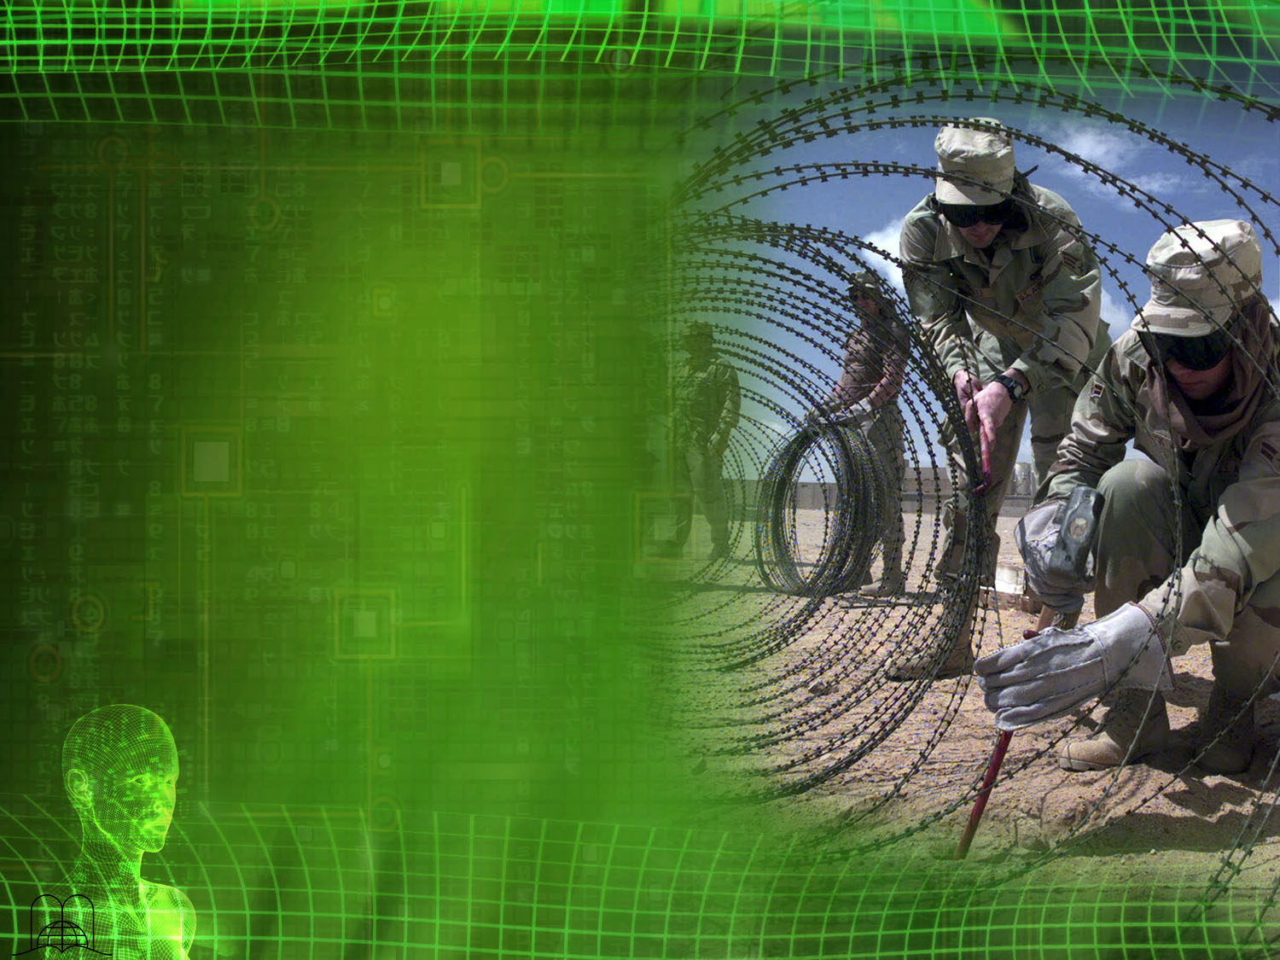

SECURITY
SECURITY
SECURITY
SECURITY
SECURITY
SECURITY
SECURITY
SECURITY
SECURITY
SECURITY
Notes:
a) There is no security or peace in our day.
The nations of the world are alarmed because of insecurity and the threat of famine. In 1987-1988 the United Nations General Assembly held a conference attended by 150 nations which dealt with the issue of disarmament. It was proved that more than two million dollars are spent on weapons every minute. A special committee unanimously signed a final declaration which reads as follows:
"Our planet is being threatened by arsenals that could make it explode in a matter of seconds, by military expenditures that could economically drown it, and by the incapacity to meet the basic needs of two thirds of its population that survive on less than a third of the earth's resources.
Should we remain indifferent witnesses when security is being pursued at such high cost?"

Slide 5

AGREEMENTS
Notes:
b) Politicians look for solutions by signing agreements; military solutions are sought either by accumulating defensive weapons or by threatening the enemy with strategical superiority, but no solution has been found so far.
The FAO has organized a plan of assistance to help the famine situation in Africa.
Violence and famine threaten the whole world.
Law enforcement agencies unsuccessfully try to control urban violence and prevent burglaries.
Psychologists, psychiatrists and religious leaders try to find a solution to the increasing anxiety that grips millions of people, but they find no answer. They ignore the true cause of the turmoil and what the Author of life has revealed.

Slide 6

What two causes have brought man to the brink of chaos?
Notes:
What two causes have brought man to the brink of chaos?

Slide 7

"For my people have committed two evils; they have forsaken me the fountain of living waters, and hewed them out cisterns, broken cisterns, that can hold no water.”
Jeremiah 2:13
Notes:
Jeremiah 2:13. They have forsaken God.
"For my people have committed two evils; they have forsaken me the fountain of living waters, and hewed them out cisterns, broken cisterns, that can hold no water.”

Slide 8

"The earth also is defiled under the inhabitants thereof; because they have transgressed the laws, changed the ordinance, broken the everlasting covenant.
Therefore hath the curse devoured the earth, and they that dwell therein are desolate: therefore the inhabitants of the earth are burned, and few men left.”
Isaiah 24:5-6
Notes:
b) Isaiah 24:5-6. They have forsaken His law.
The earth also is defiled under the inhabitants thereof; because they have transgressed the laws, changed the ordinance, broken the everlasting covenant.
Therefore hath the curse devoured the earth, and they that dwell therein are desolate: therefore the inhabitants of the earth are burned, and few men left.

Slide 9
A LIFE PLAN FOR HAPPINESS
Notes:
A LIFE PLAN FOR HAPPINESS

Slide 10
What principles were given to man in Eden?
Notes:
2. What principles were given to man in Eden? (Genesis 2:17, 18, 3).

Slide 11

Without law there would be no sin
The principles of God‘s holy law
Notes:
a) The principles of God‘s holy law were given at the very beginning. Man was told, “you shall not steal from that tree," "you shall not covet." Marriage and the rest day were given, as well as others.
b) Without law there would be no sin. Romans 4:15.

Slide 12
On what did God write the Ten Commandments and what did He write them with?
Notes:
3. On what did God write the Ten Commandments and what did He write them with?

Slide 13
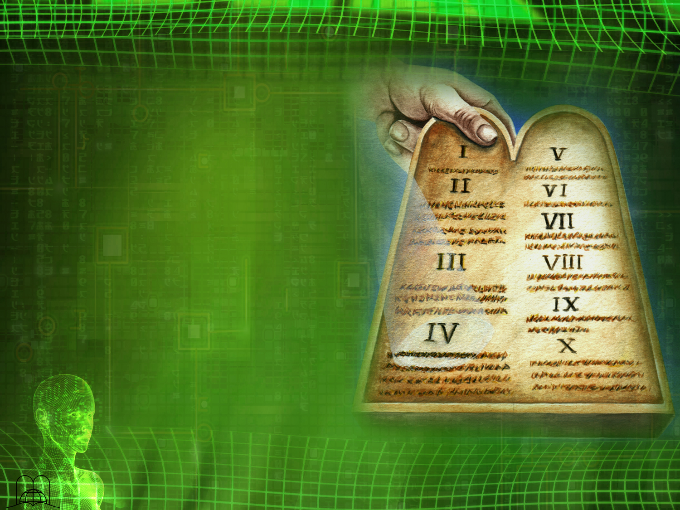
"And he gave unto Moses, when he had made an end of communing with him upon mount Sinai,
two tables of testimony, tables
of stone, written
with the finger of God."
Exodus 31:18
Notes:
Exodus 31:18
"And he gave unto Moses, when he had made an end of communing with him upon mount Sinai, two tables of testimony, tables of stone, written with the finger of God."
He wrote them on stone, which is the most durable object which symbolizes eternity. It was the only thing He wrote with His own finger. This fact proves the importance of His law.

Slide 14
Where were the two tables of the law placed?
Notes:
4. Where were the two tables of the law placed?

Slide 15

"And I turned myself and came down from the mount, and put the tables in the ark which
I had made; and there they be, as the Lord commanded me.”
Deuteronomy 10:5
Notes:
Deuteronomy 10:5
"And I turned myself and came down from the mount, and put the tables in the ark which I had made; and there they be, as the Lord commanded me.”
In the ark of the covenant.

Slide 16
LET US COMPARE…
The reflection of the character of God
The commandments are the foundation of God‘s government
Notes:
The commandments are the foundation of God‘s government (Psalm 89:14) and the reflection of His character.
Let us compare

Slide 17
LET US COMPARE
GOD IS:
Love (1 John 4:8)
Holy (Isaiah 6:3)
Just
Good (Psalms 145:9, 17)
HIS LAW IS:
Love (Romans 13:9)
Holy
Just
Good (Romans 7:12)
Notes:
GOD IS:
Love (1 John 4:8)
Holy (Isaiah 6:3)
Just (Psalms 129:4)
Good (Psalms 145:9, 17)
HIS LAW IS:
Love (Romans 13:9-10)
Holy (Romans 7:12)
Just (Deuteronomy 4:8)
Good (Romans 7:12)

Slide 18
"Wherefore the law is holy, and the commandment holy, and just, and good.”
Romans 7:12
Notes:
"Wherefore the law is holy, and the commandment holy, and just, and good.”
Romans 7:12

Slide 19
LET US COMPARE
GOD IS:
Love (1 John 4:8)
Holy (Isaiah 6:3)
Just
Good (Psalms 145:9, 17)
True (Psalms 89:14)
Faithful (Deut. 7:9)
Eternal (Psalms 45:6)
HIS LAW IS:
Love (Romans 13:9)
Holy
Just
Good (Romans 7:12)
True
Faithful
Eternal (Psalms 111:7-8)
Notes:
Also…
GOD IS:
True (Psalms 89:14)
Faithful (Deuteronomy 7:9)
Eternal (Psalms 45:6)
HIS LAW IS:
True (Malachi 2:6)
Faithful (Psalms 111:7)
Eternal (Psalms 111:7-8)

Slide 20
"The works of his hands are verity and judgment;
all his commandments are sure.
They stand fast for ever and ever, and are done in truth and uprightness.”
Psalms 111:7-8
Notes:
"The works of his hands are verity and judgment; all his commandments are sure.
They stand fast for ever and ever, and are done in truth and uprightness.” Psalms 111:7-8

Slide 21
What is the real
purpose of the law?
Notes:
5. What is the real purpose of the law?

Slide 22

"Therefore by the deeds of the law there shall no flesh be justified in his sight: for by the law is the knowledge of sin."
“Do we then make void the law through faith? God forbid: yea, we establish the law
Romans 3:20, 31
Notes:
Romans 3:20, 31
"Therefore by the deeds of the law there shall no flesh be justified in his sight: for by the law is the knowledge of sin."
“Do we then make void the law through faith? God forbid: yea, we establish the law.

Slide 23
“What shall we say then? Is the law sin? God forbid. Nay,
I had not known sin,
but by the law:
for I had not known lust,
except the law had said,
Thou shalt not covet.”
Romans 7:7
Notes:
Romans 7:7
“What shall we say then? Is the law sin? God forbid. Nay, I had not known sin, but by the law: for I had not known lust, except the law had said, Thou shalt not covet.”

Slide 24
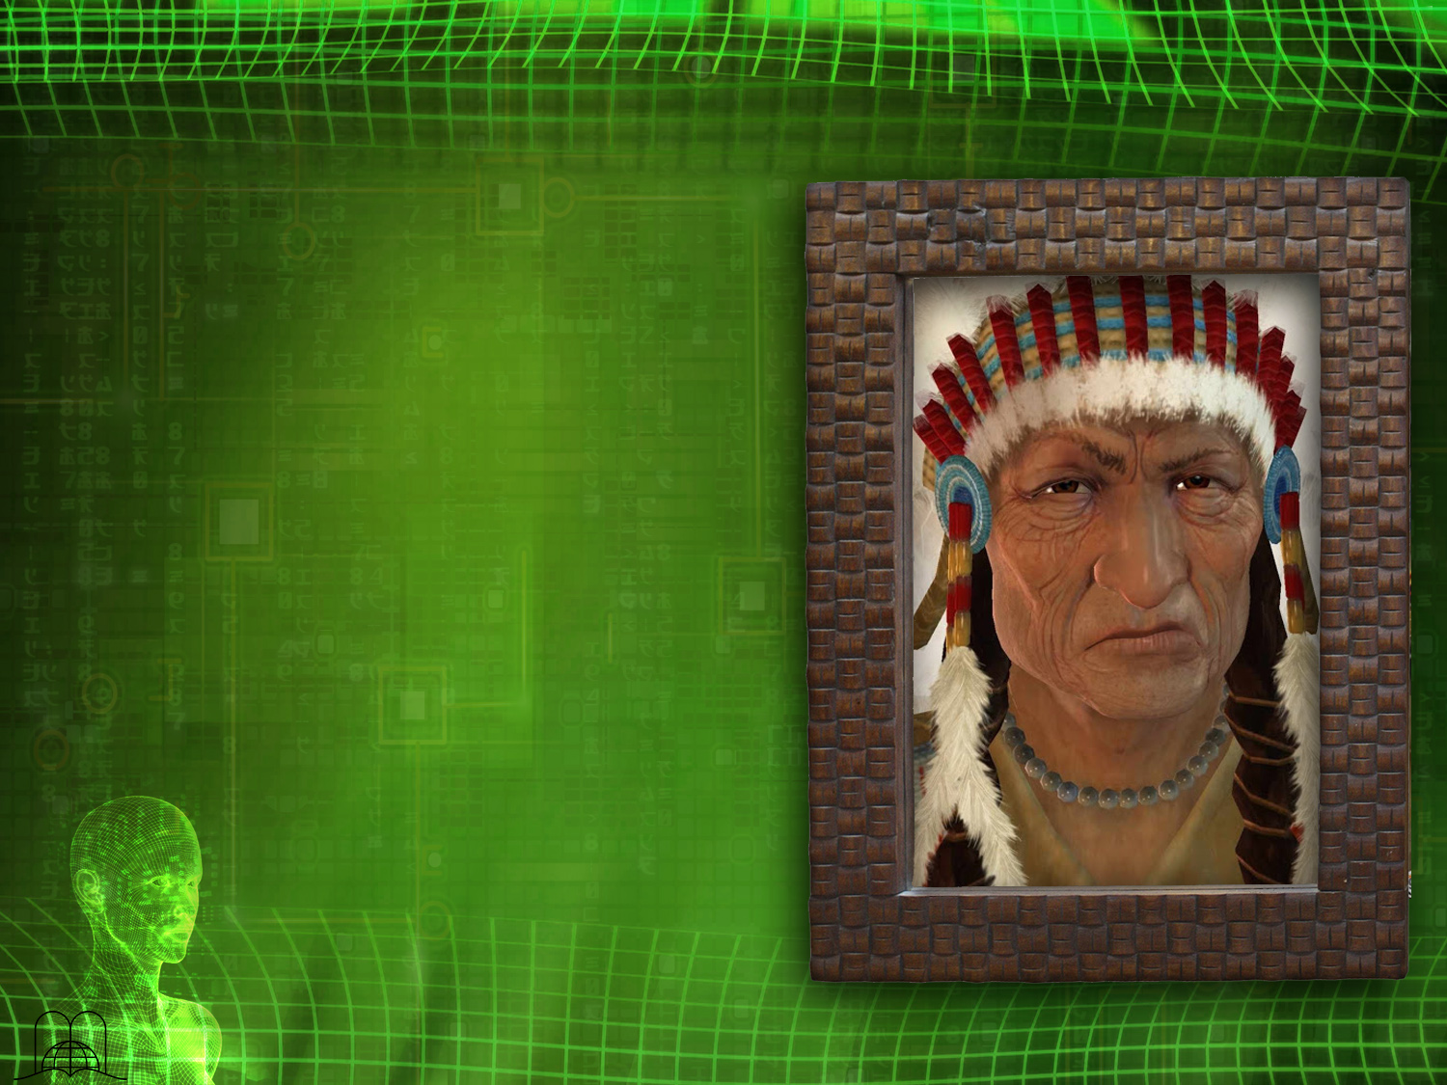
The African
chief
And the mirror
Notes:
An African chief once saw his face in a mirror in the home of a missionary, and he was shocked to discover how ugly he was.
He offered to buy the mirror so he could examine the tricky gadget that had shown him such an image of himself. He insisted so vehemently that the missionary finally gave it to him.
The native ran to the most isolated place he could find in the forest and broke the mirror against a rock, shouting: "There you are. You are never again going to show me my ugliness,” and he walked away.
Many people despise God’s law because it shows them their defects and sins.

Slide 25
By what law
will we be judged in the final judgment?
Notes:
6. By what law will we be judged in the final judgment?

Slide 26
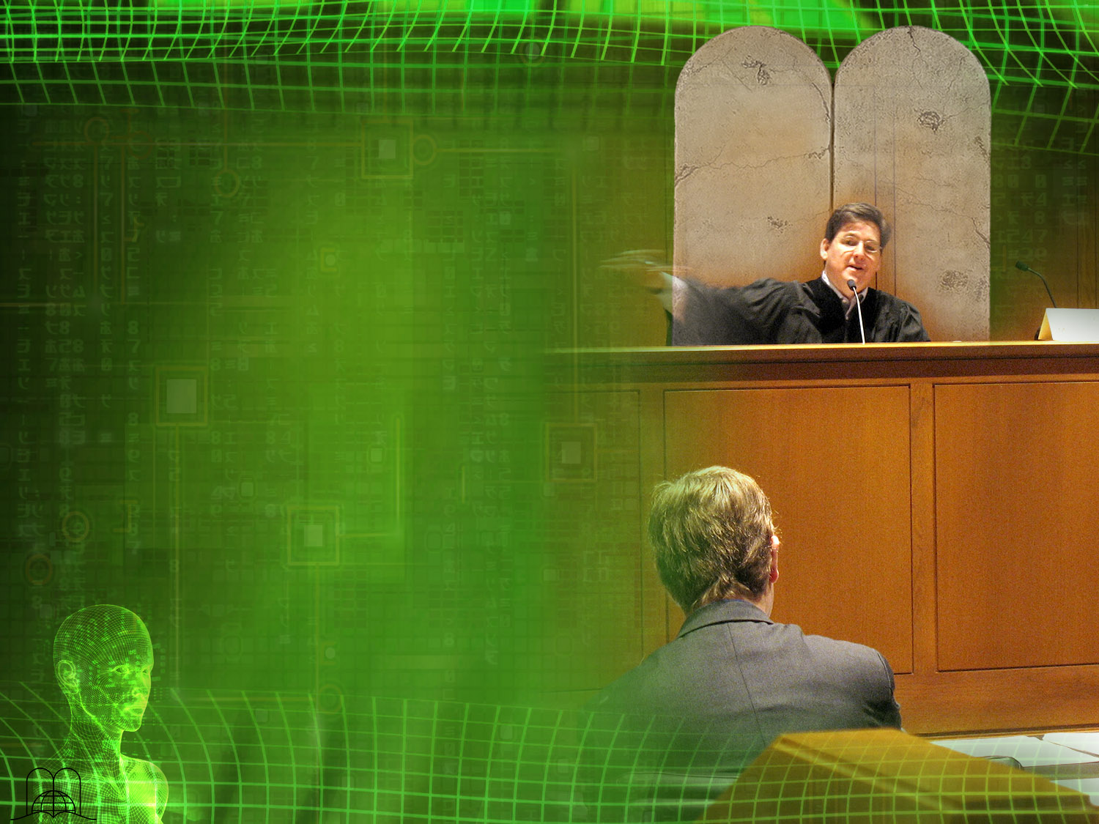
"For whosoever shall keep the whole law, and yet offend in one point, he is guilty of all.
For he that said, Do not commit adultery, said also, Do not kill.
Now if thou commit no adultery,
yet if thou kill, thou art become a transgressor of the law.
So speak ye, and so do, as they that shall be judged by the law of liberty.”
James 2:10-12
Notes:
James 2:10-12
"For whosoever shall keep the whole law, and yet offend in one point, he is guilty of all.
For he that said, Do not commit adultery, said also, Do not kill. Now if thou commit no adultery, yet if thou kill, thou art become a transgressor of the law.
So speak ye, and so do, as they that shall be judged by the law of liberty.”

Slide 27
WHAT WAS JESUS' ATTITUDE REGARDING THE TEN COMMANDNENTS?
Notes:
WHAT WAS JESUS' ATTITUDE REGARDING THE TEN COMMANDNENTS?

Slide 28
Who wrote the law on Mount Sinai: the Father or the Son?
Notes:
Who wrote the law on Mount Sinai: the Father or the Son?

Slide 29

“Moreover thou leddest them in the day by a cloudy pillar; and in the night by a pillar of fire, to give them light in the way wherein they should go.
Thou camest down also upon mount Sinai, and spakest with them from heaven, and gavest them right judgments, and true laws, good statutes and commandments.”
Nehemiah 9:12-13
Notes:
Nehemiah 9:12-13
“Moreover thou leddest them in the day by a cloudy pillar; and in the night by a pillar of fire, to give them light in the way wherein they should go.
Thou camest down also upon mount Sinai, and spakest with them from heaven, and gavest them right judgments, and true laws, good statutes and commandments.”

Slide 30
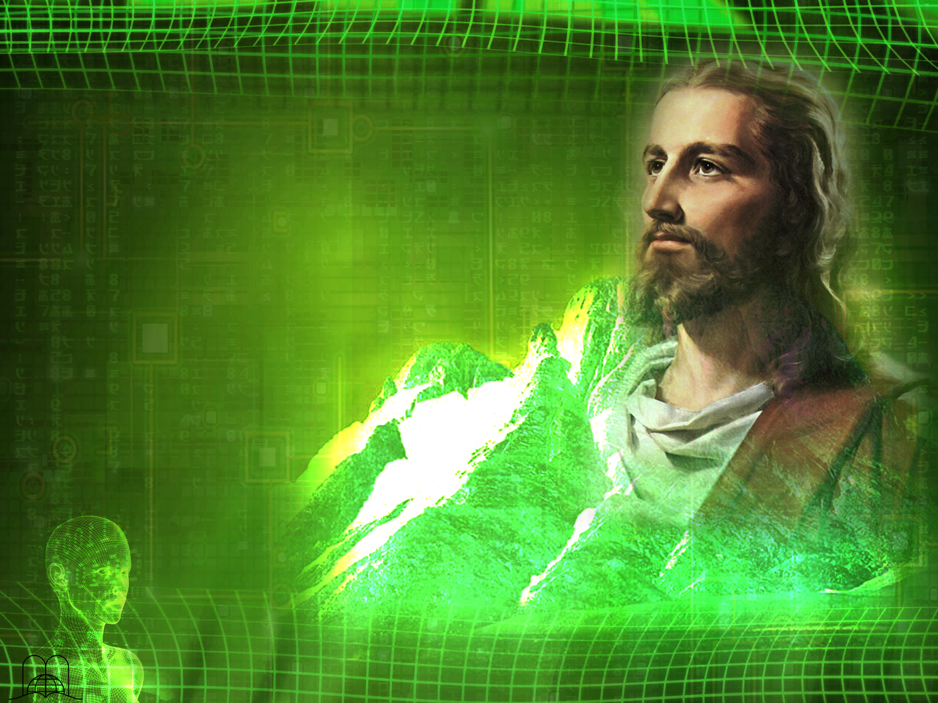
“Moreover, brethren, I would not that ye should be ignorant, how that all our fathers were under the cloud, and all passed through the sea;
and were all baptized unto Moses in the cloud and in the sea; and did all eat the same spiritual meat; and did all drink the same spiritual drink: for they drank of that spiritual Rock that followed them: and that Rock was Christ.”
1 Corinthians 10:1- 4
Notes:
1 Corinthians 10:1- 4
“Moreover, brethren, I would not that ye should be ignorant, how that all our fathers were under the cloud, and all passed through the sea;
and were all baptized unto Moses in the cloud and in the sea; and did all eat the same spiritual meat; and did all drink the same spiritual drink: for they drank of that spiritual Rock that followed them: and that Rock was Christ.”

Slide 31
What did the prophecies say about Christ‘s attitude toward the law?
Notes:
8. What did the prophecies say about Christ‘s attitude toward the law?

Slide 32

“Then said I, Lo,
I come: in the volume of the book it is written of me,
I delight to do thy will, O my God: yea,
thy law is within my heart.”
Psalm 40:7, 8
Notes:
a) Psalm 40:7, 8. His law is within my heart. (John 15:10).
“Then said I, Lo, I come:
in the volume of the book it is written of me,
I delight to do thy will,
O my God: yea, thy law is within my heart.”

Slide 33
"The Lord is well pleased for his righteousness' sake; he will magnify the law, and make it honourable.”
Isaiah 42: 21
Notes:
b) Isaiah 42: 21. It says that He would magnify the law and make it honorable. When we read the Sermon on the Mount, we can see this prophecy fulfilled. (Matthew: 5:21, 22, 27, 28, 33-37, 48).
"The Lord is well pleased for his righteousness' sake; he will magnify the law, and make it honourable.”

Slide 34
How did Jesus emphasize the eternal nature of the law?
What would happen first?
Notes:
9. How did Jesus emphasize the eternal nature of the law? What would happen first?

Slide 35

" And it is easier for heaven and earth to pass, than one tittle of the law to fail.."
Luke 16:17
Notes:
Luke 16:17
And it is easier for heaven and earth to pass, than one tittle of the law to fail.

Slide 36
What do we prove by obeying God?
Notes:
10. What do we prove by obeying God?

Slide 37

“If ye love me, keep my commandments.”
“He that hath my commandments, and keepeth them, he it is that loveth me: and he that loveth me shall be loved of my Father, and I will love him, and will manifest myself to him.”
John 14:15, 21
Notes:
Juan 14:15, 21
“If ye love me, keep my commandments.”
“He that hath my commandments, and keepeth them, he it is that loveth me: and he that loveth me shall be loved of my Father, and I will love him, and will manifest myself to him.”
The new covenant differs from the old one in that God's law is written not just on stone but on our hearts and minds. (Hebrews 10:16).
If someone says he has his wife in his heart, what does he mean? Does it mean he wants to divorce her?

Slide 38
What did Jesus answer the rich young man when he asked what he should do to inherit eternal life?
Notes:
11. What did Jesus answer the rich young man when he asked what he should do to inherit eternal life?

Slide 39
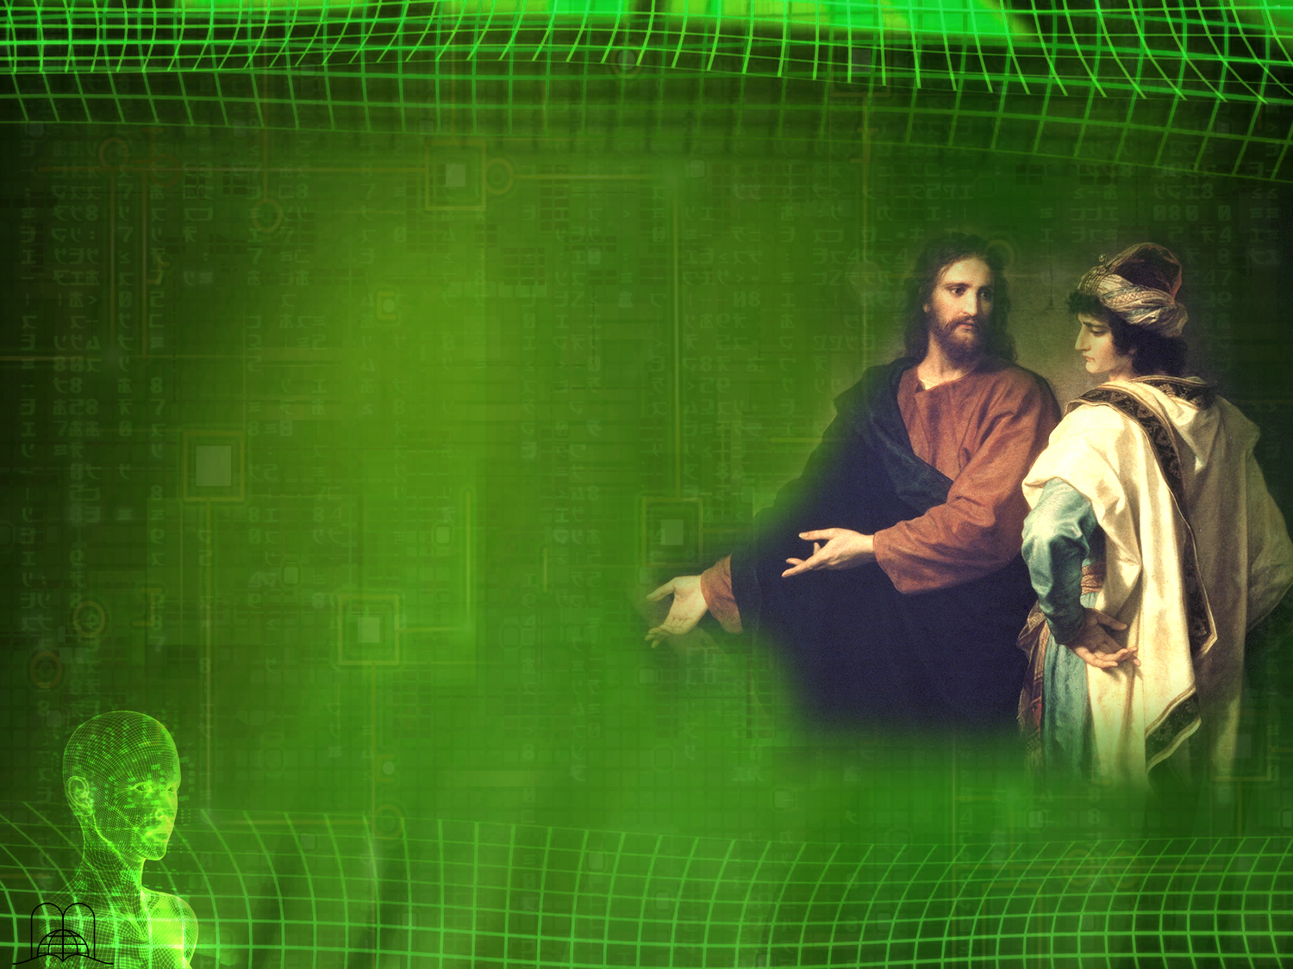
"And, behold, one came and said unto him, Good Master, what good thing shall I do, that I may have eternal life?
And he said unto him, Why callest thou me good? there is none good but one, that is, God: but if thou wilt enter into life, keep the commandments.
He saith unto him, Which? Jesus said, Thou shalt do no murder, Thou shalt not commit adultery, Thou shalt not steal, Thou shalt not bear false witness,
Honour thy father and thy mother: and, Thou shalt love thy neighbour as thyself."
Matthew 19:16-19
Notes:
Matthew 19:16-19
" And, behold, one came and said unto him, Good Master, what good thing shall I do, that I may have eternal life?
And he said unto him, Why callest thou me good? there is none good but one, that is, God: but if thou wilt enter into life, keep the commandments.
He saith unto him, Which? Jesus said, Thou shalt do no murder, Thou shalt not commit adultery, Thou shalt not steal, Thou shalt not bear false witness,
Honour thy father and thy mother: and, Thou shalt love thy neighbour as thyself.”

Slide 40
Who will be greatly disappointed in Day of Judgment?
Notes:
12. Who will be greatly disappointed in Day of Judgment?

Slide 41
"Not every one that saith unto me, Lord, Lord, shall enter into the kingdom of heaven; but he that doeth the will of my Father which is in heaven.
Many will say to me in that day, Lord, Lord, have we not prophesied in thy name? and in thy name have cast out devils? and in thy name done many wonderful works?
And then will I profess unto them, I never knew you: depart from me, ye that work iniquity.”
Matthew 7:21-23
Notes:
Those who said, Lord, Lord , and did not do the Father’s will.
Matthew 7:21-23
"Not every one that saith unto me, Lord, Lord, shall enter into the kingdom of heaven; but he that doeth the will of my Father which is in heaven.
Many will say to me in that day, Lord, Lord, have we not prophesied in thy name? and in thy name have cast out devils? and in thy name done many wonderful works?
And then will I profess unto them, I never knew you: depart from me, ye that work iniquity.”

Slide 42
But is it possible to keep the law of God?
Notes:
13. But is it possible to keep the law of God?

Slide 43

“For they that are after the flesh do mind the things of the flesh; but they that are after the Spirit the things of the Spirit.
For to be carnally minded is death; but to be spiritually minded is life and peace.
Because the carnal mind is enmity against God: for it is not subject to the law of God, neither indeed can be. So then they that are in the flesh cannot please God.”
Romans 8:5-8
Notes:
Those who live according to the flesh (carnal people) cannot keep his law.
a) Romans 8:5-8
“For they that are after the flesh do mind the things of the flesh; but they that are after the Spirit the things of the Spirit.
For to be carnally minded is death; but to be spiritually minded is life and peace.
Because the carnal mind is enmity against God: for it is not subject to the law of God, neither indeed can be. So then they that are in the flesh cannot please God.”

Slide 44
"By this we know that we love the children of God, when we love God, and keep his commandments.
For this is the love of God, that we keep his commandments: and his commandments are not grievous.”
1 John 5:2-3
Notes:
When the love of God fills our heart, we see that His commandments are not grievous.
b) 1 John 5:2-3
By this we know that we love the children of God, when we love God, and keep his commandments.
For this is the love of God, that we keep his commandments: and his commandments are not grievous.

Slide 45
How can we identify a true Christian?
Notes:
14. How can we identify a true Christian?

Slide 46
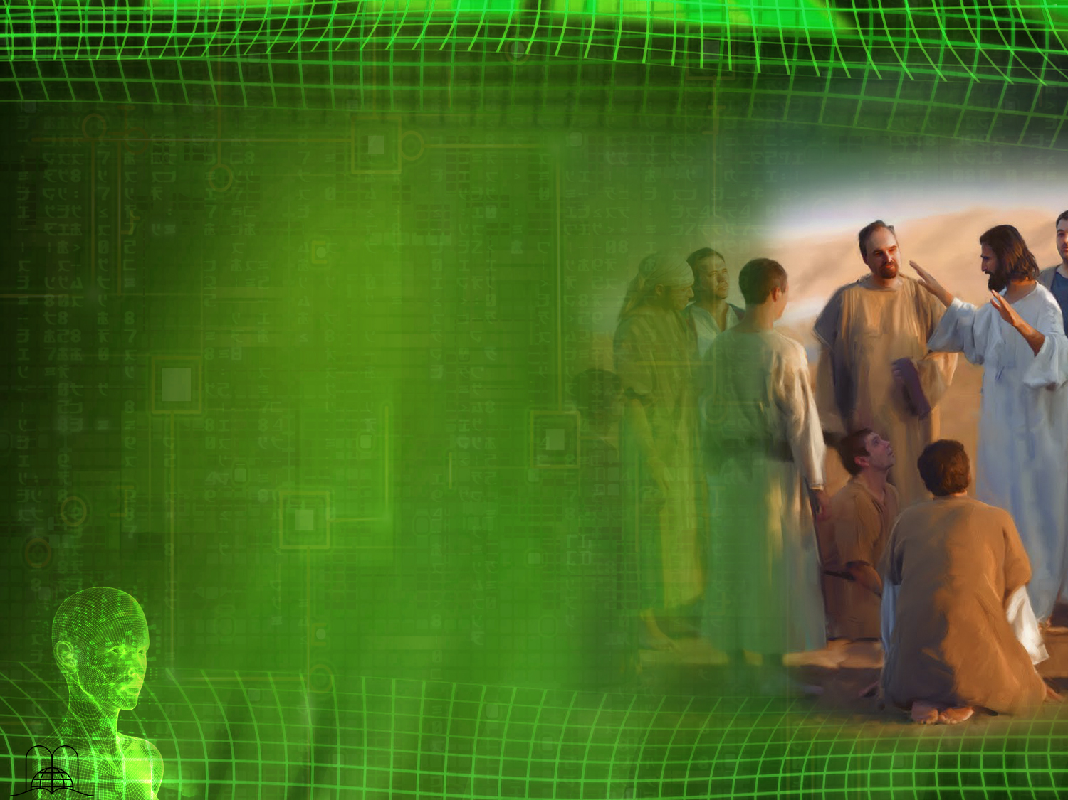
"And hereby we do know that we know him, if we keep his commandments.
He that saith, I know him, and keepeth not his commandments, is a liar, and the truth is not in him.
But whoso keepeth his word, in him verily is the love of God perfected: hereby know we that we are in him.
He that saith he abideth in him ought himself also so to walk, even as he walked.”
1 John 2:3-6
Notes:
1 John 2:3-6
"And hereby we do know that we know him, if we keep his commandments.
He that saith, I know him, and keepeth not his commandments, is a liar, and the truth is not in him.
But whoso keepeth his word, in him verily is the love of God perfected: hereby know we that we are in him.
He that saith he abideth in him ought himself also so to walk, even as he walked.”

Slide 47
CONCLUSION
Notes:
CONCLUSION
God's eternal law should be our life plan and rule our behavior. It is as immutable as God Himself.

Slide 48
What promise did God give those who keep His commandments?
Notes:
15. What promise did God give those who keep His commandments?

Slide 49

"O that there were such an heart in them, that they would fear me,
and keep all my
commandments always,
that it might be
well with them,
and with their
children for ever!
Deuteronomy 5:29
Notes:
They will prosper.
Deuteronomy 5:29
O that there were such an heart in them, that they would fear me, and keep all my commandments always, that it might be well with them, and with their children for ever!

Slide 50

"Great peace have they which love thy law:
and nothing shall offend them."
Psalm 119:165
Notes:
Our heart will be full of peace.
Psalm 119:165
Great peace have they which love thy law:
and nothing shall offend them.

Slide 51

«The violin in the master´s hands"
Notes:
There was once a beggar who was playing a violin on a bridge in a large city. People passed by, but no one dropped a coin in the hat that he had placed in front of him. A man passed by, and the beggar looked at him sadly as if he were saying: "Give me just one coin."
The passerby stopped and said: "My friend, I have no money, but I shall give you what I have; give me your violin.
" After tuning the old instrument, he started to play the sweetest melodies. People started to gather, and even the traffic was blocked. The old hat was soon full of money. In the crowd a voice was heard saying: "The beggar's violin in the hands of the master.” The man who was playing the violin was Paganini himself. » '
We are just like that untuned instrument. We are incapable of obeying God in our own strength; but if Christ abides in us, He can make us play the sweet melody of faith, love and obedience.

Slide 52
Thank you Lord, for your Perfect Program!
Notes:
Do you want to own the blessings that God offers to those who keep his commandments? Are you going to try to obey the eternal Principles of his holy law?
Thank you Lord, for your Perfect Program!

Slide 53

The next topic:
"Ten minus one equals zero"
It cannot be! In school we learned that 10 - 1 = 9, but God says that 10 - 1 = 0. Has exact science become inaccurate? No. It is mathematics in another dimension.
This topic will show the key to living with prosperity, peace and be able to enjoy the blessings of God throughout each day, as opposed to religion, at settlement price. We will see in the divine principles teachings that will help us to live in harmony with God and our fellow beings.
10-1=0
GOD BLESS YOU!
Notes:
GOD BLESS YOU!
The next topic: "Ten minus one equals zero"
It cannot be! In school we learned that 10 - 1 = 9, but God says that 10 - 1 = 0. Has exact science become inaccurate? No. It is mathematics in another dimension.
This topic will show the key to living with prosperity, peace and be able to enjoy the blessings of God throughout each day, as opposed to religion, at settlement price. We will see in the divine principles teachings that will help us to live in harmony with God and our fellow beings.

Slide 54

biblewell.org
info@biblewell.org
Notes:
If you still have questions, write to us confidently at: info@biblewell.org

