Slide 1
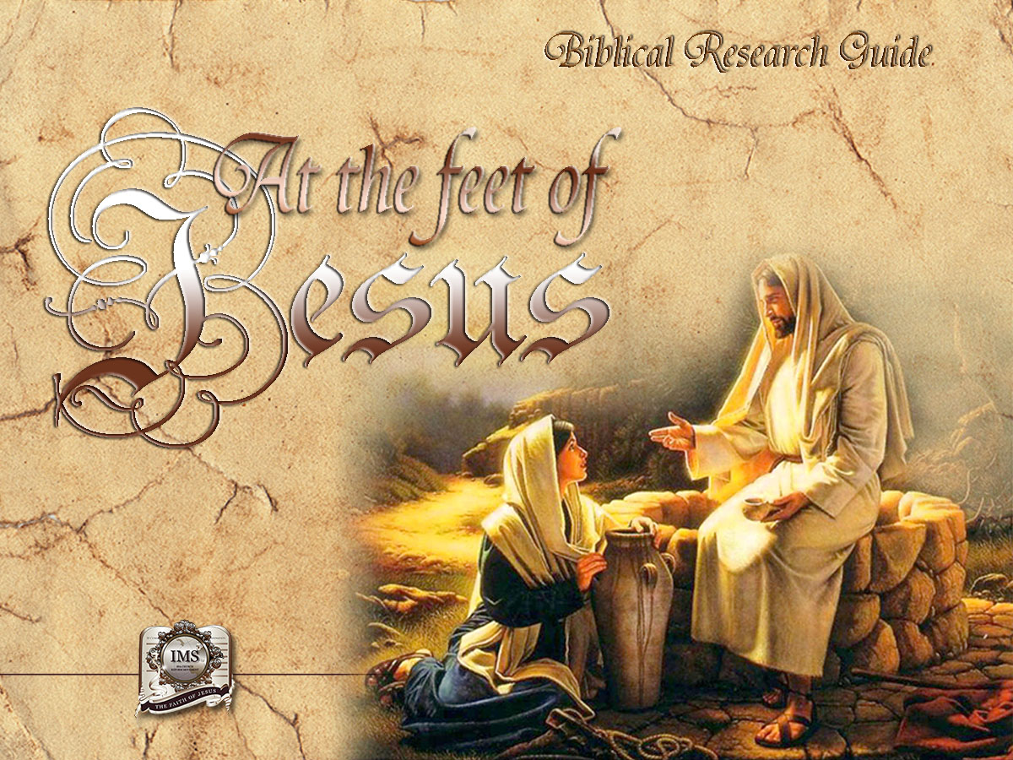

General Conference
Multimedia Department
Notes:
BIBLICAL RESEARCH GUIDE: “AT THE FEET OF JESUS”

Slide 2

A moment
of prayer
Notes:
A moment of prayer

Slide 3

13
THE BEST WAY TO OVERCOME STRESS
Notes:
Lesson 13
THE BEST WAY TO OVERCOME STRESS
Today we live under tension, fatigue and anxiety, which affect our health and happiness.
70% to 90% of all illnesses are psychosomatic, the result of our worries. We need physical and spiritual rest, to be in touch with our inner self and with our Creator, whom many of us have ignored or even rejected. When we observe creation, we are astonished. Take, for example, the birth of a child, a being that can see, hear, move, and make sounds.

Slide 4
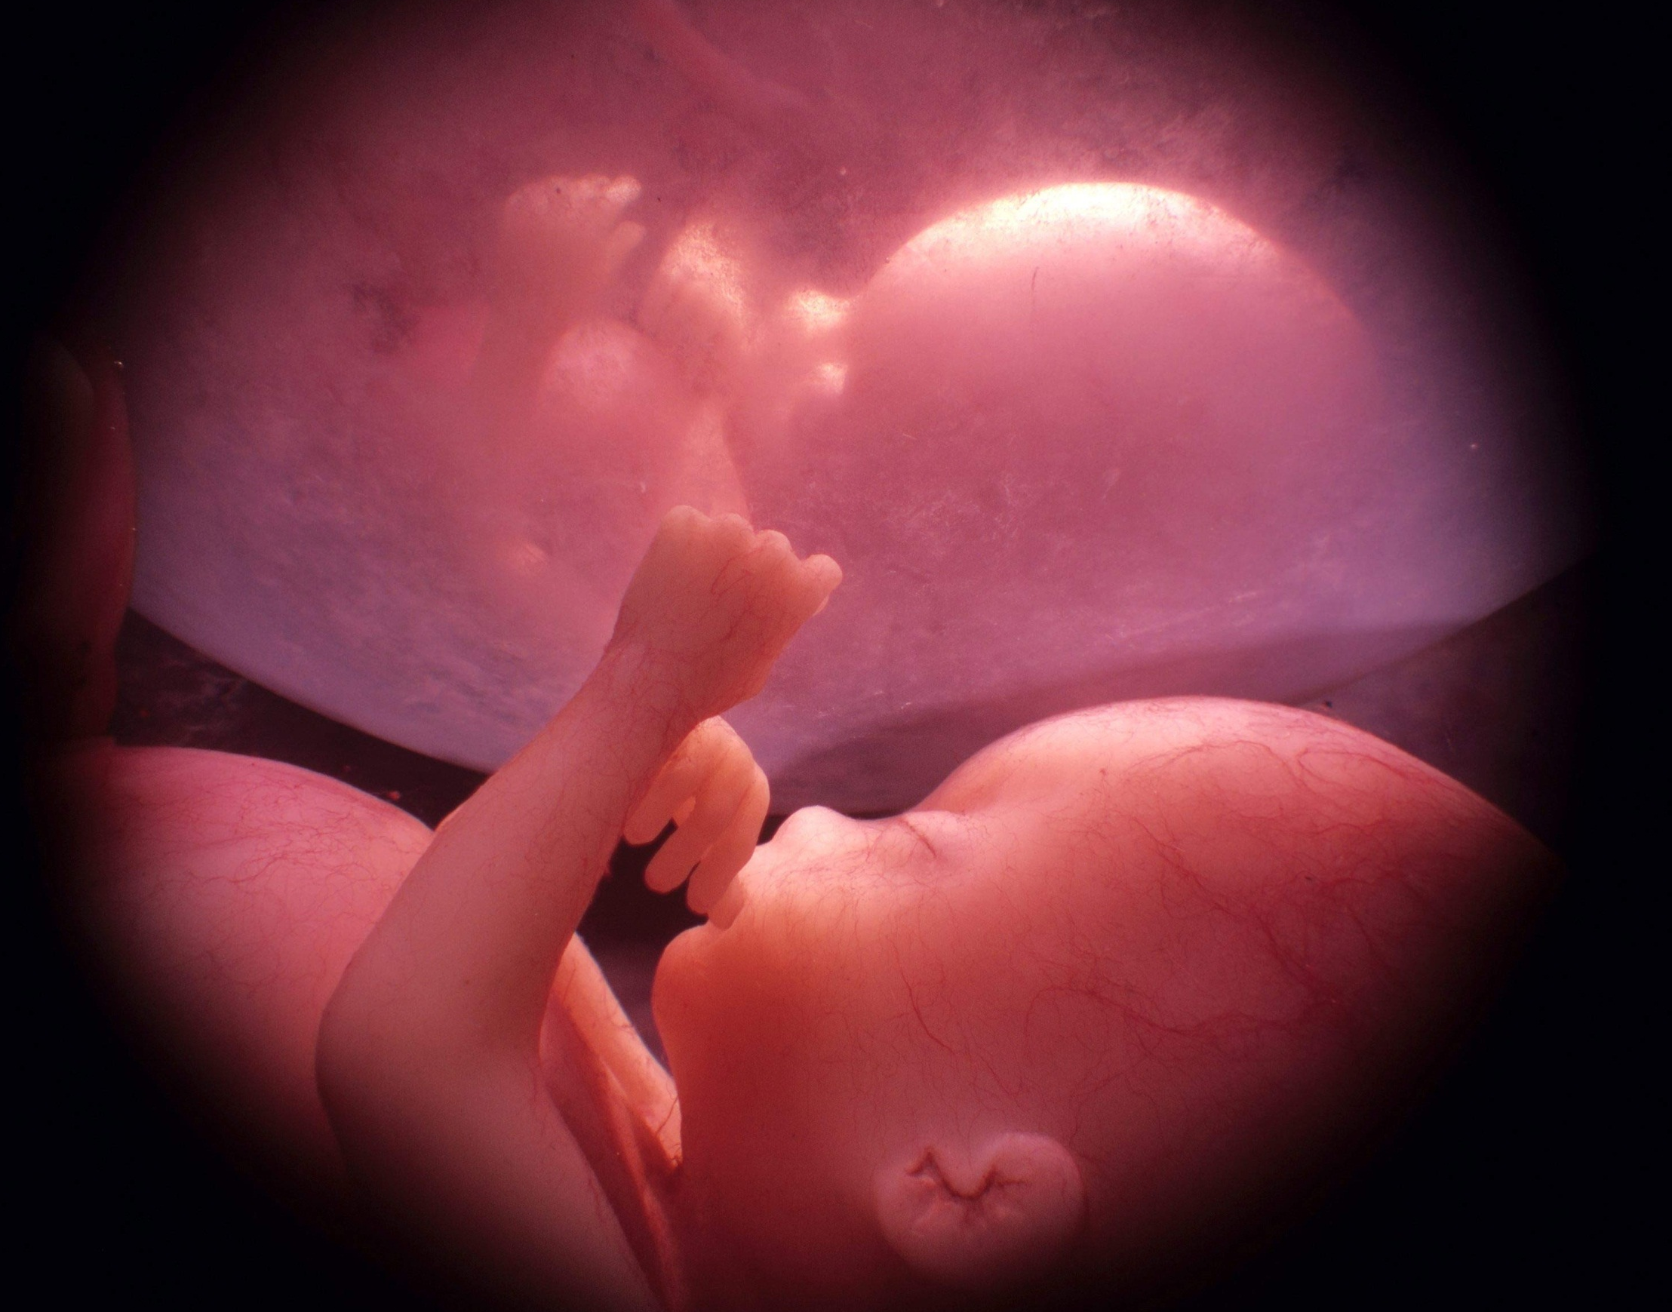


THE HUMAN BEING
266 days
200 millon cells
Notes:
THE HUMAN BEING
In about 266 days one cell the size of a pinprick develops into a fully developed human being. This human being is perfectly formed and composed of 200 million cells; from conception to birth his weight has increased about a billion times.

Slide 5
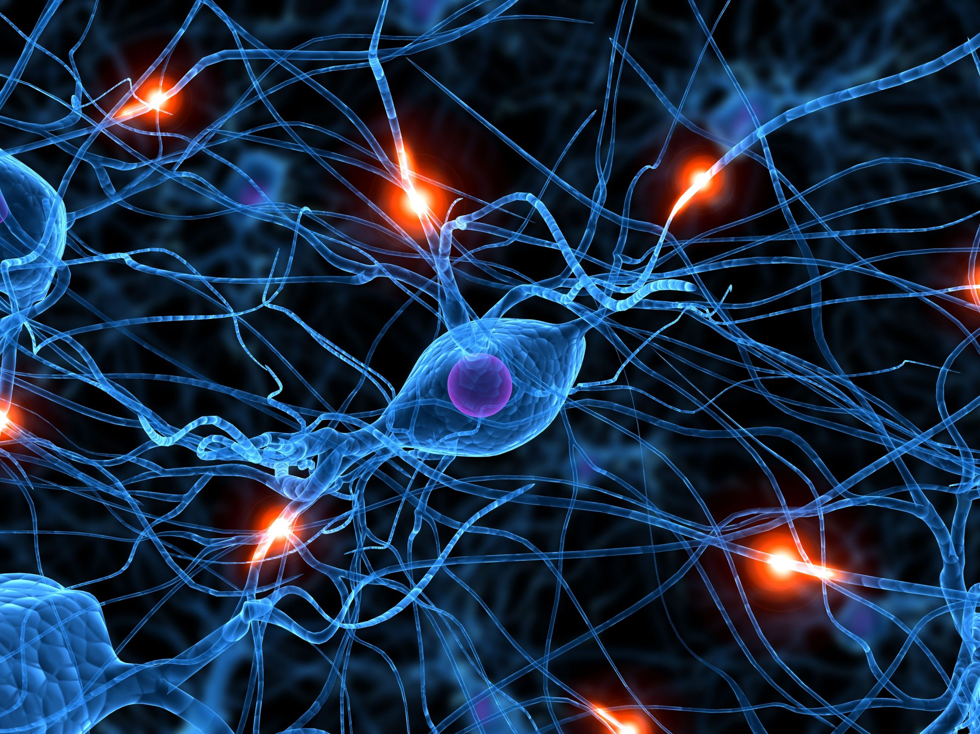


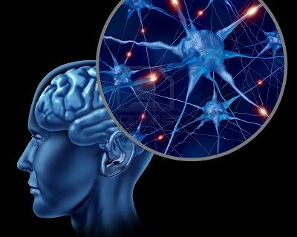



La Mente Humana
Million pieces of information
Perfect organize
100,000 million nervous cells
Each one can be compared to a city
Notes:
The human mind:
Every second, the mind is flooded by million pieces of information that come to it through the different senses. Considering that we can only think about one thing at a time, how can the mind organize all this information that comes to it like an avalanche?
Every person has about 100,000 million nervous cells, called neurons and each one can be compared to a city.

Slide 6

DNA
(dexyribonucleic acid)
1000 books of 600 pages each
Notes:
The instructions contained in a single DNA (dexyribonucleic acid) molecule of the cell would fill 1000 books of 600 pages each. This is where the master genetic code, which determines such things as the color of our hair and eyes and even the most minutes parts of our personality resides.

Slide 7

THE EYE
Hundred million rods and cones
10 billion calculations a second
Notes:
The eye:
The New York Times carried the following fact: "The eye’s retina is envied by scientists who make computers. The eye’s hundred million rods and cones, and its layers of neurons make at least 10 billion calculations a second.”

Slide 8

ANIMALS'
INSTINCT
The seaswallow, an Artic bird,
migrates a distance of 35,400 Km. every year.
Notes:
ANIMALS' INSTINCT
The seaswallow, an Artic bird, migrates a distance of 35,400 Km. every year. It makes its nest in the far north of the Antarctic Circle. How does it find its way home again?

Slide 9

ANIMALS' INSTINCT
Carrier pigeons
1.000 km. in a day
Notes:
ANIMALS' INSTINCT
Carrier pigeons that take on a trip covering a distance of 1000 km. can fly back to their nests in a single day.

Slide 10

ANIMALS' INSTINCT
The humming Gorgirrubi
weighs only 3 grams.
Its wings rotating up to 75 times a second
flies 965 km. in 25 hours
Its wings rotating a total of 6 million times!
Notes:
The humming bird called Gorgirrubi, which weighs only 3 grams, flies 965 km. across the Gulf of Mexico, in 25 hours, its wings rotating up to 75 times a second, a total of 6 million times!

Slide 11
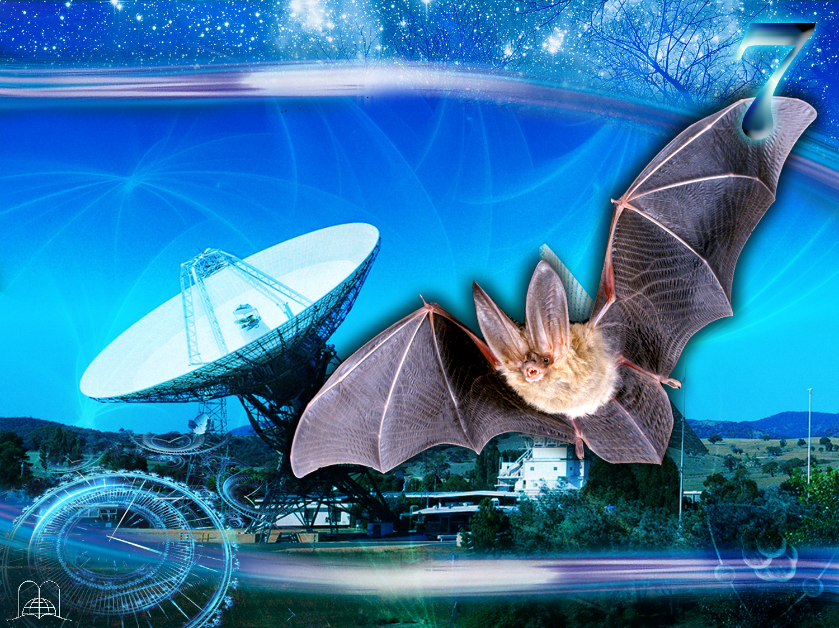
ANIMALS' INSTINCT
The bat’s radar is amazing!
Notes:
The bat’s radar is far superior to anything made by man. Thousands of bats fly about in a cave without ever colliding. Experiments have been performed in which bats are put in a dark room criss-crossed by thin wires; and they never fly into the wires. Their supersonic signals bounce against the obstacles and come back to them; the echo prevents them from colliding with objects.

Slide 12
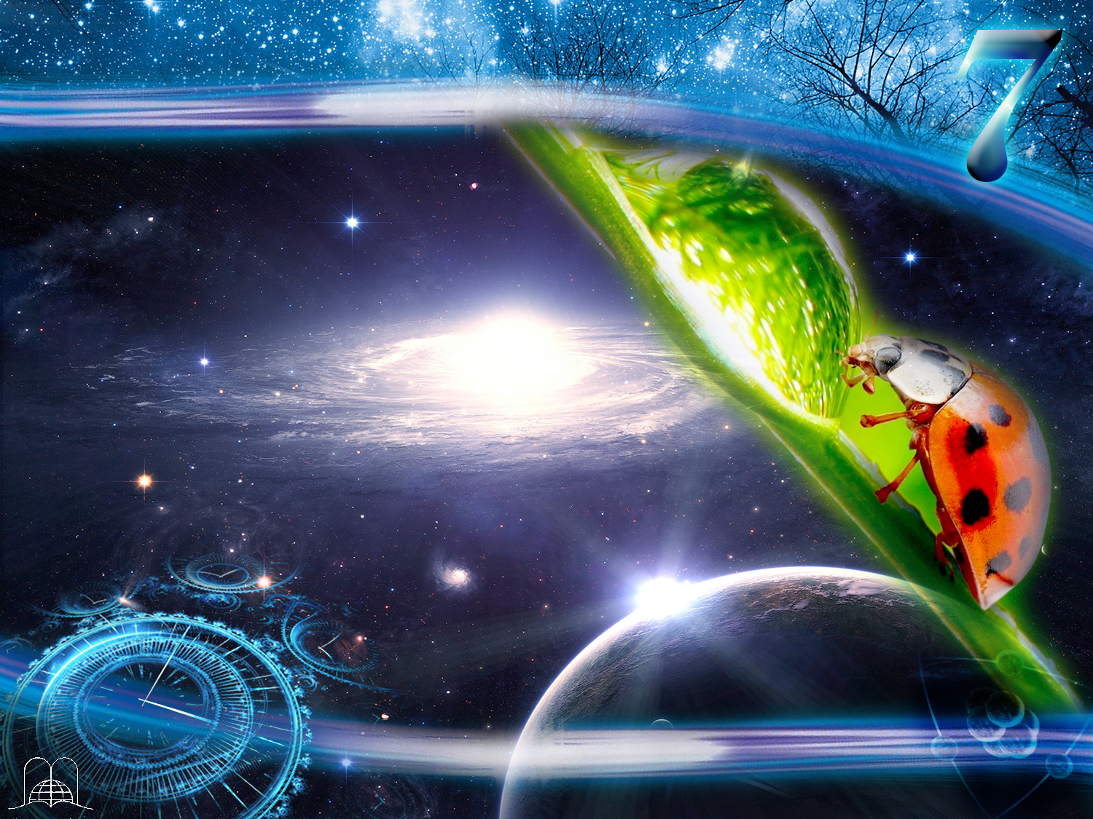
LET’S PRAISE THE CREATOR!
"I will praise thee; for I am fearfully and wonderfully made: marvellous are thy works; and that my soul knoweth right well."
Psalms 139:14
Notes:
Thinking of the human mind with its tremendous capacity to reason, the eye with its complicated functions, the stars, the tiniest insects, the lovely flowers in our garden, or a baby's smile, we cannot but praise God.
Psalm 139: 13, 14.
"For thou hast possessed my reins: thou hast covered me in my mother's womb. I will praise thee; for I am fearfully and wonderfully made: marvellous are thy works; and that my soul knoweth right well."

Slide 13
LET’S PRAISE
THE CREATOR
Notes:
LET’S PRAISE THE CREATOR

Slide 14
What does God
deserve for what
He has created?
Notes:
1. What does God deserve for what He has created?

Slide 15

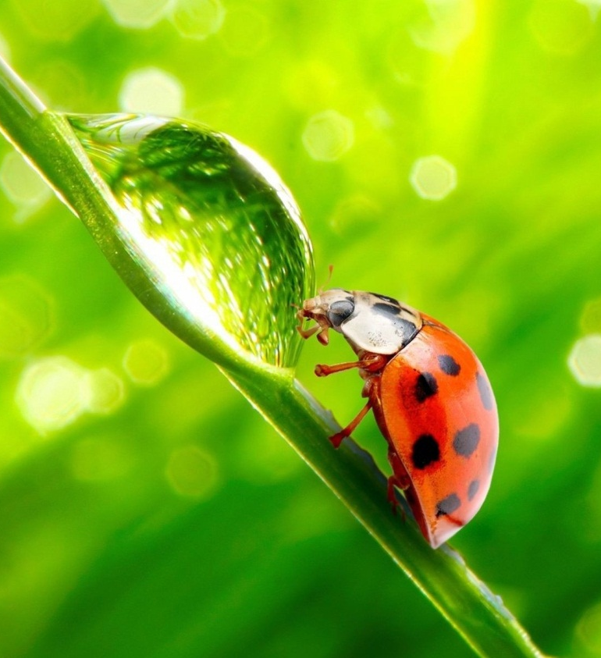
Revelation 4:11
“Thou art worthy, O Lord, to receive glory and honour and power: for thou hast created all things, and for thy pleasure they are and were created."
Notes:
Revelation 4:11
"Thou art worthy, O Lord, to receive glory and honour and power: for thou hast created all things, and for thy pleasure they are and were created."

Slide 16
Did God need thousands of years to create the world?
How long did it
take Him?
Notes:
2. Did God need thousands of years to create the world? How long did it take Him?

Slide 17

Genesis 1:31
“And God saw every thing that he had made, and, behold, it was very good. And the evening and the morning were the sixth day.”
Notes:
Genesis 1:31
"And God saw every thing that he had made, and, behold, it was very good. And the evening and the morning were the sixth day."

Slide 18
Genesis 1
El 4to. Día Ordenó
el Sol, la Luna y Estrellas
El 5to. Día Hizo
los Peces y las Aves
El 3er. Día Hizo
los Continentes y Plantas
El 6to. Día Hizo
los Animales y al Hombre
El 2do. Día Hizo
el Firmamento
The first day
He made light
Notes:
On the first day He made light. (Genesis 1:1-5) The earth was without form and void.
On the second day He made the atmosphere and the firmament. (Verses 6-8).
On the third day He made land and the plants. (Verses 9-13).
On the fourth day He organized the solar system: the sun, moon, stars. (Verses 14-19). –
On the fifth day he made the fish and birds (Verses 20-23).
On the sixth day He made the animals and man. (Verses 24-28,31).

Slide 19
Genesis 1
The second day He made
the atmosphere and
the firmament
El 4to. Día Ordenó
el Sol, la Luna y Estrellas
El 5to. Día Hizo
los Peces y las Aves
El 3er. Día Hizo
los Continentes y Plantas
El 6to. Día Hizo
los Animales y al Hombre
El 1er. Día Hizo la Luz
Notes:
The first day He made light. (Genesis 1:1-5) The earth was without form and void.
The second day He made the atmosphere and the firmament. (Verses 6-8).
The third day He made land and the plants. (Verses 9-13).
The fourth day He organized the solar system: the sun, moon, stars. (Verses 14-19). –
The fifth day he made the fish and birds (Verses 20-23).
The sixth day He made the animals and man. (Verses 24-28,31).

Slide 20
Genesis 1
The third day
He made land and
the plants
El 4to. Día Ordenó
el Sol, la Luna y Estrellas
El 5to. Día Hizo
los Peces y las Aves
El 6to. Día Hizo
los Animales y al Hombre
El 2do. Día Hizo
el Firmamento
El 1er. Día Hizo la Luz
Notes:
The first day He made light. (Genesis 1:1-5) The earth was without form and void.
The second day He made the atmosphere and the firmament. (Verses 6-8).
The third day He made land and the plants. (Verses 9-13).
The fourth day He organized the solar system: the sun, moon, stars. (Verses 14-19). –
The fifth day he made the fish and birds (Verses 20-23).
The sixth day He made the animals and man. (Verses 24-28,31).

Slide 21
Genesis 1
El 5to. Día Hizo
los Peces y las Aves
El 3er. Día Hizo
los Continentes y Plantas
El 6to. Día Hizo
los Animales y al Hombre
El 2do. Día Hizo
el Firmamento
The fourth day
The sun, moon, stars
El 1er. Día Hizo la Luz
Notes:
The first day He made light. (Genesis 1:1-5) The earth was without form and void.
The second day He made the atmosphere and the firmament. (Verses 6-8).
The third day He made land and the plants. (Verses 9-13).
The fourth day He organized the solar system: the sun, moon, stars. (Verses 14-19). –
The fifth day he made the fish and birds (Verses 20-23).
The sixth day He made the animals and man. (Verses 24-28,31).

Slide 22
Genesis 1
El 4to. Día Ordenó
el Sol, la Luna y Estrellas
El 3er. Día Hizo
los Continentes y Plantas
El 6to. Día Hizo
los Animales y al Hombre
El 2do. Día Hizo
el Firmamento
The fifth day
the fish and birds
El 1er. Día Hizo la Luz
Notes:
The first day He made light. (Genesis 1:1-5) The earth was without form and void.
The second day He made the atmosphere and the firmament. (Verses 6-8).
The third day He made land and the plants. (Verses 9-13).
The fourth day He organized the solar system: the sun, moon, stars. (Verses 14-19). –
The fifth day he made the fish and birds (Verses 20-23).
The sixth day He made the animals and man. (Verses 24-28,31).

Slide 23
Genesis 1
El 4to. Día Ordenó
el Sol, la Luna y Estrellas
El 5to. Día Hizo
los Peces y las Aves
El 3er. Día Hizo
los Continentes y Plantas
The sixth day
the animals and man
El 2do. Día Hizo
el Firmamento
El 1er. Día Hizo la Luz
Notes:
The first day He made light. (Genesis 1:1-5) The earth was without form and void.
The second day He made the atmosphere and the firmament. (Verses 6-8).
The third day He made land and the plants. (Verses 9-13).
The fourth day He organized the solar system: the sun, moon, stars. (Verses 14-19). –
The fifth day he made the fish and birds (Verses 20-23).
The sixth day He made the animals and man. (Verses 24-28,31).

Slide 24
What did He do on
the seventh day?
Notes:
3. What did He do on the seventh day?

Slide 25

Genesis 2:1-3
Thus the heavens and the earth were finished, and all the host of them. And on the seventh day God ended his work which he had made; and he rested on the seventh day from all his work which he had made. And God blessed the seventh day, and sanctified it: because that in it he had rested from all his work which God created and made.
Notes:
Genesis 2:1-3
"Thus the heavens and the earth were finished, and all the host of them. And on the seventh day God ended his work which he had made; and he rested on the seventh day from all his work which he had made. And God blessed the seventh day, and sanctified it: because that in it he had rested from all his work which God created and made.”
God rested and blessed and sanctified the seventh day.
a) God did not rest because He was tired but to give us an example.
b) God does not change what He has blessed and sanctified. (Numbers 23:19, 20).

Slide 26
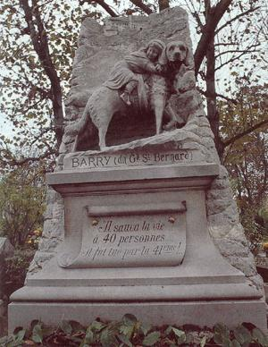
A monument to a
St. Bernard dog
Notes:
Monuments are often constructed to honor great men and women-such as liberators, heroes, poets, explorers, teachers, scientists, mothers: people who have served humanity or saved a life.
In Bern there is even a monument to a St. Bernard dog that rescued 14 people in the Alps.

Slide 27
What monument was established in the fourth commandment of God's Holy Law to honor Him as Creator?
Notes:
4. What monument was established in the fourth commandment of God's Holy Law to honor Him as Creator?

Slide 28
Exodus 20:8-11 (RVR 1995)
"Remember the sabbath day, to keep it holy.
Six days shalt thou labour, and do all thy work:
But the seventh day is the sabbath of the Lord thy God: in it thou shalt not do any work, thou, nor thy son, nor thy daughter, thy manservant, nor thy maidservant, nor thy cattle, nor thy stranger that is within thy gates, For in six days the Lord made heaven and earth, the sea, and all that in them is, and rested the seventh day: wherefore the Lord blessed the sabbath day, and hallowed it.”
Notes:
Éxodo 20:8-11
"Remember the sabbath day, to keep it holy.
Six days shalt thou labour, and do all thy work:
But the seventh day is the sabbath of the Lord thy God: in it thou shalt not do any work, thou, nor thy son, nor thy daughter, thy manservant, nor thy maidservant, nor thy cattle, nor thy stranger that is within thy gates.
For in six days the Lord made heaven and earth, the sea, and all that in them is, and rested the seventh day: wherefore the Lord blessed the sabbath day, and hallowed it.”

Slide 29
THE KEEPING
OF THE SABBATH DAY OVER TIME
Notes:
THE KEEPING OF THE SABBATH DAY OVER TIME

Slide 30
What does God consider the Sabbath?
Notes:
5. What does God consider the Sabbath?

Slide 31
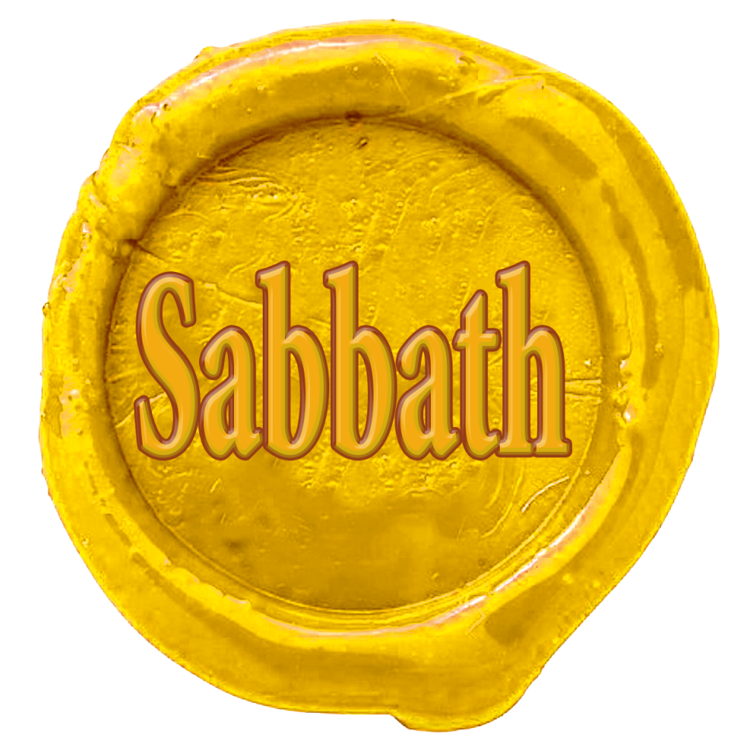
Ezekiel 20:12
"Moreover also I gave them my sabbaths, to be a sign between me and them, that they might know that I am the Lord that sanctify them.”
Notes:
Ezekiel 20:12
"Moreover also I gave them my sabbaths, to be a sign between me and them, that they might know that I am the Lord that sanctify them.”

Slide 32
Ezekiel 20:20
"And hallow my sabbaths; and they shall be a sign between me and you, that ye may know that I am the Lord your God.”
Notes:
Ezekiel 20:20
"And hallow my sabbaths; and they shall be a sign between me and you, that ye may know that I am the Lord your God.”

Slide 33
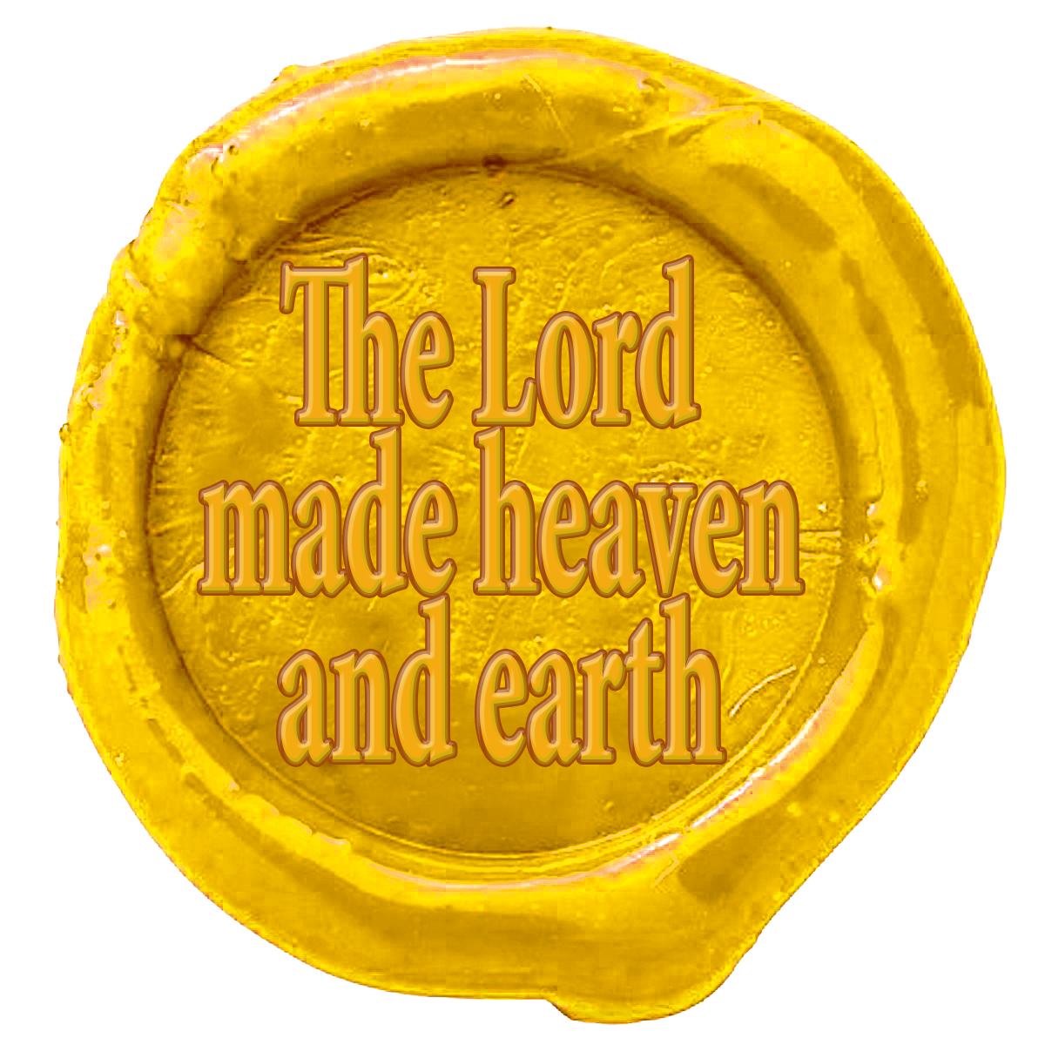
Name:
The Lord thy God,
Title:
Creator
(the Lord made…)
Territory:
Heaven and earth.
Notes:
A seal has three main features:
Name
2. Title
3. Jurisdiction.
In the Fourth commandment (Exodus 20: 8-11) we find three elements:
1. Name: The Lord thy God
2. Title: Creator (He made...)
3. Jurisdiction: Heaven and earth.

Slide 34
Was the Sabbath day observed before the law was given at Mount Sinai?
Notes:
6. Was the Sabbath day observed before the law was given at Mount Sinai?

Slide 35
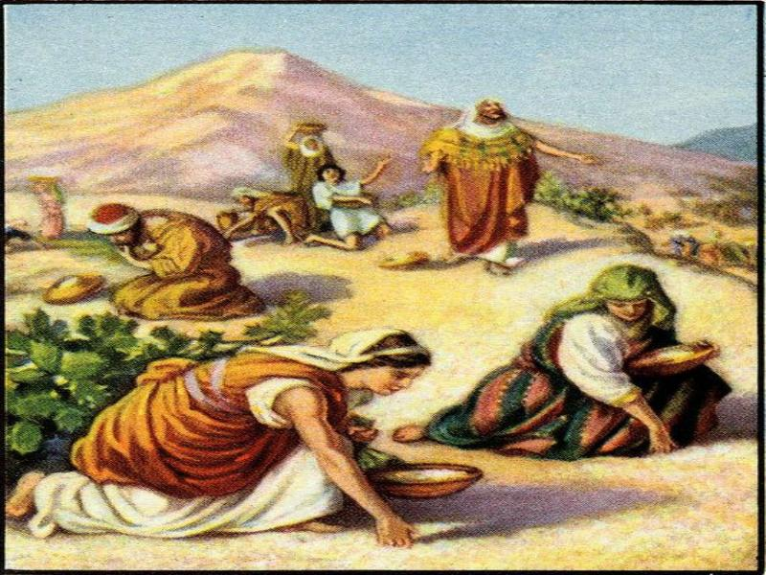
Exodus 16:15
"And when the children of Israel saw it, they said one to another, It is manna: for they wist not what it was. And Moses said unto them, This is the bread which the Lord hath given you to eat."
Notes:
Exodus 16:15
"And when the children of Israel saw it, they said one to another, It is manna: for they wist not what it was. And Moses said unto them, This is the bread which the Lord hath given you to eat."

Slide 36
Exodus 16:21-30
Y él les dijo: Esto es lo que ha dicho Jehová: Mañana es el santo día de reposo, el reposo consagrado a Jehová; lo que habéis de cocer, cocedlo hoy, y lo que habéis de cocinar, cocinadlo; y todo lo que os sobrare, guardadlo para mañana.
Y ellos lo guardaron hasta la mañana,
según lo que Moisés había mandado, y no
se agusanó, ni hedió.
Y dijo Moisés: Comedlo hoy, porque hoy es día de reposo para Jehová; hoy no hallaréis en el campo.
Mirad que Jehová os dio el día de reposo, y por eso en el sexto día os da pan para dos días. Estése, pues, cada uno en su lugar, y nadie salga de él en el séptimo día.
Así el pueblo reposó el séptimo día."
Seis días lo recogeréis; mas el séptimo día es
día de reposo; en él
no se hallará.
Y aconteció que algunos del pueblo salieron en
el séptimo día a recoger, y no hallaron.
En el sexto día recogieron doble porción de comida, dos gomeres para cada uno; y todos los príncipes de la congregación vinieron y se lo hicieron saber a Moisés.
And they gathered it every morning, every man according to his eating: and when the sun waxed hot, it melted.
Y Jehová dijo a Moisés: ¿Hasta cuándo no querréis guardar mis mandamientos y mis leyes?
Notes:
Exodus 16:21-30
And they gathered it every morning, every man according to his eating: and when the sun waxed hot, it melted.

Slide 37
Exodus 16:21-30
Y él les dijo: Esto es lo que ha dicho Jehová: Mañana es el santo día de reposo, el reposo consagrado a Jehová; lo que habéis de cocer, cocedlo hoy, y lo que habéis de cocinar, cocinadlo; y todo lo que os sobrare, guardadlo para mañana.
Y ellos lo guardaron hasta la mañana,
según lo que Moisés había mandado, y no
se agusanó, ni hedió.
Y dijo Moisés: Comedlo hoy, porque hoy es día de reposo para Jehová; hoy no hallaréis en el campo.
Mirad que Jehová os dio el día de reposo, y por eso en el sexto día os da pan para dos días. Estése, pues, cada uno en su lugar, y nadie salga de él en el séptimo día.
Así el pueblo reposó el séptimo día."
Seis días lo recogeréis; mas el séptimo día es
día de reposo; en él
no se hallará.
Y aconteció que algunos del pueblo salieron en
el séptimo día a recoger, y no hallaron.
On the sixth day they gathered twice as much bread, two omers for one man: and all the rulers of the congregation came and told Moses.
Y lo recogían cada mañana, cada uno según lo que había de comer; y luego que el sol calentaba,
se derretía.
Y Jehová dijo a Moisés: ¿Hasta cuándo no querréis guardar mis mandamientos y mis leyes?
Notes:
Éxodo 16:21-30
On the sixth day they gathered twice as much bread, two omers for one man: and all the rulers of the congregation came and told Moses.

Slide 38
Exodus 16:21-30
Y ellos lo guardaron hasta la mañana,
según lo que Moisés había mandado, y no
se agusanó, ni hedió.
Y dijo Moisés: Comedlo hoy, porque hoy es día de reposo para Jehová; hoy no hallaréis en el campo.
And he said unto them, This is that which the Lord hath said, To morrow is the rest of the holy sabbath unto the Lord: bake that which ye will bake to day, and seethe that ye will seethe; and that which remaineth over lay up for you to be kept until the morning.
Mirad que Jehová os dio el día de reposo, y por eso en el sexto día os da pan para dos días. Estése, pues, cada uno en su lugar, y nadie salga de él en el séptimo día.
Así el pueblo reposó el séptimo día."
Seis días lo recogeréis; mas el séptimo día es
día de reposo; en él
no se hallará.
Y aconteció que algunos del pueblo salieron en
el séptimo día a recoger, y no hallaron.
En el sexto día recogieron doble porción de comida, dos gomeres para cada uno; y todos los príncipes de la congregación vinieron y se lo hicieron saber a Moisés.
Y lo recogían cada mañana, cada uno según lo que había de comer; y luego que el sol calentaba,
se derretía.
Y Jehová dijo a Moisés: ¿Hasta cuándo no querréis guardar mis mandamientos y mis leyes?
Notes:
Exodus 16:21-30
And he said unto them, This is that which the Lord hath said, To morrow is the rest of the holy sabbath unto the Lord: bake that which ye will bake to day, and seethe that ye will seethe; and that which remaineth over lay up for you to be kept until the morning.

Slide 39
Exodus 16:21-30
Y él les dijo: Esto es lo que ha dicho Jehová: Mañana es el santo día de reposo, el reposo consagrado a Jehová; lo que habéis de cocer, cocedlo hoy, y lo que habéis de cocinar, cocinadlo; y todo lo que os sobrare, guardadlo para mañana.
And they laid it up till the morning, as Moses bade: and it did not stink, neither was there any worm therein. And Moses said, Eat that to day; for to day is a sabbath unto the Lord: to day ye shall not find it in the field.
Mirad que Jehová os dio el día de reposo, y por eso en el sexto día os da pan para dos días. Estése, pues, cada uno en su lugar, y nadie salga de él en el séptimo día.
Así el pueblo reposó el séptimo día."
Seis días lo recogeréis; mas el séptimo día es
día de reposo; en él
no se hallará.
Y aconteció que algunos del pueblo salieron en
el séptimo día a recoger, y no hallaron.
En el sexto día recogieron doble porción de comida, dos gomeres para cada uno; y todos los príncipes de la congregación vinieron y se lo hicieron saber a Moisés.
Y lo recogían cada mañana, cada uno según lo que había de comer; y luego que el sol calentaba,
se derretía.
Y Jehová dijo a Moisés: ¿Hasta cuándo no querréis guardar mis mandamientos y mis leyes?
Notes:
Exodus 16:21-30
And they laid it up till the morning, as Moses bade: and it did not stink, neither was there any worm therein. And Moses said, Eat that to day; for to day is a sabbath unto the Lord: to day ye shall not find it in the field.

Slide 40
Exodus 16:21-30
Y él les dijo: Esto es lo que ha dicho Jehová: Mañana es el santo día de reposo, el reposo consagrado a Jehová; lo que habéis de cocer, cocedlo hoy, y lo que habéis de cocinar, cocinadlo; y todo lo que os sobrare, guardadlo para mañana.
Y ellos lo guardaron hasta la mañana,
según lo que Moisés había mandado, y no
se agusanó, ni hedió.
Y dijo Moisés: Comedlo hoy, porque hoy es día de reposo para Jehová; hoy no hallaréis en el campo.
Mirad que Jehová os dio el día de reposo, y por eso en el sexto día os da pan para dos días. Estése, pues, cada uno en su lugar, y nadie salga de él en el séptimo día.
Así el pueblo reposó el séptimo día."
Six days ye shall gather it; but on the seventh day, which is the sabbath, in it there shall be none.
And it came to pass, that there went out some of the people on the seventh day for to gather, and they found none.
En el sexto día recogieron doble porción de comida, dos gomeres para cada uno; y todos los príncipes de la congregación vinieron y se lo hicieron saber a Moisés.
Y lo recogían cada mañana, cada uno según lo que había de comer; y luego que el sol calentaba,
se derretía.
Y Jehová dijo a Moisés: ¿Hasta cuándo no querréis guardar mis mandamientos y mis leyes?
Notes:
Six days ye shall gather it; but on the seventh day, which is the sabbath, in it there shall be none.
And it came to pass, that there went out some of the people on the seventh day for to gather, and they found none.

Slide 41
Exodus 16:21-30
Y él les dijo: Esto es lo que ha dicho Jehová: Mañana es el santo día de reposo, el reposo consagrado a Jehová; lo que habéis de cocer, cocedlo hoy, y lo que habéis de cocinar, cocinadlo; y todo lo que os sobrare, guardadlo para mañana.
Y ellos lo guardaron hasta la mañana,
según lo que Moisés había mandado, y no
se agusanó, ni hedió.
Y dijo Moisés: Comedlo hoy, porque hoy es día de reposo para Jehová; hoy no hallaréis en el campo.
Mirad que Jehová os dio el día de reposo, y por eso en el sexto día os da pan para dos días. Estése, pues, cada uno en su lugar, y nadie salga de él en el séptimo día.
Así el pueblo reposó el séptimo día."
Seis días lo recogeréis; mas el séptimo día es
día de reposo; en él
no se hallará.
Y aconteció que algunos del pueblo salieron en
el séptimo día a recoger, y no hallaron.
En el sexto día recogieron doble porción de comida, dos gomeres para cada uno; y todos los príncipes de la congregación vinieron y se lo hicieron saber a Moisés.
Y lo recogían cada mañana, cada uno según lo que había de comer; y luego que el sol calentaba,
se derretía.
And the Lord said unto Moses, How long refuse ye to keep my commandments and my laws?
Notes:
Exodus 16:21-30
And the Lord said unto Moses, How long refuse ye to keep my commandments and my laws?

Slide 42
Exodus 16:21-30
Y él les dijo: Esto es lo que ha dicho Jehová: Mañana es el santo día de reposo, el reposo consagrado a Jehová; lo que habéis de cocer, cocedlo hoy, y lo que habéis de cocinar, cocinadlo; y todo lo que os sobrare, guardadlo para mañana.
Y ellos lo guardaron hasta la mañana,
según lo que Moisés había mandado, y no
se agusanó, ni hedió.
Y dijo Moisés: Comedlo hoy, porque hoy es día de reposo para Jehová; hoy no hallaréis en el campo.
See, for that the Lord hath given you the sabbath, therefore he giveth you on the sixth day the bread of two days; abide ye every man in his place, let no man go out of his place on the seventh day.
So the people rested on the seventh day.
Seis días lo recogeréis; mas el séptimo día es
día de reposo; en él
no se hallará.
Y aconteció que algunos del pueblo salieron en
el séptimo día a recoger, y no hallaron.
En el sexto día recogieron doble porción de comida, dos gomeres para cada uno; y todos los príncipes de la congregación vinieron y se lo hicieron saber a Moisés.
Y lo recogían cada mañana, cada uno según lo que había de comer; y luego que el sol calentaba,
se derretía.
Y Jehová dijo a Moisés: ¿Hasta cuándo no querréis guardar mis mandamientos y mis leyes?
Notes:
Exodus 16:21-30
“See, for that the Lord hath given you the sabbath, therefore he giveth you on the sixth day the bread of two days; abide ye every man in his place, let no man go out of his place on the seventh day.
So the people rested on the seventh day.”
Yes. Proof of this is the miracle of the manna.
Ever since then, the order of the week has never changed in the ancient Jewish calendar nor in our own.

Slide 43
How did Isaiah
describe
the Sabbath day?
Notes:
7. How did Isaiah describe the Sabbath day?

Slide 44

Isaiah 58:13, 14
"If thou turn away thy foot from the sabbath, from doing thy pleasure on my holy day; and call the sabbath a delight, the holy of the Lord, honourable; and shalt honour him, not doing thine own ways, nor finding thine own pleasure, nor speaking thine own words. Then shalt thou delight thyself in the Lord; and I will cause thee to ride upon the high places of the earth, and feed thee with the heritage of Jacob thy father: for the mouth of the Lord hath spoken it."
Notes:
Isaiah 58:13, 14
"If thou turn away thy foot from the sabbath, from doing thy pleasure on my holy day; and call the sabbath a delight, the holy of the Lord, honourable; and shalt honour him, not doing thine own ways, nor finding thine own pleasure, nor speaking thine own words. Then shalt thou delight thyself in the Lord; and I will cause thee to ride upon the high places of the earth, and feed thee with the heritage of Jacob thy father: for the mouth of the Lord hath spoken it."

Slide 45
Was the Sabbath also for non - Jewish believers in the Old Testament, all Christians today?
Notes:
8. Was the Sabbath also for non - Jewish believers in the Old Testament, all Christians today?

Slide 46

Isaíah 56:2-7
Y a los hijos de los extranjeros que sigan a Jehová para servirle, y que amen el nombre de Jehová para ser sus siervos; a todos los que guarden el día de reposo para no profanarlo,
y abracen mi pacto, yo los llevaré a mi santo monte, y los recrearé en mi casa de oración; sus holocaustos y sus sacrificios serán aceptos sobre mi altar; porque mi casa será llamada casa de oración para todos los pueblos."
Porque así dijo Jehová: A los eunucos que guarden mis días de reposo, y escojan lo que yo quiero, y abracen mi pacto, yo les daré lugar en mi casa y dentro de mis muros, y nombre mejor que el de hijos e hijas; nombre perpetuo les daré, que nunca perecerá.
“Blessed is the man that doeth this, and the son of man that layeth hold on it; that keepeth the sabbath from polluting it, and keepeth his hand from doing any evil.
Neither let the son of the stranger, that hath joined himself to the Lord, speak, saying, The Lord hath utterly separated me from his people: neither let the eunuch say, Behold, I am a dry tree.
Notes:
Isaiah 56:2-7
"Blessed is the man that doeth this, and the son of man that layeth hold on it; that keepeth the sabbath from polluting it, and keepeth his hand from doing any evil.
Neither let the son of the stranger, that hath joined himself to the Lord, speak, saying, The Lord hath utterly separated me from his people: neither let the eunuch say, Behold, I am a dry tree.

Slide 47
Isaiah 56:2-7
Y a los hijos de los extranjeros que sigan a Jehová para servirle, y que amen el nombre de Jehová para ser sus siervos; a todos los que guarden el día de reposo para no profanarlo,
y abracen mi pacto, yo los llevaré a mi santo monte, y los recrearé en mi casa de oración; sus holocaustos y sus sacrificios serán aceptos sobre mi altar; porque mi casa será llamada casa de oración para todos los pueblos."
For thus saith the Lord unto the eunuchs that keep my sabbaths, and choose the things that please me, and take hold of my covenant;
Even unto them will I give in mine house and within my walls a place and a name better than of sons and of daughters: I will give them an everlasting name, that shall not be cut off.
"Bienaventurado el hombre que hace esto, y el hijo de hombre que lo abraza; que guarda el día de reposo para no profanarlo, y que guarda su mano de hacer todo mal.
Y el extranjero que sigue a Jehová no hable diciendo: Me apartará totalmente Jehová de su pueblo. Ni diga el eunuco: He aquí yo soy árbol seco.
Notes:
Isaiah 56:2-7
For thus saith the Lord unto the eunuchs that keep my sabbaths, and choose the things that please me, and take hold of my covenant;
Even unto them will I give in mine house and within my walls a place and a name better than of sons and of daughters: I will give them an everlasting name, that shall not be cut off.

Slide 48
Isaiah 56:2-7
Also the sons of the stranger, that join themselves to the Lord, to serve him, and to love the name of the Lord, to be his servants, every one that keepeth the sabbath from polluting it, and taketh hold of my covenant;
Even them will I bring to my holy mountain, and make them joyful in my house of prayer: their burnt offerings and their sacrifices shall be accepted upon mine altar; for mine house shall be called an house of prayer for all people.”
Porque así dijo Jehová: A los eunucos que guarden mis días de reposo, y escojan lo que yo quiero, y abracen mi pacto, yo les daré lugar en mi casa y dentro de mis muros, y nombre mejor que el de hijos e hijas; nombre perpetuo les daré, que nunca perecerá.
"Bienaventurado el hombre que hace esto, y el hijo de hombre que lo abraza; que guarda el día de reposo para no profanarlo, y que guarda su mano de hacer todo mal.
Y el extranjero que sigue a Jehová no hable diciendo: Me apartará totalmente Jehová de su pueblo. Ni diga el eunuco: He aquí yo soy árbol seco.
Notes:
Isaiah 56:2-7
Also the sons of the stranger, that join themselves to the Lord, to serve him, and to love the name of the Lord, to be his servants, every one that keepeth the sabbath from polluting it, and taketh hold of my covenant;
Even them will I bring to my holy mountain, and make them joyful in my house of prayer: their burnt offerings and their sacrifices shall be accepted upon mine altar; for mine house shall be called an house of prayer for all people.

Slide 49
DID JESUS AND HIS APOSTLES KEEP THE SABBATH?
Notes:
DID JESUS AND HIS APOSTLES KEEP THE SABBATH?

Slide 50
What is Jesus' relationship
to the Sabbath?
Notes:
9. What is Jesus' relationship to the Sabbath?

Slide 51

Christ Himself
created it
(John 1:14)
(Colossians 1:15-17)
Notes:
a) Christ Himself created it. (John 1:1-14; Colossians 1:15-17).

Slide 52

Nehemiah 9:12-13
He promulgated the Law at Mount Sinai
"Moreover thou leddest them in the day by a cloudy pillar; and in the night by a pillar of fire, to give them light in the way wherein they should go. Thou camest down also upon mount Sinai, and spakest with them from heaven, and gavest them right judgments, and true laws, good statutes and commandments.”
Notes:
b) He promulgated the Law at Mount Sinai. Nehemiah 9:12, 13; 1 Corinthians 10:4.
"Moreover thou leddest them in the day by a cloudy pillar; and in the night by a pillar of fire, to give them light in the way wherein they should go. Thou camest down also upon mount Sinai, and spakest with them from heaven, and gavest them right judgments, and true laws, good statutes and commandments.”

Slide 53
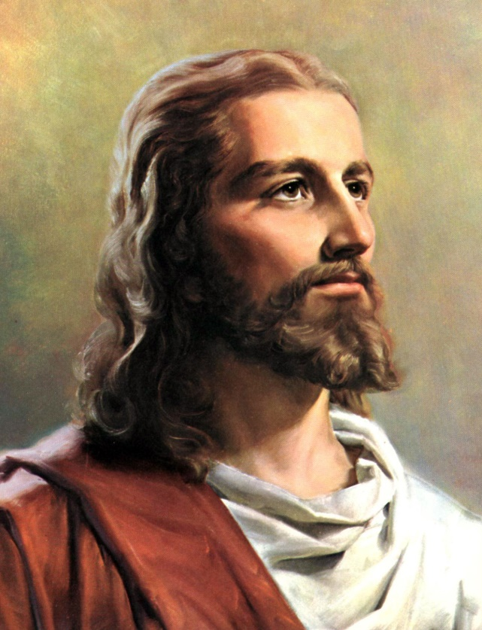
1 Corinthians 10:4
He promulgated the Law at Mount Sinai
"And did all drink the same spiritual drink: for they drank of that spiritual Rock that followed them: and that Rock was Christ."
Notes:
1 Corinthians 10:4
"And did all drink the same spiritual drink: for they drank of that spiritual Rock that followed them: and that Rock was Christ."

Slide 54
What was Jesus' custom when He lived on this earth?
Notes:
10. What was Jesus' custom when He lived on this earth?

Slide 55
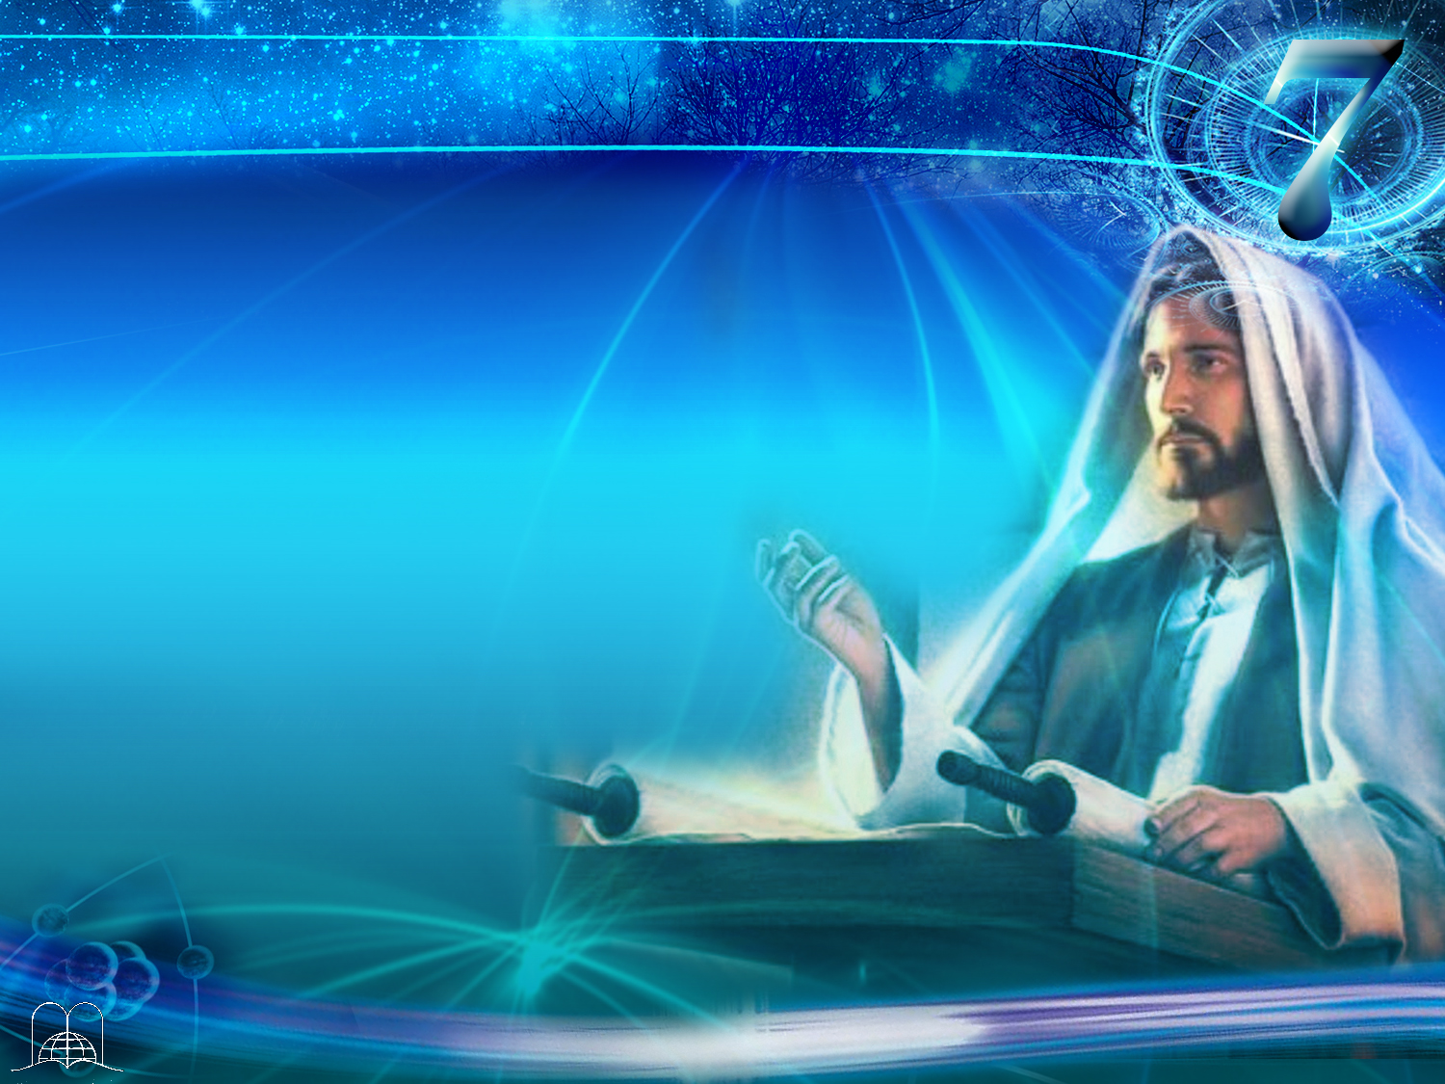
Luke 4:16, 31
"And he came to Nazareth, where he had been brought up: and, as his custom was, he went into the synagogue on the sabbath day, and stood up for to read.
And came down to Capernaum, a city of Galilee, and taught them on the sabbath days.”
Notes:
Luke 4:16, 31
"And he came to Nazareth, where he had been brought up: and, as his custom was, he went into the synagogue on the sabbath day, and stood up for to read. And came down to Capernaum, a city of Galilee, and taught them on the sabbath days.”

Slide 56
Was the Sabbath
established for all men?
Notes:
11. Was the Sabbath established only for all men?

Slide 57

Mark 2:27, 28
"And he said unto them, The sabbath was made for man, and not man for the sabbath. Therefore the Son of man is Lord also of the sabbath.”
Notes:
Mark 2:27, 28
"And he said unto them, The sabbath was made for man, and not man for the sabbath. Therefore the Son of man is Lord also of the sabbath.”

Slide 58
Jesus is the Lord, Owner and the Author of the Sabbath, so it is the day of the Lord.
He ignored the human rules that had been introduced.
He taught us how to keep the Sabbath by doing well and the gospel.
Notes:
Jesus is the Lord, Owner and the Author of the Sabbath, so it is the day of the Lord
b) He ignored the human rules that had been introduced.
c) He taught us how to keep the Sabbath by doing well and the gospel. (Matthew 12:11-12).

Slide 59
Matthew 12:11-12
“And he said unto them, What man shall there be among you, that shall have one sheep, and if it fall into a pit on the sabbath day, will he not lay hold on it, and lift it out? How much then is a man better than a sheep? Wherefore it is lawful to do well on the sabbath days.”
Notes:
Matthew 12:11-12
“And he said unto them, What man shall there be among you, that shall have one sheep, and if it fall into a pit on the sabbath day, will he not lay hold on it, and lift it out? How much then is a man better than a sheep? Wherefore it is lawful to do well on the sabbath days.”

Slide 60
What day did Mary (the mother of Jesus) and all the other faithful women who had been taught by Jesus keep after His crucifixion?
Notes:
12. What day did Mary (the mother of Jesus) and all the other faithful women who had been taught by Jesus keep after His crucifixion?

Slide 61
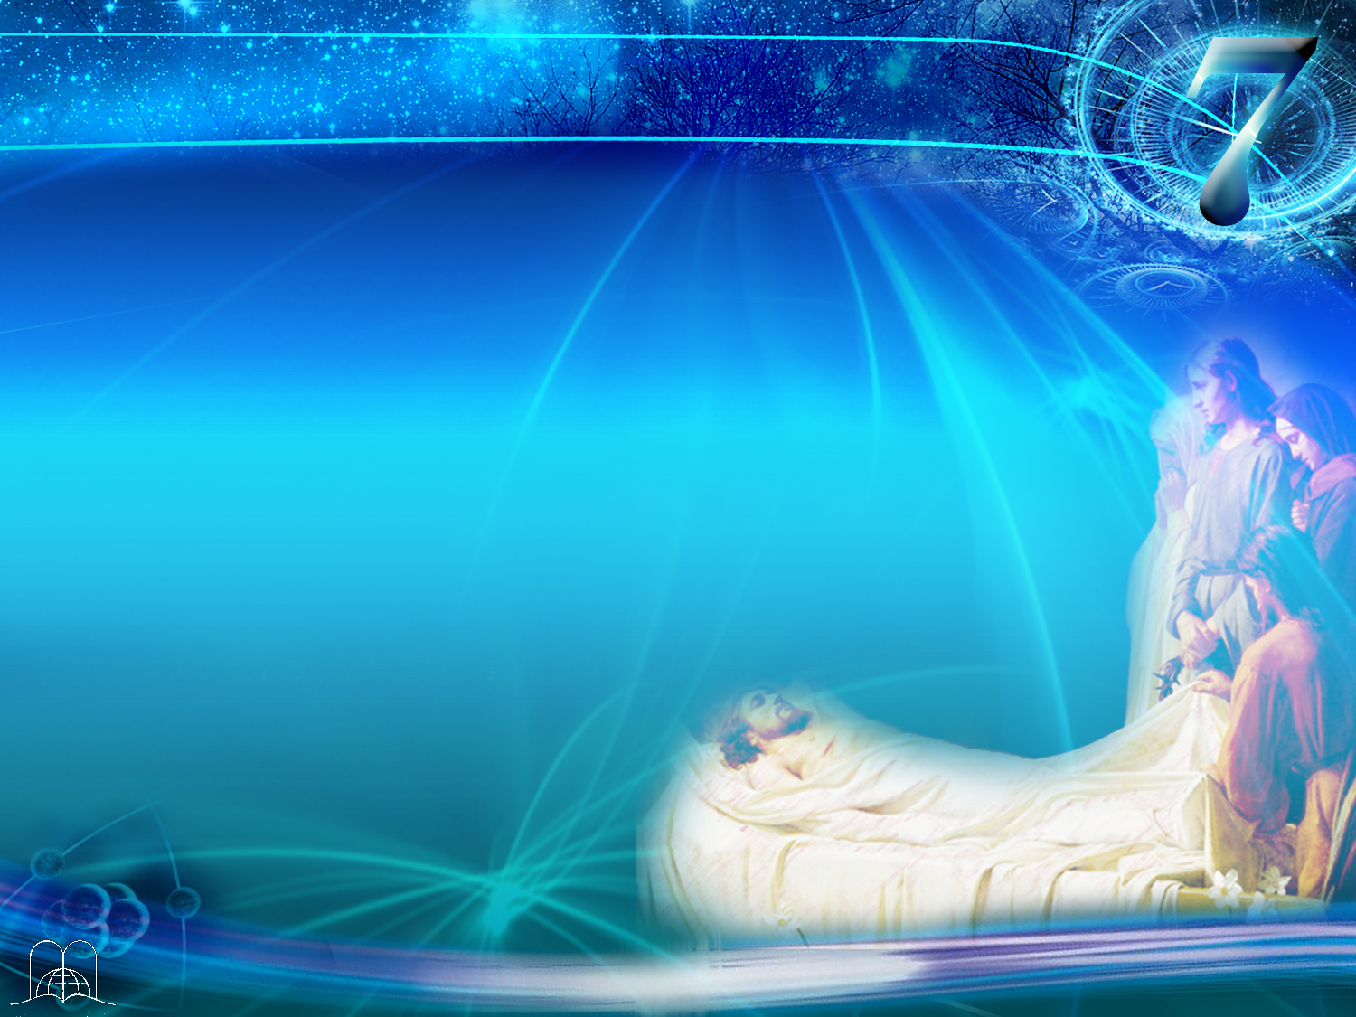
Luke 23:56
"And they returned,
and prepared spices and ointments;
and rested the sabbath day according to the commandment.”
Notes:
Luke 23:56
"And they returned, and prepared spices and ointments; and rested the sabbath day according to the commandment.”

Slide 62
Would the Sabbath continue to be holy after Christ's death?
What advice did Jesus give His disciples when He foretold
the destruction of Jerusalem
which came more than 40 years later (70 A.D.)?
Notes:
13. Would the Sabbath continue to be holy after Christ's death? What advice did Jesus give His disciples when He foretold the destruction of Jerusalem which came more than 40 years later (70 A.D.)? .)

Slide 63
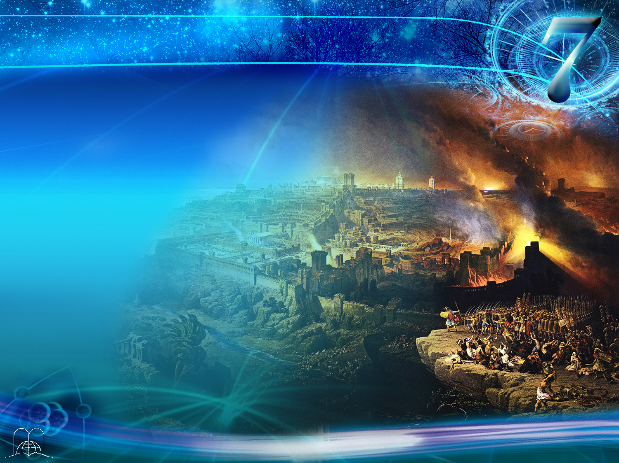
Matthew 24:20
"But pray ye that your flight be not in the winter, neither on the sabbath day."
Notes:
Matthew 24:20
"But pray ye that your flight be not in the winter, neither on the sabbath day."

Slide 64
Did the apostles
keep the Sabbath?
Notes:
14. Did the apostles keep the Sabbath?

Slide 65
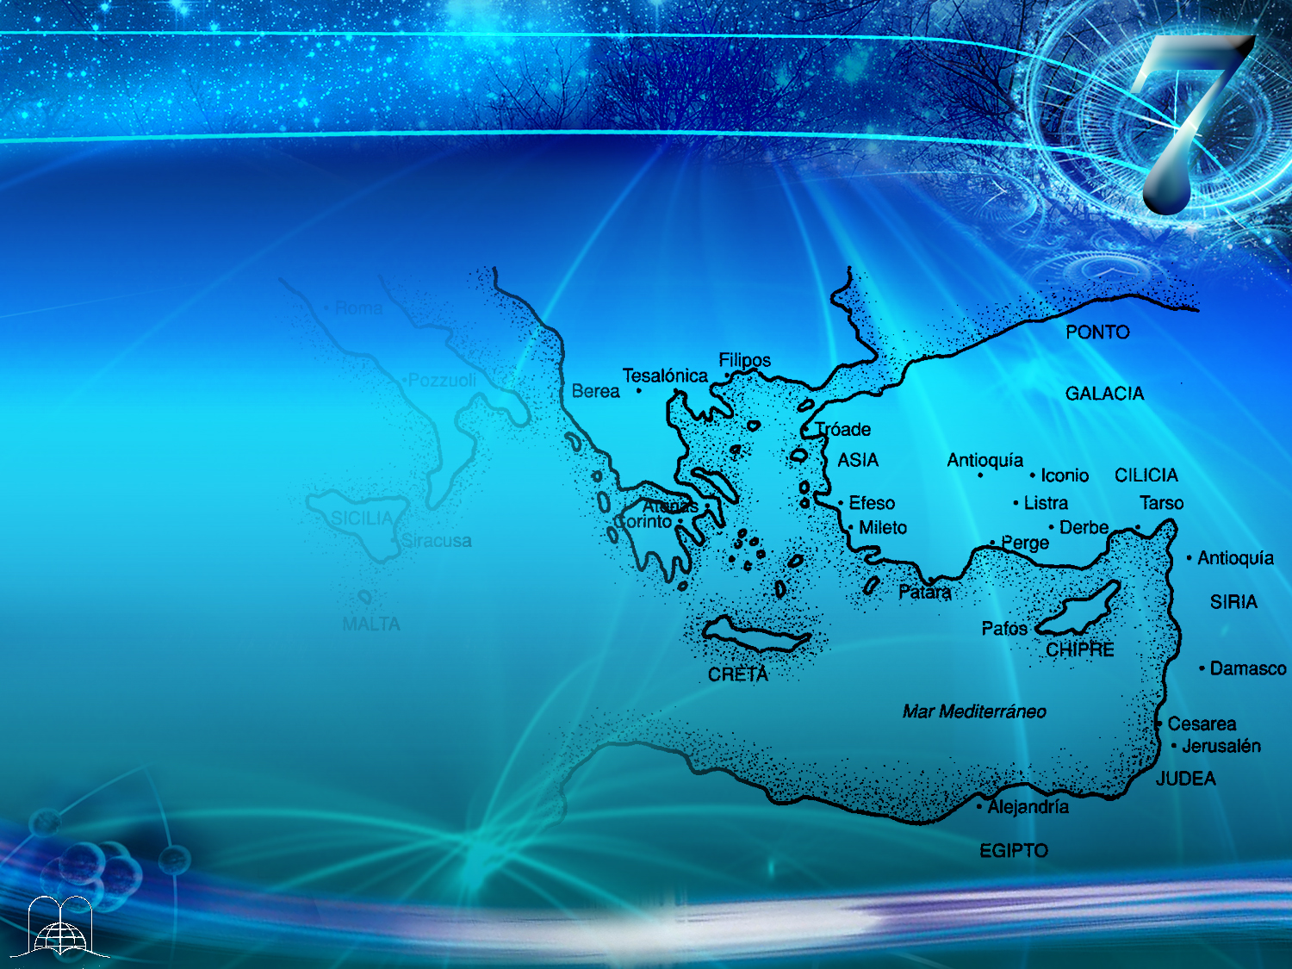
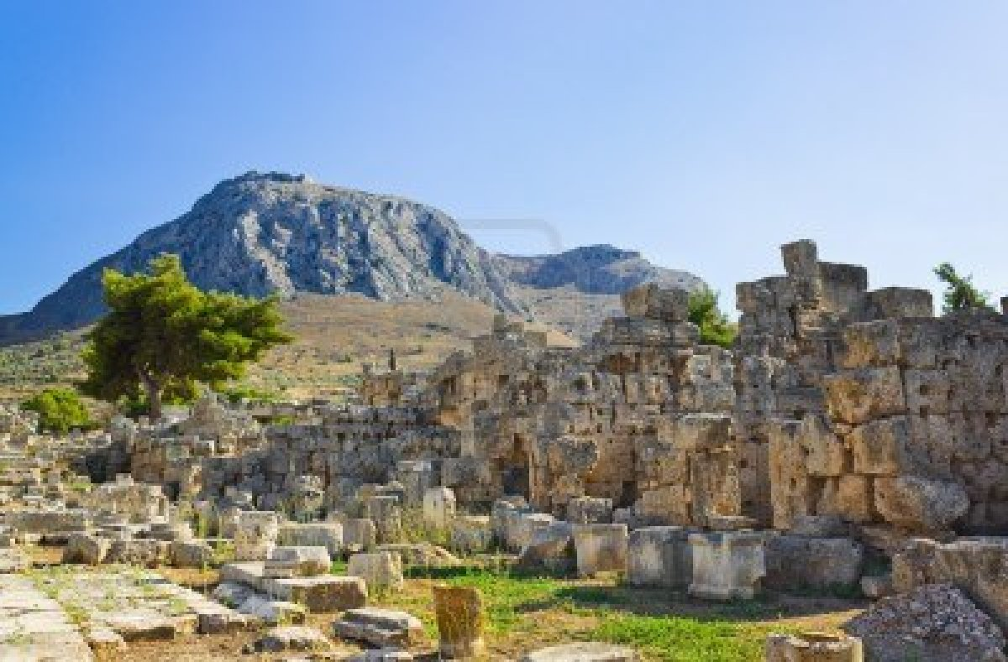
Acts 18:3-4
"And because he was of the same craft, he abode with them, and wrought: for by their occupation they were tentmakers.
And he reasoned in the synagogue every sabbath, and persuaded the Jews and the Greeks.”
Corinth
Notes:
Acts 18:3-4
"And because he was of the same craft, he abode with them, and wrought: for by their occupation they were tentmakers.
And he reasoned in the synagogue every sabbath, and persuaded the Jews and the Greeks.”

Slide 66
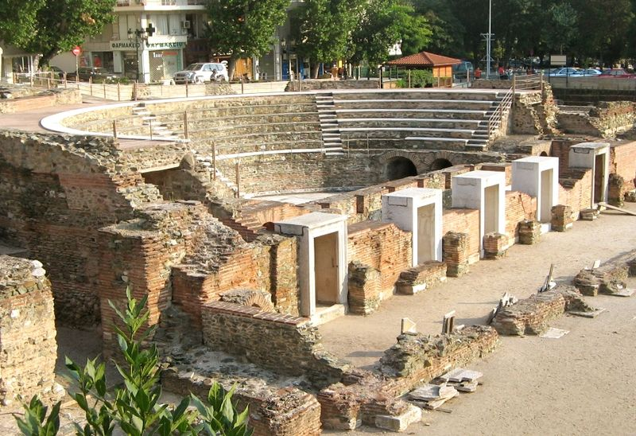
Acts 17:2-3
"And Paul, as his manner was, went in unto them, and three sabbath days reasoned with them out of the scriptures, Opening and alleging, that Christ must needs have suffered, and risen again from the dead; and that this Jesus, whom I preach unto you, is Christ.”
Thessalonica
Notes:
Acts 17:2-3
"And Paul, as his manner was, went in unto them, and three sabbath days reasoned with them out of the scriptures, Opening and alleging, that Christ must needs have suffered, and risen again from the dead; and that this Jesus, whom I preach unto you, is Christ.”

Slide 67
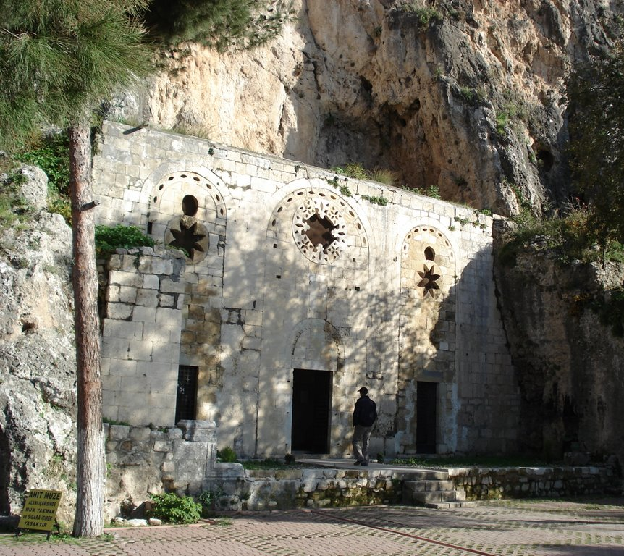
Acts 13:14, 42, 44
"But when they departed from Perga, they came to Antioch in Pisidia, and went into the synagogue on the sabbath day, and sat down.
And when the Jews were gone out of the synagogue, the Gentiles besought that these words might be preached to them the next sabbath.
And the next sabbath day came almost the whole city together to hear the word of God.."
Antioch
From
Pisidia
Notes:
Acts 13:14, 42, 44
"But when they departed from Perga, they came to Antioch in Pisidia, and went into the synagogue on the sabbath day, and sat down.
And when the Jews were gone out of the synagogue, the Gentiles besought that these words might be preached to them the next sabbath.
And the next sabbath day came almost the whole city together to hear the word of God.."

Slide 68
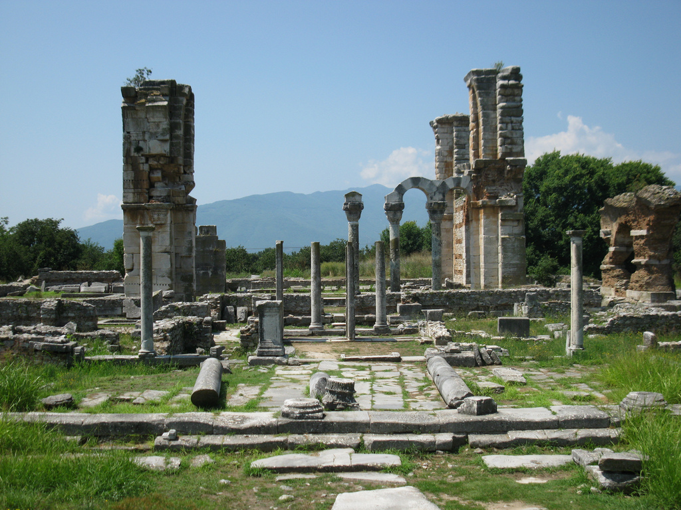
Acts 16:13
"And on the sabbath we went out of the city by a river side, where prayer was wont to be made; and we sat down, and spake unto the women which resorted thither.”
Philippi
Notes:
Acts 16:13
"And on the sabbath we went out of the city by a river side, where prayer was wont to be made; and we sat down, and spake unto the women which resorted thither.”

Slide 69
Where will the Sabbath be kept for eternity?
Notes:
15. Where will the Sabbath be kept for eternity?

Slide 70

Isaiah 66:22-23
"For as the new heavens and the new earth, which I will make, shall remain before me, saith the Lord, so shall your seed and your name remain. And it shall come to pass, that from one new moon to another, and from one sabbath to another, shall all flesh come to worship before me, saith the Lord.”
Notes:
Isaiah 66:22-23
"For as the new heavens and the new earth, which I will make, shall remain before me, saith the Lord, so shall your seed and your name remain. And it shall come to pass, that from one new moon to another, and from one sabbath to another, shall all flesh come to worship before me, saith the Lord.”
How wonderful it will be when we meet every Sabbath with Jesus in eternal life!

Slide 71
CONCLUSION
Notes:
CONCLUSION

Slide 72
Review:
It was given to man in Eden.
It was confirmed with the miracle of Manna.
It was written in the 10 commandments, in stone with the finger of God.
It was confirmed by the prophets: Isaiah, Jeremiah, Nehemiah, etc.
It was also given to non-Jewish foreigner.
It was Jesus' custom to keep it.
Notes:
Review:
It was given to man in Eden.
It was confirmed with the miracle of Manna.
It was written in the 10 commandments, in stone with the finger of God.
It was confirmed by the prophets: Isaiah, Jeremiah, Nehemiah, etc.
It was also given to non-Jewish foreigner.
It was Jesus' custom to keep it.

Slide 73
Review:
Jesus said it was for the good of man.
The women instructed by Jesus kept the Sabbath.
Jesus prophesied about the destruction of Jerusalem: pray...
The Apostles kept it in Corinth, Thessalonica
Notes:
Review:
Jesus said it was for the good of man.
The women instructed by Jesus kept the Sabbath.
Jesus prophesied about the destruction of Jerusalem: pray...
The Apostles kept it in Corinth, Thessalonica

Slide 74
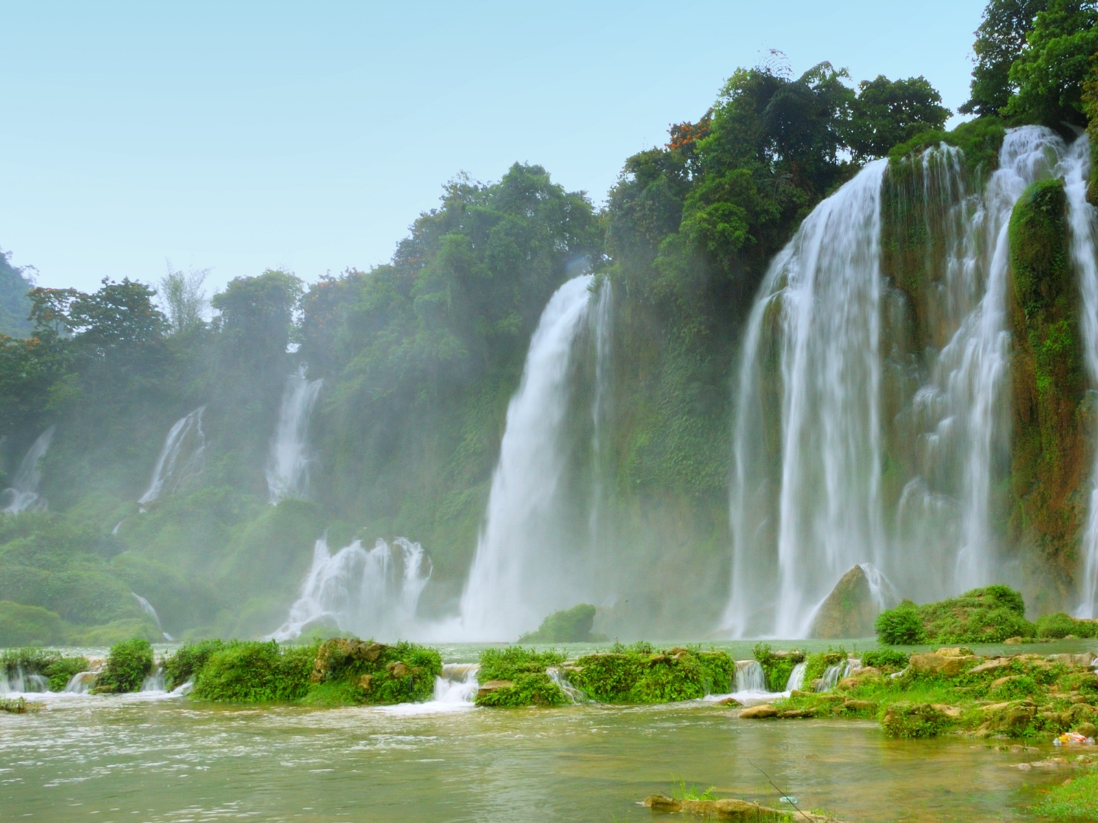
The Sabbath was created for man‘s benefit
It is the best way to conquer stress and fatigue.
It is a day of communion with Jesus
We honour the Author of life
It is a day to be dedicated to the family
Notes:
Jesus explained that the Sabbath was created for man‘s benefit. (Mark 2:27).
It is the best way to conquer stress and fatigue. It offers us rest for body, soul and spirit.
It is a day of communion with Jesus when we come together. Thus we strengthen our relationship with Him, and this relieved of psychological stress and gives us rest and peace in our soul. (Matthew 11:28-30).
We honor the Author of life when we enjoy nature and give Him "honor, glory and power" for creating everything.
It is a day to be dedicated to the family and to teach our y children the ways to God.

Slide 75
How is it possible to keep that holy day in a world that is upside down?
Notes:
16. How is it possible to keep that holy day in a world that is upside down?

Slide 76

Philippians 4:13
"I can do
all things
through
Christ
which strengtheneth me."
Notes:
Philippians 4:13
I can do all things through Christ which strengtheneth me.
We are happy when we show our love to God! We will have a clear conscience and the certainty of our duty fulfilled!

Slide 77

¡Thank you Lord, for being able to worship in
Your Day!
Notes:
Do you really think that the Sabbath is the day ordained by God, or do you have any doubts?
Would you like to make plans to dedicate to God that day?
Thank you Lord, for being able to worship in Your Day!

Slide 78
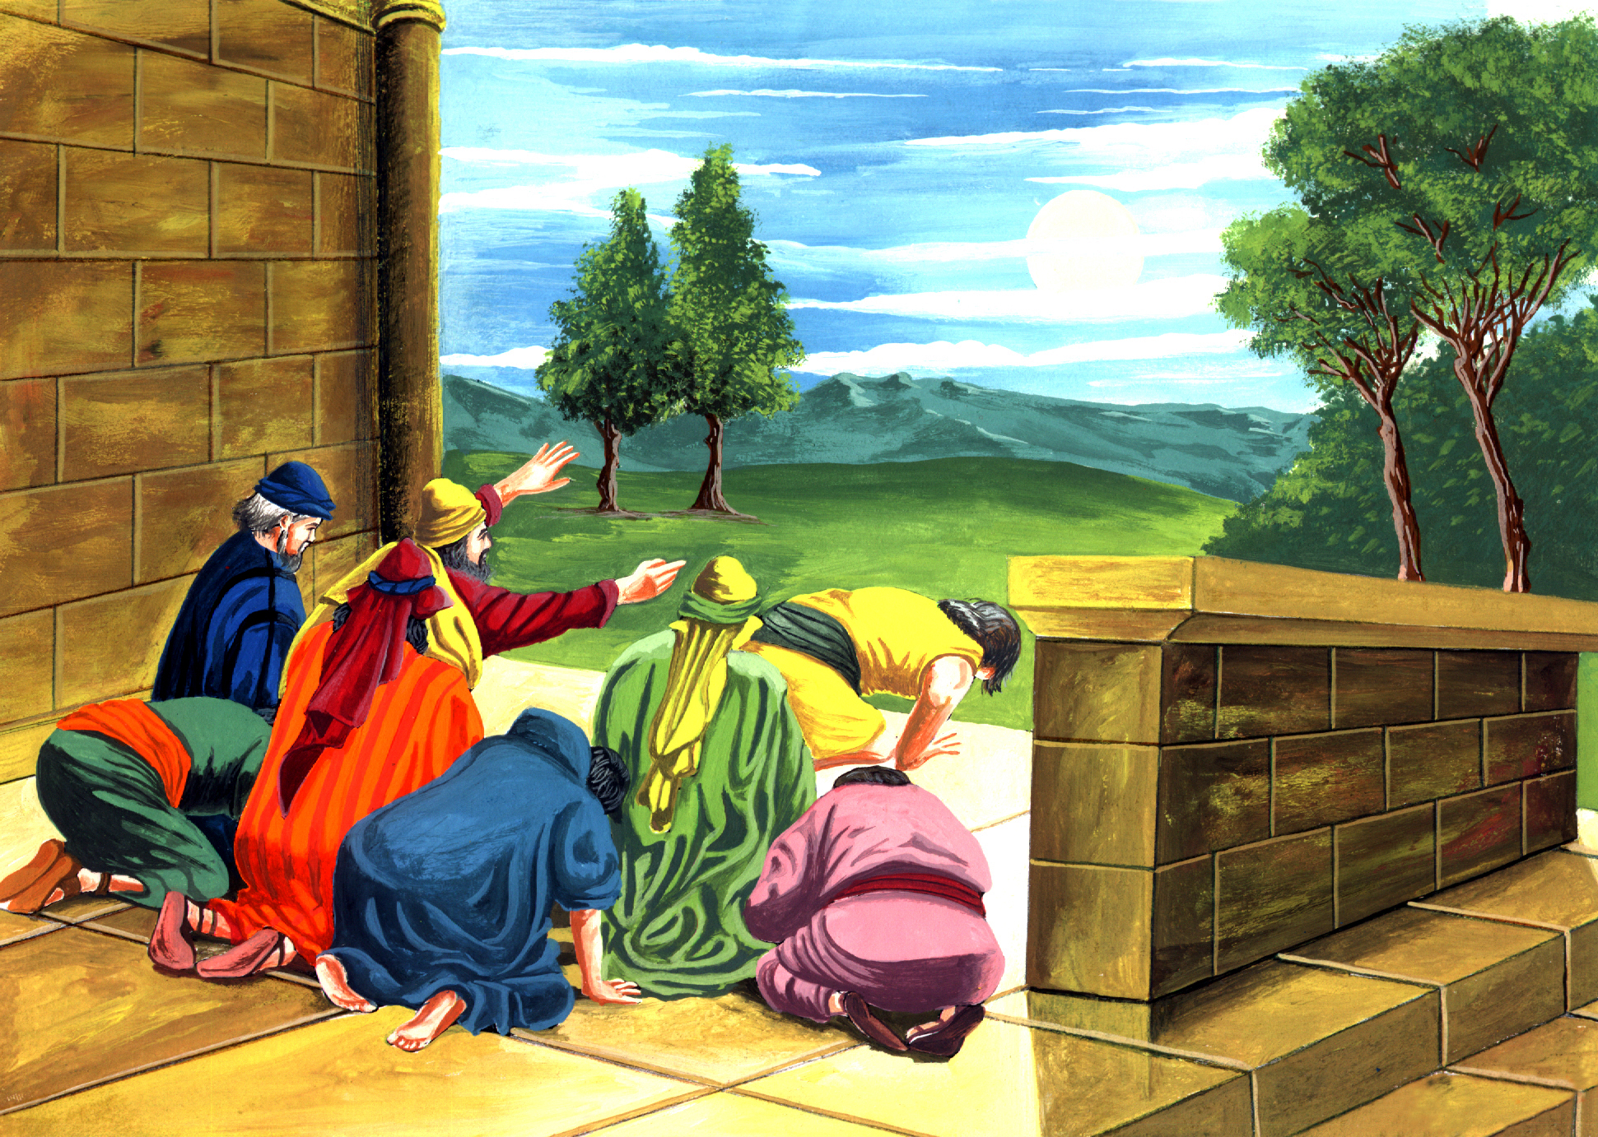
The next topic:
“The worst falsification in history“
The most fatal falsification of history has to be unmasked, and the hidden sun worship in our present civilization.
A series of questions will be answered,
which may concern
also to you.
GOD BLESS YOU!
Notes:
GOD BLESS YOU!
The next topic: "THE WORST FALSIFICATION IN HISTORY“
Every time we hear more about falsifications.
They exist in all fields: science, economics, art, literature and unfortunately also in religion.
The most fatal falsification of history has to be unmasked, and the hidden sun worship in our present civilization.
A series of questions will be answered, which may concern also to you.

Slide 79

biblewell.org
info@biblewell.org
Notes:
If you still have questions, write to us confidently at: info@biblewell.org

