Slide 1
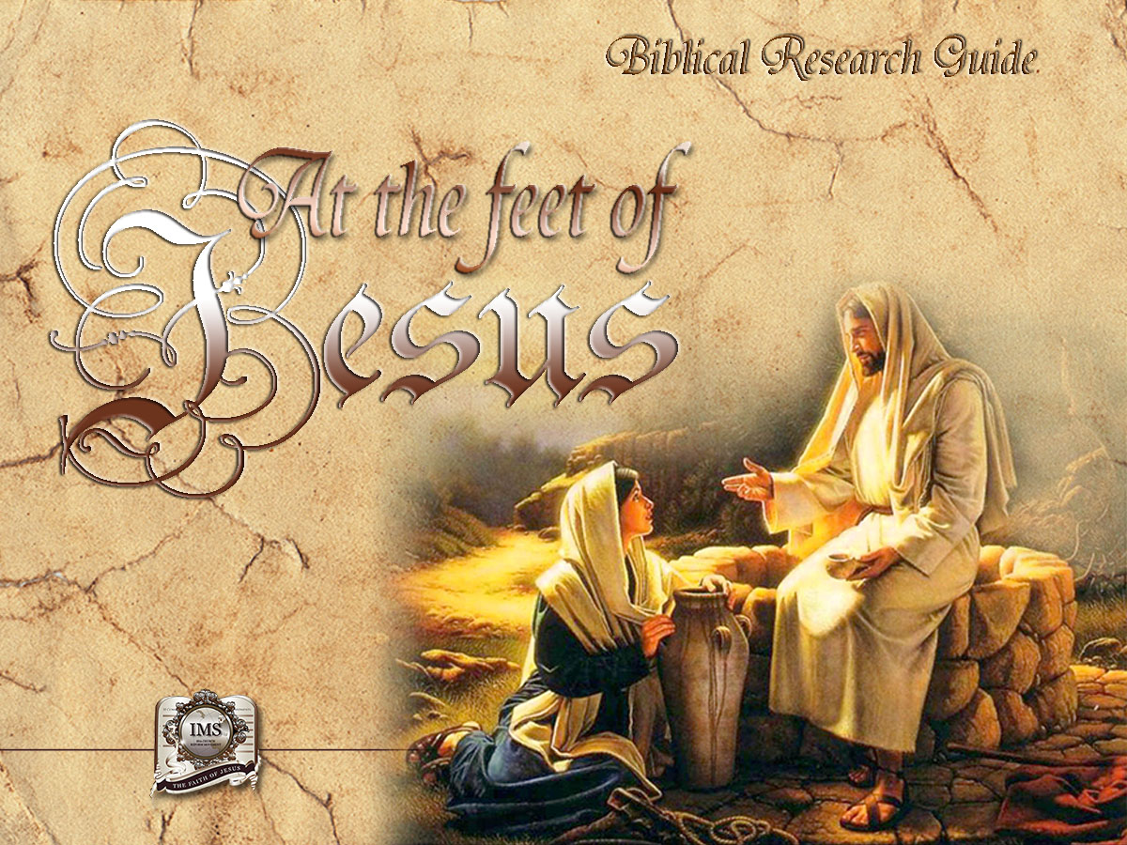

General Conference
Multimedia Department
Notes:
BIBLICAL RESEARCH GUIDE: “AT THE FEET OF JESUS”

Slide 2
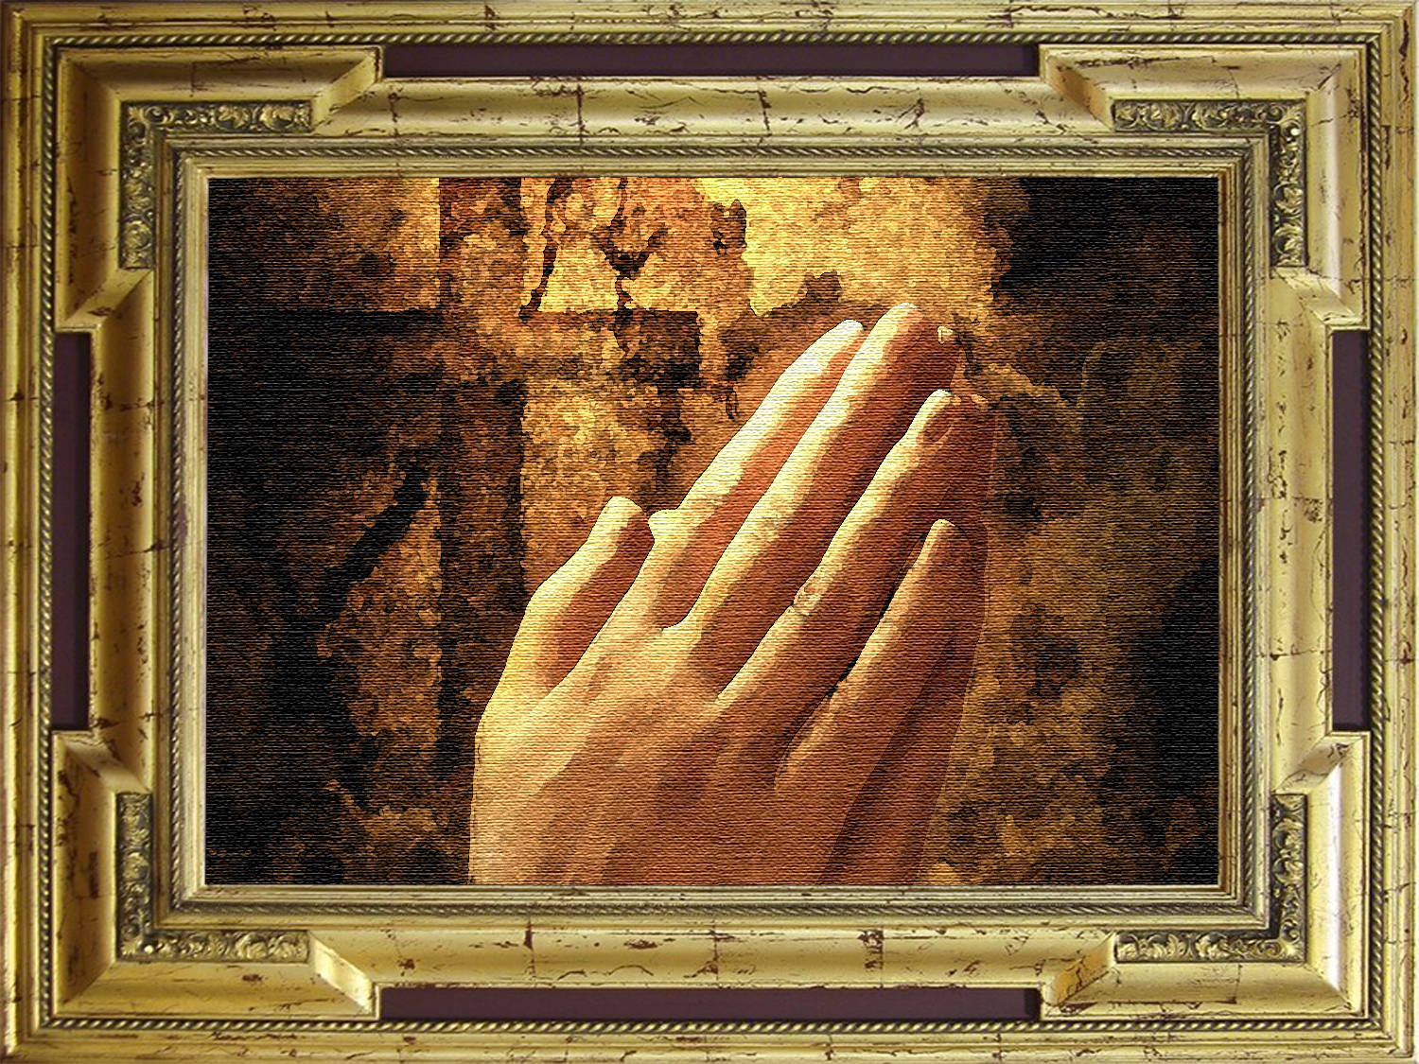
A moment of prayer
Notes:
A MOMENT OF PRAYER

Slide 3


14
THE WORST FALSIFICATION IN HISTORY
Notes:
Lesson 14
THE WORST FALSIFICATION IN HISTORY

Slide 4
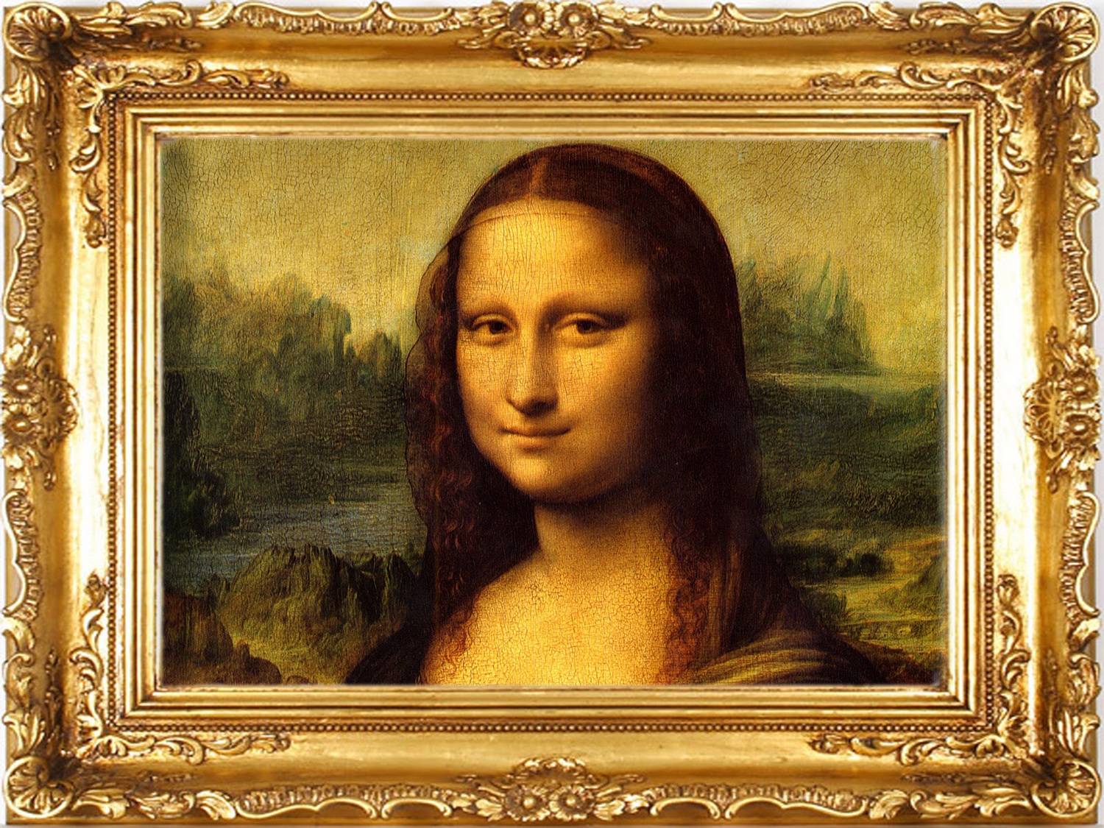
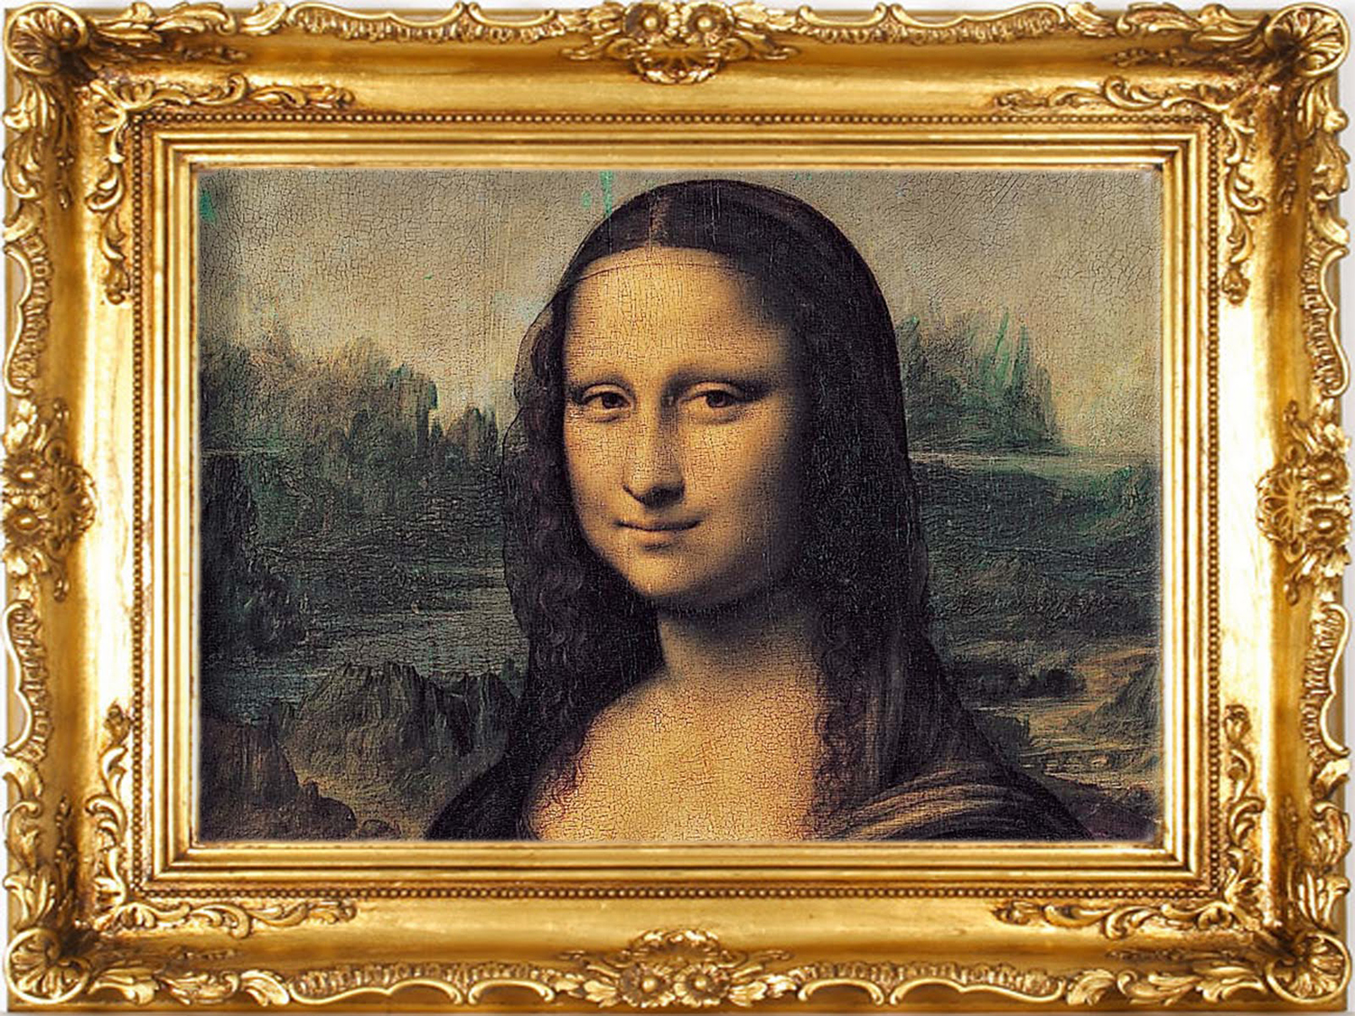
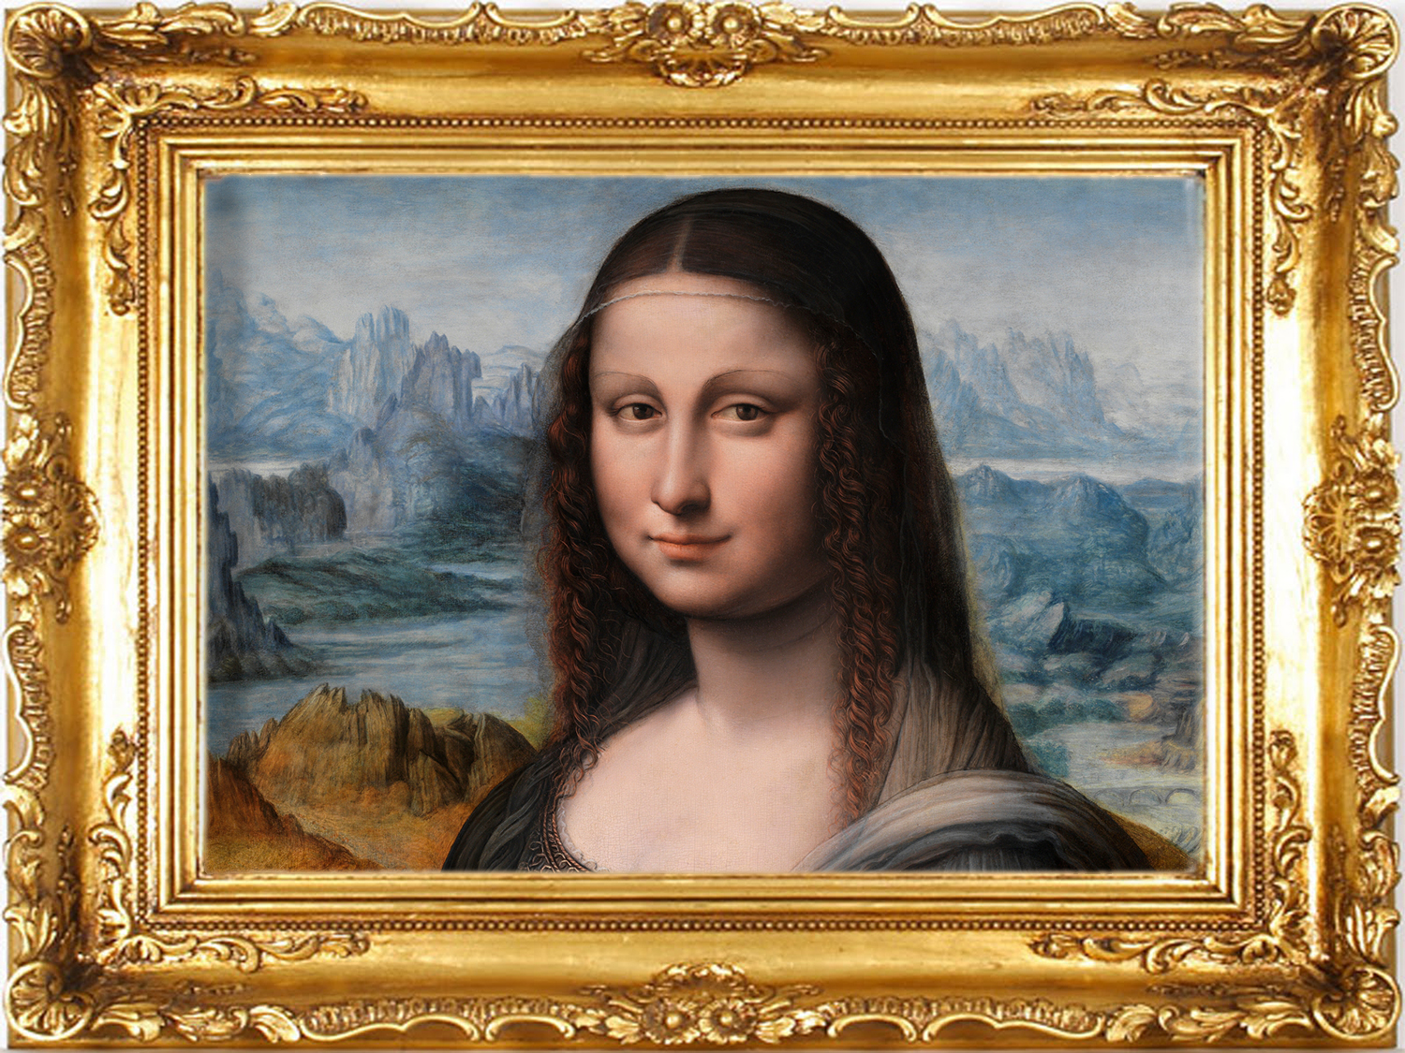

Notes:
We know that falsification abounds in every aspect of society. We find it in works of art, products, historical and scientific information, in economics and also in literature. Unfortunately, there is falsification also in religion. The most serious delusion is that pagan rites of sun worship have been subtly introduced into Christian churches to the point of substituting sun worship for one of Gods commandments. This is the most terrible falsification of all ages.

Slide 5
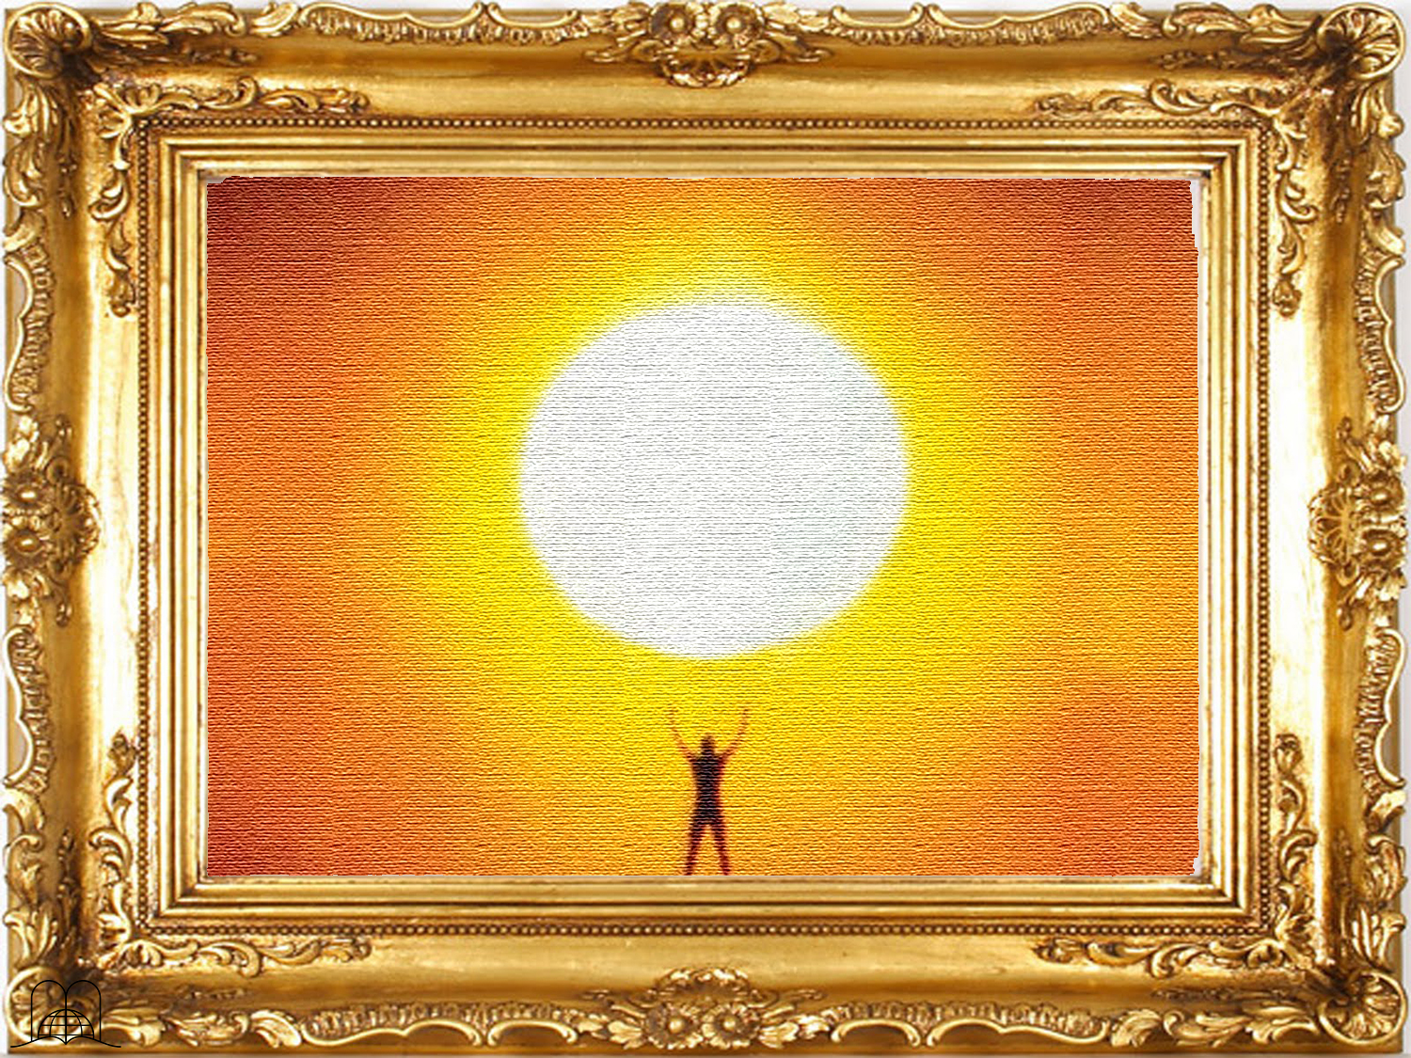
Worshipping the sun
Notes:
Falsification abounds in every aspect of society. We find it in science, the economics of art, literature, and more. Unfortunately, there are also falsifications in religious matters. The worst falsification of all ages is that of pagan rites of sun worship that have been subtly introduced in Christianity, to the point of substituting sun worship for one of the Ten Commandments.
The cult of the sun goes back to antiquity. The gods Mithra, Dawn, Marduk, Baal, Ra, Osiris and Samas represented the sun. Sun worship is the oldest. Mithras, Aurora, Marduk, Baal, Ra, Osiris and Shamash were gods that represented the sun.
Not long ago the mummy of a 25-year-old man was found at the top of Toro Mountain in the Andes Range near San Juan, Argentina.
Archaeological research reveals that the lncas sacrificed their most handsome young men to the sun, leaving their bodies to be preserved by the snow on the high peaks of the mountains next to a stone circle that was built at a location as close to the sun as possible.

Slide 6
DISGUISED
SUN
WORSHIP
Notes:
DISGUISED SUN WORSHIP

Slide 7
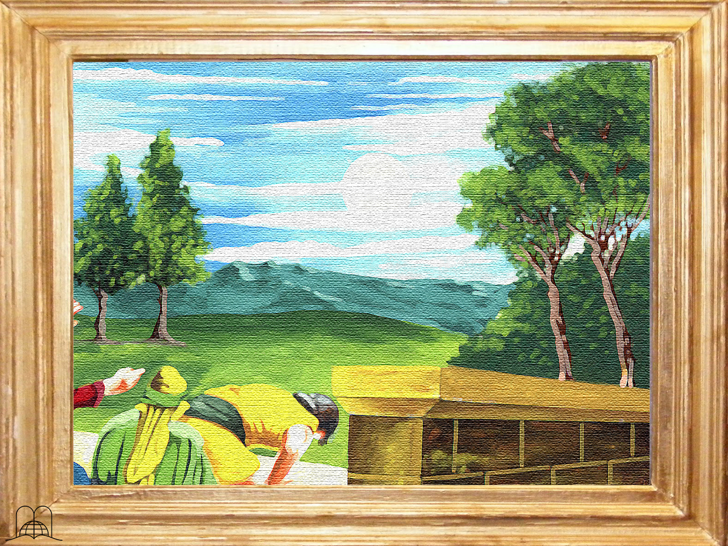
What abomination did the prophet Ezekiel see in vision?
Notes:
1. What abomination did the prophet Ezekiel see in vision?

Slide 8
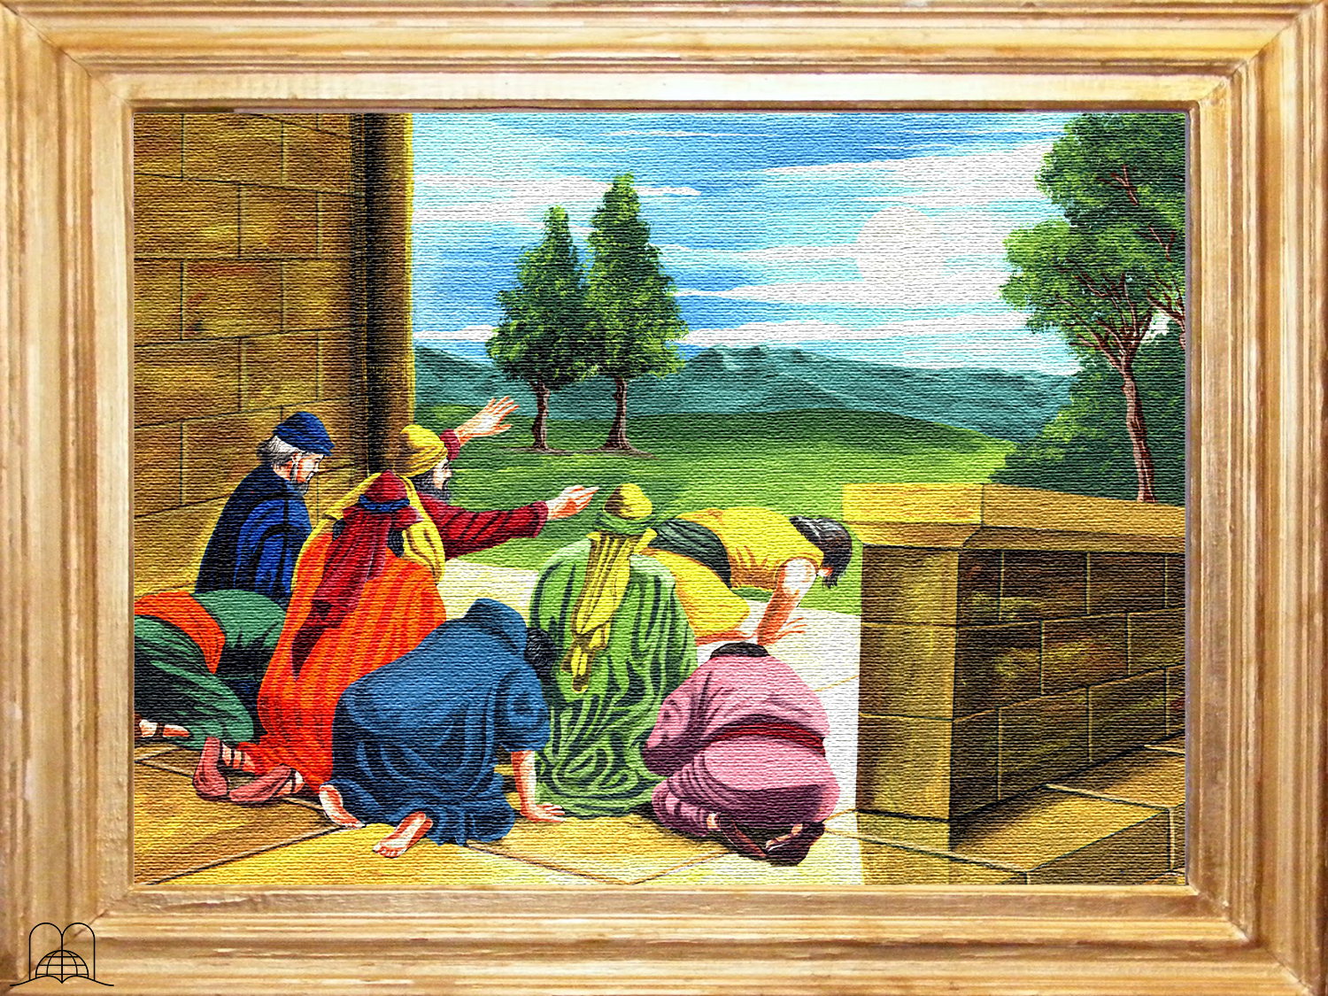

Ezekiel 8:15-18
"And he brought me into the inner court of the Lord's house, and, behold, at the door of the temple of the Lord, between the porch and the altar, were about five and twenty men, with their backs toward the temple of the Lord, and their faces toward the east; and they worshipped the sun toward the east.
Pues también yo procederé con furor; no perdonará mi ojo, ni tendré misericordia; y gritarán a mis oídos con gran voz, y no los oiré."
Y me dijo: ¿No has visto, hijo de hombre? ¿Es cosa liviana para la casa de Judá hacer las abominaciones que hacen aquí? Después que han llenado de maldad la tierra, se volvieron a mí para irritarme; he aquí que aplican el ramo a sus narices.
Notes:
Ezequiel 8:15-18
" Then said he unto me, Hast thou seen this, O son of man? turn thee yet again, and thou shalt see greater abominations than these.
And he brought me into the inner court of the Lord's house, and, behold, at the door of the temple of the Lord, between the porch and the altar, were about five and twenty men, with their backs toward the temple of the Lord, and their faces toward the east; and they worshipped the sun toward the east.

Slide 9
Ezekiel 8:15-18
Then he said unto me, Hast thou seen this, O son of man? Is it a light thing to the house of Judah that they commit the abominations which they commit here? for they have filled the land with violence, and have returned to provoke me to anger: and, lo, they put the branch to their nose.
"Y me llevó al atrio de adentro de la casa de Jehová; y he aquí junto a la entrada del templo de Jehová, entre la entrada y el altar, como veinticinco varones, sus espaldas vueltas al templo de Jehová y sus rostros hacia el oriente, y adoraban al sol, postrándose hacia el oriente.
Pues también yo procederé con furor; no perdonará mi ojo, ni tendré misericordia; y gritarán a mis oídos con gran voz, y no los oiré."
Notes:
Ezekiel 8:15-18
Then he said unto me, Hast thou seen this, O son of man? Is it a light thing to the house of Judah that they commit the abominations which they commit here? for they have filled the land with violence, and have returned to provoke me to anger: and, lo, they put the branch to their nose.

Slide 10
Ezekiel 8:15-18
"Y me llevó al atrio de adentro de la casa de Jehová; y he aquí junto a la entrada del templo de Jehová, entre la entrada y el altar, como veinticinco varones, sus espaldas vueltas al templo de Jehová y sus rostros hacia el oriente, y adoraban al sol, postrándose hacia el oriente.
Therefore will I also deal in fury: mine eye shall not spare, neither will I have pity: and though they cry in mine ears with a loud voice, yet will I not hear them.”
Y me dijo: ¿No has visto, hijo de hombre? ¿Es cosa liviana para la casa de Judá hacer las abominaciones que hacen aquí? Después que han llenado de maldad la tierra, se volvieron a mí para irritarme; he aquí que aplican el ramo a sus narices.
Notes:
Ezekiel 8:15-18
Therefore will I also deal in fury: mine eye shall not spare, neither will I have pity: and though they cry in mine ears with a loud voice, yet will I not hear them.”
God pronounced a very severe sentence against sun worshipers (Ezekiel 6:4-6).

Slide 11
Who tried to introduce pagan rites into Christianity?
Notes:
2. Who tried to introduce pagan customs into Christianity?

Slide 12
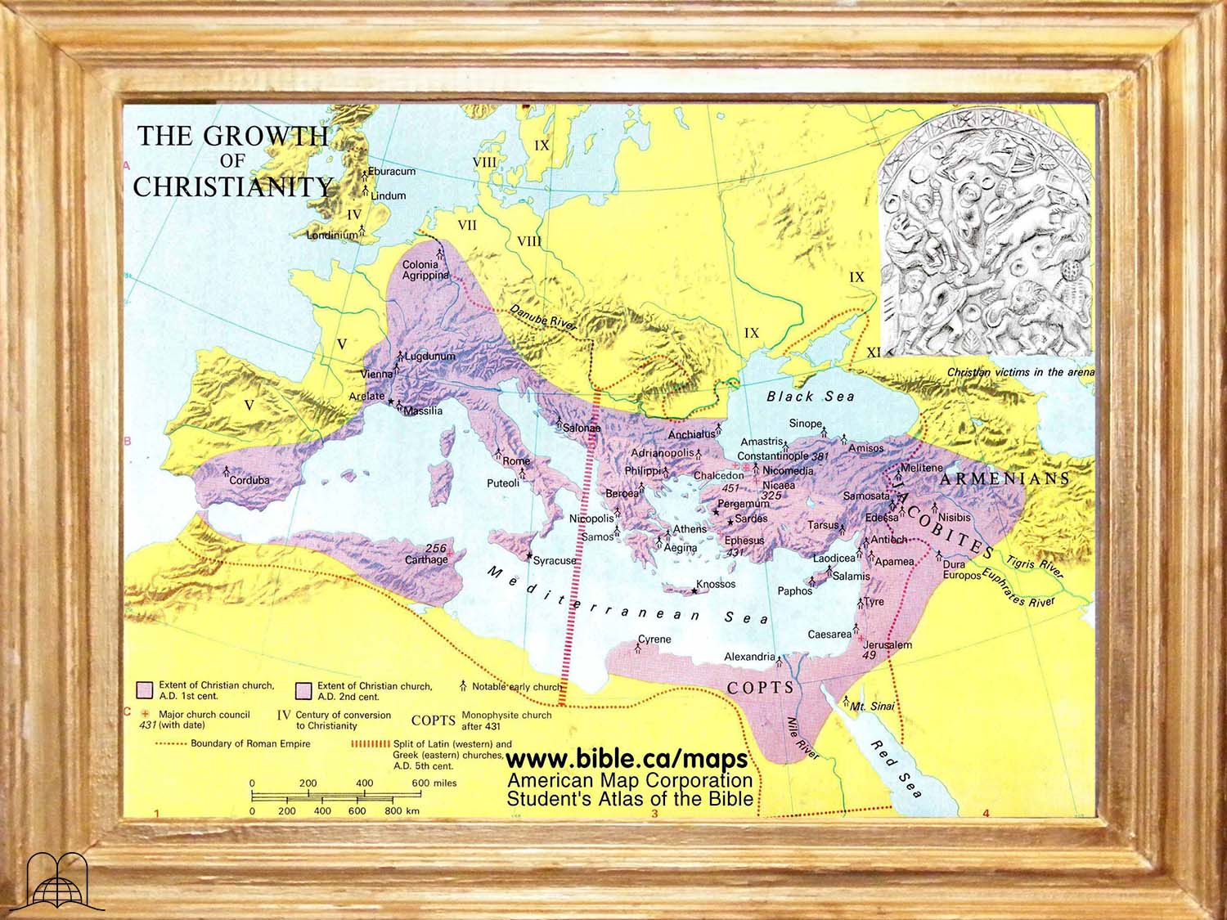
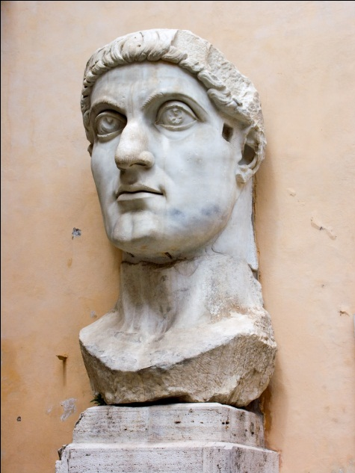
Growth of Christianity
Constantine
Edict of Tolerance · Milan · 313 A.D.
Notes:
Emperor Constantine (280-337 A.D.) noticed that Rome’s political power was weakening due to the differences existing between pagan worshipers and Christians. He then attempted to bring these two large ideological groups together. In 313 A.D., he published the Edict of Milan, in which he granted religious tolerance and complete freedom to Christians. As a result, they showed great admiration for the Emperor. Pagans worshiped many gods, Mithras being one of the main sun gods.

Slide 13
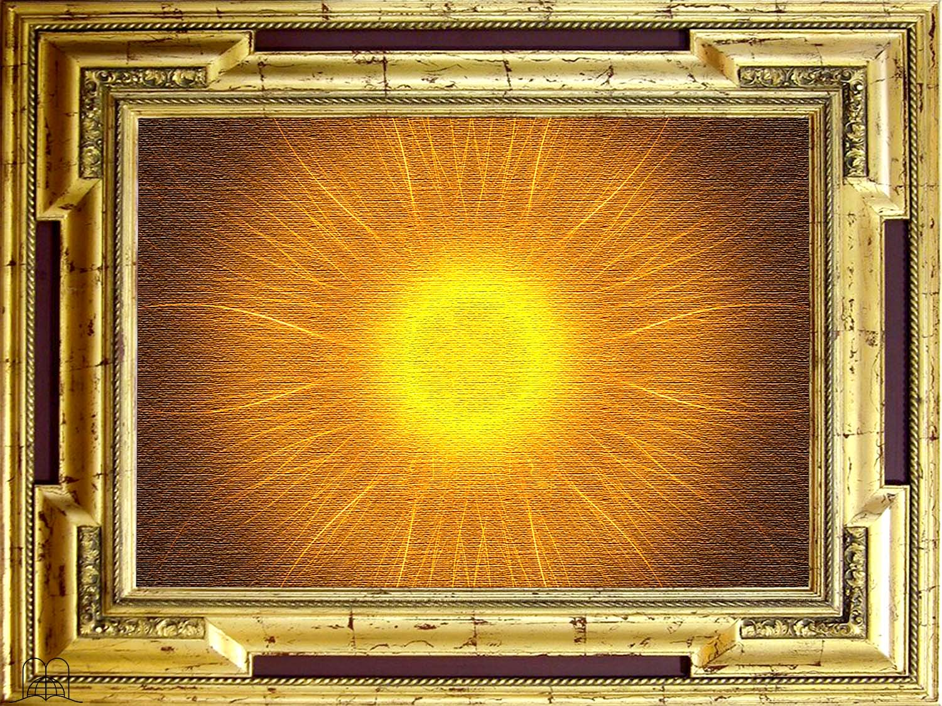
Sunday = Sonntag
Sun day
Notes:
Mithras was worshiped on Sunday. Even today, the first day of the week in English is Sunday and in German is Sonntag; both mean day of the sun when translated.
To fulfill his political agenda, Constantine himself became a Christian and established Sunday, the day of the sun, as a day of rest, in place of the Sabbath kept by faithful Christians, thus maintaining a link with sun worshipers.
Many became “Christians” and introduced a great number of pagan customs into Christianity

Slide 14
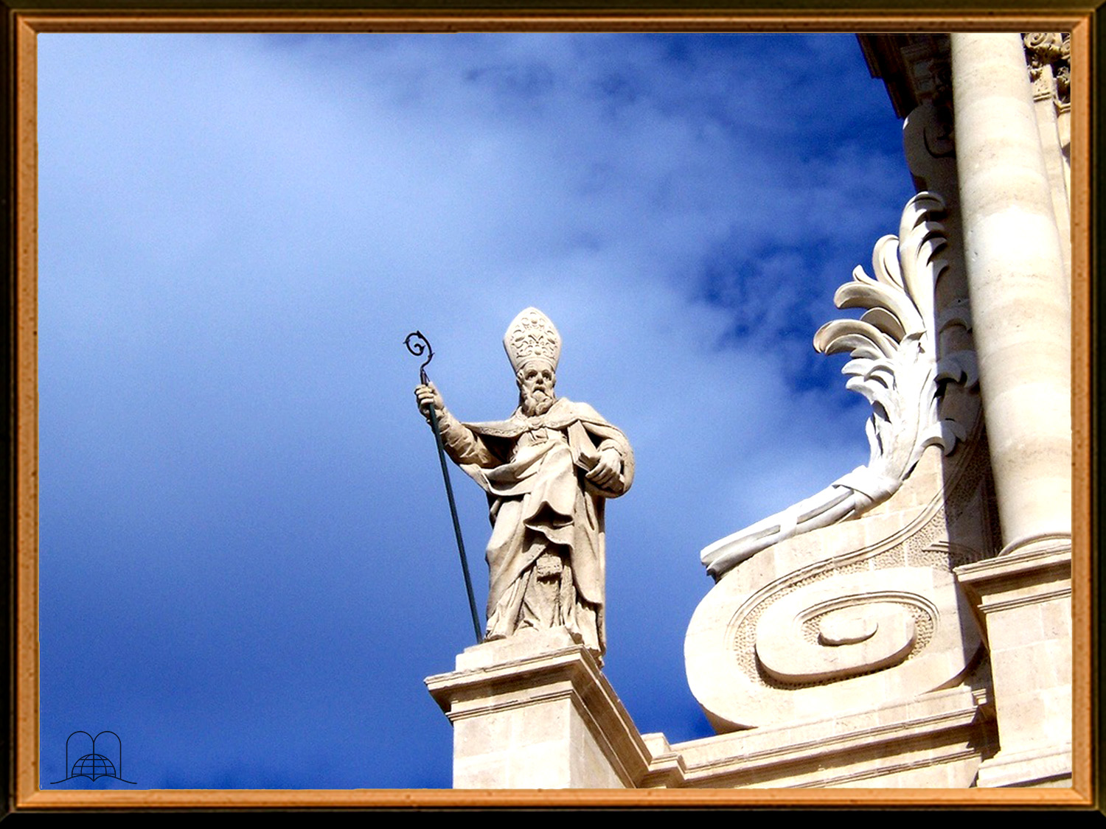
From Paganism to Christianity
Temples dedicated to special saints
Ornaments
Incense, lamps, candles
Votive offerings
Holy water
Seasonal festivities
The use of the calendar, processions
The blessing of the fields
Priestly garments
The wedding ring
The custom of facing the east
Later icons
Notes:
Cardinal John Henry Newman in his book “Development of Christian Doctrine”, p. 373, declares: “Eusebius tells us that Constantine, when recommending the new religion to the heathen, transferred to it the external ornaments to which the heathen were accustomed in their own cult: the use of temples which were dedicated to special saints, ornaments made occasionally out of branches of tree, incense, lamps, candles, votive offerings for the healing of the sick, holy water, seasonal festivities, the use of the calendar, processions, the blessing of the fields, priestly garments, the wedding ring, the custom of facing the east, and later icons, maybe ecclesiastical chanting and the “Kyrie Eleison”, all these customs having their origin in paganism and being sanctified when adopted by the church.”
The Encyclopedia Britannica (9th version), in the article “Sunday” states: “The earliest recognition of the observance of Sunday as a legal duty is a constitution of Constantine in 321 A.D. (March 7) enacting that all courts of justice, inhabitants of towns, and workshops were to be at rest on Sunday (venerably die soils) with an exception in favor of those engaged in agricultural labor.”

Slide 15
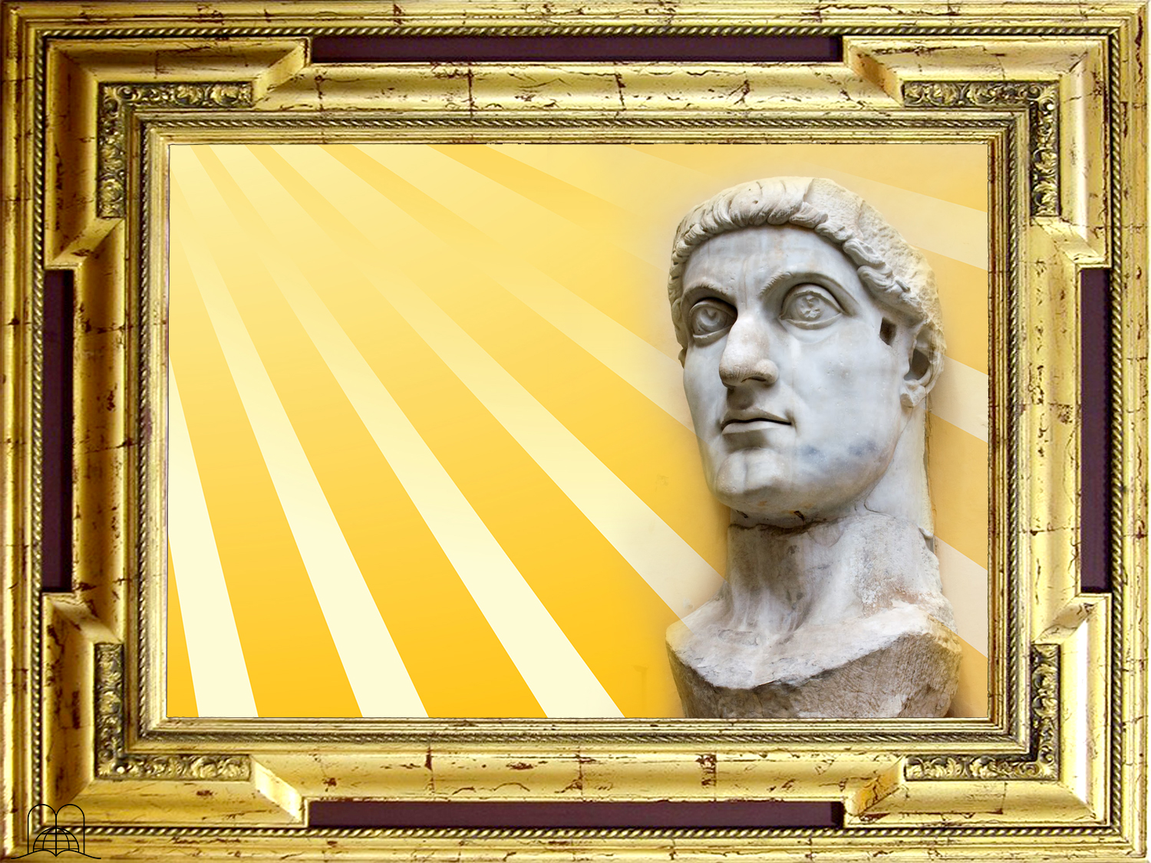
Constantine was just an emperor,
so how was the observance
of Sunday introduced into the church?
Notes:
3- Constantine was just an emperor, so how was the observance of Sunday introduced into the church?

Slide 16

"The Convert's Catechism of Catholic Doctrine"
Question: What is the day of rest?
Answer: Saturday is the day of rest.
Question: Why do we observe Sunday instead of Saturday?
Answer: We observe Sunday instead of Saturday because the Catholic Church, in the Synod of Laodicea (336 A.D.), transferred the solemnity from Saturday to Sunday.
Notes:
The change of the rest day was accepted by the Church of Rome. A catechism that received the apostolic blessing of Pope Pius X (on January 25, l910) clarifies this:
Question: What is the day of rest?
Answer: Saturday is the day of rest.
Question: Why do we observe Sunday instead of Saturday?
Answer: We observe Sunday instead of Saturday because the Catholic Church, in the Synod of Laodicea (336 A.D.), transferred the solemnity from Saturday to Sunday. Peter Geiermann, The Convert’s Catechism of Catholic Doctrine, 1946 ed., p. 50.

Slide 17
DOES GOD ALLOW HIS LAW TO BE CHANGED?
Notes:
DOES GOD ALLOW HIS LAW TO BE CHANGED?

Slide 18
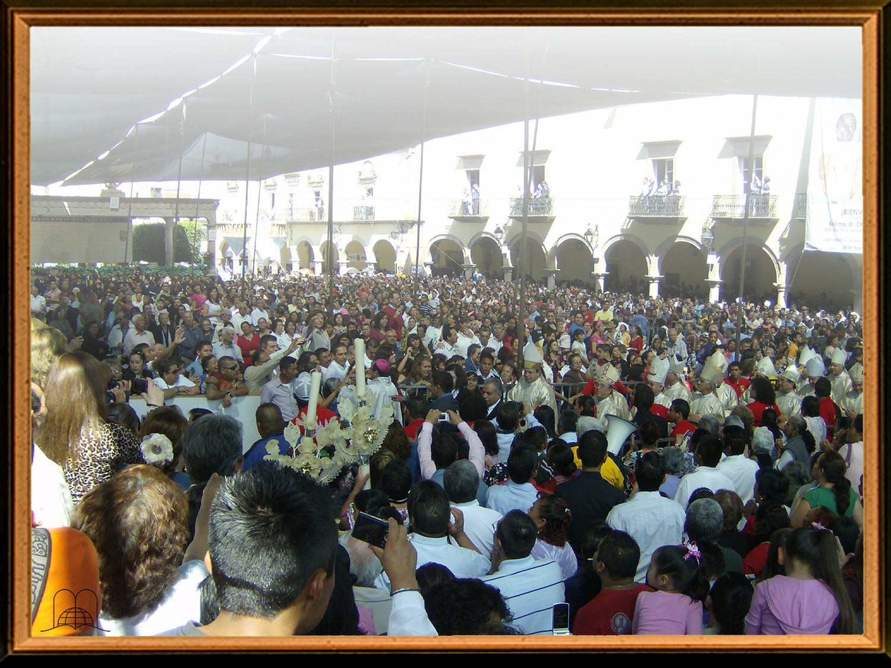
What will happen to anyone who attempts to change God's law?
Notes:
4- What will happen to anyone who attempts to change God's law?

Slide 19
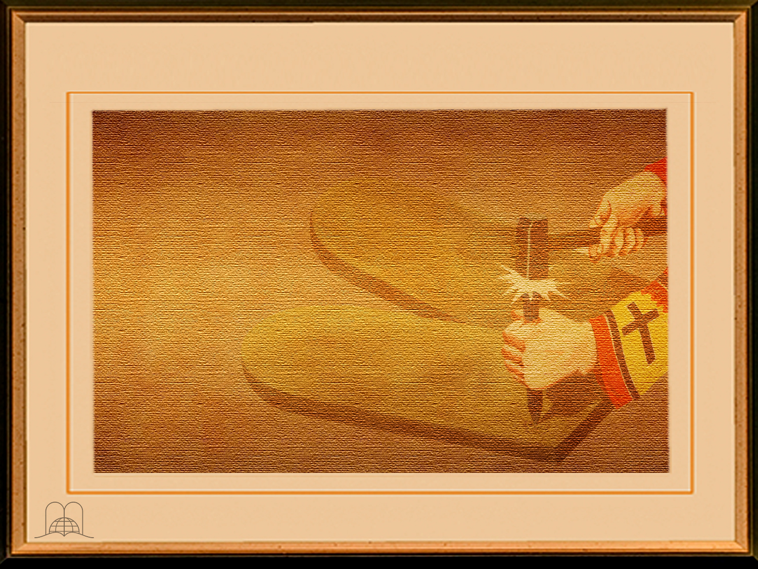
Revelation 22:19
"And if any man shall take away from the words of the book of this prophecy, God shall take away his part out of the book of life, and out of the holy city, and from the things which are written in this book."
Notes:
Revelation 22:19
“And if any man shall take away from the words of the book of this prophecy, God shall take away his part out of the book of life, and out of the holy city, and from the things which are written in this book.”

Slide 20
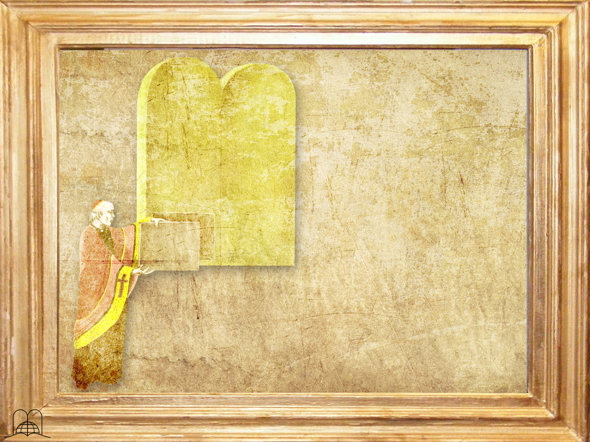
What is not
permitted
to be done
with God’s Holy law?
Notes:
5- What is not permitted to be done with God’s Holy law?

Slide 21
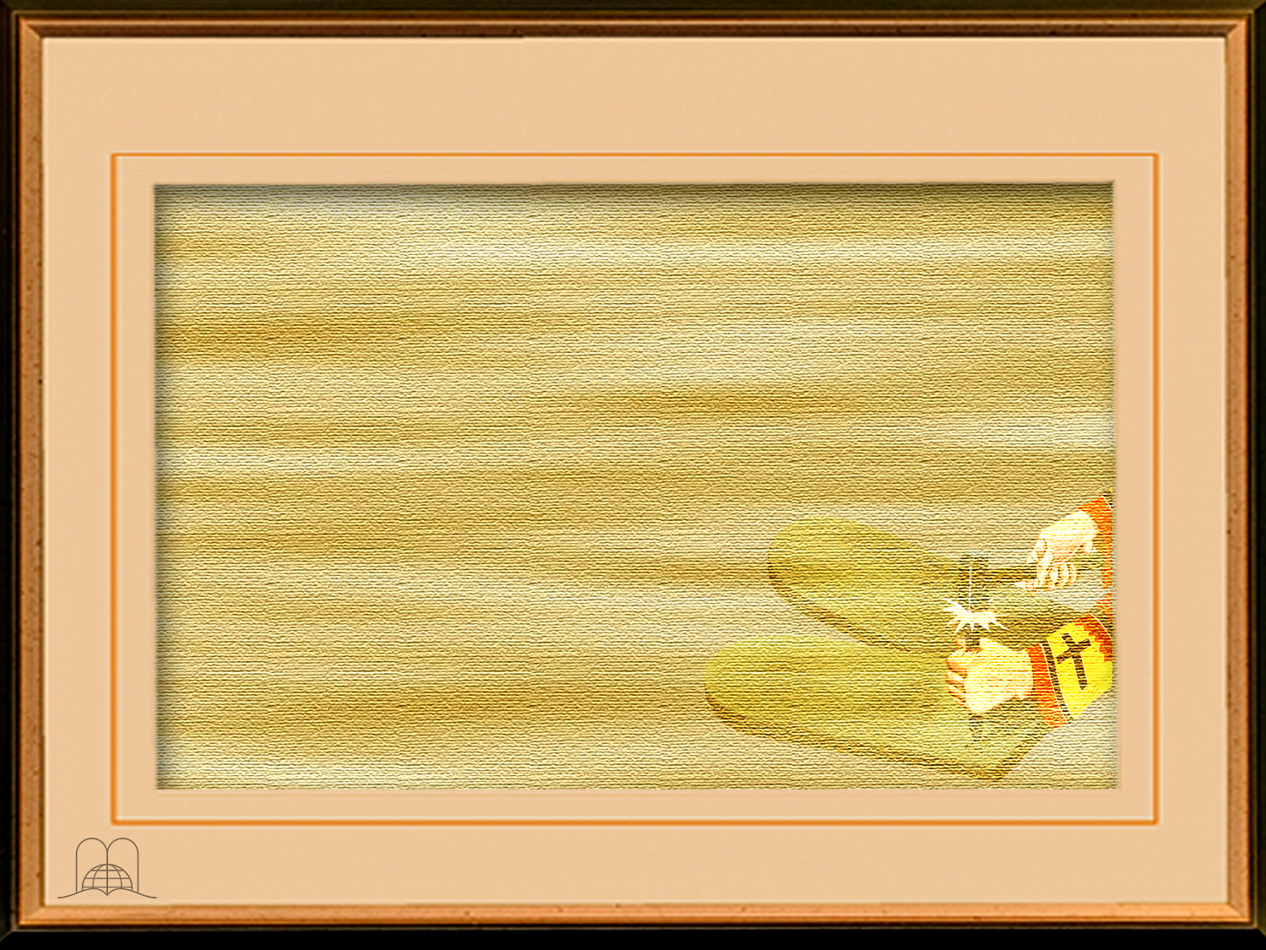
Ecclesiastes 3:14
"I know that, whatsoever God doeth, it shall be for ever: nothing can be put to it, nor any thing taken from it: and God doeth it, that men should fear before him."
Notes:
Ecclesiastes 3:14
"I know that, whatsoever God doeth, it shall be for ever: nothing can be put to it, nor any thing taken from it: and God doeth it, that men should fear before him.”

Slide 22

God himself cannot change his own law. Malachi 3:6 . (James 1:17).
God‘s law is valid for a thousand generations, (Deuteronomy 7:9).
The fact that the Ten Commandments were written by God‘s own finger on two tables of stone (Exodus 31:18), reveals its importance and its immutability.
The commandment that tells us to keep the Sabbath as a day of rest is the fourth commandment of that Holy Law. (Exodus 20:8-11).
Notes:
a) God himself cannot change his own law. Malachi 3:6 (James 1:17).
b) God‘s law is valid for a thousand generations. (Deuteronomy 7:9).
c) The fact that the Ten Commandments were written by God‘s own finger on two tables of stone (Exodus 20:8-11) reveals its importance and its immutability.
d) The commandment that tells us to keep the Sabbath as a day of rest is the fourth commandment of that Holy Law. (Exodus 20:8-11).

Slide 23
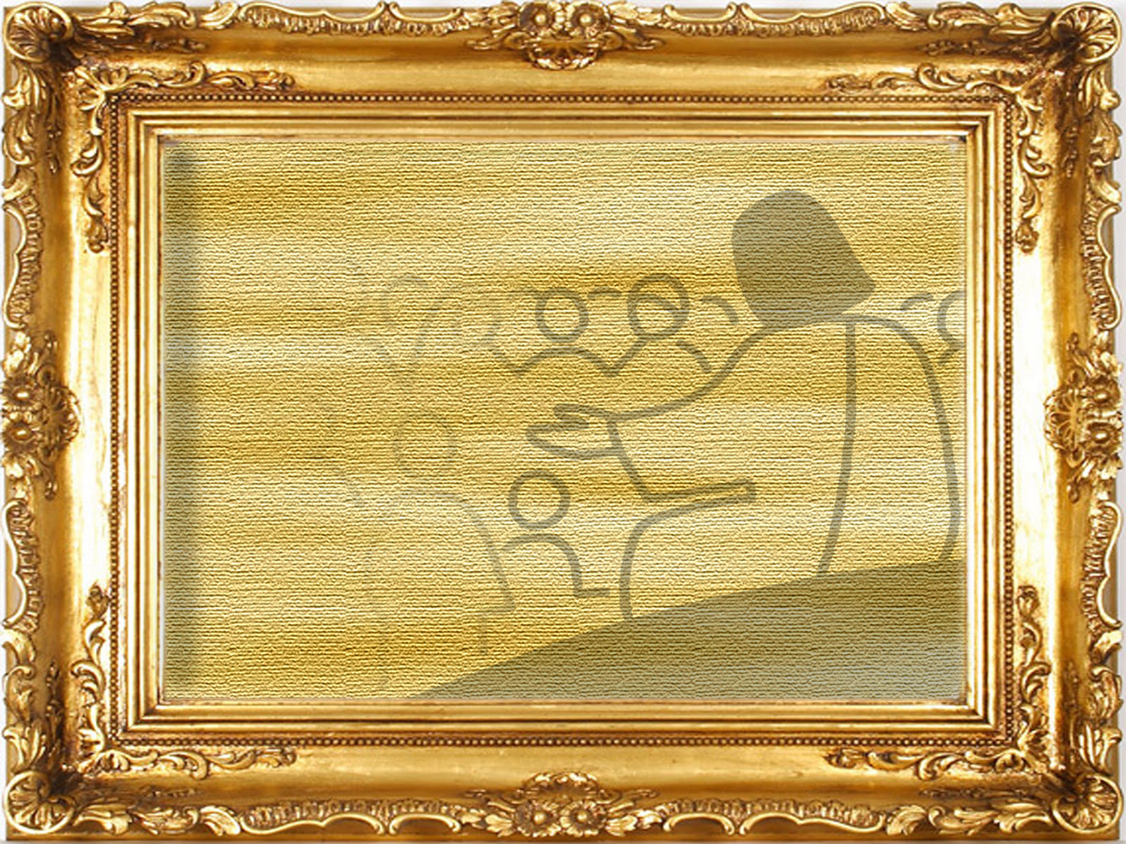
Did Jesus change the law of God or the rest day?
Notes:
6- Did Jesus change the law of God or day of rest?

Slide 24
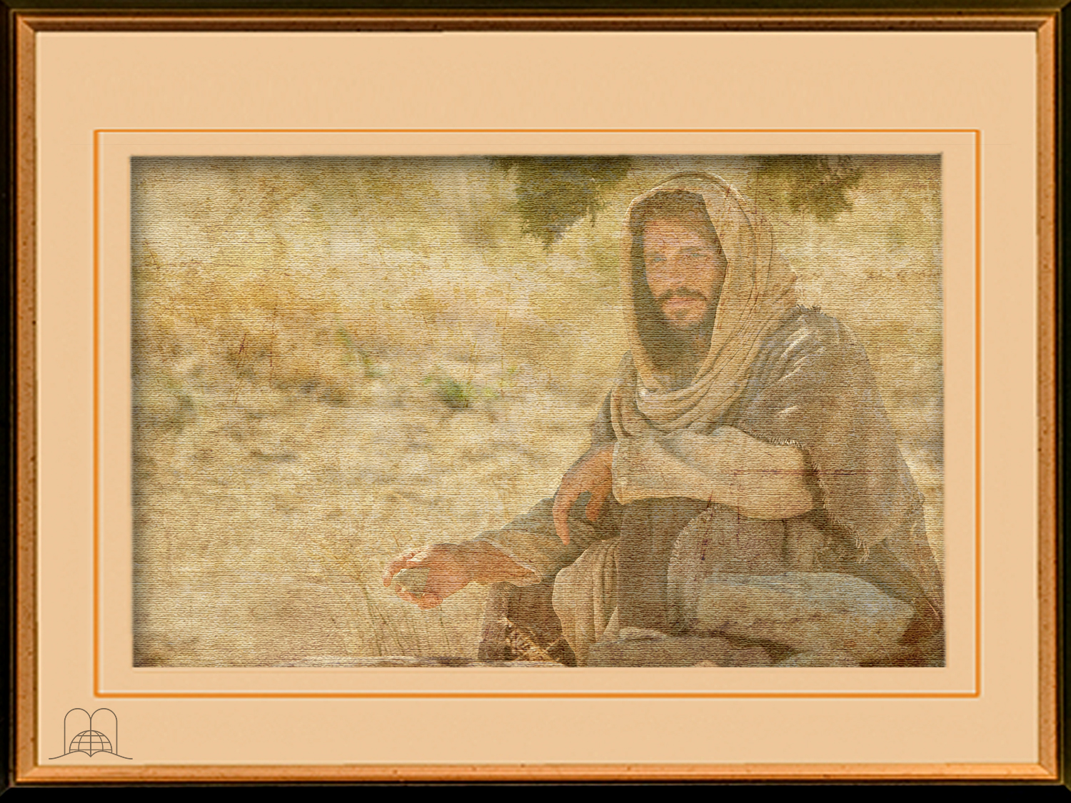
Matthew 5:17-18
"Think not that I am come to destroy the law, or the prophets: I am not come to destroy, but to fulfil.
For verily I say unto you, Till heaven and earth pass, one jot or one tittle shall in no wise pass from the law, till all be fulfilled.”
Notes:
Matthew 5:17-18
"Think not that I am come to destroy the law, or the prophets: I am not come to destroy, but to fulfil.
For verily I say unto you, Till heaven and earth pass, one jot or one tittle shall in no wise pass from the law, till all be fulfilled.”

Slide 25
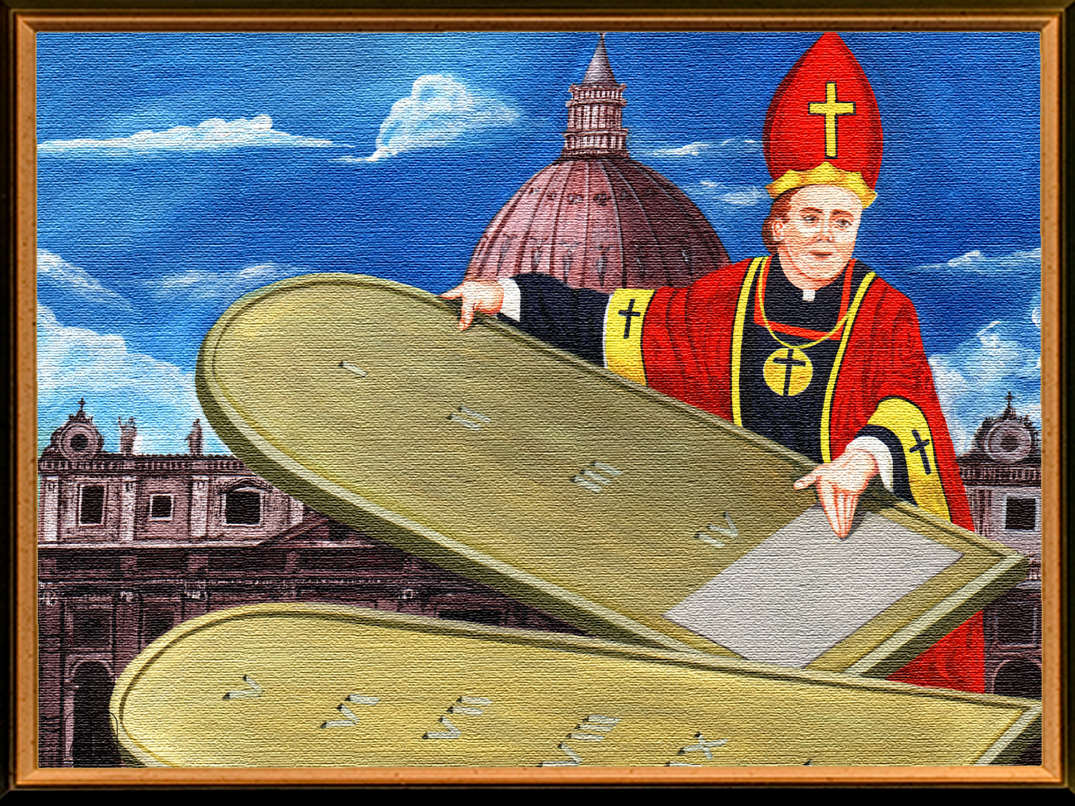
According
to Daniel's prophecies,
what would a human power try to do with the law of God?
Notes:
7- According to Daniel's prophecies, what would a human power try to do with the law of God?

Slide 26
Daniel 7:25
"And he shall speak great words against the most High, and shall wear out the saints of the most High, and think to change times and laws: and they shall be given into his hand until a time and times and the dividing of time.”
Notes:
Daniel 7:25
"And he shall speak great words against the most High, and shall wear out the saints of the most High, and think to change times and laws: and they shall be given into his hand until a time and times and the dividing of time.”

Slide 27

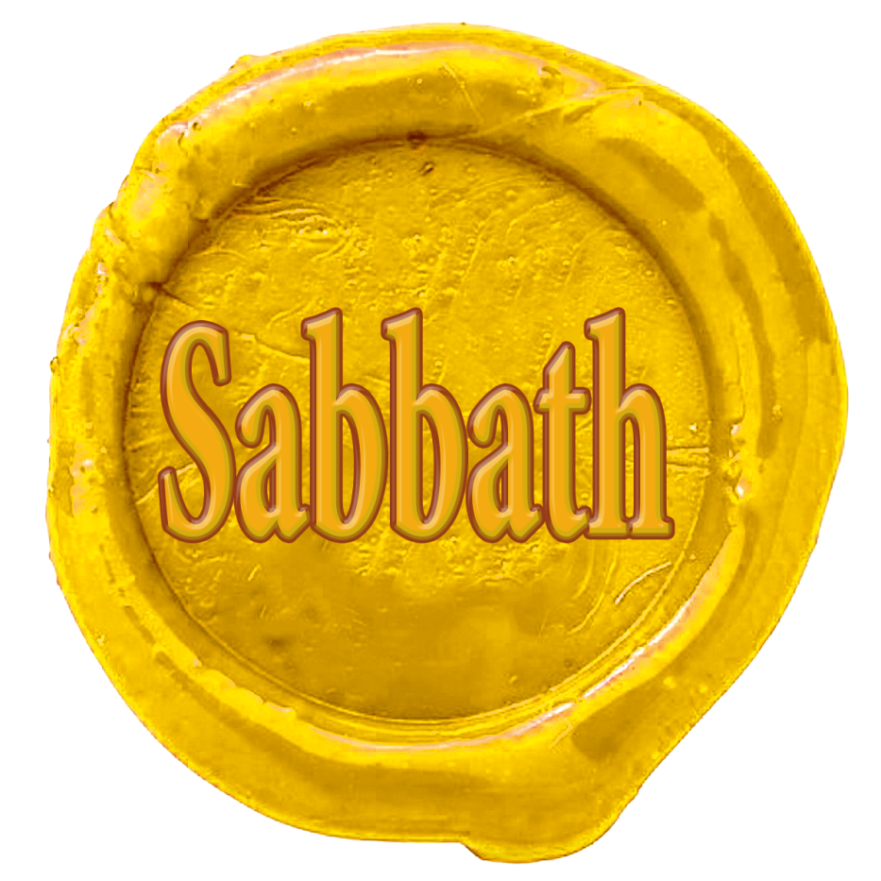

Seal of
Divine authority
Seal of
Human authority
Notes:
The church believes it has that authority to do so. A catholic priest, Stephen Keenan, wrote: "Had she (the church) not such power, she could not have done that in which all modem religionists agree with her; she could not have substituted the observance of Sunday - the first day of the week, for the observance of Saturday - the seventh day, a change for which there is no Scriptural authority." A Doctrinal Catechism, p. 74.

Slide 28

THE TEN COMMANDMENTS
According to the Bible: Exodus 20:3-17
1. Thou shalt have no other gods before me.
2. Thou shalt not make unto thee any graven image, or any likeness of any thing that is in heaven above, or that is in the earth beneath, or that is in the water under the earth. Thou shalt not bow down thyself to them, nor serve them: for I the LORD thy God am a jealous God, visiting the iniquity of the fathers upon the children unto the third and fourth generation of them that hate me; And shewing mercy unto thousands of them that love me, and keep my commandments.
3. Thou shalt not take the name of the LORD thy God in vain; for the LORDwill not hold him guiltless that taketh his name in vain.
4. Remember the sabbath day, to keep it holy. Six days shalt thou labour, and do all thy work: But the seventh day is the sabbath of the LORD thy God: in it thou shalt not do any work, thou, nor thy son, nor thy daughter, thy manservant, nor thy maidservant, nor thy cattle, nor thy stranger that is within thy gates: For in six days the LORD made heaven and earth, the sea, and all that in them is, and rested the seventh day: wherefore the LORD blessed the sabbath day, and hallowed it.
According to the catechism
1. am the LORD your God: you shall not have strange Gods before me.
2. You shall not take the name of the LORD your God in vain
3. Remember to keep holy the LORD'S Day.!
4. Honor your father and your mother.
Notes:
THE TEN COMMANDMENTS
According to the Bible: Exodus 20:3-17
Thou shalt have no other gods before me.
Thou shalt not make unto thee any graven image, or any likeness of any thing that is in heaven above, or that is in the earth beneath, or that is in the water under the earth. Thou shalt not bow down thyself to them, nor serve them: for I the Lord thy God am a jealous God, visiting the iniquity of the fathers upon the children unto the third and fourth generation of them that hate me; And shewing mercy unto thousands of them that love me, and keep my commandments.
Thou shalt not take the name of the Lord thy God in vain; for the Lordwill not hold him guiltless that taketh his name in vain.
Remember the sabbath day, to keep it holy. Six days shalt thou labour, and do all thy work: But the seventh day is the sabbath of the Lord thy God: in it thou shalt not do any work, thou, nor thy son, nor thy daughter, thy manservant, nor thy maidservant, nor thy cattle, nor thy stranger that is within thy gates: For in six days the Lord made heaven and earth, the sea, and all that in them is, and rested the seventh day: wherefore the Lord blessed the sabbath day, and hallowed it.
Honour thy father and thy mother: that thy days may be long upon the land which the Lord thy God giveth thee.
Thou shalt not kill.
Thou shalt not commit adultery.
Thou shalt not steal.
Thou shalt not bear false witness against thy neighbour.
Thou shalt not covet thy neighbour's house, thou shalt not covet thy neighbour's wife, nor his manservant, nor his maidservant, nor his ox, nor his ass, nor any thing that is thy neighbour's.
According to the catechism
I am the LORD your God: you shall not have strange Gods before me.
You shall not take the name of the LORD your God in vain.
Remember to keep holy the LORD'S Day.!
Honor your father and your mother.
You shall not kill.
You shall not commit adultery.
You shall not steal.
You shall not bear false witness against your neighbor.
You shall not covet your neighbor's wife.
You shall not covet your neighbor's goods.

Slide 29
THE TEN COMMANDMENTS
According to the Bible: Exodus 20:3-17
5. Honour thy father and thy mother: that thy days may be long upon the land which the LORD thy God giveth thee.
6. Thou shalt not kill.
7. Thou shalt not commit adultery.
8. Thou shalt not steal.
9. Thou shalt not bear false witness against thy neighbour.
10. Thou shalt not covet thy neighbour's house, thou shalt not covet thy neighbour's wife, nor his manservant, nor his maidservant, nor his ox, nor his ass, nor any thing that is thy neighbour's.
According to the catechism
5. You shall not kill.
You shall not commit adultery.
7. You shall not steal.
8. You shall not bear false witness against your neighbor.
9. You shall not covet your neighbor's wife.
10. You shall not covet your neighbor's goods.

Slide 30
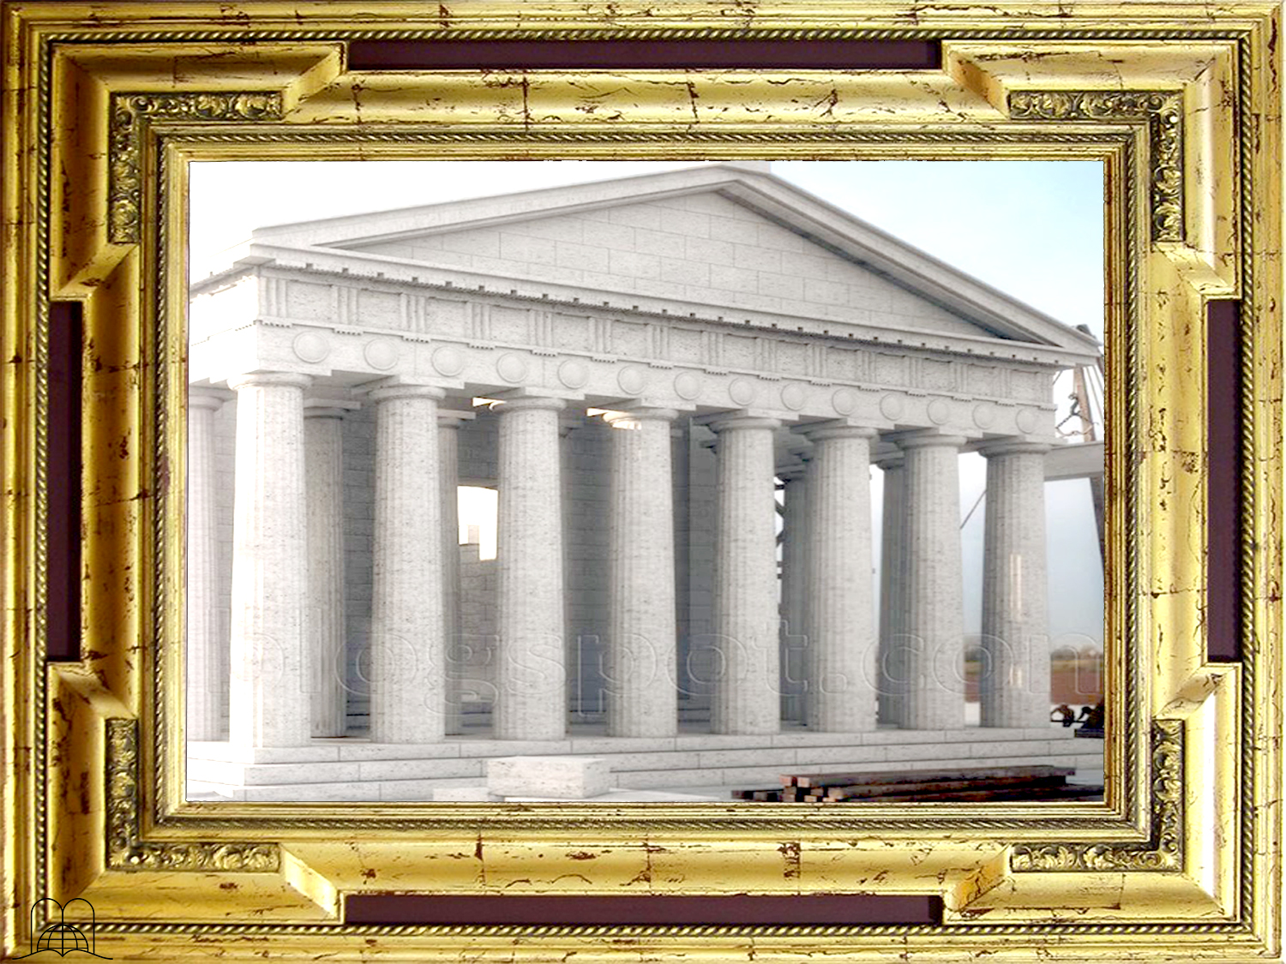
DO THE EIGHT BIBLE TEXTS THAT MENTION THE FIRST DAY OF THE WEEK
MENTION A CHANGE OF THE DAY OF REST ?
Notes:
DO THE EIGHT BIBLE TEXTS THAT MENTION THE FIRST DAY OF THE WEEK MENTION A CHANGE OF THE DAY OF REST?

Slide 31
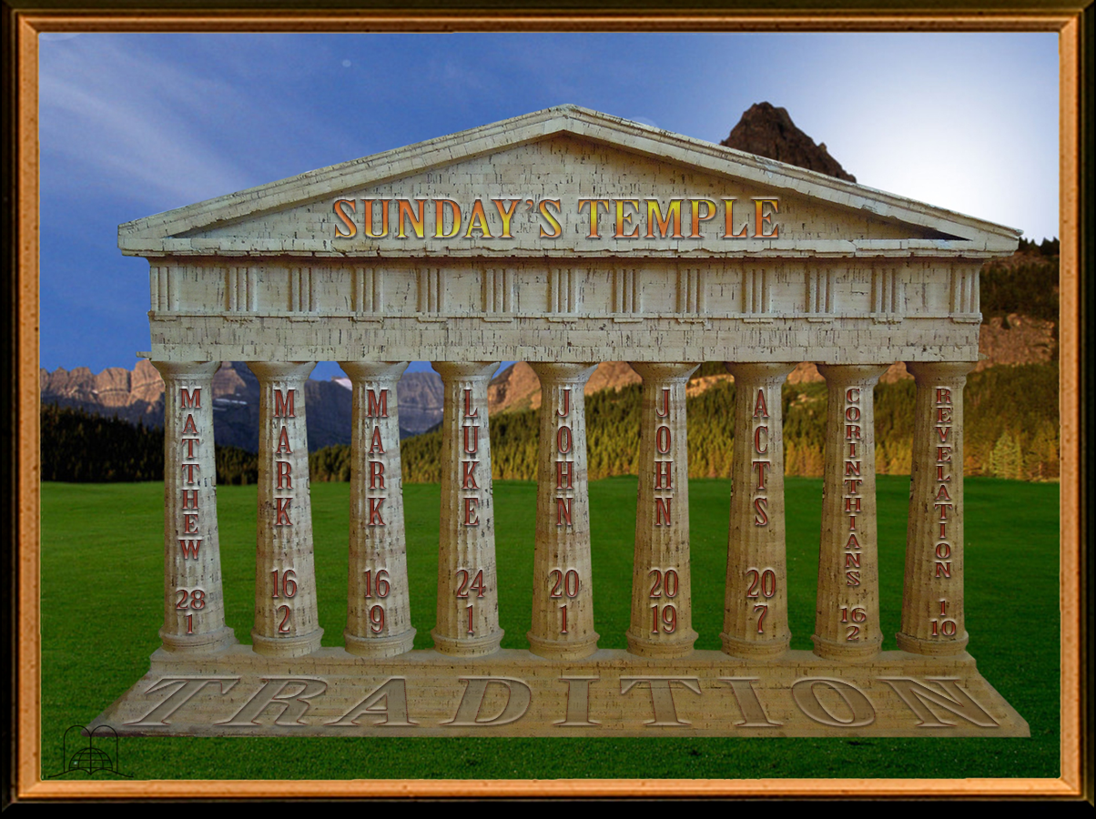
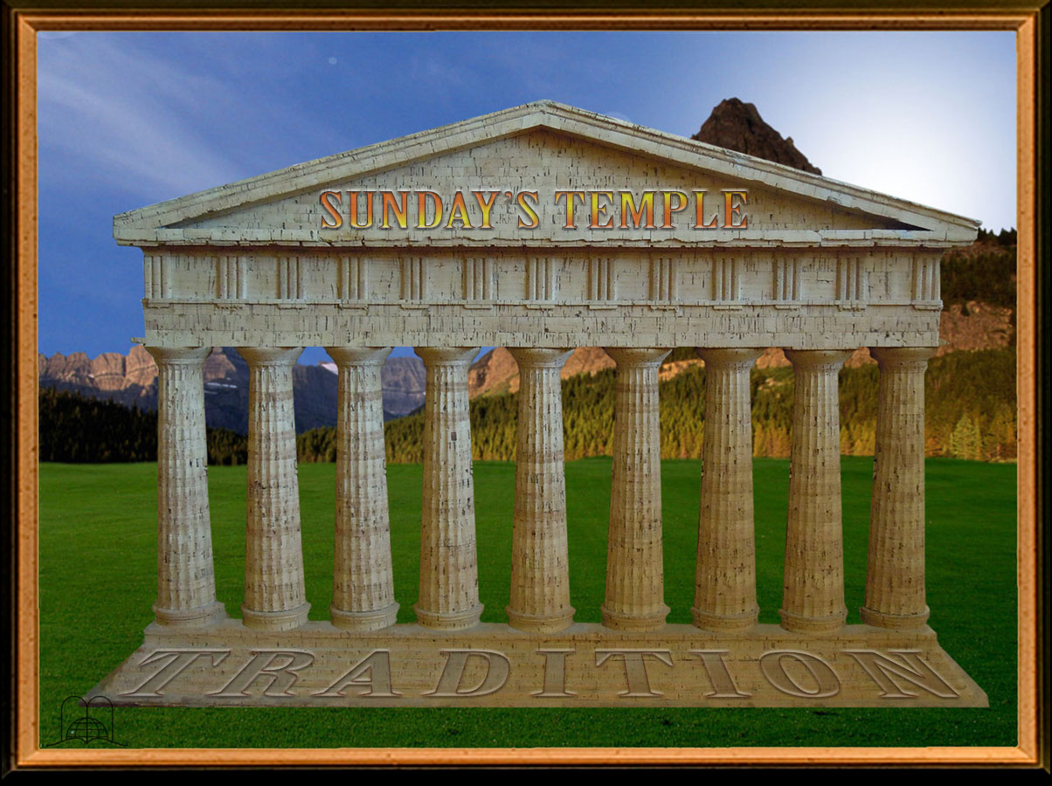
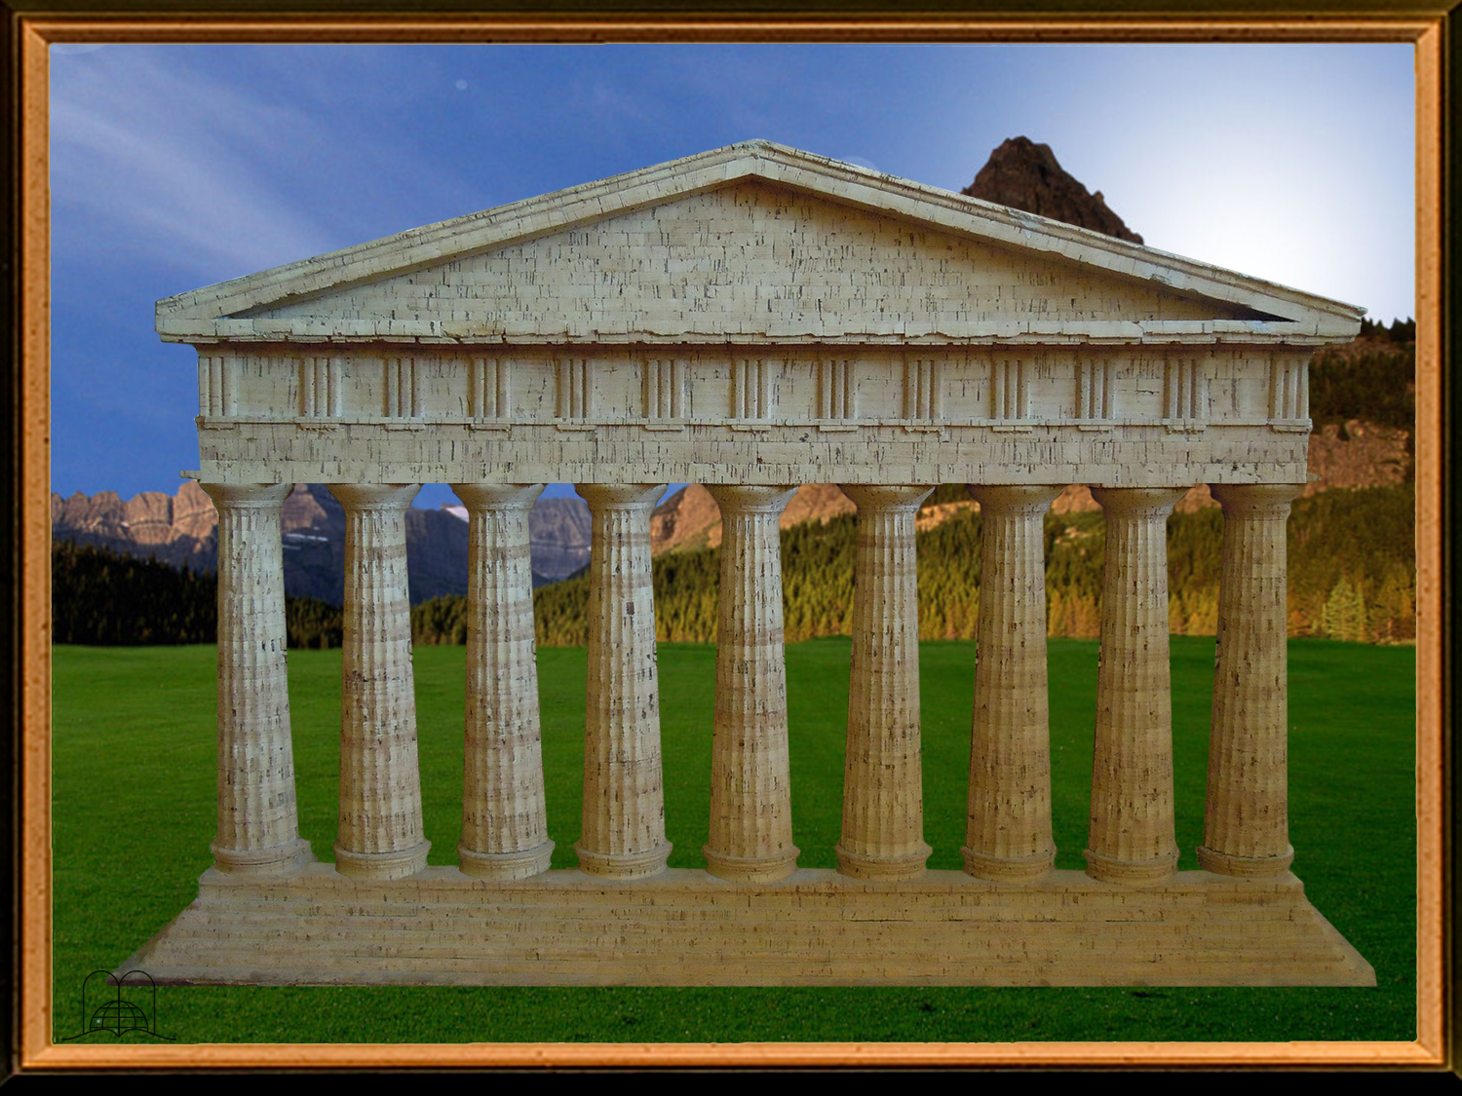
Notes:
TEMPLE OF SUNDAY
FOUNDED ON TRADITION

Slide 32
“In the end of the sabbath, as it began to dawn toward the first day of the week, came Mary Magdalene and the other Mary to see the sepulchre.”
Nothing says about a change
Notes:
Matthew 28: 1
"In the end of the sabbath, as it began to dawn toward the first day of the week, came Mary Magdalene and the other Mary to see the sepulchre.”
Nothing says about a change

Slide 33
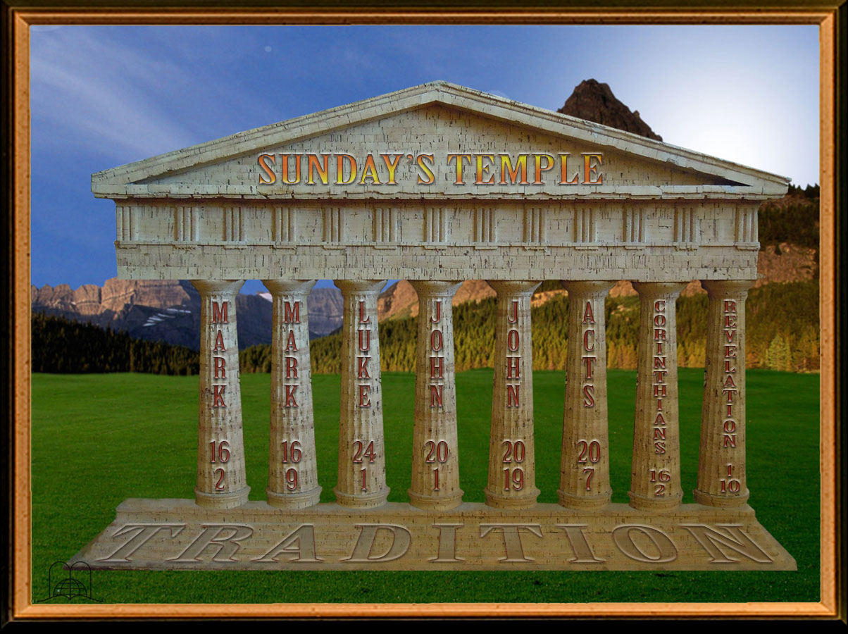
"And very early in the morning the first day of the week, they came unto the sepulchre at the rising of the sun."
Nothing says about a change
Notes:
Mark 16:2
"And very early in the morning the first day of the week, they came unto the sepulchre at the rising of the sun."
Nothing says about a change

Slide 34
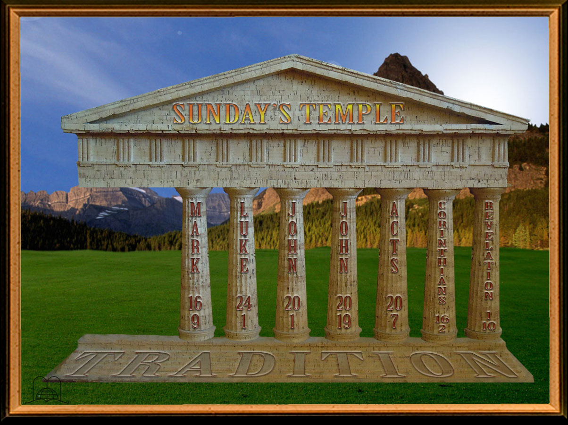
"Now when Jesus was risen early the first day of the week, he appeared first to Mary Magdalene, out of whom he had cast seven devils."
Nothing says about a change
Notes:
Mark 16:9
"Now when Jesus was risen early the first day of the week, he appeared first to Mary Magdalene, out of whom he had cast seven devils.”
Nothing says about a change

Slide 35
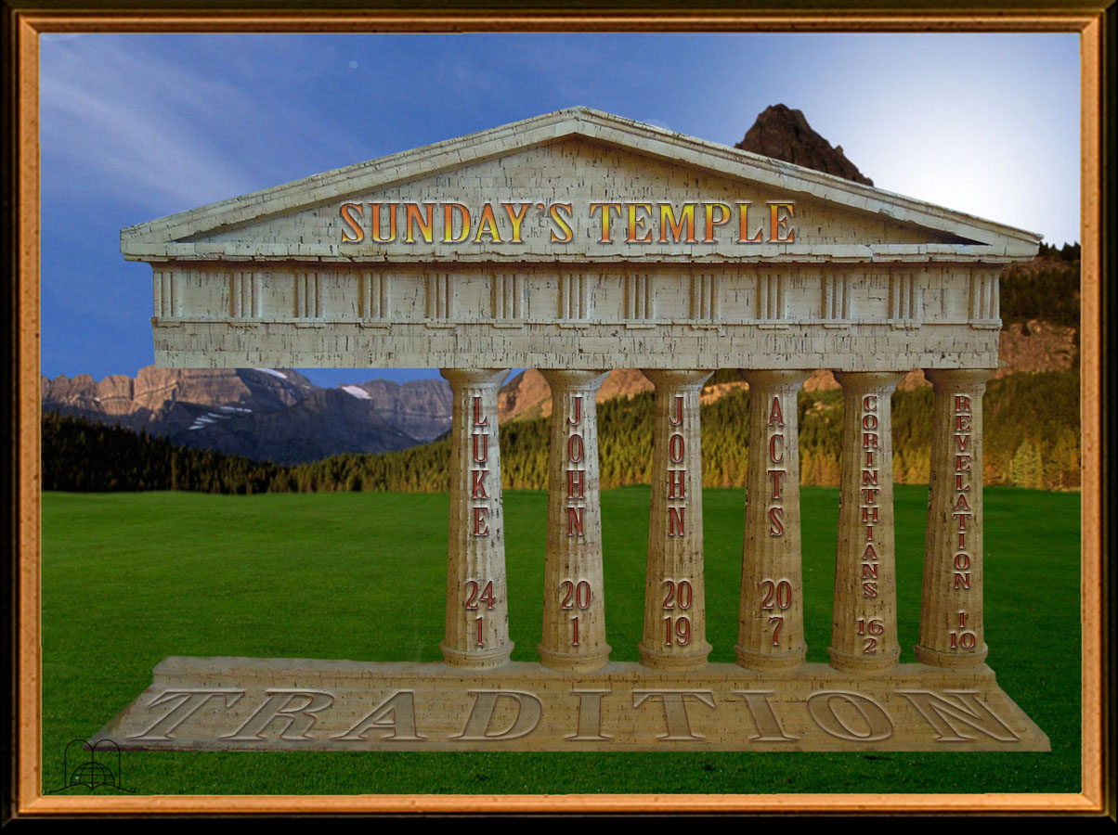
"Now upon the first day of the week, very early in the morning, they came unto the sepulchre, bringing the spices which they had prepared, and certain others with them."
Nothing says about a change
Notes:
Luke 24:1
"Now upon the first day of the week, very early in the morning, they came unto the sepulchre, bringing the spices which they had prepared, and certain others with them."
Nothing says about a change

Slide 36
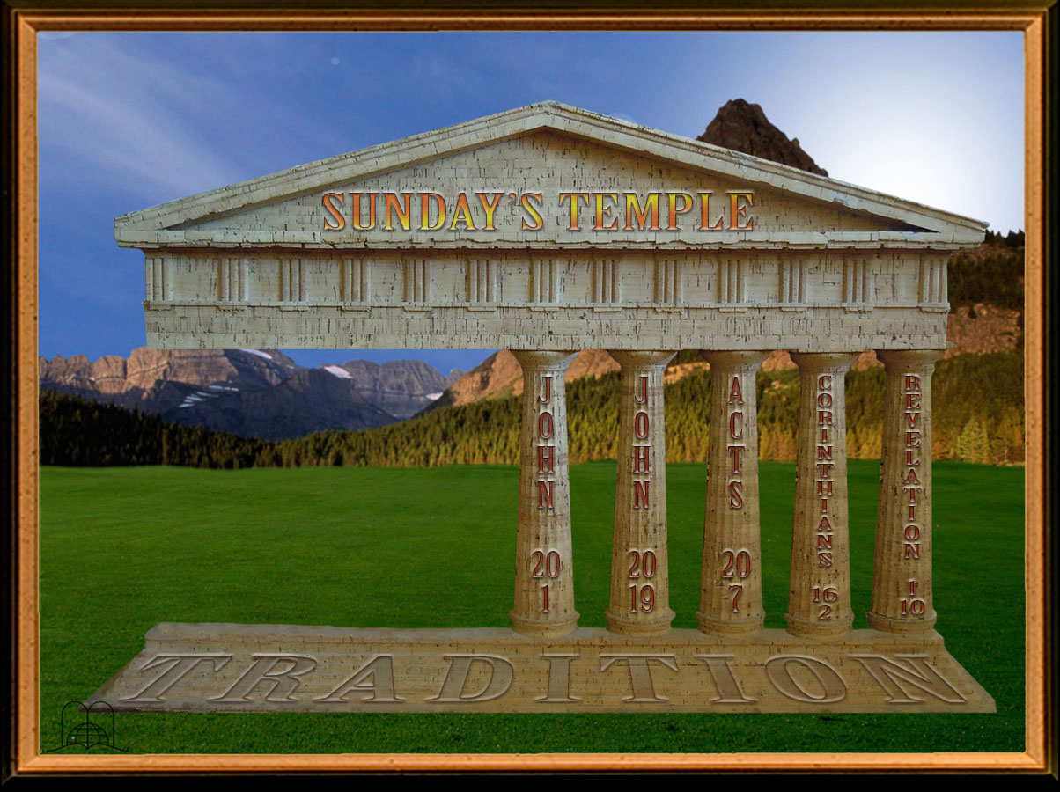
"The first day of the week cometh Mary Magdalene early, when it was yet dark, unto the sepulchre, and seeth the stone taken away from the sepulchre."
Nothing says about a change
Notes:
John 20:1
"The first day of the week cometh Mary Magdalene early, when it was yet dark, unto the sepulchre, and seeth the stone taken away from the sepulchre."
Nothing says about a change

Slide 37
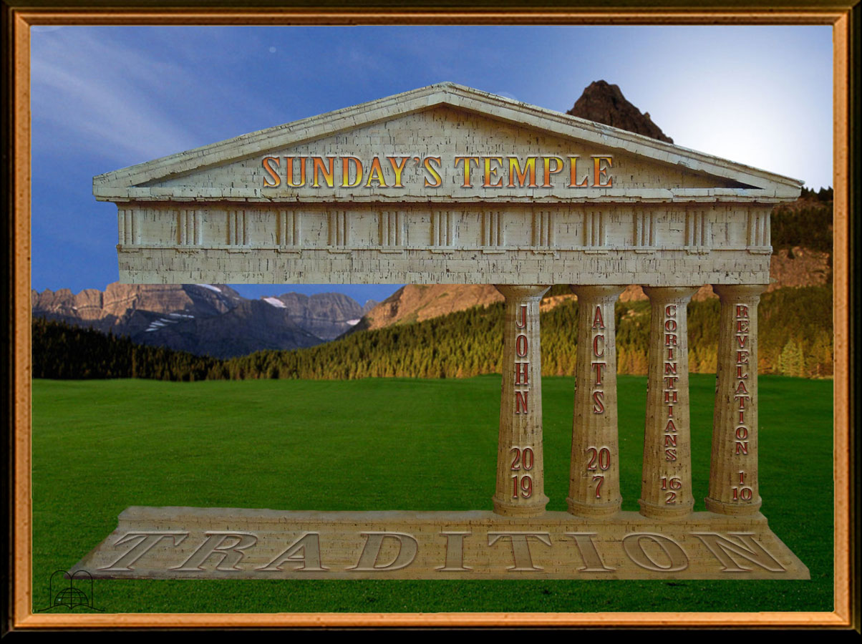
Why did the disciples gather on the first day of the week mention any change of the day of rest?
Notes:
9. Why did the disciples gather on the first day of the week mention any change of the day of rest?

Slide 38
"Then the same day at evening, being the first day of the week, when the doors were shut where the disciples were assembled for fear of the Jews, came Jesus and stood in the midst, and saith unto them, Peace be unto you."
Nothing says about a change
Notes:
John 20:19
"Then the same day at evening, being the first day of the week, when the doors were shut where the disciples were assembled for fear of the Jews, came Jesus and stood in the midst, and saith unto them, Peace be unto you.”
Because they were afraid of the Jews.
More evidence that they did not gather to keep Sunday in honor of the resurrection is that they did not even believe that Christ had risen. Mark 16:12-14.
Nothing says about a change

Slide 39
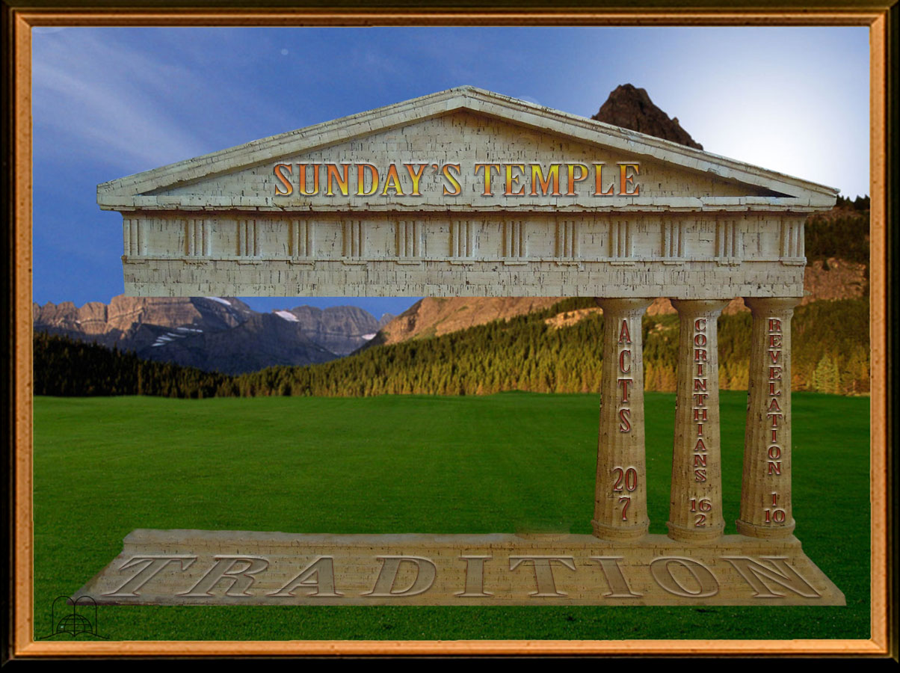
Why did Paul extend a service at Troas, on the night of the first day of the week? What did he do the next day at dawn?
Notes:
10. Why did Paul extend a service at Troas, on the night of the first day of the week? What did he do the next day at dawn?

Slide 40
"And upon the first day of the week, when the disciples came together to break bread, Paul preached unto them, ready to depart on the morrow; and continued his speech until midnight."
Nothing says about a change
Notes:
Acts 20:7
"And upon the first day of the week, when the disciples came together to break bread, Paul preached unto them, ready to depart on the morrow; and continued his speech until midnight.”
He had to leave on a trip.
In the Bible, a new day began at sunset, not midnight, and thus this was after the Sabbath. Many verses show that Paul worshiped on Sabbath; but on this particular occasion, since he had to leave at daybreak, he prolonged his speech until midnight.
b) If Paul kept Sunday, he would not have undertaken such a long trip on that day. A change of the day of rest is not mentioned
c) They broke bread every day. (Acts 2:46).
Nothing says about a change

Slide 41
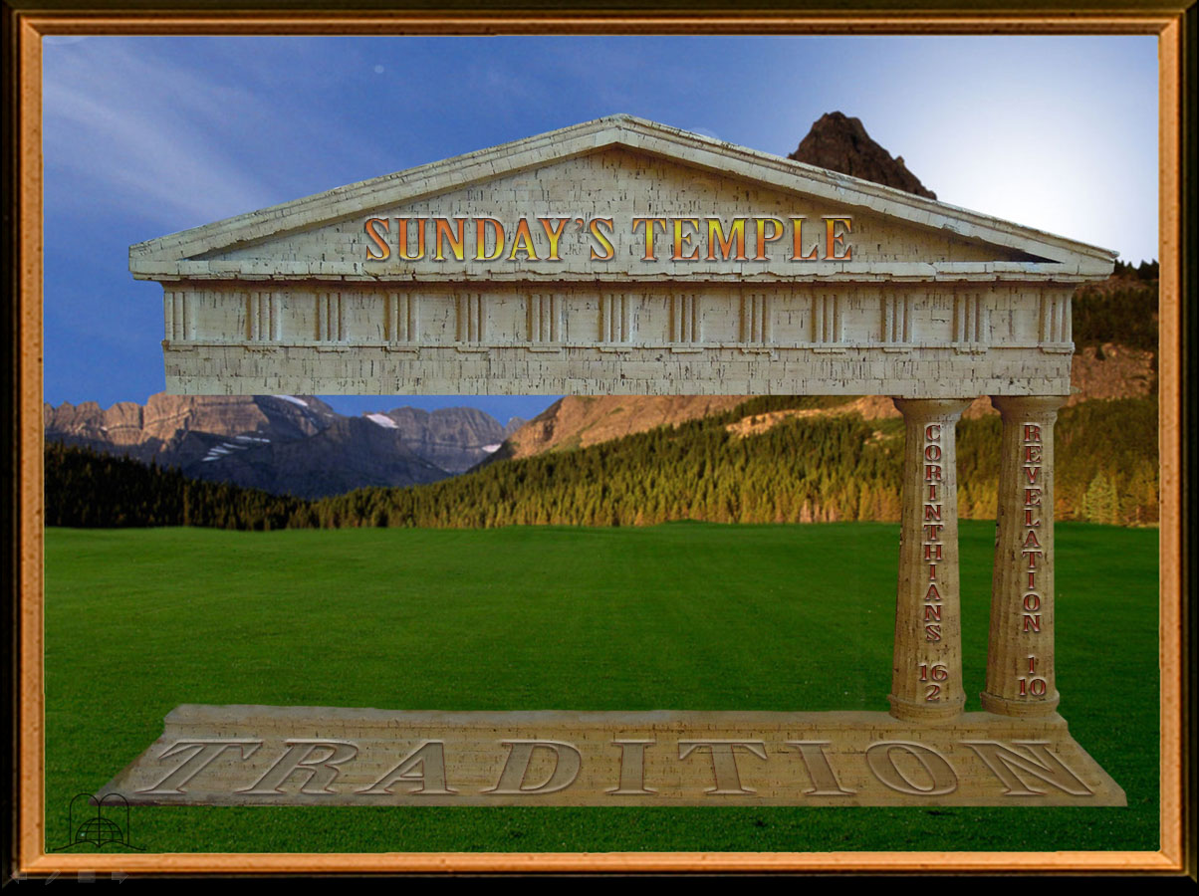
In advising to set aside an offering for the poor in Jerusalem, did Paul tell the brethren to gather or simply to set the money aside?
Notes:
11- In advising to set aside an offering for the poor in Jerusalem, did Paul tell the brethren to gather or simply to set the money aside?

Slide 42
"Upon the first day of the week let every one of you lay by him in store, as God hath prospered him, that there be no gatherings when I come."
Nothing says about a change
Notes:
1 Corinthians 16:2
"Upon the first day of the week let every one of you lay by him in store, as God hath prospered him, that there be no gatherings when I come."
Nothing says about a change

Slide 43
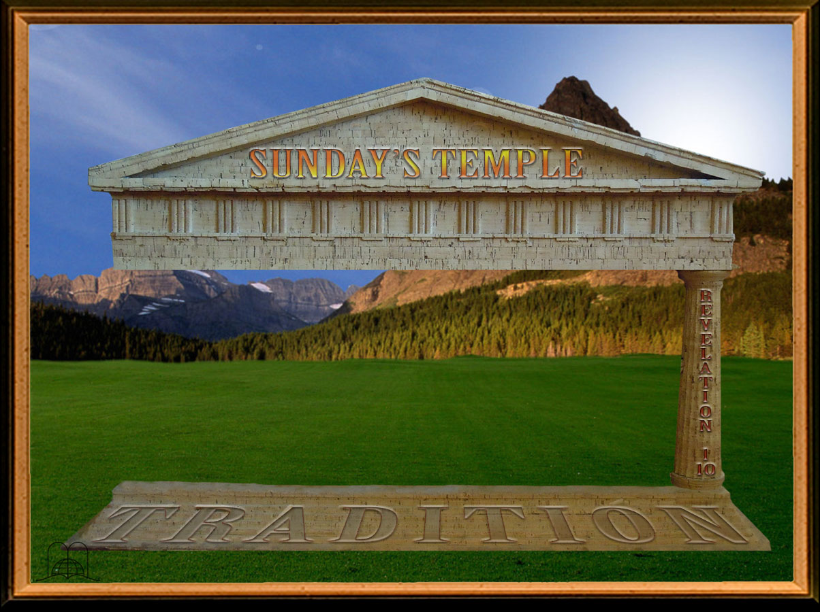
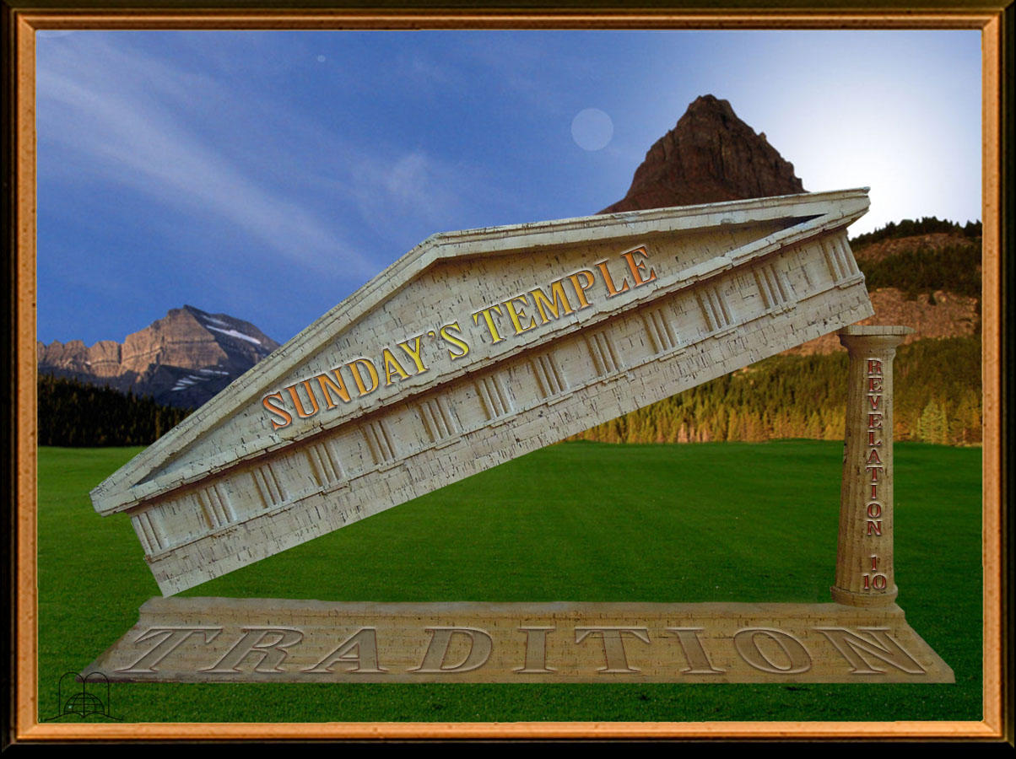
Notes:
The last column

Slide 44
"I was in the Spirit on the Lord's day, and heard behind me a great voice, as of a trumpet.”
Nothing says about a change
Notes:
Revelation 1:10
"I was in the Spirit on the Lord's day, and heard behind me a great voice, as of a trumpet.”
Nothing says about a change

Slide 45
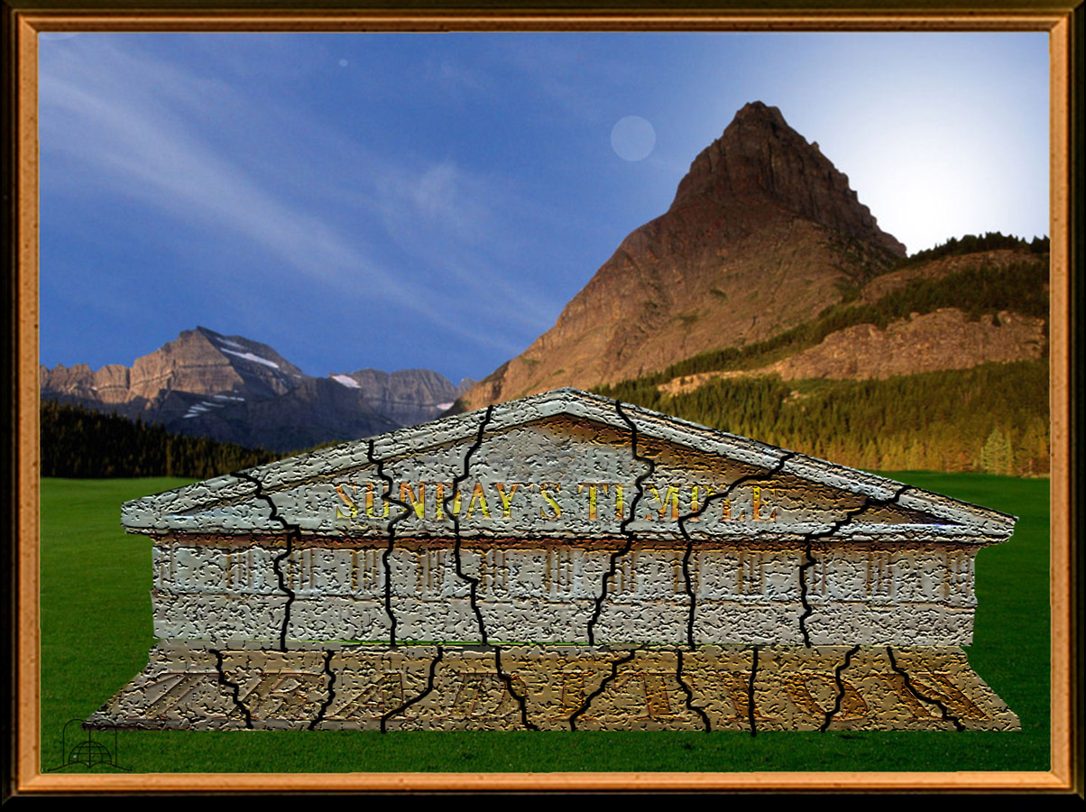
THERE IS NOT ONE SINGLE BIBLE TEXT THAT SHOWS THAT THE FIRST DAY OF THE WEEK SHOULD BE OBSERVED.
Notes:
THERE IS NOT ONE SINGLE BIBLE TEXT THAT SHOWS THAT THE FIRST DAY OF THE WEEK SHOULD BE OBSERVED.

Slide 46
Cardinal Gibbon wrote: "You may read the Bible from Genesis to Revelation, and YOU WILL NOT FIND A SINGLE LINE AUTHORIZING THE SANCTIFICATION OF SUNDAY. The Scriptures enforce the religious observance of Saturday, a day which we never sanctify."
(The Faith of our Fathers, 1917 ed, pp. 72, 73).
Notes:
- Cardinal Gibbon wrote: "You may read the Bible from Genesis to Revelation, and YOU WILL NOT FIND A SINGLE LINE AUTHORIZING THE SANCTIFICATION OF SUNDAY. The Scriptures enforce the religious observance of Saturday, a day which we never sanctify." (The Faith of Our Fathers, 1917 ed.; pp. 72, 73).

Slide 47
"The concept of a formal substitution of the first day for the seventh day of the week and the transference… IS NOT BASED EITHER IN THE 'HOLY SCRIPTURES OR IN ANCIENT CHRISTIANITY."
Smith and Cheatham, Dictionary of Christian Antiquities, art. Sabbath.
Notes:
• "The concept of a formal substitution of the first day for the seventh day of the week and the transference, maybe in a spiritual way, of the Sabbath rest established in the fourth commandment IS NOT BASED EITHER IN THE 'HOLY SCRIPTURES OR IN ANCIENT CHRISTIANITY." Smith and Cheatham, Dictionary of Christian Antiquities, article on the Sabbath.
•

Slide 48
"There was and there is a commandment to be observed as holy: the Sabbath, but that day is Saturday and not Sunday. It could be said, therefore, that the Sabbath was transferred from the seventh to the first day. Where can the registration of such a change be found? Not in the New Testament since there is absolutely nothing regarding it.”
Dr. Edward T. Hiscox, author of the Baptist Manual , From an article read at the Conference of Ministers in New York, on November 13, 1893.
Notes:
Dr. Edward T. Hiscox, author of the Baptist Manual made the following declaration before a group of pastors: "There was and there is a commandment to be observed as holy: the Sabbath, but that day is Saturday and not Sunday. It could be said, therefore, that the Sabbath was transferred from the seventh to the first day. Where can the registration of such a change be found? Not in the New Testament since there is absolutely nothing regarding it." From an article read at the Conference of Ministers in New York, on November 13, 1893.

Slide 49
SOME QUESTIONS REGARDING THE SABBATH
Notes:
SOME QUESTIONS REGARDING THE SABBATH

Slide 50
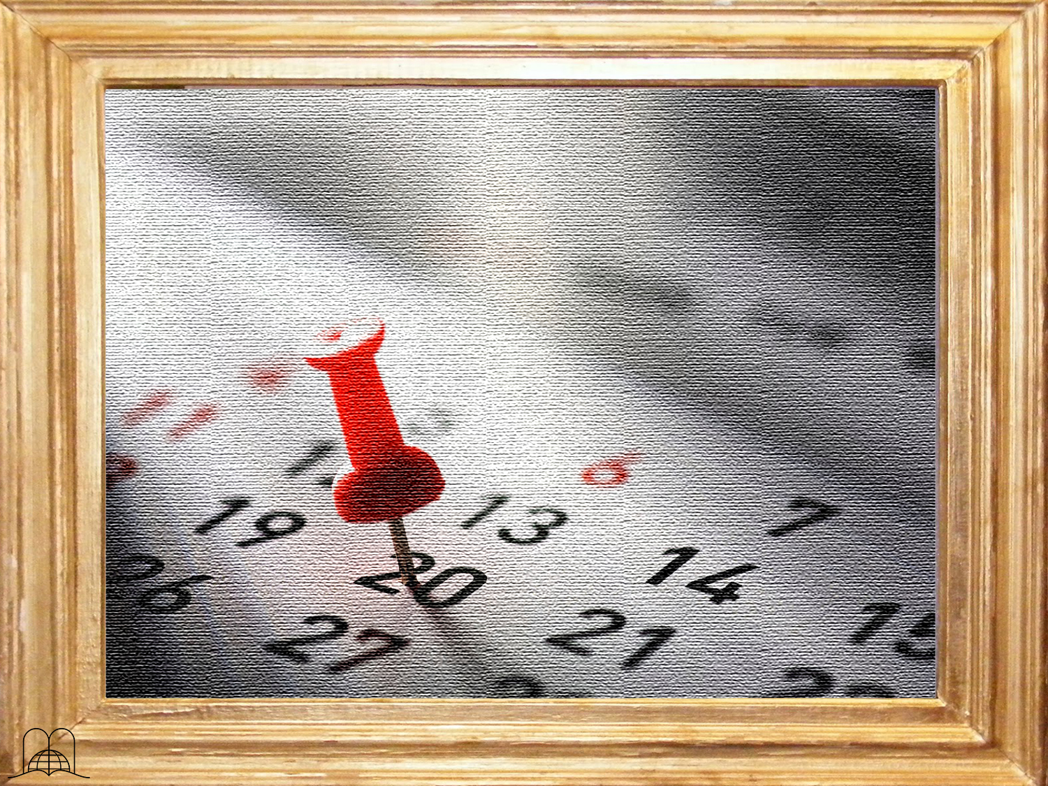
How do we know
that today's Sabbath is the same that
God established at creation?
Haven't
there been changes to the calendar?
Notes:
12- How do we know that today's Sabbath is the same that God established at creation? Haven't there been changes to the calendar?

Slide 51
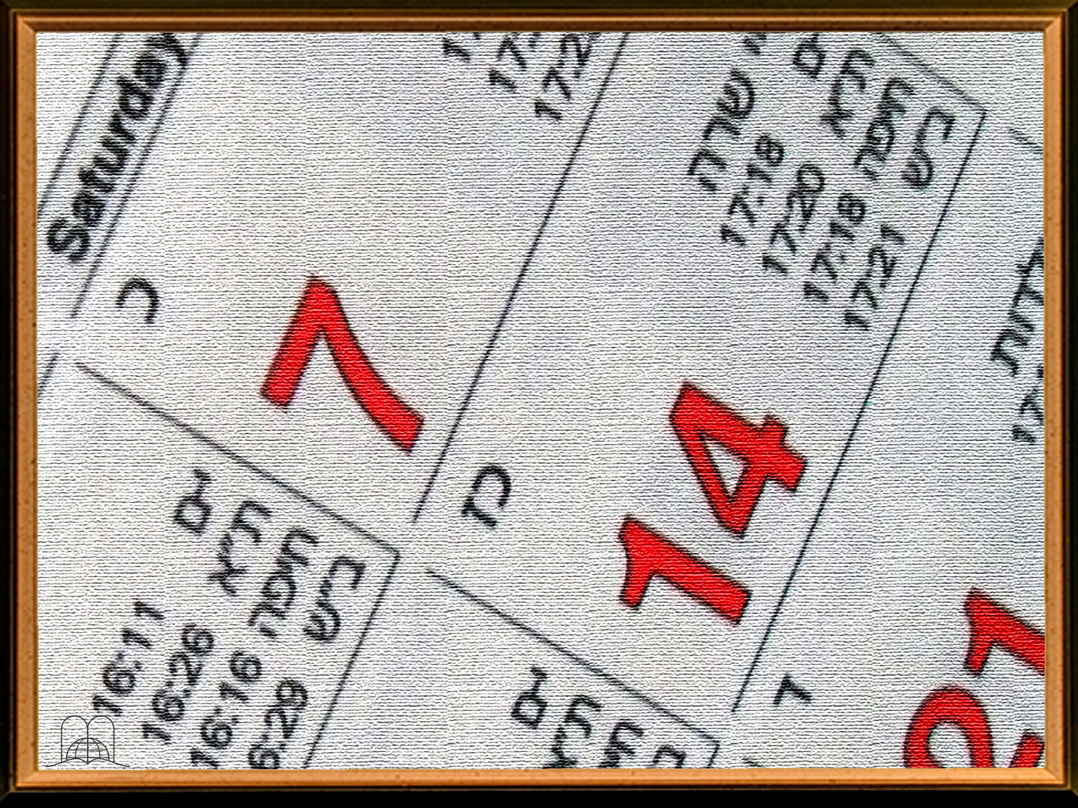
If we look at a Christian, Oriental, Muslim, Coptic or Jewish calendar we shall see that the years change, but the Sabbath remains the same. In the Jewish calendar the year 5780 is equivalent to our year 2020.
Notes:
If we look at a Christian, Oriental, Muslim, Coptic or Jewish calendar we shall see that the years change, but the Sabbath remains the same. In the Jewish calendar the year 5780 is equivalent to our year 2020.

Slide 52
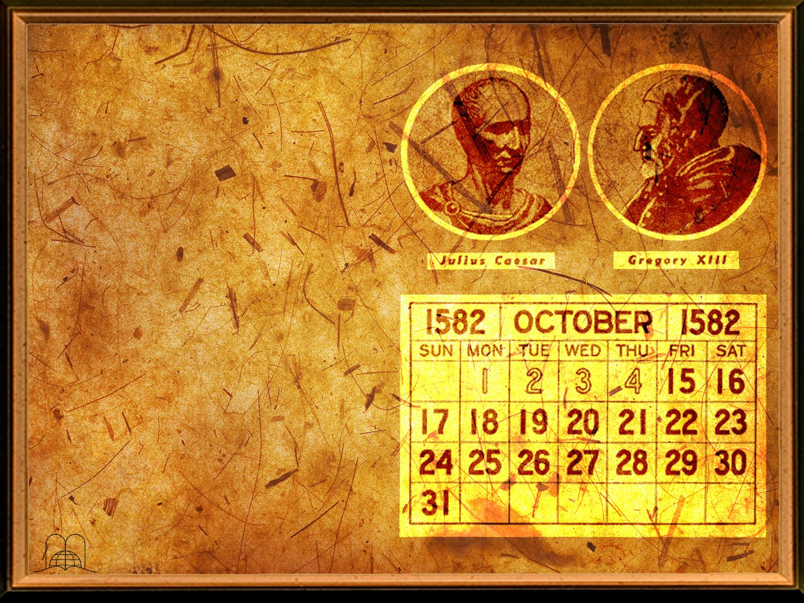
On Thursday October 4, 1582, people went to bed at night and woke up on Friday, October 15. The weekly cycle remained unchanged.
Notes:
The Julian calendar dates to the year 46 B.C., and it was corrected in 1582 and renamed Gregorian calendar; that is the calendar we use today.
If we look at a Christian, Oriental, Muslim, Coptic or Jewish When astronomers discovered that spring began at a different time; the calendar dates were moved 10 days forward. On Thursday, October 4, 1582, people went to bed at night and woke up on Friday, October 15. The weekly cycle remained unchanged.

Slide 53
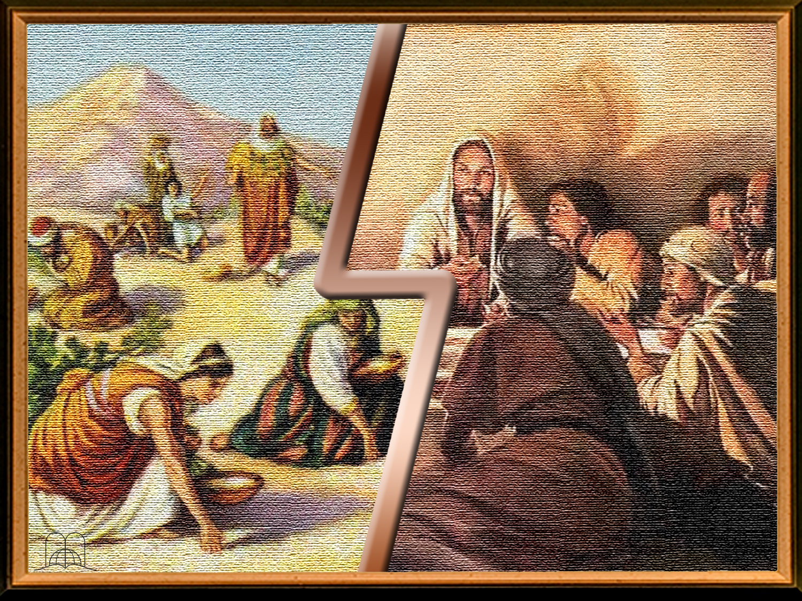
Manna
Jesus
Notes:
There are two pieces of evidences that the Sabbath is the same day in the creation:
1. The miracle of the manna in the desert. God knew the day He had sanctified. God gave a double portion of manna on Friday and none on Sabbath. (Exodus 16:4-35). God performed this miracle in the desert about 2000 times.
2. Christ and His disciples kept the Sabbath (Luke 4:16; 23:54-56). Did the Son of God keep a false day for 33 years?

Slide 54
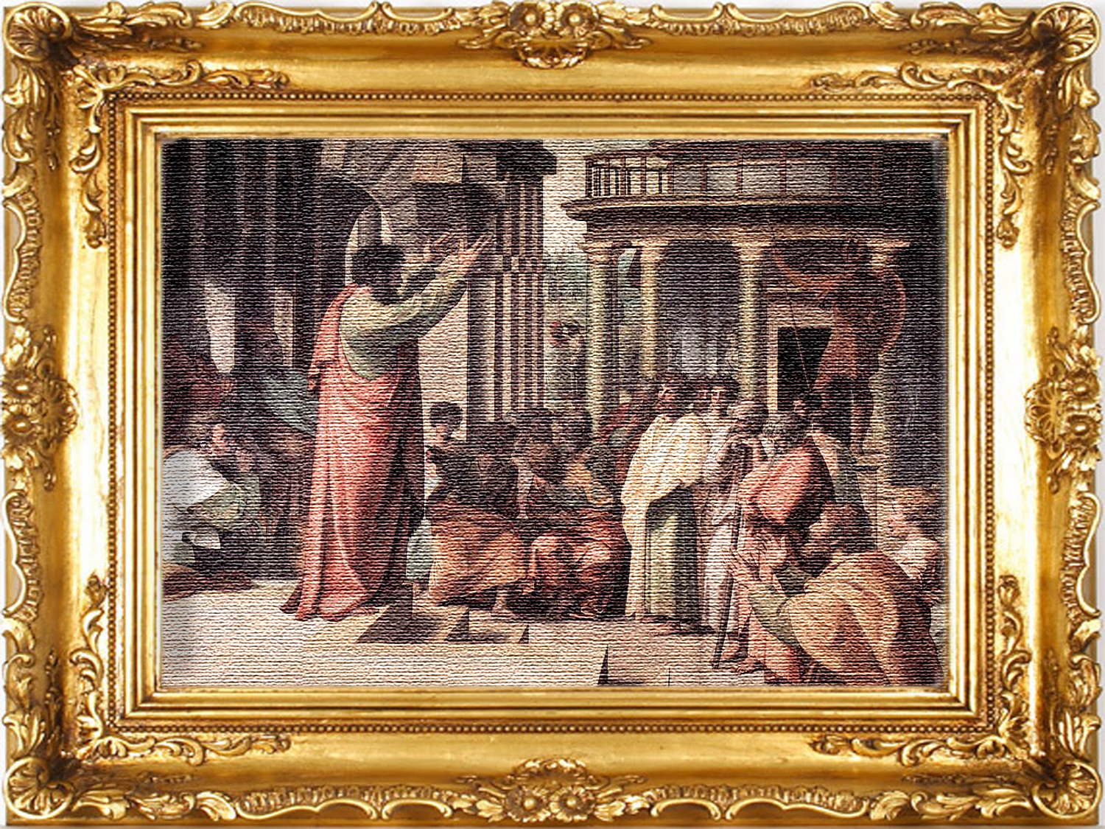
What kind of Sabbath did Paul refer to in Colossians 2:16, 17;
to the ceremonial rest days, which were
a shadow of Christ,
or the seventh day?
Notes:
13- What kind of Sabbath did Paul refer to in Colossians 2:16, 17; to the ceremonial rest days, which were a shadow of Christ, or the seventh day?

Slide 55

In the ceremonial law, written by Moses in a book (Deuteronomy 31:24-26), there are seven annual celebrations, which took place the first and seventh month. These celebrations (Passover, the feast of unleavened bread, first fruits, Pentecost, feast of Trumpets, Day of Atonement, and feast of Tabernacles) were also called Sabbaths or rest days. They had nothing to do with the fourth commandment (Leviticus 23:38, 39). They were a shadow or symbol of Christ and His ministry.
Notes:
In the ceremonial law, written by Moses in a book (Deuteronomy 31:24-26), there are seven annual feasts, which took place the first and seventh month. These feasts (Passover, the feast of unleavened bread, First Fruits, Pentecost, Feast of Trumpets, Day of Atonement, and the Feast of Tabernacles) were also called Sabbaths or days of rest. They had nothing to do with the fourth commandment (Leviticus 23:38, 39). They were a shadow or symbol of Christ and His ministry.

Slide 56

Is this issue so important?
Is it not
the same to keep another day?
Can we trust our opinion?
Notes:
14- Is this issue so important? Is it not the same to keep another day? Can we trust our opinion?

Slide 57
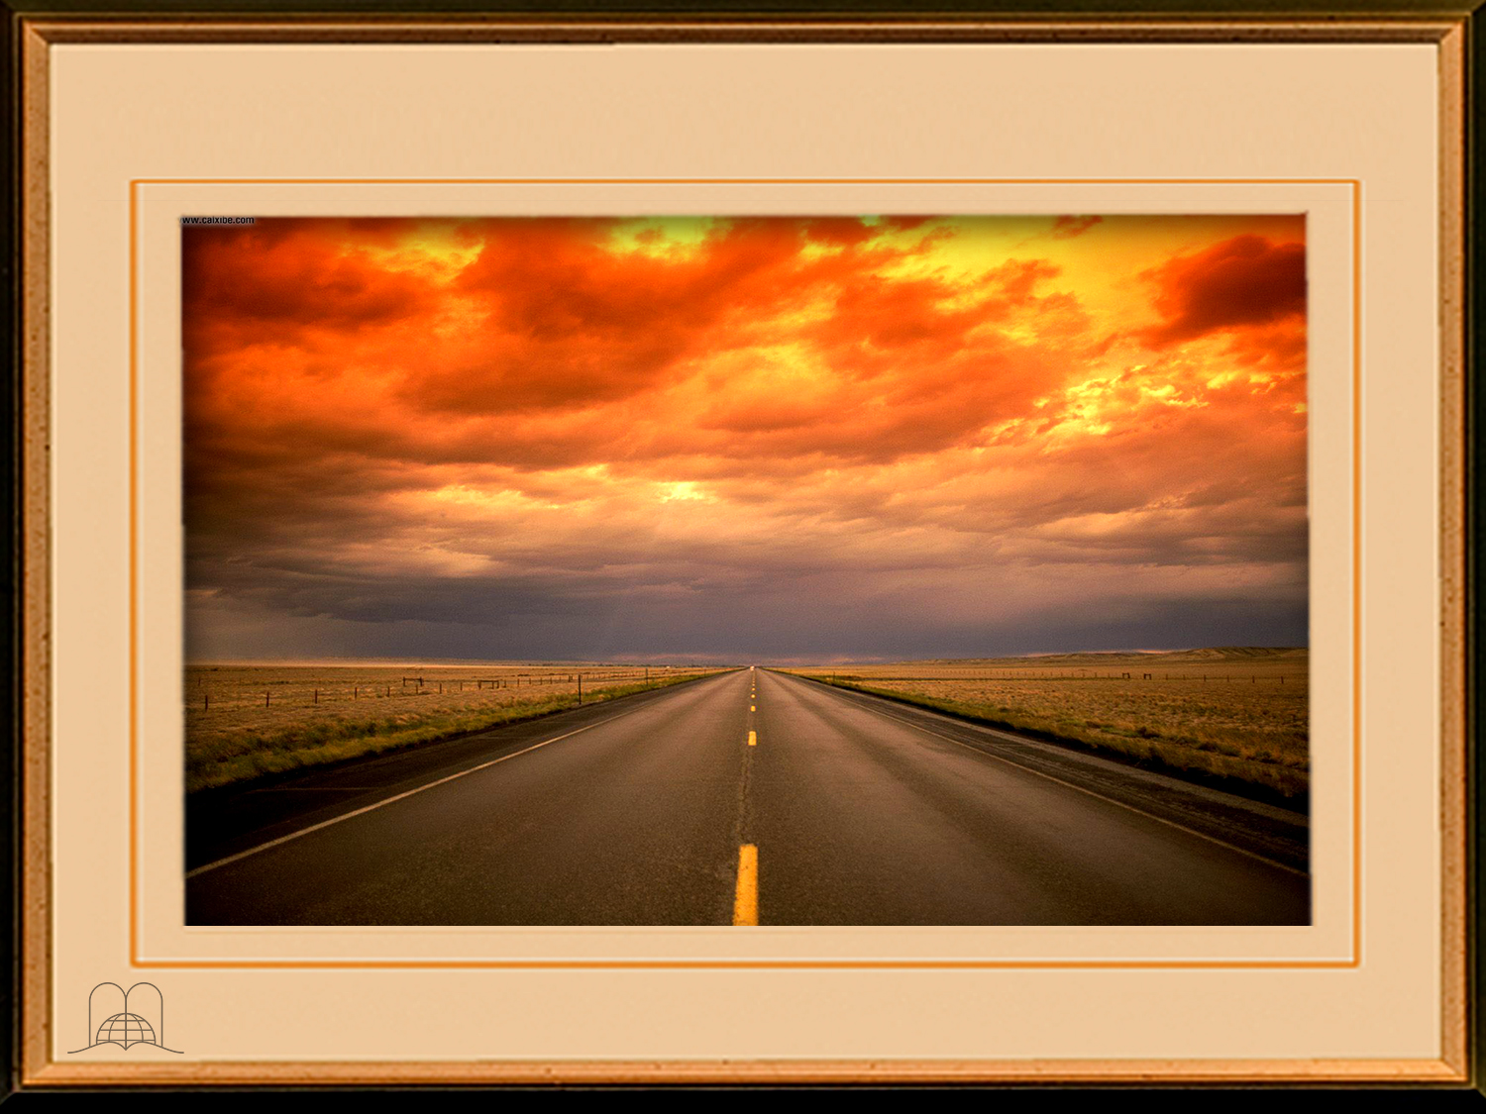
Proverbs 16:25
"There is a way that seemeth right unto a man, but the end thereof are the ways of death."
Notes:
Proverbs 16:25
"There is a way that seemeth right unto a man, but the end thereof are the ways of death."

Slide 58
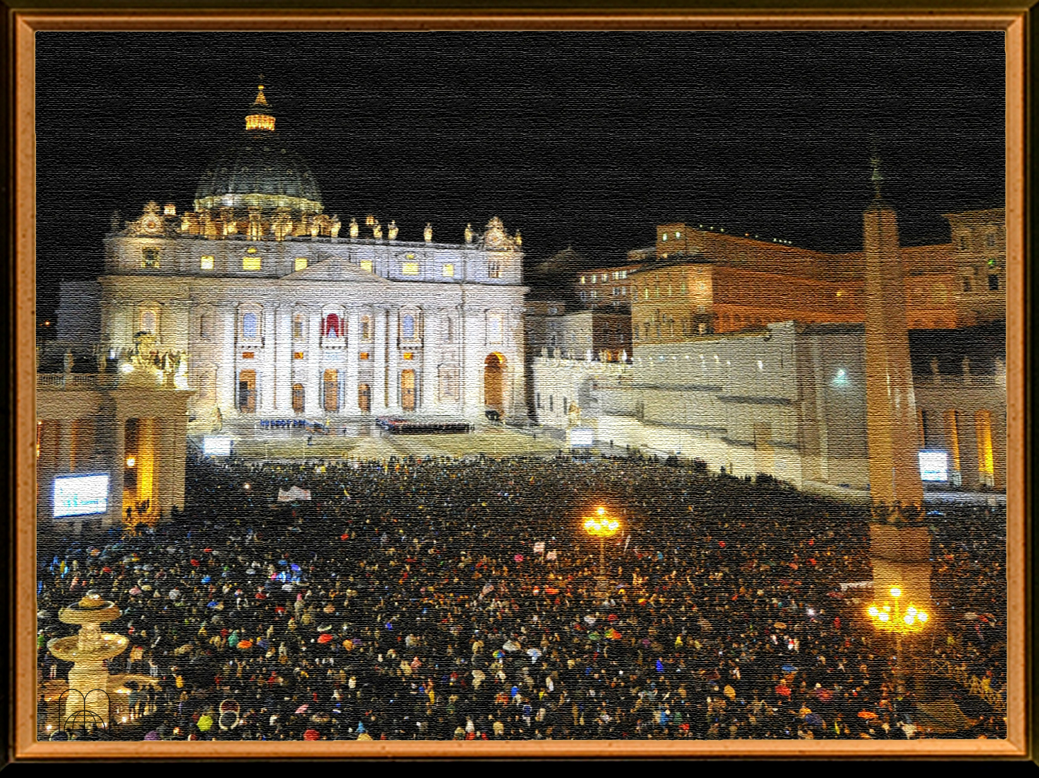
Most people observe Sunday;
can so many people be wrong?
Who will be lost?
Notes:
15- Most people observe Sunday; can so many people be wrong? Who will be lost?

Slide 59
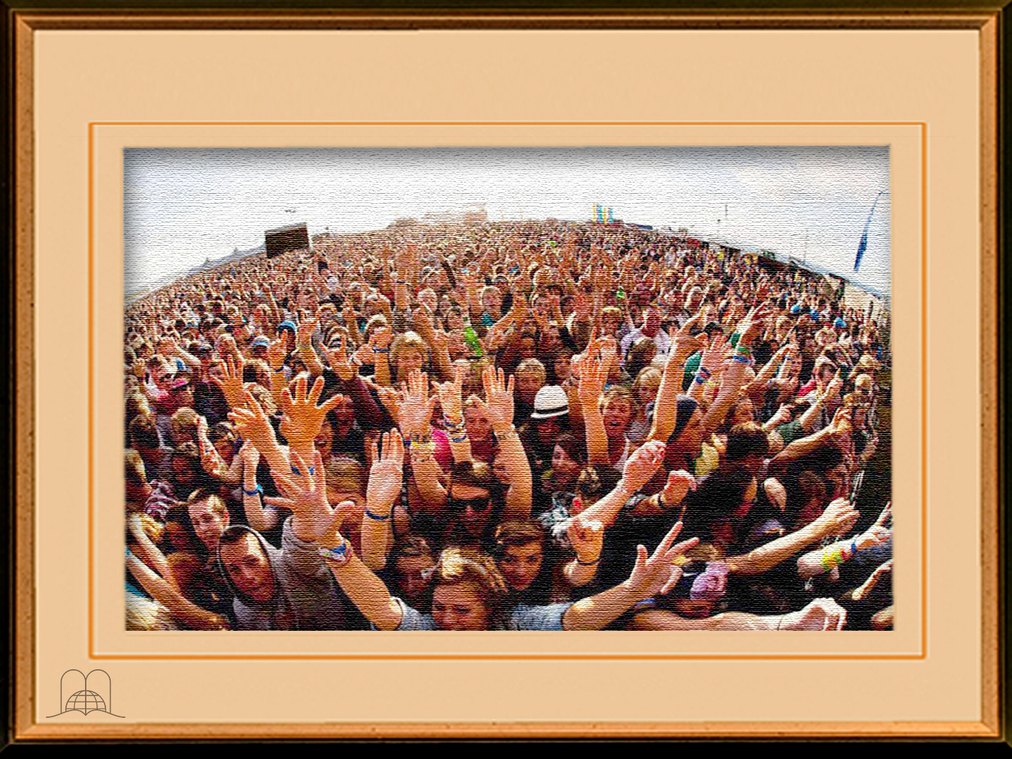
Matthew 7:21
" Not every one that saith unto me, Lord, Lord, shall enter into the kingdom of heaven; but he that doeth the will of my Father which is in heaven.
Notes:
Matthew 7:21
" Not every one that saith unto me, Lord, Lord, shall enter into the kingdom of heaven; but he that doeth the will of my Father which is in heaven.”
Matthew 7:13, 14 Enter ye in at the strait gate: for wide is the gate, and broad is the way, that leadeth to destruction, and many there be which go in thereat. Because strait is the gate, and narrow is the way, which leadeth unto life, and few there be that find it.”
- Many people say: "My parents and grandparents always observed Sunday, and I do not want to do differently.” Who will God judge and condemn - those who sinned in ignorance or those who sin consciously? (Acts 17:30; James 4:17).

Slide 60
CONCLUSION
Notes:
CONCLUSION

Slide 61
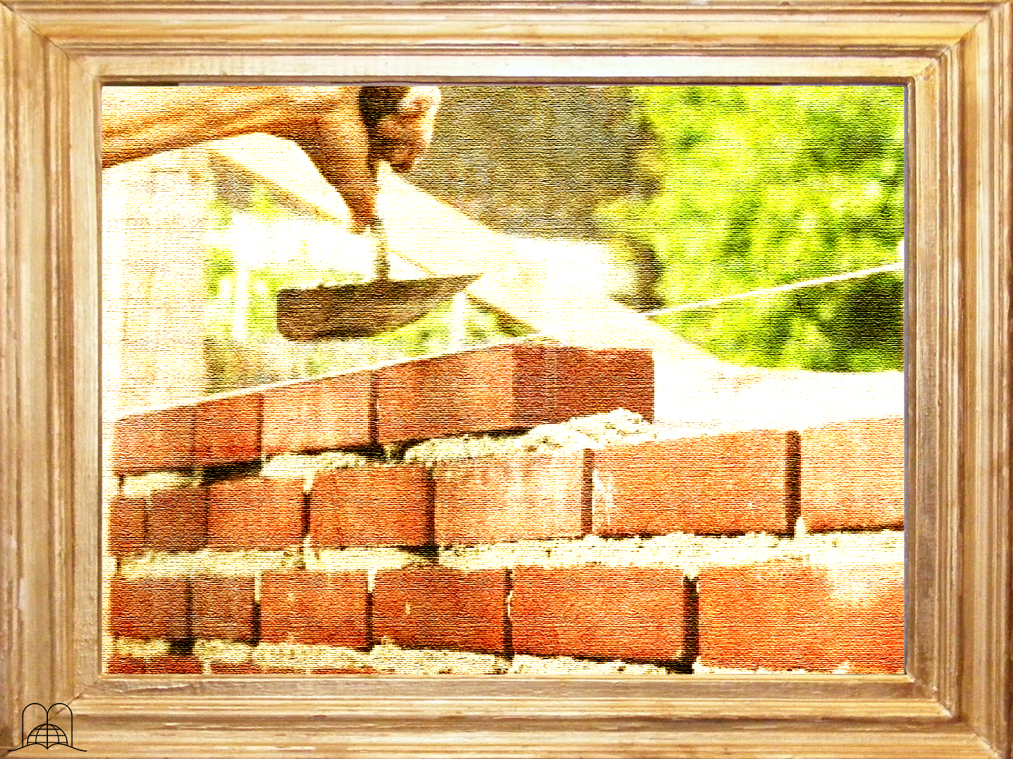
What does the Bible call those who restored the Sabbath as the day of rest?
Notes:
16- What does the Bible call those who restored the Sabbath as the day of rest?

Slide 62
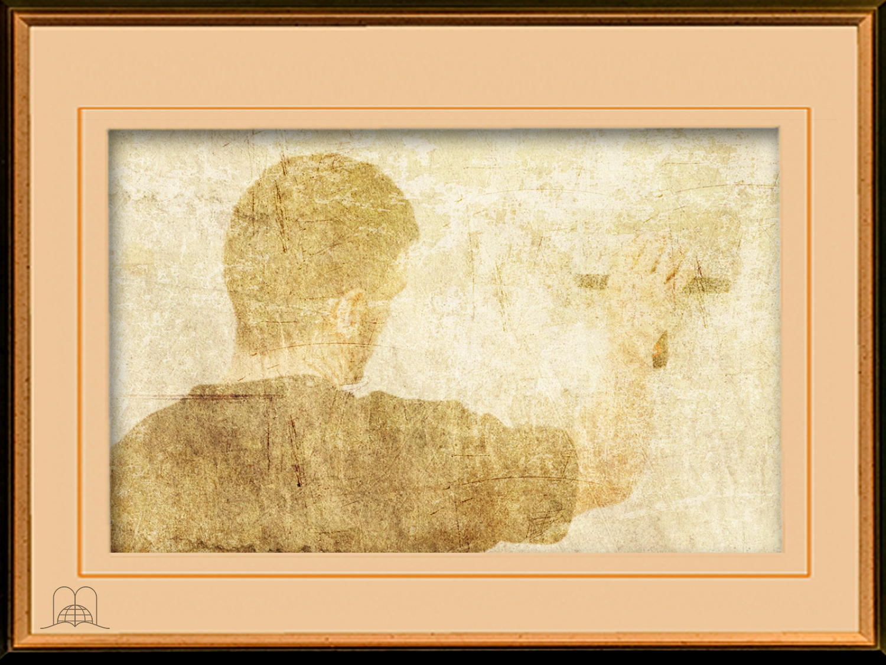
Isaiah 58:12
"And they that shall be of thee shall build the old waste places: thou shalt raise up the foundations of many generations; and thou shalt be called, The repairer of the breach, The restorer of paths to dwell in.”
Notes:
Isaiah 58:12-13
"And they that shall be of thee shall build the old waste places: thou shalt raise up the foundations of many generations; and thou shalt be called, The repairer of the breach, The restorer of paths to dwell in.”

Slide 63
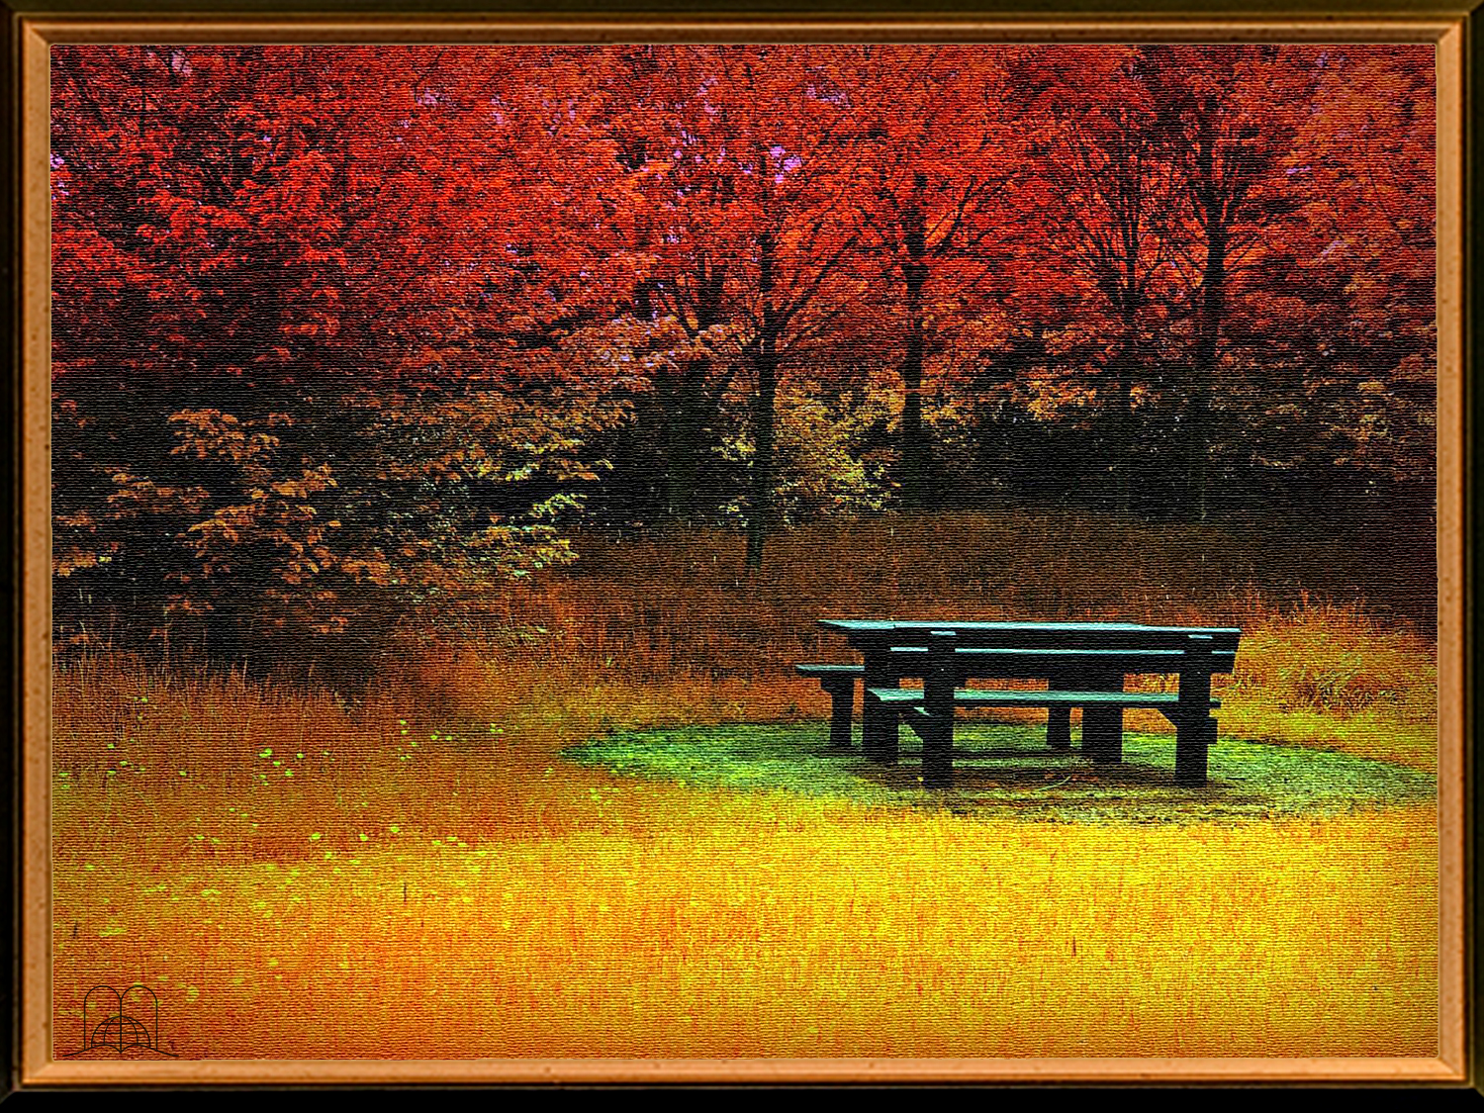
What does the Lord call the Sabbath, and what blessings do we receive on that day?
Notes:
17- What does the Lord call the Sabbath, and what blessings do we receive on that day?

Slide 64
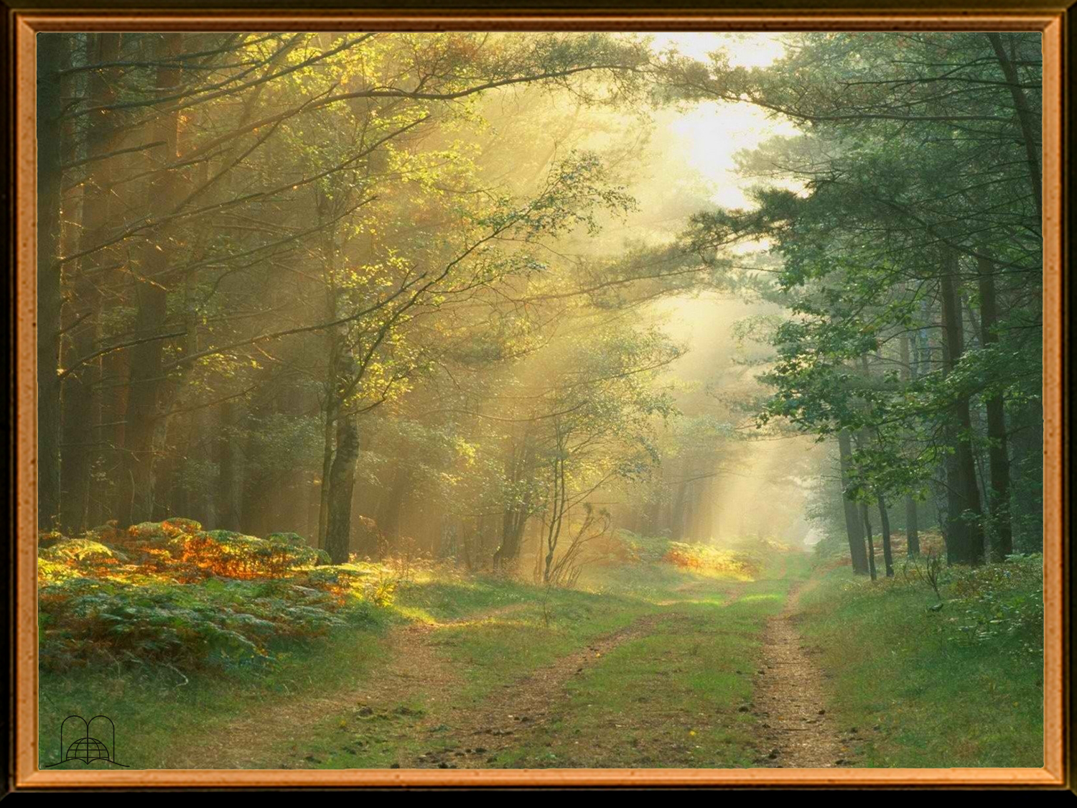
"If thou turn away thy foot from the sabbath, from doing thy pleasure on my holy day; and call the sabbath a delight, the holy of the Lord, honourable; and shalt honour him, not doing thine own ways, nor finding thine own pleasure, nor speaking thine own words:
Then shalt thou delight thyself in the Lord; and I will cause thee to ride upon the high places of the earth, and feed thee with the heritage of Jacob thy father: for the mouth of the Lord hath spoken it."
Isaiah 58:13-14
Notes:
Isaiah 58:13-14
"If thou turn away thy foot from the sabbath, from doing thy pleasure on my holy day; and call the sabbath a delight, the holy of the Lord, honourable; and shalt honour him, not doing thine own ways, nor finding thine own pleasure, nor speaking thine own words:
Then shalt thou delight thyself in the Lord; and I will cause thee to ride upon the high places of the earth, and feed thee with the heritage of Jacob thy father: for the mouth of the Lord hath spoken it."

Slide 65
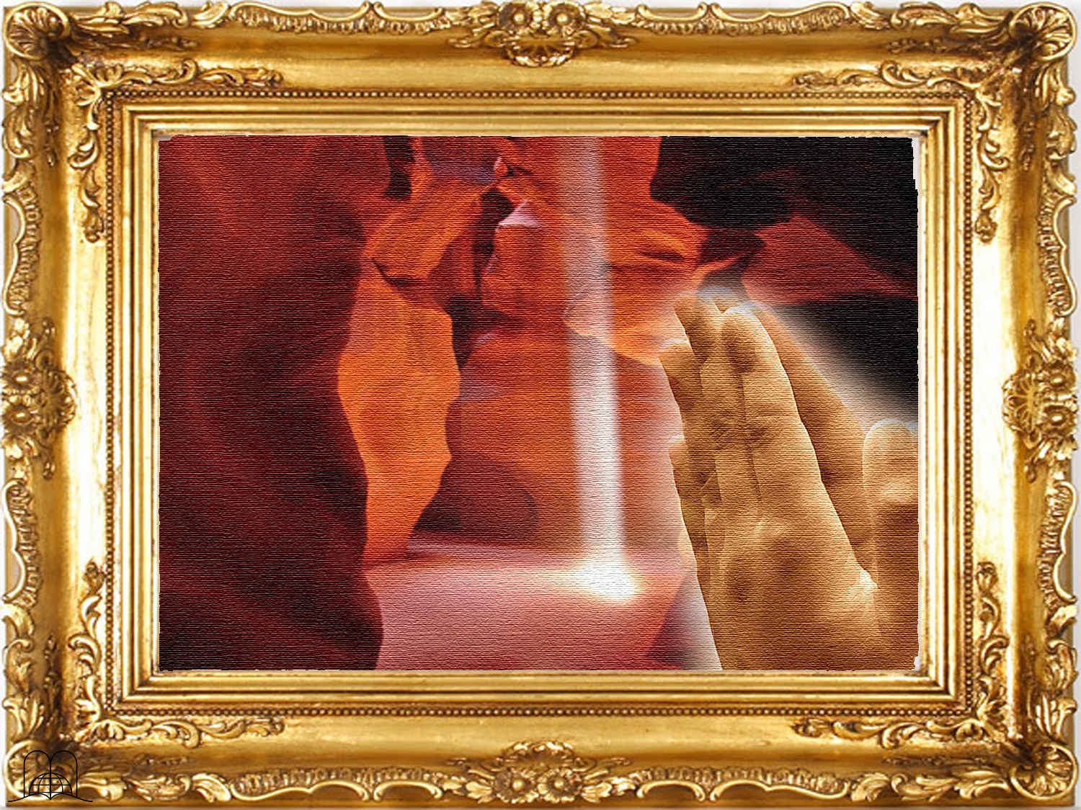
Thank you,
Lord,
for giving
me clarity
Notes:
Thank you, Lord, for giving me clarity

Slide 66
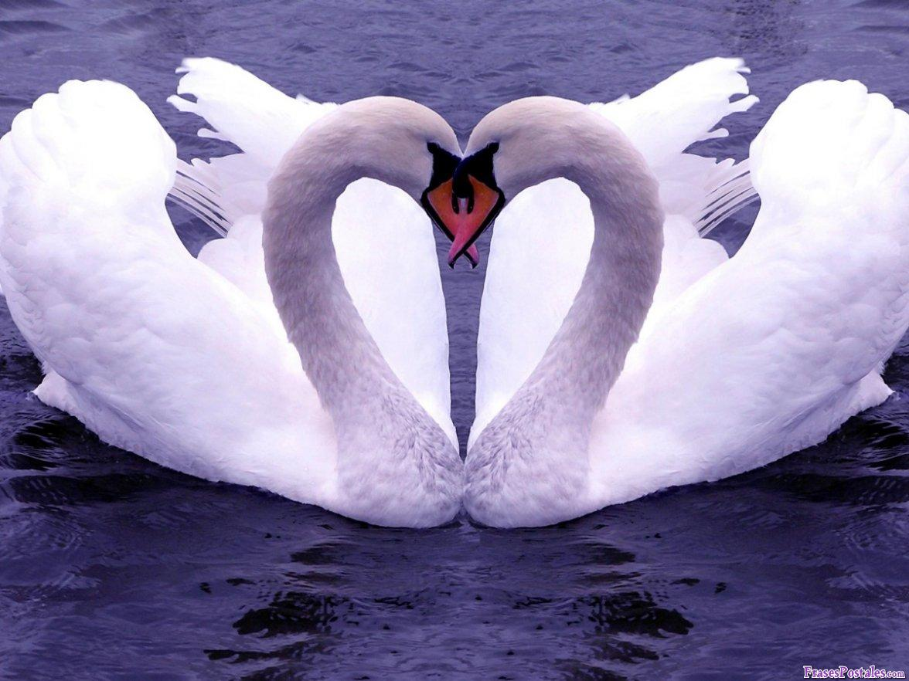
The next Topic: "The two dimensions of love"
How to be and make happy with the principles of love given by Jesus Christ same.
GOD BLESS YOU!
Notes:
GOD BLESS YOU!
The next Topic:
"The two dimensions of love"
How to be and make happy with the principles of love given by Jesus Christ same.

Slide 67

biblewell.org
info@biblewell.org
Notes:
If you still have questions, write to us confidently at: info@biblewell.org

