Slide 1
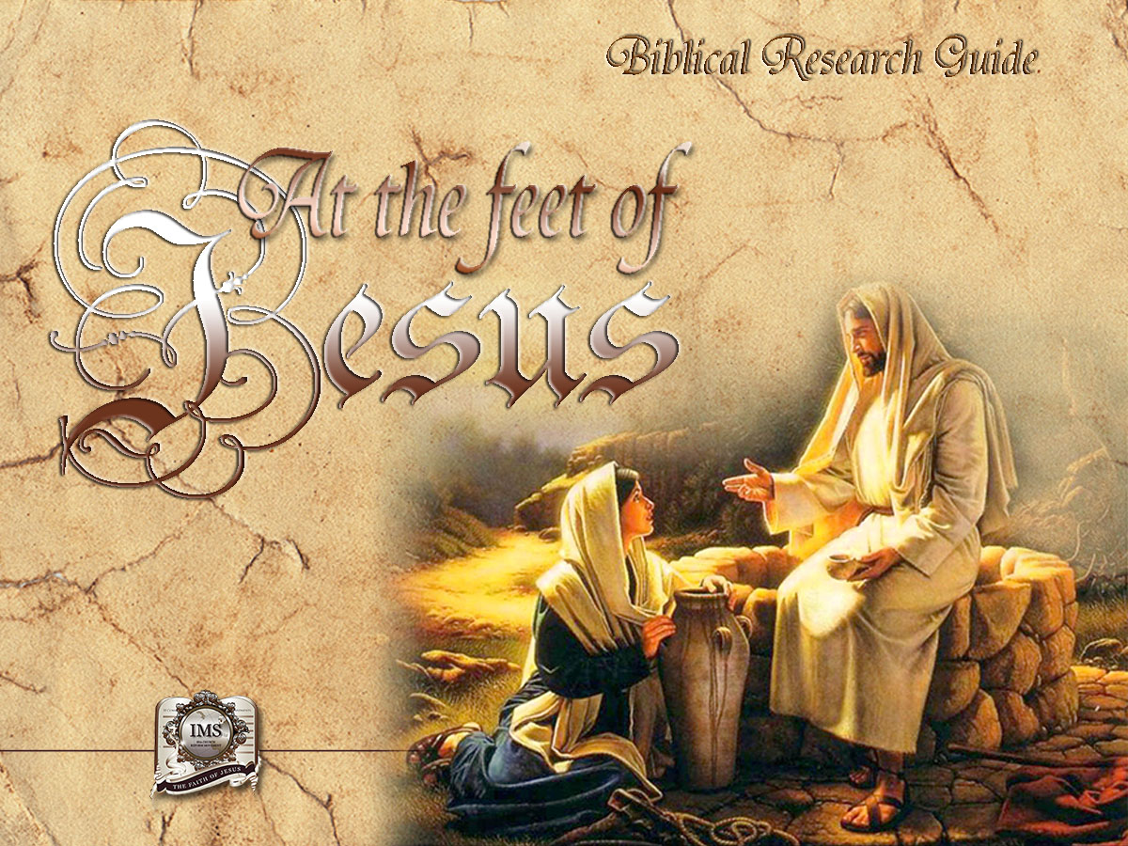

General Conference
Multimedia Department
Notes:
BIBLICAL RESEARCH GUIDE: “AT THE FEET OF JESUS”

Slide 2

A moment
of prayer
Notes:
A MOMENT OF PRAYER

Slide 3

16
IS THERE
LIFE AFTER DEATH?
Notes:
Lesson 16
IS THERE LIFE AFTER DEATH?

Slide 4
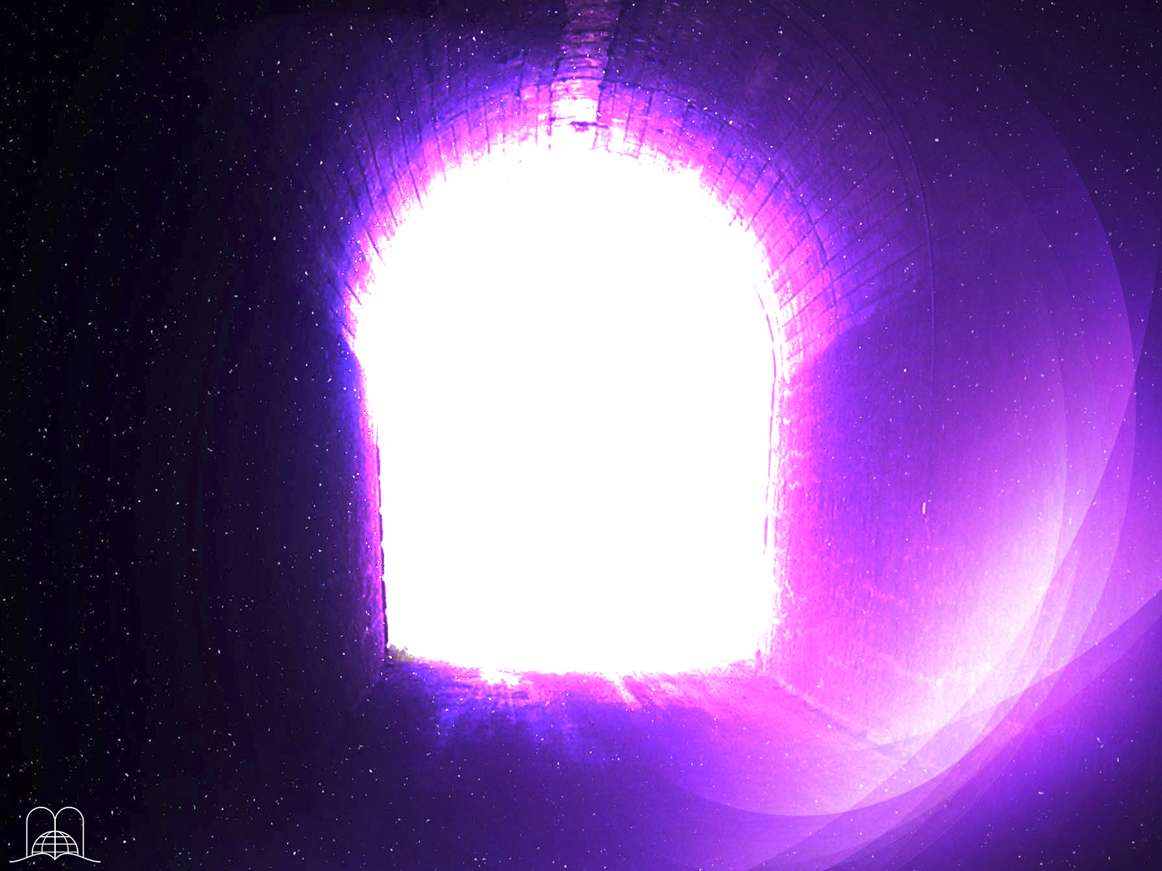
Is it reasonable
to be afraid of death?
Notes:
Many times we wonder what happens after death. There are those who, after an accident have been resuscitated and tell of their experience at the point of death. We often hear that the dead manifest themselves; some even speak with them.
Is it reasonable to be afraid of death?

Slide 5
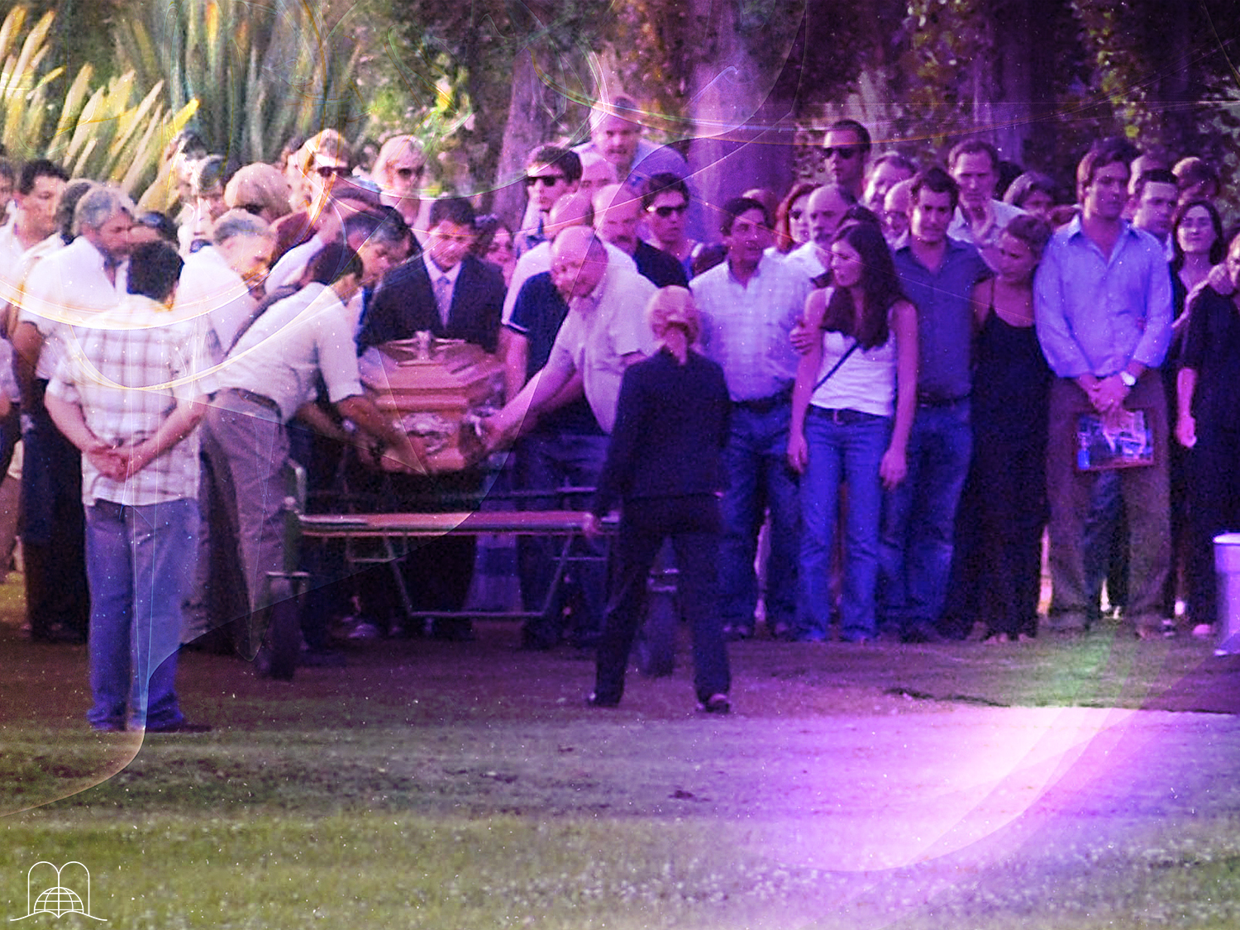
Will I ever see him again?
Notes:
Quite often we meet face to face with death when we attend a funeral of a friend or a relative to say our goodbyes, or when we see a hearse followed by a procession of mourners in black.
We wonder: Is there life after death?
Maybe when we place a wreath on a tomb we ask ourselves: do the dead have consciousness?
There are various opinions about this.
A wife, heartbroken by pain and flooded with tears wonders, will I ever see him again?
Some say a person who dies goes directly to heaven, purgatory or hell; others believe he or she goes to the spirit world or reincarnates later in a newly born being; some say that all has come to an end.

Slide 6
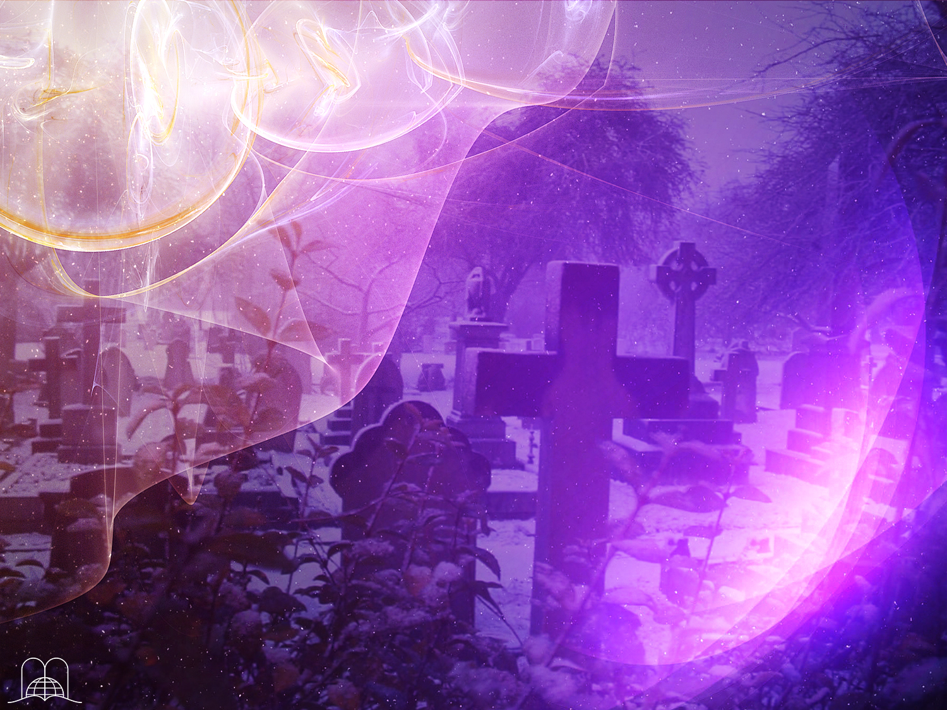
Job 14:14
"If a man die,
shall he live again?”
Notes:
Others say that a dead person knows nothing until the day of Resurrection. Who is right? What does God say? What answer does the Bible give? Will he live again? Job 14:14.
"If a man die, shall he live again?

Slide 7

THE PROCESS
OF LIFE AND DEATH
Notes:
THE PROCESS OF LIFE AND DEATH

Slide 8

To understand the process of death, we must first consider how life began.
How did it begin?
Notes:
1- To understand the process of death, we must first consider how life began.

Slide 9
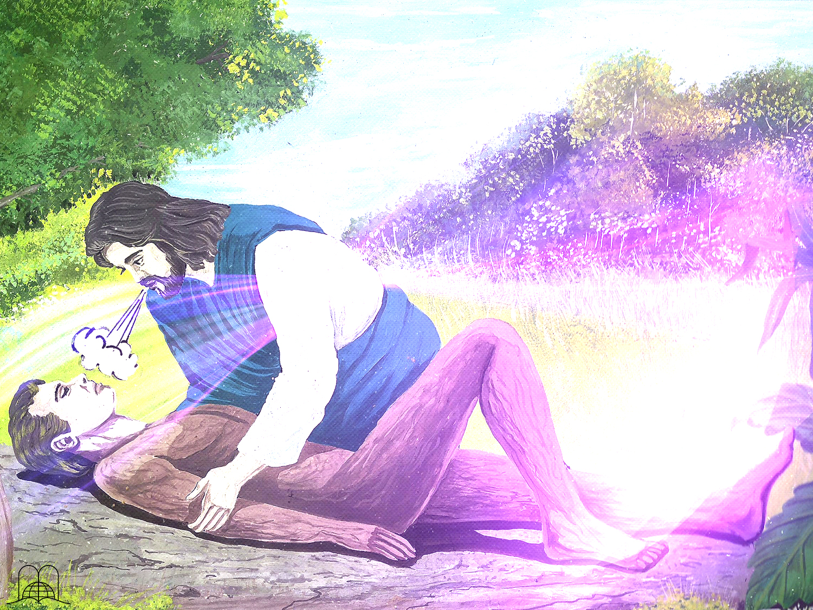
Genesis 2:7
"And the Lord God formed man of the dust of the ground, and breathed into his nostrils the breath of life; and man became a living soul."
Notes:
Genesis 2:7
"And the Lord God formed man of the dust of the ground, and breathed into his nostrils the breath of life; and man became a living soul."

Slide 10
MATTER
+
BREATH
OF LIFE
LIFE
Notes:
The human being is composed of these two elements. God took the first element from dust of the ground. Man's body is composed of protein, fat, minerals such as phosphorus, iron, magnesium, calcium, etc., and a high percentage of water. The actual value of these elements is not more than $5 dollars: this is the material value of our body. How little would we be worth without God’s breath of life! The union of these two elements made man, a completely new being.
a) If we expressed this with a mathematical equation we could say:
Matter (earth) + breath of life = living soul.
b) When God created man, he became a living soul (living being).
It does not say that God gave a soul or that man has a soul, but the union of matter and the breath of life made him a living being; therefore, man is a soul. When we say that 3,000 souls were baptized, we don’t say that 3,000 spirits were baptized but persons.

Slide 11

WATER
2 Hydrogen
+
1 Oxygen
H₂
O
Notes:
c) There are many chemical products that, when mixed, produce something totally different. For example, by mixing two atoms of hydrogen and one of oxygen, we get water: H2O.

Slide 12


LIGHT
Lamp
+
Electricity
Notes:
d) If an electric lamp receives electricity, it produces light due to the electric current that reaches it. When the energy is shut off the light goes off. The lamp cannot give light by itself, and neither can electricity.

Slide 13

Since the process of dying is the opposite of living,
what happens when somebody dies?
Notes:
2- Since the process of death is the opposite of life, what happens when somebody dies?

Slide 14
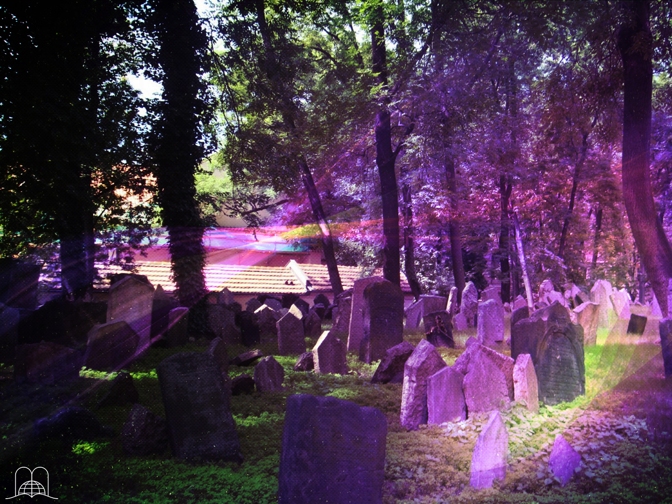
Ecclesiastes 12:7
"Then shall the dust return to the earth as it was: and the spirit shall return unto God who gave it."
Notes:
Ecclesiastes 12:7
"Then shall the dust return to the earth as it was: and the spirit shall return unto God who gave it.”
The body goes to the earth and the Spirit back to God.
(Psalm 104:29)

Slide 15
MATTER
-
BREATH
OF LIFE
DEATH
Notes:
Matter (body) - breath of life = death.
As in the case of the lamp, the matter becomes inactive when God withdraws the breath of life.

Slide 16
IS DEATH A CONSCIOUS STATE?
Notes:
IS DEATH A CONSCIOUS STATE?

Slide 17
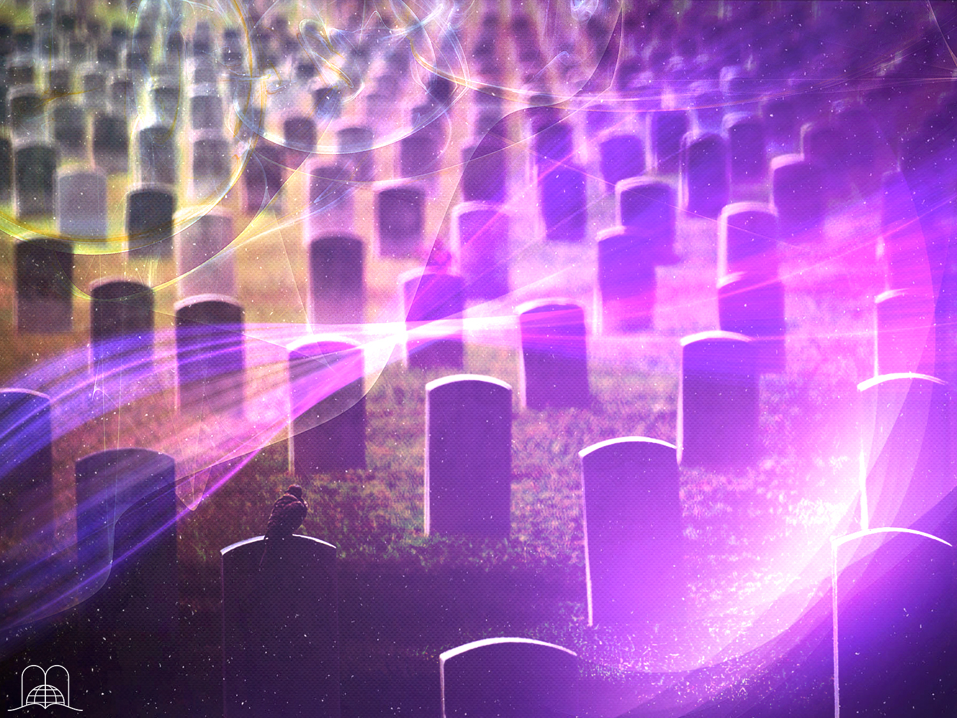
Do the dead know anything?
Notes:
3- Do the dead know anything?

Slide 18
Ecclesiastes 9:5
" For the living know that they shall die: but the dead know not any thing, neither have they any more a reward; for the memory of them is forgotten."
Notes:
Ecclesiastes 9:5
" For the living know that they shall die: but the dead know not any thing, neither have they any more a reward; for the memory of them is forgotten."

Slide 19

What happens to their feelings?
Notes:
4- What happens to their feelings?

Slide 20
Ecclesiastes 9:6, 10
"Also their love, and their hatred, and their envy, is now perished; neither have they any more a portion for ever in any thing that is done under the sun."
"Whatsoever thy hand findeth to do, do it with thy might; for there is no work, nor device, nor knowledge, nor wisdom, in the grave, whither thou goest."
Notes:
Ecclesiastes 9:6, 10
"Also their love, and their hatred, and their envy, is now perished; neither have they any more a portion for ever in any thing that is done under the sun.”
"Whatsoever thy hand findeth to do, do it with thy might; for there is no work, nor device, nor knowledge, nor wisdom, in the grave, whither thou goest.

Slide 21
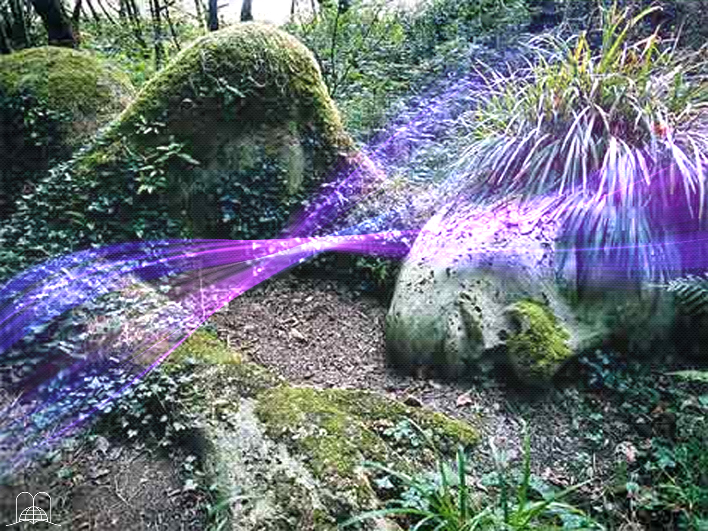
Are the dead in a conscious state?
Notes:
5- Are the dead in a conscious state?

Slide 22
Psalms 146:4
"His breath goeth forth,
he returneth to his earth;
in that very day
his thoughts perish."
Notes:
Psalms 146:4
"His breath goeth forth, he returneth to his earth; in that very day his thoughts perish."

Slide 23
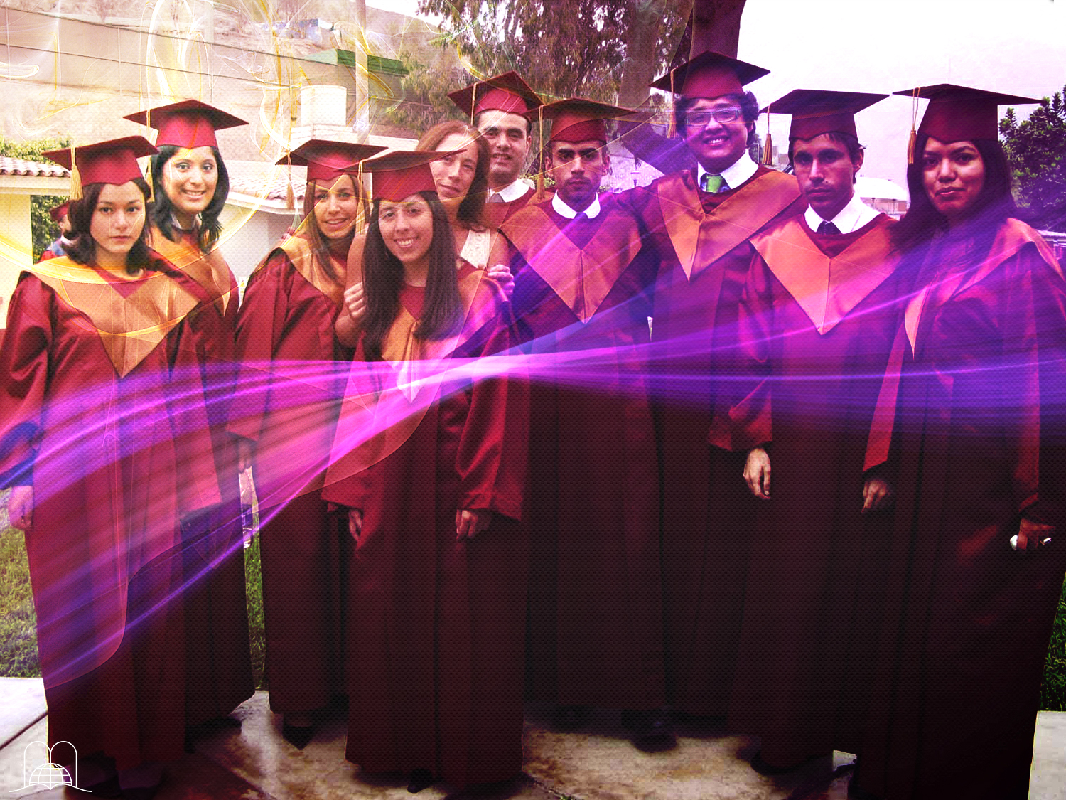
Do the dead know anything about their relatives?
Notes:
6- Do the dead know anything about their relatives?

Slide 24
Job 14:21
"His sons come to honour,
and he knoweth it not;
and they are brought low,
but he perceiveth it not of them."
Notes:
Job 14:21
"His sons come to honour, and he knoweth it not; and they are brought low, but he perceiveth it not of them."

Slide 25
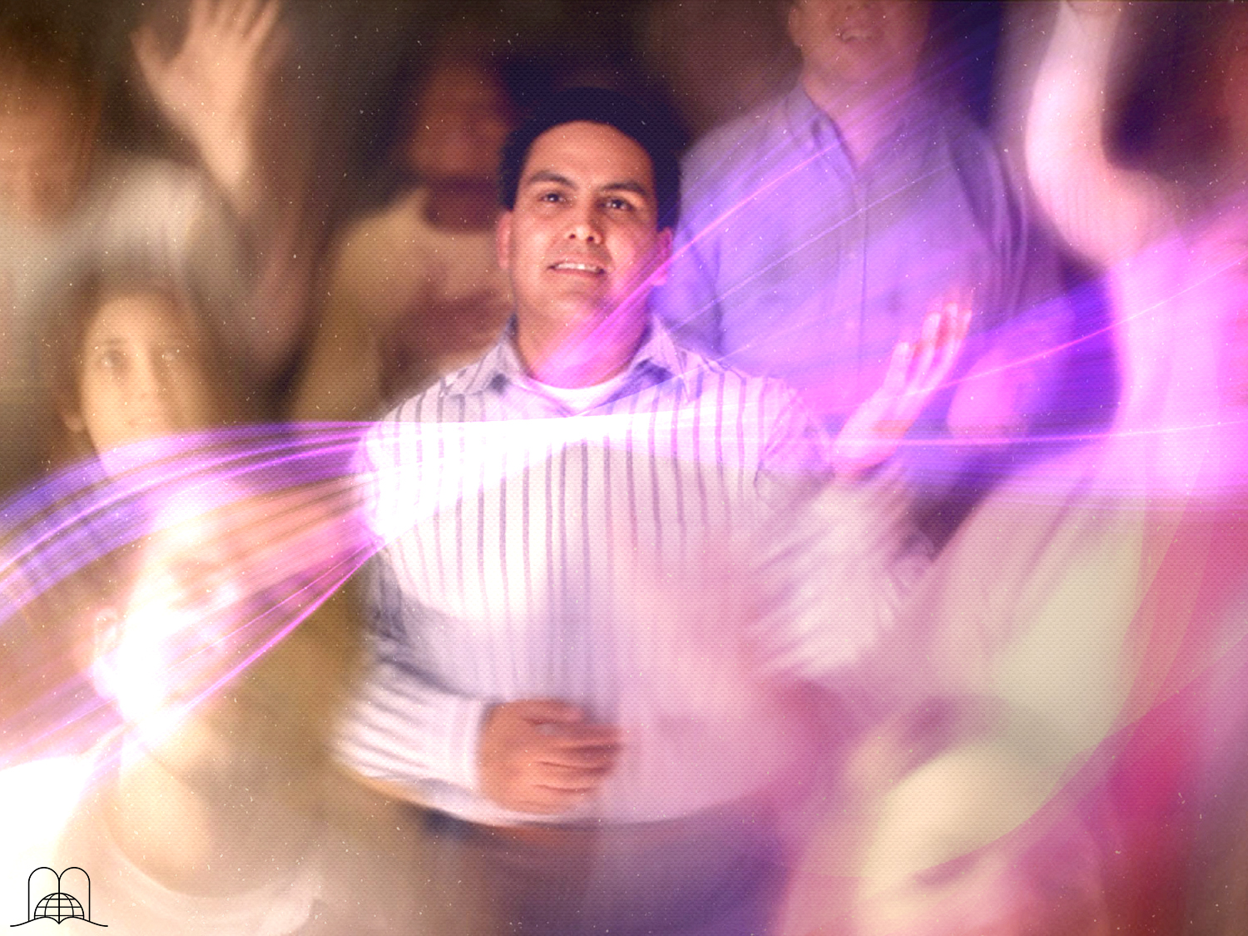
Are they in heaven
worshiping God?
Notes:
7- Are they in heaven worshiping God?

Slide 26
Psalms 115:17
"The dead praise not the Lord, neither any that go down into silence."
Notes:
Psalm 115:17
"The dead praise not the Lord, neither any that go down into silence.”
(Isaiah 38:18,19)

Slide 27
WHAT IS DEATH COMPARED TO?
Notes:
WHAT IS DEATH COMPARED TO?

Slide 28

What did Jesus
compare death to?
Notes:
8- What did Jesus compare death to?

Slide 29
John 11:11-14
"These things said he: and after that he saith unto them, Our friend Lazarus sleepeth; but I go, that I may awake him out of sleep.
Then said his disciples, Lord, if he sleep, he shall do well.
Howbeit Jesus spake of his death: but they thought that he had spoken of taking of rest in sleep.
Then said Jesus unto them plainly, Lazarus is dead.”
Notes:
John 11:11-14
"These things said he: and after that he saith unto them, Our friend Lazarus sleepeth; but I go, that I may awake him out of sleep.
Then said his disciples, Lord, if he sleep, he shall do well.
Howbeit Jesus spake of his death: but they thought that he had spoken of taking of rest in sleep.
Then said Jesus unto them plainly, Lazarus is dead.”

Slide 30

Job 14:10-12
"But man dieth, and wasteth away: yea, man giveth up the ghost, and where is he?
As the waters fail from the sea, and the flood decayeth and drieth up:
So man lieth down, and riseth not: till the heavens be no more, they shall not awake, nor be raised out of their sleep.”
Notes:
Job also compared death to sleep. The dead sleep; they are unconscious until they wake up at the resurrection.
Job 14:10-12
“But man dieth, and wasteth away: yea, man giveth up the ghost, and where is he?
As the waters fail from the sea, and the flood decayeth and drieth up:
So man lieth down, and riseth not: till the heavens be no more, they shall not awake, nor be raised out of their sleep.”

Slide 31

What other example do the Scriptures give?
Notes:
9- What other example do the Scriptures give?

Slide 32
"Man that is born of a woman is of few days and full of trouble. He cometh forth like a flower, and is cut down: he fleeth also as a shadow, and continueth not."
Job 14:1-2
Notes:
Job 14:1, 2
"Man that is born of a woman is of few days and full of trouble. He cometh forth like a flower, and is cut down: he fleeth also as a shadow, and continueth not."

Slide 33
WILL WE SEE AGAIN THOSE WHO HAVE DIED?
Notes:
WILL WE SEE AGAIN THOSE WHO HAVE DIED?

Slide 34
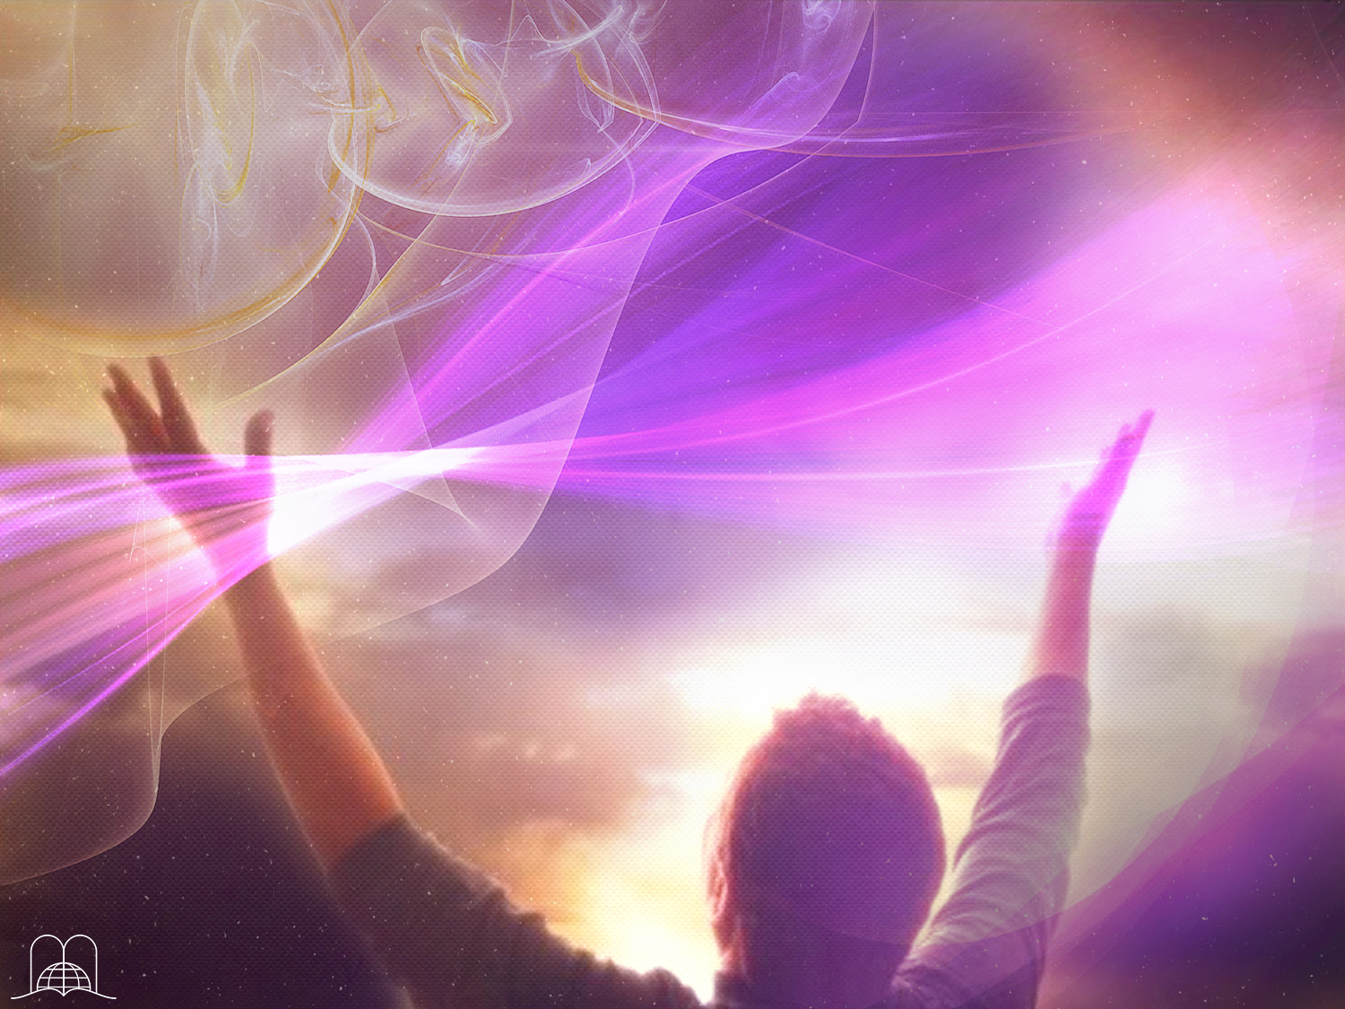
What is the glorious hope of a person who died believing in God?
Notes:
10- What is the glorious hope of those who died believing in God?

Slide 35
Isaiah 26:19
"Thy dead men shall live, together with my dead body shall they arise. Awake and sing, ye that dwell in dust: for thy dew is as the dew of herbs, and the earth shall cast out the dead.”
Notes:
Isaiah 26:19
"Thy dead men shall live, together with my dead body shall they arise. Awake and sing, ye that dwell in dust: for thy dew is as the dew of herbs, and the earth shall cast out the dead.”

Slide 36
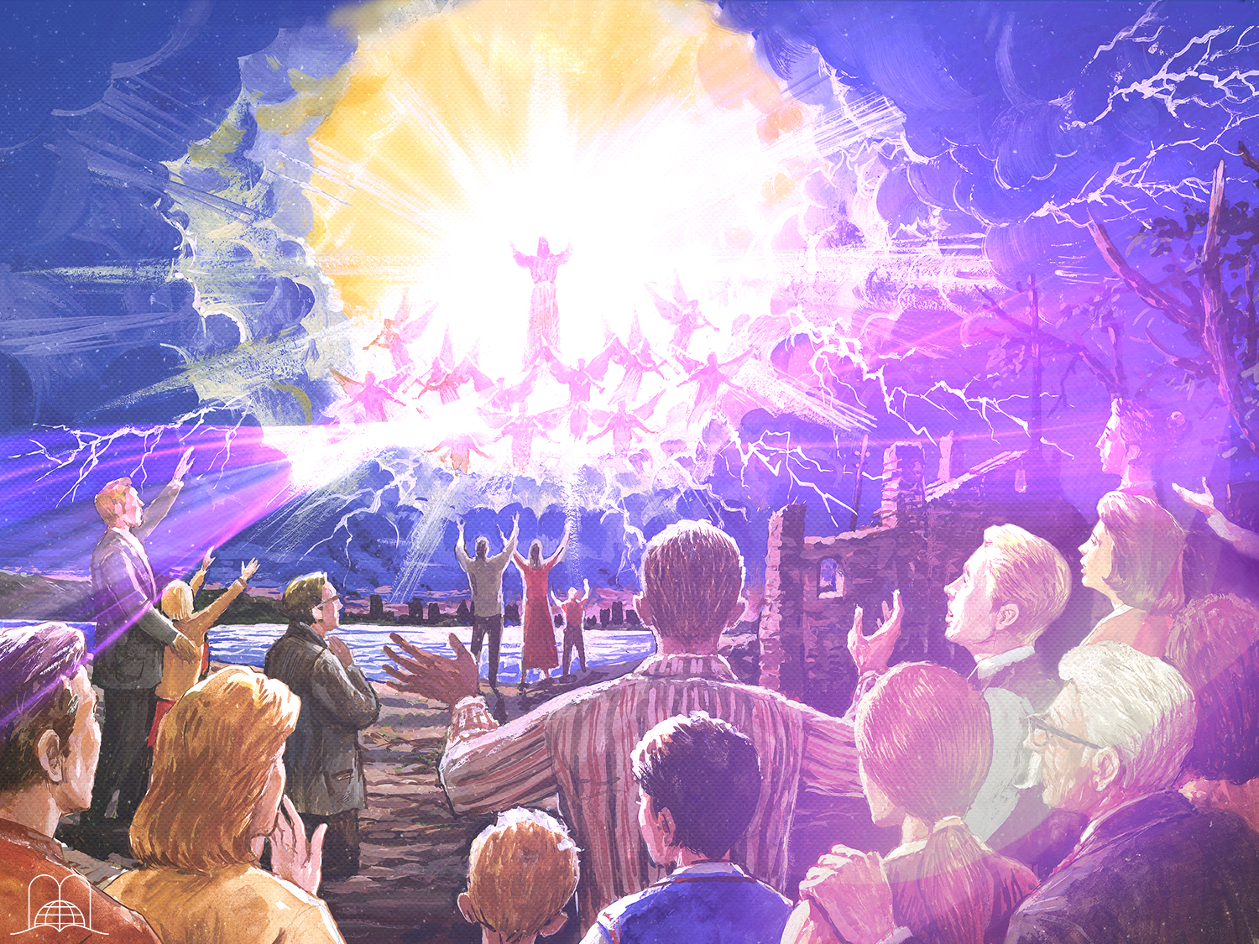
1 Thessalonians 4: 14-17
Luego nosotros los que vivimos, los que hayamos quedado, seremos arrebatados juntamente con ellos en las nubes para recibir al Señor en el aire, y así estaremos siempre con el Señor."
Porque el Señor mismo con voz de mando, con voz de arcángel, y con trompeta de Dios, descenderá del cielo; y los muertos en Cristo resucitarán primero.
Por lo cual os decimos esto en palabra del Señor: que nosotros que vivimos, que habremos quedado hasta la venida del Señor, no precederemos a los que durmieron.
"For if we believe that Jesus died and rose again, even so them also which sleep in Jesus will God bring with him.
Notes:
1 Thessalonians 4: 14-17
"For if we believe that Jesus died and rose again, even so them also which sleep in Jesus will God bring with him.

Slide 37
1 Thessalonians 4: 14-17
Luego nosotros los que vivimos, los que hayamos quedado, seremos arrebatados juntamente con ellos en las nubes para recibir al Señor en el aire, y así estaremos siempre con el Señor."
Porque el Señor mismo con voz de mando, con voz de arcángel, y con trompeta de Dios, descenderá del cielo; y los muertos en Cristo resucitarán primero.
For this we say unto you by the word of the Lord, that we which are alive and remain unto the coming of the Lord shall not prevent them which are asleep.
"Porque si creemos que Jesús murió y resucitó, así también traerá Dios con Jesús a los que durmieron en él.
Notes:
1 Thessalonians 4: 14-17
For this we say unto you by the word of the Lord, that we which are alive and remain unto the coming of the Lord shall not prevent them which are asleep.

Slide 38
1 Thessalonians 4: 14-17
Luego nosotros los que vivimos, los que hayamos quedado, seremos arrebatados juntamente con ellos en las nubes para recibir al Señor en el aire, y así estaremos siempre con el Señor."
For the Lord himself shall descend from heaven with a shout, with the voice of the archangel, and with the trump of God: and the dead in Christ shall rise first:
Por lo cual os decimos esto en palabra del Señor: que nosotros que vivimos, que habremos quedado hasta la venida del Señor, no precederemos a los que durmieron.
"Porque si creemos que Jesús murió y resucitó, así también traerá Dios con Jesús a los que durmieron en él.
Notes:
1 Thessalonians 4: 14-17
For the Lord himself shall descend from heaven with a shout, with the voice of the archangel, and with the trump of God: and the dead in Christ shall rise first:

Slide 39
1 Thessalonians 4: 14-17
Then we which are alive and remain shall be caught up together with them in the clouds, to meet the Lord in the air: and so shall we ever be with the Lord."
Porque el Señor mismo con voz de mando, con voz de arcángel, y con trompeta de Dios, descenderá del cielo; y los muertos en Cristo resucitarán primero.
Por lo cual os decimos esto en palabra del Señor: que nosotros que vivimos, que habremos quedado hasta la venida del Señor, no precederemos a los que durmieron.
"Porque si creemos que Jesús murió y resucitó, así también traerá Dios con Jesús a los que durmieron en él.
Notes:
1 Thessalonians 4: 14-17
Then we which are alive and remain shall be caught up together with them in the clouds, to meet the Lord in the air: and so shall we ever be with the Lord.”

Slide 40
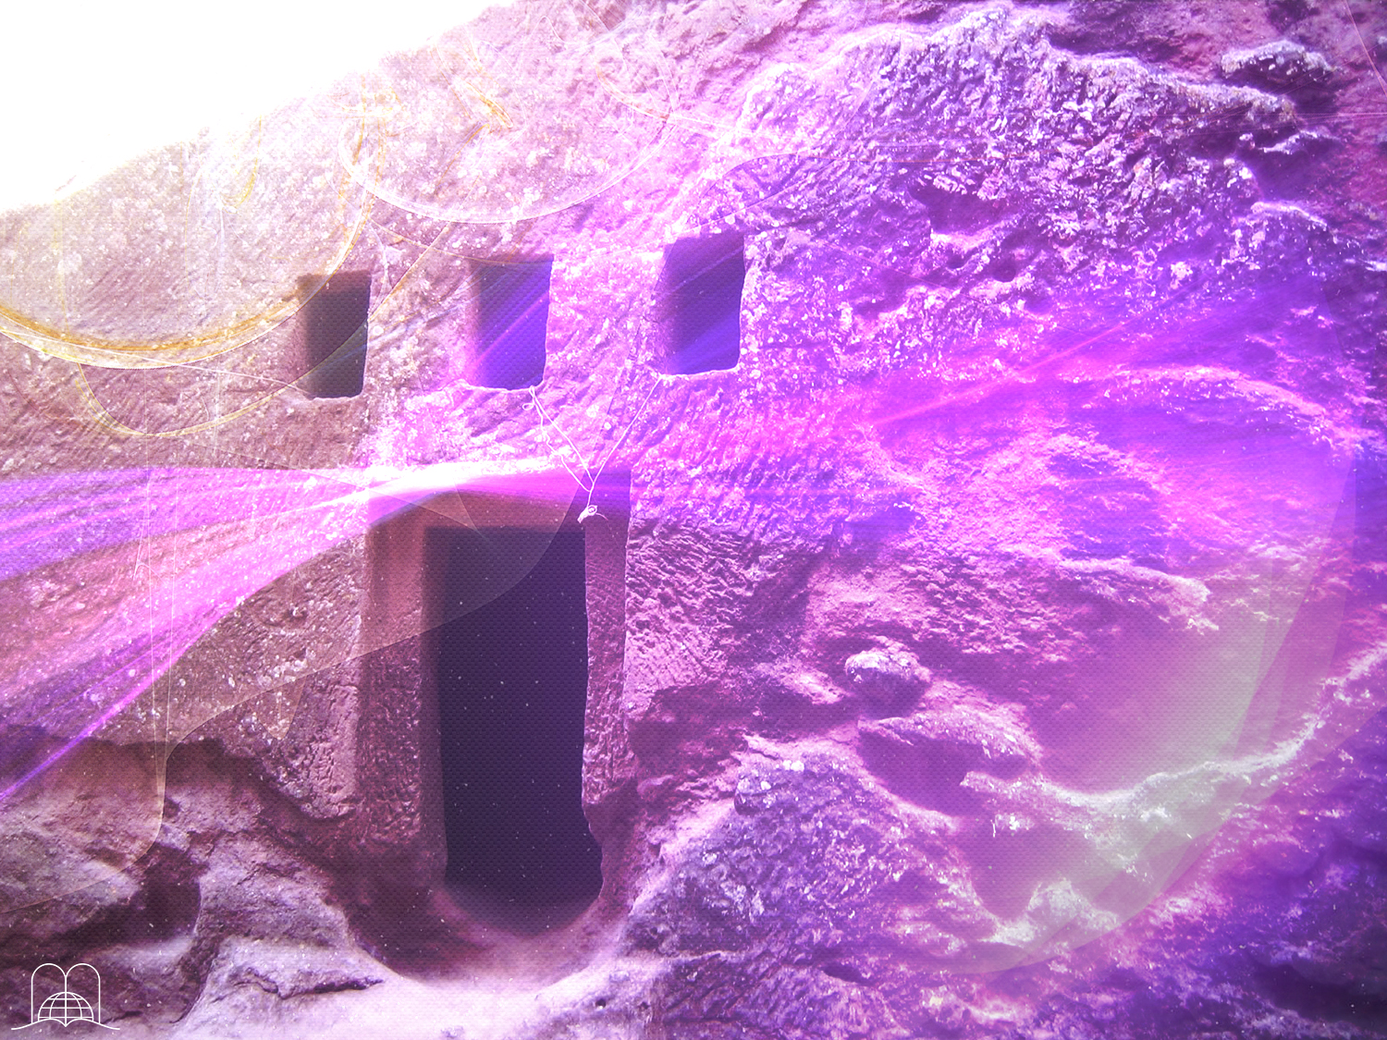
Are the faithful of old who have died already enjoying eternal life?
Notes:
11- Are the faithful of old who have died already enjoying eternal life?

Slide 41
Hebreos 11:39-40
"And these all,
having obtained a good report through faith, received not the promise: God having provided some better thing for us, that they without us should not be made perfect."
Notes:
Hebrews 11:39-40
And these all, having obtained a good report through faith, received not the promise: God having provided some better thing for us, that they without us should not be made perfect."

Slide 42

Daniel 12:13
But go thou thy way till the end be: for thou shalt rest, and stand in thy lot at the end of the days.
Notes:
Daniel 12:13
"But go thou thy way till the end be: for thou shalt rest, and stand in thy lot at the end of the days.«
There is a contradiction among those who preach immediate punishment or reward and at the same time believe in a resurrection and the judgment. If a person receives his reward when he dies, why will Jesus come to judge the dead and the living? Judge what? Those things they already received?

Slide 43
THE GREATEST, OLDEST LIE THAT HAS DECEIVED MILLIONS
Notes:
THE GREATEST, OLDEST LIE THAT HAS DECEIVED MILLIONS.

Slide 44
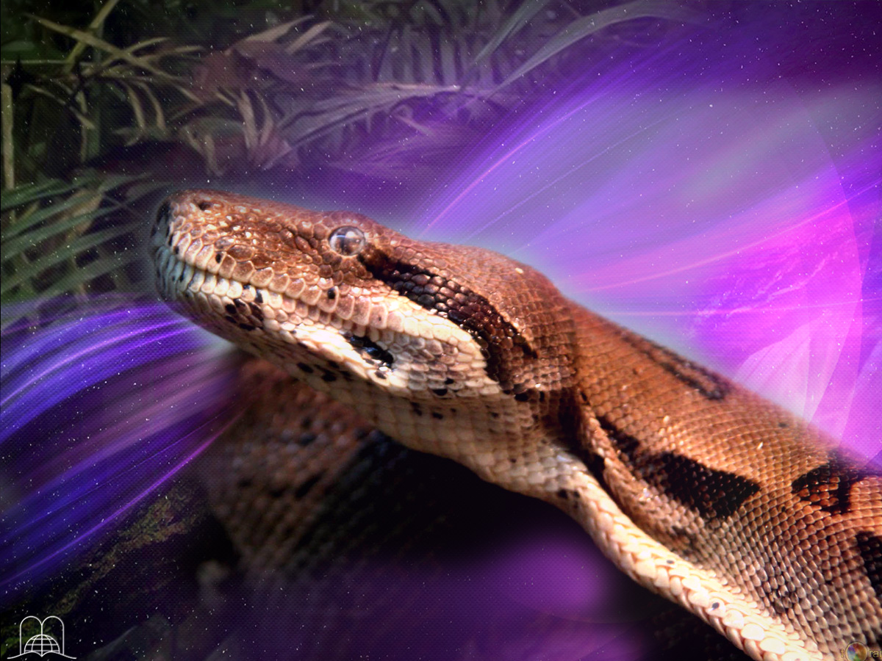
God told Adam and Eve that if they did not obey they would die. But,
What was
Satan‘s biggest lie?
Notes:
12- God told Adam and Eve that if they did not obey they would die (Genesis 2:16, 17), but what was Satan‘s biggest lie?

Slide 45
Genesis 3:4
"And the serpent said unto the woman, Ye shall not surely die.”
Notes:
Genesis 3:4
"And the serpent said unto the woman, Ye shall not surely die.”
For 6000 years, which has been believed by most cultures.
The cult of the dead existed among the Egyptians, who placed furniture, food and valuable treasures in the tombs of the Pharaos. There are millions today who believe that the dead are enjoying eternal lite or suffering punishment in purgatory or hell.

Slide 46

Who alone possesses immortality?
Notes:
13- Who alone possesses immortality?

Slide 47
1 Timothy 6:15, 16
"Which in his times he shall shew, who is the blessed and only Potentate, the King of kings, and Lord of lords; Who only hath immortality, dwelling in the light which no man can approach unto; whom no man hath seen, nor can see: to whom be honour and power everlasting. Amen.”
Notes:
1 Timothy 6:15, 16
"Which in his times he shall shew, who is the blessed and only Potentate, the King of kings, and Lord of lords; Who only hath immortality, dwelling in the light which no man can approach unto; whom no man hath seen, nor can see: to whom be honour and power everlasting. Amen.”
Jesus wants to give immortality to His children, at His second coming.
1 Corinthians 15:51-55.

Slide 48
Do we already have immortality,
or do we seek it?
Notes:
Do we already have immortality, or do we seek it?

Slide 49
Romans 2:7
“To them who by patient continuance in well doing seek for glory and honour and immortality, eternal life.”
Notes:
Romans 2:7
“To them who by patient continuance in well doing seek for glory and honour and immortality, eternal life.”

Slide 50
There are two ways to die: in sin or in Christ (eternal life).
John 11:25
“He that believeth in me, though he were dead, yet shall he live”
Notes:
The Holy Scriptures say that a person who has the Son has life (John 5:11-13). Our life is hidden in Christ.
There are two ways to die: in sin or in Christ (eternal life).
When we seek eternal life, we are able to obtain it with the help of the Holy Ghost. The gospel prepares us to arise at the last call when Jesus will come. “I am the bread of life: he that cometh to me shall never hunger; and he that believeth in me shall never thirst.” (John 6:35). He also said: “He that believeth in me, though he were dead, yet shall he live.” (John 11:25)

Slide 51
CONCLUSION
Notes:
CONCLUSION
Death is the opposite of life. When man dies he ceases to exist; he becomes unconscious.
In spite of this, our great hope is in Jesus' second coming, when we will meet our loved ones who died in Christ.

Slide 52
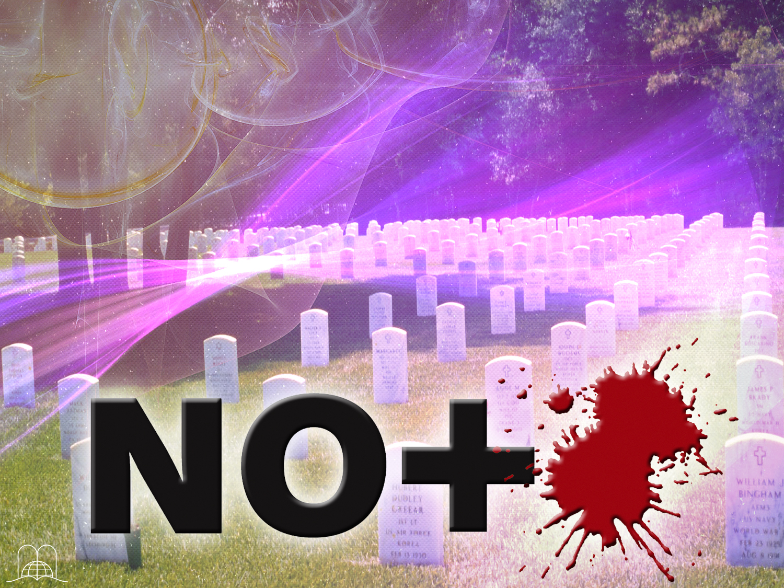
What will Jesus finally do with death?
Notes:
15- What will Jesus finally do with death?

Slide 53
"And God shall wipe away all tears from their eyes; and there shall be no more death, neither sorrow, nor crying, neither shall there be any more pain: for the former things are passed away."
Revelation 21:4
Notes:
Revelation 21:4
"And God shall wipe away all tears from their eyes; and there shall be no more death, neither sorrow, nor crying, neither shall there be any more pain: for the former things are passed away."
He will destroy it forever.

Slide 54

Our lives hang from a thread!
Notes:
We should always be prepared, because our life hangs by a thread.
At the Whytby museum in England, there is a large glass case where one can see a key that appears to be suspended in air. It is hard to grasp how this is possible. This is actually caused by a magnet placed above the key and a very thin, almost invisible thread holding the key to the bottom. Our lives hang from a thread like this, and for this reason, we should always be prepared for death.
Once our life is over, there is no more opportunity to look for salvation. Today is the day for us to make a decision. Through Christ, who defeated death, we have the glorious hope of inheriting eternal life. We should thank God for this and also for the careful way in which He reveals this subject in His word.

Slide 55
Thank you,
Lord, for having
conquered Death!
Notes:
Thank you, Lord, for having conquered Death!

Slide 56

The next topic: "Divine advices against mysterious forces”
There are many mysterious things in the world that fill us with curiosity: Some say they talk to the dead. There are forces that can do well or bad, they have thrown entire families to misery and death. How can we defend ourselves from that?
We will see the Bible advice about this and we will know the collection of the devil.
GOD BLESS YOU!
Notes:
GOD BLESS YOU!
The next topic: "Divine advices against mysterious forces”
There are many mysterious things in the world that fill us with curiosity: Some say they talk to the dead. There are forces that can do well or bad, they have thrown entire families to misery and death. How can we defend ourselves from that?
We will see the Bible advice about this and we will know the collection of the devil. It is a really interesting topic.

Slide 57

biblewell.org
info@biblewell.org
Notes:
If you still have questions, write to us confidently at: info@biblewell.org

