Slide 1
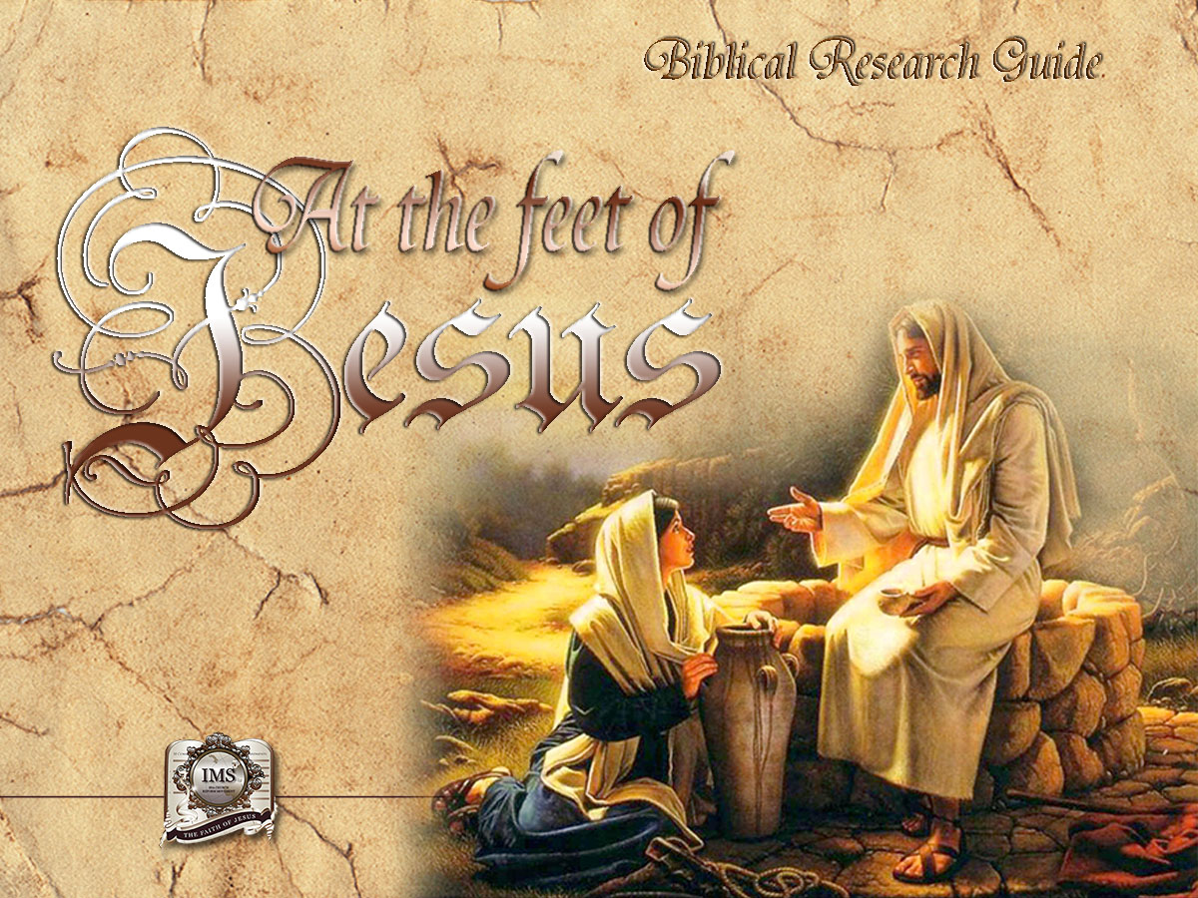

General Conference
Multimedia Department
Notes:
BIBLICAL RESEARCH GUIDE: “AT THE FEET OF JESUS”

Slide 2
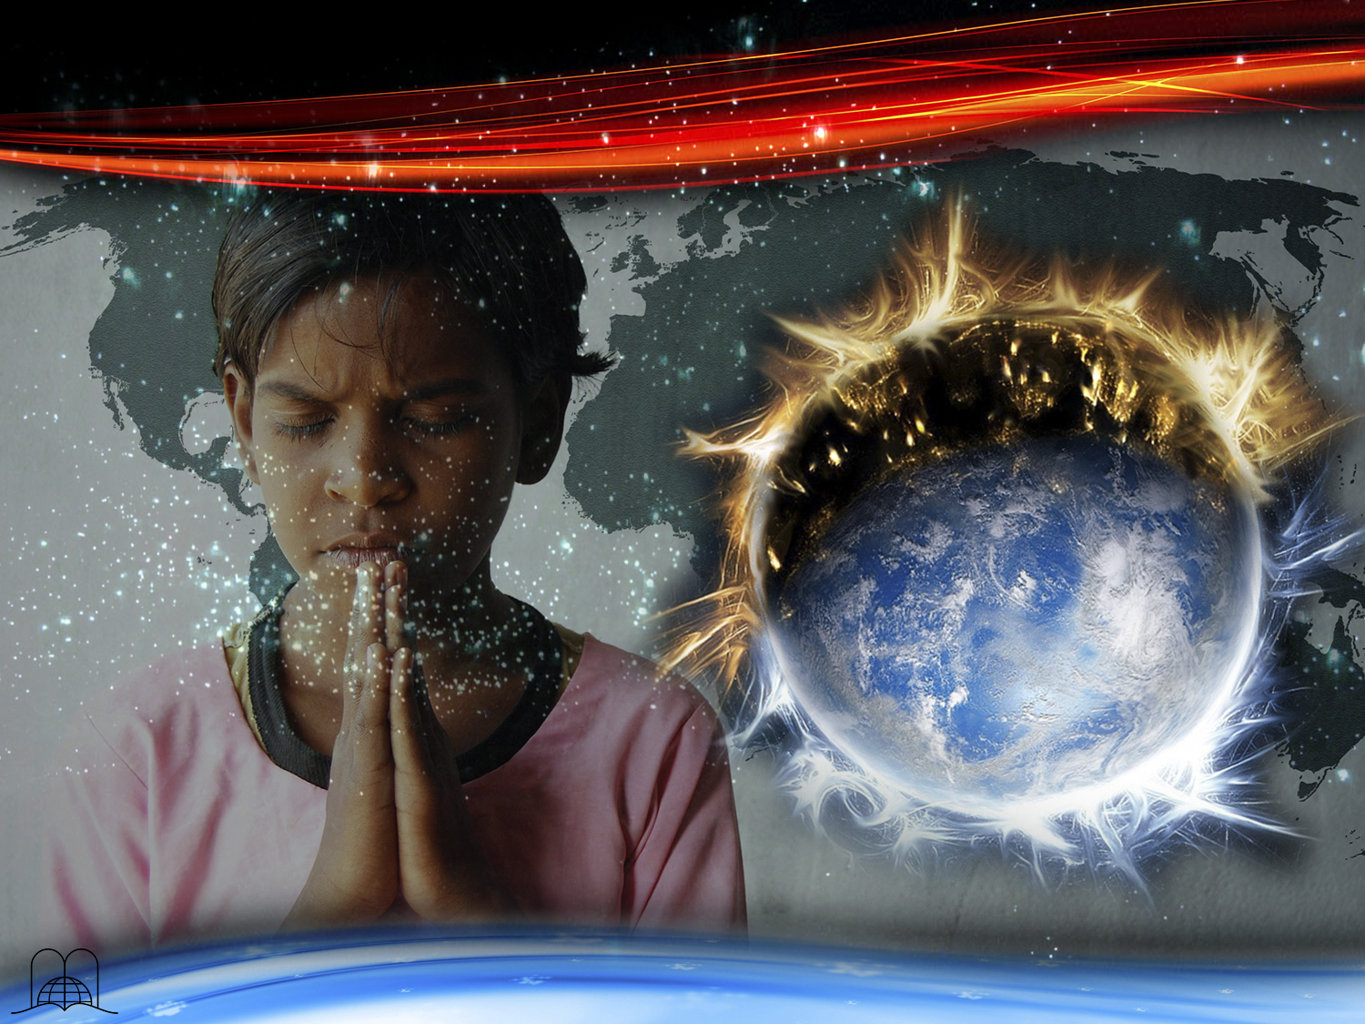
A moment
of Prayer
Notes:
A moment of prayer…

Slide 3
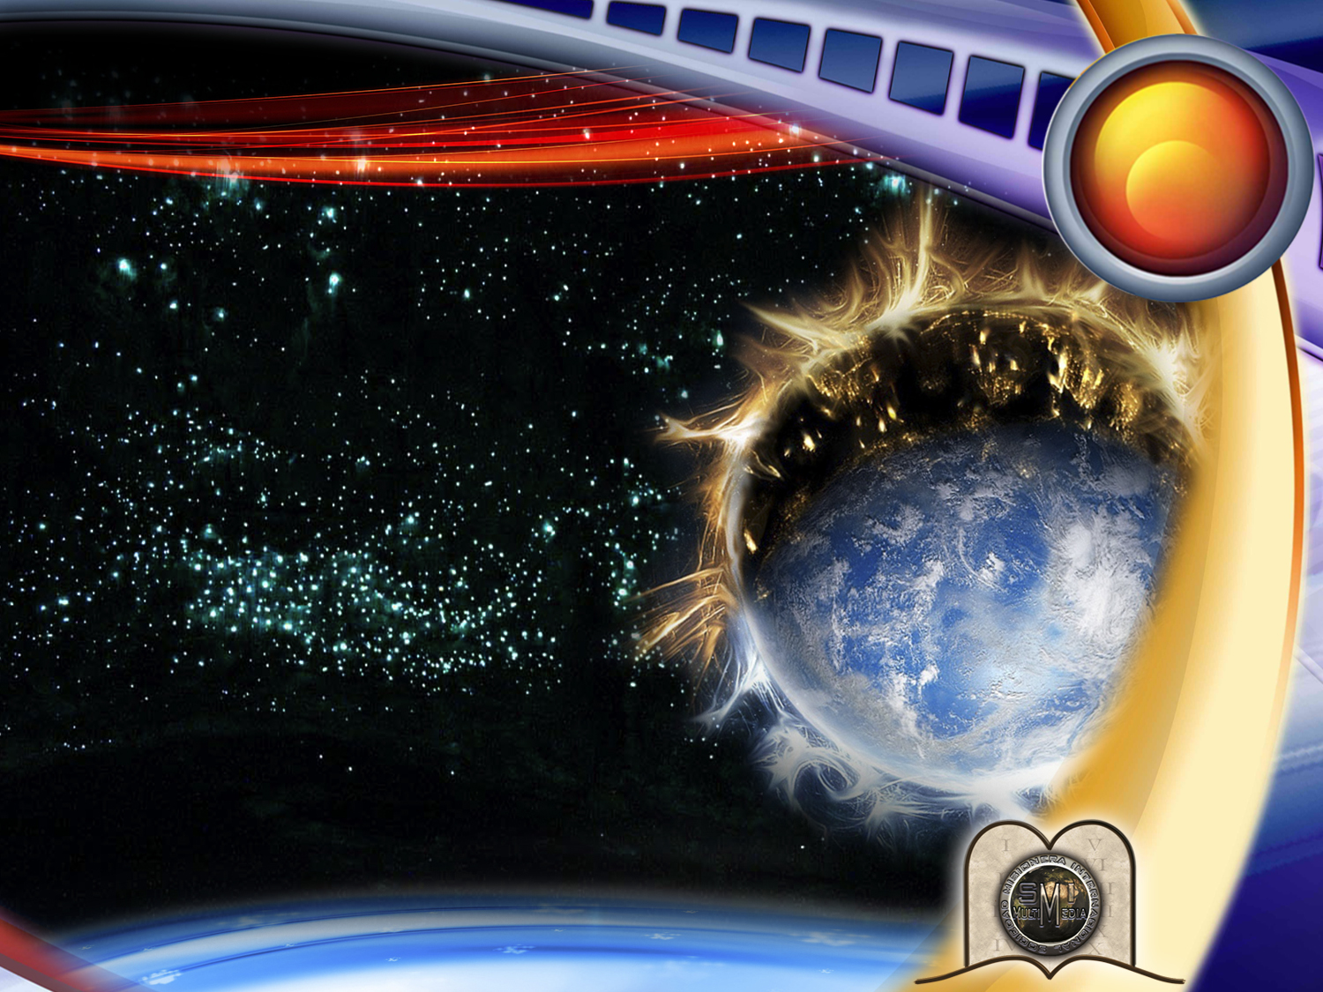
18
THE BOOK OF REVELATION AND OUR PLANET'S DESTINY
Notes:
Lesson 18
THE BOOK OF REVELATION AND OUR PLANET'S DESTINY
What will happen to our planet at the end of the world? Will it disappear? What will happen after that? Where will we live - in heaven or on the earth? God created this planet to be inhabited, but Paul wrote that we shall be caught up in the clouds of heaven (1 Thessalonians 4:16, 17). Will we ever come back to earth?...

Slide 4
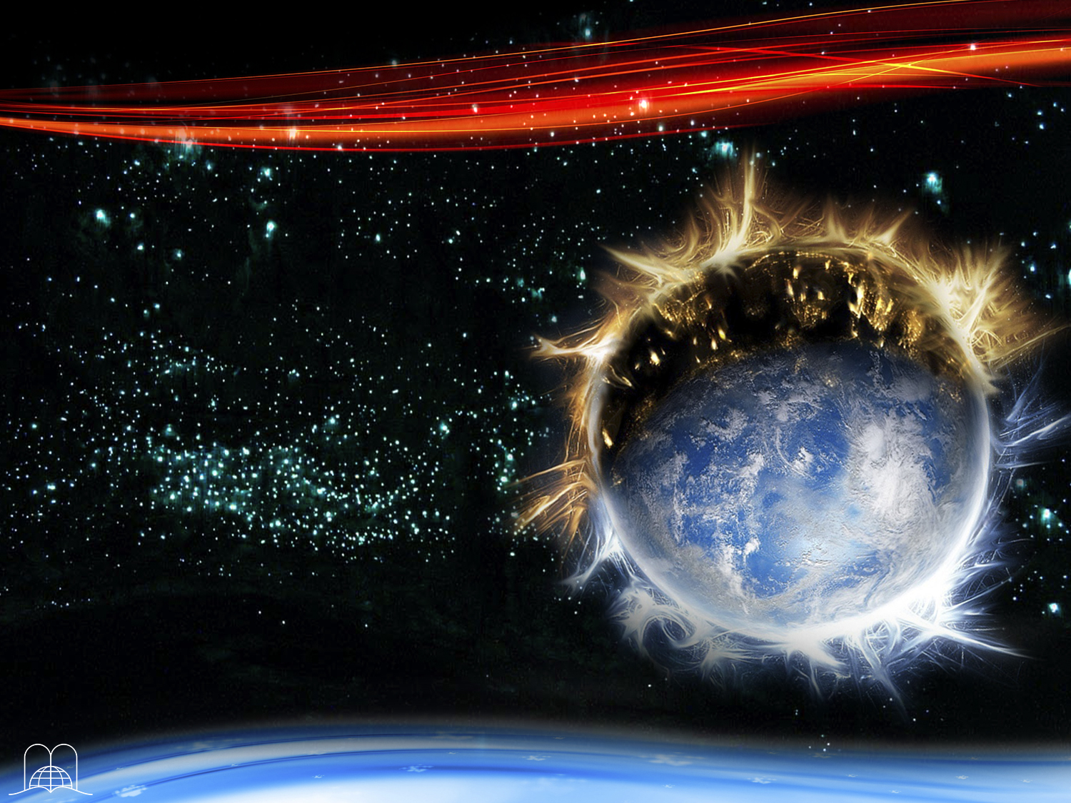
When will the last judgment take place and what will happen to the wicked?
Will they be punished?
The book of Revelation tells of a universal war; where will it take place?
It also mentions a millennium, what does it consist of?
What will be the devil's vacation?
Notes:
When will the last judgment take place and what will happen to the wicked? Will they be punished? The book of Revelation tells of a universal war; where will it take place? It also mentions a millennium, what does it consist of? What will be the devil's vacation?
These important questions have worried many people for centuries. If two people are in love and wish to get married, they make plans about where they are going to live and what their new home will be like. Will God leave us in uncertainty? Never. Christ did everything to save us and give us the wonderful hope of eternal life. In the wonderful hook of Revelation, the last events of the world ‘are described.

Slide 5
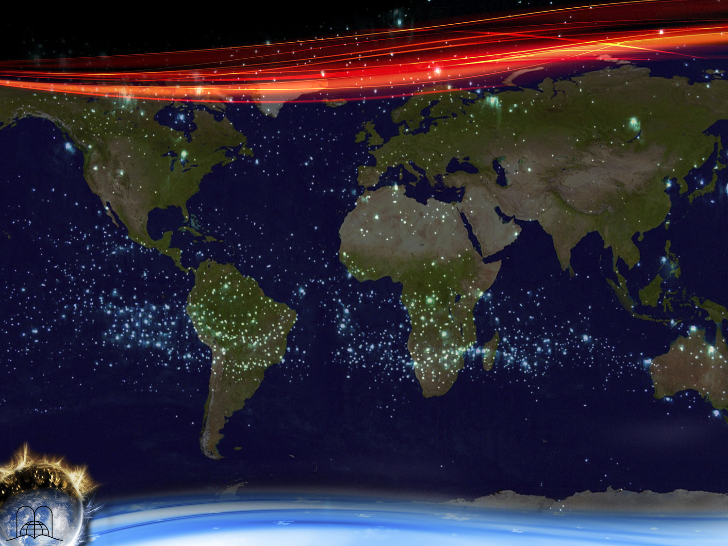
The
Development
Of Events
Notes:
THE DEVELOPMENT OF EVENTS

Slide 6
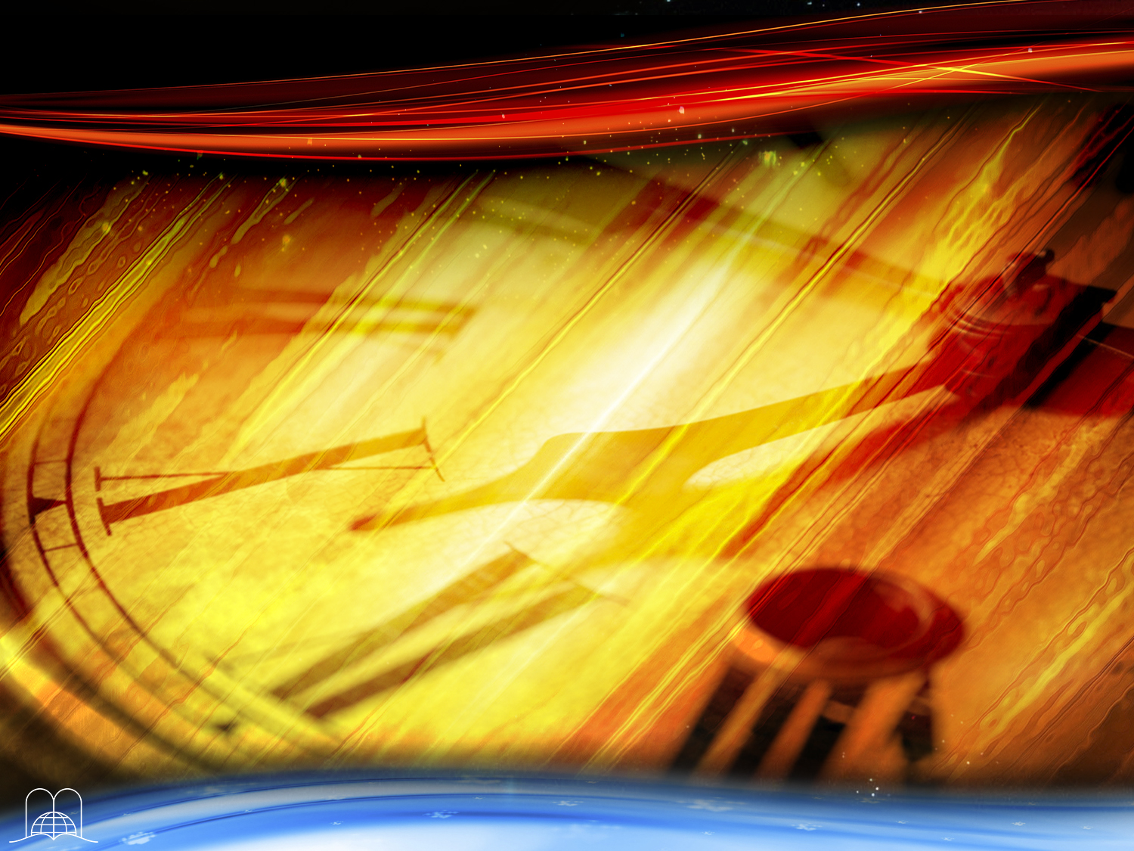
Today it is still possible
to be saved.
We are living in the
time of grace.
With what urgent
petition does God address humanity?
Notes:
1. Today it is still possible to be saved. We are living in the time of grace. With what urgent petition does God address humanity?

Slide 7
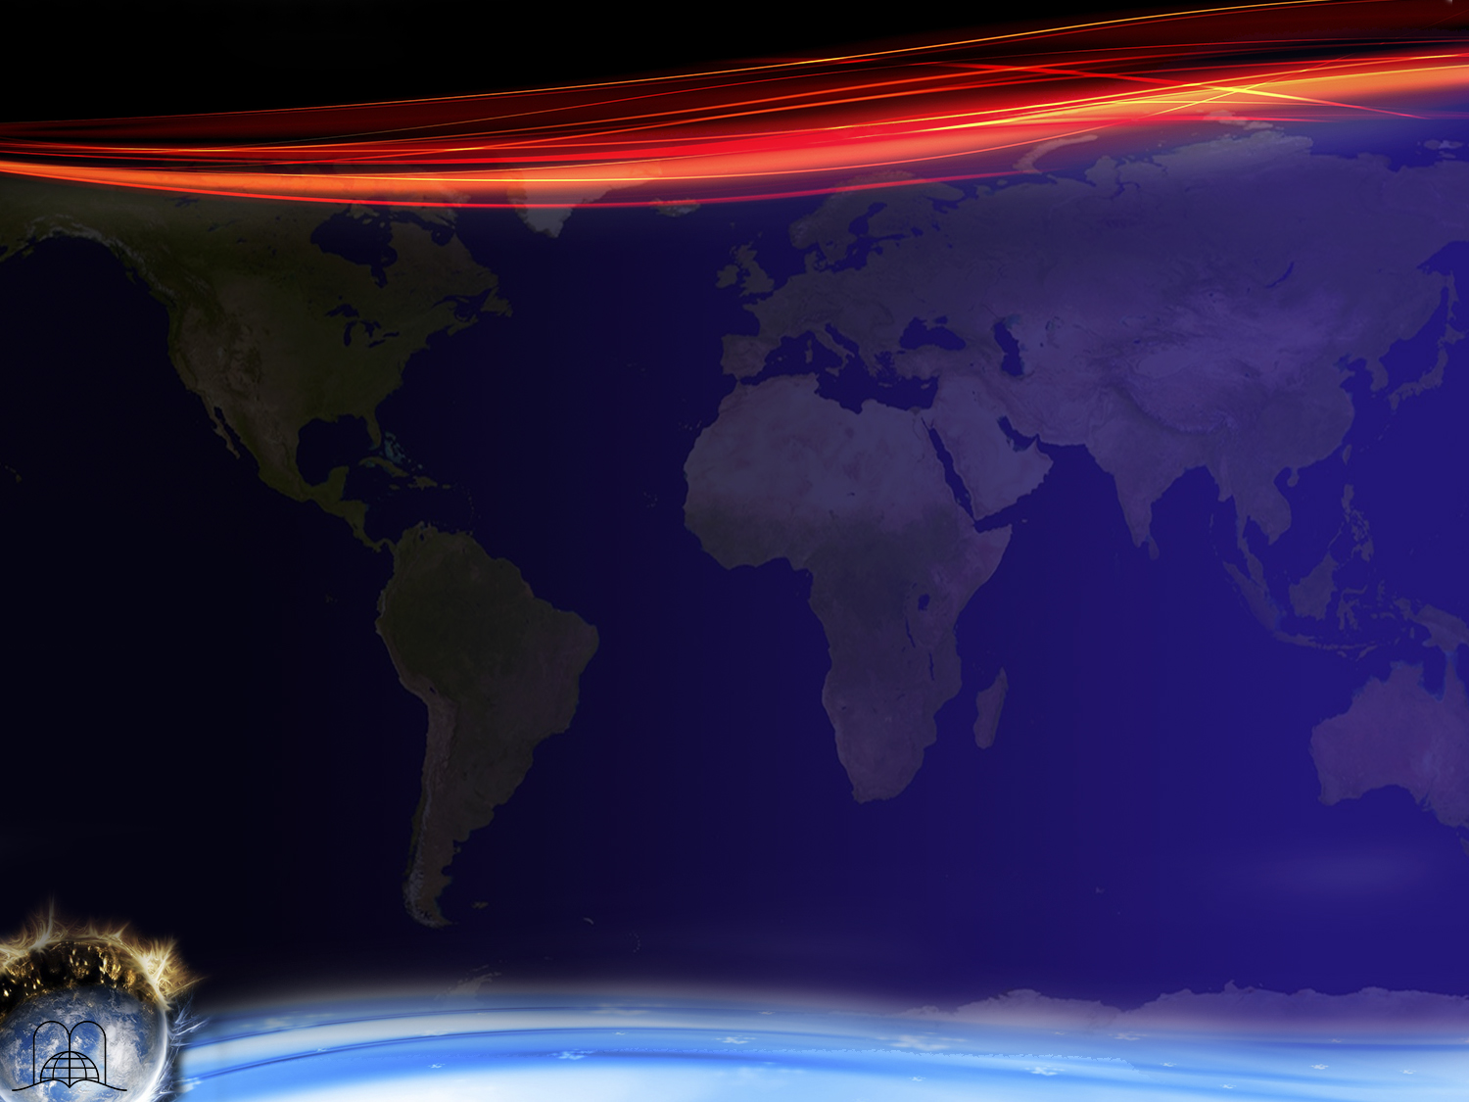
Revelation 14:6-7
“And I saw another angel fly in the midst of heaven, having the everlasting gospel to preach unto them that dwell on the earth, and to every nation, and kindred, and tongue, and people,
Saying with a loud voice, Fear God, and give glory to him; for the hour of his judgment is come: and worship him that made heaven, and earth, and the sea, and the fountains of waters..”
Notes:
Revelation 14:6-7
“And I saw another angel fly in the midst of heaven, having the everlasting gospel to preach unto them that dwell on the earth, and to every nation, and kindred, and tongue, and people,
Saying with a loud voice, Fear God, and give glory to him; for the hour of his judgment is come: and worship him that made heaven, and earth, and the sea, and the fountains of waters.»
"Fear God and give glory to Him; for the hour of His judgment is come.”
In Revelation 18:4, He calls us to come out of Babylon which represents the religious confusion of our time.

Slide 8
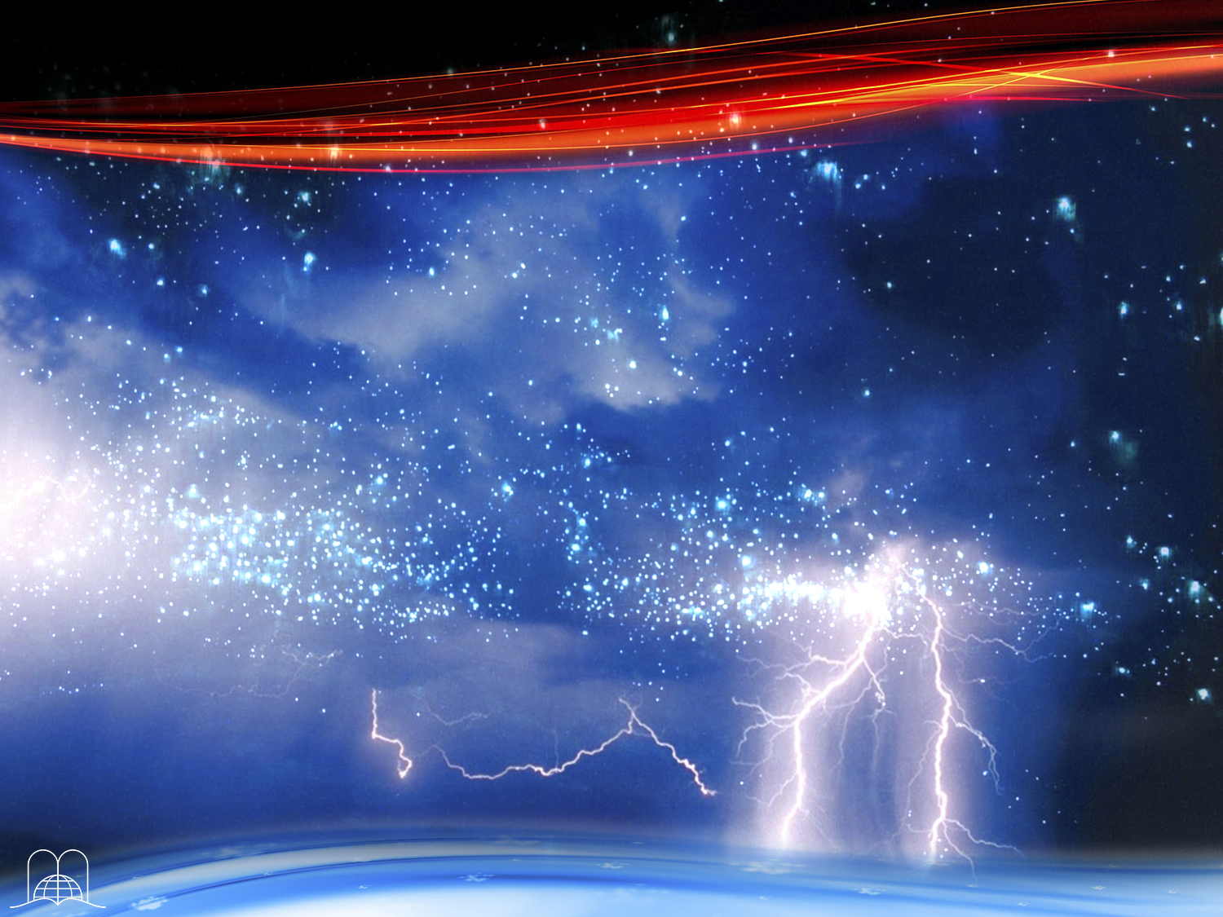
Soon the door of grace will close. All opportunity to choose God's way will come to an end, and Christ will stop interceding for men.
What will then
be heard in heaven?
Notes:
2- Soon the door of grace will close. All opportunity to choose God's way will come to an end, and Christ will stop interceding for men. What will then be heard in heaven?

Slide 9
Revelation 22:11
“He that is unjust, let him be unjust still: and he which is filthy, let him be filthy still: and he that is righteous, let him be righteous still: and he that is holy, let him be holy still.”
Notes:
Revelation 22:11
“He that is unjust, let him be unjust still: and he which is filthy, let him be filthy still: and he that is righteous, let him be righteous still: and he that is holy, let him be holy still.”
"He that is unjust, let him be unjust still, and he which is filthy, let him be filthy still, and he that is righteous, let him be righteous, still, and he that is holy, let him be holy still.”
In other words, every person's eternal destiny will have been sealed, for salvation or perdition.
The one who until that moment has been preparing will be saved and the one who will not be definitely lost, that's why, today is the time to seek God!

Slide 10
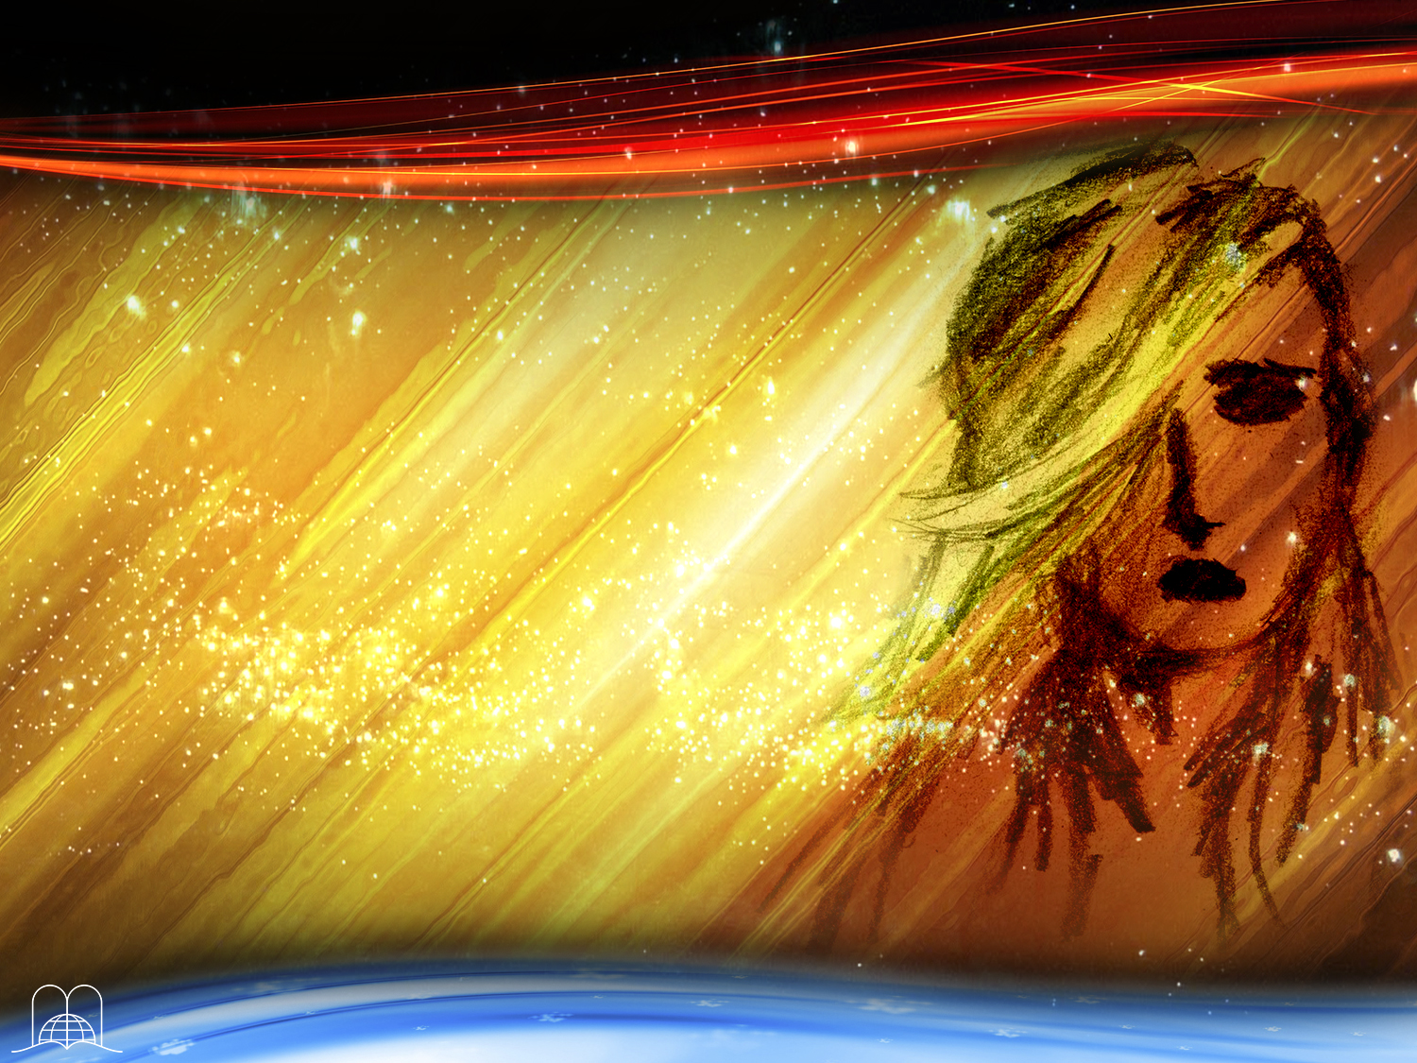
What will come after the time of grace is over?
Notes:
3. What will come after the time of grace is over?

Slide 11
Daniel 12:1
“And at that time shall Michael stand up, the great prince which standeth for the children of thy people: and there shall be a time of trouble, such as never was since there was a nation even to that same time: and at that time thy people shall be delivered, every one that shall be found written in the book.”
Notes:
Daniel 12:1; (Revelation 15:1)
“And at that time shall Michael stand up, the great prince which standeth for the children of thy people: and there shall be a time of trouble, such as never was since there was a nation even to that same time: and at that time thy people shall be delivered, every one that shall be found written in the book.”
The time of tribulation, meaning the seven last plagues.
This time of trial will be terrible for humanity. The ten plagues that fell on Egypt were an example of what the last seven plagues will be like. Under the first plague, people will suffer grievous, terrible sores. During the second and third plagues the waters of the rivers and the ocean will be turned into blood, as the blood of a dead man.

Slide 12
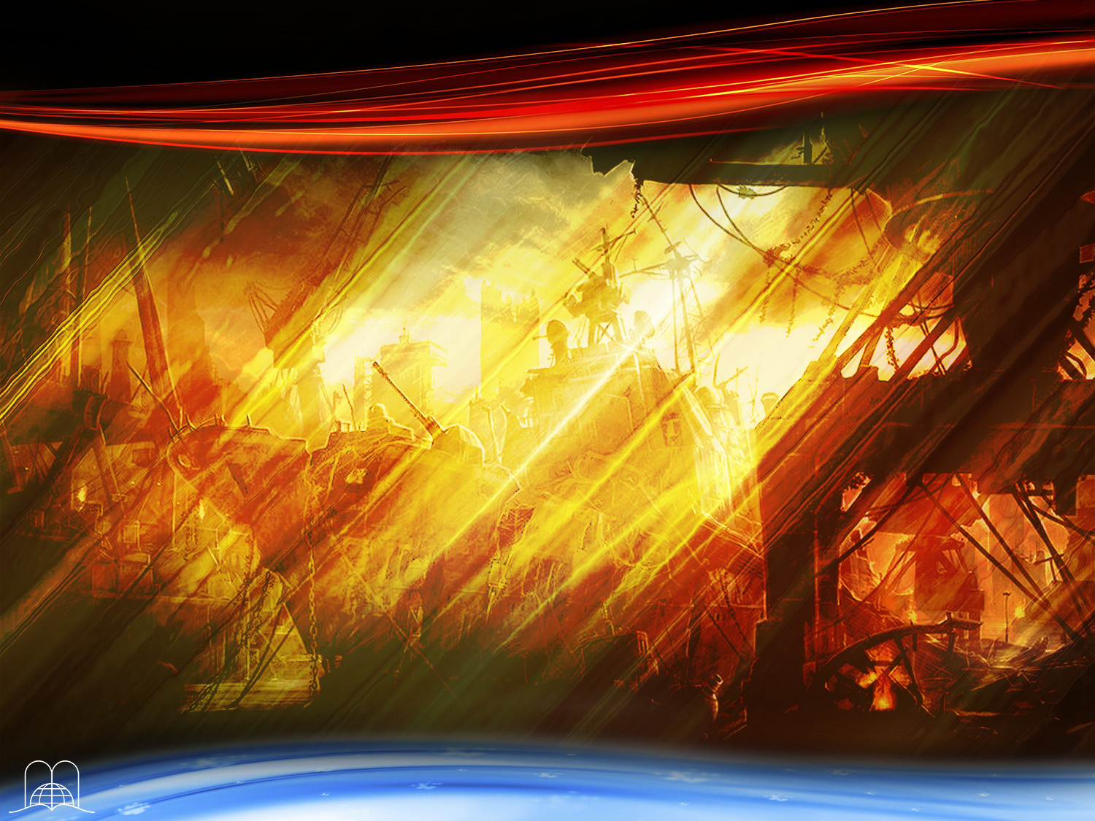
What is the name
of the terrible war
that will break out
during the sixth plague?
Notes:
4. What is the name of the terrible war that will break out during the sixth plague?

Slide 13
Revelation 16:16
“And he gathered them together into a place called in the Hebrew tongue Armageddon.”
Notes:
Revelation 16:16
“And he gathered them together into a place called in the Hebrew tongue Armageddon.”
Armageddon
a) The setting for this war will be the Middle East, near Jerusalem.
b) All the nations of the world will be involved. (Joel 3:9-14).
The Jews, Muslims and Christians all claim the Holy Land as theirs. Is is a region which has for centuries seethed with strife.
More than 3900 years ago, when Abraham’s wife could not bear a child, she arranged for Abraham to take Hagar, and a son named Ishmael was born.
Later, when Abraham was 100 years old, his own son, Isaac, was born. Ishmael made fun of his brother Isaac. (Genesis 21:9). Abraham, with God’s permission, sent the mother and child away. But God promised Hagar that a great nation would come from her son.
- From these two sons of Abraham two great nations were born; the Arab people descend from Ishmael, the Israelites from Isaac. From that time until now there has always been severe tension between these two groups of people.
The Middle East is very rich in oil. Could a power struggle arise because of this?.
c) There will be great bloodshed. (Revelation 14:20).
The Bible says that blood is going to come up to the horses’ bridles. This expression, in symbolic language, shows us the cruelty of such a war.

Slide 14
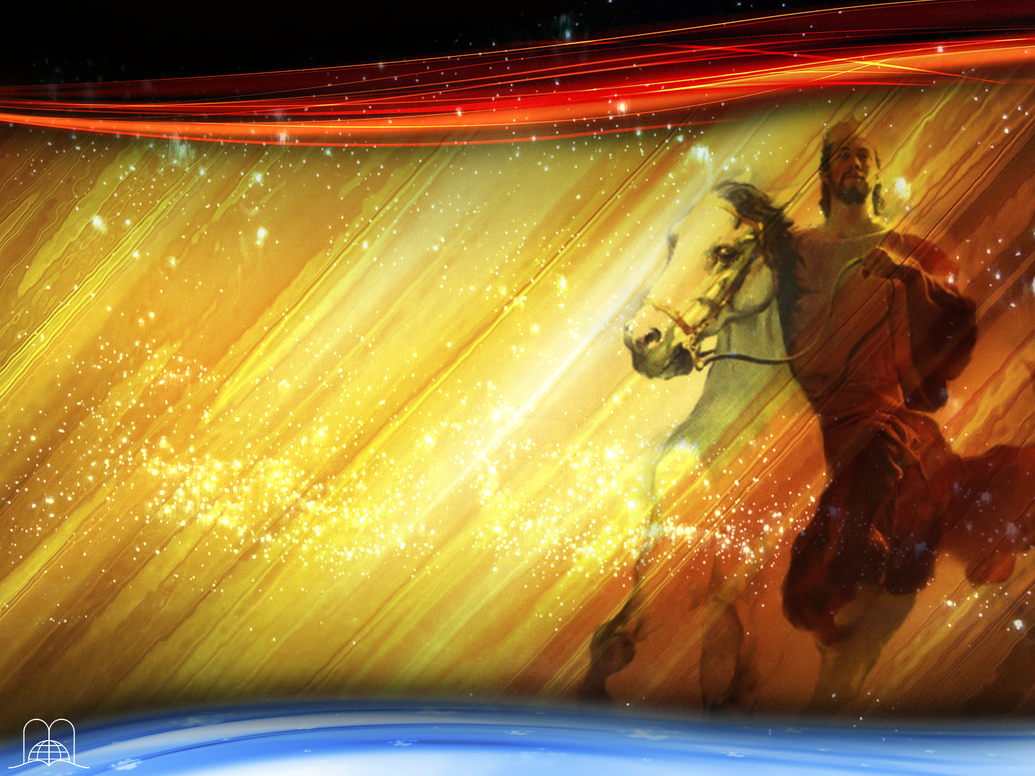
Who will win this war?
Christ will be the great victor
Notes:
d) This war will also be a battle between Satan and his followers against Christ and His people.
e) Who will win this war? Christ will be the great victor. Revelation 19:13-16.

Slide 15
Revelation 19:13-16
“And he was clothed with a vesture dipped in blood: and his name is called THE WORD OF GOD.
And the armies which were in heaven followed him upon white horses, clothed in fine linen, white and clean...
Notes:
Revelation 19:13-16.
“And he was clothed with a vesture dipped in blood: and his name is called THE WORD OF GOD.
And the armies which were in heaven followed him upon white horses, clothed in fine linen, white and clean.

Slide 16
Revelation 19:13-16
…And out of his mouth goeth a sharp sword, that with it he should smite the nations: and he shall rule them with a rod of iron: and he treadeth the winepress of the fierceness and wrath of Almighty God.
And he hath on his vesture and on his thigh a name written, KING OF KINGS, AND LORD OF LORDS.”
Notes:
…And out of his mouth goeth a sharp sword, that with it he should smite the nations: and he shall rule them with a rod of iron: and he treadeth the winepress of the fierceness and wrath of Almighty God.
And he hath on his vesture and on his thigh a name written, KING OF KINGS, AND LORD OF LORDS.”

Slide 17
EVENTS AT THE BEGINNING OF THE MILLENIUM
Notes:
EVENTS AT THE BEGINNING OF THE MILLENIUM

Slide 18
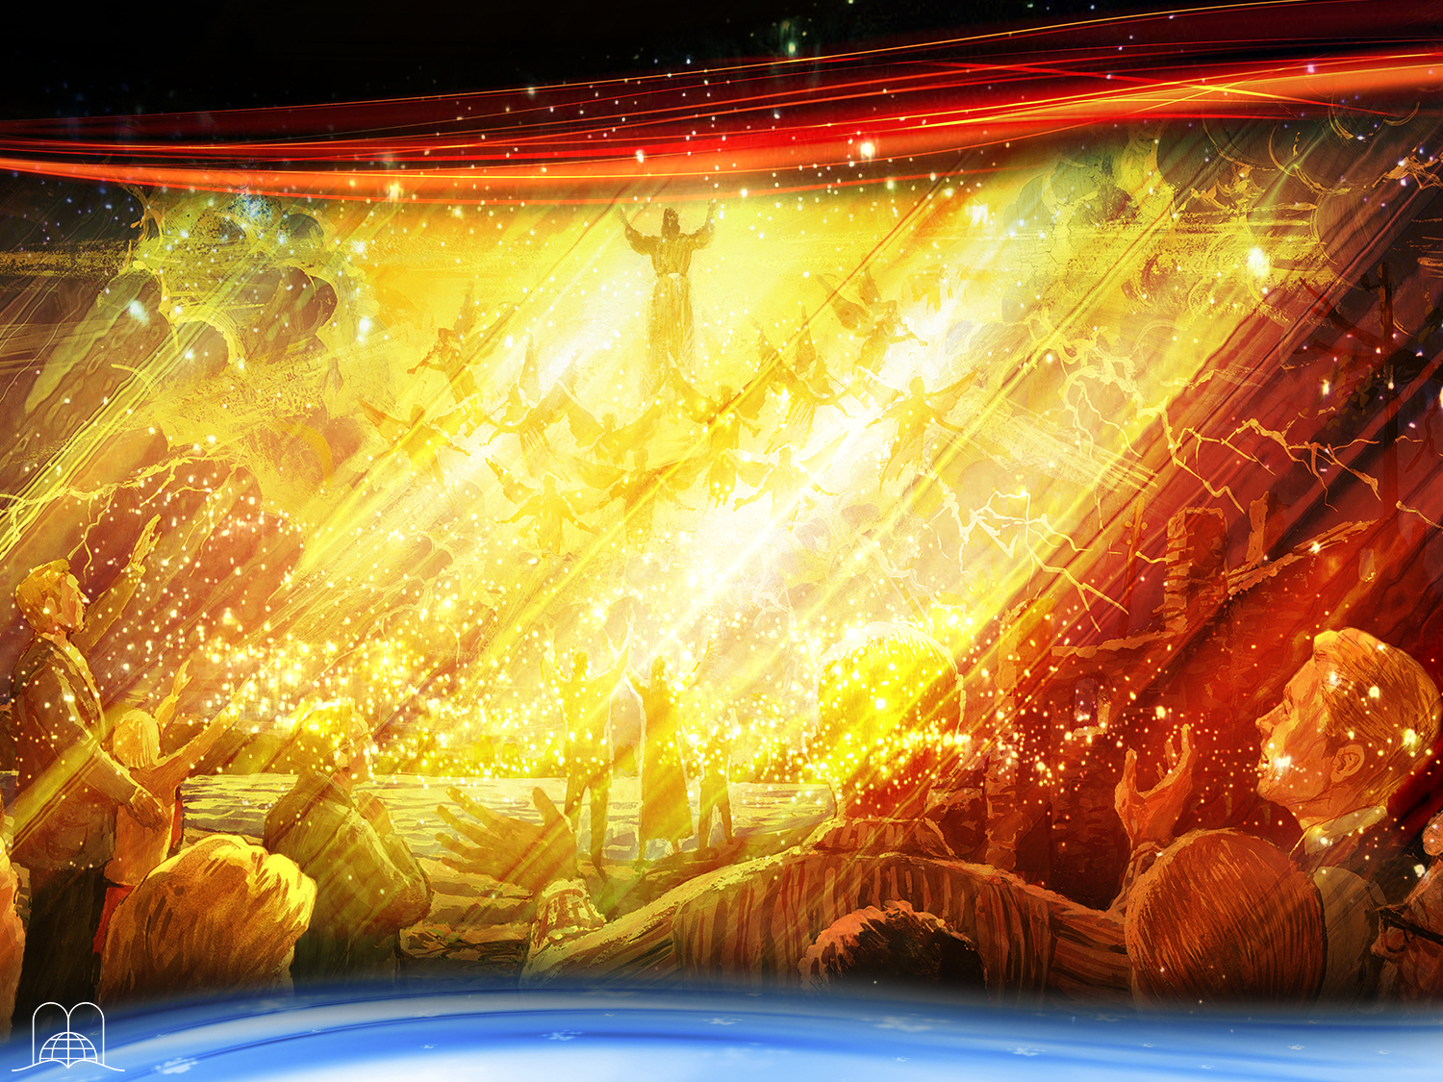
What event will mark the end of the world and the beginning of the one-thousand-year period?
Notes:
5. What event will mark the end of the world and the beginning of the one-thousand-year period?

Slide 19
Revelation 14:14-16
“And I looked, and behold a white cloud, and upon the cloud one sat like unto the Son of man, having on his head a golden crown, and in his hand a sharp sickle.
And another angel came out of the temple, crying with a loud voice to him that sat on the cloud, Thrust in thy sickle, and reap: for the time is come for thee to reap; for the harvest of the earth is ripe.
And he that sat on the cloud thrust in his sickle on the earth; and the earth was reaped.”
Notes:
Revelation 14:14-16
“And I looked, and behold a white cloud, and upon the cloud one sat like unto the Son of man, having on his head a golden crown, and in his hand a sharp sickle.
And another angel came out of the temple, crying with a loud voice to him that sat on the cloud, Thrust in thy sickle, and reap: for the time is come for thee to reap; for the harvest of the earth is ripe.
And he that sat on the cloud thrust in his sickle on the earth; and the earth was reaped.”
The second coming of Christ.
-Every eye will see Him. (Revelation 1:7), and every ear will hear Him (1 Thessalonians 4:16).
- The sky will roll up as a scroll, and the islands will be moved out of their places. (Revelation 6:14).

Slide 20

After a great earthquake, what will happen to those who have died in Christ?
Notes:
6. After a great earthquake, what will happen to those who have died in Christ? (Revelation 16:18)

Slide 21
1 Thessalonians 4:16
“For the Lord himself shall descend from heaven with a shout, with the voice of the archangel, and with the trump of God: and the dead in Christ shall rise first.”
Notes:
1 Thessalonians 4:16
“For the Lord himself shall descend from heaven with a shout, with the voice of the archangel, and with the trump of God: and the dead in Christ shall rise first.”
Those who are raised in this resurrection are called blessed. Revelation 20:6.

Slide 22
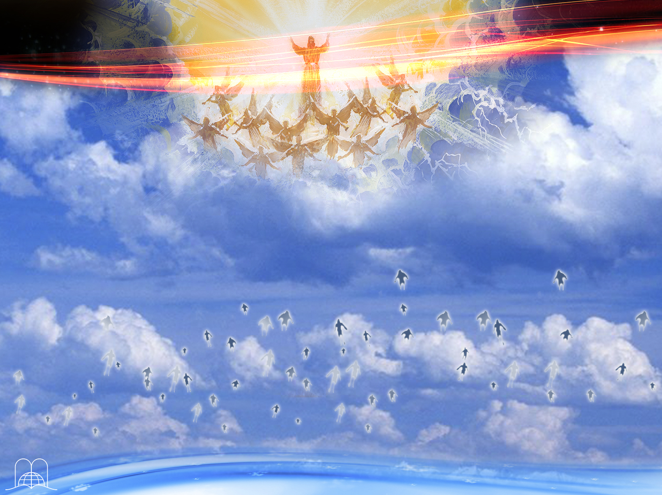
What will happen to those who are resurrected and the righteous who are alive at Jesus' coming?
Notes:
7. What will happen to those who are resurrected and the righteous who are alive at Jesus' coming?

Slide 23
1 Thessalonians 4:17
“Then we which are alive and remain shall be caught up together with them in the clouds, to meet the Lord in the air: and so shall we ever be with the Lord.”
Notes:
1 Thessalonians 4:17
“Then we which are alive and remain shall be caught up together with them in the clouds, to meet the Lord in the air: and so shall we ever be with the Lord.”
* They will be changed to immortality. (1 Corinthians 15:51-54) and caught in the clouds.The righteous will take a trip through space up to the heavenly dwellings where they will reign with Christ for a thousand years.

Slide 24
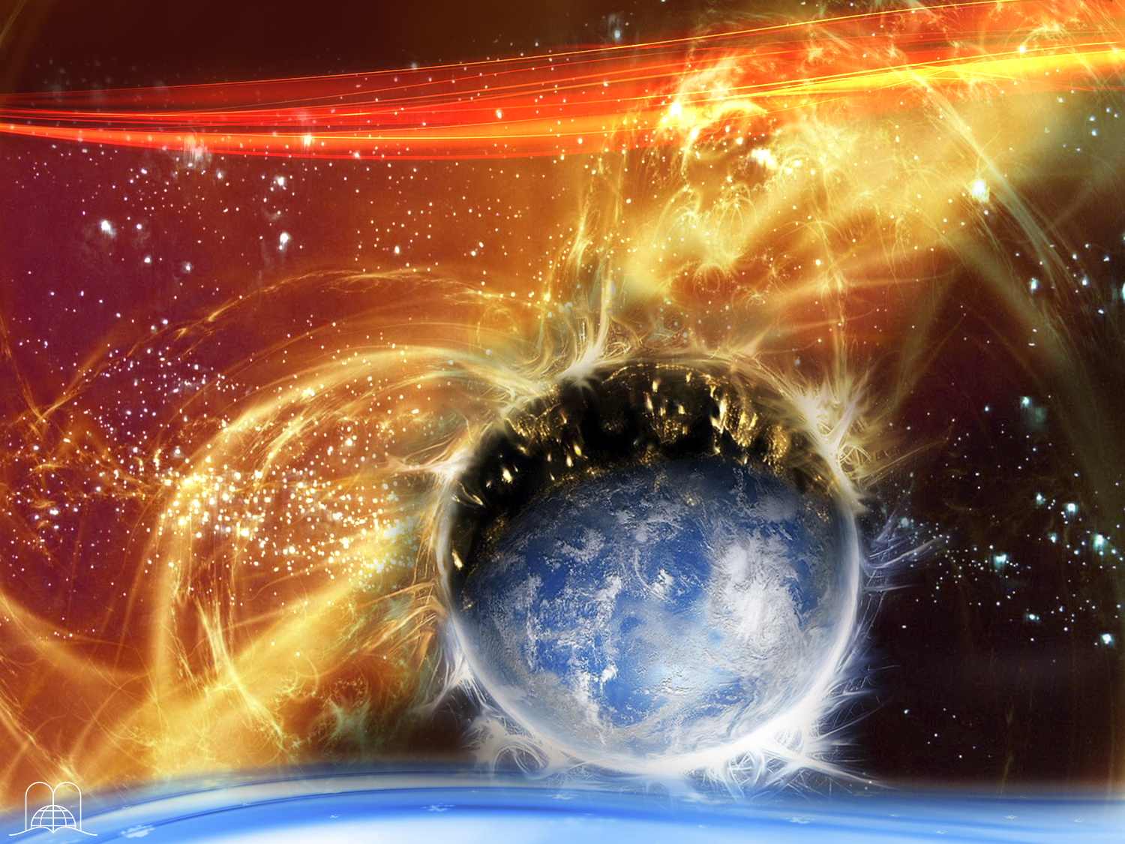
What will happen to the wicked who are still alive when Jesus comes?
Notes:
8. What will happen to the wicked who are still alive when Jesus comes?

Slide 25
2 Thessalonians 1:7-9
“…when the Lord Jesus shall be revealed from heaven with his mighty angels, In flaming fire taking vengeance on them that know not God, and that obey not the gospel of our Lord Jesus Christ: Who shall be punished with everlasting destruction from the presence of the Lord, and from the glory of his power
Notes:
2 Thessalonians 1:7-9
“…when the Lord Jesus shall be revealed from heaven with his mighty angels, In flaming fire taking vengeance on them that know not God, and that obey not the gospel of our Lord Jesus Christ: Who shall be punished with everlasting destruction from the presence of the Lord, and from the glory of his power”
They will be punished with everlasting destruction by fire.
The wicked who are dead remain dead.

Slide 26
EVENTS DURING
THE MILLENNIUM
Notes:
EVENTS DURING THE MILLENNIUM

Slide 27
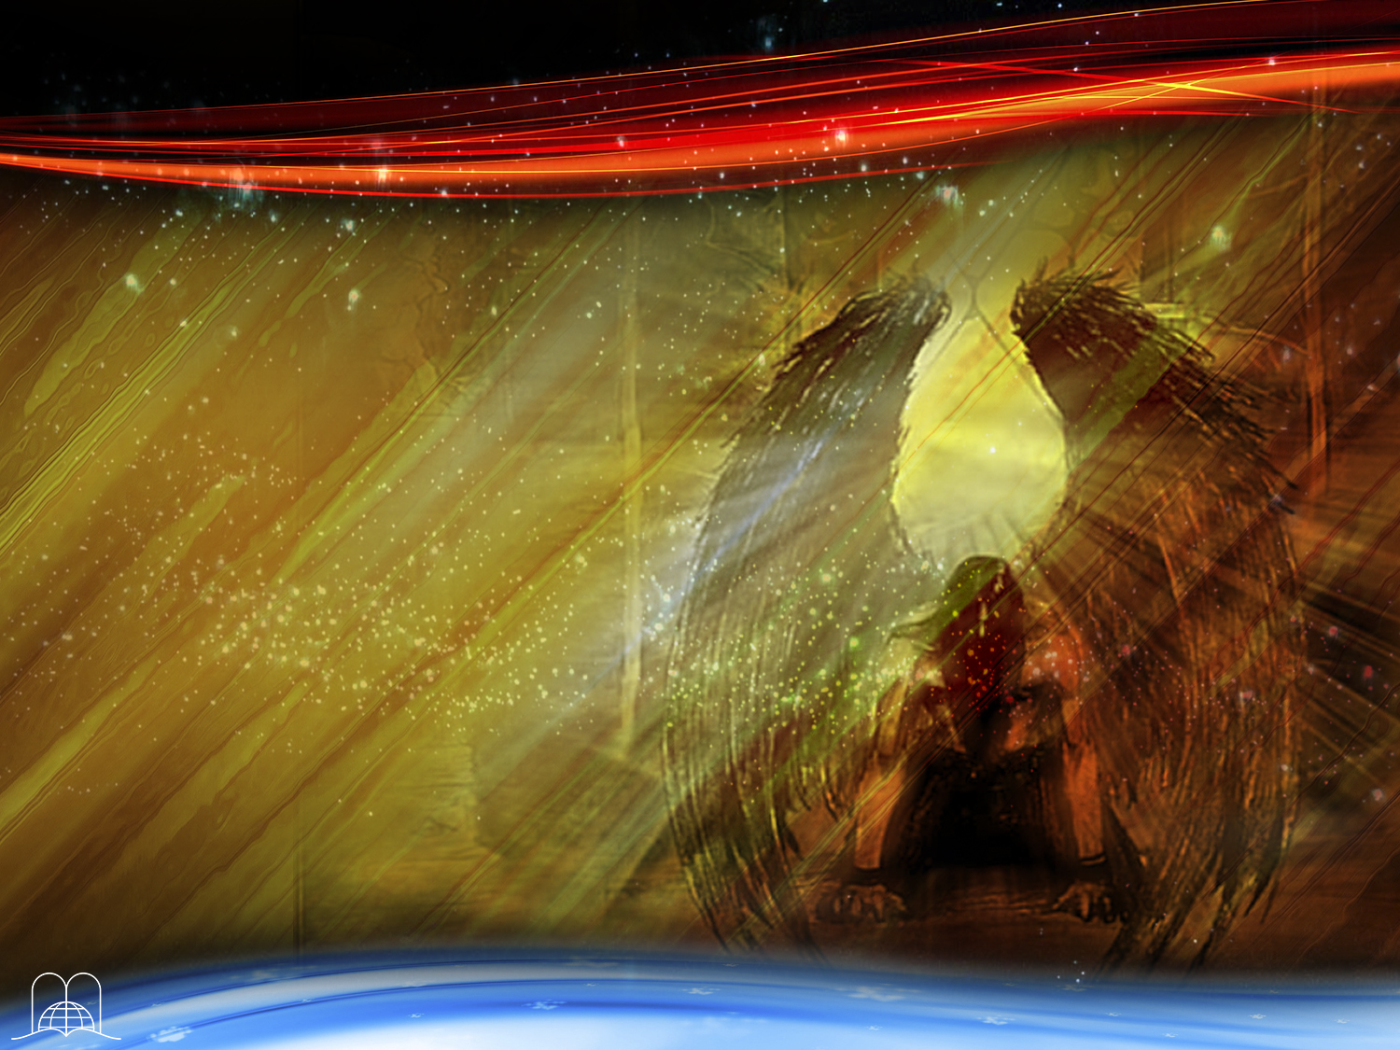
What
will happen to Satan?
Notes:
9. What will happen to Satan?

Slide 28
Revelation 20:1-3
“And I saw an angel come down from heaven, having the key of the bottomless pit and a great chain in his hand.
And he laid hold on the dragon, that old serpent, which is the Devil, and Satan, and bound him a thousand years, and cast him into the bottomless pit, and shut him up, and set a seal upon him, that he should deceive the nations no more, till the thousand years should be fulfilled: and after that he must be loosed a little season.”
Notes:
Revelation 20:1-3
“And I saw an angel come down from heaven, having the key of the bottomless pit and a great chain in his hand.
And he laid hold on the dragon, that old serpent, which is the Devil, and Satan, and bound him a thousand years,
And cast him into the bottomless pit, and shut him up, and set a seal upon him, that he should deceive the nations no more, till the thousand years should be fulfilled: and after that he must be loosed a little season.”
Satan will be bound for a thousand years.
He will not be literally bound but will be tied up by circumstances in that he will have no one to deceive, since the wicked will be dead and the righteous will be in heaven. This will be the vacation for the devil.

Slide 29
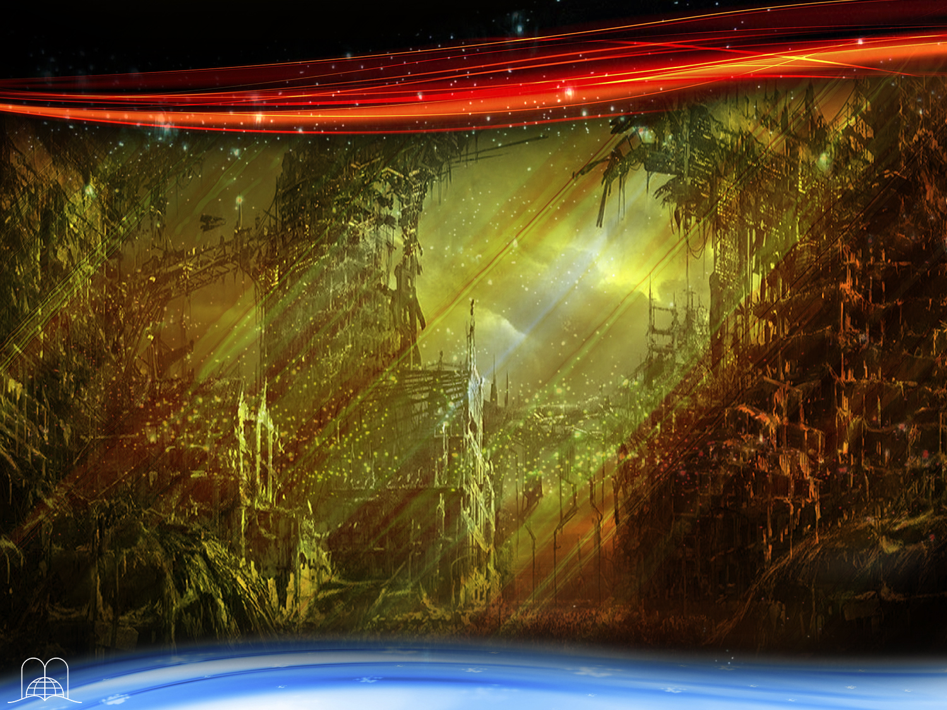
What will the earth be like during the one thousand years?
Notes:
10. What will the earth be like during the one thousand years?

Slide 30
Jeremiah 4:23-27
“I beheld the earth, and, lo, it was without form, and void; and the heavens, and they had no light. I beheld the mountains, and, lo, they trembled, and all the hills moved lightly.
I beheld, and, lo, there was no man, and all the birds of the heavens were fled. I beheld, and, lo, the fruitful place was a wilderness, and all the cities thereof were broken down at the presence of the Lord, and by his fierce anger. For thus hath the Lord said, The whole land shall be desolate; yet will I not make a full end.”
Notes:
Jeremiah 4:23-27
“I beheld the earth, and, lo, it was without form, and void; and the heavens, and they had no light.
I beheld the mountains, and, lo, they trembled, and all the hills moved lightly.
I beheld, and, lo, there was no man, and all the birds of the heavens were fled.
I beheld, and, lo, the fruitful place was a wilderness, and all the cities thereof were broken down at the presence of the Lord, and by his fierce anger.
For thus hath the Lord said, The whole land shall be desolate; yet will I not make a full end.”
a) What makes the earth desolate?
° The seven plagues will have destroyed much.
° Armageddon will leave many dead bodies. Jeremiah 25:33. (Isaiah 24:22).
° The terrible earthquake of the seventh plague will destroy all the cities of the world.
° The coming of Christ amid the flames of fire will complete the destruction. (2 Thessalonians 1:7, 8).
b) There shall be no man left, (Jeremiah 4:25).
The planet will not be destroyed, but it will remain deserted.

Slide 31
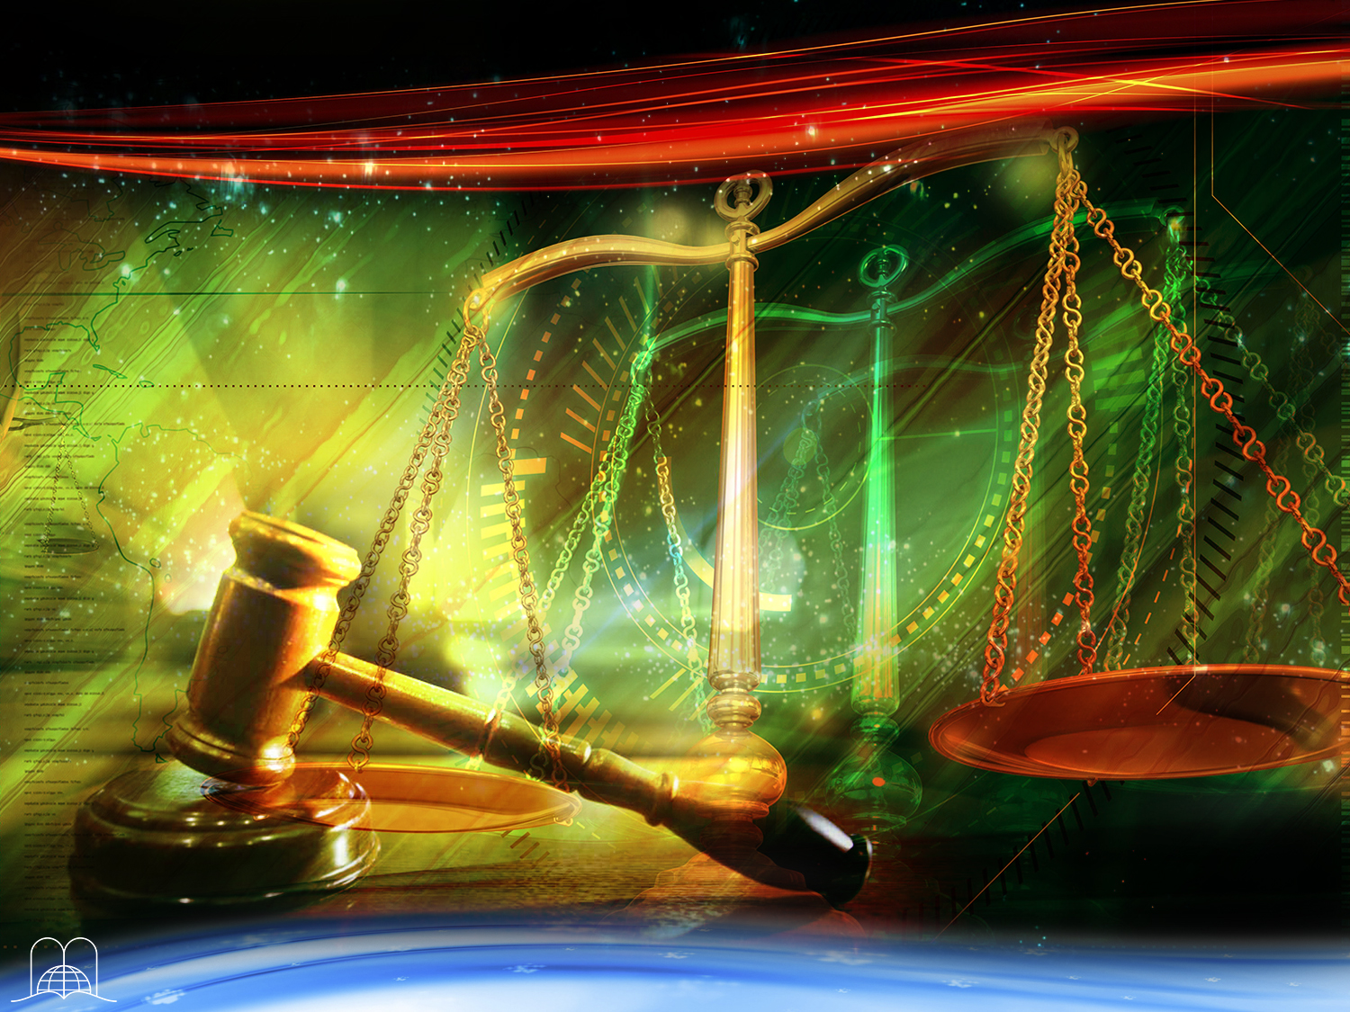
What will the saints (redeemed ones)
do in heaven?
Notes:
11. What will the saints (redeemed ones) do in heaven?

Slide 32
Revelation 20:4
“And I saw thrones, and they sat upon them, and judgment was given unto them: and I saw the souls of them that were beheaded for the witness of Jesus, and for the word of God, and which had not worshipped the beast, neither his image, neither had received his mark upon their foreheads, or in their hands; and they lived and reigned with Christ a thousand years.”
Notes:
Revelation 20:4
“And I saw thrones, and they sat upon them, and judgment was given unto them: and I saw the souls of them that were beheaded for the witness of Jesus, and for the word of God, and which had not worshipped the beast, neither his image, neither had received his mark upon their foreheads, or in their hands; and they lived and reigned with Christ a thousand years.”
They will be given the task of judging.
° They will evaluate the punishment that the wicked deserve. 1 Corinthians 6:2, 3.
° God's justice will be vindicated through the participation of the saints in the judgment.

Slide 33
EVENTS
AT THE END
OF THE MILLENNIUM
Notes:
EVENTS AT THE END OF THE MILLENNIUM

Slide 34
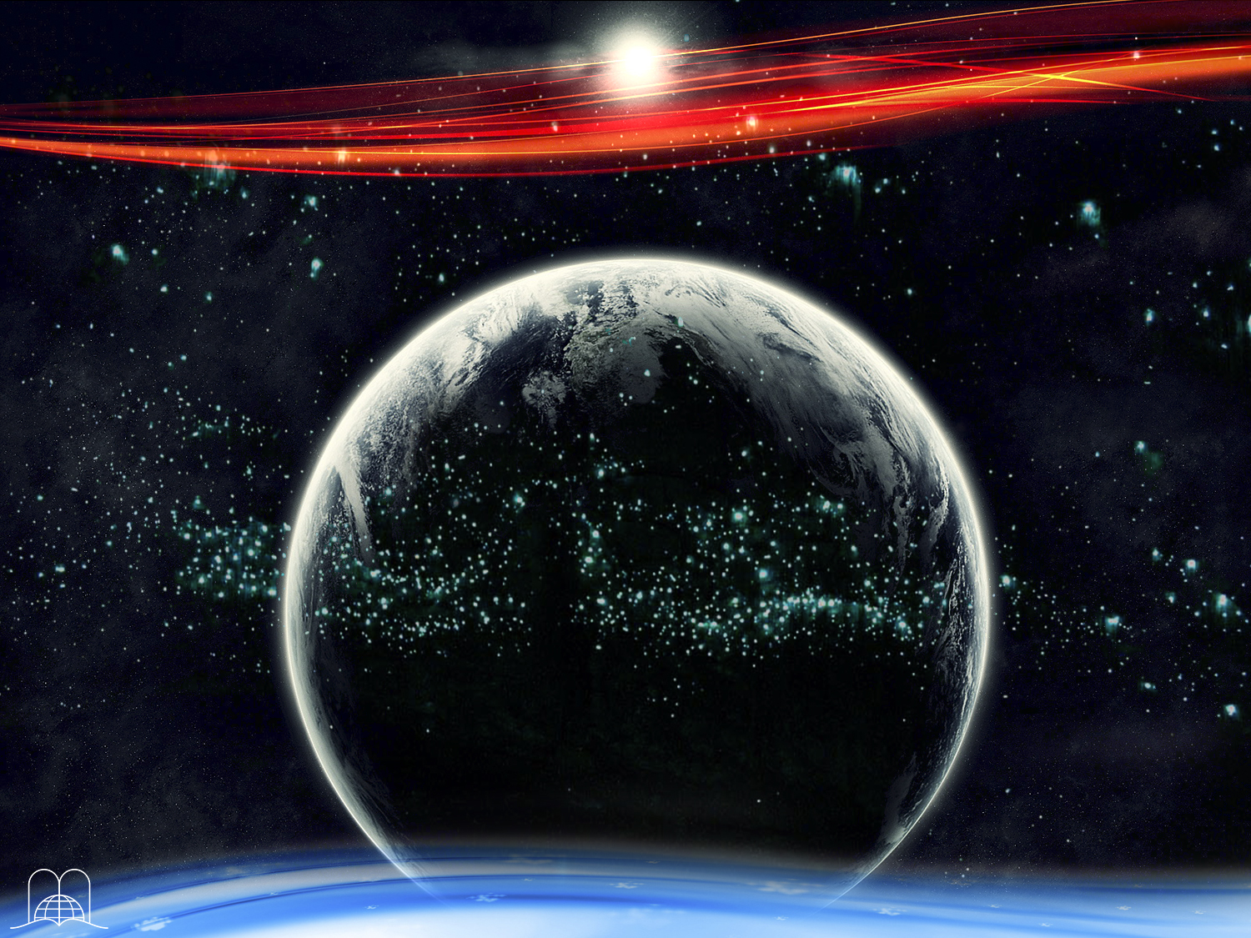
Jesus will come to this earth after a thousand years.
Who will accompany Him?
Notes:
12. Jesus will come to this earth after a thousand years. Who will accompany Him?

Slide 35
Zechariah 14:4-6
“And his feet shall stand in that day upon the mount of Olives, which is before Jerusalem on the east, and the mount of Olives shall cleave in the midst thereof toward the east and toward the west, and there shall be a very great valley; and half of the mountain shall remove toward the north, and half of it toward the south…
Notes:
Zechariah 14:4-6
“And his feet shall stand in that day upon the mount of Olives, which is before Jerusalem on the east, and the mount of Olives shall cleave in the midst thereof toward the east and toward the west, and there shall be a very great valley; and half of the mountain shall remove toward the north, and half of it toward the south…

Slide 36
Zechariah 14:4-6
…And ye shall flee to the valley of the mountains; for the valley of the mountains shall reach unto Azal: yea, ye shall flee, like as ye fled from before the earthquake in the days of Uzziah king of Judah: and the Lord my God shall come, and all the saints with thee.
And it shall come to pass in that day, that the light shall not be clear, nor dark.”
Notes:
Zechariah 14:4-6
…And ye shall flee to the valley of the mountains; for the valley of the mountains shall reach unto Azal: yea, ye shall flee, like as ye fled from before the earthquake in the days of Uzziah king of Judah: and the Lord my God shall come, and all the saints with thee.
And it shall come to pass in that day, that the light shall not be clear, nor dark.”
All the saints (the righteous)
The straubinge version says, "On that day there will be no light, only cold and ice." (Zechariah 14:16).

Slide 37
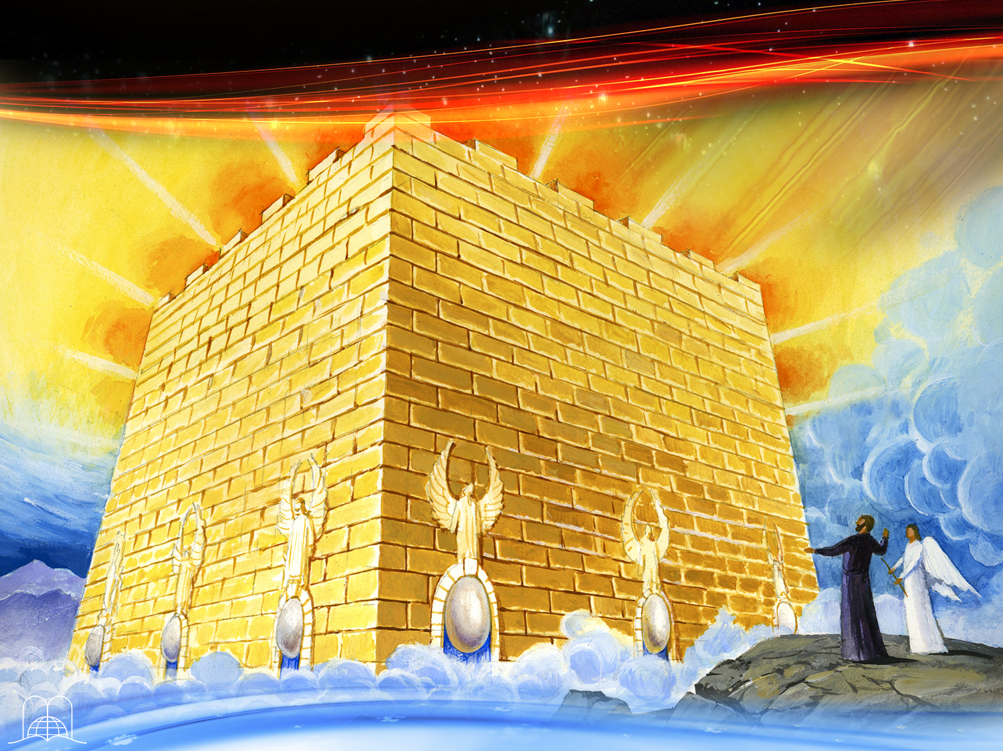
What did the Apostle John see coming down from heaven?
Notes:
13. What did the Apostle John see coming down from heaven?

Slide 38
Revelation 21:2
“And I John saw the holy city, new Jerusalem, coming down from God out of heaven, prepared as a bride adorned for her husband.”
Notes:
Revelation 21:2
“And I John saw the holy city, new Jerusalem, coming down from God out of heaven, prepared as a bride adorned for her husband.”

Slide 39
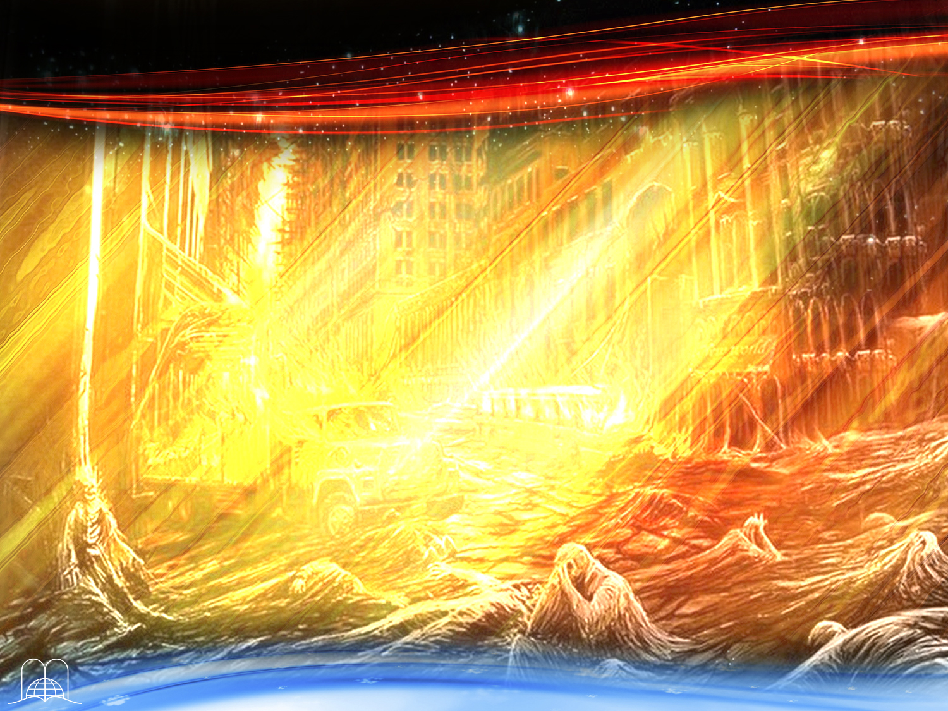
What will the happen to those still in their graves, (the wicked)?
Notes:
14. What will the happen to the others that are dead, (the wicked)?

Slide 40
Revelation 20:5
“But the rest of the dead lived not again until the thousand years were finished. This is the first resurrection.”
Notes:
Revelation 20:5
“But the rest of the dead lived not again until the thousand years were finished. This is the first resurrection”
They will be resurrected after the thousand years.

Slide 41
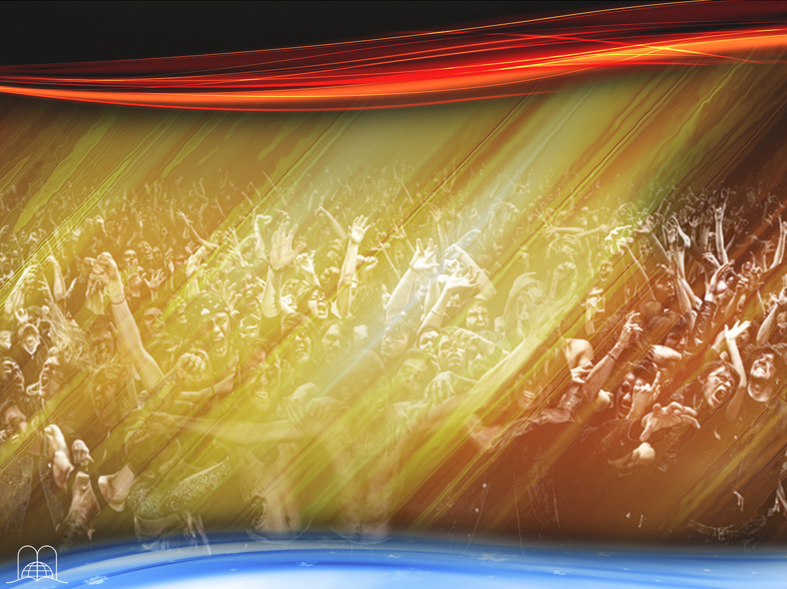
What will happen to Satan?
Notes:
15. What will happen to Satan?

Slide 42
Revelation 20:7
“And when the thousand years are expired,
Satan shall be loosed out of his prison.”
Notes:
Revelation 20:7
“And when the thousand years are expired, Satan shall be loosed out of his prison.”
He will be let out of prison.
a) The circumstances that kept him bound will have disappeared as there will again be people to be deceived.
b) The great deception will take place. Revelation 20:8, 9.
Satan will assure them that he was the one who resurrected them.
He will tell them that they can conquer the city of God and establish their own kingdom.
c) At that moment the great white throne with the Judge of the Universe sitting on it will be seen. Revelation 20:11.
° Every human being will see his own life, like a film, passing in front of their eyes.

Slide 43
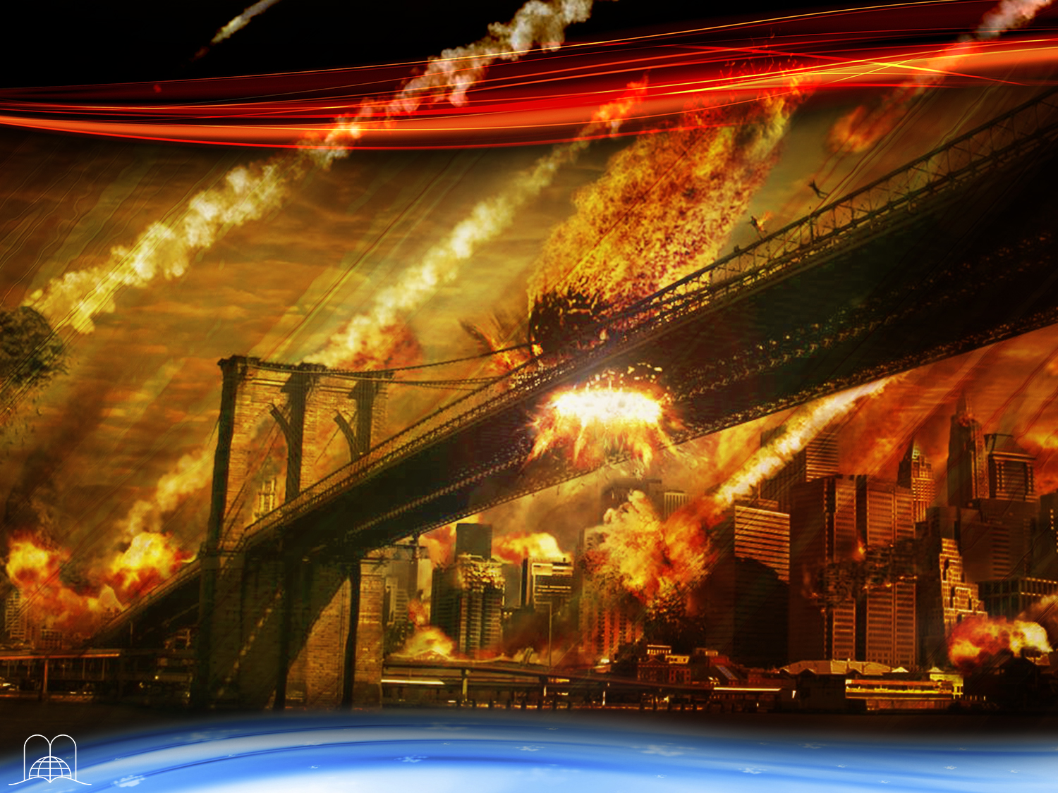
What will fall from heaven as Satan and the wicked move to attack the city?
Notes:
16. What will fall from heaven as Satan and the wicked try to attack the city?

Slide 44
Revelation 20:9
“And they went up on the breadth of the earth, and compassed the camp of the saints about, and the beloved city: and fire came down from God out of heaven, and devoured them.”
Notes:
Revelation 20:9
“And they went up on the breadth of the earth, and compassed the camp of the saints about, and the beloved city: and fire came down from God out of heaven, and devoured them.”
Fire will fall from heaven and devour the wicked.
a) The punishment will be according to what each one deserves. Revelation 20:13.
b) That second death will be final. Revelation 20:14, 15.
c) There will be neither root nor branch left. There will be just ashes, which means that at a certain point the fire will be quenched. Malachi 4:1-3.

Slide 45
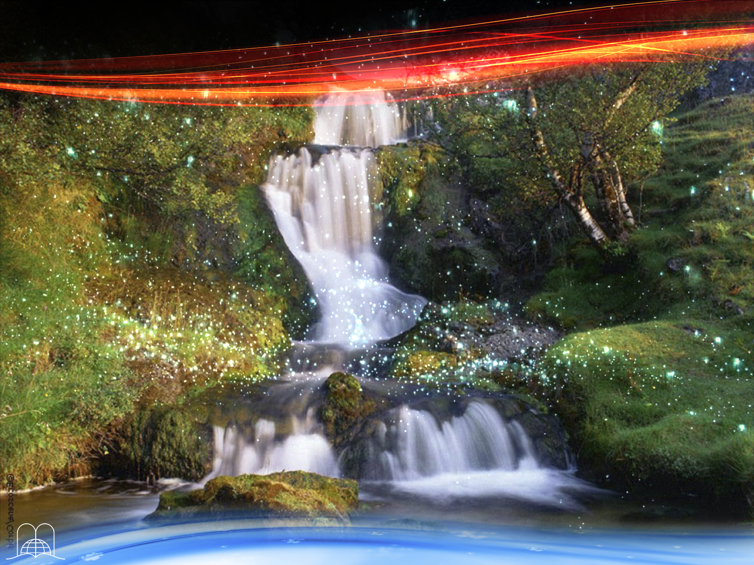
What will
God do with
the earth after
it has been purified?
Notes:
17. What will God do with the earth after it has been purified with fire?

Slide 46
2 Peter 3:11-13
Seeing then that all these things shall be dissolved, what manner of persons ought ye to be in all holy conversation and godliness,
Looking for and hasting unto the coming of the day of God, wherein the heavens being on fire shall be dissolved, and the elements shall melt with fervent heat?
Nevertheless we, according to his promise, look for new heavens and a new earth, wherein dwelleth righteousness.
Notes:
2 Peter 3:11-13
Seeing then that all these things shall be dissolved, what manner of persons ought ye to be in all holy conversation and godliness,
Looking for and hasting unto the coming of the day of God, wherein the heavens being on fire shall be dissolved, and the elements shall melt with fervent heat?
Nevertheless we, according to his promise, look for new heavens and a new earth, wherein dwelleth righteousness.
He will create a new earth.
a) The saved will live happily in this new earth for eternity. Revelation 21:3, 4.
b) The plan of God to restore the harmony of Edenic paradise will be fulfilled.
¡Qué elevado costo fue el de nuestra redención! El sacrificio cruento del propio Hijo de Dios. Todos hemos sido predestinados a participar de esta nueva vida en su gloria. El Evangelio es el llamado a recibir esa herencia. ¿Ha creído Ud. en ese anuncio? Juan 1:12 dice que todos los que le recibieron, todos los que creen en su nombre, les dio potestad de ser hechos hijos de Dios.
El Señor desea que seamos los herederos de su reino (Romanos 8:17). Dios no desea que alguien se pierda (2 Pedro 3:9; Efesios 1:3-6), y es por eso que nos escogió antes que el mundo fuera hecho.
Dios da una oportunidad a cada ser humano.

Slide 47
CONCLUSION
Notes:
CONCLUSION

Slide 48

Where will you be during the thousand years - in heaven or dead on earth?
Where will you be at the end of the millennium - in the New Jerusalem, or among the ones who perish outside?
Where do you plan to spend eternity?
Jesus has done everything for you. He wants to save you. Will you allow Him to do so?
Notes:
* Where will you be during the thousand years - in heaven or dead on earth?
* Where will you be at the end of the millennium - in the New Jerusalem, or among the ones who perish outside?
* Where do you plan to spend eternity?
* Jesus has done everything for you. He wants to save you. Will you allow Him to do so?

Slide 49
SUMMARY
of the events predicted
for the time of the end before the millennium
Notes:
SUMMARY
of the events predicted for the time of the end before the millennium

Slide 50
SUMMARY
Time of grace (2 Corinthians 6: 2)
Preaching the last warning message (Revelation 14:6-10)
Completion of the time of grace (Revelation 22:11)
People will go from sea to sea looking for the Word of God, but they will not find it (Amos 8:11-12)
The 7 pests (Revelation 16)
Last World War: Armageddon (Revelation 16:16)
Second coming of Christ visible to every eye (Revelation 1:7)
The dead in Christ are resurrected (1 Thessalonians 4:16)
They are transformed to immortality and taken away to go to heaven (1 Thes 4:17)
The wicked die with the presence of Jesus
(2 Thessalonians 1:7-9)
Total cataclysm (Revelation 6:14)
Notes:
SUMMARY
• Time of grace (2 Corinthians 6: 2)
• Preaching the last warning message (Revelation 14: 6-10)
• Completion of the time of grace (Rev. 22:11)
• People will go from sea to sea looking for the Word of God, but they will not find it (Amos 8: 11-12)
• The 7 pests (Rev. 16)
• Last World War: Armageddon (Rev. 16:16)
• Second coming of Christ visible to every eye (Revelation 1: 7)
• The dead in Christ are resurrected (1 Thessalonians 4:16)
• They are transformed to immortality and taken away to go to heaven (1 Thes 4:17)
• The wicked die with the presence of Jesus (2 Thessalonians 1: 7-9)
• Total cataclysm (Rev. 6:14)

Slide 51
SUMMARY
Events during
the Millennium
Notes:
SUMMARY
Events during the Millennium

Slide 52
SUMMARY
The wicked are dead; the saved, in heaven. 1000 years pass.
Satan tied with a chain of circumstances because he does not have to no one to cheat (Revelation 20:1-3).
The earth will be full of dead, no one will bury them (Jeremiah 25:33).
The earth will be desolate and empty, plunged in darkness (Jeremiah 4:23-27).
The holy saved ones will be occupied in heaven with the judgment of the evil (Revelation 20:4).
Notes:
RESUMEN
The wicked are dead; the saved, in heaven. 1000 years pass.
Satan tied with a chain of circumstances because he does not have to no one to cheat. (Revelation 20: 1-3)
The earth will be full of dead, no one will bury them (Jeremiah 25:33)
The earth will be desolate and empty, plunged in darkness (Jer 4: 23-27)
The holy saved ones will be occupied in heaven with the judgment of the evil (Revelation 20: 4)

Slide 53
SUMMARY
Events during
the Millennium
Notes:
RESUMEN
Events during the Millennium

Slide 54
SUMMARY
Events at the end of the millennium.
Third coming of Jesus (Zechariah 14:4-6).
The mount of the olive trees is part of a great plain.
The city New Jerusalem descends to the earth with all the saved (Revelation 21:2).
The wicked resurrect. (Revelation 20:5).
Satan will be loose in having someone to deceive (Revelation 20:7).
He will make the last great deception (Revelation 20:8-9).
Fire will come down from heaven and devour the wicked (Revelation 20:9)
The lost will be ashes, there will be neither root nor branch (Malachi 4:1-3)
The great white throne will be seen (Revelation 20:11).
The earth will be purified with fire and God will create a new earth (2 Peter 3:11-13).
Evil will be eradicated, Satan will be destroyed and there will be no more death; nor memory of suffering.
The saved will be those who today accept Jesus as Savior and Lord of their lives (John 1:12, Romans 8:17).
Notes:
RESUMEN
Events at the end of the millennium
Third coming of Jesus (Zechariah 14: 4-6)
The mount of the olive trees is part of a great plain
The city New Jerusalem descends to the earth with all the saved (Revelation 21: 2)
The wicked resurrect. (Revelation 20: 5)
Satan will be loose in having someone to deceive (Revelation 20: 7)
He will make the last great deception (Revelation 20: 8-9)
Fire will come down from heaven and devour the wicked (Revelation 20: 9)
The lost will be ashes, there will be neither root nor branch (Malachi 4: 1-3)
The great white throne will be seen (Revelation 20:11)
The earth will be purified with fire and God will create a new earth (2 Peter 3: 11-13)
Evil will be eradicated, Satan will be destroyed and there will be no more death; nor memory of suffering.
The saved will be those who today accept Jesus as Savior and Lord of their lives (John 1:12, Romans 8:17)

Slide 55
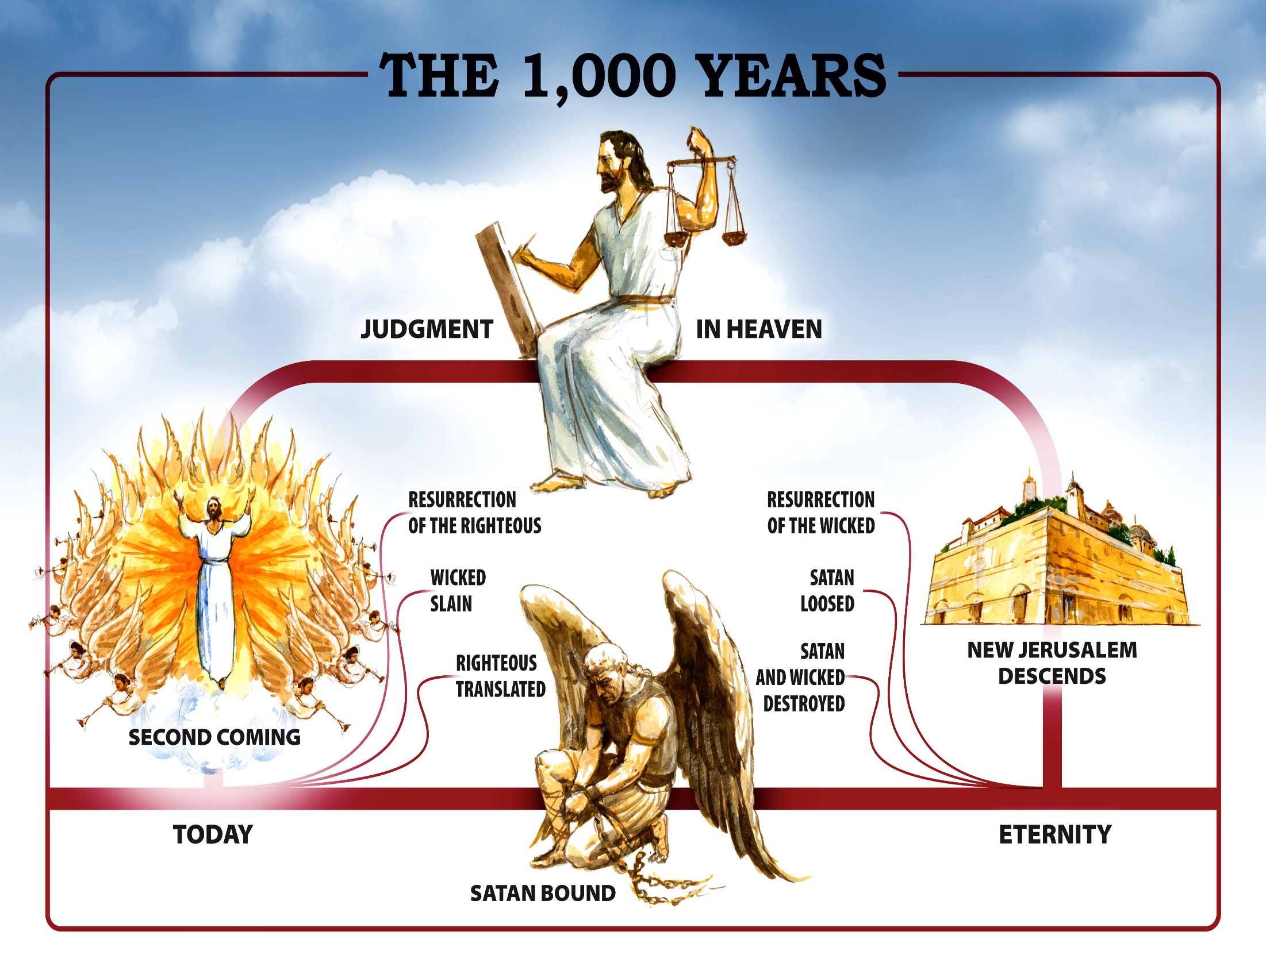
SUMMARY
Notes:
GRAPHIC SUMMARY

Slide 56
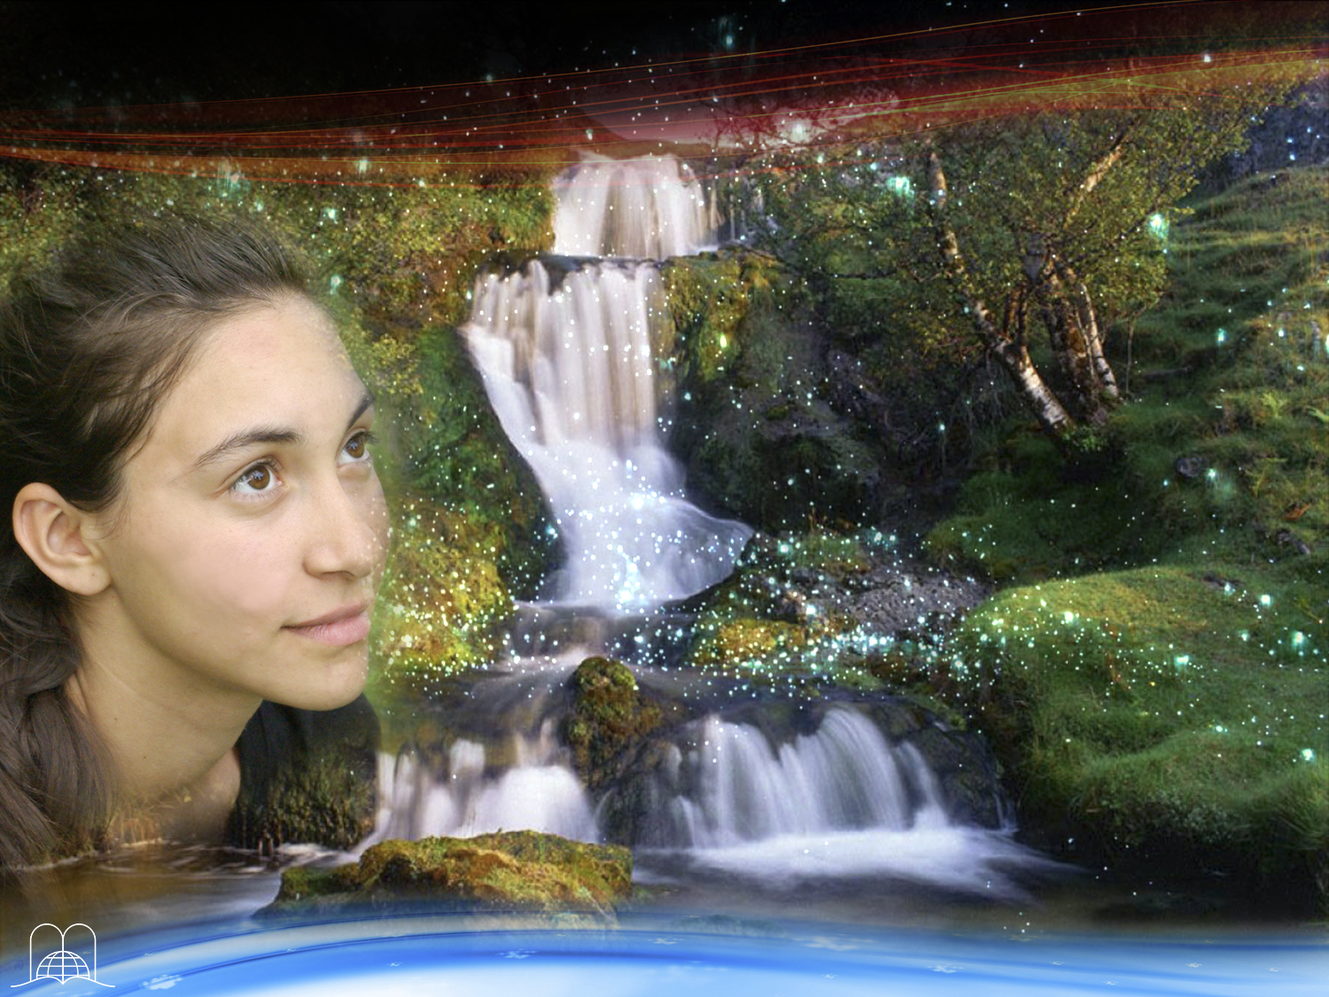
Thank you Lord,
for this Hopeful Panorama!
Notes:
Thank you Lord, for this Hopeful Panorama!

Slide 57
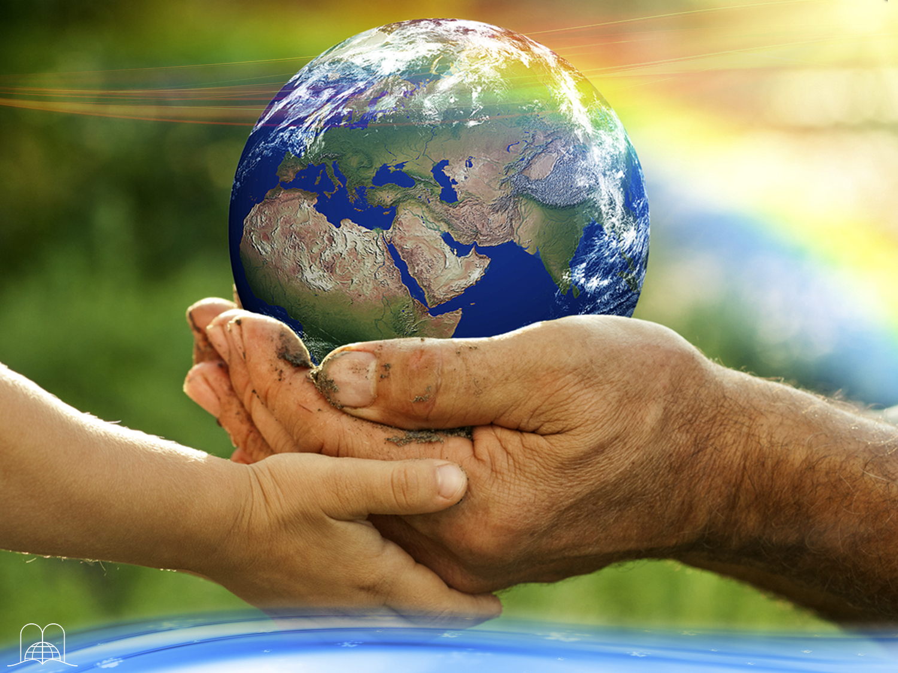
The next topic:
"Vision of a better world”
Will it be God's purpose to leave us in this world of suffering?
For many, life has become a nightmare. Disease, anguish, the struggle for bread, misunderstandings and disappointments we face in this life, lead us to the question. Will there be anything beyond? Will there be a better life?
In our next topic we will see a panoramic description of the world best.
GOD BLESS YOU!
Notes:
GOD BLESS YOU!
The next topic: "Vision of a better world”
Will it be God's purpose to leave us in this world of suffering?
For many, life has become a nightmare. Disease, anguish, the struggle for bread, misunderstandings and disappointments we face in this life, lead us to the question. Will there be anything beyond? Will there be a better life?
In our next topic we will see a panoramic description of the world best.

Slide 58

biblewell.org
info@biblewell.org
Notes:
If you still have questions, write to us confidently at: info@biblewell.org

