Slide 1
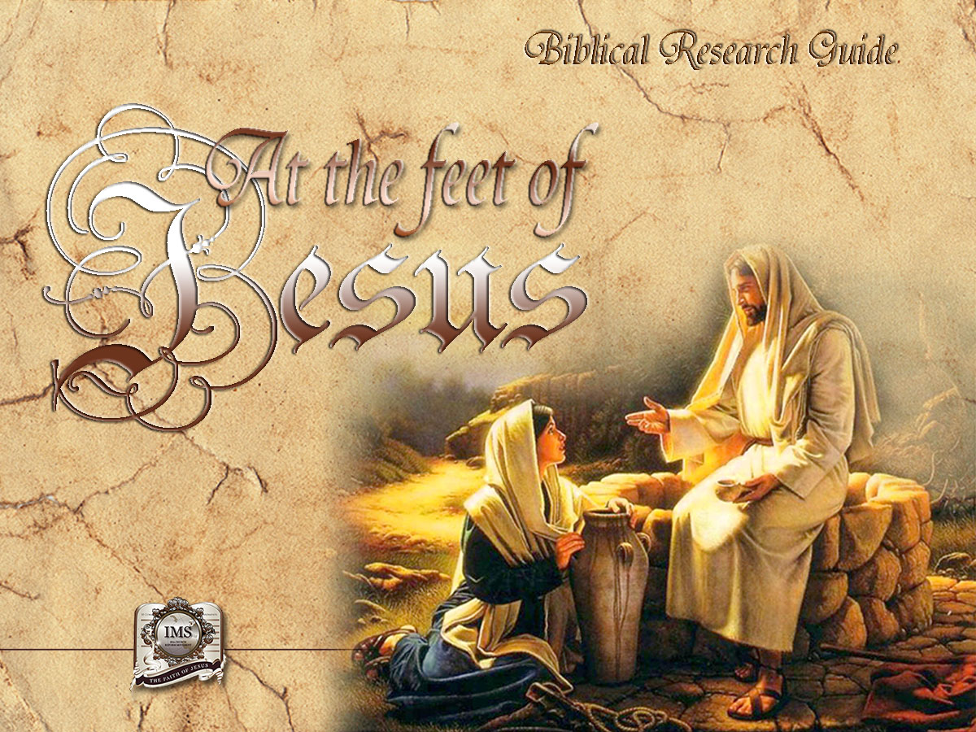

General Conference
Multimedia Department
Notes:
BIBLICAL RESEARCH GUIDE: “AT THE FEET OF JESUS”

Slide 2


A moment
of Prayer
Notes:
A moment of prayer…

Slide 3

19
VISION
OF A
BETTER WORLD
Notes:
Lesson 19
VISION OF A BETTER WORLD

Slide 4
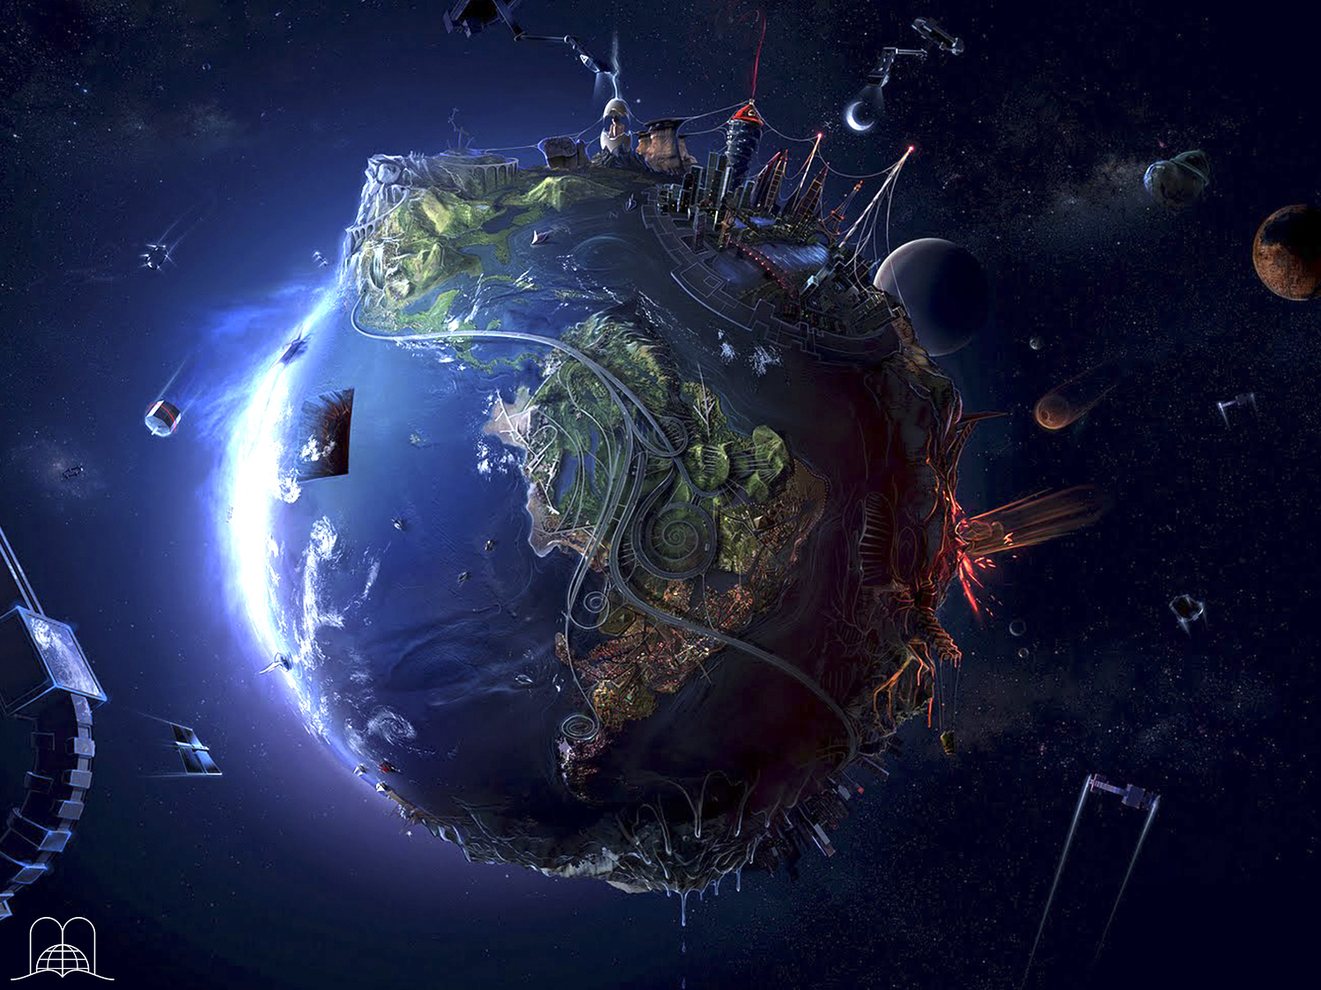
Is it God's purpose to leave us in this world of pain and suffering?
Notes:
Is it God's purpose to leave us in this world of pain and suffering?
For many, life has turned into a nightmare:
Some are tormented by sickness.
Some are consumed by anguish.
In a conquest for bread.
Misunderstood in the home.
Many are disappointed by loved ones.
Enslaved by work.
For many more, life has become a heavy burden.
How many dreams have not been fulfilled!
Many look for friendship and find rejection.
Some desire health but instead suffer from an illness.
Some want to own home, but it seems impossible.
We all wish to have our loved ones near us that death has taken from us.

Slide 5
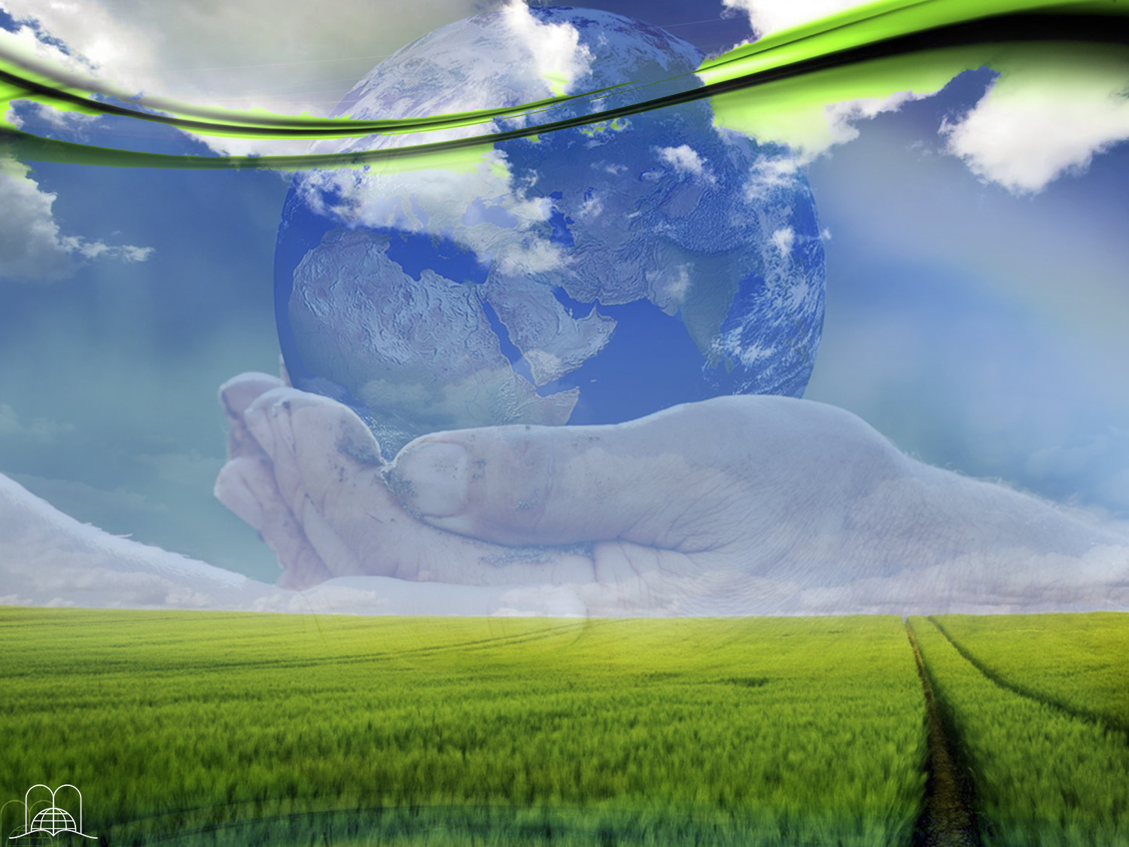
God has promised a home without shadows.
When will we receive it?
Notes:
1. God has promised a home without shadows. When will we receive it?

Slide 6

John 14:1-3
“Let not your heart be troubled: ye believe in God, believe also in me.
In my Father's house are many mansions: if it were not so, I would have told you. I go to prepare a place for you.
And if I go and prepare a place for you, I will come again, and receive you unto myself; that where I am, there ye may be also.”
Notes:
John 14:1-3
“Let not your heart be troubled: ye believe in God, believe also in me.
In my Father's house are many mansions: if it were not so, I would have told you. I go to prepare a place for you.
And if I go and prepare a place for you, I will come again, and receive you unto myself; that where I am, there ye may be also.”
° We will be given a new world like the one given to our first parents. (Genesis 1:31). Everything will be beautiful including plants, flowers and animals. We will enjoy perfect peace and happiness.
° Man received 4 gifts when created: eternal life, a perfect character, a wonderful home, and dominion over everything.
° Sin brought suffering in the place of all these gifts.

Slide 7
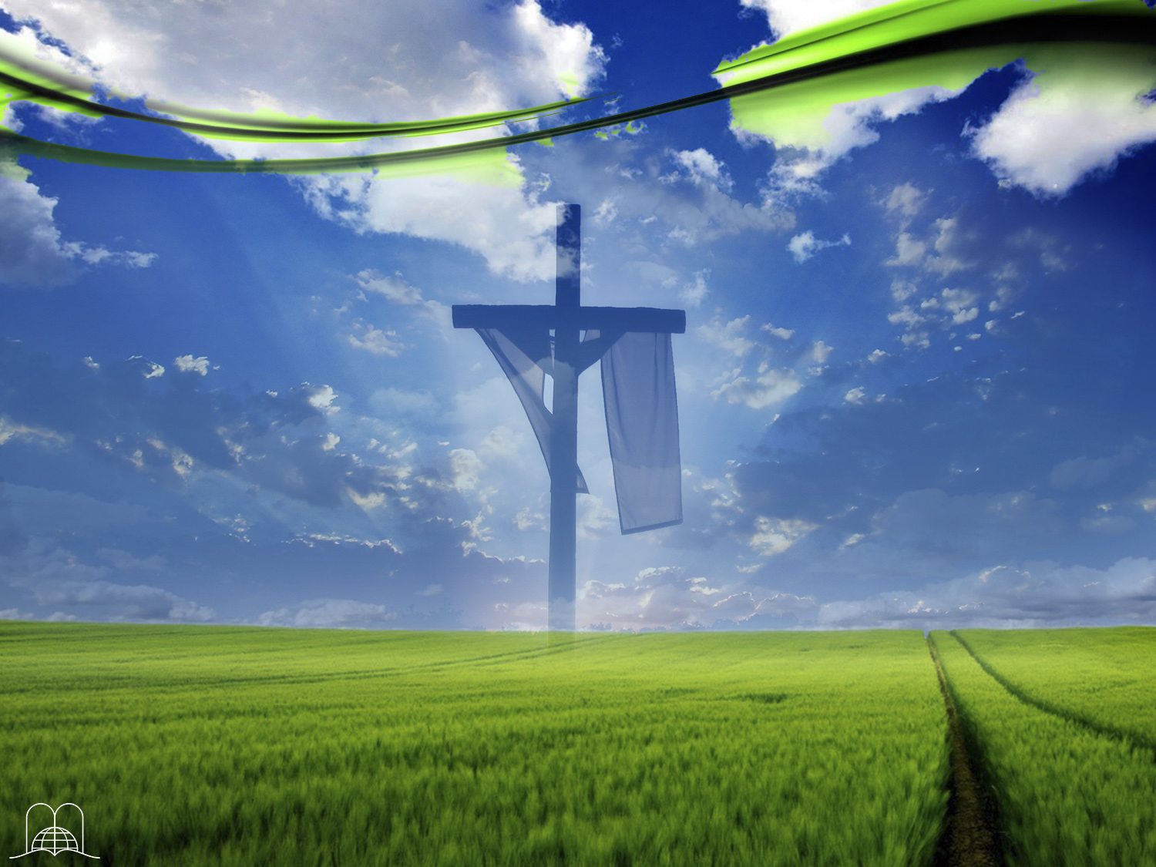
What was the purpose of Christ's death?
Notes:
2. What was the purpose of Christ's death?

Slide 8
1 John 2:25
“And this is the promise that he hath promised us, even eternal life.”
Notes:
1 John 2:25
“And this is the promise that he hath promised us, even eternal life.”
° Through Christ we will be free from slavery to the devil, and in Him will all things be made new. Isaiah 45:2.

Slide 9
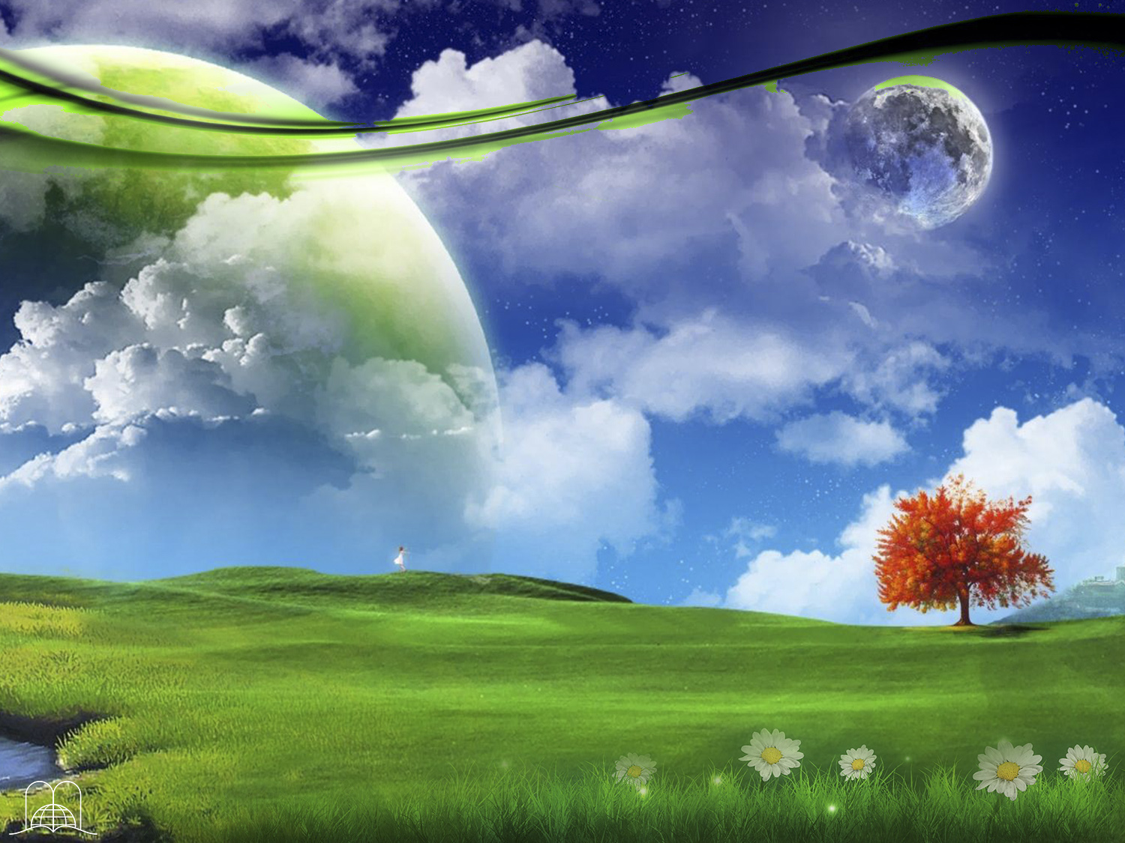
WHAT WILL THE NEW HEAVEN
AND THE NEW
EARTH BE LIKE?
Notes:
WHAT WILLTHE NEW HEAVEN AND THE NEW EARTH BE LIKE?

Slide 10

How many heavens exist now, according to the Bible?
Notes:
3. How many heavens exist now, according to the Bible?

Slide 11
2 Corinthians 12:2-4
“I knew a man in Christ above fourteen years ago, (whether in the body, I cannot tell; or whether out of the body, I cannot tell: God knoweth;) such an one caught up to the third heaven. And I knew such a man, (whether in the body, or out of the body, I cannot tell: God knoweth;) How that he was caught up into paradise, and heard unspeakable words, which it is not lawful for a man to utter.”
Notes:
2 Corinthians 12:2-4
“I knew a man in Christ above fourteen years ago, (whether in the body, I cannot tell; or whether out of the body, I cannot tell: God knoweth;) such an one caught up to the third heaven.
And I knew such a man, (whether in the body, or out of the body, I cannot tell: God knoweth;)
How that he was caught up into paradise, and heard unspeakable words, which it is not lawful for a man to utter.”
Three

Slide 12
Third heaven: The throne of God
Second heaven: The firmament
First heaven: Atmosphere
Notes:
° The first heaven is the atmosphere around the earth - the air.
° The second is the firmament - the starry sky. (Psalm 19:1).
° The third is the throne of God. (1 Kings 8:30).

Slide 13
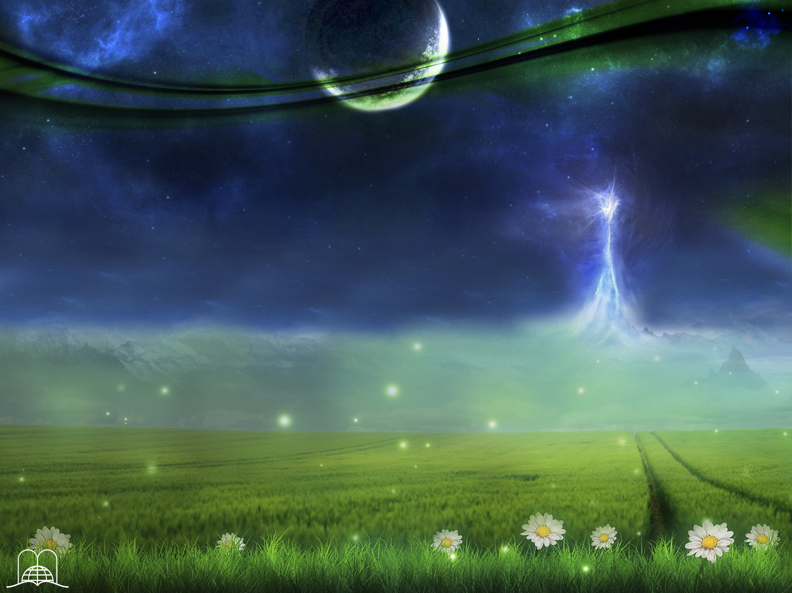
What has God prepared for us?
Notes:
4. What has God prepared for us?

Slide 14
1 Corinthians 2:9
“But as it is written, Eye hath not seen, nor ear heard, neither have entered into the heart of man, the things which God hath prepared for them that love him.”
Notes:
1 Corinthians 2:9
“But as it is written, Eye hath not seen, nor ear heard, neither have entered into the heart of man, the things which God hath prepared for them that love him.”

Slide 15

As they contemplated the heavenly home with eyes of faith, what did the believers of the past say as they considered their earthly life?
Notes:
As they contemplated the heavenly home with eyes of faith, what did the believers of the past say as they considered their earthly life?

Slide 16
Hebrews 11:13-16
“These all died in faith, not having received the promises, but having seen them afar off, and were persuaded of them, and embraced them, and confessed that they were strangers and pilgrims on the earth.
Pero anhelaban una mejor, esto es, celestial; por lo cual Dios no se avergüenza de llamarse Dios de ellos; porque les ha preparado una ciudad.”
Porque los que esto dicen, claramente dan a entender que buscan una patria; pues si hubiesen estado pensando en aquella de donde salieron, ciertamente tenían tiempo de volver.
Notes:
Hebrews 11:13-16
“These all died in faith, not having received the promises, but having seen them afar off, and were persuaded of them, and embraced them, and confessed that they were strangers and pilgrims on the earth.

Slide 17
Hebrews 11:13-16
“Conforme a la fe murieron todos éstos sin haber recibido lo prometido, sino mirándolo de lejos, y creyéndolo, y saludándolo, y confesando que eran extranjeros y peregrinos sobre la tierra.
Pero anhelaban una mejor, esto es, celestial; por lo cual Dios no se avergüenza de llamarse Dios de ellos; porque les ha preparado una ciudad.”
For they that say such things declare plainly that they seek a country. And truly, if they had been mindful of that country from whence they came out, they might have had opportunity to have returned.
Notes:
Hebrews 11:13-16
For they that say such things declare plainly that they seek a country. And truly, if they had been mindful of that country from whence they came out, they might have had opportunity to have returned.

Slide 18
Hebrews 11:13-16
“Conforme a la fe murieron todos éstos sin haber recibido lo prometido, sino mirándolo de lejos, y creyéndolo, y saludándolo, y confesando que eran extranjeros y peregrinos sobre la tierra.
But now they desire a better country, that is, an heavenly: wherefore God is not ashamed to be called their God: for he hath prepared for them a city.”
Porque los que esto dicen, claramente dan a entender que buscan una patria; pues si hubiesen estado pensando en aquella de donde salieron, ciertamente tenían tiempo de volver.
Notes:
Hebrews 11:13-16
But now they desire a better country, that is, an heavenly: wherefore God is not ashamed to be called their God: for he hath prepared for them a city.”

Slide 19

What will
the new earth be like?
Notes:
6. What will the new earth be like?

Slide 20
Isaiah 35:1-2
“The wilderness and the solitary place shall be glad for them; and the desert shall rejoice, and blossom as the rose.
It shall blossom abundantly, and rejoice even with joy and singing: the glory of Lebanon shall be given unto it, the excellency of Carmel and Sharon, they shall see the glory of the Lord, and the excellency of our God.”
“…porque aguas serán cavadas en el desierto, y torrentes en la soledad.
El lugar seco se convertirá en estanque, y el sequedal en manaderos de aguas; en la morada de chacales, en su guarida, será lugar de cañas y juncos.”
Notes:
Isaiah 35:1-2
“The wilderness and the solitary place shall be glad for them; and the desert shall rejoice, and blossom as the rose.
It shall blossom abundantly, and rejoice even with joy and singing: the glory of Lebanon shall be given unto it, the excellency of Carmel and Sharon, they shall see the glory of the Lord, and the excellency of our God.”

Slide 21
Isaiah 35:6, 7
“Se alegrarán el desierto y la soledad; el yermo se gozará y florecerá como la rosa.
Florecerá profusamente, y también se alegrará y cantará con júbilo; la gloria del Líbano le será dada, la hermosura del Carmelo y de Sarón. Ellos verán la gloria de Jehová, la hermosura del Dios nuestro.”
“…for in the wilderness shall waters break out, and streams in the desert.
And the parched ground shall become a pool, and the thirsty land springs of water: in the habitation of dragons, where each lay, shall be grass with reeds and rushes.”
Notes:
Isaiah 35:6, 7
“…for in the wilderness shall waters break out, and streams in the desert.
And the parched ground shall become a pool, and the thirsty land springs of water: in the habitation of dragons, where each lay, shall be grass with reeds and rushes..”
* ° There will be no vast deserts or huge oceans.
° The whole earth will be a garden of incredible beauty. Isaiah 55:13
° More beautiful flowers than the most beautiful orchids. (Revelation 22: 2.).
° Delicious fruits that no human being has tried here.
° A more pure and intense greenery that the spring greenery
° There will be rivers, brooks and lakes of crystal clear beauty.

Slide 22
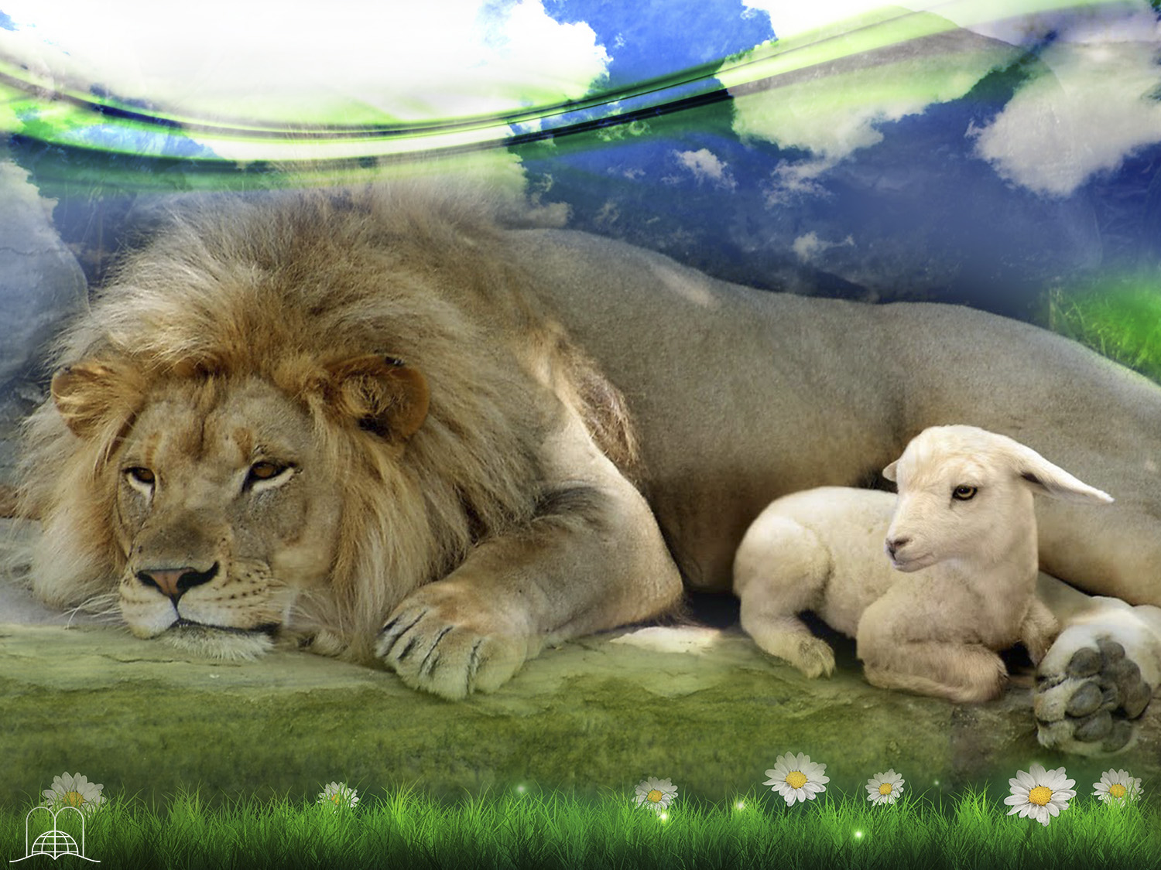
How does prophecy
describe the harmony
of the animal kingdom?
Notes:
How does prophecy describe the harmony of the animal kingdom?

Slide 23
Isaiah 11:6-9
“The wolf also shall dwell with the lamb, and the leopard shall lie down with the kid; and the calf and the young lion and the fatling together; and a little child shall lead them. And the cow and the bear shall feed; their young ones shall lie down together: and the lion shall eat straw like the ox.
Notes:
Isaiah 11:6-9; (Isaiah 32:17-18)
“The wolf also shall dwell with the lamb, and the leopard shall lie down with the kid; and the calf and the young lion and the fatling together; and a little child shall lead them.
And the cow and the bear shall feed; their young ones shall lie down together: and the lion shall eat straw like the ox.
And the sucking child shall play on the hole of the asp, and the weaned child shall put his hand on the cockatrice' den.
They shall not hurt nor destroy in all my holy mountain: for the earth shall be full of the knowledge of the Lord, as the waters cover the sea.”

Slide 24
Isaiah 11:6-9
And the sucking child shall play on the hole of the asp, and the weaned child shall put his hand on the cockatrice' den.
They shall not hurt nor destroy in all my holy mountain: for the earth shall be full of the knowledge of the Lord, as the waters cover the sea.”
Notes:
Isaiah 11:6-9; (Isaiah 32:17-18)
“The wolf also shall dwell with the lamb, and the leopard shall lie down with the kid; and the calf and the young lion and the fatling together; and a little child shall lead them.
And the cow and the bear shall feed; their young ones shall lie down together: and the lion shall eat straw like the ox.
And the sucking child shall play on the hole of the asp, and the weaned child shall put his hand on the cockatrice' den.
They shall not hurt nor destroy in all my holy mountain: for the earth shall be full of the knowledge of the Lord, as the waters cover the sea.”

Slide 25
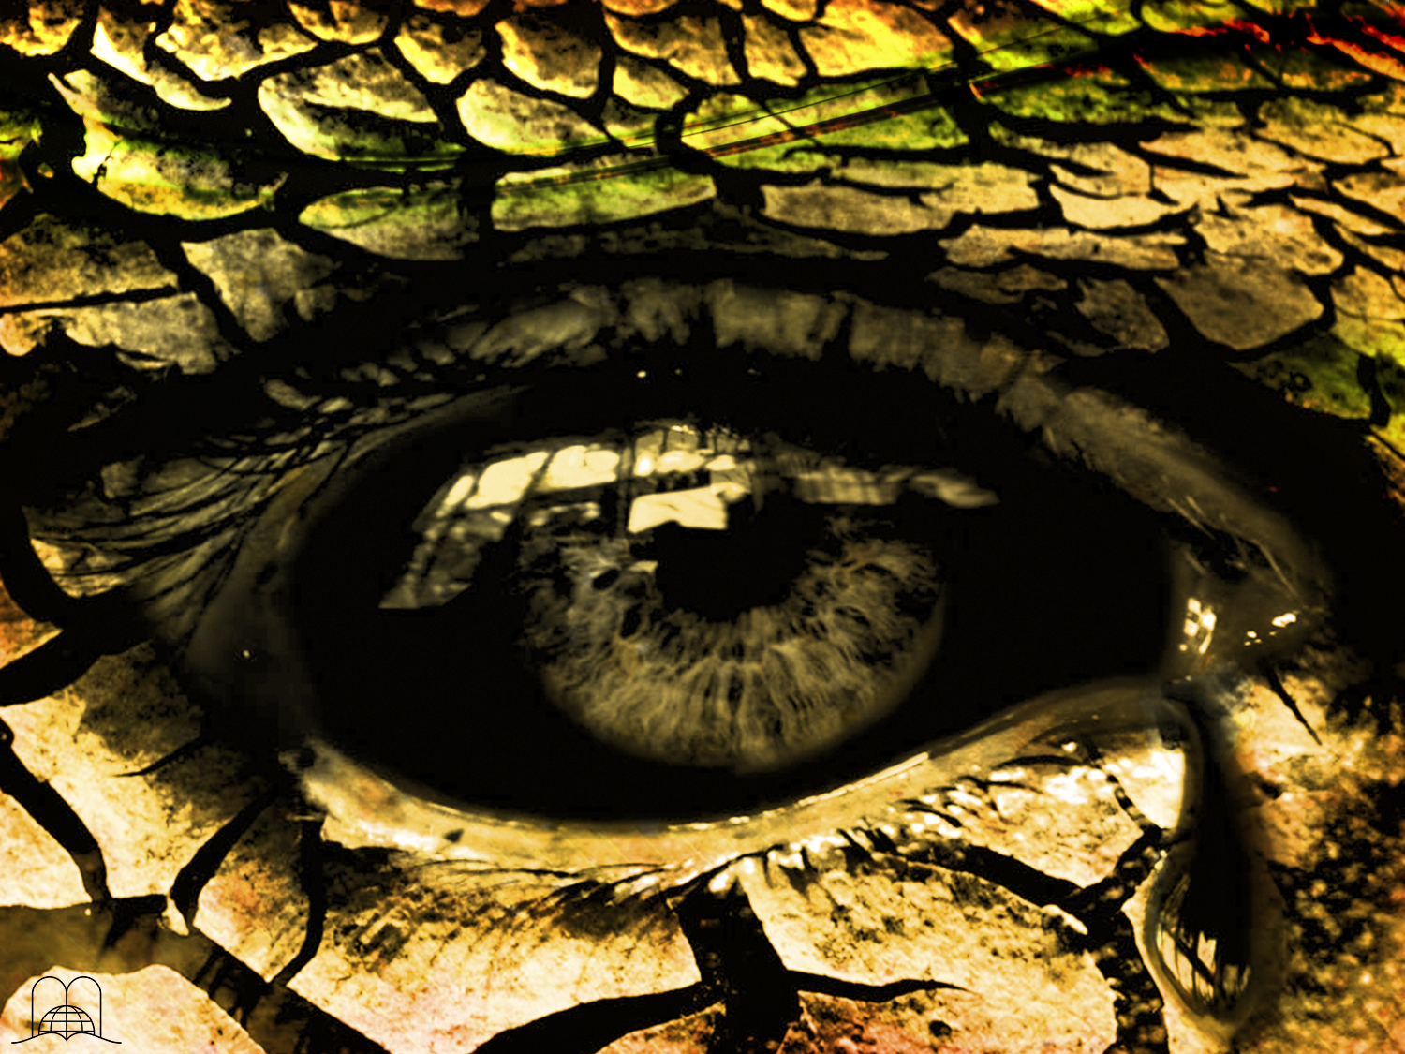
What will there not be?
Notes:
8. What will there not be?

Slide 26
Isaiah 33:24; 35:3-6
“And the inhabitant shall not say, I am sick: the people that dwell therein shall be forgiven their iniquity.”
“Strengthen ye the weak hands, and confirm the feeble knees.
Say to them that are of a fearful heart, Be strong, fear not: behold, your God will come with vengeance, even God with a recompense; he will come and save you.
Entonces los ojos de los ciegos serán abiertos, y los oídos de los sordos se abrirán.
Entonces el cojo saltará como un ciervo, y cantará la lengua del mudo; porque aguas serán cavadas en el desierto, y torrentes en la soledad.”
Notes:
Isaiah 33:24; 35:3-6
“And the inhabitant shall not say, I am sick: the people that dwell therein shall be forgiven their iniquity.”
“Strengthen ye the weak hands, and confirm the feeble knees.
Say to them that are of a fearful heart, Be strong, fear not: behold, your God will come with vengeance, even God with a recompense; he will come and save you.

Slide 27
Isaiah 33:24; 35:3-6
“No dirá el morador: Estoy enfermo; al pueblo que more en ella le será perdonada la iniquidad.”
“Fortaleced las manos cansadas, afirmad las rodillas endebles.
Decid a los de corazón apocado: Esforzaos, no temáis; he aquí que vuestro Dios viene con retribución, con pago; Dios mismo vendrá, y os salvará.
Then the eyes of the blind shall be opened, and the ears of the deaf shall be unstopped.
Then shall the lame man leap as an hart, and the tongue of the dumb sing: for in the wilderness shall waters break out, and streams in the desert.”
Notes:
Isaiah 33:24; 35:3-6
Then the eyes of the blind shall be opened, and the ears of the deaf shall be unstopped.
Then shall the lame man leap as an hart, and the tongue of the dumb sing: for in the wilderness shall waters break out, and streams in the desert.”

Slide 28

What will there be in the place of sadness?
Notes:
9. What will there be in the place of sadness?

Slide 29
Isaiah 35:9-10; 65:17-20
“Porque he aquí que yo crearé nuevos cielos y nueva tierra; y de lo primero no habrá memoria, ni más vendrá al pensamiento.
Mas os gozaréis y os alegraréis para siempre en las cosas que yo he creado; porque he aquí que yo traigo a Jerusalén alegría, y a su pueblo gozo.
“No lion shall be there, nor any ravenous beast shall go up thereon, it shall not be found there; but the redeemed shall walk there: And the ransomed of the Lord shall return, and come to Zion with songs and everlasting joy upon their heads: they shall obtain joy and gladness, and sorrow and sighing shall flee away.”
Y me alegraré con Jerusalén, y me gozaré con mi pueblo; y nunca más se oirán en ella voz de lloro, ni voz de clamor.
No habrá más allí niño que muera de pocos días, ni viejo que sus días no cumpla; porque el niño morirá de cien años, y el pecador de cien años será maldito.”
Notes:
Isaiah 35:9-10
“No lion shall be there, nor any ravenous beast shall go up thereon, it shall not be found there; but the redeemed shall walk there:
And the ransomed of the Lord shall return, and come to Zion with songs and everlasting joy upon their heads: they shall obtain joy and gladness, and sorrow and sighing shall flee away.”

Slide 30
Isaiah 35:9-10; 65:17-20
“No habrá allí león, ni fiera subirá por él, ni allí se hallará, para que caminen los redimidos.
Y los redimidos de Jehová volverán, y vendrán a Sion con alegría; y gozo perpetuo será sobre sus cabezas; y tendrán gozo y alegría, y huirán la tristeza y el gemido.”
“For, behold, I create new heavens and a new earth: and the former shall not be remembered, nor come into mind.
But be ye glad and rejoice for ever in that which I create: for, behold, I create Jerusalem a rejoicing, and her people a joy.
Y me alegraré con Jerusalén, y me gozaré con mi pueblo; y nunca más se oirán en ella voz de lloro, ni voz de clamor.
No habrá más allí niño que muera de pocos días, ni viejo que sus días no cumpla; porque el niño morirá de cien años, y el pecador de cien años será maldito.”
Notes:
Isaiah 65:17-20
“For, behold, I create new heavens and a new earth: and the former shall not be remembered, nor come into mind.
But be ye glad and rejoice for ever in that which I create: for, behold, I create Jerusalem a rejoicing, and her people a joy.

Slide 31
Isaiah 35:9-10; 65:17-20
“Porque he aquí que yo crearé nuevos cielos y nueva tierra; y de lo primero no habrá memoria, ni más vendrá al pensamiento.
Mas os gozaréis y os alegraréis para siempre en las cosas que yo he creado; porque he aquí que yo traigo a Jerusalén alegría, y a su pueblo gozo.
“No habrá allí león, ni fiera subirá por él, ni allí se hallará, para que caminen los redimidos.
Y los redimidos de Jehová volverán, y vendrán a Sion con alegría; y gozo perpetuo será sobre sus cabezas; y tendrán gozo y alegría, y huirán la tristeza y el gemido.”
And I will rejoice in Jerusalem, and joy in my people: and the voice of weeping shall be no more heard in her, nor the voice of crying. There shall be no more thence an infant of days, nor an old man that hath not filled his days: for the child shall die an hundred ye.”
Notes:
Isaiah 65:17-20
And I will rejoice in Jerusalem, and joy in my people: and the voice of weeping shall be no more heard in her, nor the voice of crying.
There shall be no more thence an infant of days, nor an old man that hath not filled his days: for the child shall die an hundred ye.”

Slide 32
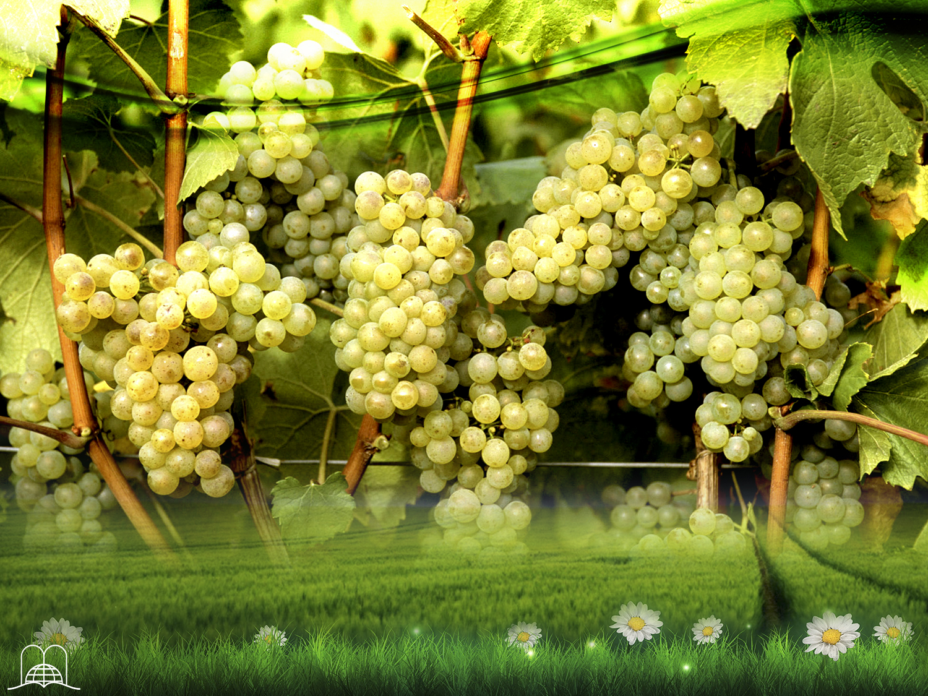
Will we work,
or live in idleness?
Notes:
10. Will we work, or live in idleness?

Slide 33
Isaiah 65:21-23
“And they shall build houses, and inhabit them; and they shall plant vineyards, and eat the fruit of them.
They shall not build, and another inhabit; they shall not plant, and another eat: for as the days of a tree are the days of my people, and mine elect shall long enjoy the work of their hands.
No trabajarán en vano, ni darán a luz para maldición; porque son linaje de los benditos de Jehová, y sus descendientes con ellos.”
Notes:
Isaiah 65:21-23
“And they shall build houses, and inhabit them; and they shall plant vineyards, and eat the fruit of them.
They shall not build, and another inhabit; they shall not plant, and another eat: for as the days of a tree are the days of my people, and mine elect shall long enjoy the work of their hands.

Slide 34
Isaiah 65:21-23
“Edificarán casas, y morarán en ellas; plantarán viñas, y comerán el fruto de ellas.
No edificarán para que otro habite, ni plantarán para que otro coma; porque según los días de los árboles serán los días de mi pueblo, y mis escogidos disfrutarán la obra de sus manos.
They shall not labour in vain, nor bring forth for trouble; for they are the seed of the blessed of the Lord, and their offspring with them.”
Notes:
Isaiah 65:21-23
They shall not labour in vain, nor bring forth for trouble; for they are the seed of the blessed of the Lord, and their offspring with them.”

Slide 35
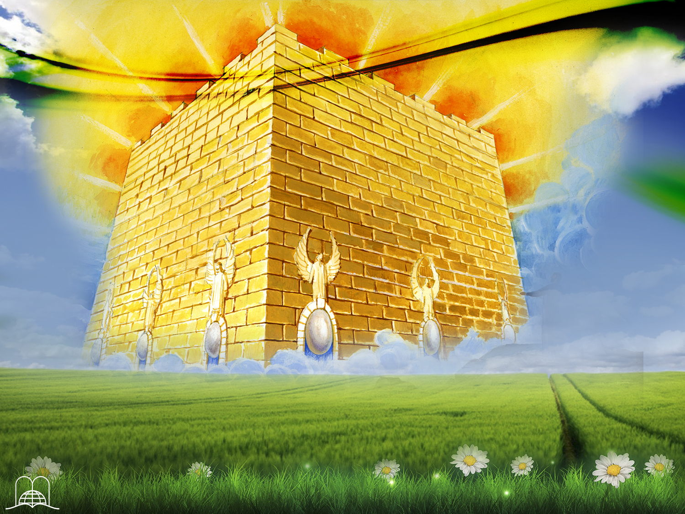
What will the capital city,
The new Jerusalem, be like?
Notes:
11. What will the capital city, The new Jerusalem, be like?

Slide 36
Revelation 21:1-5
Enjugará Dios toda lágrima de los ojos de ellos; y ya no habrá muerte, ni habrá más llanto, ni clamor, ni dolor; porque las primeras cosas pasaron.
Y el que estaba sentado en el trono dijo: He aquí, yo hago nuevas todas las cosas. Y me dijo: Escribe; porque estas palabras son fieles y verdaderas.”
“And I saw a new heaven and a new earth: for the first heaven and the first earth were passed away; and there was no more sea. And I John saw the holy city, new Jerusalem, coming down from God out of heaven, prepared as a bride adorned for her husband.
Y oí una gran voz del cielo que decía: He aquí el tabernáculo de Dios con los hombres, y él morará con ellos; y ellos serán su pueblo, y Dios mismo estará con ellos como su Dios.
Notes:
Revelation 21:1-5
“And I saw a new heaven and a new earth: for the first heaven and the first earth were passed away; and there was no more sea.
And I John saw the holy city, new Jerusalem, coming down from God out of heaven, prepared as a bride adorned for her husband.

Slide 37
Revelation 21:1-5
Enjugará Dios toda lágrima de los ojos de ellos; y ya no habrá muerte, ni habrá más llanto, ni clamor, ni dolor; porque las primeras cosas pasaron.
Y el que estaba sentado en el trono dijo: He aquí, yo hago nuevas todas las cosas. Y me dijo: Escribe; porque estas palabras son fieles y verdaderas.”
“Vi un cielo nuevo y una tierra nueva; porque el primer cielo y la primera tierra pasaron, y el mar ya no existía más.
Y yo Juan vi la santa ciudad, la nueva Jerusalén, descender del cielo, de Dios, dispuesta como una esposa ataviada para su marido.
And I heard a great voice out of heaven saying, Behold, the tabernacle of God is with men, and he will dwell with them, and they shall be his people, and God himself shall be with them, and be their God.
Notes:
Revelation 21:1-5
And I heard a great voice out of heaven saying, Behold, the tabernacle of God is with men, and he will dwell with them, and they shall be his people, and God himself shall be with them, and be their God.

Slide 38
Revelation 21:1-5
And God shall wipe away all tears from their eyes; and there shall be no more death, neither sorrow, nor crying, neither shall there be any more pain: for the former things are passed away.
And he that sat upon the throne said, Behold, I make all things new. And he said unto me, Write: for these words are true and faithful.”
“Vi un cielo nuevo y una tierra nueva; porque el primer cielo y la primera tierra pasaron, y el mar ya no existía más.
Y yo Juan vi la santa ciudad, la nueva Jerusalén, descender del cielo, de Dios, dispuesta como una esposa ataviada para su marido.
Y oí una gran voz del cielo que decía: He aquí el tabernáculo de Dios con los hombres, y él morará con ellos; y ellos serán su pueblo, y Dios mismo estará con ellos como su Dios.
Notes:
Revelation 21:1-5
And God shall wipe away all tears from their eyes; and there shall be no more death, neither sorrow, nor crying, neither shall there be any more pain: for the former things are passed away.
And he that sat upon the throne said, Behold, I make all things new. And he said unto me, Write: for these words are true and faithful.”

Slide 39
Revelation 21:10-12
“And he carried me away in the spirit to a great and high mountain, and shewed me that great city, the holy Jerusalem, descending out of heaven from God,
Having the glory of God: and her light was like unto a stone most precious, even like a jasper stone, clear as crystal
Tenía un muro grande y alto con doce puertas; y en las puertas, doce ángeles, y nombres inscritos, que son los de las doce tribus de los hijos de Israel.”
Notes:
Revelation 21:10-12
“And he carried me away in the spirit to a great and high mountain, and shewed me that great city, the holy Jerusalem, descending out of heaven from God,
Having the glory of God: and her light was like unto a stone most precious, even like a jasper stone, clear as crystal

Slide 40
Revelation 21:10-12
“Y me llevó en el Espíritu a un monte grande y alto, y me mostró la gran ciudad santa de Jerusalén, que descendía del cielo, de Dios, teniendo la gloria de Dios. Y su fulgor era semejante al de una piedra preciosísima, como piedra de jaspe, diáfana como el cristal.
And had a wall great and high, and had twelve gates, and at the gates twelve angels, and names written thereon, which are the names of the twelve tribes of the children of Israel.”
Notes:
Revelation 21:10-12
And had a wall great and high, and had twelve gates, and at the gates twelve angels, and names written thereon, which are the names of the twelve tribes of the children of Israel.”

Slide 41
550 km.
Pure golden
Measure: 2200 km.
12 foundations made of precious stones.
12 huge doors are made of gigantic pearls.
Jesus is its light.
Notes:
a) It will measure 12,000 furlongs (verse 16) or 2,000 km. (500 km. on each side).
b) It is made of pure gold, similar to clear glass. (Verse 18).
c) The wall has 12 foundations made of precious stones. (verses 19, 20).
d) The 12 huge doors are made of giant pearls. (verse 21).
e) There will be no night, because Christ will be their light. (Verse 23).
f) From the throne of God a pure river of crystal clear waters flows and on either side of the river is the tree of life. (Revelation 22:1, 2).
g) We will be with Jesus forever. (Verses 3, 4).

Slide 42

On what day will
we gather to worship God?
Notes:
12. On what day will we gather to worship God?

Slide 43
Isaiah 66:22-23
“For as the new heavens and the new earth, which I will make, shall remain before me, saith the Lord, so shall your seed and your name remain. And it shall come to pass, that from one new moon to another, and from one sabbath to another, shall all flesh come to worship before me, saith the Lord.”
Notes:
Isaiah 66:22-23
“For as the new heavens and the new earth, which I will make, shall remain before me, saith the Lord, so shall your seed and your name remain. And it shall come to pass, that from one new moon to another, and from one sabbath to another, shall all flesh come to worship before me, saith the Lord.”

Slide 44

How do we know that all these promises are true?
Notes:
13. How do we know that all these promises are true?

Slide 45

You can trust God’s promises.
The 2,300 prophesies that have been fulfilled are a guarantee that God does not lie.
The sacrifice on Calvary would be meaningless if this were not true.
When Christ comes; we shall be changed into immortal beings.
Notes:
° You can trust God’s promises. We are not talking about fantasy or fiction but about the promises of a God of love.
a) The 2,300 prophesies that are fulfilled before our eyes are a guarantee that God does not lie.
b) The sacrifice on Calvary would be meaningless if this were not true.
c) When Christ comes; we will be changed into immortal beings. (1 Corinthians 15:51-58).

Slide 46

HOW CAN WE SECURE A PLACE IN HEAVEN?
Notes:
HOW CAN I SECURE A PLACE IN HEAVEN?

Slide 47

What should we do in the first place?
Notes:
14. What should we do in the first place?

Slide 48
Acts 16:31
“And they said,
Believe on the Lord Jesus Christ, and thou shalt be saved, and thy house.”
Notes:
Acts 16:31
And they said, Believe on the Lord Jesus Christ, and thou shalt be saved, and thy house.
Accept Christ, through faith, as our personal Saviour and Lord of our life.

Slide 49

What should we do to have eternal life?
What did Jesus teach us?
Notes:
15. What should I do to have eternal life? What did Jesus teach us?

Slide 50
Matthew 19:17 l.p.
“but if thou wilt enter into life, keep the commandments.”
He that overcomes inherits all things.
There will be no room for transgressors there.
Notes:
Matthew 19:17 last part
“but if thou wilt enter into life, keep the commandments.”
a) He that overcomes will inherit all things. (Revelation 21:7).
b) There will be no room for transgressors there; only those whose names are written in the book of life will have access to that place. (Revelation 21:8, 27).
°While the word “do” is used, it should be made clear that this is not the cause, but the effect of salvation. Only the merits of Christ are the basis for our redemption. Our surrender and obedience are our response to God’s love, Him whom we have accepted not only as Savior but also as Lord of our lives.
The plan of redemption includes not only the redemption of man but also the redemption of our planet. (Romans 8:20-22)L Satan took away the sovereignty of our world and subjected it to slavery.
When the power of the devil is completely destroyed, Christ will be crowned King of kings and Lord of lords. Sin polluted the environment in which man was placed, but Christ will restore both the human being and the home in which he was placed.

Slide 51

CONCLUSION
"If ye be willing and obedient, ye shall eat the good of the land.”
Isaiah 1:19, 20
Notes:
CONCLUSION
° Christ did His part on Calvary. The rest depends on you. Isaiah 1:19,20. "If ye be willing and obedient, ye shall eat the good of the land.”
° Now is the time to make a decision and cling to the rock of salvation that is Christ Jesus.
° Accept God 's invitation today! (Ephesians 5:14-17).

Slide 52

¡Thank you, Lord,
for preparing
a wonderful place for me!
Notes:
Thank you, Lord, for preparing a wonderful place for me!

Slide 53
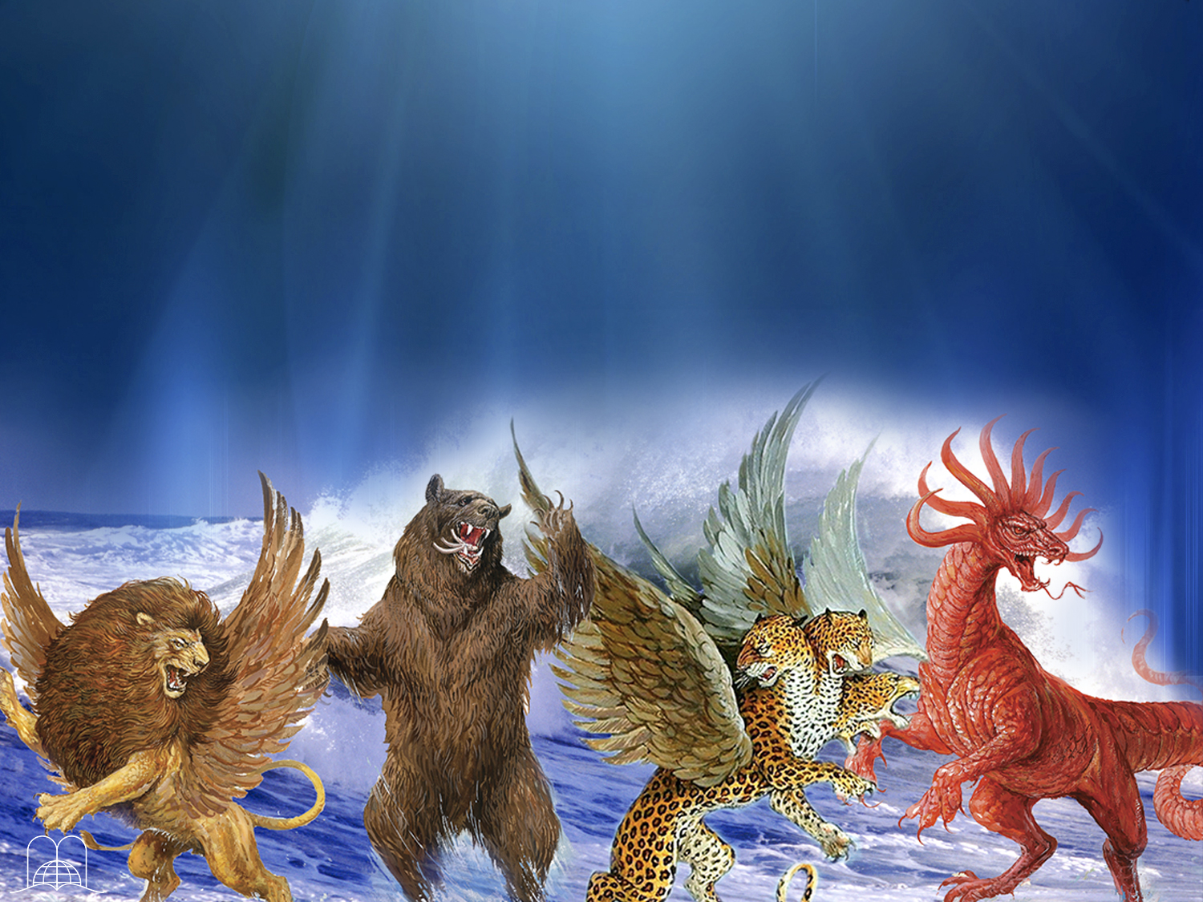
The next topic: Does the Antichrist already exist?
There are various conjectures about the antichrist, but there is only one revelation trustworthy: biblical prophecy.
In our next subject we will know the seven keys of prophecy and the history of the little horn.
GOD BLESS YOU!
Notes:
GOD BLESS YOU!
The next topic: Does the Antichrist already exist?
There are various conjectures about the antichrist, but there is only one revelation trustworthy: biblical prophecy.
In our next subject we will know the seven keys of prophecy and the history of the little horn.

Slide 54

biblewell.org
info@biblewell.org
Notes:
If you still have questions, write to us confidently at: info@biblewell.org

