Slide 1
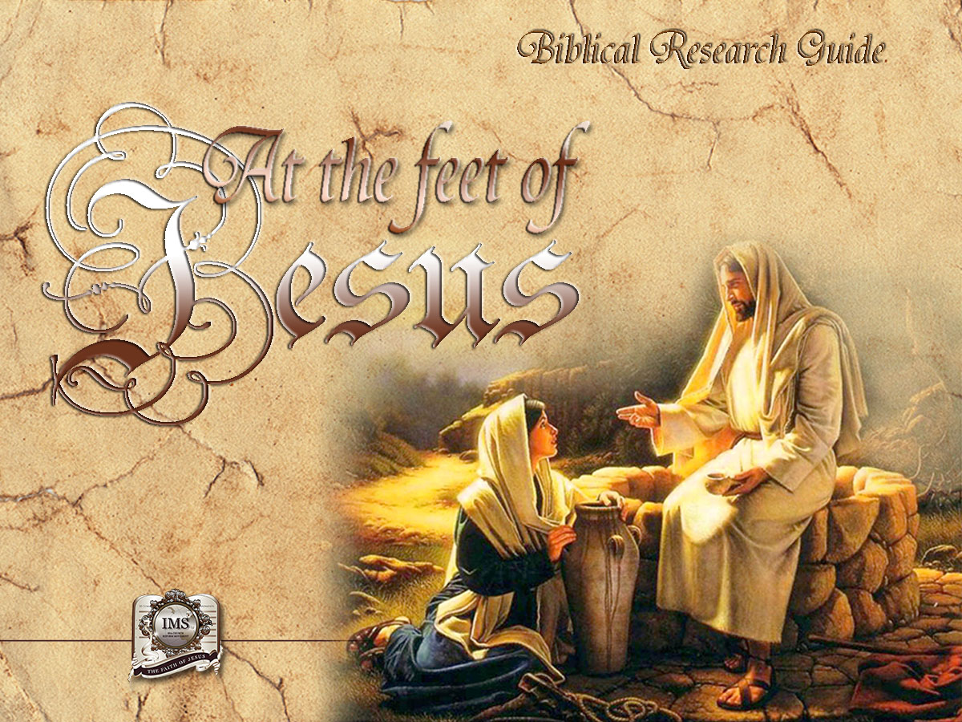

General Conference
Multimedia Department
Notes:
BIBLICAL RESEARCH GUIDE: “AT THE FEET OF JESUS”

Slide 2


A moment
of Prayer
Notes:
A moment of prayer

Slide 3

20
DOES THE
ANTICHRIST
ALREADY EXIST?
Notes:
Lesson 20
DOES THE ANTICHRIST ALREADY EXIST?
* Although there are many theories about the Antichrist, there is only one revelation that is trustworthy - Bible prophecy.

Slide 4
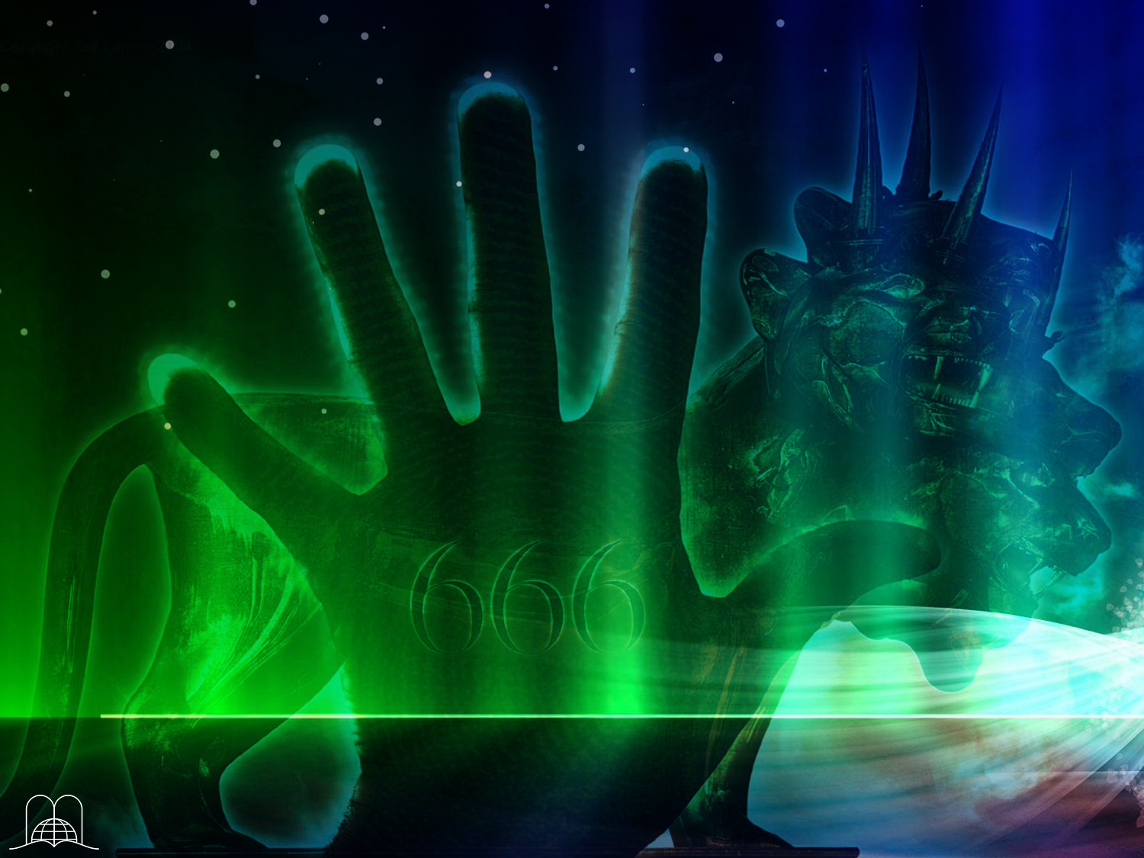

ANTI = Against
ANTICHRIST = Against Christ
“I Daniel was grieved in my spirit in the midst of my body, and the visions of my head troubled me.”
“…As for me Daniel, my cogitations much troubled me, and my countenance changed in me: but I kept the matter in my heart.”
Daniel 7:15, 28
Notes:
What does Antichrist mean? Anti = against Christ. It opposes both the doctrine of Jesus Christ and Jesus Himself. The study of this subject may cause awe, sadness, anger, disappointment or satisfaction. Daniel the prophet was very disturbed when he received this revelation.
Daniel 7:15, 28
“I Daniel was grieved in my spirit in the midst of my body, and the visions of my head troubled me.”
“Hitherto is the end of the matter. As for me Daniel, my cogitations much troubled me, and my countenance changed in me: but I kept the matter in my heart.”

Slide 5
“We have also a more sure word of prophecy; whereunto ye do well that ye take heed, as unto a light that shineth in a dark place, until the day dawn, and the day star arise in your hearts.”
2 Peter 1:19
Notes:
God has given us this prophecy so we have light and know the truth. 2 Peter 1:19.
“We have also a more sure word of prophecy; whereunto ye do well that ye take heed, as unto a light that shineth in a dark place, until the day dawn, and the day star arise in your hearts.”

Slide 6


THE ANTICHRIST
Notes:
THE ANTICHRIST

Slide 7
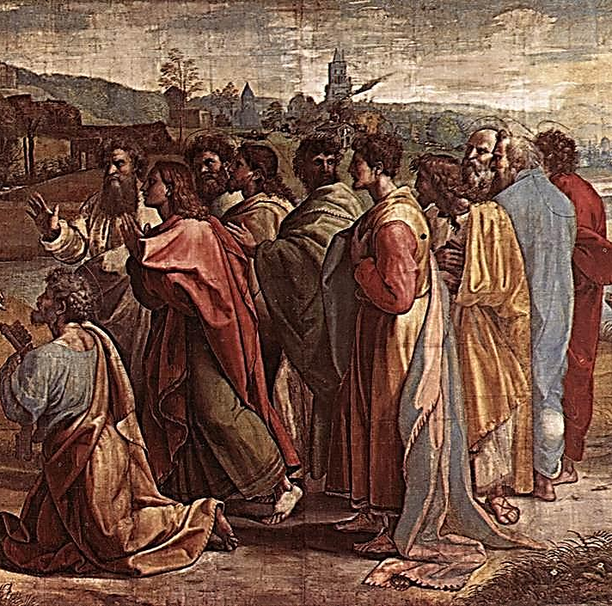
Were there Antichrists at the time of the apostles?
Notes:
Were there Antichrists at the time of the apostles?

Slide 8

“Little children, it is the last time: and as ye have heard that antichrist shall come, even now are there many antichrists; whereby we know that it is the last time.
They went out from us, but they were not of us; for if they had been of us, they would no doubt have continued with us: but they went out, that they might be made manifest that they were not all of us.”
1 John 2:18-19
Notes:
1 John 2:18-19, (Gálatas 1:6-7)
“Little children, it is the last time: and as ye have heard that antichrist shall come, even now are there many antichrists; whereby we know that it is the last time.
They went out from us, but they were not of us; for if they had been of us, they would no doubt have continued with us: but they went out, that they might be made manifest that they were not all of us.”
They were brethren, because it says: "They went out from us”

Slide 9
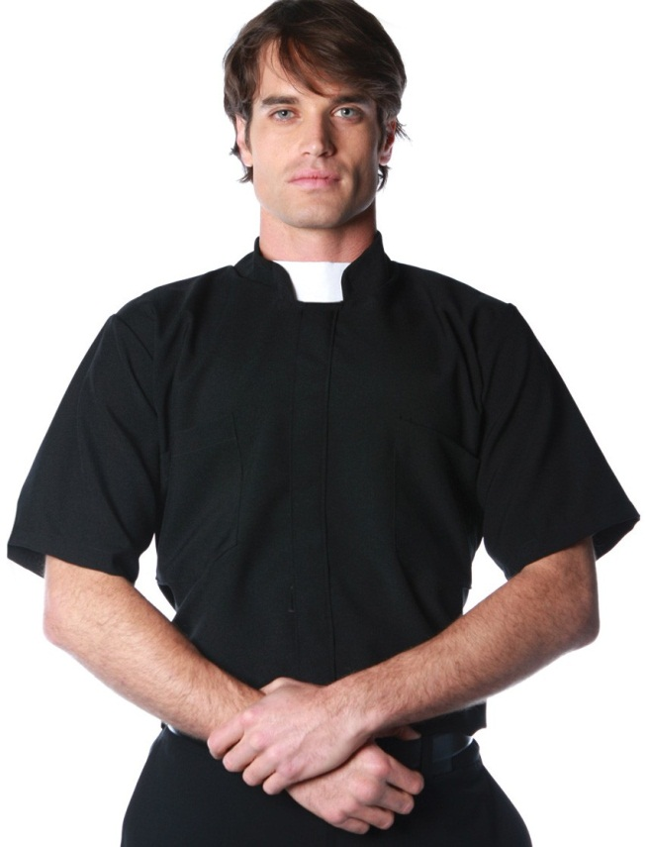
Was the Antichrist an atheistic power, or did it claim to be Christian?
Notes:
Was the Antichrist an atheistic power, or did it claim to be Christian?

Slide 10
“They profess that they know God; but in works they deny him, being abominable, and disobedient, and unto every good work reprobate.”
Titus 1:16
Notes:
Titus 1:16
“They profess that they know God; but in works they deny him, being abominable, and disobedient, and unto every good work reprobate.”
They profess to know God, but in practice the deny Him.

Slide 11

They attribute to themselves virtues that apply only to God: sanctity, infallibility, unchangeableness.
It attacks the law of God and establishes human laws and tradition.
“This people draweth nigh unto me with their mouth, and honoureth me with their lips; but their heart is far from me. But in vain they do worship me, teaching for doctrines the commandments of men.”
Matthew 15:8-9
Notes:
a) They attribute to themselves virtues that apply only to God: sanctity, infallibility, unchangeableness. (2 Thessalonians 2:3, 4).
b) It opposes and persecutes the disciples of Christ. (Revelation 13:7).
The method that Christ used was love, not threat, torture, fear, or persecution.
c) It attacks the law of God and establishes human laws and tradition. Matthew 15:8, 9.
“This people draweth nigh unto me with their mouth, and honoureth me with their lips; but their heart is far from me. But in vain they do worship me, teaching for doctrines the commandments of men.”
On the contrary, Christ established, taught and kept the commandments. (John 15:10).
d) The Antichrist preaches salvation through human works. (2 Thessalonians 2:10).
Christ shows that salvation is by faith and our works are a fruit of Christ's love working in us. Who is the Antichrist in the prophecy? The book of Daniel, which was written more that 2,600 years ago, reveals this mystery.

Slide 12
They attribute to themselves virtues that apply only to God: sanctity, infallibility, unchangeableness
It opposes and persecutes the disciples of Christ.
It attacks the law of God and establishes human laws and tradition
The Antichrist preaches salvation through human works.
So... who is the Antichrist
in the prophecy?
Notes:
d) The Antichrist preaches salvation through human works. (2 Thessalonians 2:10).
Christ shows that salvation is by faith and our works are a fruit of Christ's love working in us. So...who is the Antichrist in the prophecy? The book of Daniel, which was written more that 2,600 years ago, reveals this mystery.

Slide 13

THE SEVEN KEYS
OF THE PROPHECY
Notes:
THE SEVEN KEYS OF THE PROPHECY

Slide 14


What do winds symbolize
in prophecy?
Notes:
What do winds symbolize in prophecy?

Slide 15
“And upon Elam will I bring the four winds from the four quarters of heaven, and will scatter them toward all those winds; and there shall be no nation whither the outcasts of Elam shall not come. For I will cause Elam to be dismayed before their enemies, and before them that seek their life: and I will bring evil upon them, even my fierce anger, saith the Lord; and I will send the sword after them, till I have consumed them”
Jeremiah 49:36-37
Notes:
Winds represent wars.
Jeremiah 49: 36, 37
“And upon Elam will I bring the four winds from the four quarters of heaven, and will scatter them toward all those winds; and there shall be no nation whither the outcasts of Elam shall not come. For I will cause Elam to be dismayed before their enemies, and before them that seek their life: and I will bring evil upon them, even my fierce anger, saith the Lord; and I will send the sword after them, till I have consumed them”

Slide 16

What water
symbolize in prophecy?
Notes:
What do water symbolize in prophecy?

Slide 17
“And he saith unto me, The waters which thou sawest, where the whore sitteth, are peoples, and multitudes, and nations, and tongues.”
Apocalipsis 17:15
Notes:
Waters represent people.
Revelation 17:15
“And he saith unto me, The waters which thou sawest, where the whore sitteth, are peoples, and multitudes, and nations, and tongues”

Slide 18
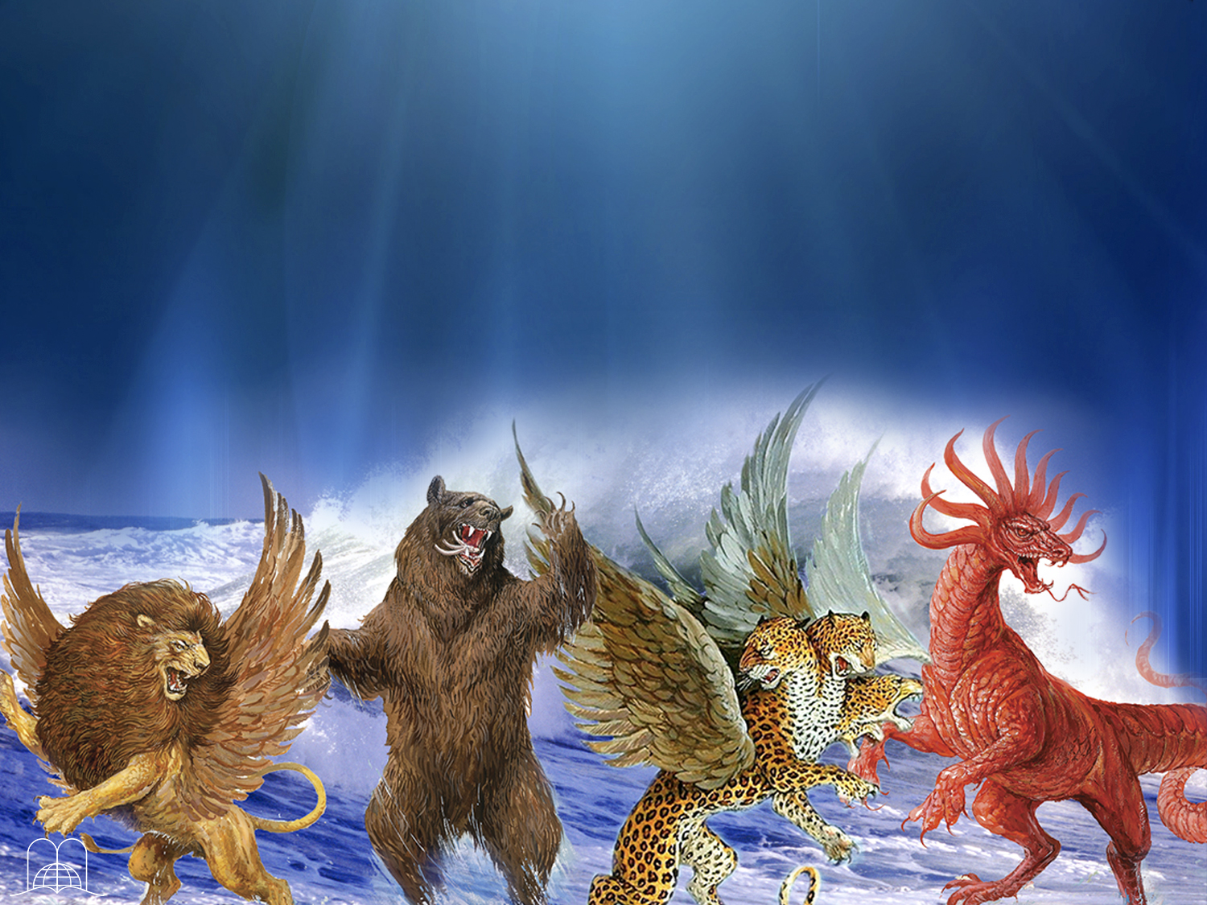
What do beasts,
heads, wings and horns represent?
Notes:
What do beasts, heads, wings and horns represent?

Slide 19

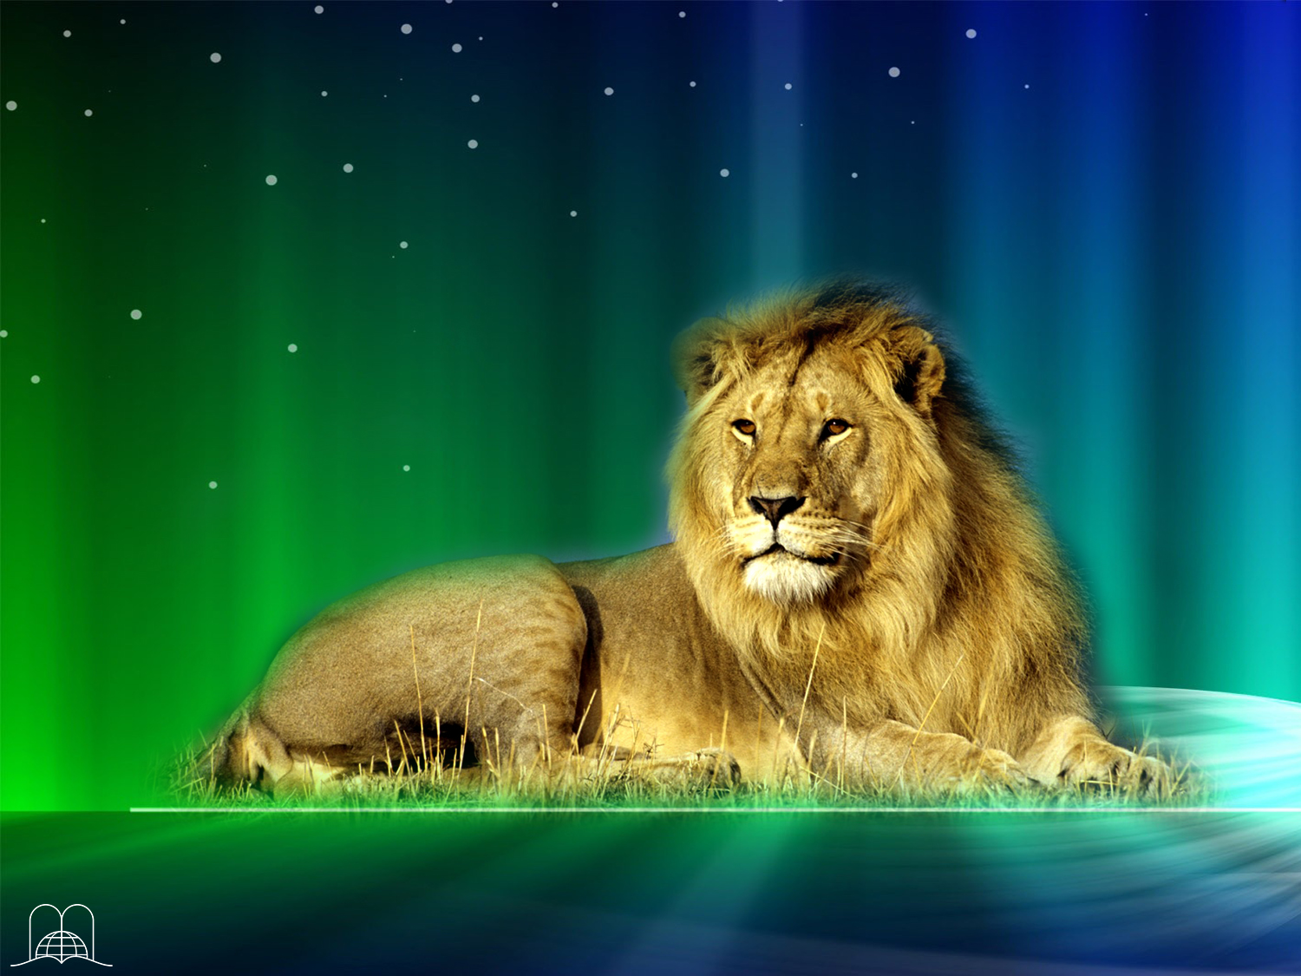
Beasts represent kingdoms
(Daniel 7:23)
Notes:
Beasts represent kingdoms. (Daniel 7:23).
Many nations are still represented by similar symbols: the USA, by an eagle; Great Britain, by a lion; Russia, by a bear; France, by a cock; China, by a dragon, etc.

Slide 20
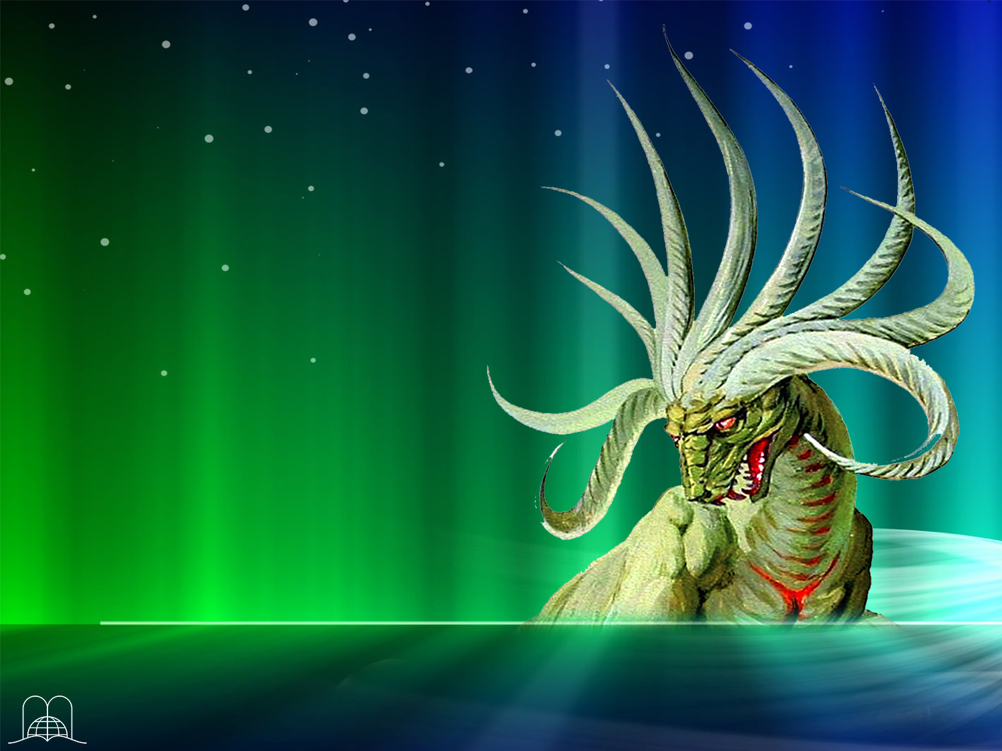
Heads and horns represent division of kingdoms
(Daniel 7:24)
Notes:
Heads and horns represent division of kingdoms.
(Daniel 7:24)

Slide 21

Wings represent speed
(Habakkuk 1:8)
Notes:
* Wings represent speed. (Habakkuk 1:8)

Slide 22
“Daniel spake and said, I saw in my vision by night, and, behold, the four winds of the heaven strove upon the great sea.
And four great beasts came up from the sea, diverse one from another.”
Daniel 7:2-3
Notes:
Daniel 7:2-3
“Daniel spake and said, I saw in my vision by night, and, behold, the four winds of the heaven strove upon the great sea.
And four great beasts came up from the sea, diverse one from another.”
° The four winds strove upon the sea, which means there were wars among many people.
° Four beasts came up from the sea.

Slide 23
1 day = 1 year
“…I have appointed thee each day for a year.”
(Ezekiel 4:6; Numbers 14:34).
Notes:
1 day= 1 year. In prophecy, a day equals one year. (Ezekiel 4:6; Numbers 14:34).

Slide 24
FOUR NATIONS
IN PROPHECY
Notes:
FOUR NATIONS IN PROPHECY

Slide 25
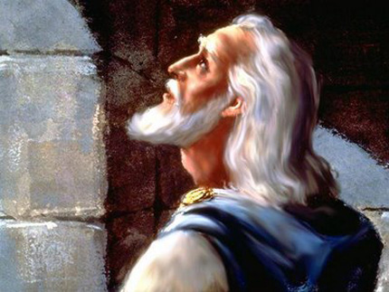
What did
Daniel see
in vision?
Notes:
What did Daniel see in vision?

Slide 26
“Daniel spake and said, I saw in my vision by night, and, behold, the four winds of the heaven strove upon the great sea.
And four great beasts came up from the sea, diverse one from another.”
Daniel 7:2-3
Notes:
Daniel 7:2-3
“Daniel spake and said, I saw in my vision by night, and, behold, the four winds of the heaven strove upon the great sea.
And four great beasts came up from the sea, diverse one from another.”
° The four winds strove upon the sea, which means there would be wars among multitudes of people.
° Four beasts came up from the sea.

Slide 27
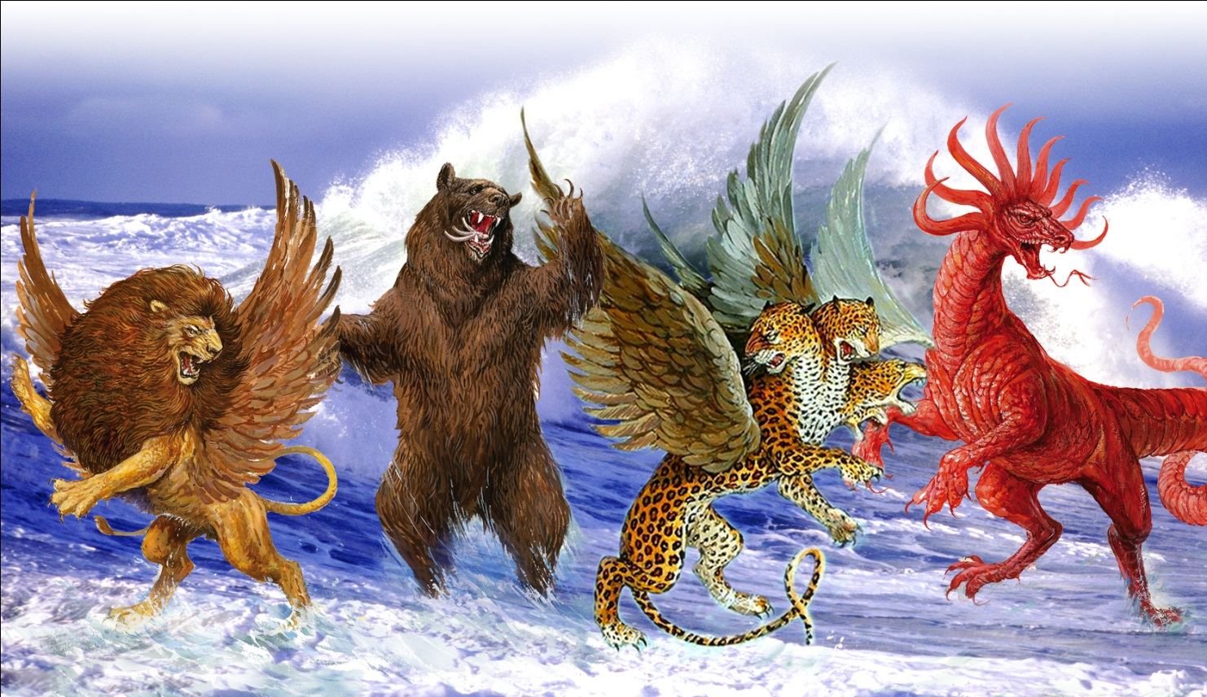
What did the four beast represent?
Notes:
What did the four beast represent?

Slide 28
“I came near unto one of them that stood by, and asked him the truth of all this. So he told me, and made me know the interpretation of the things.
These great beasts, which are four, are four kings, which shall arise out of the earth.“Dijo así: La cuarta bestia será un cuarto reino en la tierra…”
“Thus he said, The fourth beast shall be the fourth kingdom upon earth…”
Daniel 7:16-17, 23 f.p.
Notes:
Daniel 7:16-17, 23 f.p.
“I came near unto one of them that stood by, and asked him the truth of all this. So he told me, and made me know the interpretation of the things.
These great beasts, which are four, are four kings, which shall arise out of the earth.»
“Thus he said, The fourth beast shall be the fourth kingdom upon earth…”
Kingdoms
° They are the same kingdoms represented in the statue of Daniel chapter 2.
Keys to prophetic interpretation given in the Bible
Beasts = Kingdoms
Waters = People
Wings = Speed
Winds = Wars
Heads = Division of kingdoms
Horns = Division of kingdoms
1 Day= 1 Year

Slide 29
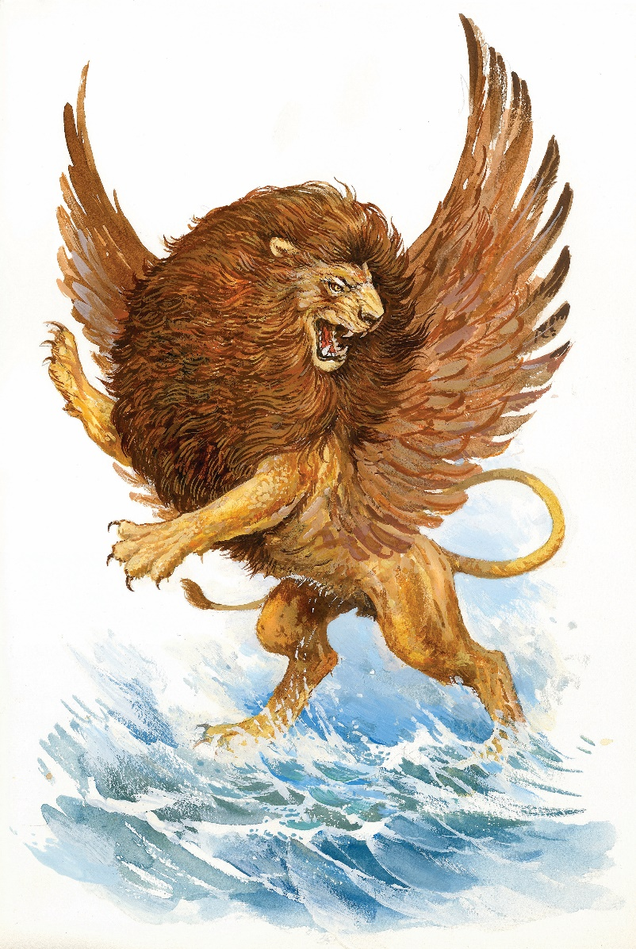
What were the characteristics
of the first beast?
Notes:
What were the characteristics of the first beast?

Slide 30
“The first was like a lion, and had eagle's wings: I beheld till the wings thereof were plucked, and it was lifted up from the earth, and made stand upon the feet as a man, and a man's heart was given to it.”
Daniel 7:4
Notes:
Daniel 7:4
“The first was like a lion, and had eagle's wings: I beheld till the wings thereof were plucked, and it was lifted up from the earth, and made stand upon the feet as a man, and a man's heart was given to it.”
A lion with two wings.

Slide 31
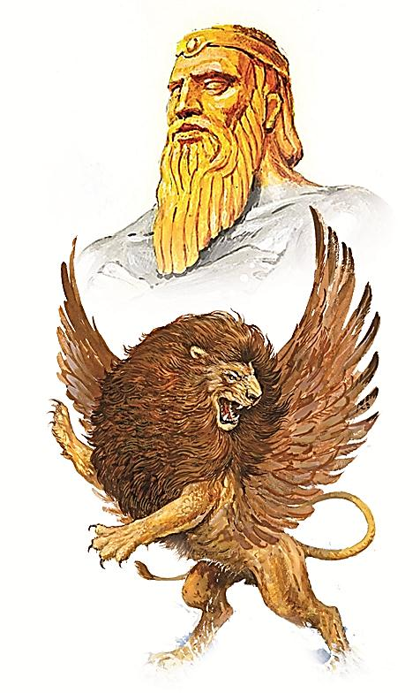
Babylon
(606 - 538 B.C.)
Notes:
a) Represents Babylon (606-538 B.C.).
b) Just as gold is the most precious metal, the lion is the king of the jungle.
c) Two wings represented Nebuchadnezzar' s speedy conquests.

Slide 32
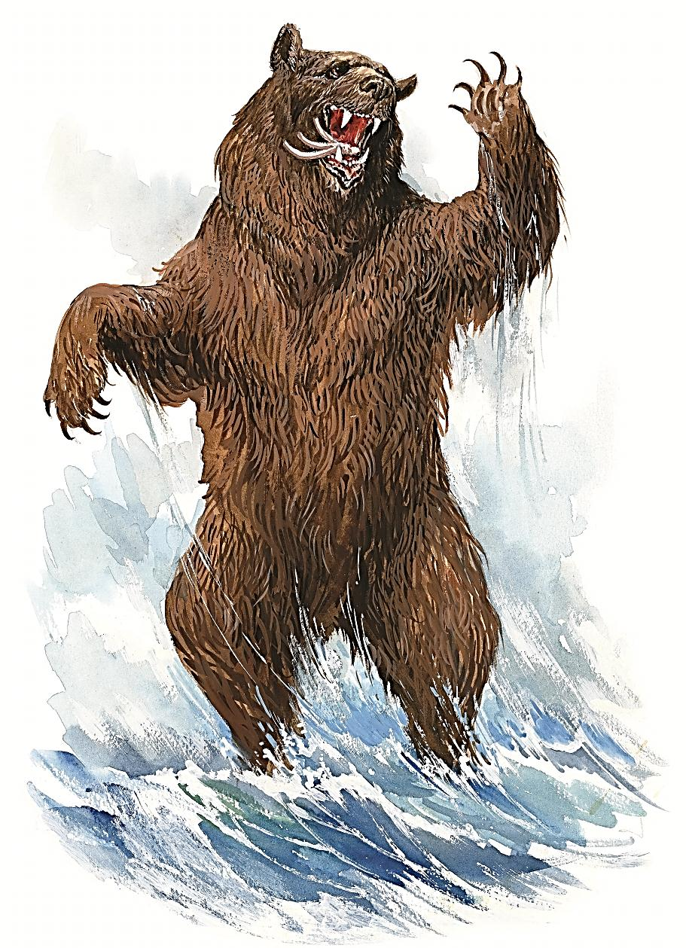
What did
the second beast look like?
Notes:
What did the second beast look like?

Slide 33
“And behold another beast, a second, like to a bear, and it raised up itself on one side, and it had three ribs in the mouth of it between the teeth of it: and they said thus unto it, Arise, devour much flesh.”
Daniel 7:5
Notes:
Daniel 7:5
“And behold another beast, a second, like to a bear, and it raised up itself on one side, and it had three ribs in the mouth of it between the teeth of it: and they said thus unto it, Arise, devour much flesh.”
To a bear

Slide 34
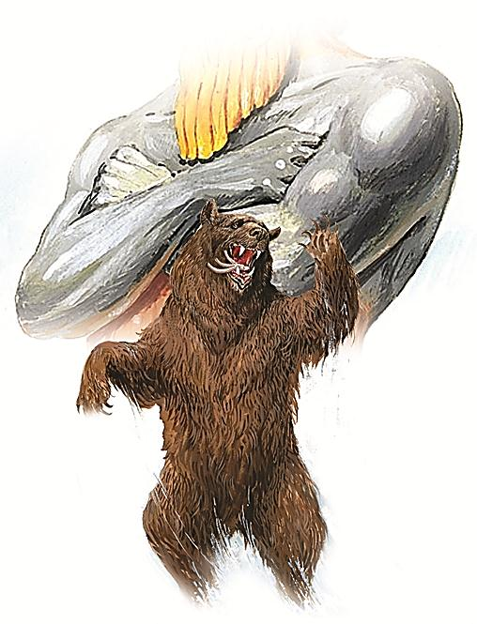
Medo-Persia
(538 - 331 B.C.)
Notes:
a) Represents Medo-Persia (538-331 B.C.).
b) It leans on one side, representing the superiority of the Persians over the Medes.
c) It held three ribs in its mouth, depicting its conquest of three provinces - Babylon, Lydia and Egypt.
d) It devours much meat, meaning they were very vicious in their conquests.

Slide 35
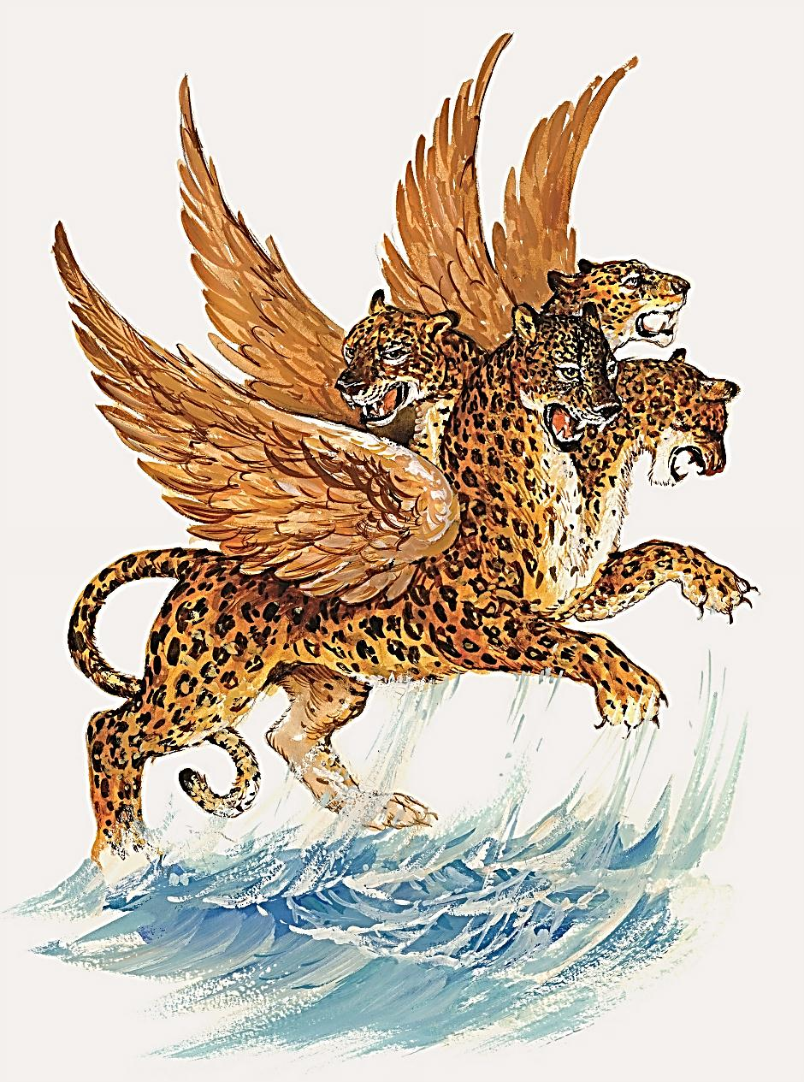
¿What characterized the leopard
depicted
in verse 6?
Notes:
What characterized the leopard depicted in verse 6?

Slide 36
“After this I beheld, and lo another, like a leopard, which had upon the back of it four wings of a fowl; the beast had also four heads; and dominion was given to it.”
Daniel 7:6
Notes:
Daniel 7:6
“After this I beheld, and lo another, like a leopard, which had upon the back of it four wings of a fowl; the beast had also four heads; and dominion was given to it.”
It had four heads and four wings

Slide 37
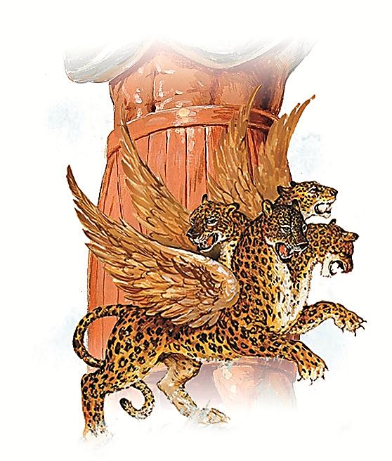
Greek
(331 - 168 B.C.)
Notes:
This represent the Greek empire (331-168 B.C.).
a) The four wings represent the speed of conquest - twice that of Nebuchadnezzar. It took Alexander the Great only 8 years to conquer an area of 5 million square kilometers.
b) Four heads: When Alexander died (323 B.C.), his empire was divided among his four generals: Lysimachus ruled over Thrace; Cassander over Greece; Seleucus over Syria and Babylon, and Ptolomy over Egypt.

Slide 38
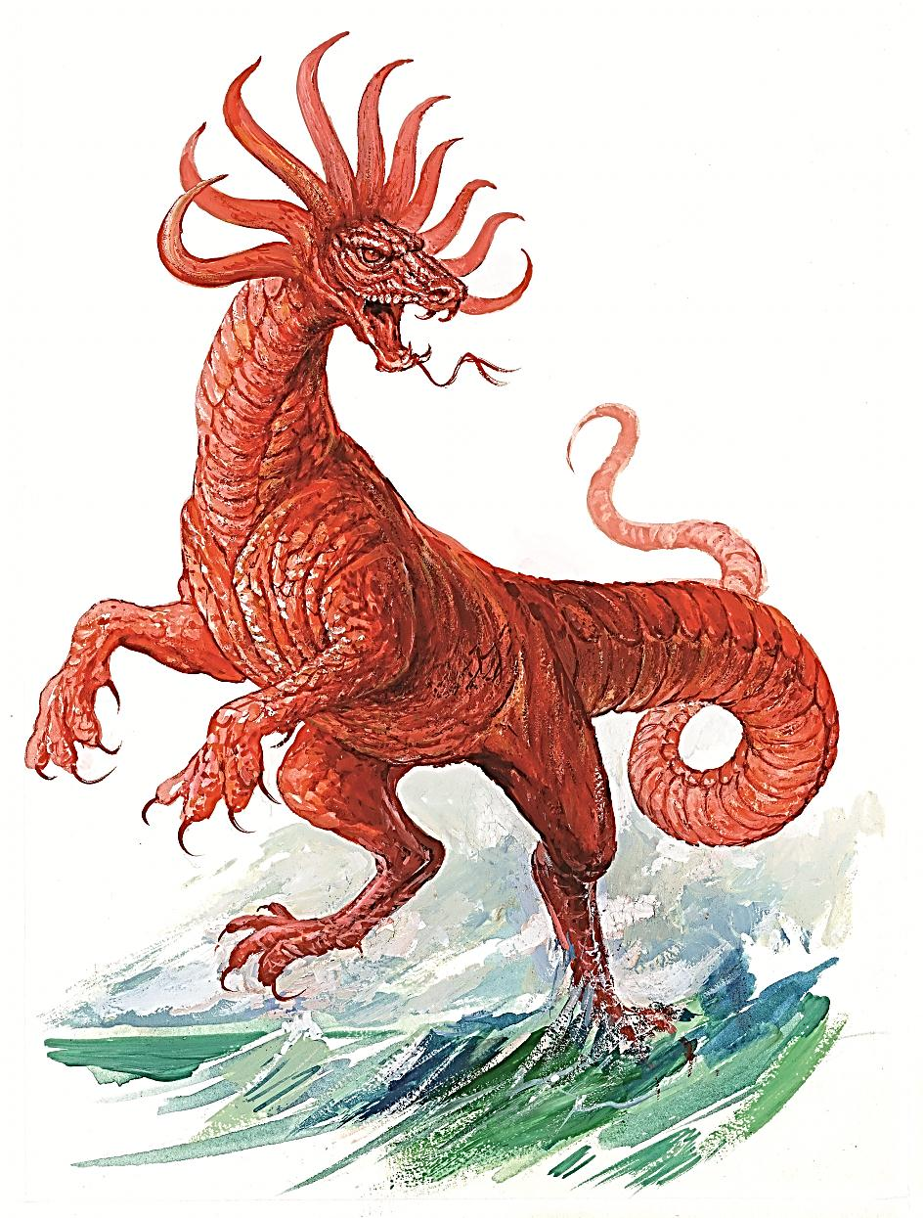
What
was the
fourth
beast like?
Notes:
What was the fourth beast like?

Slide 39
“After this I saw in the night visions, and behold a fourth beast, dreadful and terrible, and strong exceedingly; and it had great iron teeth: it devoured and brake in pieces, and stamped the residue with the feet of it: and it was diverse from all the beasts that were before it; and it had ten horns.”
Daniel 7:7
Notes:
Daniel 7:7
“After this I saw in the night visions, and behold a fourth beast, dreadful and terrible, and strong exceedingly; and it had great iron teeth: it devoured and brake in pieces, and stamped the residue with the feet of it: and it was diverse from all the beasts that were before it; and it had ten horns.”

Slide 40
“Then I would know the truth of the fourth beast, which was diverse from all the others, exceeding dreadful, whose teeth were of iron, and his nails of brass; which devoured, brake in pieces, and stamped the residue with his feet;
And of the ten horns that were in his head, and of the other which came up, and before whom three fell; even of that horn that had eyes, and a mouth that spake very great things, whose look was more stout than his fellows.”
Daniel 7:19-20
Notes:
Daniel 7:19-20
“Then I would know the truth of the fourth beast, which was diverse from all the others, exceeding dreadful, whose teeth were of iron, and his nails of brass; which devoured, brake in pieces, and stamped the residue with his feet;
And of the ten horns that were in his head, and of the other which came up, and before whom three fell; even of that horn that had eyes, and a mouth that spake very great things, whose look was more stout than his fellows.”

Slide 41
“Thus he said, The fourth beast shall be the fourth kingdom upon earth, which shall be diverse from all kingdoms, and shall devour the whole earth, and shall tread it down, and break it in pieces.”
Daniel 7:23
Notes:
Daniel 7:23
“Thus he said, The fourth beast shall be the fourth kingdom upon earth, which shall be diverse from all kingdoms, and shall devour the whole earth, and shall tread it down, and break it in pieces.”
Dreadful and terrible

Slide 42
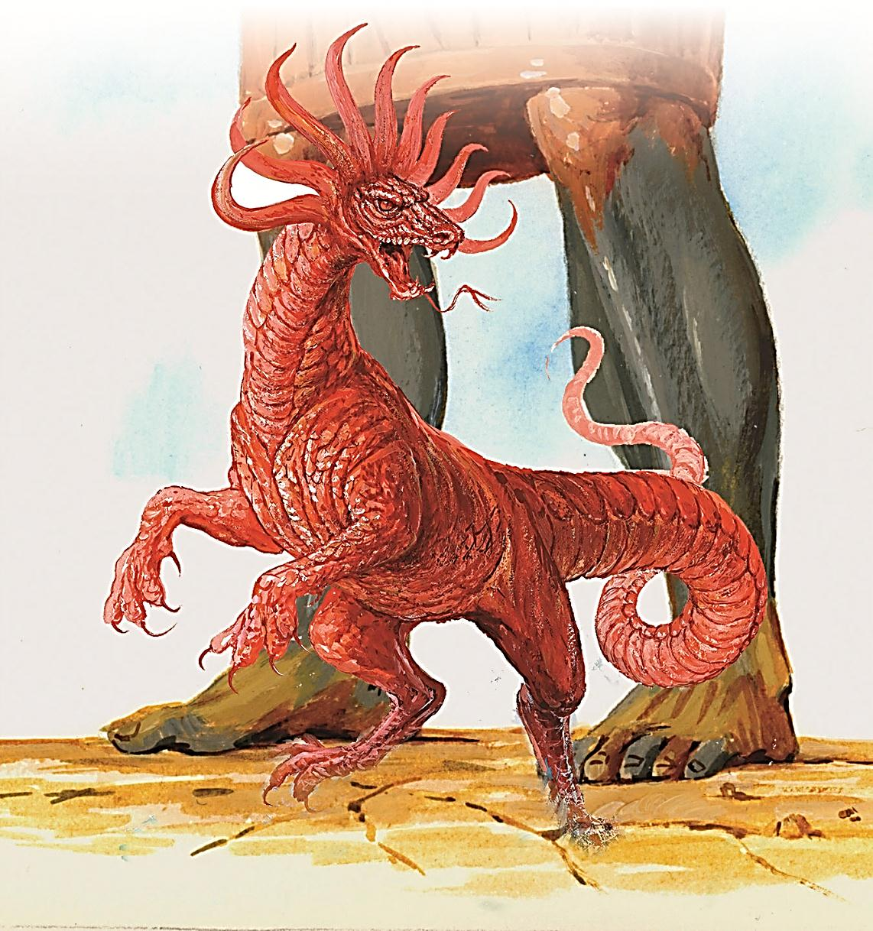
Rome
(168 B.C.-476 A.D.)
Notes:
a) The fourth beast represented Rome (169 B.C.-476 A.D.). Its cruelty was represented by its bronze nails and the iron teeth.
b) The ten horns are equivalent to the ten toes in Daniel 2, and they represent the ten nations of Western Europe which remained at the end of the Roman Empire. (Verse 24).

Slide 43
THE SMALL
HORN
Notes:
THE SMALL HORN

Slide 44
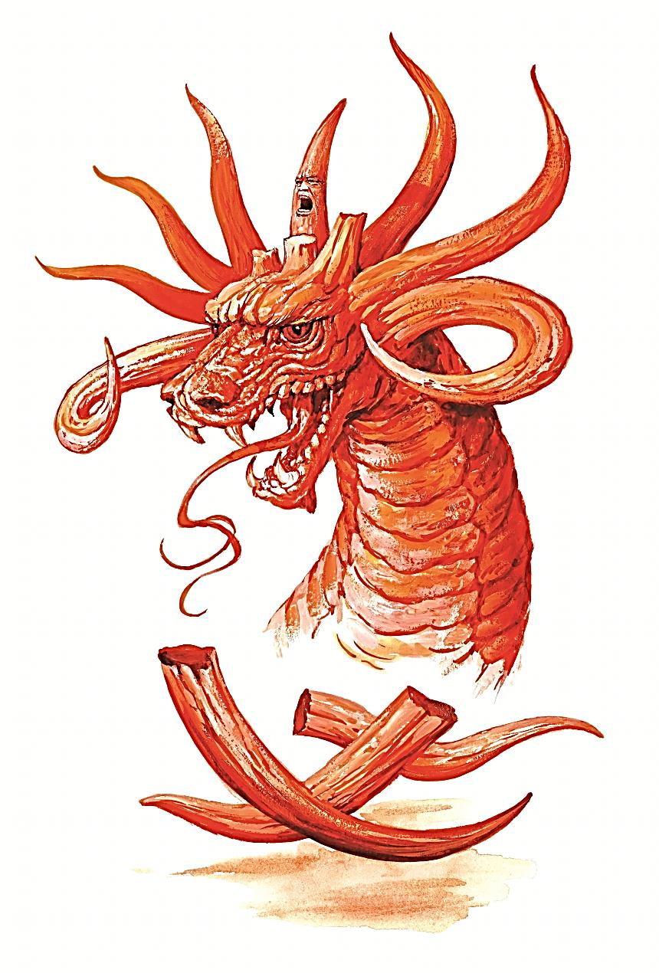
What
characterized
the small
horn that came up?
Notes:
What characterized the small horn that came up?

Slide 45
“I considered the horns, and, behold, there came up among them another little horn, before whom there were three of the first horns plucked up by the roots: and, behold, in this horn were eyes like the eyes of man, and a mouth speaking great things.”
Daniel 7:8
Notes:
Daniel 7:8
“I considered the horns, and, behold, there came up among them another little horn, before whom there were three of the first horns plucked up by the roots: and, behold, in this horn were eyes like the eyes of man, and a mouth speaking great things.”

Slide 46
“And of the ten horns that were in his head, and of the other which came up, and before whom three fell; even of that horn that had eyes, and a mouth that spake very great things, whose look was more stout than his fellows.
Y veía yo que este cuerno hacía guerra contra los santos, y los vencía, hasta que vino el Anciano de días, y se dio el juicio a los santos del Altísimo; y llegó el tiempo, y los santos recibieron el reino.
Dijo así: La cuarta bestia será un cuarto reino en la tierra, el cual será diferente de todos los otros reinos, y a toda la tierra devorará, trillará y despedazará.
Y los diez cuernos significan que de aquel reino se levantarán diez reyes; y tras ellos se levantará otro, el cual será diferente de los primeros, y a tres reyes derribará.
Y hablará palabras contra el Altísimo, y a los santos del Altísimo quebrantará, y pensará en cambiar los tiempos y la ley; y serán entregados en su mano hasta tiempo, y tiempos, y medio tiempo.”
Daniel 7:20-25
Notes:
Daniel 7:20-25
“And of the ten horns that were in his head, and of the other which came up, and before whom three fell; even of that horn that had eyes, and a mouth that spake very great things, whose look was more stout than his fellows.

Slide 47
I beheld, and the same horn made war with the saints, and prevailed against them;
Until the Ancient of days came, and judgment was given to the saints of the most High; and the time came that the saints possessed the kingdom.
“Asimismo acerca de los diez cuernos que tenía en su cabeza, y del otro que le había salido, delante del cual habían caído tres; y este mismo cuerno tenía ojos, y boca que hablaba grandes cosas, y parecía más grande que sus compañeros.
Dijo así: La cuarta bestia será un cuarto reino en la tierra, el cual será diferente de todos los otros reinos, y a toda la tierra devorará, trillará y despedazará.
Y los diez cuernos significan que de aquel reino se levantarán diez reyes; y tras ellos se levantará otro, el cual será diferente de los primeros, y a tres reyes derribará.
Y hablará palabras contra el Altísimo, y a los santos del Altísimo quebrantará, y pensará en cambiar los tiempos y la ley; y serán entregados en su mano hasta tiempo, y tiempos, y medio tiempo.”
Daniel 7:20-25
Notes:
Daniel 7:20-25
I beheld, and the same horn made war with the saints, and prevailed against them;
Until the Ancient of days came, and judgment was given to the saints of the most High; and the time came that the saints possessed the kingdom.

Slide 48
Thus he said, The fourth beast shall be the fourth kingdom upon earth, which shall be diverse from all kingdoms, and shall devour the whole earth, and shall tread it down, and break it in pieces.
“Asimismo acerca de los diez cuernos que tenía en su cabeza, y del otro que le había salido, delante del cual habían caído tres; y este mismo cuerno tenía ojos, y boca que hablaba grandes cosas, y parecía más grande que sus compañeros.
Y veía yo que este cuerno hacía guerra contra los santos, y los vencía, hasta que vino el Anciano de días, y se dio el juicio a los santos del Altísimo; y llegó el tiempo, y los santos recibieron el reino.
Y los diez cuernos significan que de aquel reino se levantarán diez reyes; y tras ellos se levantará otro, el cual será diferente de los primeros, y a tres reyes derribará.
Y hablará palabras contra el Altísimo, y a los santos del Altísimo quebrantará, y pensará en cambiar los tiempos y la ley; y serán entregados en su mano hasta tiempo, y tiempos, y medio tiempo.”
Daniel 7:20-25
Notes:
Daniel 7:20-25
Thus he said, The fourth beast shall be the fourth kingdom upon earth, which shall be diverse from all kingdoms, and shall devour the whole earth, and shall tread it down, and break it in pieces.

Slide 49
“Asimismo acerca de los diez cuernos que tenía en su cabeza, y del otro que le había salido, delante del cual habían caído tres; y este mismo cuerno tenía ojos, y boca que hablaba grandes cosas, y parecía más grande que sus compañeros.
Y veía yo que este cuerno hacía guerra contra los santos, y los vencía, hasta que vino el Anciano de días, y se dio el juicio a los santos del Altísimo; y llegó el tiempo, y los santos recibieron el reino.
Dijo así: La cuarta bestia será un cuarto reino en la tierra, el cual será diferente de todos los otros reinos, y a toda la tierra devorará, trillará y despedazará.
And the ten horns out of this kingdom are ten kings that shall arise: and another shall rise after them; and he shall be diverse from the first, and he shall subdue three kings.
Y hablará palabras contra el Altísimo, y a los santos del Altísimo quebrantará, y pensará en cambiar los tiempos y la ley; y serán entregados en su mano hasta tiempo, y tiempos, y medio tiempo.”
Daniel 7:20-25
Notes:
Daniel 7:20-25
And the ten horns out of this kingdom are ten kings that shall arise: and another shall rise after them; and he shall be diverse from the first, and he shall subdue three kings.

Slide 50
And he shall speak great words against the most High, and shall wear out the saints of the most High, and think to change times and laws: and they shall be given into his hand until a time and times and the dividing of time.”
“Asimismo acerca de los diez cuernos que tenía en su cabeza, y del otro que le había salido, delante del cual habían caído tres; y este mismo cuerno tenía ojos, y boca que hablaba grandes cosas, y parecía más grande que sus compañeros.
Y veía yo que este cuerno hacía guerra contra los santos, y los vencía, hasta que vino el Anciano de días, y se dio el juicio a los santos del Altísimo; y llegó el tiempo, y los santos recibieron el reino.
Dijo así: La cuarta bestia será un cuarto reino en la tierra, el cual será diferente de todos los otros reinos, y a toda la tierra devorará, trillará y despedazará.
Y los diez cuernos significan que de aquel reino se levantarán diez reyes; y tras ellos se levantará otro, el cual será diferente de los primeros, y a tres reyes derribará.
Daniel 7:20-25
Notes:
Daniel 7:20-25
And he shall speak great words against the most High, and shall wear out the saints of the most High, and think to change times and laws: and they shall be given into his hand until a time and times and the dividing of time.”

Slide 51
It was different from the other horns
It was bigger than the other beasts
The three horns fell
It spoke against the Most High
Notes:
When this horn came up three horns were plucked up. It had eyes like a man and a mouth that spoke great things.
a) It was different from the other horns, which means that it was not a political power but a religious one. Which power assumed the place of Imperial Rome? The papacy.
b) It was bigger than the other beasts, apart from its religious power it also had political power. Its influence is still powerful today.
c) The three horns that fell when this one came up represent the three kings who were defeated and destroyed before the establishment of the papacy. In the year 493, the Heruli were defeated, in 534, the Vandals; and in 538, the Ostrogods were conquered by Justinian.
d) It would speak against the Most High. The Pope calls himself infallible, gives indulgences and calls himself the Holy Father, attributes that belong only to God. (Matthew 23:9).

Slide 52

What would
the little horn
do to the
saints,
the true believers?
Notes:
What would the little horn do to the the saints, the true believers?

Slide 53
“And of the ten horns that were in his head, and of the other which came up, and before whom three fell; even of that horn that had eyes, and a mouth that spake very great things, whose look was more stout than his fellows.”
Daniel 7:21
Notes:
Daniel 7:21
“And of the ten horns that were in his head, and of the other which came up, and before whom three fell; even of that horn that had eyes, and a mouth that spake very great things, whose look was more stout than his fellows.”
It made war against the saints, it persecuted them.
This reminds us of the dark ages mentioned in history, when millions of Christians who were called heretics were put to death by various horrible means during the “Inquisition.”

Slide 54
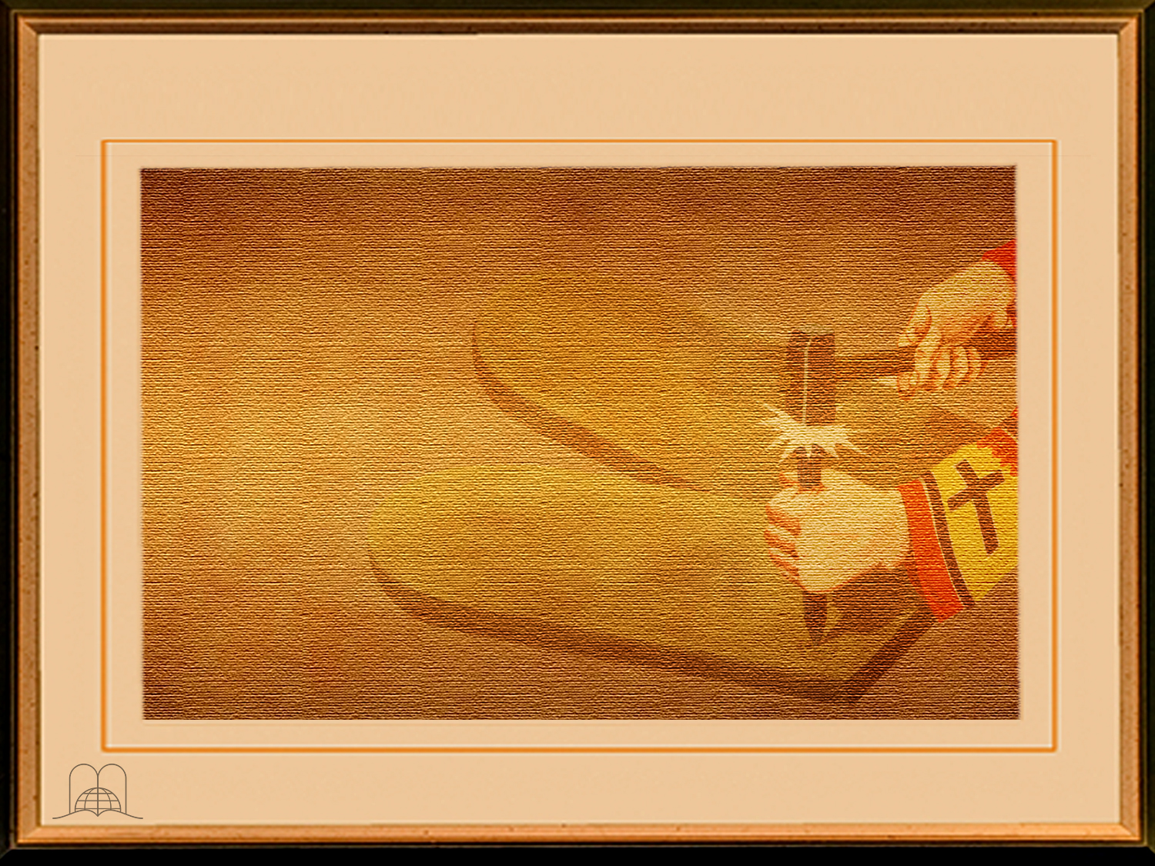
What did that power think to change according
to the prophecy?
Notes:
What did that power think to change according to the prophecy?

Slide 55
“And he shall speak great words against the most High, and shall wear out the saints of the most High, and think to change times and laws: and they shall be given into his hand until a time and times and the dividing of time.”
Daniel 7:25
Notes:
Daniel 7:25
“And he shall speak great words against the most High, and shall wear out the saints of the most High, and think to change times and laws: and they shall be given into his hand until a time and times and the dividing of time.”
Times and the law.
The Ten Commandments were changed. In catechism, the second commandment is omitted and the tenth is divided in two. The fourth commandment which commands the observance of the Sabbath (Saturday) as the true day of rest, but this day has been substituted by “keep holy the Lord’s day.” . God has not authorized anyone to change His law. (Matthew 5:16, 17; Ecclesiastes 3:14).

Slide 56

How long
was the
persecution
to last?
Notes:
How long was the persecution to last?

Slide 57
“…and they shall be given into his hand until a time and times and the dividing of time.”
1260 YEARS
538 A.D.
1798 A.D.
PAPAL SUPREMACY
Daniel 7:25
Notes:
Daniel 7:25 ú.p.
“…and they shall be given into his hand until a time and times and the dividing of time.”
A time and times and the dividing of times.
A time is equal to a year; times is equal to two years; and the dividing of times is equal to half a year, totaling three and a half years. If we calculate a biblical year as having 360 days, it’s 1260 days. This is the same calculation that is mentioned in Revelation 12:6, 14 and 13:5. These 1260 prophetic days are 1260 literal years. This is the period starting in 538, when the papacy's supremacy began, to 1798. During the French Revolution, Napoleon sent General Berthier to take Pope Pius VI captive. This Pope died in exile.
So who is the Antichrist? It is a religious power that arose from Imperial Rome. It is a power that claims the prerrogatives of God. It is a power that carried on the Persecution for 1260 years and changed the holy law of God. Have you recognized which power this is? It is the papacy]
God is the author of History, and all the events that take place have been foreseen by the great Omniscient One. At the same time that the prophecy spoke of a power that would oppose the plan of redemption, it also told about the incarnation of Christ to fulfill the plan of salvation. (Galatians 4:4).

Slide 58
CONCLUSION
Notes:
CONCLUSION

Slide 59
God Himself guides the destiny of nations.
Prophecy outlines the development of history and the war between light and darkness, but Christ is the victor, and all who believe in Him will share in this great victory.
This prophecy clearly shows that Christ does not change his law but the Antichrist attempted to do so.
Let not men change God’s truth.
Let us acknowledge the eternal validity of the Ten Commandments because Jesus Christ wants us to keep them and He wishes to bless those who accept Him as their Savior and Lord.
Notes:
° God Himself guides the destiny of nations.
° Prophecy outlines the development of history and the war between light and darkness, but Christ is the victor, and all who believe in Him will share in this great victory.
° This prophecy clearly shows that Christ does not change His law but the Antichrist attempted to do so. Let not men change God’s truth.
° Let us acknowledge the eternal validity of the Ten Commandments because Jesus Christ wants us to keep them and He wishes to bless those who accept Him as their Savior and Lord.

Slide 60

Thank you, Lord,
for the clarity
of your Word!
Notes:
Thank you, Lord, for the clarity of your Word!

Slide 61
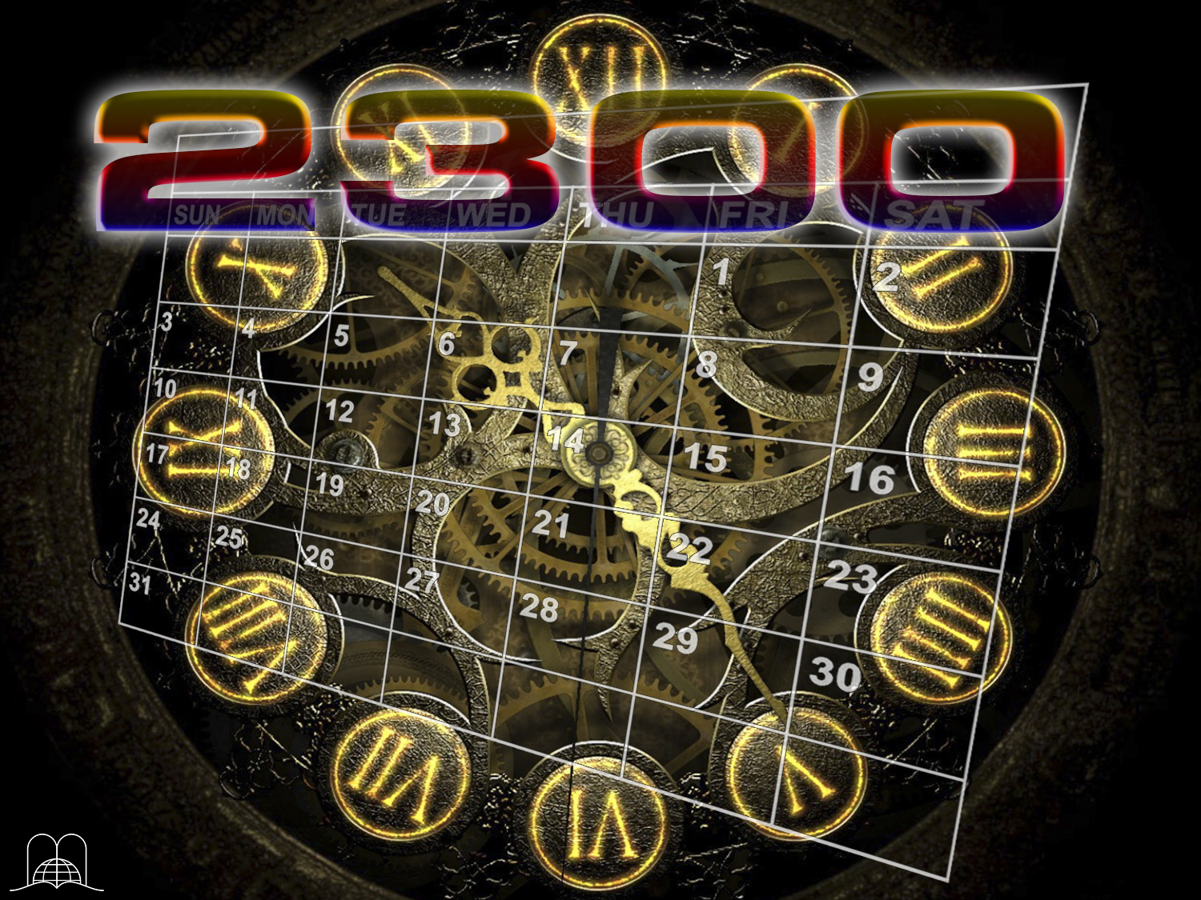
The next topic:
“The fascinating prophecy of the 2300 years”
This is one of the 10 mathematical predictions that the Bible has. They are the watch of God.
It was pointed out the time when the Messiah would appear, when it would be restored the truth cast down by the antichrist, and the beginning of the time of the end. A prophecy that is worth knowing.
GOD BLESS YOU!
Notes:
GOD BLESS YOU!
The next topic: “The fascinating prophecy of the 2300 years”
This is one of the 10 mathematical predictions that the Bible has. They are the watch of God.
It was pointed out the time when the Messiah would appear, when it would be restored the truth cast down by the antichrist, and the beginning of the time of the end. A prophecy that is worth knowing.

Slide 62

biblewell.org
info@biblewell.org
Notes:
If you still have questions, write to us confidently at: info@biblewell.org

