Slide 1
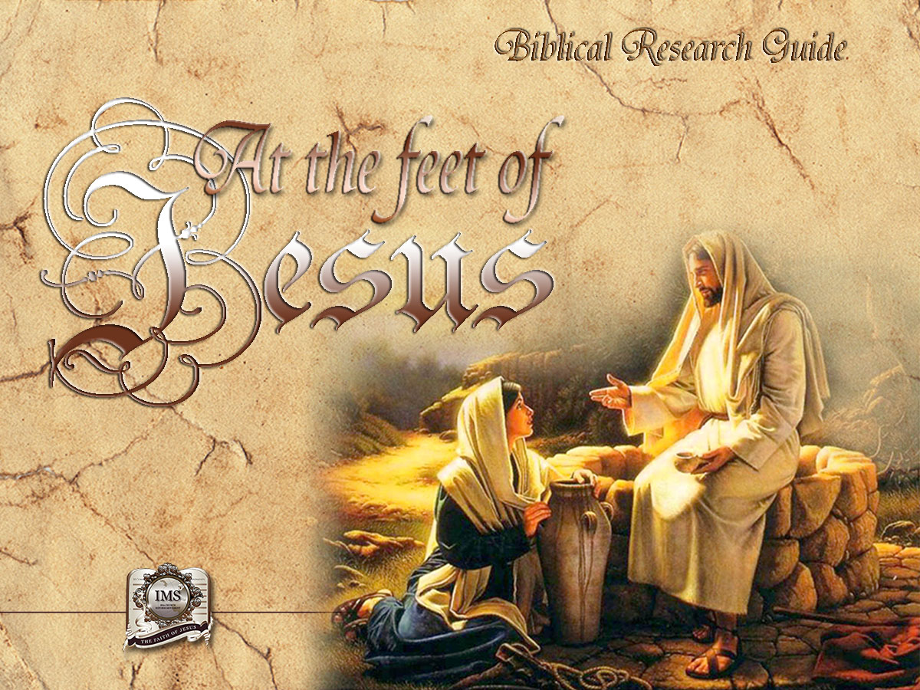

General Conference
Multimedia Department
Notes:
BIBLICAL RESEARCH GUIDE: “AT THE FEET OF JESUS”

Slide 2
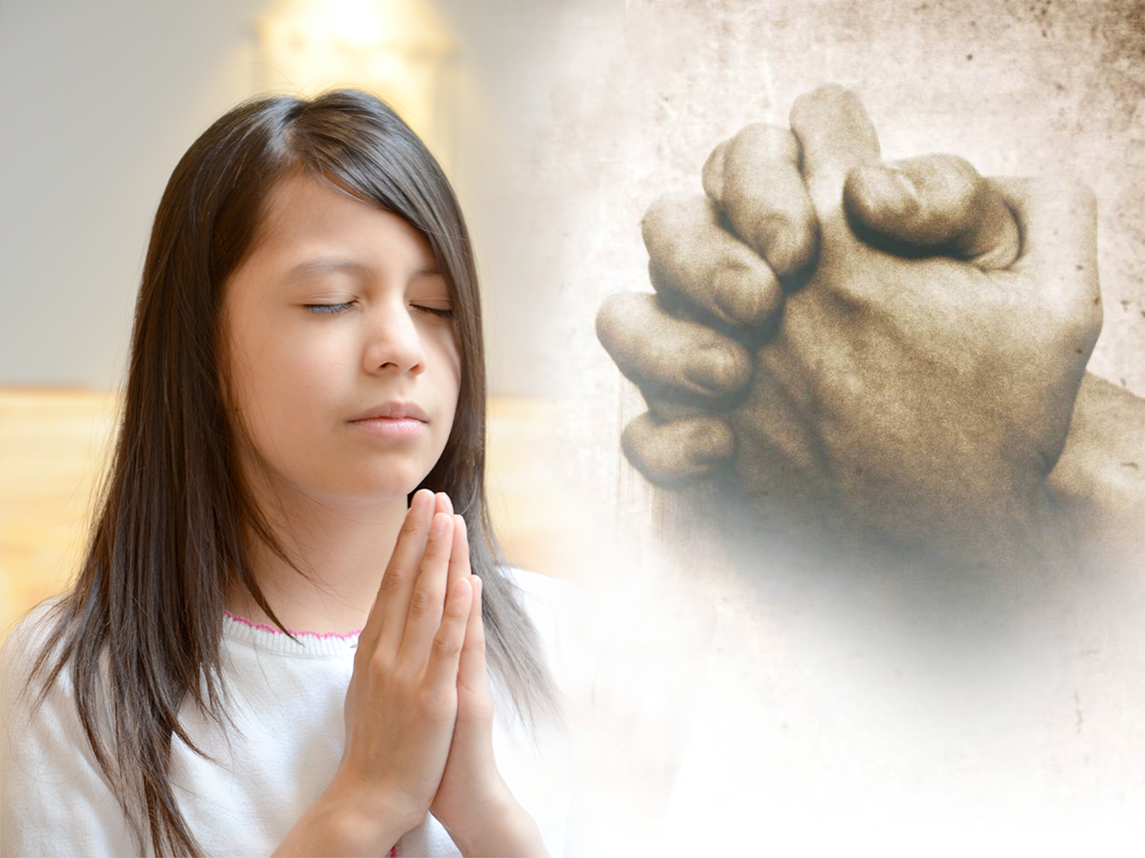

A MOMENT OF PRAYER…
Notes:
A MOMENT OF PRAYER…

Slide 3
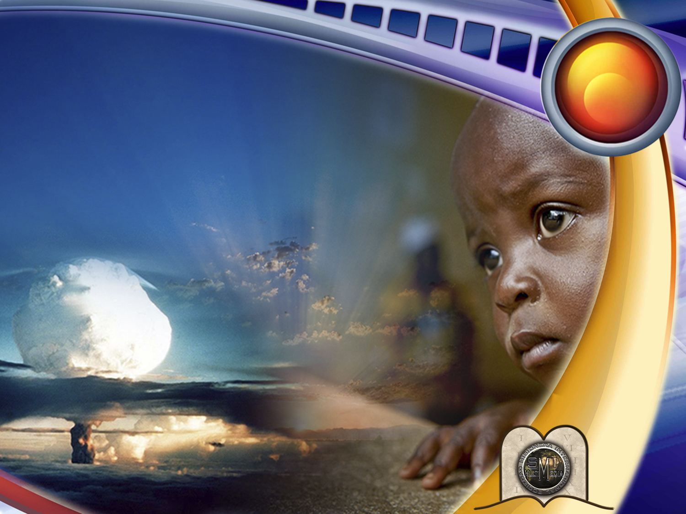
3
What is the cause of so much suffering?
Notes:
What is the cause of so much suffering?

Slide 4
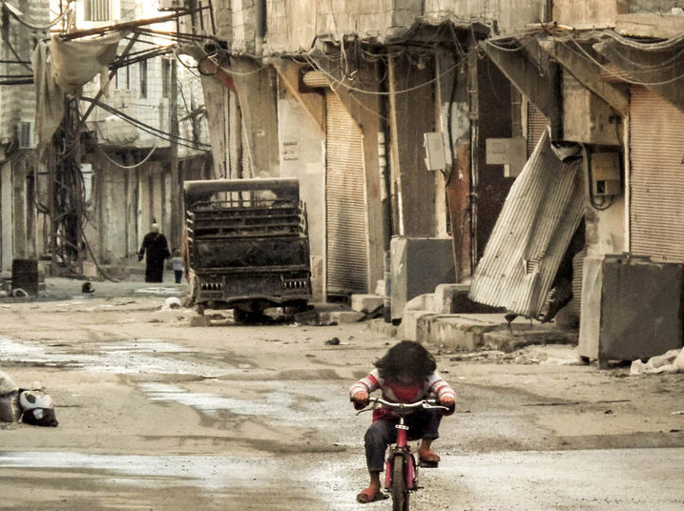
Notes:
As a result of the bombings of the last world war, thousands were left homeless.
Children wondered around the streets looking for their parents. Many did not find them, for they had either died or the cruelty of war had separated them. Their home, where they could possibly be found, no longer existed.
Today, there are people who are still looking for their roots… They do not know who or where their parents are. Many desire to know where they came from and where they are going. The true origin and destiny of mankind.

Slide 5
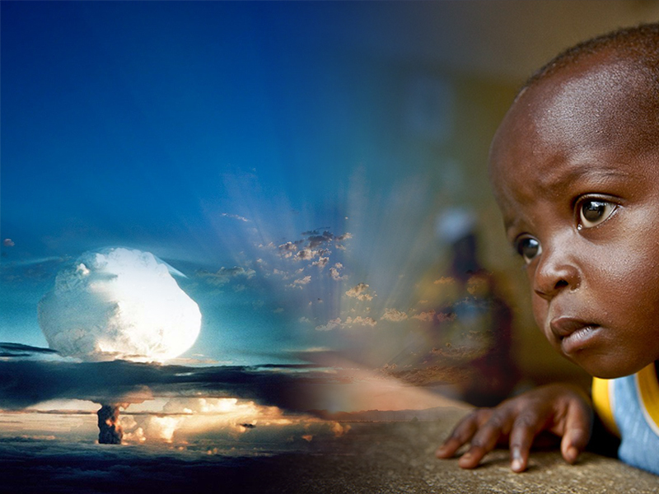
Natural disasters, armed conflicts, the growing number of illnesses, social differences, these things in many people produce worry and anguish. They become prisoners to their fears, and sorrows.
Notes:
Natural disasters, armed conflicts, the growing number of illnesses, social differences, these things in many people produce worry and anguish. They become prisoners to their fears, and sorrows.
All of humanity is disoriented. Something has led them to lose the right course. Instead of happiness, fustration is expeirienced; in place of well-being, there is discomfort.

Slide 6
These are the questions that haunt most people but only the Author of life can give us the answers.
Why do the innocent people suffer?
Why does pain, sickness and death exist?
Did God create an evil world?
What is our true origin and destiny?
Where have we come from, and where are we going?
Notes:
Why do the innocent people suffer?
Why does pain, sickness and death exist?
Did God create an evil world?
What is our true origin and destiny?
Where have we come from, and where are we going?
These are the questions that haunt most people but only the Author of life can give us the answers.

Slide 7
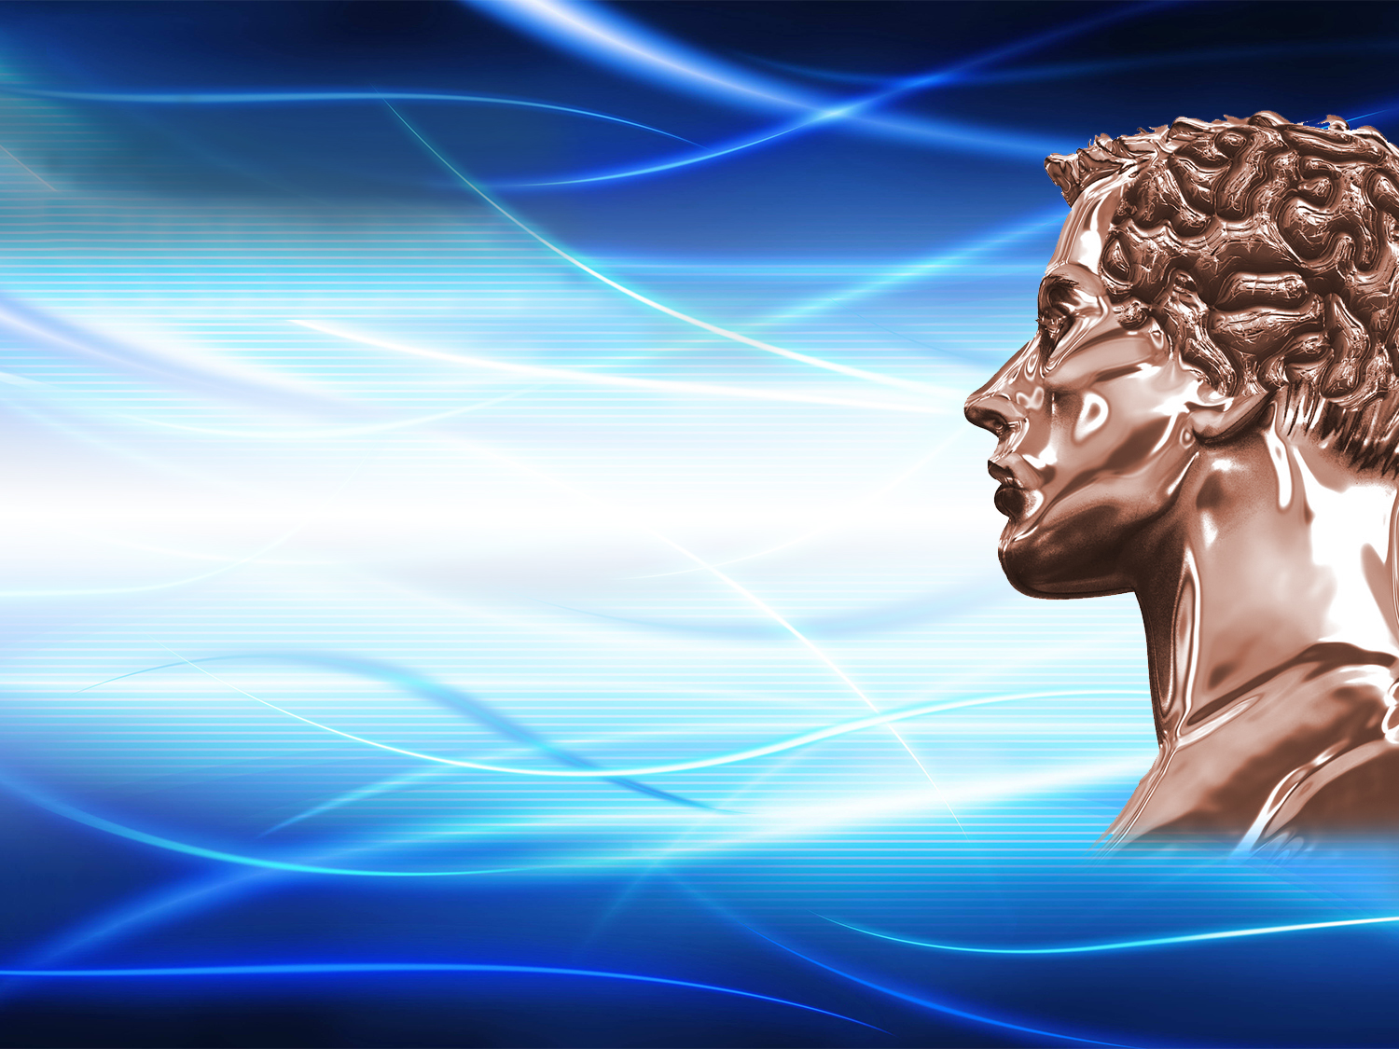
MAN’S ORIGIN
Notes:
MAN’S ORIGIN

Slide 8
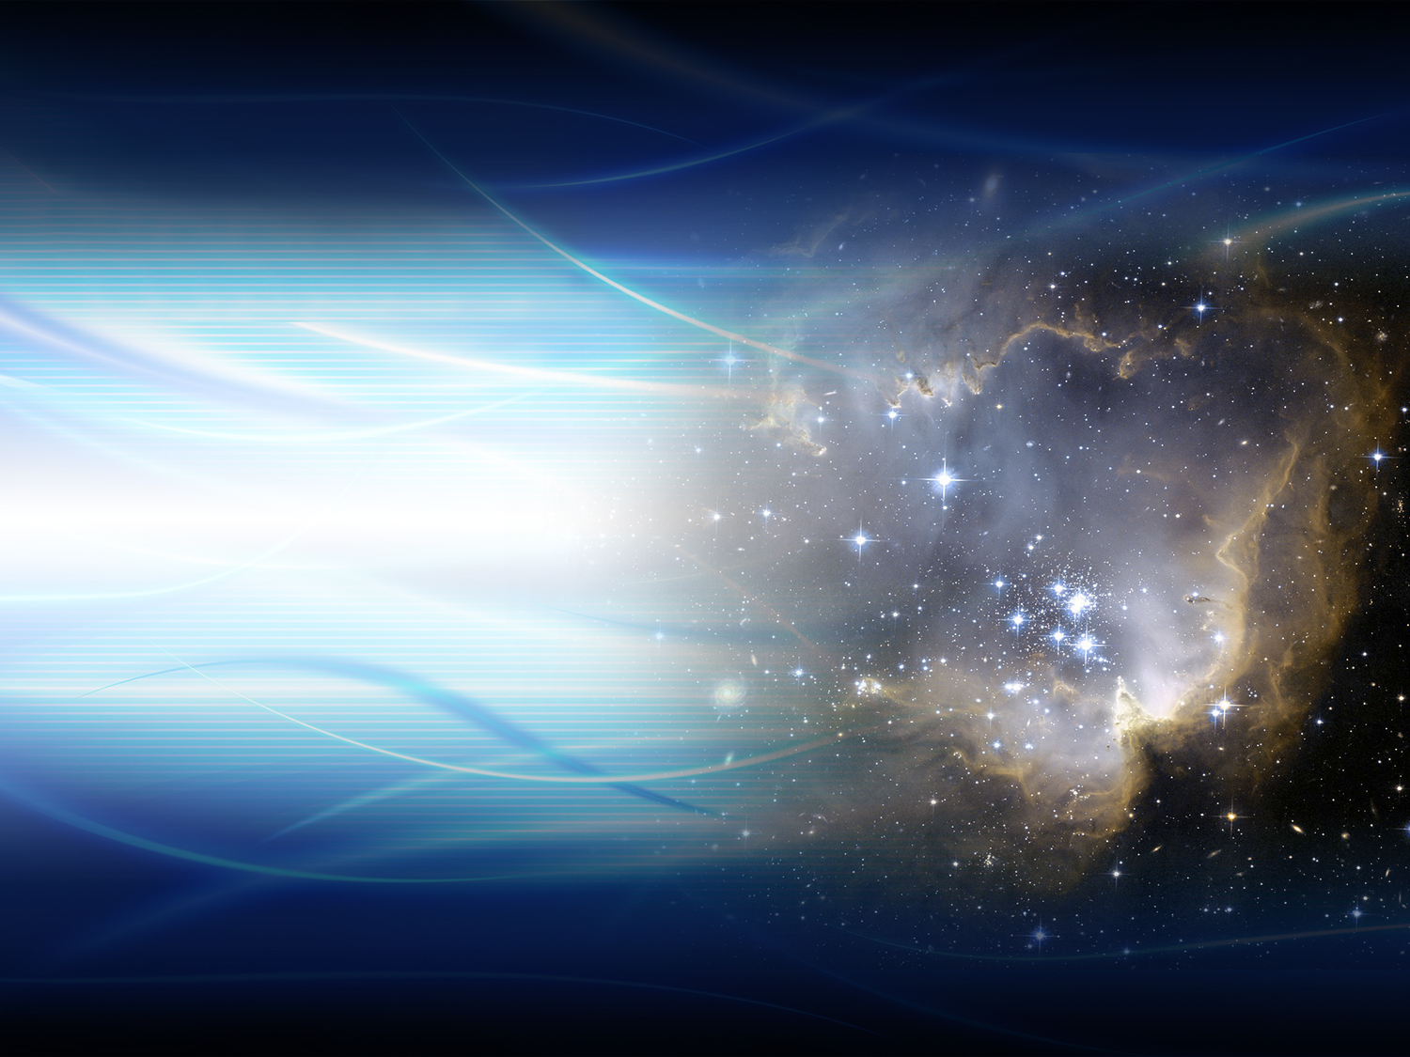
Genesis 1:1
“In the beginning God created the heaven and the earth.”
Notes:
Genesis 1:1
“In the beginning God created the heaven and the earth.”

Slide 9
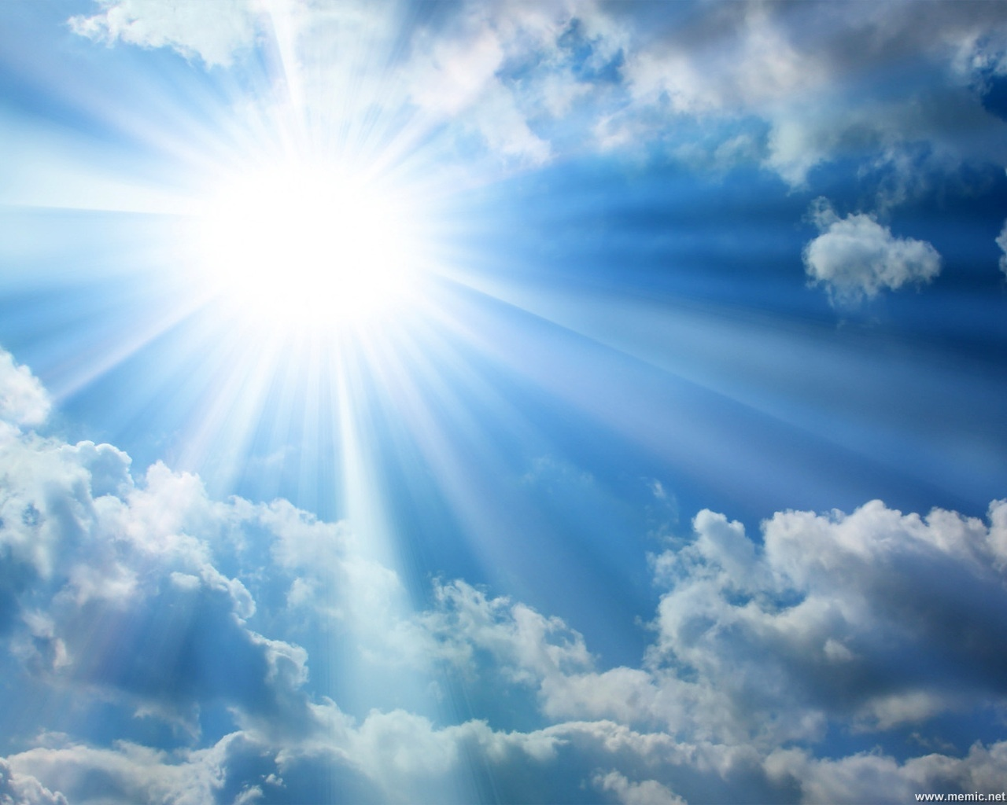
GOD
IS THE
LORD
God is Lord and He existed before anything was created. By Him were all things created
Notes:
1. God is Lord and He existed before anything was created. By Him were all things created

Slide 10
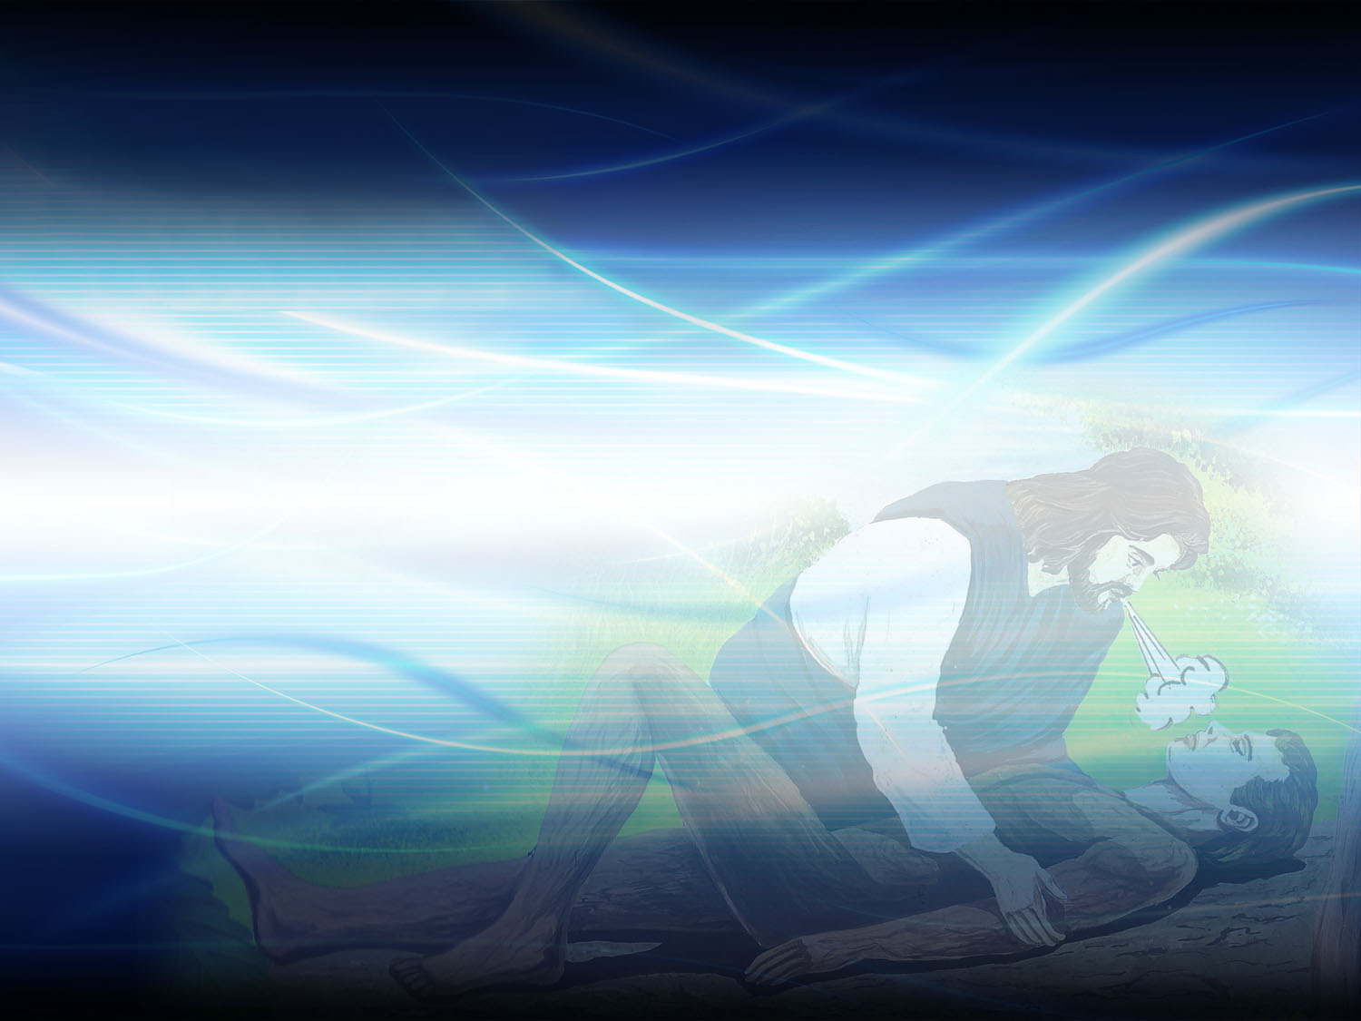
Genesis 1:26
And God said, Let us make man in our image, after our likeness: and let them have dominion over the fish of the sea, and over the fowl of the air, and over the cattle, and over all the earth, and over every creeping thing that creepeth upon the earth.
Notes:
And God said, Let us make man in our image, after our likeness: and let them have dominion over the fish of the sea, and over the fowl of the air, and over the cattle, and over all the earth, and over every creeping thing that creepeth upon the earth.
Genesis 1:26

Slide 11

But what does the Bible mean, when referring to the plural term “Let us make” , in Genesis 1:26?
The Heavenly father: (Ephesians 4:6)
The Son, Jesus Christ: (John 1:1-4)
The Holy Ghost: (John 14:26)
Notes:
But what does the Bible mean, when referring to the plural term “Let us make”, in Genesis 1:26?
The heavenly father (Ephesians 4:6)
The Son, Jesus Christ ( John 1:1-4)
The Holy Ghost: John 14:26
From the first page of the Bible there is a reference of the three persons of the Deity. Several verses in the Scriptures mention the presence of Christ and his role in the creation of the world. (Colossians 1:15-17; Hebrews 1:1-3, 8-10).

Slide 12
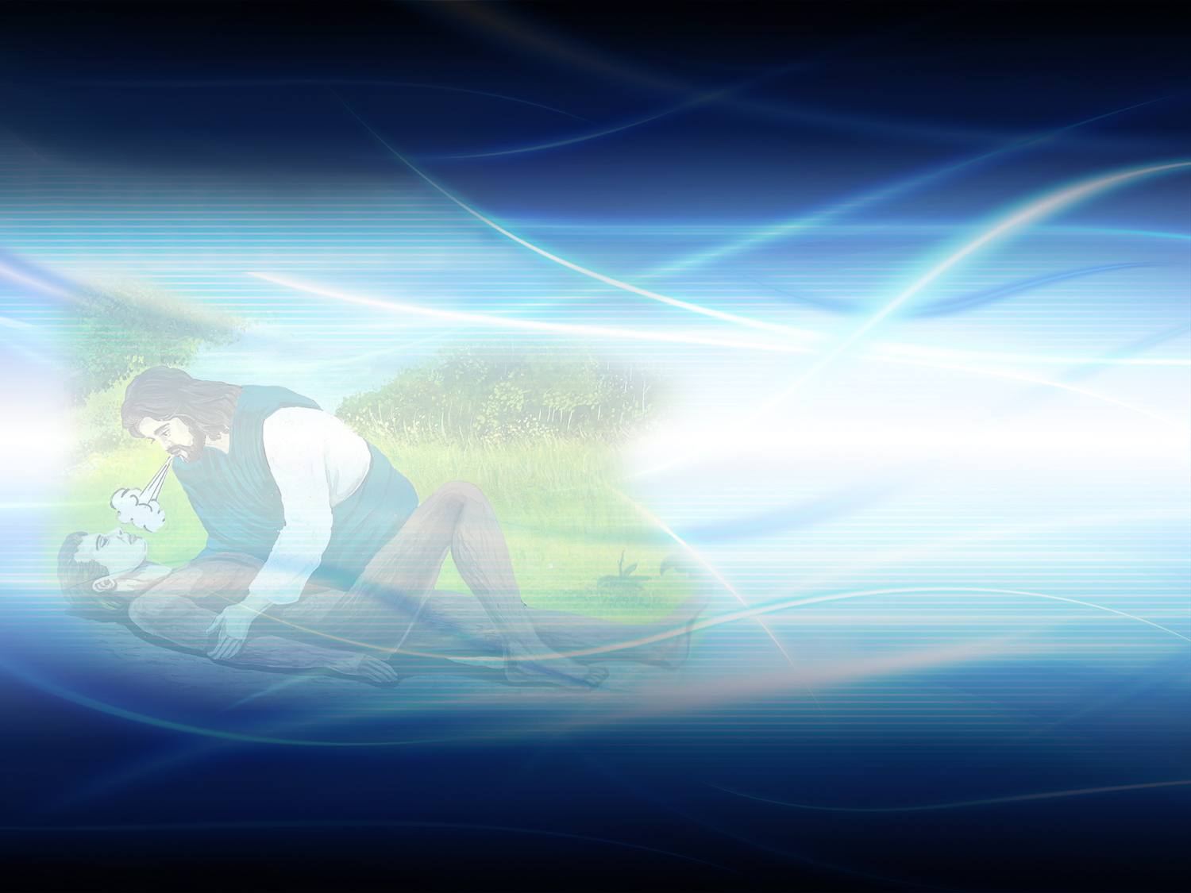
How was man created?
Notes:
2. How was man created?

Slide 13

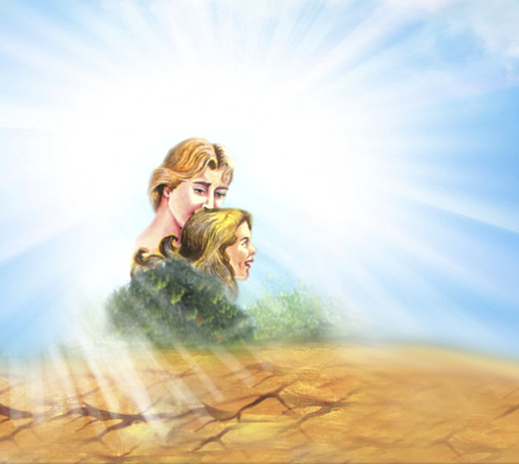
Ecclesiastes 7:29
Lo, this only have I found, that God hath made man upright; but they have sought out many inventions.
Notes:
Lo, this only have I found, that God hath made man upright; but they have sought out many inventions.
Ecclesiastes 7:29

Slide 14
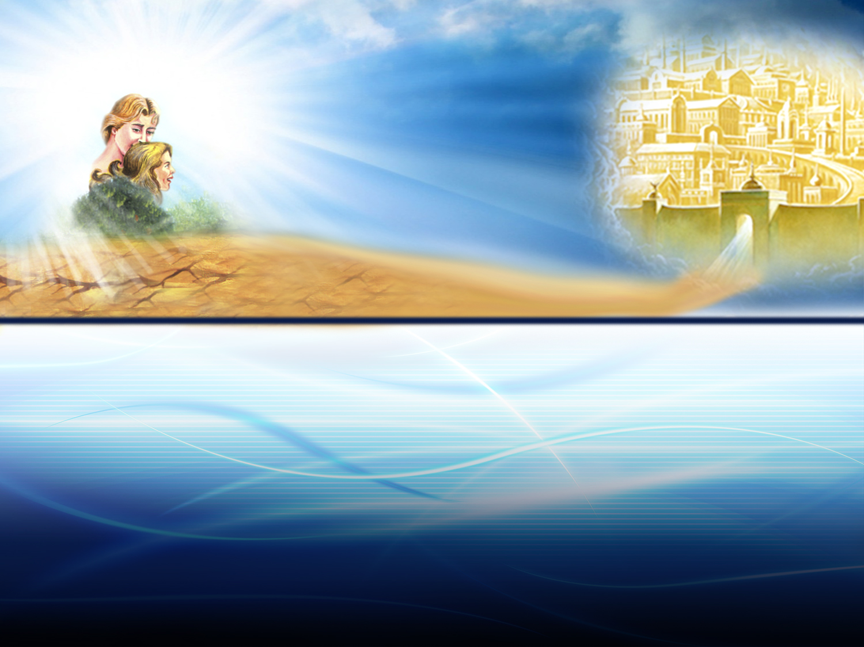
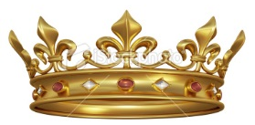
PERFECT
PATH OF JUSTICE
Man received four gifts from his Creator:
Eternal life
A righteous character.
A wonderful home.
The dominion over everything.
Notes:
God wanted man to live happy forever. He placed him on a path of life and justice, without sin and death
3. Man received four gifts from his Creator;
Eternal life. Man was not condemned to die
A righteous character. There was no stain of sin in him
A wonderful home. Pain and suffering did not exist.
Dominion over everything. Adam was the crown of creation. All nature was under his command.

Slide 15
PERFECT
PATH OF JUSTICE
What was the only condition given for maintaining on that path?
Notes:
4. What was the only condition given for maintaining on that path?

Slide 16
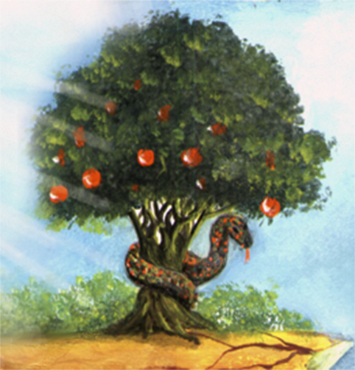
Genesis 2:16, 17
And the Lord God commanded the man, saying, Of every tree of the garden thou mayest freely eat. But of the tree of the knowledge of good and evil, thou shalt not eat of it: for in the day that thou eatest thereof thou shalt surely die.
Notes:
And the Lord God commanded the man, saying, Of every tree of the garden thou mayest freely eat. But of the tree of the knowledge of good and evil, thou shalt not eat of it: for in the day that thou eatest thereof thou shalt surely die.
Genesis 2:16, 17

Slide 17
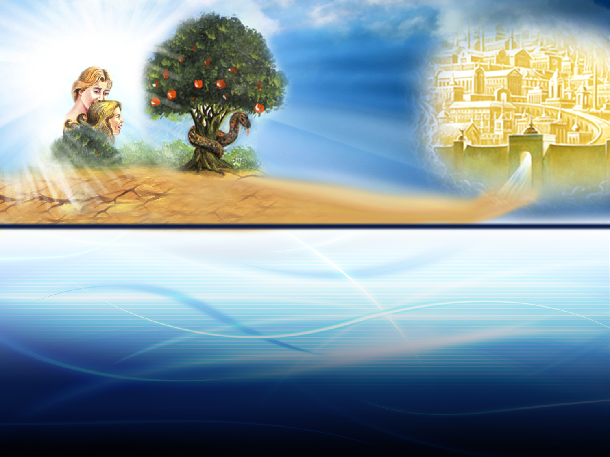

PERFECT
PATH OF JUSTICE
The law of God was placed in the hearts of men from the beginning.
Notes:
To know God as Creator and Lord
For man´s own well being, learning to obey is essential. Can there be happiness in a home or order in a nation if there is no respect to parents or governors? The law of God was placed in the hearts of men from the beginning. It is the foundation of God’s government.

Slide 18
BUT…
Notes:
BUT…

Slide 19
Man decided to obey another Lord. Satan, the prince of darkness, who seduced them.
Notes:
5. Man decided to obey another Lord. Satan, the prince of darkness, who seduced them.

Slide 20
Genesis 3:1-5
Now the serpent was more subtil than any beast of the field which the Lord God had made. And he said unto the woman, Yea, hath God said, Ye shall not eat of every tree of the garden?
And the woman said unto the serpent, We may eat of the fruit of the trees of the garden; But of the fruit of the tree which is in the midst of the garden, God hath said, Ye shall not eat of it, neither shall ye touch it, lest ye die. And the serpent said unto the woman, Ye shall not surely die; For God doth know that in the day ye eat thereof, then your eyes shall be opened, and ye shall be as gods, knowing good and evil.
Notes:
Génesis 3:1-5
Now the serpent was more subtil than any beast of the field which the Lord God had made. And he said unto the woman, Yea, hath God said, Ye shall not eat of every tree of the garden?
And the woman said unto the serpent, We may eat of the fruit of the trees of the garden; But of the fruit of the tree which is in the midst of the garden, God hath said, Ye shall not eat of it, neither shall ye touch it, lest ye die. And the serpent said unto the woman, Ye shall not surely die; For God doth know that in the day ye eat thereof, then your eyes shall be opened, and ye shall be as gods, knowing good and evil.

Slide 21

Did God create the devil?
What was Satan in the beginning?
Notes:
Did God create the devil?
What was Satan in the beginning?

Slide 22
Ezekiel 28:13-17
Thou hast been in Eden the garden of God; every precious stone was thy covering, the sardius, topaz, and the diamond, the beryl, the onyx, and the jasper, the sapphire, the emerald, and the carbuncle, and gold: the workmanship of thy tabrets and of thy pipes was prepared in thee in the day that thou wast created.
Thou art the anointed cherub that covereth; and I have set thee so: thou wast upon the holy mountain of God; thou hast walked up and down in the midst of the stones of fire. Thou wast perfect in thy ways from the day that thou wast created, till iniquity was found in thee.
Notes:
Ezekiel 28:13-17.
Thou hast been in Eden the garden of God; every precious stone was thy covering, the sardius, topaz, and the diamond, the beryl, the onyx, and the jasper, the sapphire, the emerald, and the carbuncle, and gold: the workmanship of thy tabrets and of thy pipes was prepared in thee in the day that thou wast created.
Thou art the anointed cherub that covereth; and I have set thee so: thou wast upon the holy mountain of God; thou hast walked up and down in the midst of the stones of fire. Thou wast perfect in thy ways from the day that thou wast created, till iniquity was found in thee.

Slide 23
Ezekiel 28:13-17
By the multitude of thy merchandise they have filled the midst of thee with violence, and thou hast sinned: therefore I will cast thee as profane out of the mountain of God: and I will destroy thee, O covering cherub, from the midst of the stones of fire. Thine heart was lifted up because of thy beauty, thou hast corrupted thy wisdom by reason of thy brightness: I will cast thee to the ground, I will lay thee before kings, that they may behold thee.
Notes:
Ezekiel 28:13-17
By the multitude of thy merchandise they have filled the midst of thee with violence, and thou hast sinned: therefore I will cast thee as profane out of the mountain of God: and I will destroy thee, O covering cherub, from the midst of the stones of fire. Thine heart was lifted up because of thy beauty, thou hast corrupted thy wisdom by reason of thy brightness: I will cast thee to the ground, I will lay thee before kings, that they may behold thee.
He was a perfect angel until he rebelled against the Creator.
When he usurped the dominion that corresponded to God, he was expelled from heaven (Revelation 12:9).

Slide 24
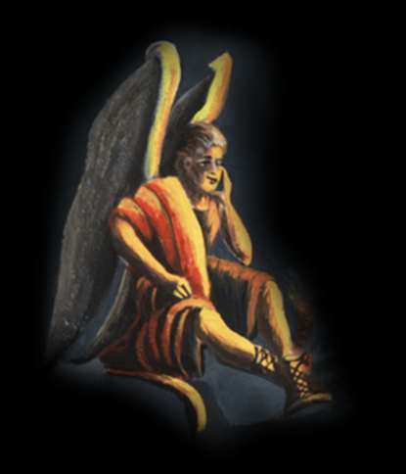
PERFECT
PATH OF JUSTICE
THE FALL
Notes:
God created men as free beings. He showed them the path of life, but our first fathers chose the wrong path. Because of disobedience, because the obeyed another Lord, they fell into a deep abyss.

Slide 25

What did man become when he allowed Satan to defeat him?
Notes:
6. What did man become when he allowed Satan to defeat him?

Slide 26
2 Peter 2:19
While they promise them liberty, they themselves are the servants of corruption: for of whom a man is overcome, of the same is he brought in bondage.
Notes:
While they promise them liberty, they themselves are the servants of corruption: for of whom a man is overcome, of the same is he brought in bondage.
2 Peter 2:19
They became slaves of Satan

Slide 27
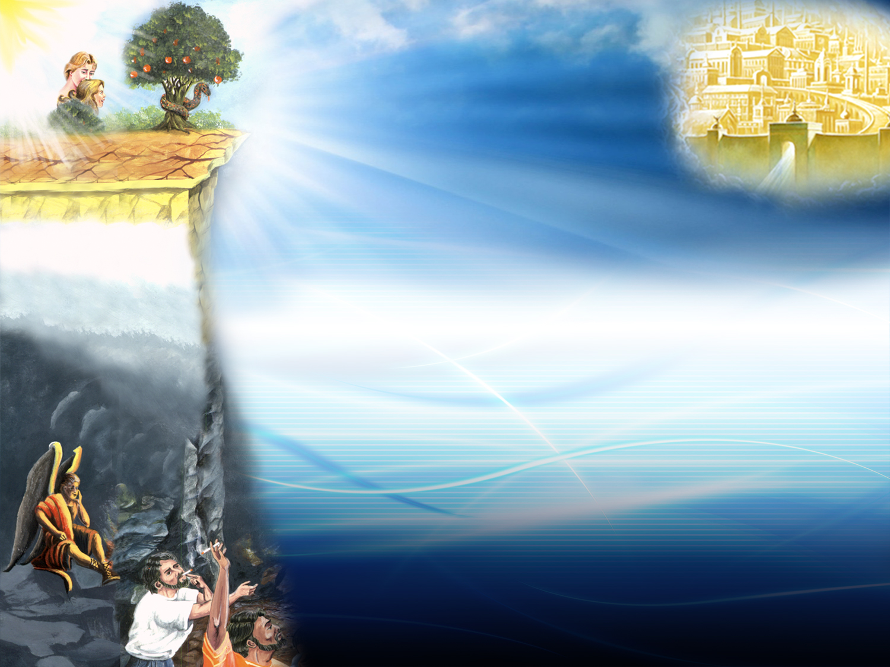
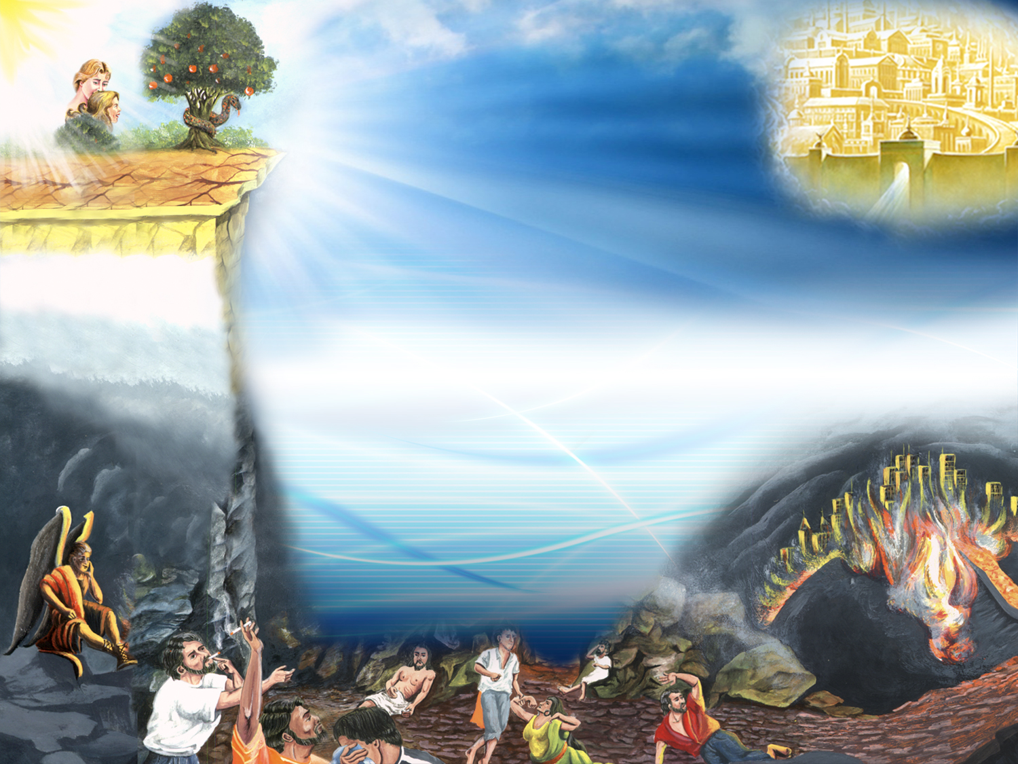

Eternal life
A righteous character
A wonderful home
Dominion over everything
FALL
Death
Sin
A land full of thorns
Slavery
PATH OF SIN AND DEATH
Notes:
a) The gifts received in creation were substituted:
eternal life, death,
a righteous character, sin,
a wonderful home, a land full of thorns, A path of sin and death
dominion over everything, slavery.
Satan took man's dominion.
(The crown leaves Adam and goes to Satan)
b) Because of this, men inherits a path of sin and death, which ends in eternal death and final destruction.

Slide 28

What inheritance have we received and what is man’s current state?
Notes:
7. What inheritance have we received and what is man’s current state?

Slide 29
Romans 5:12
“Wherefore, as by one man sin entered into the world, and death by sin; and so death passed upon all men, for that all have sinned.”
Notes:
“Wherefore, as by one man sin entered into the world, and death by sin; and so death passed upon all men, for that all have sinned.”
Romans 5:12
In this manner, suffering was introduced into the world, for sin and death has been passed to all men.
From the time we are born, we have a sinful nature, Psalms 51:5.The prophet Isaiah illustrates our body by stating: “From the sole of the foot even unto the head there is no soundness in it…” (Isaiah 1:6).

Slide 30

Is there a perfect or entirely righteous person in this world?
Notes:
8. Is there a perfect or entirely righteous person in this world?

Slide 31
Romans 3:10-12
As it is written, There is none righteous, no, not one.
There is none that understandeth,
there is none that seeketh after God.
They are all gone out of the way,
they are together become unprofitable; there is none that doeth good, no, not one.
Notes:
As it is written, There is none righteous, no, not one.
There is none that understandeth,
there is none that seeketh after God.
They are all gone out of the way,
they are together become unprofitable;
there is none that doeth good, no, not one.
Romans 3:10-12

Slide 32
What consquences will all human beings confront?
Notes:
What consquences will all human beings confront?

Slide 33
Romans 3:23; 6:23
For all have sinned, and come short of the glory of God;
For the wages of sin is death; but the gift of God is eternal life through Jesus Christ our Lord.
Notes:
For all have sinned, and come short of the glory of God;
For the wages of sin is death; but the gift of God is eternal life through Jesus Christ our Lord.
Romans 3:23; 6:23

Slide 34
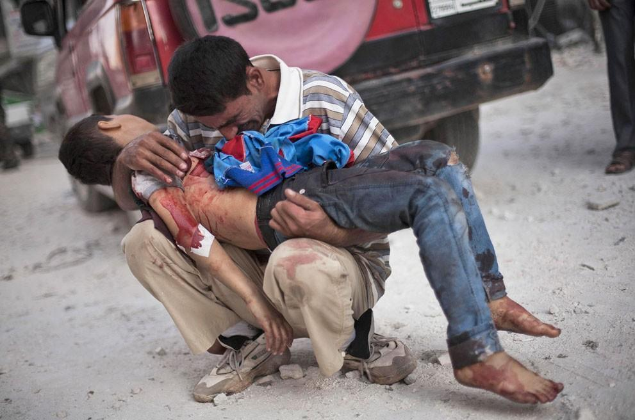
Notes:
Perhaps now we may comprehend why suffering exists. God did not create man to suffer, but he did give all free will. The wrong choice of disobeying God has led all to the valley of tears. How much pain! How many suffer! It is due to sin that it is in this world.

Slide 35
RETURN
CAIDA
PATH OF SIN AND DEATH
Notes:
Yet…How can man get back on the path of life? Returning to where we fell is impossible since we are guilty of death and slaves to sin. So…

Slide 36

?
IS THERE A WAY OUT?
Notes:
IS THERE A WAY OUT?

Slide 37

What is the saving bridge that is capable in reaching across the existent gap between the path of death and the path of life?
Notes:
What is the saving bridge that is capable in reaching across the existent gap between the path of death and the path of life?

Slide 38




PATH OF SIN AND DEATH
Notes:
a) There are those who believe that by practicing a religion they will be saved. However, this bridge cannot save because it does not reach the other side of the abyss.

Slide 39
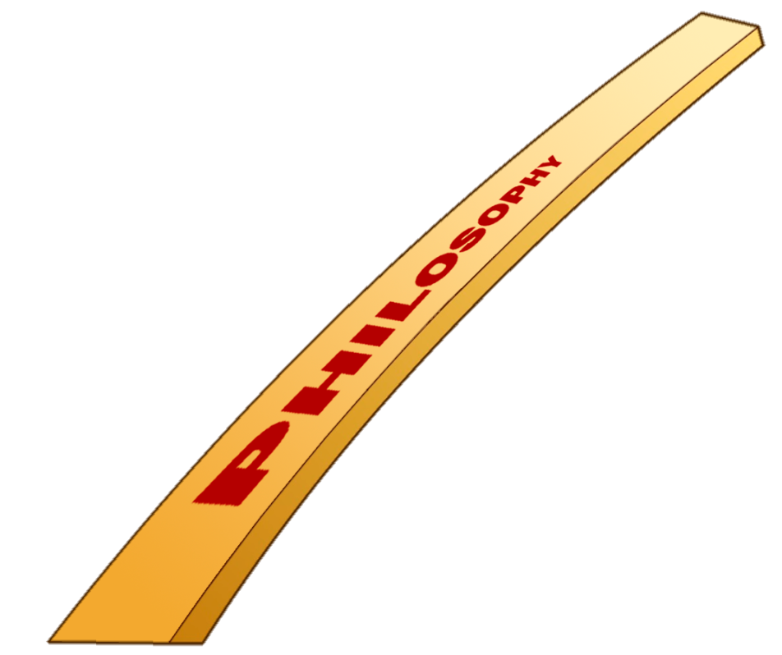
PATH OF SIN AND DEATH
Notes:
b) Others believe that this can be done by following a certain philosophy, but this is not so.

Slide 40

PATH OF SIN AND DEATH
Notes:
c) Most believe that the bridge to eternal life is based on good deeds.
By studying the scriptures, we learn that human works cannot save the sinner.

Slide 41
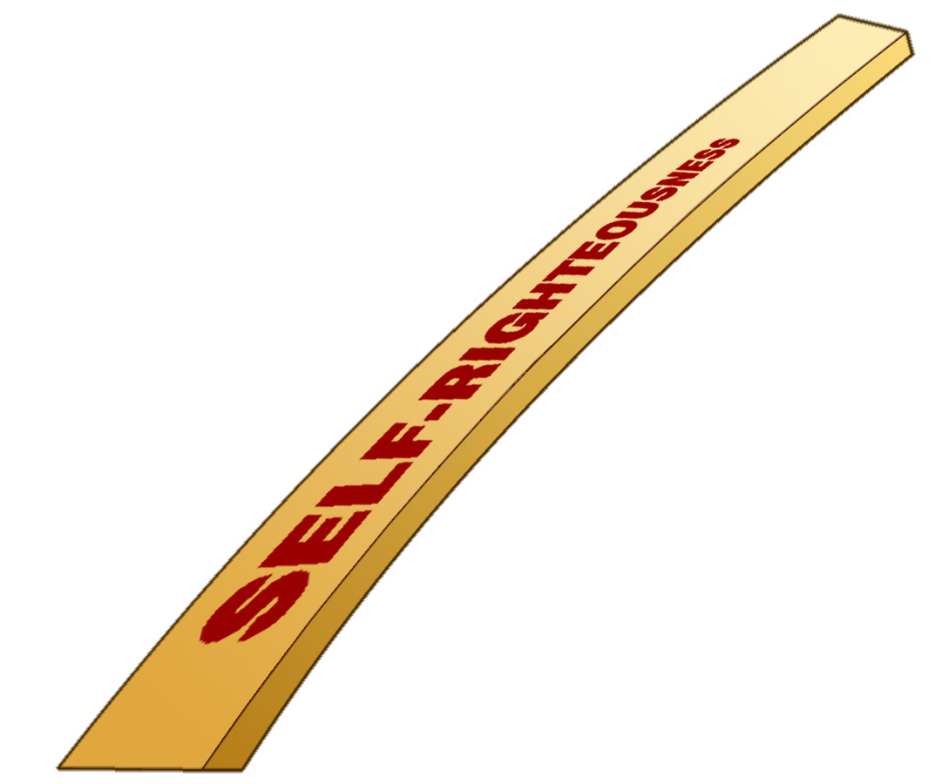
PATH OF SIN AND DEATH
Notes:
d) Neither can self-righteousness: No perfection or obedience that we can achieve.
If none of these things are the bridge able to close the gap between man and God, what bridge can?

Slide 42

What does God want the sinner to do?
Notes:
9. What does God want the sinner to do?

Slide 43
Ezekiel 33:11
Say unto them, As I live, saith the Lord God, I have no pleasure in the death of the wicked; but that the wicked turn from his way and live: turn ye, turn ye from your evil ways; for why will ye die, O house of Israel?
Notes:
Say unto them, As I live, saith the Lord God, I have no pleasure in the death of the wicked; but that the wicked turn from his way and live: turn ye, turn ye from your evil ways; for why will ye die, O house of Israel?
Ezekiel 33:11

Slide 44

Only through who can we be saved?
Notes:
10. Only through who can we be saved?

Slide 45
Acts 4:11-12
This is the stone which was set at nought of you builders, which is become the head of the corner.
Neither is there salvation in any other: for there is none other name under heaven given among men, whereby we must be saved.
Notes:
This is the stone which was set at nought of you builders, which is become the head of the corner.
Neither is there salvation in any other: for there is none other name under heaven given among men, whereby we must be saved.
Acts 4:11-12

Slide 46

Notes:
Christ came into the world and took on human nature, lived a sinless life and voluntarily offered to die in our place. "The just for the unjust"
(1 Peter 3:18). His death and resurrection was the victory won against Satan because it was the only way to take back the domain that had been snatched from man.

Slide 47
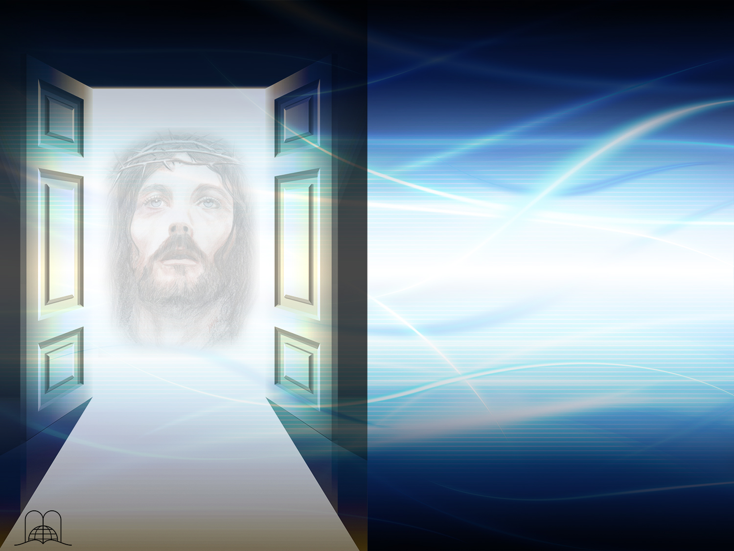
What solution has God provided?
Notes:
11. What solution has God provided?

Slide 48
John 10:7, 9
Then said Jesus unto them again, Verily, verily, I say unto you, I am the door of the sheep.
I am the door: by me if any man enter in, he shall be saved, and shall go in and out, and find pasture.
Notes:
Then said Jesus unto them again, Verily, verily, I say unto you, I am the door of the sheep.
I am the door: by me if any man enter in, he shall be saved, and shall go in and out, and find pasture.
John 10:7, 9

Slide 49
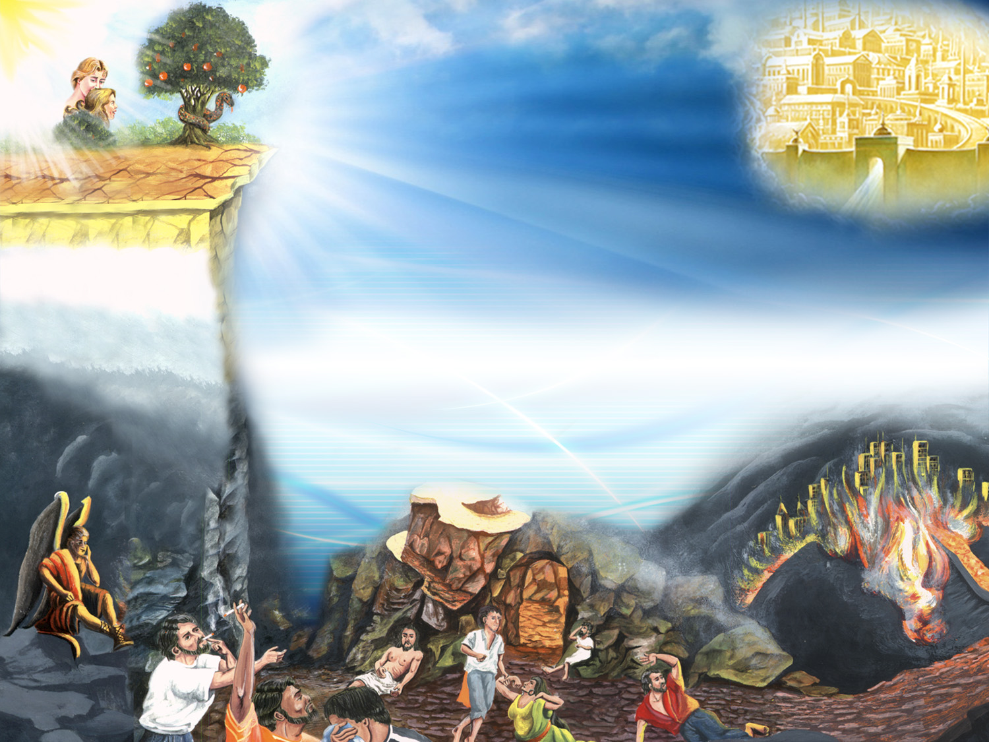
Jesus
Is the door
PATH OF SIN AND DEATH
Notes:
Jesus is the door

Slide 50

What does Jesus invite us to do?
Notes:
12. What does Jesus invite us to do?

Slide 51
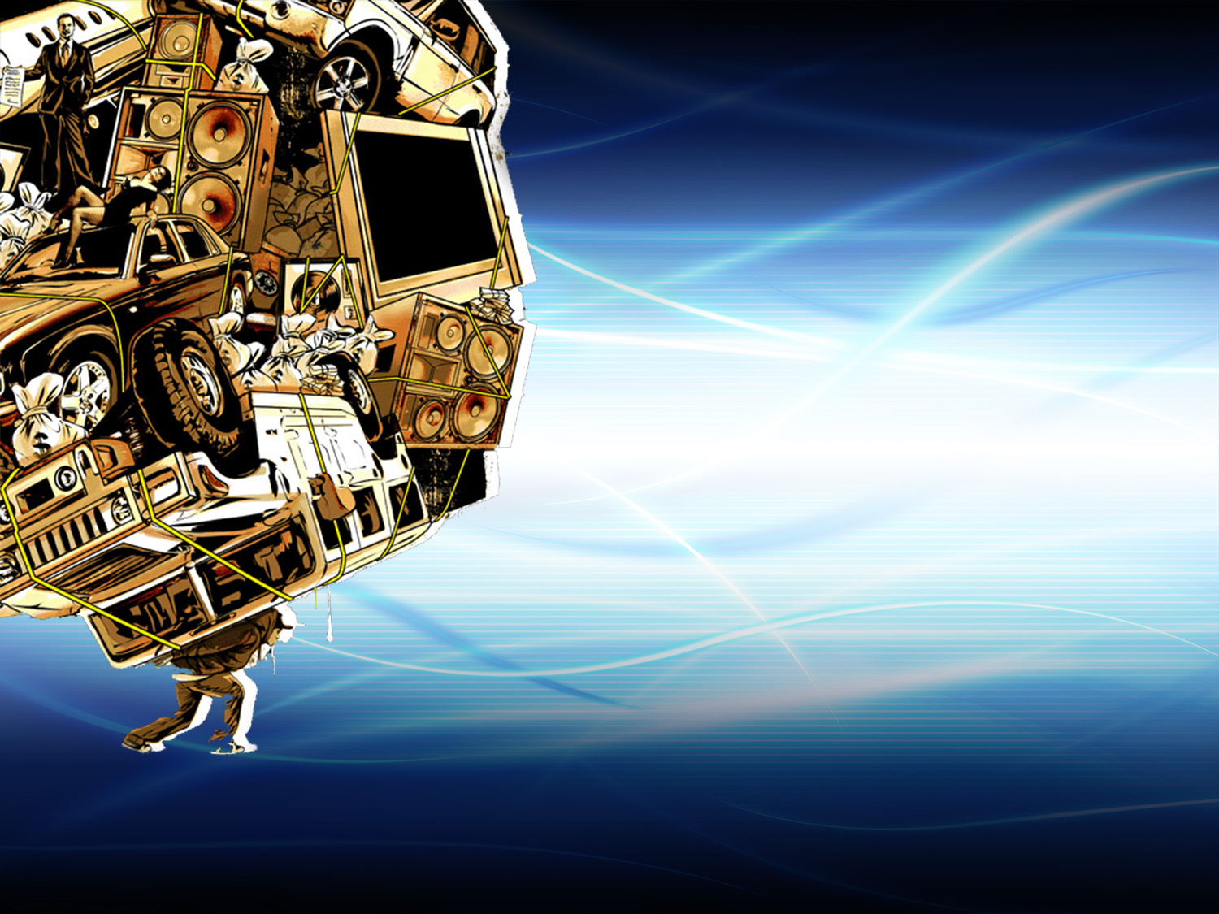
Matthew 11:28
“Come unto me, all ye that labour and are heavy laden, and I will give you rest.”
Notes:
“Come unto me, all ye that labour and are heavy laden, and I will give you rest.”
Matthew 11:28

Slide 52

What is the only bridge between life and dead?
Notes:
13. What is the only bridge between life and dead?

Slide 53

Jesus said, “I am the way the truth and the life…
John 14:6
Notes:
Jesus said, "I am the way the truth and the life.»
John 14:6

Slide 54

Notes:
A building was on fire. From a window, up high, three people were calling out for help. Firefighters arrived, they put up the ladder, but realized that it was not tall enough, it was short almost two meters. The firefighter who was already at the top of the ladder, in a heroic deed, climbed to the last step and made a bridge with his body, ordering the people to pass over him. The first person passed, then the second, and finally the third, but his body could not resist any longer and fell to his death .
The three people who had been saved were at his burial. Although they did not know him, they grieved greatly for he had given his life for them. Their tears were tears of love.

Slide 55
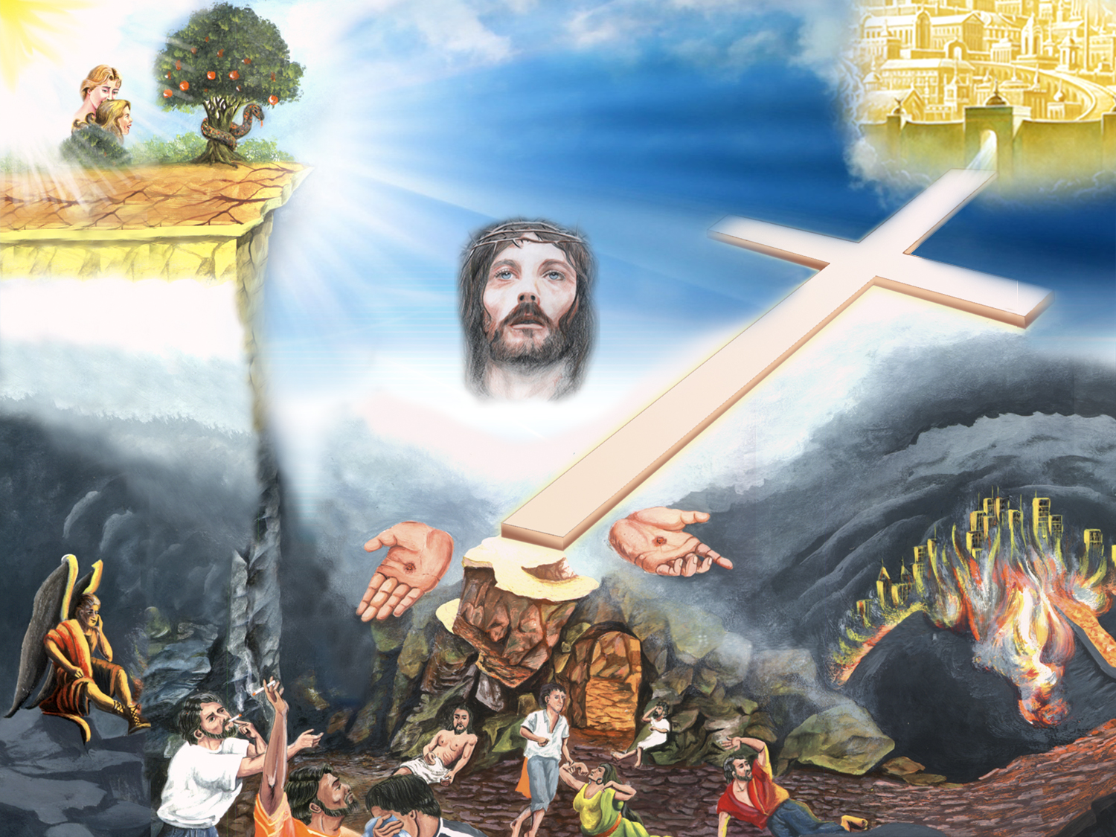
I am the way…
Notes:
In the same manner, Jesus reached out with his own body making a bridge between life and death.
Evidence of His immense love!
When we walk through that Door, in other words, when we accpet Jesus in our life, we are free, and no longer slaves to Satan but Children of God. We accept Jesus as our Savior and as our Lord. We accept His law as our rule of life instead of sin.
Obedience to the law is not the bridge but a demonstration of our love and loyalty to God.
When Jesus overcame Satan on the cross, he regained the dominion that had been usurped by the enemy.

Slide 56
ENCOURAGING PROMISES
Notes:
ENCOURAGING PROMISES

Slide 57
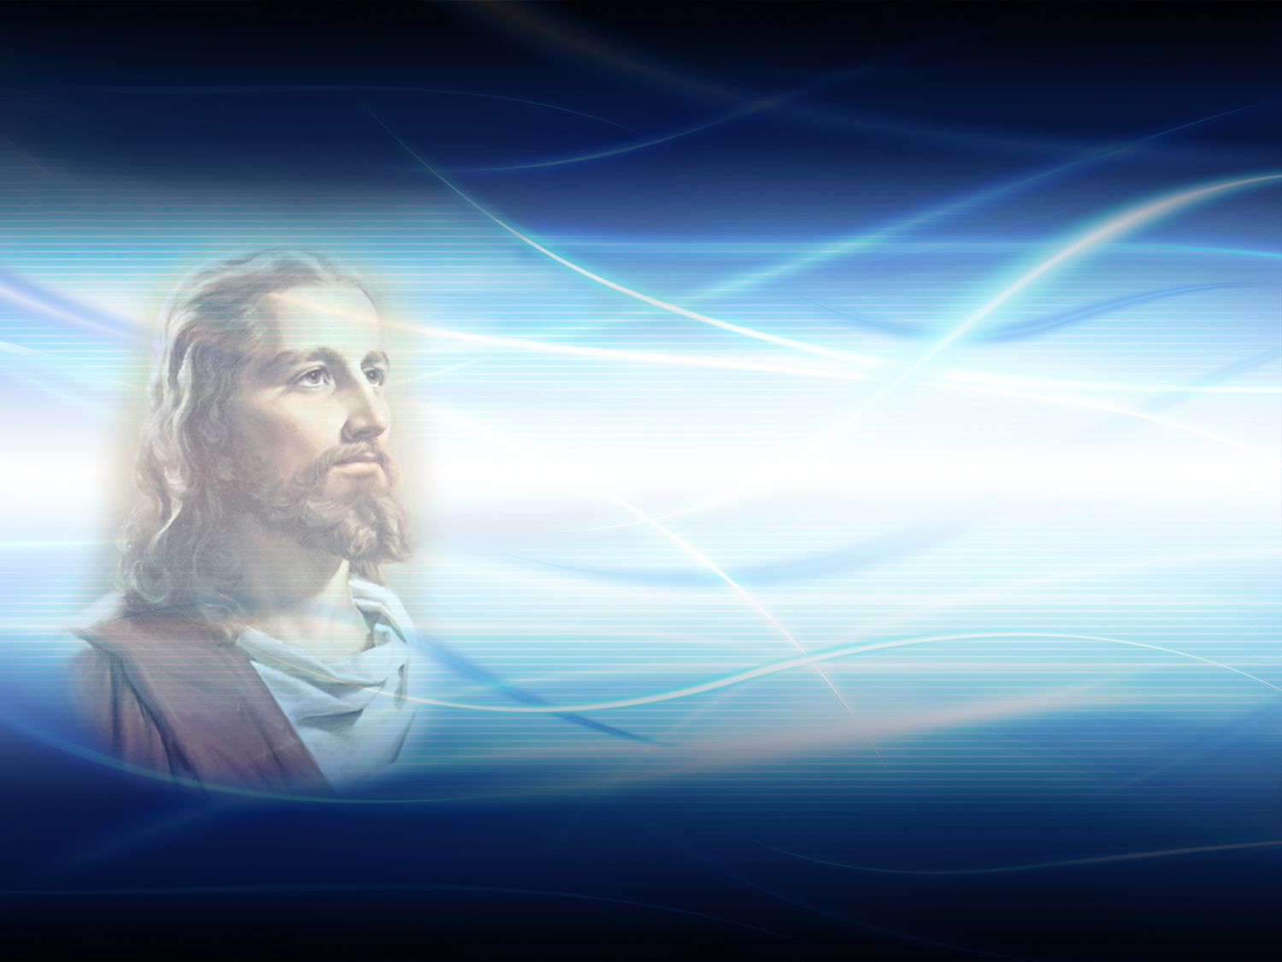
What does God give to those who sincerely believe in Jesus?
Notes:
14. What does God give to those who sincerely believe in Jesus?

Slide 58
1 John 5:11-13
And this is the record, that God hath given to us eternal life, and this life is in his Son.
He that hath the Son hath life; and he that hath not the Son of God hath not life.
These things have I written unto you that believe on the name of the Son of God; that ye may know that ye have eternal life, and that ye may believe on the name of the Son of God.
Notes:
And this is the record, that God hath given to us eternal life, and this life is in his Son.
He that hath the Son hath life; and he that hath not the Son of God hath not life.
These things have I written unto you that believe on the name of the Son of God; that ye may know that ye have eternal life, and that ye may believe on the name of the Son of God.
1 John 5:11-13
He who has the Son has life.
You can hold on to this promise of eternal life! Living with hope and certainty is to live happy!

Slide 59

Does Jesus reject any one who comes to Him seeking salvation?
Notes:
15. Does Jesus reject any one who comes to Him seeking salvation?

Slide 60
John 6:37
All that the Father giveth me shall come to me; and him that cometh to me I will in no wise cast out.
Notes:
No one is turned away.
He says: "... and whoever comes to me I will never drive away"
God wants to justify us freely, that is, declare us forgiven and reconciled by his grace through Christ. "Being justified freely by his grace through the redemption that came by Christ Jesus" (Romans 3:24).
He Promises to not remember our sins. (Isaiah 43:25).

Slide 61

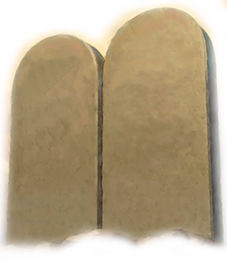
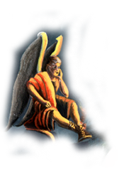
Eternal life
The right character
A wonderful home
Dominion over all
Notes:
Soon Jesus will return to find his children. We will once again obtain the four lost gifts: Life, the right character, a wonderful home and dominion over all.
We will live eternally with Jesus, sin will no longer exist and his law of love will be our standard of living.
Satan will definitely be destroyed and sin will be eradicated forever.

Slide 62
conclusion
Notes:
conclusion

Slide 63
What must we do to be called children of God and receive salvation?
Notes:
16. What must we do to be called children of God and receive salvation?

Slide 64
John 1:12
But as many as received him, to them gave he power to become the sons of God, even to them that believe on his name.
Notes:
But as many as received him, to them gave he power to become the sons of God, even to them that believe on his name. John 1:12

Slide 65



Accept Jesus as Lord and Savior of our lives.
Ephesians 1:7
Notes:
Accept Jesus as Lord and Savior of our lives
A young woman had run away from home. She devoted herself to a licentious life and she became a dancer. In her best days, she suffered a serious accident and ended up in the hospital. From there, she wrote to her mother: "Mother, I know I will die, perhaps very soon, do you have something to tell me?" When the mother received the letter, she went to the post office and sent a telegram, the text said: "In whom we have redemption through His blood, the forgiveness of sins, according to the riches of His grace. Ephesians 1: 7. Your mother who loves you"
A telegrapher was about to kill himself that day, but decided to go to work for the last time. When transcribing this telegram, he read the text repeated times. He knelt there in his office, and gave his heart to the Lord. The daughter also received the telegram and the promise of forgiveness from God gave her so much peace. She held on to this, and that glorious hope healed her. On that day, two lives were saved.

Slide 66

God is anxious to save us, but we must make the choice.
Dear friend, on what path do you find yourself? There are only two: life and death; salvation or damnation; the way of Jesus Christ or the way of sin.
Notes:
God is anxious to save us, but we must make the choice.
Dear friend, on what path do you find yourself? There are only two: life and death; salvation or damnation; the way of Jesus Christ or the way of sin.

Slide 67
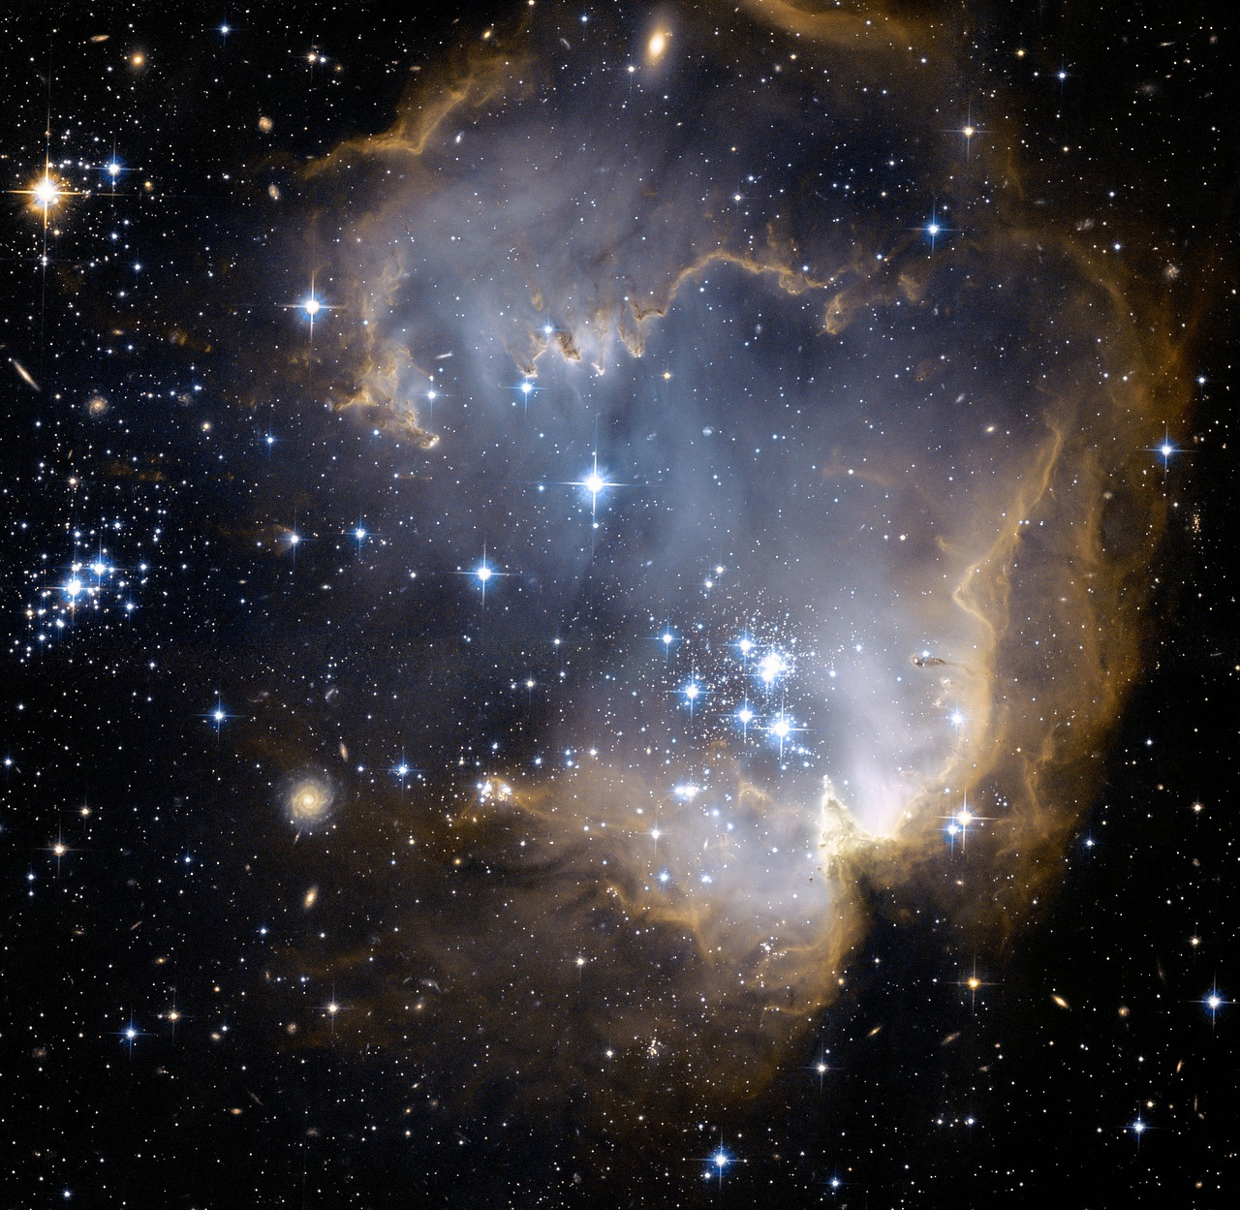
By accepting Jesus, we become acquainted with Him and His law, for He is our Lord.
We will obey Him out of love, and because of what He has done for us, we will strive to live with Him daily.
The purpose of His death was to rid us from this valley of suffering and pain, and to give us inheritance of eternal life.
This is good news. Don’t you think?
Notes:
By accepting Jesus, we become acquainted with Him and His law, for He is our Lord. We will obey Him out of love, and because of what He has done for us, we will strive to live with Him daily. The purpose of His death was to rid us from this valley of suffering and pain, and to give us inheritance of eternal life. This is good news. Don’t you think?

Slide 68

Would you like to now accept Jesus as Savior and Lord of your life?
If so, this is the time to let God know through a prayer
Notes:
Would you like to now accept Jesus as Savior and Lord of your life?
If so, this is the time to let God know through a prayer.
(For the instructor. In the next topic there is an important decision to be made at the end. Observe the spiritual maturity of the person and also the right time for a special prayer of devotion).

Slide 69

The next topic: "Four Steps to Enjoy Peace and Live Happily."
The greatest desire of man is to enjoy peace and happiness, yet searches through false springs. However having peace does not mean to be free from problems but to know how to face them. The Bible shows us the key in this search and presents 4 simple steps that have given inner peace and joy to many. This can become a beautiful spiritual experience for you as well!
GOD BLESS YOU!
Notes:
GOD BLESS YOU!
The next topic: "Four Steps to Enjoy Peace and Live Happily."
The greatest desire of man is to enjoy peace and happiness, unfortunately he searches within false sources. Having peace does not mean to be free from problems but to know how to face them. The Bible shows us the key in this study presenting 4 simple steps that have given inner peace and joy to many. This can become a beautiful spiritual experience for you as well!

Slide 70

biblewell.org
info@biblewell.org
Notes:
If you still have questions, write to us with confidence at: info@biblewell.org

