Slide 1
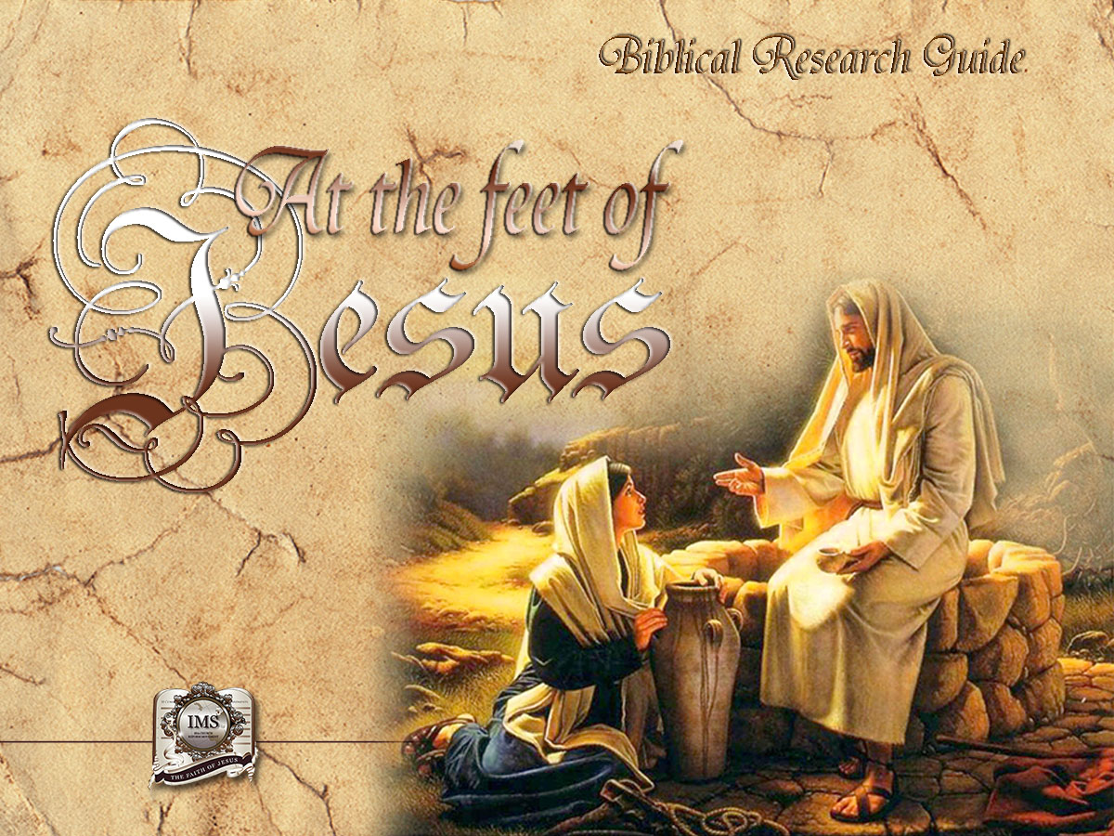

General Conference
Multimedia Department

Slide 2
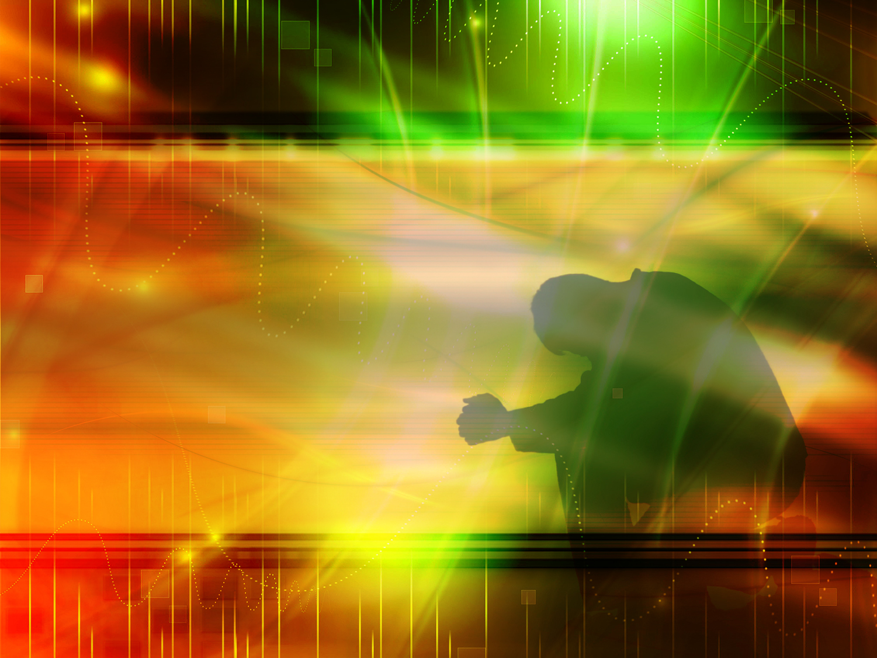

A moment of prayer…
Notes:
A moment of prayer

Slide 3
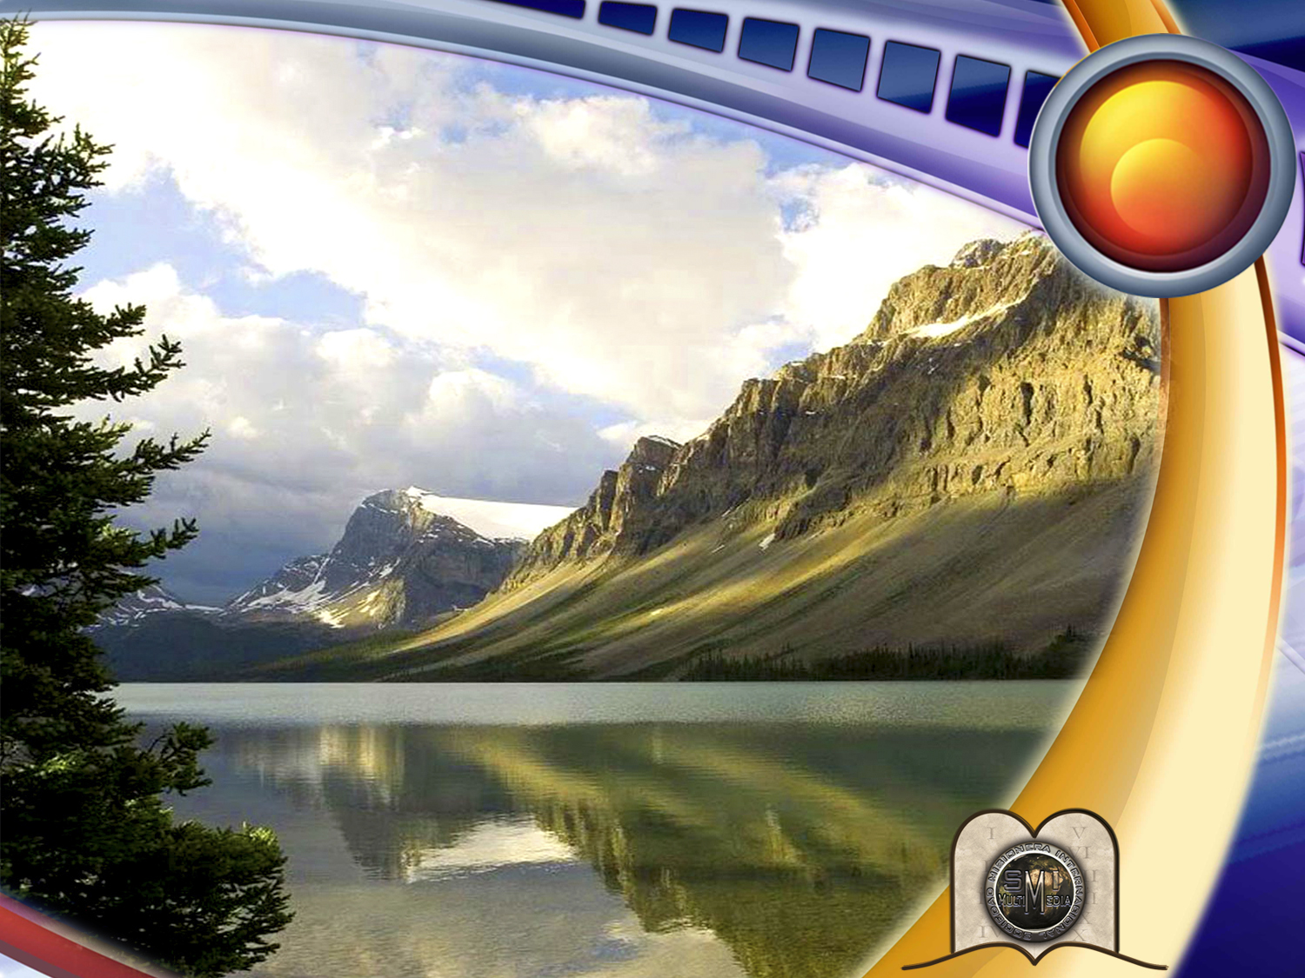
4
Four steps to inner peace
and happiness
Notes:
Four steps to inner peace and happiness

Slide 4

WHERE CAN WE FIND
PEACE AND HAPPINESS?
Notes:
WHERE CAN WE FIND PEACE AND HAPPINESS?

Slide 5

MATERIAL THINGS
AMUSEMENT
TRIBUTE
SEX
DRUGS
ALCOHOL
?
Notes:
Every human being longs for genuine peace and happiness. But is it possible to find this in material things, amusement, tribute, sex, drugs or alcohol? Certainly not! These are false sources!

Slide 6

“I have never been happy”
Marilyn Monroe
Notes:
... The well known actress Marilyn Monroe once said to a journalist: "I am admired for my beauty, I have money, I lack nothing. But I have never been happy."

Slide 7
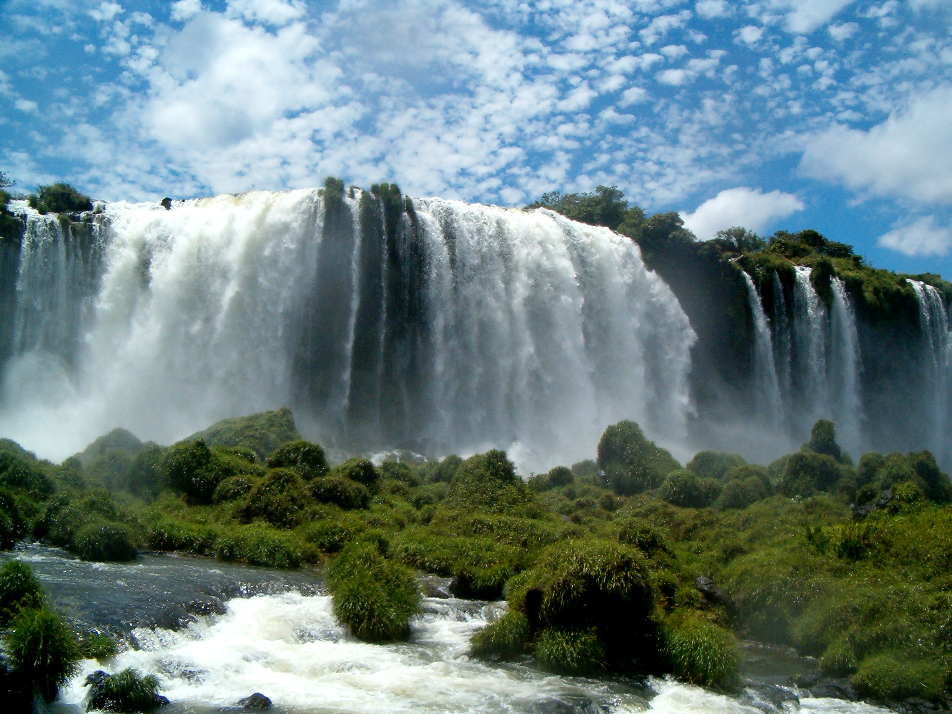

Notes:
But, does peace and happiness mean not having problems?
There was once a picture contest on the subject of "peace" and many pictures were submitted for it. Some depicted a peaceful morning; others, a quiet sunset and other similar subjects. The first prize was awarded to a picture showing a turbulent waterfall which fell abruptly over the rocks of a cliff, creating a thick cloud of mist. Leaning halfway over the waterfall was a tree, and on one branch a robin had built its nest and was chirping away happily.
Truly, the best concept of peace is the one that is experienced, not when circumstances are favorable, but amid the noise of a storm. The robin was on a branch of a tree rooted on a rock and it stretched over the thundering waterfall. Up there nothing could happen to the bird. Such should be the peace of him who trusts in God.
In our search for happiness, we long for strength, love, someone we can trust, someone to love us without disappointing us.

Slide 8
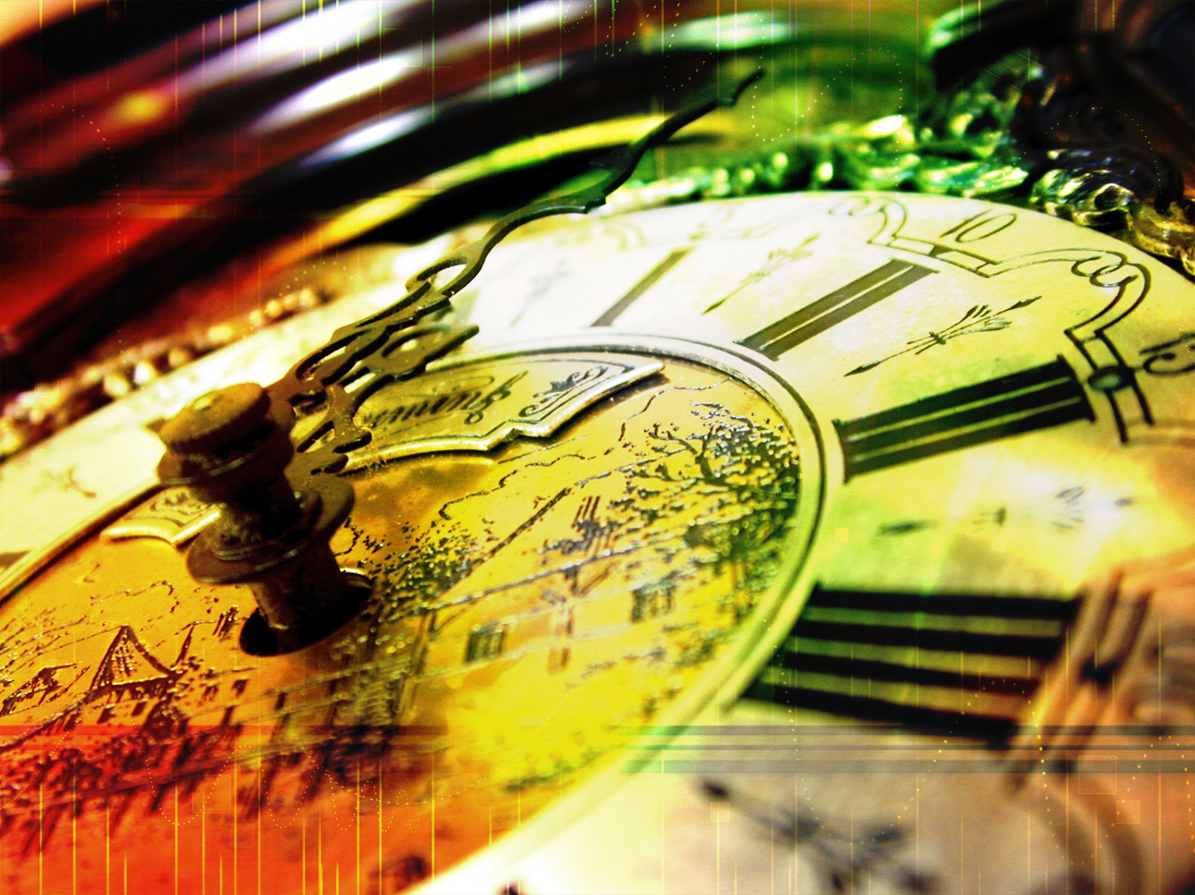
How can we find peace with God, the security of His forgiveness, and a reassuring and steady hope? How can we be certain that if we die today we will obtain eternal life?
Notes:
How can we find peace with God, the security of His forgiveness, and a reassuring and steady hope? How can we be certain that if we die today we will obtain eternal life?

Slide 9
WHAT IS THE KEY TO FINDING PEACE AND HAPPINESS?
Notes:
WHAT IS THE KEY TO FINDING PEACE AND HAPPINESS?

Slide 10

What is the name of this key?
Notes:
1. What is the name of this key?

Slide 11


“But without faith it is impossible to please him: for he that cometh to God must believe that he is, and that he is a rewarder of them that diligently seek him.”
Hebrews 11:6
Notes:
“But without faith it is impossible to please him: for he that cometh to God must believe that he is, and that he is a rewarder of them that diligently seek him.”
Hebrews 11:6

Slide 12
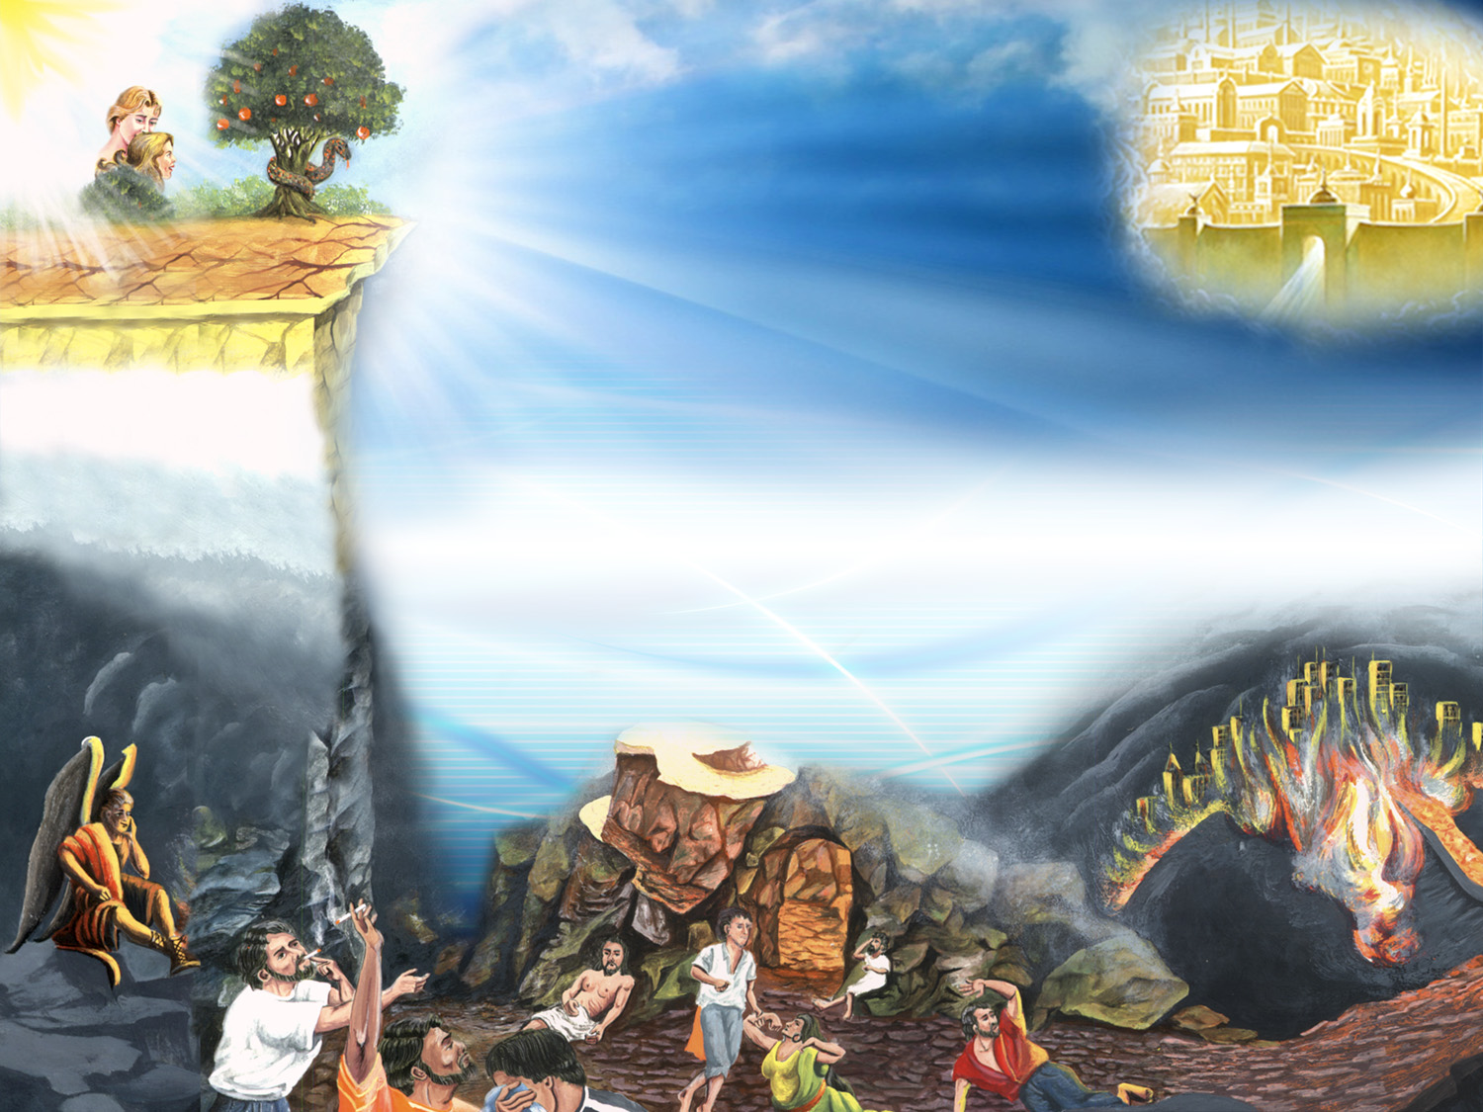
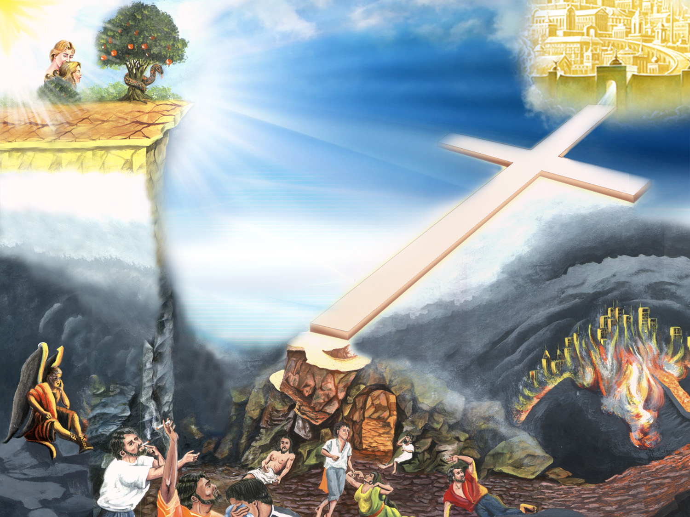
I am going the way of death, even though I know the way to salvation, and still I show it to others, but I do not walk in it.
Is this faith?
Notes:
2. Faith is not:
Assuming something or having an uncertain opinion. For example: "I think the sun will rise tomorrow” or “I think this or that may happen.”
A mere affirmation.
To have something for certain. This is only part of it.
A wavering feeling.
To just speak about a religion.
I am going the way of death, even though I know the way to salvation, and still I show it to others, but I do not walk in it.
Is this faith?

Slide 13
What is
true faith?
Notes:
What is true faith?

Slide 14
Now faith is the substance of things hoped for, the evidence of things not seen.
Hebrews 11:1
Notes:
“Now faith is the substance of things hoped for, the evidence of things not seen.”
Hebrews 11:1
Unwavering trust in God’s promises.
To believe in God and His word.
To know, trust, and surrender to someone, but not just anyone.
We should have genuine faith in Christ, the Author of life and the Bible.

Slide 15
4
FOUR STEPS
TO DEFINE FAITH
Notes:
FOUR STEPS TO DEFINE FAITH
(Hebrews 4:16
Let us therefore come boldly unto the throne of grace, that we may obtain mercy, and find grace to help in time of need.)

Slide 16
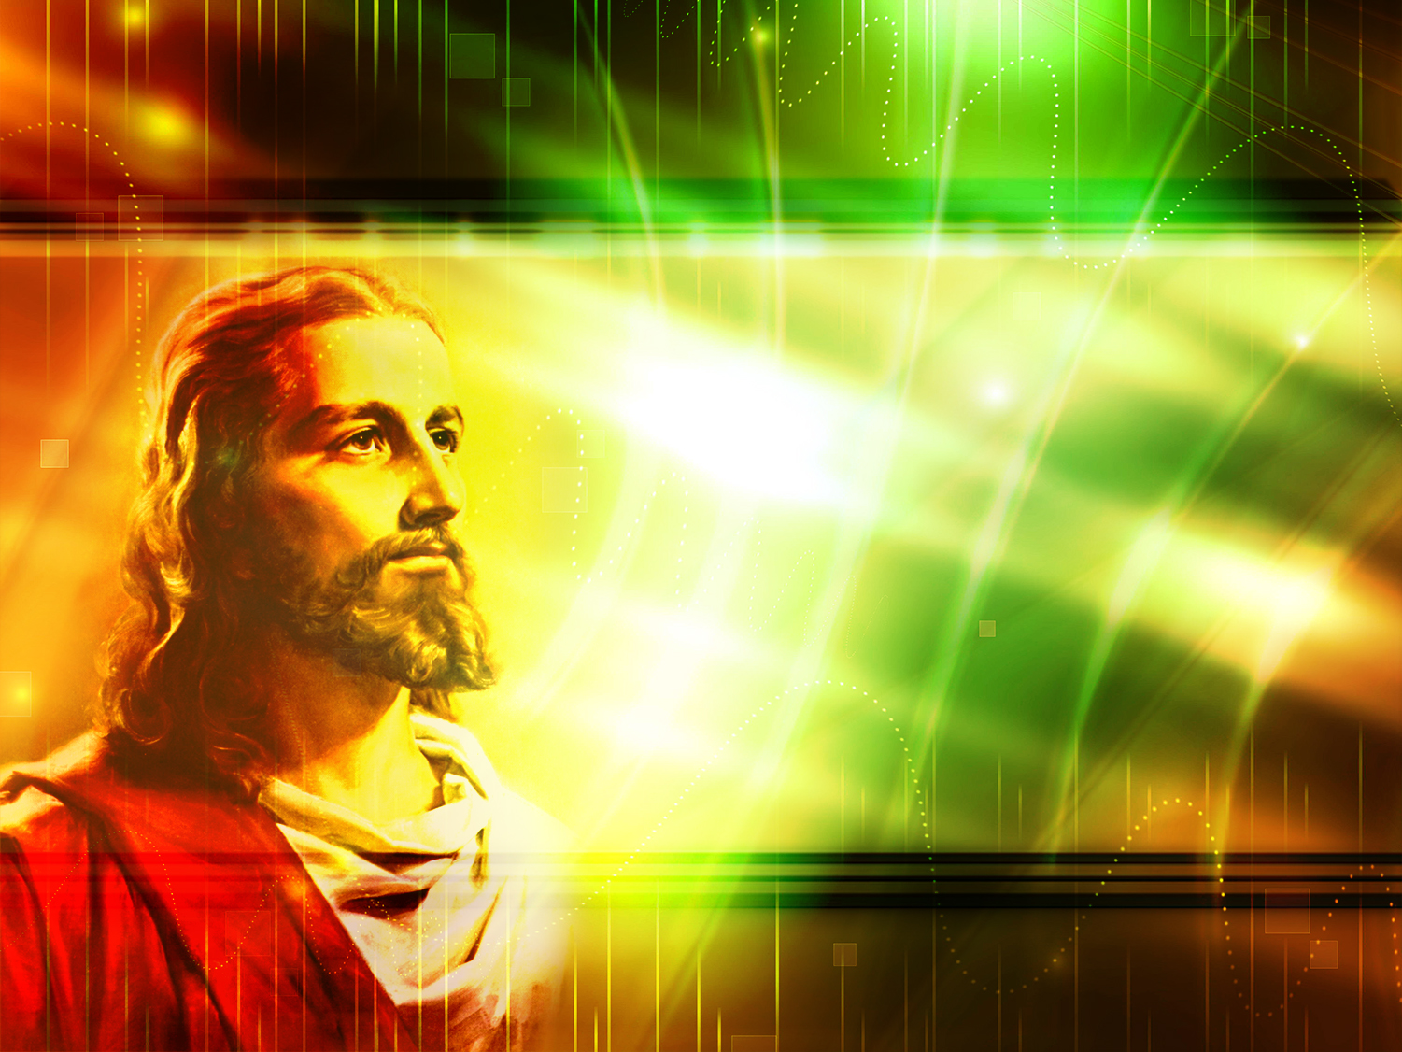
STEP ONE:
TO KNOW JESUS
Notes:
3. Step one: TO KNOW JESUS.

Slide 17
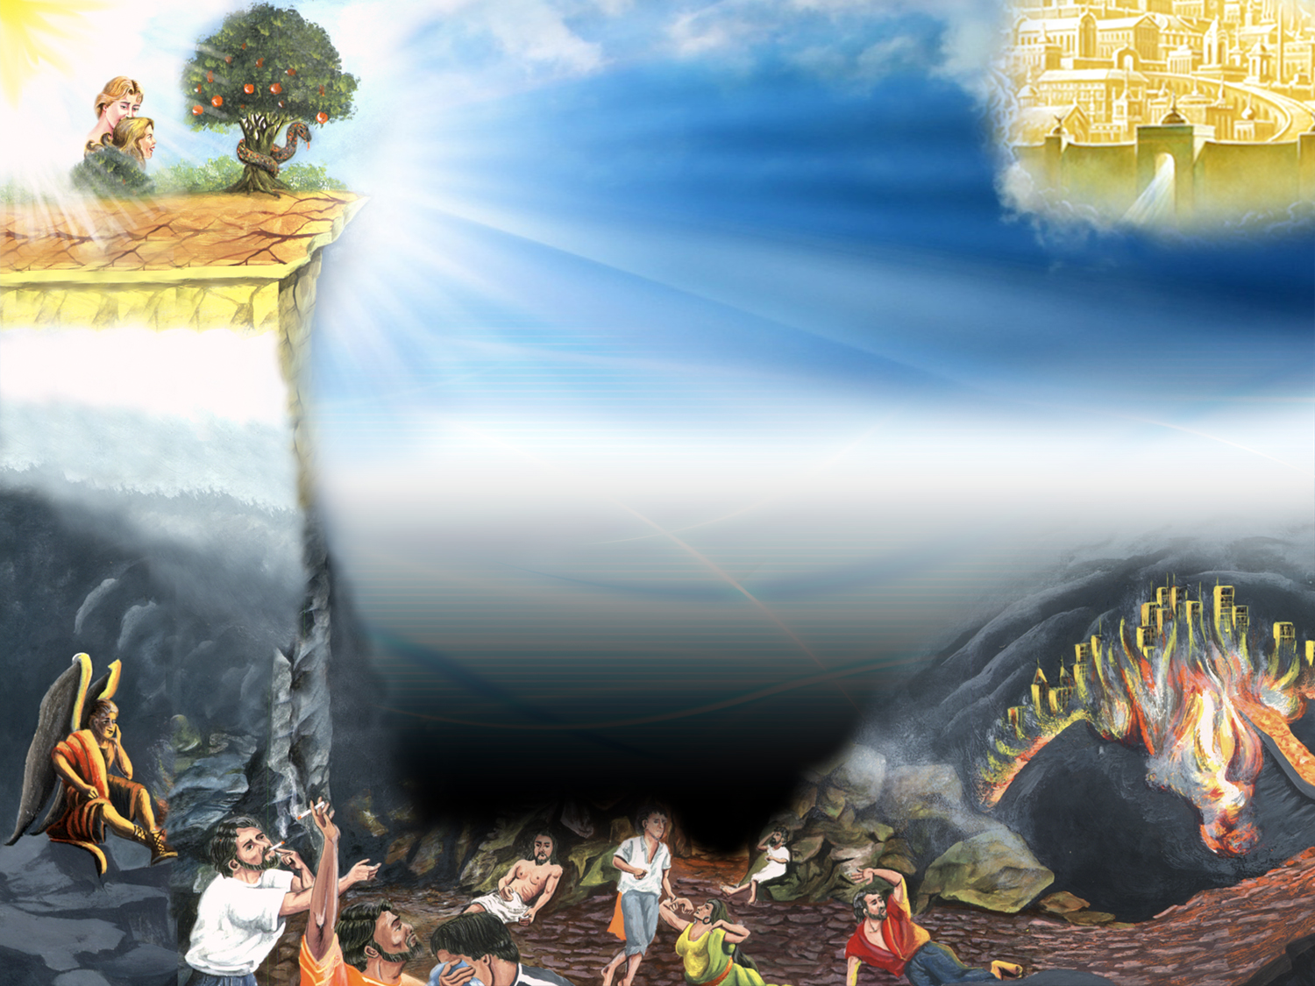
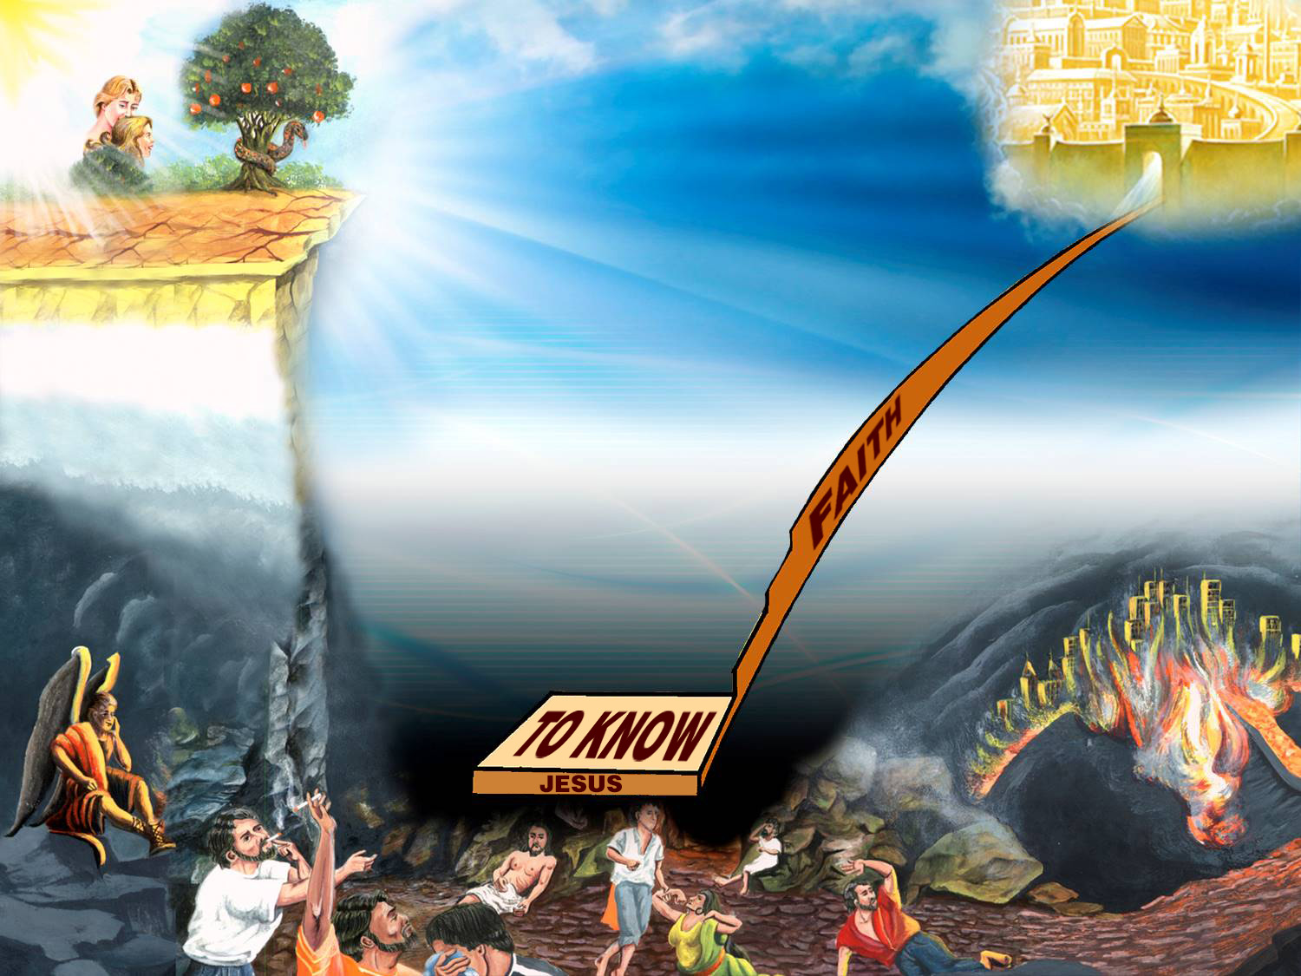

Slide 18
What is knowing Jesus related to?
Notes:
What is knowing Jesus related to?

Slide 19
“And this is life eternal, that they might know thee the only true God, and Jesus Christ, whom thou hast sent.”
John 17:3
Notes:
And this is life eternal, that they might know thee the only true God, and Jesus Christ, whom thou hast sent.
John 17:3
``A man once awoke in the middle of the night with a terrible headache. In the darkness he picked up a box containing pills and took one, thinking they were aspirin. However, they happened to be rat poison. The man died because he believed in something yet was wrong. It could be said he died because he had faith´´.
We can know Jesus through His Word. (John 17.3)

Slide 20
Mediador
1ª Timoteo 2:5
Salvador
Lucas 19:10
Who is Jesus?
Eterno Hijo de Dios
Mateo 16:16
Creador
Juan 1:1-3, 34;
Colosenses 1:16
Legislador
Nehemías 9:13
1ª Corintios 10:4
Juez
Hechos 10:42
Nuestro amigo
Juan 15:14-15
Señor y rey
Apocalipsis 17:14
Porque hay un solo Dios, y un solo mediador entre Dios y los hombres, Jesucristo hombre
Porque el Hijo del Hombre vino a buscar y a salvar lo que se había perdido
Notes:
4. Who is Jesus?

Slide 21
Mediador
1ª Timoteo 2:5
Salvador
Lucas 19:10
The Eternal
Son of God
Matthew 16:16
Creador
Juan 1:1-3, 34;
Colosenses 1:16
Legislador
Nehemías 9:13
1ª Corintios 10:4
Juez
Hechos 10:42
Nuestro amigo
Juan 15:14-15
Señor y rey
Apocalipsis 17:14
Porque hay un solo Dios, y un solo mediador entre Dios y los hombres, Jesucristo hombre
Porque el Hijo del Hombre vino a buscar y a salvar lo que se había perdido
…Thou art the Christ,
the Son of the living God.
Notes:
The Eternal Son of God.
(Matthew 16:16)
…Thou art the Christ, the Son of the living God.

Slide 22
Mediador
1ª Timoteo 2:5
Salvador
Lucas 19:10
The Creator
John 1:1-3, 14;
Colossians 1: 16
¿Quién es Jesús?
Eterno Hijo de Dios
Mateo 16:16
Legislador
Nehemías 9:13
1ª Corintios 10:4
Juez
Hechos 10:42
Nuestro amigo
Juan 15:14-15
Señor y rey
Apocalipsis 17:14
Porque hay un solo Dios, y un solo mediador entre Dios y los hombres, Jesucristo hombre
Porque el Hijo del Hombre vino a buscar y a salvar lo que se había perdido
All things were made
by him…
Notes:
The Creator.
John 1:1-3, 14;
Colossians 1: 16
All things were made by him…

Slide 23
Mediador
1ª Timoteo 2:5
Salvador
Lucas 19:10
The Lawgiver
Nehemiah 9:13
1 Corinthians 10:4
¿Quién es Jesús?
Eterno Hijo de Dios
Mateo 16:16
Creador
Juan 1:1-3, 34;
Colosenses 1:16
Juez
Hechos 10:42
Nuestro amigo
Juan 15:14-15
Señor y rey
Apocalipsis 17:14
Porque hay un solo Dios, y un solo mediador entre Dios y los hombres, Jesucristo hombre
Porque el Hijo del Hombre vino a buscar y a salvar lo que se había perdido
…and gavest them right judgments, and true laws, good statutes and commandments.
Notes:
The Lawgiver.
Nehemiah 9:13
1 Corinthians 10:4
…and gavest them right judgments, and true laws, good statutes and commandments:

Slide 24
Mediador
1ª Timoteo 2:5
The Savior
Luke 19:10
¿Quién es Jesús?
Eterno Hijo de Dios
Mateo 16:16
Creador
Juan 1:1-3, 34;
Colosenses 1:16
Legislador
Nehemías 9:13
1ª Corintios 10:4
Juez
Hechos 10:42
Nuestro amigo
Juan 15:14-15
Señor y rey
Apocalipsis 17:14
Porque hay un solo Dios, y un solo mediador entre Dios y los hombres, Jesucristo hombre
He came to seek and save that which was lost.
Notes:
The Savior
Luke 19:10
He came to seek and save that which was lost.

Slide 25
Mediador
1ª Timoteo 2:5
Salvador
Lucas 19:10
¿Quién es Jesús?
Our friend
John 15:14-15
Eterno Hijo de Dios
Mateo 16:16
Creador
Juan 1:1-3, 34;
Colosenses 1:16
Legislador
Nehemías 9:13
1ª Corintios 10:4
Juez
Hechos 10:42
Señor y rey
Apocalipsis 17:14
Porque hay un solo Dios, y un solo mediador entre Dios y los hombres, Jesucristo hombre
Porque el Hijo del Hombre vino a buscar y a salvar lo que se había perdido
Ye are my friends, if ye do whatsoever I command you.
Notes:
Our friend.
John 15:14-15
Ye are my friends, if ye do whatsoever I command you…

Slide 26
Mediator
1 Timothy 2:5
Salvador
Lucas 19:10
¿Quién es Jesús?
Eterno Hijo de Dios
Mateo 16:16
Creador
Juan 1:1-3, 34;
Colosenses 1:16
Legislador
Nehemías 9:13
1ª Corintios 10:4
Juez
Hechos 10:42
Nuestro amigo
Juan 15:14-15
Señor y rey
Apocalipsis 17:14
Porque el Hijo del Hombre vino a buscar y a salvar lo que se había perdido
For there is one God, and one mediator between God and men, the man Christ Jesus.
Notes:
Mediator
1 Timothy 2:5
For there is one God, and one mediator between God and men, the man Christ Jesus.

Slide 27
Mediador
1ª Timoteo 2:5
Salvador
Lucas 19:10
¿Quién es Jesús?
Lord and King
Revelation 17:14
Eterno Hijo de Dios
Mateo 16:16
Creador
Juan 1:1-3, 34;
Colosenses 1:16
Legislador
Nehemías 9:13
1ª Corintios 10:4
Juez
Hechos 10:42
Nuestro amigo
Juan 15:14-15
Porque el Hijo del Hombre vino a buscar y a salvar lo que se había perdido
Porque hay un solo Dios, y un solo mediador entre Dios y los hombres, Jesucristo hombre
…for he is Lord of lords, and King of kings…
Notes:
Lord and King
Revelation 17:14
…for he is Lord of lords, and King of kings…

Slide 28
Mediador
1ª Timoteo 2:5
Salvador
Lucas 19:10
¿Quién es Jesús?
Señor y rey
Apocalipsis 17:14
Judge
Acts 10:42
Eterno Hijo de Dios
Mateo 16:16
Creador
Juan 1:1-3, 34;
Colosenses 1:16
Legislador
Nehemías 9:13
1ª Corintios 10:4
Nuestro amigo
Juan 15:14-15
Porque el Hijo del Hombre vino a buscar y a salvar lo que se había perdido
Porque hay un solo Dios, y un solo mediador entre Dios y los hombres, Jesucristo hombre
…it is he which was ordained of God to be the Judge of quick and dead.
…Porque él es Señor de señores y Rey de reyes…
Notes:
Judge
Acts 10:42
…it is he which was ordained of God to be the Judge of quick and dead.

Slide 29

Tomó mi culpa
Isaías 53:5-6
Murió en mi lugar,
por mis pecados
1ª Corintios 15:3
What has He done for me?
Resucitó de
los muertos
1ª Corintios 15:20
Prometió regresar
a buscarme
Juan 14:3
“Mas él herido fue por nuestras rebeliones, molido por nuestros pecados; el castigo de nuestra paz fue sobre él, y por su llaga fuimos nosotros curados.
Todos nosotros nos descarriamos como ovejas, cada cual se apartó por su camino; mas Jehová cargó en él el pecado de todos nosotros.“
Intercede por mí
1ª Timoteo 2:5
Se hizo hombre
Filipenses 2:7
Vivió sin pecado
Hebreos 4:15
“Porque primeramente os he enseñado lo que asimismo recibí: Que Cristo murió por nuestros pecados, conforme a las Escrituras”
Notes:
5. What has He done for me?

Slide 30
Tomó mi culpa
Isaías 53:5-6
Murió en mi lugar,
por mis pecados
1ª Corintios 15:3
He was made in the likeness of men Philippians 2:7
¿Qué ha hecho por mí?
Resucitó de
los muertos
1ª Corintios 15:20
Prometió regresar
a buscarme
Juan 14:3
“Mas él herido fue por nuestras rebeliones, molido por nuestros pecados; el castigo de nuestra paz fue sobre él, y por su llaga fuimos nosotros curados.
Todos nosotros nos descarriamos como ovejas, cada cual se apartó por su camino; mas Jehová cargó en él el pecado de todos nosotros.“
Intercede por mí
1ª Timoteo 2:5
Vivió sin pecado
Hebreos 4:15
“Porque primeramente os he enseñado lo que asimismo recibí: Que Cristo murió por nuestros pecados, conforme a las Escrituras”
“But made himself of no reputation, and took upon him the form of a servant, and was made in the likeness of men.”
Notes:
He was made in the likeness of men.
Philippians 2:7
“But made himself of no reputation, and took upon him the form of a servant, and was made in the likeness of men.”

Slide 31
Tomó mi culpa
Isaías 53:5-6
Murió en mi lugar,
por mis pecados
1ª Corintios 15:3
He lived without sin Hebrews 4:15
¿Qué ha hecho por mí?
Resucitó de
los muertos
1ª Corintios 15:20
Prometió regresar
a buscarme
Juan 14:3
“Mas él herido fue por nuestras rebeliones, molido por nuestros pecados; el castigo de nuestra paz fue sobre él, y por su llaga fuimos nosotros curados.
Todos nosotros nos descarriamos como ovejas, cada cual se apartó por su camino; mas Jehová cargó en él el pecado de todos nosotros.“
Intercede por mí
1ª Timoteo 2:5
Se hizo hombre
Filipenses 2:7
“Porque primeramente os he enseñado lo que asimismo recibí: Que Cristo murió por nuestros pecados, conforme a las Escrituras”
“…but was in all points tempted like as we are, yet without sin.”
Notes:
He lived without sin
Hebrews 4:15
“…but was in all points tempted like as we are, yet without sin.”

Slide 32
He took my fault
Isaiah 53:5-6
Murió en mi lugar,
por mis pecados
1ª Corintios 15:3
¿Qué ha hecho por mí?
Resucitó de
los muertos
1ª Corintios 15:20
Prometió regresar
a buscarme
Juan 14:3
“But he was wounded for our transgressions, he was bruised for our iniquities: the chastisement of our peace was upon him; and with his stripes we are healed. All we like sheep have gone astray; we have turned every one to his own way; and the Lord hath laid on him the iniquity of us all.”
Intercede por mí
1ª Timoteo 2:5
Se hizo hombre
Filipenses 2:7
Vivió sin pecado
Hebreos 4:15
“Porque primeramente os he enseñado lo que asimismo recibí: Que Cristo murió por nuestros pecados, conforme a las Escrituras”
Notes:
He took my fault.
Isaiah 53:5-6.
“But he was wounded for our transgressions, he was bruised for our iniquities: the chastisement of our peace was upon him; and with his stripes we are healed. All we like sheep have gone astray; we have turned every one to his own way; and the Lord hath laid on him the iniquity of us all.”
A mischievous child at a school stained the papers on the teacher´s desk with ink. When the teacher arrived and discovered the damage, he demanded of his class to tell him who was guilty.
Spencer! A child shouted. -Spencer come here! ordered the teacher taking a rod in his hands.
Two students had the same last name because they were brothers. The older brother stood up and without a word received stoically the painful punishment. Suddenly the younger brother stood up crying.
-"Teacher, do not beat him anymore. He is not guilty; I was the one who did it."
The teacher stopped and asked the older brother:
-"Why did you take the punishment without pleading your innocence?."
-"Because he is younger, weaker and is a little sick, answered the boy.
The teacher really moved, hugged him and said:
-boy, never in your life you will be more Christian than today. Christ did this for you and for me. God bless you son!

Slide 33
Tomó mi culpa
Isaías 53:5-6
He died in my place for my sins
1 Corinthians 15:3
¿Qué ha hecho por mí?
Resucitó de
los muertos
1ª Corintios 15:20
Prometió regresar
a buscarme
Juan 14:3
“Mas él herido fue por nuestras rebeliones, molido por nuestros pecados; el castigo de nuestra paz fue sobre él, y por su llaga fuimos nosotros curados.
Todos nosotros nos descarriamos como ovejas, cada cual se apartó por su camino; mas Jehová cargó en él el pecado de todos nosotros.“
Intercede por mí
1ª Timoteo 2:5
Se hizo hombre
Filipenses 2:7
Vivió sin pecado
Hebreos 4:15
“…Christ died for our sins according to the scriptures.”
Notes:
He died in my place for my sins.
1 Corinthians 15:3
“…Christ died for our sins according to the scriptures.”

Slide 34
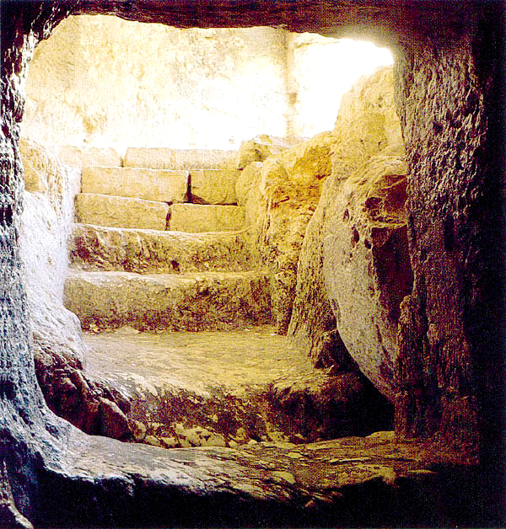
Tomó mi culpa
Isaías 53:5-6
Murió en mi lugar,
por mis pecados
1ª Corintios 15:3
He rose
from the dead
1 Corinthians 15:20
¿Qué ha hecho por mí?
Prometió regresar
a buscarme
Juan 14:3
“Mas él herido fue por nuestras rebeliones, molido por nuestros pecados; el castigo de nuestra paz fue sobre él, y por su llaga fuimos nosotros curados.
Todos nosotros nos descarriamos como ovejas, cada cual se apartó por su camino; mas Jehová cargó en él el pecado de todos nosotros.“
Intercede por mí
1ª Timoteo 2:5
Se hizo hombre
Filipenses 2:7
Vivió sin pecado
Hebreos 4:15
But now is Christ risen from the dead, and become the firstfruits of them that slept.
Notes:
He rose from the dead
1 Corinthians 15:20
“But now is Christ risen from the dead, and become the firstfruits of them that slept.”

Slide 35
Tomó mi culpa
Isaías 53:5-6
Murió en mi lugar,
por mis pecados
1ª Corintios 15:3
Resucitó de
los muertos
1ª Corintios 15:20
He intercedes for me
1 Timothy 2:5
¿Qué ha hecho por mí?
Prometió regresar
a buscarme
Juan 14:3
“Mas él herido fue por nuestras rebeliones, molido por nuestros pecados; el castigo de nuestra paz fue sobre él, y por su llaga fuimos nosotros curados.
Todos nosotros nos descarriamos como ovejas, cada cual se apartó por su camino; mas Jehová cargó en él el pecado de todos nosotros.“
Se hizo hombre
Filipenses 2:7
Vivió sin pecado
Hebreos 4:15
“For there is one God, and one mediator between God and men, the man Christ Jesus.”
Notes:
He intercedes for me.
1 Timothy 2:5
“For there is one God, and one mediator between God and men, the man Christ Jesus.”

Slide 36
Tomó mi culpa
Isaías 53:5-6
Murió en mi lugar,
por mis pecados
1ª Corintios 15:3
Resucitó de
los muertos
1ª Corintios 15:20
He promised to come back and take me with Him
John 14:3
Intercede por mí
1ª Timoteo 2:5
¿Qué ha hecho por mí?
“Mas él herido fue por nuestras rebeliones, molido por nuestros pecados; el castigo de nuestra paz fue sobre él, y por su llaga fuimos nosotros curados.
Todos nosotros nos descarriamos como ovejas, cada cual se apartó por su camino; mas Jehová cargó en él el pecado de todos nosotros.“
Se hizo hombre
Filipenses 2:7
Vivió sin pecado
Hebreos 4:15
“…I will come again, and receive you unto myself; that where I am, there ye may be also.”
Notes:
He promised to come back and take me with Him
John 14:3
“…I will come again, and receive you unto myself; that where I am, there ye may be also.”

Slide 37
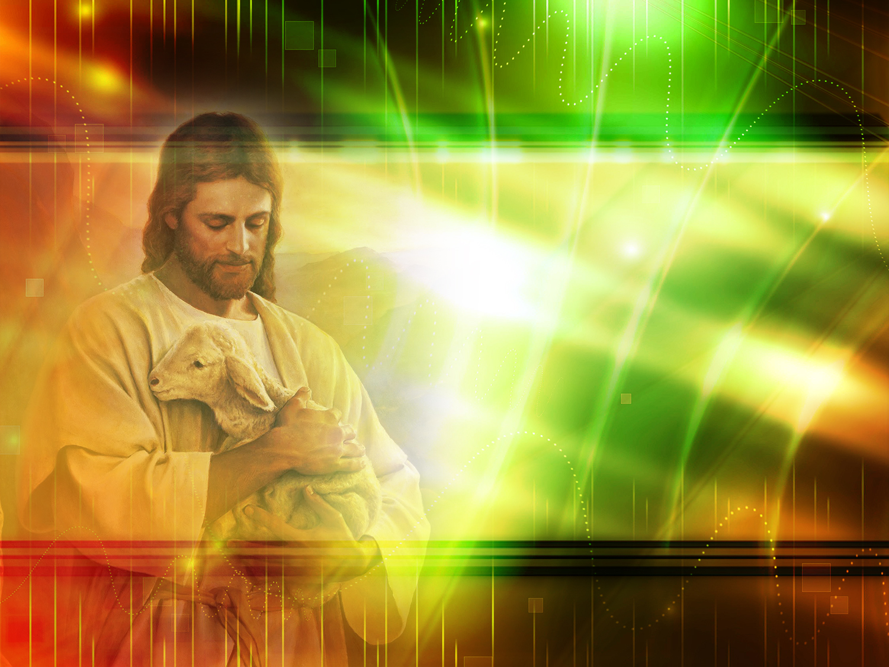
STEP TWO:
TO TRUST IN JESUS
Notes:
6. Step two: TO TRUST IN JESUS

Slide 38


Slide 39
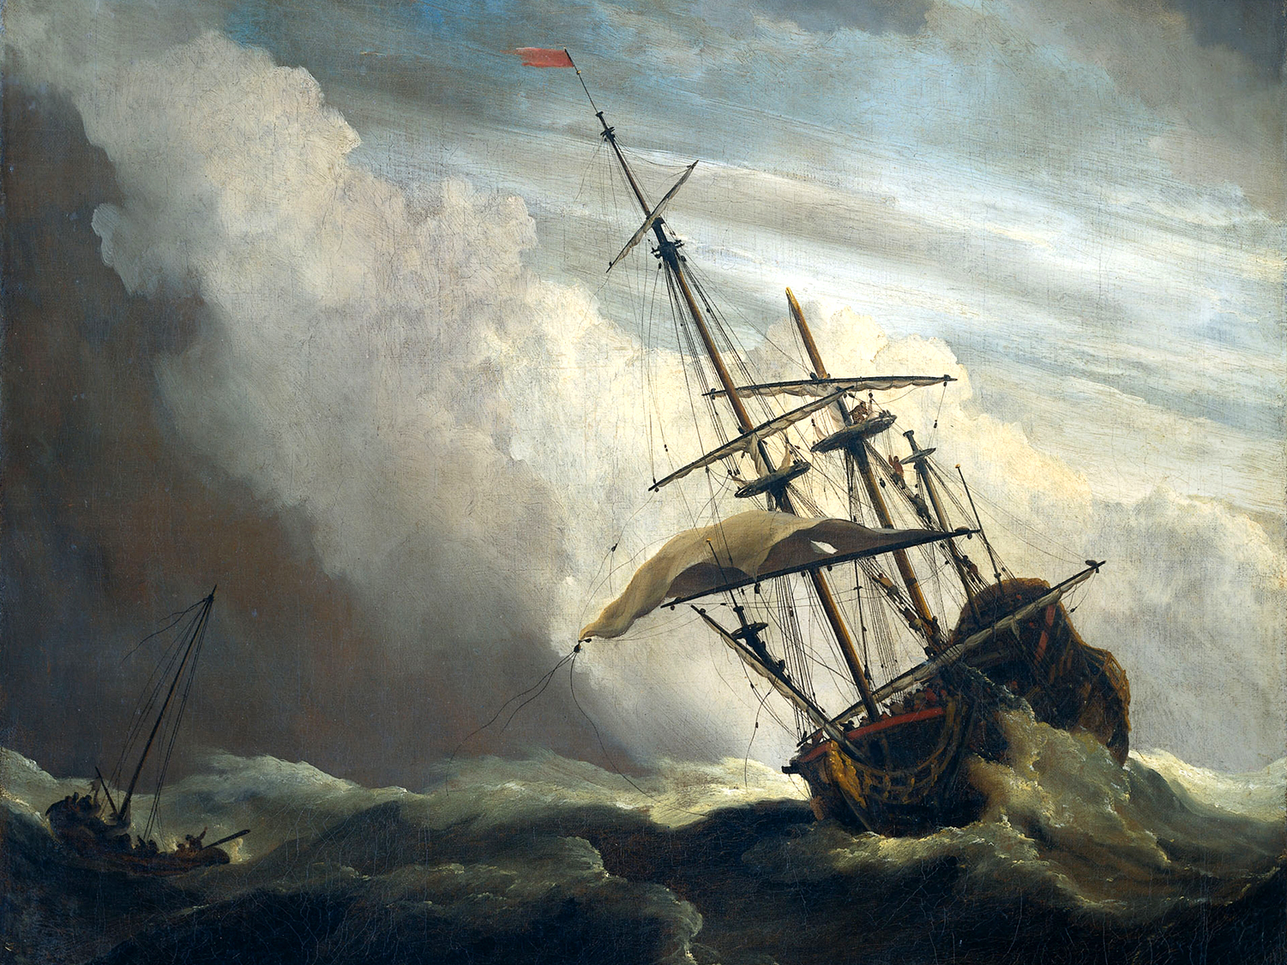
Notes:
There was once a ship sailing on the high seas in the midst of a violent storm. Fear and anxiety was painted on every person's face. Some were crying, and others were very seasick. Amid all this commotion, a little child kept playing on the stairs of the ship, quite indifferent to what was happening. When a passenger saw him, he approached him and asked how he could be so calm:
-Aren't you afraid of the storm?
-"No, Sir, because my father is the captain".- answered the child.
When we know Jesus, we learn to trust Him. In the difficult moments of our life. We should take all our hardships and sins to Him.

Slide 40
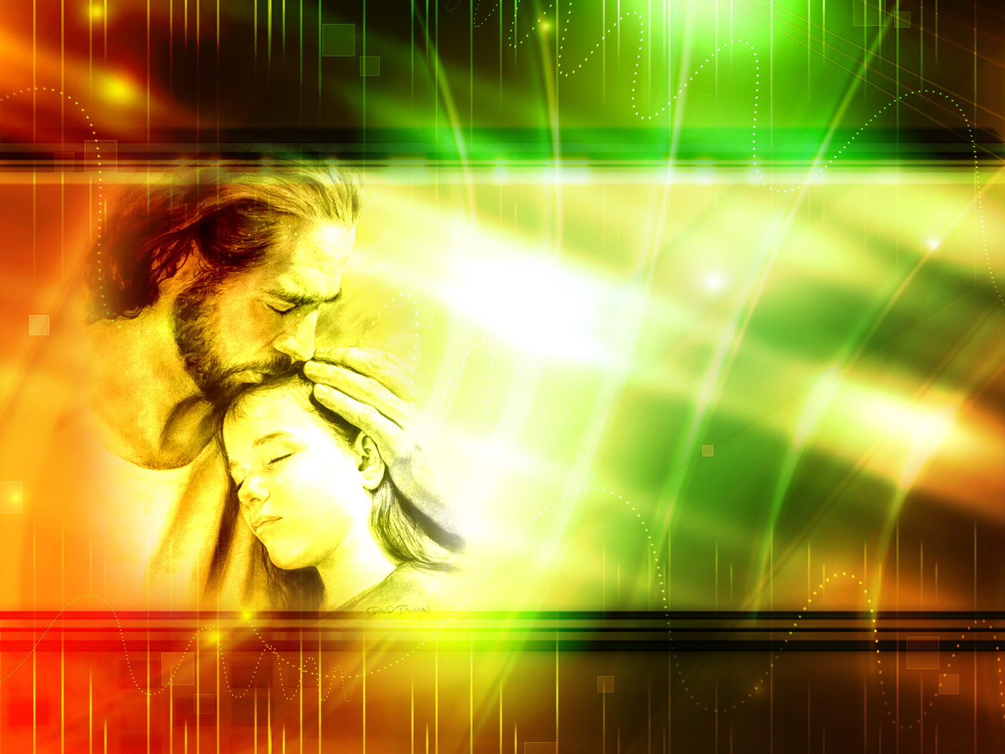
What is His greatest virtue?
Notes:
What is His greatest virtue?

Slide 41
“For God so loved the world, that he gave his only begotten Son, that whosoever believeth in him should not perish, but have everlasting life.”
John 3:16
Notes:
“For God so loved the world, that he gave his only begotten Son, that whosoever believeth in him should not perish, but have everlasting life.”
John 3:16
As I see His love, I will open my heart to Him, I will trust Him, and I will tell Him all those things that worry me.

Slide 42
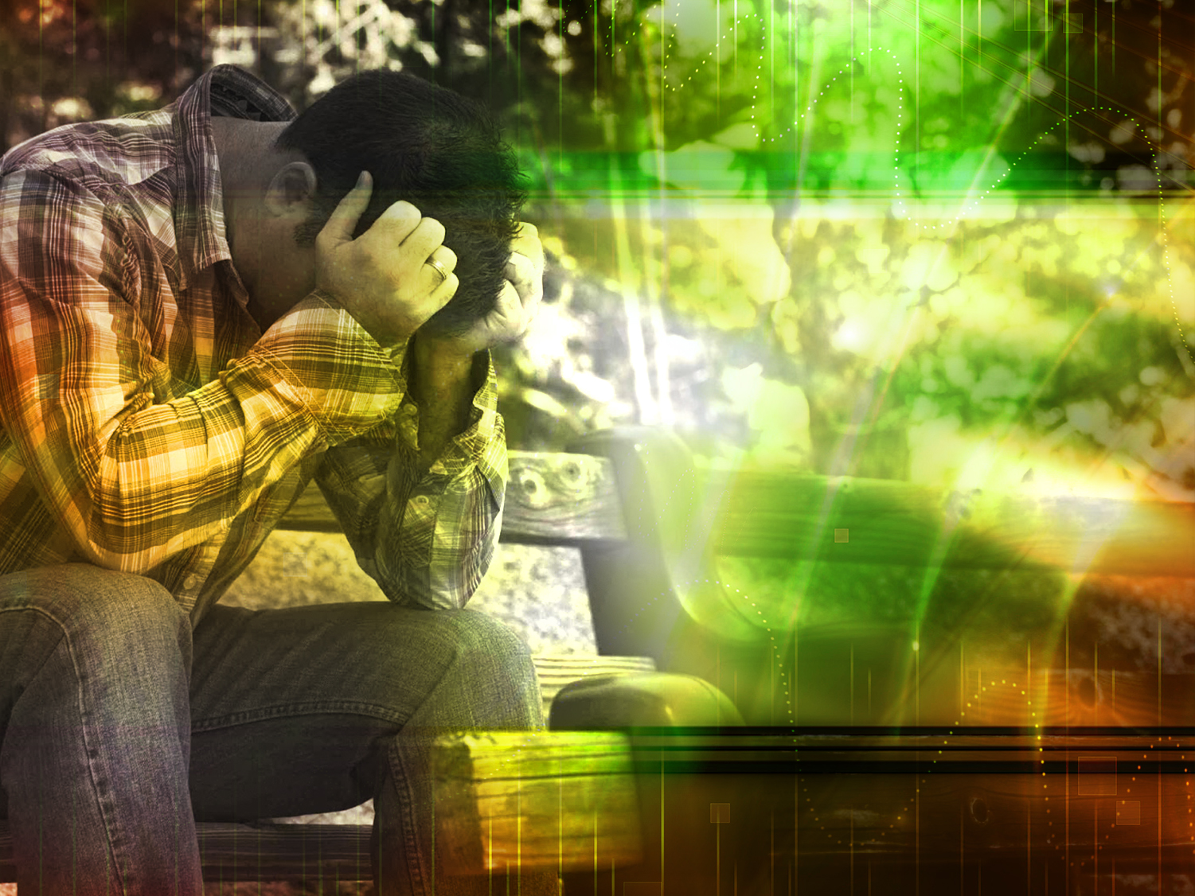
STEP THREE:
TO ACKNOWLEDGE OUR SINS
Notes:
7. Step Three: TO ACKNOWLEDGE OUR SINS.

Slide 43


Slide 44
What should His love lead us to?
Notes:
What should His love lead us to?

Slide 45
“Or despisest thou the riches of his goodness and forbearance and longsuffering; not knowing that the goodness of God leadeth thee to repentance?”
Romans 2:4
Notes:
“Or despisest thou the riches of his goodness and forbearance and longsuffering; not knowing that the goodness of God leadeth thee to repentance?”
Romans 2:4

Slide 46
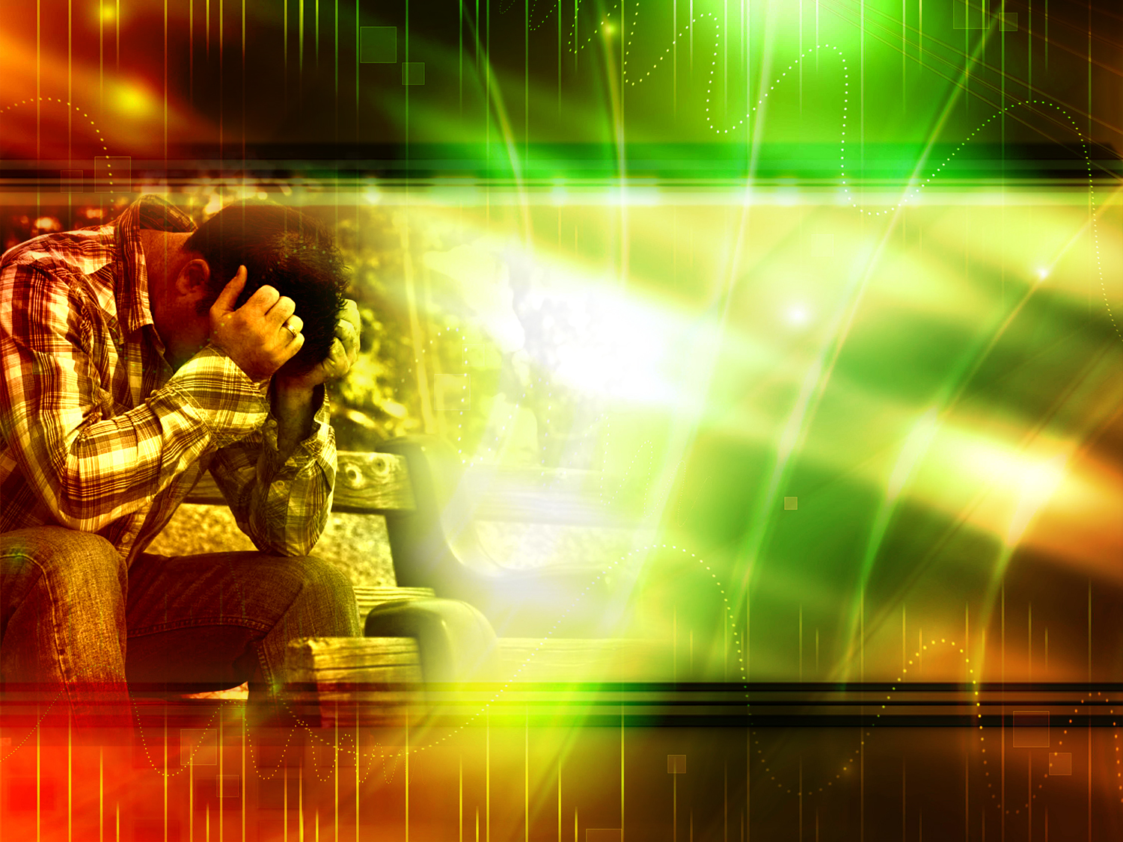
What should we do with
our sins?
Notes:
8. What should we do with our sins?

Slide 47
Confess them to God
“If we say that we have no sin, we deceive ourselves, and the truth is not in us. If we confess our sins, he is faithful and just to forgive us our sins, and to cleanse us from all unrighteousness.”
1 John 1:8, 9
Notes:
Confess them to God
“If we say that we have no sin, we deceive ourselves, and the truth is not in us. If we confess our sins, he is faithful and just to forgive us our sins, and to cleanse us from all unrighteousness.” 1 John 1:8, 9

Slide 48
Be willing to abandon them
“Seek ye the Lord while he may be found, call ye upon him while he is near. Let the wicked forsake his way, and the unrighteous man his thoughts: and let him return unto the Lord, and he will have mercy upon him; and to our God, for he will abundantly pardon.”
Isaiah 55:6, 7
Notes:
Be willing to abandon them
“Seek ye the Lord while he may be found, call ye upon him while he is near. Let the wicked forsake his way, and the unrighteous man his thoughts: and let him return unto the Lord, and he will have mercy upon him; and to our God, for he will abundantly pardon.”
Isaiah 55:6, 7
We do not need to do great physical sacrifices, go on pilgrimages or take vows to be forgiven by God. He wants our heart. He wants us to confess and forsake our sins. (Proverbs 23:26).

Slide 49
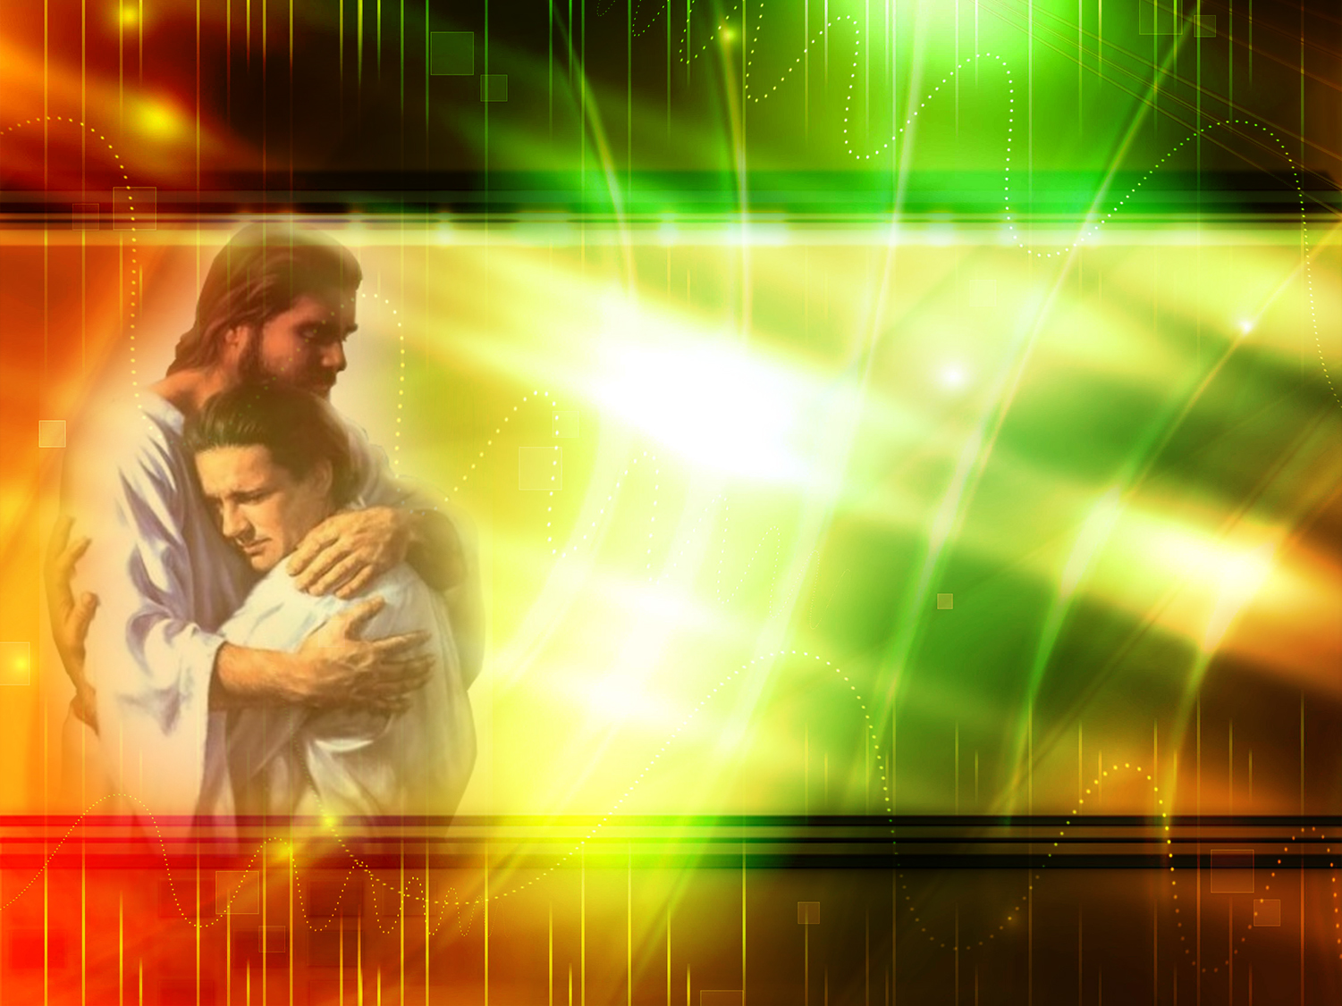
STEP FOUR:
TO ACCEPT JESUS AS OUR SAVIOR AND LORD
Notes:
9. Step four: TO ACCEPT JESUS AS OUR SAVIOR AND LORD

Slide 50
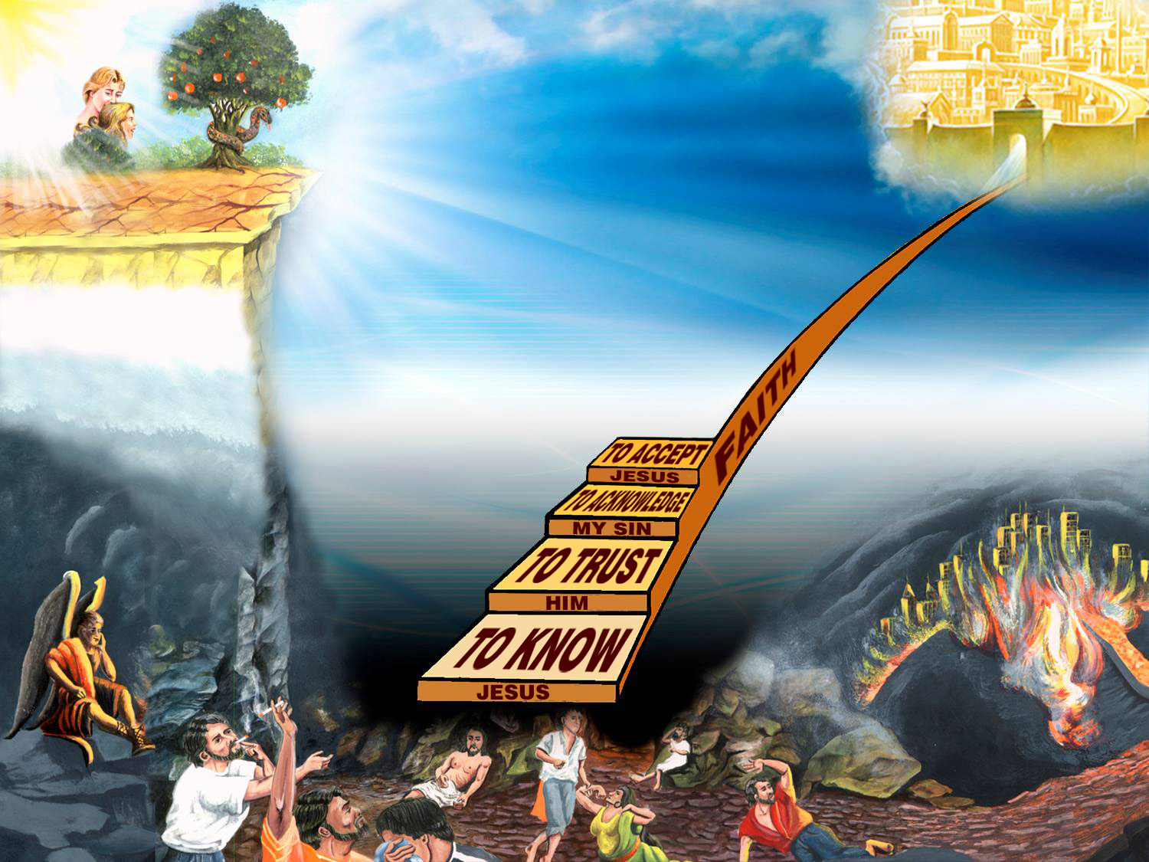

Slide 51
Behold, I stand at the door, and knock: if any man hear my voice, and open the door, I will come in to him, and will sup with him, and he with me.
Revelation 3:20
Notes:
Behold, I stand at the door, and knock: if any man hear my voice, and open the door, I will come in to him, and will sup with him, and he with me.
Revelation 3:20

Slide 52
What is the difference between accepting him as our Savior versus accepting him as our Lord?
Notes:
What is the difference between accepting him as our Savior versus accepting him as our Lord?

Slide 53
“But as many as received him, to them gave he power to become the sons of God, even to them that believe on his name.”
John 1:12
Notes:
“But as many as received him, to them gave he power to become the sons of God, even to them that believe on his name.”
John 1:12

Slide 54

Savior
Lord
I must believe He died in my place.
As my Lord, Master and Ruler, I must obey His commandments.
Notes:
a) As my Savior. I must believe He died in my place
b) As my Lord, Master and Ruler, I must obey His commandments.
Let us say with Paul "Lord, what wilt Thou have me to do? (Acts 9:5-6).

Slide 55
GENUINE FAITH AND TEMPORARY FAITH
Notes:
GENUINE FAITH AND TEMPORARY FAITH

Slide 56
What is the difference between genuine and temporary faith?
Notes:
10. What is the difference between genuine and temporary faith?

Slide 57

THE ENTIRE BEING
SPIRIT
SOUL
BODY
Notes:
a) Genuine faith has to do with our entire being, for we are three dimensional beings.
- REASONING (mind) Knowing Jesus and believing He exists.
-HEART (feelings) Trust Him, opening our hearts and confessing all our sins to Him, and loving Him
-WILL (decision) being willing to obey Him.

Slide 58

SURRENDER
Notes:
b) Genuine faith means surrendering to Him.
For example: we consult a doctor, but we do not follow through with a surgery recommended by him.

Slide 59
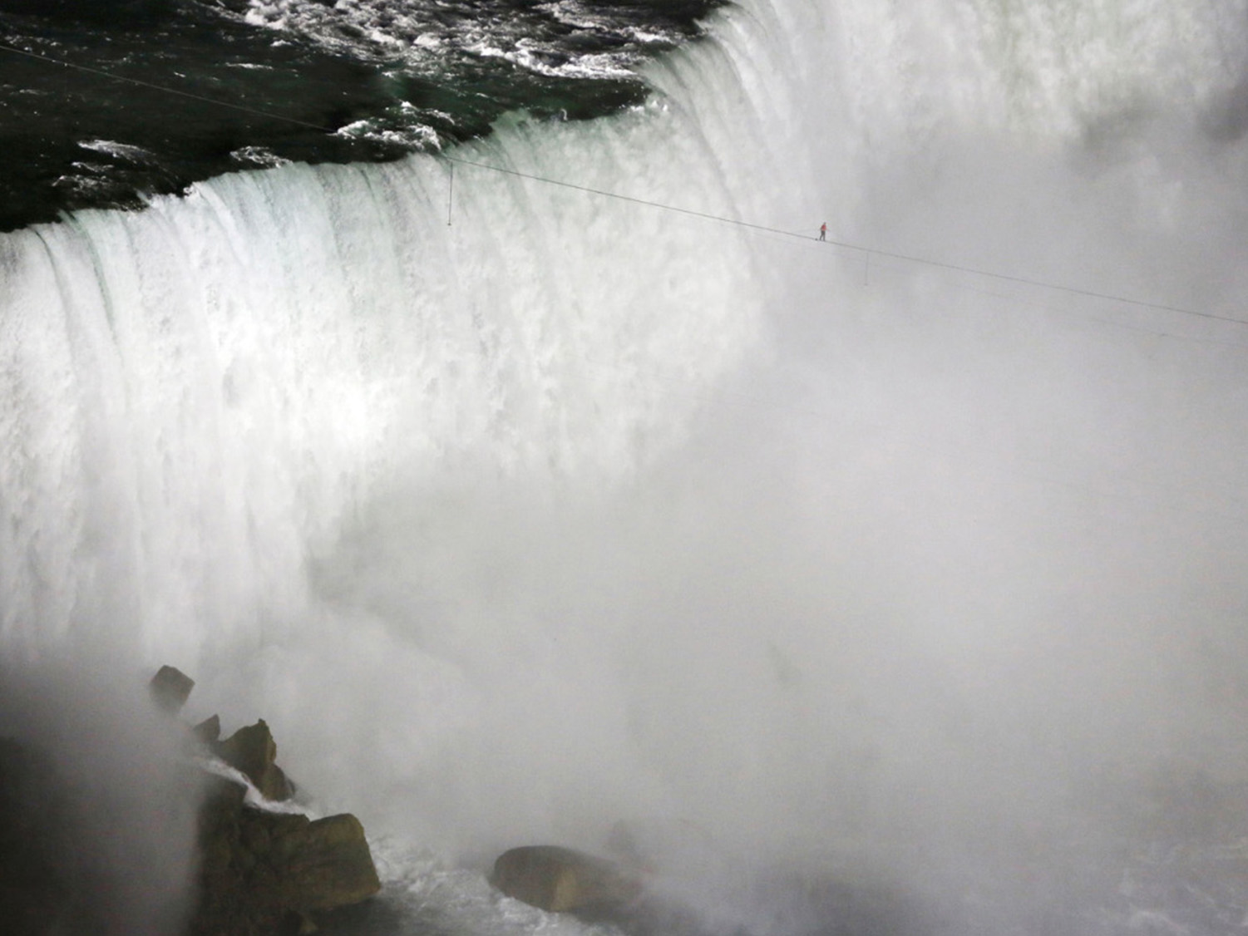
Notes:
"One day a famous tightrope walker strung a rope across the Niagara Falls and announced that he would give a performance. Many people came to see the great performance. When the time came, the man asked them to be silent and then asked:
-Do you believe I can walk on this rope?"
-"Yes!"- answered the crowd. The man then walked back and forth on the rope, and the public applauded enthusiastically.
Again he asked them to be silent, then, he took a chair and put it on his shoulders and asked:
-"Do you believe I can cross holding this chair?"
Another enthusiastic "Yes", was heard. The man, once again, walked back and forth and the people applauded very much. Again he asked the audience to keep quiet and then asked:
- "Do you believe I can cross the Falls with a man sitting on this chair on my shoulders without dropping him into the water?
"The enthusiasm was great, and the crowd answered "Yes"
Then, the man asked, very seriously:
- "Which of you will be the first volunteer to come and sit on the chair?"
A deep silence was heard and nobody volunteered.
There are many people who act in this way in reference to spiritual life. They say: "Yes, I believe in Christ!" but they do not really believe Christ can carry them across the terrible falls of this world and bring them safely to eternal life.

Slide 60

EGO
EGO
Notes:
c) We do not need to be perfect to come to Christ. Let us go to Him as we are, full of our defects, so He can cleanse us and change us. (John 6:37)
d) We should overcome our ego and let Him come into our life. When our ego reigns, all our interests revolve around ourselves. When Christ is in the throne of our hearts, our interests will be fixed on God.
e) We should make a pact with Him, a commitment of love, just as in marriage

Slide 61
THE RESULT
Notes:
THE RESULT

Slide 62
What will we become through Jesus?
Notes:
11. What will we become through Jesus?

Slide 63
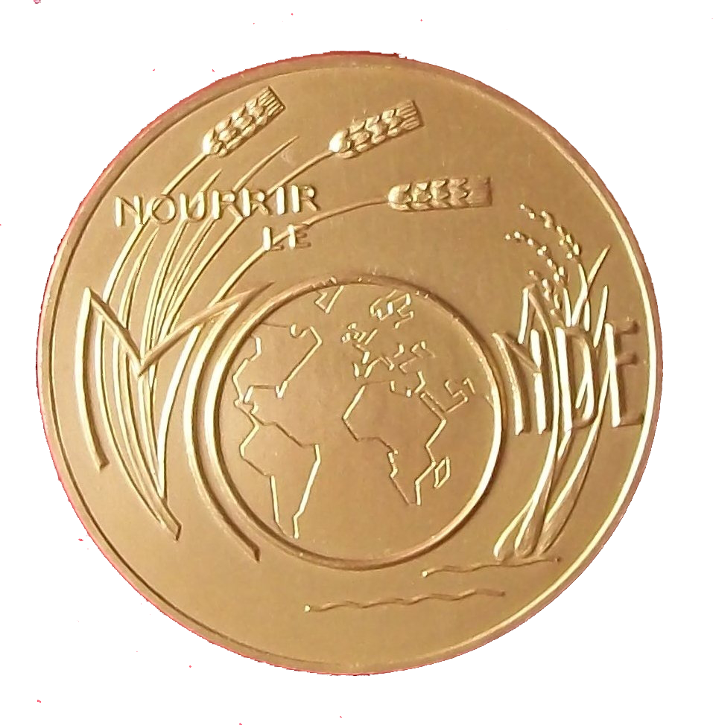
“Therefore if any man be in Christ, he is a new creature: old things are passed away; behold, all things are become new.”
2 Corinthians 5:17
Notes:
“Therefore if any man be in Christ, he is a new creature: old things are passed away; behold, all things are become new.”
2 Corinthians 5:17
Someone dropped a precious medal in the mud. When it was finally found, it was completely ruined. There were two ways to restore it: either straighten it and fill in the parts that were dented, or melt it down and make it over again. Which of the two ways would be the easiest?

Slide 64
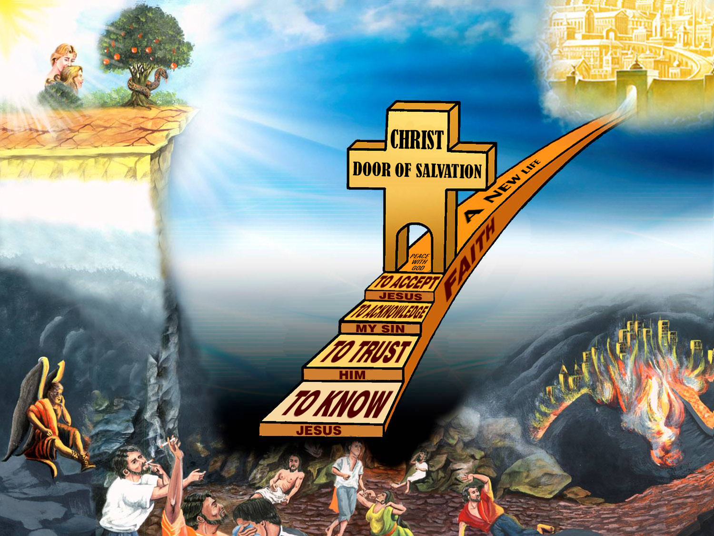

Slide 65
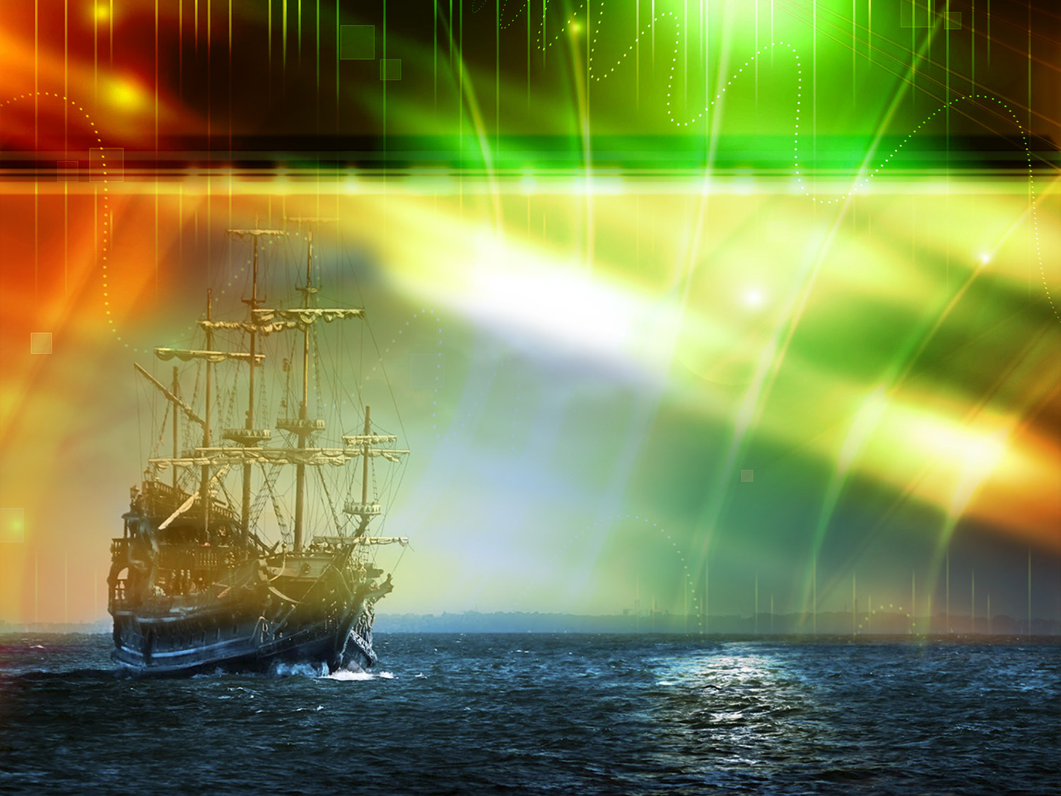
What does God promise us regarding our sins?
Notes:
What does God promise us regarding our sins?

Slide 66
“Who is a God like unto thee, that pardoneth iniquity, and passeth by the transgression of the remnant of his heritage? he retaineth not his anger for ever, because he delighteth in mercy. He will turn again, he will have compassion upon us; he will subdue our iniquities; and thou wilt cast all their sins into the depths of the sea.”
Micah 7: 18, 19
Notes:
“Who is a God like unto thee, that pardoneth iniquity, and passeth by the transgression of the remnant of his heritage? he retaineth not his anger for ever, because he delighteth in mercy. He will turn again, he will have compassion upon us; he will subdue our iniquities; and thou wilt cast all their sins into the depths of the sea.” Micah 7: 18, 19.
We can rejoice in salvation, because He who has the Son has life.

Slide 67
What does Jesus offer to every soul who accepts Him?
Notes:
13. What does Jesus offer to every soul who accepts Him?

Slide 68
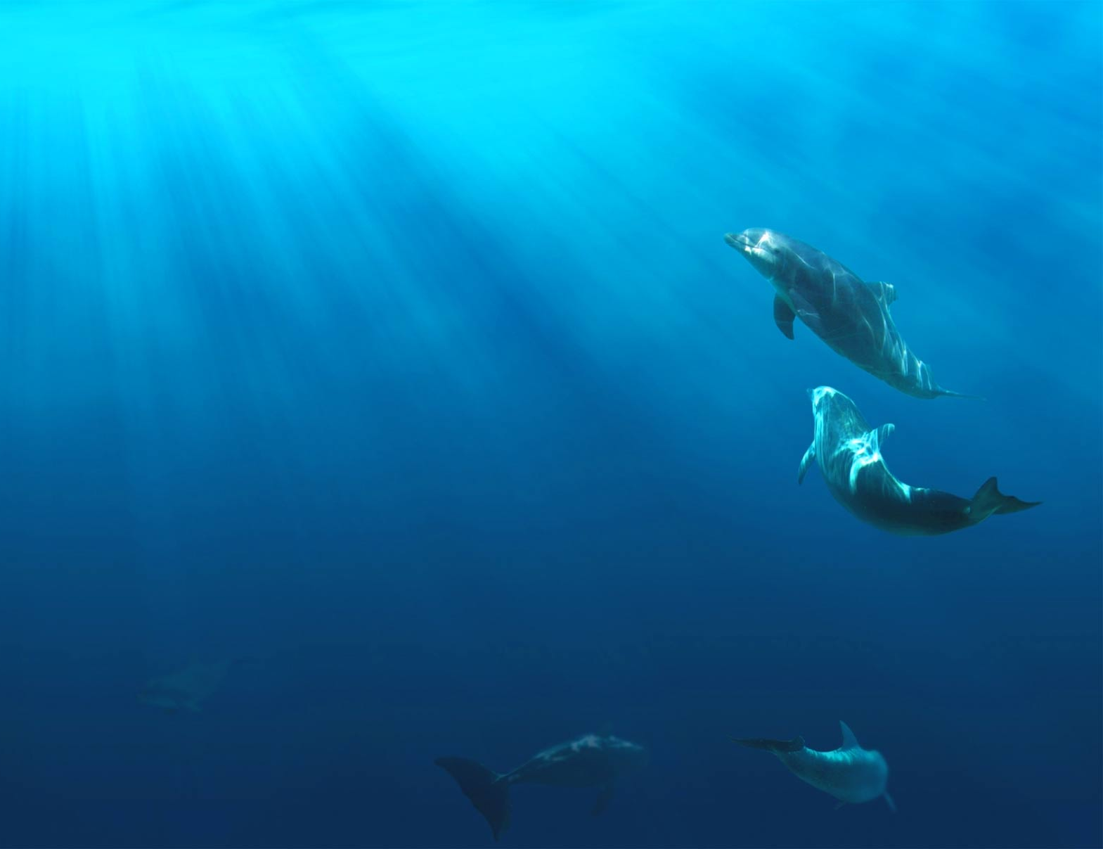
“Peace I leave with you, my peace I give unto you: not as the world giveth, give I unto you. Let not your heart be troubled, neither let it be afraid.”
John 14:27
Notes:
“Peace I leave with you, my peace I give unto you: not as the world giveth, give I unto you. Let not your heart be troubled, neither let it be afraid.”
John 14:27.
We will be reconciled to God.

Slide 69
CONCLUSION
Notes:
CONCLUSION

Slide 70
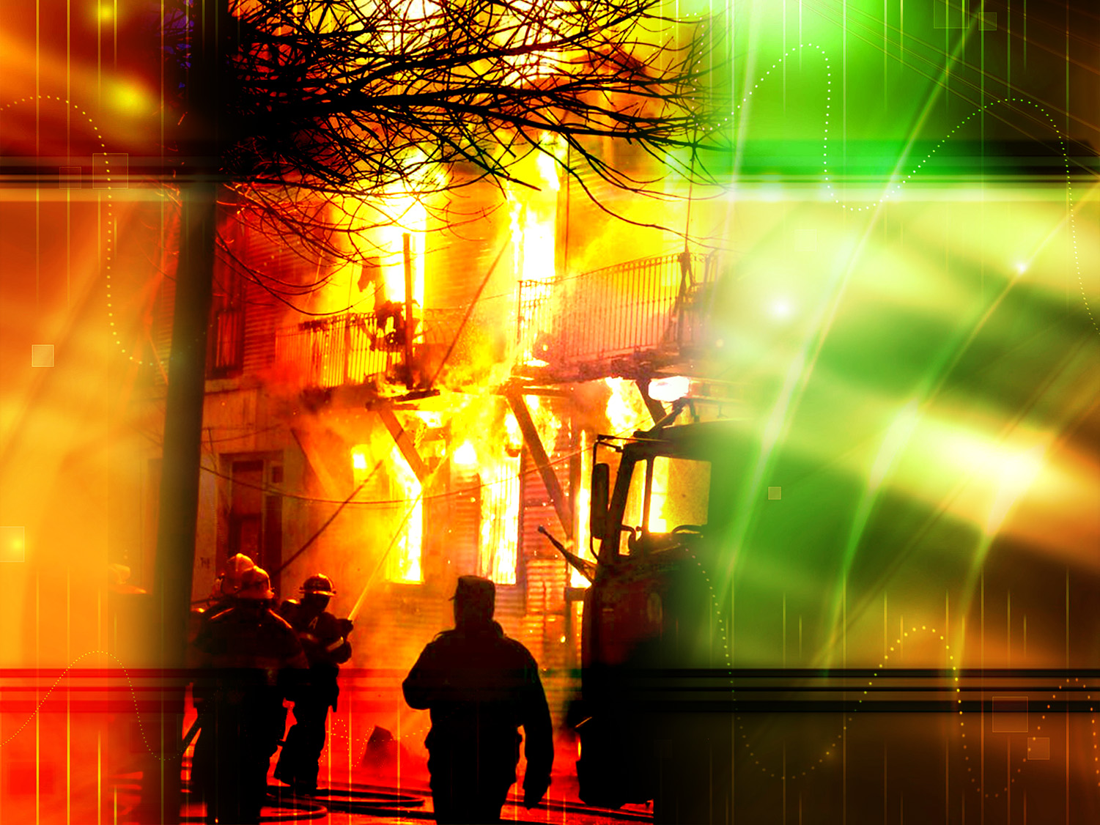
A JUMP OF FAITH
Notes:
A JUMP OF FAITH
Some years ago in England, a wooden house caught fire. On the top floor of the house, a child was screaming and crying desperately for someone to save him; but it was impossible to climb up to where the child was because the stairs had completely burned. Flames were coming out of the window, preventing anyone from putting up a ladder to save the child.
The only solution was for the child to jump through the smoke and flames and for some loving arms to catch him and keep his body from hitting the ground. Still, how could a 6 year-old child be persuaded to perform such a heroic act? The voice of the child's father was heard amid the silent crowd, ordering his son to jump without fear.
The boy hesitated and said: -Daddy, I can hear you but I can't see you, Where are you?
-"My son, I am here, waiting for you. Jump!"
-I am afraid Daddy!" But if you say so, I will jump. Catch me."
Remarkably, the child jumped, and after few seconds, he was safe and sound in his father's arms.
Similarly, the invisible God, whose wonderful works we can see through creation, is asking us to trust His Holy Word, to acknowledge the wonderful promises it contains making them our own, and to accept His offer of salvation through Jesus Christ.

Slide 71

God wants to make you happy!
He wants to forgive your sins and give you salvation.
Today, He wants to call you His child.
Notes:
God wants to make you happy!
He wants to forgive your sins and give you salvation.
Today, He wants to call you His child.

Slide 72
The question is:
Will you allow Him?
Do you accept Jesus in your life as your Savior and Lord?
Confess this to God now in prayer.
Notes:
The question is: Will you allow Him?
Do you accept Jesus in your life as your Savior and Lord?
Now is the time to confess this to God in prayer.
(For the instructor: about Salvation and accepting Jesus)
Mr./Mrs./Miss...Do you realize what Christ wants to do for you?
Christ left heaven and died on the cross to give you the gift of eternal life. Do you want to receive this gift?
(Also, explain what it means to accept Jesus as personal Savior and Lord in ones life, and what it means to make a pact with Him. Also, emphasize the blessings He wants to give.)
Mr./Mrs./ Miss...Do you want to open the door of your heart and welcome Him in right now?
The Lord says that "where two or three are gathered in My name, there am I in the midst of them." (Matthew 18:20)
He is with us now, and we can talk to Him through our prayers. I will pray and tell the Lord what you have just told me; if you wish you can repeat my after me. Would you like this?

Slide 73
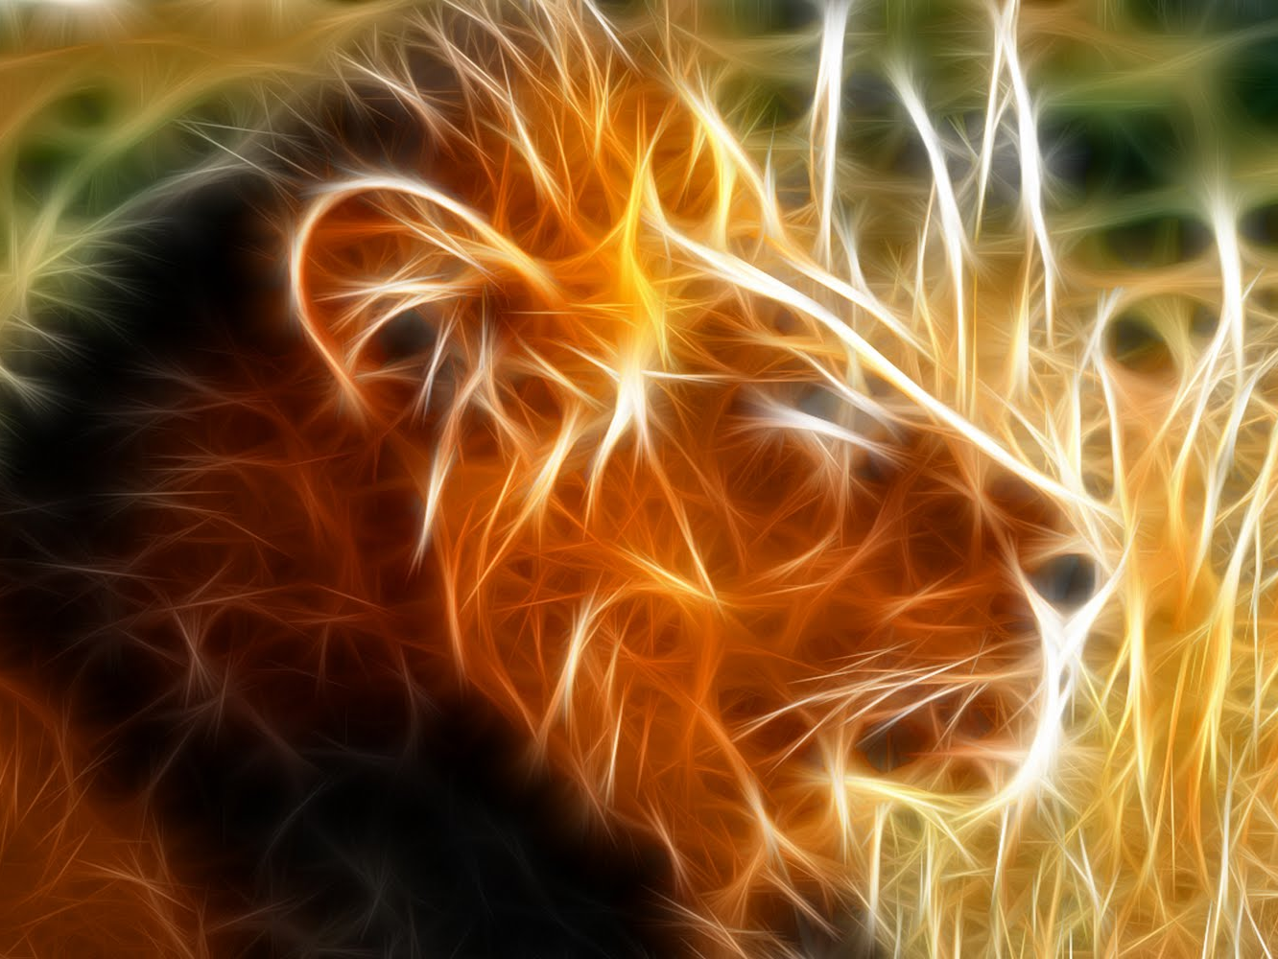
The next topic:
"How to Improve our Personality"
We all want to have an attractive personality, but we realize that we need to change many things in our character. How then can we achieve this? How can we have the certainty of God's acceptance, the certainty of His forgiveness and a new life of triumph?
The secret is in knowing the four miracles and the three joys in the life of a believer. Have you heard of them? This is a topic that summarizes God's plan for you. It contains the good news that will fill your soul!
GOD BLESS YOU!
Notes:
GOD BLESS YOU!
The next topic:
"How to Improve our Personality"
We all want to have an attractive personality, but we realize that we need to change many things in our character. How then can we achieve this? How can we have the certainty of God's acceptance, the certainty of His forgiveness and a new life of triumph?
The secret is in knowing the four miracles and the three joys in the life of a believer. Have you heard of them? This is a topic that summarizes God's plan for you. It contains the good news that will fill your soul!

Slide 74

biblewell.org
info@biblewell.org
Notes:
If you still have questions, write to us with confidence at: info@biblewell.org

