Slide 1
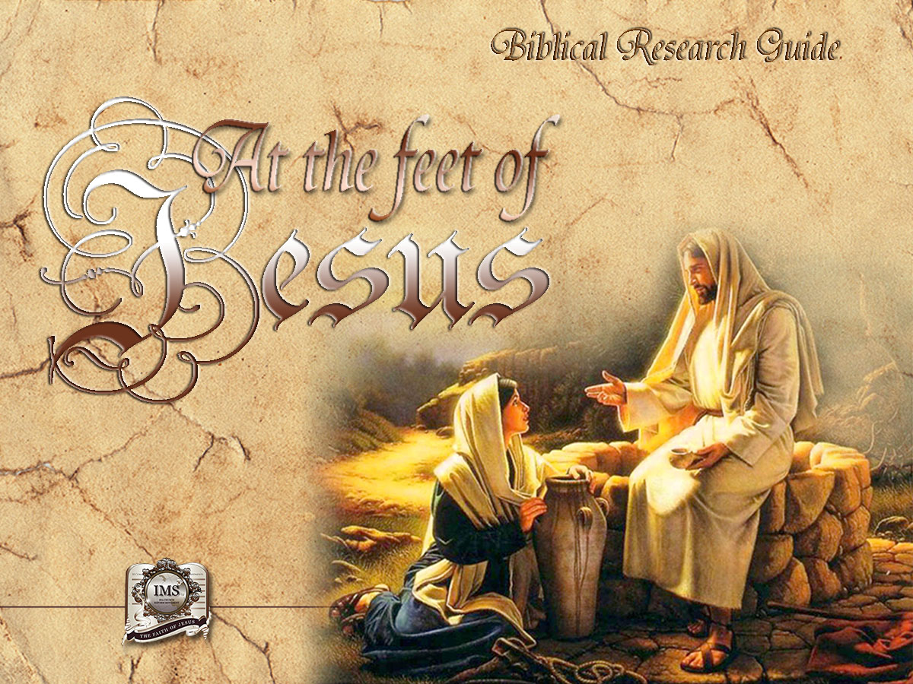

General Conference
Multimedia Department

Slide 2
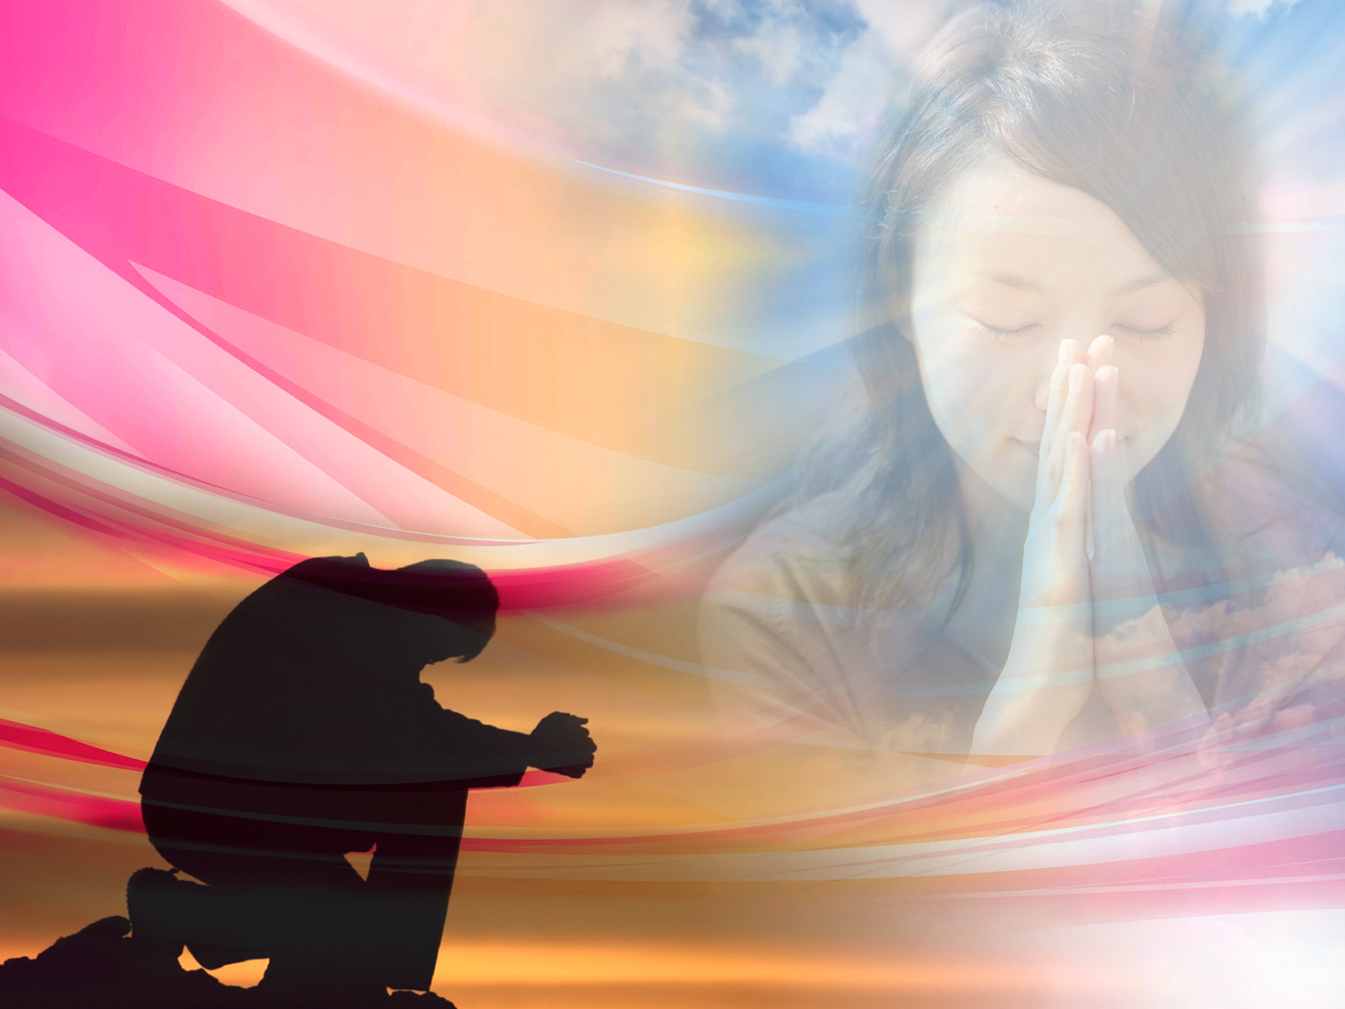

A moment of prayer…
Notes:
A MOMENT OF PRAYER…

Slide 3
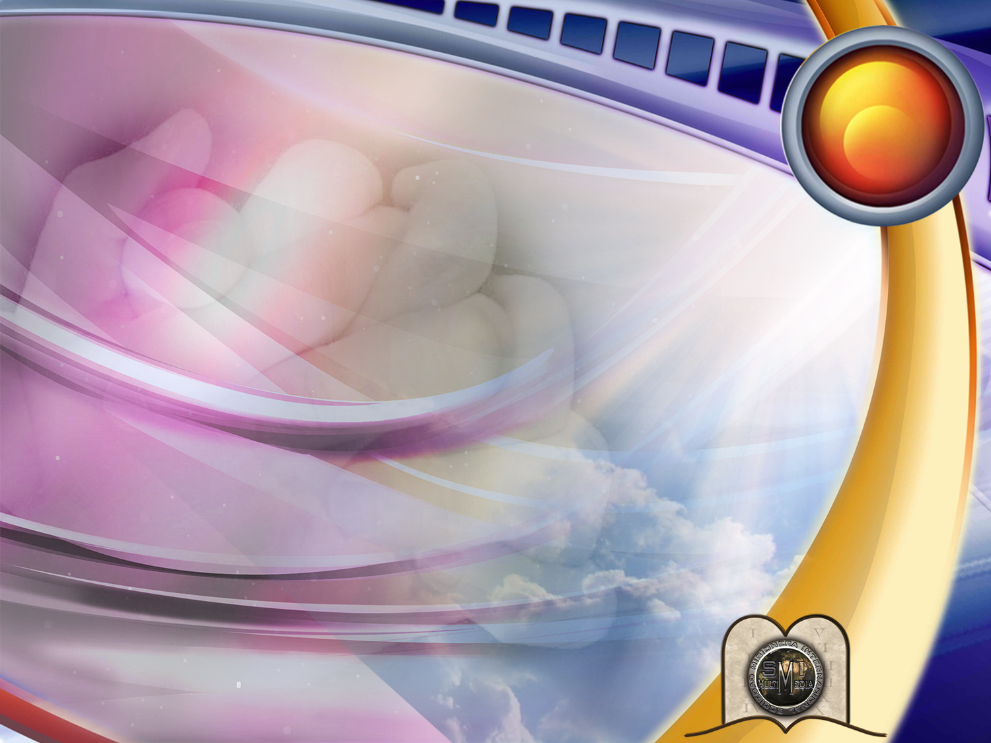
6
THE BEST SOLUTION TO ALL MY CONCERNS AND PROBLEMS
Notes:
THE BEST SOLUTION TO ALL MY CONCERNS AND PROBLEMS

Slide 4
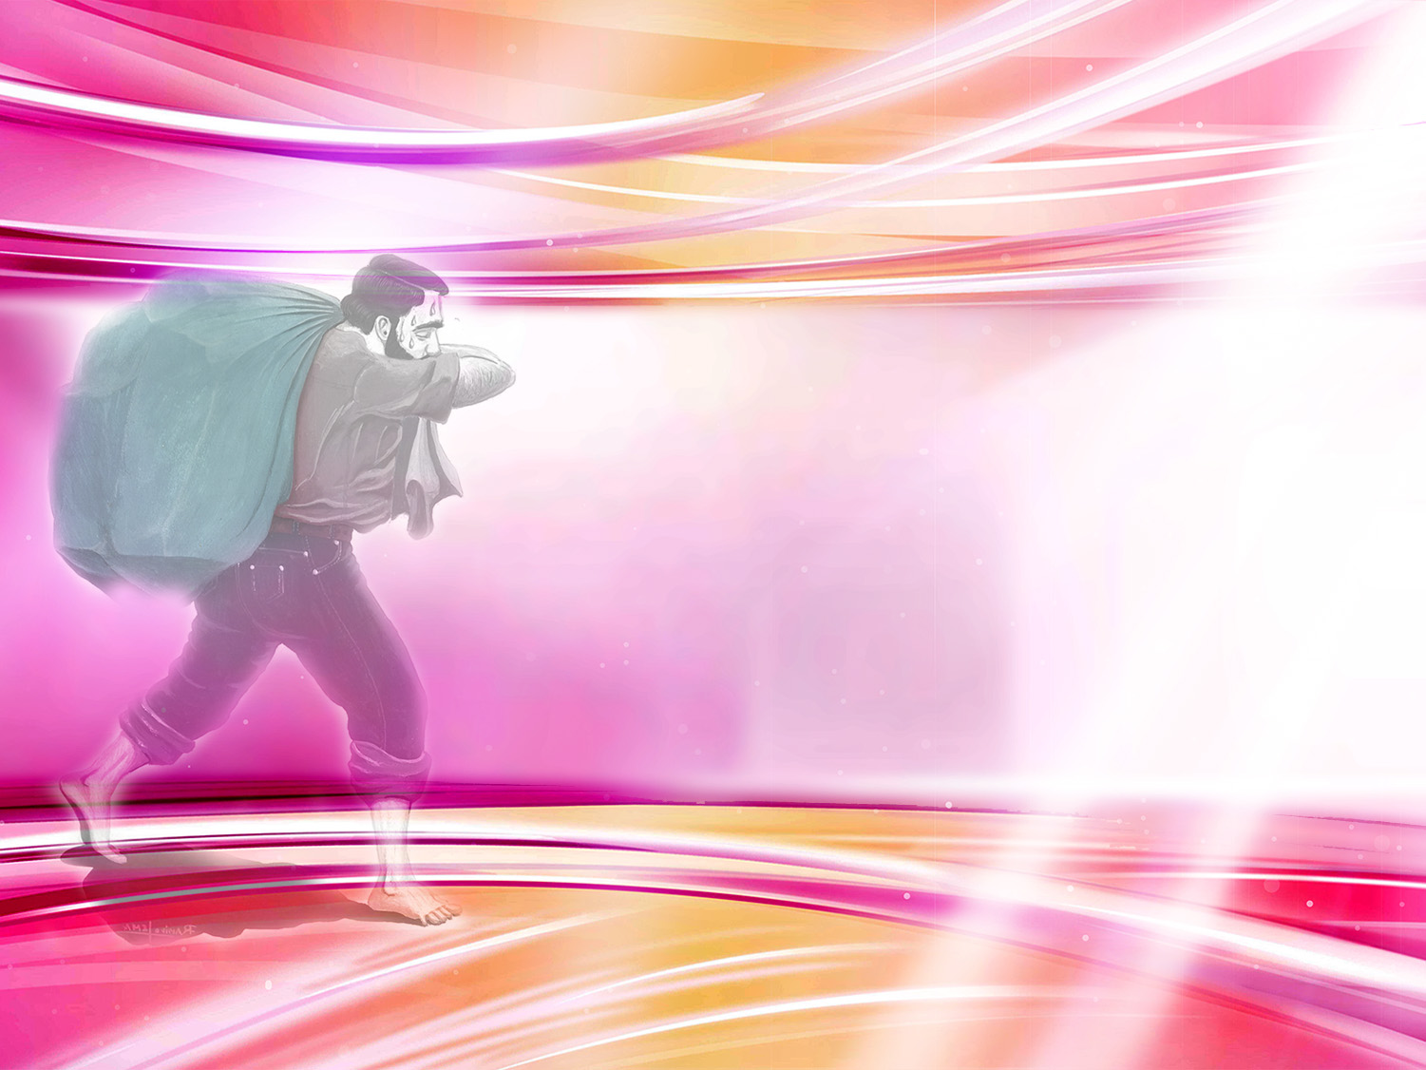
What can we do when we have problems associated with our health, work, family, or personal well-being? Maybe you feel remorse for the times you have failed or perhaps you feel frustrated, lonely, and discouraged not knowing whom you can open your heart to.
Problems
Concerns
Doubts
Guilt
Notes:
Every human being faces concerns and problems! These may involve our family, job, social status or our personal and spiritual life.
An ill child is on his death bed and his mother is in despair.
- Her children suffer from lack of food, clothing and a proper and stable shelter, meanwhile her husband is an alcoholic. They long and need a change in their lives!
What can we do when we have problems related to our health, work, family, or personal well-being? Maybe you feel remorse for the times you have failed or perhaps you feel frustrated, lonely, and discouraged not knowing whom you can open your heart to.

Slide 5

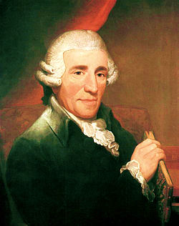
When I feel depressed, I pray; only God can give me strength and comfort.
Joseph Haydn
Notes:
It is said that the great composer HAYDN was talking about sadness and depression with two of his friends.
-" When I feel depressed, I start drinking and that gives me strength" one of them said
-"What I do"- the other one said- "is to start playing music, and soon I feel better."
-"When I feel depressed"- said HAYDN - "I pray; only God can give me strength and comfort"

Slide 6

Prayer is a wonderful solution. It can be compared to a telephone, with which we can contact God directly.
DIOS
Notes:
Prayer is the best remedy. It can be compared to a direct telephone call to God.

Slide 7

Psalms 34:6
“This poor man cried,
and the Lord heard him,
and saved him
out of all his troubles.”
Notes:
“This poor man cried, and the Lord heard him, and saved him out of all his troubles.”
Psalms 34:6

Slide 8
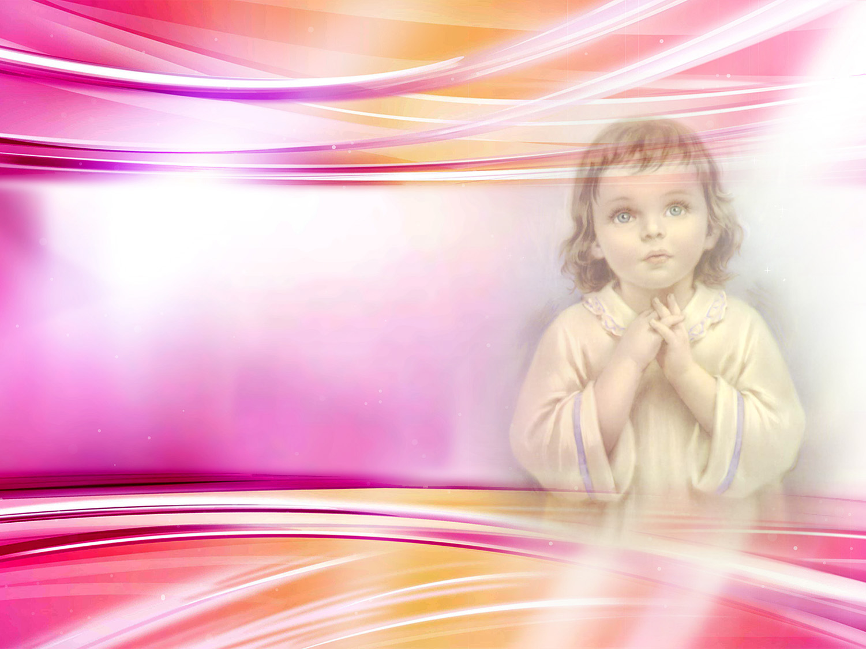
The simple faith of a child
Notes:
There was once a poor widow who had been reading the story of Elijah and how he had been fed by a crow. Both the widow and her child were sitting in a small room with no fire to keep them warm. Neither the mother nor the child had eaten that day, and they were hungry.
-"Mom", said the child, "if the crows come, they will find the door closed. May I open the door?"
-"Sure"- answered his mother.
-"Now that it is open, why don't we ask the Lord to send us at least a crow with a loaf of bread?"
-"Let's do that"- said the mother.
As they were praying, the mayor passed by, and when he heard the prayer, he stopped by the open door to listen. Moved by the words he heard, he rushed home and brought a basket full of food. God answered their prayer and rewarded the child's faith.

Slide 9
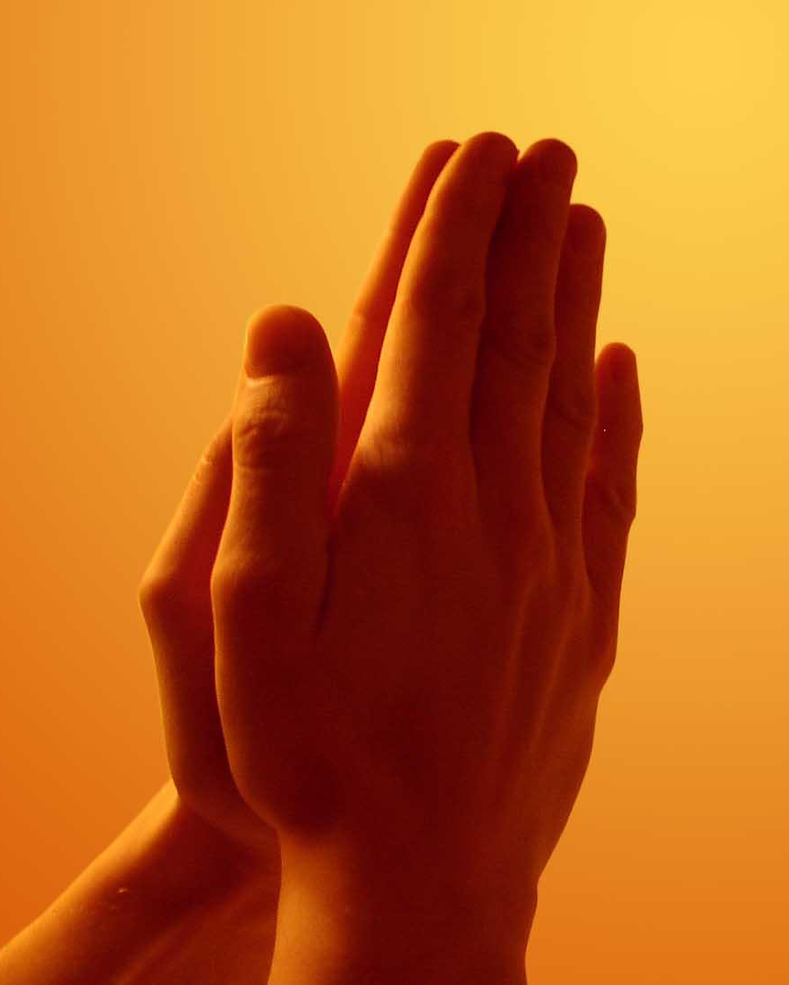
Definitions of prayer
“Prayer is a necessity for it is the life of the soul.”
“Es el acto de abrir nuestro corazón a Dios como a un amigo.”
"Es la llave en la mano de la fe para abrir el almacén del cielo, en donde están atesorados los recursos infinitos de la omnipotencia".
“Es una vitamina espiritual.”
Notes:
How can prayer be defined?
Definition of prayer
“Prayer is a necessity for it is the life of the soul.”

Slide 10
Definitions of prayer
“La oración es una necesidad porque es la vida del alma.”
“Prayer is the opening of the heart to God as to a friend”
"Es la llave en la mano de la fe para abrir el almacén del cielo, en donde están atesorados los recursos infinitos de la omnipotencia".
“Es una vitamina espiritual.”
Notes:
“Prayer is the opening of the heart to God as to a friend”

Slide 11
Definitions of prayer
“La oración es una necesidad porque es la vida del alma.”
“Es el acto de abrir nuestro corazón a Dios como a un amigo.”
"Prayer is the key in the hand of faith to unlock heavens storehouse where are treasured the boundless resources of omnipotence."
“Es una vitamina espiritual.”
Notes:
"Prayer is the key in the hand of faith to unlock heavens storehouse where are treasured the boundless resources of omnipotence." Ellen White, Steps to Christ, p. 94.

Slide 12
Definitions of prayer
“La oración es una necesidad porque es la vida del alma.”
“Es el acto de abrir nuestro corazón a Dios como a un amigo.”
"Es la llave en la mano de la fe para abrir el almacén del cielo, en donde están atesorados los recursos infinitos de la omnipotencia".
“It is a spiritual vitamin.”
Notes:
It is a spiritual vitamin.
When we have vitamin A deficiency, we have problems with our eyesight; if we lack vitamin B, we have problems with our nerves. Vitamin C deficiency leads to viral infections.
The same thing occurs with our spiritual health. When we lack the "vitamin" of prayer our spiritual eyesight suffers, our faith weakens, and we can easily fall into temptation.

Slide 13
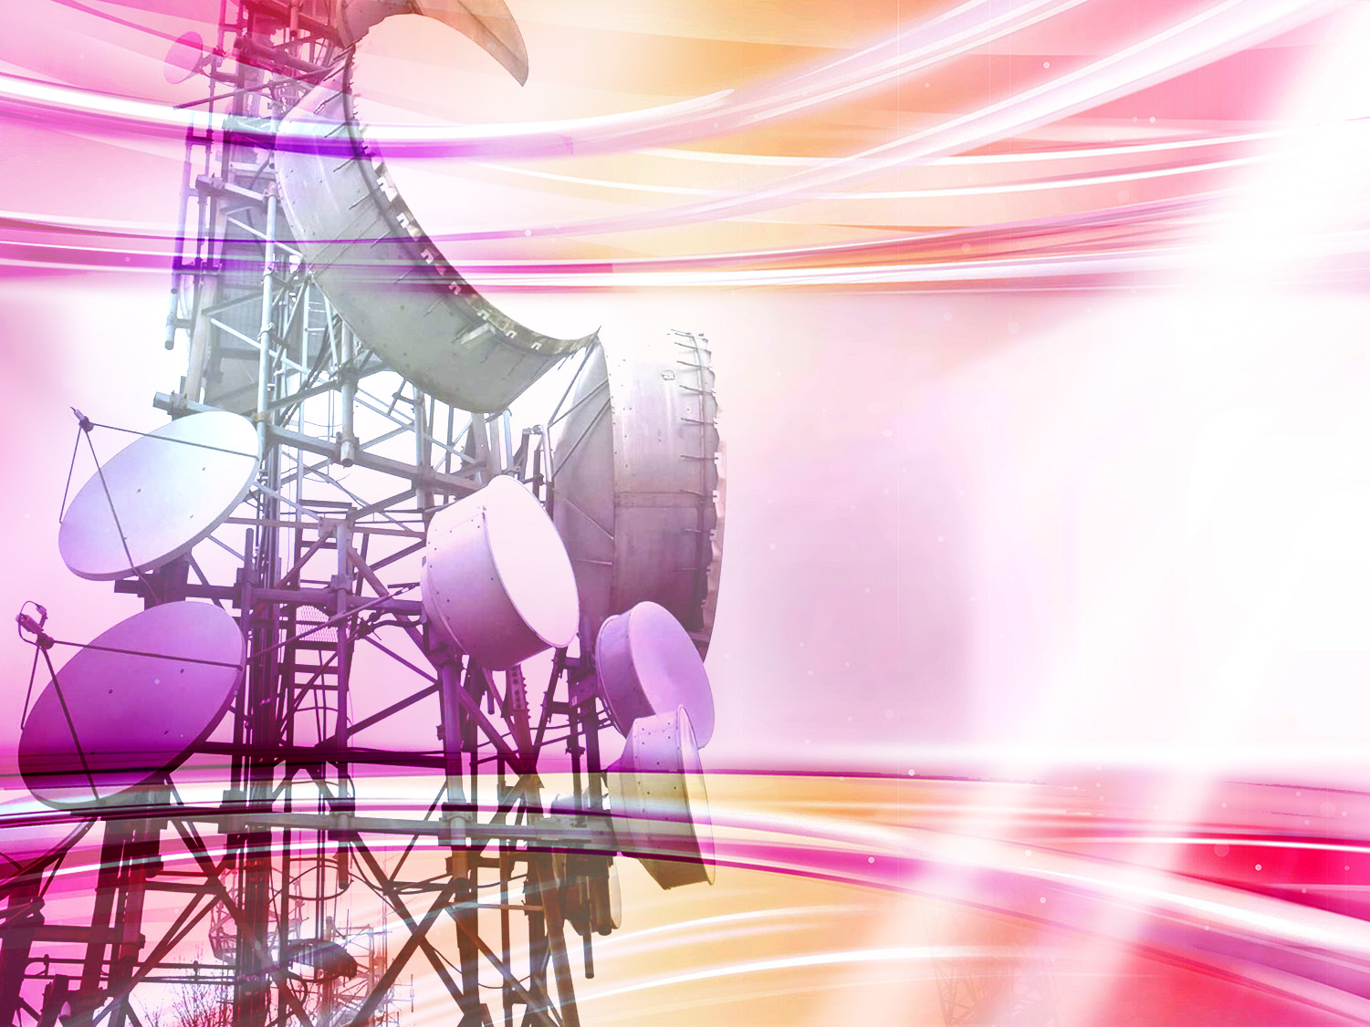
What means of communication did God provide after the fall into sin?
Notes:
2. What means of communication did God provide after the fall into sin?

Slide 14

Our friend Jesus wants to help us. He talks through His word. We should study it daily.
(John 15:15; Acts 17:11)
Notes:
Our friend Jesus wants to help us. He speaks to us though His Word. We should study it daily. (John 15:15) (Acts 17:11).

Slide 15
We speak with Him
through prayer.
Daniel 9:20
“And whiles I was speaking, and praying, and confessing my sin and the sin of my people Israel, and presenting my supplication before the Lord my God for the holy mountain of my God.”
Notes:
We speak with Him through prayer. (Daniel 9:20).
“And whiles I was speaking, and praying, and confessing my sin and the sin of my people Israel, and presenting my supplication before the Lord my God for the holy mountain of my God”
Daniel 9:20
A criminal, when taken to the gallows, cried: "Oh, if I had prayed to God that morning! ... I would not have committed a crime and if I had thought of you, Lord, you would have kept me from committing it."

Slide 16
WHEN, WHERE AND HOW SHOULD WE PRAY?
Notes:
WHEN, WHERE AND HOW SHOULD WE PRAY?

Slide 17
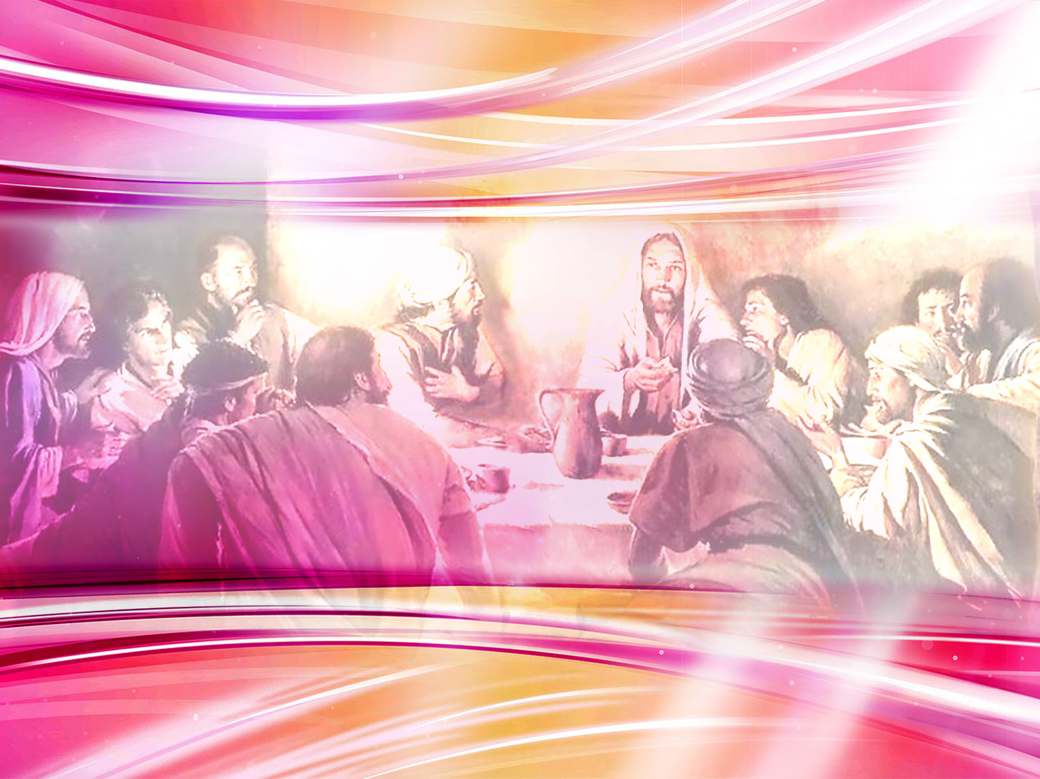
What did the disciples
Ask Jesus to do?
Notes:
3. What did the disciples ask Jesus to do?

Slide 18
Luke 11:1
“And it came to pass, that, as he was praying in a certain place, when he ceased, one of his disciples said unto him, Lord, teach us to pray, as John also taught his disciples.”
Notes:
“And it came to pass, that, as he was praying in a certain place, when he ceased, one of his disciples said unto him, Lord, teach us to pray, as John also taught his disciples.”
Luke 11:1

Slide 19
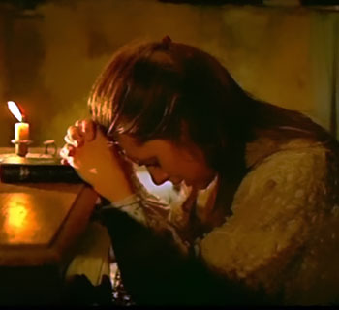
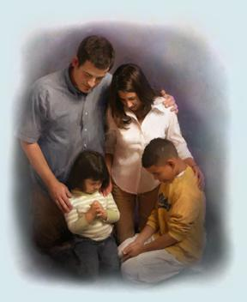
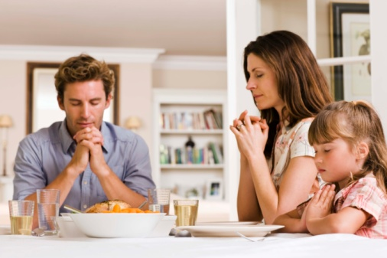
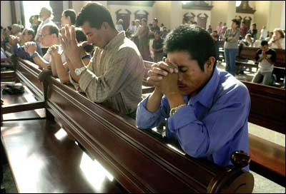
What are the different types of prayer?
EN EL HOGAR
Por la mañana y por la anoche, debería juntarse la familia, leer la Palabra de Dios y orar.
ANTES DE COMER
Agradecer y pedir la bendición para los alimentos.
PUBLIC
One person prays and the congregation listens with reverence.
(Should not be long)
EN LA INTIMIDAD
“Mas tú, cuando ores, entra en tu aposento, y cerrada la puerta, ora a tu Padre que está en secreto; y tu Padre que ve en lo secreto te recompensará en público.” Mateo 6:6.
Notes:
4. What are the different types of prayer?
Public.
One person prays and the congregation listens reverently.
(Should not be long)

Slide 20
What are the different types of prayer?
ANTES DE COMER
Agradecer y pedir la bendición para los alimentos.
Family
Every morning and every evening the family should read the Word of God and pray.
EN PÚBLICO
Uno ora y la congregación escucha con reverencia.
(Deben ser cortas).
EN LA INTIMIDAD
“Mas tú, cuando ores, entra en tu aposento, y cerrada la puerta, ora a tu Padre que está en secreto; y tu Padre que ve en lo secreto te recompensará en público.” Mateo 6:6.
Notes:
Family
Every morning and every evening the family should read the Word of God and pray.

Slide 21
What are the different types of prayer?
EN EL HOGAR
Por la mañana y por la anoche, debería juntarse la familia, leer la Palabra de Dios y orar.
BEFORE MEALS
We should thank the Lord for the food He provides us and ask Him to bless it.
EN PÚBLICO
Uno ora y la congregación escucha con reverencia.
(Deben ser cortas).
EN LA INTIMIDAD
“Mas tú, cuando ores, entra en tu aposento, y cerrada la puerta, ora a tu Padre que está en secreto; y tu Padre que ve en lo secreto te recompensará en público.” Mateo 6:6.
Notes:
BEFORE MEALS
We should thank the Lord for the food He provides us and ask Him to bless it.

Slide 22
What are the different types of prayer?
EN EL HOGAR
Por la mañana y por la anoche, debería juntarse la familia, leer la Palabra de Dios y orar.
ANTES DE COMER
Agradecer y pedir la bendición para los alimentos.
EN PÚBLICO
Uno ora y la congregación escucha con reverencia.
(Deben ser cortas).
IN PRIVATE
“But thou, when thou prayest, enter into thy closet, and when thou hast shut thy door, pray to thy Father which is in secret; and thy Father which seeth in secret shall reward thee openly.”
Matthew 6:6.
Notes:
IN PRIVATE
Matthew 6:6.
“But thou, when thou prayest, enter into thy closet, and when thou hast shut thy door, pray to thy Father which is in secret; and thy Father which seeth in secret shall reward thee openly.”
"It is secret communion with God that sustains the life of the soul."- Education, p 258.

Slide 23
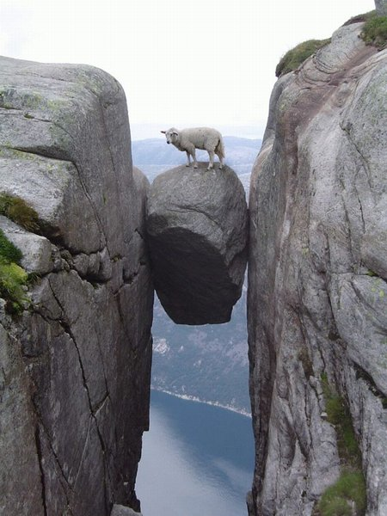
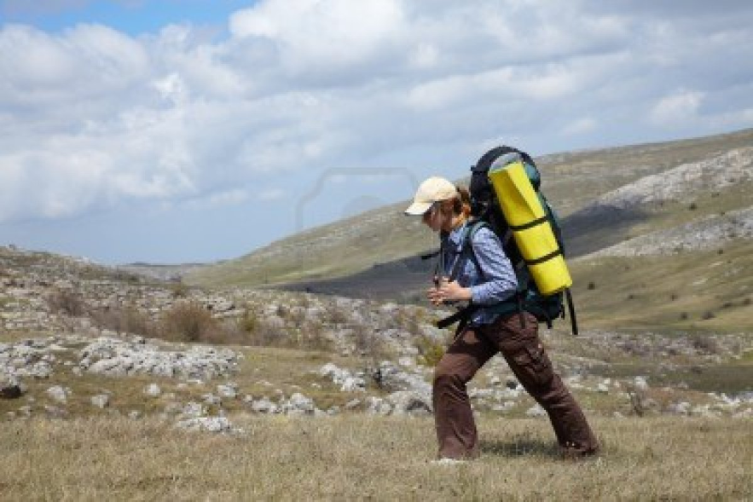
When can we pray?
When we are travelling or working (in your mind), (1 Corinthians 14:15).
In moments of danger and need. (Jonah 2:1).
En momentos de peligro y necesidad. Jonás 2:1
En el camino mientras viajamos o trabajamos (mentalmente). 1ª Corintios 14:15
Notes:
When can we pray?
a) We can pray when we are travelling or working (in your mind), We can pray in silence. (1 Corinthians 14:15)
b) In moments of danger and need. (Jonah 2:1)

Slide 24
When can we pray?
Ideally, we should pray three times a day, (Daniel 6:10). Nevertheless, we should constantly have a spirit of prayer.
“Pray without ceasing.”
1 Thessalonians 5:17
En momentos de peligro y necesidad. Jonás 2:1
En el camino mientras viajamos o trabajamos (mentalmente). 1ª Corintios 14:15
Notes:
c) Ideally, we should pray three times a day, (Daniel 6:10). Nevertheless, we should constantly have a spirit of prayer. (1 Thessalonians 5:17)

Slide 25
WHAT SHOULD WE AVOID WHEN WE PRAY?
Notes:
6. What should we avoid when we pray?

Slide 26
Matthew 6:7,8
“But when ye pray, use not vain repetitions, as the heathen do: for they think that they shall be heard for their much speaking. Be not ye therefore like unto them: for your Father knoweth what things ye have need of, before ye ask him.”
Notes:
“But when ye pray, use not vain repetitions, as the heathen do: for they think that they shall be heard for their much speaking. Be not ye therefore like unto them: for your Father knoweth what things ye have need of, before ye ask him.”
Matthew 6:7,8
Vain repetitions and much speaking.
Pray in a concise, simple manner.
The Lord's prayer is a wonderful example of what a prayer should be like.

Slide 27
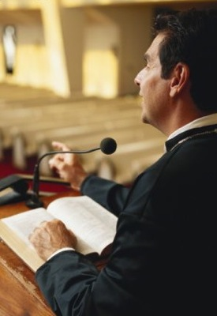
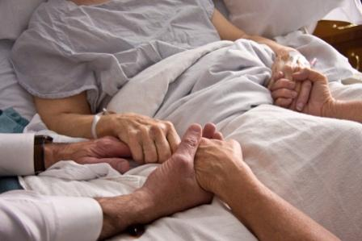
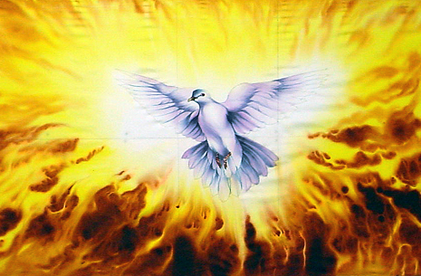
Whom should we pray for?
Por los mensajeros del Evangelio y la obra de predicación. Hechos 12:5 Habacuc 3:2
Por el derramamiento del Espíritu Santo. Lucas 11:13
For the sick; for individuals.
James 5:13-16
Notes:
7. Whom should we pray for?
For the sick; for individuals. James 5: 13-16

Slide 28
Whom should we pray for?
For the messengers of God and the progress of the Gospel. Acts 12:5
Habakkuk 3:2
Por el derramamiento del Espíritu Santo. Lucas 11:13
Por los enfermos y unos por otros. Santiago 5:13-16
Notes:
For the messengers of God and the progress of the Gospel.
Acts 12:5
Habakkuk 3:2

Slide 29
Whom should we pray for?
Por los mensajeros del Evangelio y la obra de predicación. Hechos 12:5 Habacuc 3:2
For the outpouring of the Holy Spirit
Luke 11:13
Por los enfermos y unos por otros. Santiago 5:13-16
Notes:
For the outpouring of the Holy Spirit Luke 11:13

Slide 30
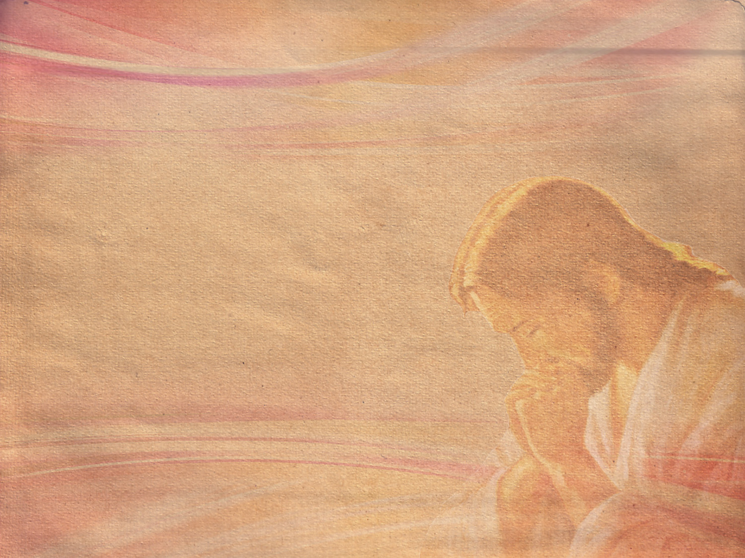
Model Prayer:
Address the Father: Our Father
Thank Him: Thank you for...
Ask: for our needs, for others, for the forgiveness of sin
In the name of Jesus
Amen
Notes:
Model Prayer:
1. Address the Father: Our Father
2. Thank Him: Thank you for...
3. Ask: for our needs, for others, for the forgiveness of sin
4. In the name of Jesus
5. Amen
The Lord's prayer is a wonderful model of prayer.
We should speak as if we were talking directly to God.

Slide 31
A prayer has several parts:
Vocative: "our Father in Heaven"
Body:
Praise: "Hallowed be Thy name..."
Thanksgiving: "I thank you for..."
Confession: "forgive me for...."
Request: "I ask you to..."
Mediation: "Please help to...“
Ending: "In the name of Jesus..."
Closure: "Amen", which means "so be it"
Notes:
A prayer has several parts:
a) Vocative: "our Father in Heaven"
b) Body:
- Praise: "Hallowed be Thy name..."
- Thanksgiving: "I thank you for..."
-Confession: "forgive me for...."
- Request: "I ask you to..."
- Mediation: "Please help to..."
c) Ending: "In the name of Jesus..."
d) Closure: "Amen", which means "so be it"

Slide 32
FOR GOD TO LISTEN, WHAT SHOULD OUR ATTITUDE BE?
Notes:
FOR GOD TO LISTEN, WHAT SHOULD OUR ATTITUDE BE?

Slide 33

What are
we to manifest?
Sincerity
Notes:
8. What are we to manifest?
Sincerity, no trace of hypocrisy.

Slide 34
Matthew 6:5
“And when thou prayest, thou shalt not be as the hypocrites are: for they love to pray standing in the synagogues and in the corners of the streets, that they may be seen of men. Verily I say unto you, They have their reward.”
Notes:
“And when thou prayest, thou shalt not be as the hypocrites are: for they love to pray standing in the synagogues and in the corners of the streets, that they may be seen of men. Verily I say unto you, They have their reward.”
Matthew 6:5

Slide 35

How should we ask?
With faith
Notes:
9. How should we ask?
With faith

Slide 36
James 1:6,7
“But let him ask in faith, nothing wavering. For he that wavereth is like a wave of the sea driven with the wind and tossed. For let not that man think that he shall receive any thing of the Lord.”
Notes:
“But let him ask in faith, nothing wavering. For he that wavereth is like a wave of the sea driven with the wind and tossed. For let not that man think that he shall receive any thing of the Lord.”
James 1:6,7

Slide 37
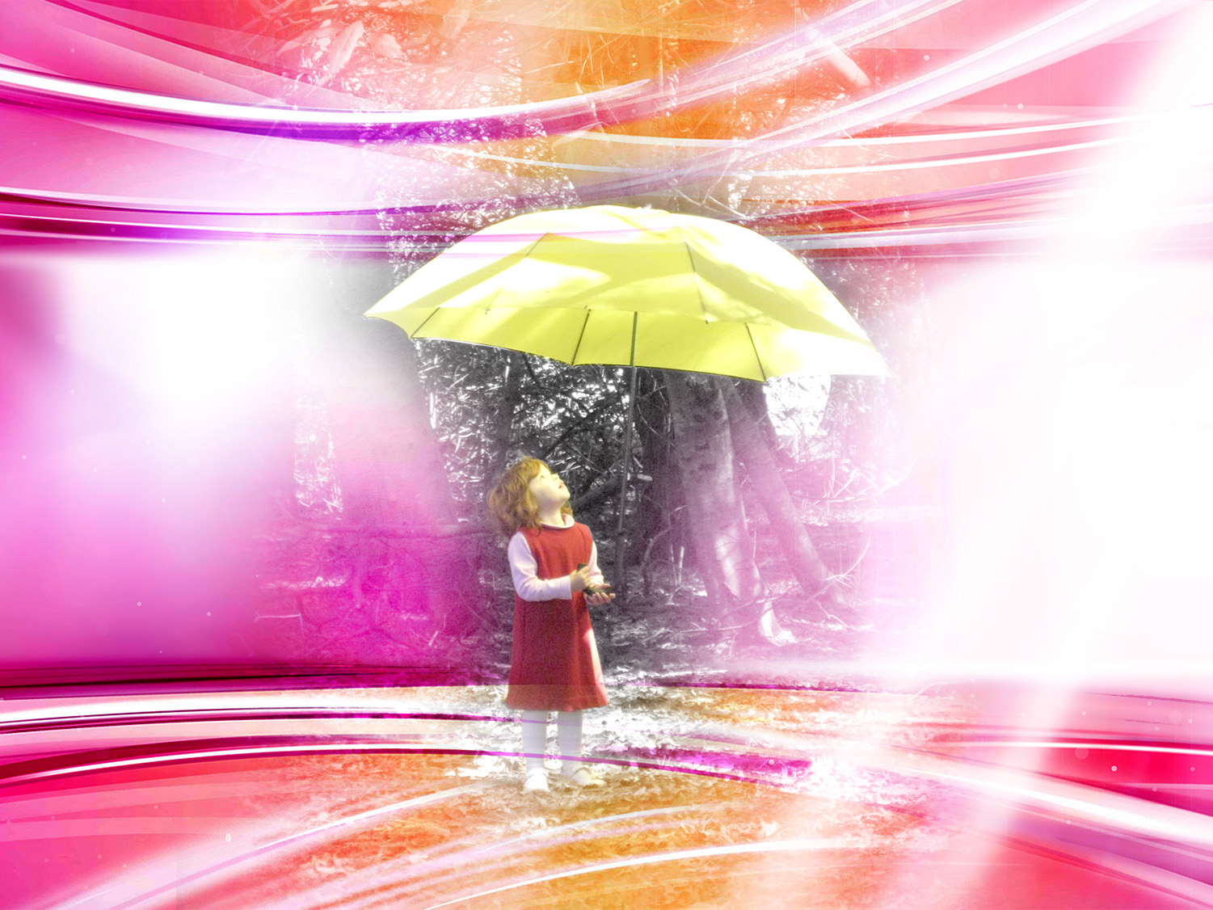
Ask in faith
Notes:
Ask in faith
There was once a terrible drought; the soil was cracked and unable to produce anything. Everyone was very worried, so the believers decided to meet in the fields to ask God for rain. In one of the houses, a family was getting ready to go to the meeting when they saw their little daughter carrying an umbrella.
Her father asked her: "why are you carrying an umbrella? Don't you see how sunny it is?"
"Aren't we going to ask God for rain?"- asked the girl. She had true faith.
Faith is compared to a seed that has been sown, watered and taken care of. It should be fed by the daily study of God's Word. Romans 10: 17.

Slide 38
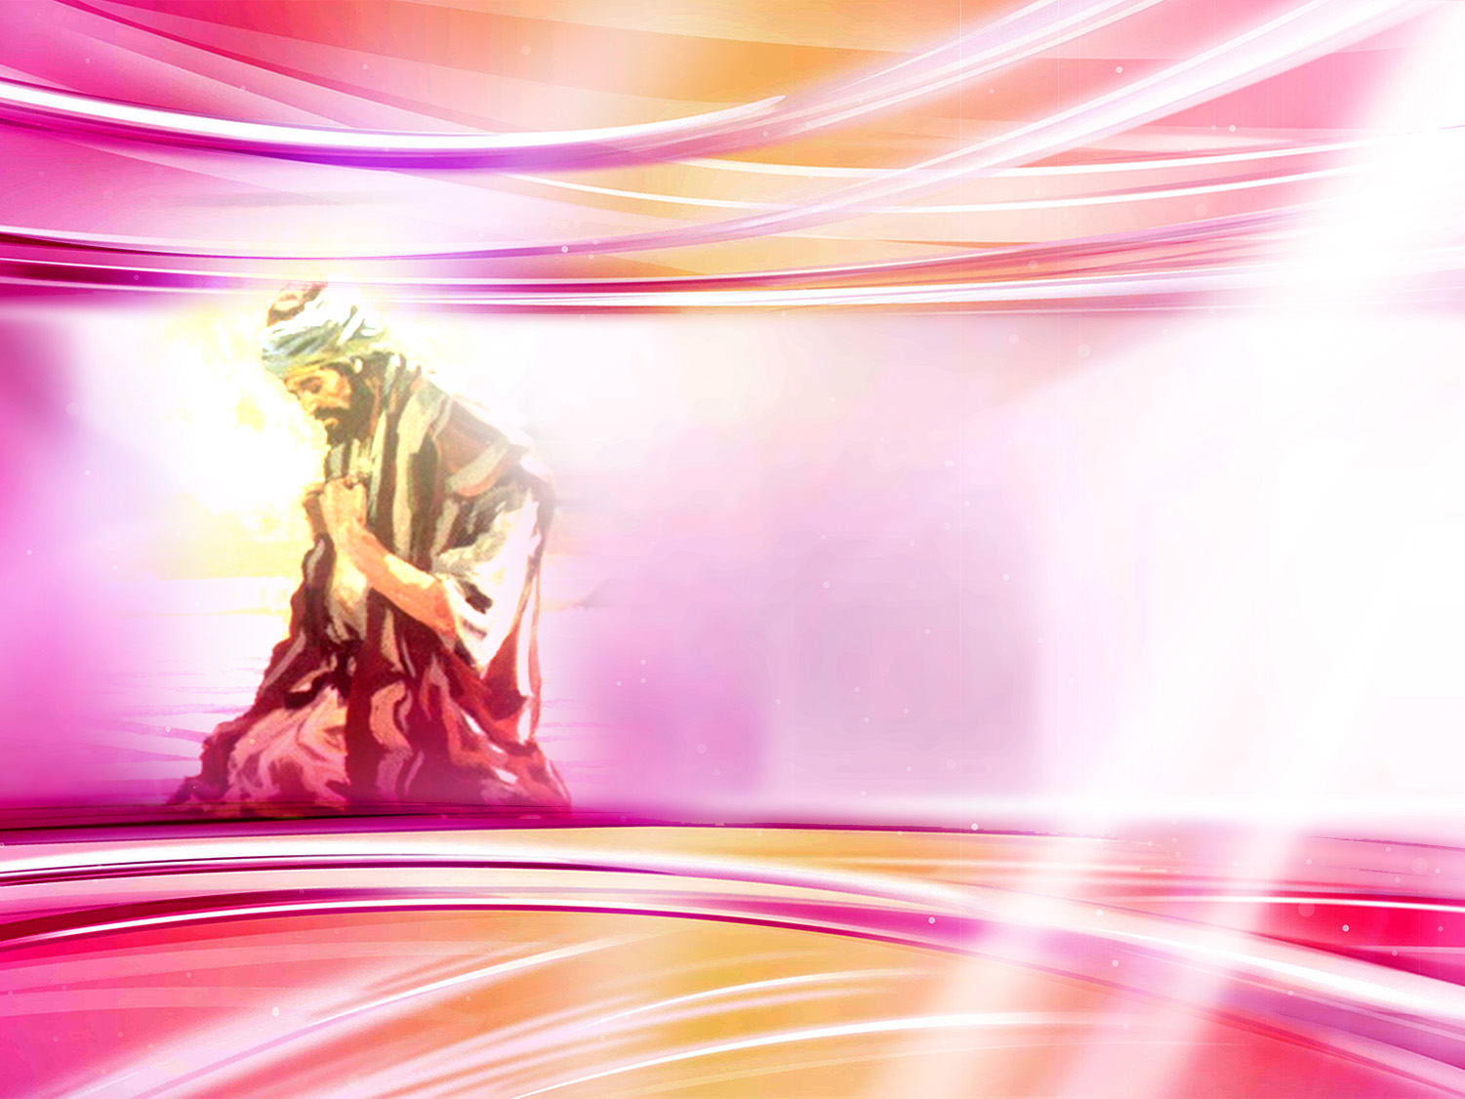
We have to be humble.
What parable shows us this?
humility
Notes:
10. We have to be humble.
What parable shows us this?

Slide 39
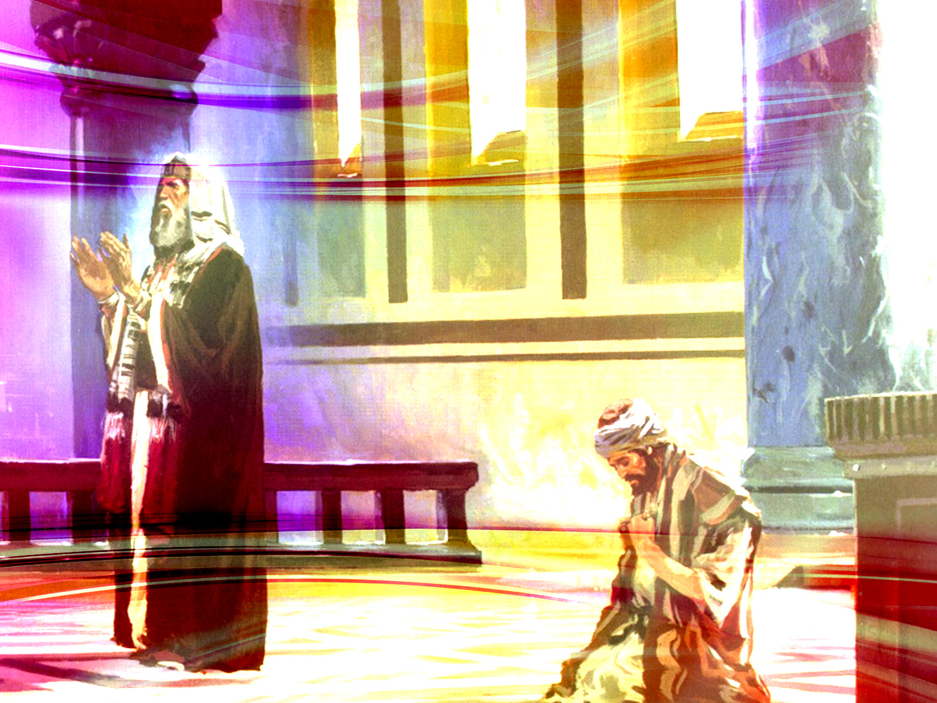
The Pharisee and the publican.
Luke 18:9-14
Notes:
Luke 18:9-14
⁹ And he spake this parable unto certain which trusted in themselves that they were righteous, and despised others:
¹⁰ Two men went up into the temple to pray; the one a Pharisee, and the other a publican.
¹¹ The Pharisee stood and prayed thus with himself, God, I thank thee, that I am not as other men are, extortioners, unjust, adulterers, or even as this publican.
¹² I fast twice in the week, I give tithes of all that I possess.
¹³ And the publican, standing afar off, would not lift up so much as his eyes unto heaven, but smote upon his breast, saying, God be merciful to me a sinner.
¹⁴ I tell you, this man went down to his house justified rather than the other: for every one that exalteth himself shall be abased; and he that humbleth himself shall be exalted.

Slide 40
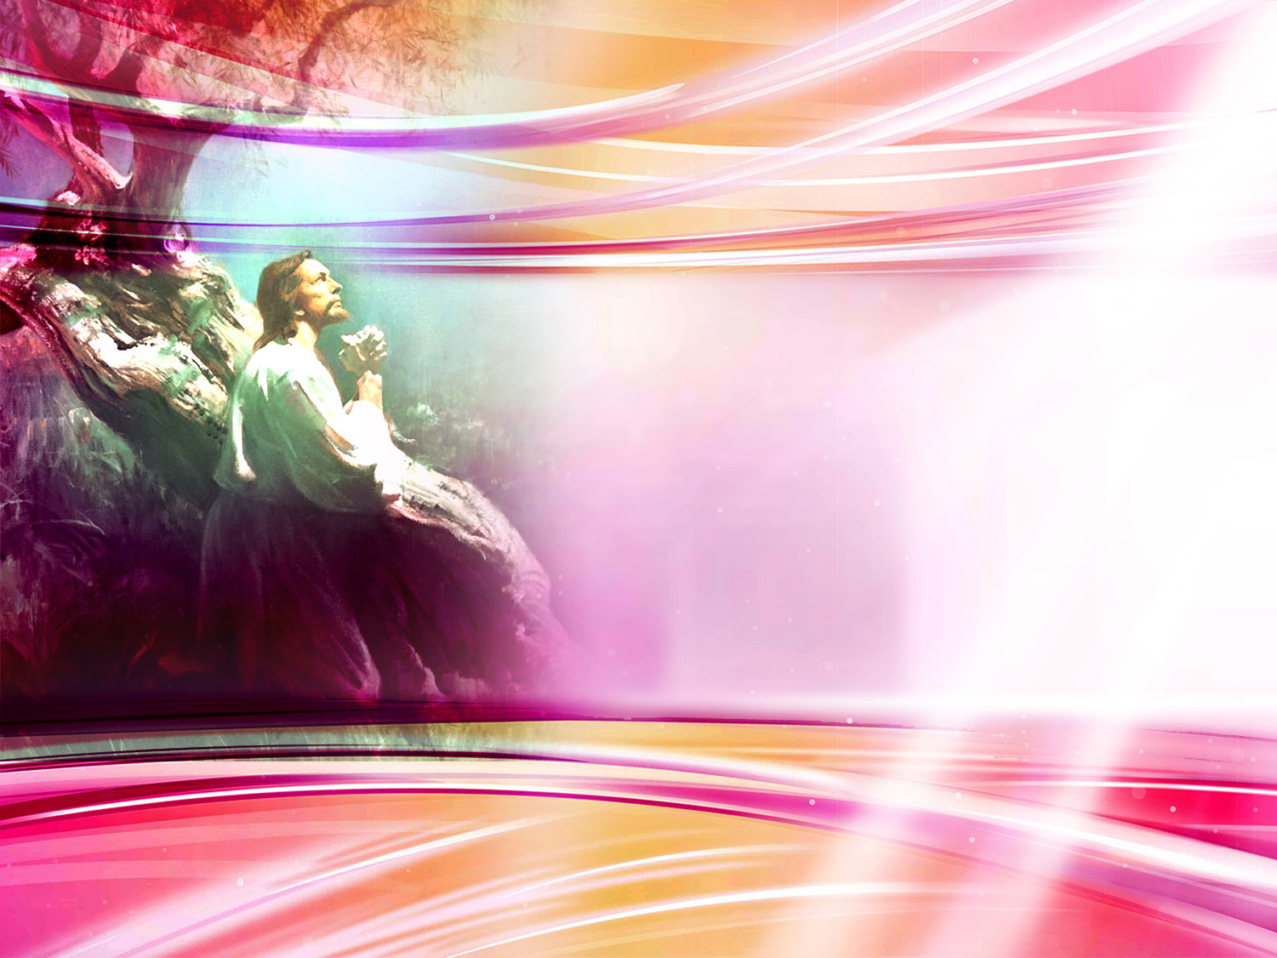
What is the best position for praying with reverence?
REVERENCe
Notes:
11. What is the best position for praying with reverence?

Slide 41
Romans 14:11
“For it is written, As I live, saith the Lord, every knee shall bow to me, and every tongue shall confess to God..”
Notes:
“For it is written, As I live, saith the Lord, every knee shall bow to me, and every tongue shall confess to God.”
Romans 14:11
Kneeling down.
You can also pray standing, but always bowing your head, closing your eyes and clasping your hands.

Slide 42
What must we always have?
A forgiving spirit
Notes:
12. What must we always have?

Slide 43
Matthew 6:15
“But if ye forgive not men their trespasses, neither will your Father forgive your trespasses.”
Notes:
“But if ye forgive not men their trespasses, neither will your Father forgive your trespasses.”
Matthew 6:15
A forgiving spirit.
This is shown in the parable of the two debtors (Matthew 18:23-35)

Slide 44
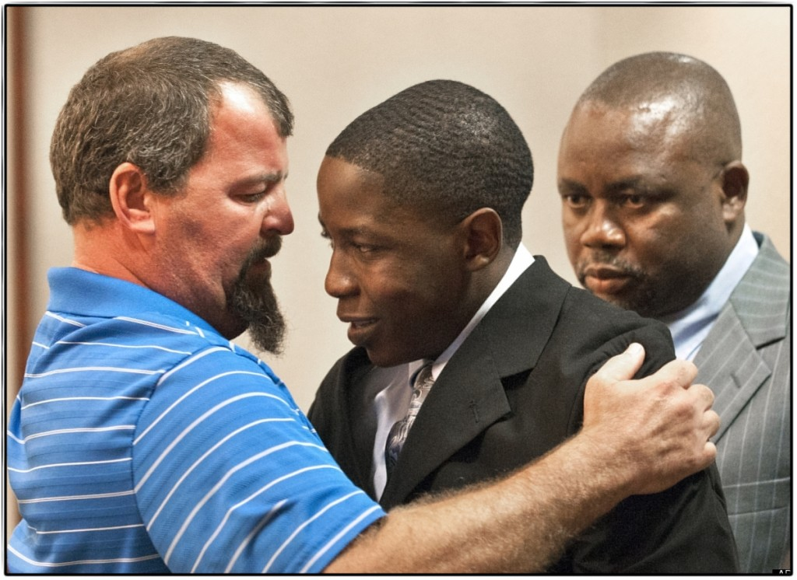
Mr. See and Takunda Mavima
Notes:
On May 20, 2012, 18-year-old Takunda Mavima was driving while drunk after leaving a party. He lost control of his car causing him to crash on an exit ramp near Grand Rapids, Michigan. He was accompanied by Tim See, 17, and Howell Crista, 15 years old. Both died in the accident.
Mavima survived the accident and pleaded guilty to all the charges. He received a sentence between 30 months and 15 years in prison.
Despite his pain and unimaginable rage, the father of Tim See, one of the victims, gave a touching speech in court interceding for Mavima. He pleaded before the judge for a light sentence.
"I'm begging you to allow Takunda Mavima to make something of himself in the real world - do not send him to jail to become harden and bitter. That kid has learned his lesson a thousand times and will never make the same mistake again", he said.
When the hearing ended, the victim's family made their way through the room to hug, comfort, and publicly forgive Mavima.
Picture taken by: Chris Clark, Grand Rapids Press

Slide 45
What must we remember to say when we ask God for something?
Matthew 26: 39
As thou wilt
Notes:
13. What must we remember to say when we ask God for something?
Matthew 26: 39

Slide 46
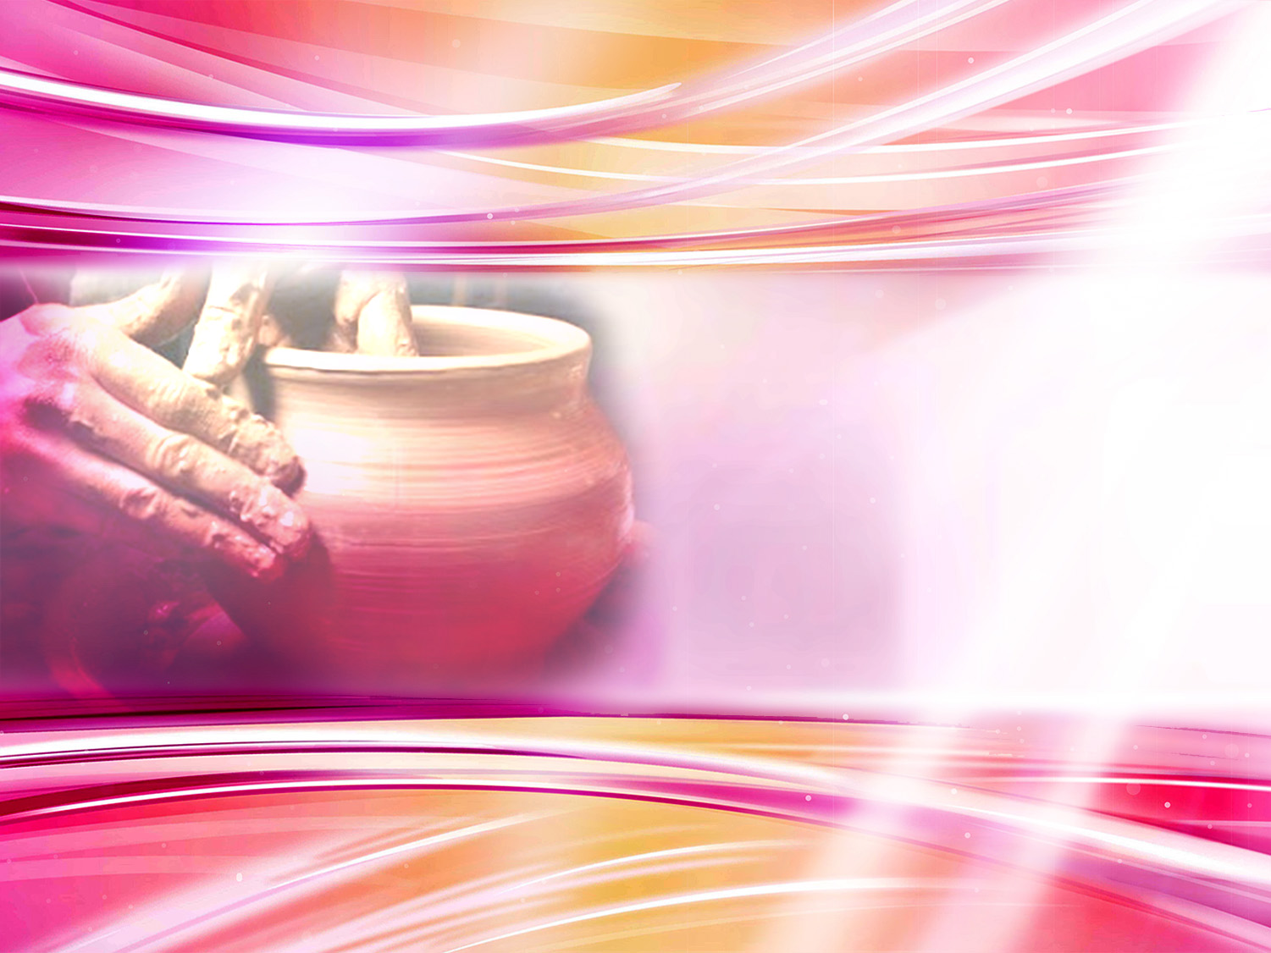
God knows our needs. (Romans 8:26)
We should let the Lord mold us, as a potter molds clay with his hands.
(Jeremiah 18:6)
As thou wilt
Notes:
God knows our needs (Romans 8:26).
We should let the Lord mold us, as a potter molds clay with his hands. (Jeremiah 18:6)

Slide 47

God can answer:
NO. WAIT. YES.
He knows what is best for us.
As thou wilt
Notes:
God can answer:
YES.
NO.
WAIT.
God can give an answer. If He does not, WAIT.
He knows what is best for us.
Once, a desperate mother pleaded to God concerning the health of her dying son. She repeated over and over again: "Lord, you have to restore his health," forcing God to do so. The child recovered but as he grew up, he turned into a real torment for his mother, who had the bitter experience of seeing him hang on the scaffold as a criminal at the age of twenty two. She then realized that she should have said: "AS THOU WILT"

Slide 48
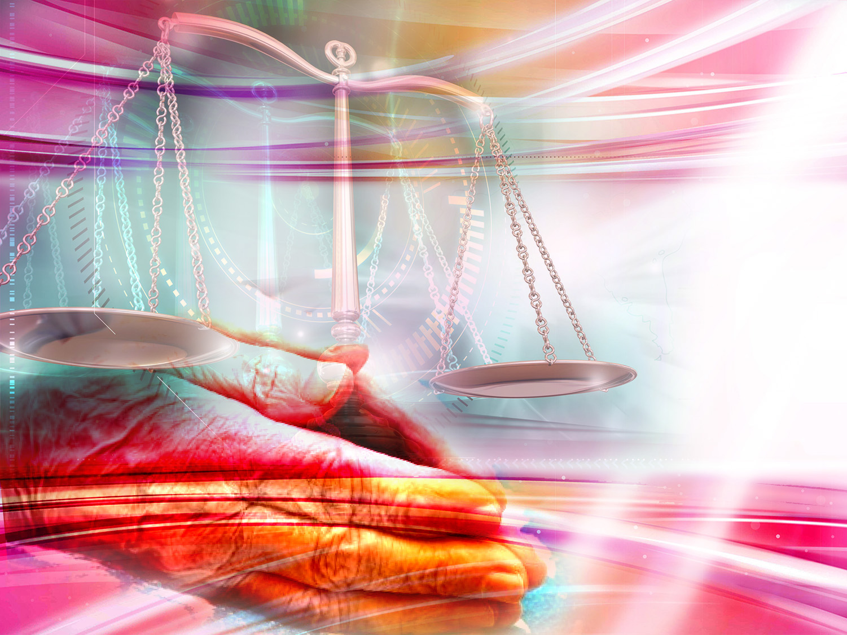
The Parable of the Persistent Widow
Luke 18:1-7
persevering
Notes:
Let's be persevering.
The Parable of the Persistent Widow.
Luke 18:1-7
And he spake a parable unto them to this end, that men ought always to pray, and not to faint;
² Saying, There was in a city a judge, which feared not God, neither regarded man:
³ And there was a widow in that city; and she came unto him, saying, Avenge me of mine adversary.
⁴ And he would not for a while: but afterward he said within himself, Though I fear not God, nor regard man;
⁵ Yet because this widow troubleth me, I will avenge her, lest by her continual coming she weary me.
⁶ And the Lord said, Hear what the unjust judge saith.
⁷ And shall not God avenge his own elect, which cry day and night unto him, though he bear long with them?

Slide 49
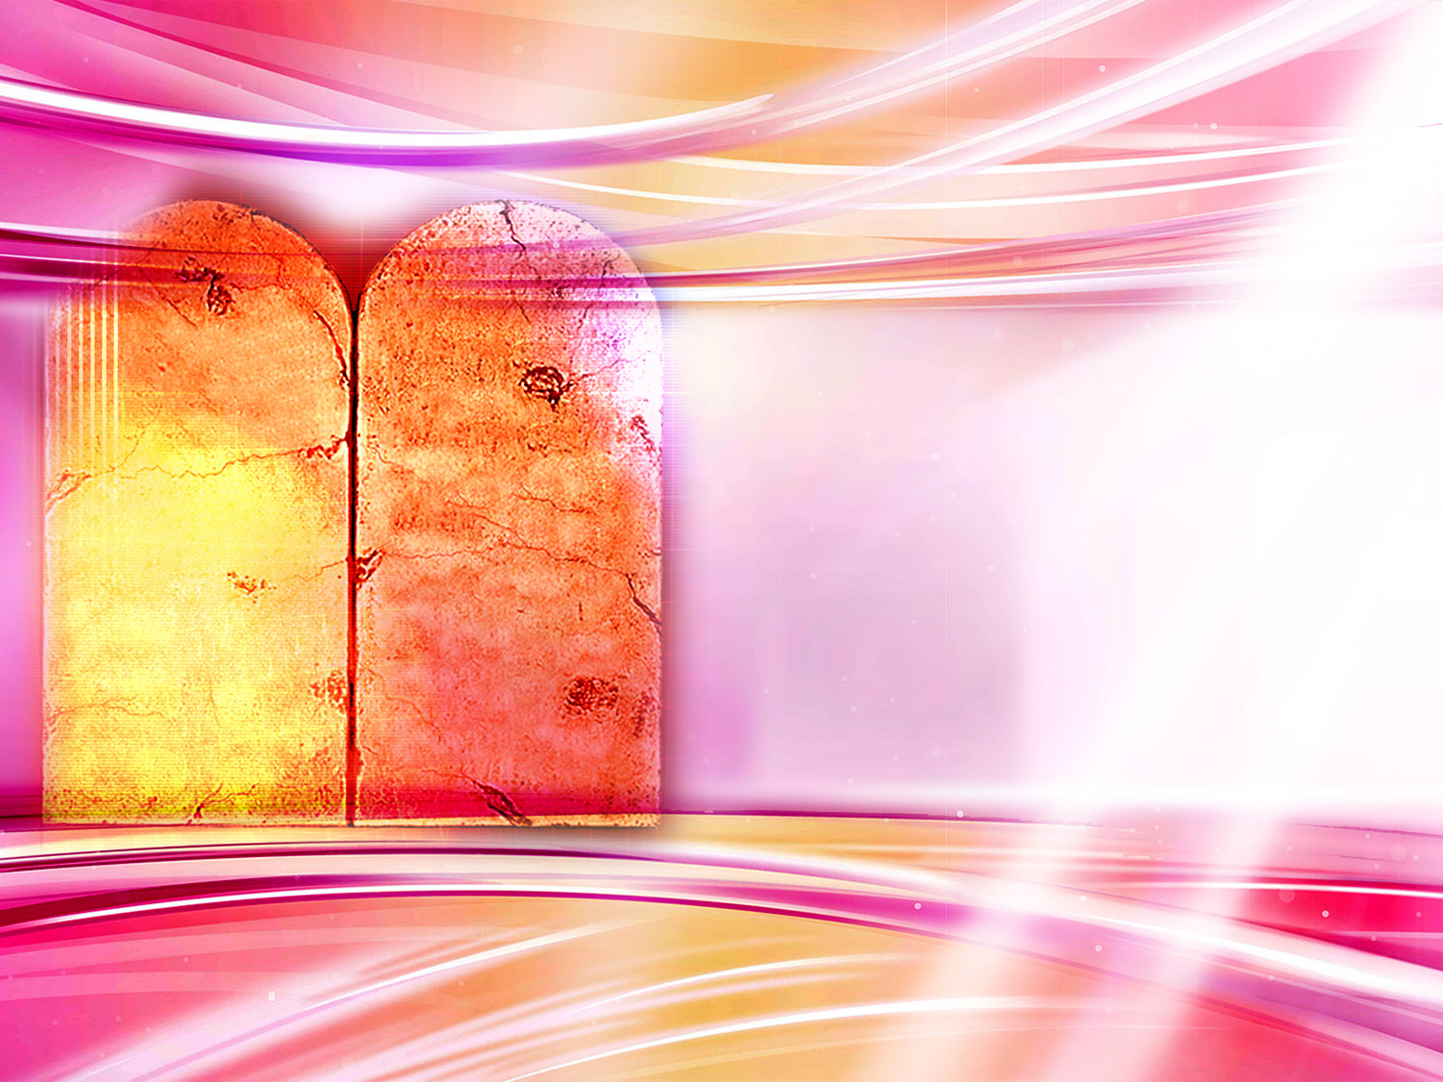
V
VI
VII
VIII
IX
X
What should we respect in order to be heard by God?
I
II
III
IV
Respect his law
Notes:
15. What should we respect in order to be heard by God?
Respect his law

Slide 50
1 John 3:22
“And whatsoever we ask, we receive of him, because we keep his commandments, and do those things that are pleasing in his sight.”
Notes:
“And whatsoever we ask, we receive of him, because we keep his commandments, and do those things that are pleasing in his sight.”
1 John 3:22
He that turneth away his ear from hearing the law, even his prayer shall be abomination. (Prov. 28:9)

Slide 51

In whose name should we pray? Why?
In the name of Jesus
Notes:
16. In whose name should we pray? Why?
In the name of Jesus.
Sin separated us from God. It is only through the grace of Christ that we can expect our prayers to reach God's throne.

Slide 52
John 16:23,24
And in that day ye shall ask me nothing. Verily, verily, I say unto you, Whatsoever ye shall ask the Father in my name, he will give it you.
Hitherto have ye asked nothing in my name: ask, and ye shall receive, that your joy may be full.
Notes:
And in that day ye shall ask me nothing. Verily, verily, I say unto you, Whatsoever ye shall ask the Father in my name, he will give it you.
Hitherto have ye asked nothing in my name: ask, and ye shall receive, that your joy may be full.
John 16:23,24

Slide 53
RELIEF AND JOY THROUGH PRAYER
Notes:
RELIEF AND JOY THROUGH PRAYER

Slide 54
Proverbs 15: 8,9
The sacrifice of the wicked is an abomination to the Lord: but the prayer of the upright is his delight.
The way of the wicked is an abomination unto the Lord: but he loveth him that followeth after righteousness.
Notes:
The sacrifice of the wicked is an abomination to the Lord: but the prayer of the upright is his delight.
The way of the wicked is an abomination unto the Lord: but he loveth him that followeth after righteousness.
Proverbs 15: 8,9

Slide 55
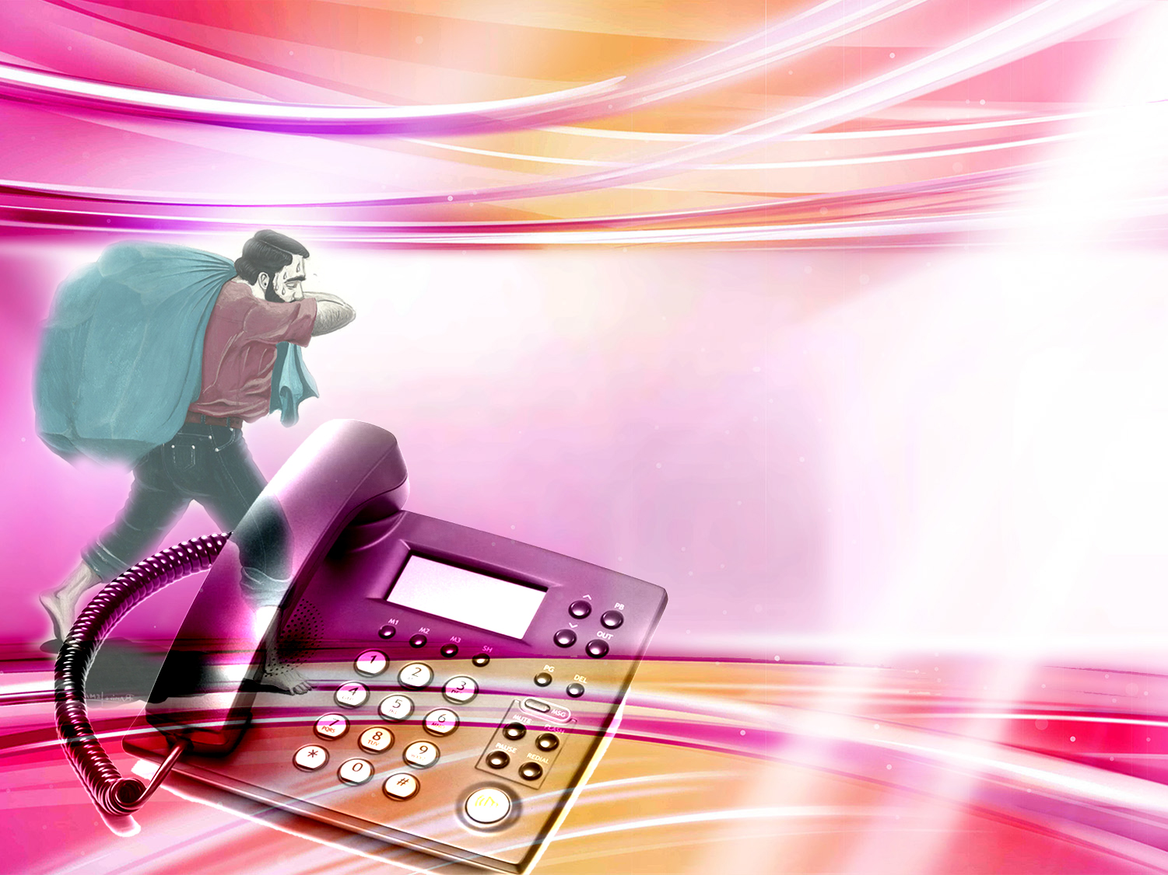
When we feel defeated by our problems, who can we call for help?
Notes:
17. When we feel defeated by our problems, who can we call on for help?
Every human being carries a burden of concerns and problems on his shoulders.
Fear, uncertainty, disappointment, frustration, bitterness, and failure, along with his own faults and sins.
So...let's take God's phone and call Him! Jesus will come to our side and take our heavy burden off our shoulders and places them on His own; He carries our concerns, problems and sins.

Slide 56
Matthew 11:28
Come unto me, all ye that labour and are heavy laden, and I will give you rest.
Notes:
Come unto me, all ye that labour and are heavy laden, and I will give you rest.
Matthew 11:28

Slide 57

What is God´s calling to us?
Notes:
18. What is God´s calling to us?

Slide 58
Romans 12:11-12
“Not slothful in business; fervent in spirit; serving the Lord; Rejoicing in hope; patient in tribulation; continuing instant in prayer.”
Notes:
“Not slothful in business; fervent in spirit; serving the Lord; Rejoicing in hope; patient in tribulation; continuing instant in prayer.” Romans 12:11-12

Slide 59

FOOTPRINTS….
“I dreamt I was walking along the beach with the Lord. Many scenes from my life flashed across the sky. In each scene, I noticed footprints in the sand. Sometimes there were two sets of footprints; other times there was only one. This bothered me, because I noticed that during the difficult times of my life, when I was suffering from anguish, sorrow or defeat I could see only one set of footprints.
This really disturbed me so I said to the Lord: "You told me when I decided to follow you that you would walk with me always. But I have noticed that during the most difficult moments of my life there has been only one set of footprints in the sand. Why, when I needed you most, have you not been there for me?" The Lord replied: "The times when you have seen only one set of footprints, my child, is when I CARRIED YOU IN MY ARMS"
Notes:
FOOTPRINTS…
“I dreamt I was walking along the beach with the Lord. Many scenes from my life flashed across the sky. In each scene, I noticed footprints in the sand. Sometimes there were two sets of footprints; other times there was only one. This bothered me, because I noticed that during the difficult times of my life, when I was suffering from anguish, sorrow or defeat I could see only one set of footprints.
This really disturbed me so I said to the Lord: "You told me when I decided to follow you that you would walk with me always. But I have noticed that during the most difficult moments of my life there has been only one set of footprints in the sand. Why, when I needed you most, have you not been there for me?" The Lord replied: "The times when you have seen only one set of footprints, my child, is when I CARRIED YOU IN MY ARMS"

Slide 60

Thank you Lord for listening to me!
Notes:
Let's use God's ``telephone´´, the key in the hand of faith, the "vitamin" of the soul, and let us use it to praise Him, to thank Him, to confess our sins to Him, to tell Him our worries, and to keep a daily, personal contact with Him.
Cultivate the habit of prayer in your family, teach your children how to pray.
This is the only way we can live in happiness and in peace, feeling certain that our most difficult problems will be dealt with and that He sustains us.
Thank you Lord for listening to me!

Slide 61

Next topic: ¿Who will Dominate the World in the Future?
Will it be the USA, Russia, China, Japan or any other power?
Why did Hitler and Napoleon lose the war?
The reason they failed are found in seven words written 2,600 years ago in the times of Babylon!
GOD BLESS YOU!
Notes:
GOD BLESS YOU!
Next topic:
Who will Dominate the World in the Future?
Will it be USA, Russia, China, Japan or any other power?
Why did Hitler and Napoleon lose the war?
The reason they failed are found in seven words written 2,600 years ago in the times of Babylon!

Slide 62

biblewell.org
info@biblewell.org
Notes:
If you still have questions, write to us with confidence at: info@biblewell.org

