Slide 1
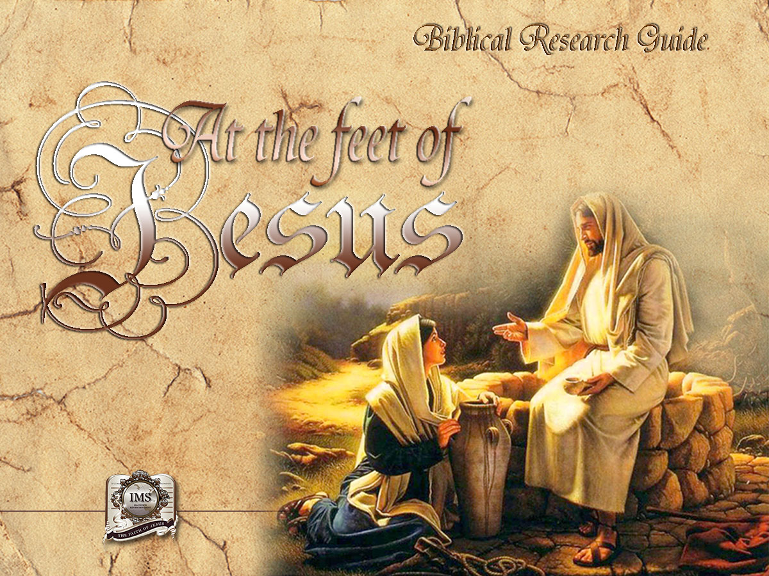

General Conference
Multimedia Department

Slide 2


A moment of prayer…
Notes:
A moment of prayer…

Slide 3
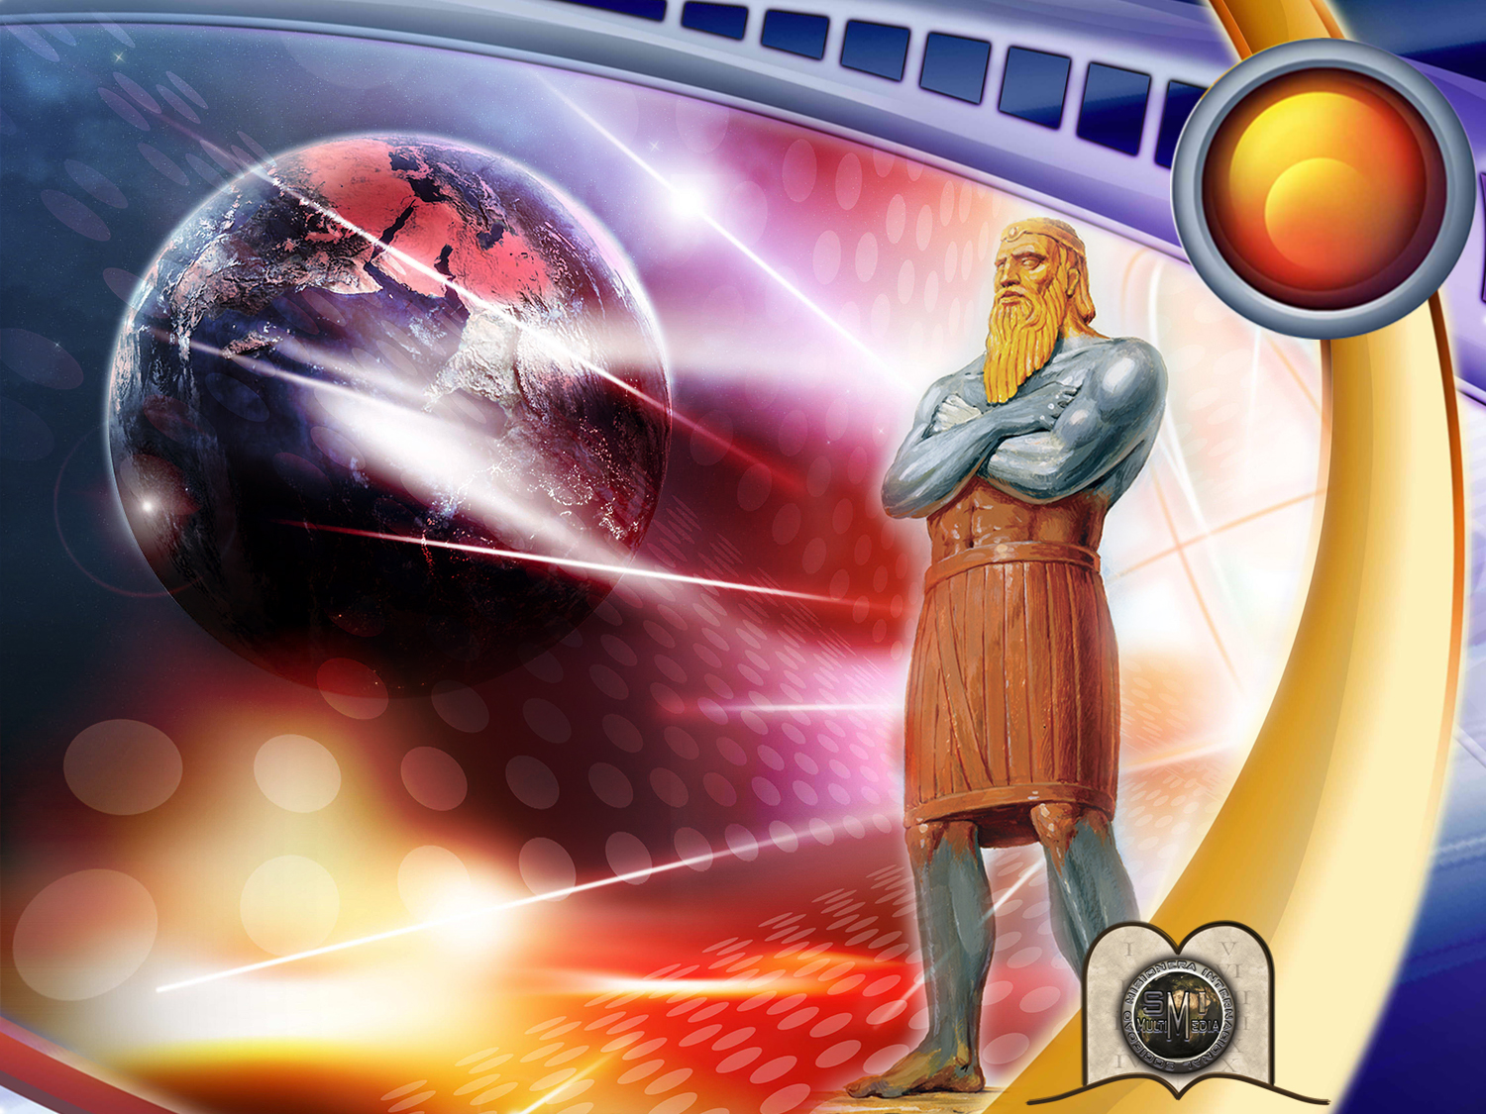
7
WHO WILL Dominate THE WORLD IN THE FUTURE?
Notes:
WHO WILL DOMINATE THE WORLD IN THE FUTURE?
Will it be the USA, Russia, China, Japan, or some other power?
Hitler and Napoleon dreamt of having a great empire, however seven words written 2,600 years ago prevented them from doing so!

Slide 4

Only where can we find true light concerning the future?
Notes:
1. Only where can we find true light concerning the future?

Slide 5

2 Peter 1:19
“We have also a more sure word of prophecy; whereunto ye do well that ye take heed, as unto a light that shineth in a dark place, until the day dawn, and the day star arise in your hearts.”
Notes:
“We have also a more sure word of prophecy; whereunto ye do well that ye take heed, as unto a light that shineth in a dark place, until the day dawn, and the day star arise in your hearts.”
2 Peter 1:19

Slide 6

AN EXTRAORDINARY REVELATION
OF THE FUTURE:
DANIEL CHAPTER 2
Notes:
AN EXTRAORDINARY REVELATION OF THE FUTURE: DANIEL CHAPTER 2

Slide 7
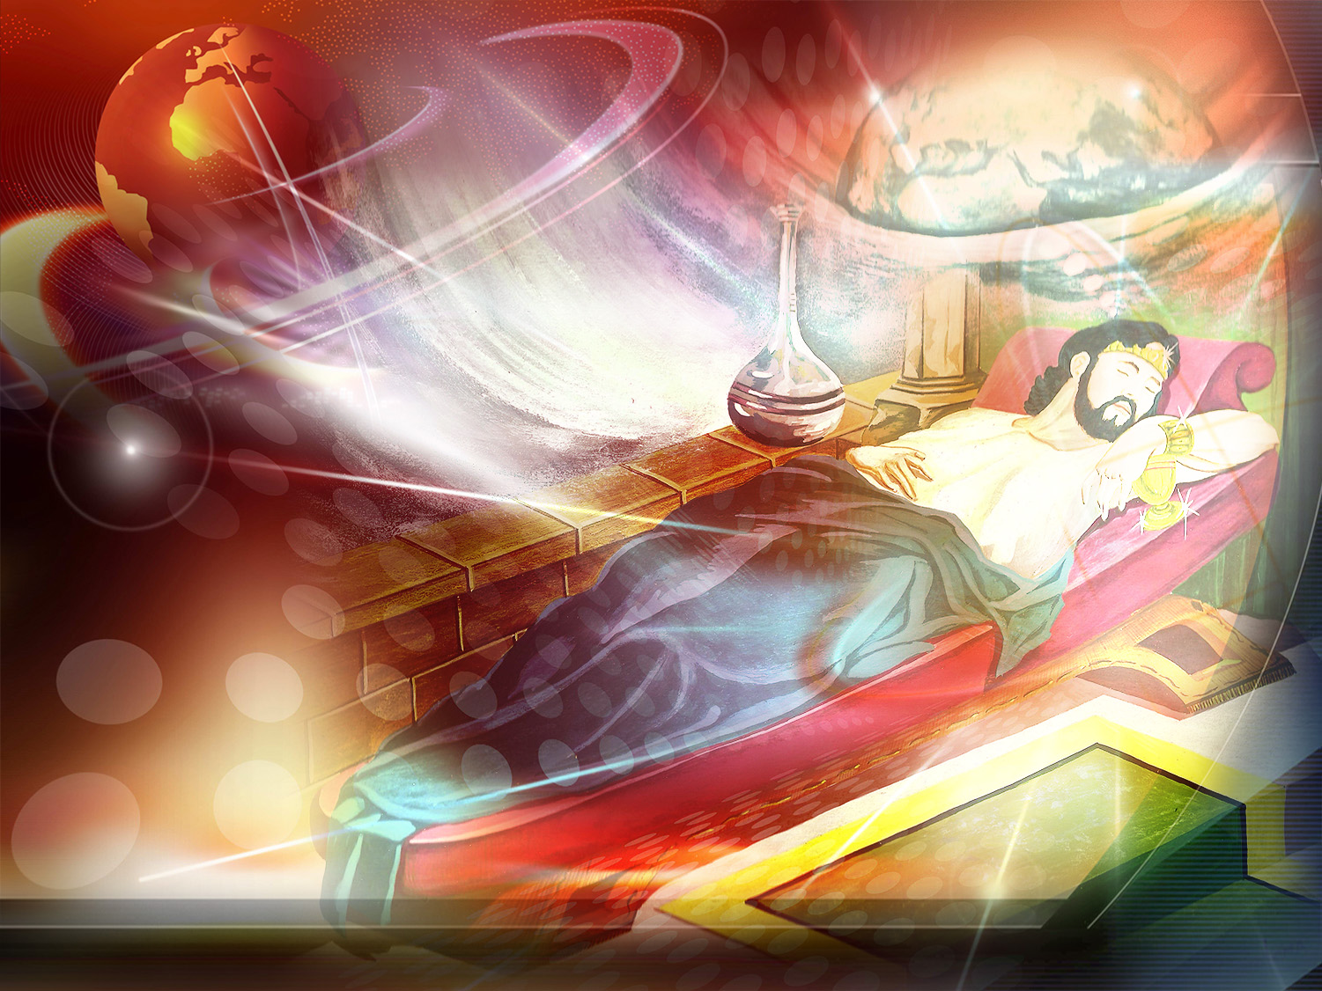
Nebuchadnezzar
600 a.c.
Notes:
Late one night, around 600 B.C, the King of Babylon, Nebuchadnezzar, laid to rest perplexed about the future. That night he had a strange dream which deeply impressed him. However, when he awoke he realized he had forgotten completely what he had dreamt (Daniel 2:1). Eager to remember, he summoned his sorcerers and astrologers to reveal to him the dream and its significance, but they could not (Verses 2-11). Angered by this, the king signed a decree which commanded that all the wise men of Babylon, among whom were Daniel and his companions, should be put to death. (Verses 12-14). Daniel asked the king to give him some time during which he and his companions prayed to God, whom revealed everything to Daniel in a vision. (Verses 15-19).

Slide 8
Who is the only one who can direct and reveal the destiny of nations?
Notes:
2. Who is the only one who can direct and reveal the destiny of nations?

Slide 9

Daniel 2:20-22
“Daniel answered and said, Blessed be the name of God for ever and ever: for wisdom and might are his. And he changeth the times and the seasons: he removeth kings, and setteth up kings: he giveth wisdom unto the wise, and knowledge to them that know understanding. He revealeth the deep and secret things: he knoweth what is in the darkness, and the light dwelleth with him.”
Notes:
“Daniel answered and said, Blessed be the name of God for ever and ever: for wisdom and might are his. And he changeth the times and the seasons: he removeth kings, and setteth up kings: he giveth wisdom unto the wise, and knowledge to them that know understanding. He revealeth the deep and secret things: he knoweth what is in the darkness, and the light dwelleth with him.”
Daniel 2:20-22

Slide 10
Daniel 2:27-28
“Daniel answered in the presence of the king, and said, The secret which the king hath demanded cannot the wise men, the astrologers, the magicians, the soothsayers, shew unto the king.
But there is a God in heaven that revealeth secrets, and maketh known to the king Nebuchadnezzar what shall be in the latter days. Thy dream, and the visions of thy head upon thy bed, are these.”
Notes:
“Daniel answered in the presence of the king, and said, The secret which the king hath demanded cannot the wise men, the astrologers, the magicians, the soothsayers, shew unto the king.
But there is a God in heaven that revealeth secrets, and maketh known to the king Nebuchadnezzar what shall be in the latter days. Thy dream, and the visions of thy head upon thy bed, are these.”
Daniel 2:27-28
Daniel even revealed what the king was pondering about before falling asleep. (Verses 29-30).

Slide 11
What did Nebuchadnezzar see in his dream?
Notes:
3. What did Nebuchadnezzar see in his dream?

Slide 12
Daniel 2:31-35
“Thou, O king, sawest, and behold a great image. This great image, whose brightness was excellent, stood before thee; and the form thereof was terrible.”
Notes:
Daniel 2:31-35
“Thou, O king, sawest, and behold a great image. This great image, whose brightness was excellent, stood before thee; and the form thereof was terrible.”

Slide 13
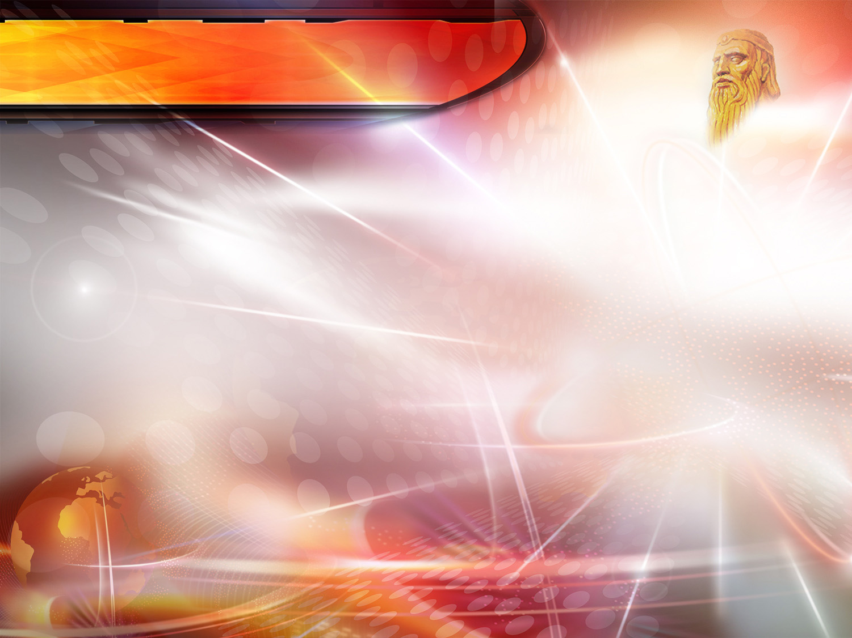
Daniel 2:31-35
This image's head was of fine gold…
Notes:
This image's head was of fine gold; …

Slide 14
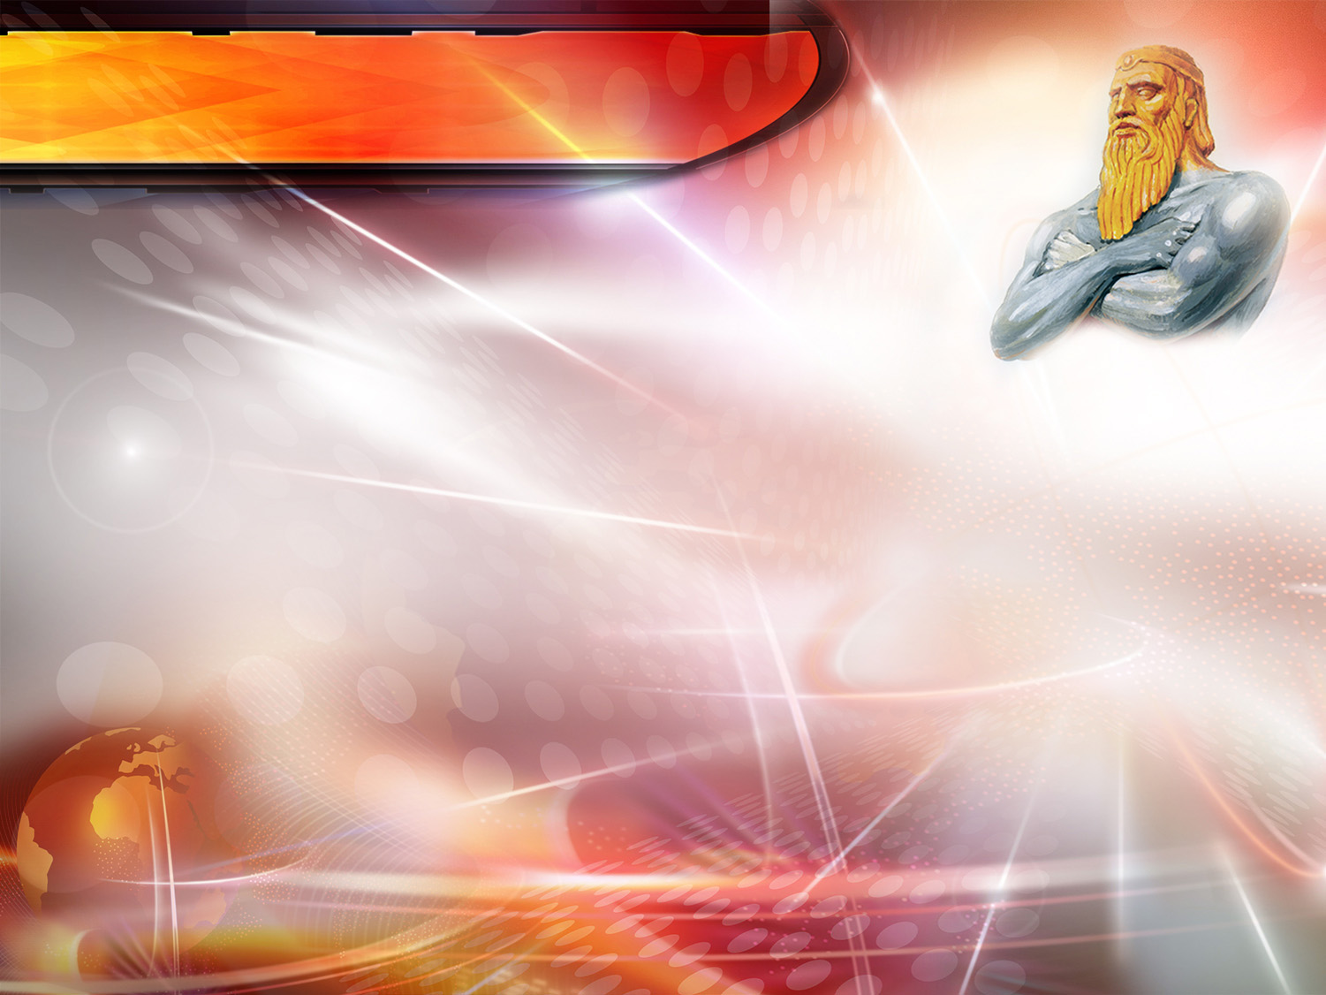
Daniel 2:31-35
This image's head was of fine gold, his breast and his arms of silver…
Notes:
his breast and his arms of silver…

Slide 15
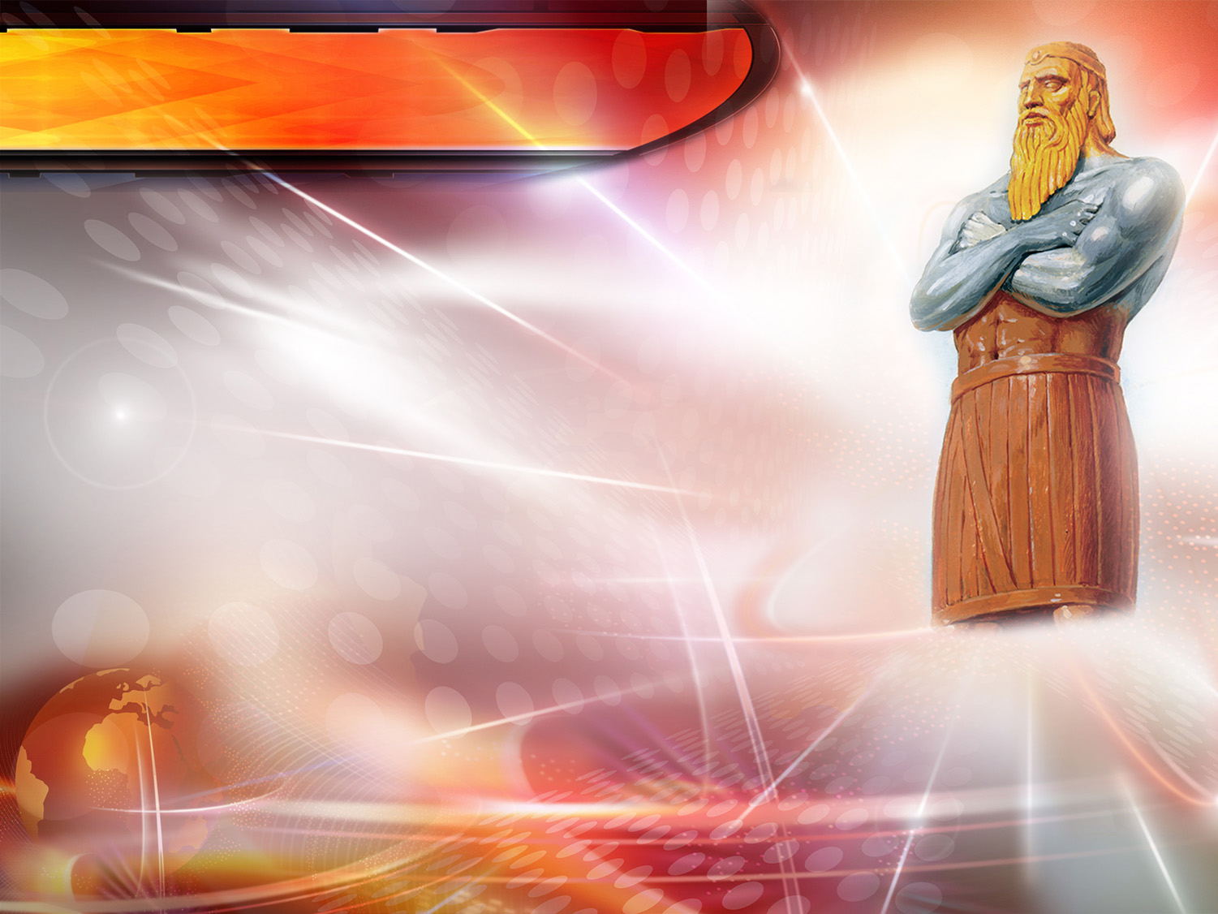
Daniel 2:31-35
This image's head was of fine gold, his breast and his arms of silver, his belly and his thighs of brass;…
Notes:
…his belly and his thighs of brass; …

Slide 16
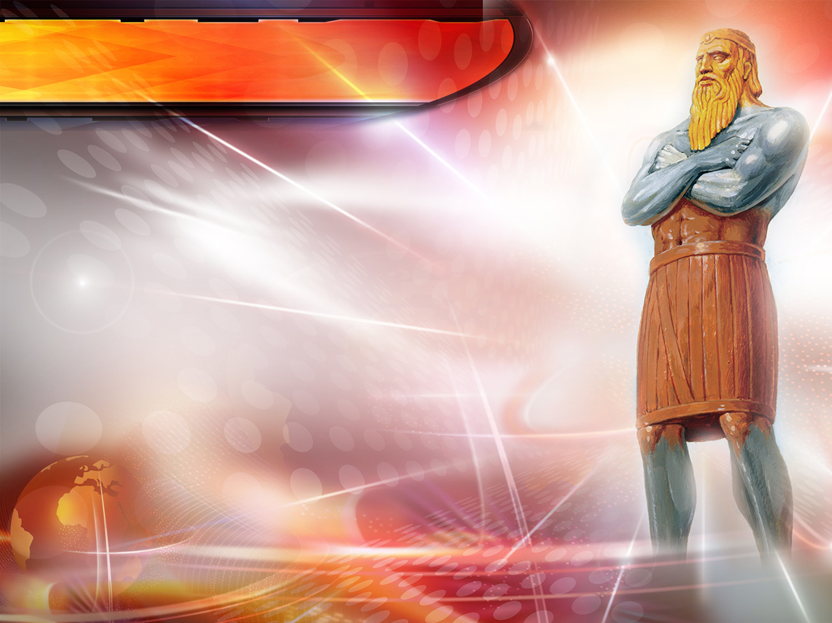
Daniel 2:31-35
This image's head was of fine gold, his breast and his arms of silver, his belly and his thighs of brass, His legs of iron, …
Notes:
…His legs of iron…

Slide 17
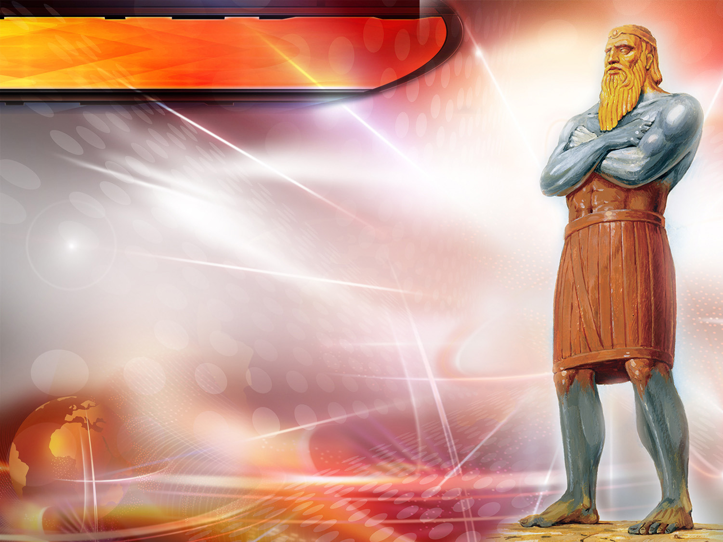
Daniel 2:31-35
This image's head was of fine gold, his breast and his arms of silver, his belly and his thighs of brass, His legs of iron, his feet part of iron and part of clay.
Notes:
…his feet part of iron and part of clay.

Slide 18
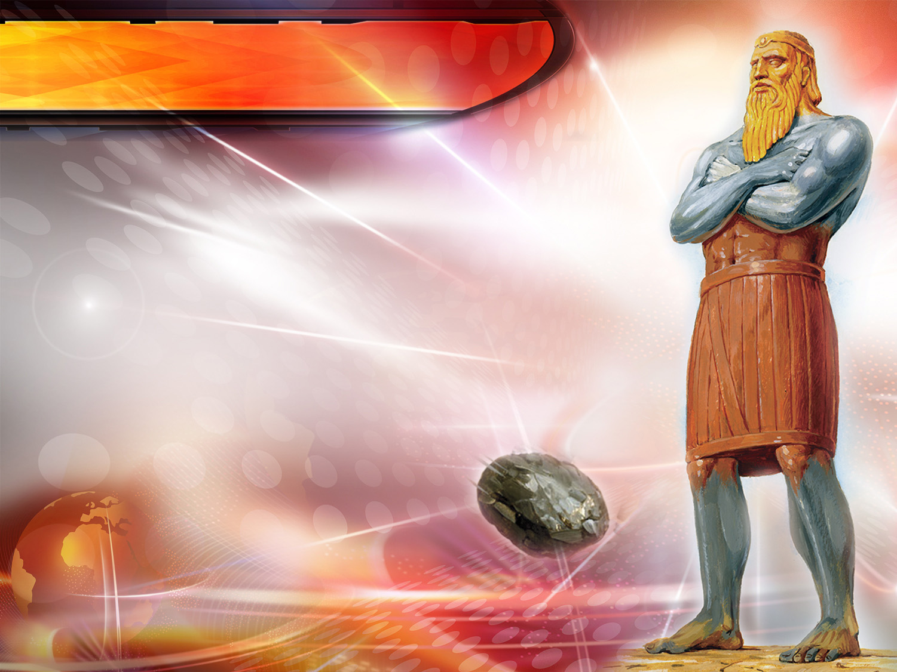
Daniel 2:31-35
Thou sawest till that a stone was cut out without hands, which smote the image upon his feet that were of iron and clay, and brake them to pieces.
Notes:
Thou sawest till that a stone was cut out without hands, which smote the image upon his feet that were of iron and clay, and brake them to pieces.

Slide 19
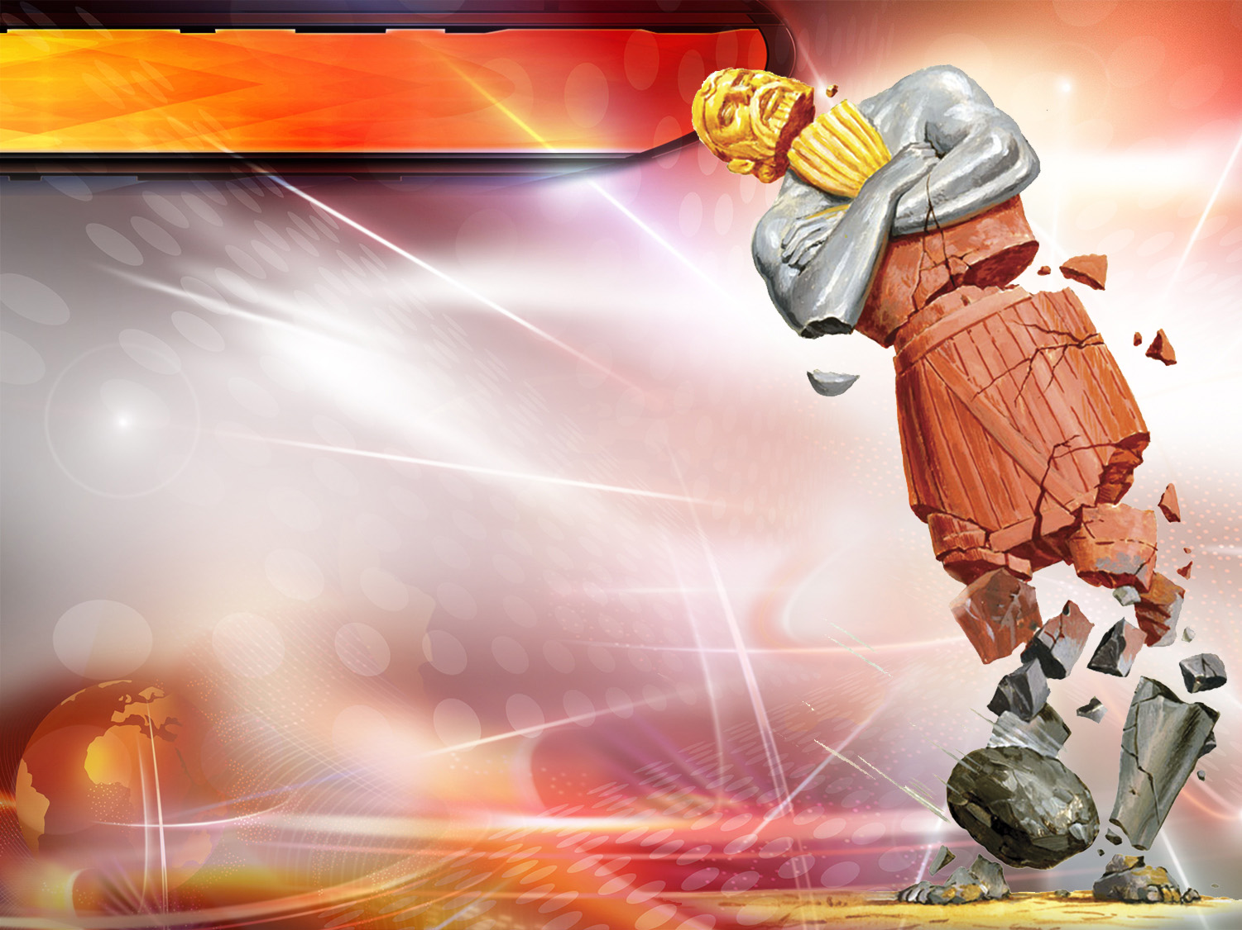
Daniel 2:31-35
Then was the iron, the clay, the brass, the silver, and the gold, broken to pieces together, and became like the chaff of the summer threshingfloors; and the wind carried them away, that no place was found for them: and the stone that smote the image became a great mountain, and filled the whole earth.
Notes:
Then was the iron, the clay, the brass, the silver, and the gold, broken to pieces together, and became like the chaff of the summer threshingfloors; and the wind carried them away, that no place was found for them: and the stone that smote the image became a great mountain, and filled the whole earth.

Slide 20
THE MEANING
OF THE DREAM
Notes:
THE MEANING OF THE DREAM

Slide 21
What empire did the head of gold represent?
Notes:
4. What empire did the head of gold represent?

Slide 22
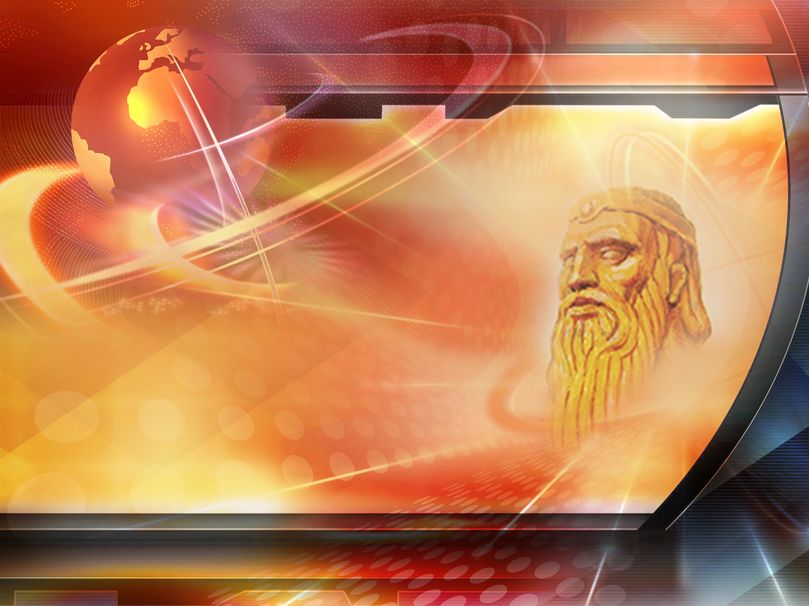
BABYLON
606-538 B.C.
Notes:
BABYLON 606-538 B.C.

Slide 23
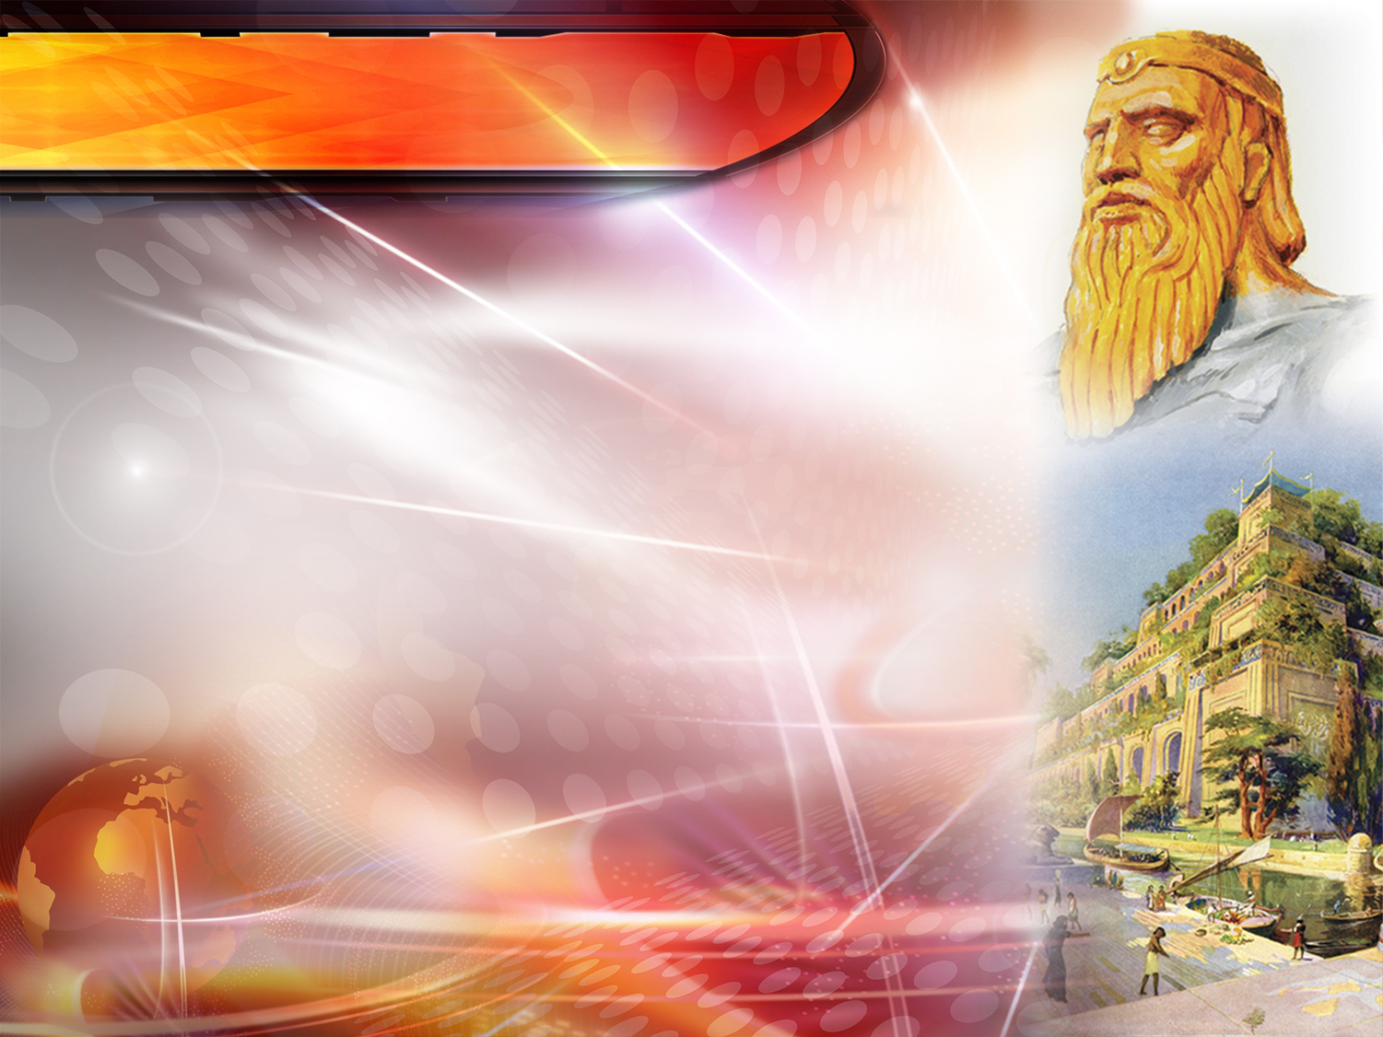
Daniel 2:37-38
“Thou, O king, art a king of kings: for the God of heaven hath given thee a kingdom, power, and strength, and glory.
And wheresoever the children of men dwell, the beasts of the field and the fowls of the heaven hath he given into thine hand, and hath made thee ruler over them all. Thou art this head of gold.”
Notes:
“Thou, O king, art a king of kings: for the God of heaven hath given thee a kingdom, power, and strength, and glory.
And wheresoever the children of men dwell, the beasts of the field and the fowls of the heaven hath he given into thine hand, and hath made thee ruler over them all. Thou art this head of gold.”
Daniel 2:37-38
- This was a kingdom of great splendor. The city of Babylon had wide avenues and luxurious palaces.

Slide 24
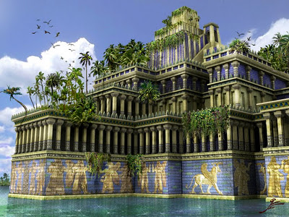
BABYLON 606-538 B.C.
The splendor of Babylon
Hanging Gardens.
Wide avenues and luxurious palaces.
There was an abundance of gold. In the great temple of Marduk there were images of Baal and an enormous table 12 x 4.50 m., both made of pure gold which weighed 23,000 kg.
Notes:
Its hanging gardens were one of the seven wonders of the ancient world. Large amounts of soil were placed in huge terraces and giant trees would grow there.
- There was an abundance of gold. In the great temple of Marduk was an image of Baal and an enormous table that measured 12 x 4.50 m., both made of pure gold which weighed 23,000 kg. There were also lions and a sculpture made of the same metal, which was 5, 40 m. tall.

Slide 25
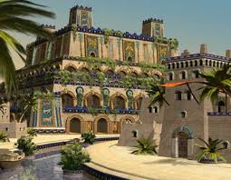
BABYLON 606-538 B.C.
The splendor of Babylon
Walls of about 60 m height.
Provisions for 20 years.
The river Euphrates flowed under the center into the middle of the city.
The city was considered impregnable.
Notes:
- The city was apparently impregnable. According to Herodotus, a Greek historian, it was surrounded by a wall of about 60 m. height and by a deep trench.
- It had enough provisions to last for 20 years. There was plenty of water since the Euphrates river flowed under its walls, straight to the center of the city.

Slide 26
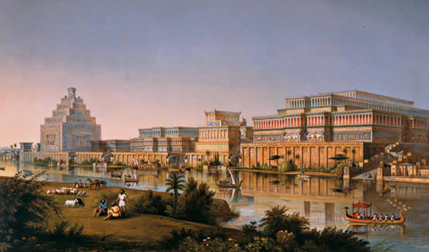
BABYLON 606-538 B.C.
The fall of Babylon
The Medo-Persians diverted the course of the Euphrates
The bravest soldiers walked along the river and passed under the walls.
The doors by the river were open
600,000 soldiers on foot, 120,000 on horseback, and 2,000 chariots.
Notes:
THE FALL OF BABYLON
Cyrus, leading the Medo-Persian army, besieged the city. Near the city of Sippar there was an artificial lake that King Nebuchadnezzar had built to control the flow of the river. Cyrus changed the course of the river; and one evening, while the Babylonians were having a feast, he entered and conquered the city. The water of the river decreased until it was only to the height of the knees. The bravest soldiers walked along the river, passed under the walls and, finding the doors open, entered the palace. They then opened the outer doors and let the whole army in. They killed the king, and thus Babylon fell. The Persian army was composed by 600,000 soldiers on foot, 120,000 on horseback, and 2,000 chariots.

Slide 27
What empire represents the chest and arms of silver?
Notes:
5. What empire represents the chest and arms of silver?

Slide 28
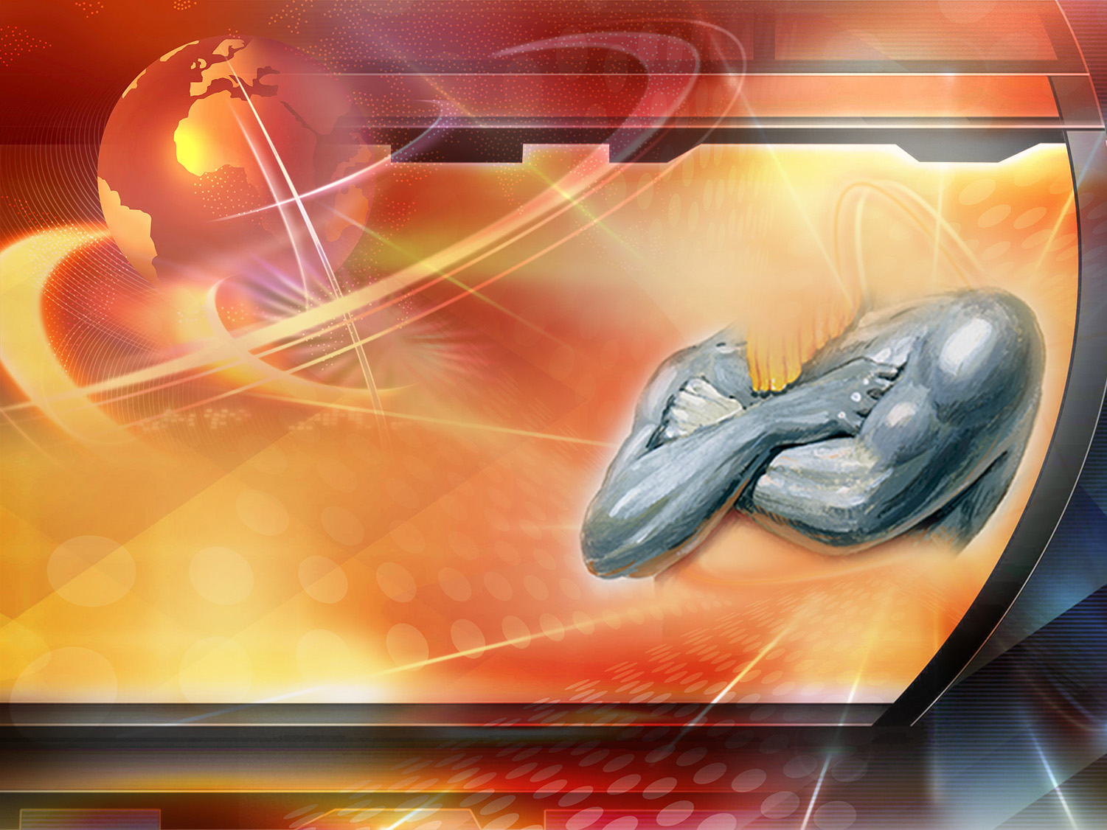
MEDO-PERSIAN
538-331 B.c.
Notes:
MEDO-PERSIAN
538-331 B.C.

Slide 29
How would this empire compare to the previous one?
Notes:
How would this empire compare to the previous one?

Slide 30
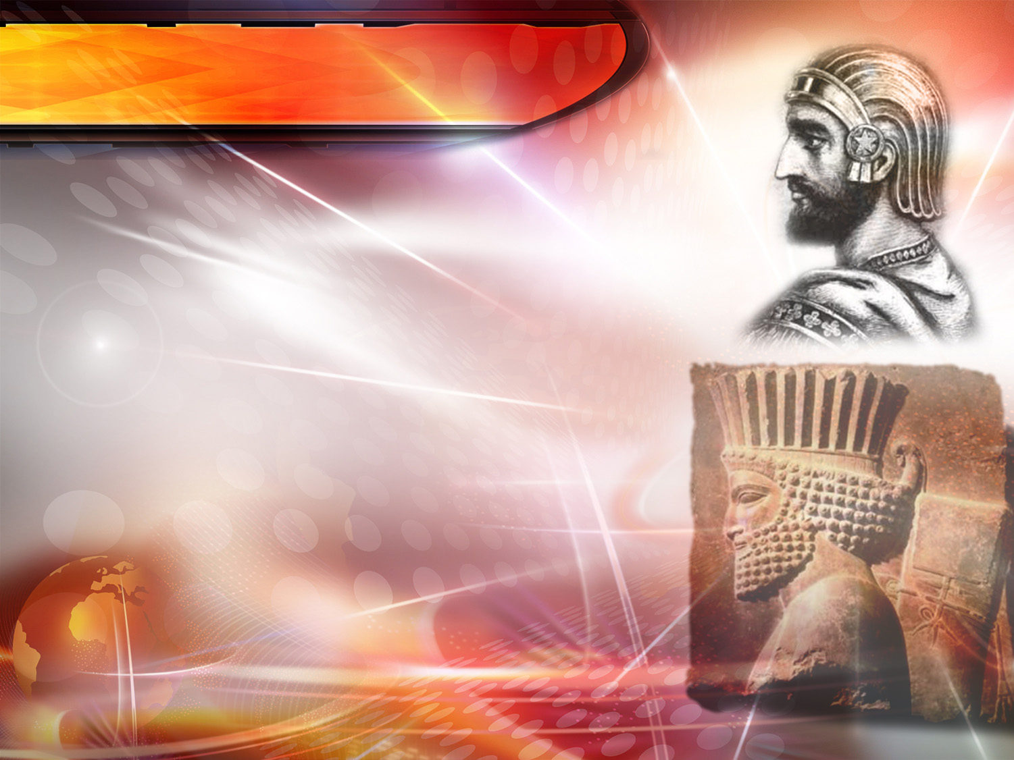
Daniel 2:39
" And after thee shall arise another kingdom inferior to thee…”
Ciro
Notes:
" And after thee shall arise another kingdom inferior to thee…”
Daniel 2:39

Slide 31
MEDO-PERSIAN
Two arms: the Medes and the Persians associated.
Lower in splendor, as silver is less than gold
The use of silver coins begins
Ciro
Notes:
- The two arms represented the two parts that composed the empire - Media and Persia
- For the first time, silver coins were used for commercial transactions.

Slide 32
What did the prophecy say about the kingdom represented by the bronze belly?
Notes:
6. What did the prophecy say about the kingdom represented by the bronze belly?

Slide 33

GREECE
331-168 B.c.
Notes:
GREECE
331-168 B.c.

Slide 34
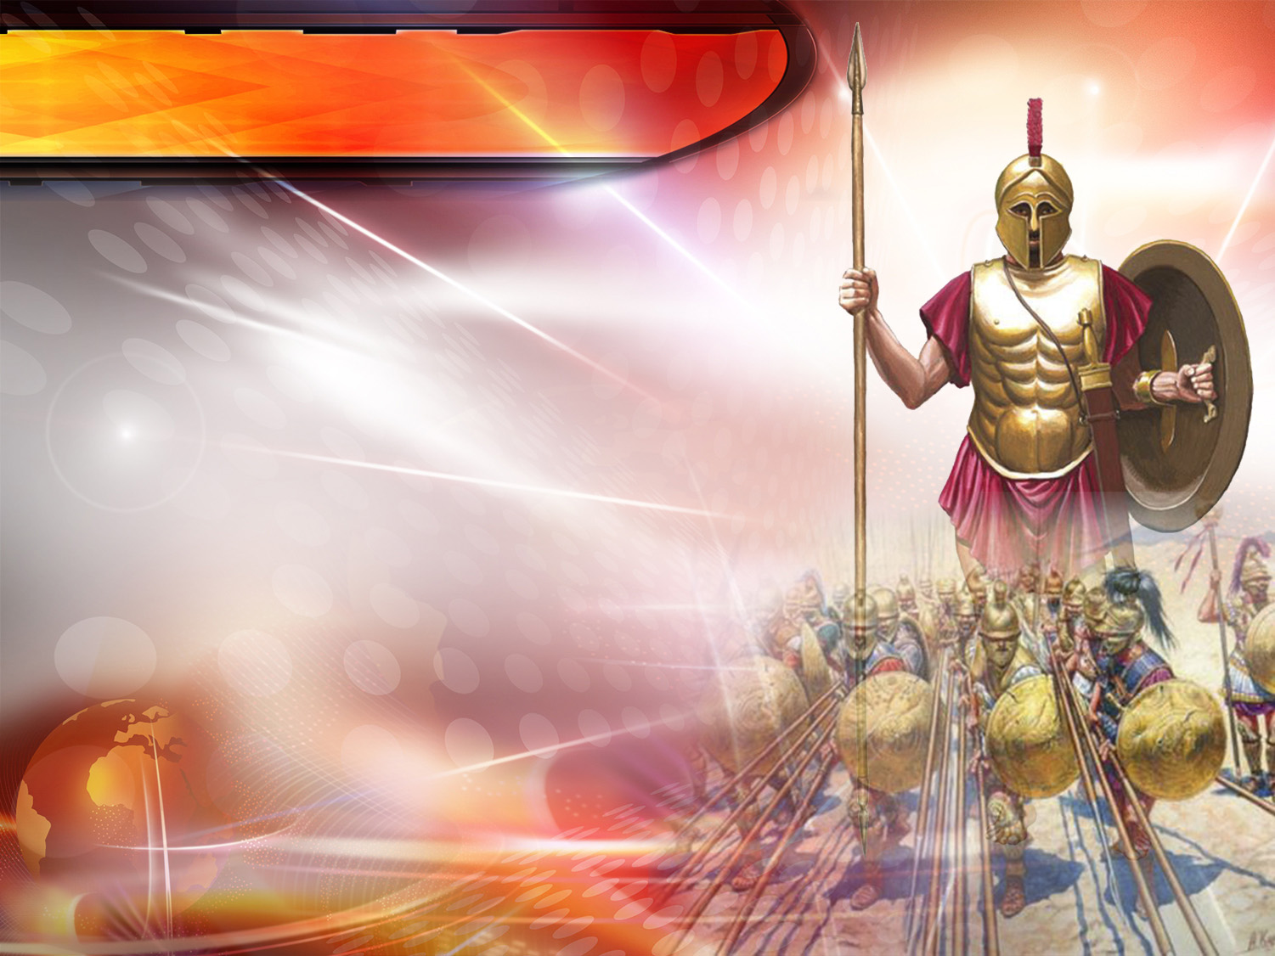
Daniel 2:39 l.p.
"... and another third kingdom of brass, which shall bear rule over all the earth.”
Notes:
"... and another third kingdom of brass, which shall bear rule over all the earth.”
Daniel 2:39

Slide 35
GREECE
They used bronze weapons.
Alexander the Great died because he loved his belly.
Ephemeral glory as the brilliance of bronze.
Notes:
- The weapons used by the Greeks were made of bronze. Greek soldiers were called "brass soldiers.”
- The belly - Alexander the Great was a slave to his stomach, for this reason he died very young due to the feasts he participated in. Alexander died at the age of 32, drinking his second round of the Herculean cup, which contained 5 liters of wine. His kingdom was later divided.
- The temporary shine of bronze aptly depicted the passing glory of his kingdom.

Slide 36
What would the fourth kingdom, symbolized by the iron legs, be like?
Notes:
7. What would the fourth kingdom, symbolized by the iron legs, be like?

Slide 37
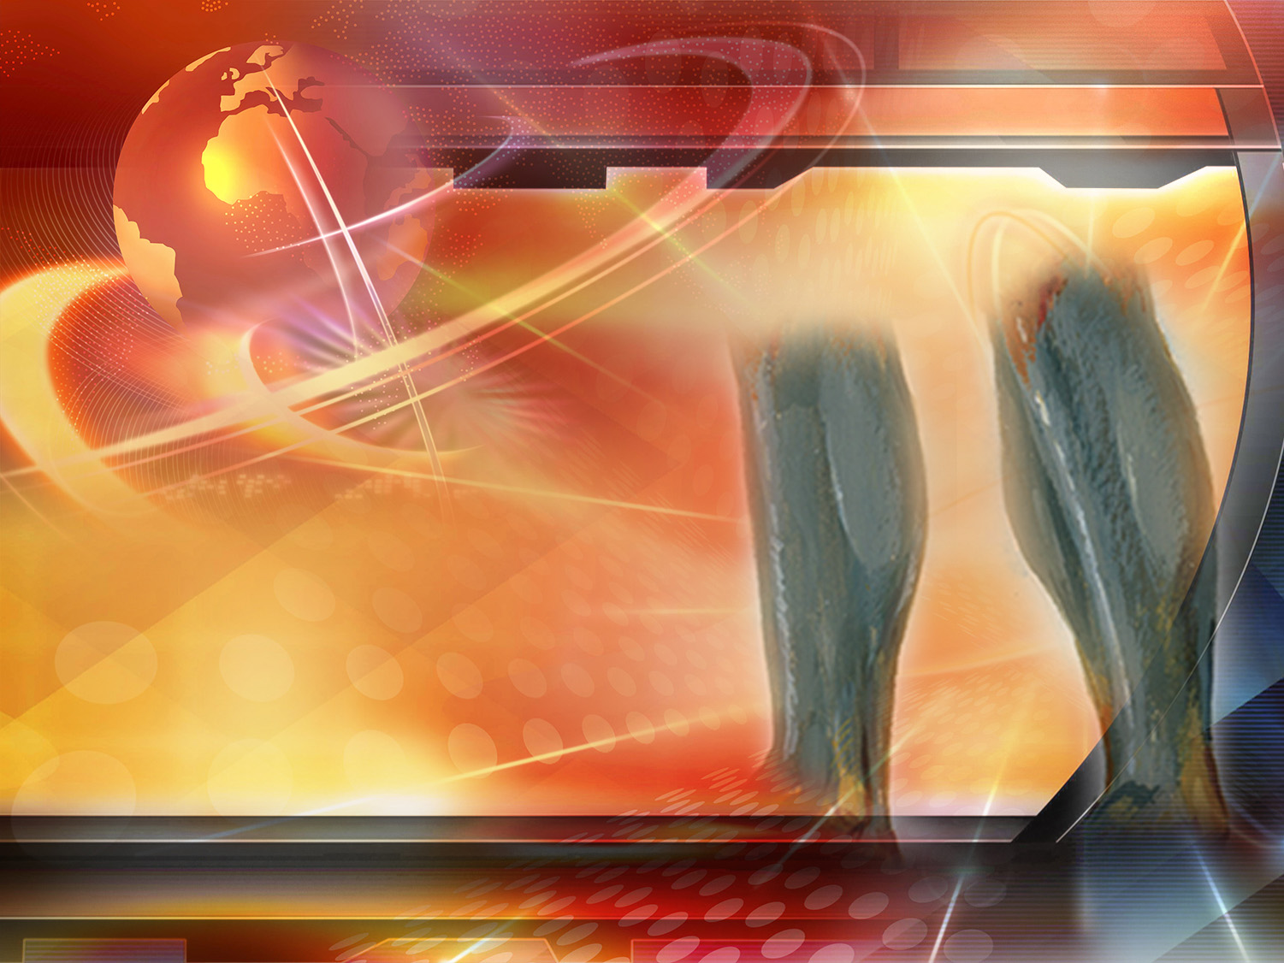
THE ROMAN EMPIRE 168 B.C.- 476 A.D.
Notes:
THE ROMAN EMPIRE
168 B.C.- 476 A.D.

Slide 38
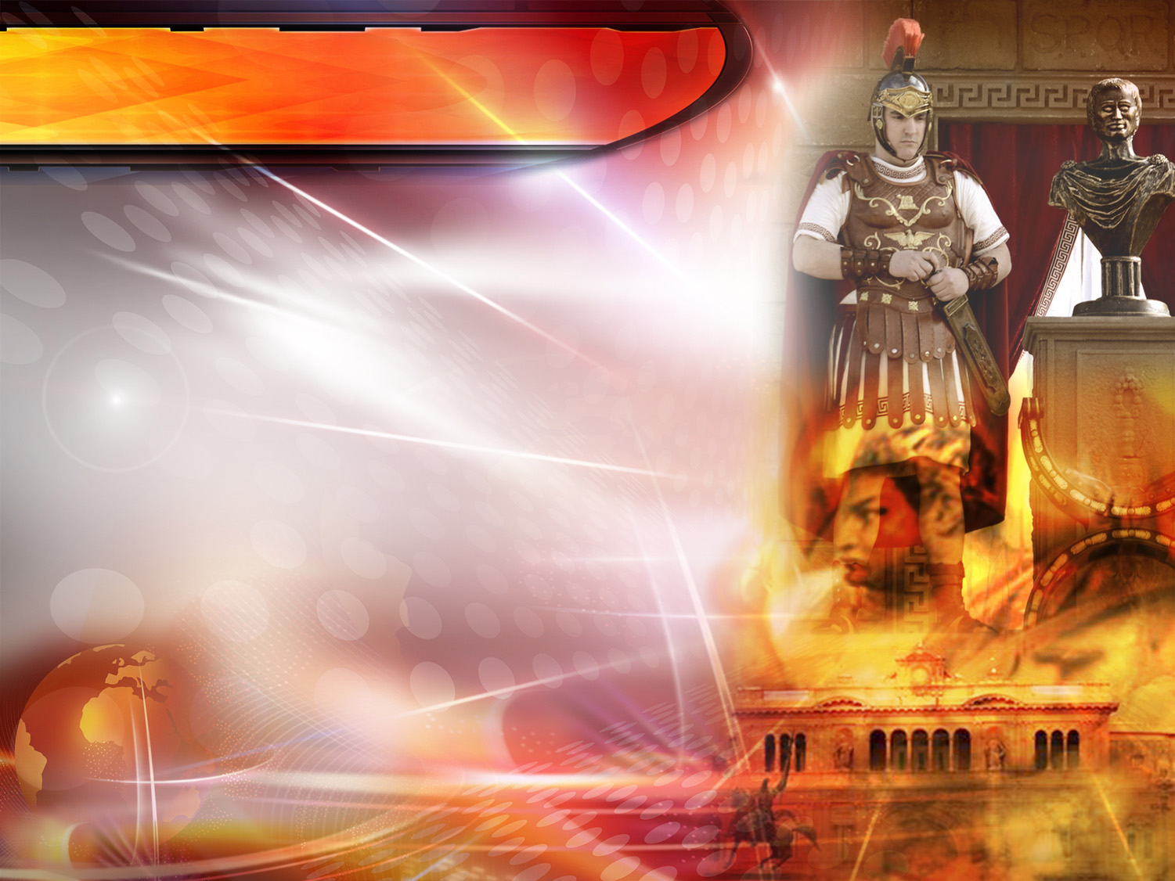
Daniel 2:40
“And the fourth kingdom shall be strong as iron: forasmuch as iron breaketh in pieces and subdueth all things: and as iron that breaketh all these, shall it break in pieces and bruise.”
Notes:
“And the fourth kingdom shall be strong as iron: forasmuch as iron breaketh in pieces and subdueth all things: and as iron that breaketh all these, shall it break in pieces and bruise.”
Daniel 2:40

Slide 39
THE ROMAN EMPIRE
Hard, cold and rough as iron: cruelty of Nero and others.
Lasted 644 years.
The weapons they used: short swords of iron.
Notes:
- The Roman Empire lasted 644 years. It was rough and cold, just like iron. It´s cruelty and fearsomeness can be seen by the atrocities committed by Nero and other emperors.
- The weapons used by the Romans were short iron swords.
The history of the Roman Empire is well known to everyone. The eminent historian Gibbon wrote: "... The weapons of the Republic... always victorious in war, advanced.... and the images of gold, silver and bronze which could be used to represent nations and their kings that were destroyed one after the other by the iron monarchy of Rome."
Thus, the Romans, with their short swords, conquered the world displaying unprecedented cruelty and destroying whatever was left of the three empires that preceded them. History, once again, affirmed the panoramic view of world events presented in the Bible. But Rome has also vanished, therefore let us turn to the statue to see where we stand in history.

Slide 40
What kind of a kingdom was represented by the feet of iron mixed with clay?
Notes:
8. What kind of a kingdom was represented by the feet of iron mixed with clay?

Slide 41
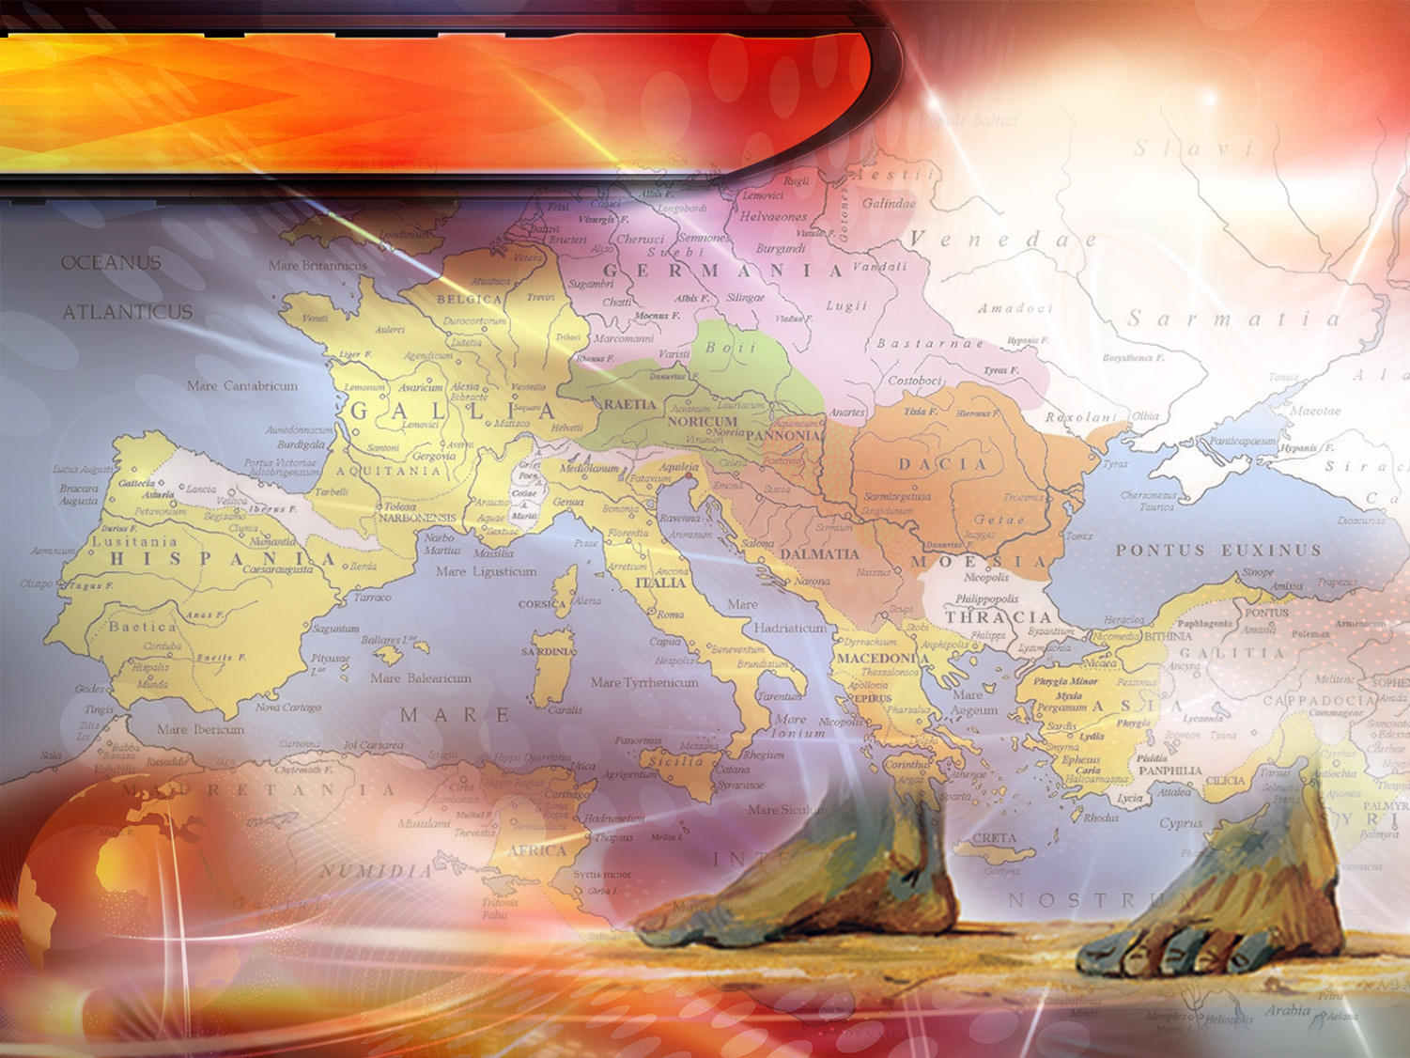
Daniel 2:41-43
"And whereas thou sawest the feet and toes, part of potters' clay, and part of iron, the kingdom shall be divided; but there shall be in it of the strength of the iron, forasmuch as thou sawest the iron mixed with miry clay....
Notes:
"And whereas thou sawest the feet and toes, part of potters' clay, and part of iron, the kingdom shall be divided; but there shall be in it of the strength of the iron, forasmuch as thou sawest the iron mixed with miry clay…
Daniel 2:41-43

Slide 42
Daniel 2:41-43
…And as the toes of the feet were part of iron,
and part of clay, so the kingdom shall be partly strong,
and partly broken.…
Notes:
…And as the toes of the feet were part of iron, and part of clay, so the kingdom shall be partly strong, and partly broken…

Slide 43
Daniel 2:41-43
…And whereas thou sawest iron mixed with miry clay, they shall mingle themselves with the seed of men: but they shall not cleave one to another, even as iron is not mixed with clay."
Notes:
…And whereas thou sawest iron mixed with miry clay, they shall mingle themselves with the seed of men: but they shall not cleave one to another, even as iron is not mixed with clay.”

Slide 44

A Divided kingdom.
Franks (France)
Germans (Germany)
Anglo-saxons (England)
Lombards (Italy)
Suevi (Portugal)
Visigoths (Spain)
Burgundios (Switzerland).
The Herul
Vandals
Ostrogoths
• (They no longer exist)
Notes:
The Roman Empire was divided into 10 parts between the fourth and the fifth century. It weakened under the pressure of the Germanic tribes coming from the north of Europe.
Finally the territory of the Roman Empire was occupied by the Franks (France), Germans (Germany), Anglo-saxons (England), Lombards (Italy), Suevi (Portugal), Visigoths (Spain) and Burgundians (Swiss). The Herul, Vandals and Ostrogoths had disappeared. All these nations were partly strong and partly weak. (verse 42)

Slide 45
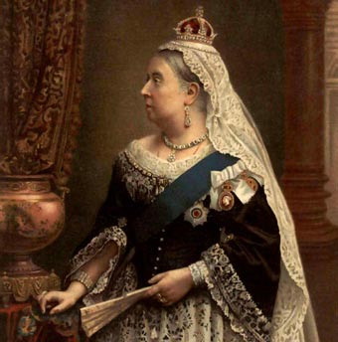
A DIVIDED KINGDOM
476 A.D. - …
Notes:
They would try to be united again through intermarriage.
Alliances
Marriages between Royals until 1914, with the intention of uniting these divided nations into a great empire.
Empress Dowager Dagmar of Russia and Queen Mother Alexandra of England were sisters.
The kings of Norway and Denmark, were brothers.
The king of England, Russia and Greece were cousins of kings of Norway and Denmark.
The five were grandchildren of King Christian of Denmark.
The son of Queen Victoria was Edward VII of England.
The daughter of Queen Victoria married William from Germany.
Almost all were related to Queen Victoria.

Slide 46
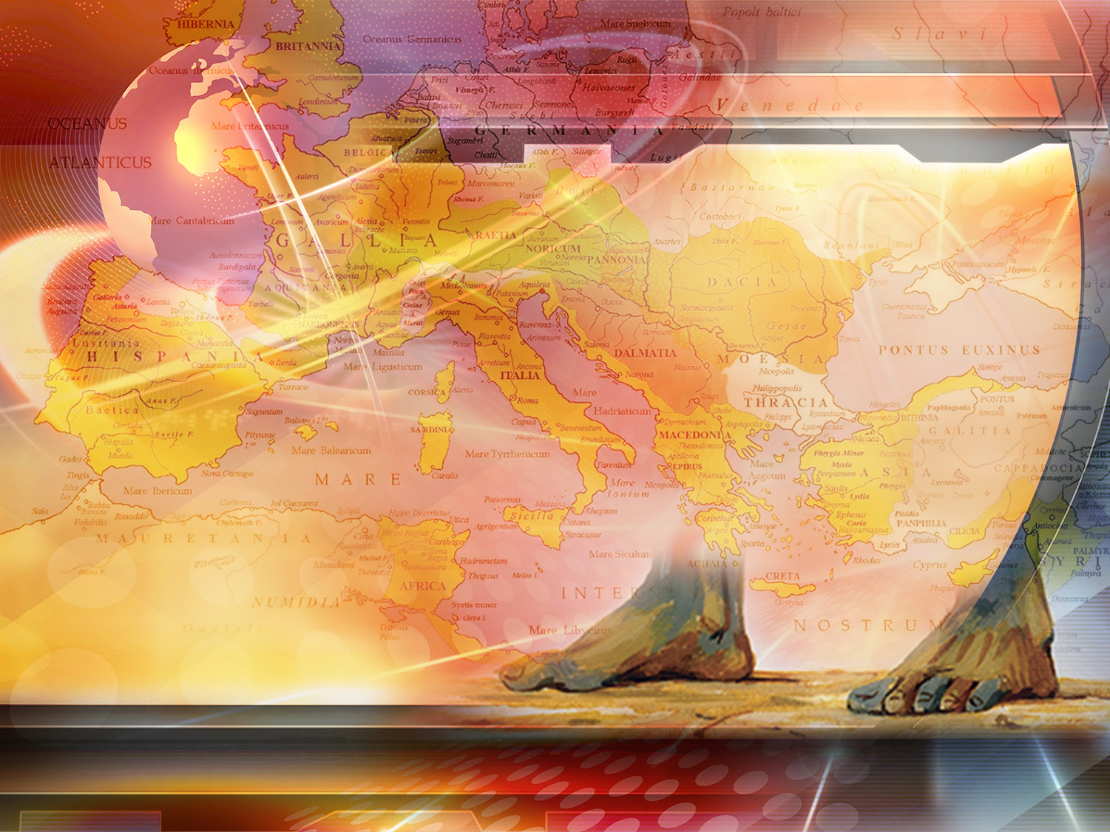
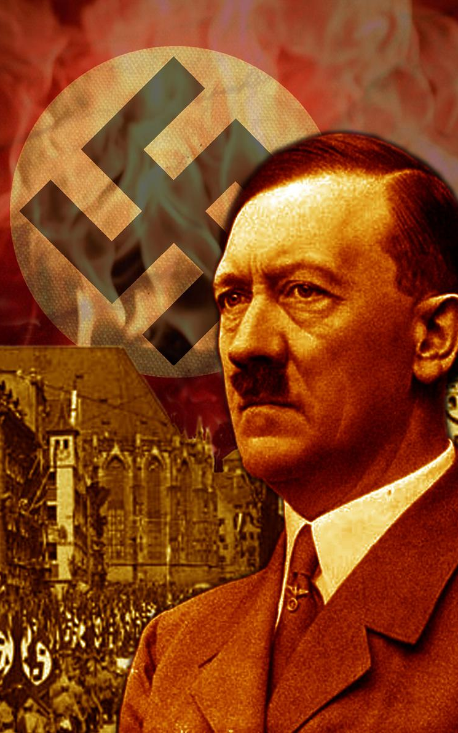
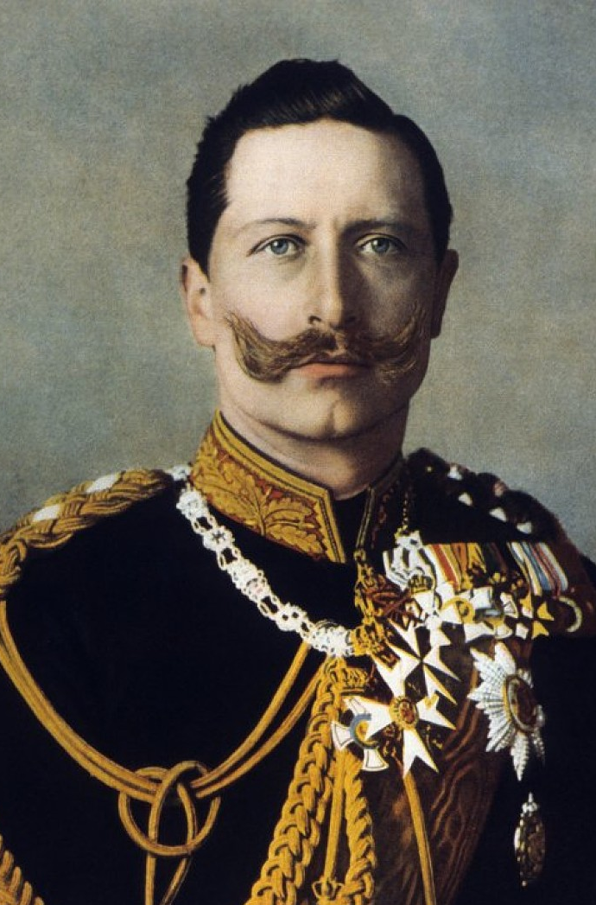
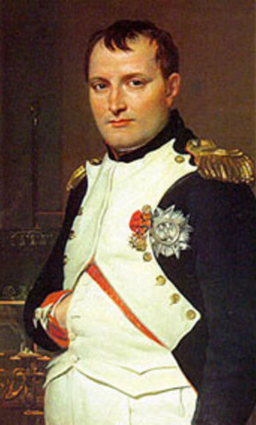
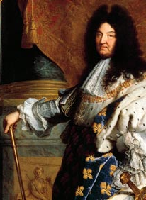
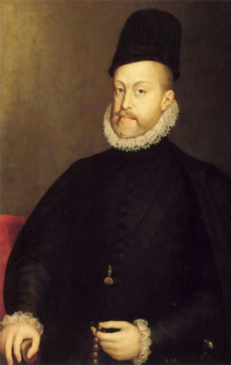
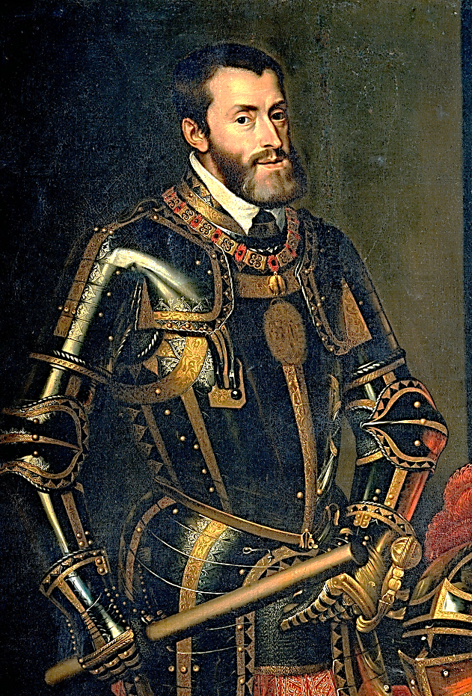
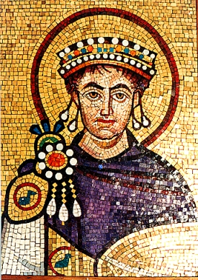
A DIVIDED KINGDOM
• Justinian
• Charles V
• Philip II
• Louis XIV
• Napoleon
• Kaiser William
• Hitler
Notes:
Justinian, Emperor of the East, Charles V, Philip II, Louis XIV, Napoleon, Kaiser William and Adolf Hitler tried to achieve this unity by using force, but they all failed.

Slide 47
What are the seven words written in the Bible which tells us that all attempts to unite Europe would fail?
Notes:
9. What are the seven words written in the Bible which tells us that all attempts to unite Europe would fail?

Slide 48
Daniel 2:43
…And whereas thou sawest iron mixed with miry clay, they shall mingle themselves with the seed of men: but they shall not cleave one to another, even as iron is not mixed with clay.."
but they shall not cleave one to another
Notes:
…And whereas thou sawest iron mixed with miry clay, they shall mingle themselves with the seed of men: but they shall not cleave one to another, even as iron is not mixed with clay.."
Daniel 2:43

Slide 49
What will God establish in the days when these nations are trying to unite?
Notes:
10. What will God establish in the days when these nations are trying to unite?

Slide 50
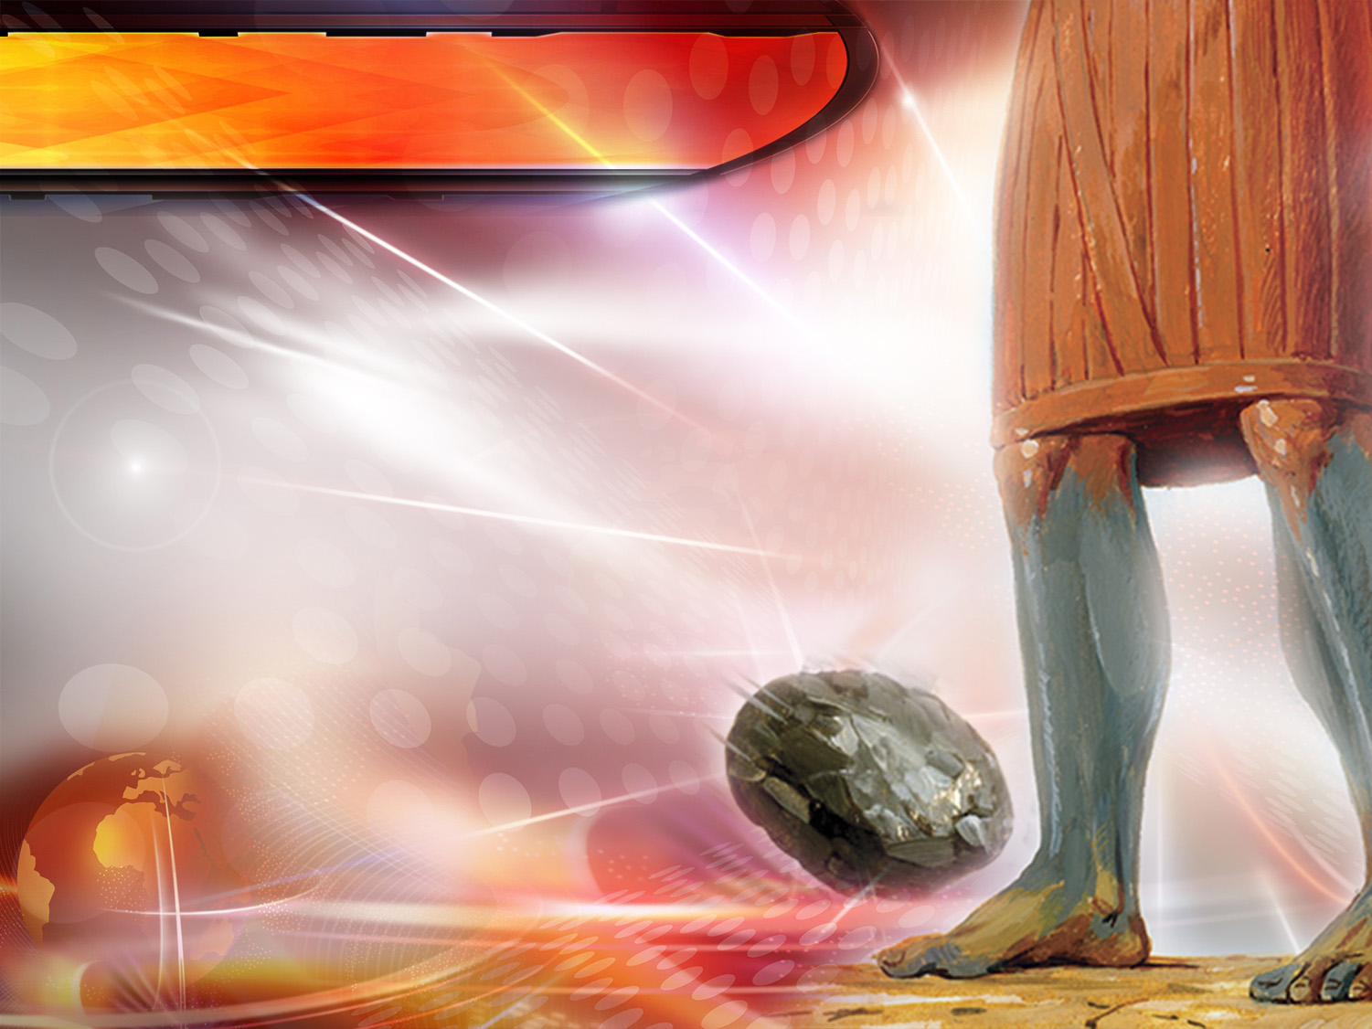
Daniel 2:34
"Thou sawest till that a stone was cut out without hands, which smote the image upon his feet that were of iron and clay, and brake them to pieces.”
Notes:
"Thou sawest till that a stone was cut out without hands, which smote the image upon his feet that were of iron and clay, and brake them to pieces.”
Daniel 2:34

Slide 51
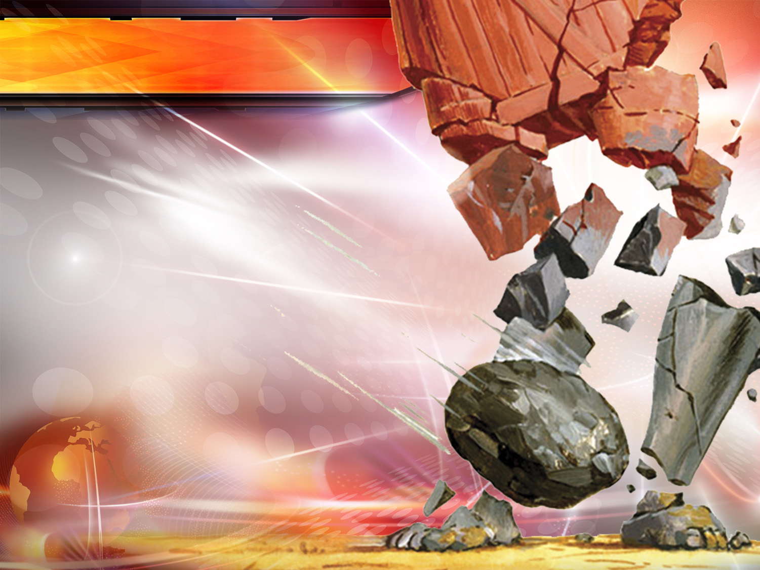
Daniel 2:44
“And in the days of these kings shall the God of heaven set up a kingdom, which shall never be destroyed: and the kingdom shall not be left to other people, but it shall break in pieces and consume all these kingdoms, and it shall stand for ever…
Notes:
"And in the days of these kings shall the God of heaven set up a kingdom, which shall never be destroyed: and the kingdom shall not be left to other people, but it shall break in pieces and consume all these kingdoms, and it shall stand for ever…
Daniel 2:44

Slide 52
Daniel 2:45
…Forasmuch as thou sawest that the stone was cut out of the mountain without hands, and that it brake in pieces the iron, the brass, the clay, the silver, and the gold; the great God hath made known to the king what shall come to pass hereafter: and the dream is certain, and the interpretation thereof sure.."
Notes:
…Forasmuch as thou sawest that the stone was cut out of the mountain without hands, and that it brake in pieces the iron, the brass, the clay, the silver, and the gold; the great God hath made known to the king what shall come to pass hereafter: and the dream is certain, and the interpretation thereof sure.
Daniel 2:45
The words "without hands“ mean that it is not a human but a divine event.

Slide 53
Whom did the stone that smote the image represent?
Notes:
11. Whom did the stone that smote the image represent?

Slide 54
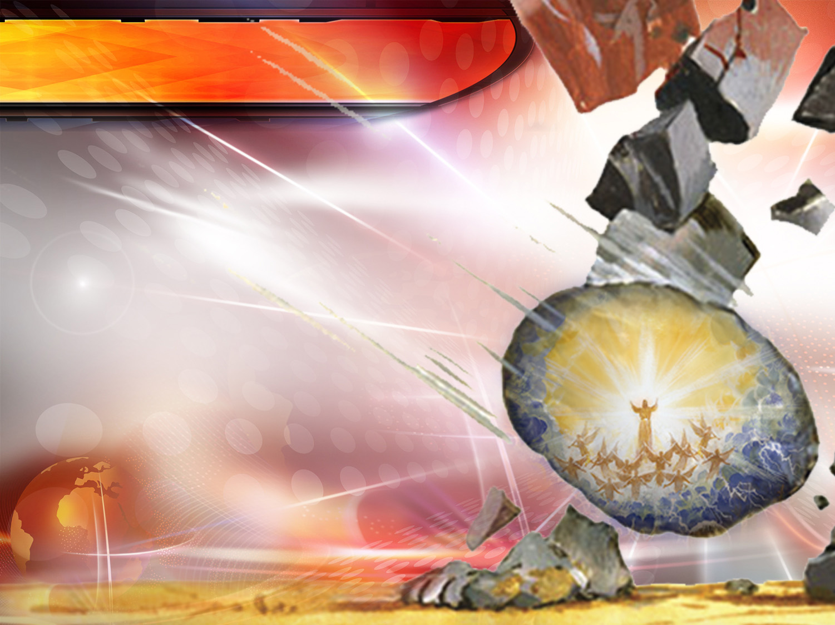
Acts 4:11
This is the stone which was set at nought of you builders, which is become the head of the corner.
Represents Jesus
Notes:
This is the stone which was set at nought of you builders, which is become the head of the corner.
Acts 4:11
Jesus Christ will intervene in human affairs in his second coming.

Slide 55
CONCLUSION
Notes:
CONCLUSIÓN

Slide 56
Who will be the ruler of the next world empire?
Notes:
12. Who will be the ruler of the next world empire?

Slide 57

Revelation 11:15
“And the seventh angel sounded; and there were great voices in heaven, saying, The kingdoms of this world are become the kingdoms of our Lord, and of his Christ; and he shall reign for ever and ever.”
Notes:
“And the seventh angel sounded; and there were great voices in heaven, saying, The kingdoms of this world are become the kingdoms of our Lord, and of his Christ; and he shall reign for ever and ever.”
Revelation 11:15
Jesus Christ will intervene in human affairs in his second coming.

Slide 58
Now that this wonderful event is imminent, what appeal does the Lord make?
Notes:
13. Now that this wonderful event is imminent, what appeal does the Lord make?

Slide 59

Luke 12:40
"Be ye therefore ready also: for the Son of man cometh at an hour when ye think not.”
Notes:
"Be ye therefore ready also: for the Son of man cometh at an hour when ye think not.”
Luke 12:40
Would you also like to prepare to be a citizen of the kingdom of Christ?

Slide 60

Thank you, Jesus, for giving me hope!
Notes:
Thank you, Jesus, for giving me hope!

Slide 61

GOD BLESS YOU!
Next topic: “What is the Cause of the World´s Current Situation?”
We know that there is crisis in society among nations, in the economy, in the family, in health and in the social and religious world.
There are a large number of extraordinary revelations about our time, which no one should ignore. They reveal the meaning of the present hour.
This is a really interesting topic. We will show the biblical predictions written 2000 years ago, and you will see that they describe what you read in today´s newspaper. Let us study this topic.
Notes:
GOD BLESS YOU!
Next topic:
" What is the Cause of the World´s Current Situation?"
We know that there is crisis in society, in all nations, in the economy, in the family, in health and in the social and religious world.
There are a large number of extraordinary revelations about our time, which no one should ignore. They reveal the meaning of the present hour.
This is a really interesting topic. We will show the biblical predictions written 2000 years ago, and you will see that they describe what you read in today´s newspaper. Let us study this topic.

Slide 62

biblewell.org
info@biblewell.org
Notes:
If you still have questions, write to us with confidence at: info@biblewell.org

