Slide 1

Notes:
(Presenter)
We wish to extend a cordial welcome to all of our friends and listeners to the third conference of the series "There is still Hope".
The RESCUE project wants to bring solutions to the concerns of humanity. We need to rescue Hope because many give up while facing the challenges of life.
There are situations where logic tells us that it is impossible to find a solution to our difficulties, but today we will hear how we can find Hope against Hope.

Slide 2
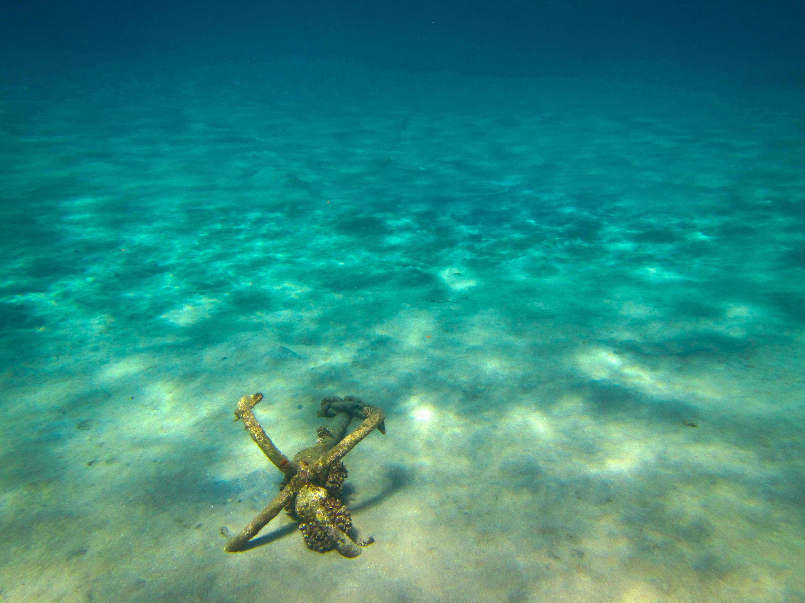

Pastor Idel Suárez Moleiro
Notes:
These conference will be presented by Dr. Idel Suarez Moleiro Jr. from the United States of America. Dr. Idel Suarez Moleiro Jr., holds a doctorate in nutrition, but more importantly, he is also a minister with a lot of experience in the spiritual area of work. He has presented conferences on all continents, helping alleviate human suffering in both the physical and spiritual areas of ​​thousands of people’s lives.

Slide 3

Notes:
We will now enjoy a melody and thus prepare our hearts for the message.

Slide 4
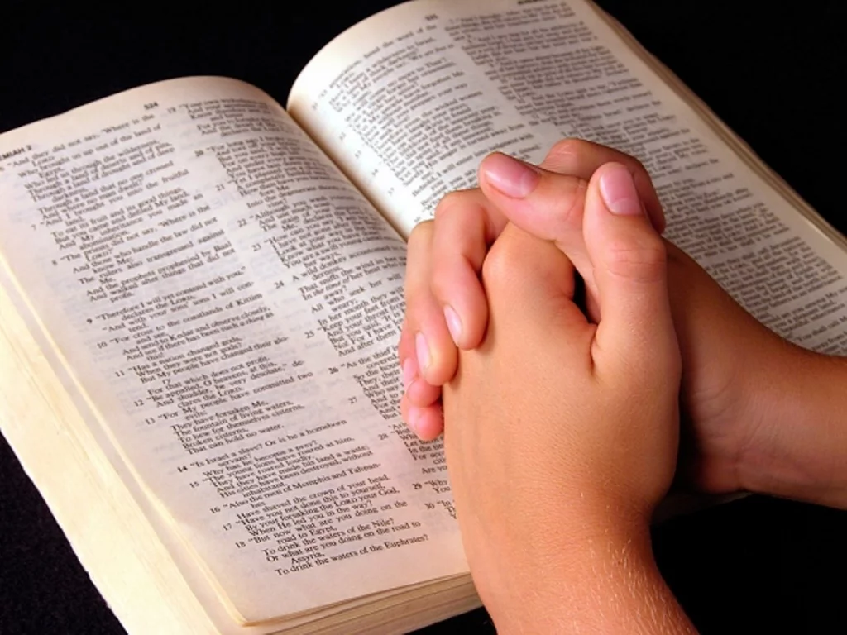
Notes:
Before listening to the conference, we want to ask God to guide our hearts today. Please bow your head with me as we pray.
(Presenter's Prayer)

Slide 5
Hope against Hope
Notes:
We now invite the lecturer, Dr. Idel Suarez Moleiro Jr. to share today’s topic entitled "Hope against Hope".
(Idel)
Good evening, I’m Dr. Idel Suarez jr.
And I am happy to share with you a third message of Hope.
I’ve titled tonight’s talk: Hope against Hope.

Slide 6
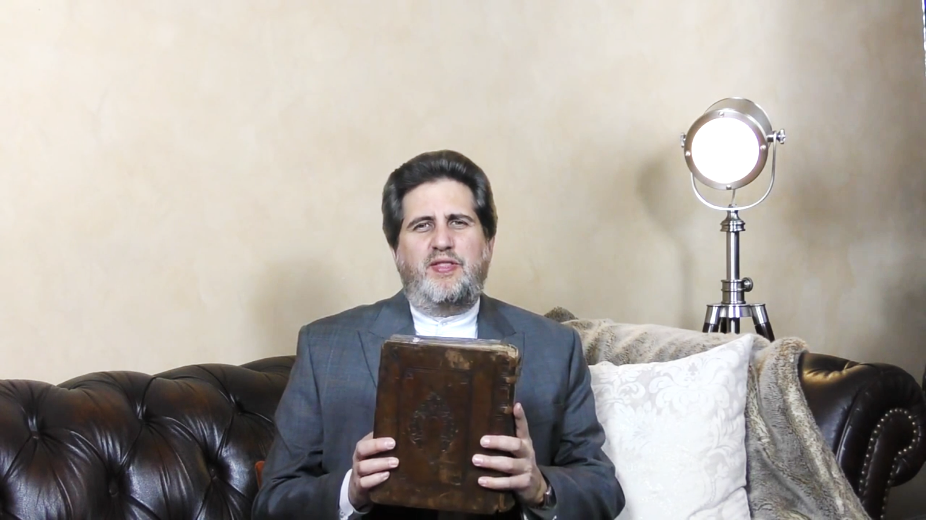
King James, 1676
Notes:
I have in my hands another old Bible. This one is 100 years older than the United States. It dates to 1676. It is a King James Version. It is an original. And when I read the King James in Romans chapter 4 verse 18 it says: Who against hope believed in hope. So against Hope. Tyndale translated that verse contrary to hope. He believed in hope. Paul was referring to the great patriarch Abraham.

Slide 7
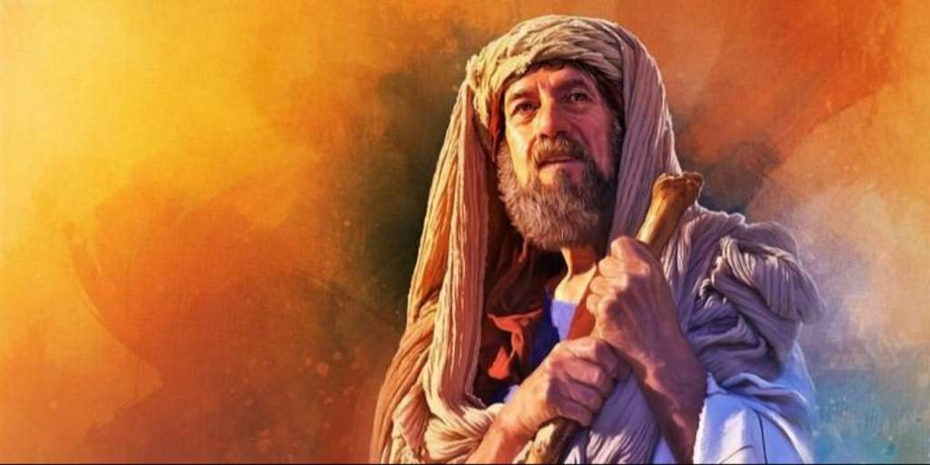
He believed in hope against hope.
Notes:
Abraham is considered the faher of the Jews, the father of Christians and the father of Moslems. And Abraham literally means the father of many nations. He had several difficult trials in his life. And the apostle Paul is referring to his desire to the desire of Abraham to have a son. And so he believed. It says, who against hope believed in hope. He believed in hope against hope.

Slide 8
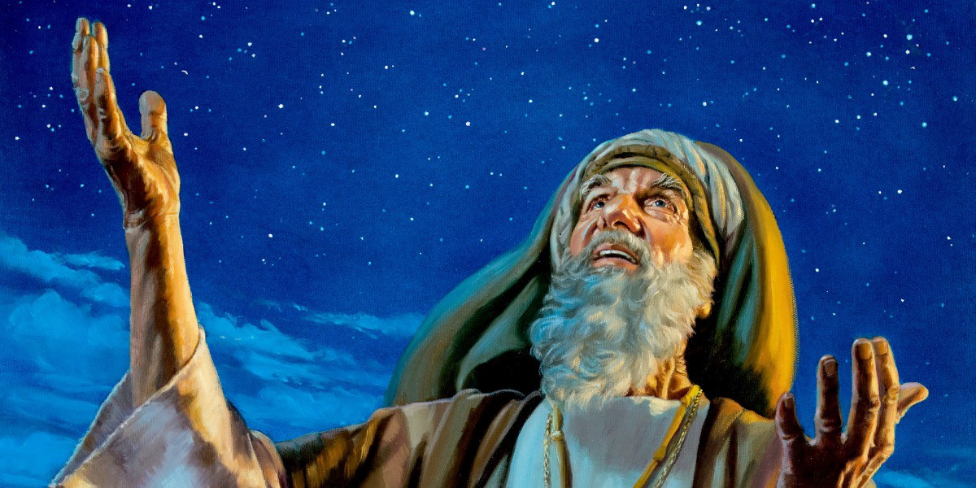
Notes:
Now lets put Abraham in context. He lived about 1000 years before David and 1000 years after Noah. And 2000 years before Christ. Abraham was a nomad. He had a following of about 1000 people. Many of them were slaves, servants, born in his house, but Abraham would be considered like a paterfamilias by the Romans who would come centuries later. That means that everyone in his household was important to him. He treated every person in his household, every servant, every slave, as his son, as his daughter. Abraham was from the city of Ur of Chaldies that is in Southern Irak and God called him out of there and he left with his father, he went through Syria and then down into Palestine. And in Palestine he continued to have visions from God. Imagine this Abraham who is wealthy who is brilliant militarily who is a diplomat who is happily married who is deeply religious, everything seems to go well, except one thing, he doesn’t have: a son. And God gives him a vision. He says: Abraham, I am going to give you a son and you are going to have children, grandchildren, your children will be like the stars in the night.

Slide 9
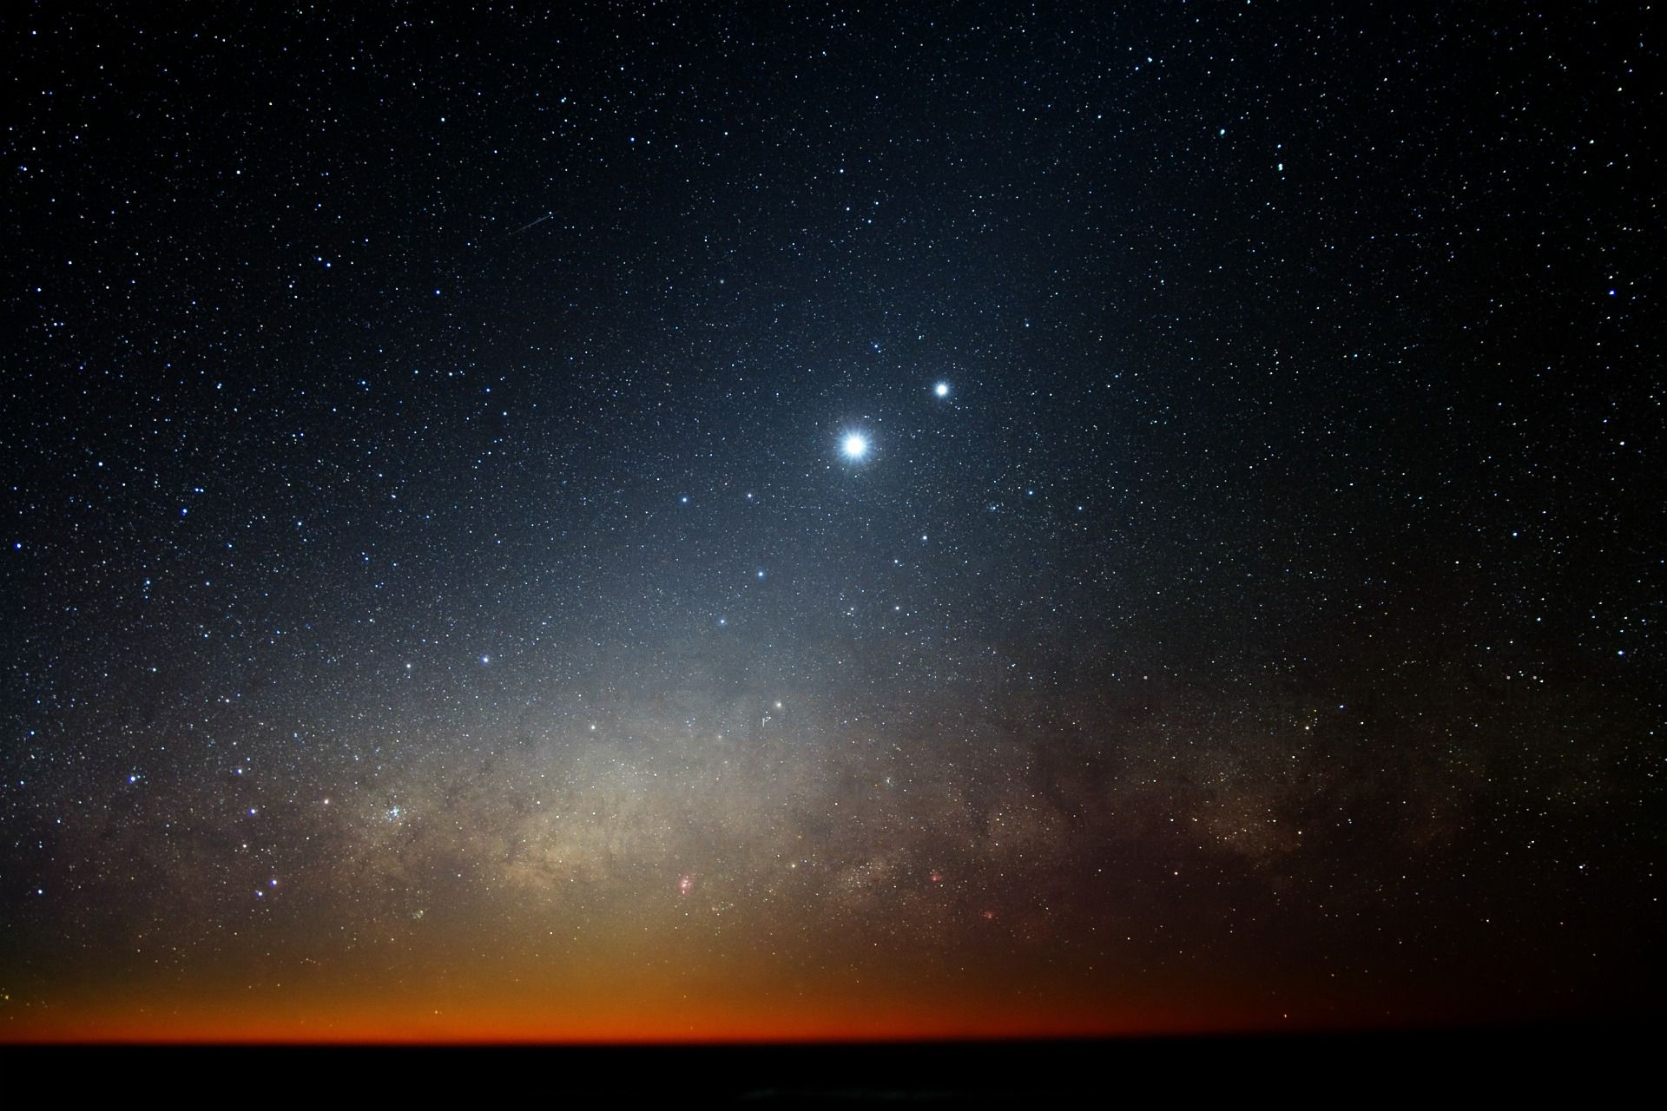
Notes:
Now on any given night, away from the city lights, away from the town lights, away from all artificial light, with the naked eye you can count about 2000 stars I’ve been told. And so Abraham, you can imagine him there in Beersheba that is south of Jerusalem and I’ve been in that area. There is a place called “Abram’s well” and they say that Abraham was the one that dug that well. Well, there are many wells and they are all ancient wells there and perhaps Abraham dugged one of those wells. But Abraham was looking deeper. He was looking into the future and he was happy to hear the words of God that he would have a son. Now what does this mean when I read from Rom. Chapter 4:18: Who against hope believed in hope that he might become the father of many nations according to that which was spoken so shall thy seed be? That would be like the stars of the heaven.

Slide 10
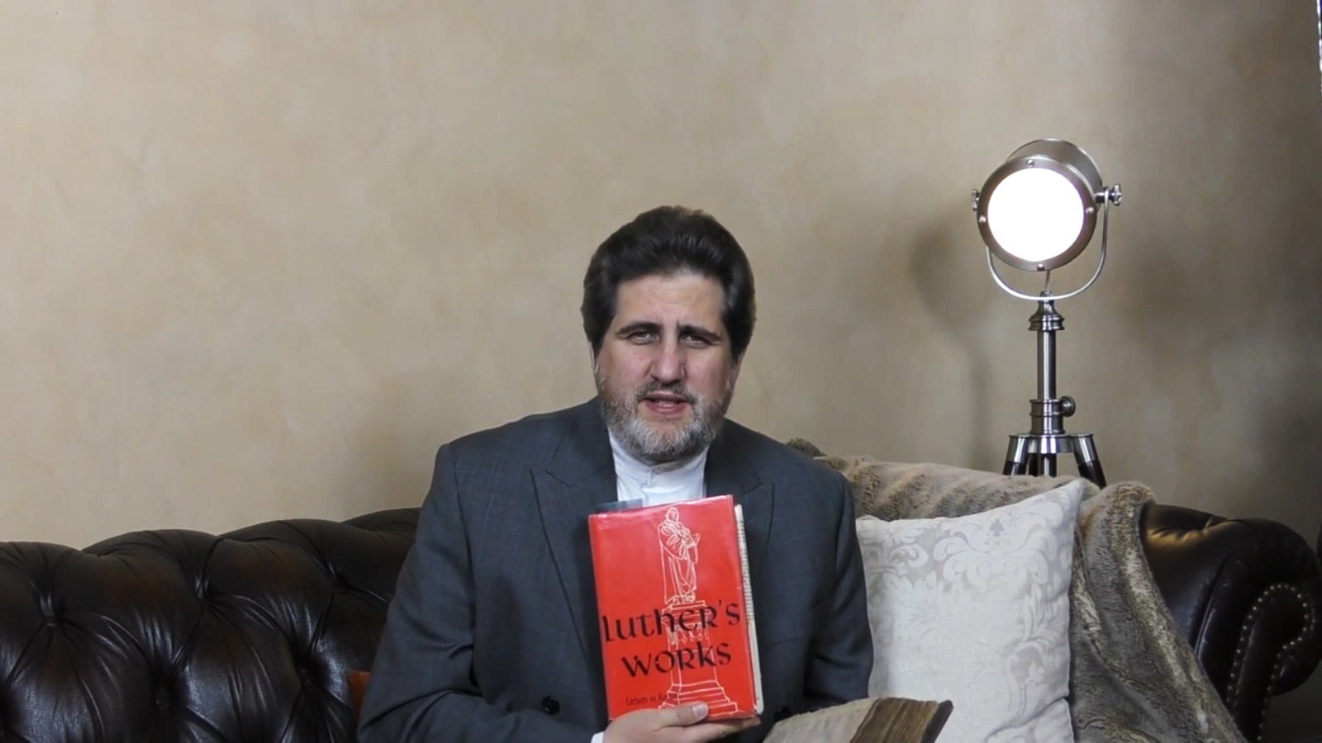
Luther’s Works
• Natural hope
• Supernatural hope
Notes:
Now I’m going to call to the witness stand. The two great reformers of the 16th century, Dr. Martin Luther and also Master John Calvin. One was a German, the other was a French man. And Martin Luther says, that there are two types of hope. And I have his book here you can if you have access to Luther’s works, his commentary to the Romans, I’m going to summarize what he said. He said that there are two types of hope. There is a carnal hope there is a hope that is based on the expectations of the people based on their passed knowledge and there is a different hope which he calls the supernatural hope. So there is the carnal and the natural hope and then there is the supernatural hope. I quote what he says:

Slide 11
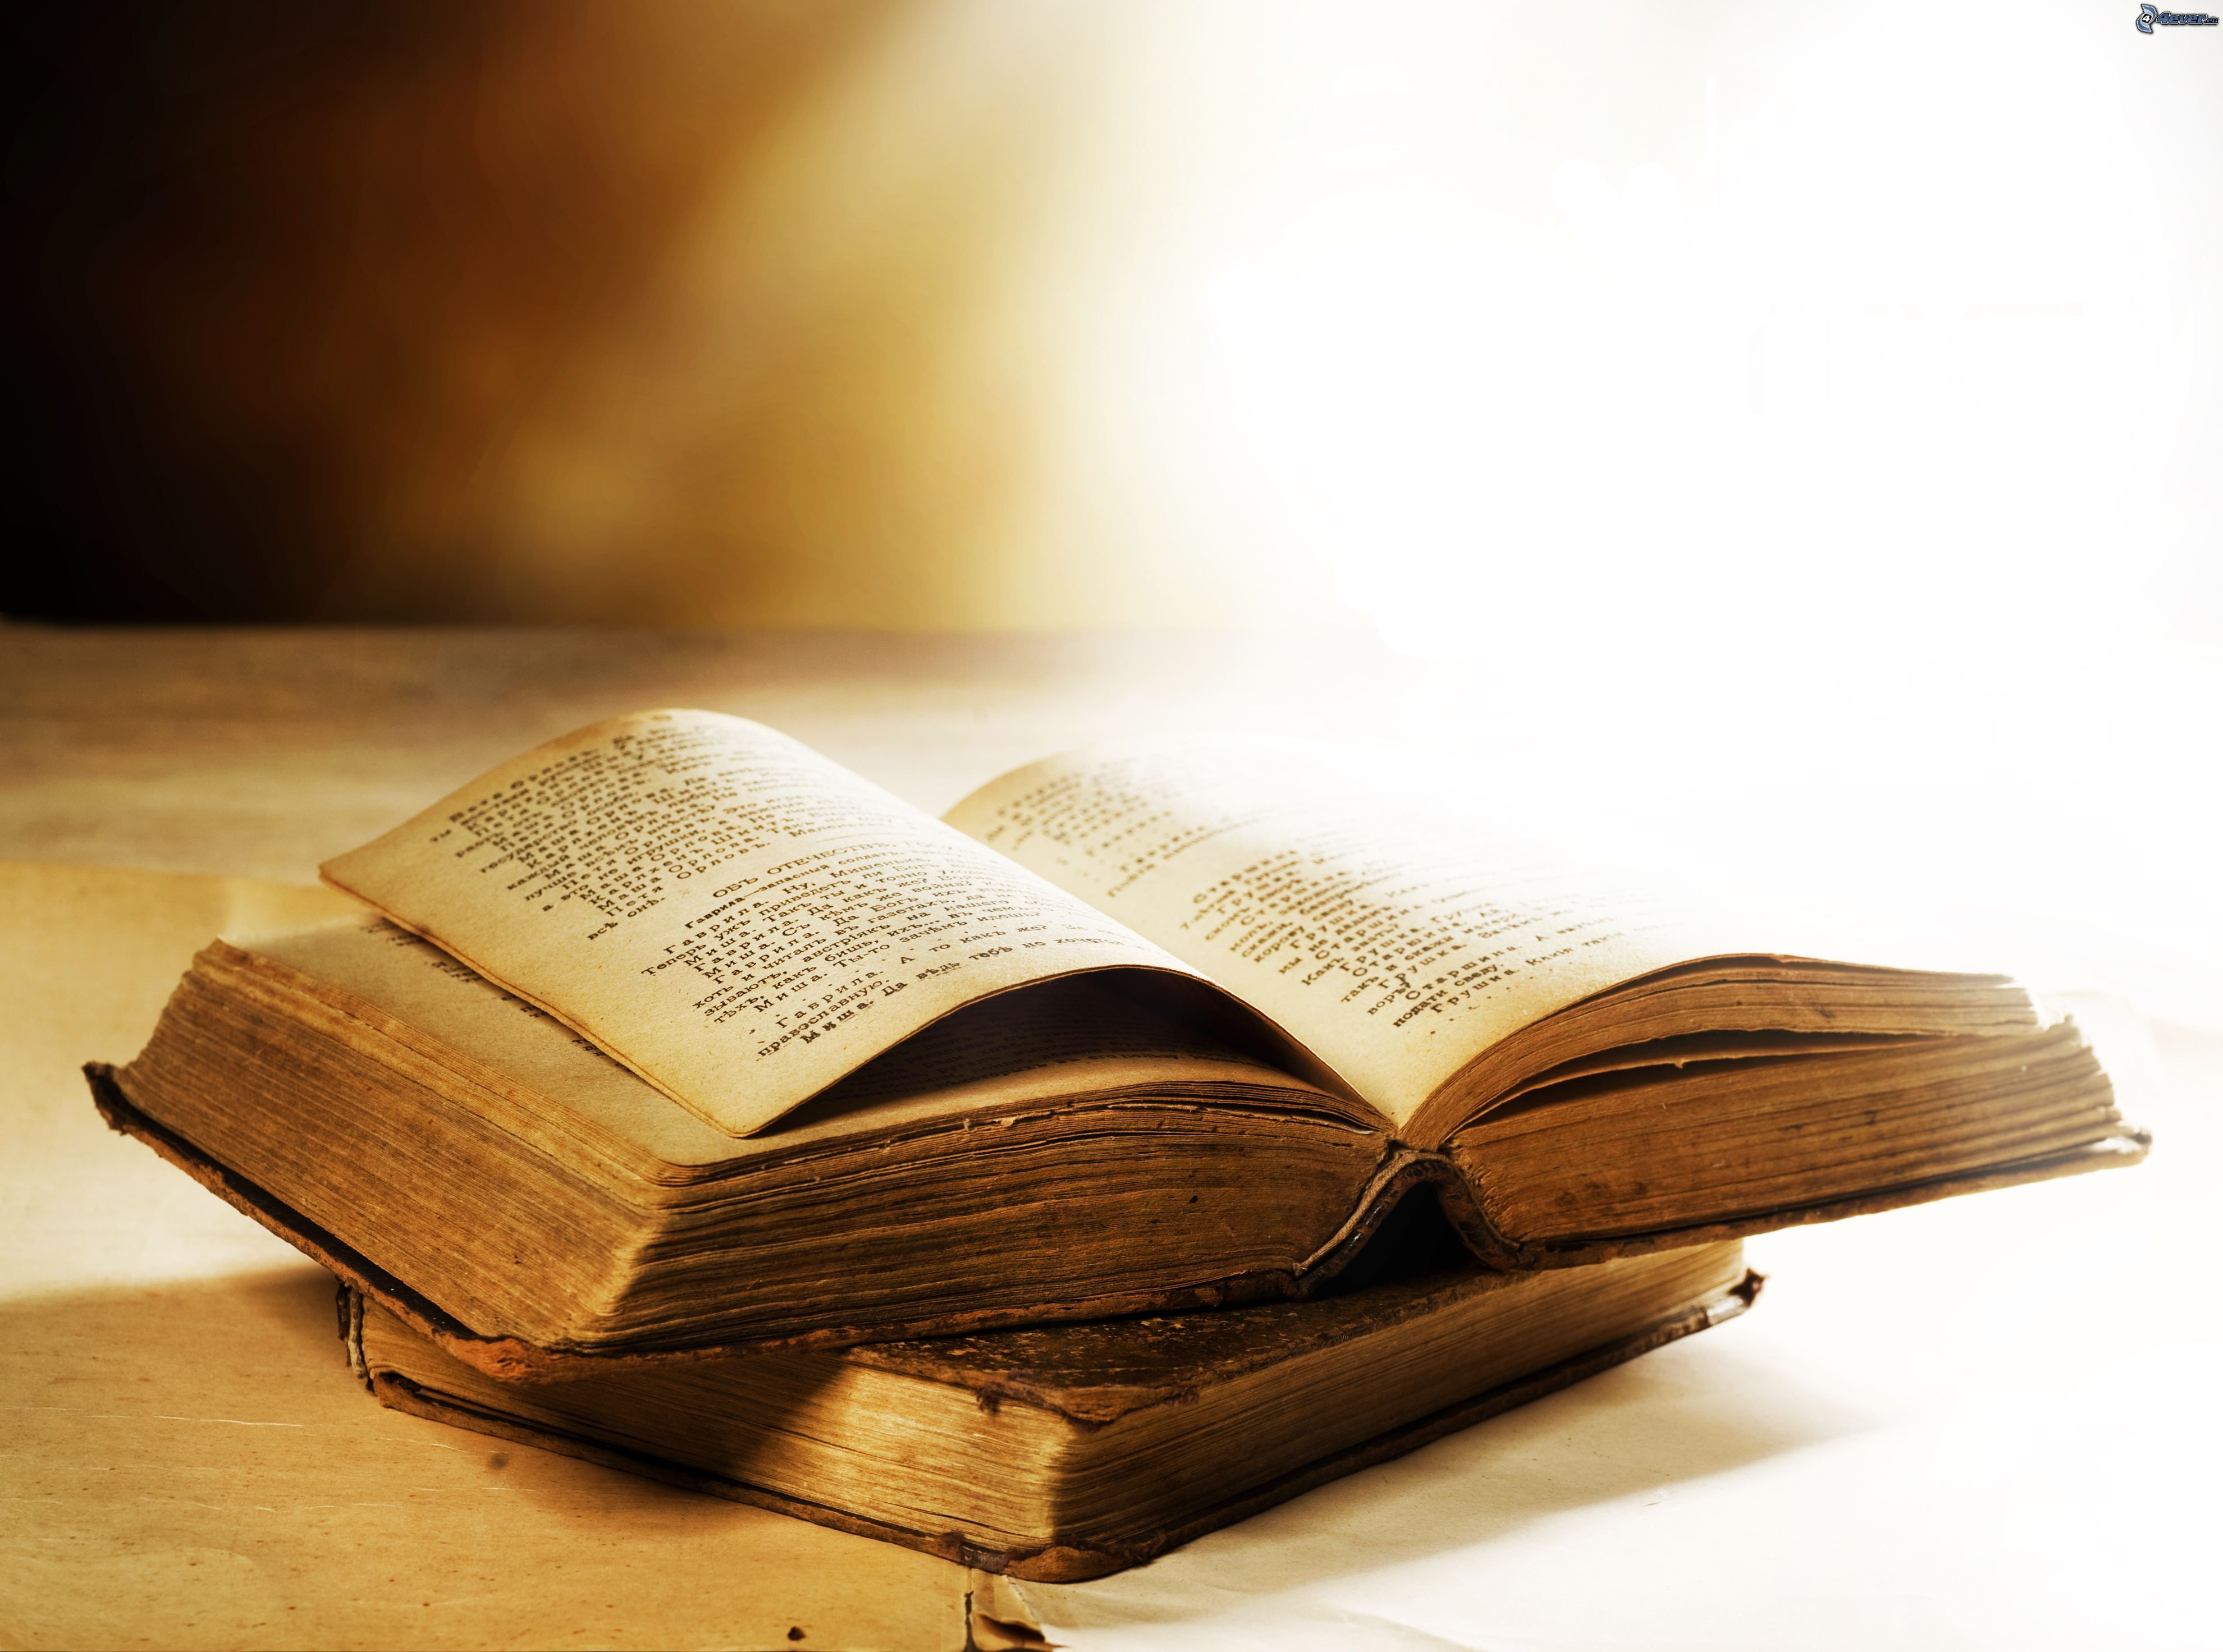
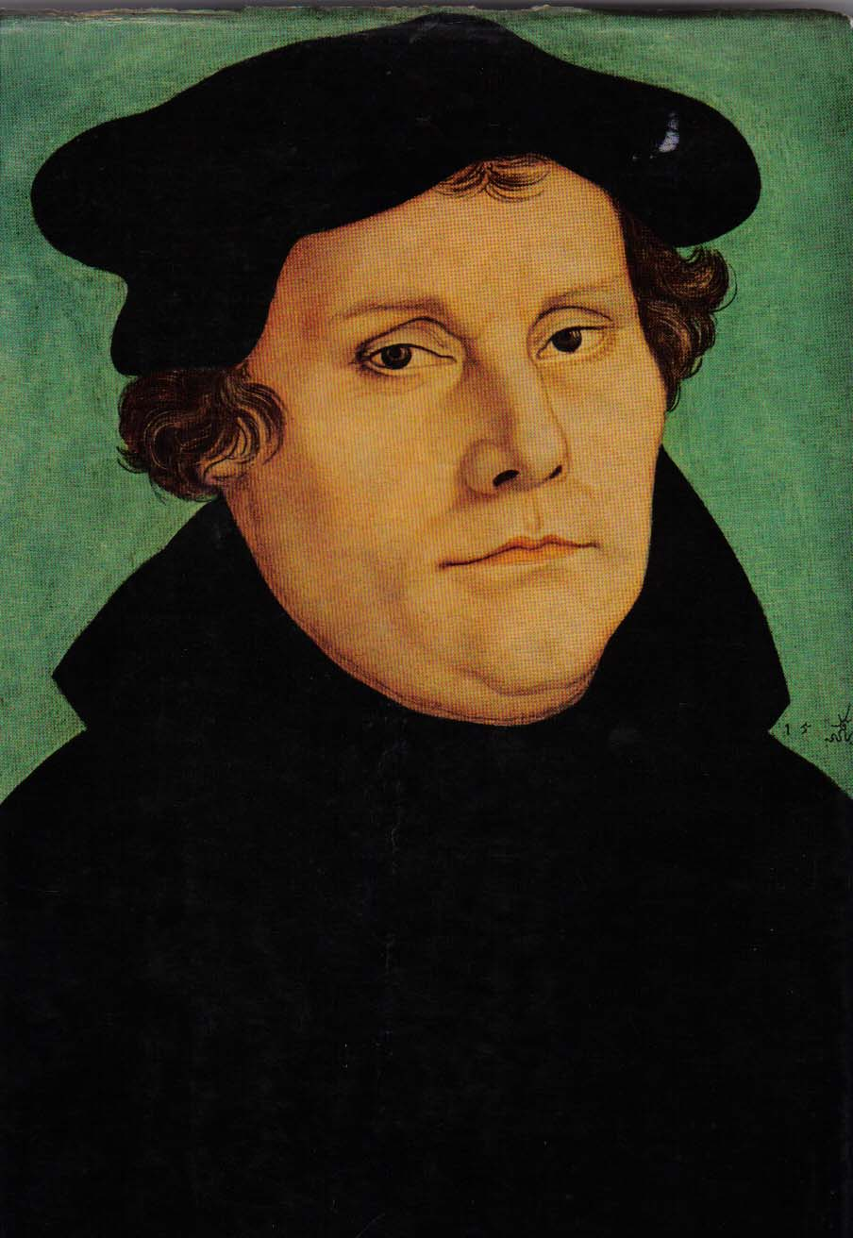

“A Christian’s hope is a hope that knows that the expected things must happen and that they will not be hindered while waiting, since no one can hinder God."
Notes:
The hope of Christians is a hope that knows that the things hoped for must come to pass and will be hindered as it is hoped for, for no one can hinder God.

Slide 12
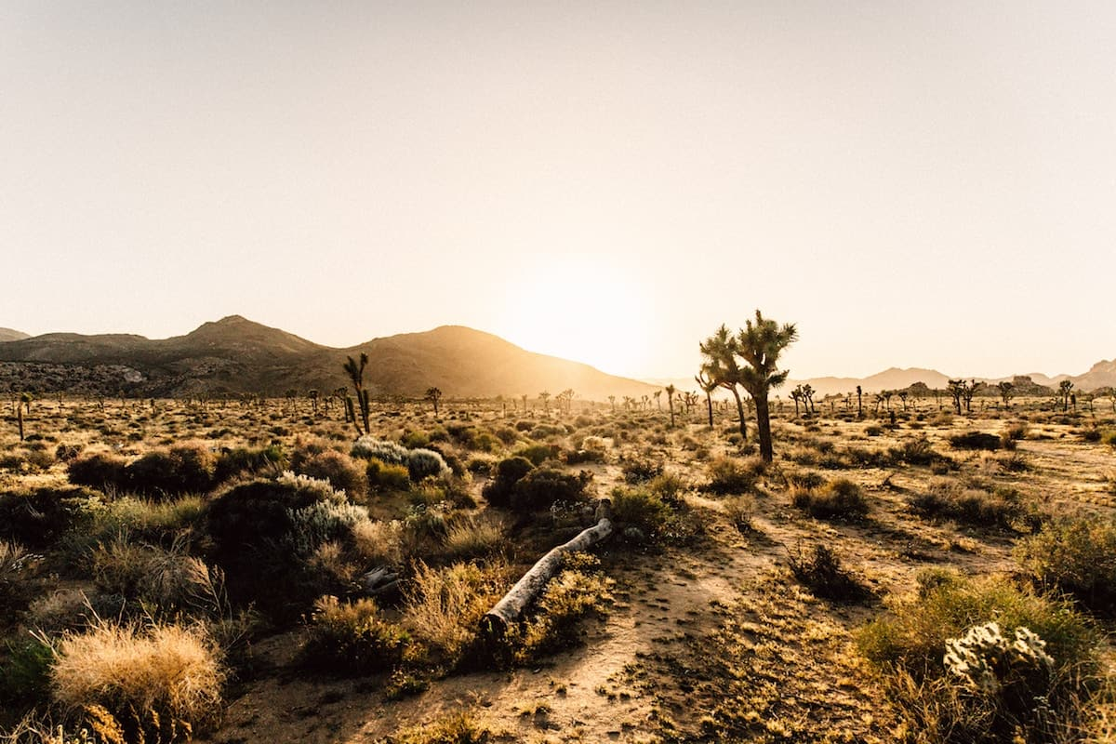
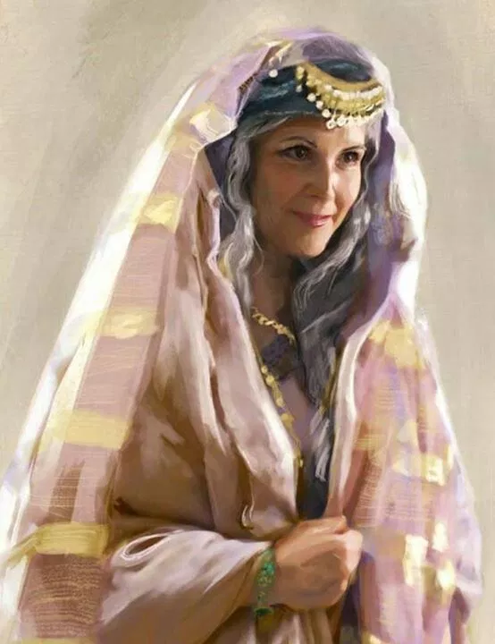
Notes:
Now Sarah’s bodily condition was not promising, she was old, she was sterile and perhaps she was passed her menopause. So she was not going to have children, humanly speaking, medically speaking. Now Calvin agrees with Luther and he adds then in the first instance Paul is referring to a probable evidence for hoping. He says the first type of hope that natural hope that carnal hope is based on probability and natural observation. But there is another hope. And Calvin says this second hope is a hope that relies on the promises of God. Abraham thought as sufficient reason of hoping that the Lord had promised however incredible the thing was in itself, would happen.

Slide 13
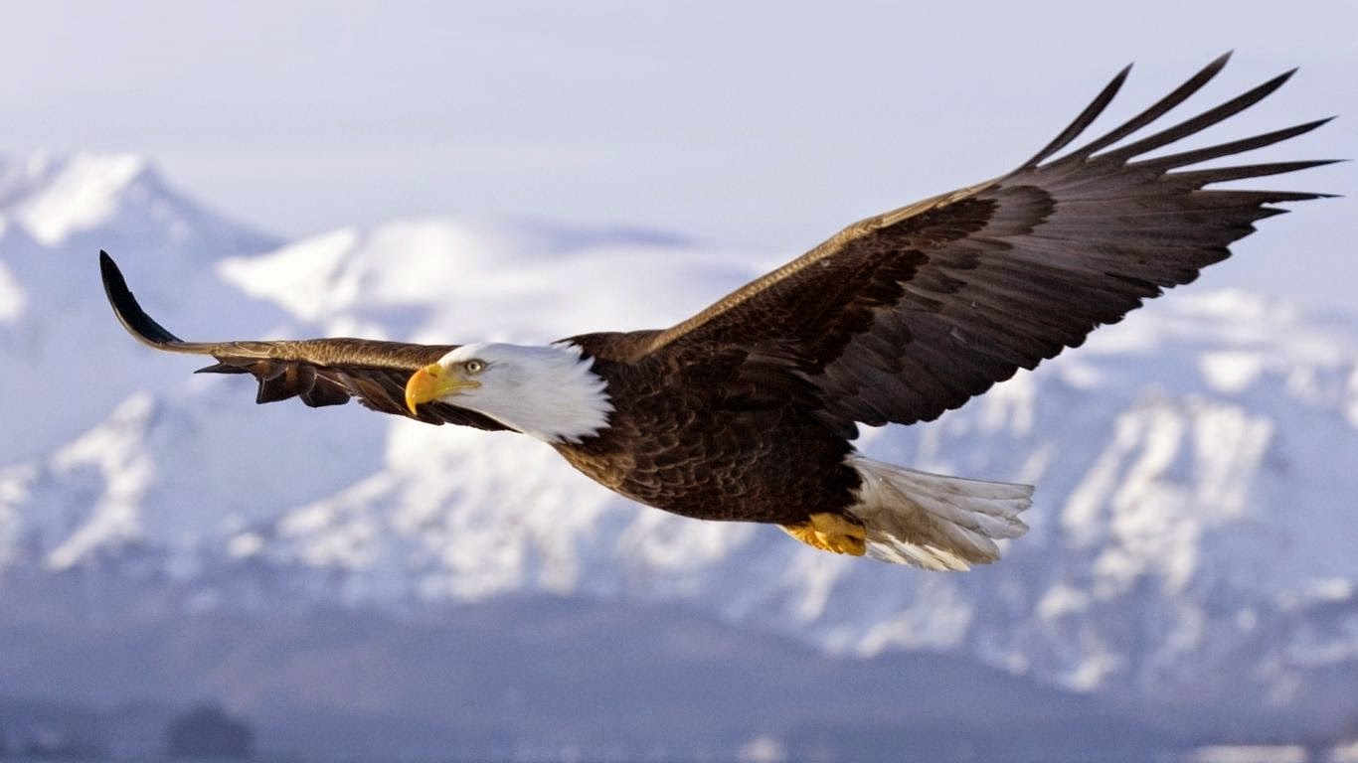
Notes:
And then Calvin gives this analogy of hope and faith like two wings of a bird and they says they fly above the mother of earth the mother of flesh and they see with celestial vision with celestial wings the promises of God.

Slide 14
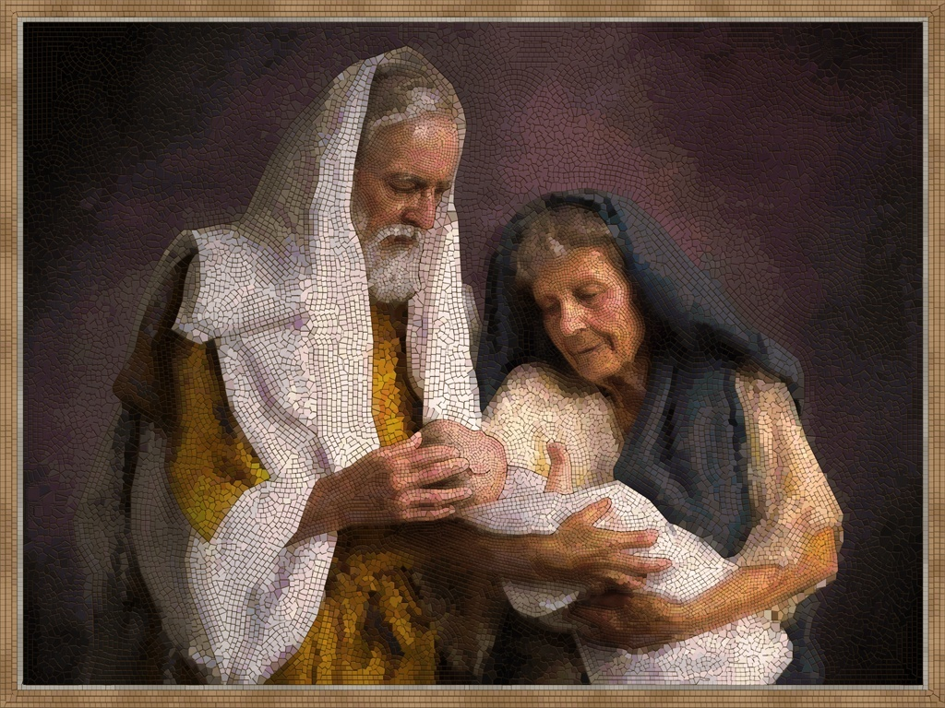
Notes:
Now Abraham had a son and they named him Isaac and this was a miracle. Isaac means laughter. I can see Sarah laughing as she is breastfeeding her baby as she is tickling him as she sees him become a toddler and give his first steps as she beholds him as a child as a teenager. Isaac lived with Sarah according to the biblical record for 37 years till he was a full grown man. What a miracle what a joy it was for Sarah to behold Isaac. And what a joy for Abraham to see Sarah so happy and his son. Now this coming of Isaac has a double meaning. Abraham hoped to have a son and his hope was against hope. He didn’t rely on a carnal hope on a natural hope on the evidence or the probability according to human calculations. But no, he relied on a super natural hope, a hope that God would give, that was based on God’s promises and Isaac came and Isaac means laughter. And the allegory for us today is that Isaac can be born in us today. We can have that joy, that laughter, that rejoicing. The same rejoicing Isaac brought to the family of Abraham, the gospel of Christ can bring to your home. It is a gift of the spirit.

Slide 15
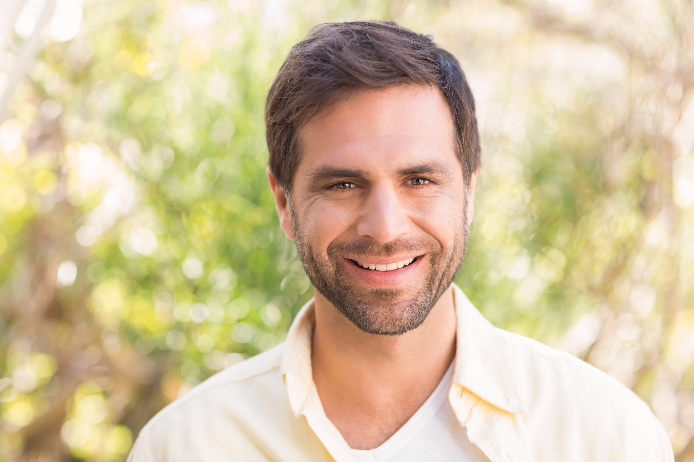
Notes:
We can create our own existential experience, regardless of the situation in which we live and we can live as if it was with God intended it to be to live to see our hopes materializing become real. Isaac, the laughter, the joy, the rejoicing can be born in our hearts in our minds and in our families.

Slide 16
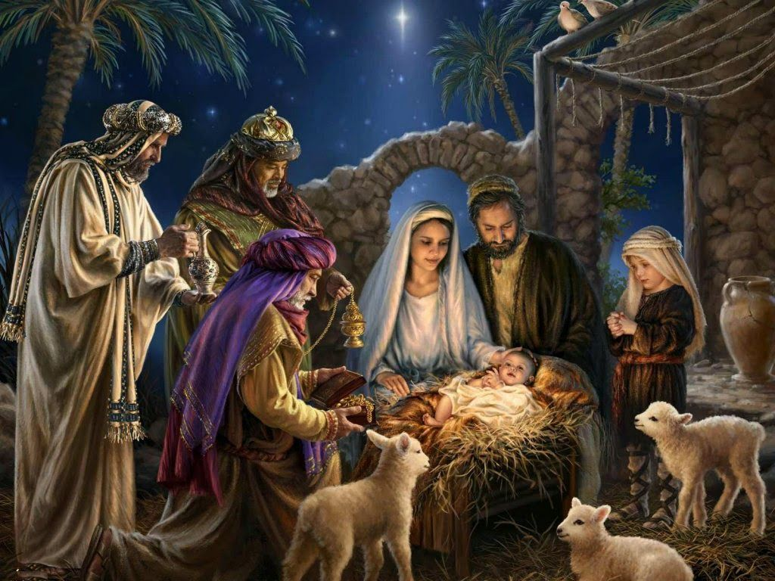
Notes:
But there is a second meaning. You see Isaac was a prototype of Jesus Christ. Why does God repeat the story of Abraham and Sarah having a child? Because if they in their old age in her sterility, in Abraham seeing his body is nearly dead as being incapable of having anymore children. After Ismael God worked this miracle. It was to prepare the Jewish mind that even a virgin could have a child. It would be of the same magnitude the workings of God in human flesh. And Isaiah foretold, I read to you form Isaiah 7:14. It says: Therefore the Lord himself shall give you a sign; Behold, a virgin shall conceive, and bear a son, and shall call his name Immanuel.”

Slide 17
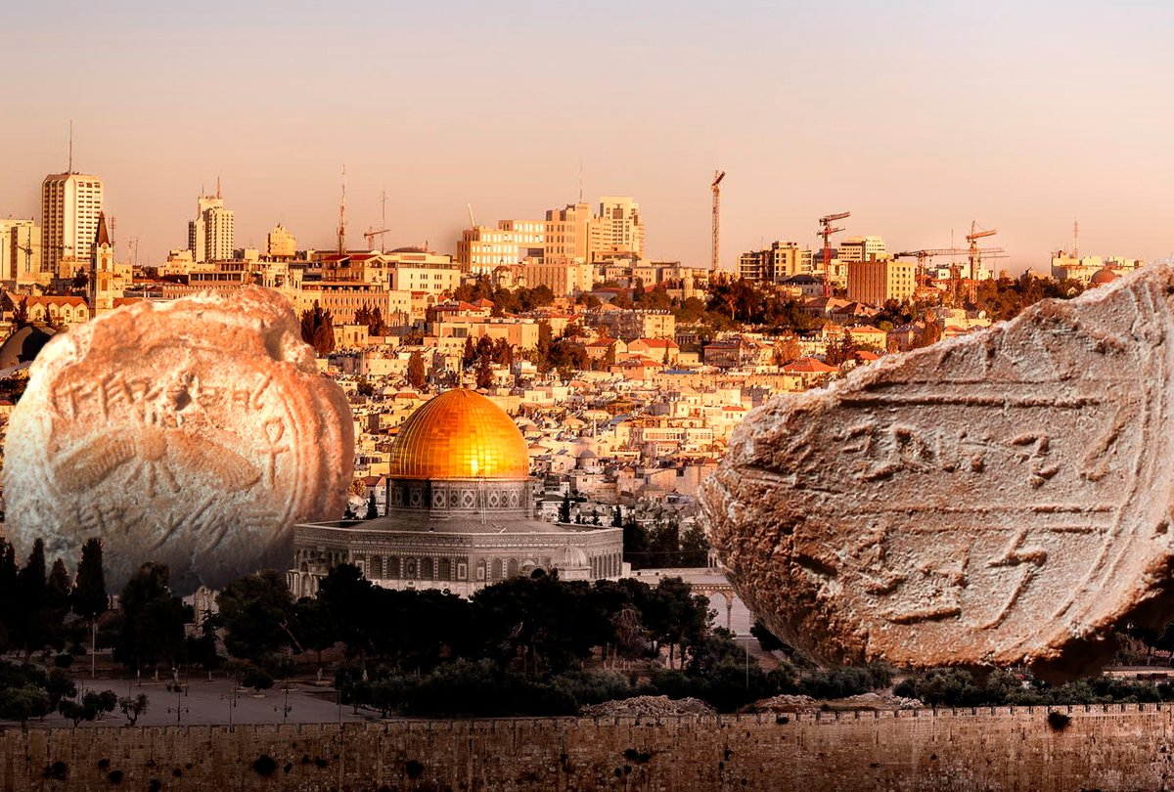
Notes:
I was so happy when I read that they discovered the stamp of Isaiah. Isaiah has a stamp and it was discovered very close to the stamp of Hezekiah the king, that ring at the time of Isaiah. There is proof that Isaiah is a real person, that he wrote the book of Isaiah. And Isaiah foretold that the messiah would be born of a virgin. That virgin we know was Mary of Nazareth.

Slide 18
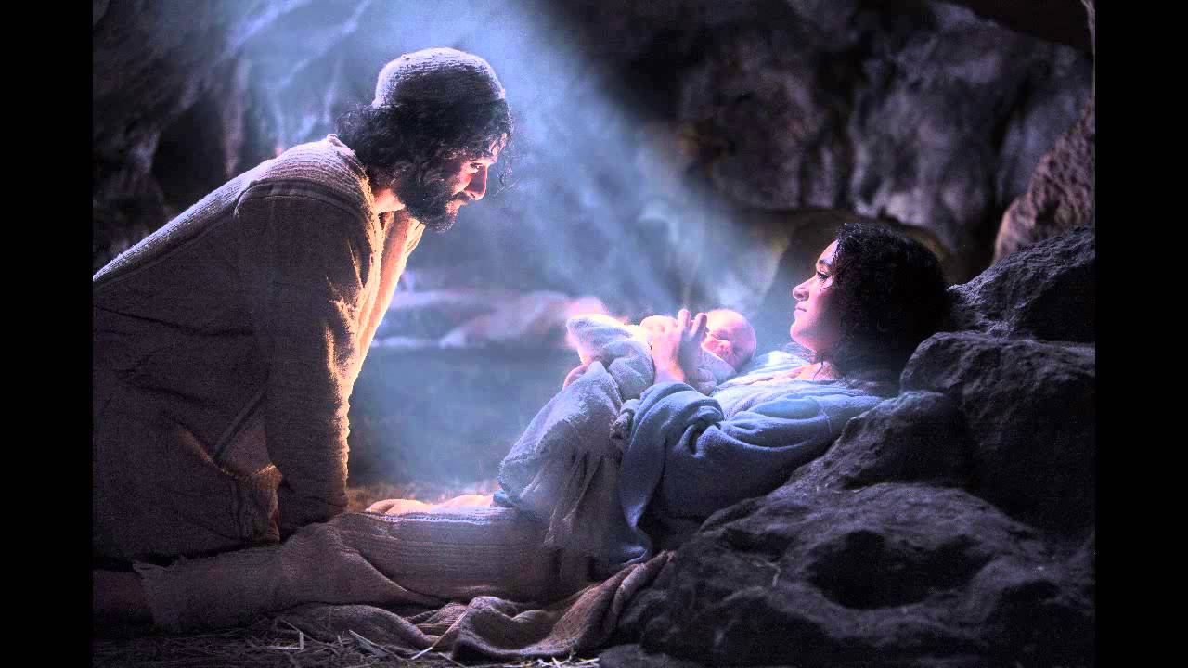
Notes:
What a miracle! God was preparing the Jewish people for the coming of Christ, that they could go back and think about Abraham and what God did in the family of Abraham he would do now among the descendents of Abraham. The almighty God would be born of a virgin. His entrance to the world would be a miracle, but it is enough that Christ was born of the virgin Mary. The apostle Paul says in 1st Timothy chapter 3:16: And without controversy great is the mystery of godliness: God was manifest in the flesh.” It’s not enough that Christ was born in the bosom of Mary in her womb and that he was born like a little baby. No, that is not enough, he has to be born in my heart in my mind in your heart in your mind. Christ must be born. The prince of peace, the prince of joy. The great hope of Israel was the Messiah and he used to be our hope also.

Slide 19
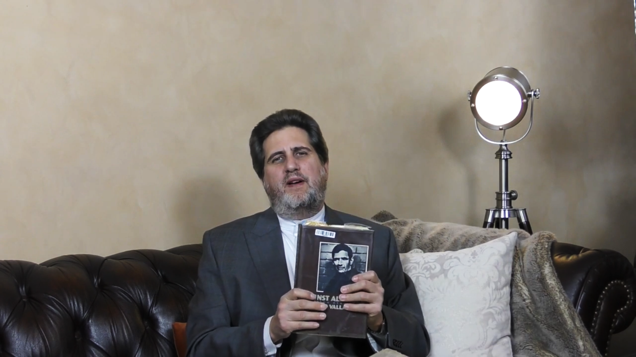

Notes:
I want to illustrate this with the life of Armando Valladares. You see throughout history throughout the history of humankind there have been men and women who had hope against hope. And I have here the book written by Armando Valladares. His memoires, his prison memoires against all hope. Armando Valladares was kept in Cuban prisons for 22 years.

Slide 20
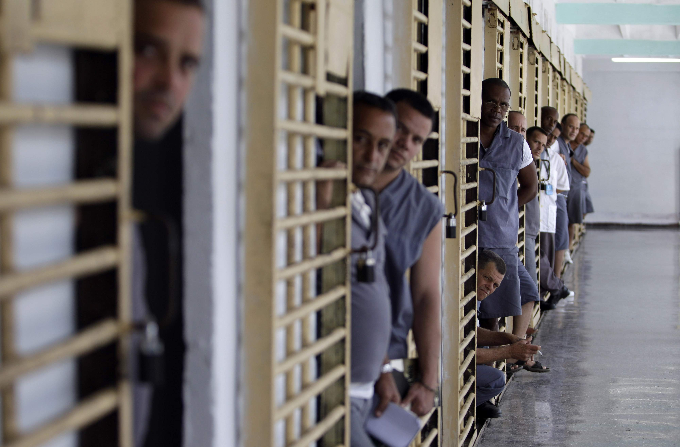
Notes:
He was a political prisoner. He didn’t agree with the ideology of the socialist government and he was put in jail and he says, while he was in jail he was tortured, he was beaten. He went on a hunger strike. He ended up being crippled. He could not walk. He had to move in a wheel chair. He was separated from seeing the sun, the stars and hearing the birds and seeing the butterflies. No exercise outside in the open air.

Slide 21
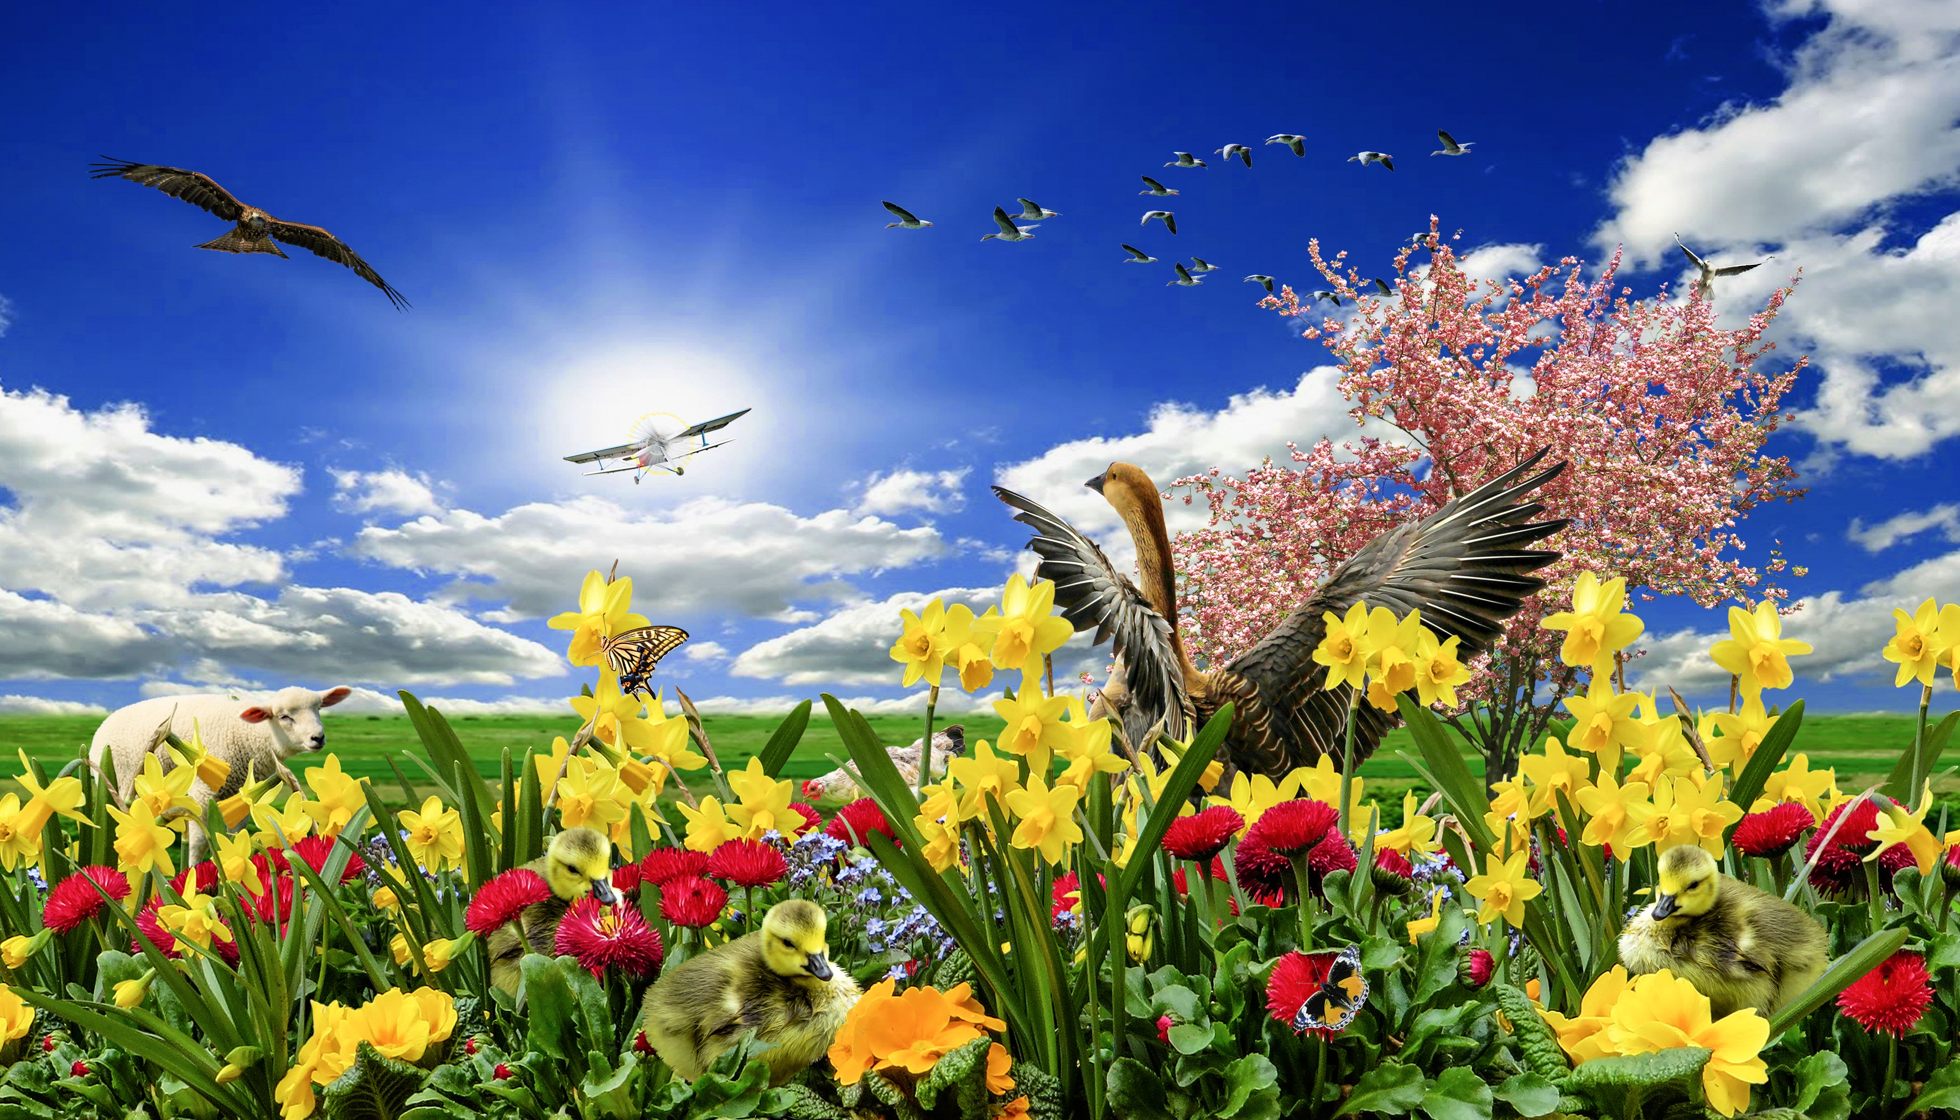
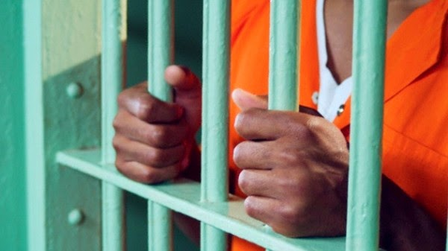
Notes:
And he says that he was able to create in his mind an environment with a shiny sun, with birds and butterflies. He was able to picture in his mind the stars at night, the moon, and he started to compose poems from his jail cell, from his confinement. And they were able somehow to smuggle these little pieces of paper with his poems.

Slide 22

"They've taken everything from Me: pens, pencils, but I still have the ink of life, my own blood. And I'm still writing poems with that "
Notes:
But the guards found out and they took away his paper, they took away his pen and they took away his writing material. And this is what he says in his book and I am going to read it to you. His poem, it is translated from Spanish: They have taken everything away from me, pens, pencils, but I still have life’s ink, my own blood. And I am still writing poems with that. He ended up pinching himself and with his blood writing verses and poems to express the desires of his heart.

Slide 23
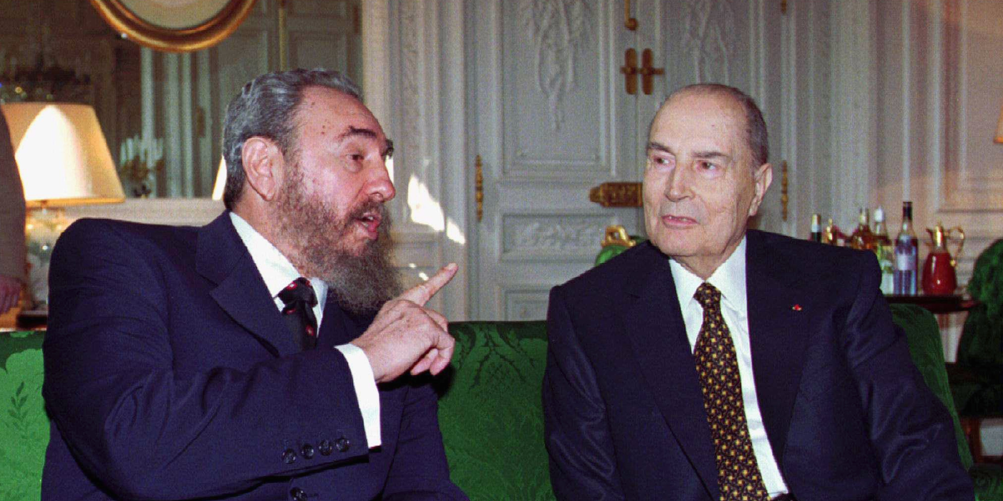
Notes:
Well after 22 years he had lost all hope of being freed. And his wife was in Europe and she spoke to France’s president, Francois Mitterrand. And Mitterrand spoke to Fidel Castro and interceded for Valladares. A miracle occurred. Those same people that crippled him now were providing physical therapy for him. They had a doctor assigned to him, an orthopedic doctor and they started to give him certain exercises and they started to feed him more food and they started to take him out. They created a special cell for him. They wanted to train him, train his body so he would be well, without telling him that he would be free. And for many months he went through this rehabilitation to the point that he was able to walk. And they called him in, the general called him in. He says, in his book and I’m reading form the last chapter. And he says: They have manipulated the hopes of freedom o many of the prisoners. For years I have survived without the hope of being free.

Slide 24
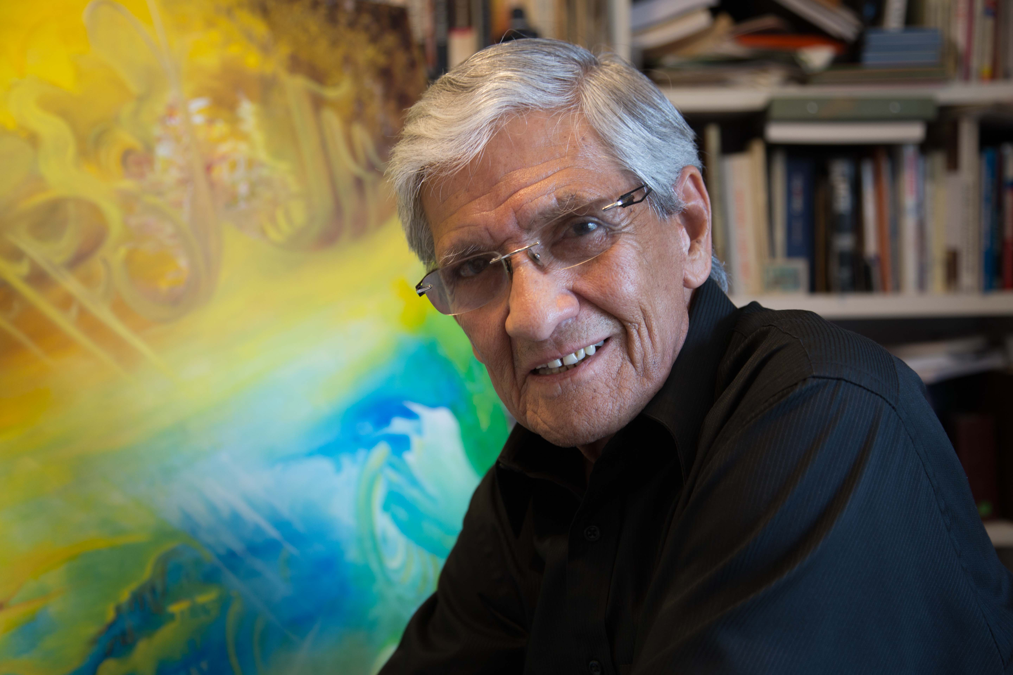
Notes:
But he hoped against hope. And he was able to break away from his mental prison. And his faith brought him through. He was able to leave the prison, he was able to leave Cuba and he was able to be reunited with his wife. And today he lives in Florida. Hope was able to revive his body, to resurrect his dead body to the point that he could walk again.

Slide 25
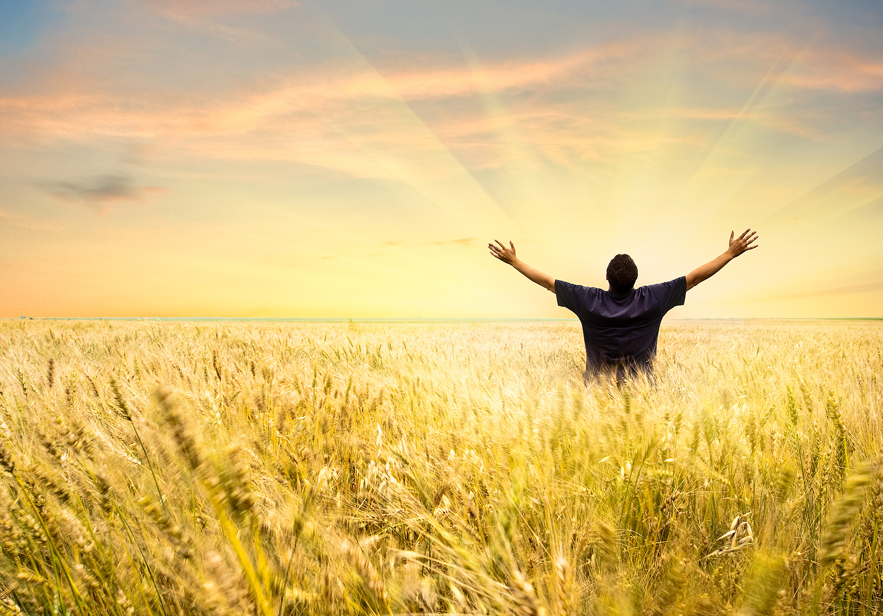
Will you wait with hope?
Will you ask God to release you from any emotional prison you may be in?
Notes:
Perhaps you have been crippled because of certain experiences in life. Perhaps you feel like dead on the inside like Abraham felt, but by God’s sovereign grace you can hope against hope. Against hope you can believe in the hope of God. Will you hope against hope? Will you ask God to free you from whatever emotional prison you might be in. Will you plead with the wings of faith and hope to fly above your present circumstances and believe that the expectation of a regenerated heart is the joy and laughter with God, the fulfillment of your dreams according to God’s will? I hope that you too, against hope, will believe in Hope. Will you do that? Thank you very much and may the hope of faith and the love of God be with you. Good night.

Slide 26


The Following Topic:
“There is Still Hope”
biblewell.org
Notes:
(Presenter)
How wonderful it is to know that there is hope in God when hope in men vanishes. We have an almighty God.
We have reached the end of the third conference.
Tomorrow we will listen to the last conference of the series entitled "There is still hope" Do not miss tomorrow’s topic at the same time as today.
(If you have not prayed in the conference you have to make a prayer before finishing)
God bless you. We wait for you with your family and friends.
See you tomorrow!

