Slide 1

Notes:
We would like to extend a cordial welcome to all of our friends and listeners to the fourth and final conference of the series "There is still Hope"
Finding hope means finding strength to fight and move on. To find hope is to see a ray of light after a night of darkness.

Slide 2
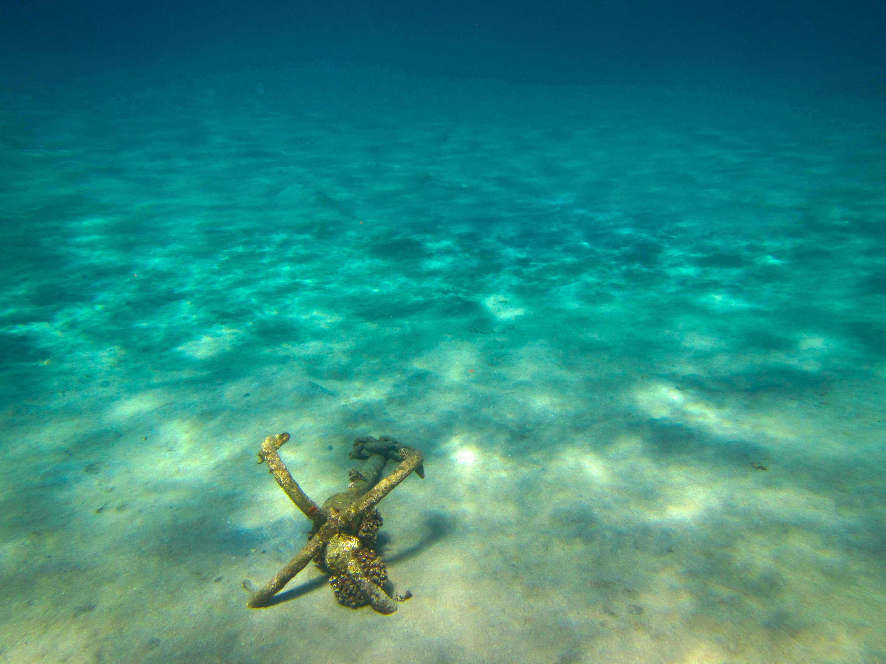
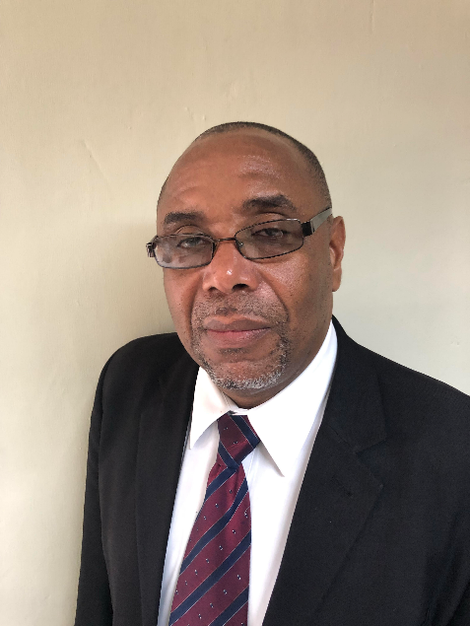

Pastor George Gowie
Notes:
The conference tonight will be presented by the lecturer, George Gowie from Jamaica. Besides serving in Jamaica, the speaker- Pastor George Gowie, has contributed to bringing hope to people from different countries of the Caribbean Islands as well as other continents.

Slide 3

Notes:
We will enjoy a melody to prepare our hearts for the message.

Slide 4
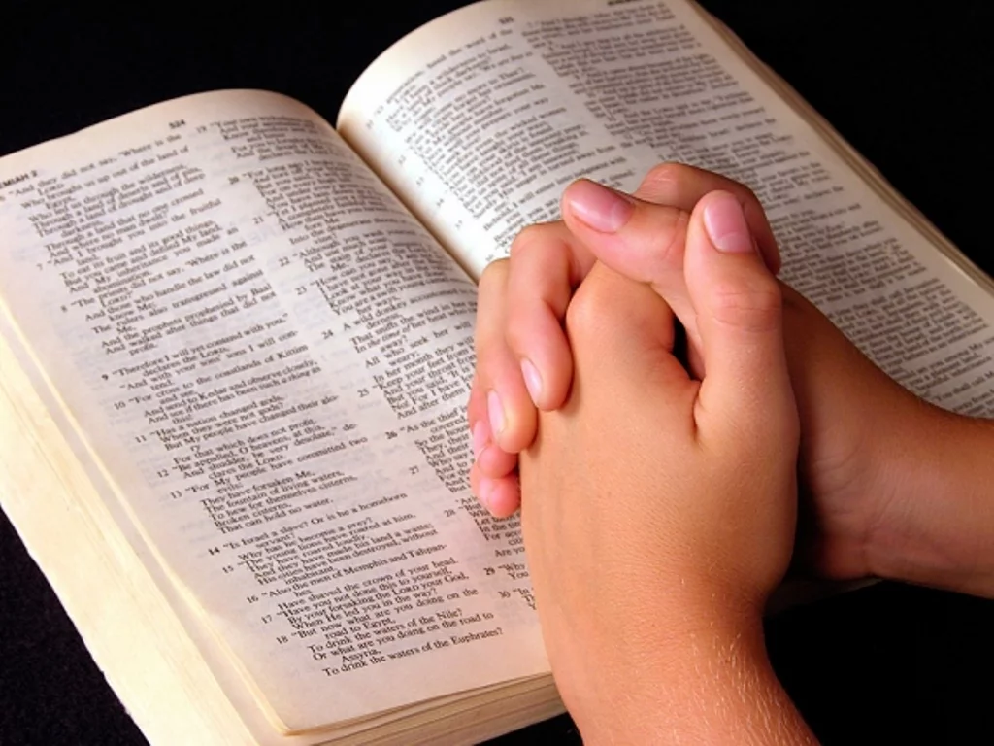
Notes:
Before listening to the conference we want to ask for God's direction through a prayer. I invite you to stand and bow your head. Listen to a prayer.
(Presenter's Prayer)

Slide 5
There is still Hope
Notes:
We now invite the speaker, Pr. George Gowie with the subject entitled "There is still Hope".
(Gowie)
May the peace of God be with you. I like to speak to you about “There is still hope”. This word hope speaks to us that the future will be better.

Slide 6
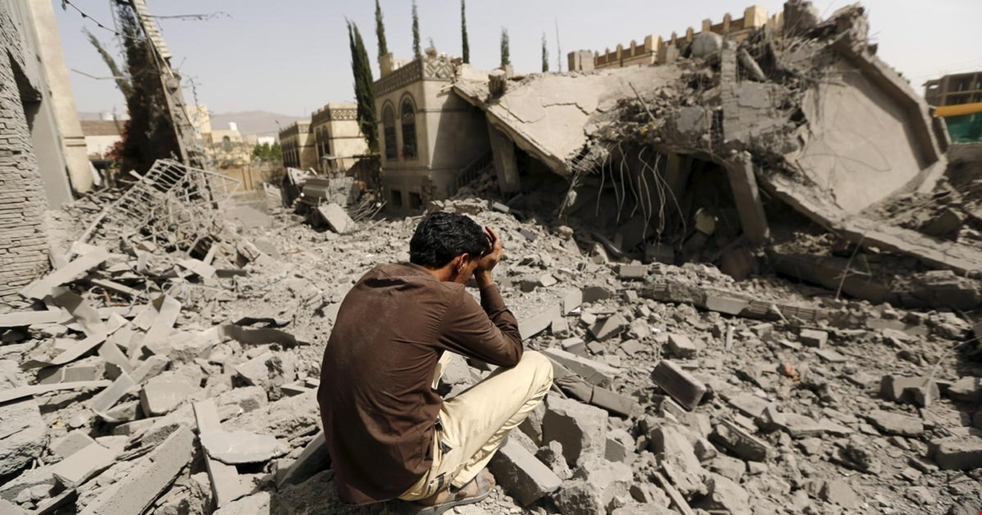
Notes:
Even though we live in a world that is full o wars, and famine, pestilences, and earthquakes and even death. There are many people who are destroying themselves because they are seeking something that is better, something that is fulfilling. But in this hopeless world many times they believe death is the solution. Many people question where is God, is God still exist? If God exists, why is this world in crisis that it is in today?

Slide 7
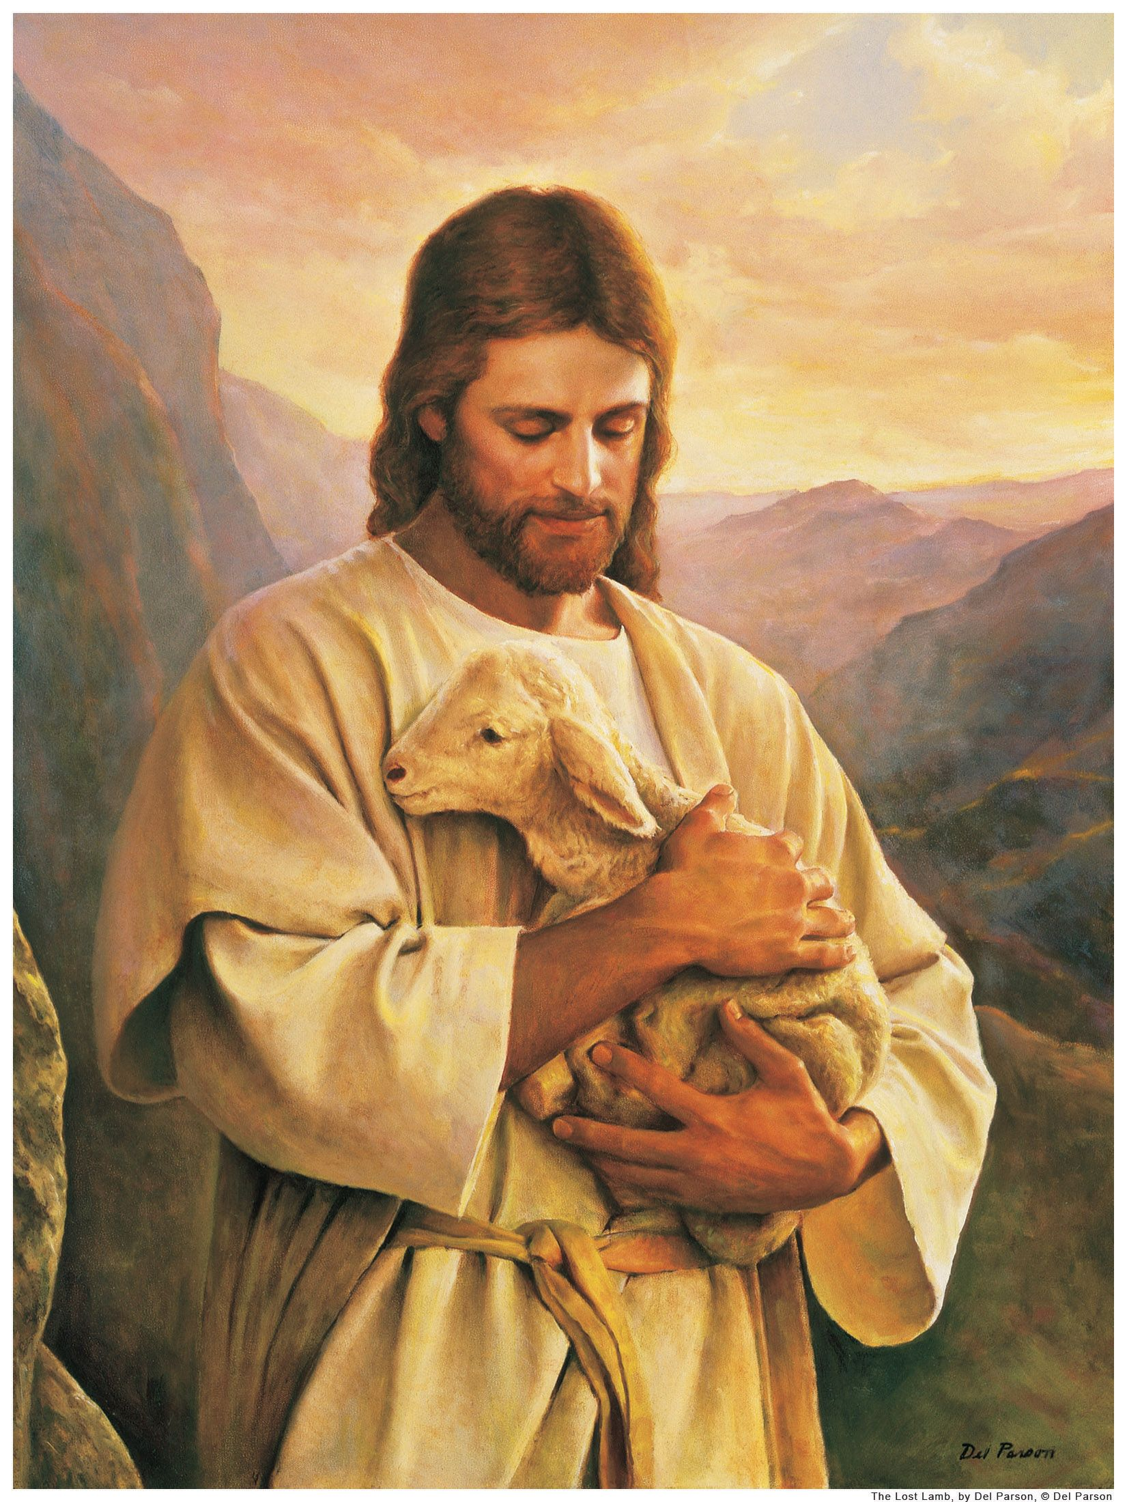
“For thou art my hope o Lord God, thou art my trust from my youth”.
Notes:
Anyway I want to share with you from the Word of God that there is still hope. According to Job chapter 11:18: And thou shall be secure because there is hope.” Yes, my friends, there is hope. And this hope is centered in one person, that person is Jesus Christ. According to Psalms 71:5 . Psalms 71:5 says. And I read it for you here Psalms 71: 5:It says: “ For thou art my hope o Lord God, thou art my trust from my youth.” So according to the psalmist, God is our hope. And we know that God is still alive. And God is on his throne. And as long as God exists, hope exist.

Slide 8
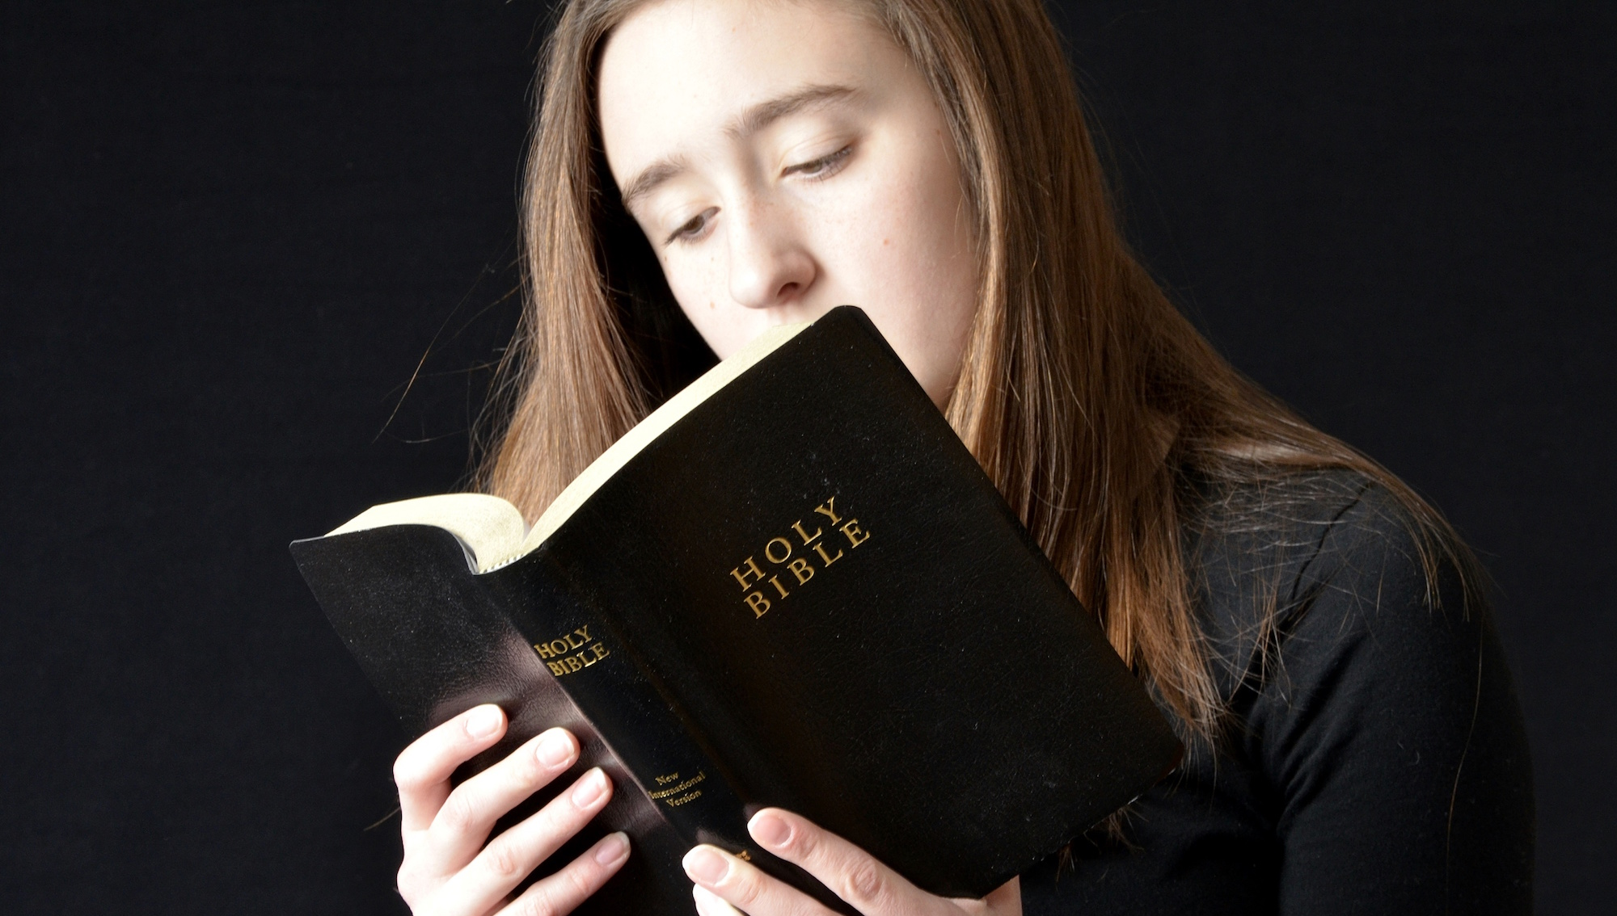
Notes:
Dear friend, I like to tell you a story, a story about a young women who I used to give Bible study with. She lived in an abusive situation. Her husband was very abusive. And we will go to her house every Sunday evening to study with her, and we didn’t know that she was going through such great trials in her marriage life. And one day she met us and she said to me, you are my angel. And I said: What do you mean? She said: Many times I wanted to put an end to my life. And there were times when I was about to kill myself and it was you, the brothers and sisters from the church who came to my door and they would knock and then you people would open to us and talk about the Word of God and the Bible. And the same problem that we were going through, the Bible study was about it and the Bible study was able to solve the problems. And because of those words, the word of God, today I am still alive.

Slide 9
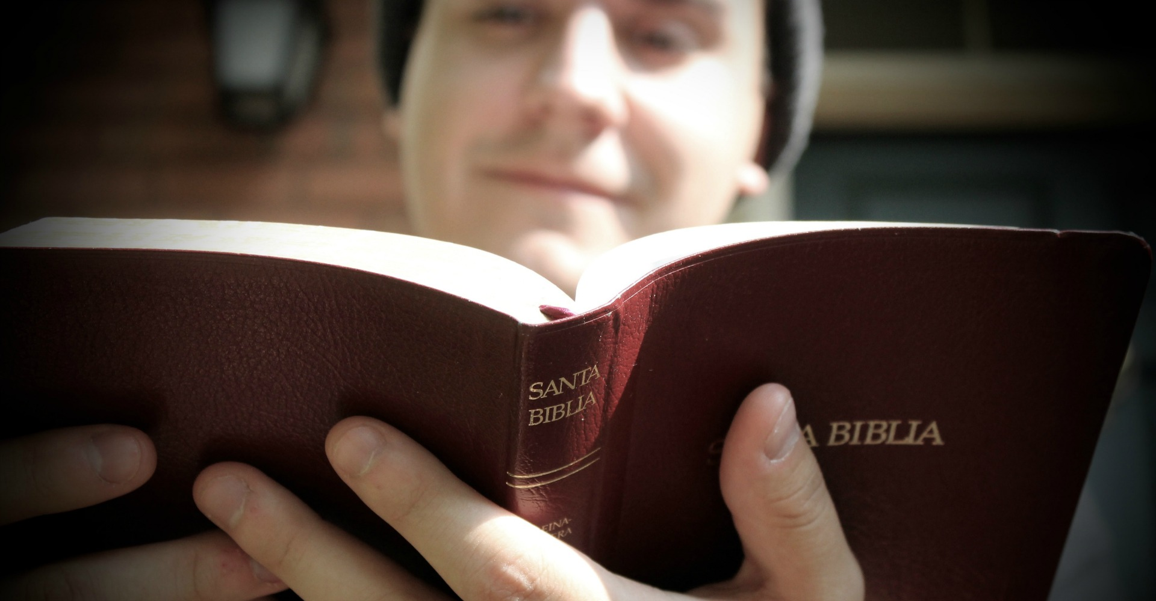
“Blessed is the man that trusted in the Lord and whose hope the Lord is”.
Notes:
And it showed that sometimes we feel like giving up. Sometimes we feel like there is so much trouble and so much problems in our lives and it seems like nobody cares and nobody would worry about what would happen to us, but God does. According to Jeremiah 17 in verse 7, Jeremiah 17: 7. I just like to share this also with you. Jeremiah 17:7. It says: Blessed is the man that trusted in the Lord and whose hope the Lord. Is. “ So according to the Bible the Lord is our hope. Why is God our hope? Because God is everlasting and God has no beginning and he has no end and God has all the answers for our problems, even in death, God has the answer.

Slide 10
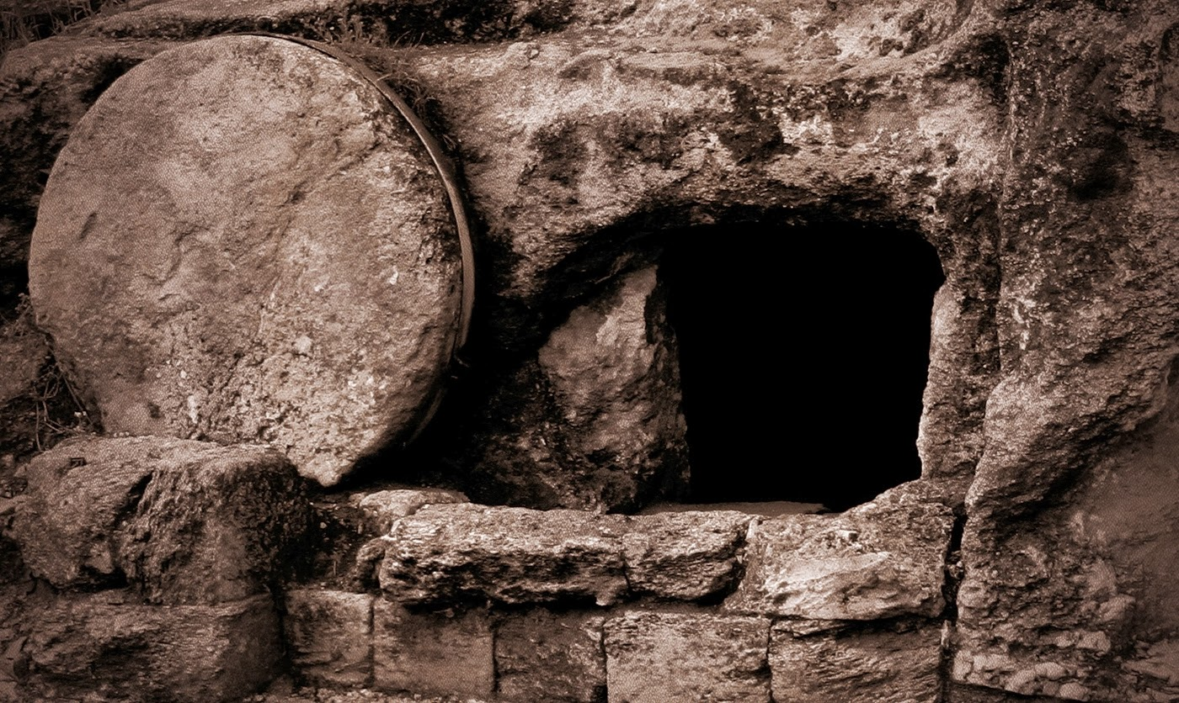
Notes:
The Bible tells us that he is the resurrection and he is life. There is a story in the Bible of Lazarus and Martha and Mary. Lazarus died and the sisters they were troubled, and they sent for Jesus and when Jesus came. Martha said: If you were here, my brother would not have died. And Jesus said to her according to John 11. John 11 tells us what Jesus said to Martha. John 11 and from verse 23 John 11:23 said: “Jesus saith unto her, Thy brother shall rise again. Martha saith unto him, I know that he shall rise again in the resurrection at the last day. Jesus said unto her, I am the resurrection, and the life: he that believeth in me, though he were dead, yet shall he live: And whosoever liveth and believeth in me shall never die. Believes thou this?”
And we know according to the Bible that Jesus Christ raised Lazarus form the dead. And that gave this eternal hope to his family. They now realized that it is only in Jesus that we will live forever. So it doesn’t matter what is our problem, no matter what Is happening in our lives. There is someone who can help us. Someone who can make the future better for us. Even someone who can make the present what we are going through lighter.

Slide 11
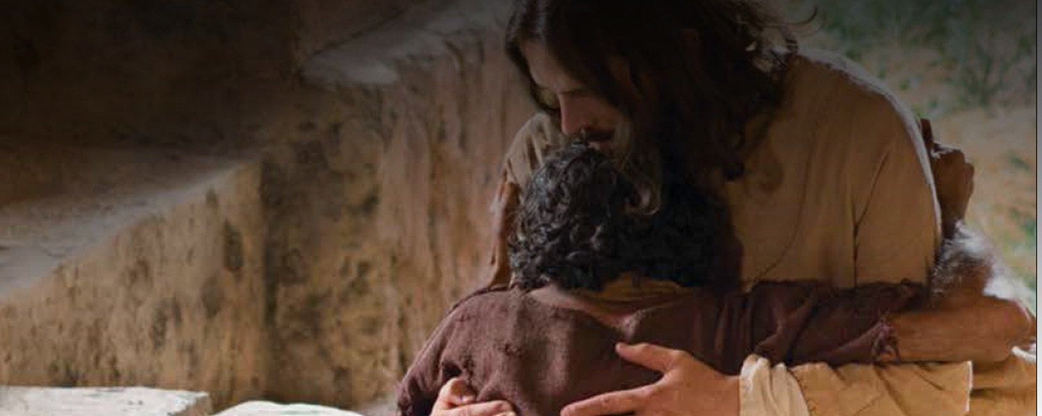
“Come unto me all that you are labored and heavy loaded and I will give you rest”.
Notes:
He said: “Come unto me all that you are labored and heavy loaded and I will give you rest.” So when trouble and trials and problems come into your life, don’t give up. Trust in Jesus. He is able to rescue you. He is able to make your life better. For he said: I am the way, the truth and the life. No one comes to the father but through me”.

Slide 12
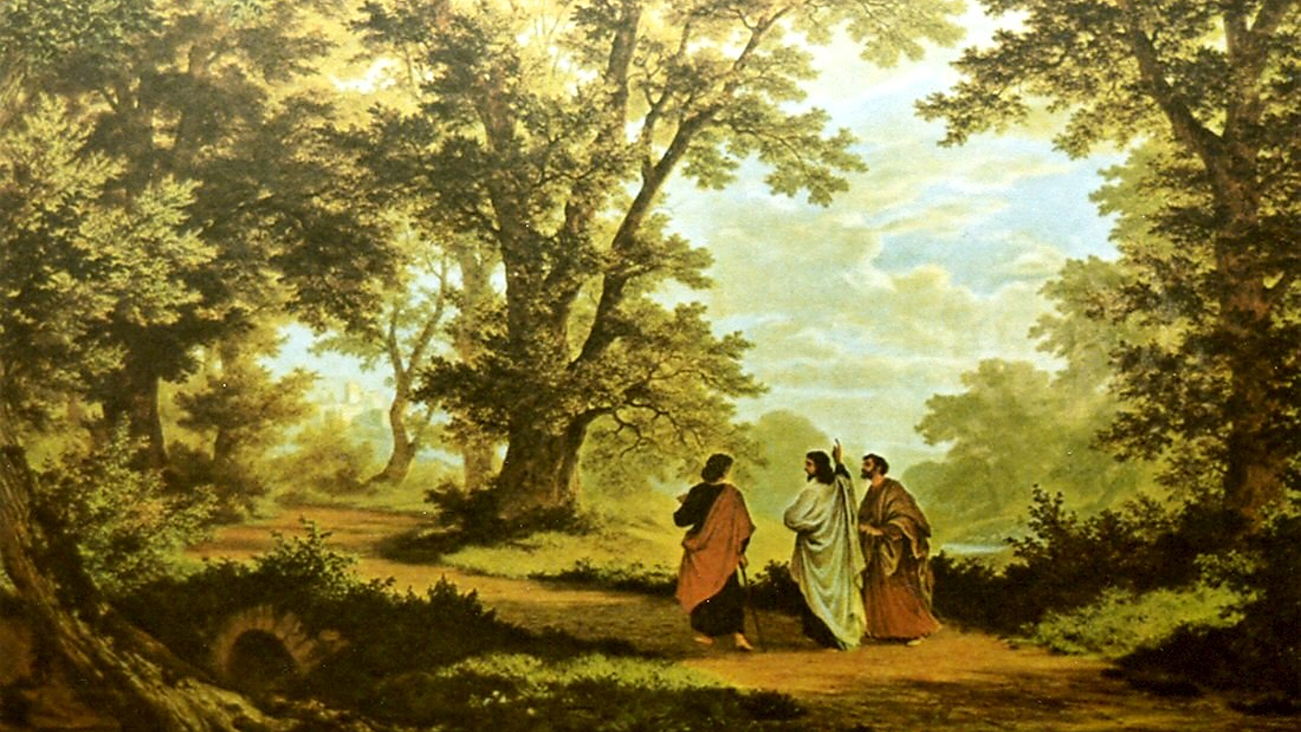
Notes:
So when you have Jesus in your life, when Jesus is first and last and always in your life, you will have this eternal hope, you will be optimistic, you will see the future in a bright way, because there is someone beside you, someone to understands all things, someone who gave his life for you that you can have life and abundant life. So, don’t love the wars, the troubles, the pestilence, the earthquakes, the economical crisis, no matter what is happening in your life don’t allow it to get you down because in Jesus Christ, there is hope, there is a better future.

Slide 13

Notes:
And so my prayer and wish for you is that you will trust Jesus that you will allow him to become the center of your life, that you will live your life, a life of peace and happiness in this wicked and sinful world. The Bible also tells us in 1st Timothy 1, in verse 1. It First Timothy 1 and verse one. It says: “Here we see that Jesus Christ is our hope.” The Bible tells us that he is also the hope of glory. And so not only do we have hope in this world, in Jesus Christ. But in the world to come, a world that is full of peace and happiness, a world that is full of joy. A world in which we will have no more sorrow, no more pain, no more suffering, no more death.

Slide 14
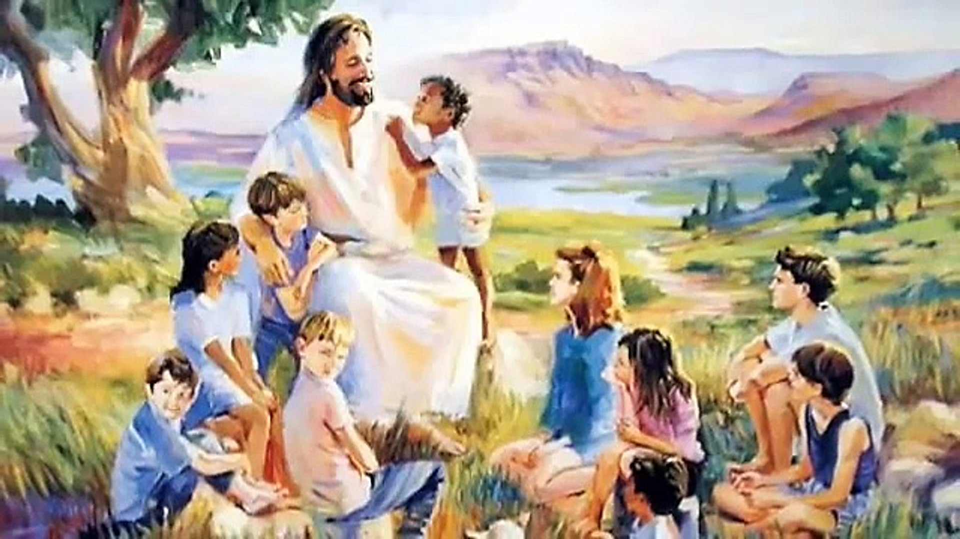
Notes:
John, in the book of Revelation tells us in Revelation 22. In Revelation chapter 22 it says in verse three: And there shall be no more curse, but the throne of God and of the lam in it and his servant shall serve him and they shall see his face and his name shall be on their forehead.” My friends, yes, God, our Creator, our Savior is coming back again to this sinful world and to put an end to all the problems that we have and to make a brand new earth. The Bible tells us that he said, he is going to prepare a place for us and if he goes to prepare a place for us, he will come again and receive us unto himself, that we are his - there we may be also.

Slide 15
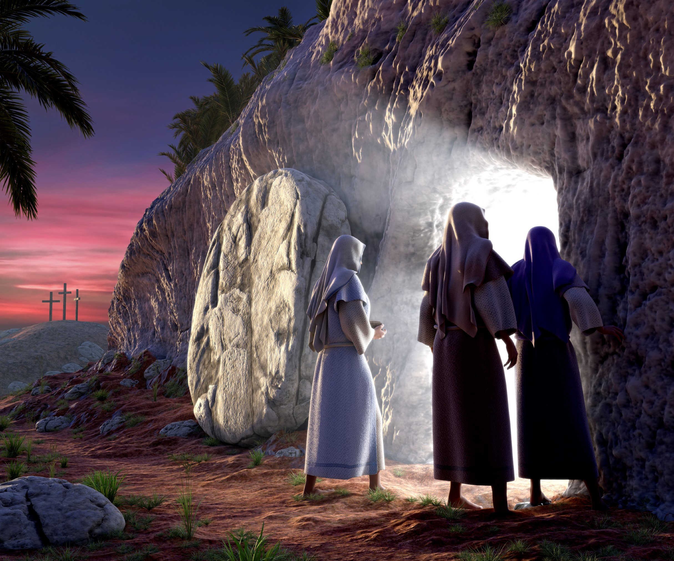
Notes:
So, my friends, and loved ones in this present world of trouble and hopelessness, we can find hope in Jesus Christ and even if we die in this world, we have the hope of resurrection. Because Jesus Christ tells us, he said: I am the resurrection and the life. And and when he returns, he is going to raise all those who died in the Lord and we are going to live with him throughout eternity.

Slide 16


Notes:
So there is no reason for us to believe to give up. There is no reason for us to believe that God has abandoned us. According to Acts 2:26 I’d like to share this Bible verse with you also. Acts two and verse 26. : “Therefore did my heart rejoice and my tongue was glad moreover my flesh shall rest in hope.” So, all of us, here today, can rest in hope. Rest in the faith that tomorrow will be better, that tomorrow will be brighter than today.

Slide 17
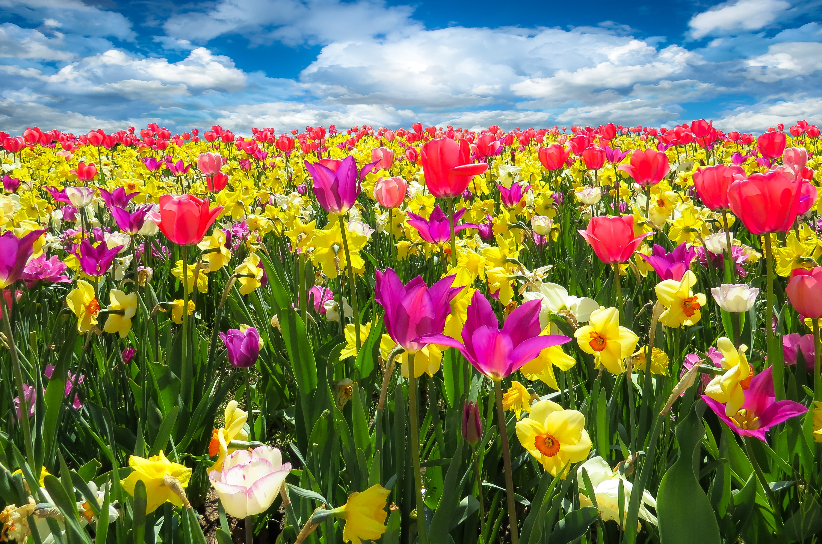
Notes:
We serve a God, a God of spring and you know that in the time of spring. In the time of spring everything comes to live. Our God is not just a God of the winter, but he is also the God of the spring, even when there are clouds, there is still sunshine and all our faith must do, our faith must look beyond the cloud and see the sun. Our faith must pass winter and see spring, because our God will make things better every day for us. All we have to do is to trust him and believe in him and have this eternal hope in him because as I have said in the beginning, Hope is still there. There is still hope. Hope in the fact that Jesus Christ is still alive. He did not stay at the cross forever.

Slide 18
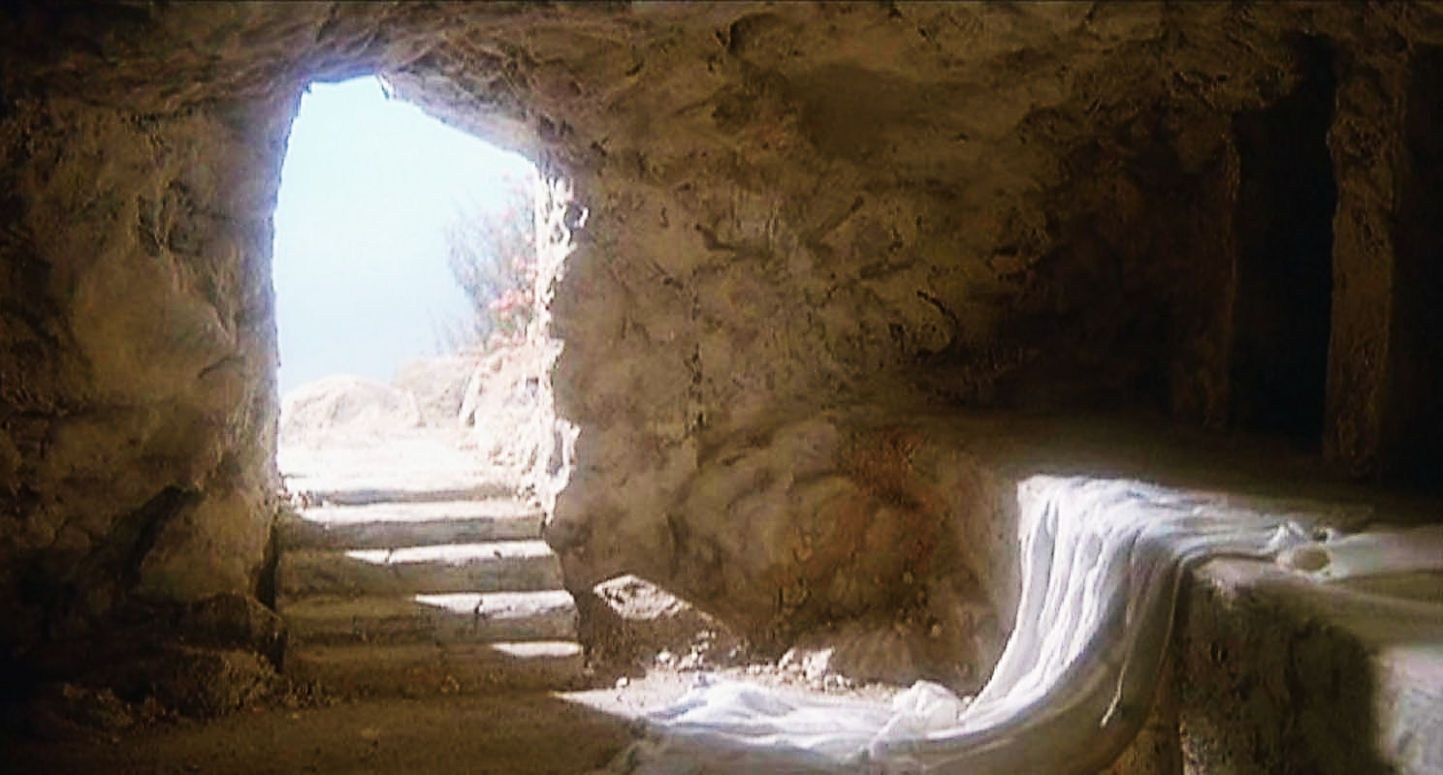
Notes:
We know the story of the crucifixion. On a Friday, he died and he rested in the tomb on the Sabbath and on the first day of the week he was resurrected he came back to life and he lived forever and more. And you and I can trust him you and I can believe in him and have that faith in him that our lives will be better tomorrow.

Slide 19
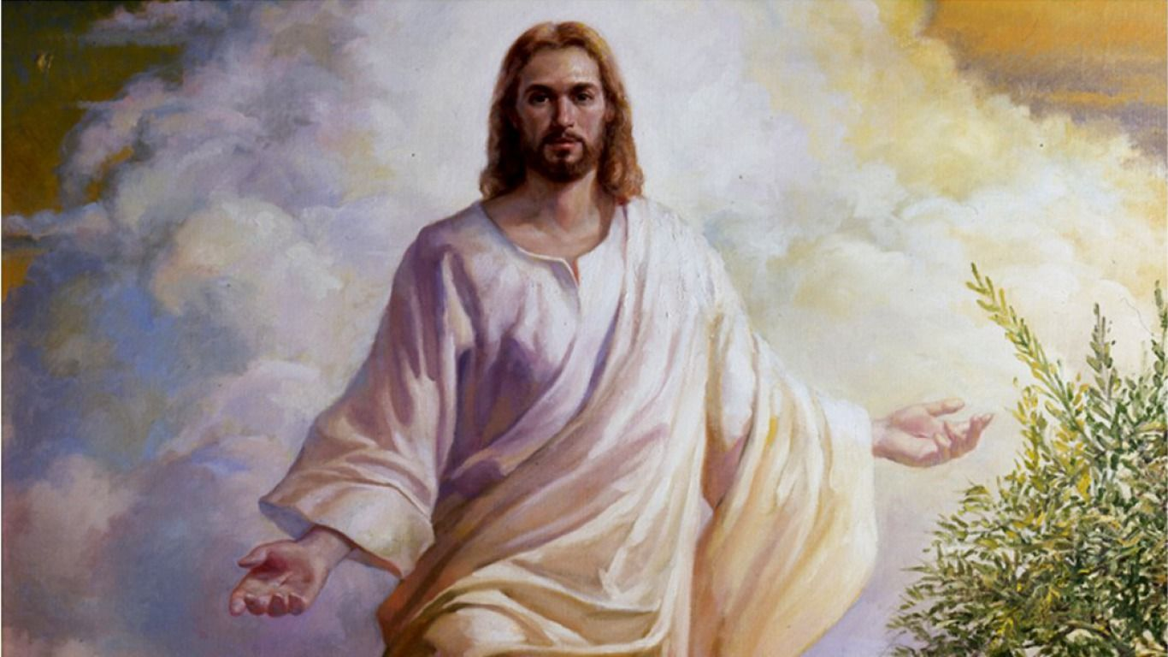
Notes:
And so, my friend I appeal to you, I appeal to you to give your life to Jesus Christ because he loves you. He wants to rescue you from this hopeless world that you can live your life believing in this eternal hope. The hope that is in Jesus Christ. And so I appeal to you that you give your life to Jesus, and your heart to Jesus, that he will work this great miracle in your life that you can experience the resurrection from a life of sin and that you can live a new life in Jesus Christ.

Slide 20
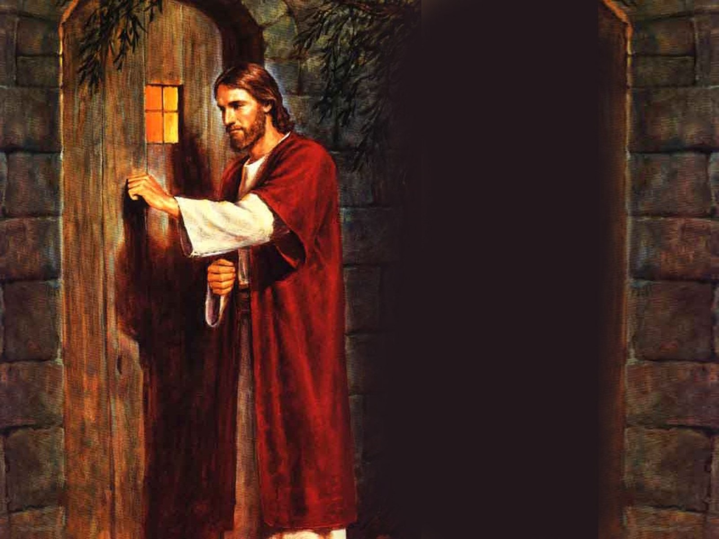
“If any man be in Christ, he is a new creature. Old things have passed away and behold, all things become new”.
Notes:
The apostle Paul tells us that if any man be in Christ, he is a new creature. Old things have passed away and behold, all things become new.” And that is the hope that we have in Jesus, that we can make our lives better. And so, today you can experience that! So I invite you to come to Jesus. Wherever you are listening to these words, I beg of you: Give your life to Jesus. And so I appeal to you this moment that I would like to pray with you. I would like to help you to find this man, Jesus Christ, that you can have this hope that still exists, that hope that it is in him. And so, would you stand where you are, would you come forward, will you make a covenant with our Lord and the Savior Jesus Christ?

Slide 21
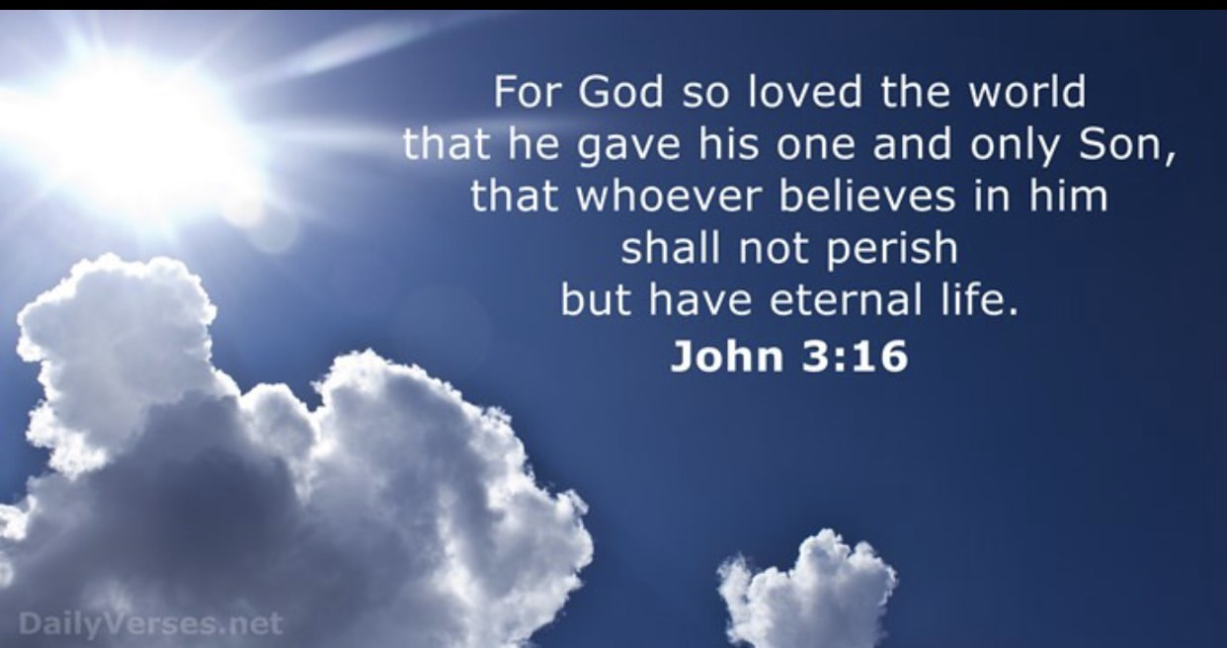
Notes:
The Bible also tells us that the wages of sin is dead, but the gift of God is eternal life. Jesus Christ came that we may have life. The Bible also tells us that : “For God so loved the world, that he gave his only begotten Son, that whosoever believeth in him should not perish, but have everlasting life.” John 3:16.
And so as you come forward and as you stand for Jesus, you too can have everlasting life, you too can hope for the best, you too can recognize that tomorrow will be better than today. May the peace of God be with you. And may I pray for you?

Slide 22
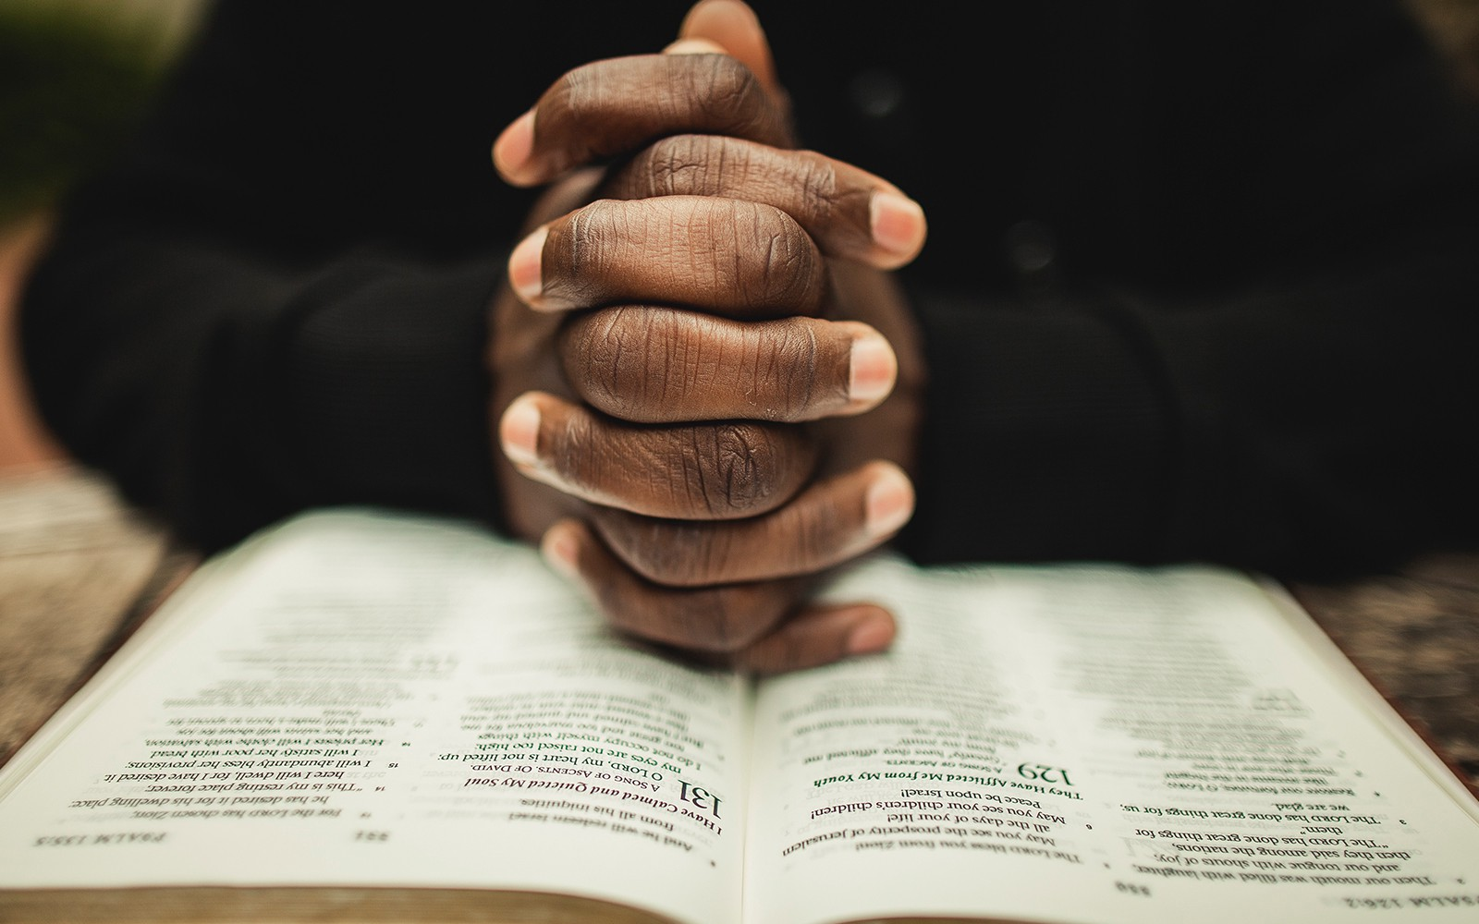
Notes:
Let us pray: Oh gracious father who art in heaven. We bless your holy name and we thank you for those who have responded to thy word. Lord we live in a world that is full of hopelessness. There is famine, and war and pestilences and earthquakes. Many are turning to drugs, and even death for the solution of their lives, but we know that in Jesus Christ, there is hope. We know that in Jesus tomorrow or today can be better. So I pray for them that Lord, they will give their lives today. That they will recognize that this world has nothing to offer. But in Jesus Christ they can find true peace, and that one day when he returns, they will have eternal live. And they will live with him forever in a world of total peace and happiness, in a world where there will be no more sorrow, no more pain and no more suffering. A world Lord, where there will be perfect peace. And so I pray that you will bless us, and bless thy people and bless those who are also listening to your words today. In the name of Jesus, Amen.

Slide 23

Notes:
My dear friends, before you leave us, I would like to give you a decision card. And in this card you will find four things. In the first one you can seek anyone of these. If you like to accept Jesus as your personal savior. Would you like us to pray for you or if you like somebody also to contact you. But also we have a free Bible Course. It is entitled: At the feet of Jesus. And so we hope you will fill out this card and that the blessings of the Lord will be in your life from this day forward. This is my prayer. Amen.

Slide 24


Soon:
“The Value of Family Time”
from May 10 to 12, 2019
biblewell.org
Notes:
(Presenter)
We have reached the end of the final topic in the series "There is still Hope". How wonderful it is to know that we are not alone. We have a triumphant God, who victoriously conquered the tomb and who wishes to give victory to each one of his children.
It is beautiful to walk hand in hand with Jesus. It is a blessing to know that we have an aid at hand that has defeated Satan.
If you have not received the decision card yet, ask one of the collaborators where you are at for one and fill out your decision.
Also, don’t miss the opportunity to take the free Bible course "At the feet of Jesus". It will be of great help for you to grow on the path of Hope, in the knowledge of God's love, and His will for your life.
If you would like to receive audio devotionals sent to your whattsapp, you can also send us a Whatsapp message at: +1 678-988-5048.
If you want more information, you can visit our website www.biblewell.org
We hope that this series of topics has been a blessing for your life.
We invite you to join us for the next RESCUE series where we will talk about the Family. The theme will be "The Value of Family Time". The series will take place from May 10 to 12, 2019. Don’t miss it!
God bless you richly! See you next time!

