Slide 1

Waytolead.org

Slide 2
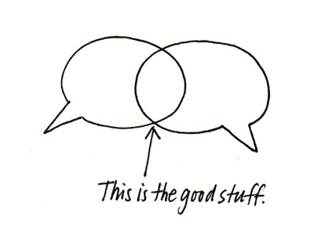
CHECK IN
How are you feeling after Hurricane Harvey?
Notes:
The impact of a natural disaster varies from person to person in a group, family or congregation. There are many variables that can paralyze leaders and keep them from facilitating a shared conversation about communal pain – just when the community needs it most. Courageous leaders will stop regular programing or practices to pay attention to current events in order to deepen the faith, trust, and overall health of the community..
This resource is a guide to building resiliency following Hurricane Harvey that could easily be modified for other natural disasters. Please feel free to use this and share this to create a safe space for people to talk about their feelings. There are five parts to this one-hour session.
Part I. Share your feelings: Begin by creating a brave space, inviting people to share their feelings as they are ready. Remind people that they can reveal as much or as little about their feelings as they choose. Invite people to opt out if that is their brave response to the invitation. Feelings will be shared first by inviting people to walk to the part of the room that most reflects their perspective.
Set Up: Designate the four corners of the room as A, B, C, and D. People will gather in the corner that corresponds to their answer to each question below. After the question is read, people can move to the place that most reflects how they are feeling. As noted above, people may opt out of moving and stay in the middle.

Slide 3
My personal loss due to Hurricane Harvey is:
a. Friends or family had flooding or other impact from the storm.
b. I had some flooding or other impact from the storm at my home.
c. I lost my home or am still waiting to hear about my home.
d. People I care about or know have had a death related to this storm.
Notes:
Invite those who feel ready to move to the corners of the room designated A, B, C, or D.
Do this without conversation.
If a space is left empty it is okay to note that. You may want to pray together for the people not in the room who represent a certain perspective.
Go to the next slide.

Slide 4
.My personal experience with other natural disasters:
a. This is my first experience.
b. I have been through several hurricanes or other natural disasters.
c. I have worked on recovery teams, heard stories, and felt the impact of disaster many times.
d. I have been flooded, lost my home or had a death in my family in the past due to a natural disaster.
Notes:
Invite people to move to the appropriate place in the room. Do not insist people move if they prefer to watch others. Some may not be ready to share.
Do this without talking.
Go to the next slide.

Slide 5
In the past week I have:
a. been able to move into a normal routine.
b. felt unable to concentrate, felt moved to tears or generally been overwhelmed.
c. been in a deep fog, unable to make decisions or carry out daily activities much at all.
d. been paralyzed by my feelings.
Notes:
For the last time, read the slide, inviting people to move to the appropriate places in the room, if they wish.
This is the most personal question so remind people they can opt out at any time by standing in the middle of the room or sitting down.

Slide 6

Write it down
Start now, write anything you are thinking
Keep going –
15 minutes for 4 days
Notes:
Pass out paper. Let people know you will give them 2 minutes to write their thoughts based on the three questions they just processed. No one will collect their writing or expect them to share what they write.
Let people know that one practice for healthy leaders following a trauma is to write for 15 minutes a day – about anything that comes to mind – for four days. If it is helpful, they can keep writing but the real key is to do this for 4 consecutive days.

Slide 7
CHECK IN
What surfaced? What bothers you? What do you value? What do you need?
Notes:
Invite people to put their written paper away and to move into small groups of 2 or 3 at the most.
Ask them to respond to the questions on the screen for the next 5-10 minutes. No one person should do all the talking so you may want to encourage sharing at the halfway point in the time.

Slide 8
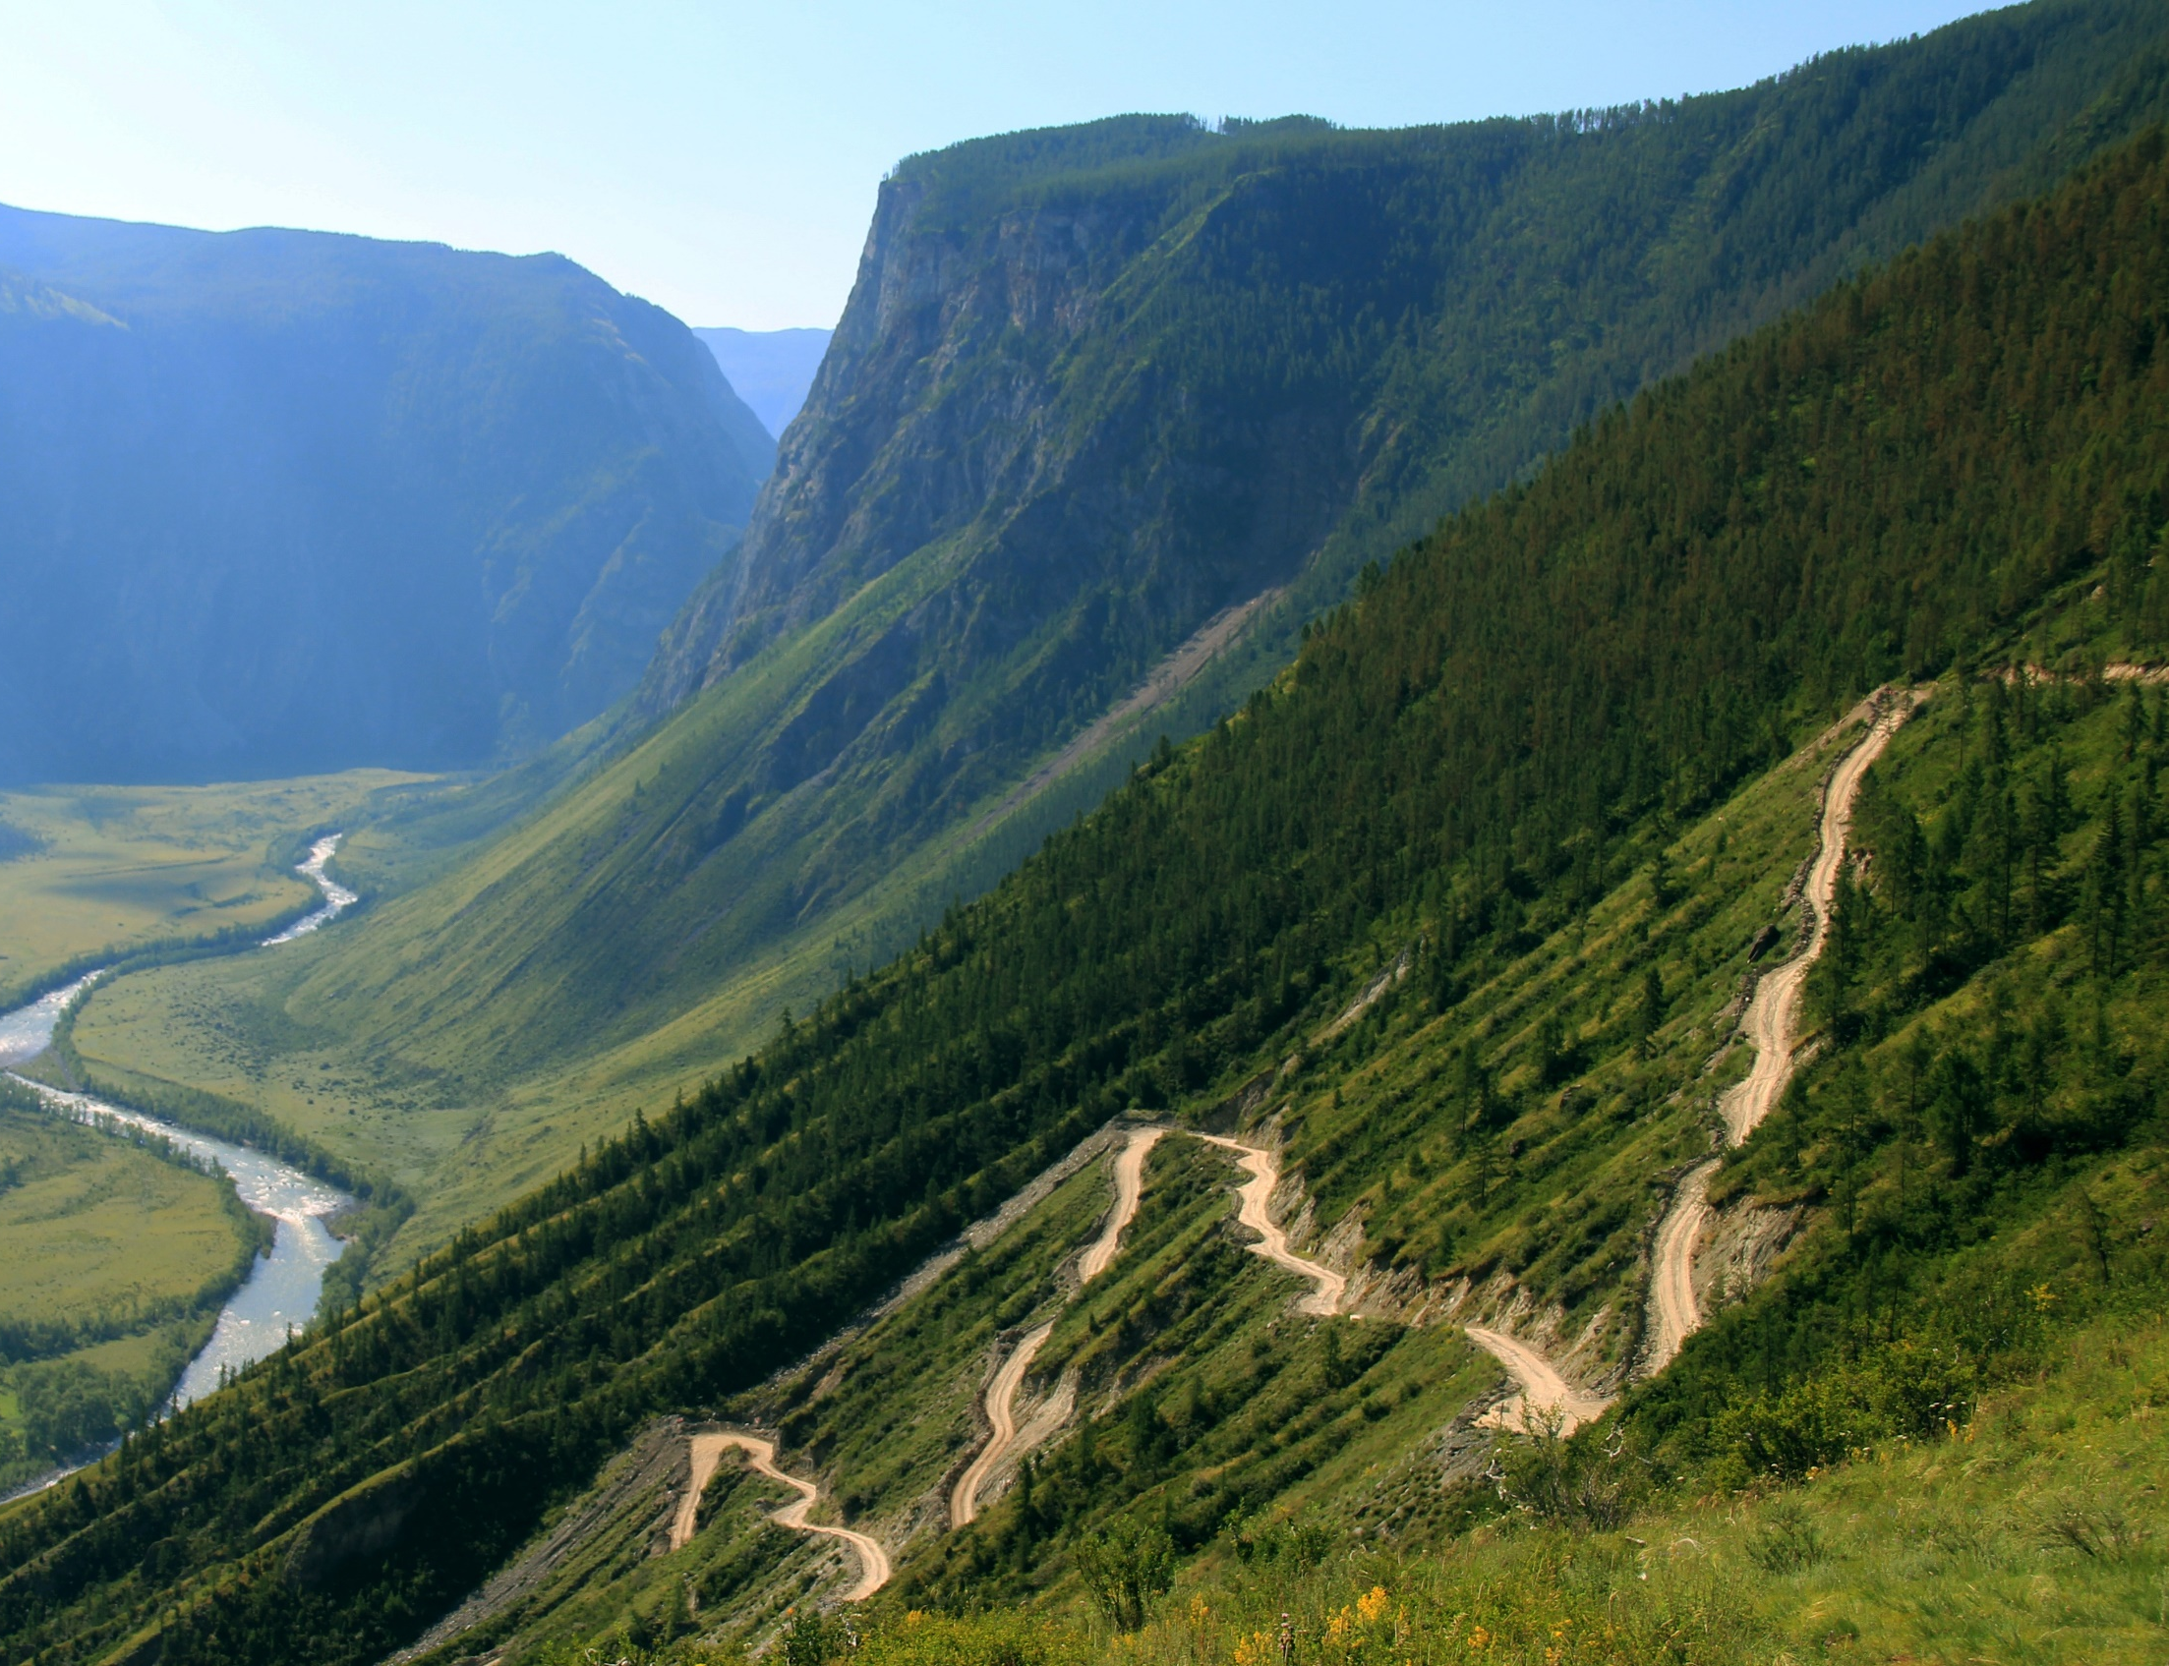
You are practicing
adaptive leadership.
It starts in the valley…
Notes:
Tell people that recovery is a practice of adaptive leadership that starts in the valley but moves to the balcony.
The Practice of Adaptive Leadership by Heifetz, Grashow and Linsky is a great leadership resource for referral.

Slide 9

Moves to the balcony.
Notes:
The balcony and the dance floor are the two perspectives an adaptive leader must have. The “balcony” (looking down on the “dance”) is where you get a larger perspective of what you’re facing and how you are doing with your response. From here you do your observing of patterns, reflecting, option thinking, analyzing, and monitoring of the change.
When you take action and make an intervention, you have stepped onto the “dance floor” and are participating in the “dance.”
When we are on the dance floor we are part of the dance and lose perspective. We miss the big picture.
The listening we have been doing in the Tune In process has helped us gain some perspective and brought us to the balcony.
How many of you felt like you were moving outside of your comfort zone in this work? We have to stretch, to get outside of our comfort zone in order to gain perspective. In fact we must move between the dance floor and the balcony over and over and over – it is not a one-time experience.

Slide 10

Technical
vs
Adaptive Challenges
Notes:
Do you know the difference between a technical and an adaptive challenge? Have you heard the phrase “adaptive change?”
The slide you are looking at is a great example of an adaptive change. It is a painting of an Ancient Incan Calendar.

Slide 11
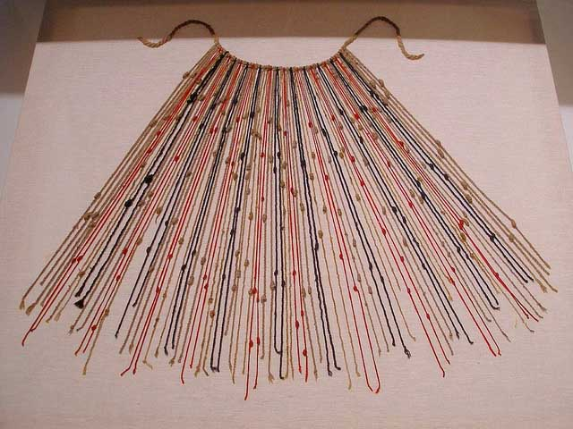
Notes:
Here’s the real calendar. Very little is known today about how to use this “device” yet for the Incans, this gave meaning to their life, outlining the 12 lunar months, and helping them know when to plant. Obviously, things have changed.
Think about the way your calendar has adapted in just the last 20 years. The calendar is a great image for both technical and adaptive change – here’s why.

Slide 12

Technical Challenges
Use current knowhow, expertise, and management
Draw on rules or techniques that have worked in the past
Mean doing a better job at what we have done before
Notes:
This slide gives us a few definitions of a technical challenge. Can you think of some technical changes we can make in our ministries that are pretty easy to identify?
Some ideas include:
Becoming more welcoming to visitors by using one form of worship communication. (Not the screen, bulletin, hymn book, hymn board and announcements in some random order.)
Communicating in more than one language.
Training our members to engage in conversation with people they don’t know.
Using best practices to count the offering, rather than letting one person count the money alone.
Getting background checks on adults who work with children and youth.
Actually training adults and youth who work with children.
Cleaning up the property, tending the garden, getting rid of old donated items, old banners, etc.
Doing a website makeover so there is no empty building on the front page or out of date info as this is your congregation’s front door…
You get the idea. EVERY faith community could make this list and go to work on it. The thing is, we know how to do this stuff or we know someone who does. This is within the recourse we currently possess.

Slide 13
Adaptive Challenges
Challenges outside scope of expertise
Learning new skills, habits, attitudes
Experiments & risks across system
Notes:
Adaptive challenges are very different. They are more experimental – more.
Because the nature of these challenges is different, the work required to address them and who does that work is different.,
Transition - Experience teaches us nothing. The only experiences that are helpful are those we “reflect upon.”

Slide 14
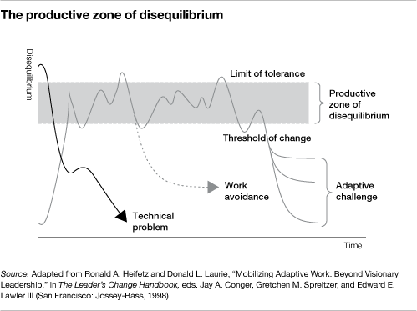
Notes:
Effective adaptive leadership manages the heat with the ability to turn the heat up or down as they observe the system.
Basically there is a sweet spot for change. You want just enough heat to keep creative energy and experiments happening as a learning community, but not so much that the community catches fire! Do you see that sweet spot in the gray zone? Notice that this is not a comfortable space, but neither does it leave casualties.
People will always be trying to pull you back into their comfort zone - they act like a rubber band, always wanting to return to their original shape.
There is a space in which productive change can happen – but there is a threshold of change that can exceed the limit of tolerance.
Notice that this is a long-term reality for leaders, not a one and done situation.
If there is one thing you take away from this session today, I hope it is this: It is your job as leaders to manage the heat.
Process the slide together.

Slide 15
The adaptive leadership process
Observe
Interpret
Process of diagnosing
Intervene
Notes:
So here’s the rhythm. There is a move from observing – to interpreting – to intervening. It is a way of life for adaptive leaders.

Slide 16

Discipleship Ministry
To equip every child, youth, and adult to live out their faith every day.
Discipleship Ministry is…
to follow Jesus
to take heart
to share and teach

Slide 17

  Do not fear, for I have redeemed you; I have called you by name, you are mine. When you pass through the waters, I will be with you; and through the rivers, they shall not overwhelm you; when you walk through fire you shall not be burned, and the flame shall not consume you. For I am the Lord your God, the Holy One of Israel, your Savior. -Isaiah 43:1-2

Slide 18

LEAD
Waytolead.org

