Slide 1

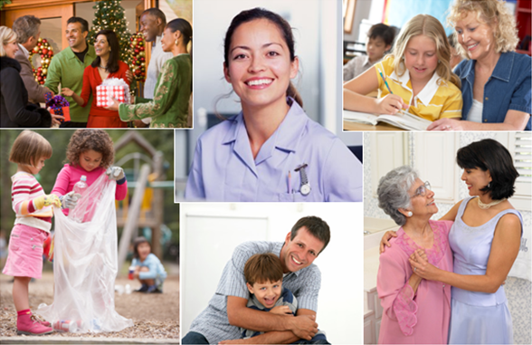
When People
WORK TOGETHER,
Great Things Happen!
There are NO LIMITS to what a community can do…if it wants to.
– George McLean, The Tupelo Miracle
Notes:
We are thankful for the opportunity to share with you today. We bring you “good news.”
Across the country, communities are discovering new and exciting ways to work together for common good and greater impact.
The results are amazing!

Slide 2
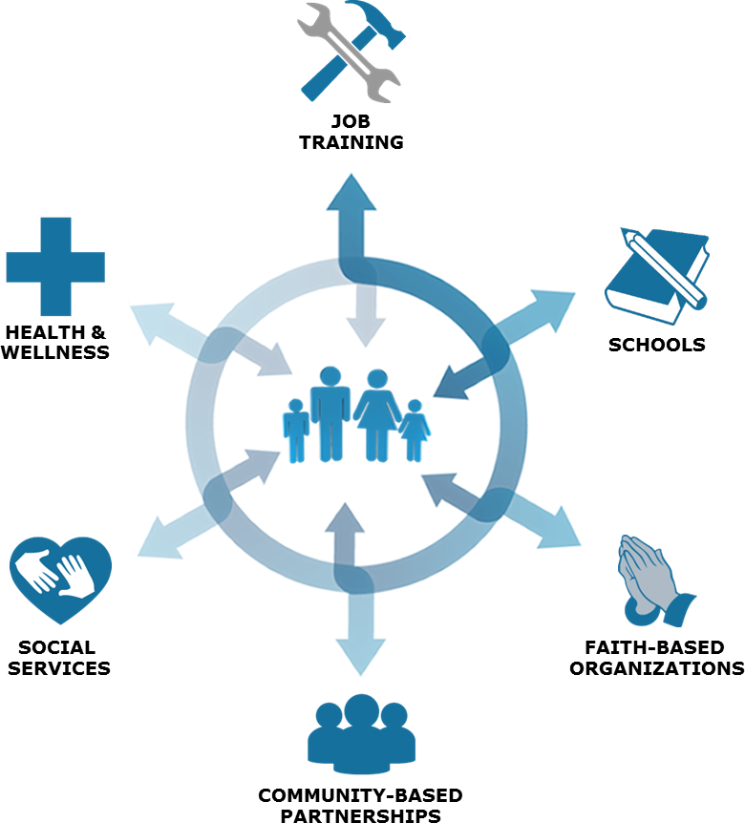
Vibrant Healthy
COMMUNITIES
WELL-CONNECTED
for Greater Impact
Innovative Approaches
Mutually Beneficial Networking
Multi-Sector Collaboration
Comprehensive Empowerment
Potentially Can Become
SUCCESSFUL MODEL
for transforming lives
and communities
Notes:
Communities are learning how to advance innovative and promising approaches to address complex community challenges. These approaches are making a real and lasting difference in their communities.
These include:
Mutually Beneficial Networking – sharing knowledge and information that benefits all the helping agencies in your community
Multi-Sector Collaboration – working together to address complex community challenges
Comprehensive Empowerment – a well-connected care network and continuum of care that helps individuals and families move from surviving to thriving
But first, let’s look at some realities.

Slide 3


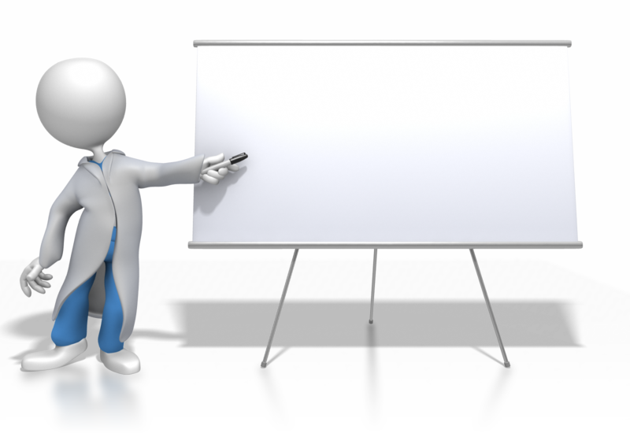




PEOPLE are very concerned
America
ROUGH
ECONOMY
AHEAD
46.2 million people live in poverty
16.1 million children are food insecure
32 million adults can’t read
20+ million people are unemployed
or grossly underemployed
Notes:
People are very concerned about the road ahead.
Many people are working hard but still cannot make ends meet.
Single-moms are struggling to provide income and take care of their families.
Parents are wondering about the quality of their children’s education.
And, families are most concerned about affordable healthcare

Slide 4
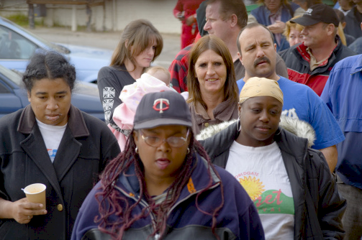
HELPING AGENCIES are also concerned
ROUGH
ECONOMY
AHEAD
increased demand for services
needs are so complex
dwindling government aid
How can we do more with less?
Notes:
Most helping agencies, across the country, struggle to maintain a constant flow of resources that sustain and advance their mission.
Many agencies, with limited staff and volunteers, cannot keep pace with the increased demand for services which is forcing them to “do more, with less.”
Also, people’s needs are becoming more complex and beyond the scope of many agencies, which are not connected to a community-wide referral system.
Because of this, many children, youth, and adults go without access to effective programs and services that can help transform their lives.

Slide 5

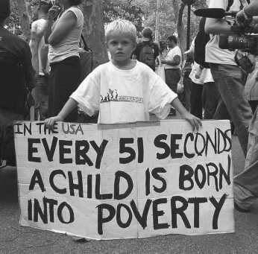
NOW
is the time!
For neighbors, churches, charities, businesses, elected officials, and others to come together to…
make sense of the changes that impact our community
better understand people’s needs
implement sustainable solutions through collective action
Notes:
Many citizens believe that now is the time for neighbors, churches, charities, businesses, elected officials, and others to come together to make sense of the changes that impact our community, better understand people’s needs, and implement long-term solutions through collective action.

Slide 6


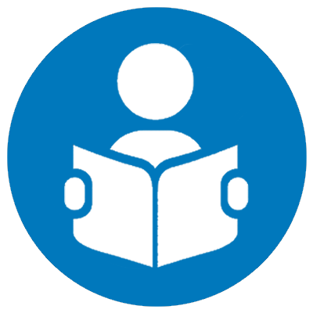



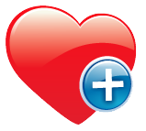



Community Helping Systems are Transforming
Social SERVICE Model
Social CHANGE Model
Church
Healthcare
Education
Justice
Food
Housing
Government
Nonprofit
Fragmented & Limited
Transactional (handout)
Duplication of Efforts
Isolated Impact
Collaborative & Comprehensive
Transformational (hand up)
Coordinated Efforts
Collective Impact
at work in over 1,100 cities – adding 100 new cities each year
Notes:
Communities are learning how to maximize their collective caring power. They are working together to transform their helping systems – from a “social service” to a “social change” model. They are doing more than just help people get by. They are learning how to collectively help them get ahead to a better quality of life and brighter future. (For further learning about this, see The Power of Collaborative Solutions by Tom Wolff)
Social Service Model
Helping agencies are disconnected and don’t talk to each other; fostering a fragmented and limited service delivery system.
Fragmented service delivery causes wasteful duplication of services and efforts; resulting in a dysfunctional referral system that frustrates and discourages people.
People see agency services as a short-term transactional process. “You need something. I’ve got it…maybe.”
Services can be perceived as a handout or something just meant to help people get by for the moment.
Helping agencies work in isolation (silos) and compete for the greatest amount of credibility and independent impact.
Social Change Model
Helping agencies communicate and rely upon each other; fostering a well-connected and collaborative service delivery system.
Well-connected service delivery streamlines coordinated efforts; creating a resourceful and effective referral system that encourages people and offers them hope.
People see agency services as a long-term transformational process. “Let’s make sure everyone is satisfied with the results”
Services are designed to be a hand up – an opportunity for people to get ahead to a better quality of life and brighter future.
Helping agencies work together more efficiently and effectively; co-creating evidenced-based solutions that drive collective impact.
A “social change” model offers communities the chance to make a real and lasting difference in people’s lives. The results can be amazing: people are better served, agencies are better informed, and communities are better engaged.

Slide 7



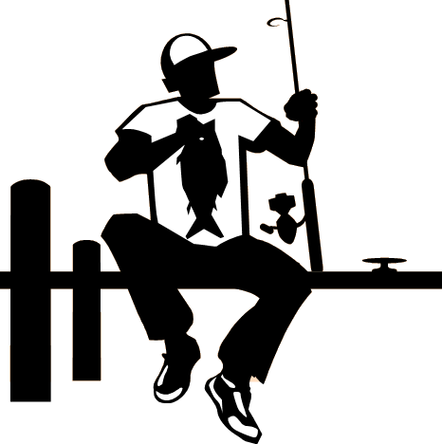


Transforming People’s Lives
CRISIS
VULNERABLE
STABLE
IMPROVING
THRIVING
get by
get ahead
GIVE A HUNGRY PERSON A FISH
TEACH A
PERSON TO FISH
PERSON IS
WELL-EQUIPPED
PERSON HAS FAIR ACCESS TO THE POND
- - - - - - - - - - - - - -
BENEFITS CLIFF
Human
Development
Community
Development
Strengthen our community-wide “safety net”
Improve our helping and referral systems
Share knowledge and best practices
Reduce duplication / increase accountability
Become more efficient and effective
Build safe, vibrant, and healthy neighborhoods
Strengthen our economy and create good jobs
Develop a reliable, well-trained workforce
Increase civic engagement and cooperation
Strive for large-scale collective impact
Partnering “hand in hand” to advance a more networked, collaborative,
and comprehensive approach to transforming lives and communities.
Notes:
A “social change” model breathes new life into a community’s helping system by enabling all stakeholders to strengthen and maximize their collective caring power.
Communities are learning that no one person, organization, or government agency has all the information, skills, or resources necessary to address complex community challenges, let alone develop effective sustainable solutions. Many communities believe that now is the time for neighbors, churches, charities, businesses, elected officials, and others to come together to make sense of the changes that impact their community, better understand people’s needs, and implement long-term solutions through collective action.
Community leaders suggest that the way to move forward towards large-scale social change is for all community sectors to work together by engaging in strategic planning that supports innovation, invites broader civic participation, and allows collective impact to emerge. Their first action is to find innovative ways to increase communication and connectivity among all agencies. And, they must be able to broadly share best practices and make time to collaborate for the well-being of everyone in their communities.
Communities, that use Simon Solutions networking technology, soon realize that increased connectivity can help a “social change” model to emerge. Networking improves communication between agencies and streamlines information-sharing, which benefits everyone. Agencies make better-informed decisions as how to allocate limited resources where they are most needed. And, they can work together more efficiently and effectively to address complex challenges by reducing duplication, increasing resourcefulness, and broadening their impact.
A helping system that transforms into a “social change” model sets the stage for a more networked, collaborative, and comprehensive approach to transforming people’s lives. Agencies, along with the people they serve, gain greater access to knowledge and resources, from across the community, that support social and economic well-being. Any agency, or collectively with others, can now work closely with individuals and families – helping them to map-out a successful journey from crisis to sustainability. This journey includes a “holistic” action plan with practical goals, learning opportunities, and resources that are tailored to each person’s hopes and dreams.
A person’s ability to “work the plan” is measurable, using our technology. All assistance, referrals, and outcomes are monitored in real-time – making it easier for helping agencies to collectively track a person’s progress toward self-sustainability. And if needed, agencies can suggest adjustments to the plan. The goal is to make sure that people thrive; not just survive.

Slide 8





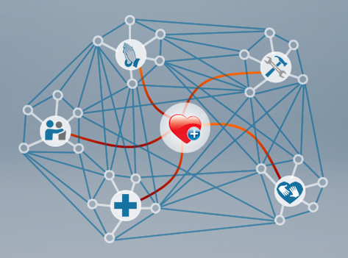





Better Way to Find and Coordinate Resources
Faster
Easier
Broader
COMMUNITY-WIDE
Resource Network
Don’t Worry.
I will help you find
what you need.
Constantly Updated
Working Together More Efficiently & Effectively
JOB READINESS
HEALTHCARE
HELP
DESK
FAITH-BASED ORGS.
SOCIAL SERVICES
COUNSELORS
Monitors Referrals & Outcomes in REAL-TIME
Personal Care
Comprehensive Empowerment
People and Helping Agencies gain GREATER ACCESS to knowledge and
resources that support a healthier, more prosperous, and meaningful life
Notes:
Our innovative tools provide you and your community with a better way to find and coordinate resources.
It’s FASTER…what once took days, can now happen in minutes.
It’s EASIER…you don’t have to call around. Everything you need to know is right there on your PC or laptop, constantly updated in real-time.
It’s BROADER…you can now tap into an abundant, but often unrecognized, wealth of local community resources.
This is a wonderful opportunity to create the most caring, community-minded, and empowering “resource network” that your city, and its surrounding areas, have ever seen. A network that clearly demonstrates to residents and funding sources that your public, private, and social community sectors are working together for common good and greater impact.
And, you are doing this by aligning an abundant wealth of local knowledge, resources, and resolve to build stronger families, create vibrant healthy neighborhoods, and tackle tough community challenges with powerful collective action.

Slide 9

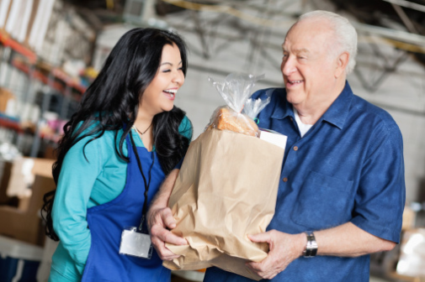
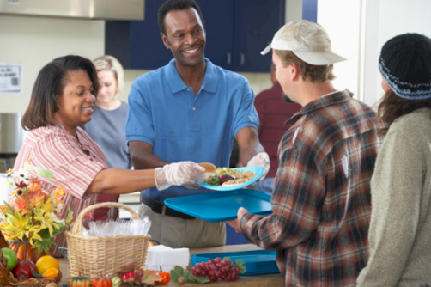
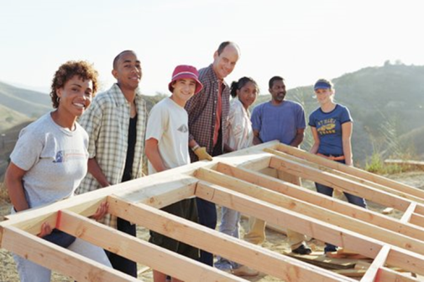
Amazing Results
PEOPLE
are better served
HELPING AGENCIES
are better informed
COMMUNITIES
are better engaged
Stronger Safety Net
Responsive Service Delivery
Continuum of Care
Informed Decision-making
Reduced Duplication
Increased Funding
Improved Cooperation
Data-driven Collaboration
Collective Impact
Notes:
People are better served
Stronger Safety Net –we assist helping agencies, throughout the community, in creating a “well-connected” care network for emergency relief and long-term recovery. One that keeps individuals and families from falling through the cracks, and quickly connects them with the care they need.
Responsive Service Delivery – we make it easier and faster for helping agencies to communicate with each other in real-time and quickly mobilize resources for people in need. Agencies, and people they serve, gain greater access to knowledge and resources, from across the entire community, which support social and economic well-being.
Continuum of Care – we provide helping agencies with simple-to-use tools that advance a more caring, customized, and comprehensive approach to transforming people’s lives. These empowerment tools help guide and monitor people’s successful progress from crisis to sustainability.
Helping agencies are better informed
Informed Decision-making – our HIPAA-driven, client management systems enable helping agencies to make better informed decisions for allocating limited resources where they are most needed. Our simple and customizable features also streamline intake, assessments, and referrals – all in real-time.
Reduced Duplication – our networking tools track how people are being served by other agencies, making it easier for agencies to collectively coordinate appropriate assistance. This increases accountability and supports more efficient and effective ways to serve individuals and families that are facing hardship.
Increased Funding – our solutions give donors and other funders peace of mind in knowing that the right resources are getting into the right hands, at the right time. In many communities, data-driven decision-making and collaboration have increased funding from local citizens, foundations, and government.
Communities are better engaged
Improved Cooperation – all helping agencies (nonprofit, church, food bank, healthcare, and government) are better able to work together for common good and greater outcomes. Communities are more aware and responsive to people’s needs and gaps in service that need attention.
Data-driven Collaboration – we provide care networks with big data analysis systems that measure engagement and outcomes at individual, organizational, and community levels. Oftentimes, our systems have supported and advanced the work of multi-sector collaboratives that drive innovation, best practices, and sustainable solutions.
Collective Impact – our solutions help “jump start” and support partnerships that strive to address complex community challenges. Communities can strengthen and mobilize their collective caring power by becoming more resourceful; using what they have, to create what they need.

Slide 10
When People
WORK TOGETHER,
Great Things Happen!
Communities that strive for “singleness in heart and action*” are better able to transform people’s lives.
— Mike Simon, President of Simon Solutions
*Jer 32:39, NIV

