Slide 1

R&D Race

Slide 2
R&D Race
Overview
  Firms compete to find a disease cure through R&D
  Each firm has a different value of finding the cure
  Each firm’s current spending in public
  You can increase your investment at any time and as many times as you want
    Increase in investment must be higher than the current highest level of investment
  Firm with highest level of investment when time expires wins
9

Slide 3
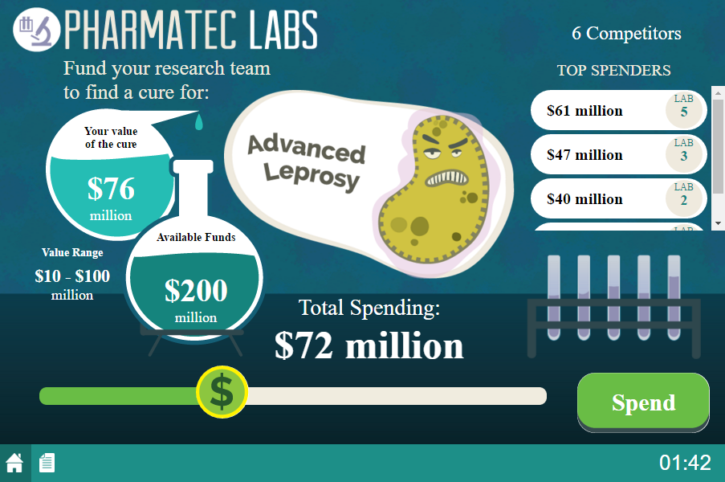
Game Screen
Your firm’s value of finding the cure
9

Slide 4
Game Screen
Range of possible values of cure for other firms
9

Slide 5
Game Screen
Move slider to desired spending level
9

Slide 6
Game Screen
Slider changes total spending

Slide 7
Game Screen
Click Spend to invest!
9

Slide 8
Game Screen
Sorted list of current investments made

Slide 9
Payoffs
Happy playing!
End of Game
  Highest spending firm when time runs out is the winner
  Only the winner receives revenue
    Revenue = Winner’s Value of Cure
Payoff for Winning Firm
  Payoff = Revenue – Investment
Payoff for All Other Firms
  Payoff = $0 – Investment

