Slide 1

R&D Race

Slide 2
R&D Race
Overview
  Firms compete to find a disease cure through R&D
  Each firm has a different value of finding the cure
  Each firm chooses its investment spending without knowing how much other firms spend
  Firm that invested the most wins
9

Slide 3
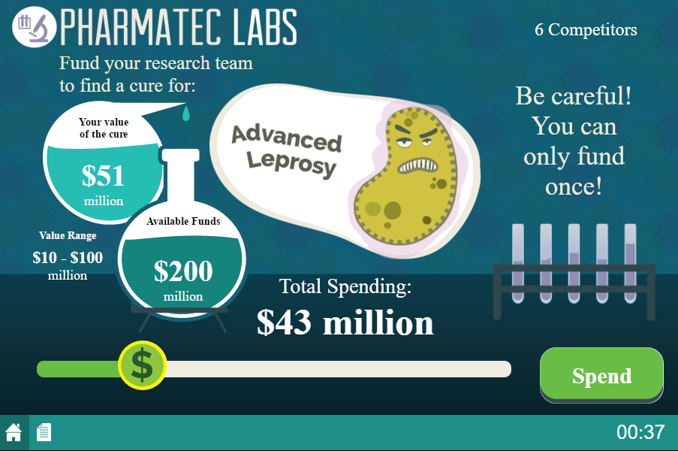
Game Screen
Your firm’s value of finding the cure

Slide 4
Game Screen
Range of possible values of cure for other firms

Slide 5
Game Screen
Move slider to desired spending level

Slide 6
Game Screen
Click Spend to invest!

Slide 7
Payoffs
Happy playing!
End of Game
  Highest spending firm is the winner
  Only the winner receives revenue
    Revenue = Winner’s Value of Cure
Payoff for Winning Firm
  Payoff = Revenue – Investment
Payoff for All Other Firms
  Payoff = $0 – Investment

