Slide 1

Car Auction

Slide 2
Car Auction
Overview
You and other bidders are in a car auction
The current price of a car increases every few seconds
You can choose to leave the auction permanently at any point
Auction ends when Remaining Bidders = Cars for Sale
Winners receive a car and pay the final price

Slide 3
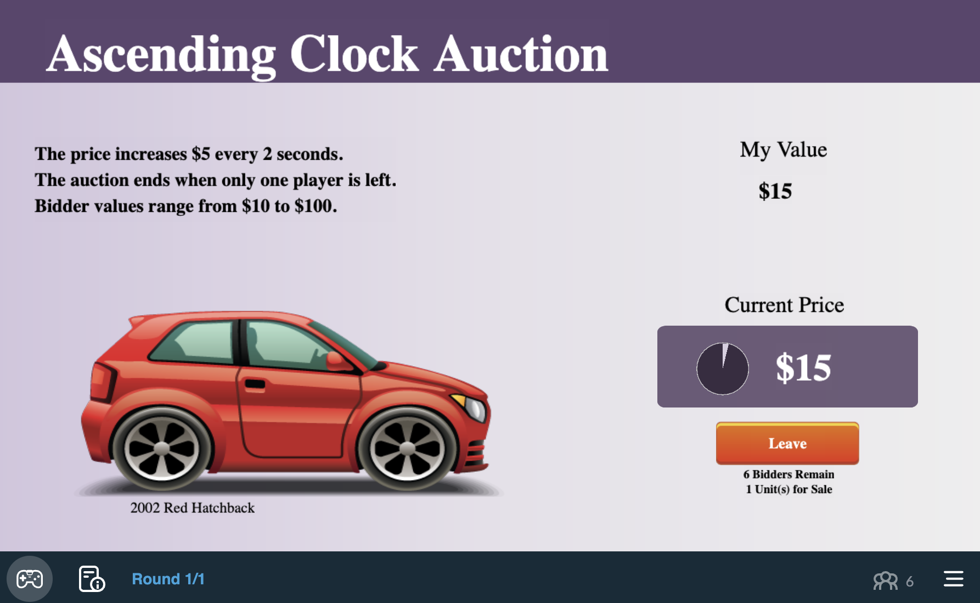
Game Screen
Your value of the car
9

Slide 4
Game Screen
Range of other bidder values

Slide 5
Game Screen
Current price increases every few seconds

Slide 6
Game Screen
Click Leave to permanently leave the auction

Slide 7
Game Screen
Number of units for sale

Slide 8
Game Screen
Number of bidders remaining

Slide 9
Payoffs
Happy Playing!
End of Game
When Number of Bidders Remaining = Number of Units
Final Price = “Current Price” when auction ends
Payoff for a Winner
Payoff for a Winner = Winner’s Value – Final Price
Payoff for Non-Winners
Payoff for a Non-Winner = $0

