Slide 1

Bank Run

Slide 2
To Withdraw, or Not to Withdraw?
Overview
  Island bank takes deposits and makes profitable loans
  You and others made deposits: each day, each chooses whether to withdraw deposit
  Island bank fails if too many withdraw
Payoffs
  Bank does not fail? High return to depositors
  Withdraw and bank has not failed? Get back deposit
  Bank fails? Those withdrawing get back some of deposit; those not withdrawing lose deposit

Slide 3
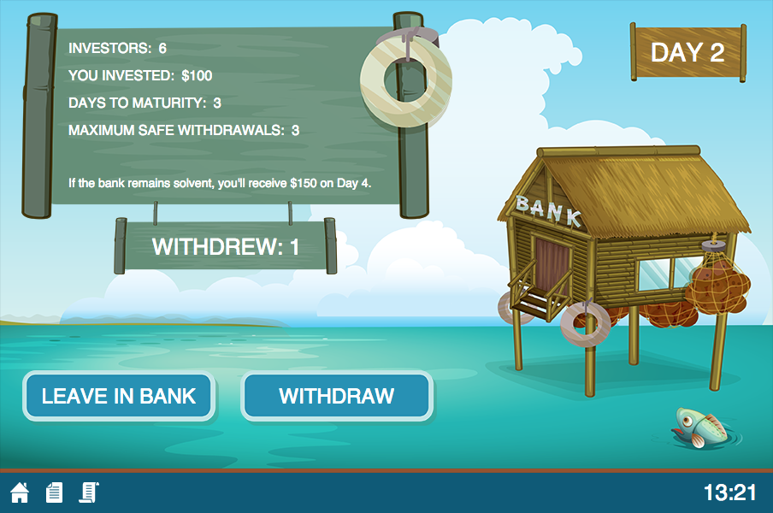
Your Screen
Initial investment (deposit)

Slide 4
Your Screen
(Maximum) Number of decision days

Slide 5
Your Screen
Bank will not fail if withdrawals < maximum

Slide 6
Your Screen
If bank does not fail

Slide 7
Your Screen
Currently

Slide 8
Your Screen
Happy Playing!
Your choice

