Slide 1

booby trap
overview
  one bomb randomly placed in 1 of 100 boxes
  How many boxes will you open? both players earn $0
9A Playground for Decisions
9

Slide 2
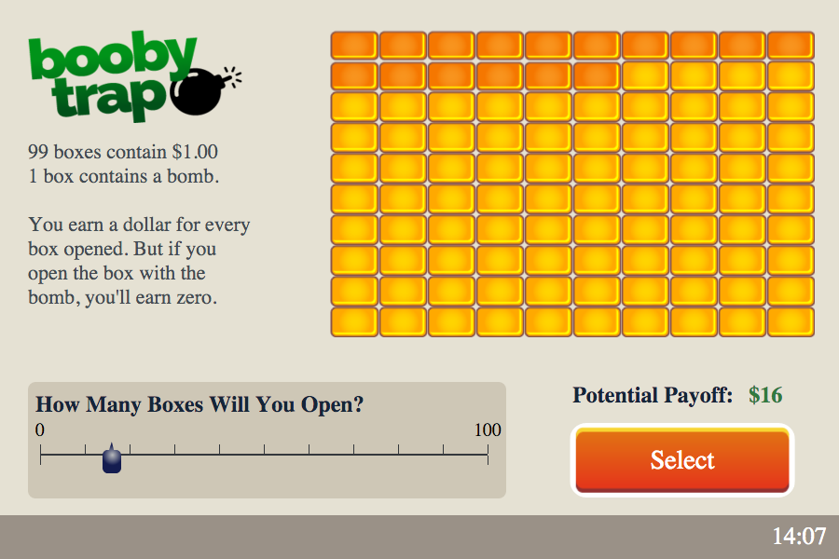
game screen
use slider to choose number to open
9A Playground for Decisions
9

Slide 3
game screen
then press Select
9A Playground for Decisions
9

Slide 4
booby trap
overview
  one bomb randomly placed in 1 of 100 boxes
  How many boxes will you open? b
payoffs
  open a box with a bomb? payoff = 0
  otherwise, payoff = number boxes opened
happy playing!
9A Playground for Decisions
9

