Slide 1

Oil Rights Auction
Overview
  You and other bidders are in an auction for the oil rights of a field
  Field has a true value; each bidder has own estimate
  Bids can be made until the end of the auction
    You can bid as many times as you want
    A new bid must be higher than the current highest bid
  Highest bid when time expires wins the oil rights
9Serious games. Seriously fun.
9

Slide 2
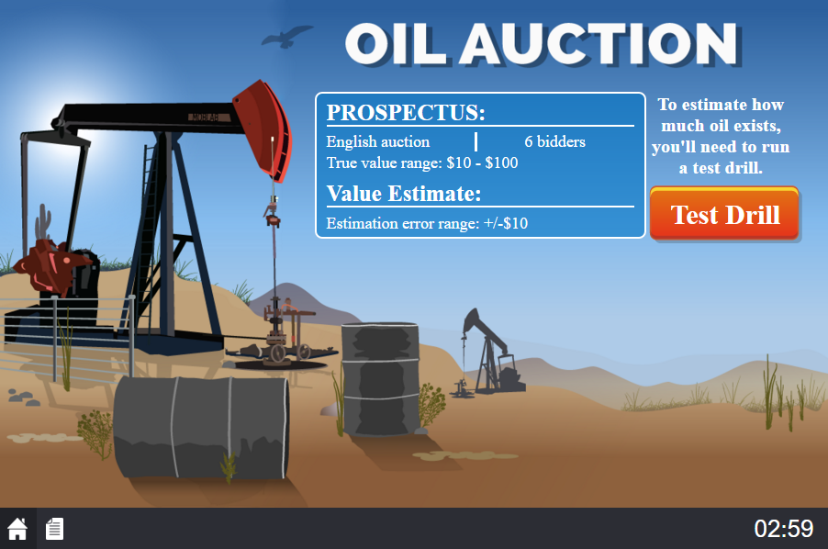
Game Screen
true value will be in this range
9Serious games. Seriously fun.
9

Slide 3
Game Screen
amount estimate may differ from true value
9Serious games. Seriously fun.
9

Slide 4
Game Screen
click Test Drill to get your estimate
9Serious games. Seriously fun.
9

Slide 5
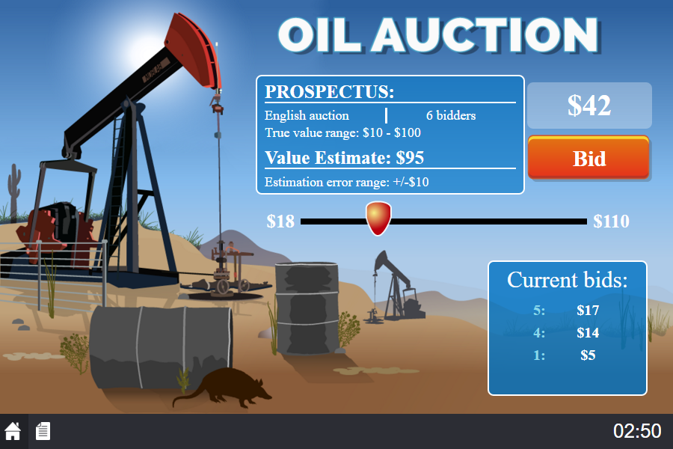
Game Screen
your estimate of the oil field’s value
9Serious games. Seriously fun.
9

Slide 6
Game Screen
move slider to desired bid
9Serious games. Seriously fun.
9

Slide 7
Game Screen
indicates number the slider is currently resting on
9Serious games. Seriously fun.
9

Slide 8
Game Screen
click Bid to place a bid!
9Serious games. Seriously fun.
9

Slide 9
Game Screen
sorted list of all bids
9Serious games. Seriously fun.
9

Slide 10
Payoffs
Happy playing!
End of Game
  Highest bidder when time runs out is the winner
Payoff for Winner
  Payoff = True Value of Field – Winner’s Bid
Payoff for All Other Players
  Payoff for all other players = $0
9Serious games. Seriously fun.
9

