Slide 1

Oil Rights Auction
Overview
  You and other bidders are in an auction for the oil rights of a field
  Field has a true value; each bidder has own estimate
  Each player submits one bid
    You do not know what others bid
  Highest bidder wins the oil rights to the field
    Pays her bid in a first-price auction
    Pays the second highest bid in a second-price auction
9Serious games. Seriously fun.
9

Slide 2
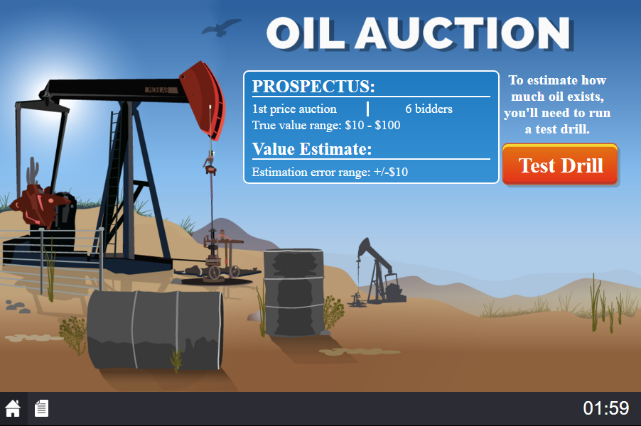
Game Screen
the price rule of this auction
9Serious games. Seriously fun.
9

Slide 3
Game Screen
true value will be in this range
9Serious games. Seriously fun.
9

Slide 4
Game Screen
amount estimate may differ from true value
9Serious games. Seriously fun.
9

Slide 5
Game Screen
click Test Drill to get your estimate
9Serious games. Seriously fun.
9

Slide 6
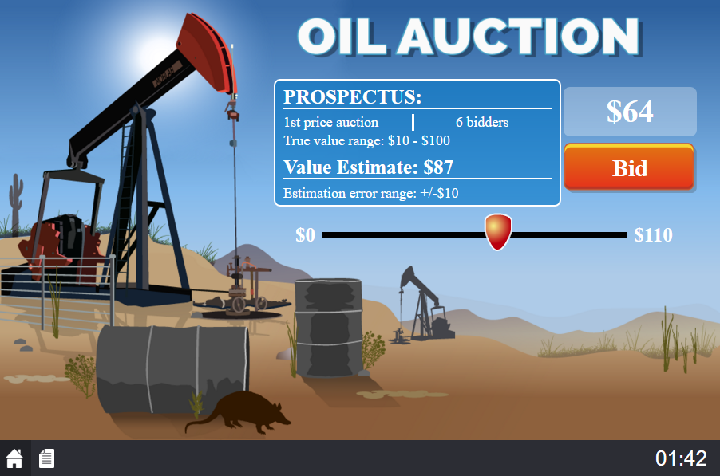
Game Screen
your estimate of the oil field’s value
9Serious games. Seriously fun.
9

Slide 7
Game Screen
move slider to desired bid
9Serious games. Seriously fun.
9

Slide 8
Game Screen
indicates number the slider is currently resting on
9Serious games. Seriously fun.
9

Slide 9
Game Screen
click Bid to place a bid!
9Serious games. Seriously fun.
9

Slide 10
Payoffs
Happy playing!
End of Game
  Highest bidder at the end of the auction is the winner
Payoff for Winner
  First-price
    Payoff = True Value of Field – Winner’s Bid
  Second-price
    Payoff = True Value of Field – Second Highest Bid
Payoff for All Other Players
  Payoff for all other players = $0
9Serious games. Seriously fun.
9

